Slide 1
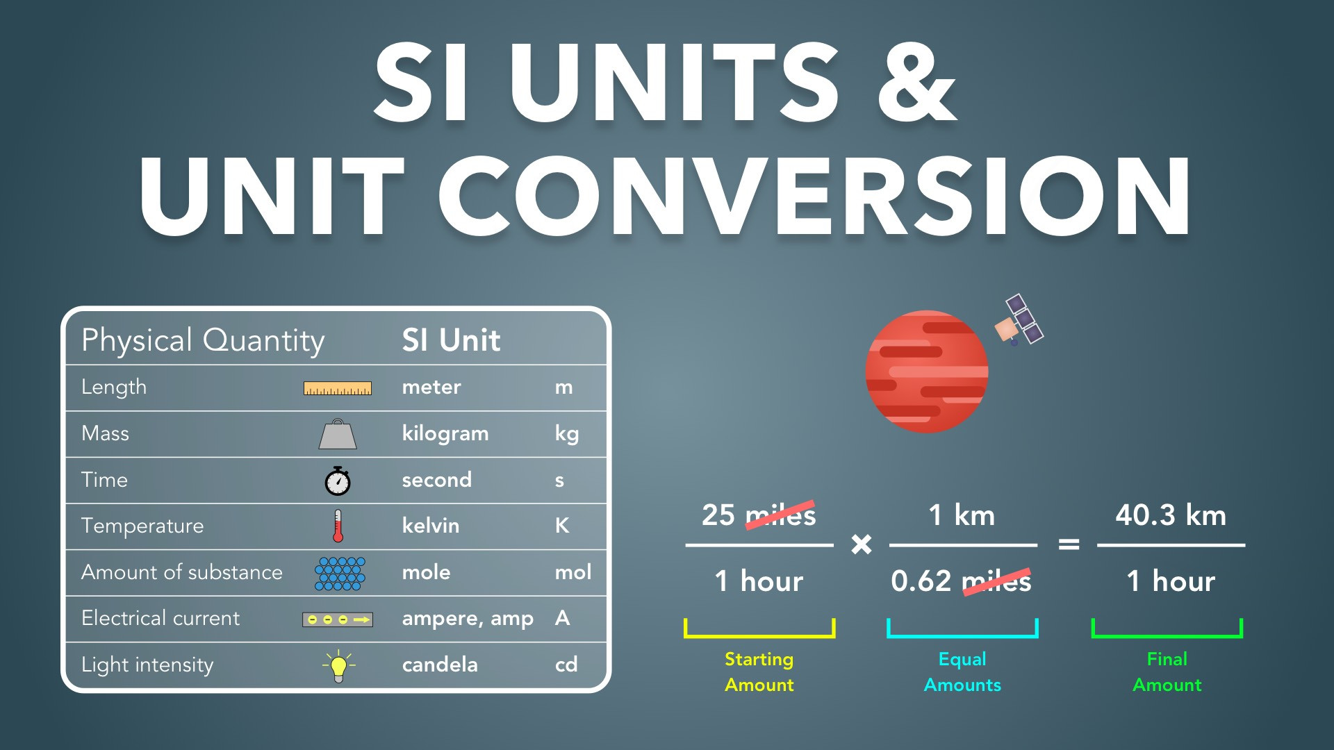
Notes:
SI Units & Unit Conversion
Slides Version 1
physicslab.app
These slides include screenshots from the video. Want more slides? Less slides? Different material on the slides or a different format? If you have any questions, suggestions or feedback about these slides please email me at chris@physicslab.app or send me a message on Discord @physicslab.

Slide 2
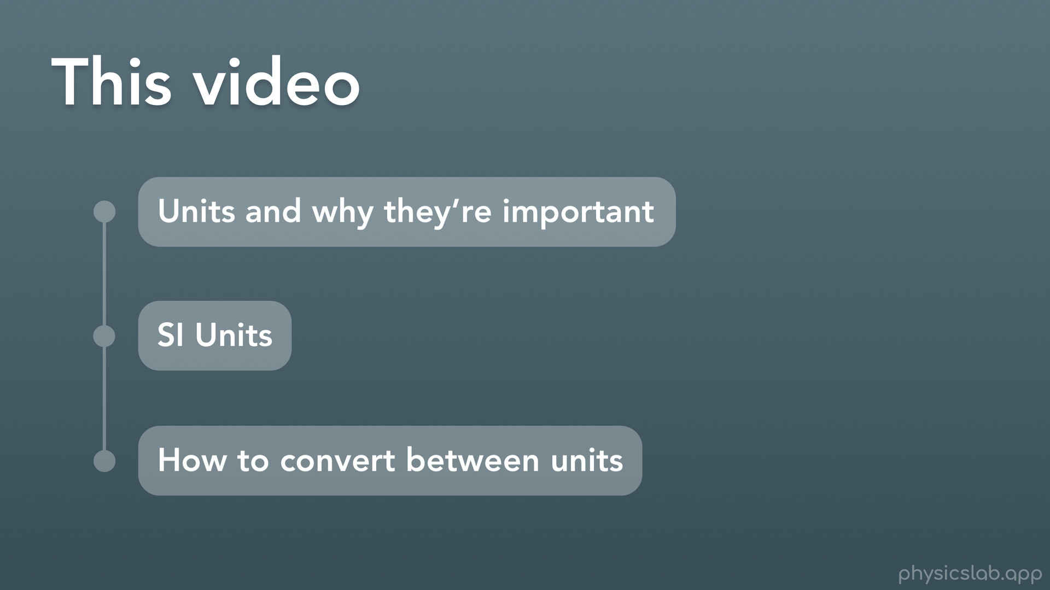
Notes:
Hey everyone, welcome to this Basics video on SI units, conversion, prefixes and scientific notation. These Basics videos go over some of the things that you’ll be using a lot in physics, so I wanted to make sure that everyone is up to speed. For some of you these videos might be the first time you’re learning something and for some of you it might just be a refresher. Either way, I would definitely recommend watching the Basics videos because it will probably make the rest of physics easier.
In this video we’re gonna talk about SI units and why units are important, converting between units, and finally prefixes and scientific notation, which are ways that we can write really big and really small numbers.

Slide 3


Slide 4
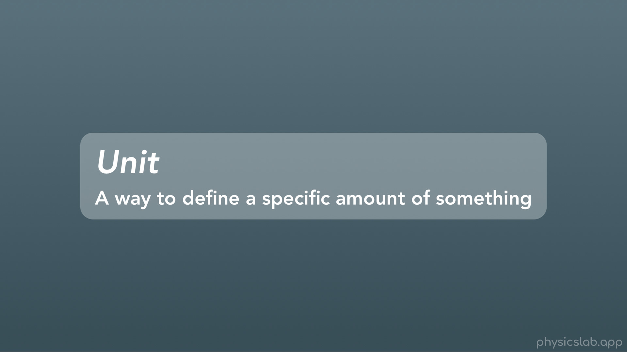
Notes:
Alright so let’s start with units. What do we mean by “unit”? A “unit” is really just a way to define a specific amount of something

Slide 5
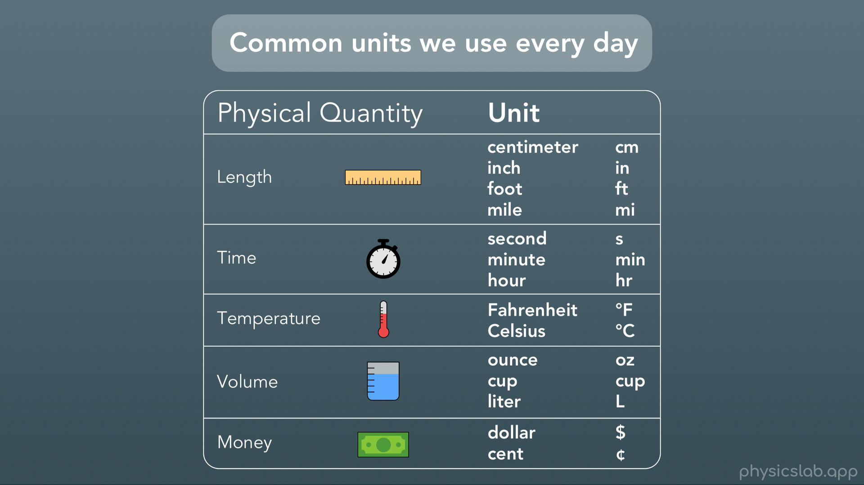
Notes:
We all use units every day to describe different things. When we measure or talk about length or distance, we might use centimeters, inches, feet or miles. For time, we might use seconds, minutes or hours. For temperature we could use degrees Fahrenheit or degrees Celsius. For volume we might use ounces or cups, or we might use liters. Even money has different units, like dollars and cents. Notice that almost every unit we use will also have an abbreviation as a shorter way to write the unit.

Slide 6
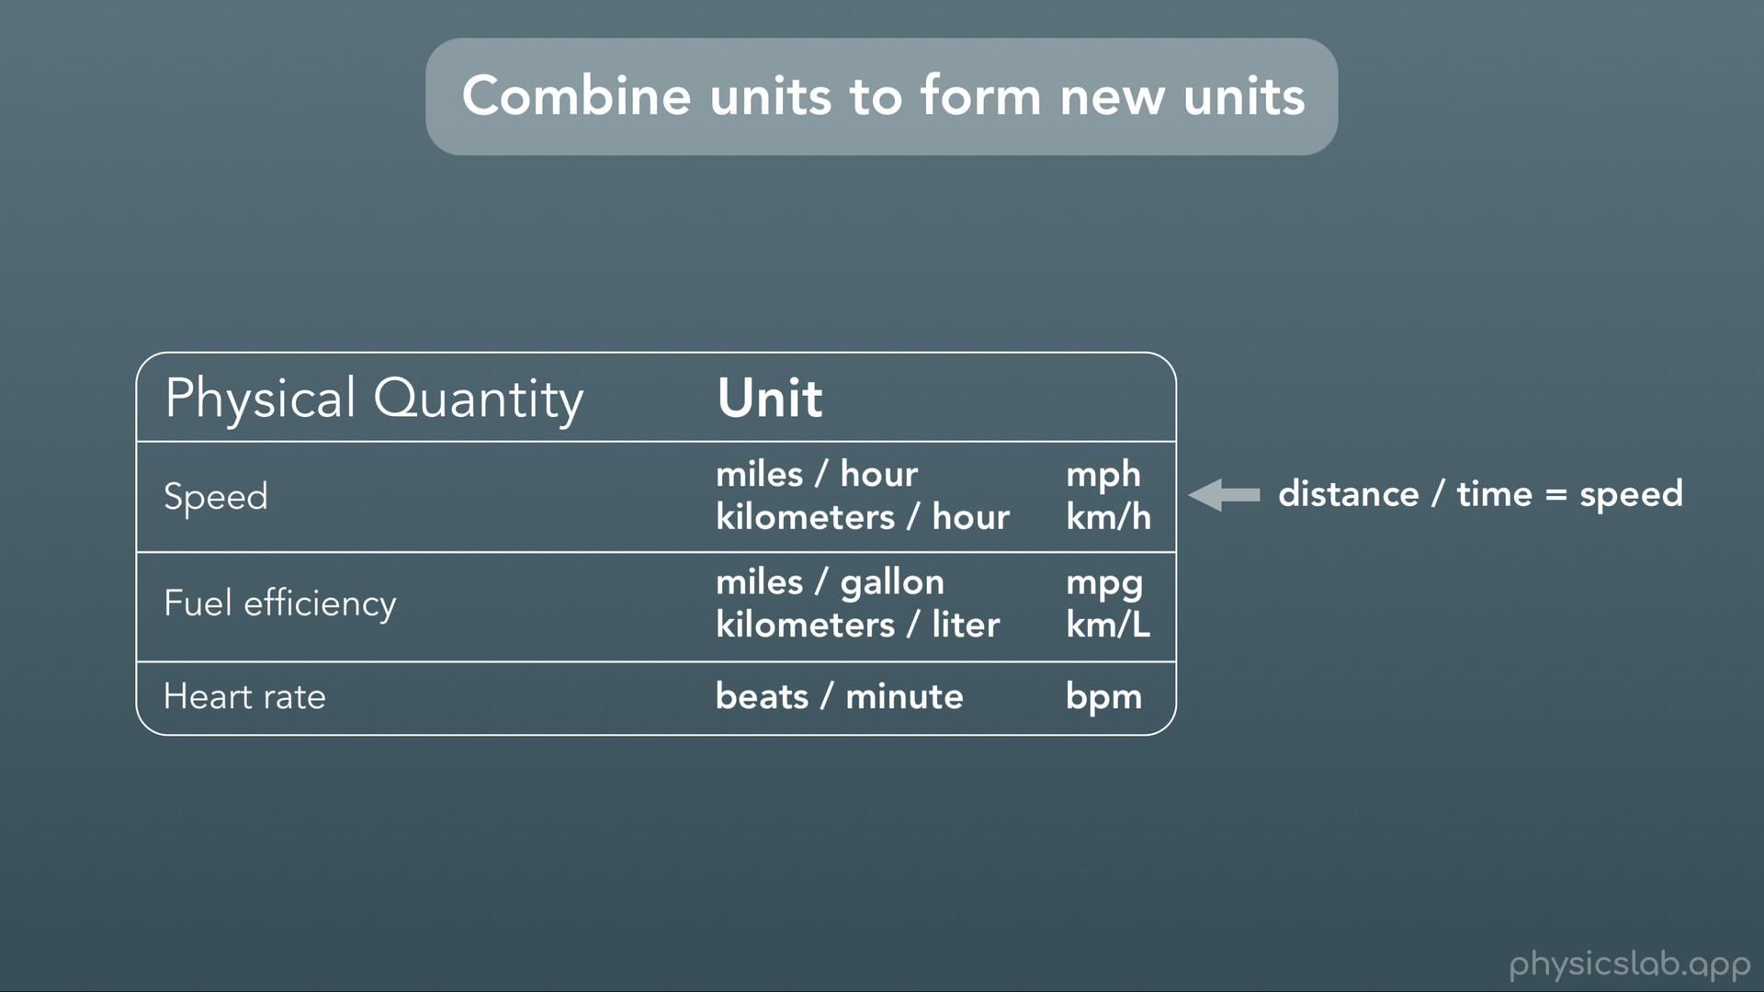
Notes:
We can even combine those units to form new units. For example, when we measure speed in miles per hour, we’re combining units for distance (miles) and time (hours) to form a unit for speed. We might describe our car’s fuel efficiency in miles per gallon or kilometers per liter, and we measure our heart rate in beats per minute.

Slide 7
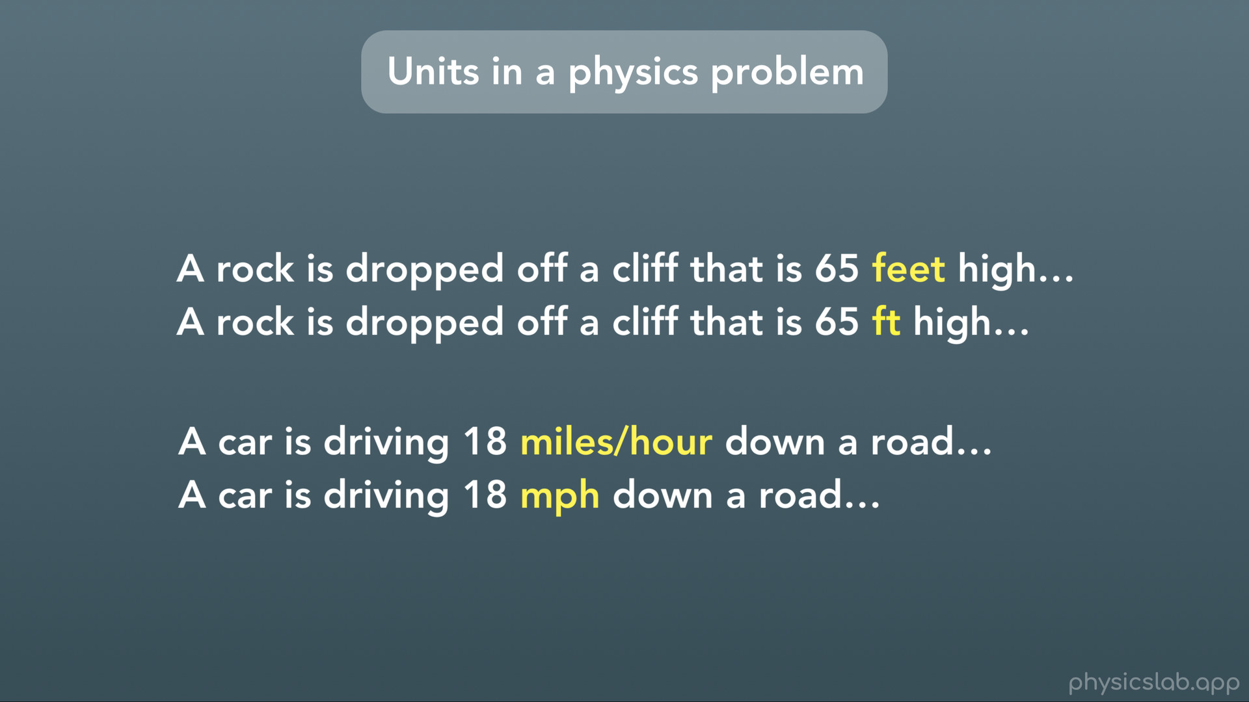
Notes:
When units show up in a sentence or in a physics problem, you’ll see the number (or value) followed by the unit, and we might use the abbreviation or we might use the full words to write the unit.

Slide 8
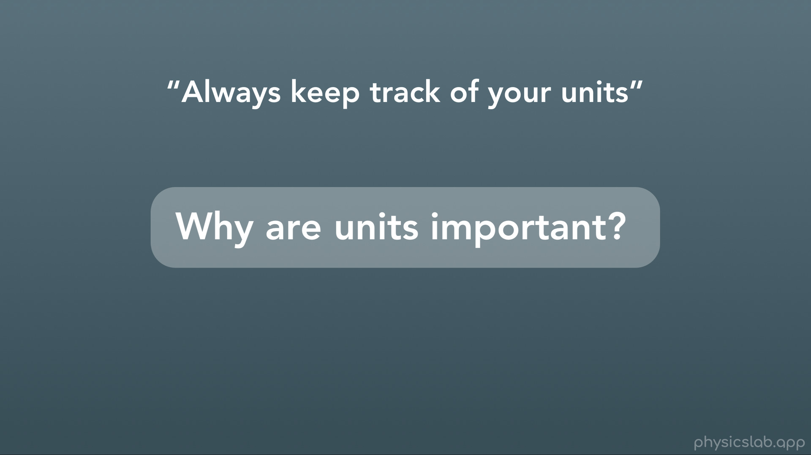
Notes:
You’ve probably been told to “always keep track of and include your units”. So why are units important?

Slide 9
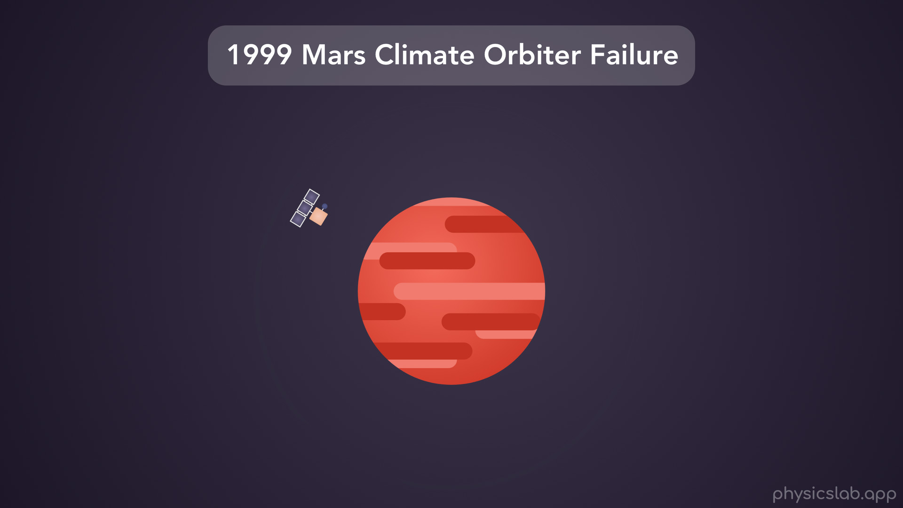
Notes:
Well the 1999 Mars Climate Orbiter failure is a good example. The Mars Climate Orbiter was a space probe made by the American aerospace company Lockheed Martin and launched by NASA with the goal of orbiting Mars in order to study the Martian climate and atmosphere. The probe was supposed to orbit Mars high above its atmosphere and study the planet. But on September 23, 1999 NASA lost communications with the probe. They discovered that the trajectory of the space probe had been wrong. It got much closer to the surface of Mars than they wanted, and the probe likely burned up in the atmosphere. It wasn’t clear why the trajectory had been off, but eventually they found the root cause.

Slide 10
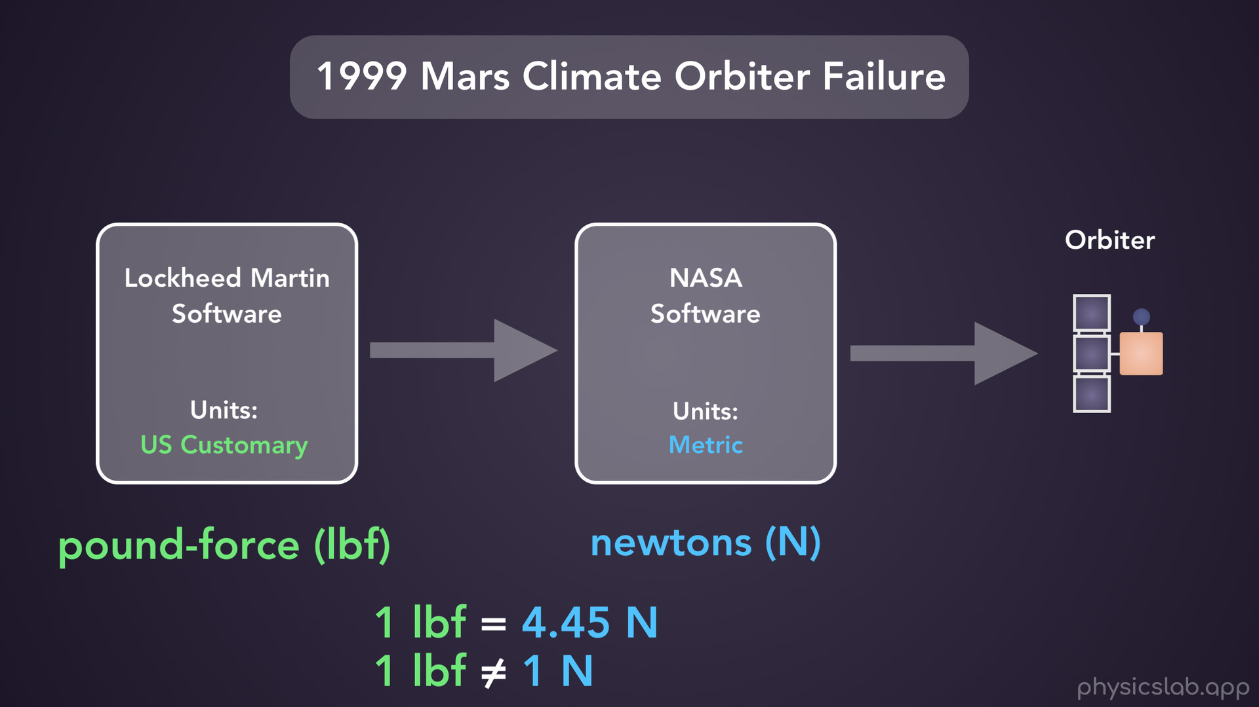
Notes:
The issue was with the software that was used to make calculations in order to control the space probe, and one piece of software from Lockheed Martin that sent data to software used by NASA caused the problem. The reason was that the two pieces of software were using different units. The short version is, Lockheed Martin was sending numbers in units of pound-force (which is a US customary units) but NASA was expecting them to be in newtons (which is a metric unit). 1 pound-force = 4.45 newtons, so NASA sent instructions to the orbiter that were off by a factor of 4.45. This caused the orbiter’s trajectory to be way off and eventually enter the atmosphere, and probably burn up or crash.

Slide 11
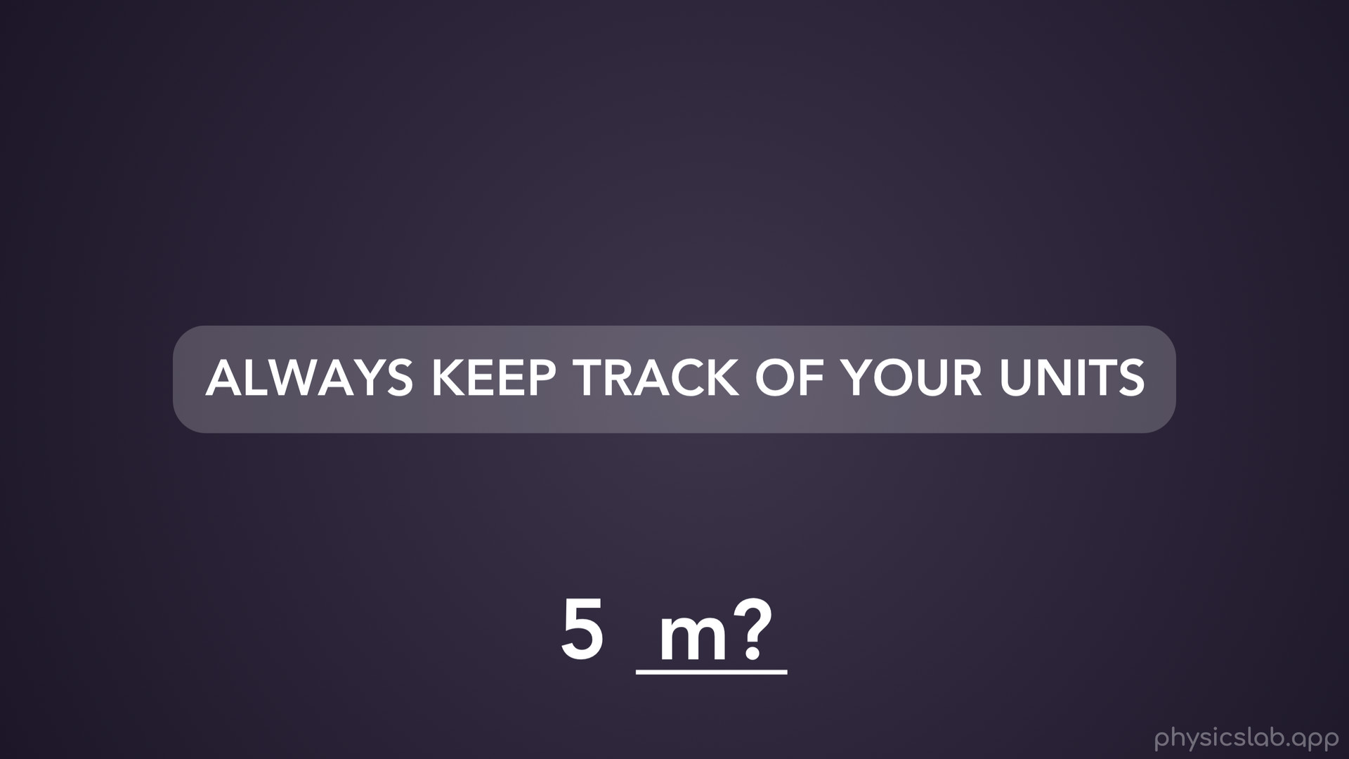
Notes:
The lesson here is that it’s true: ALWAYS KEEP TRACK OF YOUR UNITS. If you have a number on your paper with no units, it could be anything, and your answer might be way off.

Slide 12
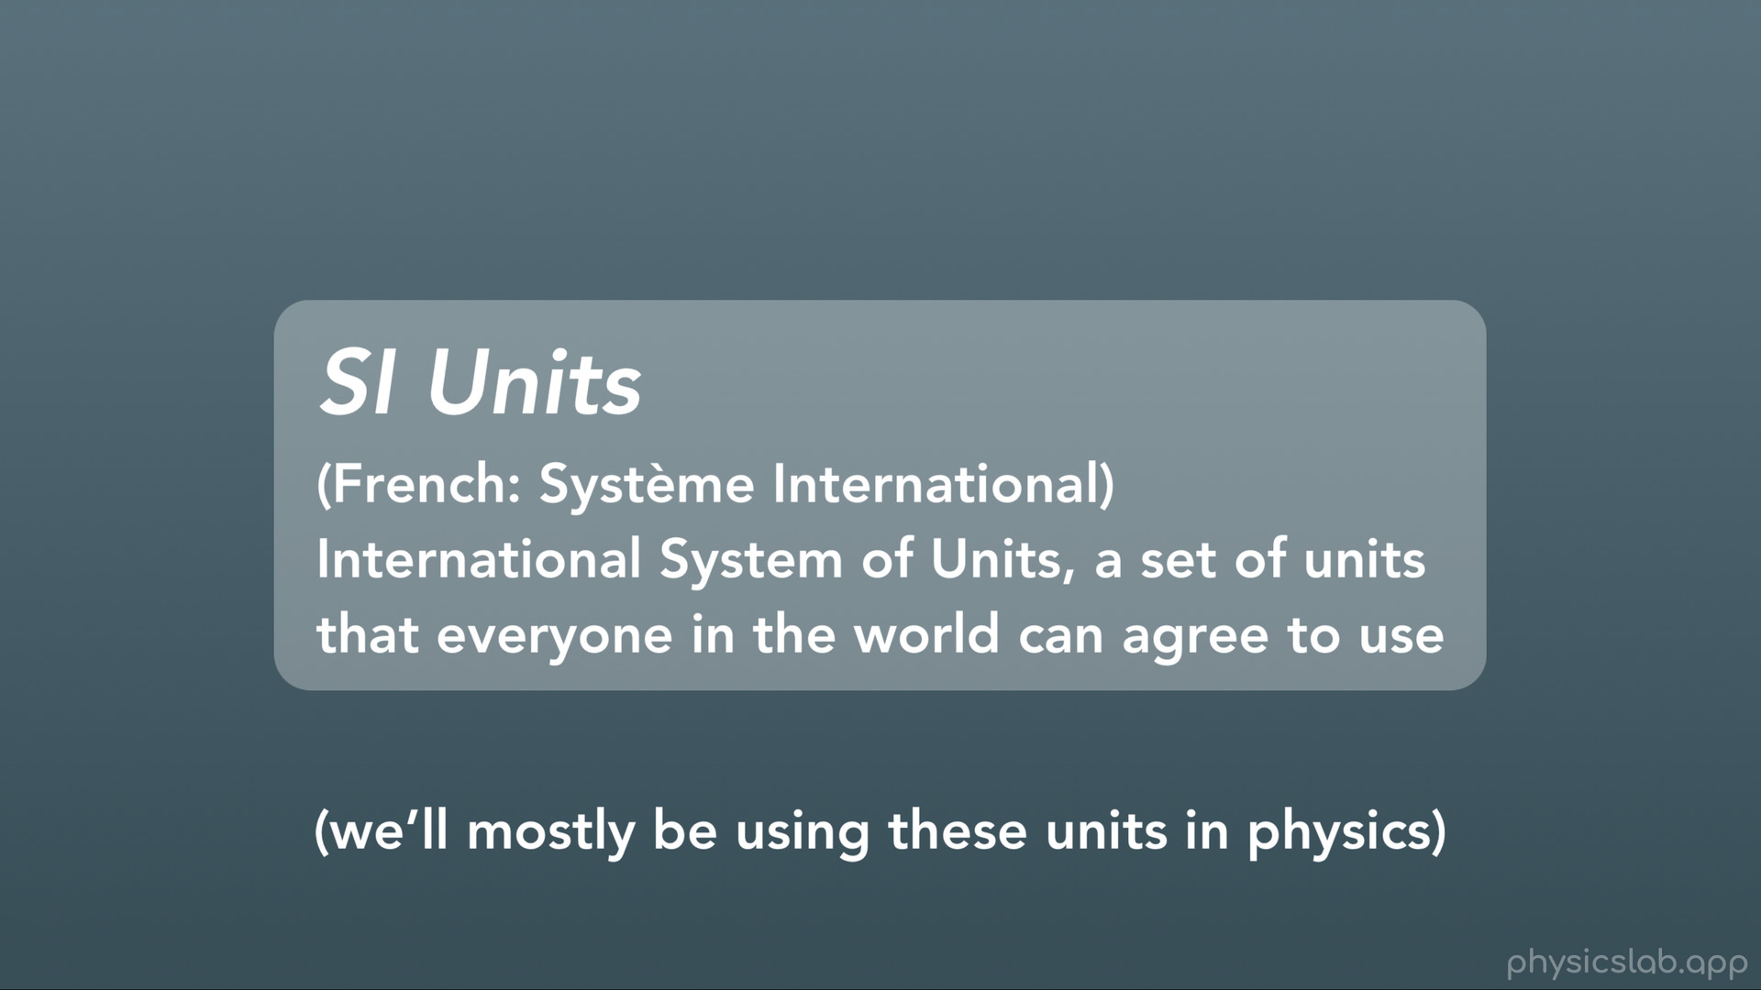
Notes:
The Mars climate orbiter example also shows how hard it is to communicate between different teams when you’re using different systems of units.
And that leads us into SI Units, or the International System of Units, which is a set of units that everyone in the world can agree to use. (We’ll mostly be using these units in physics)

Slide 13
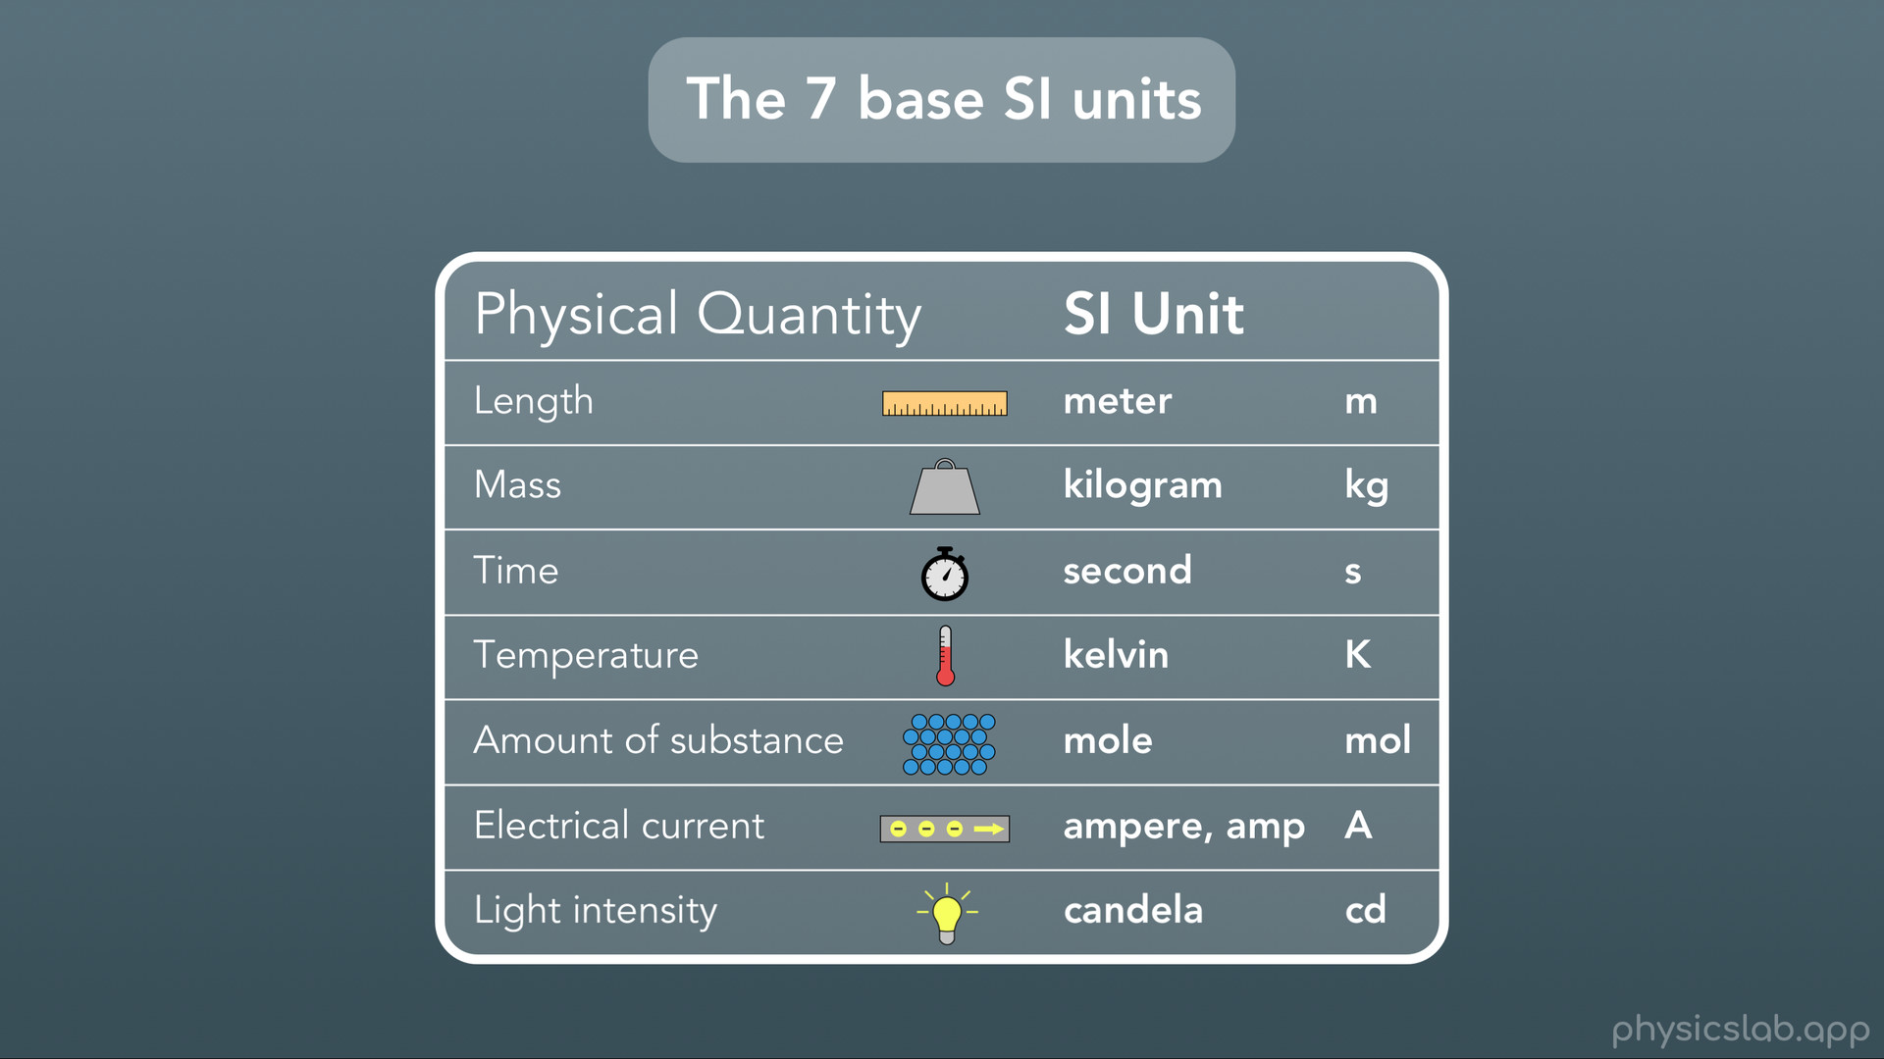
Notes:
Here are the 7 base SI units. The unit for length or distance is meters (abbreviated lowercase m), for mass its kilograms (abbreviated lowercase kg), for time its seconds (or lowercase s), for temperature we use kelvin (abbreviated capital K), for amount of substance we use moles (abbreviated as lowercase mol), for electrical current we use amperes, commonly referred to as amps (abbreviated as capital A), and for light intensity we use candelas (or lowercase cd). You’re really only going to use the first 4 units in physics class, and you’ll probably use moles in chemistry class. Also note that this SI system is the same as the metric system, so these are also all metric units. So these are the base units…

Slide 14
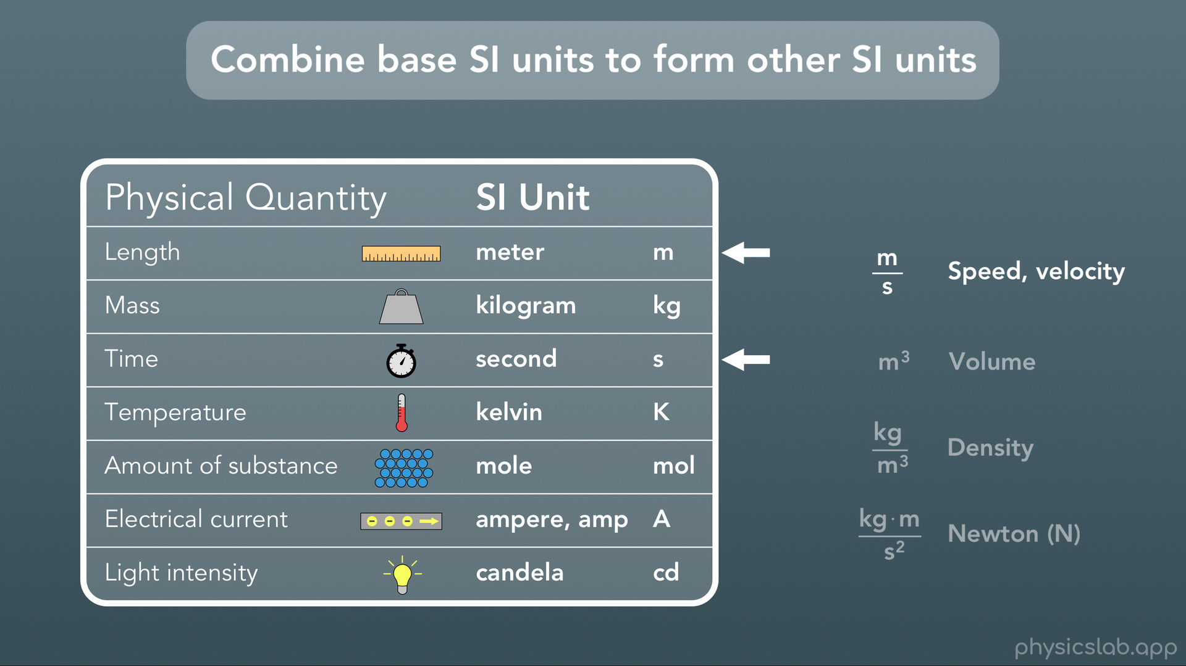
Notes:
And just like we mentioned before, you can combine these base SI units to form other SI units. For example: the SI unit for speed or velocity is meters/second

Slide 15
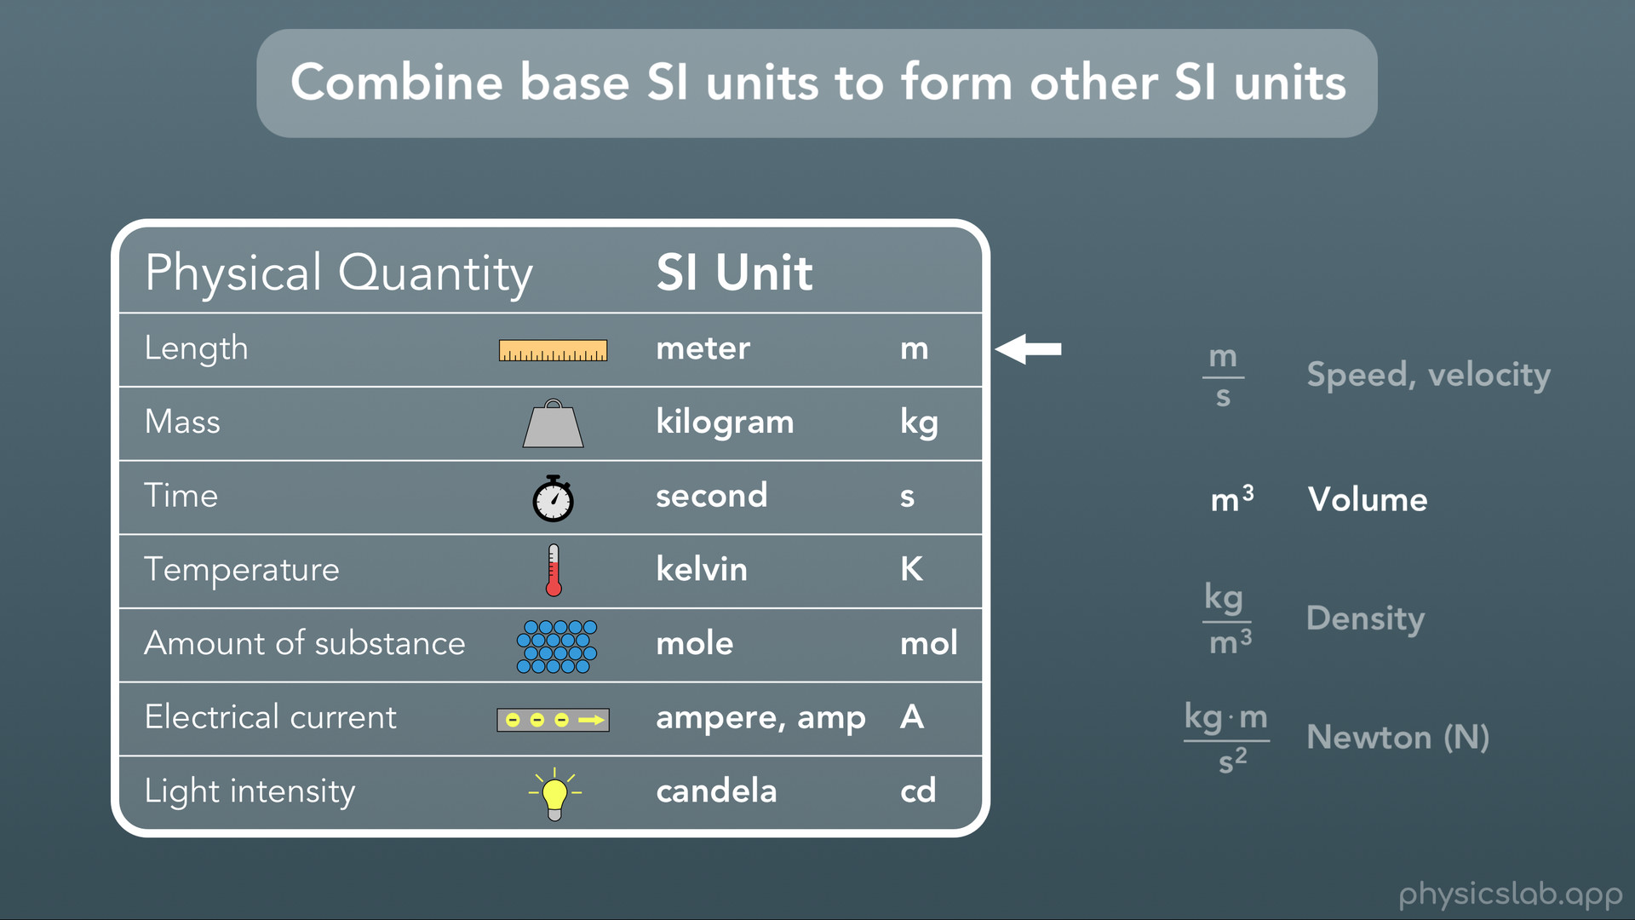
Notes:
the SI unit for volume is cubic meters

Slide 16
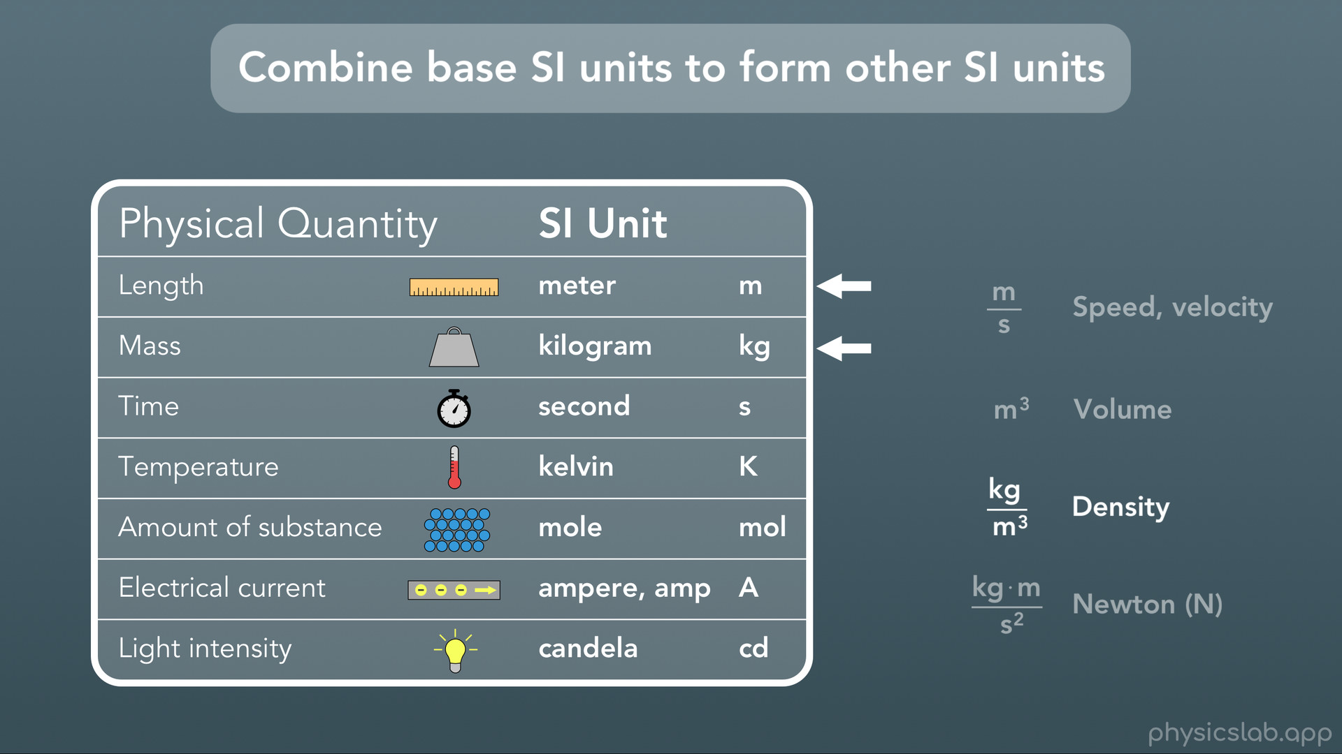
Notes:
for density it’s kilograms/cubic meters

Slide 17
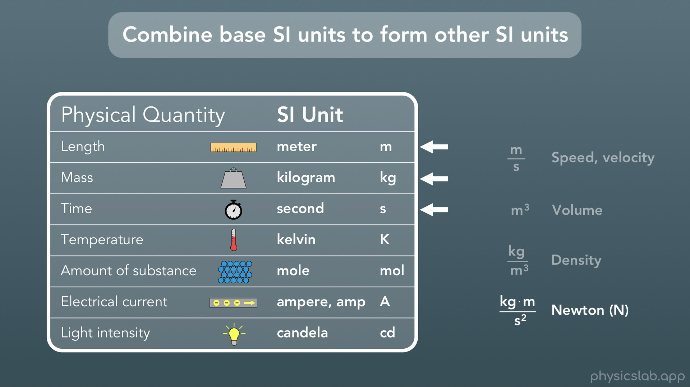
Notes:
and for Newtons (which is the SI unit for force) it’s kilogram-meters/seconds squared. So we’ll be using a lot of different units in physics, but you’ll find that pretty much all of them are made by combining the same 3 or 4 base SI units.

Slide 18

Notes:
Next we’re gonna talk about converting between units

Slide 19
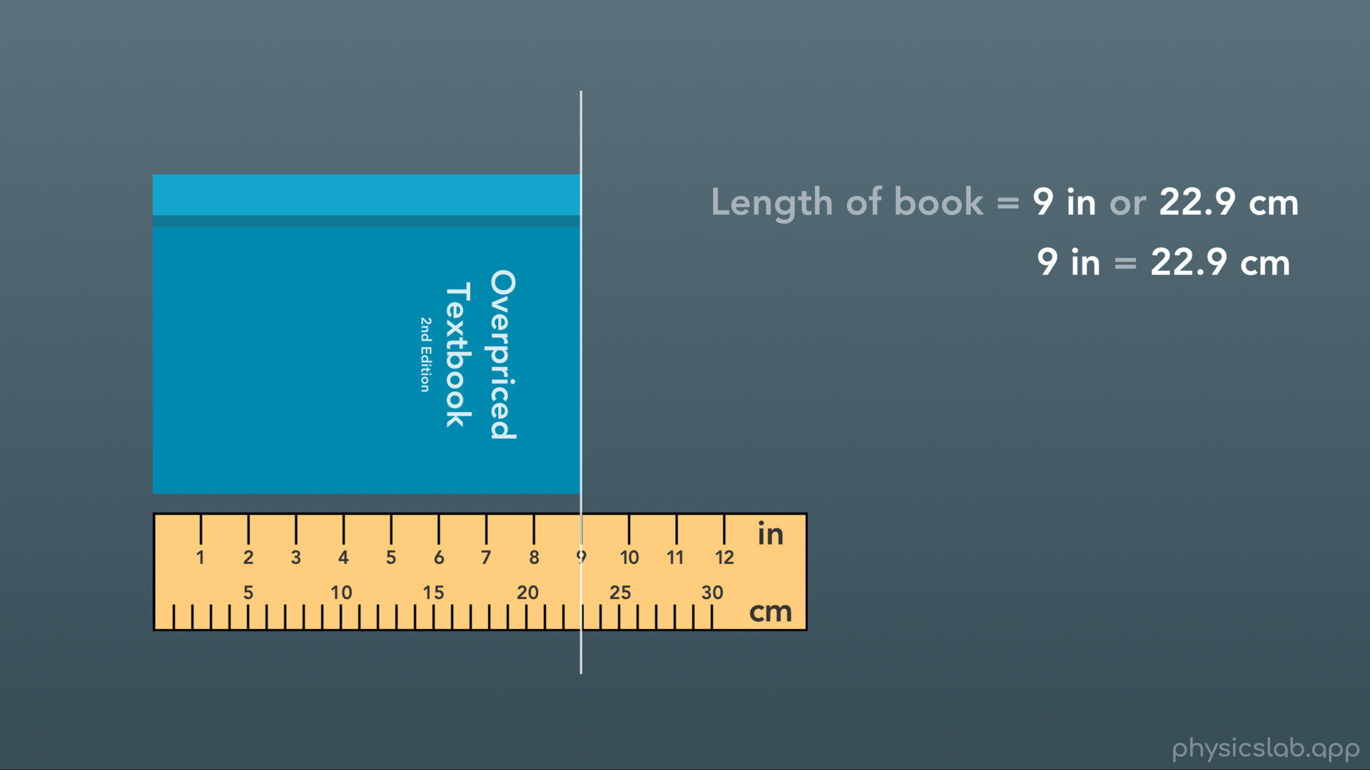
Notes:
So what do we mean when we talk about “converting between units”? Well we mentioned before how we can use different units to describe or measure the same thing. For example, we can use a ruler to measure the length of this book in inches, or we can measure the length in centimeters. In this case the book is 9 inches, or 22.9 centimeters (rounded up). Both of these are correct, because 9 inches equals 22.9 centimeters. We’re just using 2 different units, inches and centimeters, to describe the exact same length. Either one is fine to use, there are a bunch of reasons why we’ll want to convert from one unit to a different unit.

Slide 20
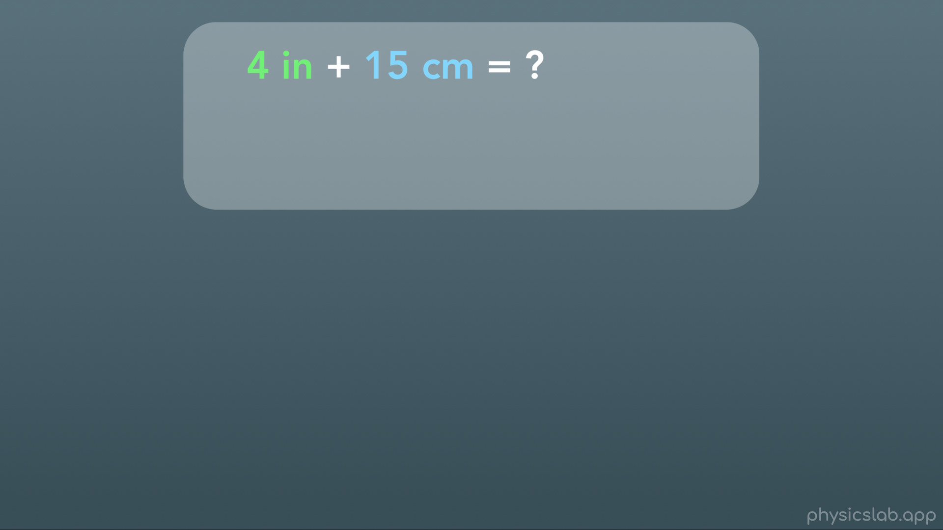
Notes:
For example, if we wanted to add 2 lengths together. What is 4 inches plus 15 centimeters?

Slide 21
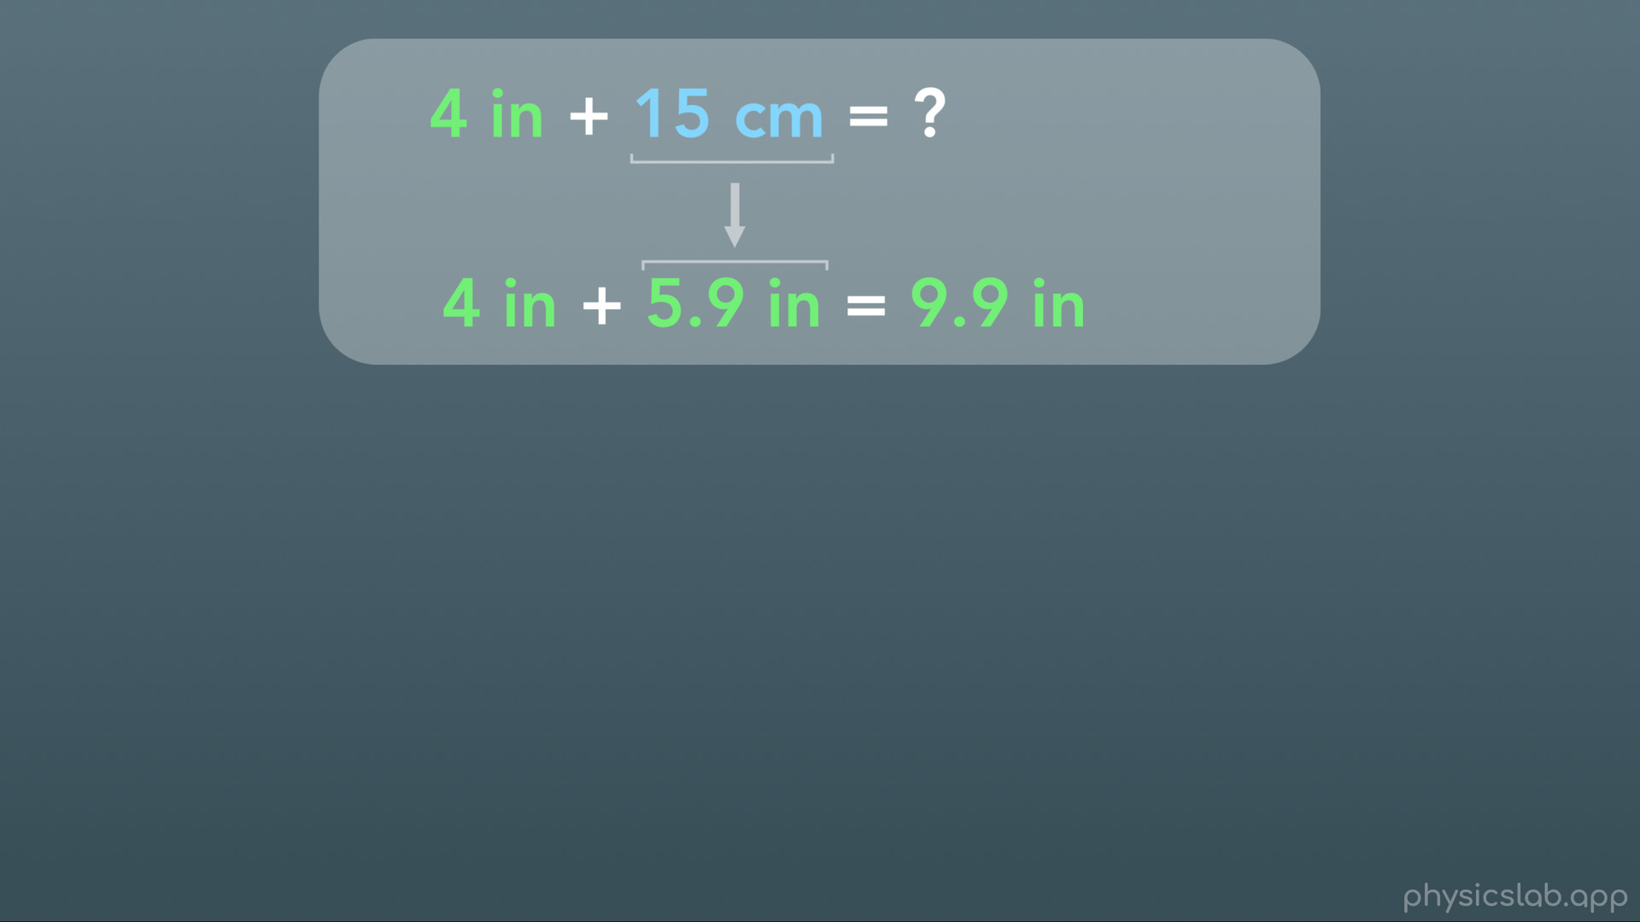
Notes:
Well… the answer is probably most useful if we give it in terms of a single unit. So we could convert the 15 cm into inches and we get 5.9 in, then we can add 4 in plus 5.9 in equals 9.9 inches.

Slide 22
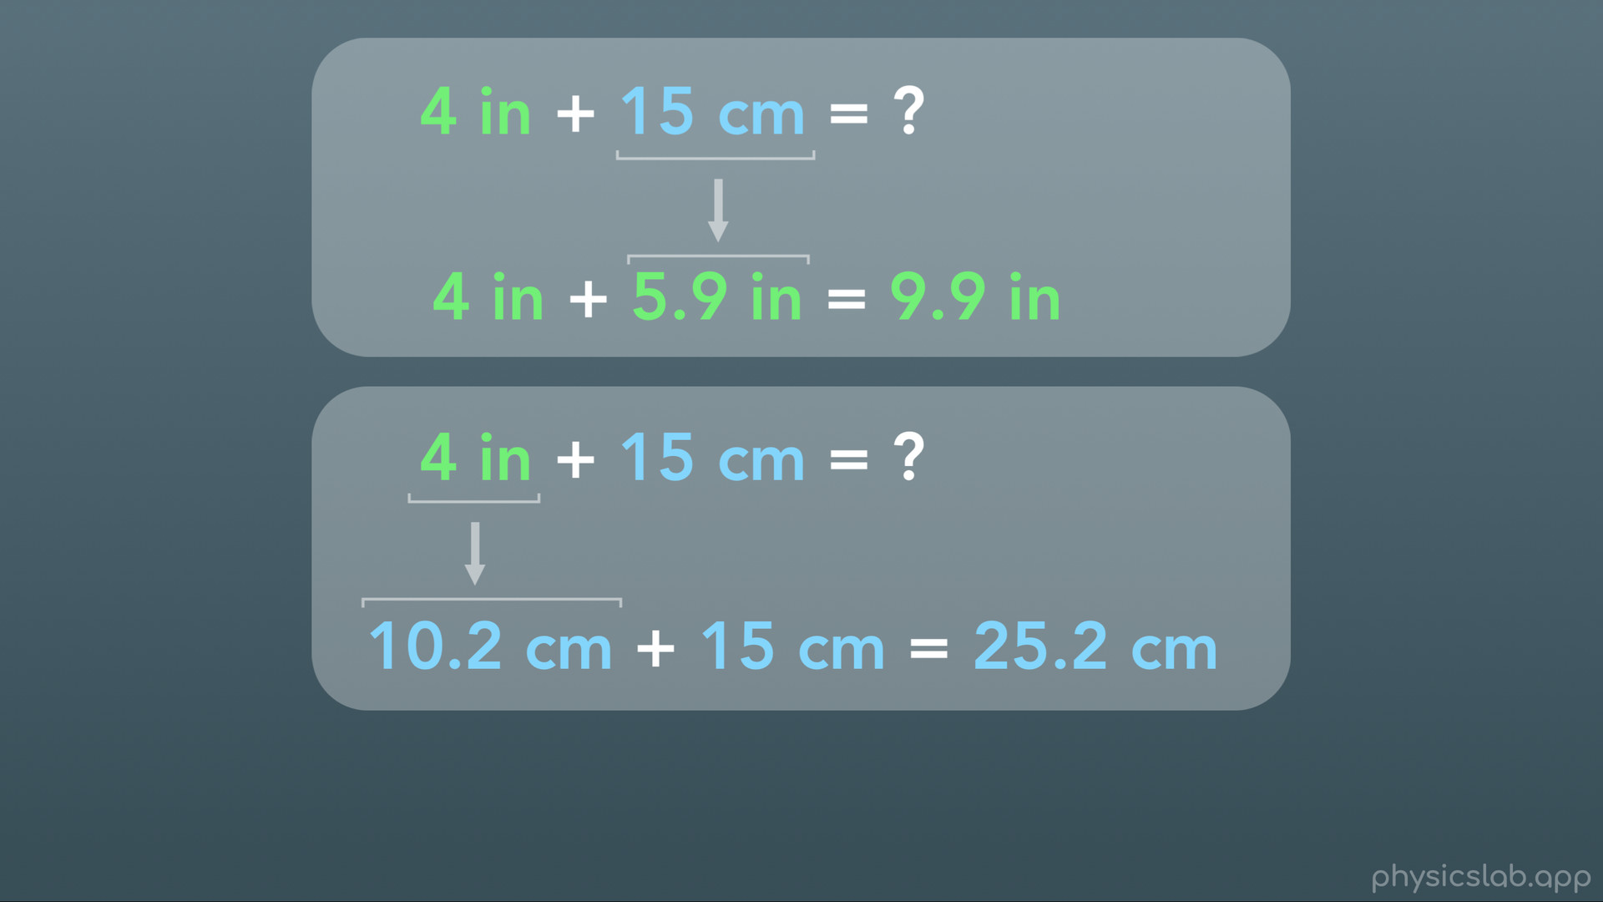
Notes:
OR we could convert the 4 in to cm and we get 10.2 cm, then we can add 10.2 cm plus 15 cm equals 25.2 cm. Notice that we can’t do math with these 2 numbers if they’re in different units, and this is the biggest reason we’ll have to convert units. Most of the time, we will be converting from a unit that we’re given TO an SI unit, so that we can plug that number into an equation and actually use it.

Slide 23
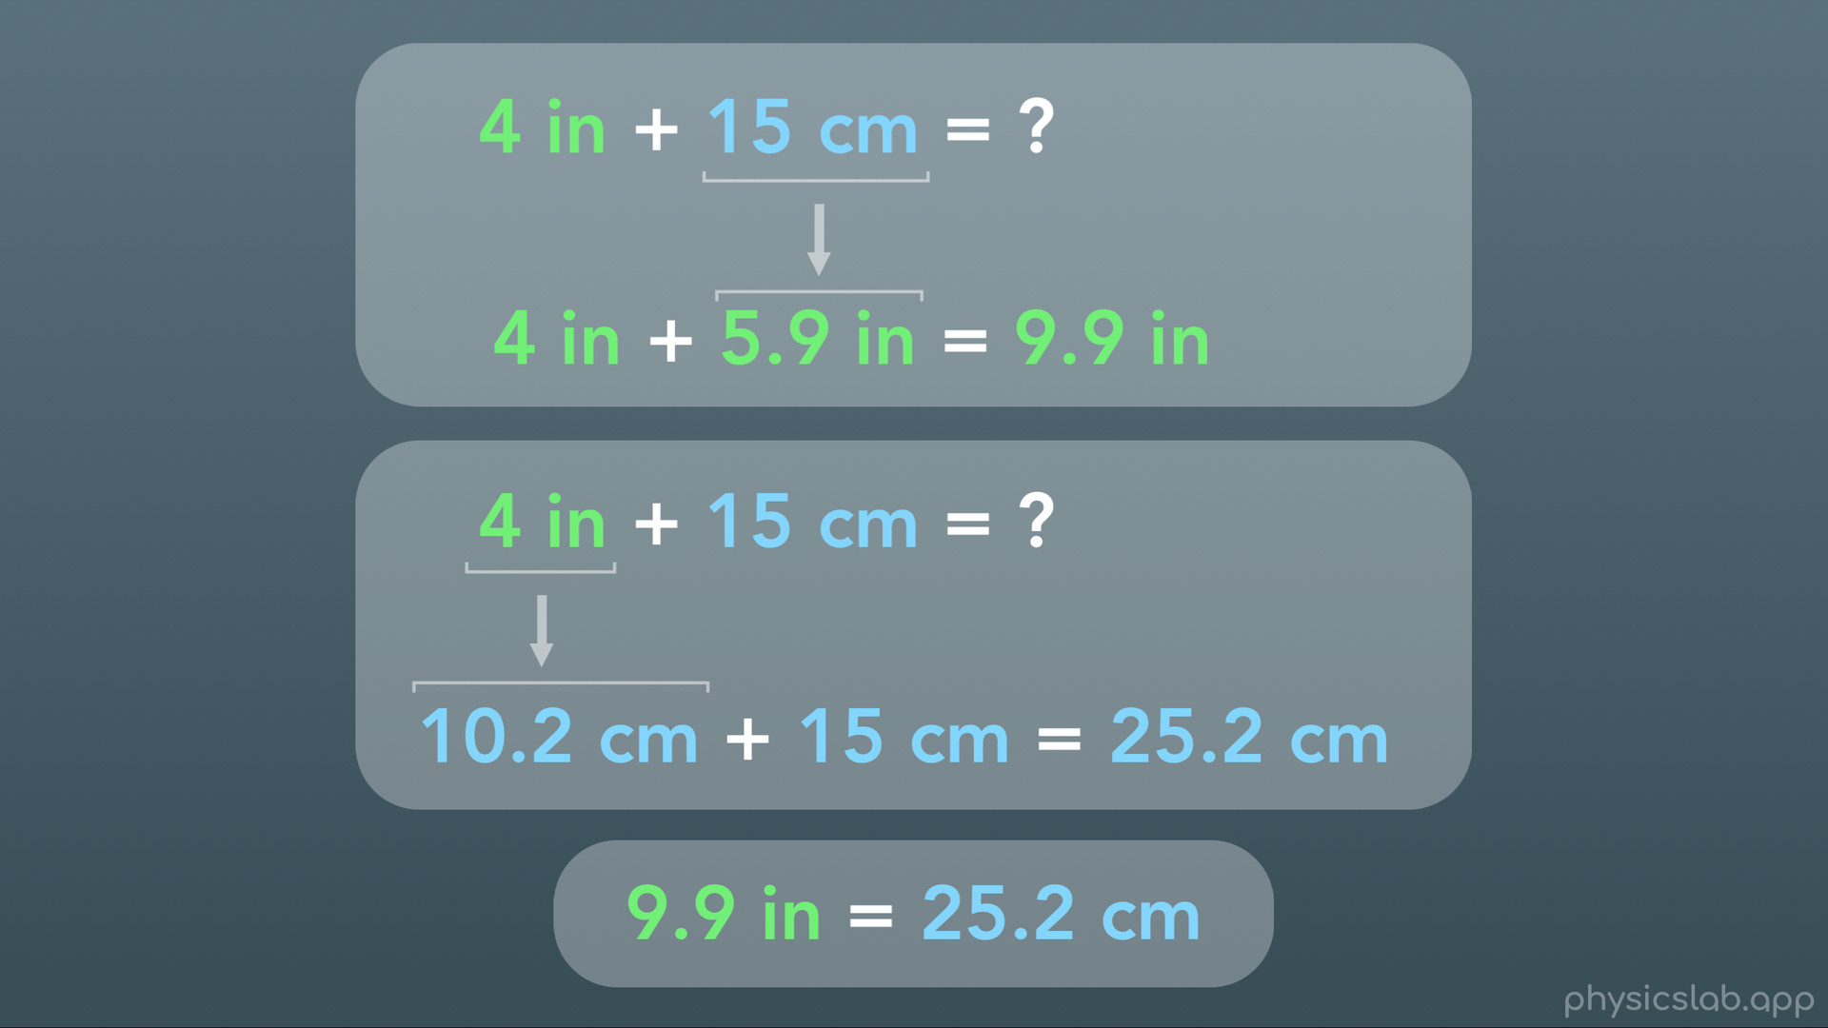

Slide 24
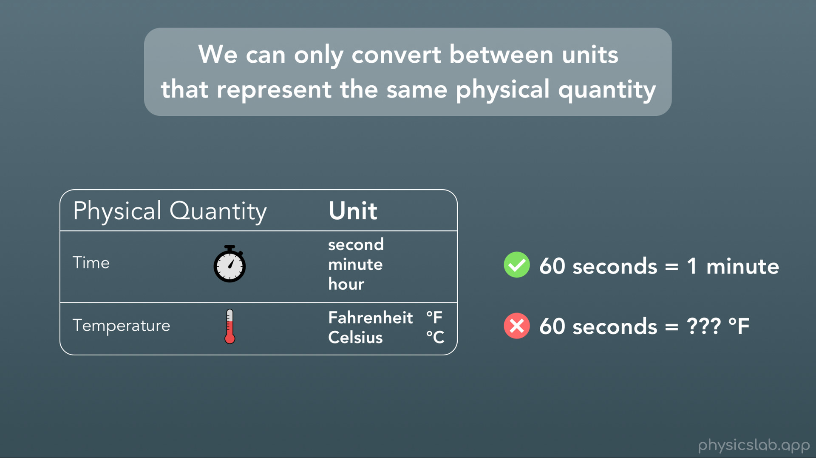
Notes:
So, first we need to establish something that might seem obvious, but we can sometimes forget when we’re solving a problem. And that is that we can only convert between units that represent the same physical quantity. The physical quantity of time has different units like seconds, minutes, hours etc, so we can convert between the units of time. For example 60 seconds of time equals 1 minute of time. But we can’t convert units of time into units of temperature. No amount of seconds equals some amount of degrees Fahrenheit. Again this may seem obvious, but we can’t forget it when we’re using physics equations with different units: if all we want to do is convert from one unit to another, we can only convert one unit at a time and they have to both represent the same thing, like time.

Slide 25
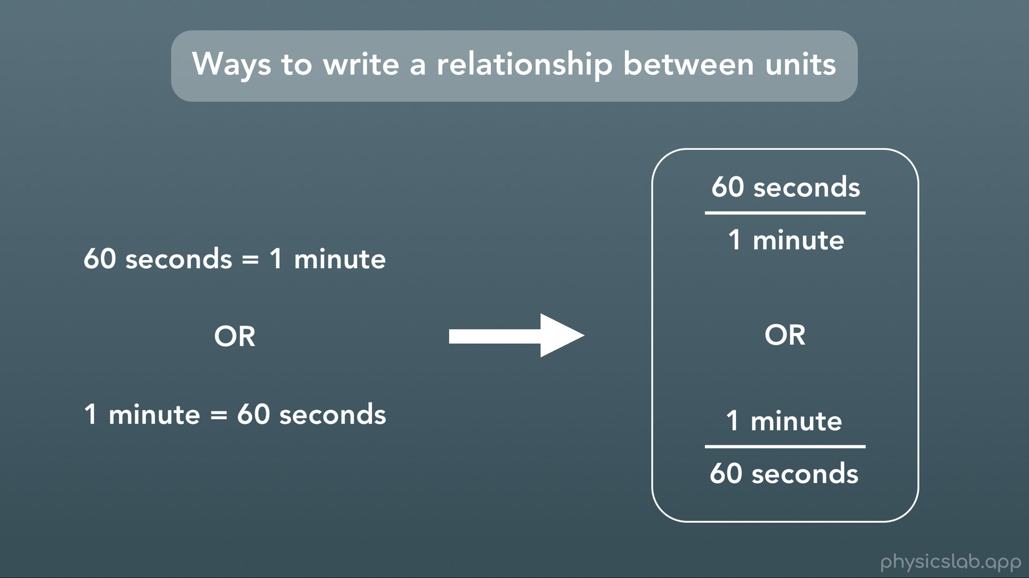
Notes:
Ok so how do we actually convert between units? Well first, there are different ways to write a relationship between units. You could write “60 seconds = 1 minute” or you could write “1 minute = 60 seconds”. We’re gonna find it easier to write these relationships as fractions like this. You could think of it as 60 seconds “per” minute, or 1 minute “per” 60 seconds. Both of these are the same.

Slide 26
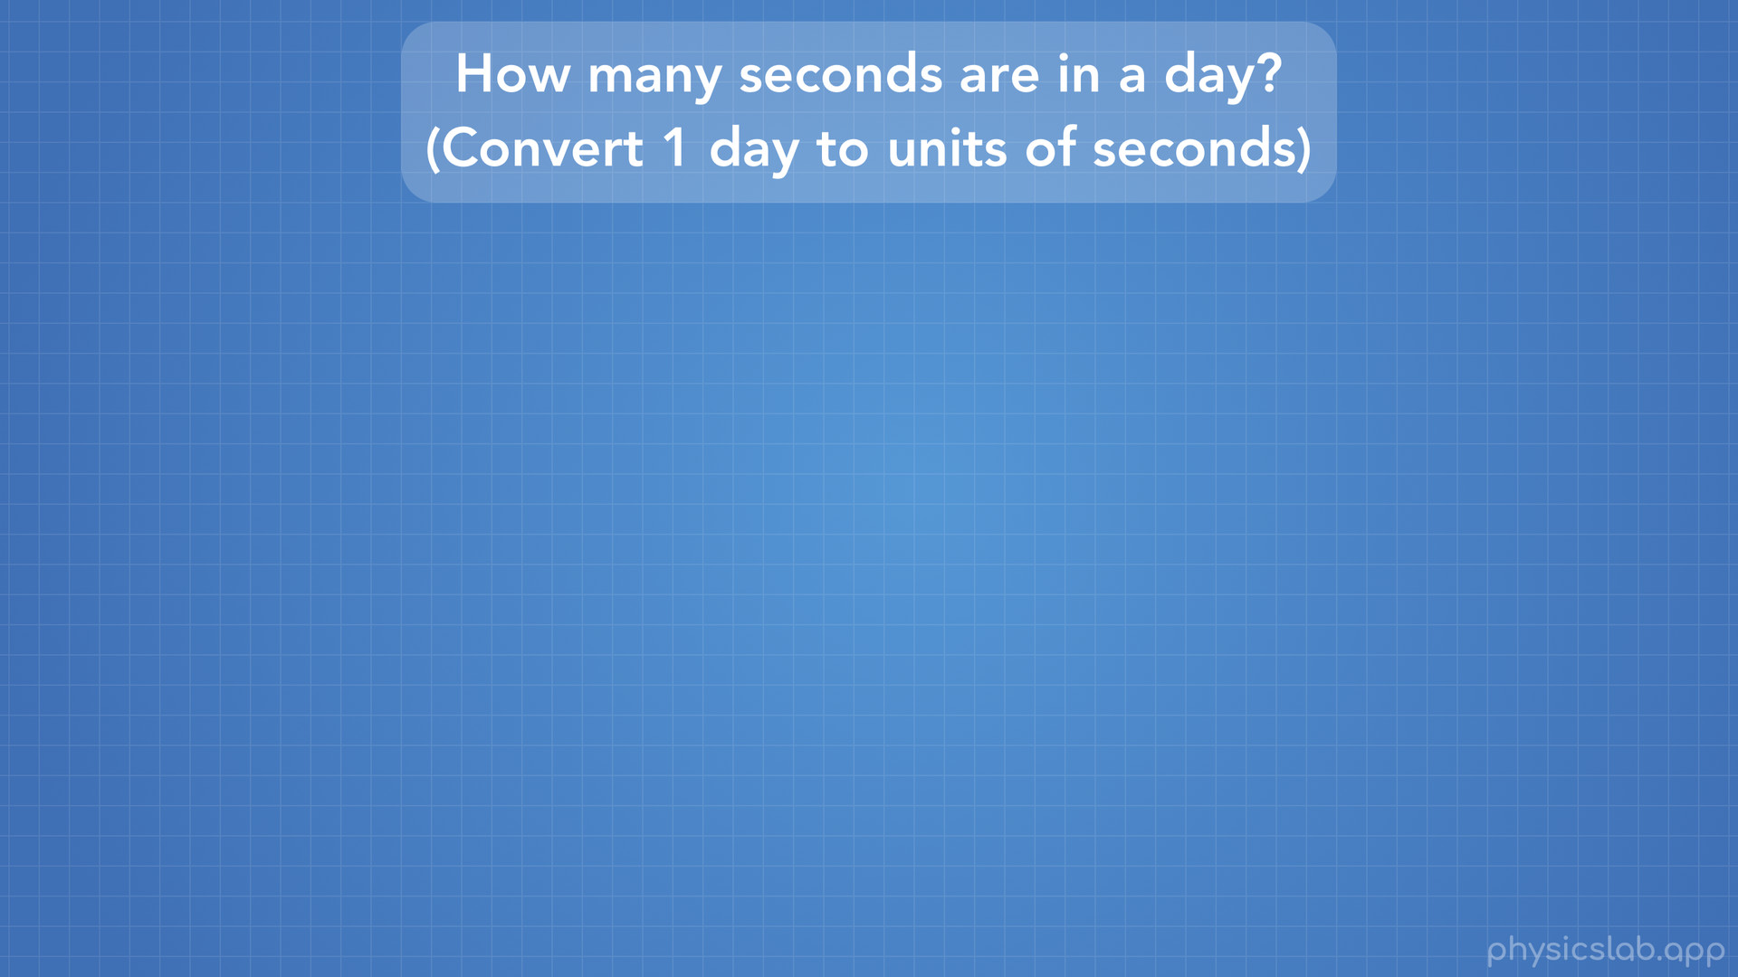
Notes:
So let’s walk through an example. How many seconds are in 1 day? That’s the same thing as saying “convert 1 day from units of days into units of seconds”.

Slide 27
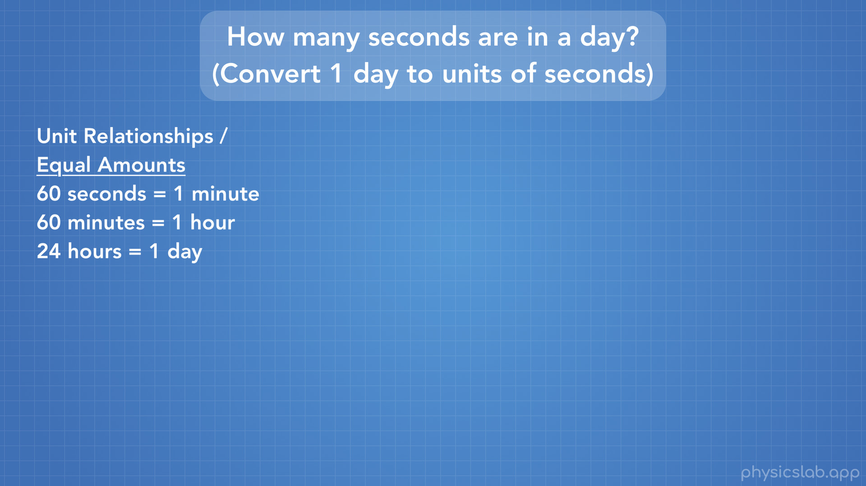
Notes:
In order to convert between units, you need to know what the relationships are between the units you’re working with. You might know these off the top of your head, or they might be given to you. In our case we know that 60 seconds = 1 minute, 60 minutes = 1 hour, and 24 hours = 1 day.

Slide 28
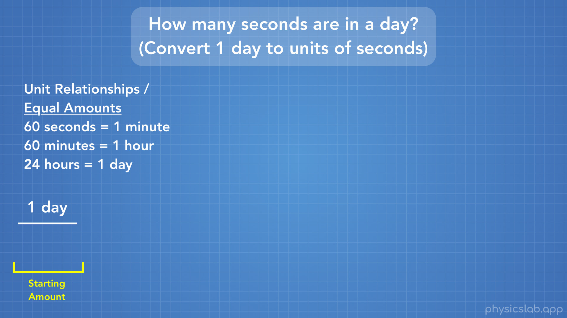
Notes:
First, we write the amount we start with. We’re starting with 1 day and converting to seconds, so in our case our starting amount is 1 day.

Slide 29
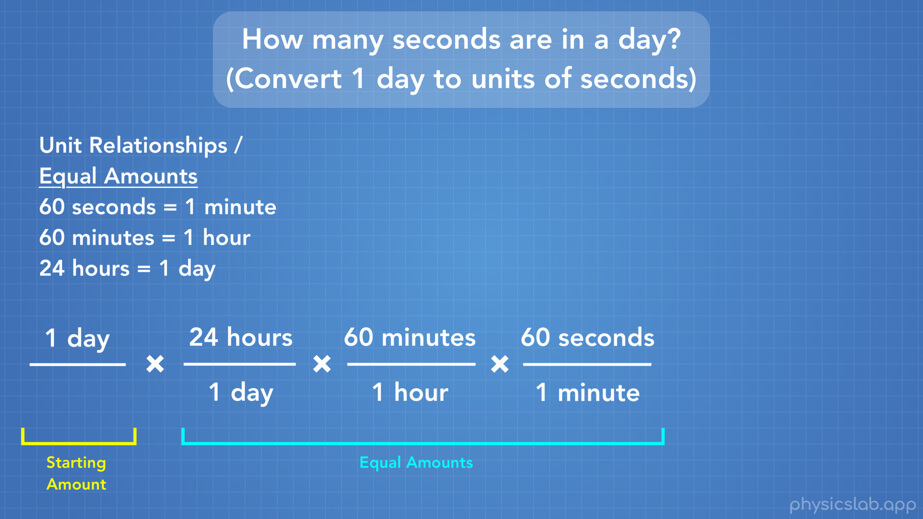
Notes:
Next, we’re going to multiply by those unit relationships, which are the amounts of each unit that are equal to each other. We have 24 hours per day, then 60 minutes per hour, then 60 seconds per minute. Now, mentioned that we could write these relationships either way: for example 24 hours per 1 day OR 1 day per 24 hours. So how do we know which ones go on top when we’re doing this conversion?

Slide 30
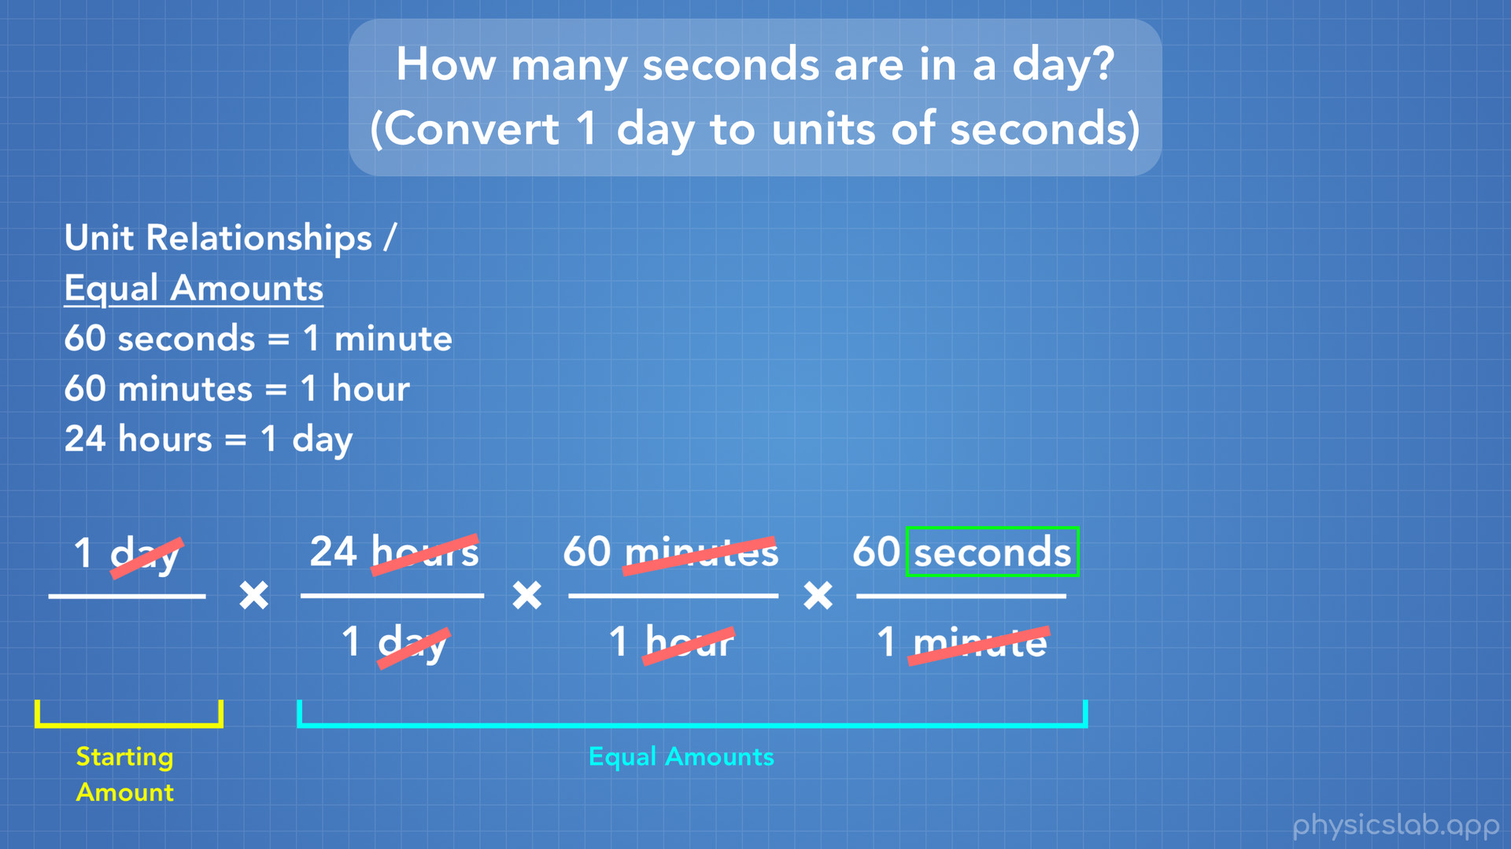
Notes:
Well here’s the thing: we’re going to multiplying these fractions, so if we have the same unit on the top and the bottom of this list of fractions, they cancel each other out and we can cross them both out. We have day on the top and the bottom, so we can cross them out. We can do the same for hours, and minutes. The only unit that we haven’t crossed out is seconds, and that’s the unit we want our answer to be in. So there’s the answer to our question: when we write these relationships or equal amounts, we put the right one on the top or bottom so that we can cross units out and end up with only the unit we want.

Slide 31
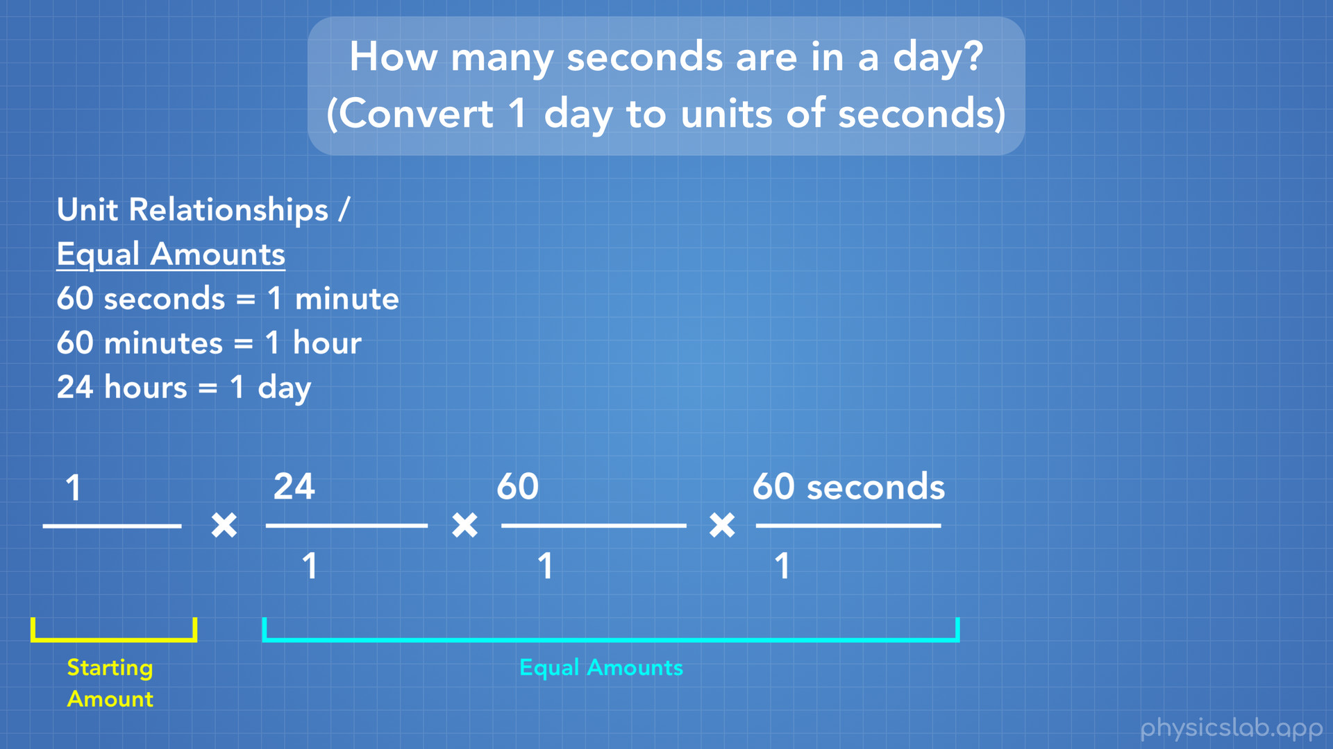
Notes:
So now that we’ve crossed out our units and found that we’re only left with the unit we want, we know we wrote everything down correctly.

Slide 32
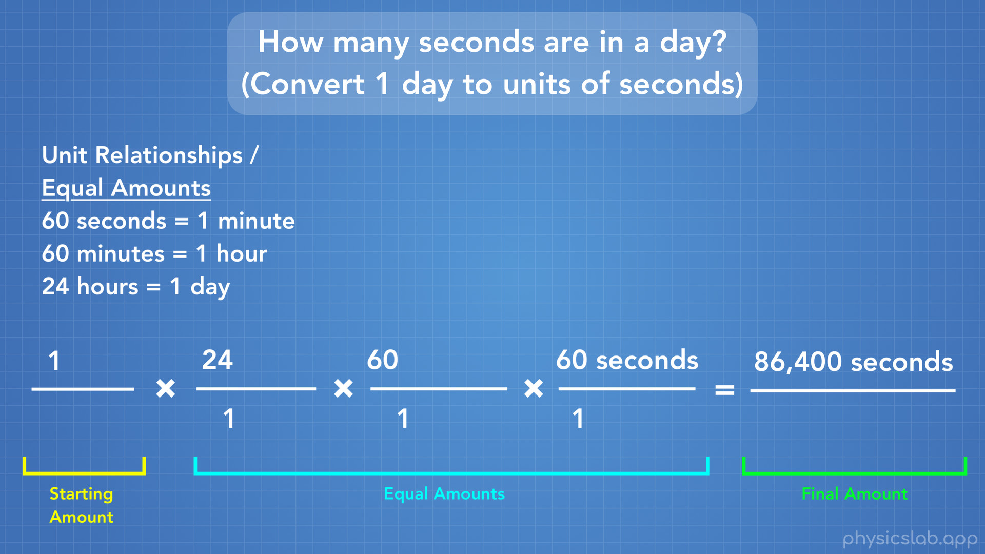
Notes:
Now all we have to do is multiply these fractions to get our answer. We do that multiplying all of the numbers on top, which gives us our top number or numerator, then multiplying all the numbers on the bottom, which gives us our bottom number or denominator. In our case, on the top we multiply 1 x 24 x 60 x 60 seconds and we get 86,400 seconds. On the bottom we multiply 1 x 1 x 1 and we get 1. Since any number divided by 1 is just itself, we can just ignore the 1 on the bottom since it has no unit.
There’s our answer! 1 day is equal to 86,400 seconds, or we could say there’s 86,400 seconds per day.

Slide 33
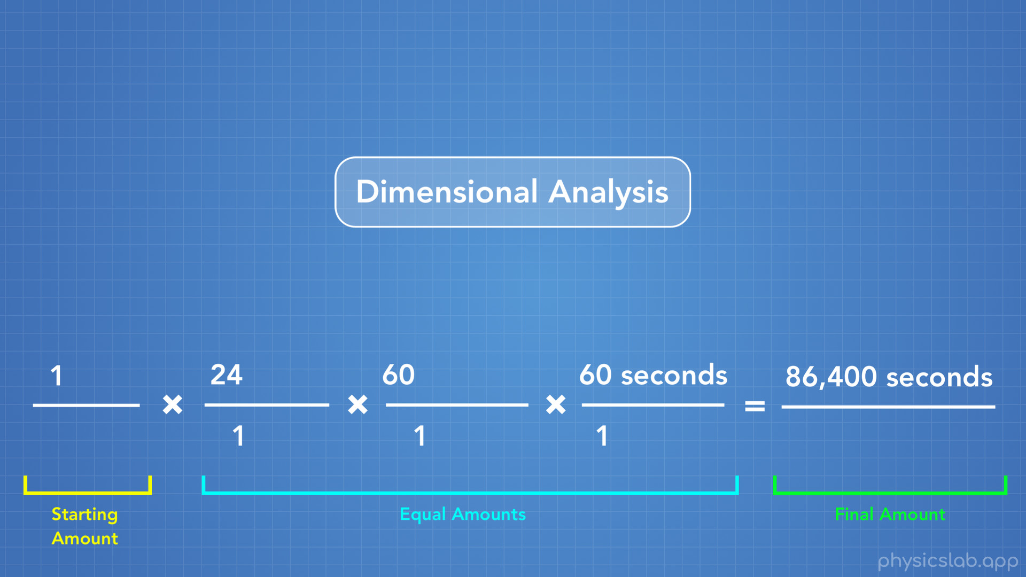
Notes:
This method of converting between units is called Dimensional Analysis. And even for simple conversions, I always use this method so that I know I won’t mess up, and multiply when I should have divided or whatever.

Slide 34
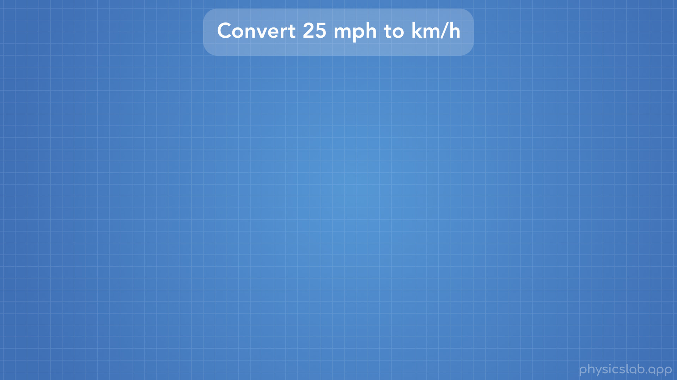
Notes:
Let’s convert 25 mph to km/h.

Slide 35
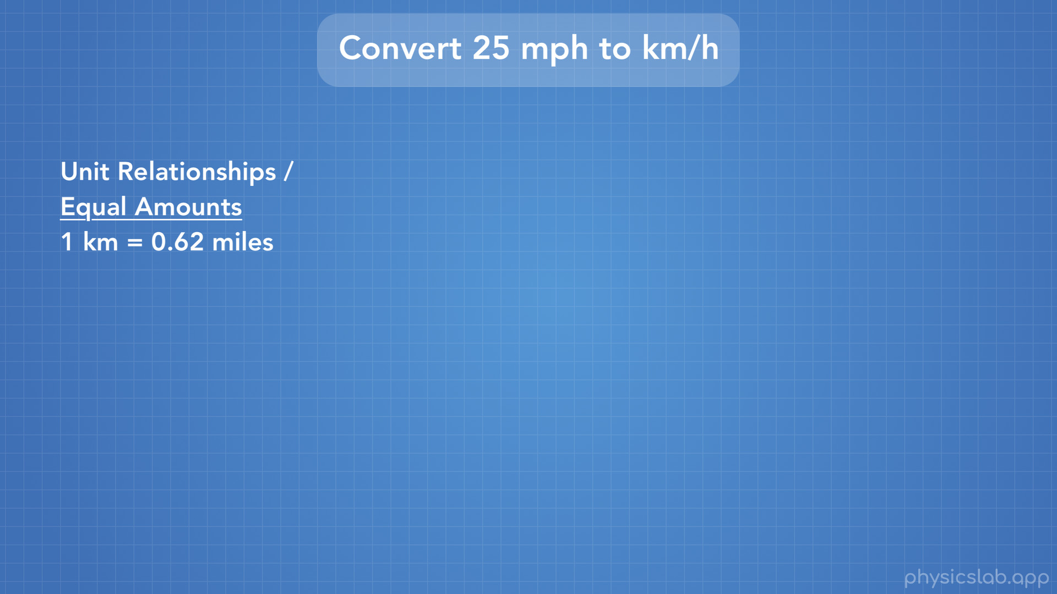
Notes:
First we need to know the relationships between the units we’re dealing with. In this case we’re given that 1 km = 0.62 miles.

Slide 36
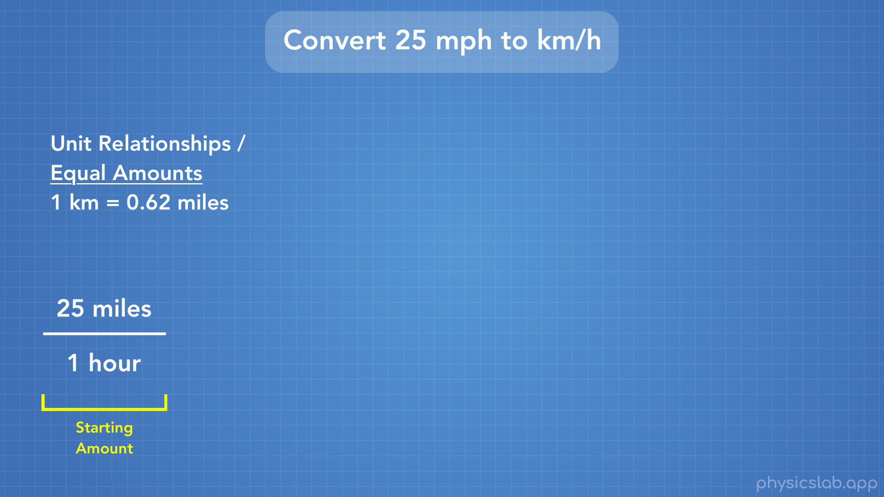
Notes:
iNext we write the starting amount, which is 25 mph. Notice how miles per hour was written as mph, but now we have 25 miles / 1 hour. When we convert between units, we write them out as fractions.

Slide 37
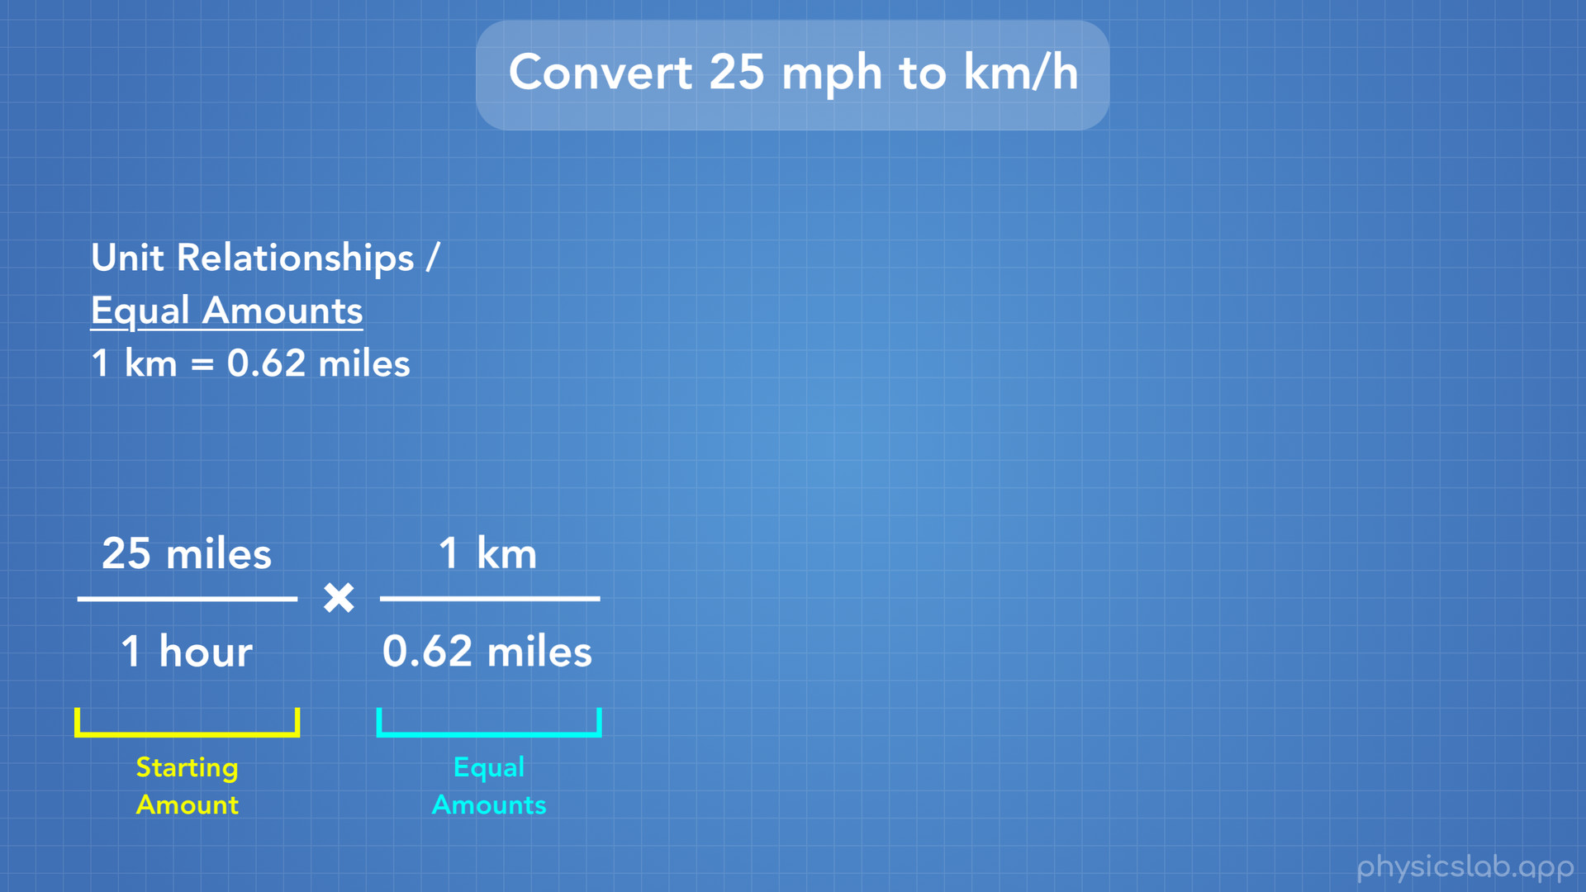
Notes:
Next we write our equal amounts that we’re given. Since we have “miles” on the top and we want to get rid of miles and end up with km, we write our relationship with miles on the bottom of the fraction.

Slide 38
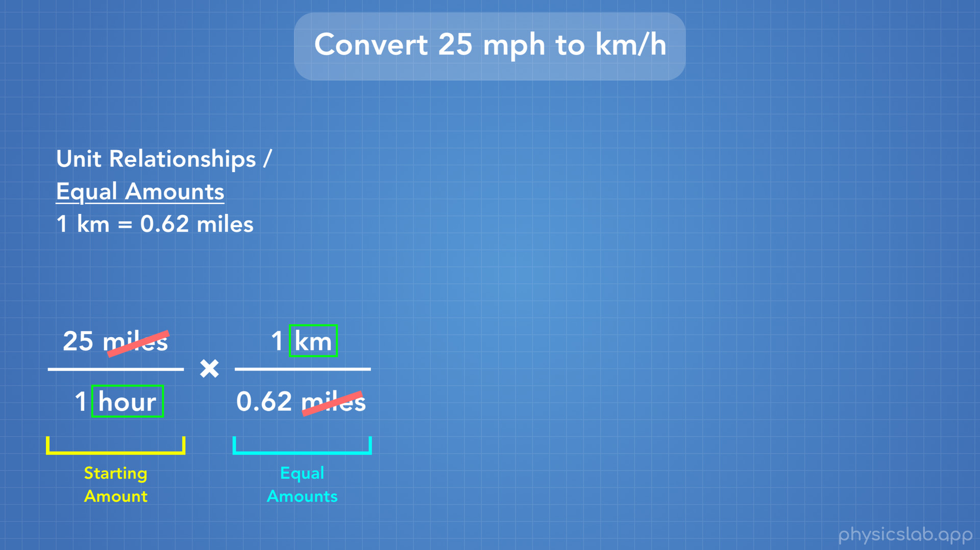
Notes:
Now we can cross out “miles” since it’s on the top and the bottom.

Slide 39
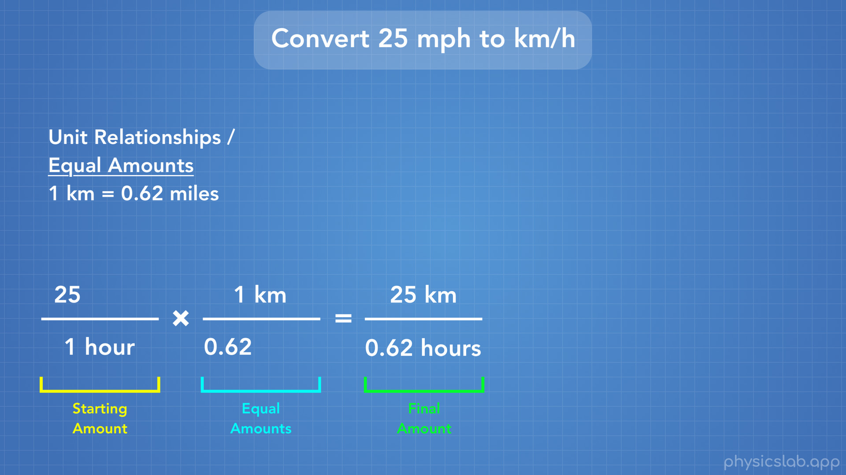
Notes:
What we’ve left with is km on the top and hours on the bottom, which is the unit we want: km / hour. To get our answer we multiply the top numbers: 25 x 1 km = 25 km, then the bottom: 1 hour x 0.62 = 0.62 hours.

Slide 40
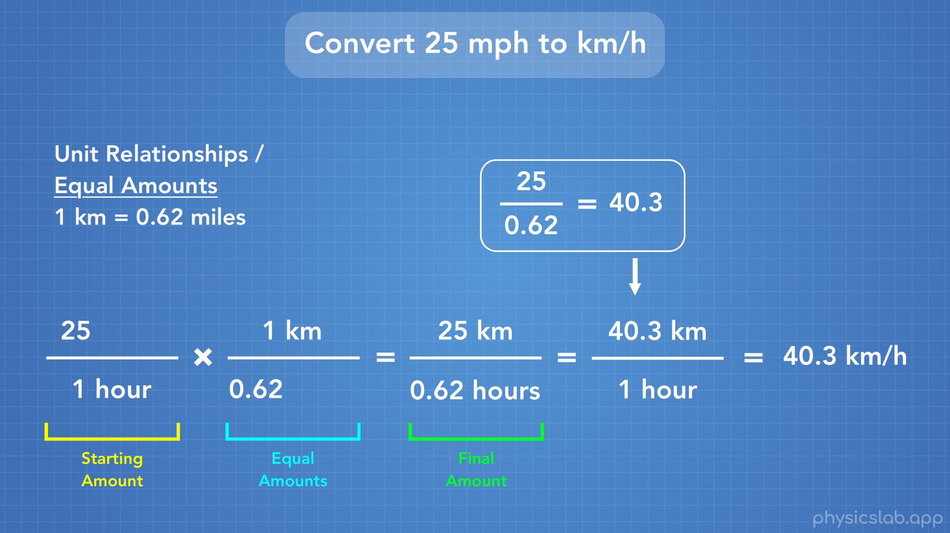
Notes:
We end up with 25 mph is equal to 25 km / 0.62 hours, which is true. But what we really want is km per “1 hour”. To do that we just finish the math: we do 25 / 0.62, and we get 40.3, so we write that on the top. So our answer is 40.3 km / hour. So, that’s how we convert between units.

Slide 41

Notes:
Alright that was a lot of stuff, so let’s recap.

Slide 42
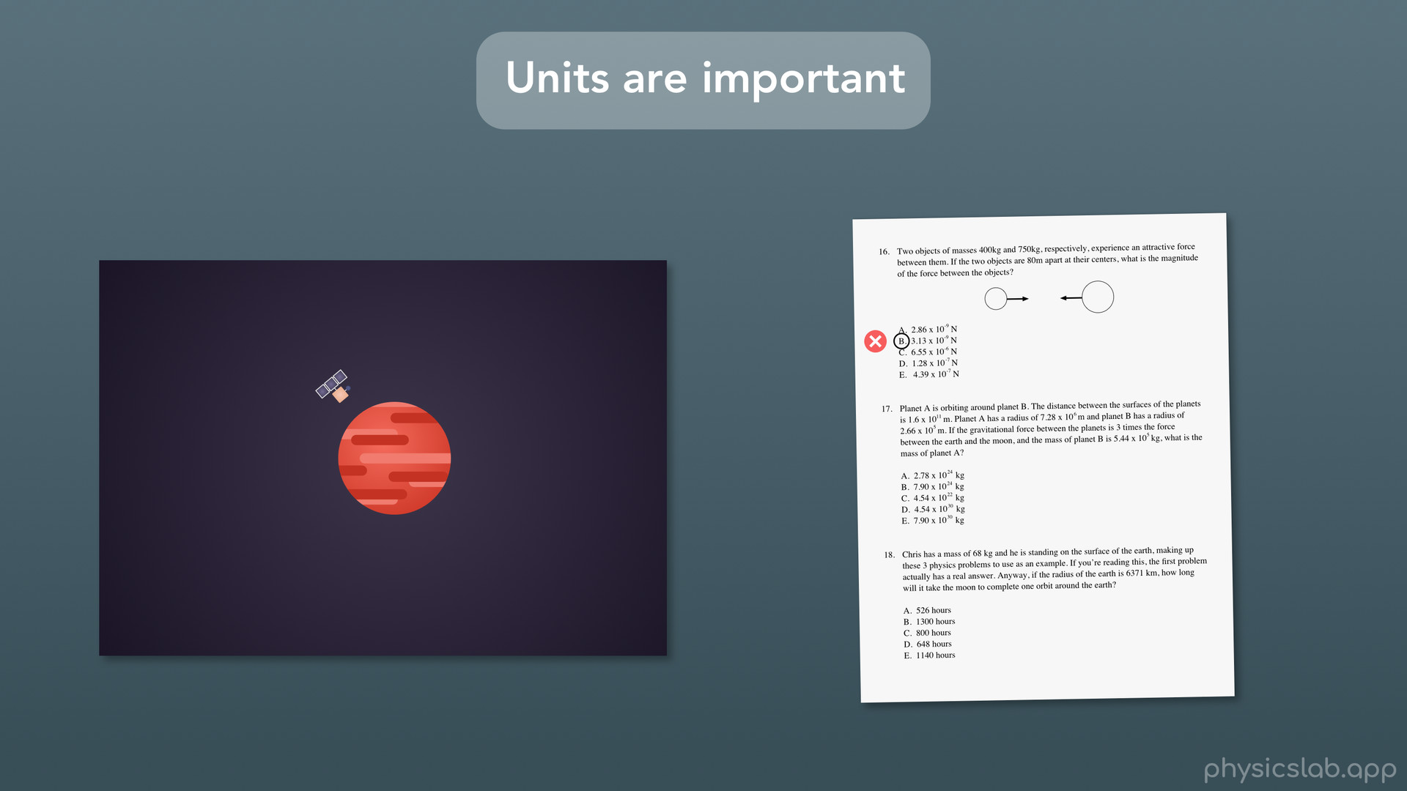
Notes:
First off, we learned that units are important to keep track of: you might crash a $193 million space orbiter, or you might just get the wrong answer on a test, but let’s not risk it.

Slide 43
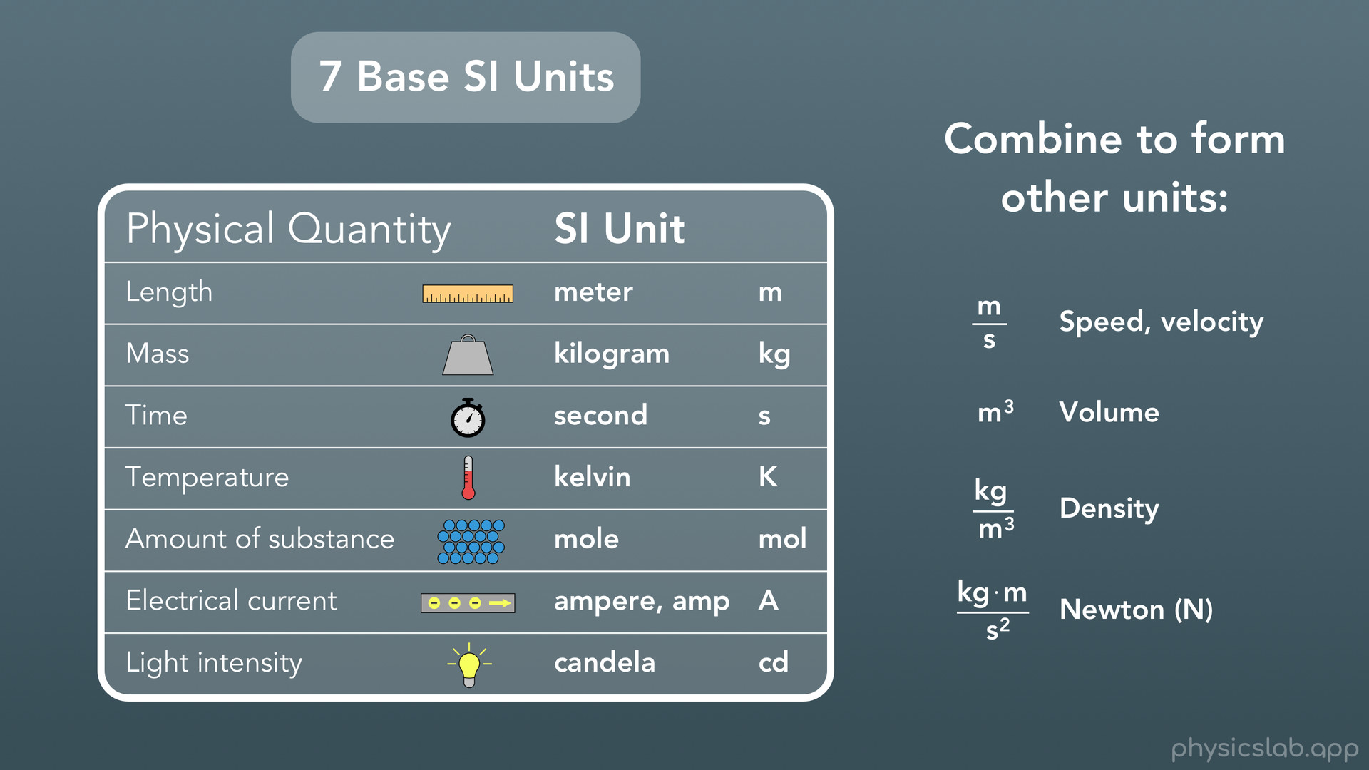
Notes:
We covered the 7 base SI units, and mostly we’ll just be using the first 4 in physics. We also know we can combine those base units to form units for other things.

Slide 44
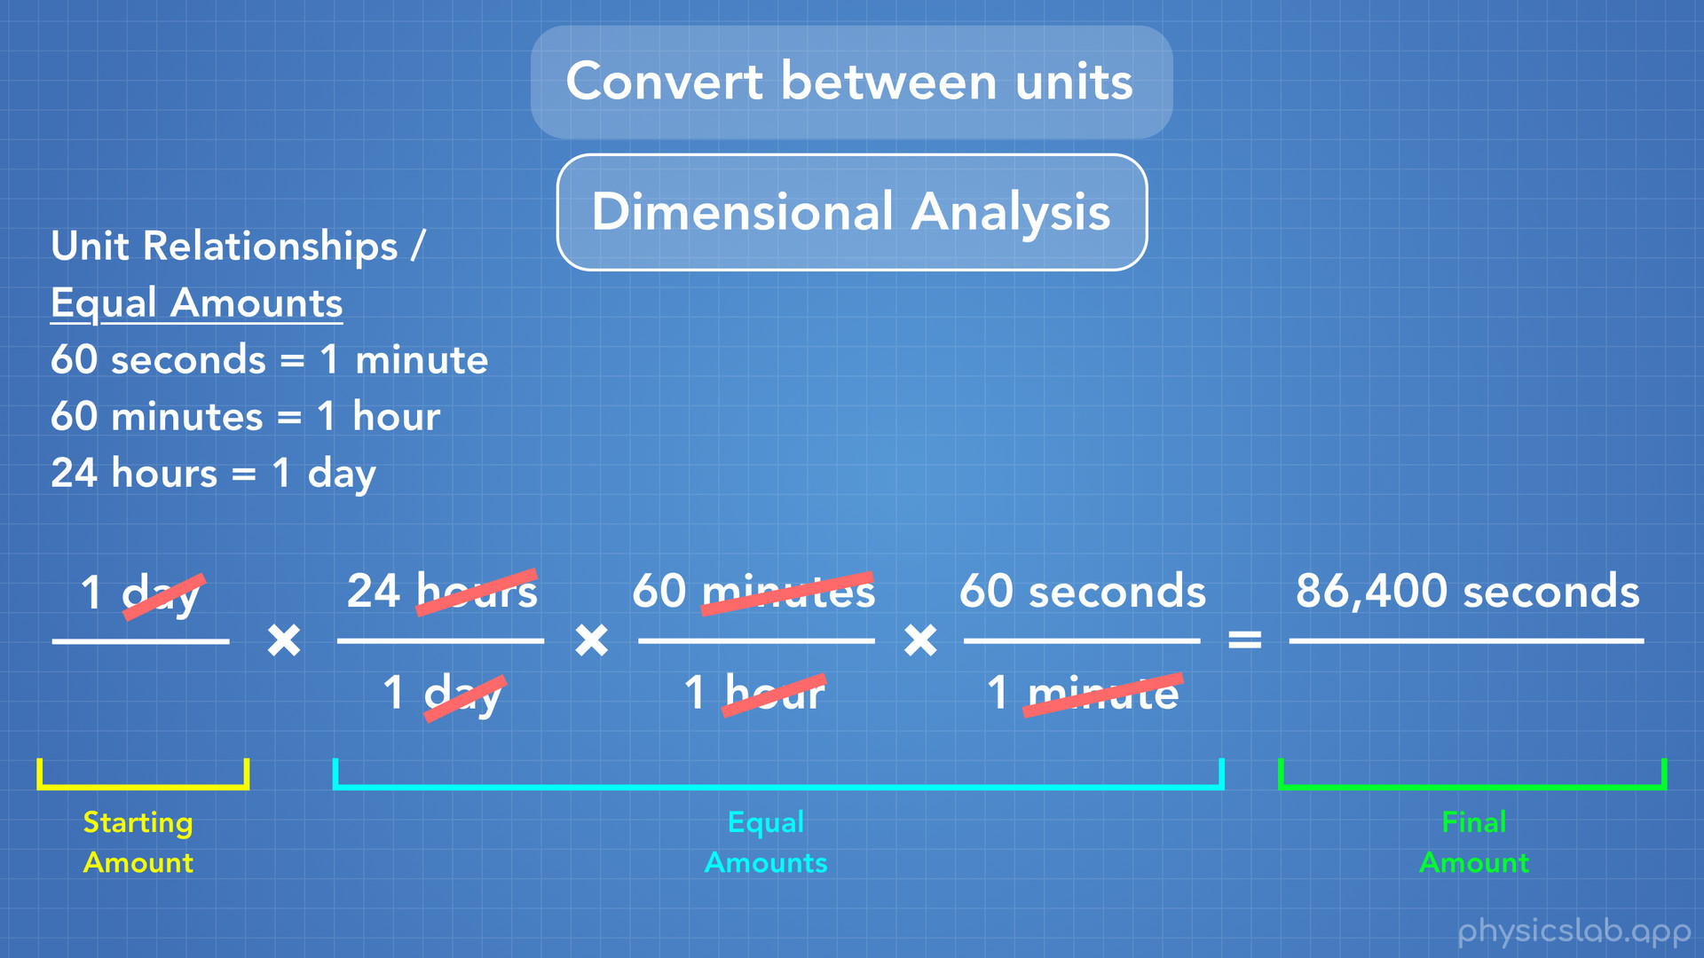
Notes:
Finally, we learned how to convert a number from one unit to a different unit, using a method we called dimensional analysis.

