Slide 1
Kinetic Friction
Slides Version 2
This version includes:
Slides with screenshot images from the video.
The video narration in the slide notes.
A blank template slide with the same background and font as the video.
Slides with some basic graphics from this video for you to use however you like.
Feel free to add, delete and edit slides to make your own presentation. You can use these slides in class or share them with your students, but please do not share them with anyone else.
If you have any feedback, suggestions or questions about these slides please email me at chris@physicslab.app or send me a message on Discord @physicslab.
physicslab.app

Slide 2
Heading
Text

Slide 3








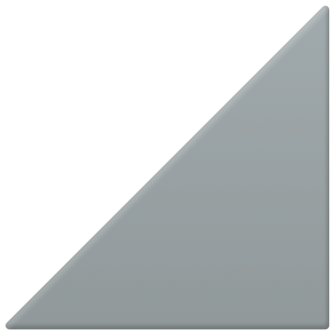






Slide 4




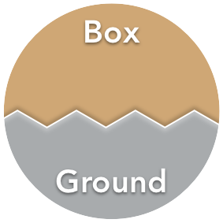









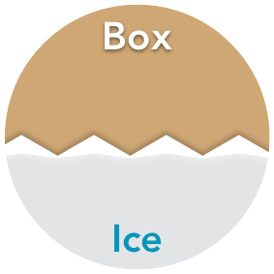








Slide 5


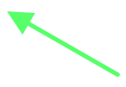



















Slide 6
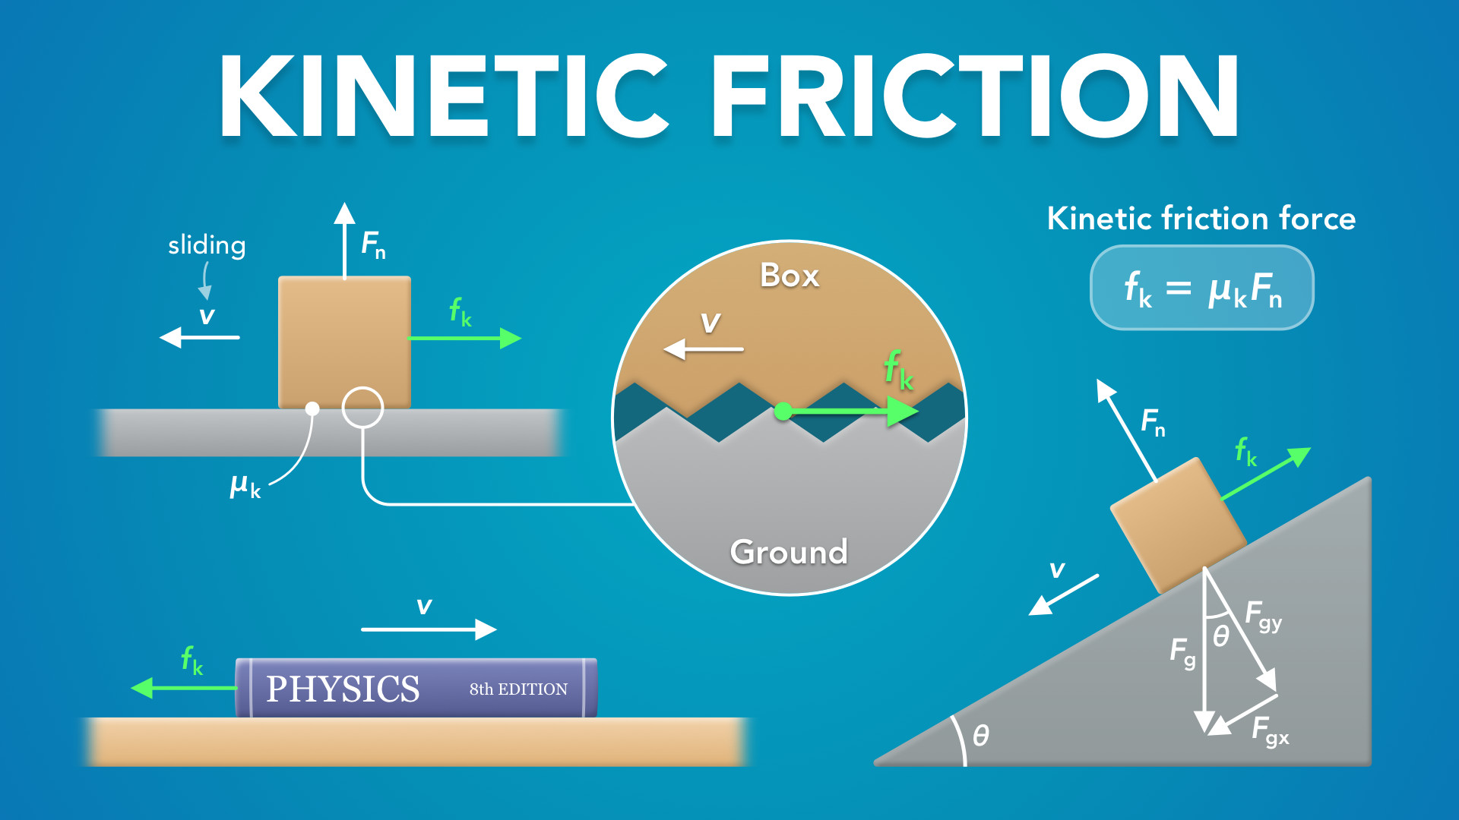
Notes:
Kinetic Friction
physicslab.app
If you have any questions, suggestions or feedback about these slides please email me at chris@physicslab.app or send me a message on Discord @physicslab.

Slide 7

Notes:
• Hey everyone! In this video, we’re gonna learn about kinetic friction.

Slide 8
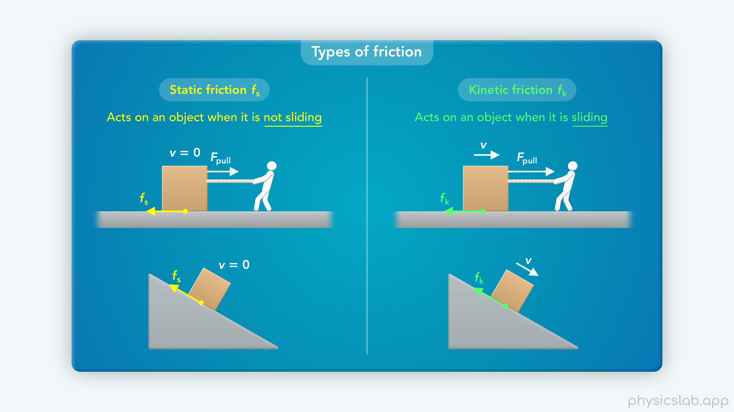
Notes:
• If you haven’t already, make sure you watch the introduction to friction video first.
• We covered static friction in the last video, and this video will cover kinetic friction, which is lot simpler.

Slide 9
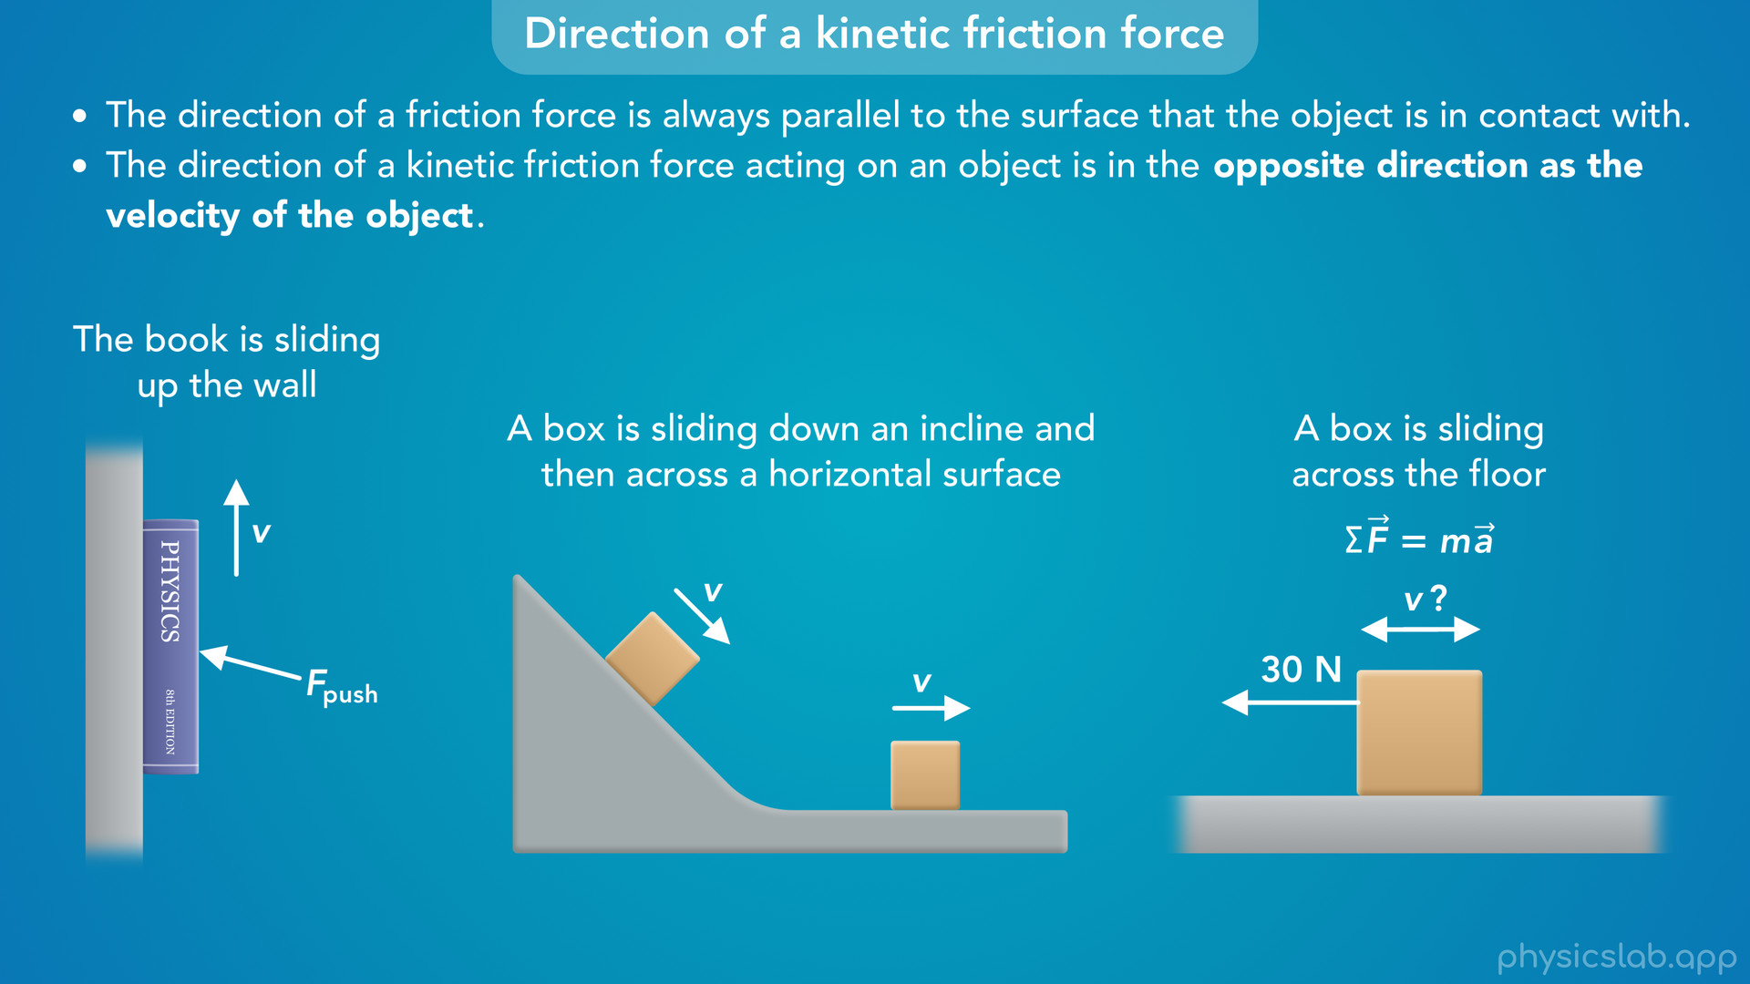
Notes:
• We’ll learn what a kinetic friction force is and how to figure out its direction.

Slide 10
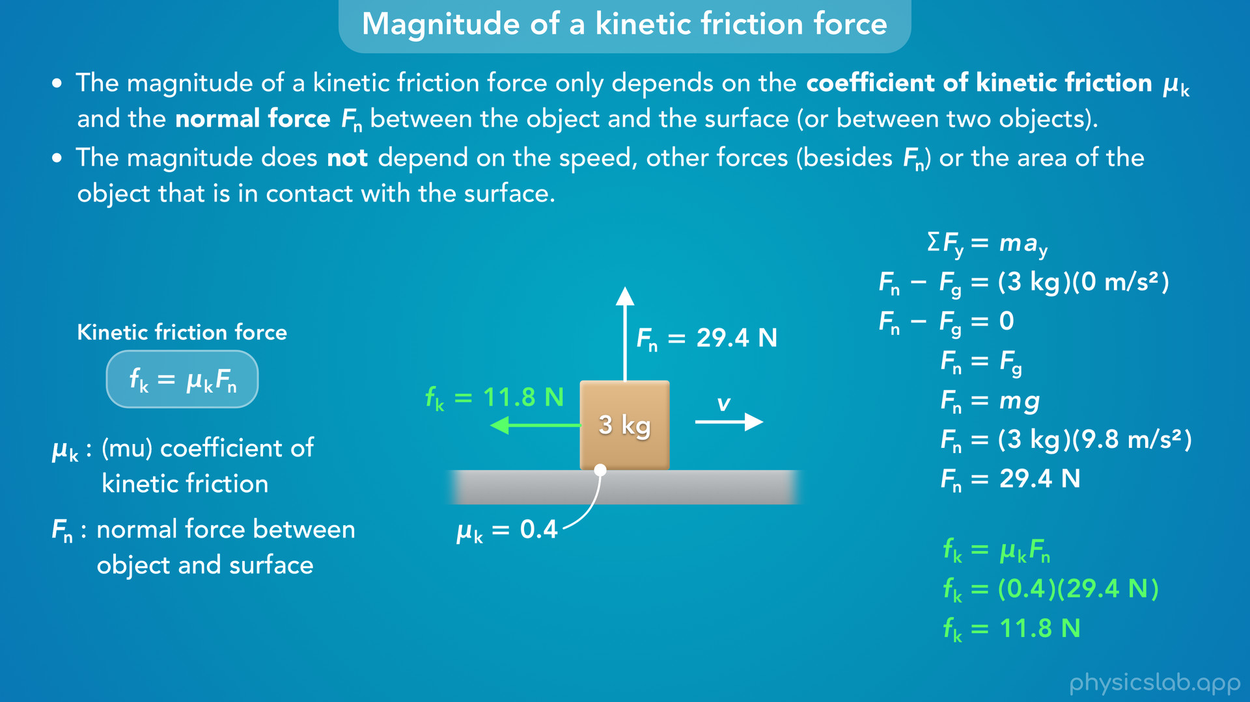
Notes:
• Then we’ll learn how to find the magnitude of a kinetic friction force using this equation.

Slide 11
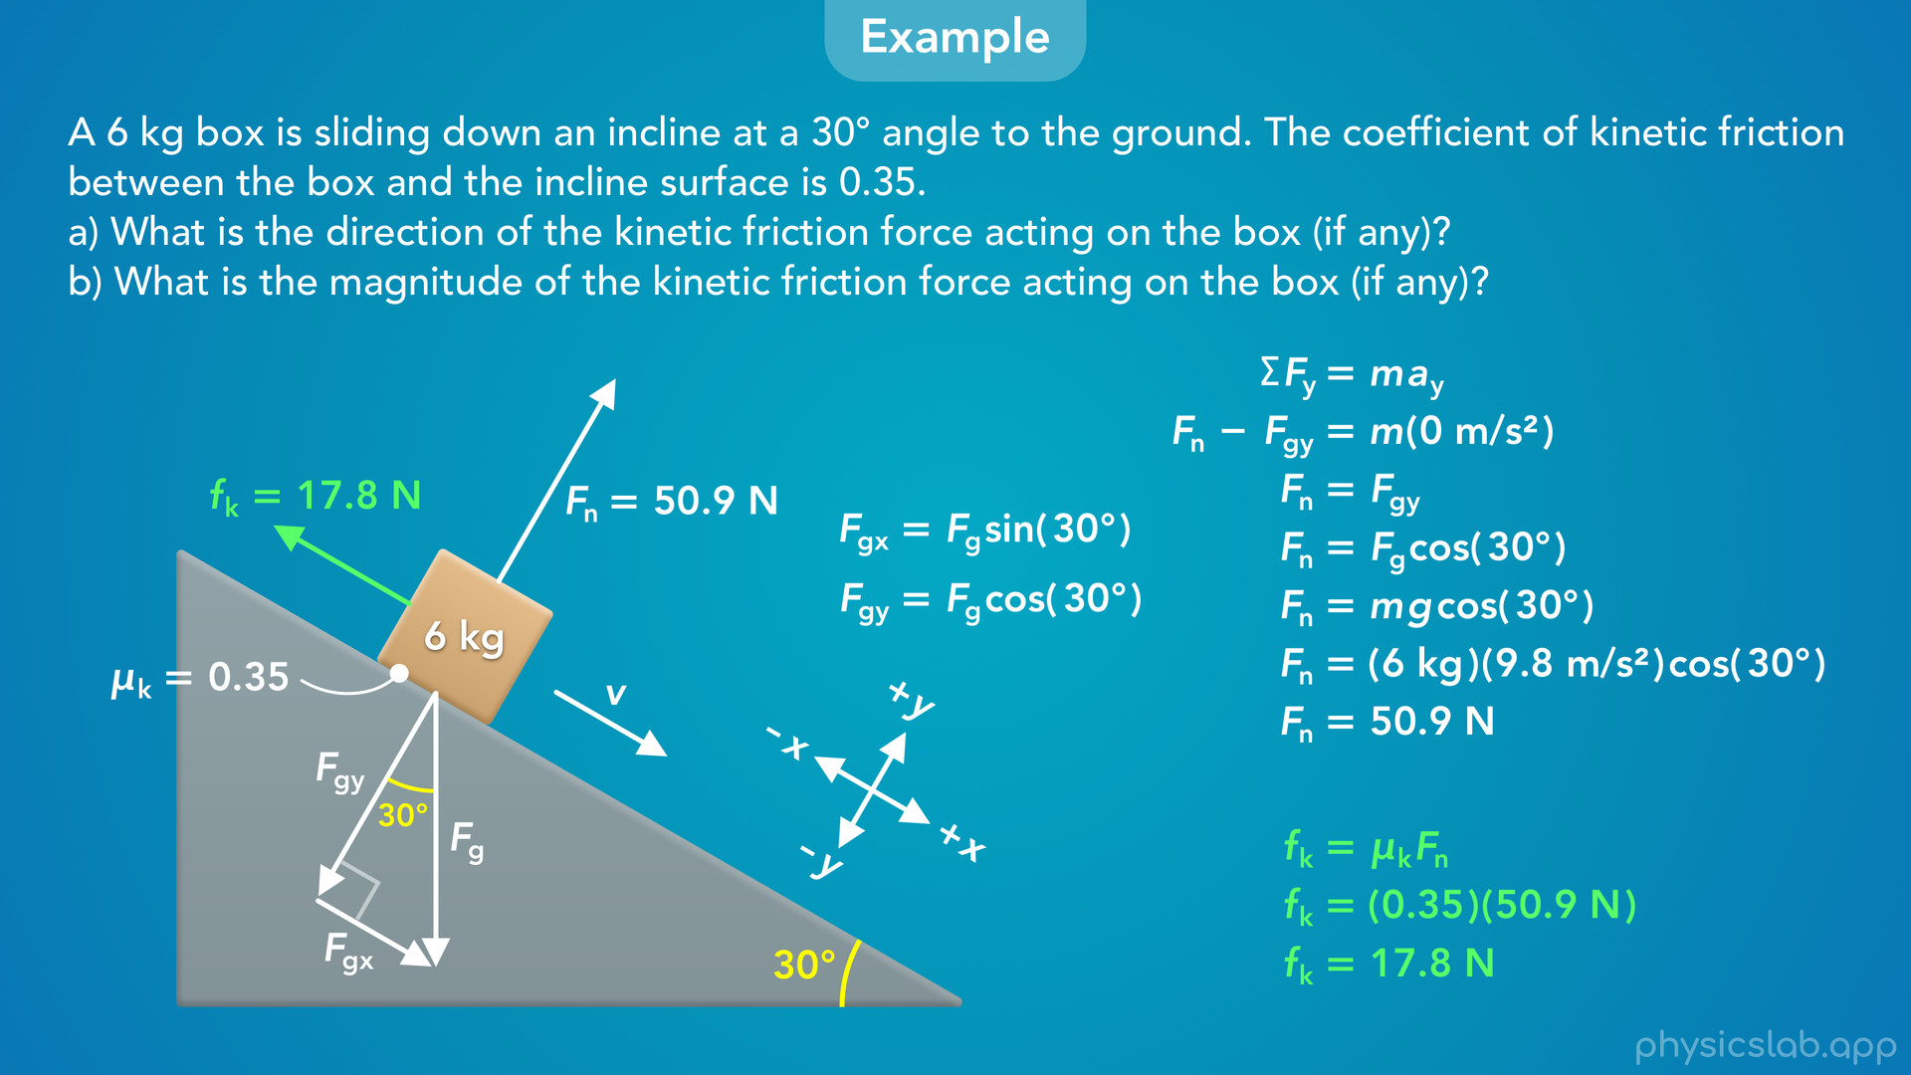
Notes:
• At the end, we’ll walk through an example of finding the kinetic friction force on an incline.

Slide 12

Notes:
• So what is kinetic friction, and how is it different from static friction?

Slide 13
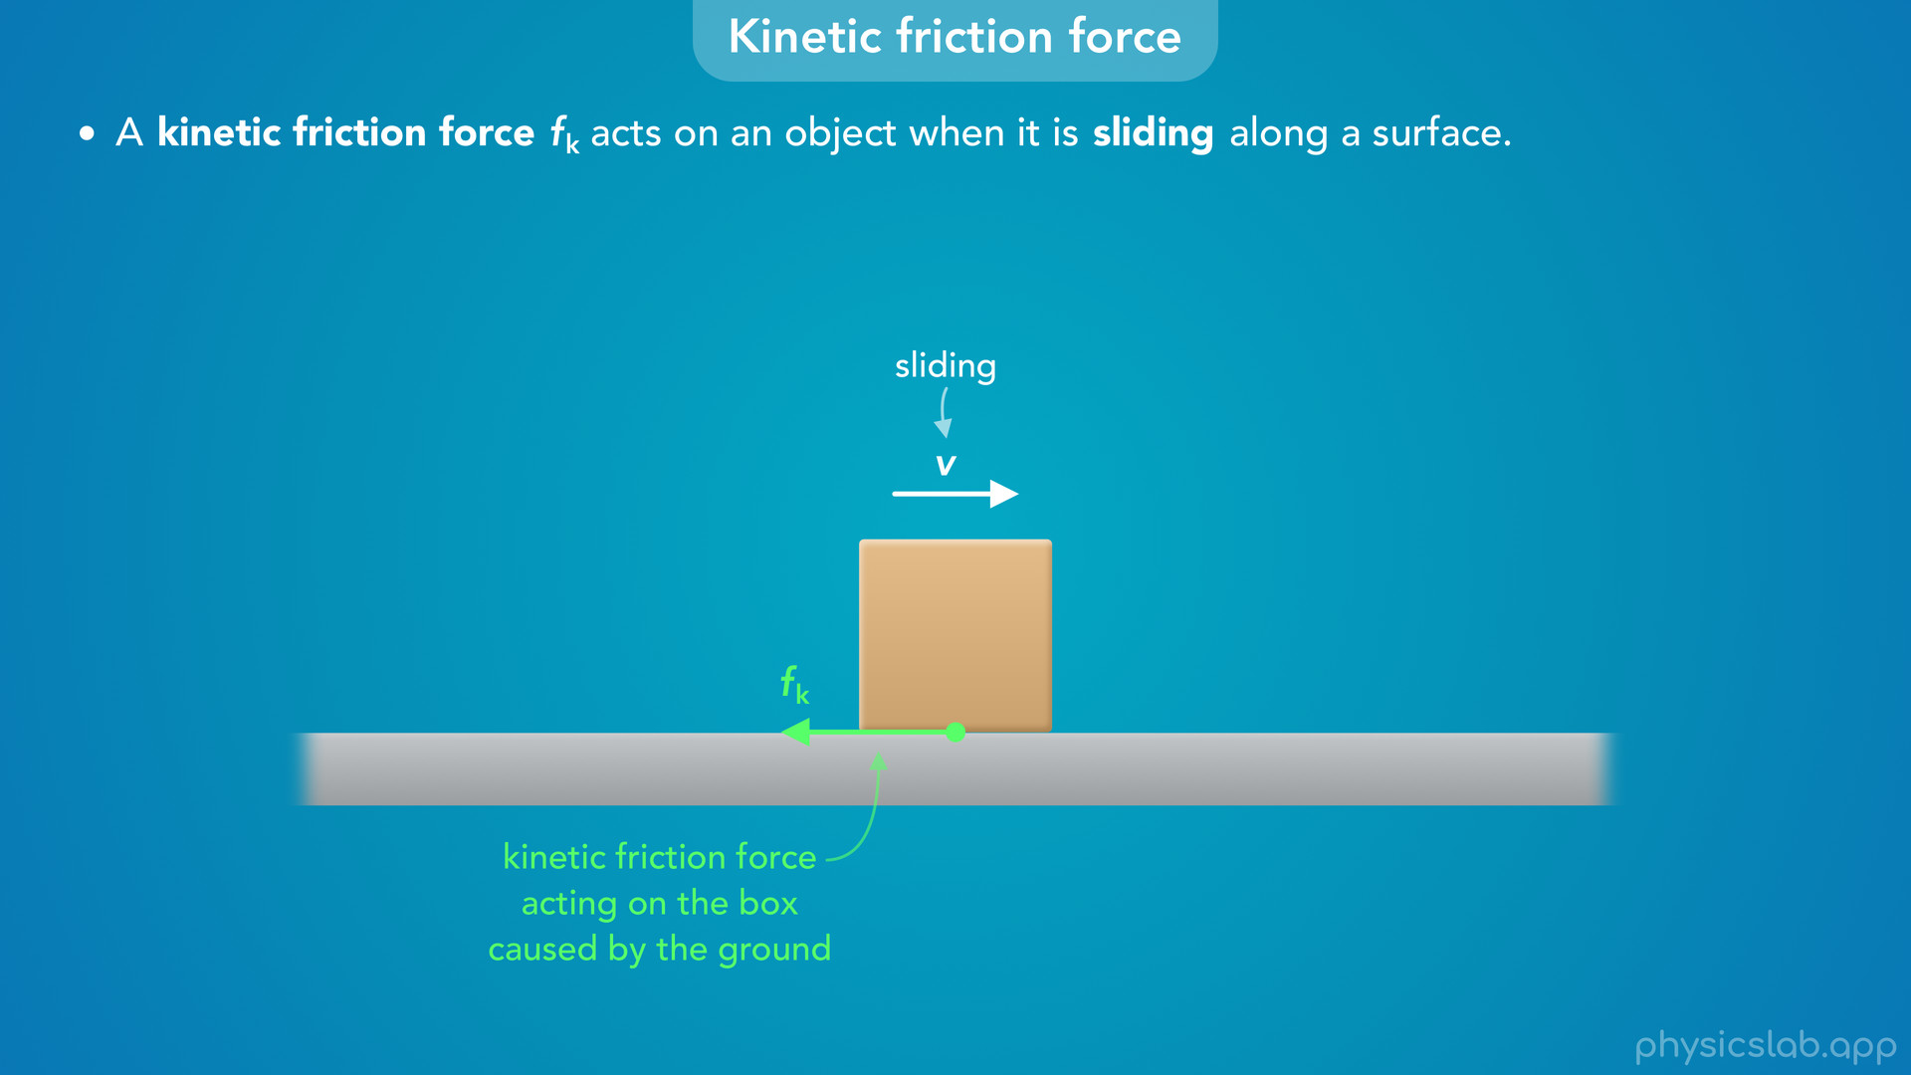
Notes:
• A kinetic friction force, which we label fk, acts on an object when it is sliding along a surface.
• So if this box is sliding along the ground and it has some velocity, then there’s a kinetic friction force acting on the box.
• This force acts on the bottom surface of the box, and it’s caused by the ground.

Slide 14
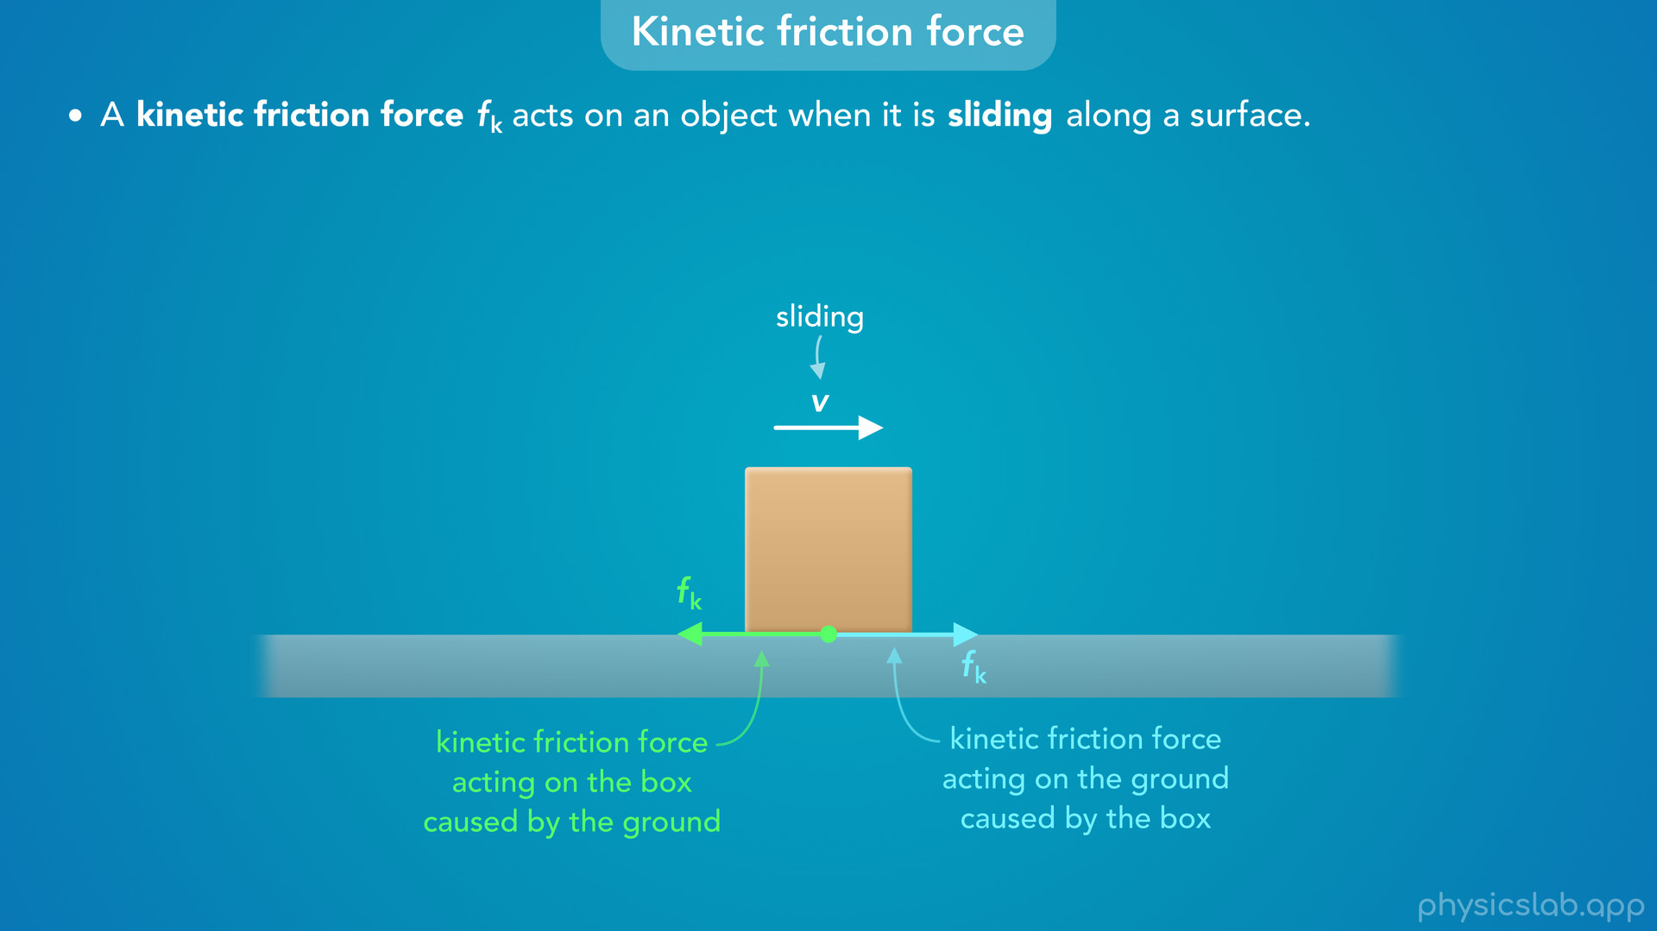
Notes:
• And we know from Newton’s 3rd law of motion that forces come in pairs, so the box must also be exerting a kinetic friction force on the ground, which has the same magnitude and the opposite direction.

Slide 15
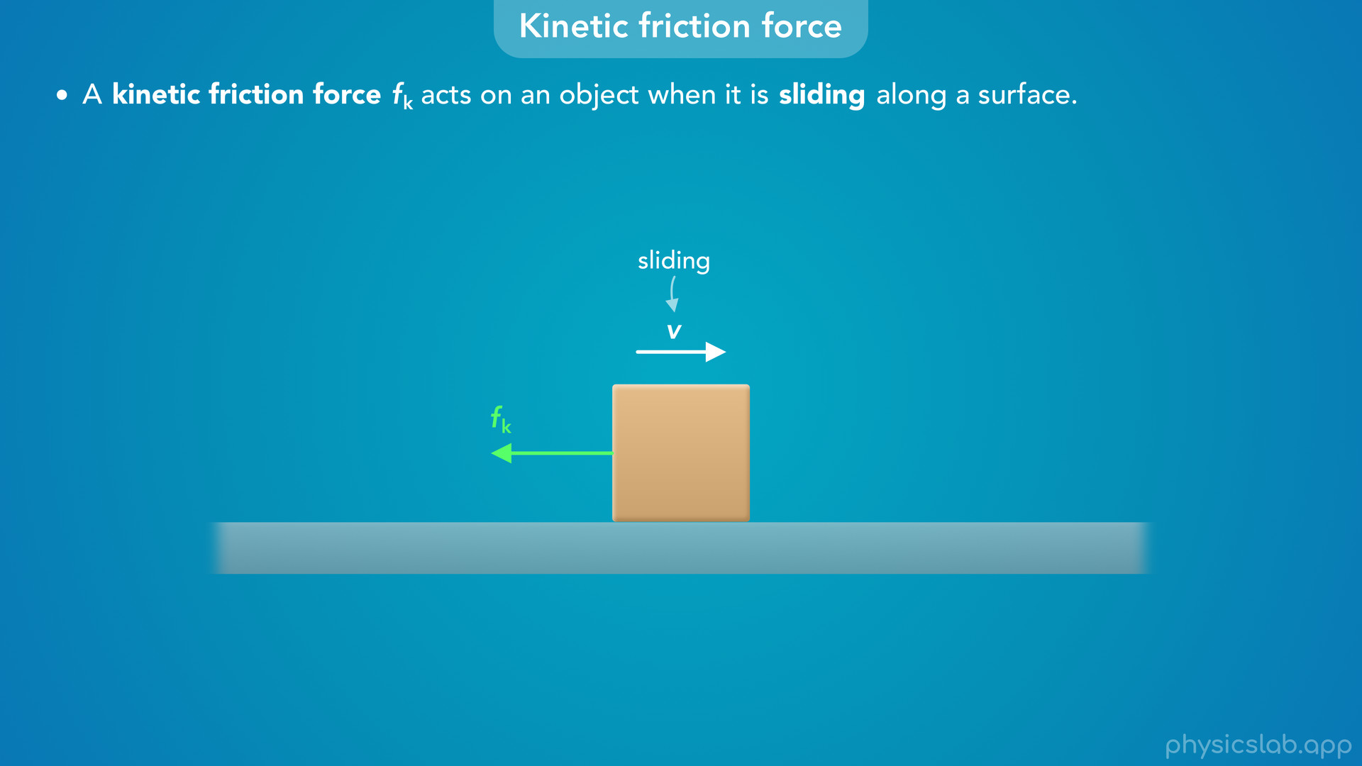
Notes:
• But we’re just gonna focus on the force that’s acting on the box, and we’re gonna draw it on the side of the box.

Slide 16
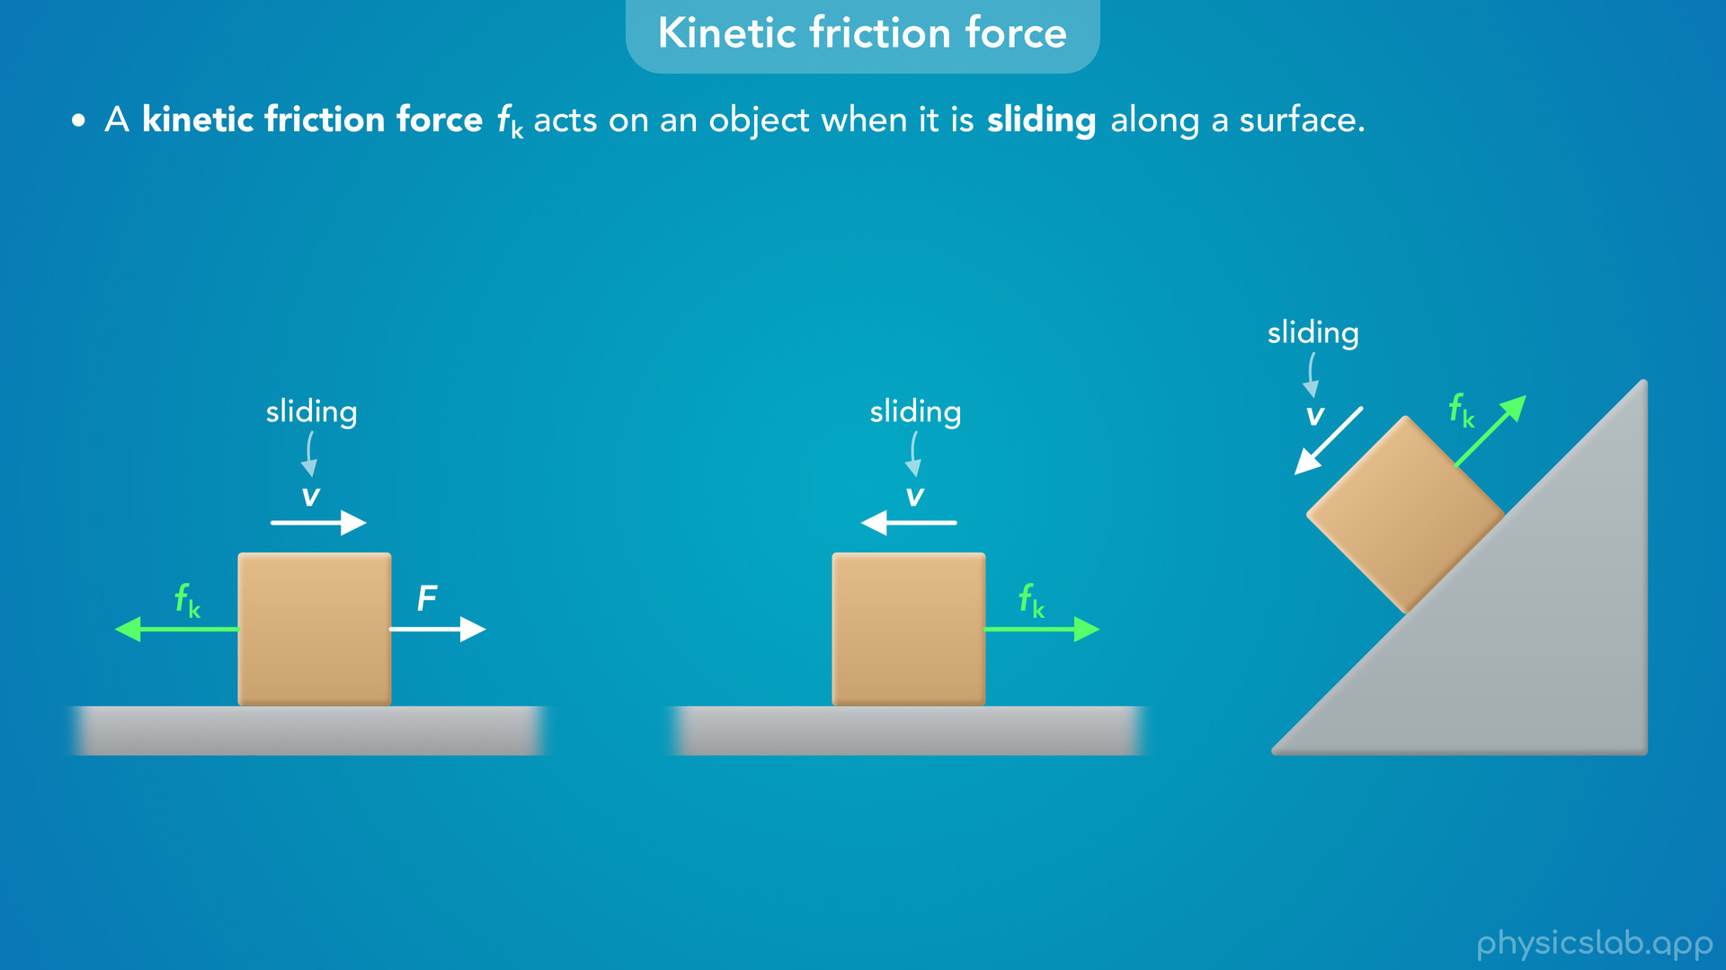
Notes:
• So whenever an object is sliding, there’s a kinetic friction force.
• It doesn’t matter if there are other forces acting on the object, or if the surface is at an angle.
• As long as the object is in contact with a surface and it’s sliding, there’s a kinetic friction force.

Slide 17
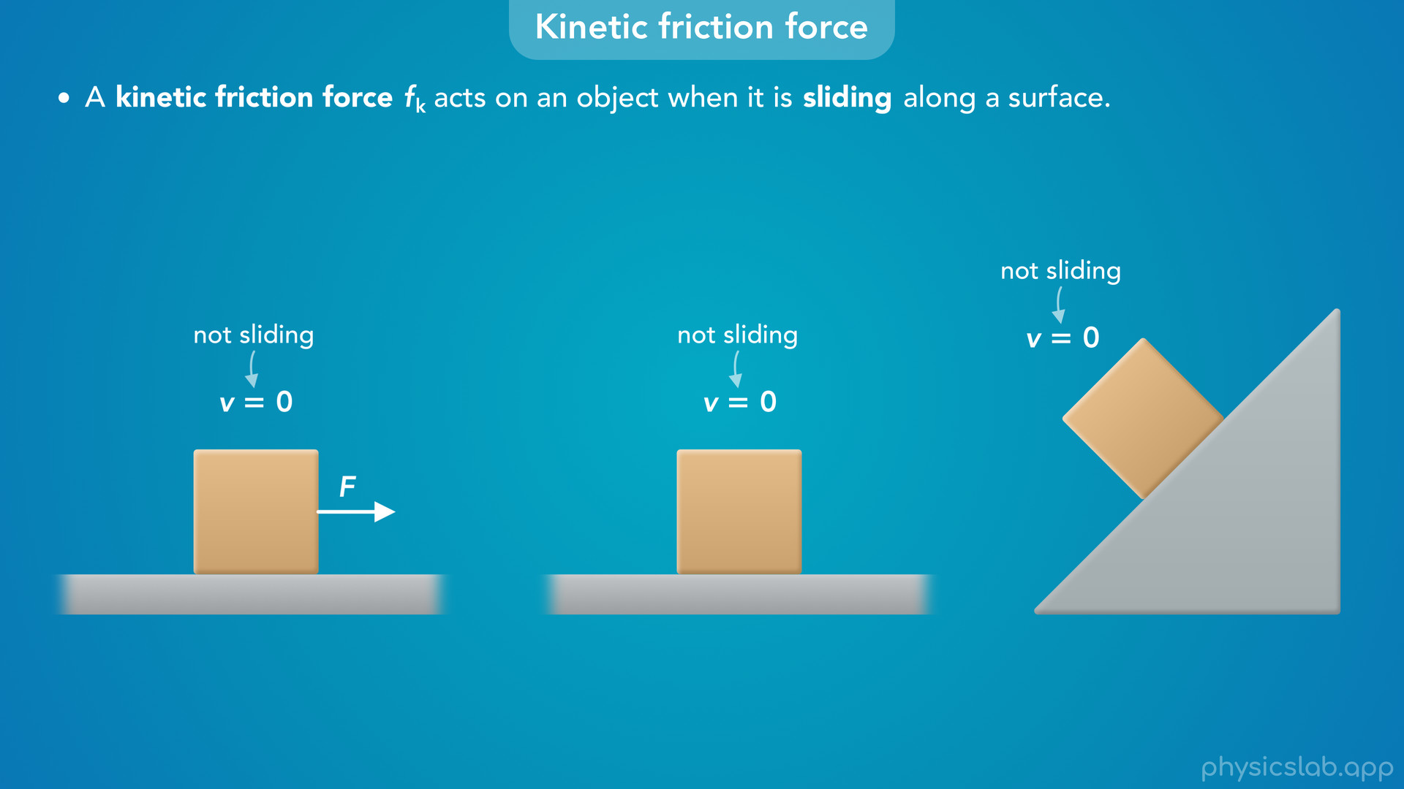
Notes:
• If it’s not sliding, then there’s no kinetic friction. But there may be static friction.

Slide 18
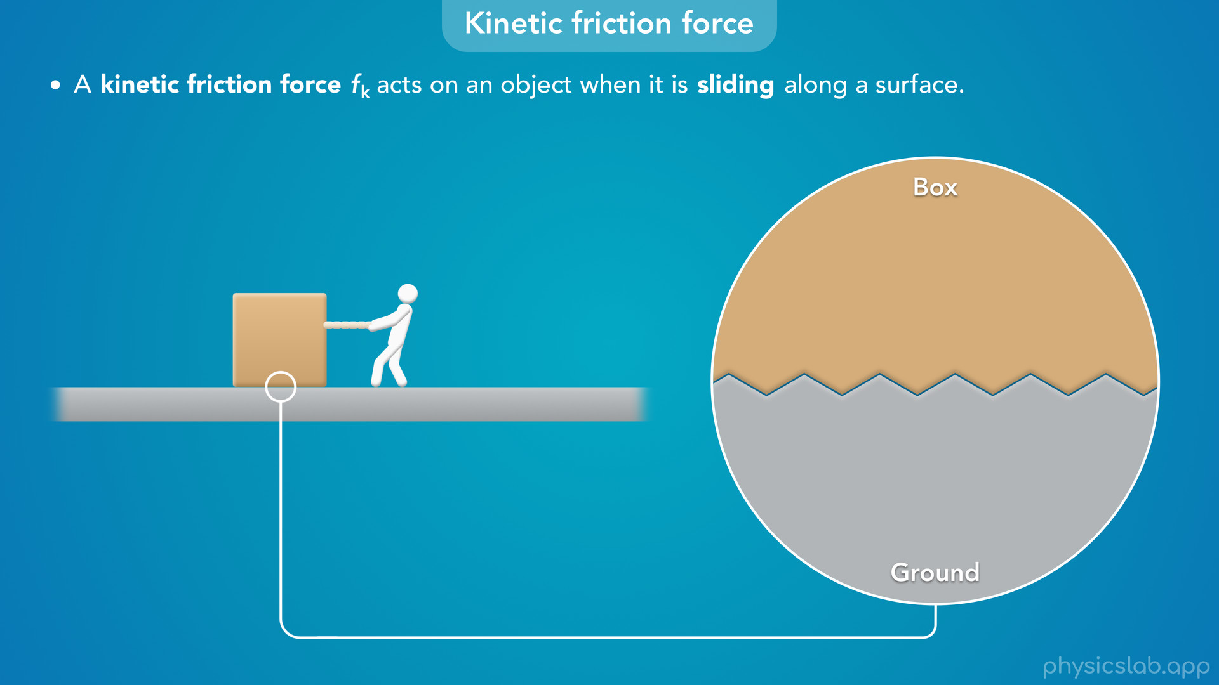
Notes:
• Like we mentioned in the previous videos, a friction force is caused by the microscopic roughness of each surface.

Slide 19
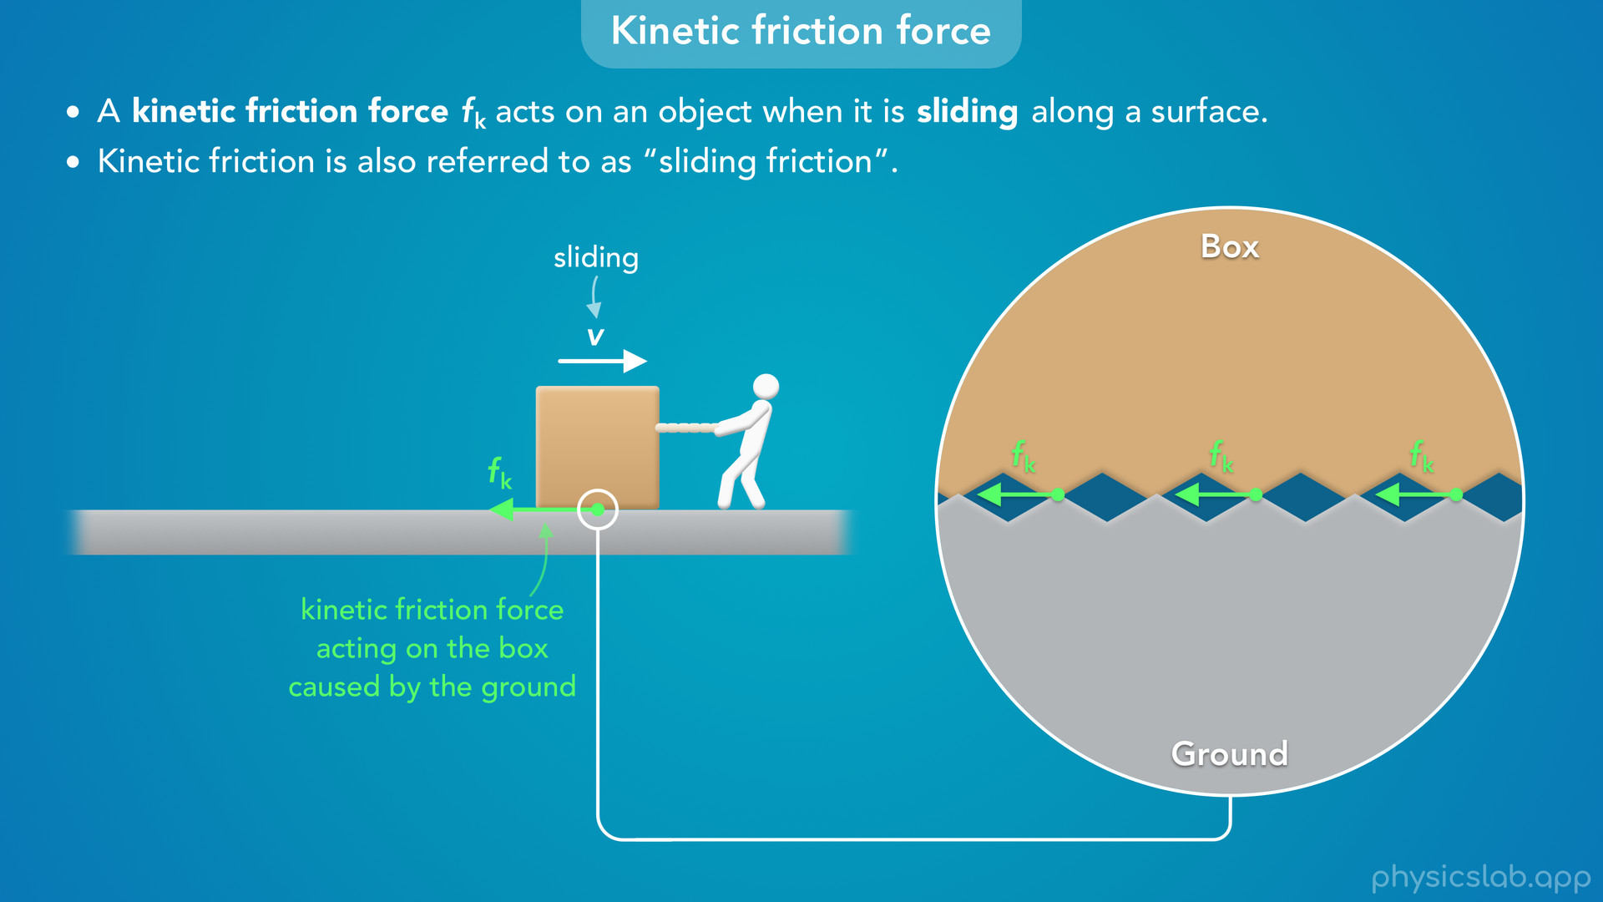
Notes:
• If this box is sliding, we can imagine that the bumps on the box are rubbing against the bumps on the ground, so the ground exerts a kinetic friction force on the box.
• It’s important to note that we’re using the word “sliding”, and not the word “moving”.
• Kinetic friction is also referred to as “sliding friction”, because it only exists when the object is sliding relative to the surface.
• If an object is rolling but it’s not sliding, then there would not be a kinetic friction force.

Slide 20
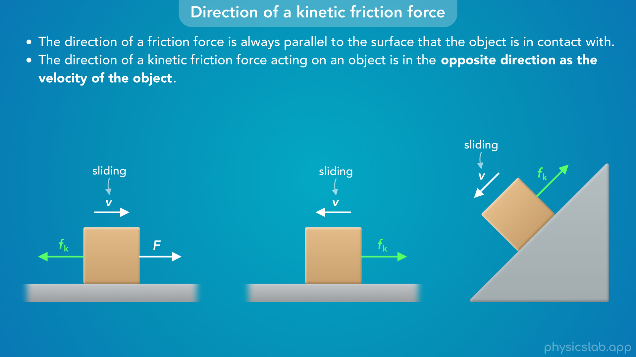
Notes:
• So what is the direction of a kinetic friction force?
• First, we know that the direction of a friction force is always parallel to the surface that the object is in contact with.
• So the kinetic friction forces on these two boxes are parallel to the ground.
• And the kinetic friction force on this box is parallel to the surface of the incline.
• Second, the direction of a kinetic friction force acting on an object is in the opposite direction as the velocity of the object.
• So if this box is sliding to the right, its velocity is to the right, so the kinetic friction force on the box acts to the left.
• The velocity of this box is to the left, so the kinetic friction force acts to the right.
• And the velocity of this box is down the incline, so the kinetic friction force is up the incline.
• It doesn’t matter if there are other forces acting on the object, like with static friction.
• And the direction of object’s acceleration also doesn’t matter.
• All that matters is the direction of the velocity, or the motion.
• So draw the velocity vector, and then the kinetic friction force will act in the opposite direction.

Slide 21
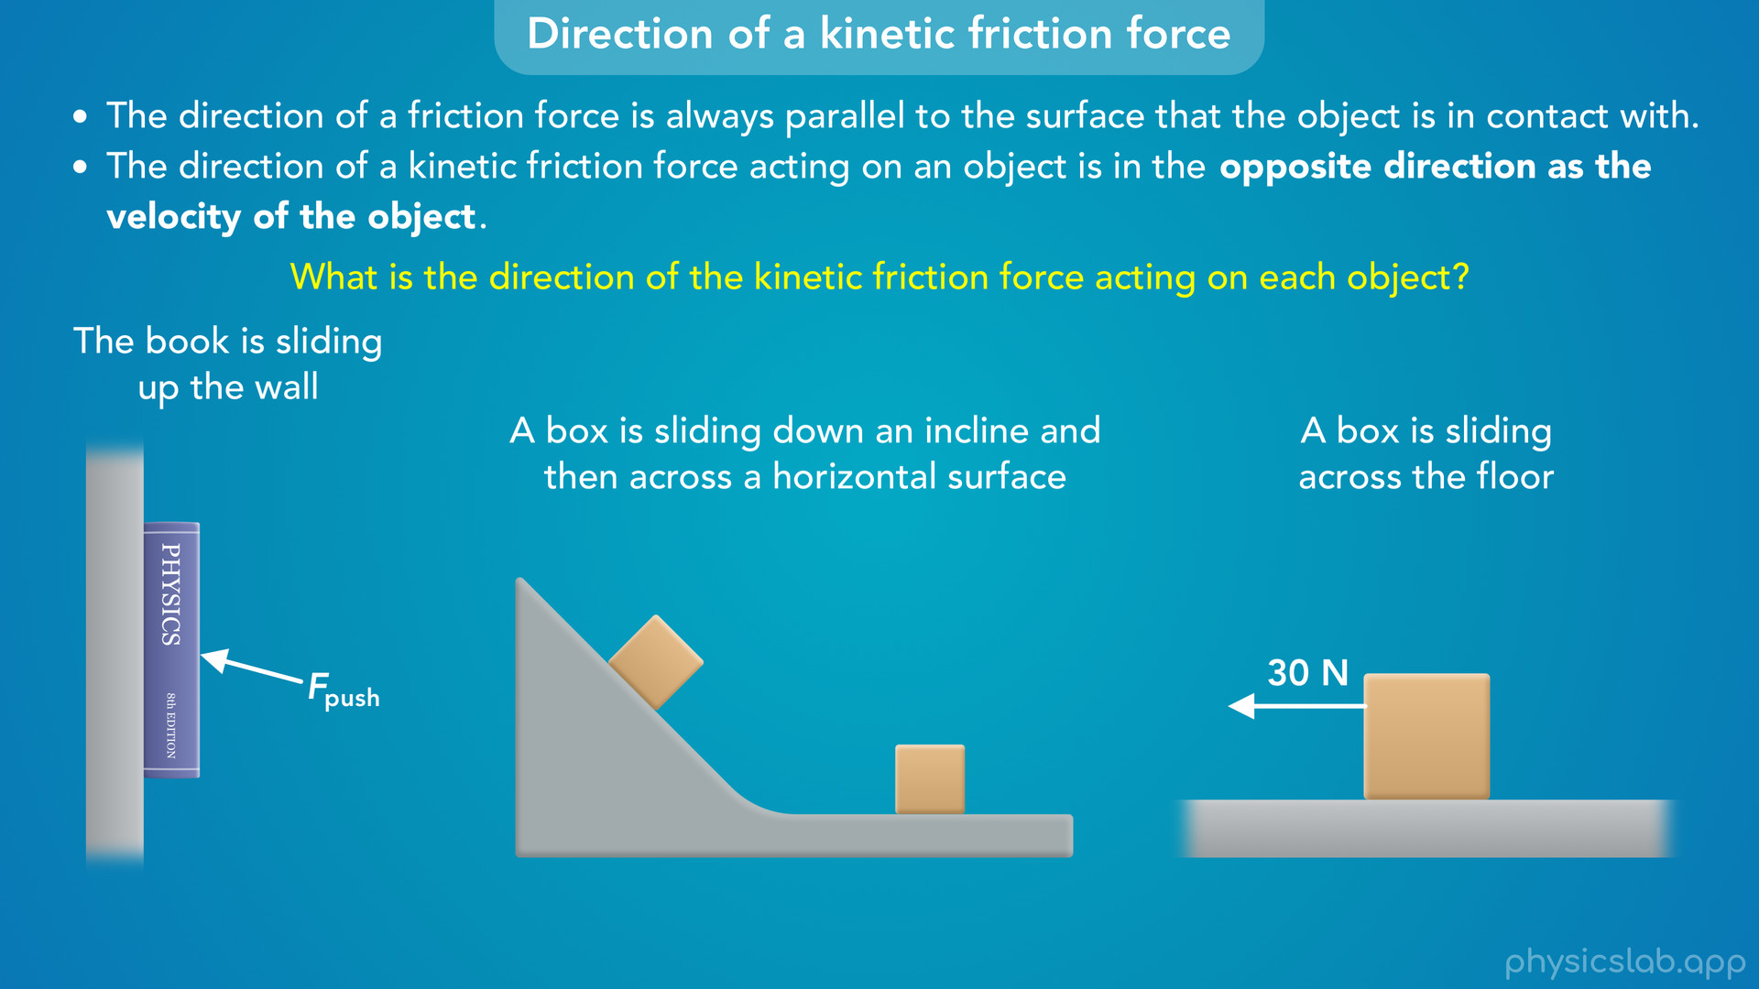
Notes:
• Here’s a few more examples to make sure we understand this concept.
• First, a person is pushing a book against a wall and the book is sliding up the wall.
• Second, a box is sliding down an incline and then across a horizontal surface.
• Third, a box is sliding across the floor and there’s a 30 N force acting on the box.
• Pause the video and see if you can figure out the direction of the kinetic friction force acting on each object.

Slide 22
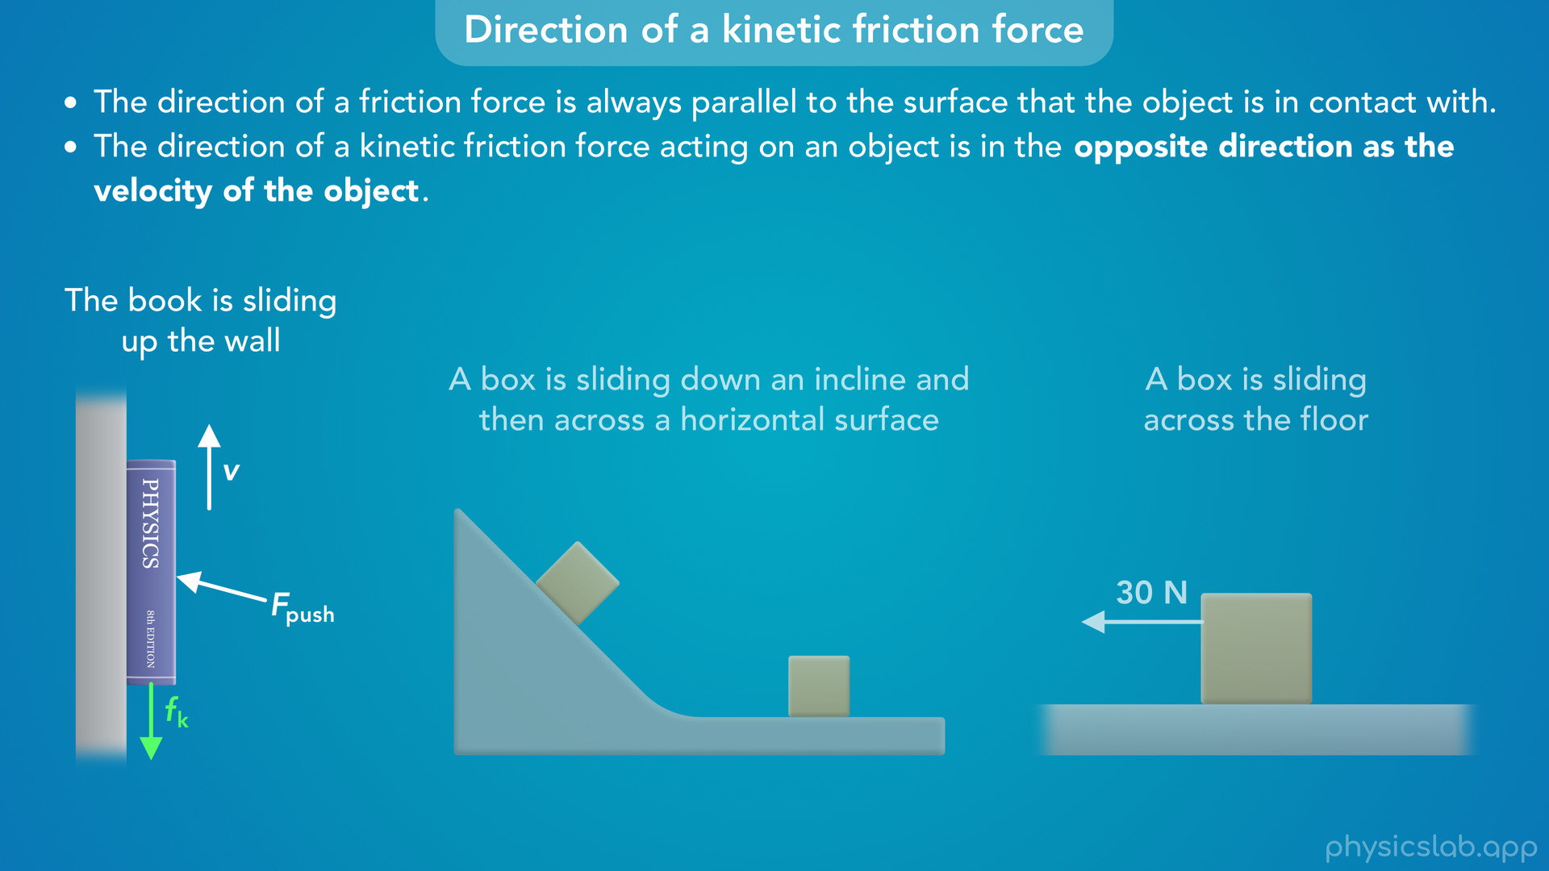
Notes:
• In the first example, we’re told that the book is sliding up the wall, so we would draw the velocity vector pointing upwards.
• That means the kinetic friction force must be acting downwards, and it’s parallel to the wall.

Slide 23
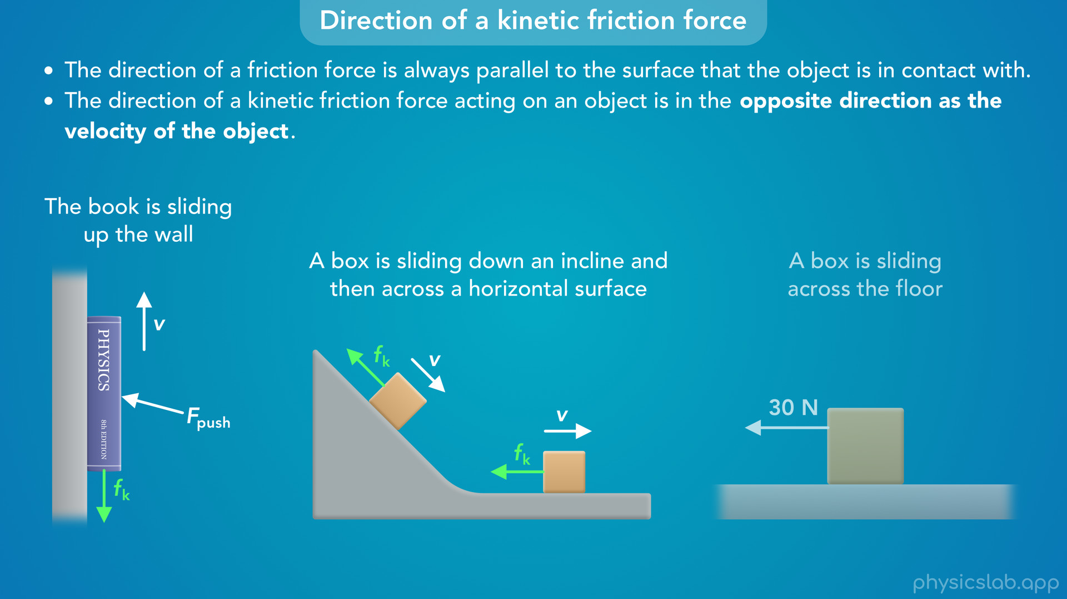
Notes:
• In the second example, the velocity vector of the box on the incline would point down the incline.
• So the kinetic friction force on the box at that time would point up the incline, parallel to the surface.
• When the box is sliding across the horizontal surface, the velocity vector would point to the right, so the kinetic friction force would point to the left.

Slide 24
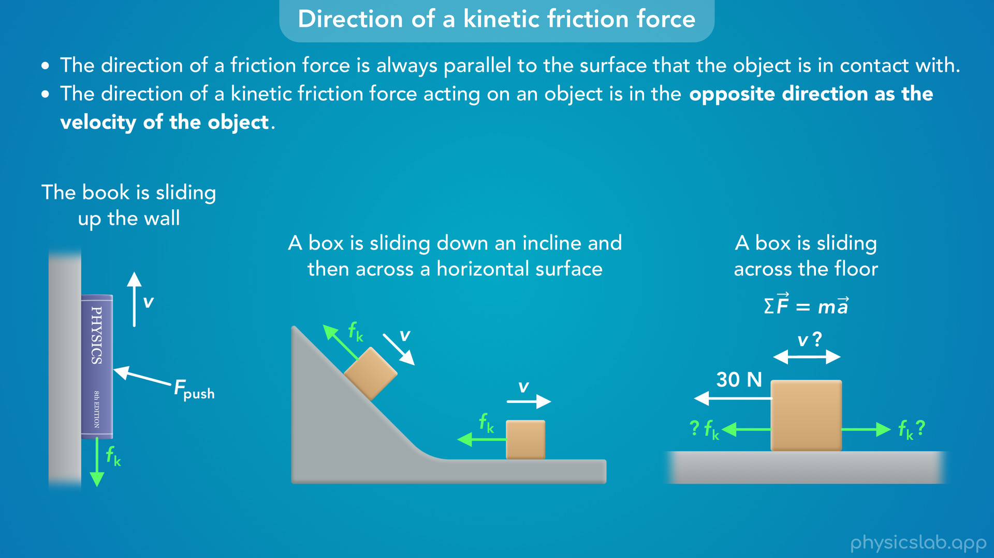
Notes:
• In the third example, which direction is the box sliding?
• There’s a 30 N force acting on the box to the left, but that doesn’t tell us the direction of the velocity.
• Newton’s 2nd law says that the acceleration is in the same direction as the net force, but we don’t know the net force with friction, and we don’t care about the acceleration.
• So this box could be moving to left, but it could also be moving to the right.
• Without more information, we can’t figure out the direction of the kinetic friction force on this box.
• We need to know the direction of the velocity.

Slide 25
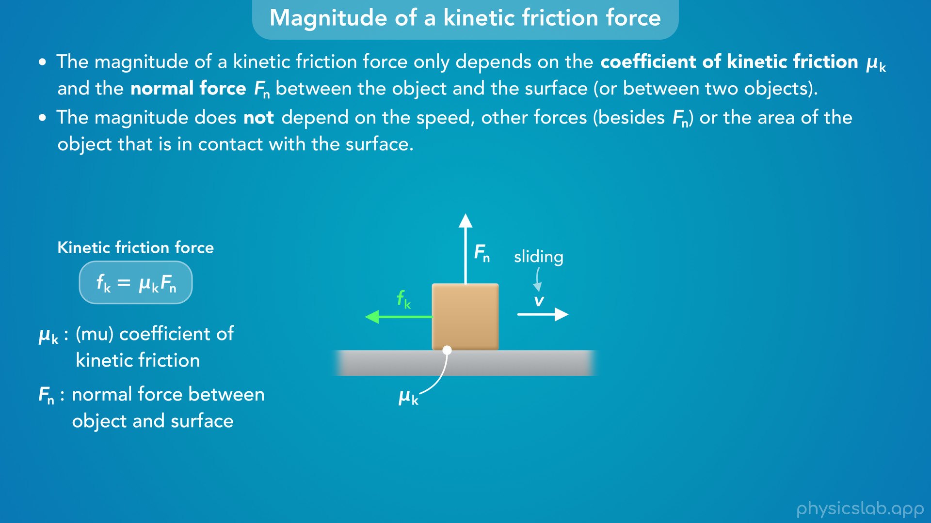
Notes:
• So now that we covered direction, how do we find the magnitude?
• This is a lot simpler than with static friction.
• The magnitude of a kinetic friction force only depends on the coefficient of kinetic friction and the normal force between the object and the surface (or between two objects).
• And the magnitude does not depend on the speed, other forces (besides the normal force) or the area of the object that is in contact with the surface.
• This is the equation for kinetic friction force.
• Mu k is the coefficient of kinetic friction, and Fn is the normal force between the object and the surface.

Slide 26
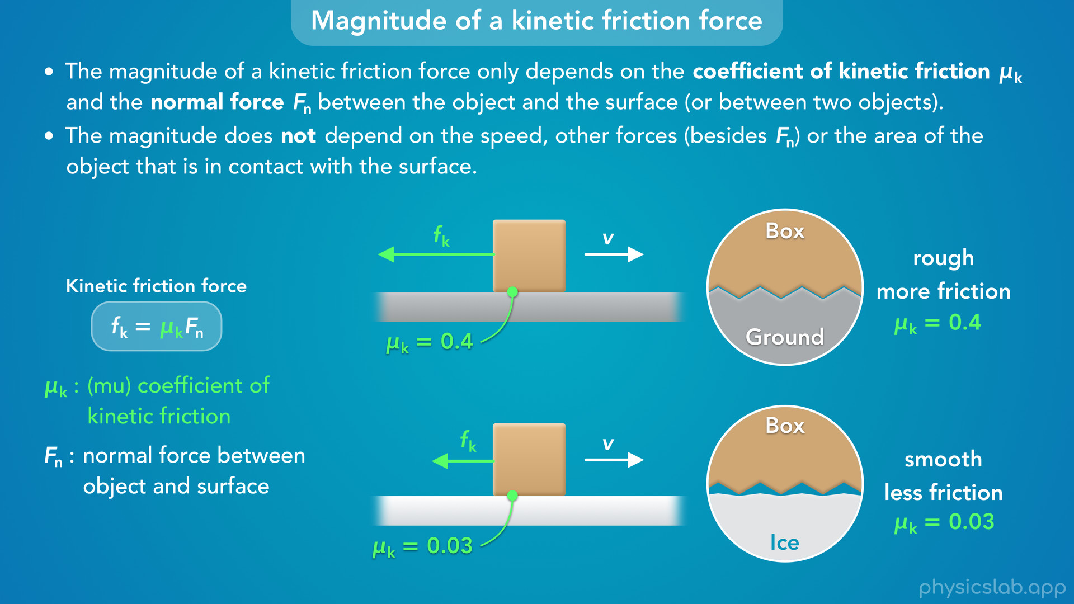
Notes:
• Remember that the coefficient of friction is a number that we use to quantify the roughness, or the relative amount of friction, between two surfaces.
• In this example, the surface of the ground is rougher than the surface of the ice.
• So there’s a larger coefficient of kinetic friction between the box and ground, and a smaller coefficient between the box and the ice.
• A larger coefficient means more friction, so if the normal forces are the same, then the ground will exert a greater kinetic friction force than the ice.

Slide 27
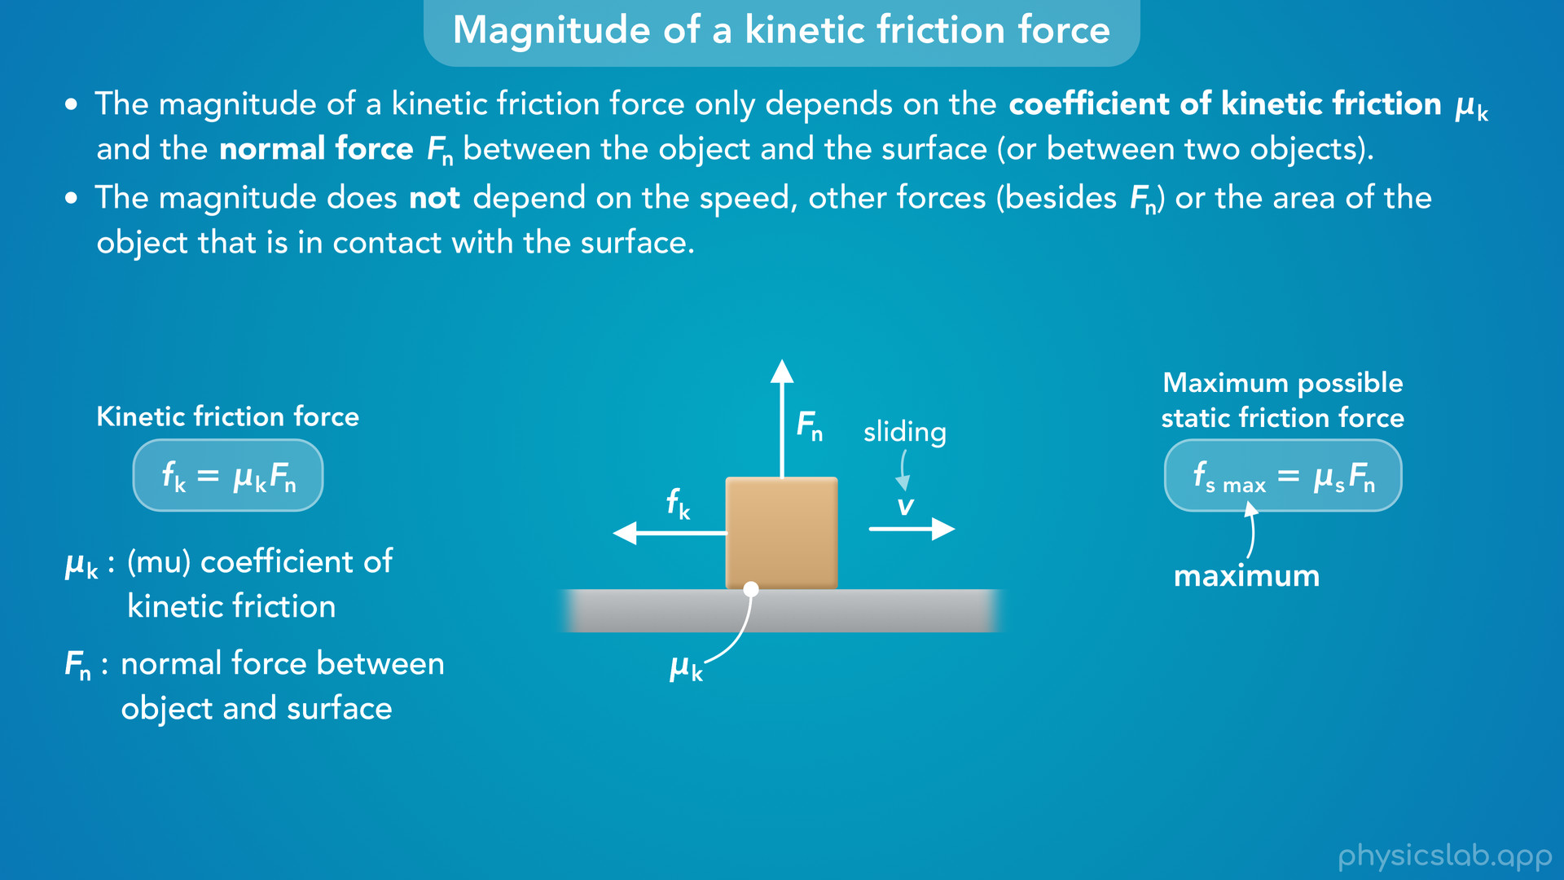
Notes:
• This equation might look very similar to the one we saw in the last video on static friction.
• But that equation was for the maximum possible static friction force.
• This equation gives us the actual value of the kinetic friction force, not the maximum.
• The magnitude of a kinetic friction force is always equal to the coefficient of kinetic friction times the normal force.
• It does not depend on any other forces acting in the same direction, like the static friction force did.

Slide 28
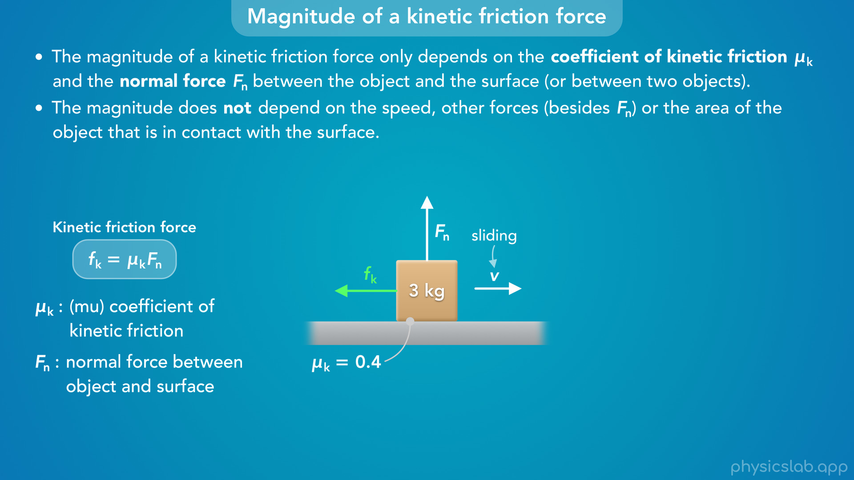
Notes:
• So let’s do a quick example of calculating the kinetic friction force with this equation.
• Let’s say the mass of the block is 3 kg and the coefficient of kinetic friction between the box and the ground is 0.4.
• If the box is sliding to the right, the kinetic friction force is acting to the left.

Slide 29
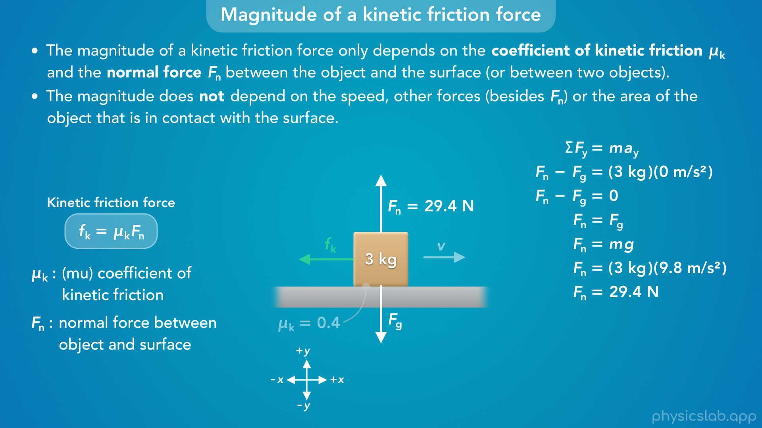
Notes:
• To find the magnitude of the kinetic friction force, we need to know the normal force.
• To do that, let’s apply Newton’s 2nd law in the vertical y direction.
• The net force in the y direction is the upwards normal force minus the downwards gravitational force.
• That’s equal to the mass times the vertical acceleration, which is zero, because the box is not accelerating in the y direction.
• So the net vertical force is zero, and the normal force is equal to the gravitational force.
• We can replace Fg with m times g, plug in those values, and we get 29.4 N for the normal force acting on the box from the ground.

Slide 30
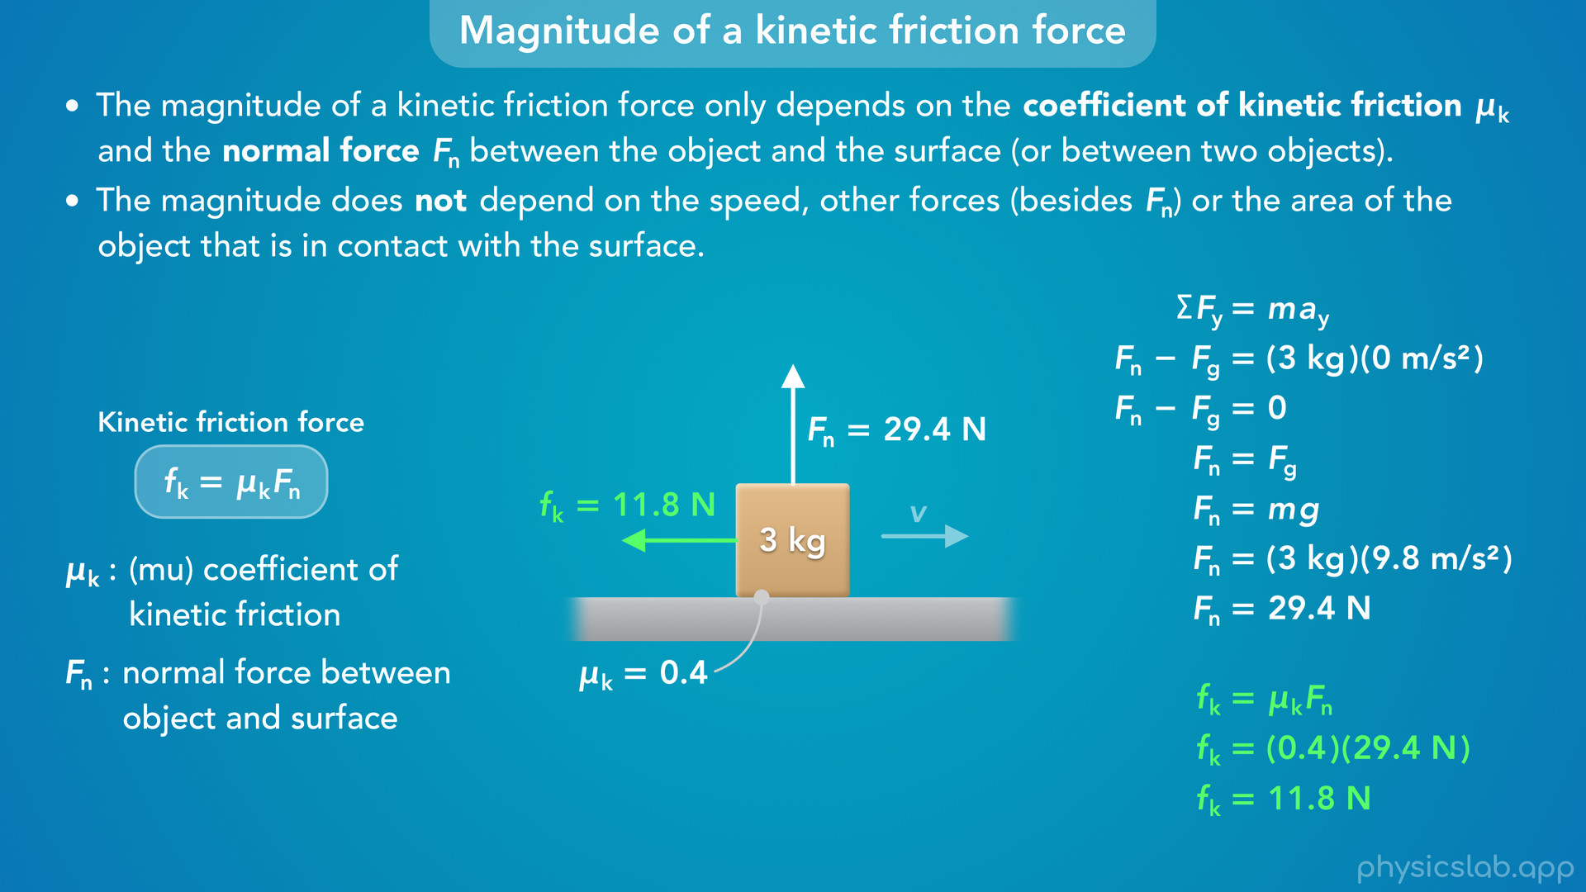
Notes:
• Now we can use this new equation to calculate the kinetic friction force.
• We plug in 0.4 for the coefficient of kinetic friction and 29.4 N for the normal force, and we get 11.8 N.
• So as long as the box is sliding, the kinetic friction force will always be 11.8 N in the opposite direction as the velocity.
• It doesn’t matter how fast the box is moving, and it doesn’t matter if there are other forces acting to the right or the left.

Slide 31
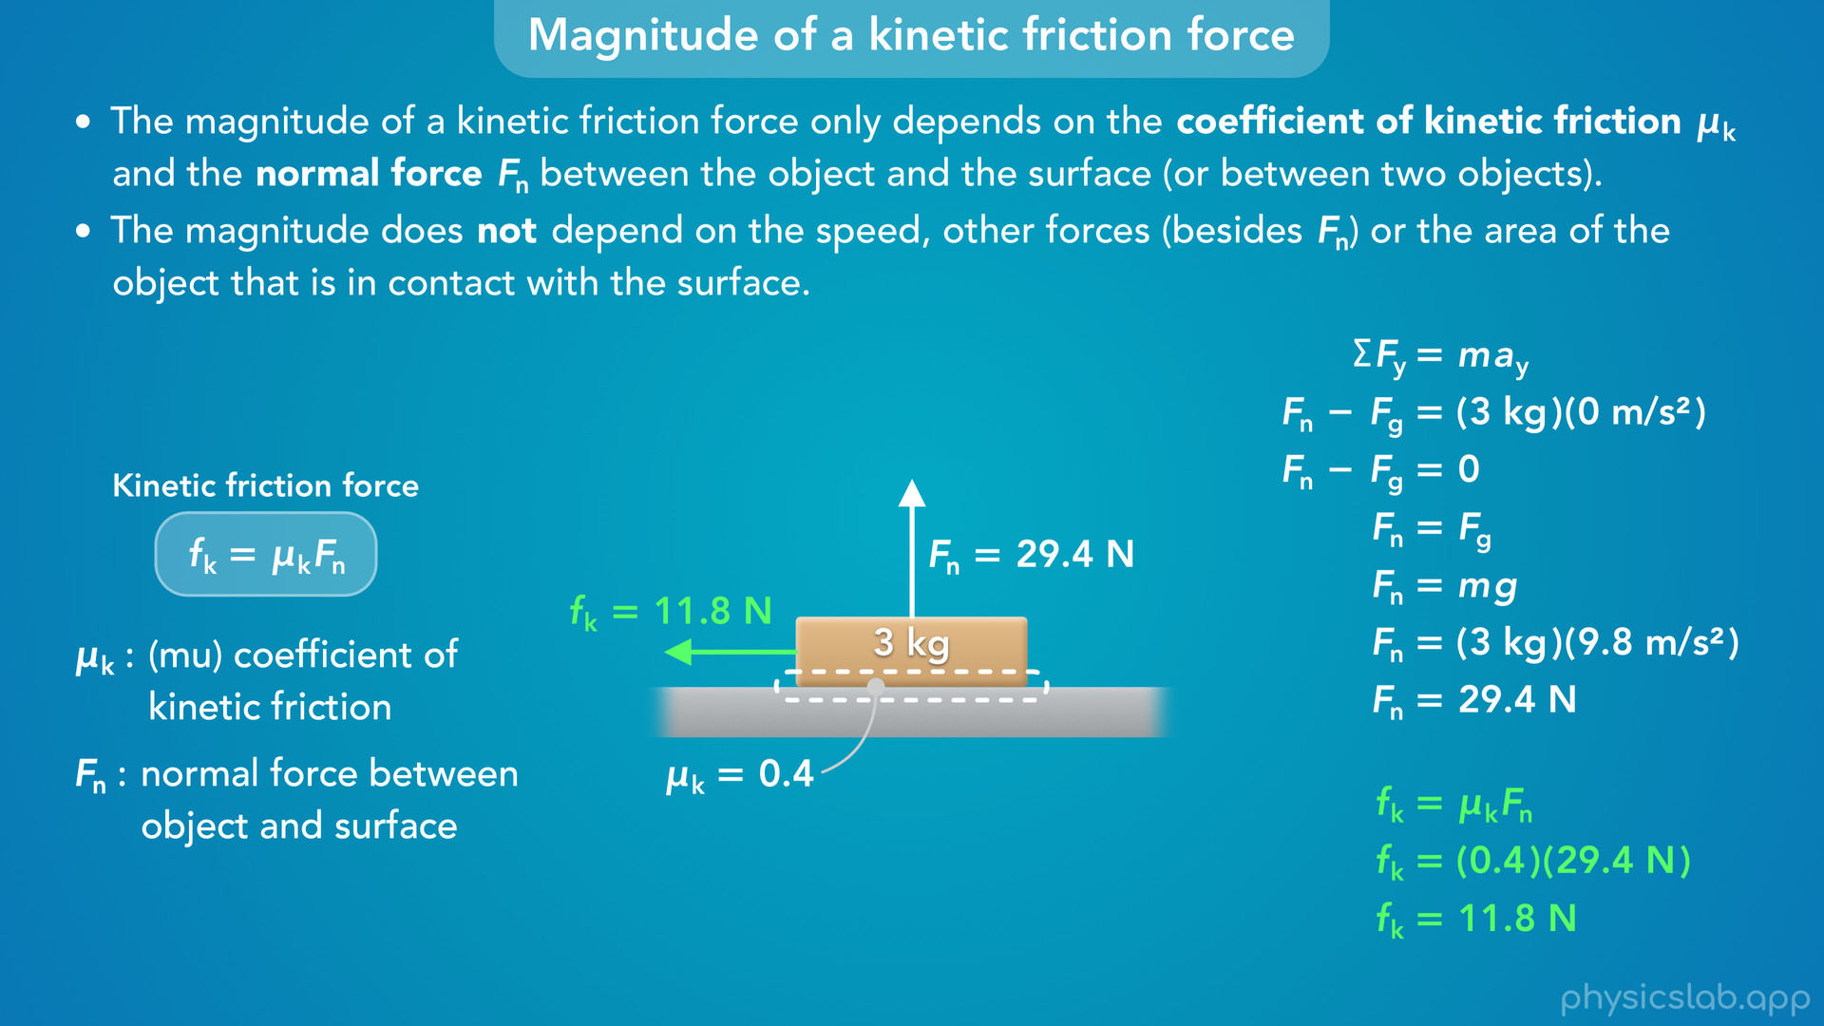
Notes:
• It also doesn’t matter how big the box is, as long as its mass is the same.
• Even if the box was wider and there was more surface area in contact with the ground, the kinetic friction force would still be the same because box has the same mass and the same normal force.
• So if an object is sliding, we always use this equation to calculate the kinetic friction force.

Slide 32
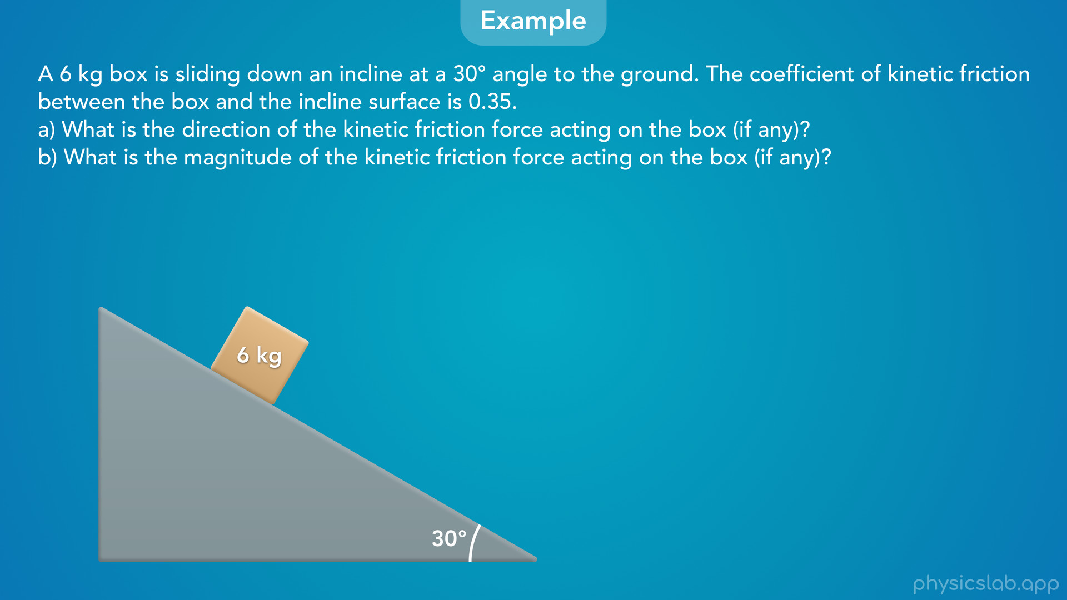
Notes:
• Let’s walk through an example with kinetic friction on an incline.
• A 6 kg box is sliding down an incline at a 30 degree angle to the ground. The coefficient of kinetic friction between the box and the incline surface is 0.35.
• What is the direction of the kinetic friction force acting on the box, if there’s is any?
• And what is the magnitude of the kinetic friction force?
• Pause the video and try solving this on your own first.

Slide 33
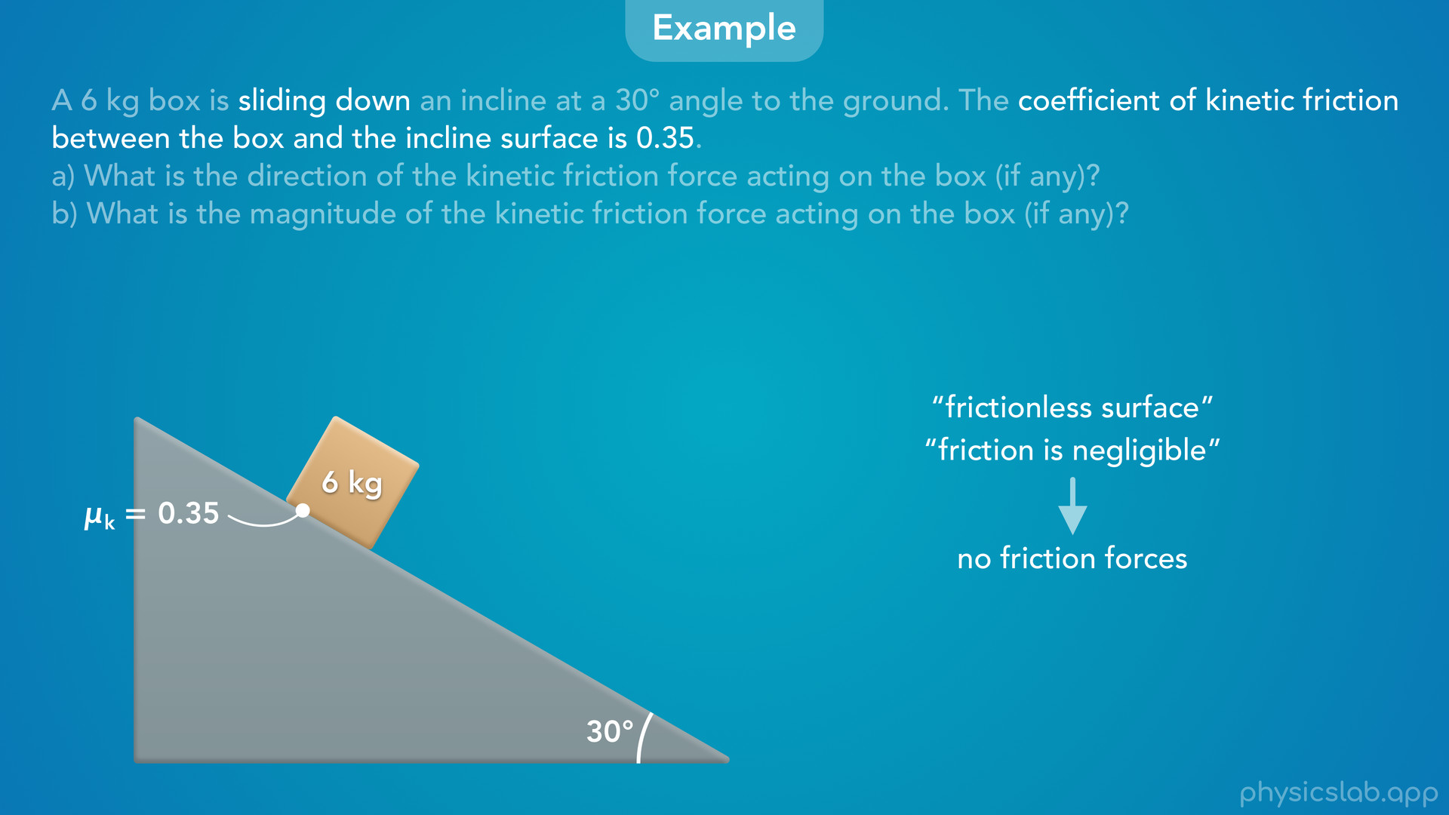
Notes:
• So for part a, how do we know if there’s a kinetic friction force acting on the box?
• We’re told that the box is sliding, and we’re given the coefficient of kinetic friction, so there would be a kinetic friction force acting on the box from the surface of the incline.
• If the box was not sliding, there would not be a kinetic friction force.
• And if the question had said this is a frictionless surface, or friction is negligible, then there would be no friction forces.

Slide 34
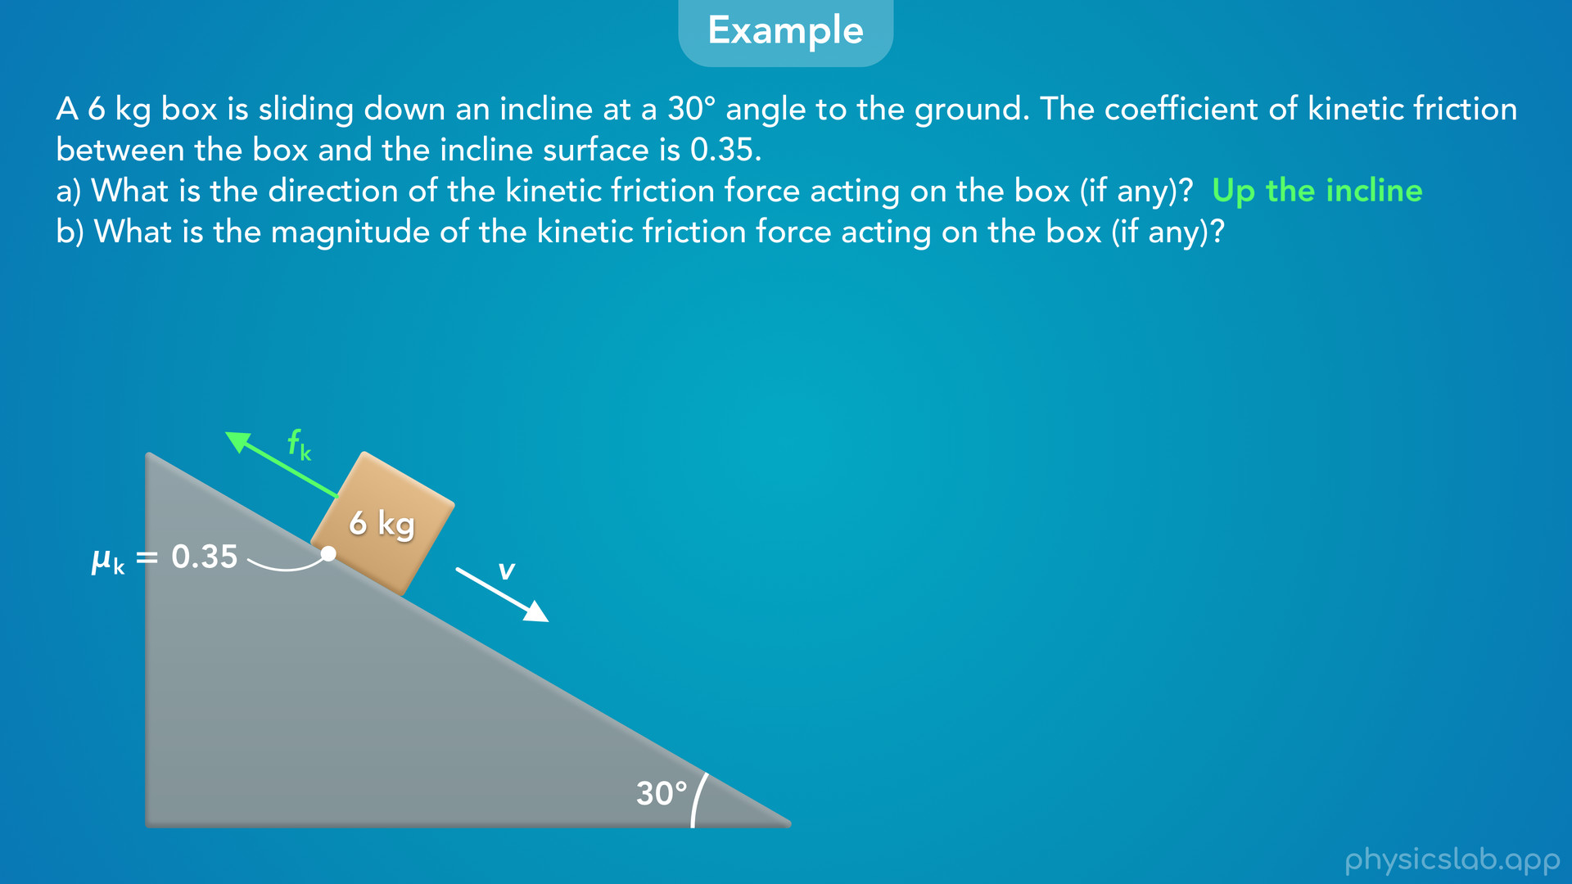
Notes:
• So there is kinetic friction, but in which direction?
• The question says the box is sliding down the incline, so it’s velocity vector is down the incline, parallel to the surface.
• That means the kinetic friction force points up the incline, again parallel to the surface.

Slide 35
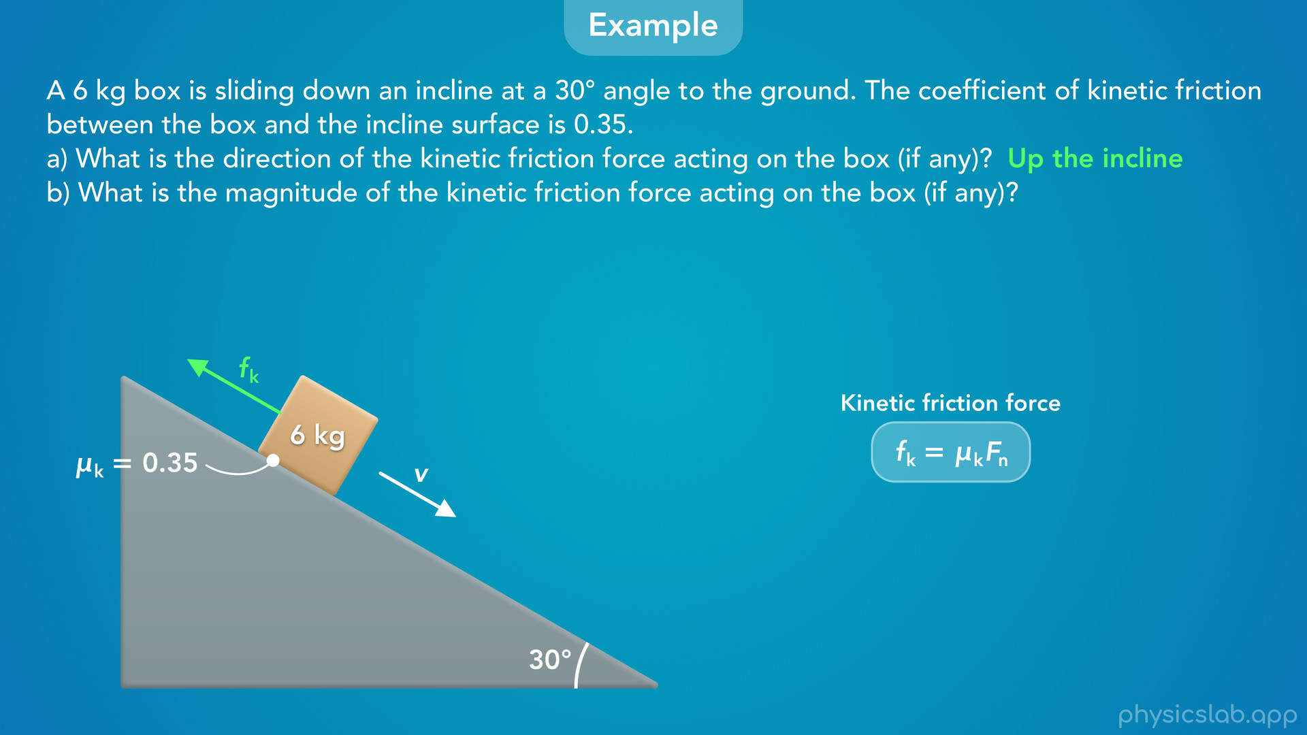
Notes:
• For part b, how would we find the magnitude?
• Remember, we always use this equation for kinetic friction, as long as the object is sliding.
• We’re given the coefficient of kinetic friction, but first we need to find the normal acting on the box.

Slide 36
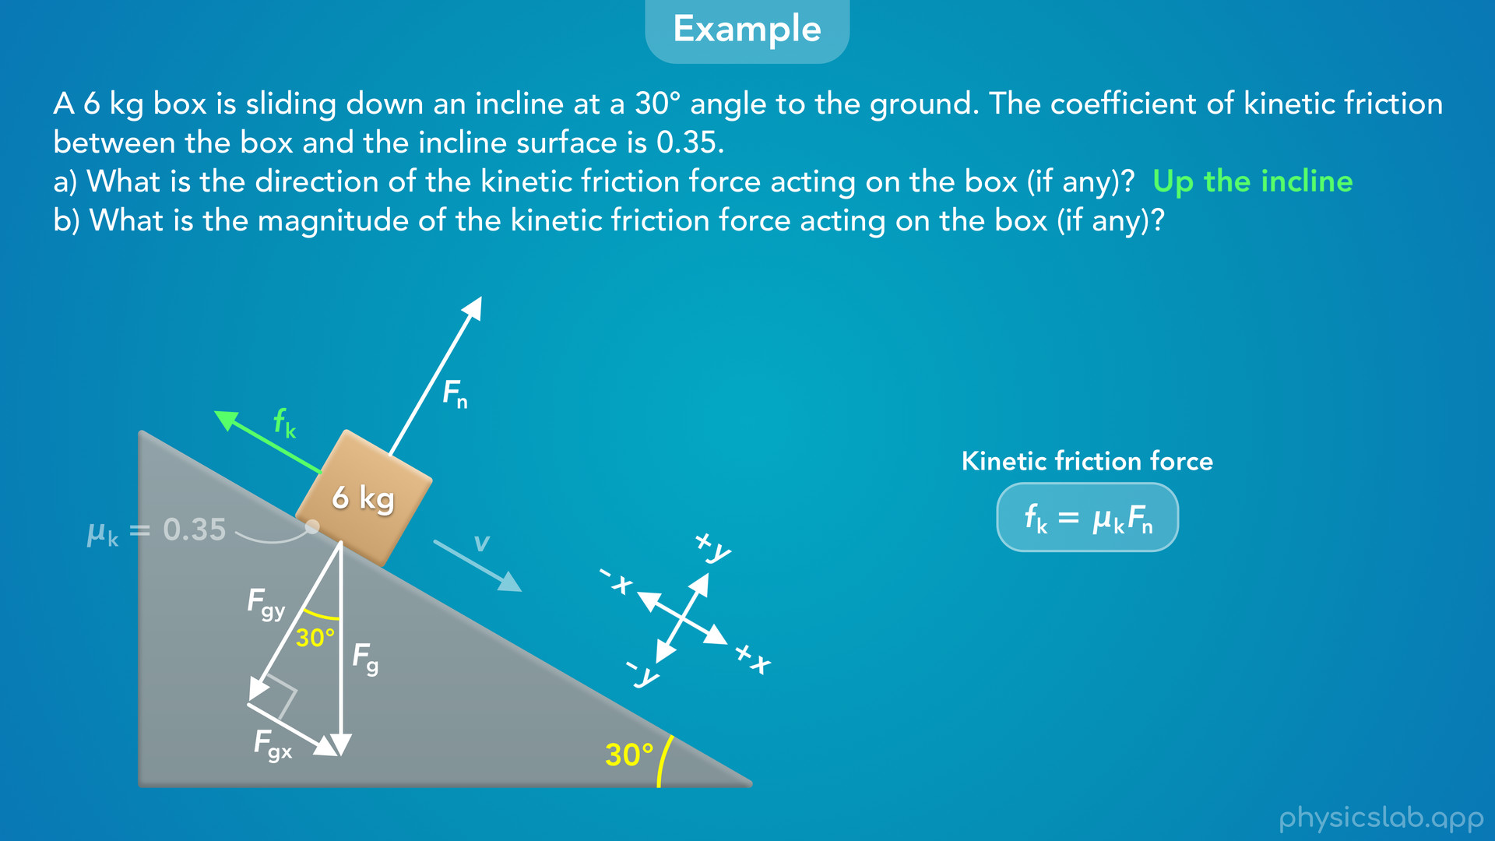
Notes:
• So what would that be?
• Let’s draw the rest of the forces acting on the box.
• We’ll go through this pretty quickly, but we covered weight and normal force on an incline in a previous video, so watch that one if you need to understand it better.
• So there’s a downwards gravitational force on the box that’s vertical and points towards the earth.
• The normal force is always perpendicular to the surface, so it would point in this direction.
• To find the magnitude of the normal force, we need to use Newton’s 2nd law in that direction.
• For incline problems, it helps to use a rotated coordinate system, where the x axis is parallel to the incline and the y axis is perpendicular to the incline.
• So the normal is in the positive y direction.
• The gravitational force is not parallel to the x or y axis, so we need to draw the x and y components of Fg.
• Fgx is parallel to the x axis, and Fgy is parallel to the y axis.
• We learned that the angle between the incline and the ground is the same as the angle between Fg and Fgy.
• So this angle is also 30 degrees.

Slide 37
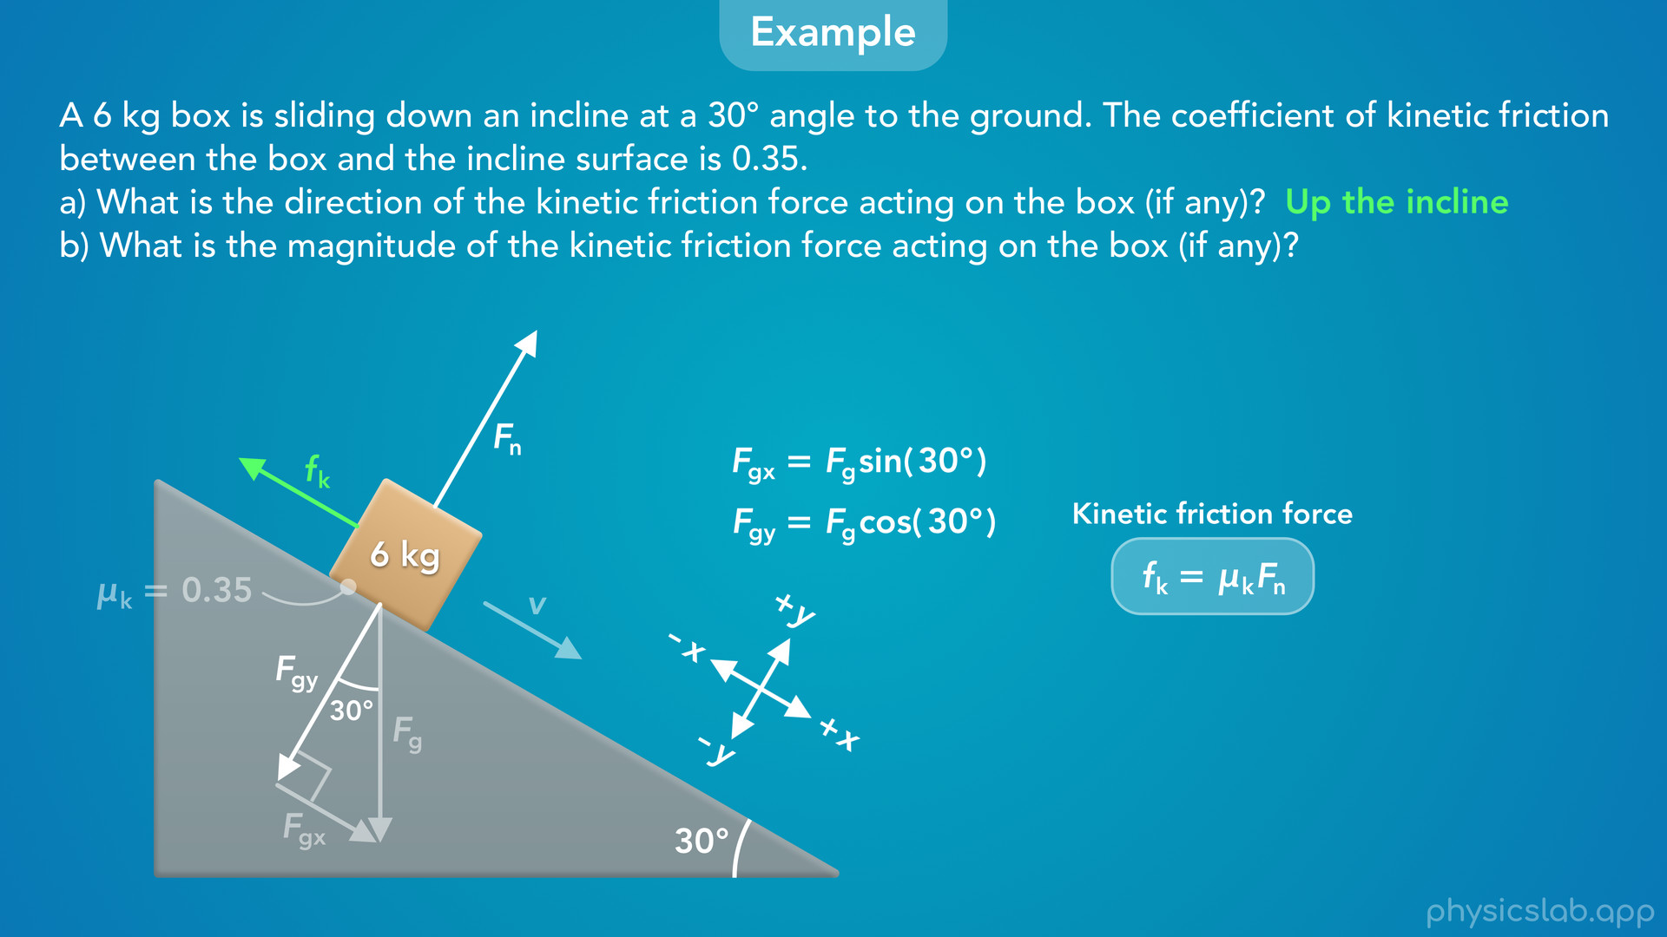
Notes:
• Using right triangle trig, Fgx is equal to Fg times the sine of 30 degrees because it’s opposite from that angle.
• And Fgy is equal to Fg times the cosine of 30 degrees, because it’s adjacent to that angle.

Slide 38
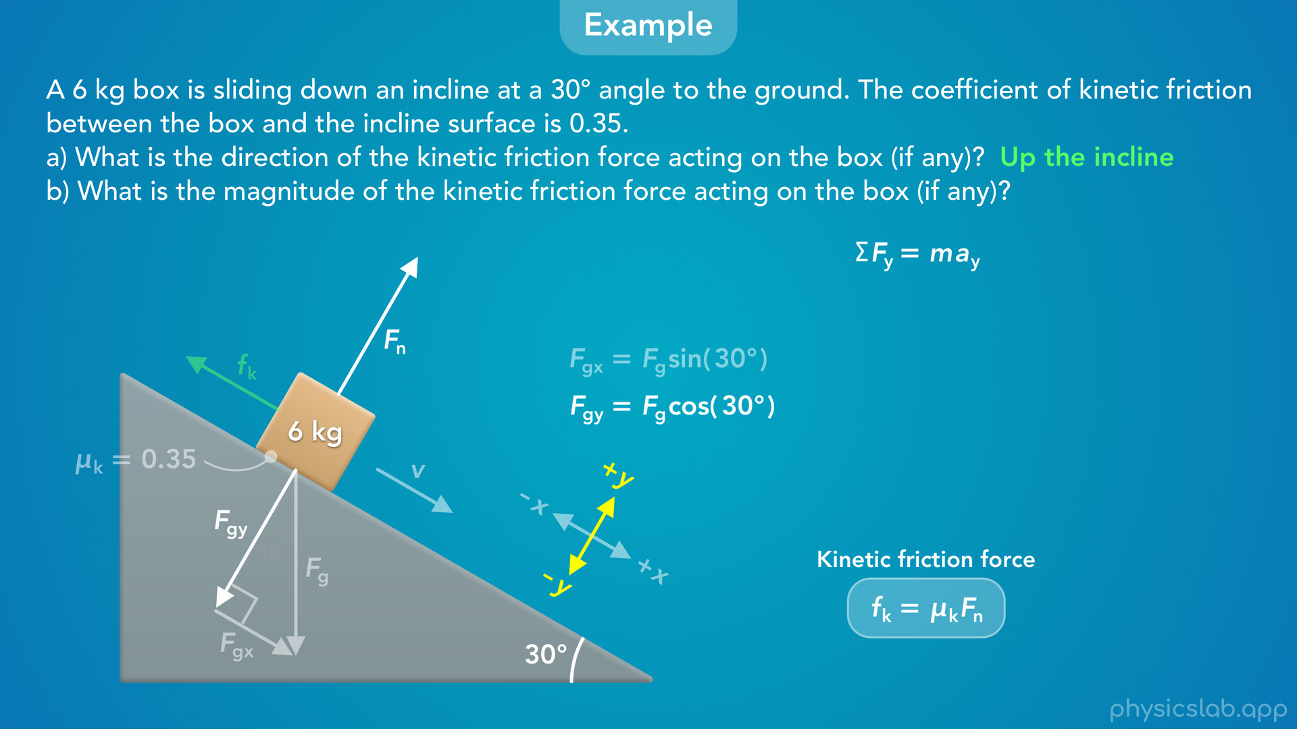
Notes:
• Now we can use Newton’s 2nd law in the y direction to find the normal force.

Slide 39
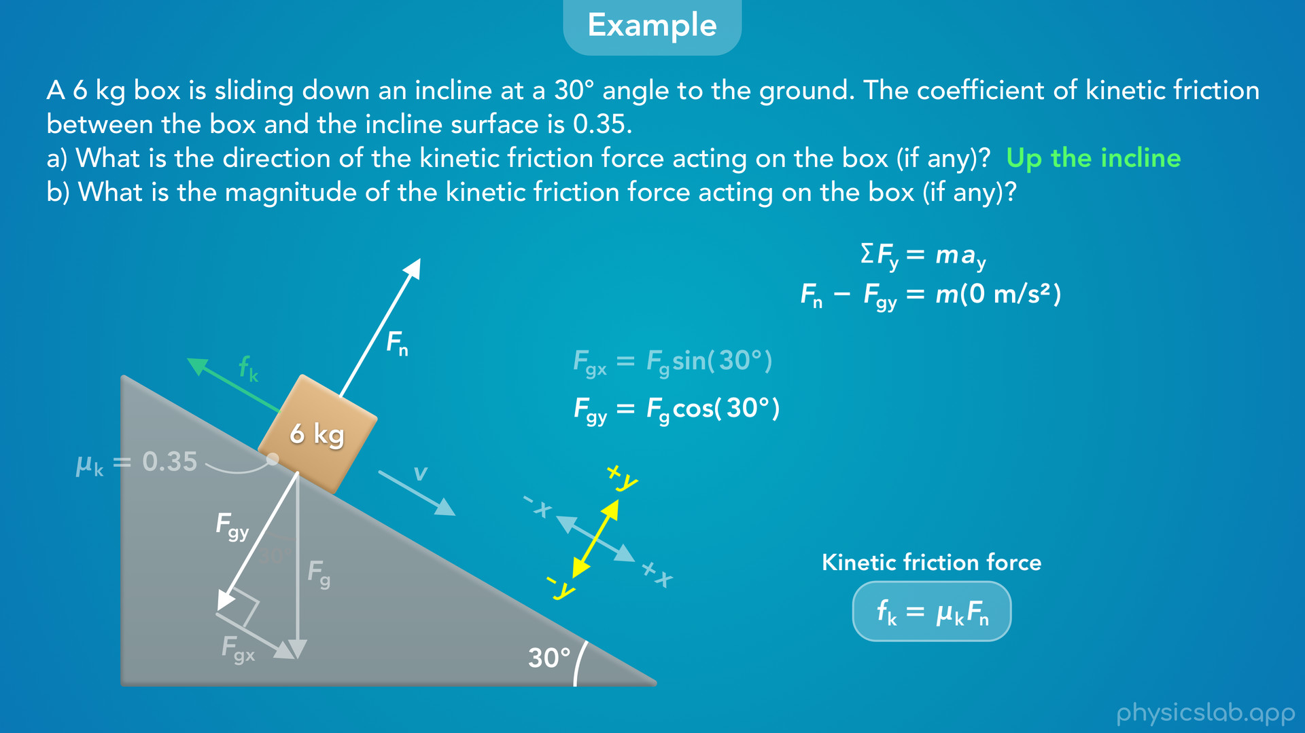
Notes:
• The net force in the y direction is the normal force minus Fgy, and the acceleration in the y direction is 0, the box is not accelerating into or away from the incline.

Slide 40
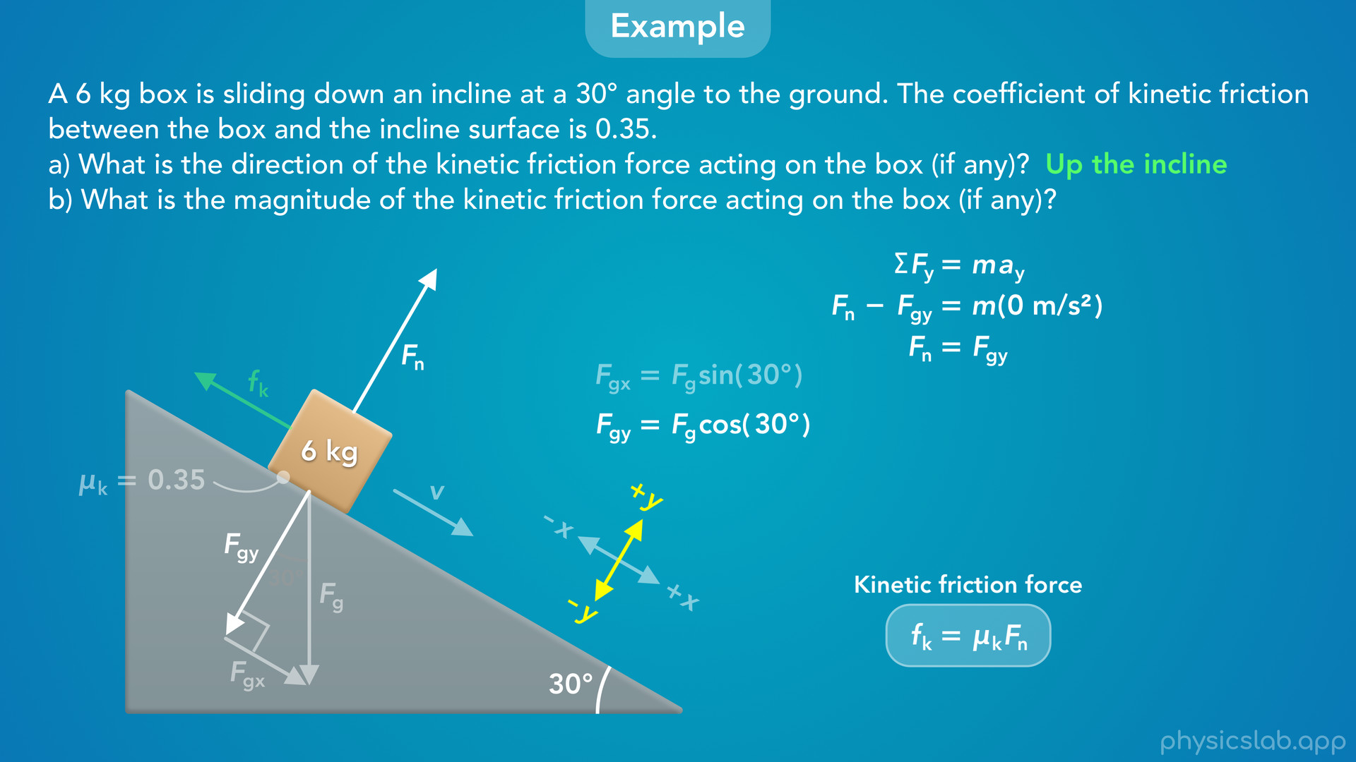
Notes:
• This means that the normal force is equal to Fgy.

Slide 41
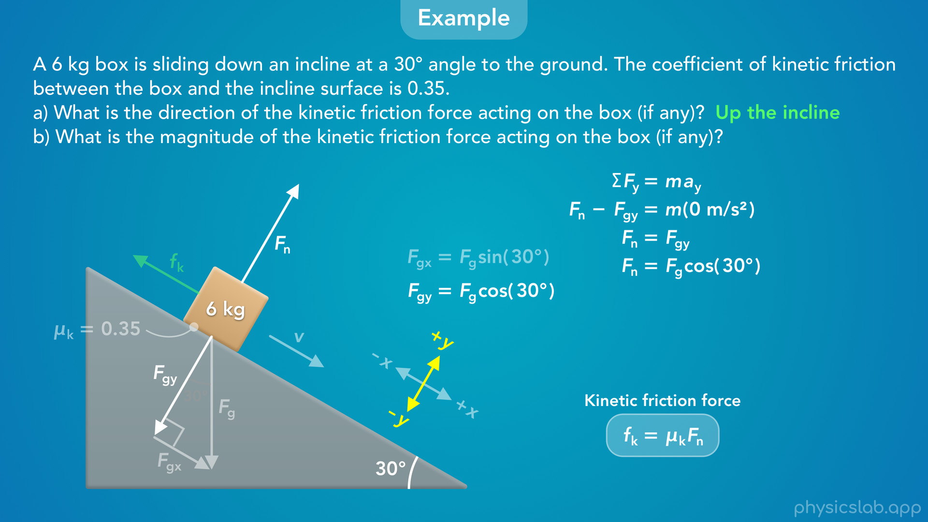
Notes:
• We can replace Fgy with Fg times the cosine of 30 degrees…

Slide 42
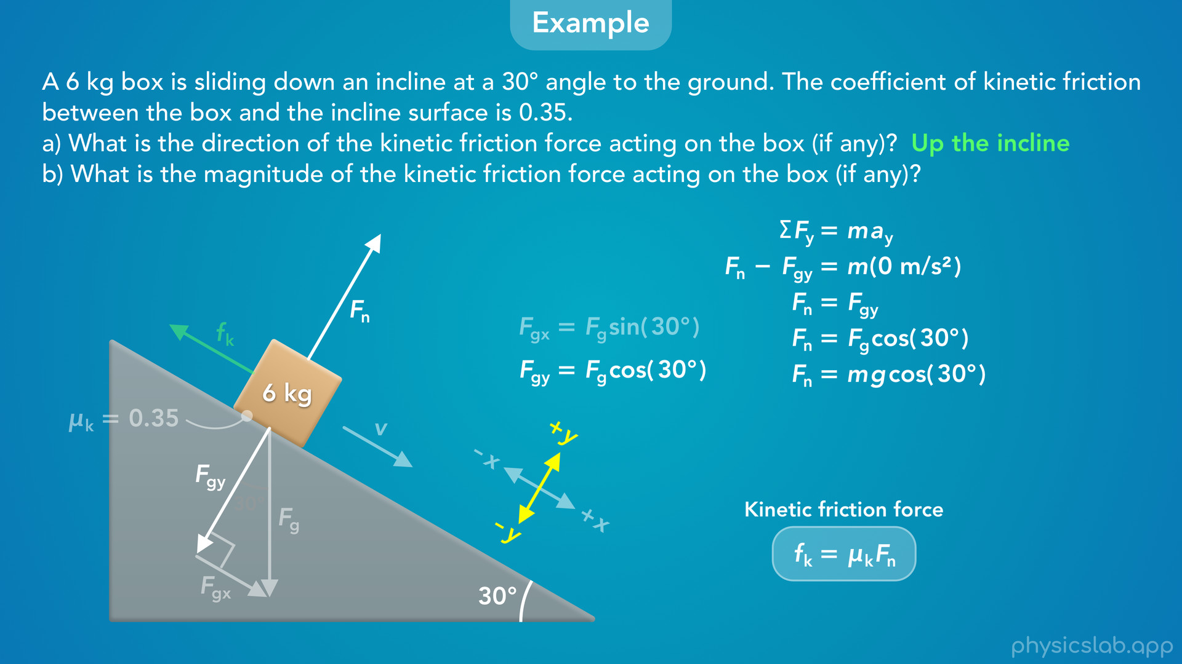
Notes:
replace Fg with m times g…

Slide 43
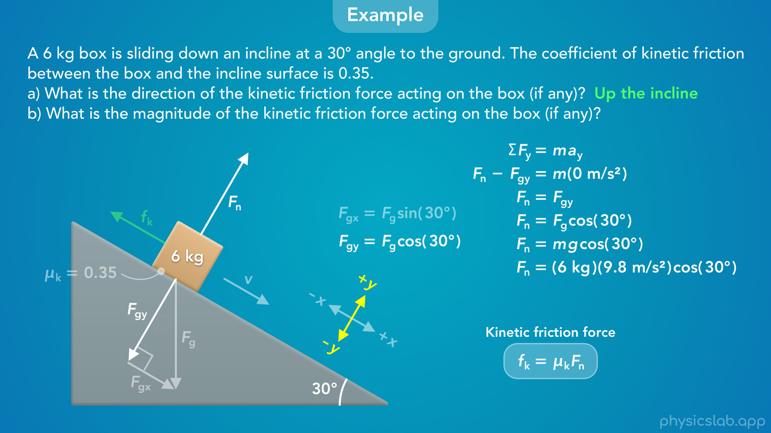
Notes:
plug in 6 kg for the mass and 9.8 m/s^2 for g…

Slide 44
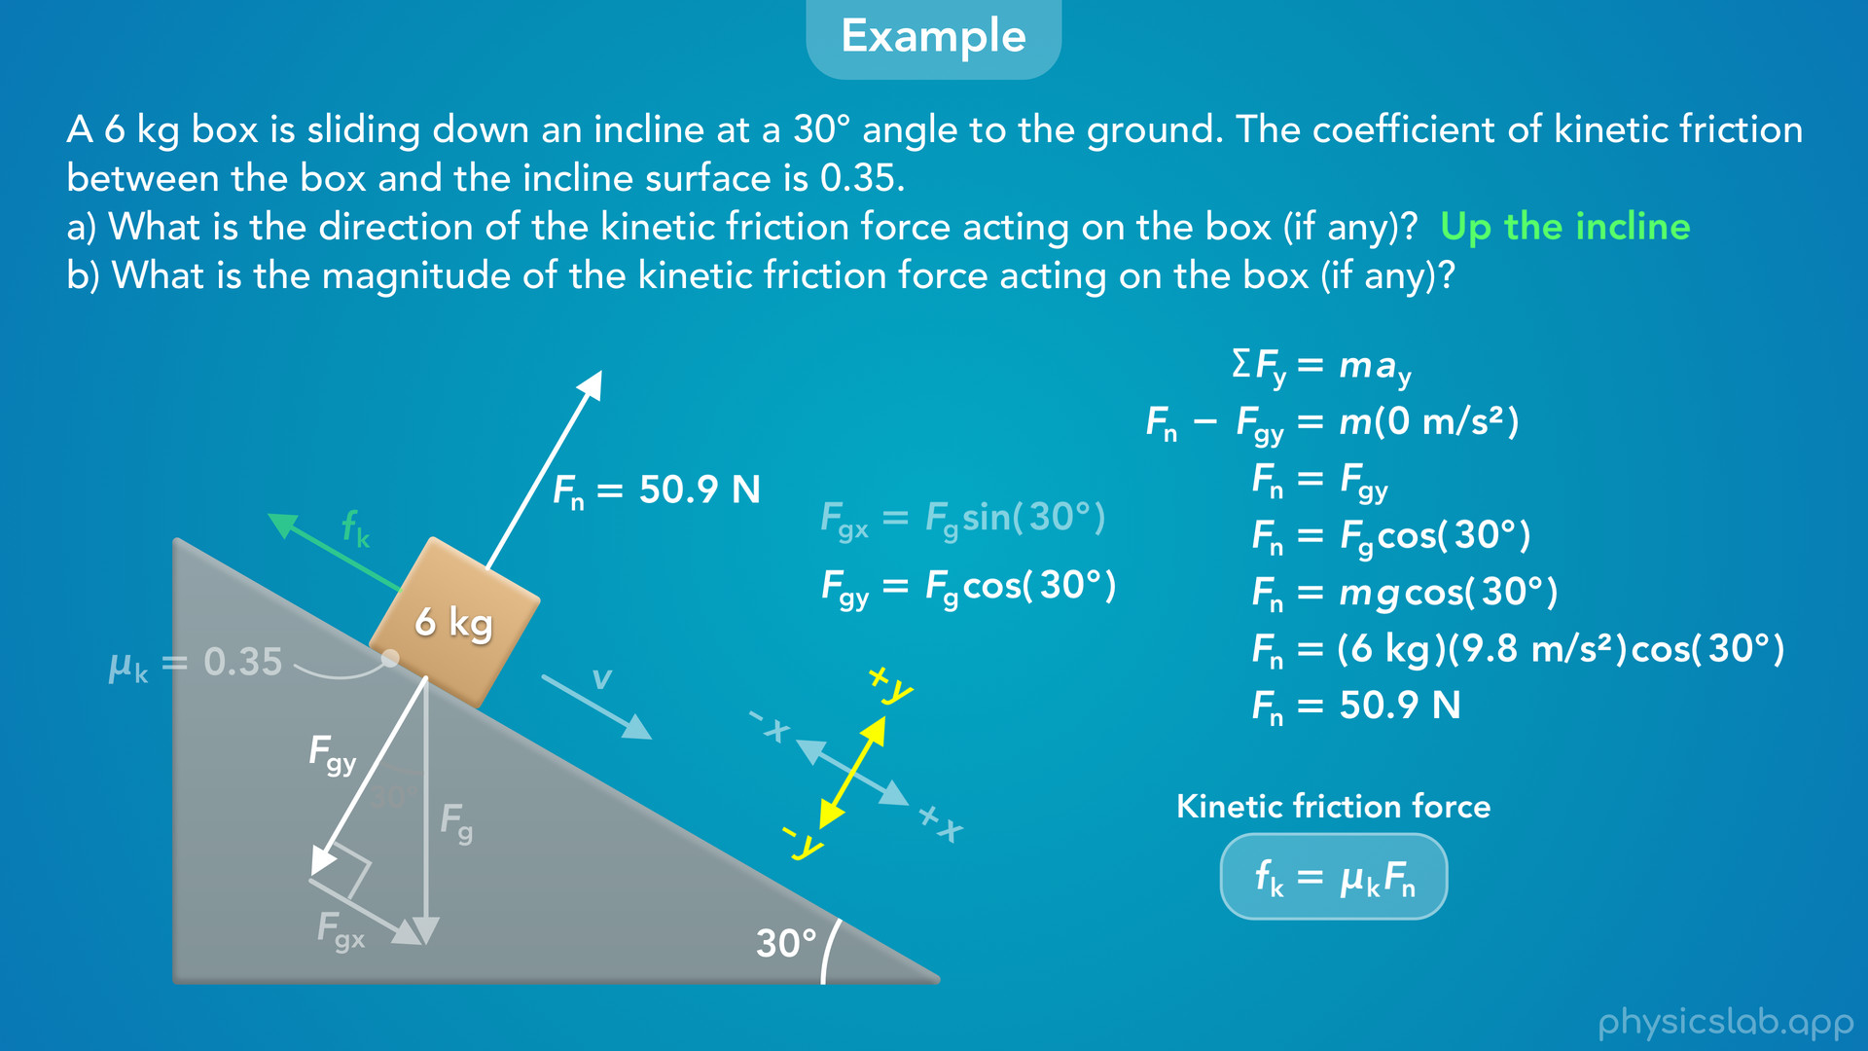
Notes:
and we get 50.9 N for the normal force.

Slide 45
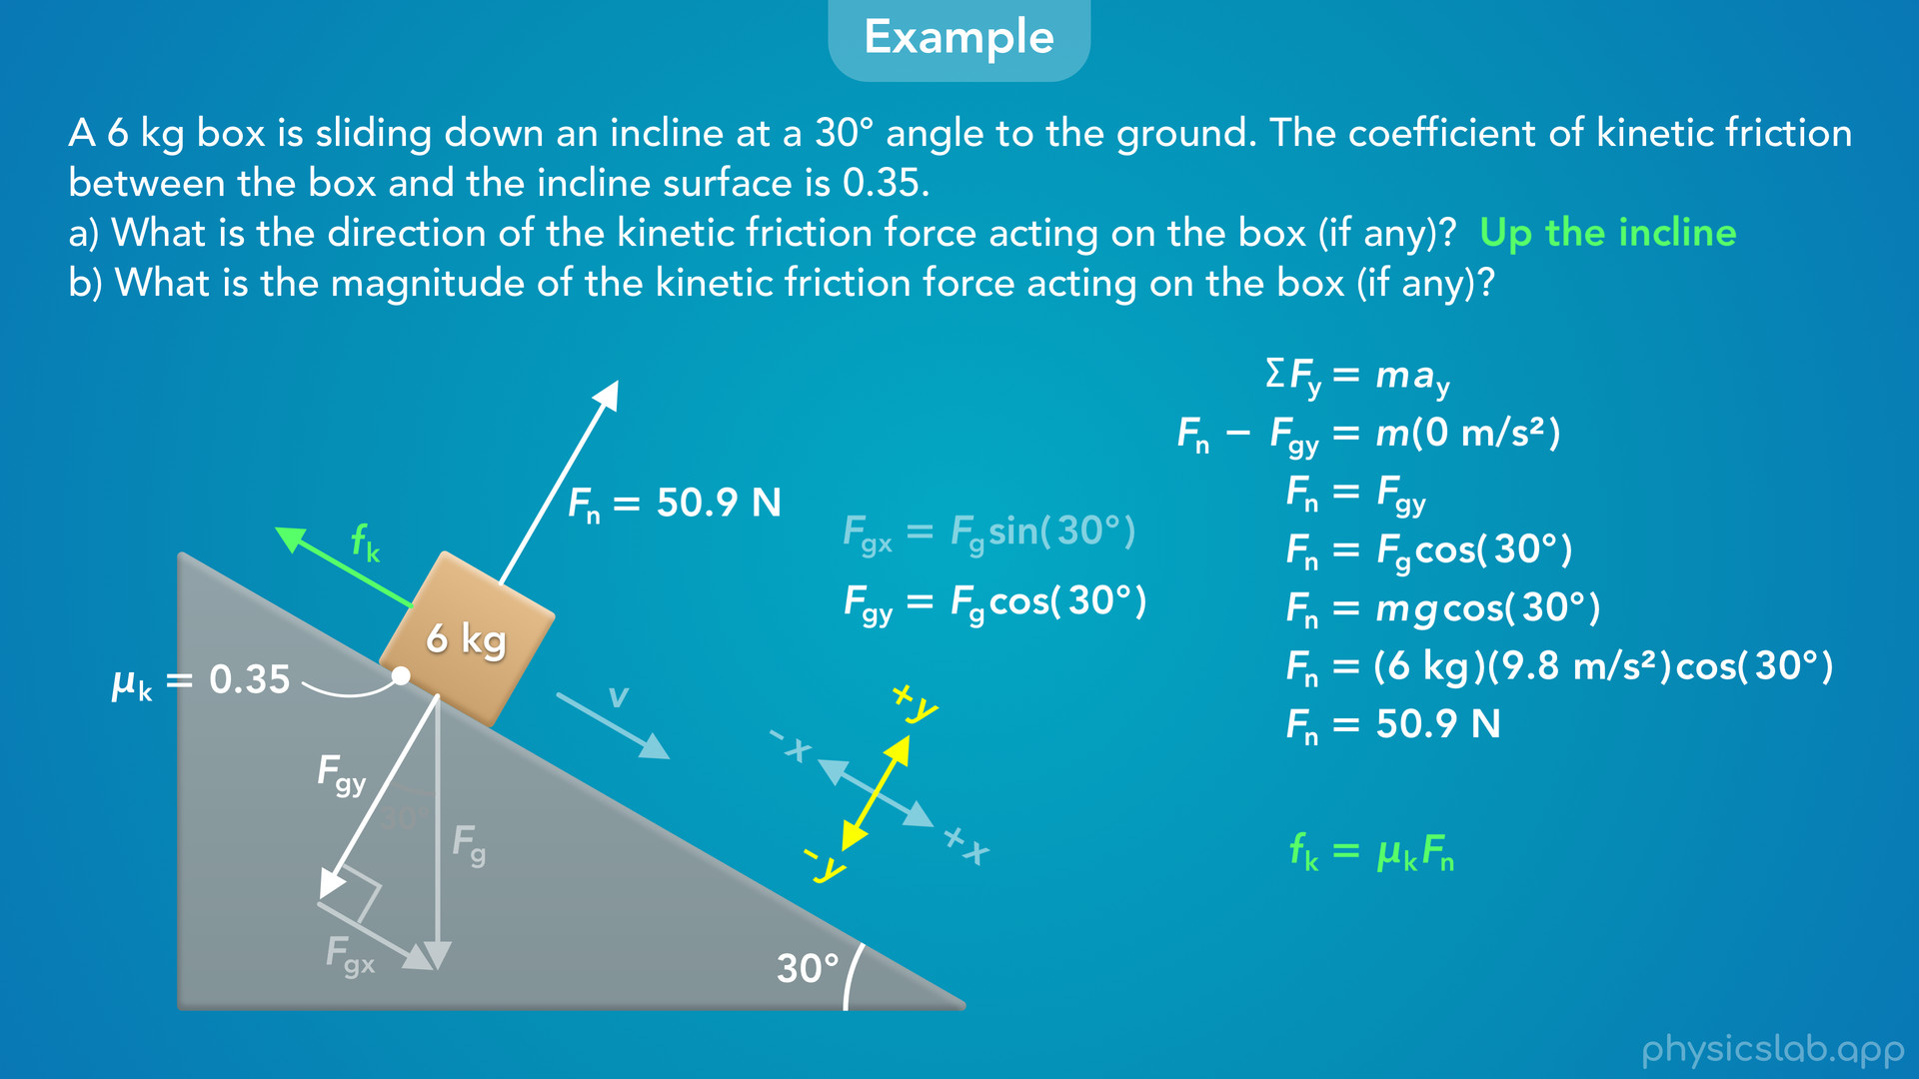
Notes:
• Now we can use this equation to find the kinetic friction force.

Slide 46
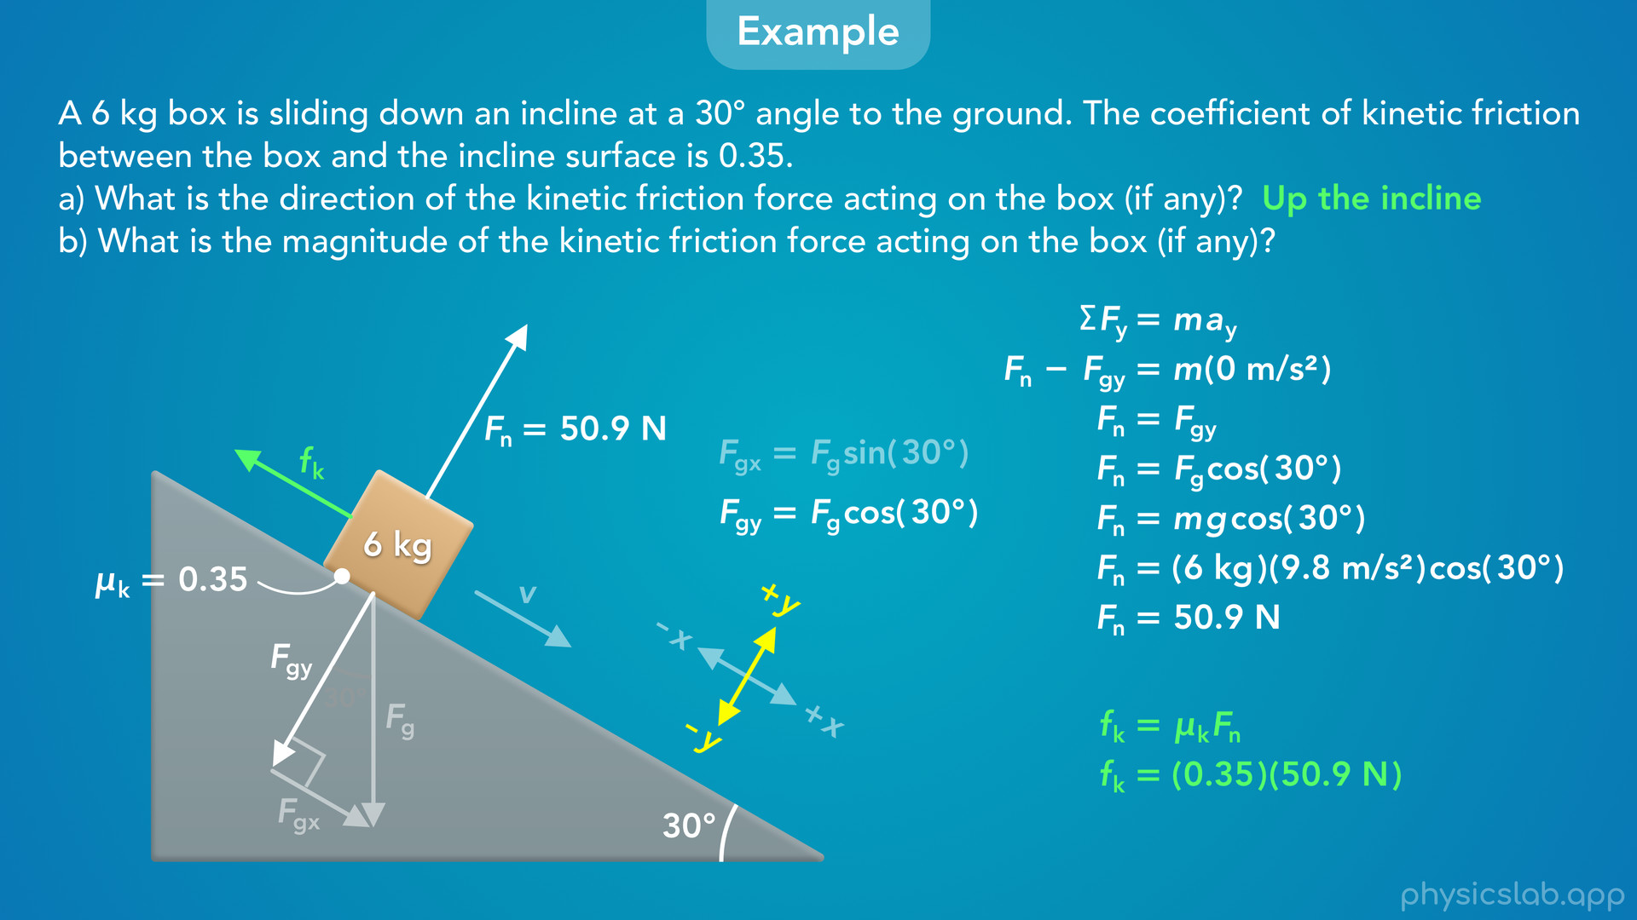
Notes:
• We plug in 0.35 for the coefficient of kinetic friction, 50.9 N for the normal force

Slide 47
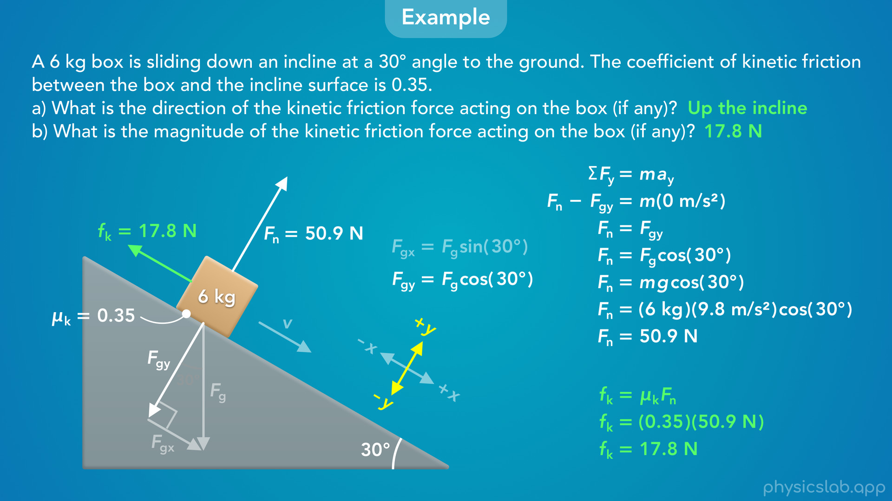
Notes:
and we get 17.8 N.
• That is the magnitude of the kinetic friction force acting on the box up the incline.

Slide 48
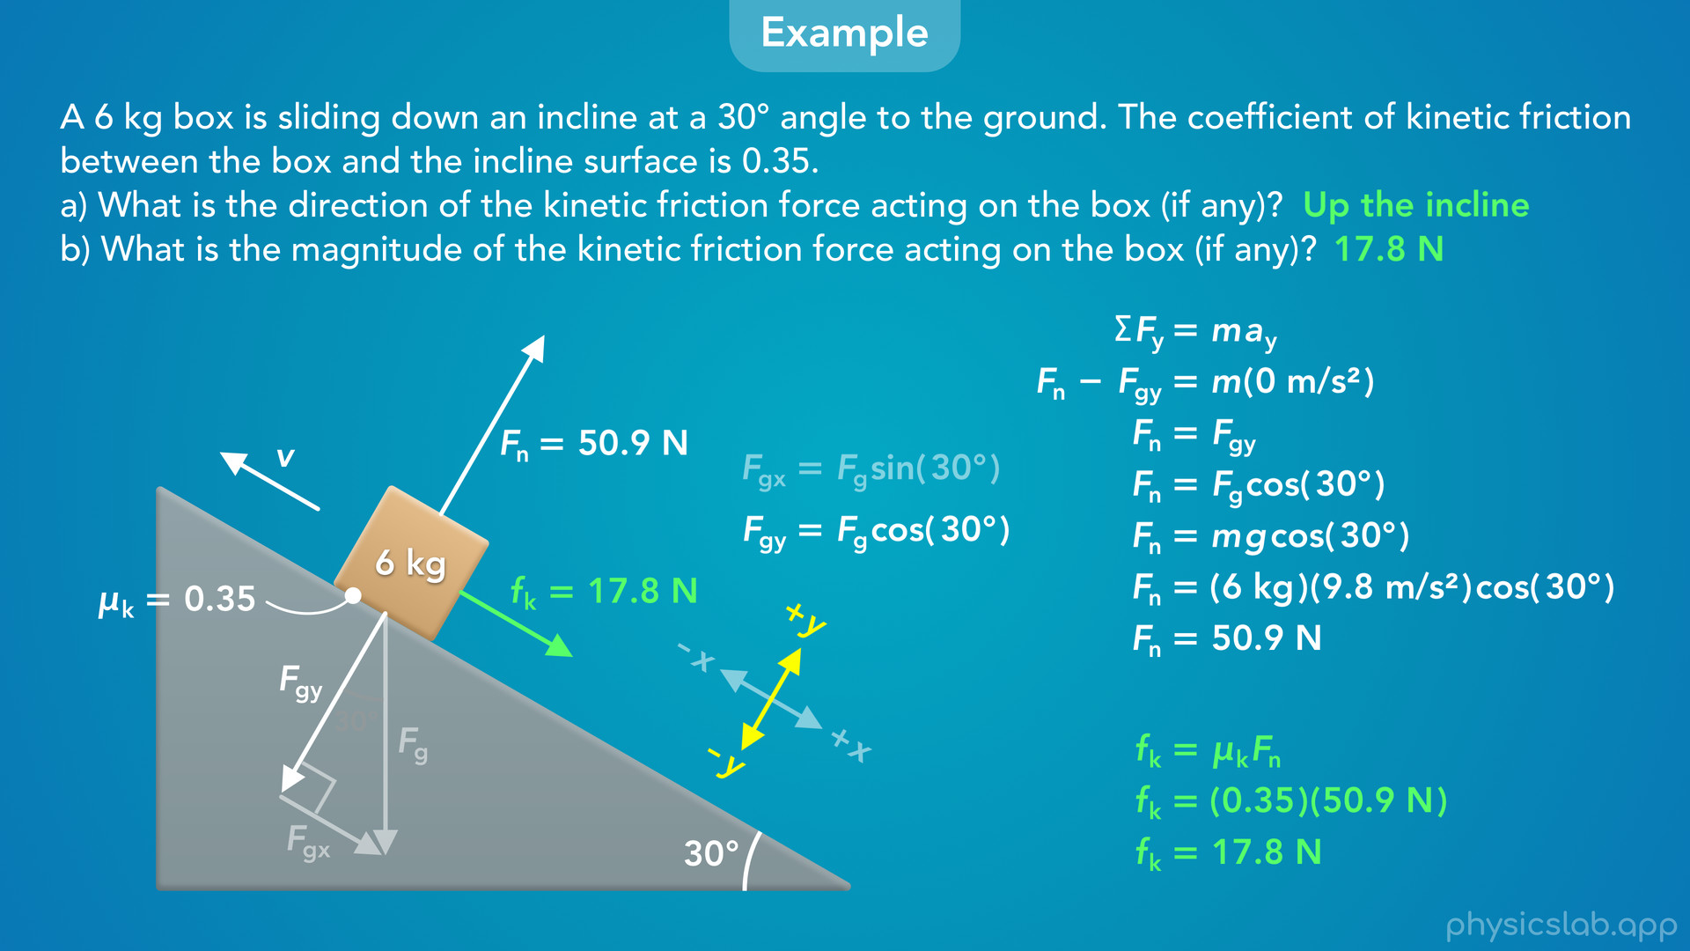
Notes:
• And if the box was sliding up the incline instead, it would be the magnitude of the kinetic friction force acting down the incline.
• It doesn’t matter how fast the box is sliding, and it doesn’t matter if there are other forces parallel to the incline.
• The kinetic friction force only depends on the coefficient of kinetic friction and the normal force.

Slide 49
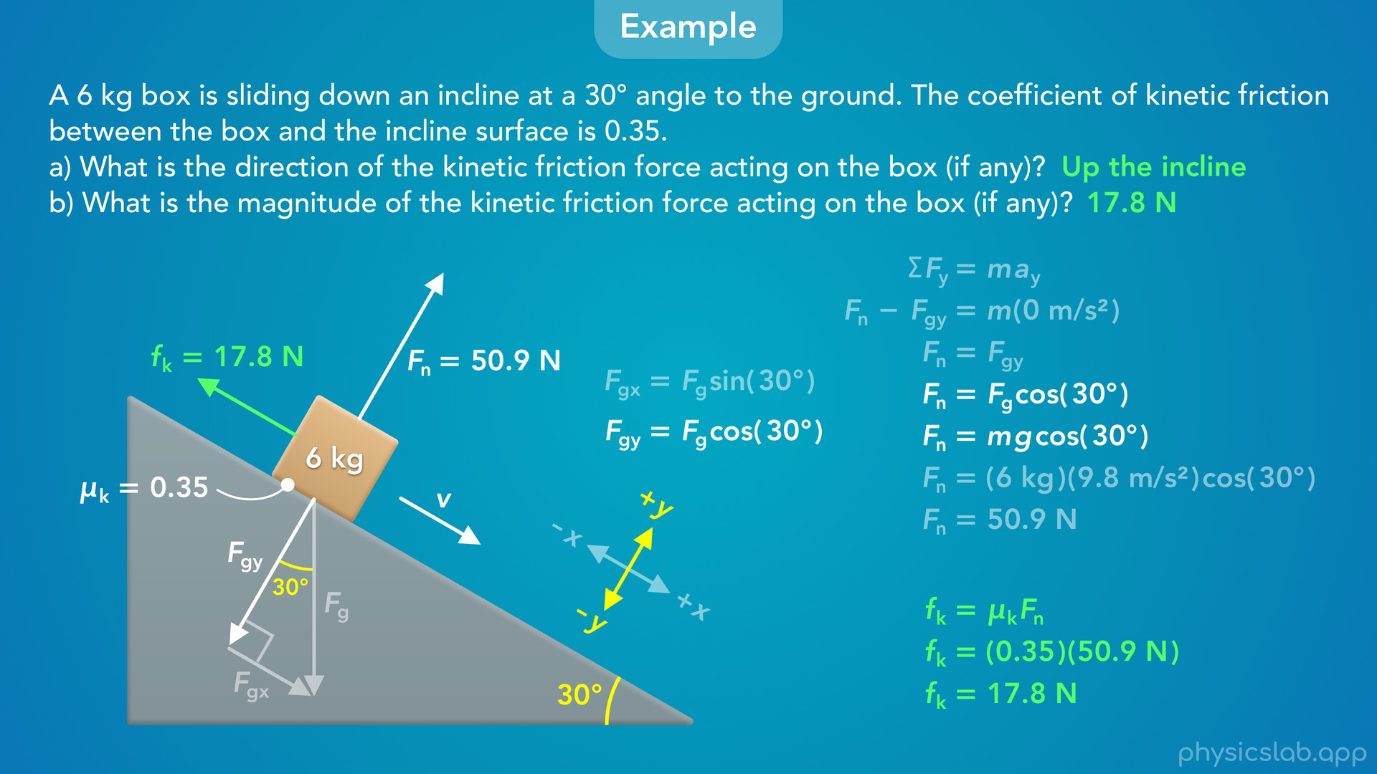
Notes:
• And we learned in that other video that the normal force depends on the angle of the incline
• We can see that in this equation on the right, Fn = mg times the cosine of 30 degrees.

Slide 50
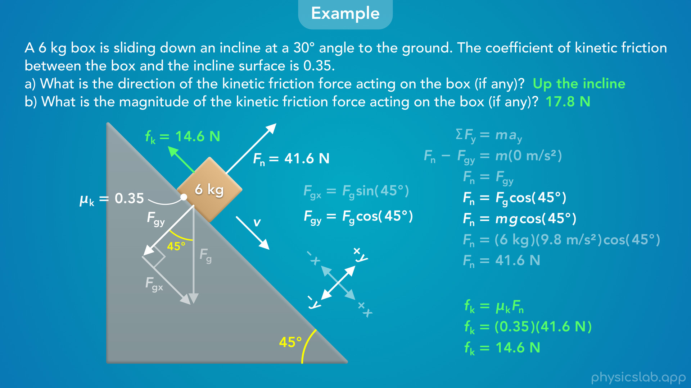
Notes:
• So if this incline was steeper and the angle was 45 degrees, the normal force would decrease, which means the kinetic friction force would also decrease.
• If the mass and coefficient were the same, the new kinetic friction force would 14.6 N.
• So that’s an example of working with kinetic friction on an incline.

