Slide 1
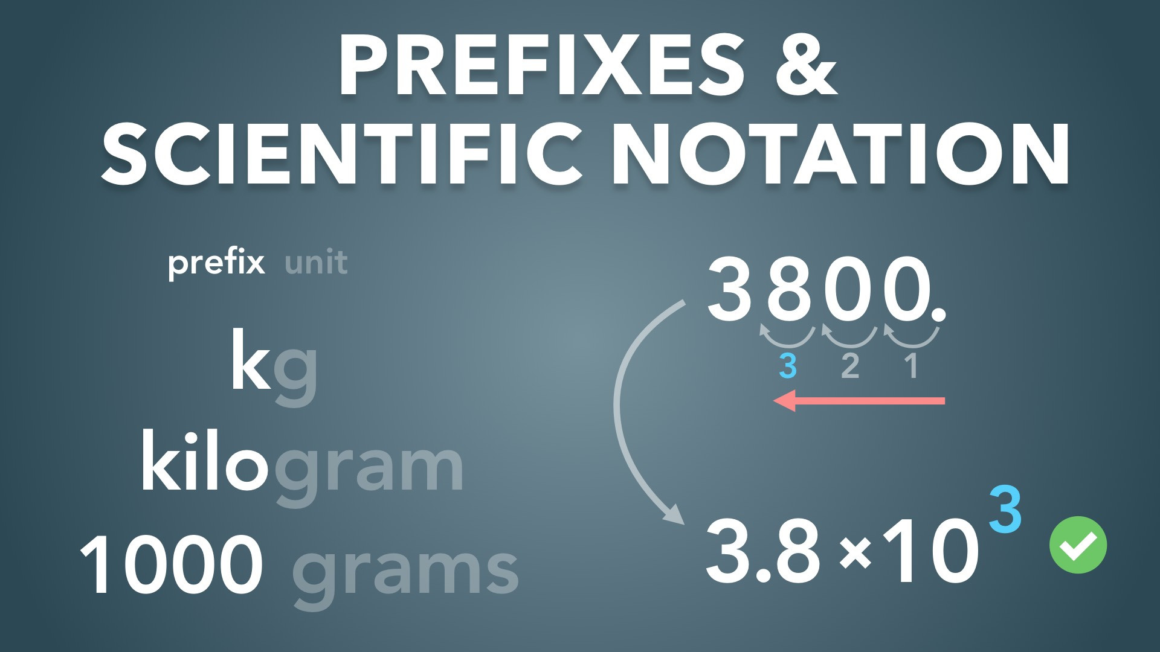
Notes:
Prefixes & Scientific Notation
Slides Version 1
physicslab.app
These slides include screenshots from the video. Want more slides? Less slides? Different material on the slides or a different format? If you have any questions, suggestions or feedback about these slides please email me at chris@physicslab.app or send me a message on Discord @physicslab.

Slide 2
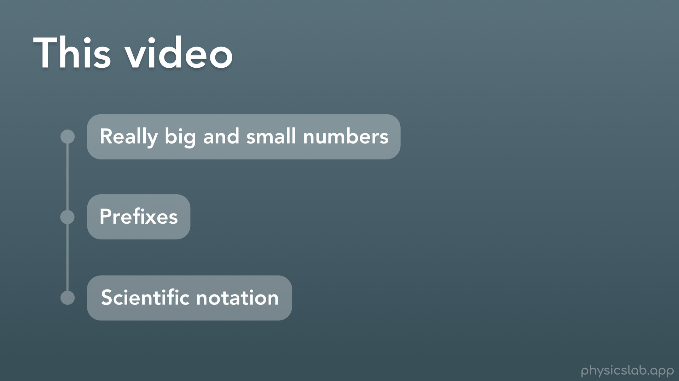
Notes:
Hey everyone, welcome to this video on Prefixes and Scientific notation. These are things that we use, as a way to write big and small numbers, and they show up in almost every physics problem.
So in this video we’ll cover
i. Really big and small numbers, and different ways that we can write them
ii. Then we’ll learn about prefixes and how to use them
iii. And last, we’ll cover scientific notation. We’ll learn how it works, and an easy method to write any number using scientific notation.

Slide 3
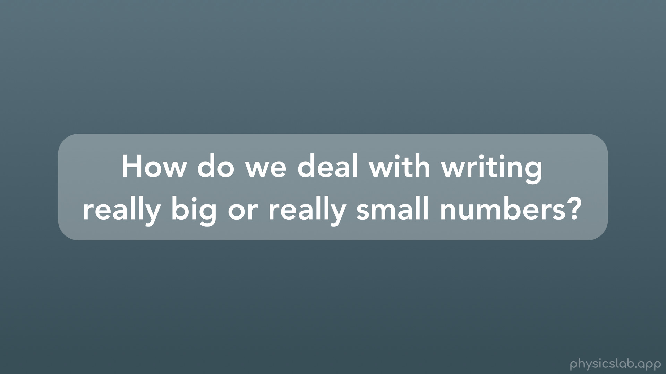
Notes:
So first, how do we deal with writing really large or really small numbers?

Slide 4
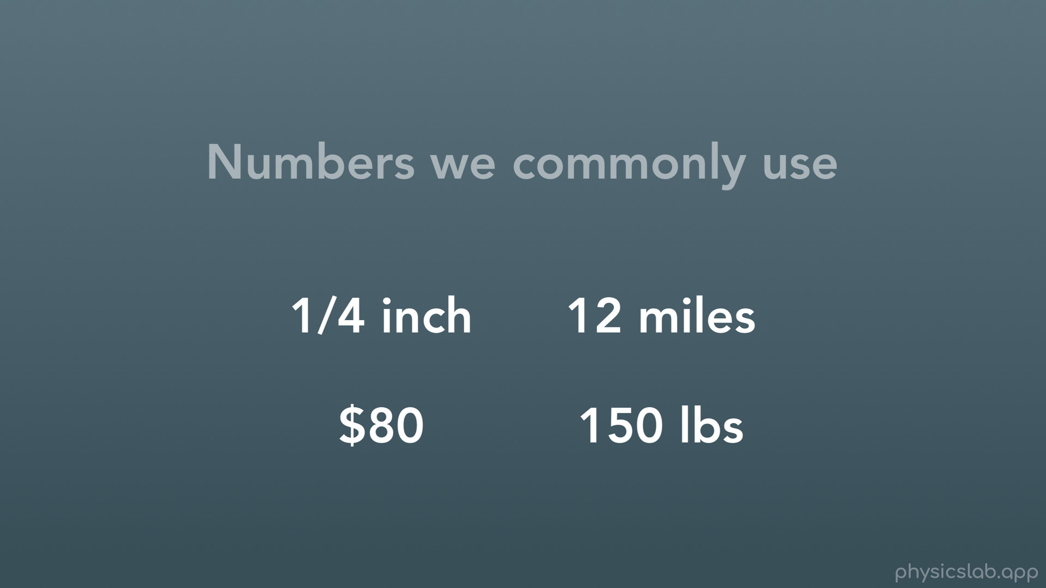
Notes:
This might not seem like something we have to worry about, because the numbers we use every day aren’t really big or small, so they’re easy to write.

Slide 5

Notes:
For example: Timmy went to the market and bought 6 apples.

Slide 6

Notes:
What if timmy bought 600 apples? That’s a lot of apples, but it’s still easy to write.

Slide 7
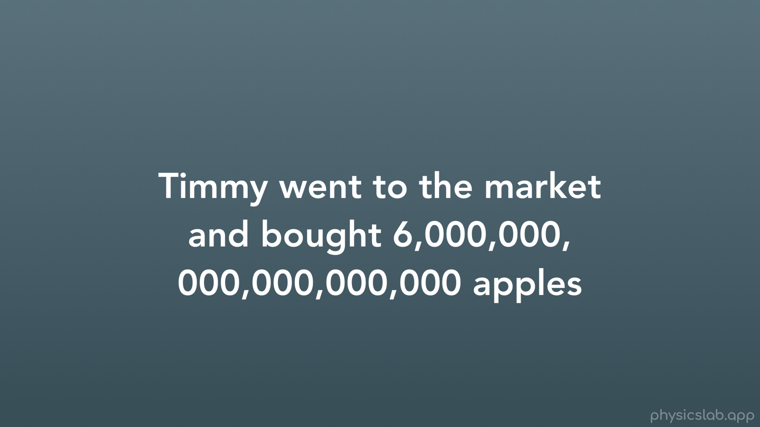
Notes:
But what if timmy bought 6 quintillion apples? Well then it gets a little ridiculous to take the time and the space to write out such a large number. Nobody would by that many apples, so let’s look at some real examples.

Slide 8
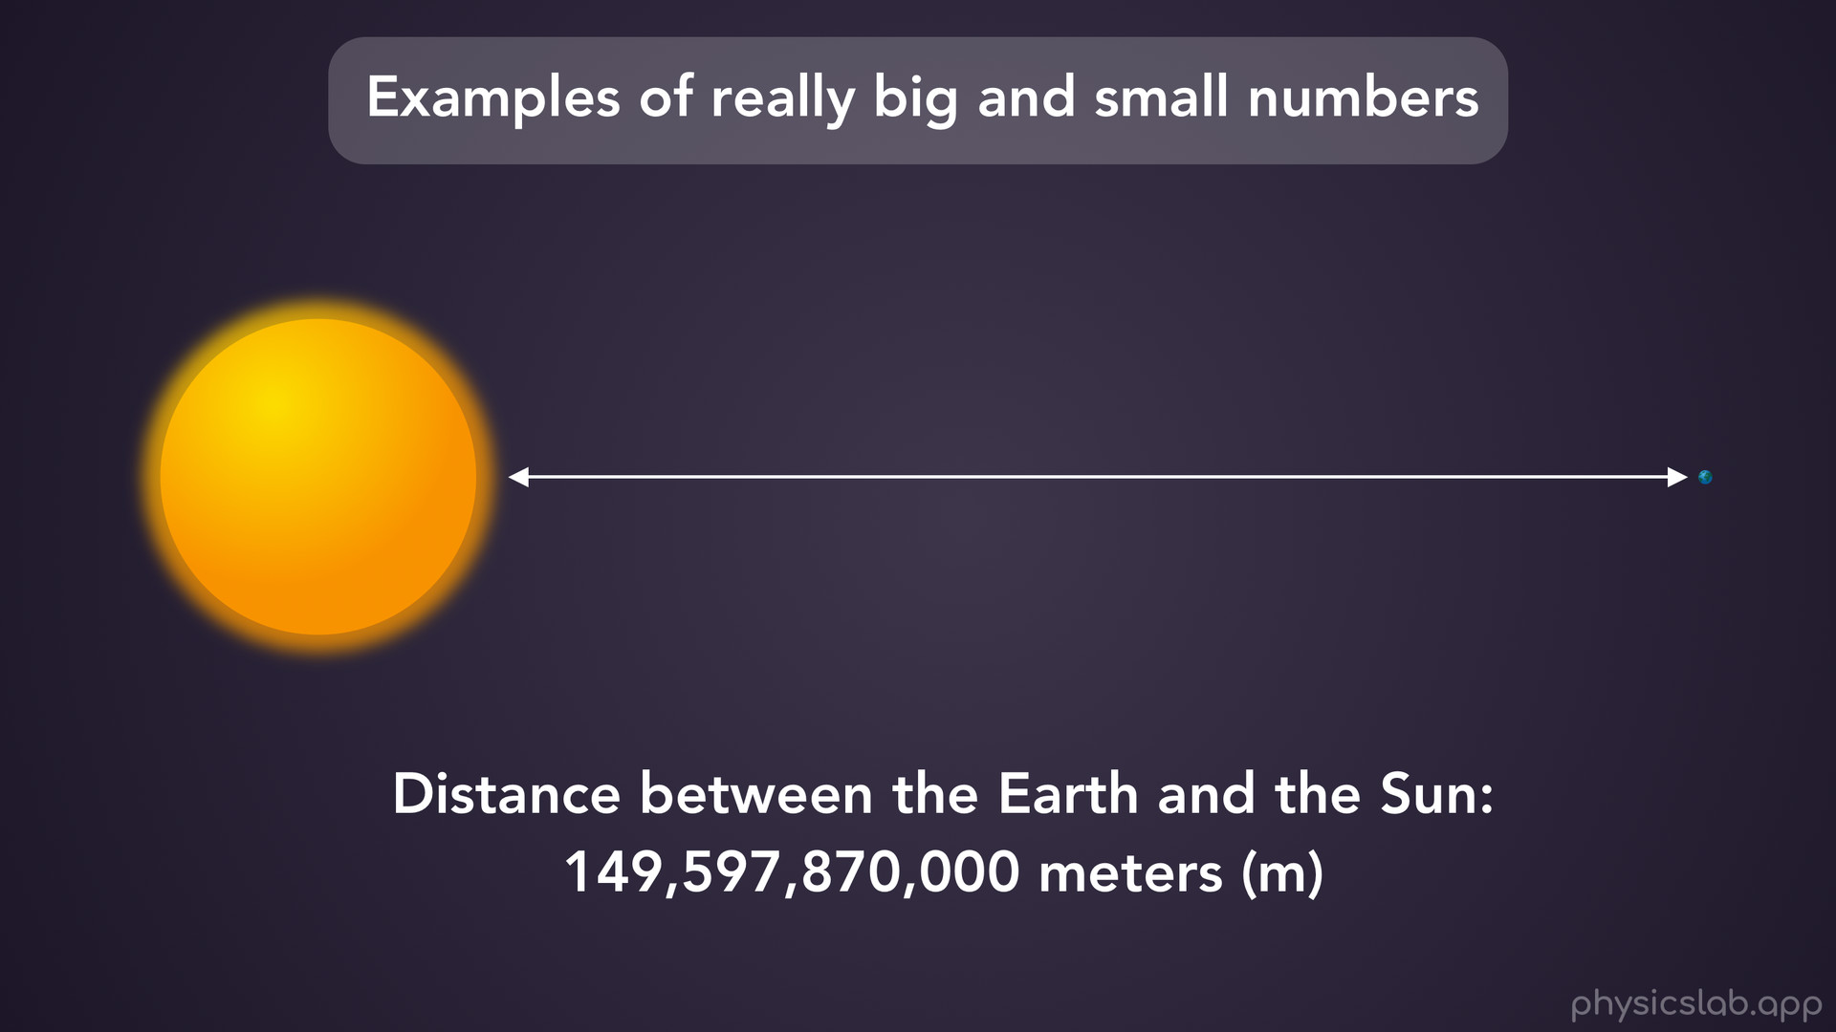
Notes:
The distance between the earth and the sun, in SI units of meters is: 149 billion, 597 million, 870 thousand meters.

Slide 9
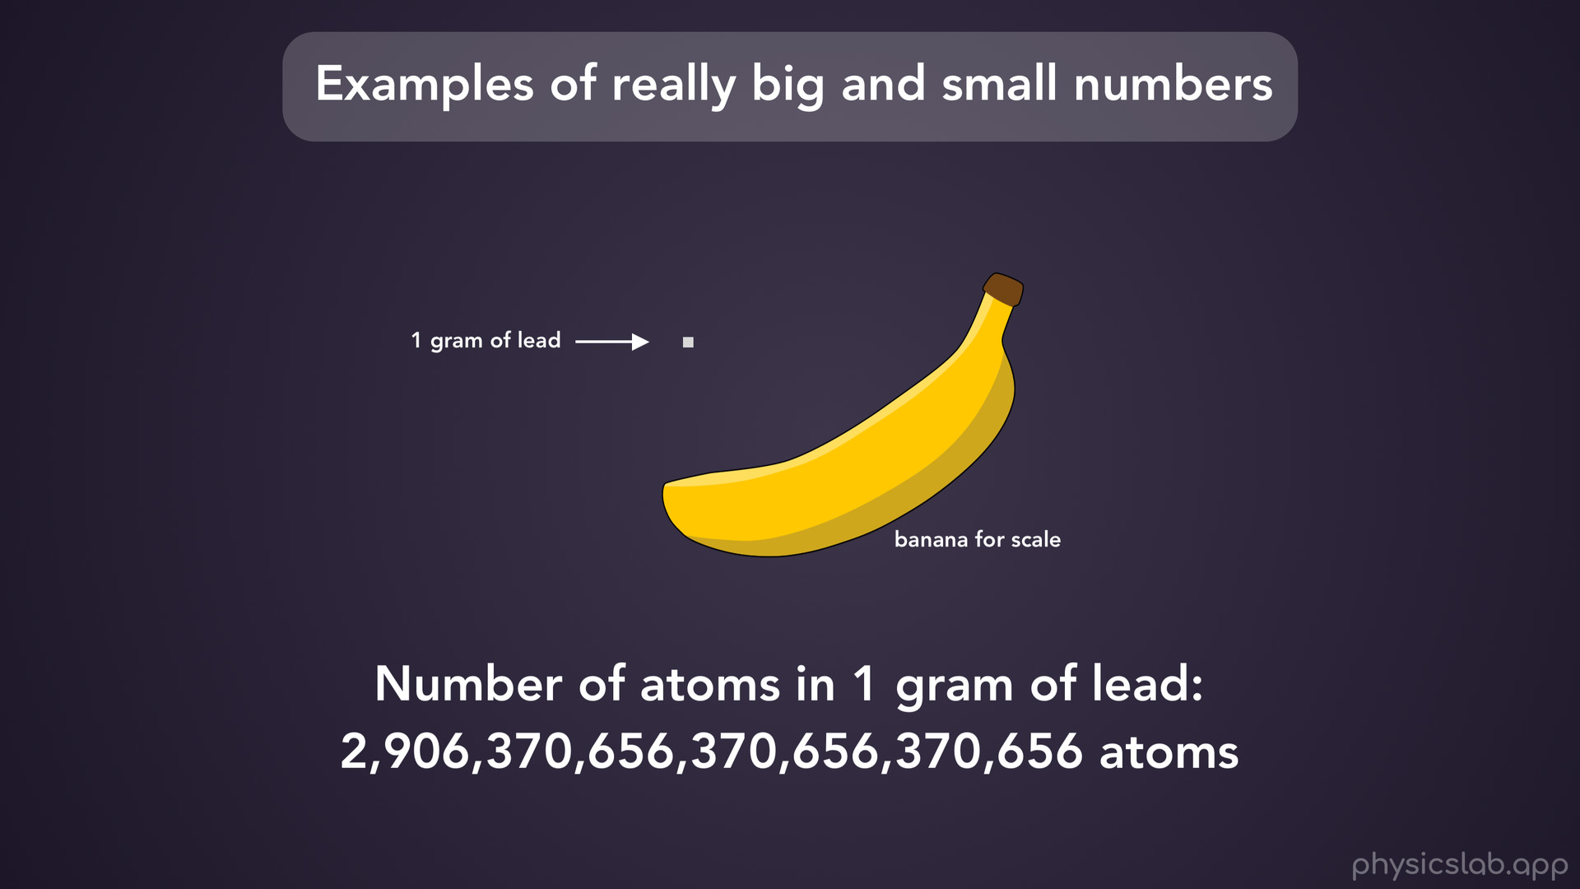
Notes:
The number of atoms in 1 gram of lead is a really big number of atoms.

Slide 10
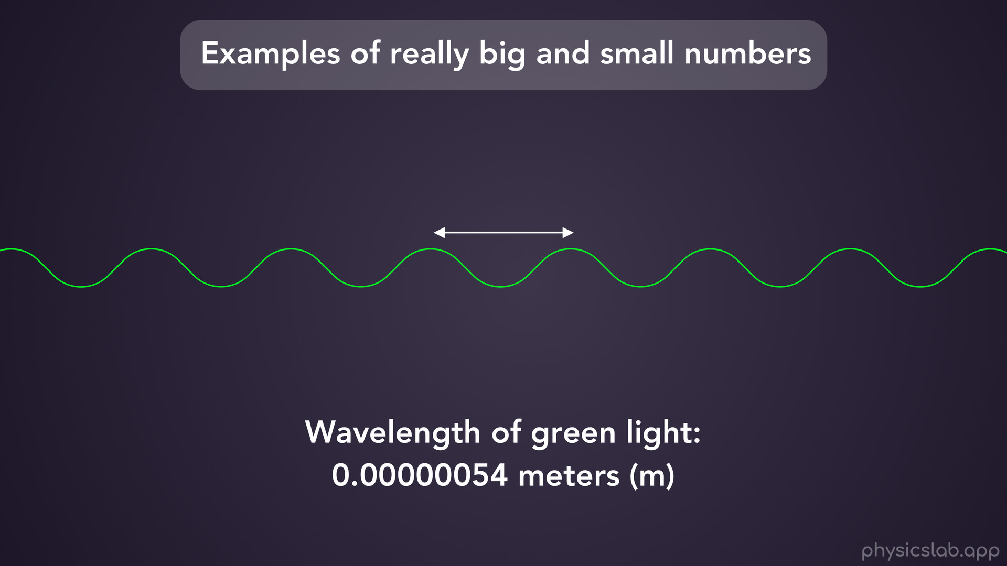
Notes:
On the small end, the wavelength of green light is 0.0 0 0 0 0 0 54 meters. Writing out these numbers every time would be crazy.

Slide 11
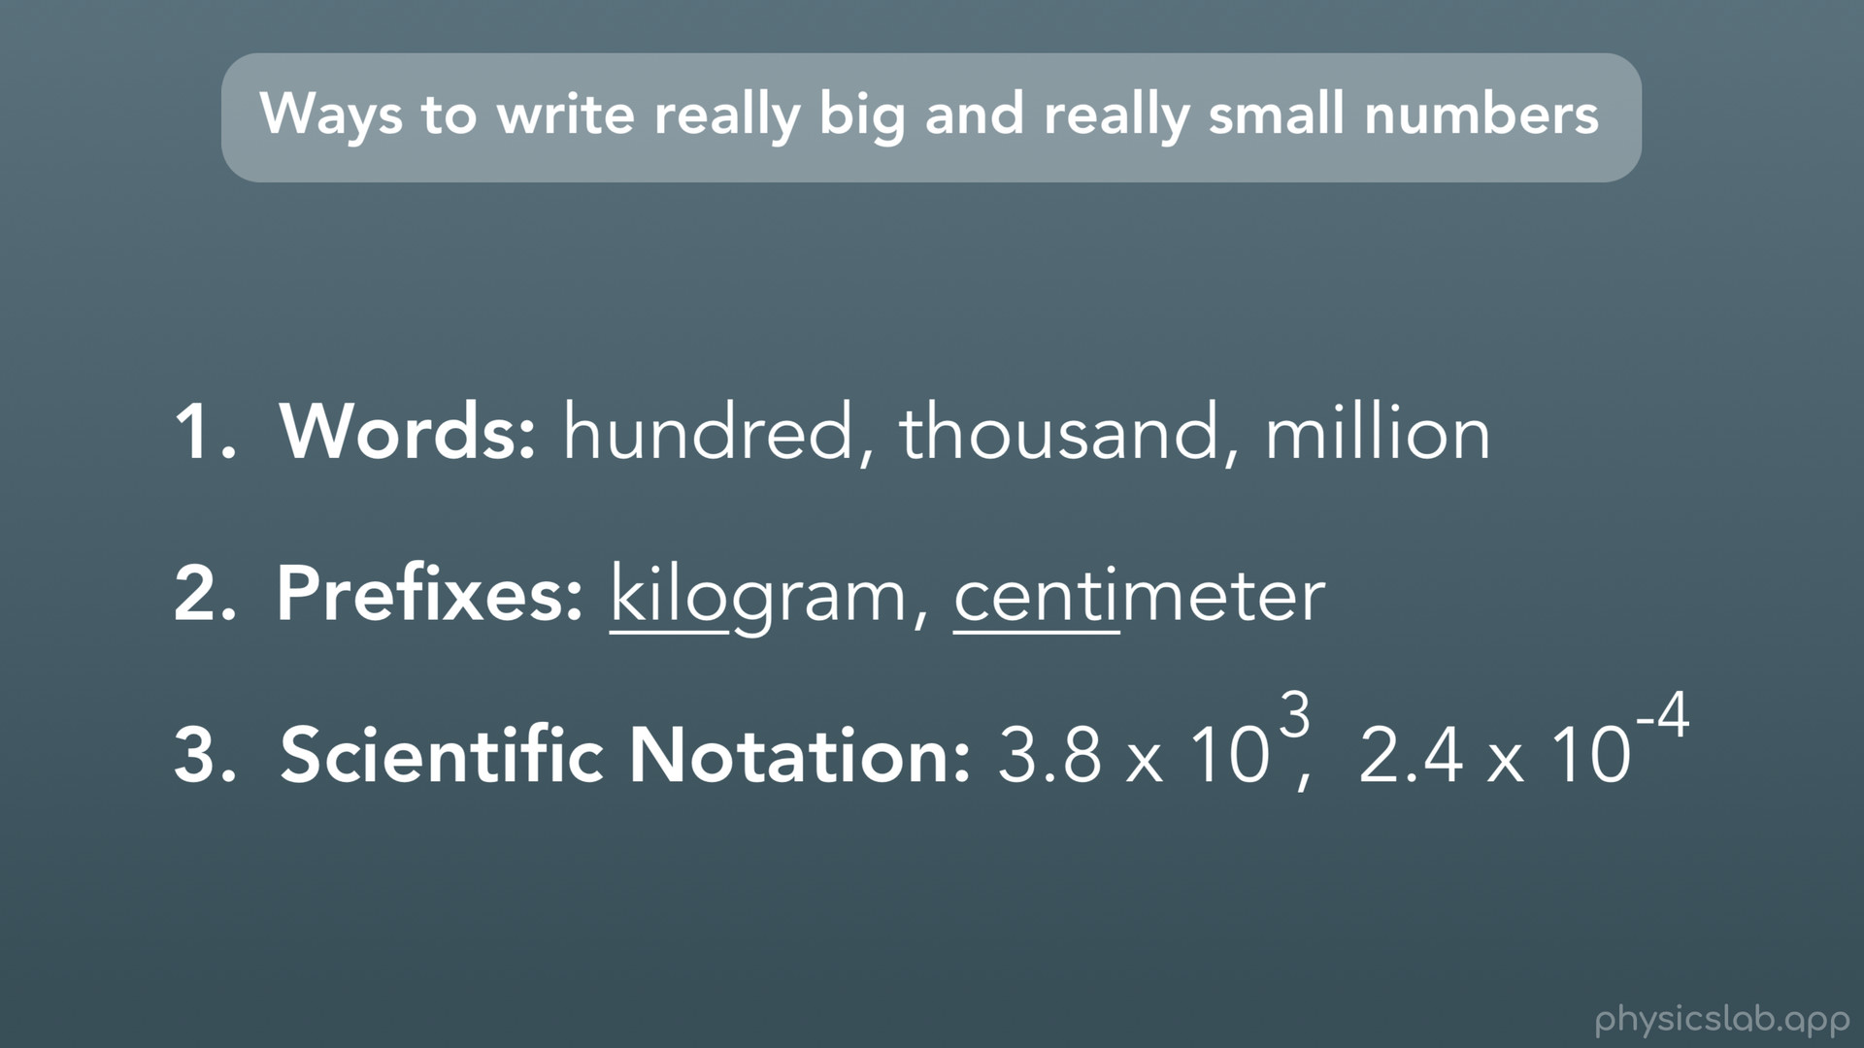
Notes:
To sum it up, there are several ways to write really big or really small numbers. First, we can use words, like hundred, thousand, or million. Instead of writing 8 with 6 zeros after it, we can just write 8 million. Second, we can use prefixes. Prefixes are little words that you can stick onto the front of another word. In this case we can add prefixes to units as a way to write big or small numbers. Third, we can use what we call scientific notation. We’ll explain that later, but long story short, scientific notation is when you multiply a number by 10 to some power or exponent, to make it really big or small.

Slide 12
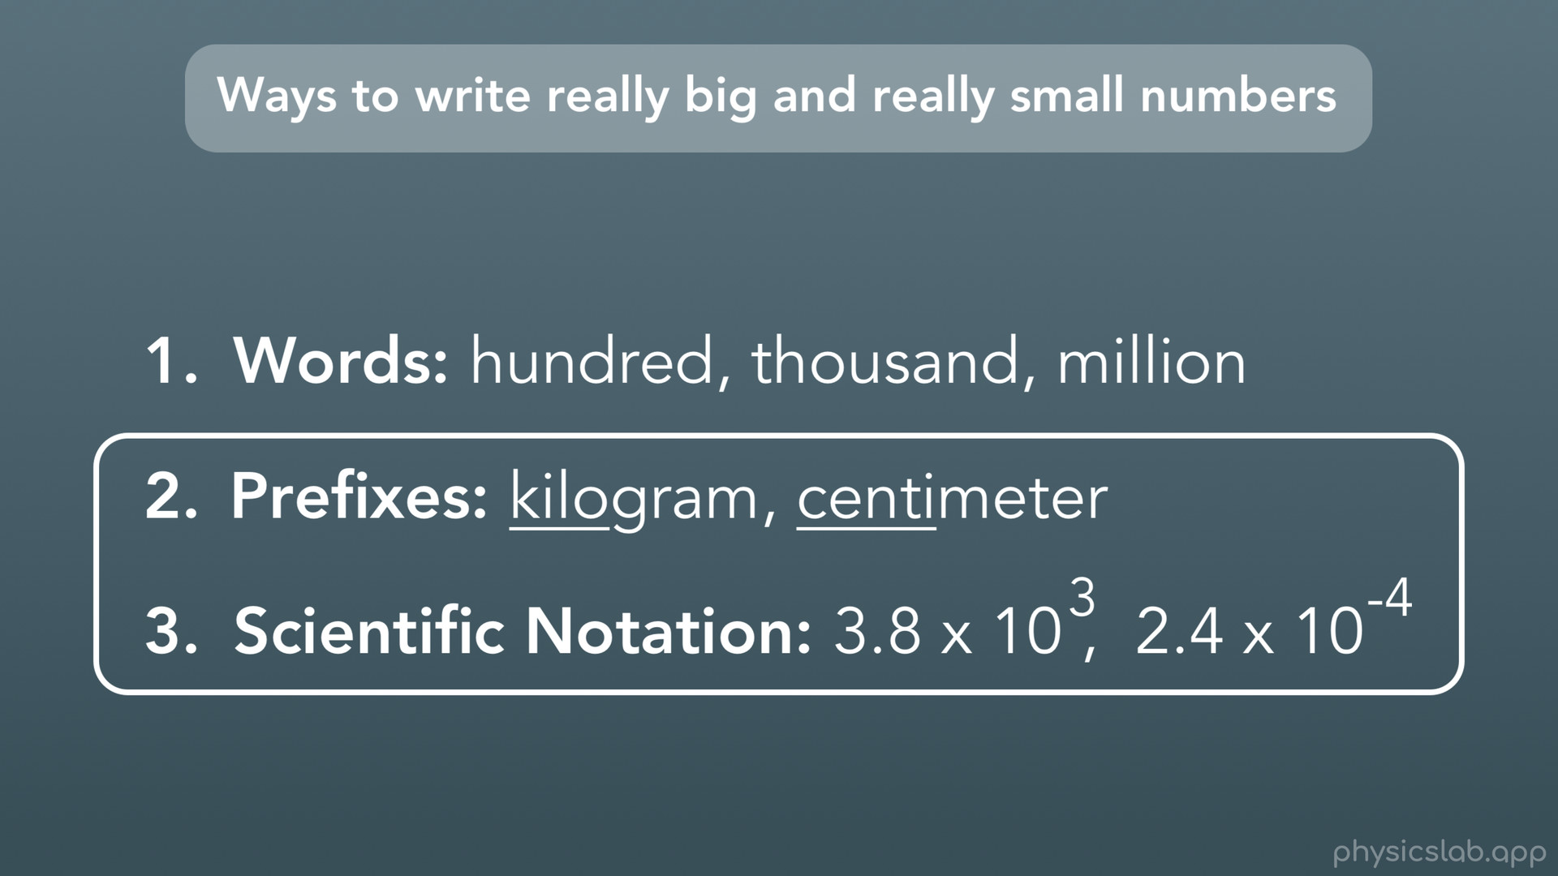
Notes:
Prefixes and scientific notation is what we’ll really use in physics.

Slide 13

Notes:
So, let’s start with prefixes.

Slide 14
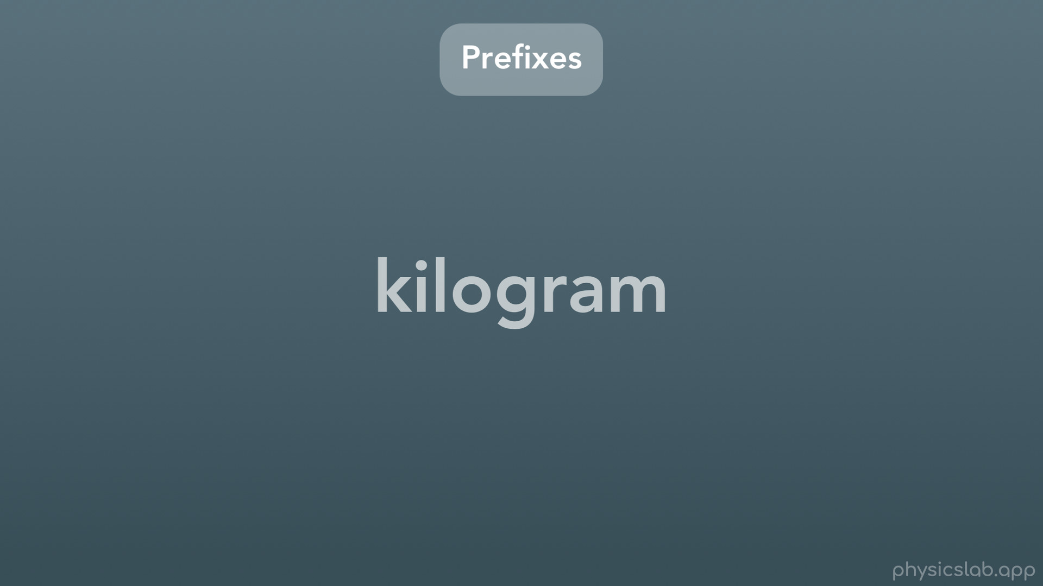
Notes:
For example, the word kilogram is made with the prefix kilo and the unit of gram.

Slide 15
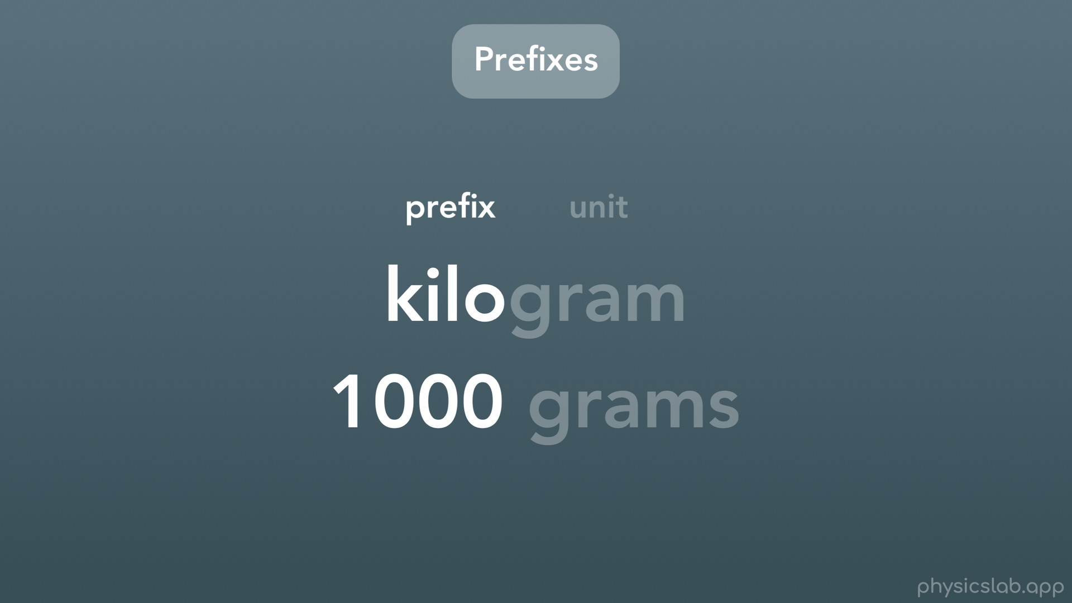
Notes:
The prefix kilo stand for 1000, so a kilogram is equal to 1000 grams.

Slide 16
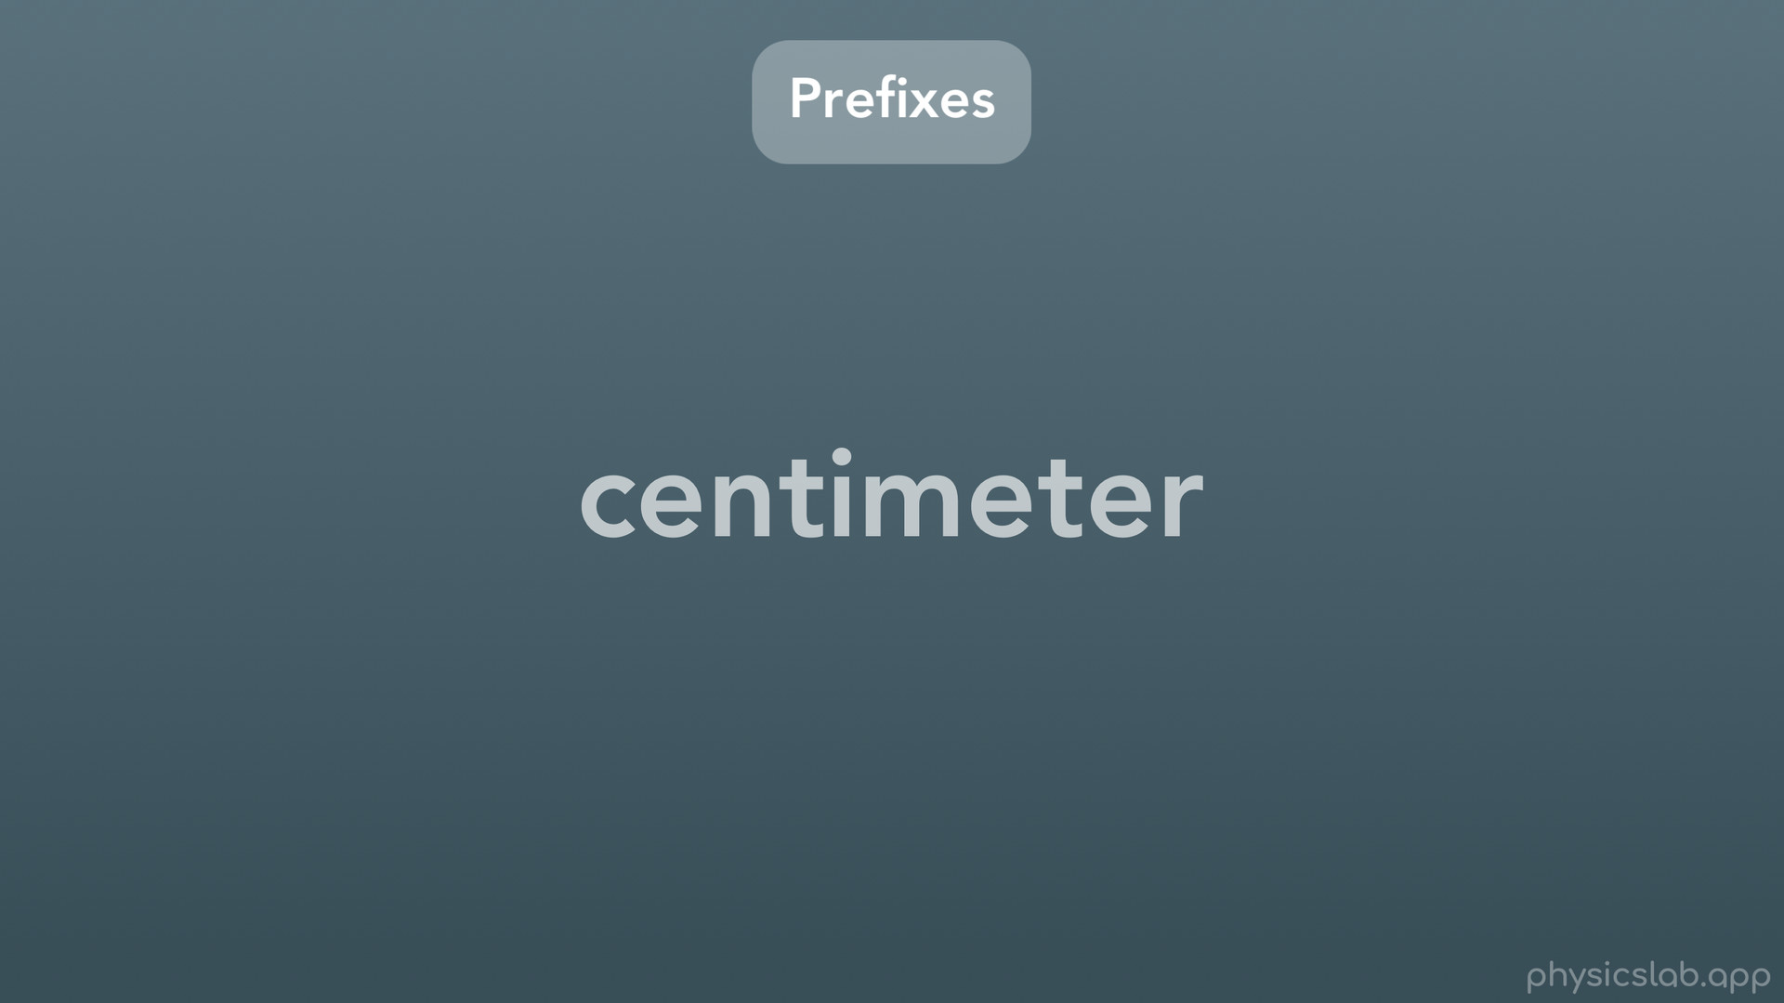
Notes:
Another example: the prefix centi means 1/100, so a centimeter is 1/100 of a meter.

Slide 17
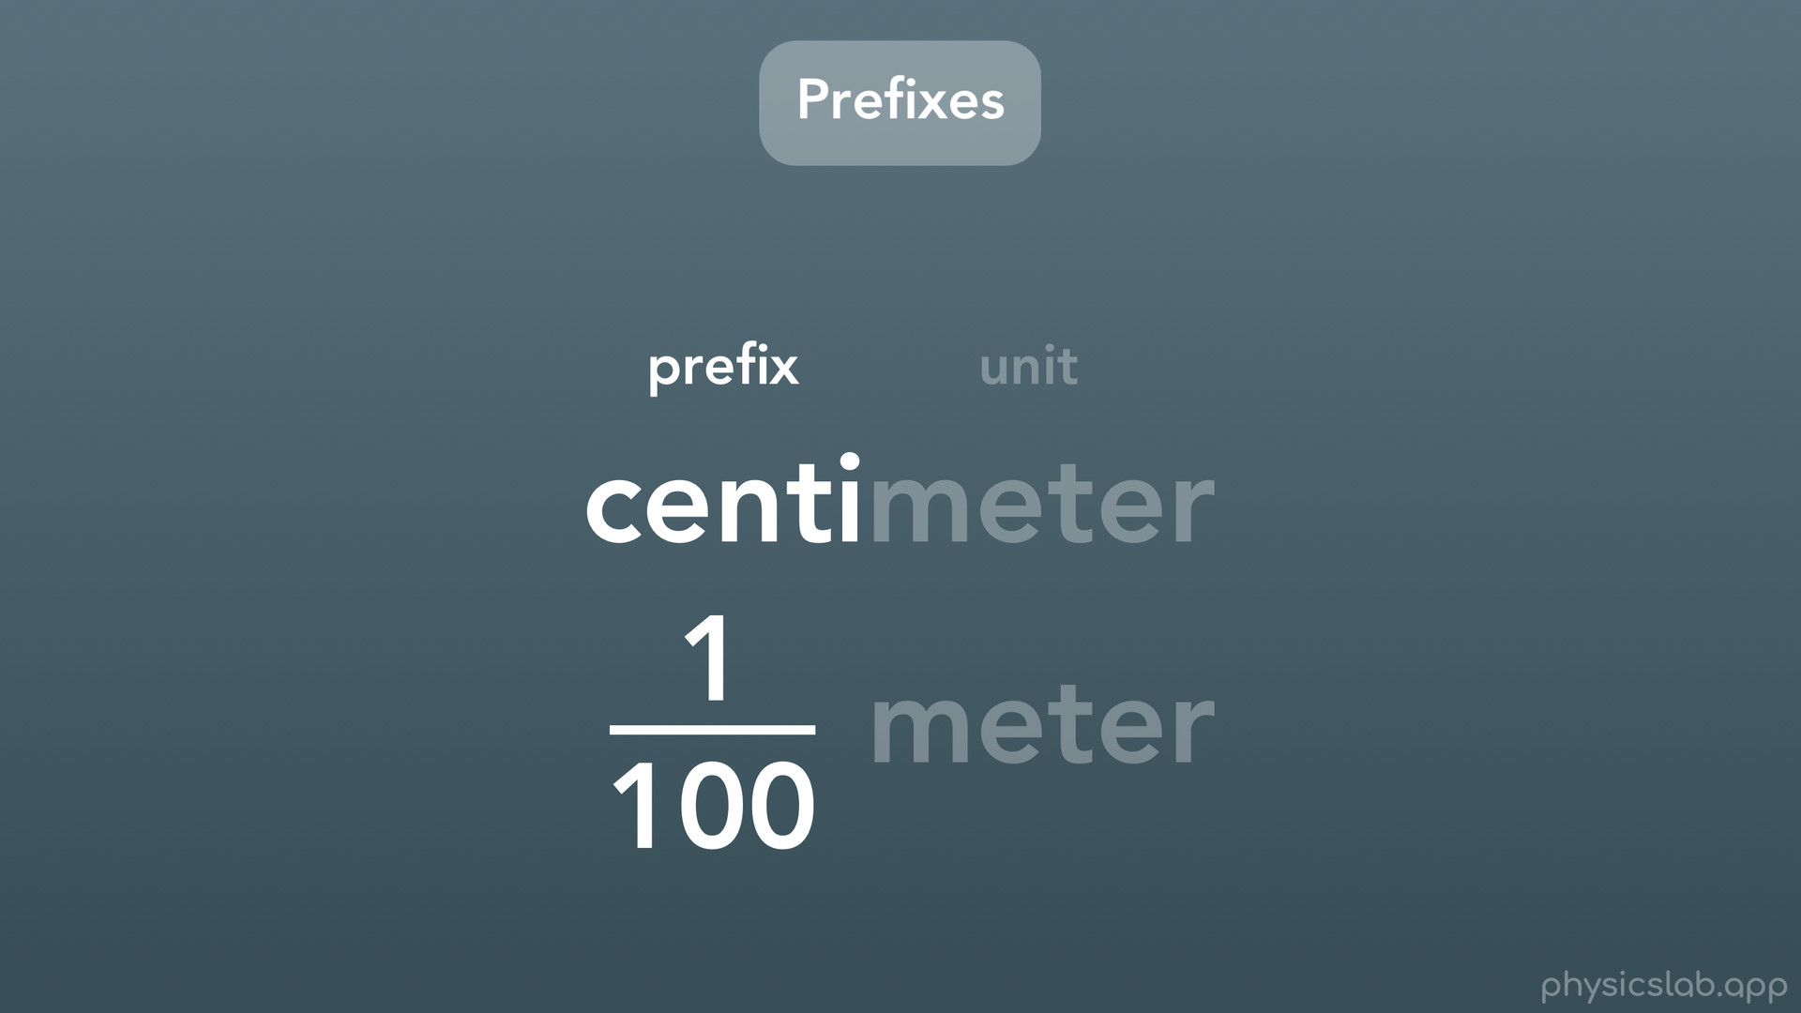

Slide 18
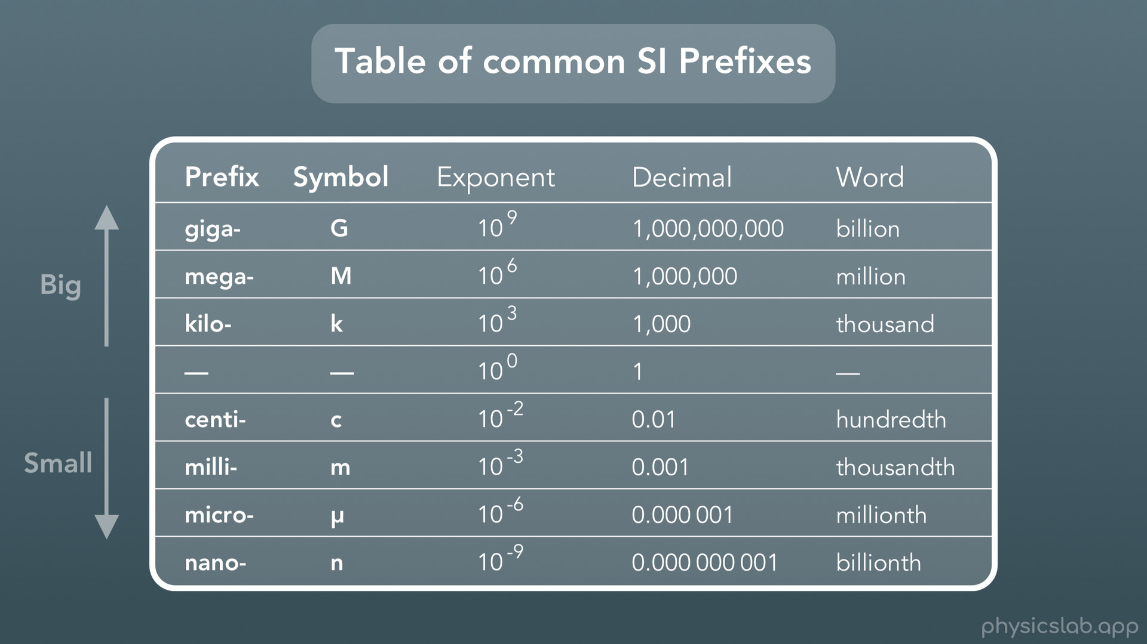
Notes:
Here is a table of some common SI prefixes that we use. Each prefix has its own symbol or abbreviation, for example kilo is lowercase k, and centi is a lowercase c. As you can see, as you go up the prefixes get bigger, and as you go down the prefixes get smaller.

Slide 19
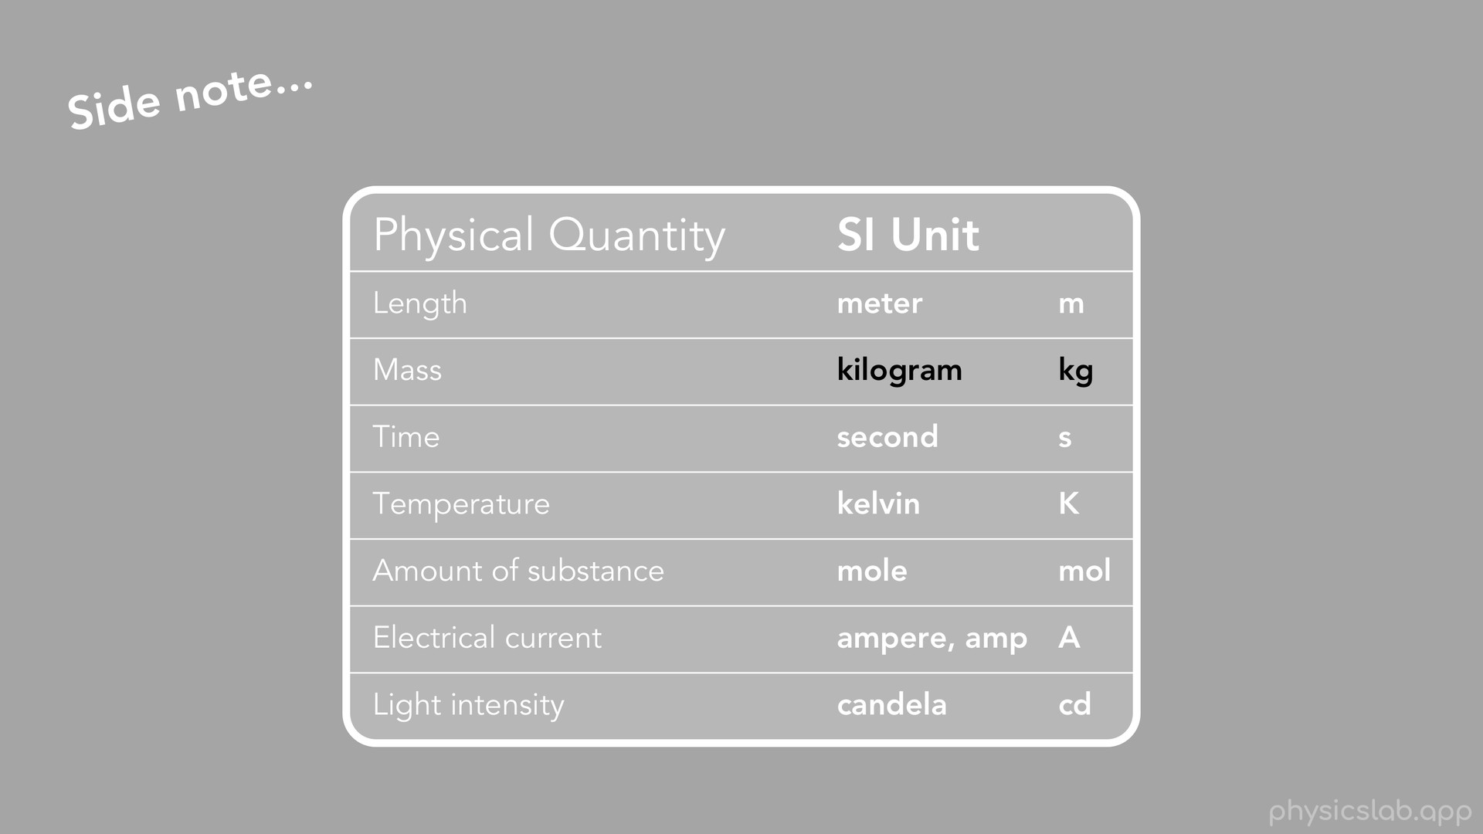
Notes:
A quick side note. You may have realized that in the list of SI units that we covered, the SI unit for mass is the kilogram, rather than the gram. The reason for that is some historical thing involving some king from the 1700s, not important. But it's interesting to note that the unit for mass is the only SI unit that uses a prefix, the rest are just regular units.

Slide 20
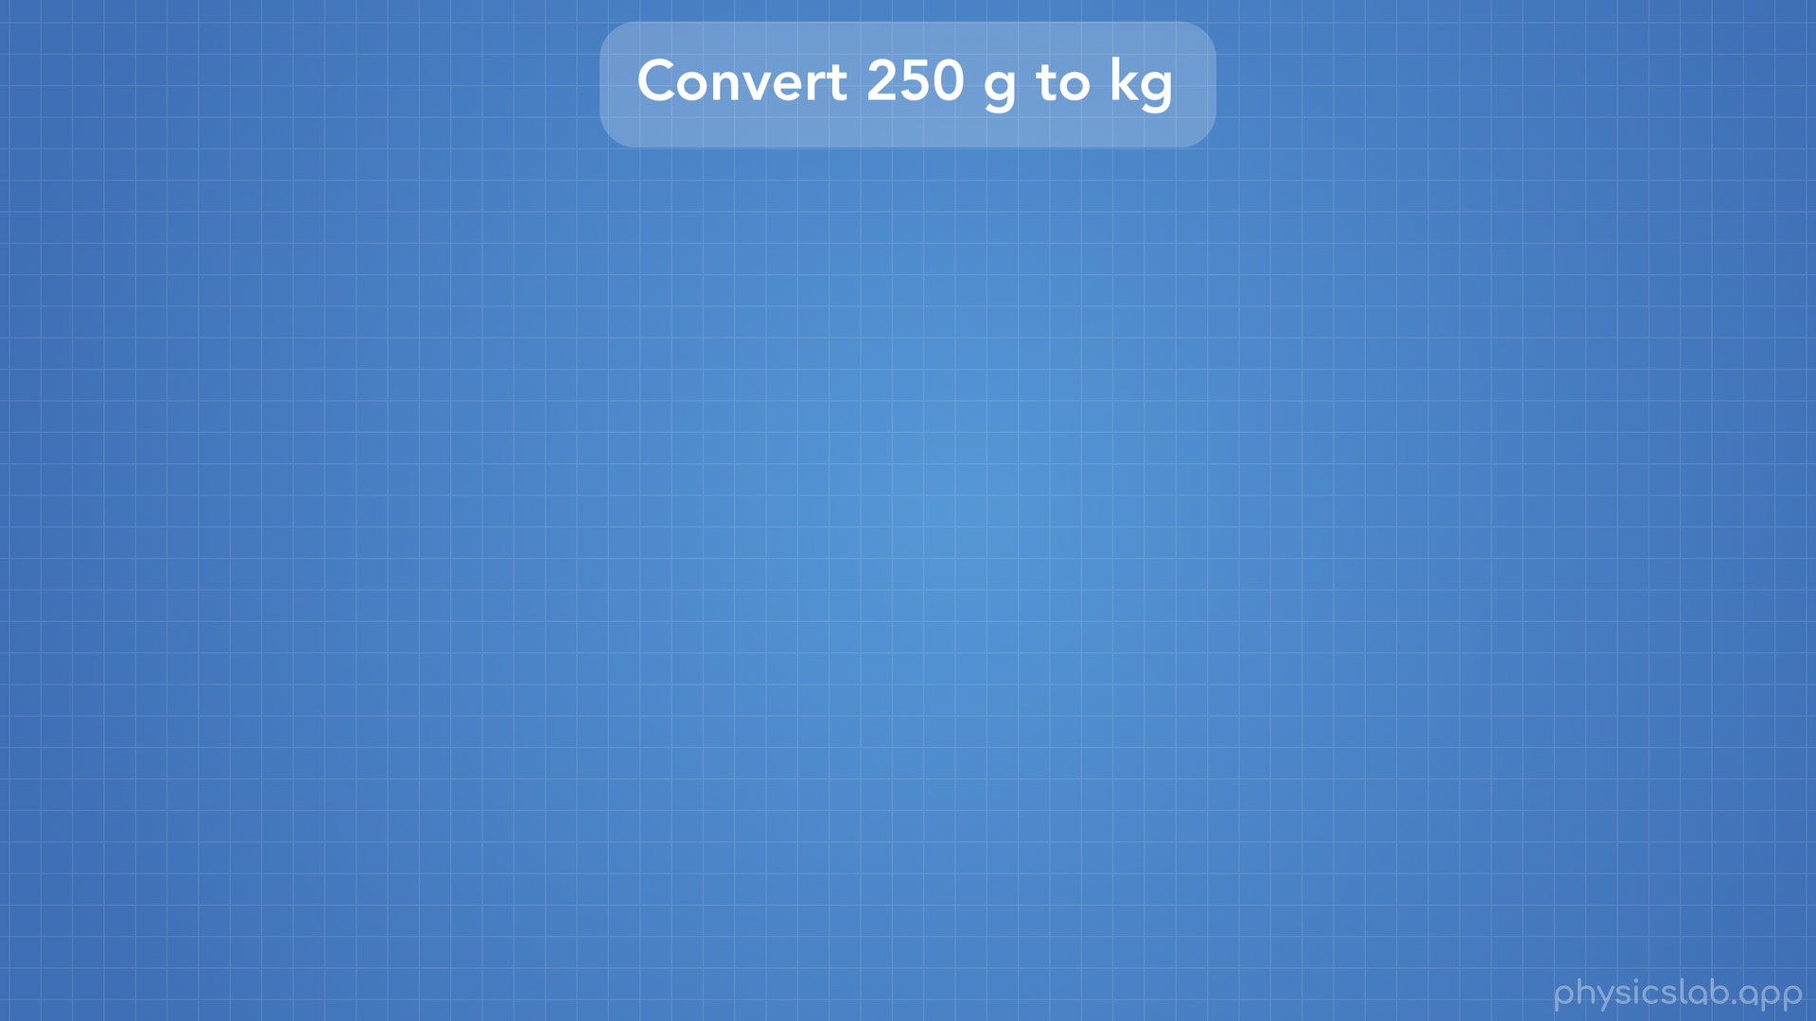
Notes:
Let’s try an example of converting between units with prefixes. Let’s convert 250 g to kg.

Slide 21
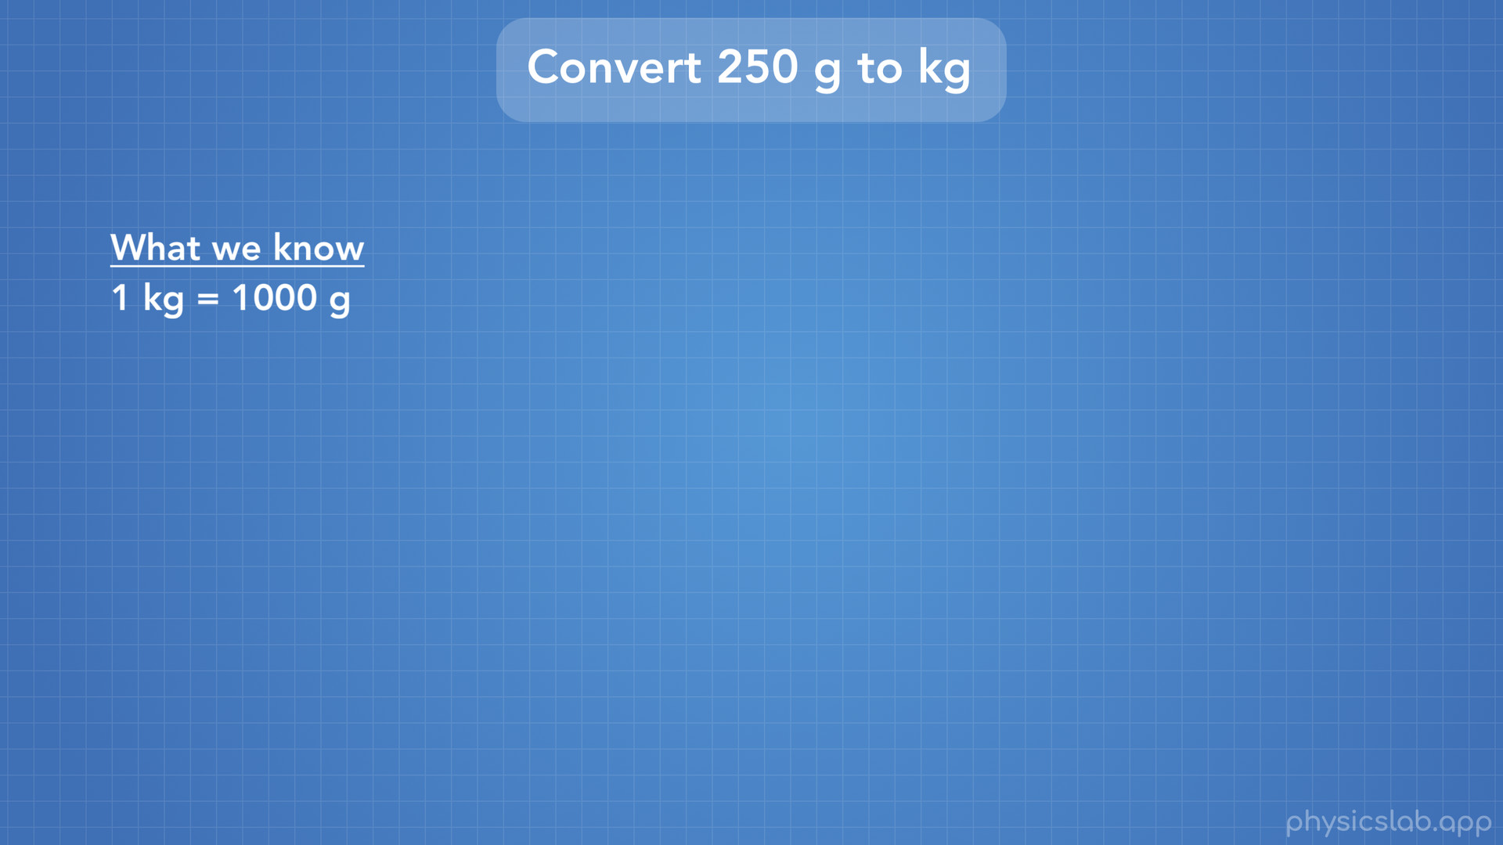
Notes:
We know our unit relationship that 1kg = 1000g.

Slide 22
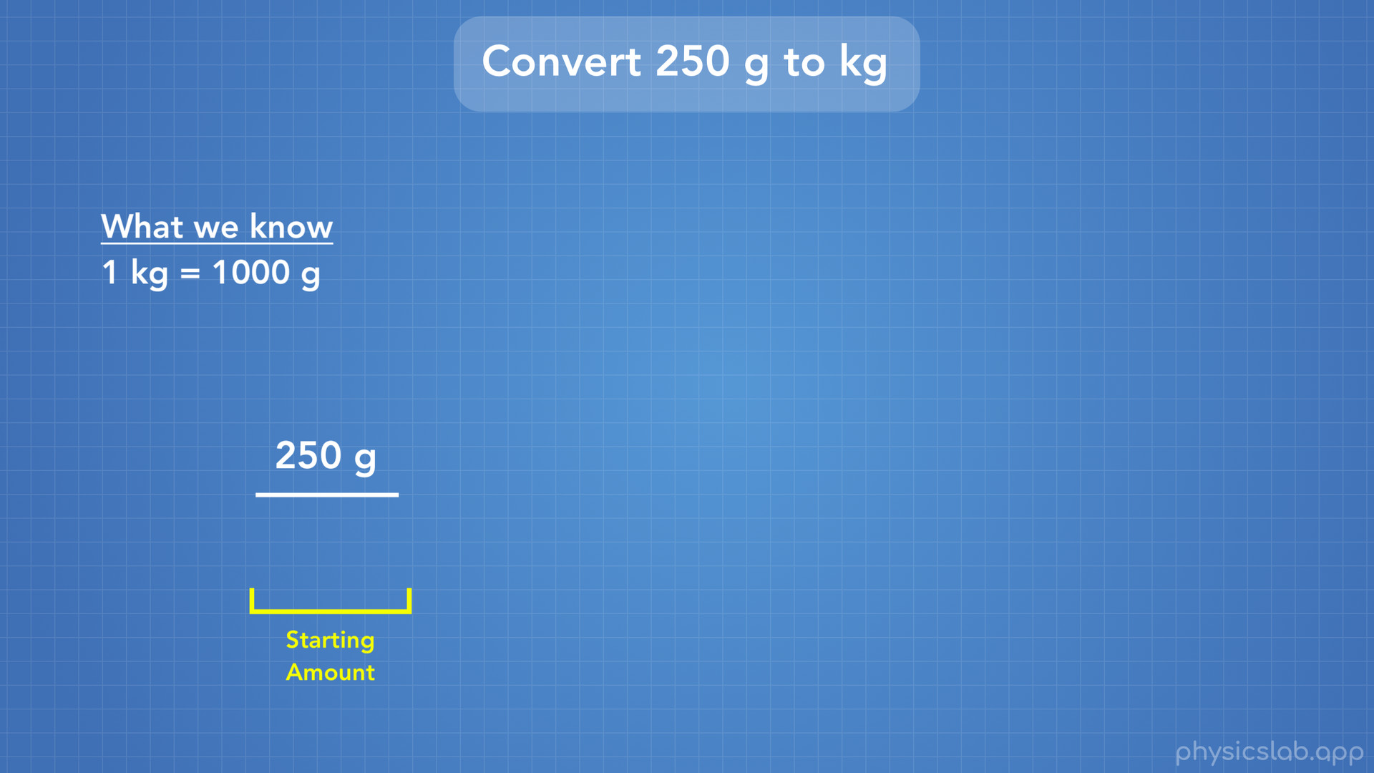
Notes:
First we write our starting amount, 250g.

Slide 23
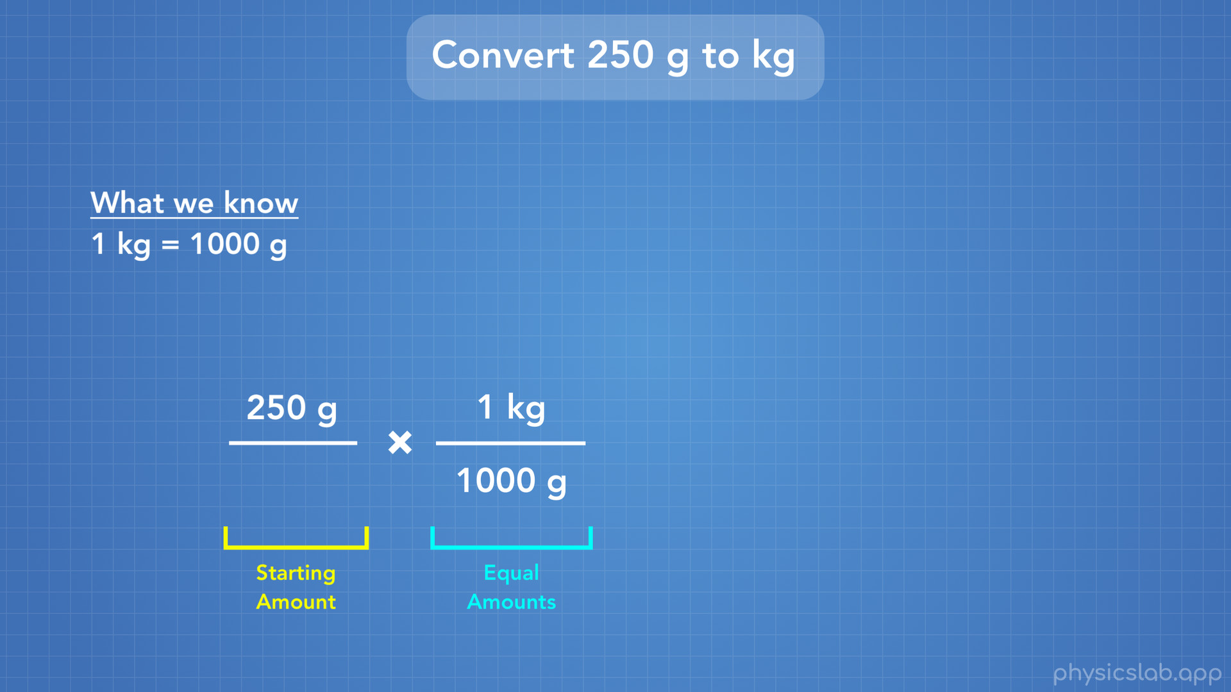
Notes:
Next we write the relationship with grams on the bottom so we can cross grams out.

Slide 24
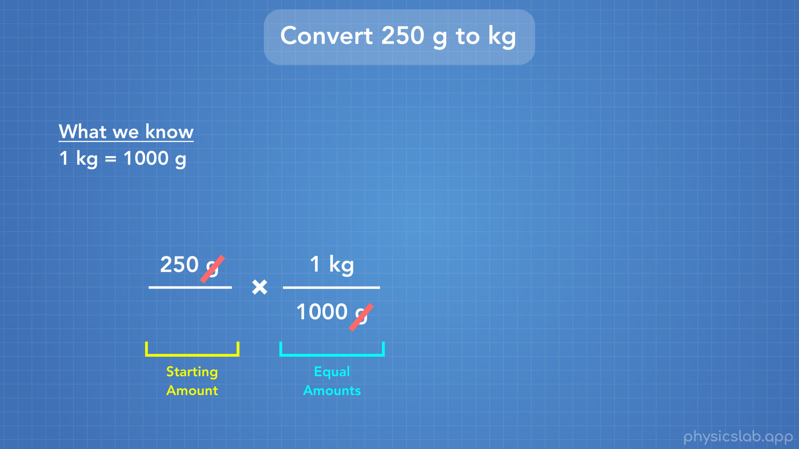

Slide 25
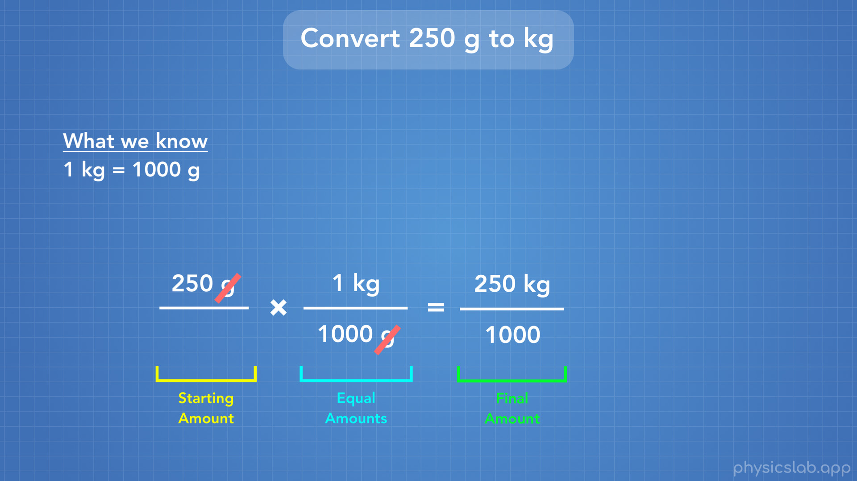
Notes:
Next we multiply 250 x 1 kg to get 250 kg, and we only have 1000 on the bottom.

Slide 26
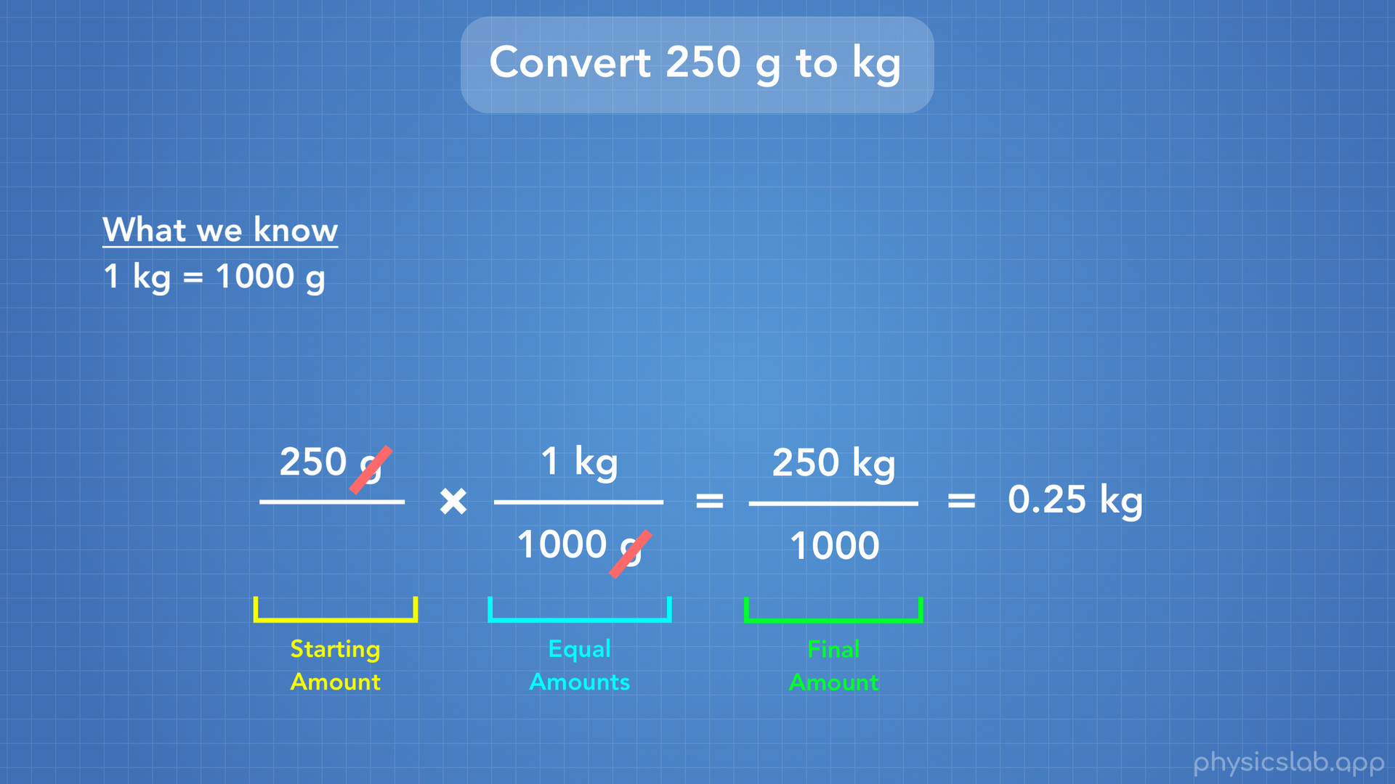
Notes:
250/1000 = 0.25 kg. So 250 g = 0.25 kg.

Slide 27

Notes:
Our last method of writing really big or small numbers is using scientific notation.

Slide 28
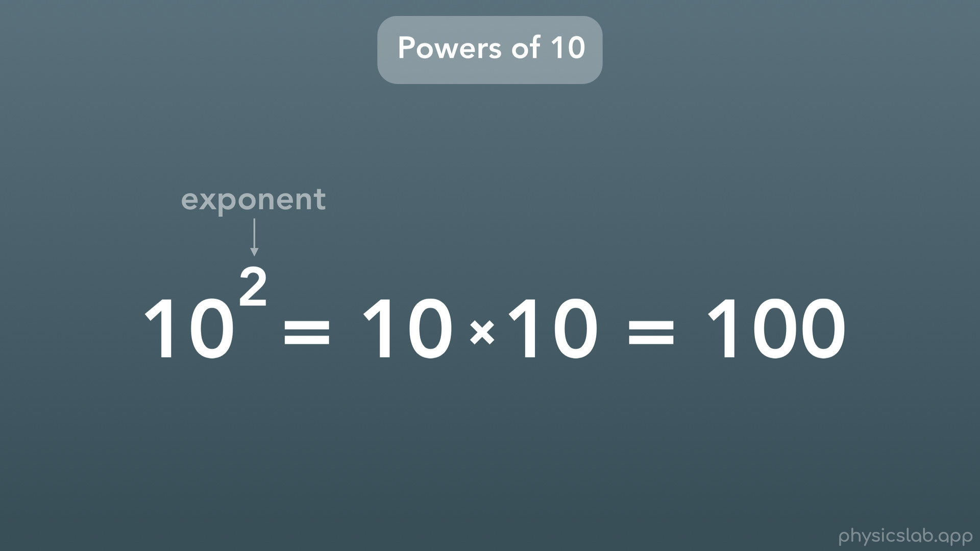
Notes:
First let’s start with the foundation of scientific notation: powers or exponents of 10. Recall that when you see a number with a tiny number above and to the right, the tiny number is called an exponent. That exponent tells you how many times you will multiply the number by itself. In this case we have 10 to the power of 2, so we multiply 10 by itself 2 times and we get 100.

Slide 29
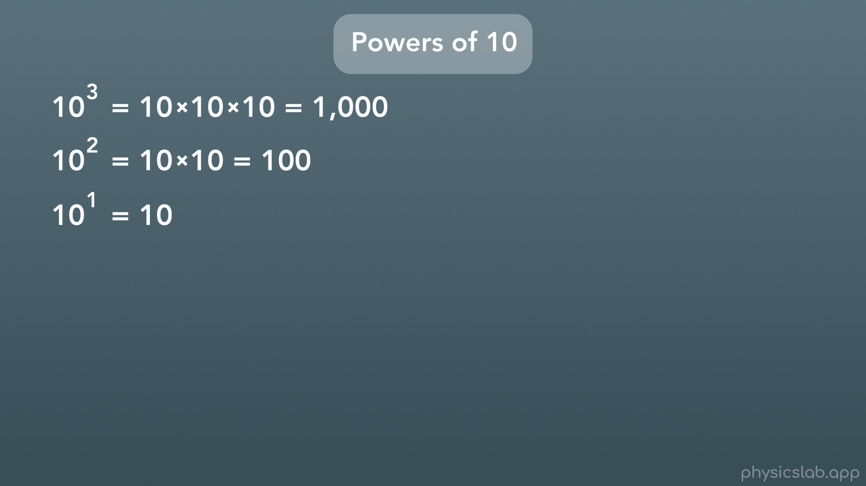
Notes:
So we have 10 to the power of 2 = 100. If we have 10 to the power of 3, we multiply 10 by itself 3 times, and we get 1000. If we have 10 to the power of 1, its just itself, so we have 10.

Slide 30
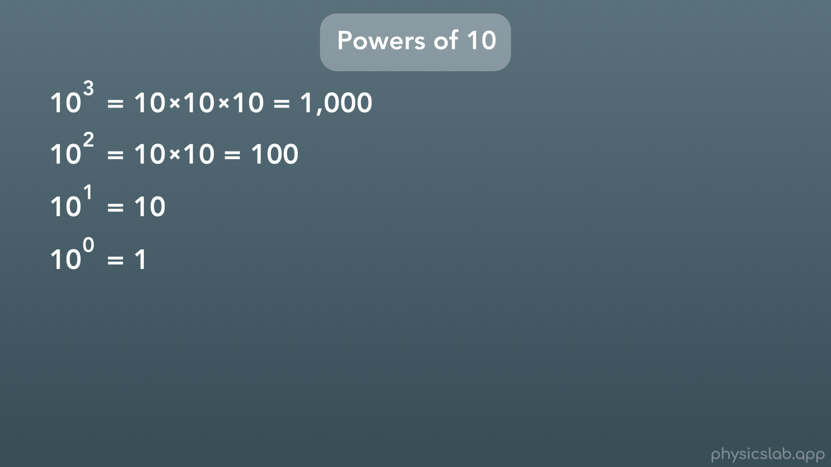
Notes:
What happens if we have 10 to the power of 0? Well any number to the power of 0 is actually 1. Great. So if we make the exponent bigger, the number gets bigger.

Slide 31
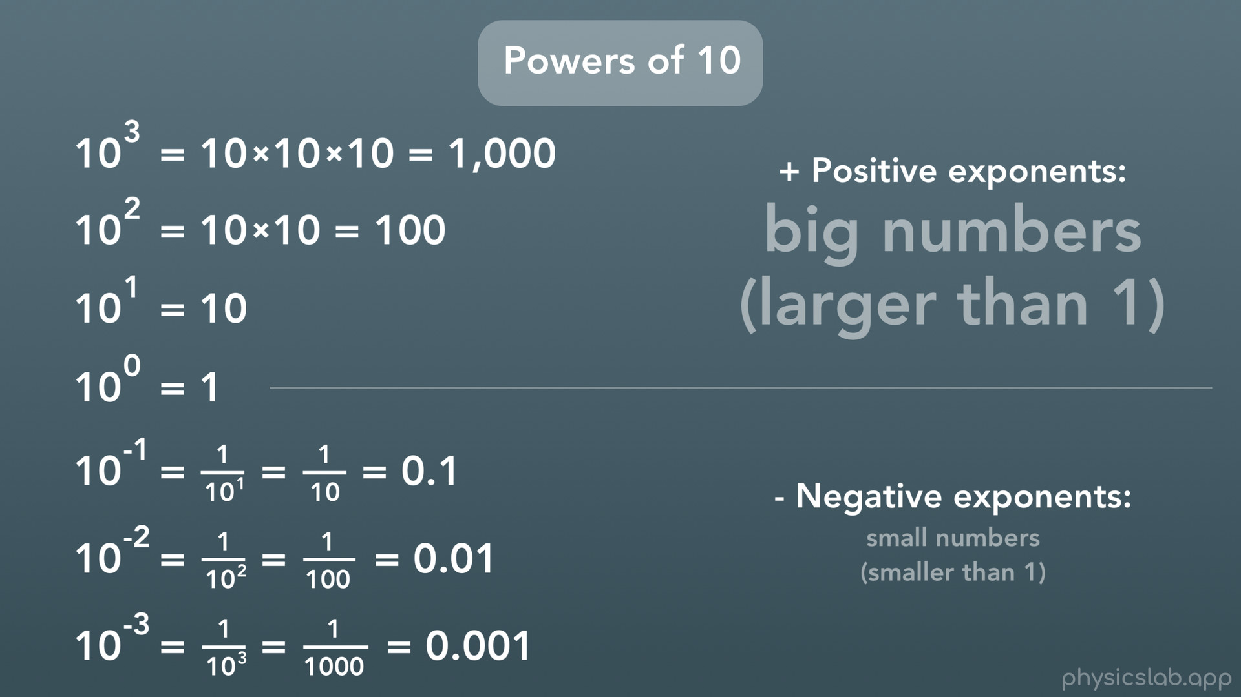
Notes:
What happens if we make the exponent smaller than 0? Turns out we can actually have negative exponents. If the exponent is negative, you write 1 / that number to the positive exponent. So 10^-1 is 1 over 10^1, which is 1 over 10 or 1 tenth. 10^-2 would be 1 / 10x10, or 1/100 or one hundredth. 10^-3 would be 1/1000 or one thousandth. So to sum it up, positive exponents give you big numbers (numbers larger than 1) and negative exponents give you small numbers (numbers smaller than 1).

Slide 32
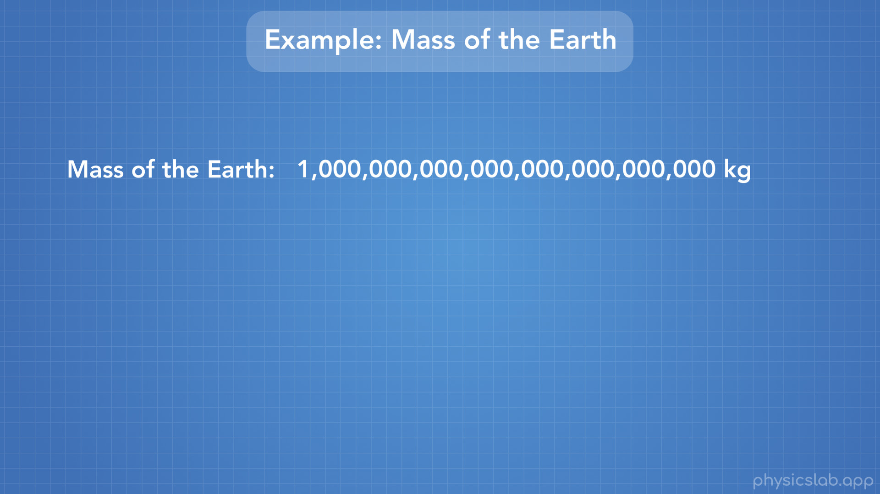
Notes:
Let’s look at an example. Let’s say this is the mass of the earth.

Slide 33
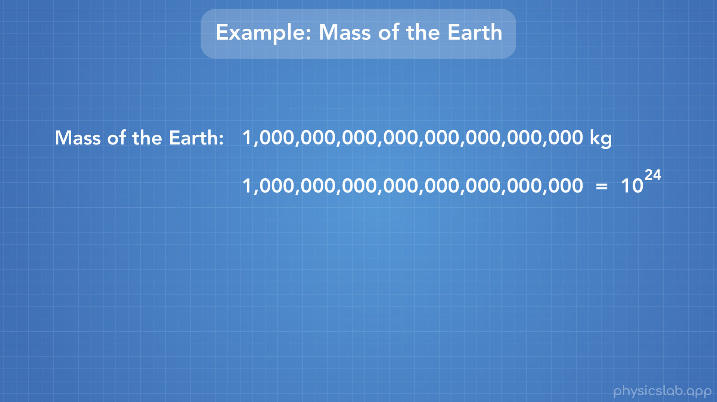
Notes:
Well it turns out that this number is equal to 10 to the power of 24.

Slide 34
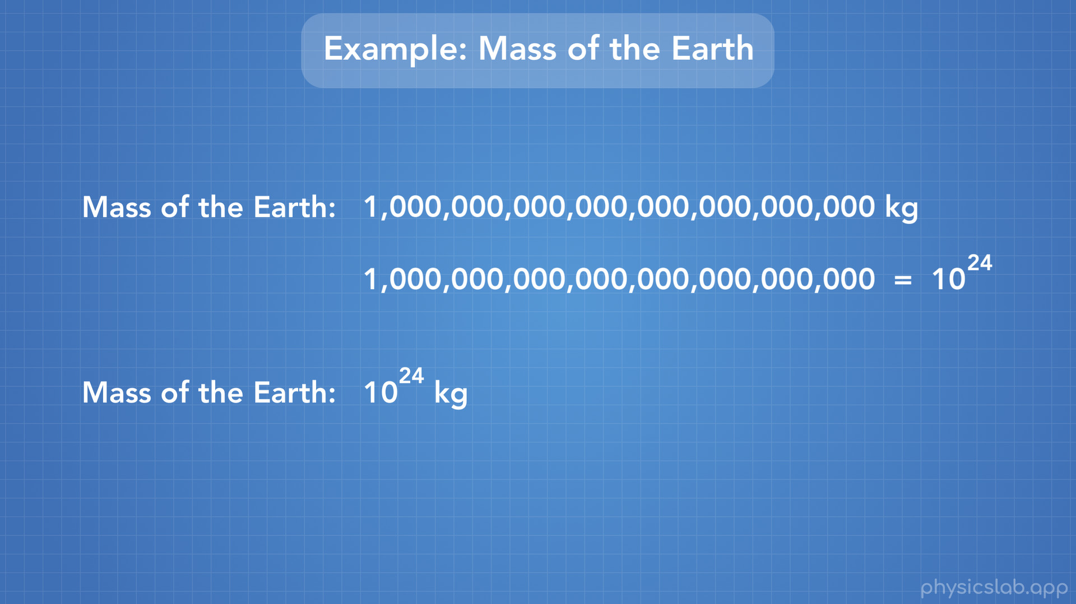
Notes:
So instead of writing this really big number all the time, we could just write that the mass of the earth is 10^24 kg.

Slide 35
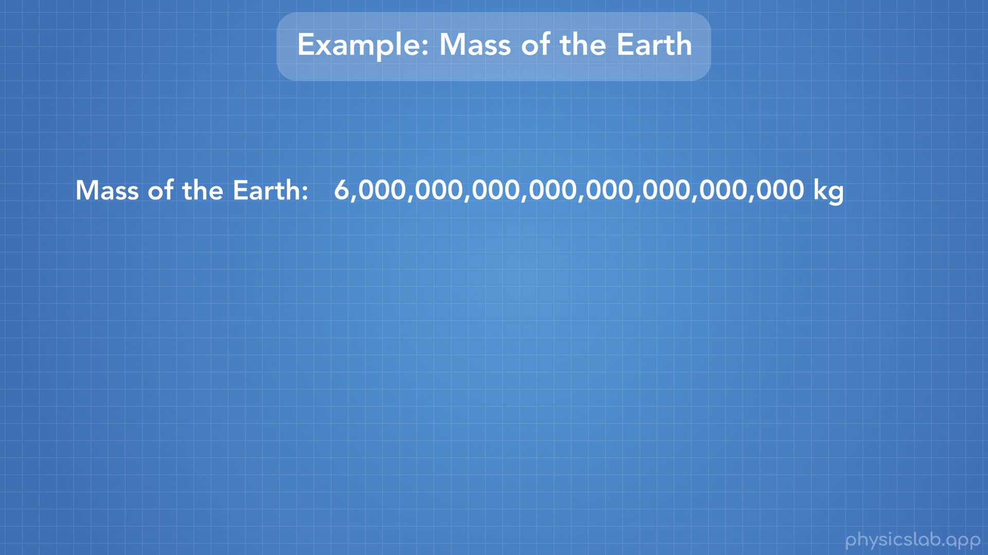
Notes:
But that’s not the mass of the earth, this is the mass of the earth (roughly). A 6 with a lot of zeroes after it.

Slide 36

Notes:
Well we’re given that this big number with a 1 at the beginning is 10^24. So then how do we write the mass of the earth?

Slide 37
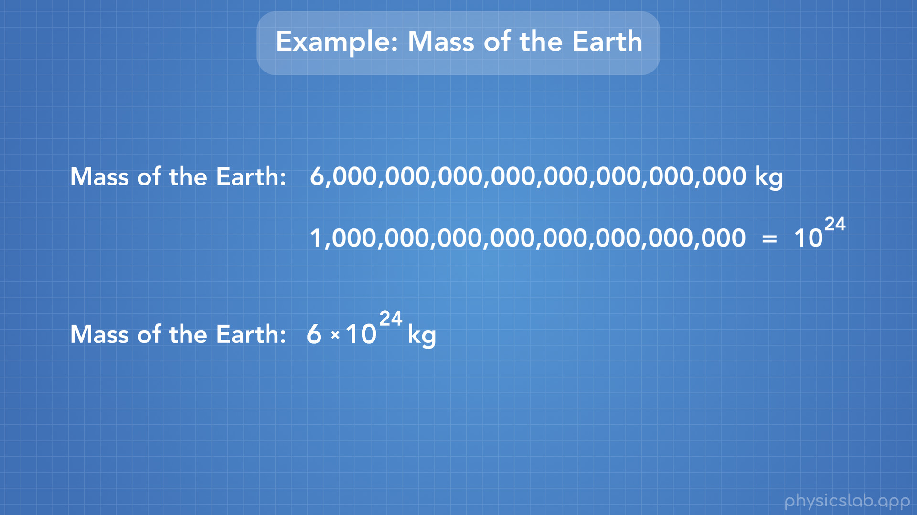
Notes:
Well it’s just 6 times that really big number, so we can write 6 x 10^24. And this right here is scientific notation.

Slide 38
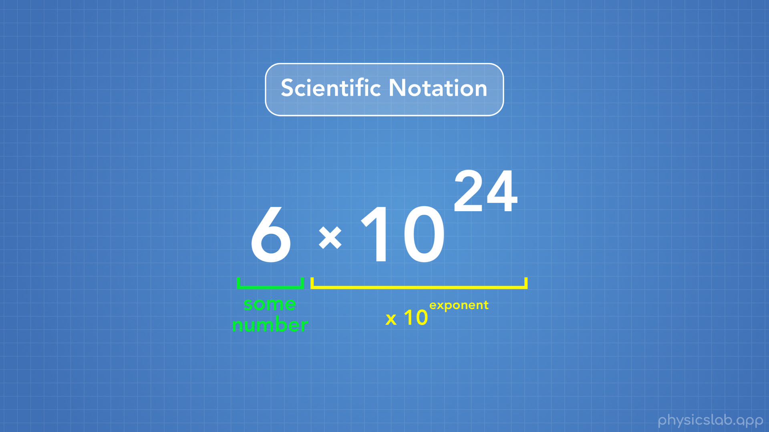
Notes:
This is what scientific notation looks like. We have some number multiplied by 10 to some exponent, and that exponent can be either positive or negative.

Slide 39
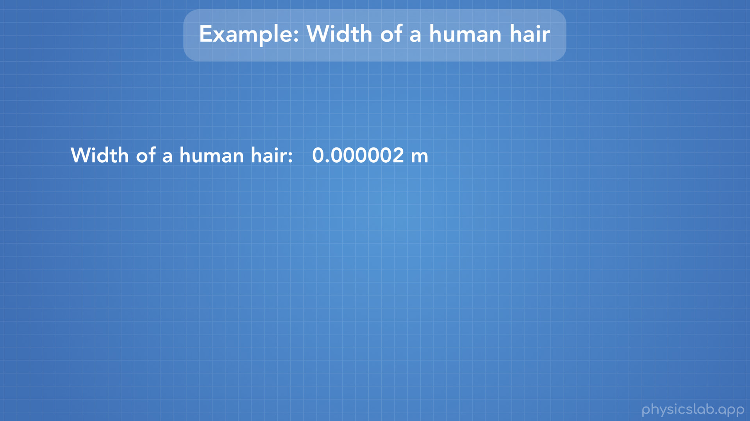
Notes:
Let’s take a look at one more example. This number here is the width of a human hair, in units of meters. It’s really small: 0.000 002 meters. How can we write this using scientific notation

Slide 40
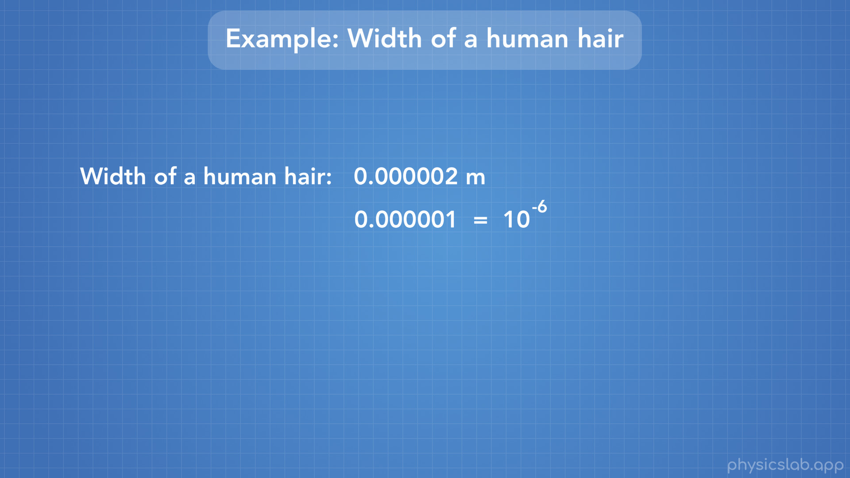

Slide 41
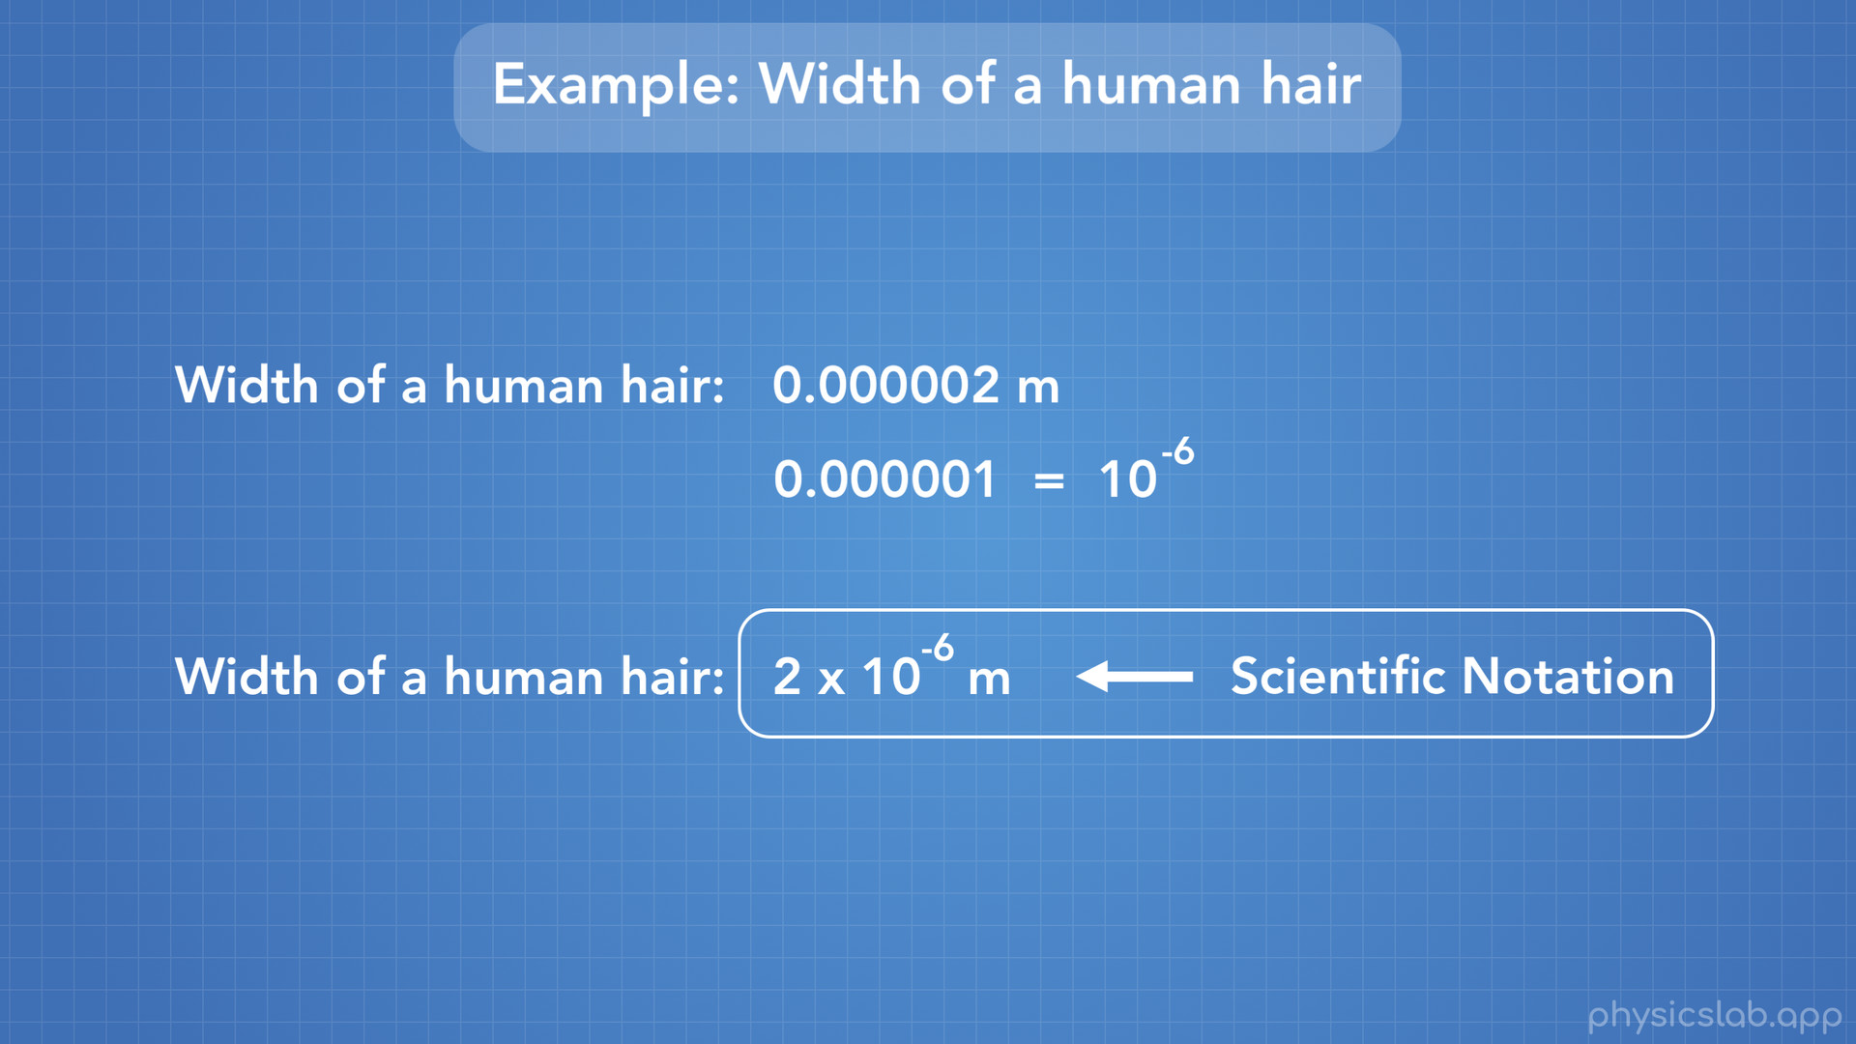
Notes:
Well if we’re given that this number is equal to 10 to the negative 6th power, then the width of a human hair is just 2 times that number, or 2 x 10 ^-6th. And there we have a small number written in scientific notation using a negative exponent.

Slide 42
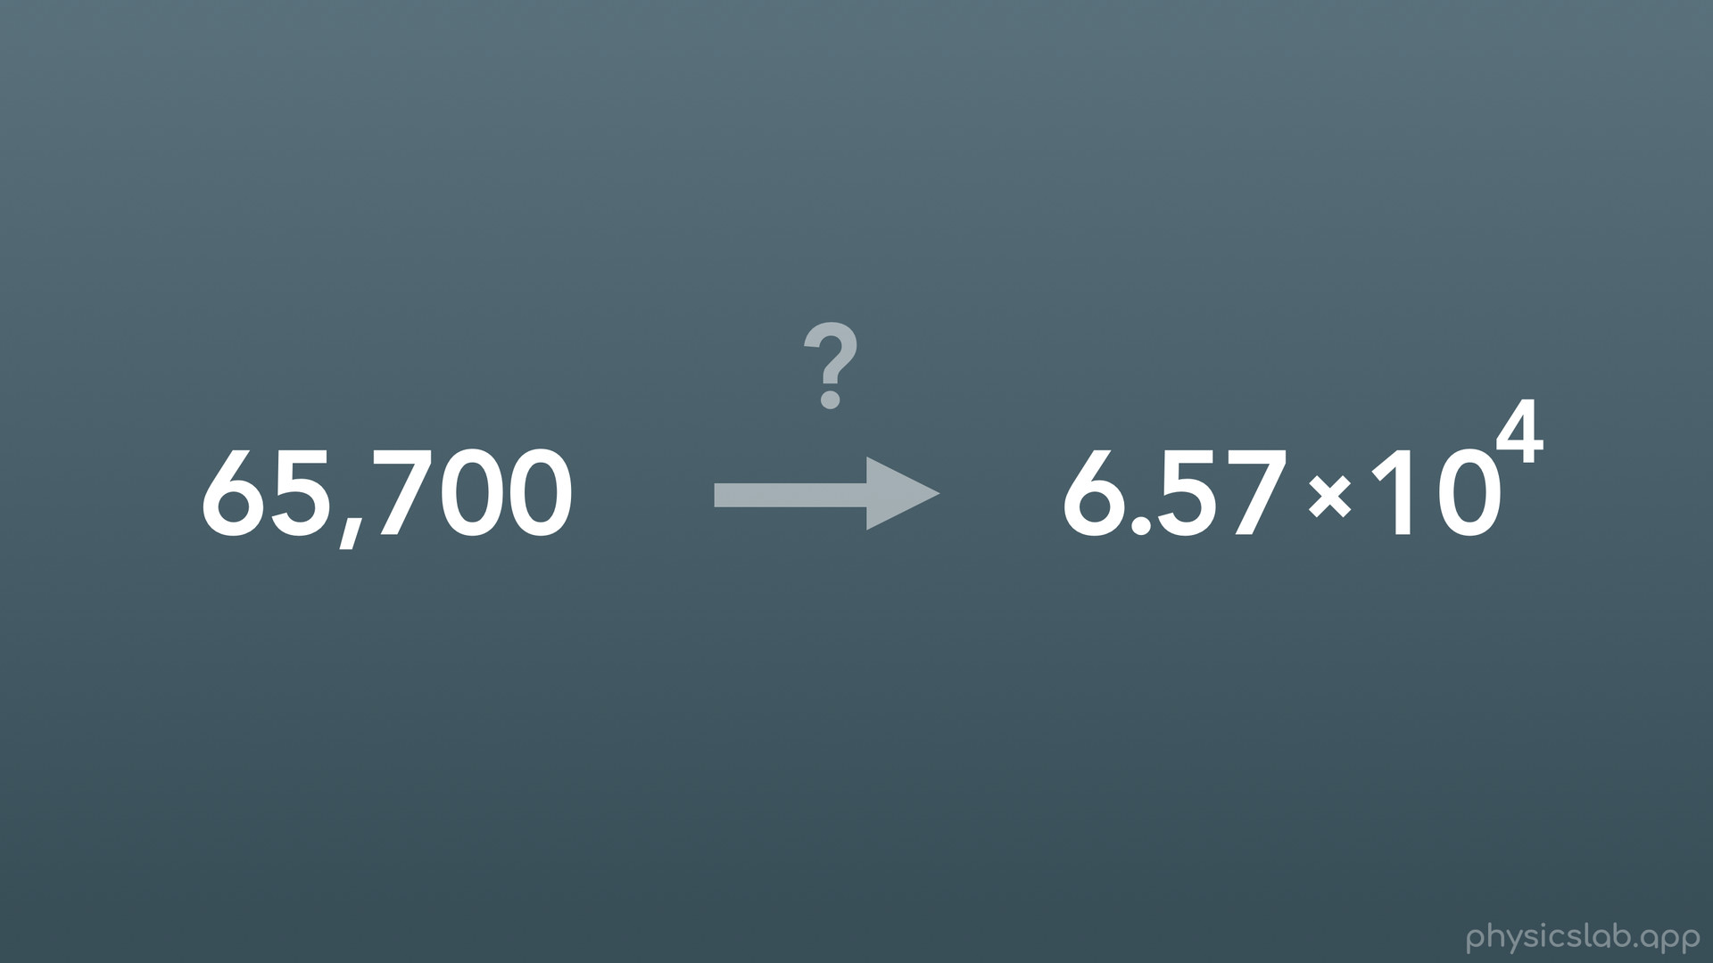
Notes:
Alright, so is there an easy way to take a number and write it using scientific notation? There is, and this is all you really need to remember.

Slide 43
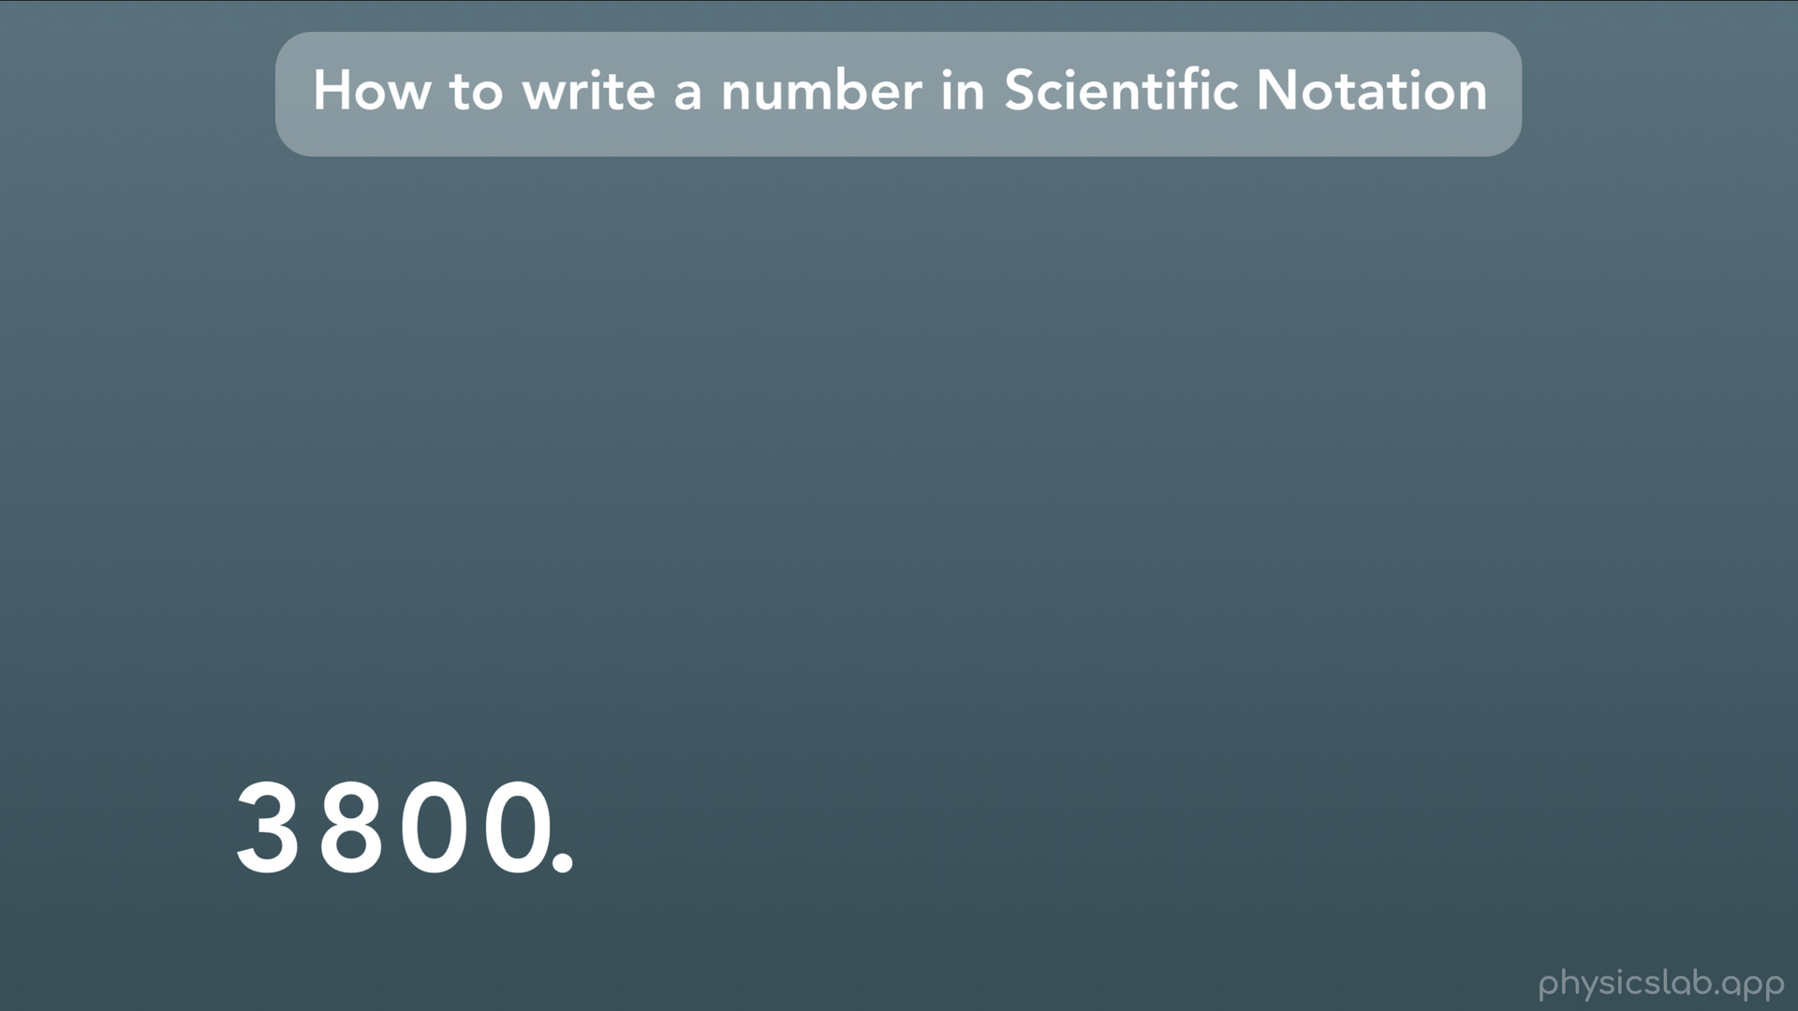
Notes:
The trick is to move the decimal, and count how many times you move it. Let’s walk through it using this number: 3800.

Slide 44
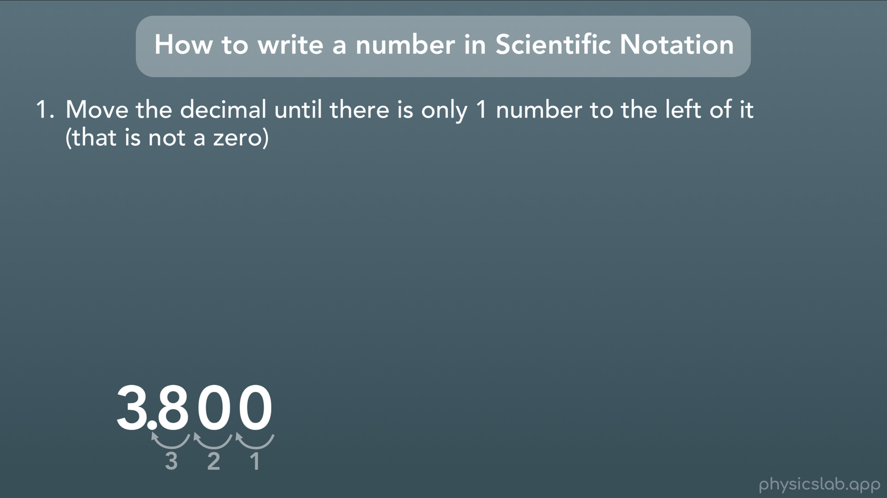
Notes:
First, we’re going to move the decimal until there is only 1 number to the left of the decimal. Something to remember here is that sometimes there isn’t a decimal written down, because it’s implied. In our case, the decimal would be here at the end of our number 3800. Any farther left or right, and it wouldn’t be the same number. So, we want to move the decimal one digit at a time until there is only 1 digit to the left of the decimal. In this case we’ll move it left 1 digit, 2 digits, 3 digits, and we’re done.

Slide 45
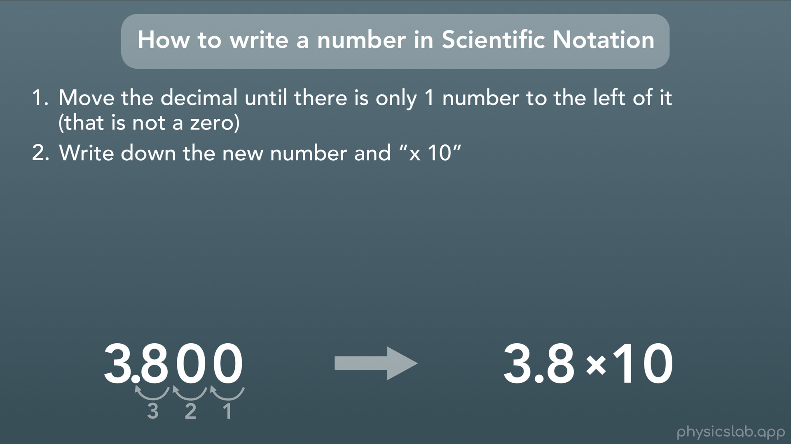
Notes:
Next, we write down that new number and we multiply it by 10, which is how we write scientific notation. All we’re missing is the exponent above 10. (Technically we could include the 2 zeroes, but we don’t need to for this example.)

Slide 46
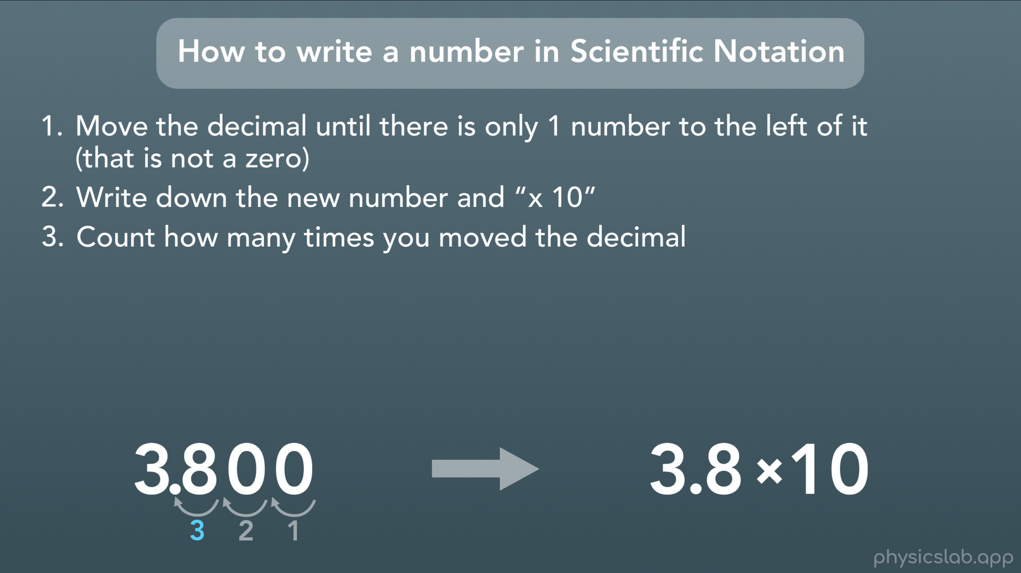
Notes:
The next step is to count how many times we moved the decimal. In our case we moved it 3 times.

Slide 47
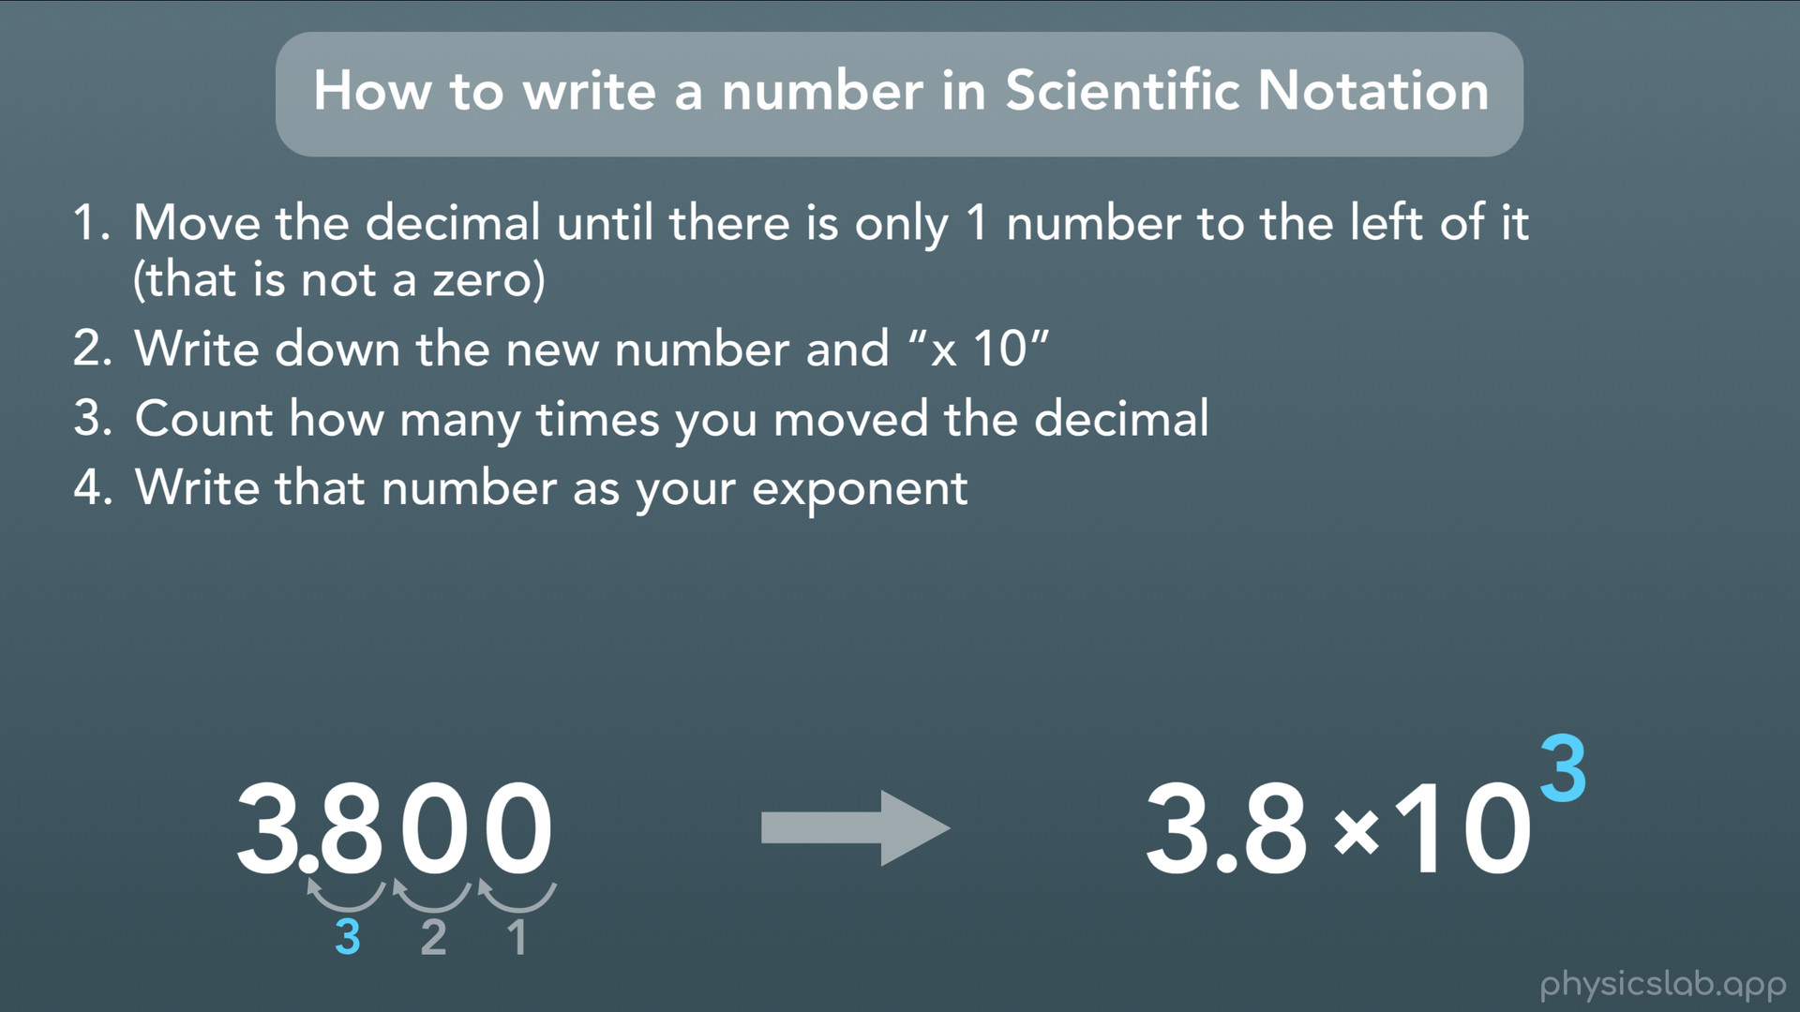
Notes:
Finally, we write that number as our exponent above the 10.

Slide 48
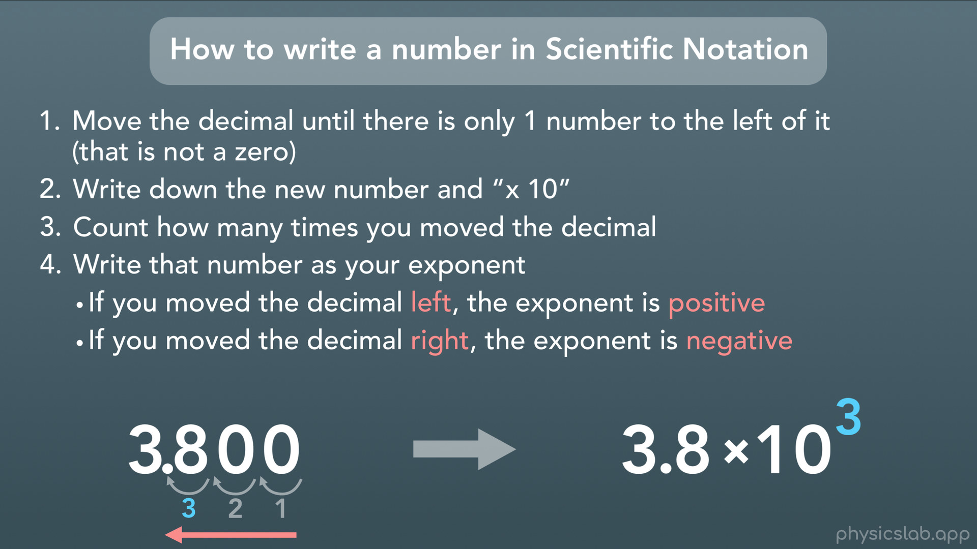
Notes:
So here we need to decide if this exponent is positive or negative, and here’s how we know: If we moved the decimal to the left, the exponent is positive. And if we moved the decimal to the right, the exponent is negative. In our case, we moved the decimal to the left, so the exponent is positive 3. This makes sense, because we learned that positive exponents are used for numbers larger than 1, and negative exponents are used for numbers smaller than 1, and 3800 is definitely larger than 1. Ok cool, so we took a number, 3800, and we re-wrote it using scientific notation, 3.8x10^3.

Slide 49
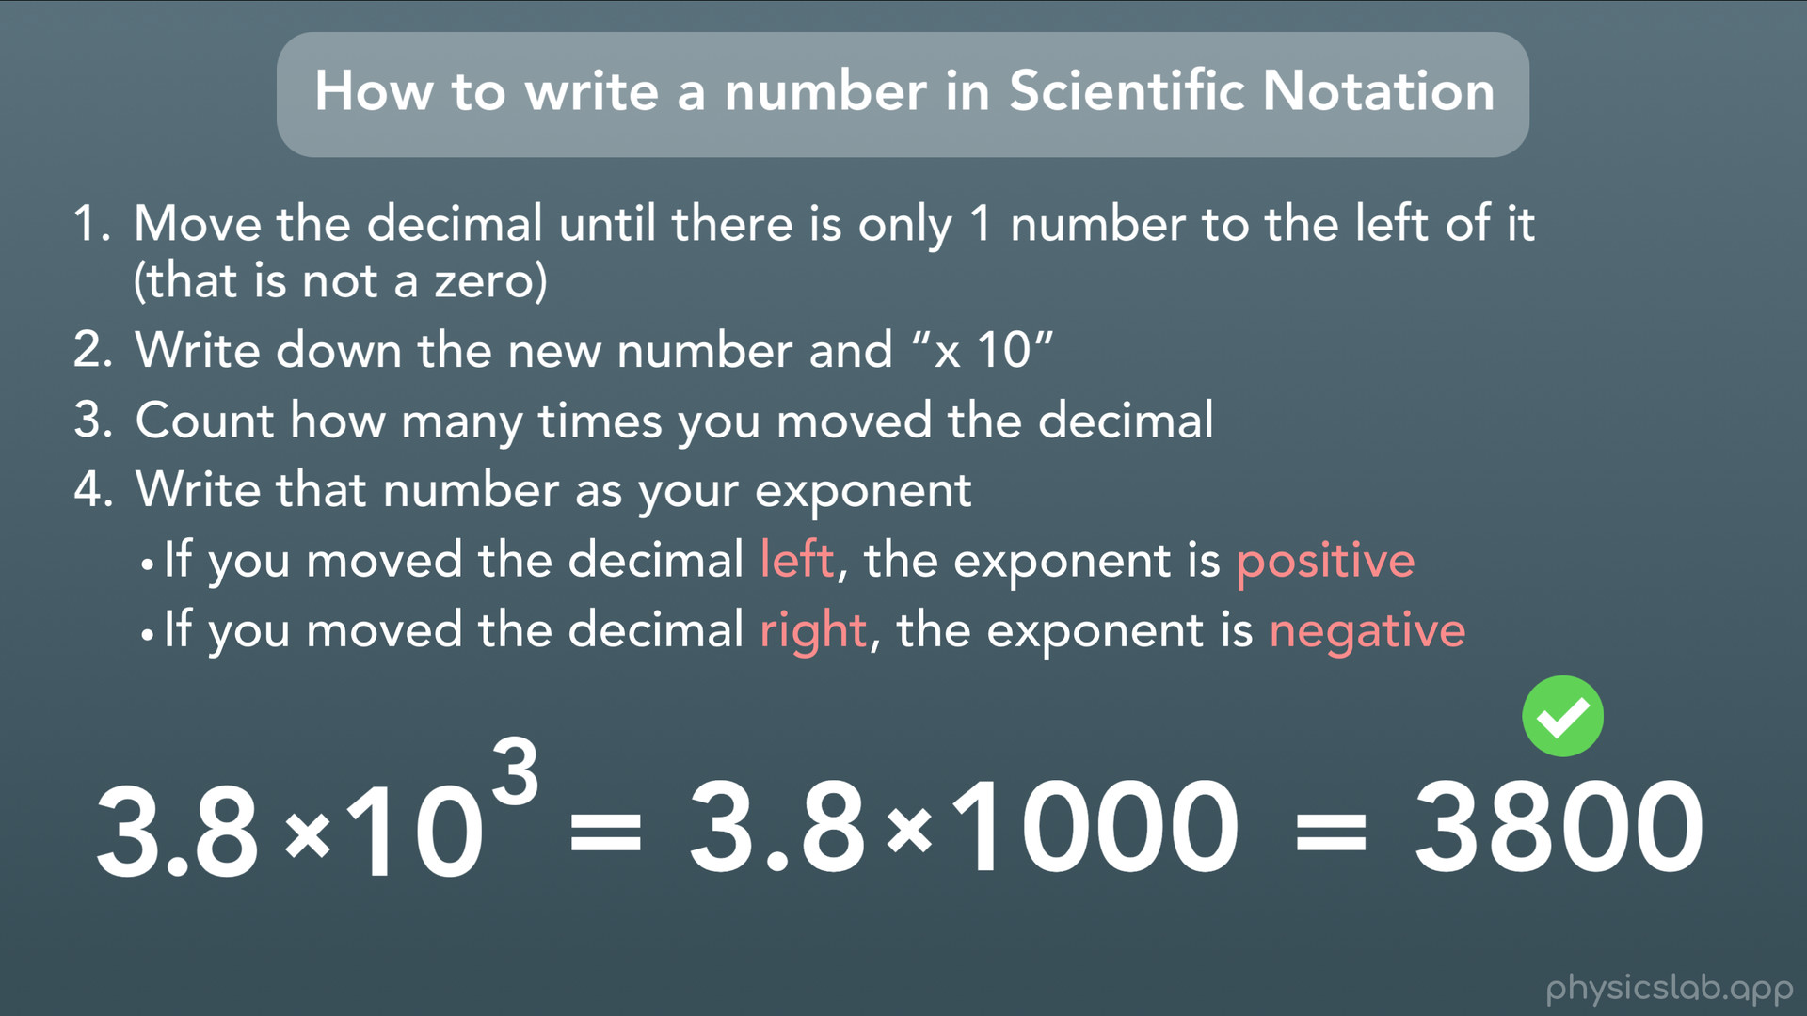
Notes:
This one was pretty simple, but there’s a quick way we can check to make sure we did it right. All we do is multiply 3.8x10^3 and see if we get our original number. You can use a calculator or reference the table earlier in the video, or you might just remember that 10^3 = 10x10x10 = 1000. 3.8x1000 = 3800, which is our original number, so we did it right.

Slide 50
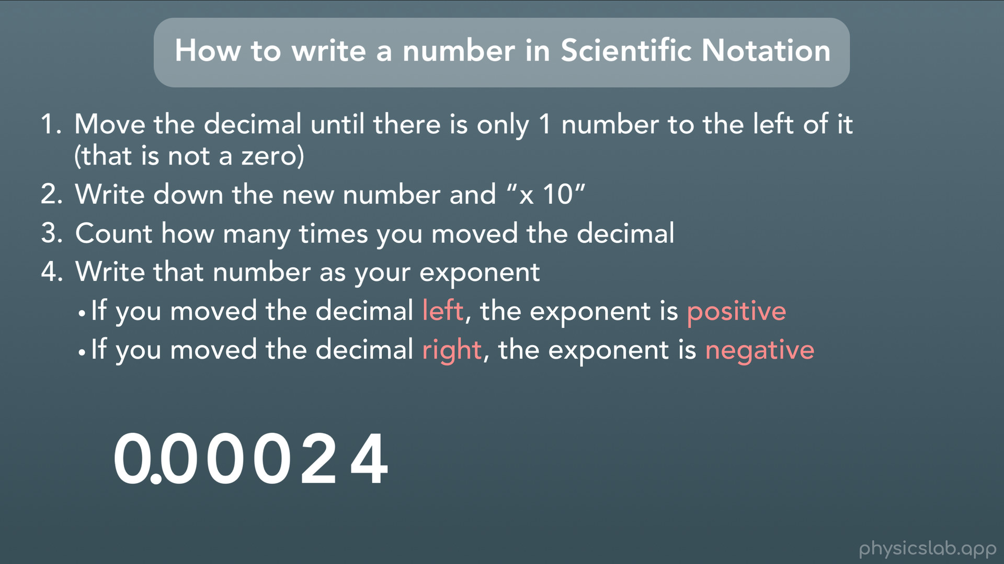
Notes:
Let’s try one final example, going the other way. Let’s use this number: 0.00024

Slide 51
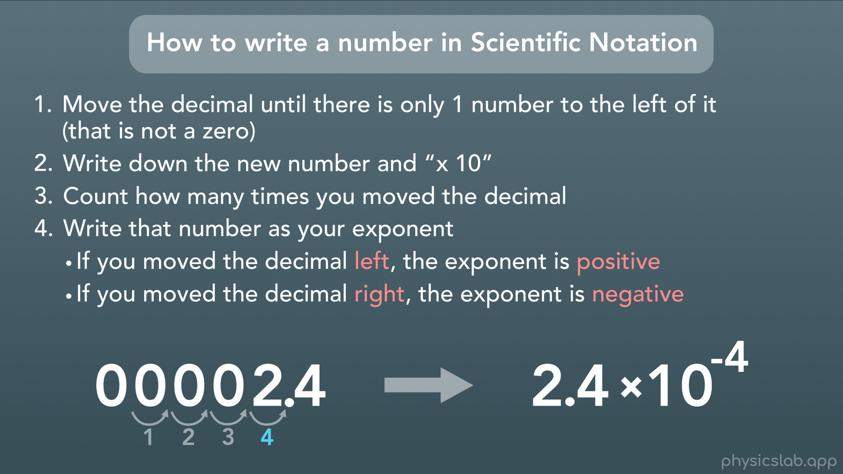
Notes:
First we move the decimal until there is only 1 number to the left of the decimal. Here we move it 1, 2, 3, 4 times until only one number (the 2) is to the left.
Next we write down this new number times 10.
Finally, we count the number of times we moved the decimal, which was 4 times, and write that as the exponent. But this time, we moved the decimal to the right, so our exponent is negative. So there we go, 0.00024 written in scientific notation is 2.4x10^-4.

Slide 52
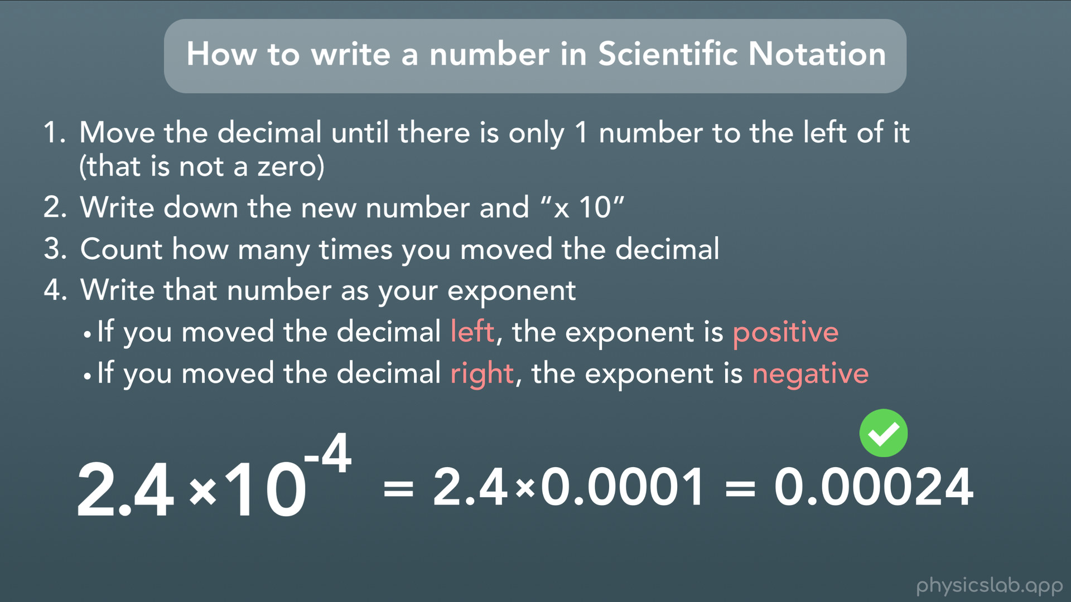
Notes:
And if we put that into our calculator, we’ll get our original number.

Slide 53
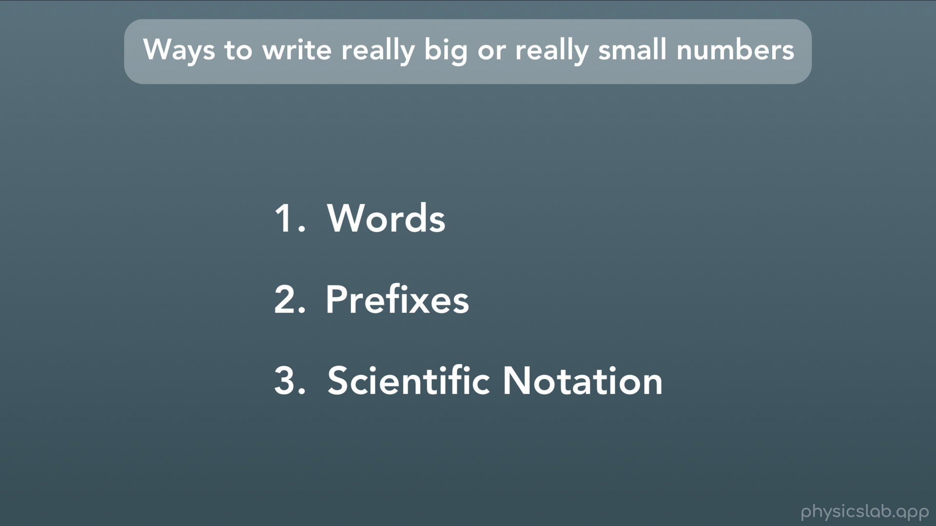
Notes:
So to sum it up, here are the ways we can write really big or small numbers. We can use words, prefixes, or scientific notation.

Slide 54
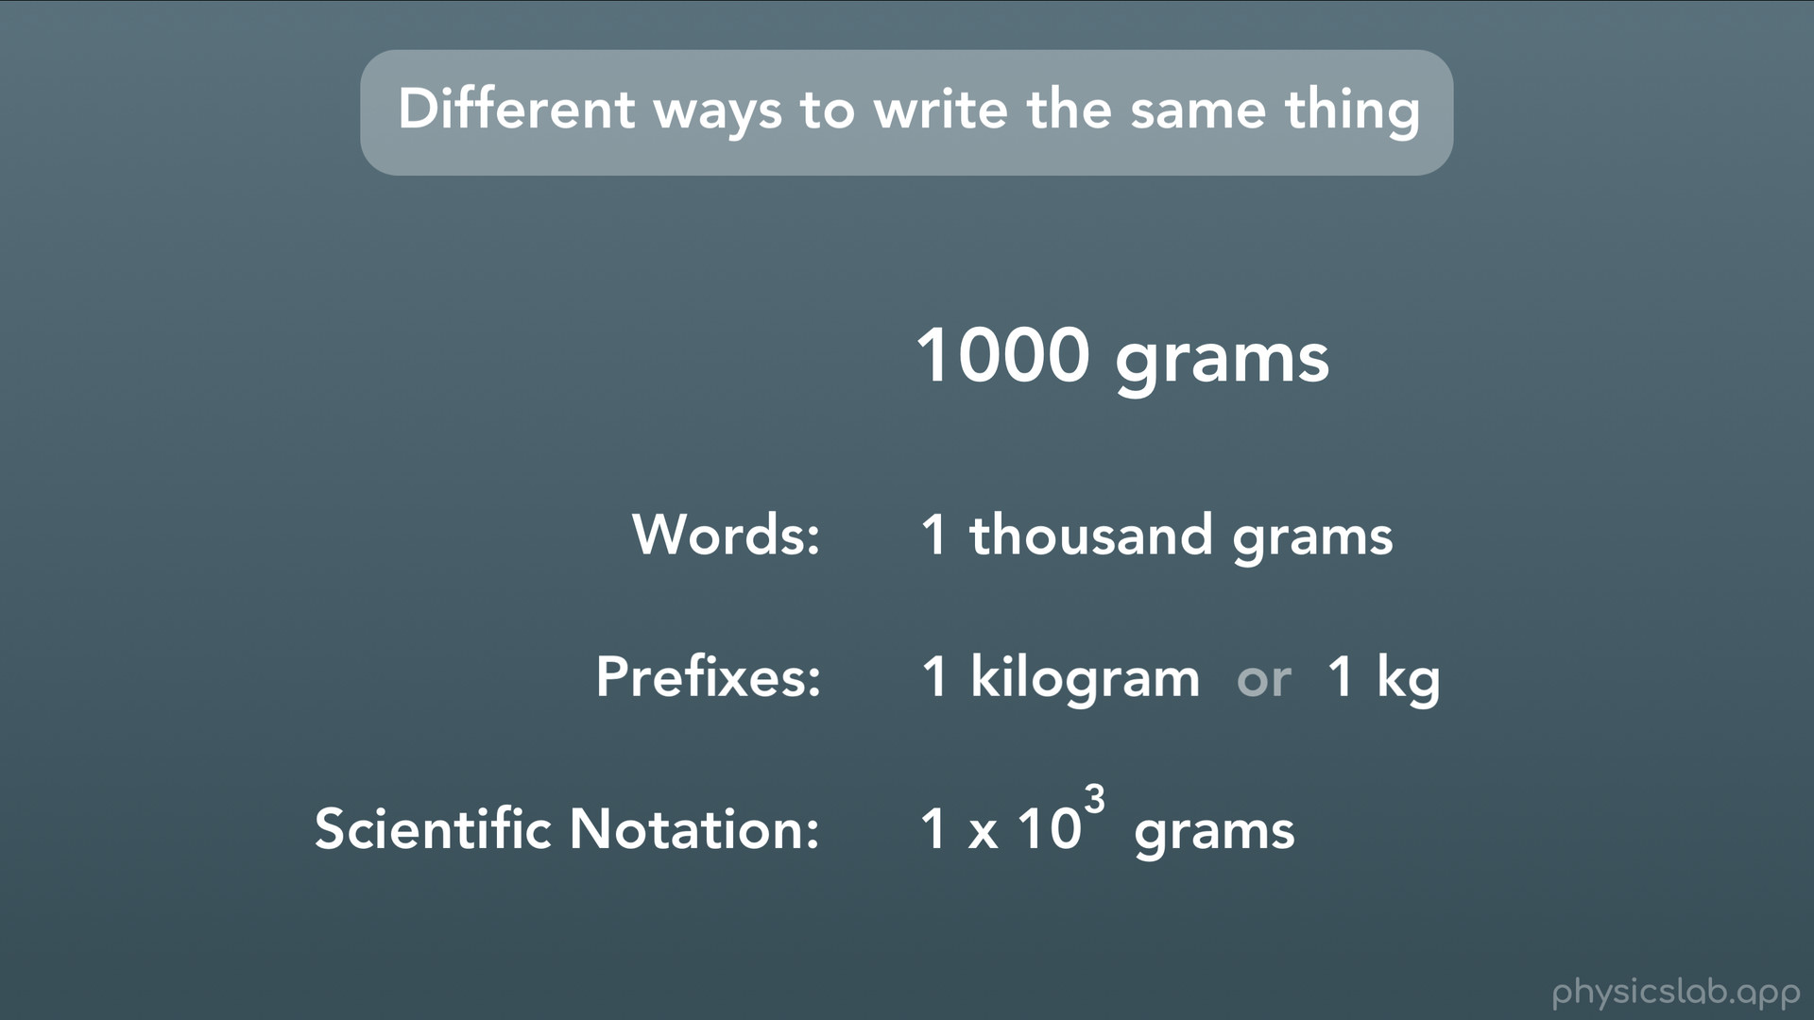
Notes:
And as an example, here’s how we can use all three to represent: this. We can write 1 thousand grams, we can use a prefix and write 1 kilogram, or we can use scientific notation and write 1x10^3 grams.

Slide 55

Notes:
Alright that was a lot of stuff, so let’s recap.

Slide 56
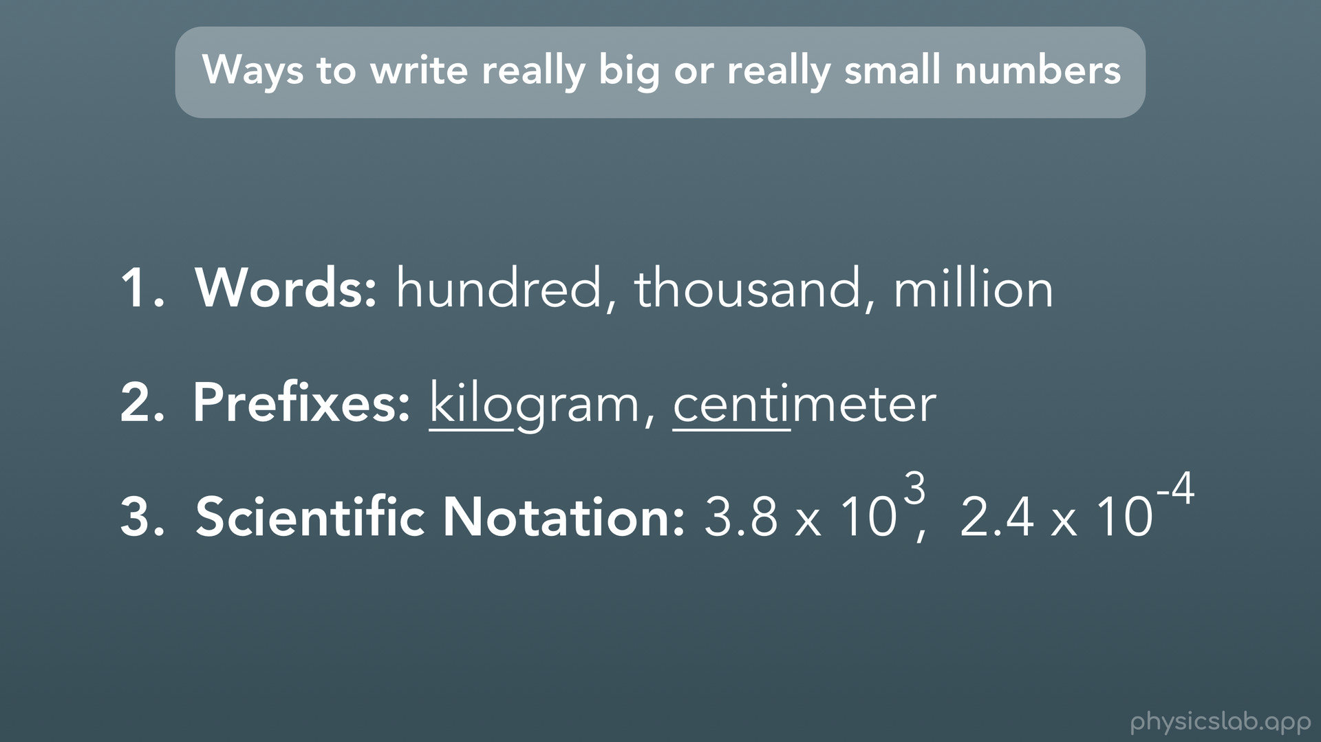
Notes:
We covered different ways that we can write really large or small numbers: words, prefixes and scientific notation.

Slide 57

Notes:
We learned how to write a number using scientific notation.

Slide 58

Notes:
And we have a nice handy table that shows lists some of the prefixes, their symbols, and the exponents we’d use for scientific notation.

