Slide 1


Code of Conduct & Compliance for MF Distributors
Omnicompounding Enterprises Pvt. LTD.
AMFI Registered Mutual Fund Distributor
ARN-328218

Slide 2

Session Overview
1
Decoding Mutual Fund Category Naming Rules
2
Ethics & Conduct for MF Distributors
3
AMFI Guidelines on Illustrations in Marketing Material (Non-Scheme Materials)
4
Rules for Performance-Based Advertisements
5
SEBI Guidelines in Relation to Unsuitability of Product
6
Cooperation in Due Diligence
7
Q&A

Slide 3
Nomenclature Circular
Use only the term "Mutual Fund Distributor" on visiting cards, social media, and communications.
Do NOT use terms like: Financial Advisor, Wealth Manager, Investment Consultant (unless separately certified/licensed).
Example: Writing "Financial Advisor" on your visiting card without SEBI RIA registration is a violation.
Purpose: Avoid misleading investors regarding roles and responsibilities.

Slide 4






Code of Conduct
Follow AMFI Code of Conduct and Ethics.
Always disclose product risks to clients.
Avoid mis-selling or promising guaranteed returns.
Example: Recommending a small-cap fund to a retired investor without risk explanation is a violation.
Maintain transparency about commissions and fees.
Maintain client confidentiality and avoid front-running or insider activities.

Slide 5
AMFI Guidelines - Non-Scheme Illustration Usage
Only use AMFI-approved calculators or brochures for return projections.
Avoid phrases like “double your money in 5 years” or “safe and assured.”
Example: If sharing a SIP illustration, clearly mention it is only a projection and not an assurance.
All marketing materials must include the standard mutual fund disclaimer.

Slide 6

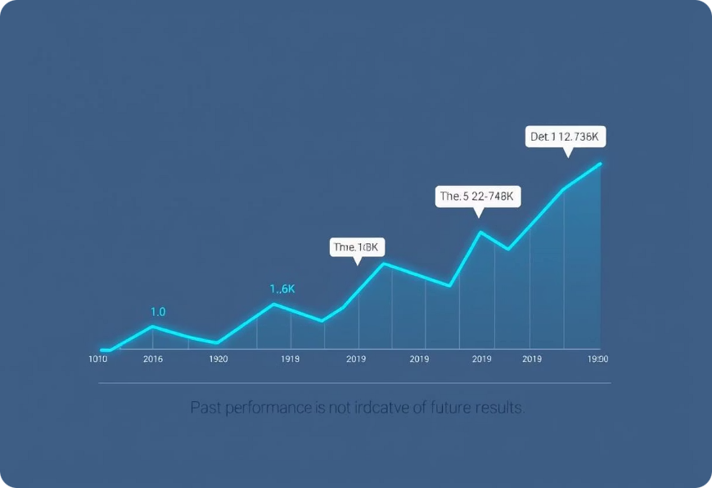
Disclosure of Performance in Advertisement
Display 1-year, 3-year, and 5-year returns (CAGR) with benchmarks.
Mention: “Past performance is not indicative of future returns.”
Example: While promoting an ELSS scheme, show actual fund returns versus benchmark and clearly highlight volatility.
Disclose all expenses (TER, exit loads, etc.).

Slide 7
SEBI Guidelines - Unsuitability of Product
Assess client’s risk appetite and investment horizon.
Maintain risk-profiling documents as proof of suitability.
Example: Don’t recommend sectoral or thematic funds to a conservative investor aiming for capital preservation.
Educate clients about associated risks and alternatives.

Slide 8
Product knowledge requirement
SID – Scheme Information Document
SAI – Statement of Additional Information
KIM – Key Information Memorandum
Explain scheme features and associated risks.

Slide 9




Cooperation in Due Diligence
Participate in internal audits, compliance checks, and training.
Keep documents like ARN renewal, KYD, and certifications updated.
Example: If requested for transaction audits or client communication review, respond promptly.
Report suspicious transactions (as per PMLA norms).

Slide 10

Q & A

