Slide 1
Connecting Circular and Rotational Motion
Slides Version 2
This version includes:
Slides with screenshot images from the video.
The video narration in the slide notes.
A blank template slide with the same background and font as the video.
Slides with some basic graphics from this video for you to use however you like.
Feel free to add, delete and edit slides to make your own presentation. You can use these slides in class or share them with your students, but please do not share them with anyone else.
If you have any feedback, suggestions or questions about these slides please email me at chris@physicslab.app or send me a message on Discord @physicslab.
physicslab.app

Slide 2
Heading
Text

Slide 3











Slide 4














Slide 5









Slide 6
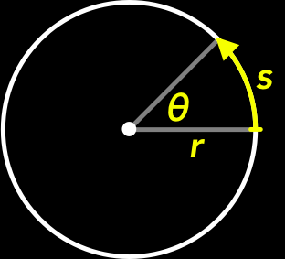
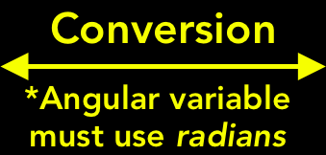


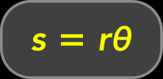




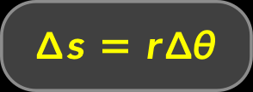



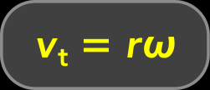







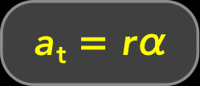



Slide 7
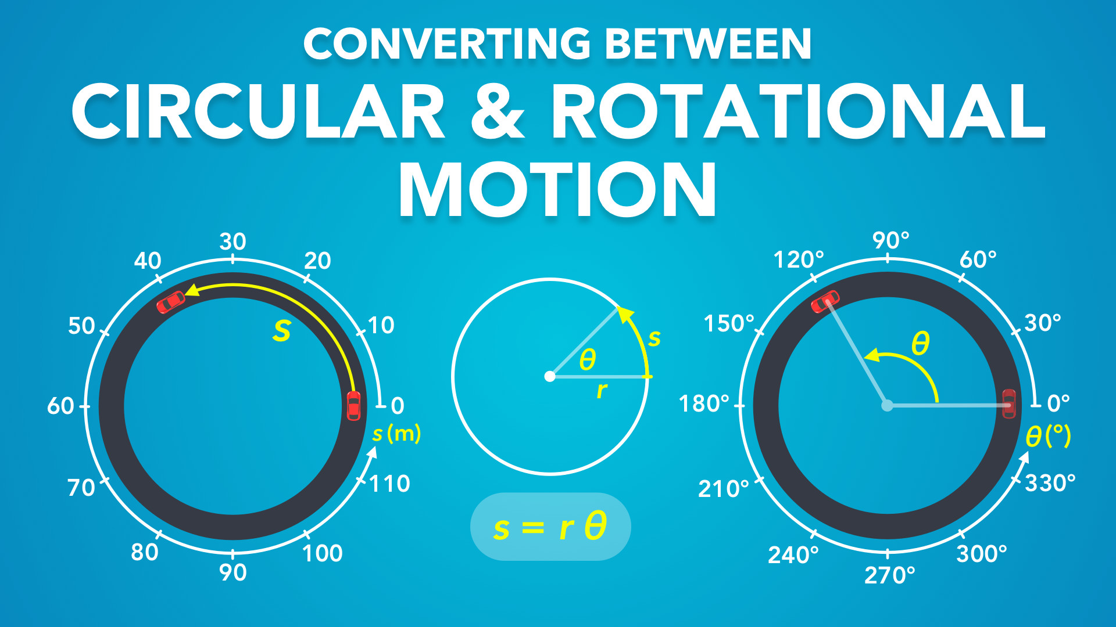
Notes:
Connecting Circular & Rotational Motion
physicslab.app
If you have any questions, suggestions or feedback about these slides please email me at chris@physicslab.app or send me a message on Discord @physicslab.

Slide 8
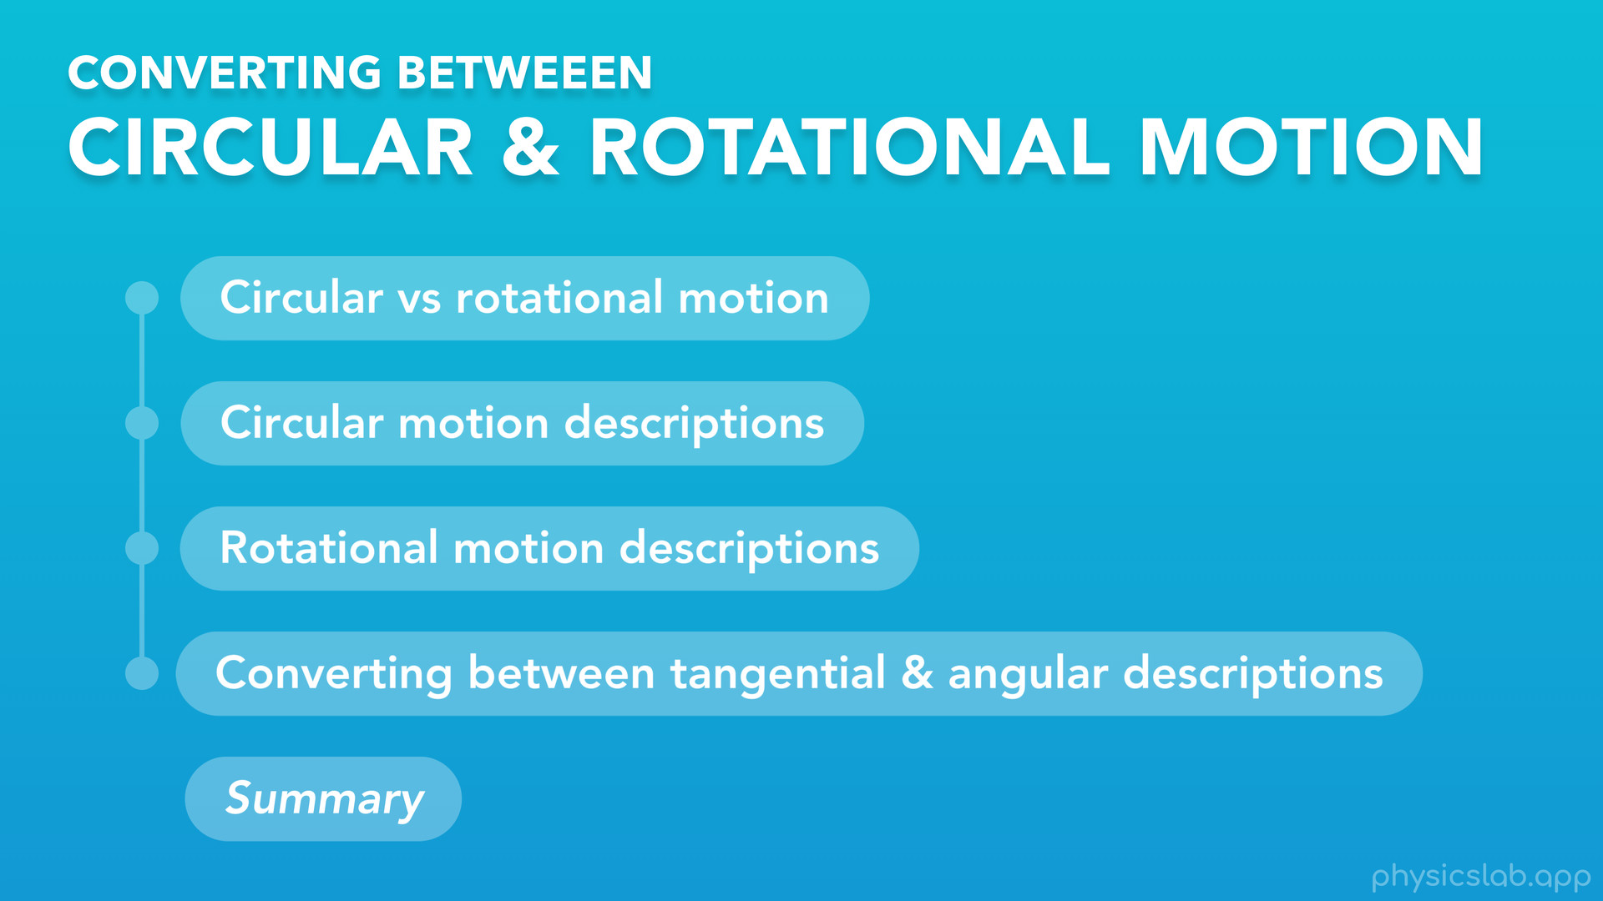
Notes:
○ Hey everyone, in this video we’re gonna talk about the tangential and angular descriptions of motion that we learned about in the previous videos, and how exactly they tie into circular and rotational motion. This topic can get a little confusing, so let’s review how everything is related and introduce a few more things.

Slide 9
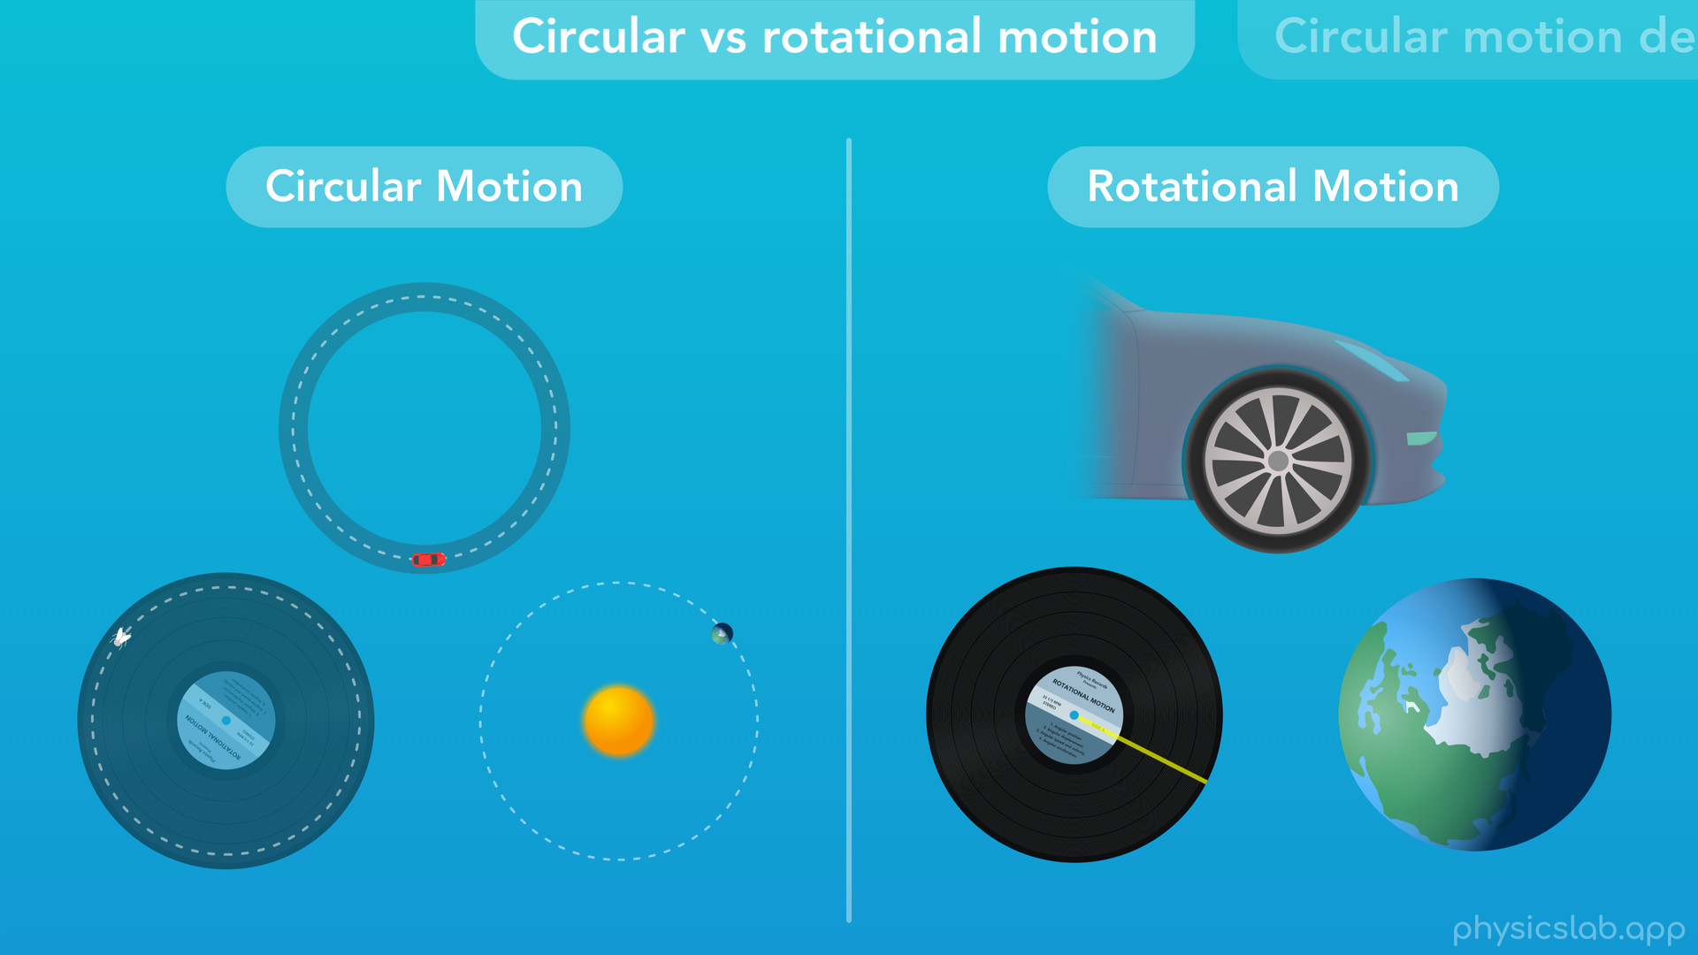
Notes:
○ First, we’ll review the difference between circular and rotational motion.

Slide 10
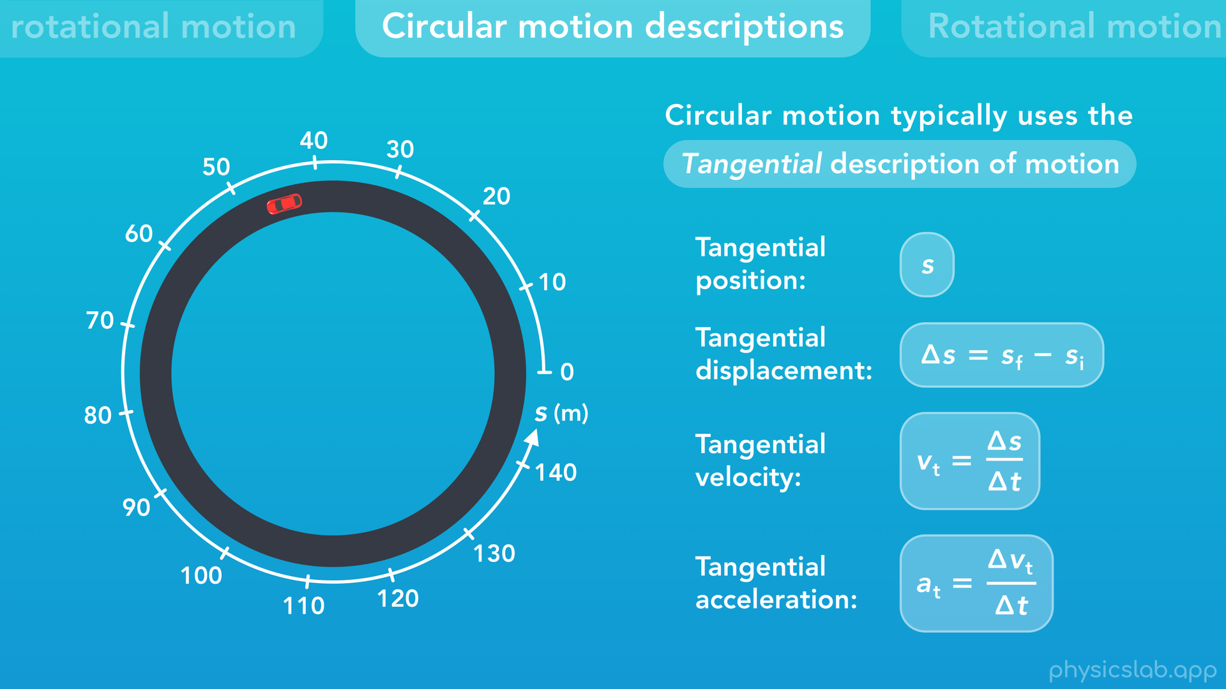
Notes:
Then we’ll talk about the circular motion descriptions…

Slide 11
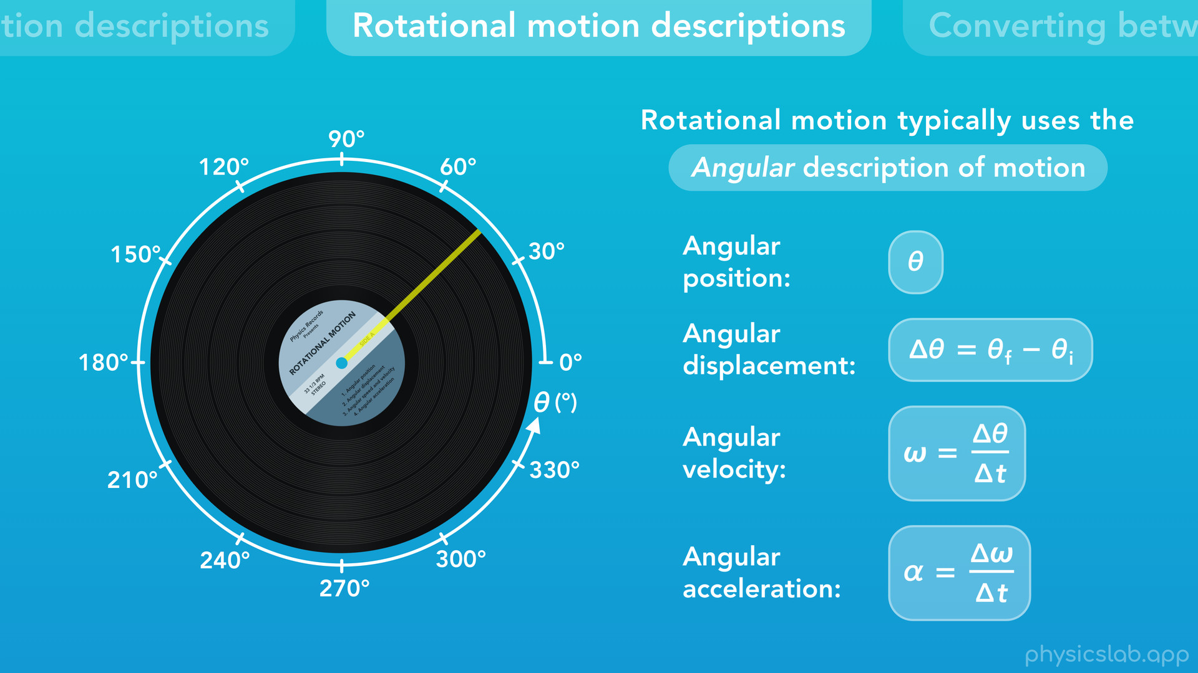
Notes:
the rotational motion descriptions…

Slide 12
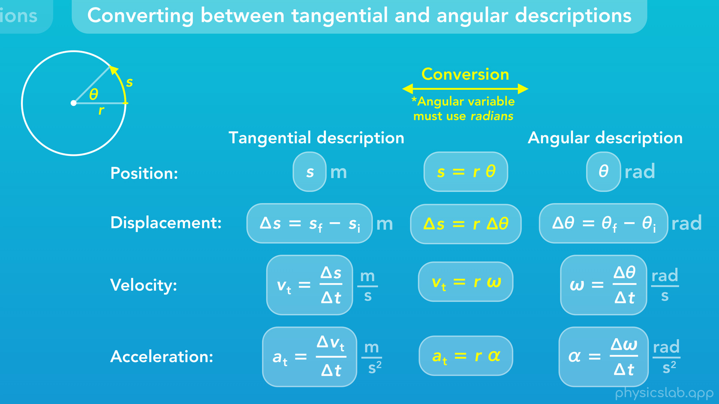
Notes:
and then converting between the tangential and angular descriptions.

Slide 13
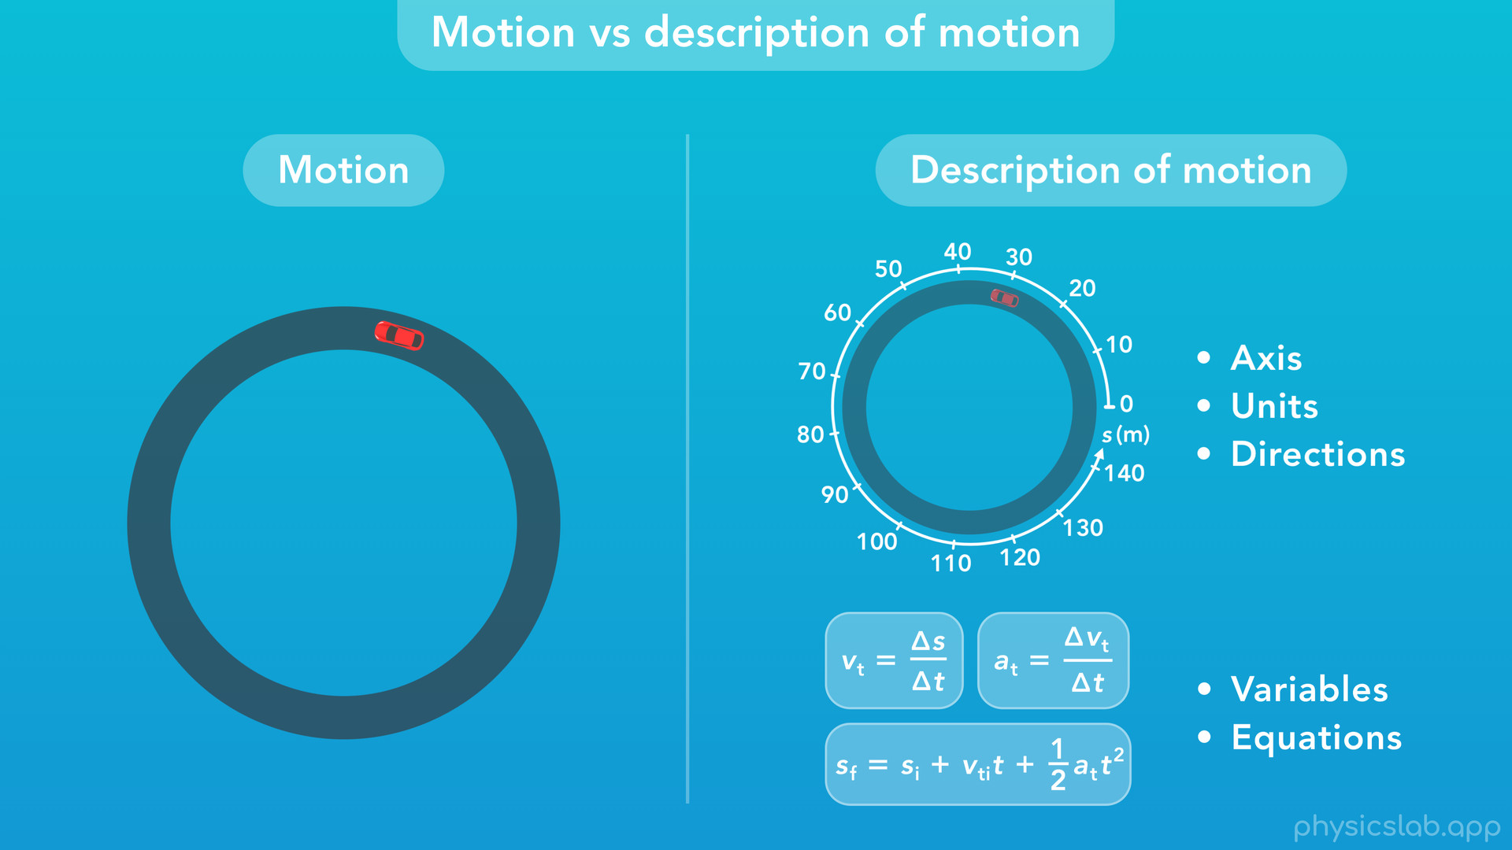
Notes:
○ Before we start, what do we mean by “description of motion”? Let’s look at this car driving in a circle. The motion is what the car is doing, what’s happening in the real, physical world.
○ The description of that motion is how we’re choosing to describe, measure or study the motion of the car. The description of motion includes the axis, the units and the positive and negative directions that we choose, so that we can describe this motion in a way that’s useful. Based on the description that we choose, we get some variables and equations that we can use to study that motion, do some math and solve problems.
○ So the motion is what’s actually happening with the car, and the description is the way we choose to study that motion. The car doesn’t care what description we choose, it’s gonna do the same thing either way.
○ The reason we’re distinguishing between the two is because there’s more than one way to describe a given motion. Depending on the situation or the problem we’re solving, we might choose one description or another, and we might need to convert from one description to a different one.

Slide 14
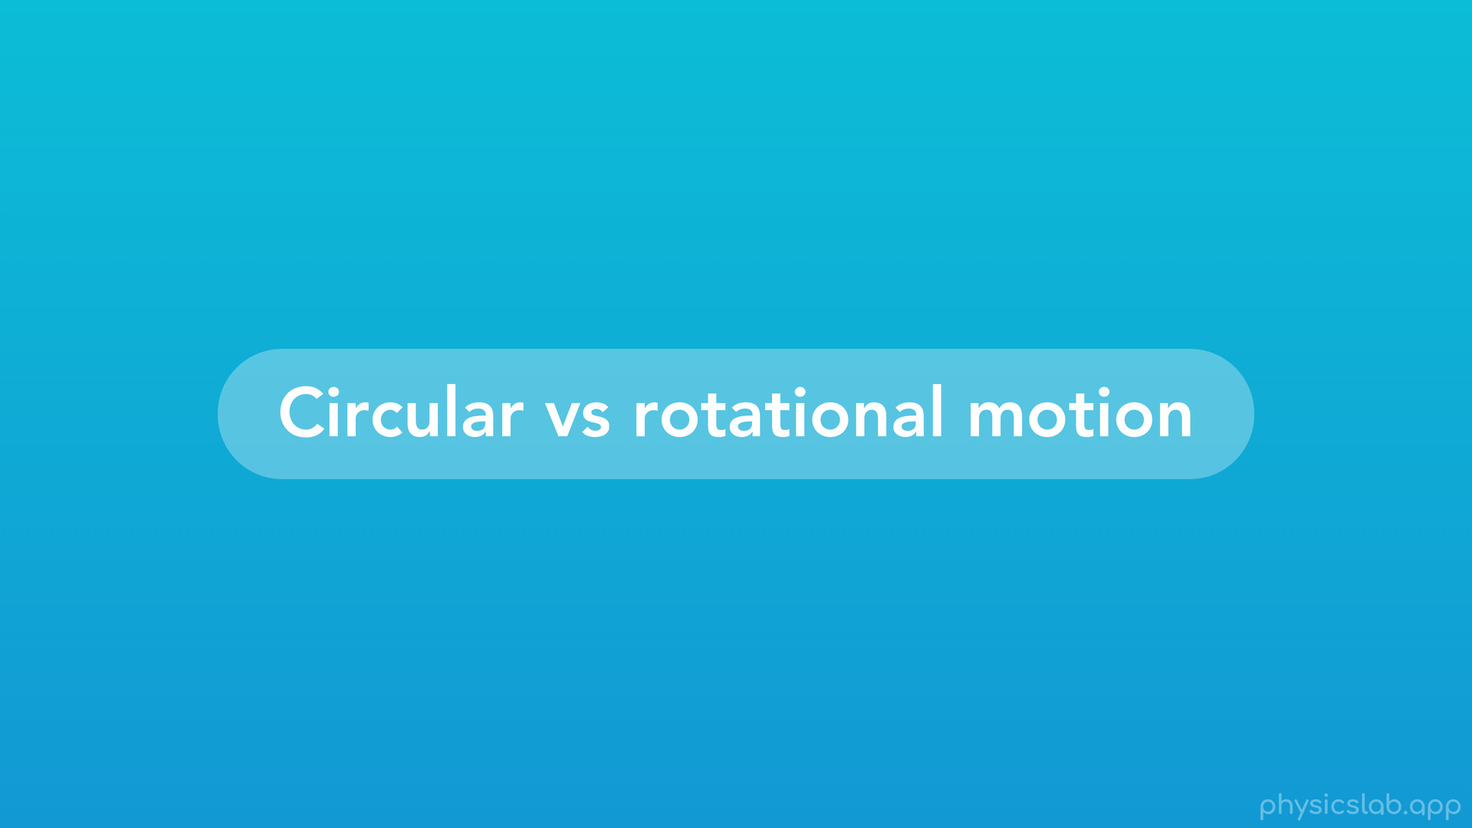
Notes:
○ Now, let’s quickly review the difference between circular and rotational motion. We’re talking about an object’s motion here, not the description of motion.

Slide 15
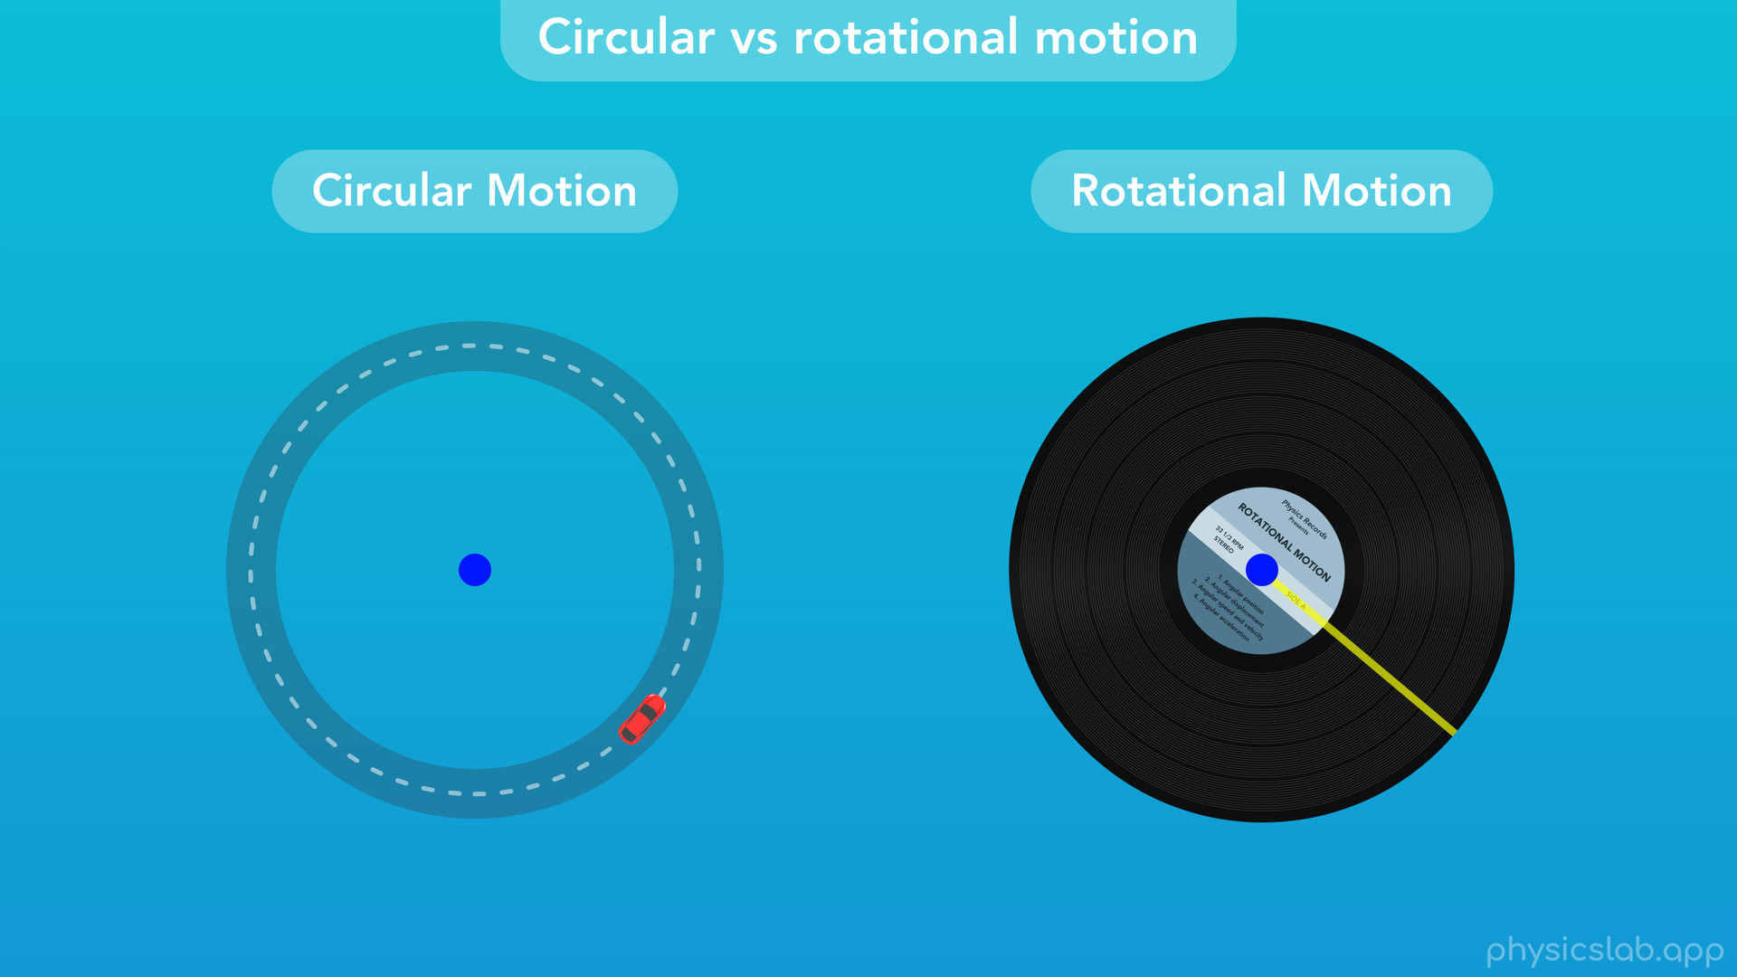
Notes:
○ With circular motion, an object follows a circular path centered on a point that is some distance away from the object. With rotational motion, an object is rotating around its own center, a point that lies on the object itself. We could say that the car on the left is translating through 2-dimensional space, while the record on the right is not translating, it’s only rotating.

Slide 16
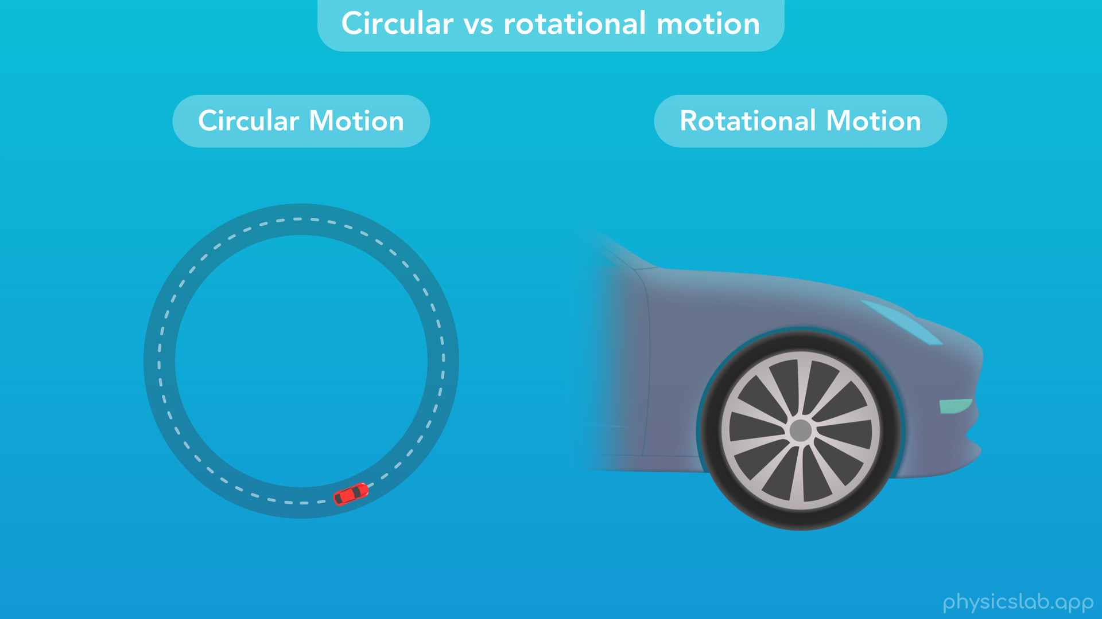
Notes:
○ The car on the left is in circular motion, but if we could look at one of the wheels and ignore the car, we would see that the wheel is in rotational motion.

Slide 17
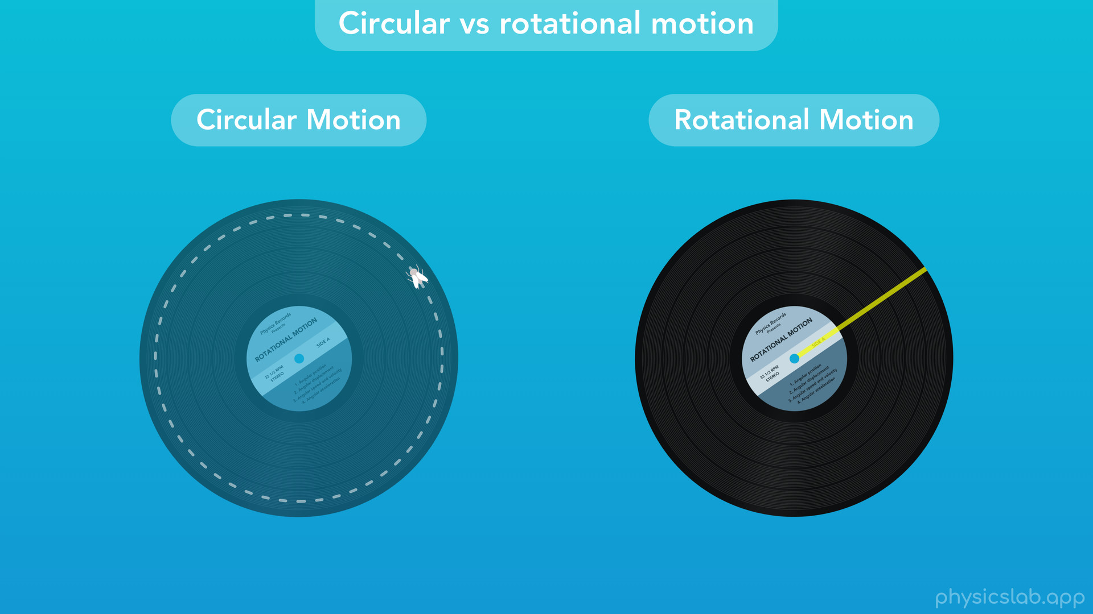
Notes:
○ We’ve seen that a record is in rotational motion while it’s being played. But imagine a small fly is sitting on the record. What’s the motion of the fly? The fly traces out a circular path, so the fly is in circular motion, while the record is in rotational motion.

Slide 18
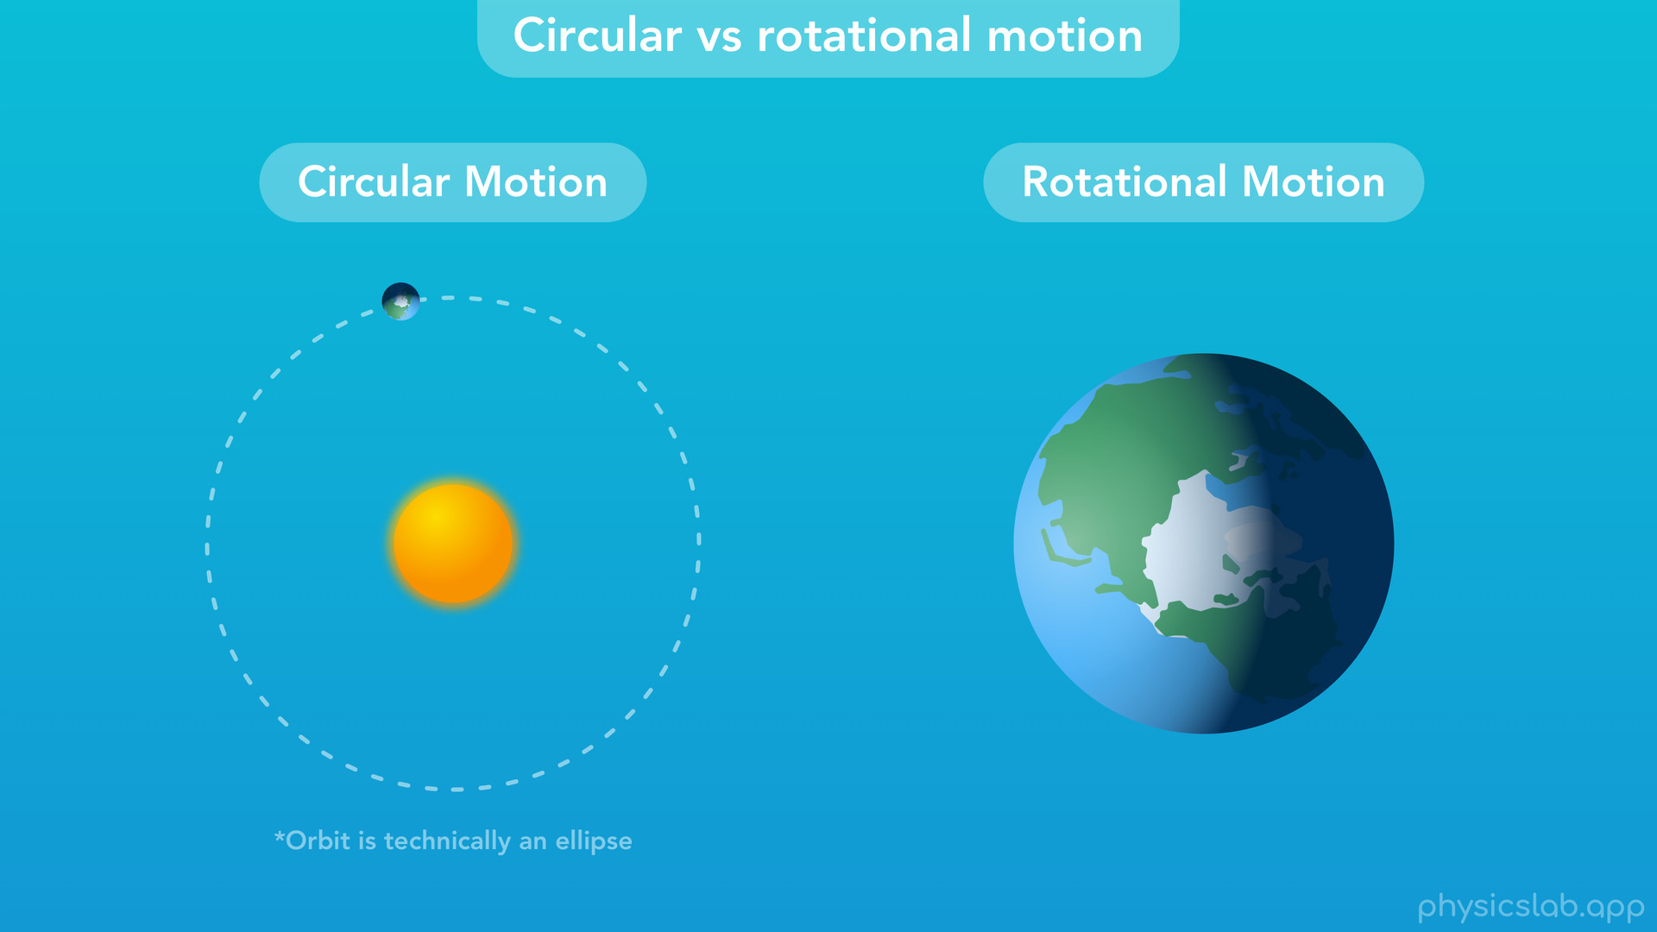
Notes:
○ The Earth orbits the sun once a year, and from this point of view the Earth is in circular motion around the sun. (Although technically the orbit is an ellipse). At the same time, the Earth rotates once a day around its own axis, so if we only look at the Earth, it’s in rotational motion.

Slide 19
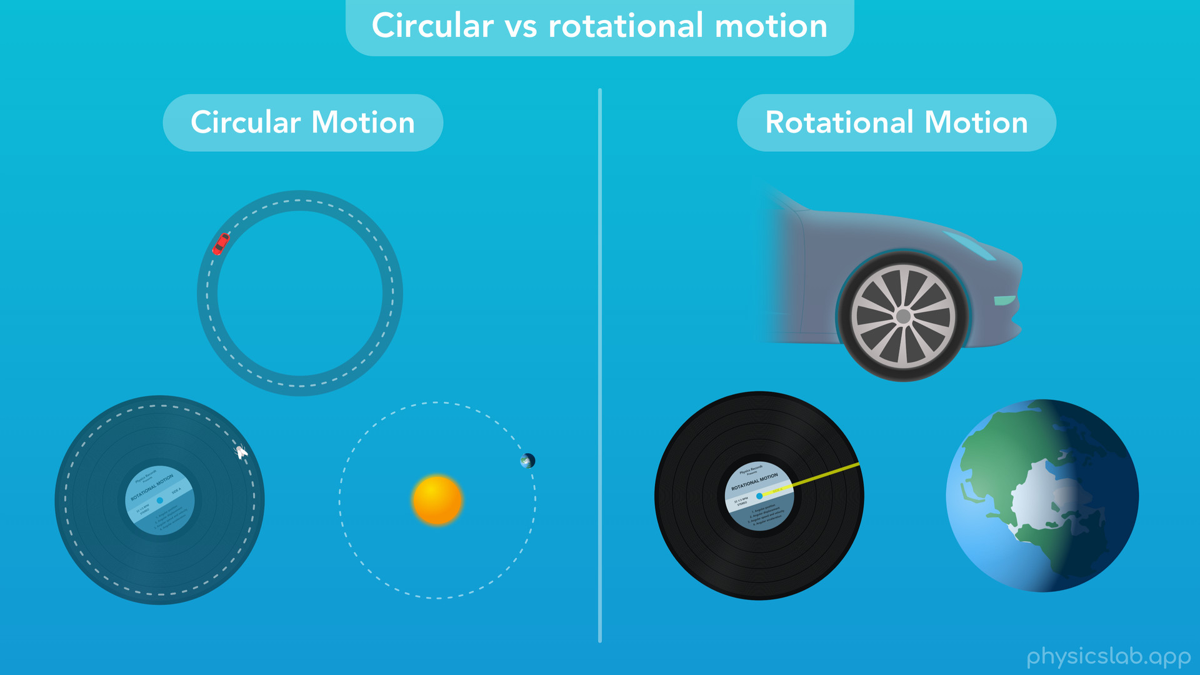
Notes:
○ So those are a few examples. The terms “circular “and “rotational” are only referring to the type of real, physical motion. Now, let’s talk about the descriptions of motion that can be used for each one.

Slide 20

Notes:
○ We’ll start with circular motion descriptions.

Slide 21
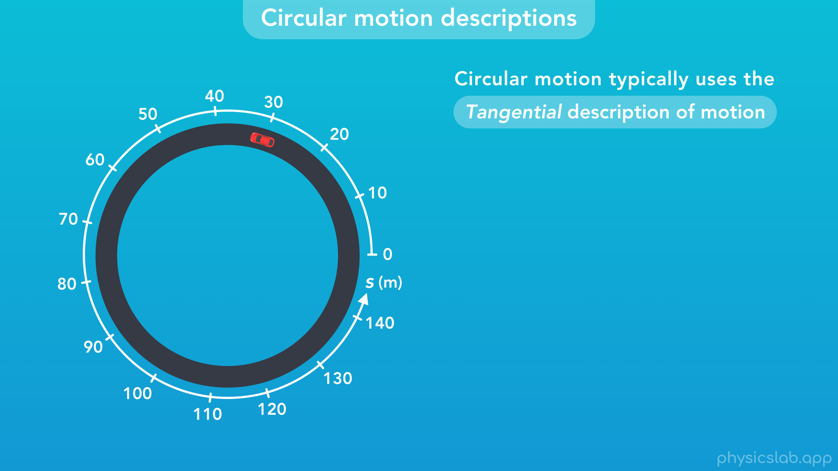
Notes:
○ Circular motion typically uses the tangential description of motion. That’s what we used in the video on circular motion.

Slide 22
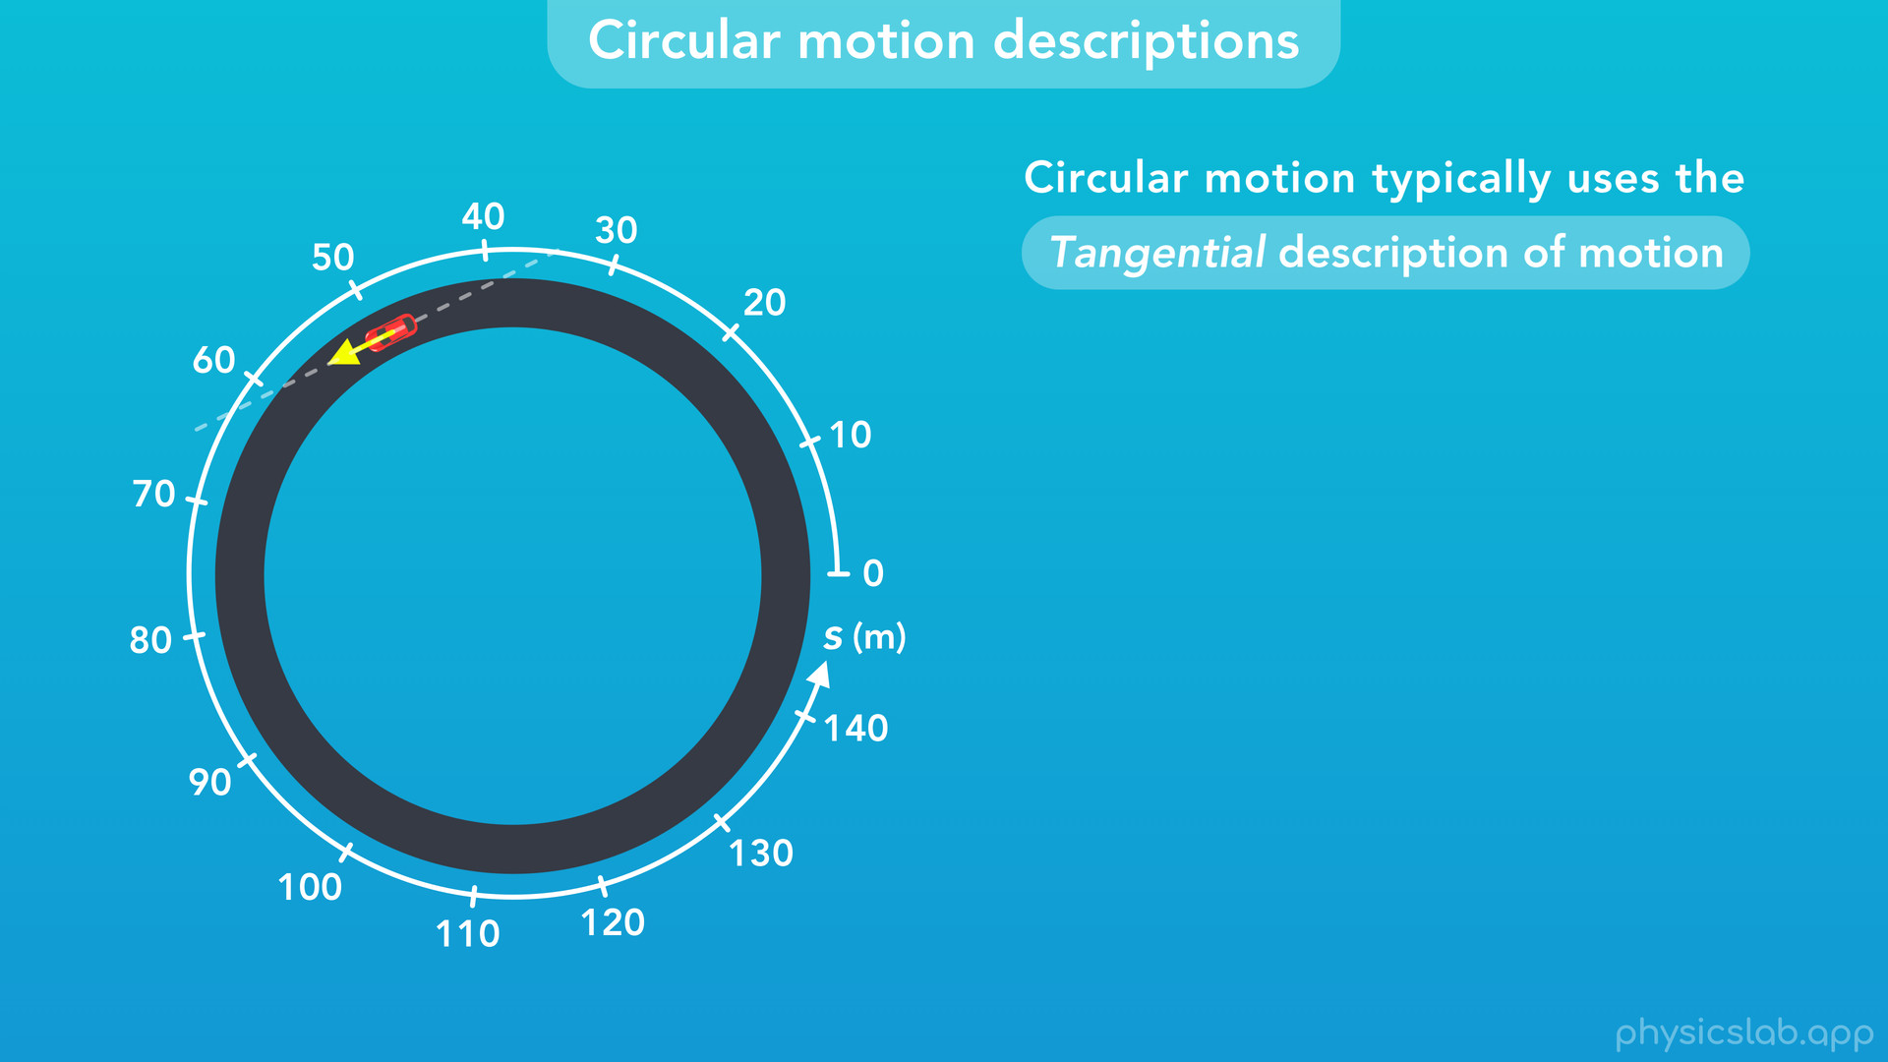
Notes:
The tangential description means we’re focusing on the path of the object around the circumference of a circle, and the direction of that motion is always tangential to the circle.

Slide 23
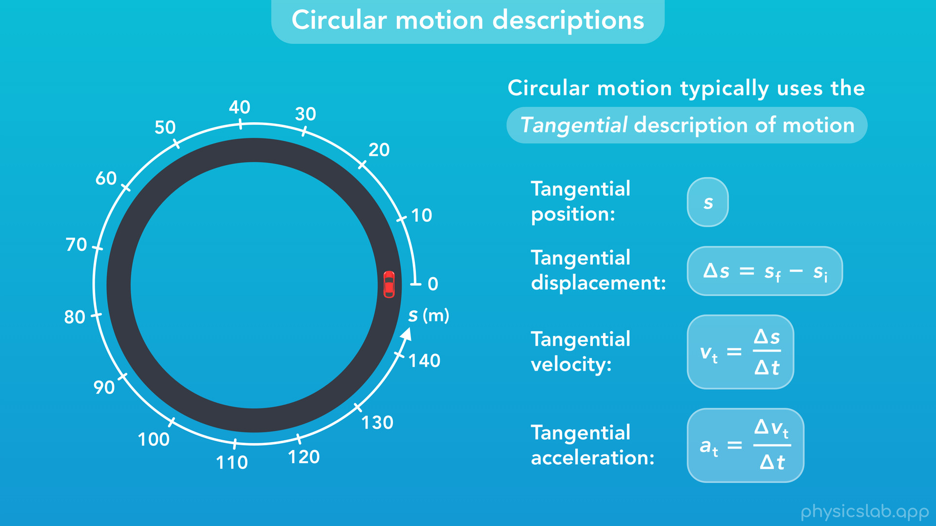
Notes:
These are the variables and equations that we use, and the units represent length.

Slide 24
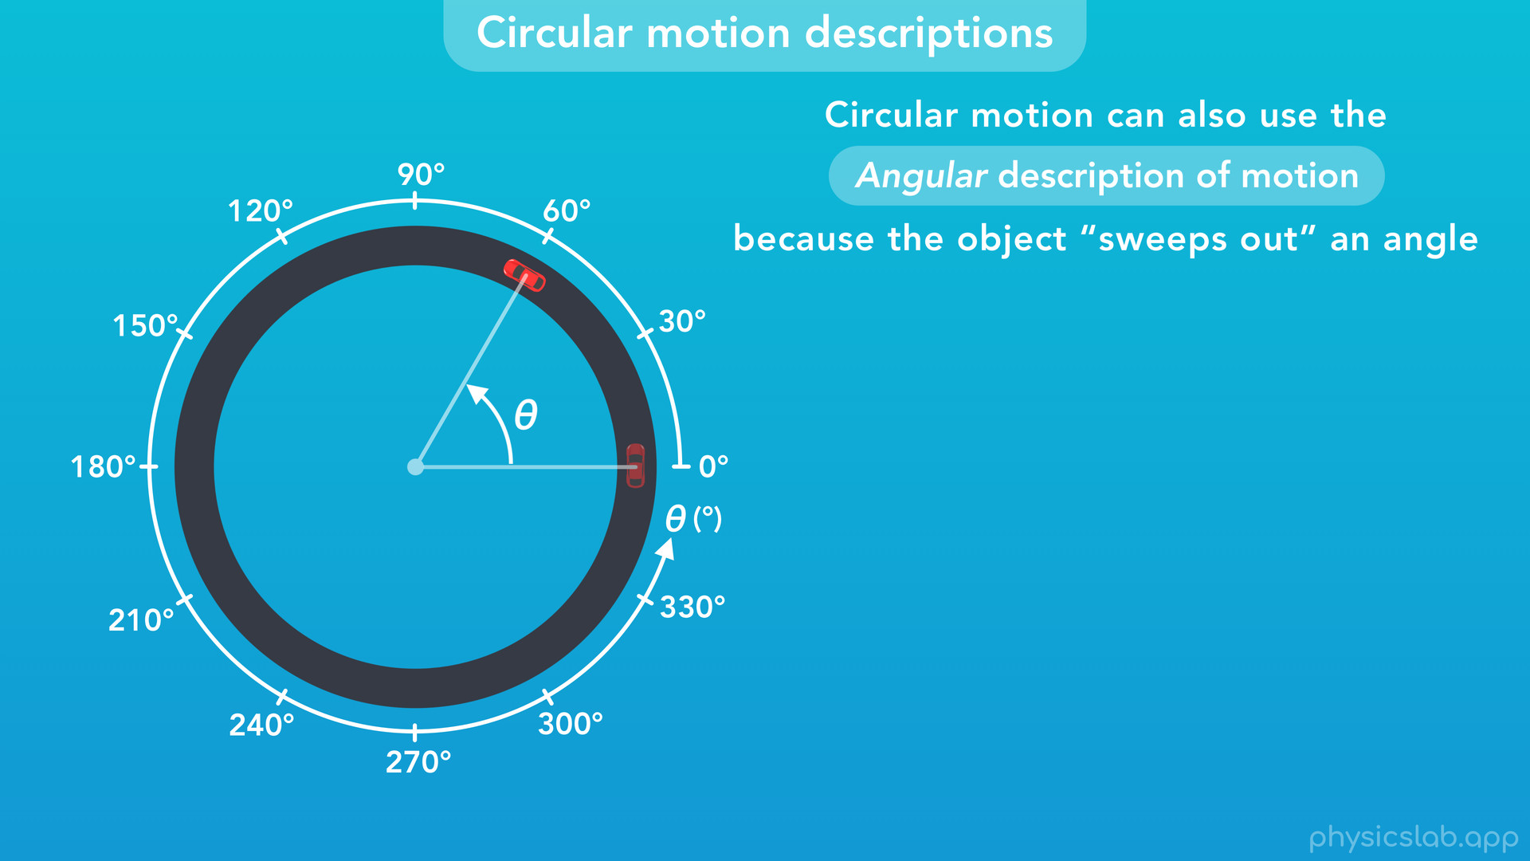
Notes:
Now, imagine we draw a line between the center of this circle and the car, which follows the car as it moves.
When we look at it this way, we find that circular motion can also use the angular description of motion because the object “sweeps out” an angle as it moves.

Slide 25
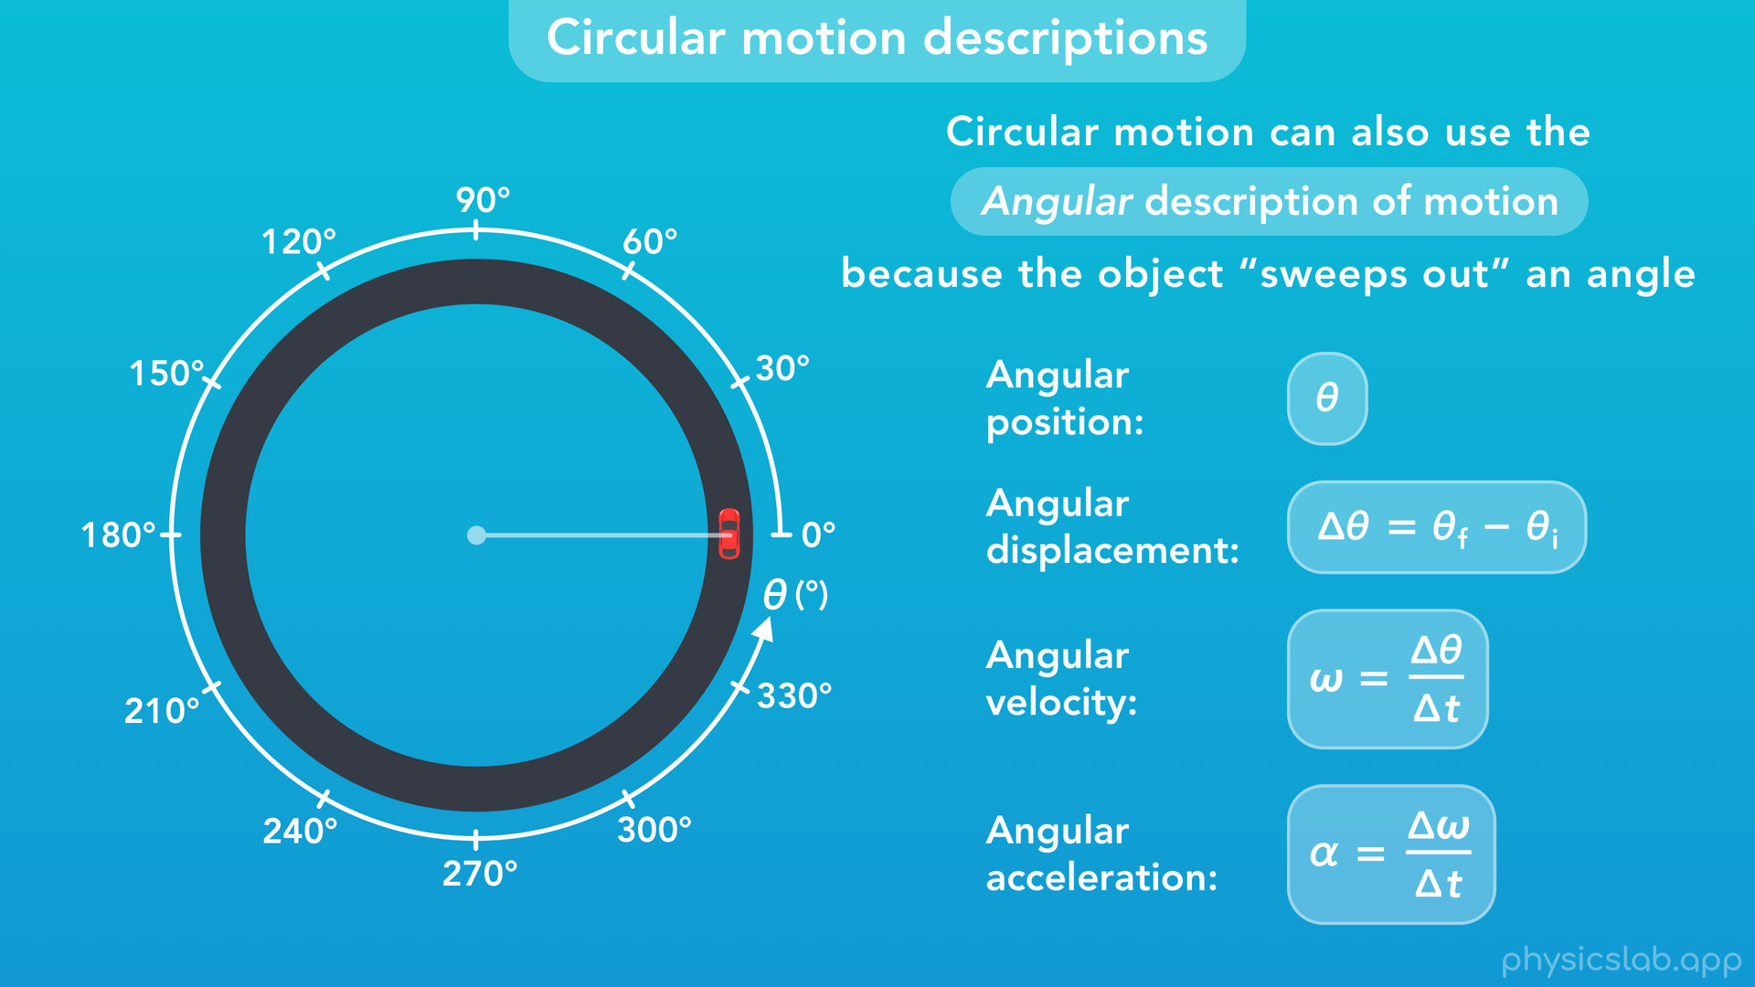
Notes:
So even though the car is an object in circular motion, it’s possible to describe its motion using angles, and we can use the units, axis, variables and equations from the angular description of motion.

Slide 26
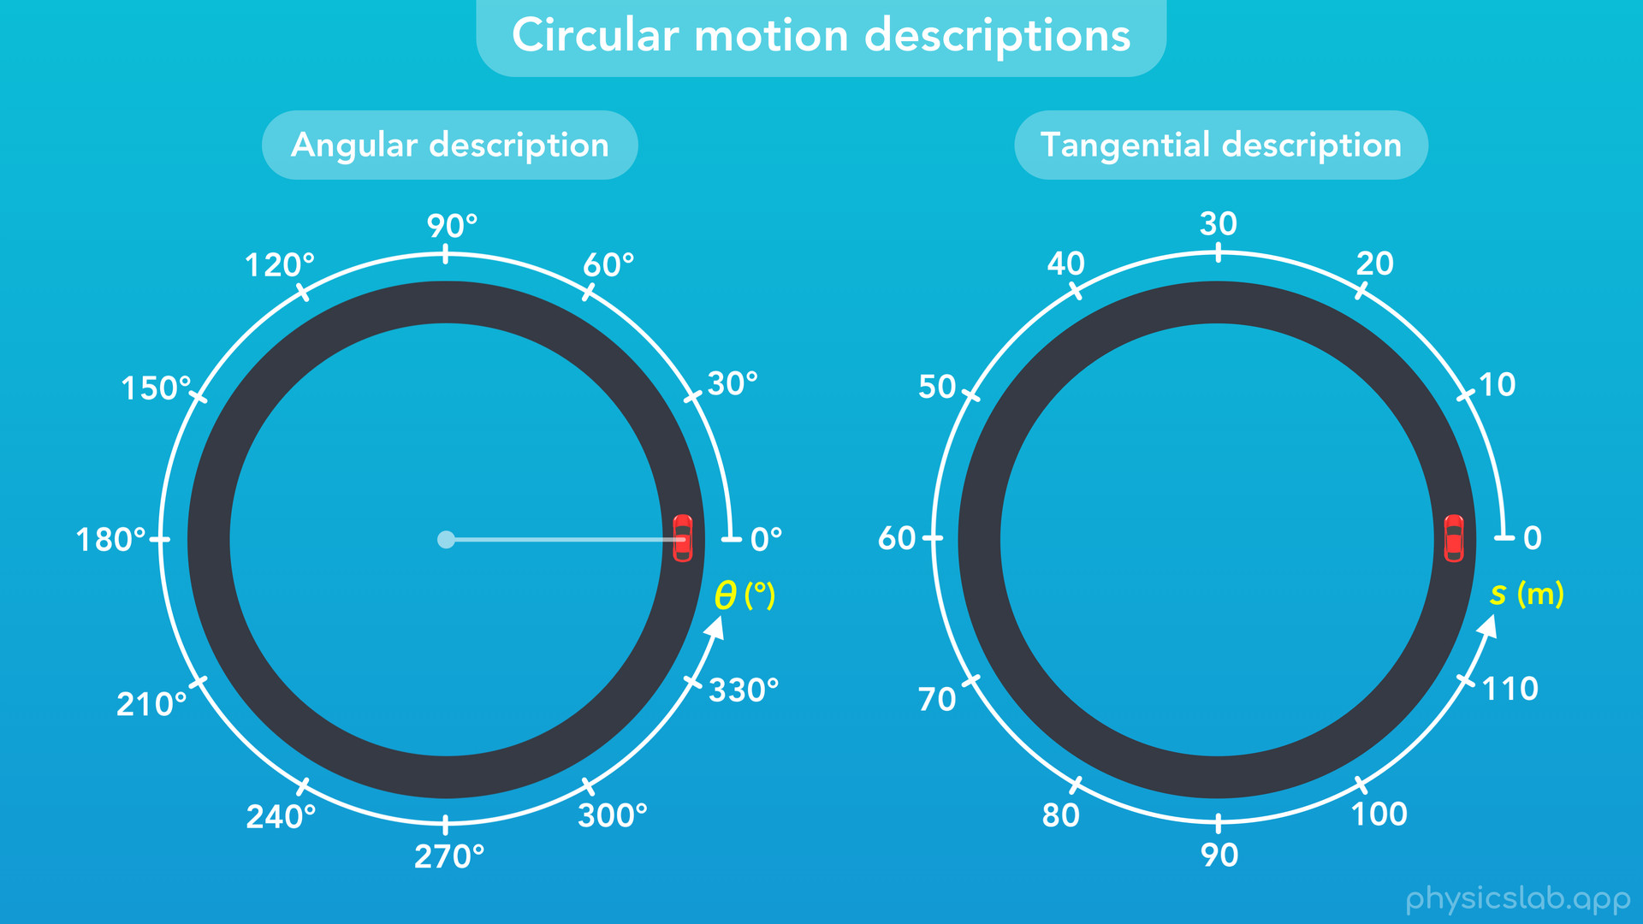
Notes:
○ Here’s the two descriptions side by side. The car is doing the same circular motion in each case.

Slide 27
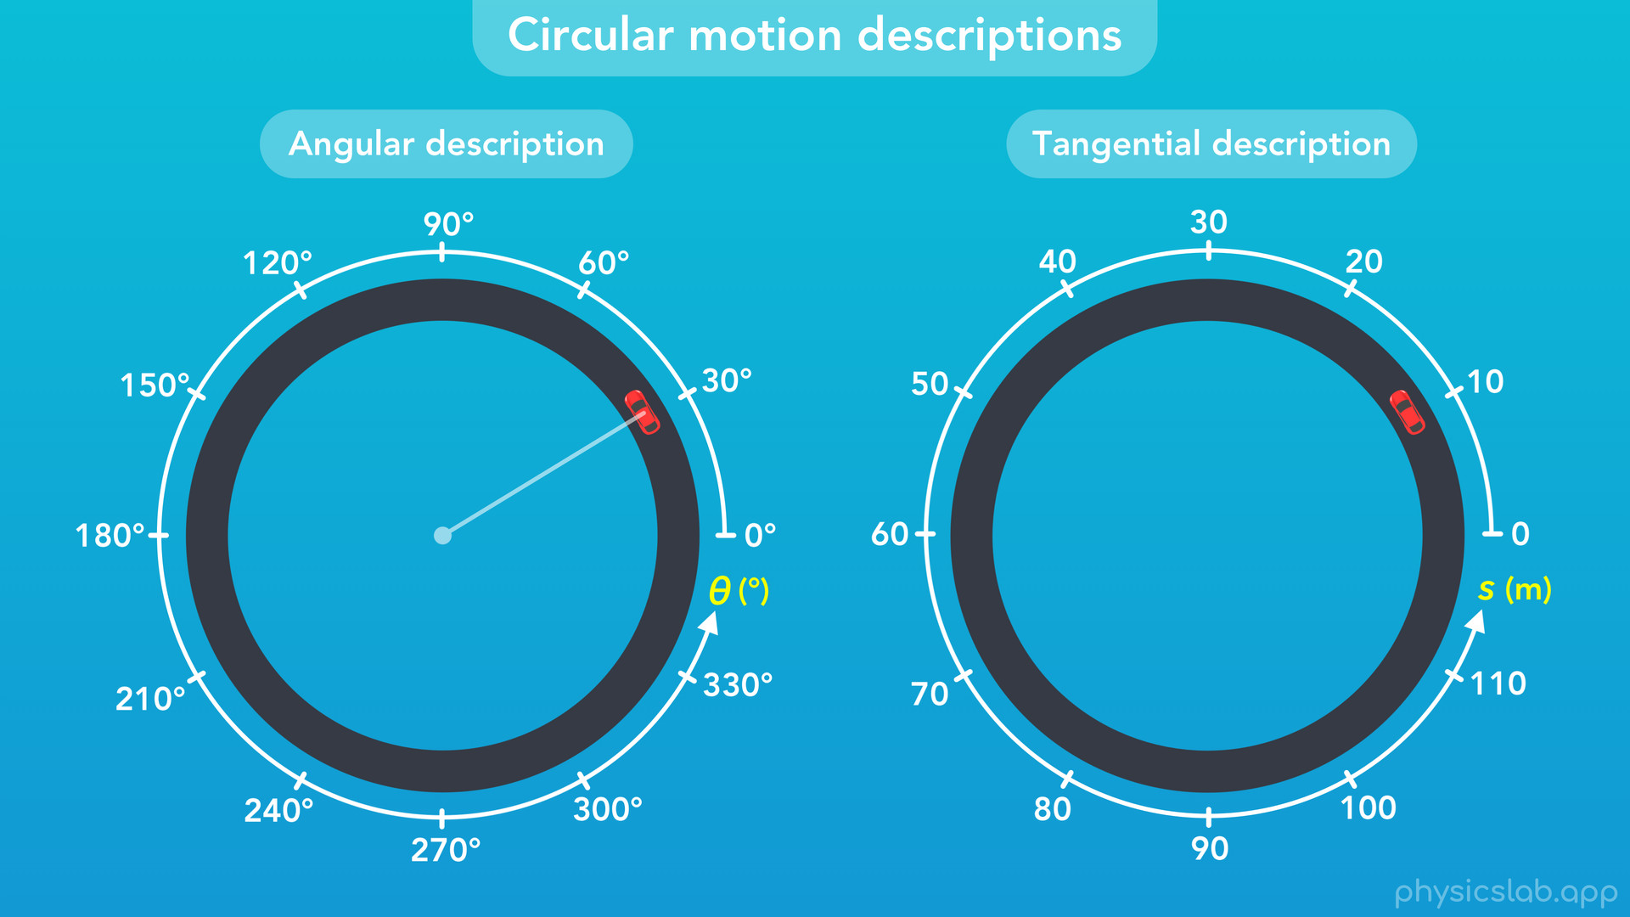

Slide 28
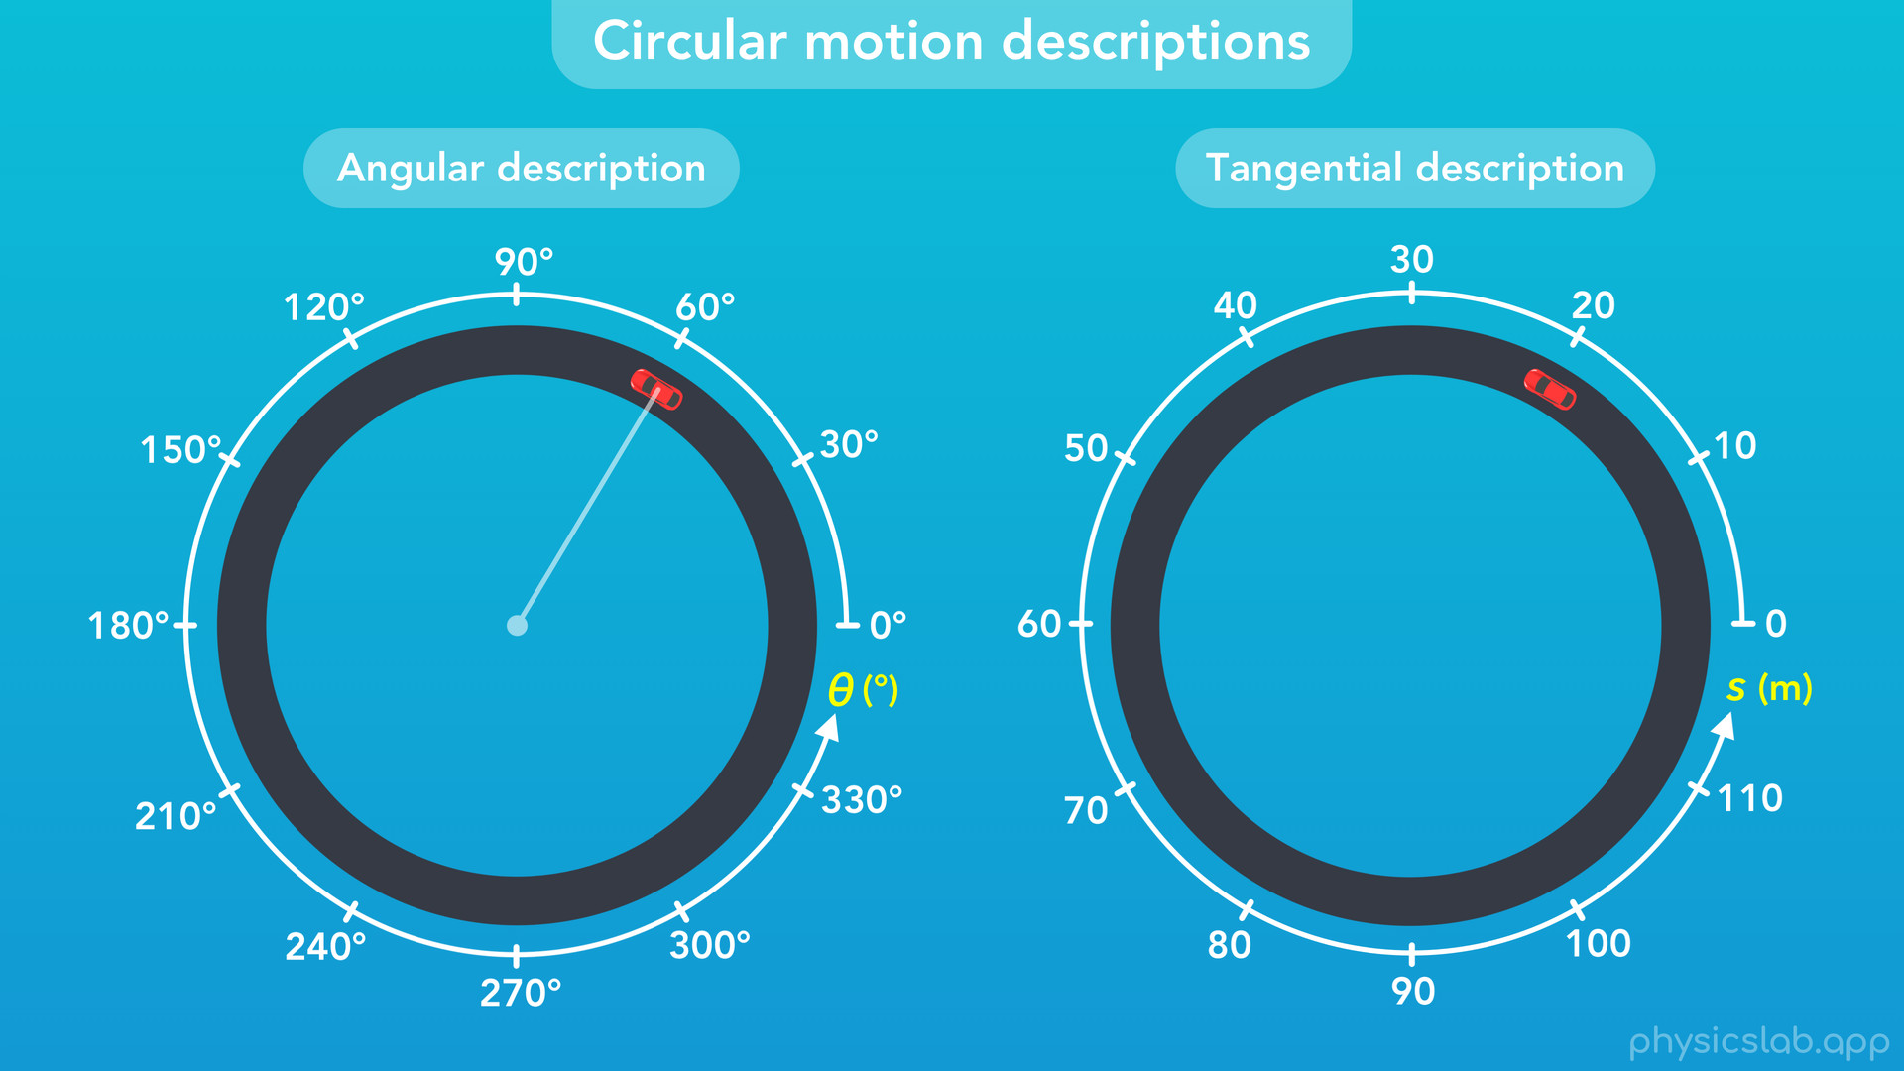

Slide 29
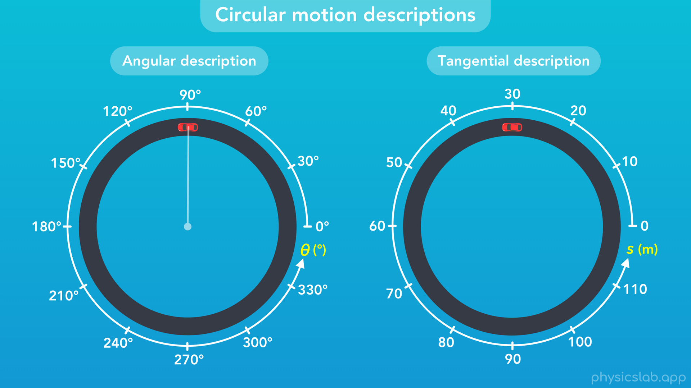
Notes:
But using the angular description on the left, we’d say the car moved to an angular position of 90 degrees. And using the tangential description on the right, we’d say the car moved to a position of 30 meters, based on that axis.

Slide 30
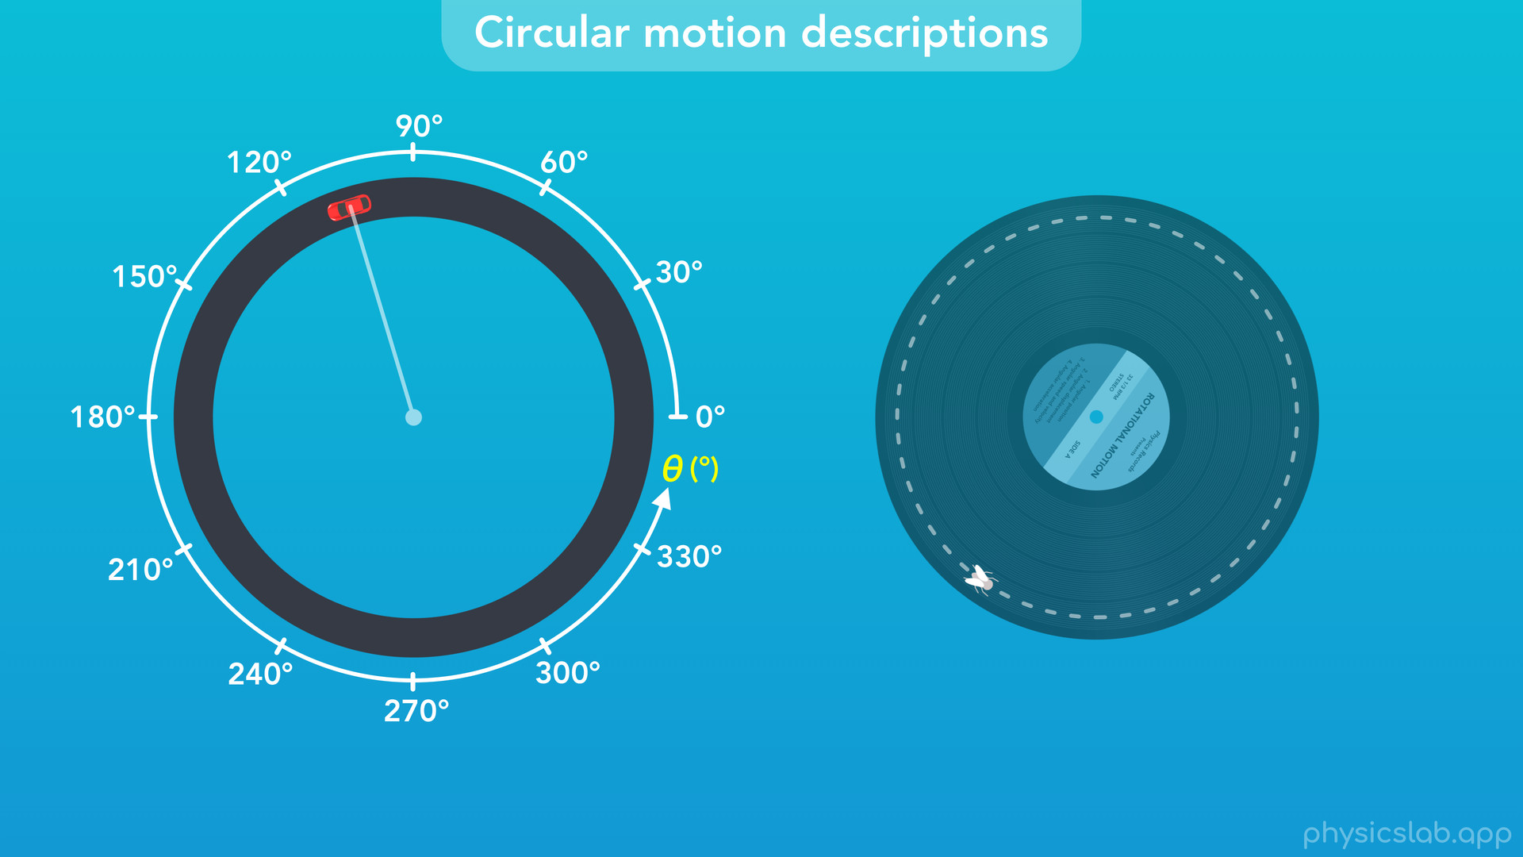
Notes:
You might be wondering why anyone would want to describe the motion of this car using angles. Even though this car is moving around on its own, it’s more common for things that travel in a circle to be attached to something that’s rotating, like the fly sitting on a record. Also, this will be is useful when we learn about periodic motion later on.

Slide 31
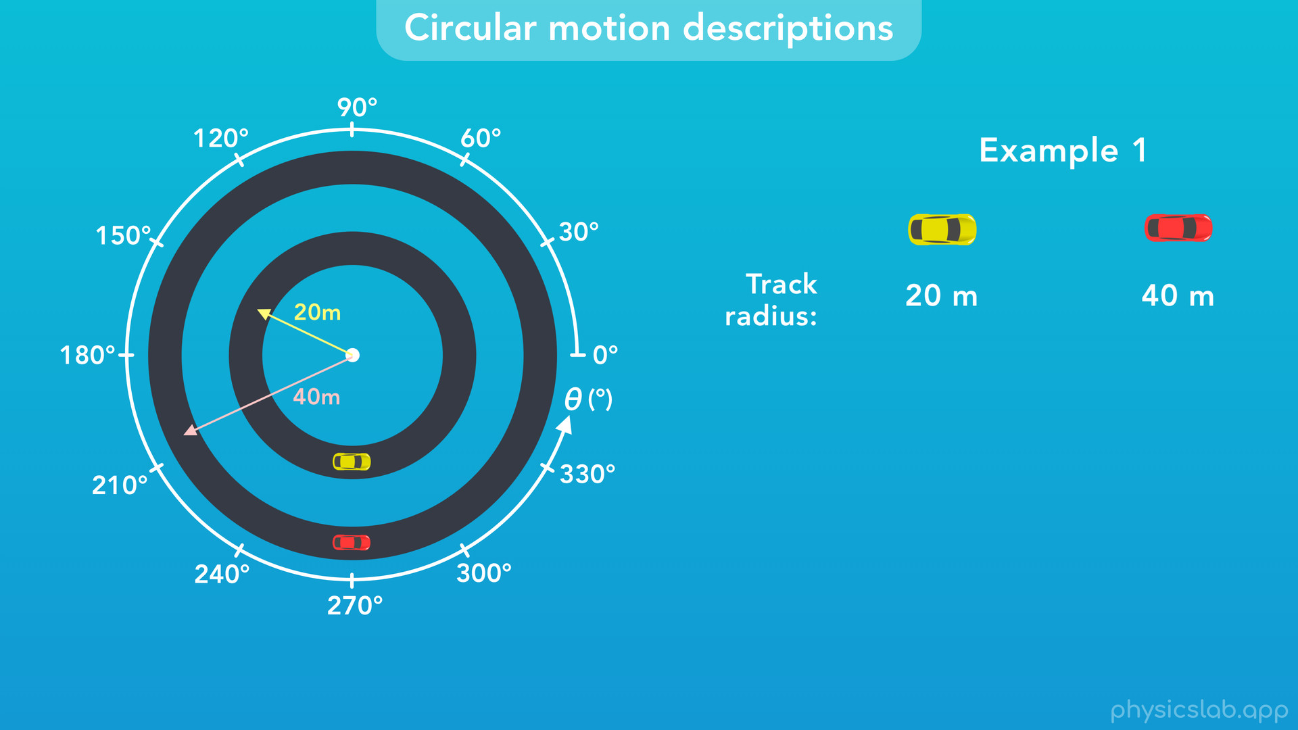
Notes:
Here’s another example that highlights the difference between these descriptions.
The yellow car and the red car are in circular motion on two different tracks.
The yellow car is on a track with a radius of 20 m, and the red car is on a track with a radius of 40 m.

Slide 32
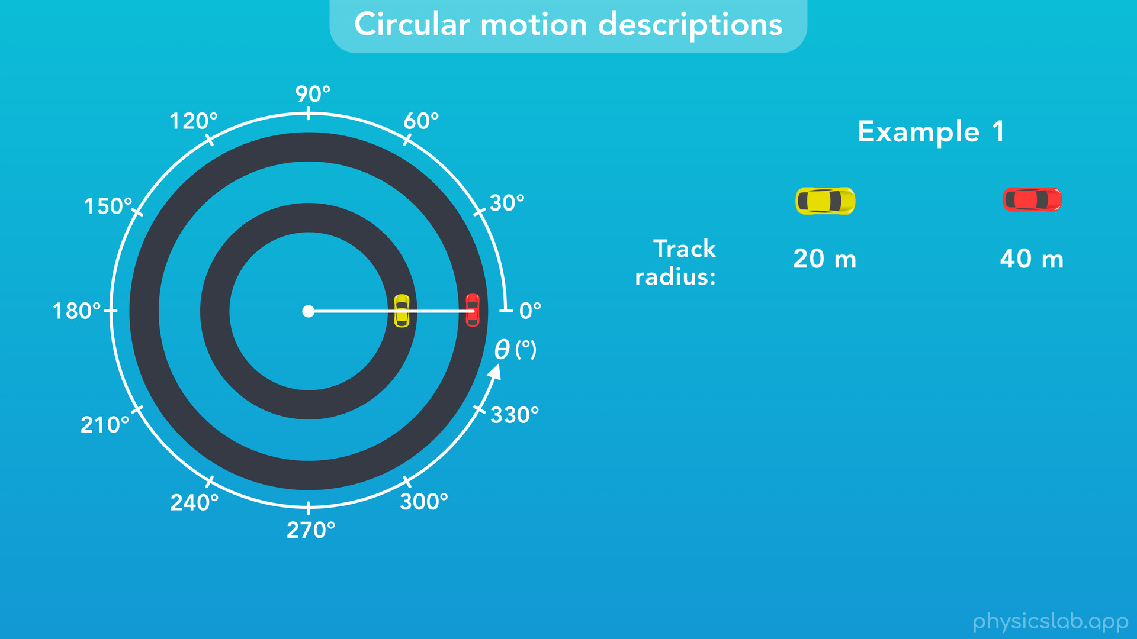
Notes:
If we use a line to follow the motion of the cars, we see that both cars have the same angular motion.

Slide 33
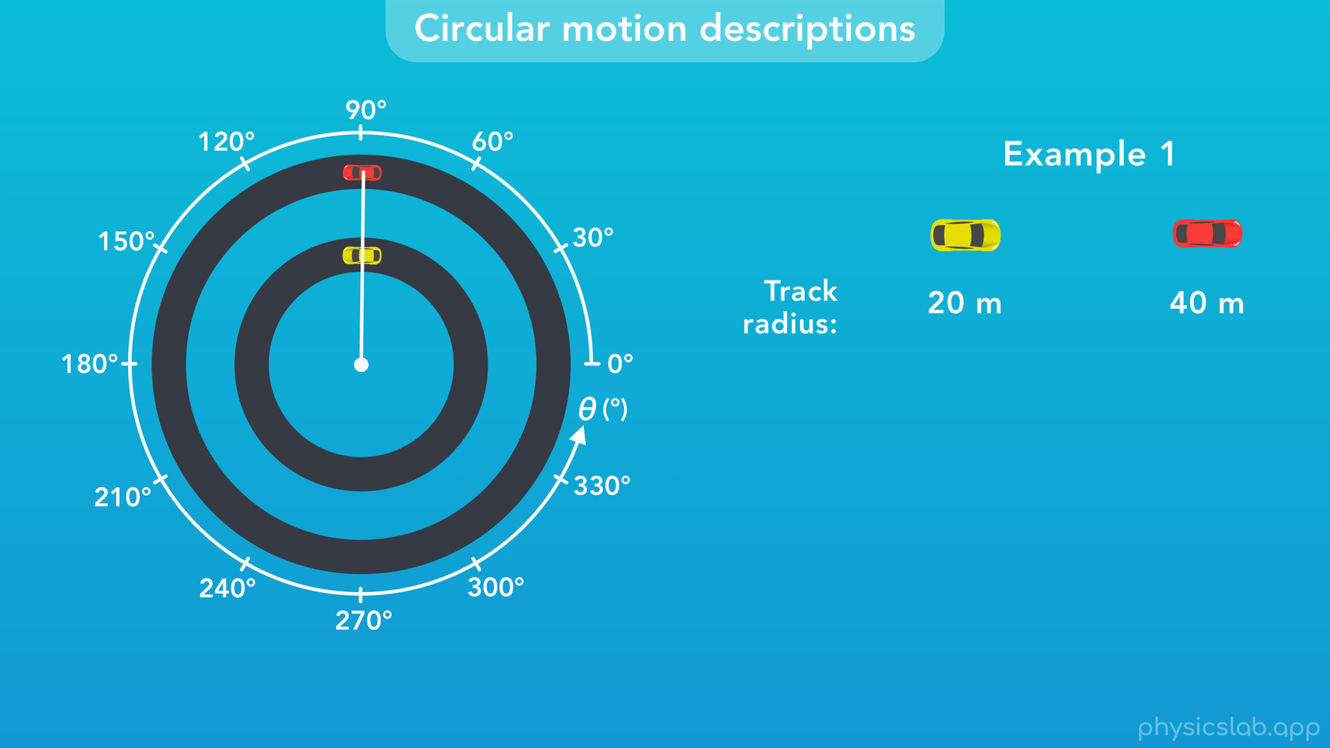

Slide 34
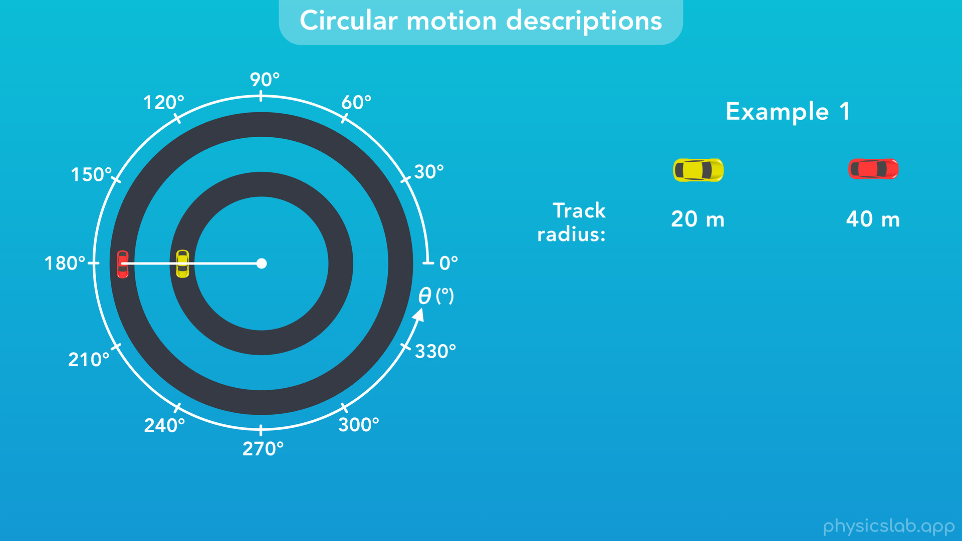

Slide 35
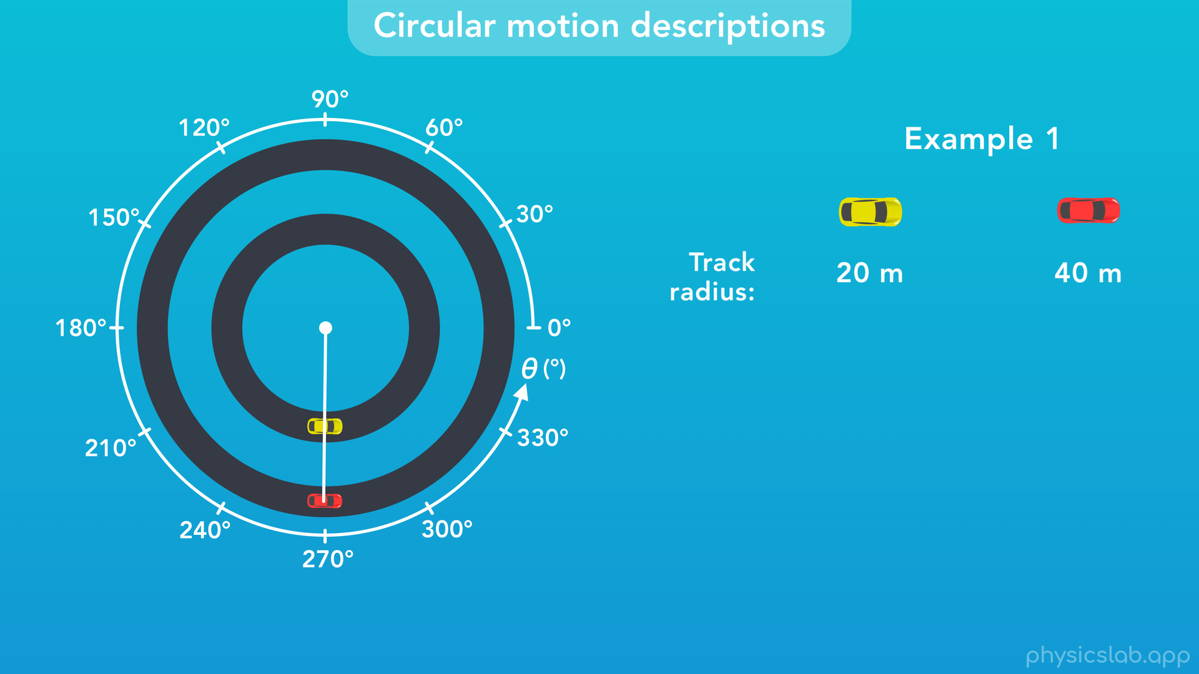

Slide 36
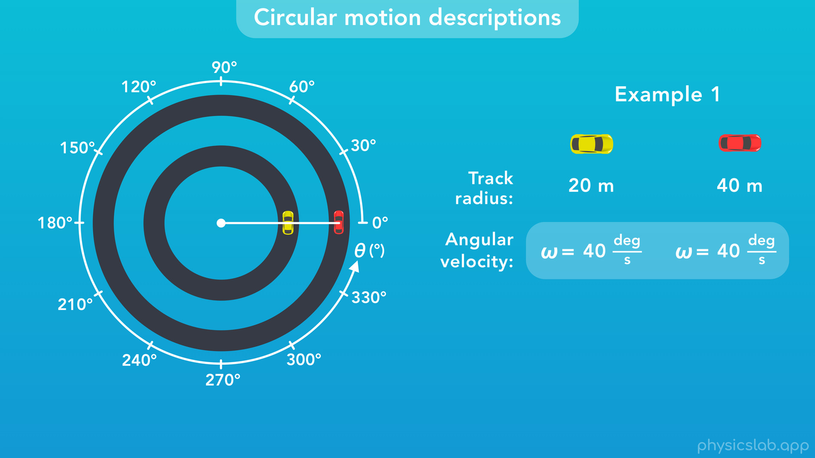
Notes:
They sweep out the same angle in the same amount of time, so they have the same angular velocity. We could also say they both travel a full revolution, 360 deg, in the same time.

Slide 37
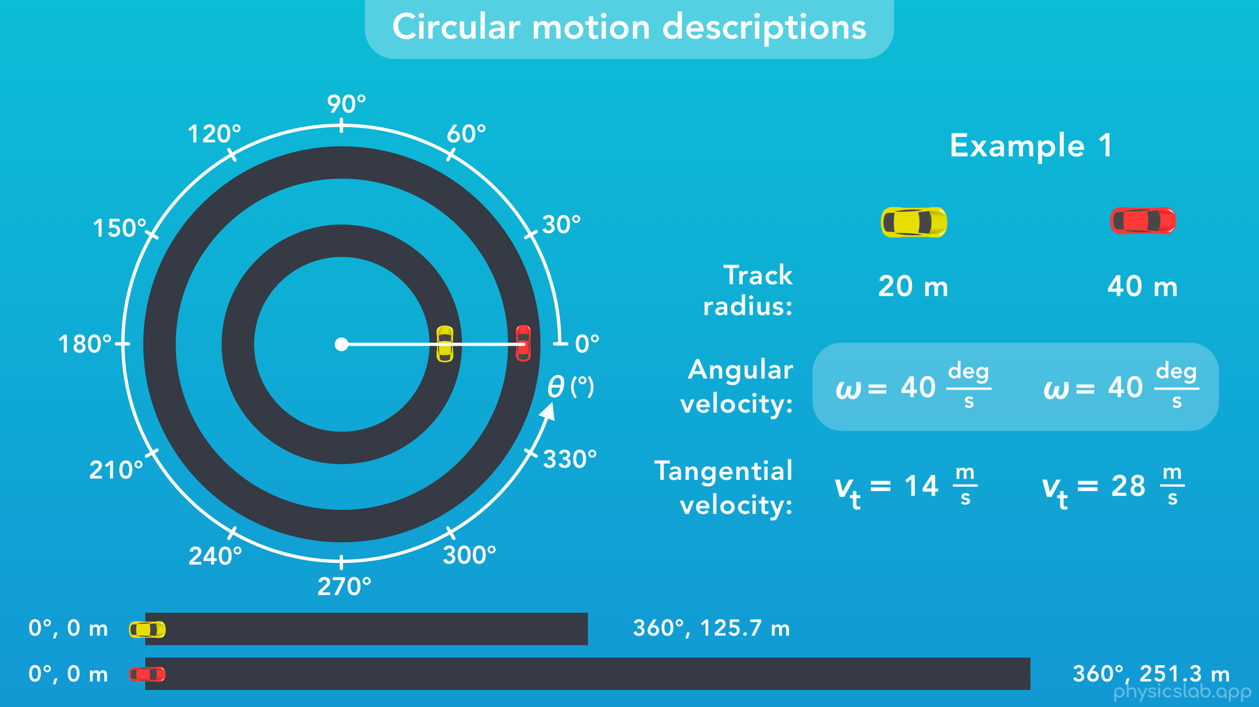
Notes:
However, the cars have different tangential velocities, so the drivers in each car are seeing different speeds on their dashboard.
The red car is on a track with a bigger radius, so its circumference is bigger and the road is longer. If both cars travel one revolution in the same amount of time, and the red car covers more distance, then it has a
greater tangential velocity.

Slide 38
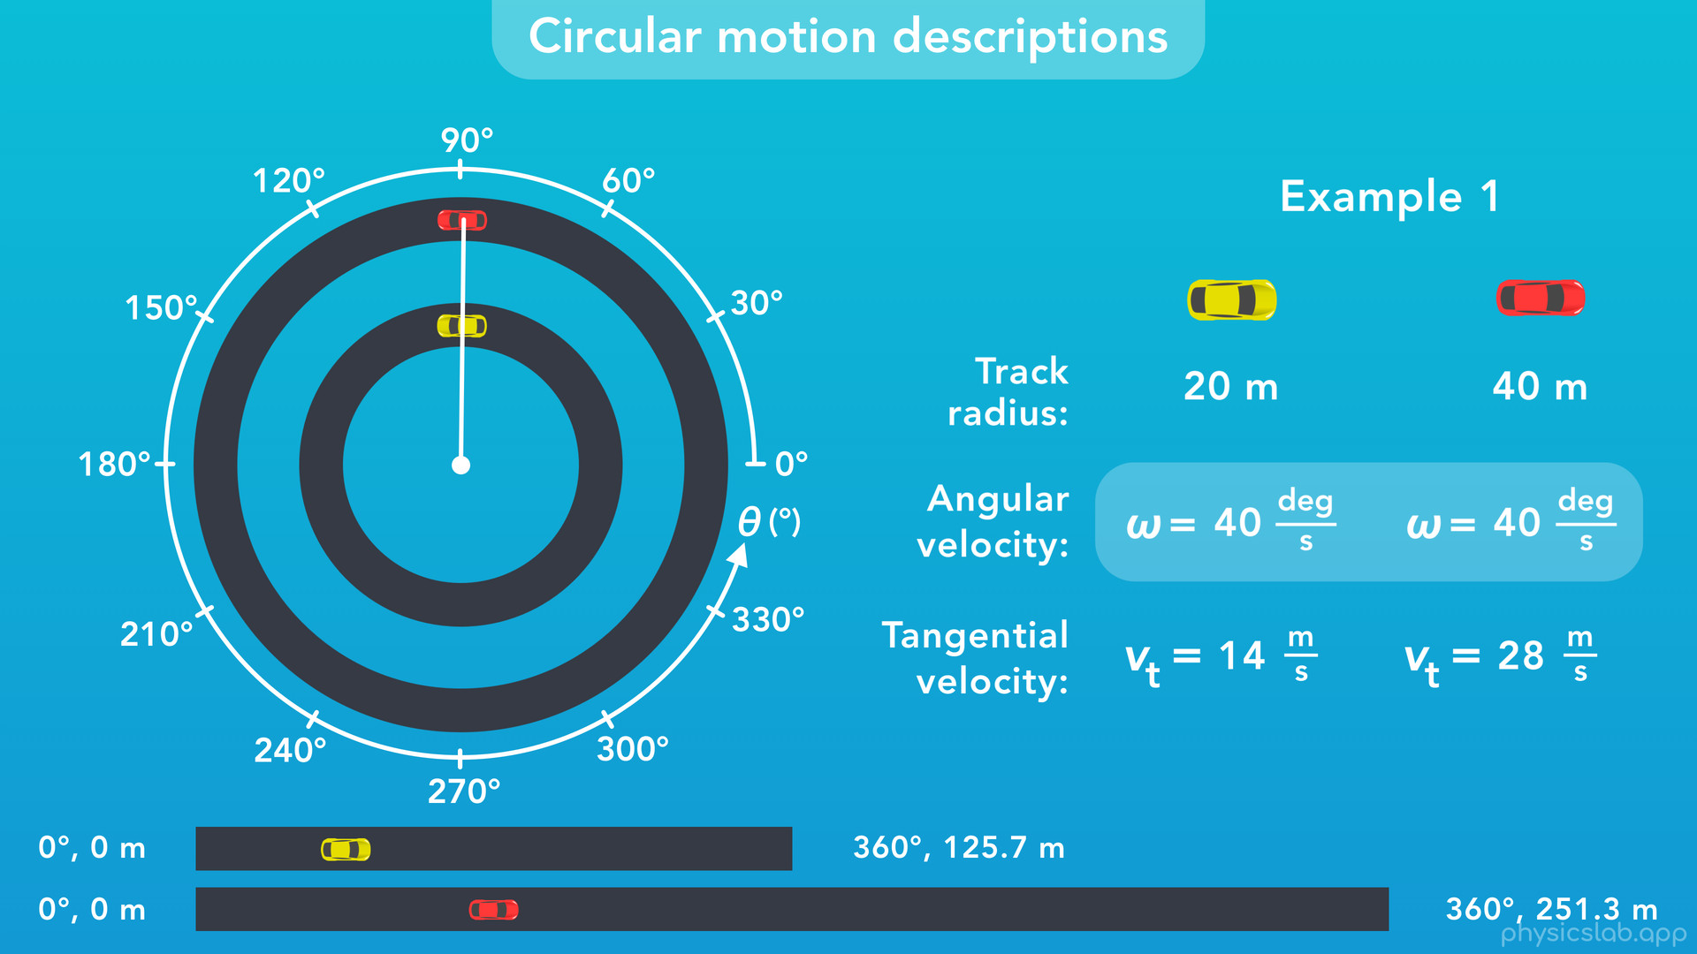

Slide 39
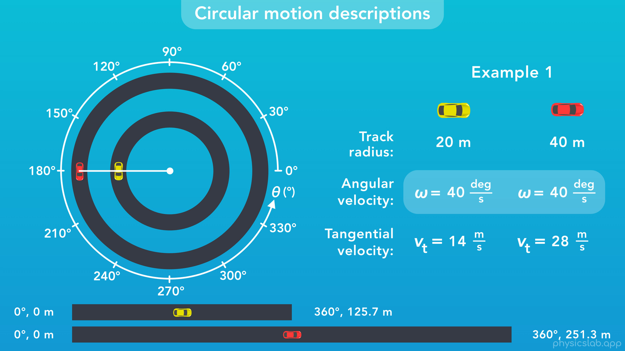

Slide 40
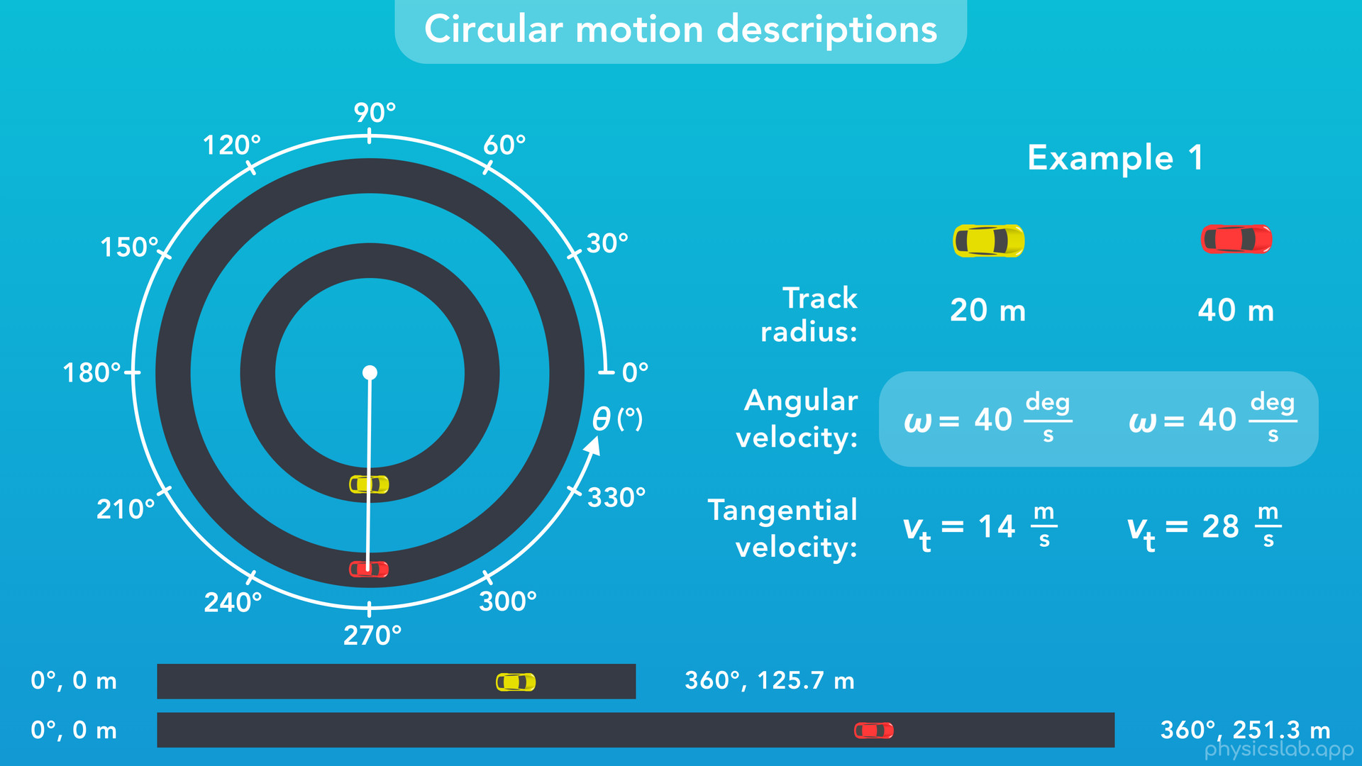

Slide 41
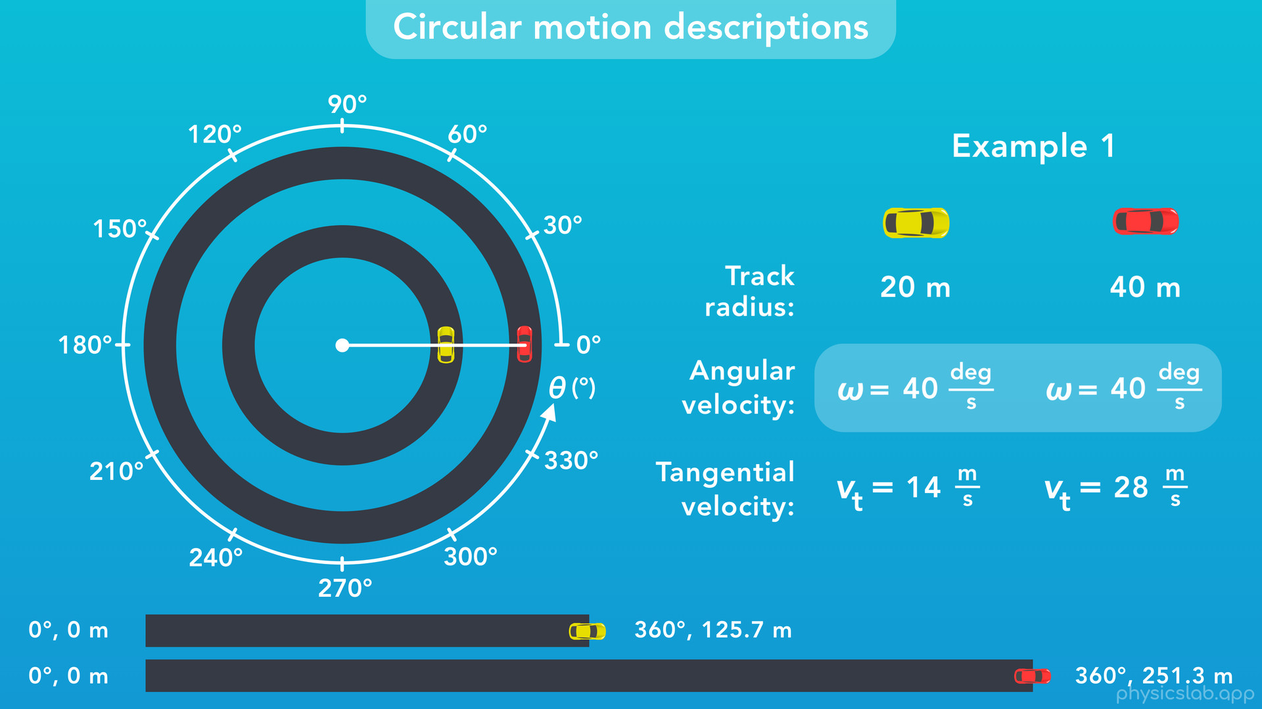

Slide 42
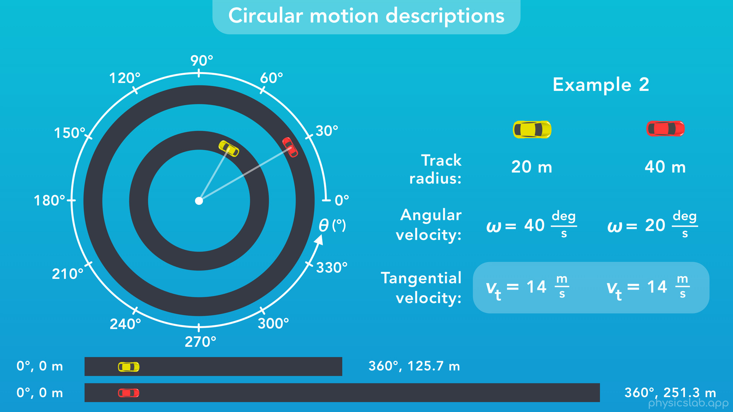
Notes:
○ On the flip side, here’s an example where the cars have the same tangential velocity, but different angular velocities. The person in the yellow car is driving the same speed as the person in the red car. But, since the yellow car is driving around a smaller circumference, it drives around its track, which is 360 deg, in less time. So, it has a higher angular velocity. Even though the tracks have different lengths, or different tangential distances, they both cover the same angle of 360 degrees. Or in SI units, 2 pi radians.

Slide 43
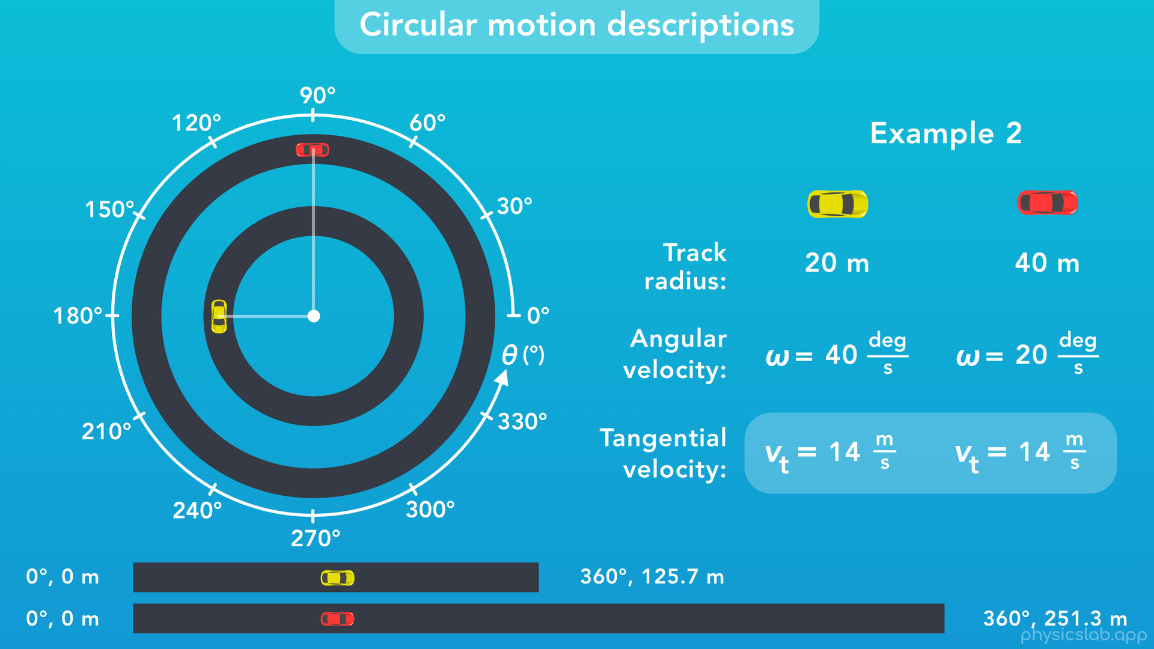

Slide 44
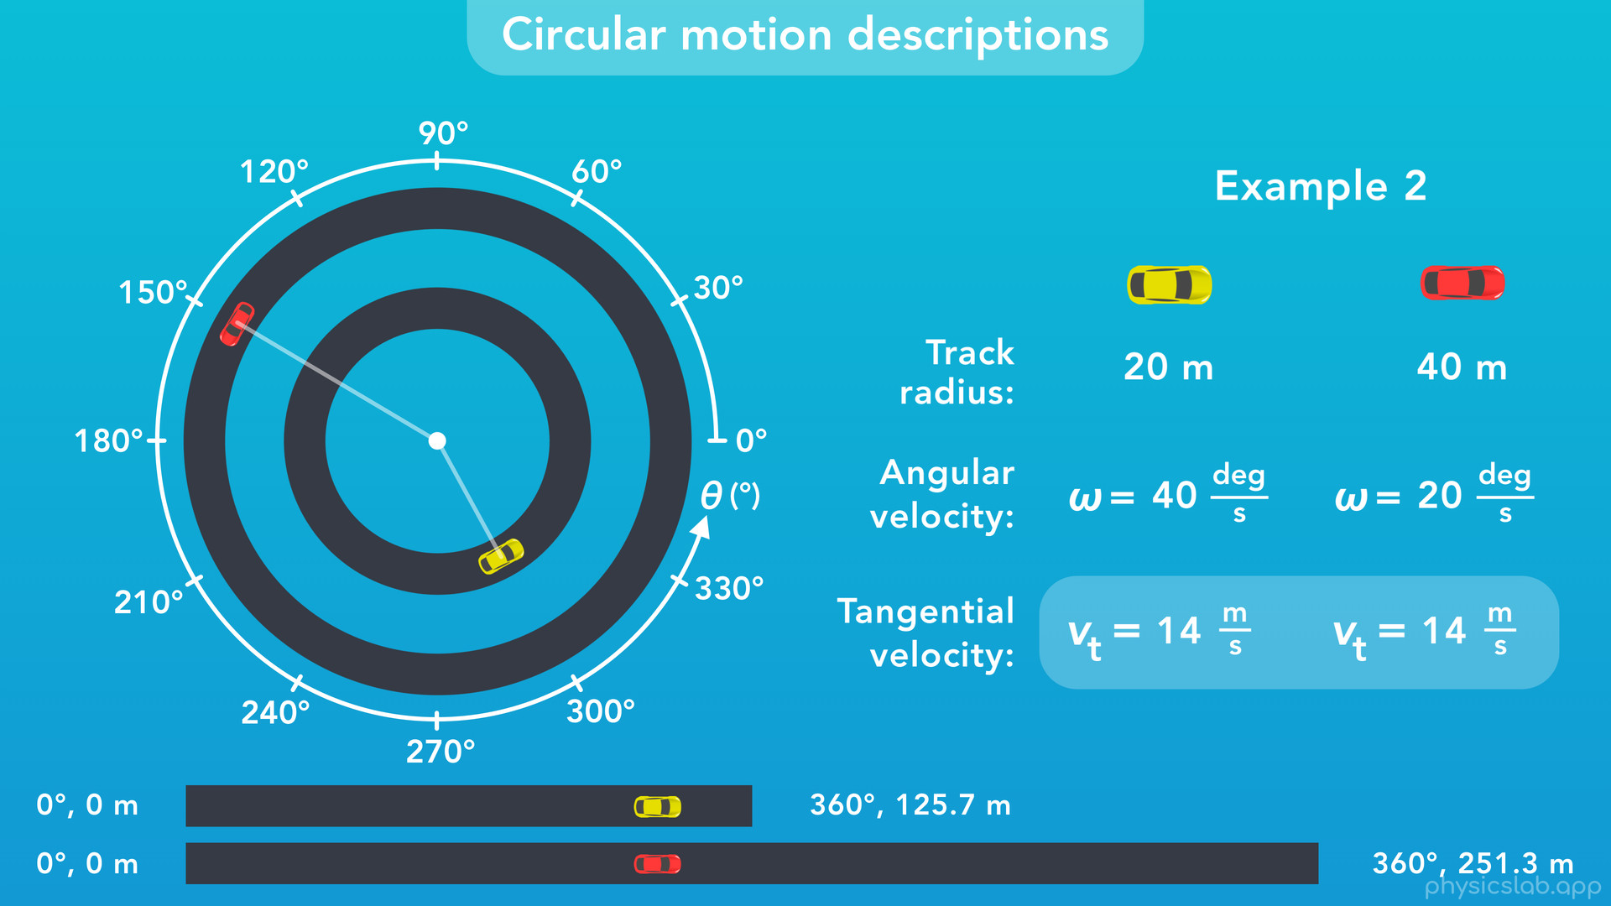

Slide 45
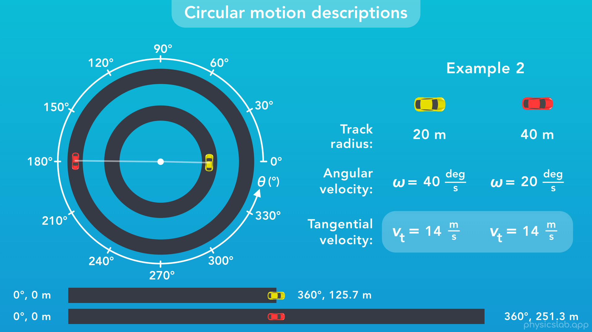

Slide 46
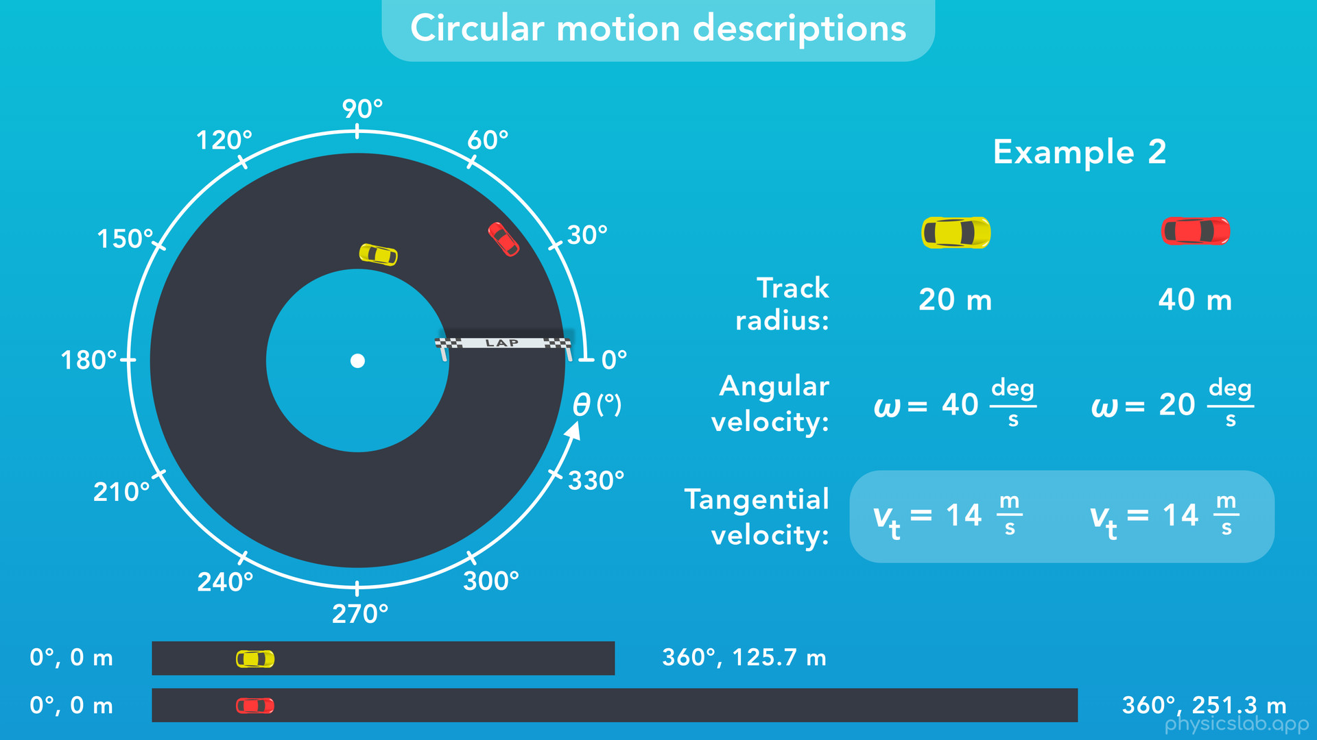
Notes:
○ This is why cars want to take the inside path, or hug the inside of a curve during a race. The goal of a race with a track like this isn’t to travel a certain distance, it’s to complete a certain number of laps, which are revolutions around the track. If the two cars are driving at the same speed, the yellow car will complete a lap in less time because it’s taking a shorter path. It’s following the path of a circle with a smaller circumference.
○ So, those are some of the ways we can describe circular motion.

Slide 47
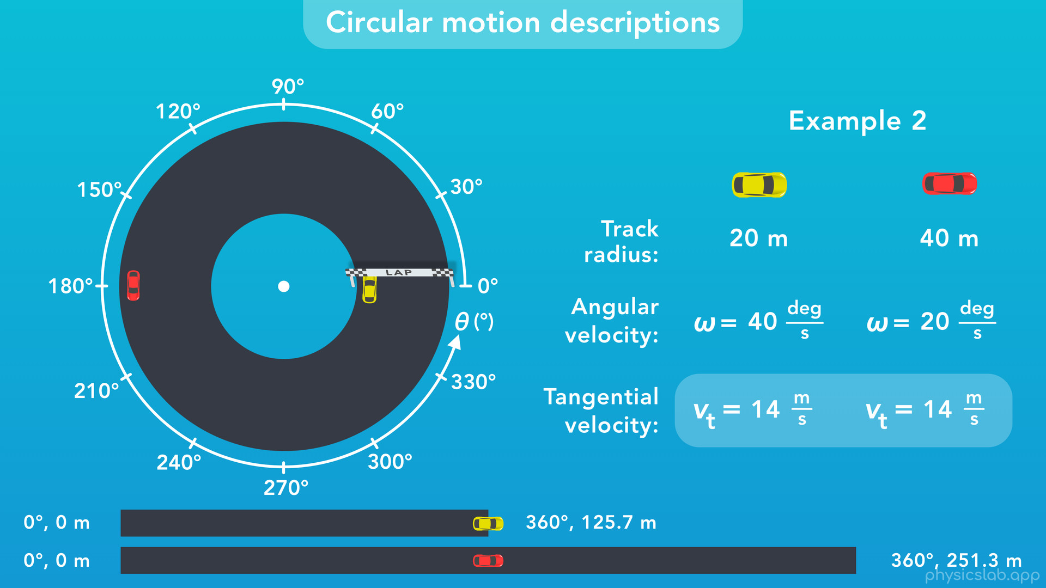

Slide 48

Notes:
○ Now, let’s move on to rotational motion descriptions.

Slide 49
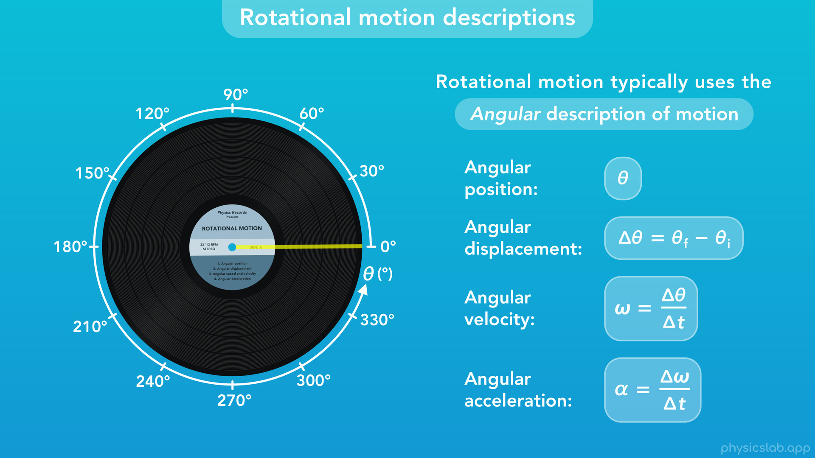
Notes:
Rotational motion typically uses the angular description of motion, like we did in the rotational motion video.
With the angular description, we’re placing an imaginary line on the object and watching how the angle of that line changes over time.
These are the variables and equations that we use for the angular description of motion, and the units represent angles.

Slide 50

Notes:
Like we mentioned earlier, what if a small fly is sitting on this record while it’s playing?
The record is in rotational motion, but the fly is in circular motion because it’s following a circular path. From the fly’s perspective, it’s like driving a car around a circular track.

Slide 51
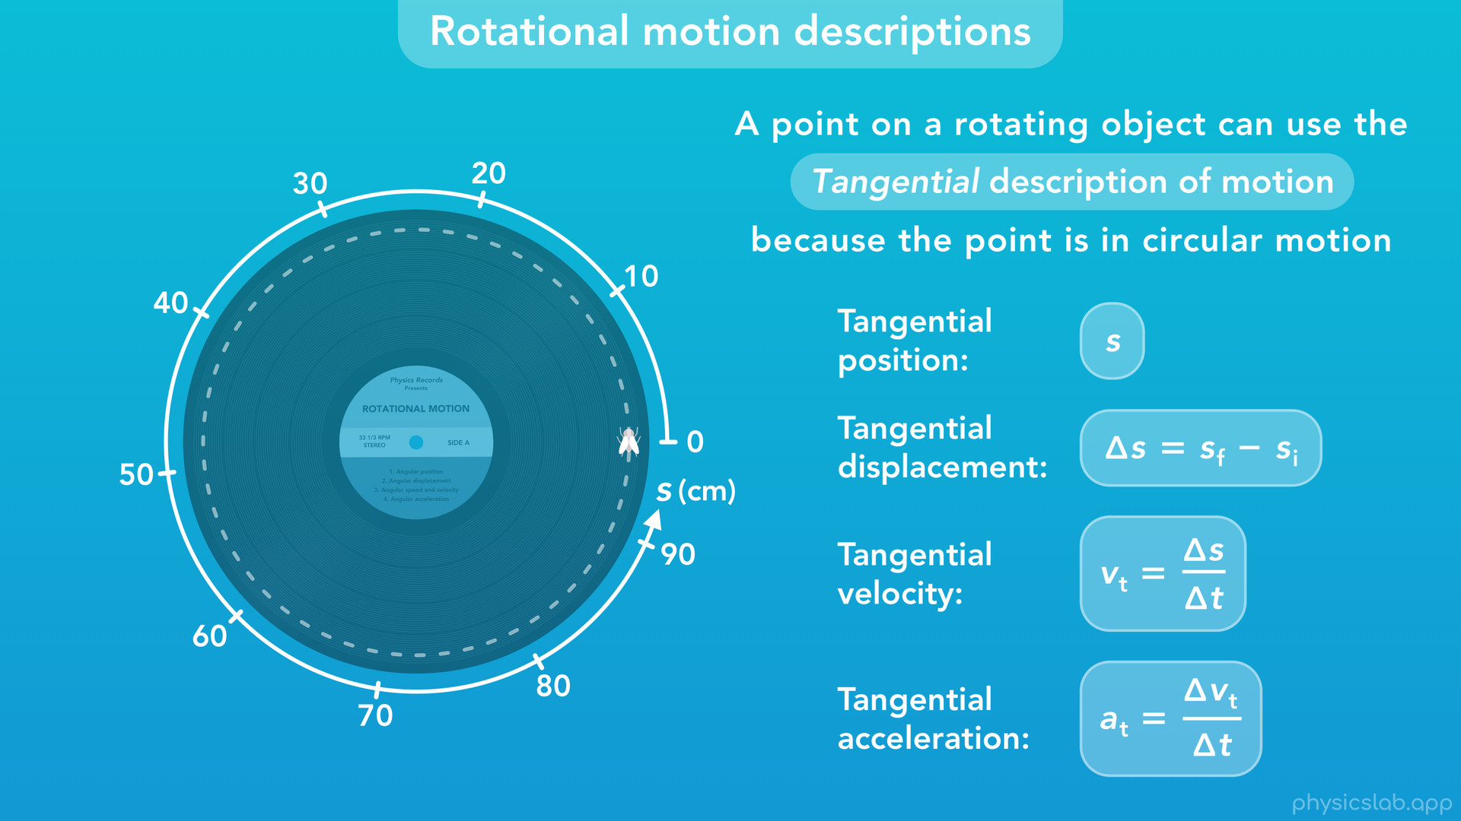
Notes:
○ We’re using a small fly as an example because the fly represents a point on the record. So, we could say that a point on a rotating object can use the tangential description of motion because that point is in circular motion. That means we can describe the motion of the fly using the variables, equations and units of the tangential description of motion. We could measure the distance the fly travels using a unit of length, like meters or centimeters.

Slide 52
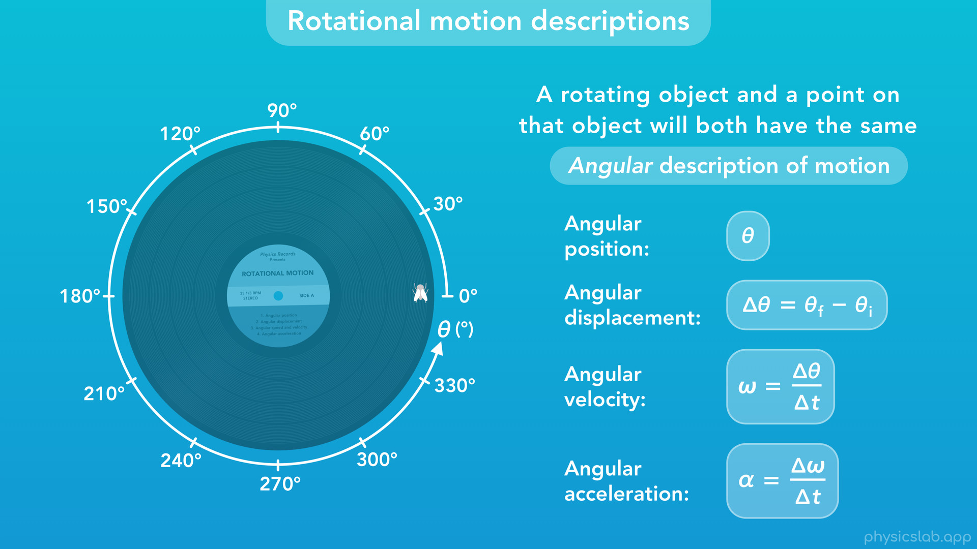
Notes:
○ We already knew that circular motion uses the tangential description, so why is this important? Since the motion of the fly is linked to the motion of the record, we can say that a rotating object and a point on that object, will both have the same angular description of motion. If the record goes through one revolution, so does the fly.

Slide 53
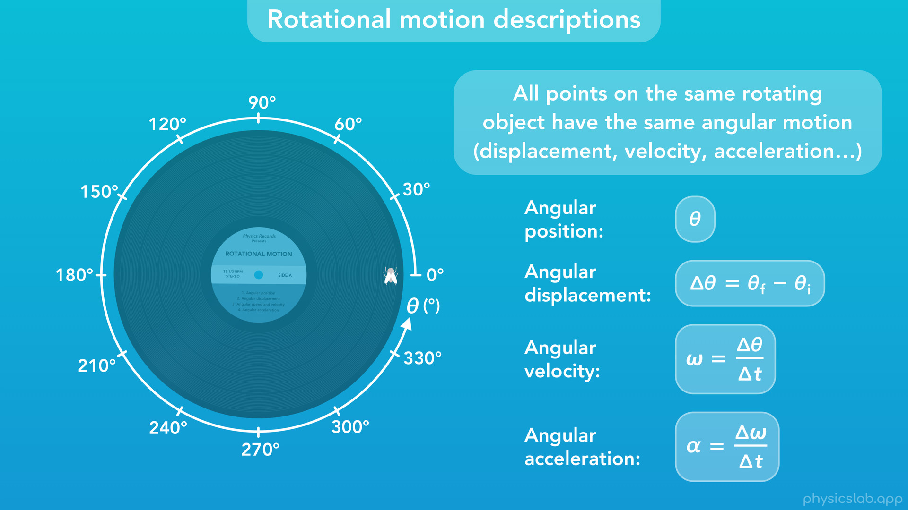
Notes:
○ In fact, all points on a rotating object have the same angular motion.

Slide 54

Notes:
This is why we could place the line anywhere on the record, because all points on the record rotate together.

Slide 55

Notes:
As an example, now we have three flies on this record.
Because the flies are all on the same rotating object, they all have the same angular velocity, the same angular velocity as the record itself.

Slide 56

Notes:
Fly A and B also have the same tangential velocity as each other, but Fly C has a slower tangential velocity. Why is that?
It’s like the example with the cars. Fly C is traveling along a circular path with a smaller circumference, so it’s traveling less distance in the same amount of time. But Fly A and B both travel along a path with the same circumference, so they have the same tangential velocity.
It might seem weird that two points on the same object could be travelling at different speeds. Their angular speeds are the same, but because they follow different circular paths in the same time, their tangential speeds are different. This is an important point, so take a moment to think about it.

Slide 57

Notes:
○ It’s like the cars on different tracks that happen to be traveling at the same angular speed. They have different tangential speeds, and the car on the outside is traveling faster. It just seems weird that the flies have different tangential speeds because they’re on the same object.

Slide 58

Notes:
○ So, we’re finding that an object’s distance from the center of rotation makes a difference. We call the distance between the circumference and the center of a circle, the radius. And it turns out that we can convert between an object’s angular motion and its tangential motion by using the radius.

Slide 59

Notes:
○ With that in mind, let’s move on to the final topic, converting between tangential and angular descriptions.

Slide 60

Notes:
○ Let’s think about how we might do this using an example. This car is in circular motion.

Slide 61

Notes:
During a period of time, the car travels both an angular displacement, delta theta, and a tangential displacement, delta s.
If the angular displacement is pi/2 rad, what is the tangential displacement? Put another way, what is the arc length that corresponds to an angle of pi/2 rad?
We can see that the car travelled one quarter or one fourth of the way around the circle. If we did the math, we would also find that pi/2 rad is 1/4th of 2 pi rad, the number of rad in a full circle. So, if the angle is 1/4th of a circle, then the arc length would also be 1/4th of the circumference. If we knew the circumference, we could find 1/4th of that to get the arc length. So to solve this, we’re going to need the radius of the circle.

Slide 62

Notes:
If the radius is 5 m, then the circumference would be 2*pi*5 m, which is 10 pi m.

Slide 63

Notes:
○ Usually we can’t tell what fraction of a circle we’re dealing with, so let’s calculate that first. If we start with the angle, theta, which is pi/2 rad

Slide 64

Notes:
and we multiply by the relationship of 1 circle equals 2 pi rad

Slide 65

Notes:
then the rad will cancel out

Slide 66

Notes:
and we find that the angle is ¼ of a circle.

Slide 67

Notes:
Now, we can take that fraction and multiply it by the circumference.

Slide 68

Notes:
But let’s continue using unit relationships. So we’ll multiply ¼ of a circle times the relationship of 1 circumference per 1 circle. We just found the circumference, which is 10 pi m.

Slide 69

Notes:
Now the unit of circles will cancel out

Slide 70

Notes:
and we get 10 pi/4 m, which simplifies to 5 pi/2 m. That’s about 7.85 m in decimal form. So, that’s the arc length, or tangential displacement delta s, that we’re looking for. To recap, we found what fraction of a circle the angle theta represents, then we multiplied that fraction by the circumference to get the arc length, because the angle and arc length represent the same fraction of a circle.
What if we were given a different angle and radius, and we wanted to do the same thing? Let’s simplify the work that we did to find something that applies to any angle and radius.

Slide 71

Notes:
○ First, instead of calculating the fraction of the circle and then multiplying it by the circumference, we could have just multiplied the first part by the circumference. Rad and circles would cancel out, and we’d get the same answer.

Slide 72

Notes:
Next, instead of multiplying the angle, pi/2 rad, by the relationship 1 circle per 2 pi rad, and then 1 circumference per circle, we could combine those into 1 relationship. 1 circumference corresponds to 2 pi rad, because they both correspond to 1 circle. Remember, 10 pi m is the circumference.

Slide 73

Notes:
○ So that’s a lot less stuff to write. Now, let’s replace the values with variables. Using this general formula, we can plug in an angle in rad, a radius in m, and we’ll get an arc length in m.

Slide 74

Notes:
If we remove the units, we get this simple equation.

Slide 75

Notes:
And in fact, this is the equation for arc length, although we usually write it like this.

Slide 76

Notes:
○ What happens with we plug in 1 radian for the angle, theta?

Slide 77

Notes:
R * 1 is just r, so the arc length equals the radius. That’s actually the definition of a radian. It’s the angle swept out by an arc length that’s equal to the radius.

Slide 78

Notes:
○ What if we plug in 2 pi rad for theta? Then we get an arc length of r * 2 pi, which is the equation for the circumference of a circle.

Slide 79

Notes:
○ So this works for angular and tangential displacements, what if we wanted to convert from an angular velocity to a tangential velocity? Let’s say this car is driving around the same circle with a radius of 5 m, and an angular velocity of pi/2 rad/s. What’s the car’s tangential velocity?

Slide 80

Notes:
○ We could come up with an equation the same way we did before. If we take an angular velocity, omega, in rad/s

Slide 81

Notes:
and multiply it by the relationship of 1 circumference, 2 pi r m, which corresponds to an angle of 2 pi rad

Slide 82

Notes:
then the 2pi would cancel out and the rad would cancel out

Slide 83

Notes:
leaving us with a tangential velocity in m/s.

Slide 84

Notes:
So, the radius times the angular velocity gives us the tangential velocity.

Slide 85

Notes:
This will be our conversion equation for velocity.

Slide 86

Notes:
Let’s test it. If we plug in 5 m for the radius and pi/2 rad/s for the angular velocity, the equation tells us the tangential velocity will be 5 pi/2 in m/s.

Slide 87

Notes:
○ Why does this equation also work with velocity? Let’s think about it this way. We know from before that an angular displacement of pi/2 rad corresponds to a tangential displacement of 5 pi/2 m.

Slide 88

Notes:
If the car travels those displacements in 1 second, then we’re just dividing the displacement by seconds, to get the velocities. This works for angular and tangential acceleration too. Let’s look at everything together.

Slide 89

Notes:
○ On the left, we have the equations for the tangential description of motion, and on the right is the angular description.

Slide 90

Notes:
Now, we have equations that we can use to convert between the two. If we take the angular variable and multiply it by the radius of the circular path, we get the tangential variable. It’s important to remember that for this to work, the angular variable must use radians. So if it uses degrees or revolutions, we have to convert to radians, rad/s or rad/s2 before plugging it in. Technically, as long as the tangential variable and the radius use the same length unit, things still work, but it might be good practice to only use the SI units.

Slide 91

Notes:
○ To wrap up this section, let’s look at some examples with a car driving around a circle with a radius of 20 m. The tangential and angular values are linked, and their relationship depends on the radius.

Slide 92

Notes:
○ If the car’s angular position at a certain time is 2 rad, then the tangential position would be 2 * 20 or 40 m.

Slide 93

Notes:
○ If the car travels a tangential displacement of 60 m during a period of time, it also travels an angular displacement of 3 rad. In this case, we take delta s and divide it by r to get delta theta.

Slide 94

Notes:
○ If the car’s angular velocity is 1 rad/s, the tangential velocity would be 20 m/s.

Slide 95

Notes:
○ If the car speeds up, both velocities would increase.

Slide 96

Notes:
And if the car slows down, both velocities decrease.

Slide 97

Notes:
○ If the car’s velocity is constant, then both the tangential and angular acceleration are zero.

Slide 98

Notes:
○ If the car speeds up and its tangential acceleration is 10 m/s2, then it’s angular acceleration would be 0.5 rad/s2.

Slide 99

Notes:
○ Again, the tangential and angular motions are linked together if they describe the same object. The difference is that tangential describes the motion around the circumference in terms of length, and angular describes the motion around a circle in terms of angles.
○ So hopefully, now you have an idea of how we can convert between the tangential and angular descriptions of motion.

Slide 100

Notes:
○ So that’s everything we’re going to cover, what should we be expected to know from this video?

Slide 101

Notes:
○ Motion, and the description of that motion, are two separate things. The motion is what the object is doing in the physical world, and the description is how we choose to study that motion.

Slide 102

Notes:
○ The terms circular and rotational refer to two different types of physical motion. Circular motion is when an object follows a circular path, and rotational motion is when an object rotates around its own center.

Slide 103

Notes:
○ Circular motion typically uses the tangential description of motion.

Slide 104

Notes:
○ However, circular motion can also use the angular description of motion because the object “sweeps out” an angle as it moves.

Slide 105

Notes:
○ On the other hand, rotational motion typically uses the angular description of motion.

Slide 106

Notes:
○ But, a point on a rotating object can use the tangential description of motion because the point is in circular motion.

Slide 107

Notes:
○ Also, all points on the same rotating object will have the same angular motion. However, those points will have different tangential motions if the points are different distances from the center.

Slide 108
Notes:
○ Finally, if we want to convert between the tangential and angular descriptions of motion, we can use these equations, which are based on the relationship between an arc length and the angle swept out by that arc. If we multiply the angular value, using radians, times the radius of the circular path, we get the corresponding tangential value.

