Slide 1


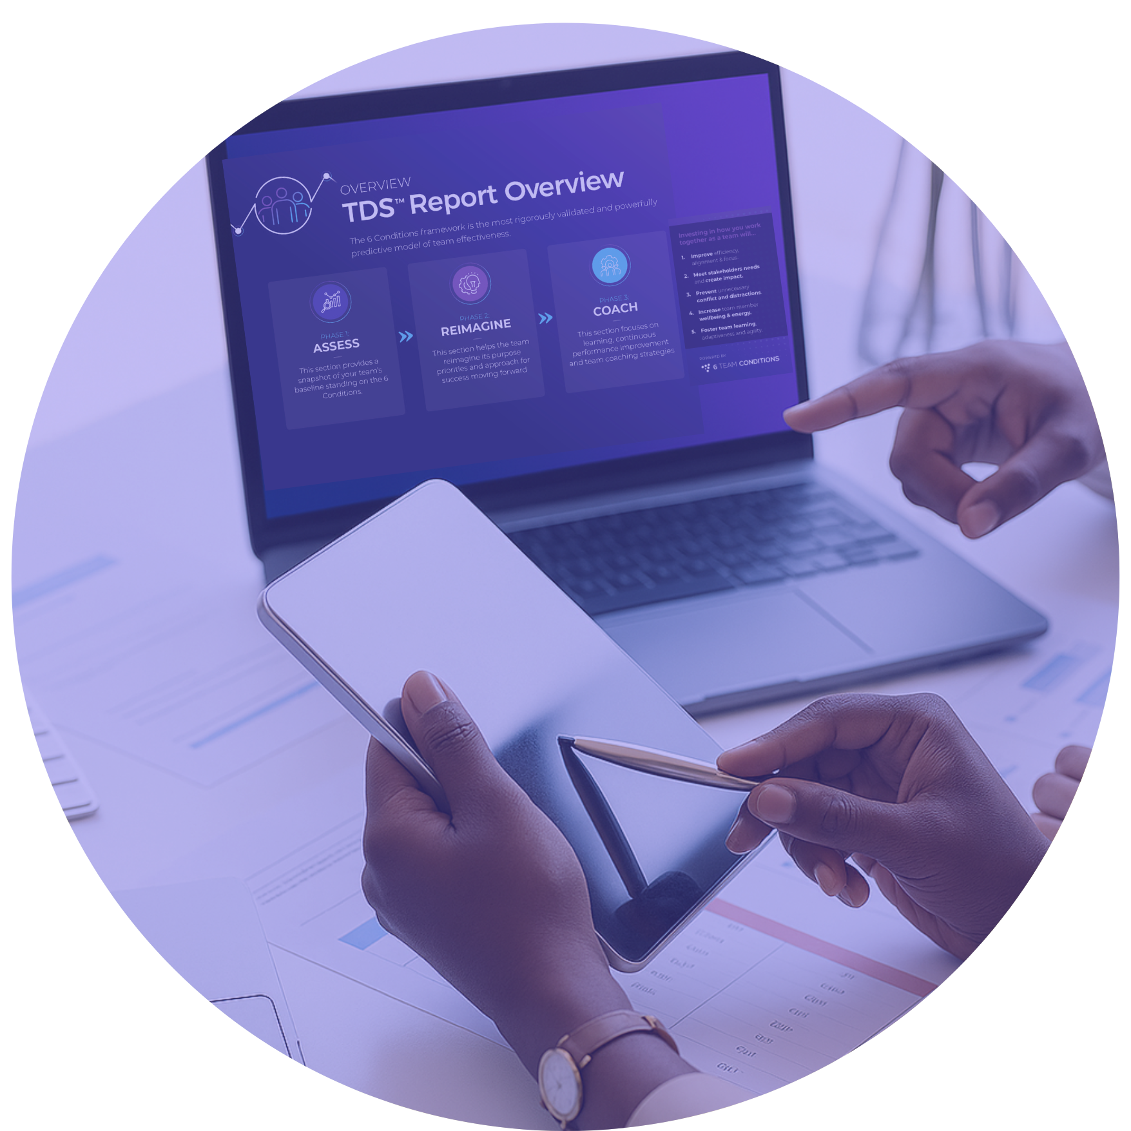
Foundational
Practitioner
Certification
PROGRAM INTRODUCTION
Copyright 6TCG, Inc. 2025

Slide 2


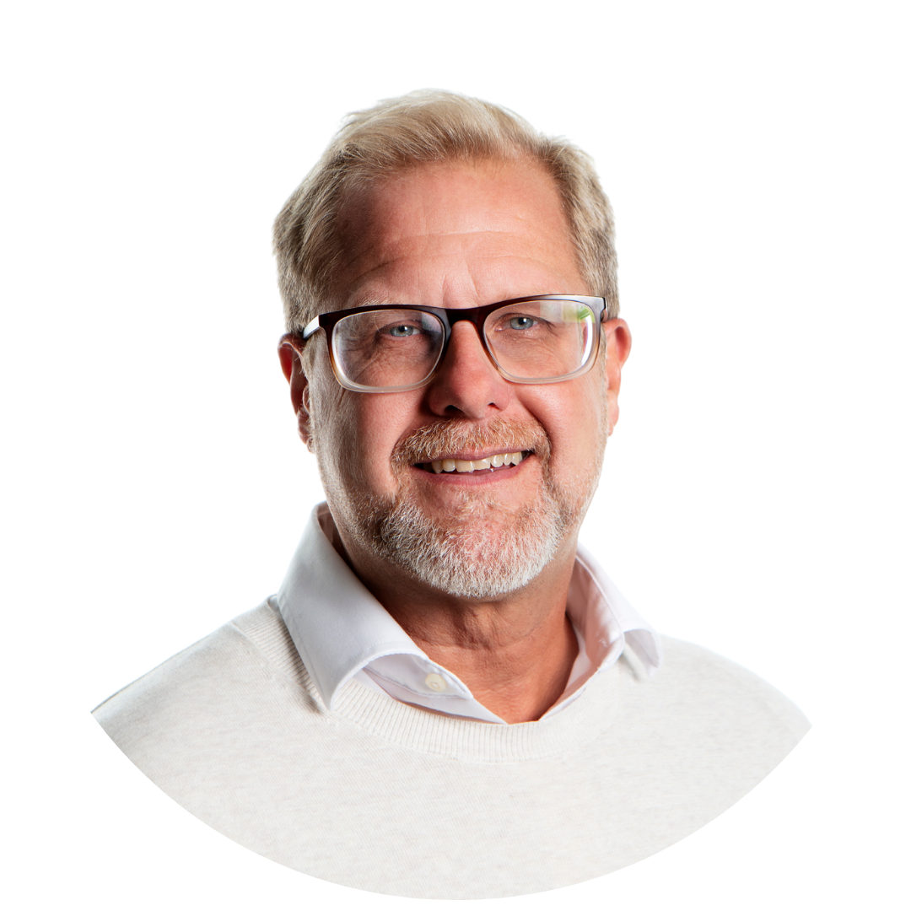

Course Instructors
Dr. Melissa J. Sayer
Dr. Melissa Sayer is a Co-founder and Managing Partner at 6 Team Conditions Global. She is a recognized scholar-practitioner and a passionate advocate of he power of teamwork to transform organizations.
Dr. Krister Lowe
Dr. Krister Lowe is Co-founder and Chief of Innovation at 6 Team Conditions Global. He has deep expertise coaching senior and mission critical teams as well as training team practitioners.
Dr. Ruth Wageman
Dr. Ruth Wageman is Co-founder and Chair at 6 Team Conditions Global. She is one of the foremost scholars and practitioners studying and working with teams, especially leadership teams.

Slide 3




Program Overview: Four Modules of Learning
01.
02.
03.
04.
The Science of Team Effectiveness: Organizing your experience and insights about teams
Assessing a team using the Team Diagnostic Survey
Recognizing patterns and drawing useable insights from data
Team Practitioner Key Skills: Sharpening your team development practice
Extending your learning: Deepening your learning about the 6 Conditions and expanding your practice beyond developing one team
6 Team Conditions Framework &
Team Diagnostic Survey

Slide 4
Purpose of the Course
Learning Objectives
Intended Outcomes
Introduce the Science of 6 Team Conditions as a distinctive approach to team development
Remember the 6 Conditions framework and recall it “at your fingertips”
Analyze teams using the Team Diagnostic Survey and other data forms to diagnose team effectiveness -the Assess Phase of the TDS
Demonstrate the depth and breadth of the Team Diagnostic Survey (TDS) to Assess, Reimagine (launch) and Coach teams
Apply practical team practitioner skills when working with leaders and teams
Plan and execute an intervention with a team leader and team utilizing the TDS to Assess a team’s strengths and areas for development
Synthesize the learning and apply to a case study team
Achieve a certification in the Foundations of 6 Team Conditions and a professional user of the TDS
Join a community of lifelong learners

Slide 5
Foundational
Practitioner
Certification
THE SCIENCE OF TEAM EFFECTIVENESS
MODULE
ONE
MODULE TWO
MODULE THREE
MODULE FOUR
Copyright 6TCG, Inc. 2025

Slide 6
Module Objectives & Outcomes
Learning Objectives
Intended Outcomes
A thought experiment to think about your own team experiences
Understand “Conditions Thinking” for Team Effectiveness
Introduce Conditions Thinking for Team and the 6 Team Conditions framework
Evaluate the 6 Conditions for Team Effectiveness
Demonstrate a team in action that is clear about its team structure and its authority structures
Analyse the 6 Conditions and authority structures that exist in teams
Setting us up for M2, this module will conclude with Ruth joining me so that I can introduce a case study of example of assessing a team around the framework us
Appreciate the use of the Assessment or diagnostic phase of working with a team through a case study example

Slide 7


03.
Participant Exercise: Your Insights on Team Performance
Copyright 6TCG, Inc. 2025.

Slide 8

Best Team | Worst Team
VS
VS.

Slide 9
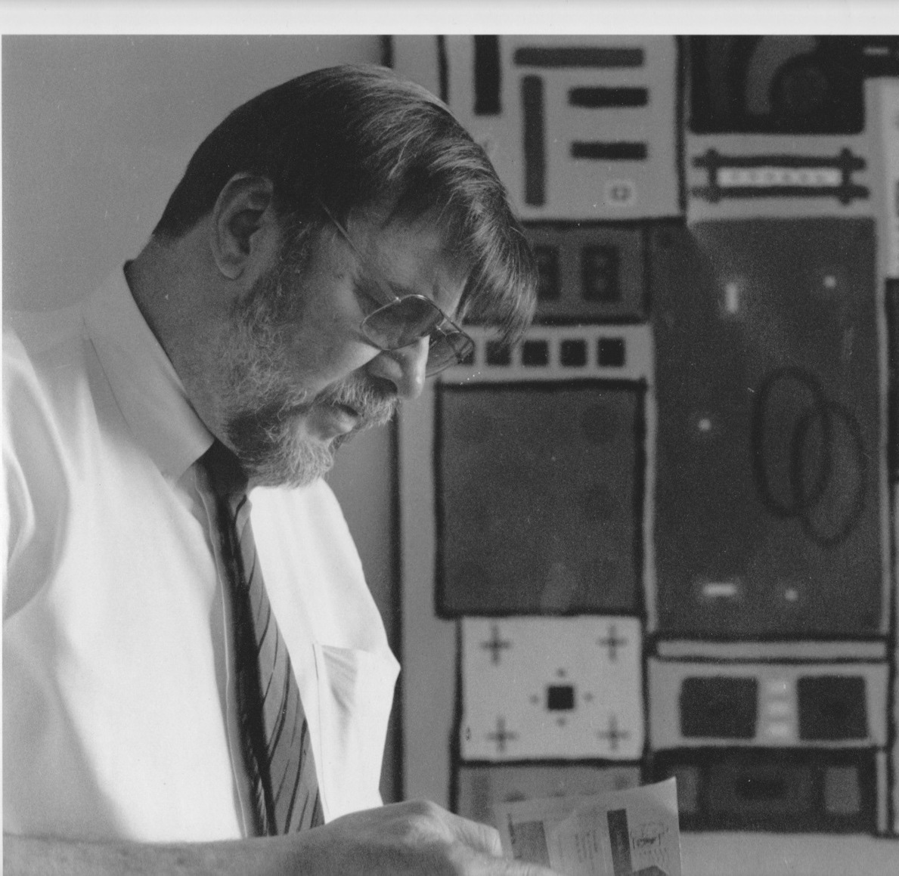
“
I have no question that when you have a team, the possibility exists that it will generate magic, producing something extraordinary….
But don’t count on it
J. Richard Hackman

Slide 10
04.
Lecturette: Introducing Conditions Thinking
Copyright 6TCG, Inc. 2025.

Slide 11
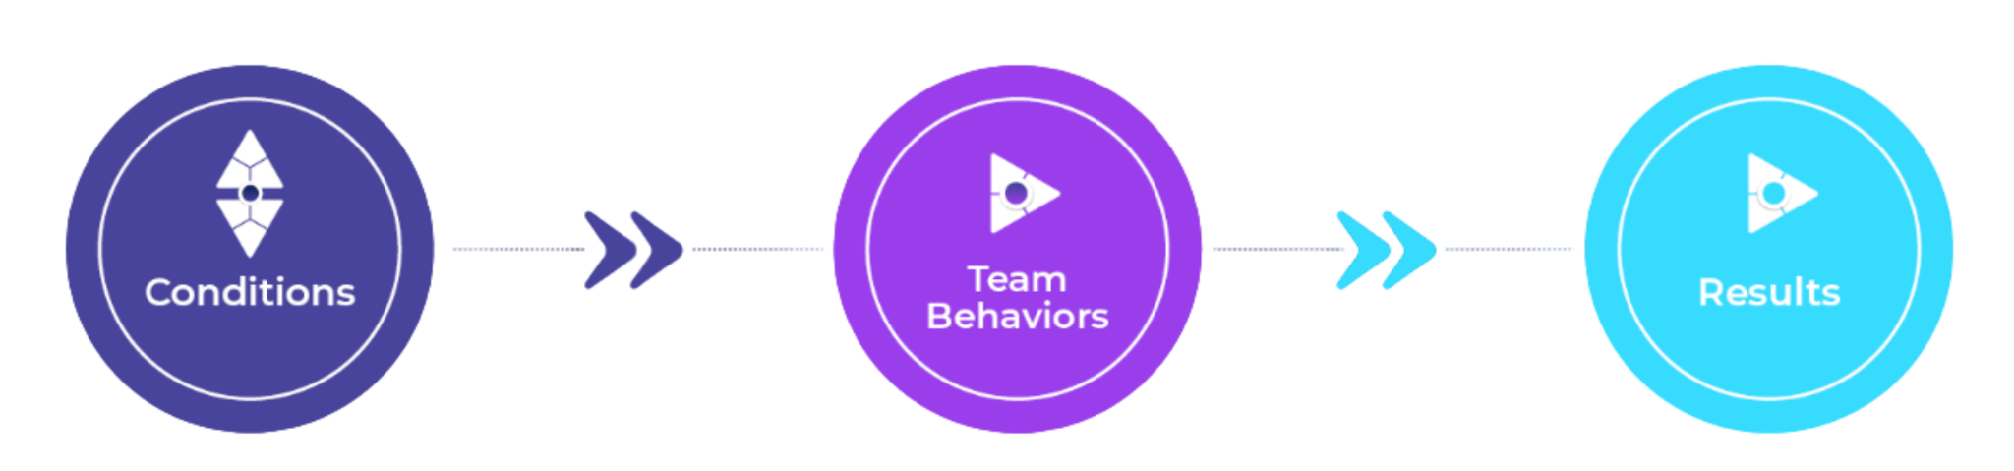
Conditions Thinking For Team Effectiveness
Copyright 6TCG, Inc. 2025.

Slide 12
05.
Lecturette: 6 Conditions for Team Effectiveness
Copyright 6TCG, Inc. 2025.

Slide 13


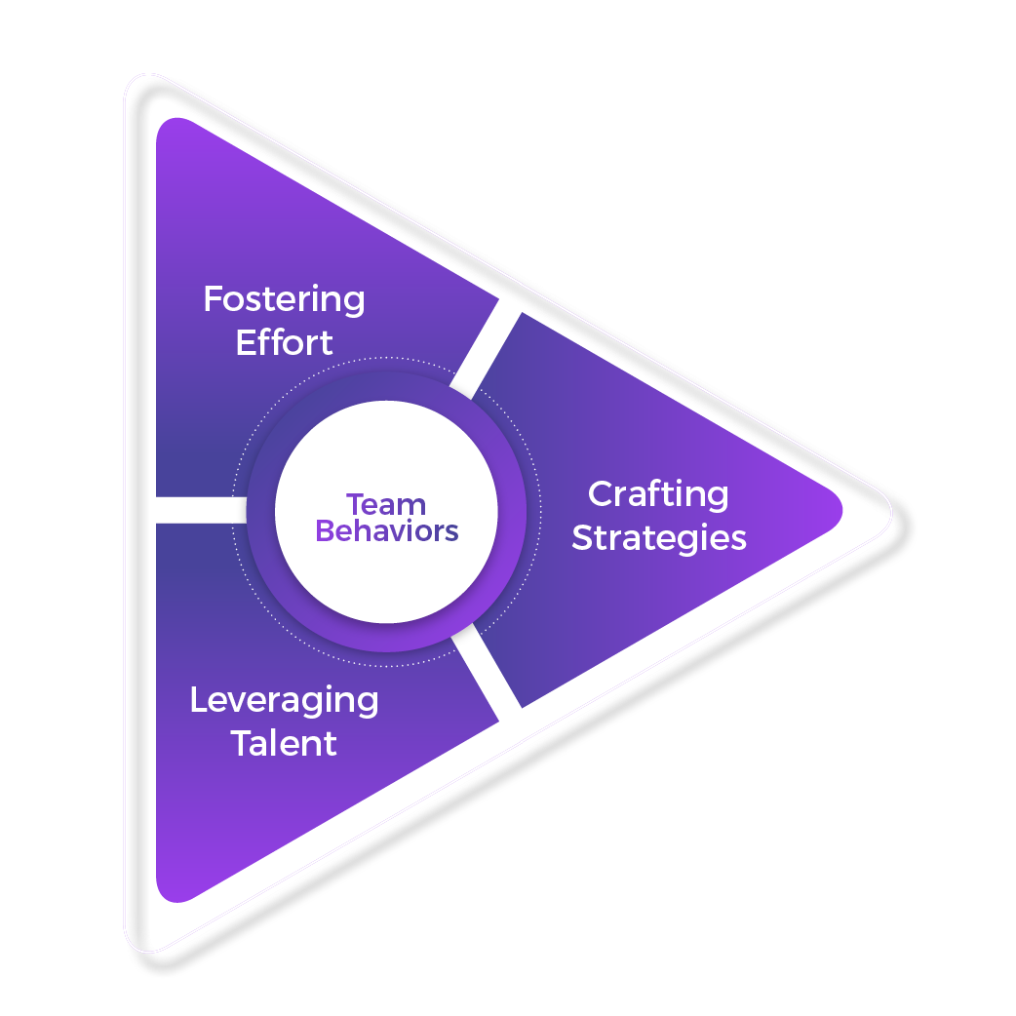
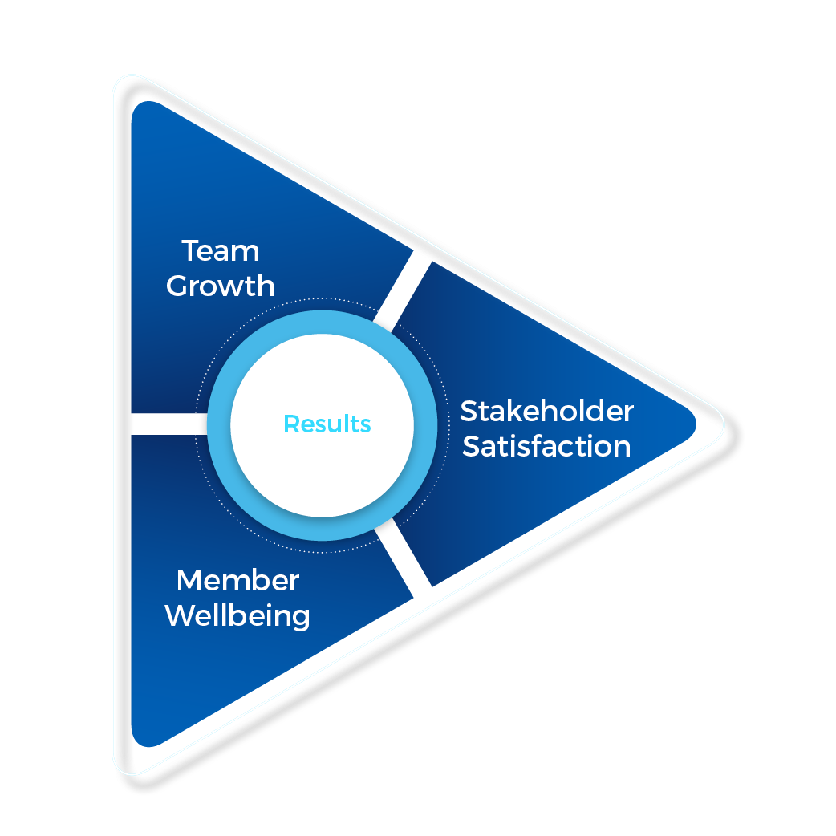
Overview of the 6 Conditions Framework
Real
Team
ESSENTIALS
Right
People
Compelling
Purpose
Conditions
Work
Design
Organizational
Support
ENABLERS
Team Coaching
Copyright 6TCG, Inc. 2025.

Slide 14
6 Conditions
ESSENTIALS
Building blocks
Conditions
Accelerators
ENABLERS
Copyright 6TCG, Inc. 2025.

Slide 15



Condition 1: Real Team
1
A Real Team is more than a label; it is a group of people who identify as a team and need to work closely together to accomplish their main work.
Boundedness:
Clear who is—and who is not—on the team
Essential Conditions
3
2
Stability:
Membership is kept intact long enough to accomplish something significant
4
5
Enabling Conditions
Interdependence:
Members are accountable for a common outcome and must work together to accomplish it
6

Slide 16



Condition 2: Compelling Purpose
A Compelling Purpose is a statement of what the team exists to accomplish in service of their stakeholders. It captures the team’s unique contribution to the success of the enterprise and the potential for impact.
1
Clarity:
Essential Conditions
Conveys what it would look like to accomplish the purpose
2
3
Challenge:
4
5
Requires a stretch but is not impossible
Enabling Conditions
Consequence:
Has meaningful impact on the lives and work of others
6

Slide 17




Condition 3: Right People
Right People means that the team is composed of the smallest configuration of members who have the skills to achieve the Purpose.
1
Task Skills:
Members have the array of capabilities to achieve the purpose
Essential Conditions
Teamwork Skills:
3
Members have the skills necessary to collaborate well with others
2
4
5
Cognitive Diversity:
Enabling Conditions
Team members bring a range of perspectives and experiences
Team Size:
As small as possible, but large enough to meet the demands of the work
6

Slide 18


Condition 4: Work Design
1
The team’s work design consists of the discrete tasks that are designed for the team to complete together, and an explicit set of norms and work practices that will promote effectiveness in the work.
Essential Conditions
Team Tasks:
Tasks that progress the purpose, draw on multiple members, and allow them to use a range of skills and judgment
3
2
4
5
Enabling Conditions
Norms and Practices:
Shared expectations about what the team does and does not do in working together
6

Slide 19




Condition 5: Organizational Support
Organizational support for teamwork means that the structures and systems that affect the team promote and enable teamwork rather than creating obstacles to collaboration.
1
Information System:
Provides timely data the team needs, in a form it can use, to monitor and manage its own work
Essential Conditions
Training and Education:
Training or consultation for novel challenges is readily available to teams
3
2
5
4
Enabling Conditions
Rewards/Recognition System:
Superb team performance is pervasively rewarded, not just individual accomplishments
Material Resources:
Teams can readily get the time, space, materials needed to collaborate
6

Slide 20
Condition 6: Team Coaching
Someone is available to the team—a leader, a member, an external consultant, who pays attention to the team’s process and intervenes at helpful moments.
1
Effective Team Coaching Has Two Features
Essential Conditions
Availability:
Someone readily available to observe the team in action and to offer coaching when the team needs it
3
2
4
5
Helpfulness:
Enabling Conditions
The coach has knowledge of how and when teams can be helped with their teamwork
6

Slide 21
3 Team Behaviors
Fostering Effort:
Fostering Effort
Helping the team to operate in ways that build shared commitment to the team
Crafting Strategies:
Helping the team devise uniquely suitable approaches to the work
Crafting Strategies
Behaviors
Leveraging Talent:
Helping the team use the full complement of knowledge and skill available from its members
Leveraging Talent

Slide 22




3 Team Results
Team
Growth
Stakeholder Satisfaction:
A great team meets or exceeds its stakeholder requirements.
Team Growth:
Stakeholder Satisfaction
Results
A great team gets better in capability
over time.
Member Wellbeing:
A great team has a positive impact
on the growth and wellbeing of its
members.
Member Wellbeing

Slide 23
06.
Participant Exercise: Evaluate a Team through the 6 Conditions Lens
Copyright 6TCG, Inc. 2025.

Slide 24
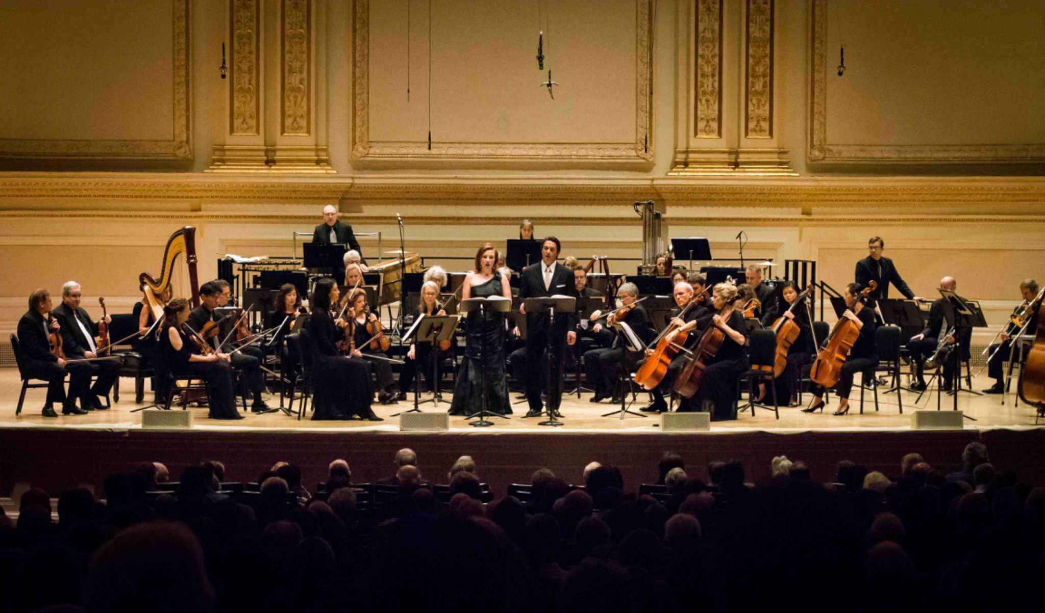
An Orchestra without a Conductor!
Lessons from Orpheus Chamber Orchestra
Copyright 6TCG, Inc. 2025.
Notes:
Allows for frame to appear with Video
Video is an introduction to the context and inviting learners to reflect on key questions
orpheus richard hackman
https://orpheusnyc.org/
https://www.youtube.com/watch?v=JU576t6B94U
https://www.youtube.com/watch?v=lR1M7HBC2Qg

Slide 25
An Orchestra without a Conductor!
Lessons from Orpheus Chamber Orchestra
VIDEO
Copyright 6TCG, Inc. 2025.
Notes:
Allows for frame to appear with Video
Video is an introduction to the context and inviting learners to reflect on key questions
orpheus richard hackman
https://orpheusnyc.org/
https://www.youtube.com/watch?v=JU576t6B94U
https://www.youtube.com/watch?v=lR1M7HBC2Qg

Slide 26
07.
Authority Structures
Copyright 6TCG, Inc. 2025.

Slide 27
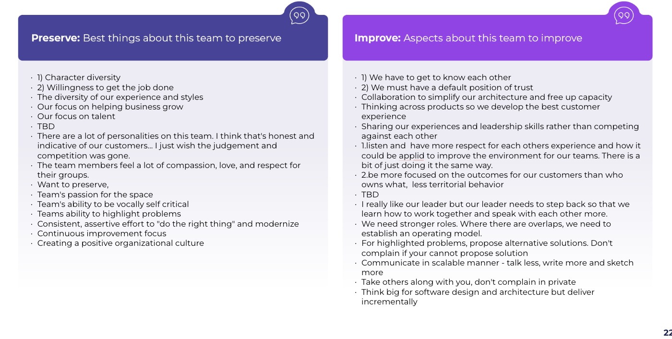
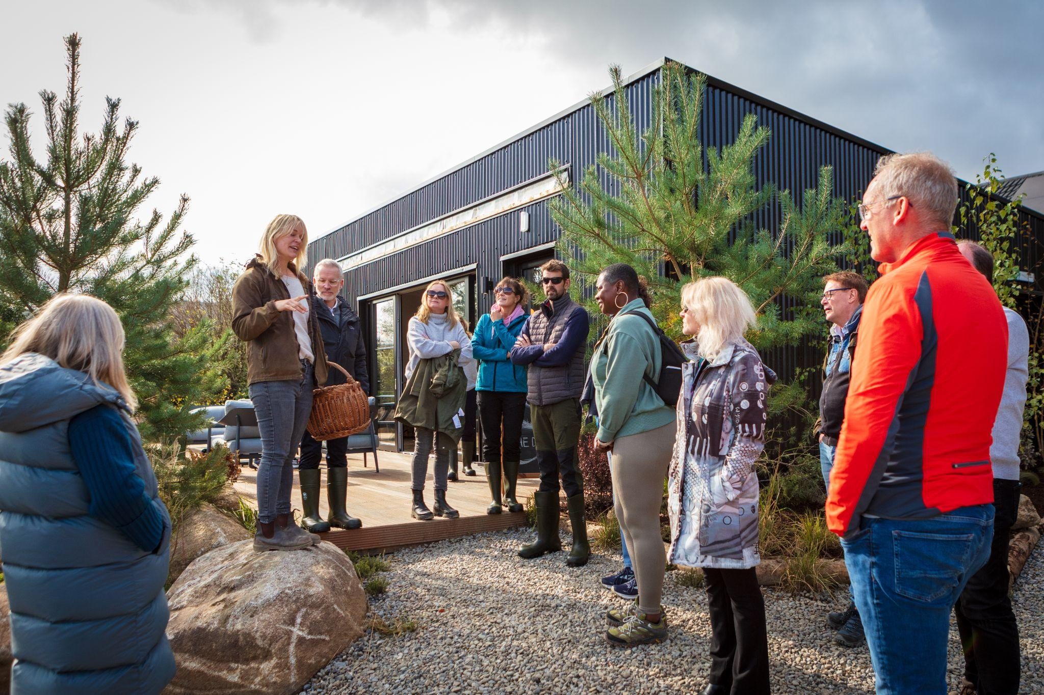
Leadership and Authority
J. Richard Hackman
“Orpheus is anything but a leaderless orchestra. It has, in fact, more leadership than I have seen in over a decade of research on group behavior and performance. Precisely because there is no conductor, each player must help decide about musical interpretations. Each must take responsibility for ensuring musical entrances are together, that themes are passed smoothly from section to section, and that the composer’s vision for a piece is realized beautifully and musically.
Four activities to perform in teams;
Establish Team Purpose & Overall Direction,
Choose the Members and Secure Resources
Monitor and Manage Work Priorities
Execute the Team Task

Slide 28




Team Authority Matrix
SELF-GOVERNING
SET OVERALL PURPOSE
WHO HOLDS AUTHORITY?
Self-governing teams execute tasks, monitor performance, design the team, and determine their main purposes.
SELF-DESIGNING
DESIGN THE TEAM MEMBERSHIP AND DISTRIBUTE RESOURCES
MANAGER’S
AUTHORITY
Self-designing teams execute their tasks, monitor their work, and also design the team and secure resources.
SELF-MANAGING
MONITOR AND MANAGE WORK PROCESSES
TEAM’S
AUTHORITY
Self-managing teams execute their tasks and also monitor their own performance and how the work gets done.
MANAGER-LED
EXECUTE THE TEAM TASK
Manager-led teams have authority only over executing their tasks. All other decisions are under the authority of the manager.
Manager-led
Team
Self-managing
Team
Self-designing
Team
Self-governing
Team

Slide 29
08.
Context Setting: Introducing a Case Study for Program Learning
Copyright 6TCG, Inc. 2025.

Slide 30



Case Study Example: Team A “Pulling off the Plaster”
Management Team
01.
02.
03.
04.
03.
04.
Introduce the Case: context for team coaching
Talk you through the Team Development Process 6 month Journey
Demonstrate how the framework was introduced to this team
Provide some high level insights on how the team are doing and how 6 Conditions will support

Slide 31
Case Context: Team A: “Pulling off the Plaster”
An organization in the financial services industry with over 12,000 employees in multiple office and retail locations. Working with one of the Divisions - Division responsible for the Customer, so the bloodline of the Organization. The organization experienced significant challenges after the Great Recession, and many crisis practices emerged in response, however, that crisis continues to exist in the institution some 10 years later.
This case study is one of four teams coached in parallel with the process supported by senior leadership as participants and sponsors as a means to developing team effectiveness as a competency as part of a transformation agenda STRATEGY 2021 and the future of the organization.
This management team is made up of 12 team members, with a pair of co-leaders. The Co-leaders are also members of a leadership team receiving coaching in parallel. The Division is central to the organization and many divisions rely on its outputs to meet Customer’s needs. Key stakeholders of the team recognize that the crisis and subsequent years were particularly grueling for this team, and that the pain if still felt.
The team have vast experience, and technical expertise. They all have large teams that report to them and whilst they are through the “crisis”, it is very much BAU and reactive to the needs of the organization and customers. TIME IS NOT FOUND FOR THE TRANSFORMATION. There is a lot of infighting with the leader and team describing “bickering” “toxic” “blame culture” “you get roasted at team meetings” “our teams hear it”.

Slide 32
Case: Team Development Process
›
CONTRACTING
Leader
Leader & Team
Vision of Success
ANALYZE
data and prepare interpretation with supporting themes. DESIGN Relaunch Session
RELAUNCH
Re-contract;
share vision of success
Agree Norms
Debrief Data and Sensemake
RELAUNCH
Agree actions and commitments with timelines for actions
OBSERVATION
Contracting & Observe team in regular meeting, utilise TDS data, focus on process loss and gain
COACH
Co-created session with team team based on progress and urgency
DIAGNOSTIC
Interview:
Team Members
Stakeholders
Organizational Data
Team Diagnostic Survey
DEBRIEF
Team Leader
Share Relaunch Design
Re-Contract
RELAUNCH
Support development of Essentials & Enables.
CHECK-IN
Progress check in on milestones and
progress
COACH
Share feedback with team and focus on team learning practices
SUSTAIN
Pulse Check and Sustainability
EVALUATION

Slide 33
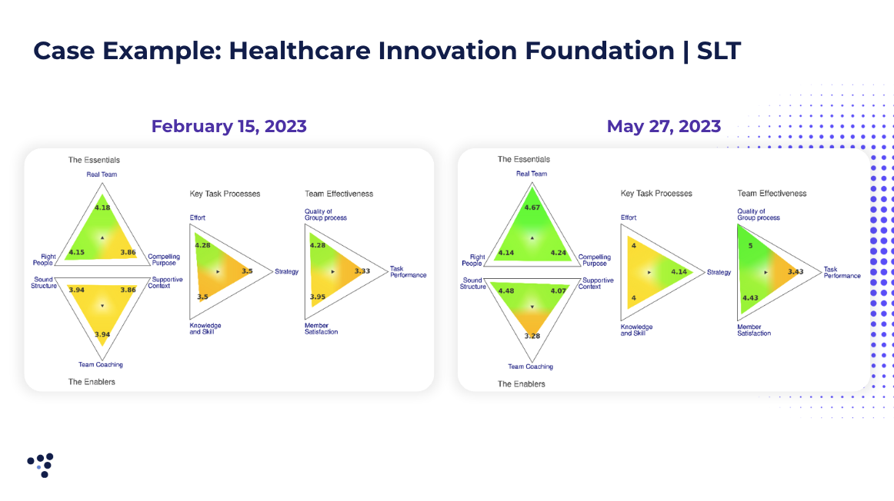




Introducing the the 6TC Framework:
Tips & Best Practices
DEBRIEF
Team Leader
Share Relaunch Design
Re-Contract
›
Farming
Rocket Launch
Building a House
Sailing

Slide 34
Vision of success for Team Coaching
Work together
Be one team
Listen to our teams
Be role models
Retain our people
Have a common vision
Respect and be respected
Communicate our successes
Contracting
Contracting with the team leader and team on what they want to achieve from team coaching.
What will be different about this team, following a team coaching intervention.

Slide 35
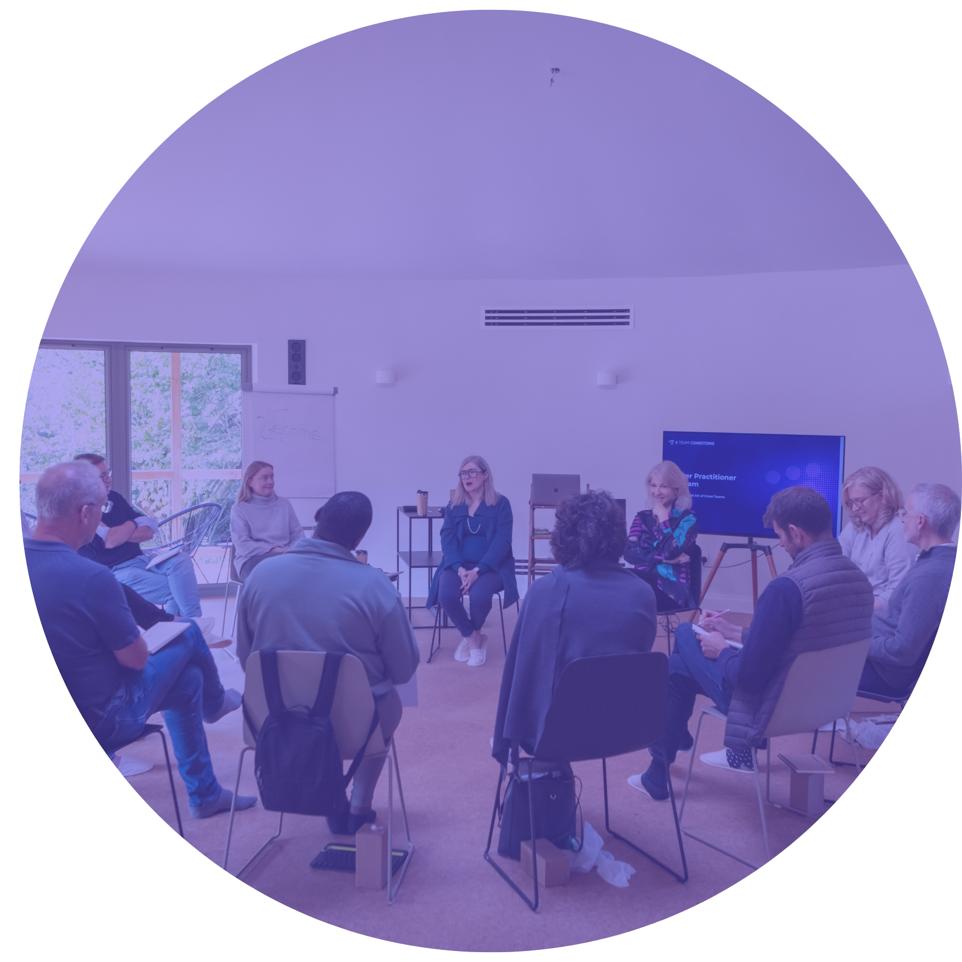
Module Review

