Slide 1

Financial Planning
Live Your Dream Life Years Sooner

Slide 2
Planning Your Ideal Life with a Financial Plan
Why Do You Need Financial Planning?
FREEDOM

Slide 3
Planning Your Ideal Life with a Financial Plan
Why Do You Need Financial Planning?
Freedom in how you use your time
Freedom from worry
Freedom in how you do your job
Freedom to make the life choices you want

Slide 4
Planning Your Ideal Life with a Financial Plan
Why Do You Need Financial Planning?
“I hope I don’t get sued”
“If something happened to me, I don’t know if my family would be ok”
“I don’t think I’ll buy a business for another 5 years”
“This housing market is too hot. I’m going to sit it out until things cool off”
“I wish I could work less, but I can’t right now”
“In my ideal life, I’d probably work part time”
“I think about my student loans all the time. It’s a constant worry”
“Honestly, I have no idea how much I spend”
“Every time I look at my paycheck, I’m floored by how much I spend in taxes”
A FINANCIAL PLAN DESTROYS LIMITING BELIEFS

Slide 5


Planning Your Ideal Life with a Financial Plan
Financial planning also helps you use the tools you need to achieve your goals

Slide 6




Investing After the Corona Recession in 2021
Planning Your Ideal Life with a Financial Plan
Why is Financial Planning About to Become a Lot More Important?
Inflation is pushing up
prices for everything
We could be facing a
recession
You now have far more
choices for your money

Slide 7
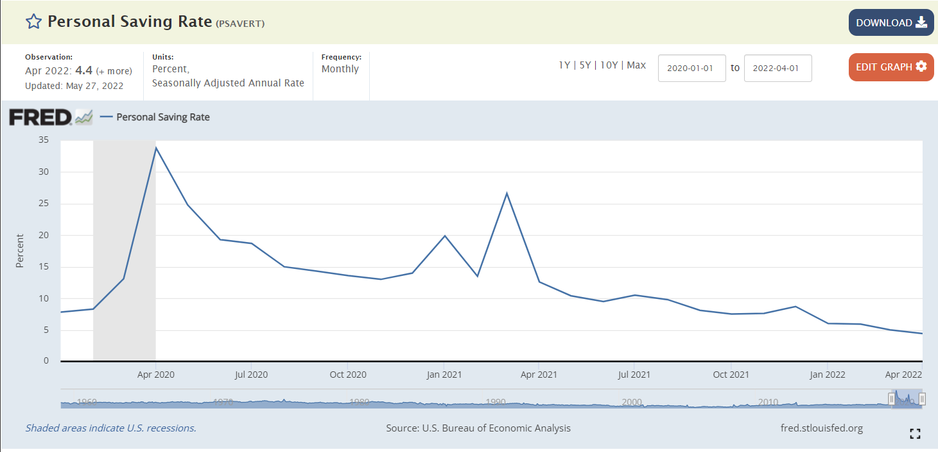
Planning Your Ideal Life with a Financial Plan
PLUS, the US Personal Savings Rate Just hit the lowest rate since the financial crisis of 2008
35%, April 2020, big stimulus
26%, March 2021, big stimulus
4.4%,
high inflation

Slide 8
Planning Your Ideal Life with a Financial Plan
Why You Need Financial Planning
Spend what you want to without worrying
Pay less in taxes, which helps you get to your goals faster
Protect against worst-case scenarios
You’ll be prepared for big life milestones instead of being stressed about them
Gets you to your dream life faster

Slide 9
Planning Your Ideal Life with a Financial Plan
1. Spend what you want to with cash flow management and budgeting
The only way to say no to something is to have a bigger yes
When mortgage rates double, you decide not to buy the $1 million dream house
Why?
Because you like travelling more than you value a large home

Slide 10
Planning Your Ideal Life with a Financial Plan
1. Spend what you want to with cash flow management and budgeting
You can manage spending by:
Using “traditional budget method”
Using “goal prioritization method”
Using the “fixed expenses method”

Slide 11
Planning Your Ideal Life with a Financial Plan
Why You Need Financial Planning
Spend what you want to without worrying
Pay less in taxes, which helps you get to your goals faster
Protects against worst-case scenarios
You’ll be prepared for big life milestones instead of being stressed about them
Gets you to your dream life faster

Slide 12
Planning Your Ideal Life with a Financial Plan
2. Pay less in taxes to get to your goals faster
W-2 vs 1099
Business owner vs. employee
Passive investing vs. active investing
Retirement vehicles
Avoiding taxes on big life events
Itemizing deductions

Slide 13
Planning Your Ideal Life with a Financial Plan
Why You Need Financial Planning
Spend what you want to without worrying
Pay less in taxes, which helps you get to your goals faster
Protects against worst-case scenarios
You’ll be prepared for big life milestones instead of being stressed about them
Gets you to your dream life faster

Slide 14
Planning Your Ideal Life with a Financial Plan
3. Protecting against worst case scenarios
Are your assets properly titled?
Do you need term life or own occupation disability? How much?
How do you pay less for better quality coverage?
Do you have the right kind of health insurance?
Did you get adequate umbrella and homeowner’s insurance?
Do you need a will and power of attorney?

Slide 15
Planning Your Ideal Life with a Financial Plan
Why You Need Financial Planning
Spend what you want to without worrying
Pay less in taxes, which helps you get to your goals faster
Protects against worst-case scenarios
You’ll be prepared for big life milestones instead of being stressed about them
Gets you to your dream life faster

Slide 16
Planning Your Ideal Life with a Financial Plan
4. Being prepared for big life milestones
Get on track for retirement
Navigate big housing decisions confidently
Know how to get the best car purchase deals
Know what to expect when having a child or getting married financially
Should you own a business? If yes, you’ll want to take a few actions first
Prepare for before and after becoming financially independent

Slide 17
Planning Your Ideal Life with a Financial Plan
Why You Need Financial Planning
Spend what you want to without worrying
Pay less in taxes, which helps you get to your goals faster
Protects against worst-case scenarios
You’ll be prepared for big life milestones instead of being stressed about them
Gets you to your dream life faster

Slide 18

Planning Your Ideal Life with a Financial Plan
A Financial Plan is Your “Treasure Map” to an Ideal Life

Slide 19
Planning Your Ideal Life with a Financial Plan
What’s Important to You? Ask 3 Questions*
1. You win the lottery. What do you do?
2. You find out you have 5 to 10 years left to live. What do you do?
3. You find out you have 1 day left to live. What are your regrets?
*Credit: George Kinder

Slide 20
Planning Your Ideal Life with a Financial Plan
What’s Important to You? Ask 3 Questions*
How does your life change with no financial constraints?
This shows your dreams
2. If you need to prioritize your goals with urgency, what’s most important?
This is what you should focus on doing asap
3. Identifying regrets helps you eliminate them
*Credit: George Kinder

Slide 21
Planning Your Ideal Life with a Financial Plan
Remember that tools are just tools until you use them for a specific purpose

Slide 22
Planning Your Ideal Life with a Financial Plan
Always Reflect on Your
WHY
And adjust your plan accordingly

Slide 23
Planning Your Ideal Life with a Financial Plan
5 Action Steps to Take Now
1. Track and understand your spending so it reflects your values (use one of three methods)
Double check that you’re minimizing your taxes
Review your insurance coverage to make sure you don’t have unnecessary policies
and that you have good coverage for the stuff you really need
Think about your biggest life goals for the next 5 years.
Invest properly for these specific goals
Write down everything on a one-page financial plan customized for you

Slide 24
Planning Your Ideal Life with a Financial Plan
Tips for Getting the Most Out of the Course
ASK QUESTIONS in each comment section
Join live webinars when we offer them, and listen to old ones when we post them
Take the time to watch the course videos
THANKS!

