Slide 1


Disabled
Wilfred Owen
Narrator: Barbara Njau

Slide 2

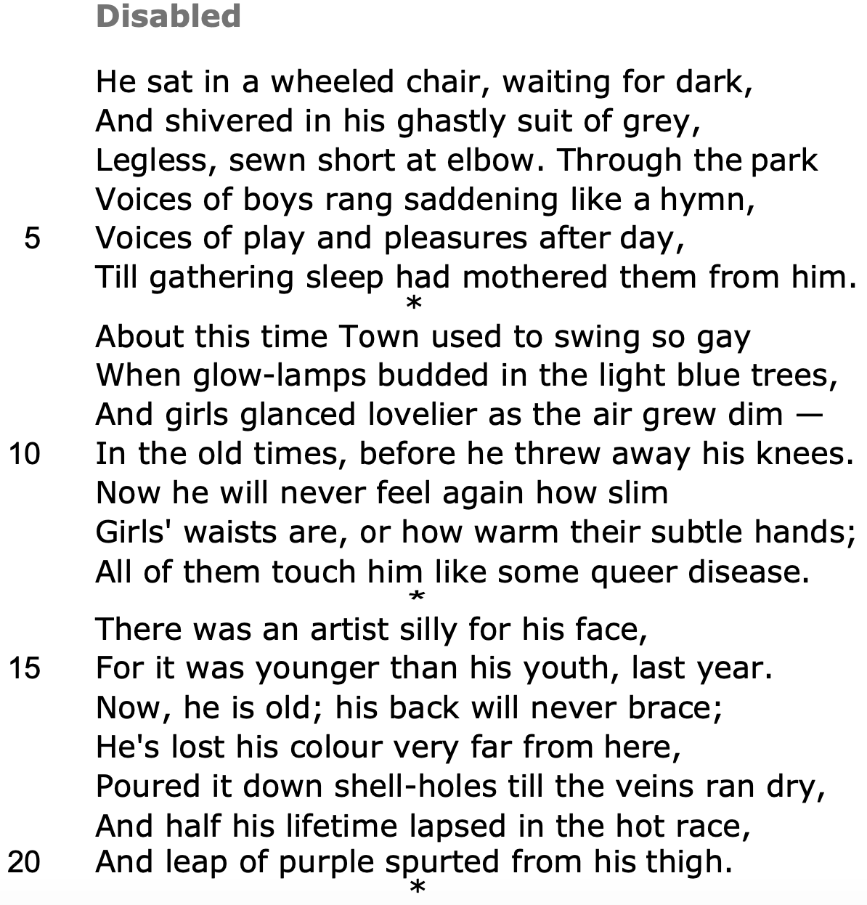

Metonym replaces the wholeness of his identity
Pronoun - anonymous
Caesura
Stasis and passivity
Semantic field of darkness shows existence is nihilistic
Sibilance
Enjambment
Repetition suggests
only he can hear this
Simile shows this is a sad song for him
Alliteration
Sleep is personified -
comforting escape for him
Alliteration - temporal focus
Intensifier highlights positive past
Metaphor - carefree youth
Alliteration highlights the promise of youth
Suggests decision to
enlist was careless
Antithetical temporal shift between the past and present
Synecdoche
Semantic field of body parts shows he misses being able to move in an agile way and he misses intimacy from women
Comparative adjective focuses on his vitality as a young person
Simile - ostracised
Oxymoron flashes forward and creates a stark contrast
Metaphor shows he gave
his life away to the war
Alliteration emphasises his lost years

Slide 3
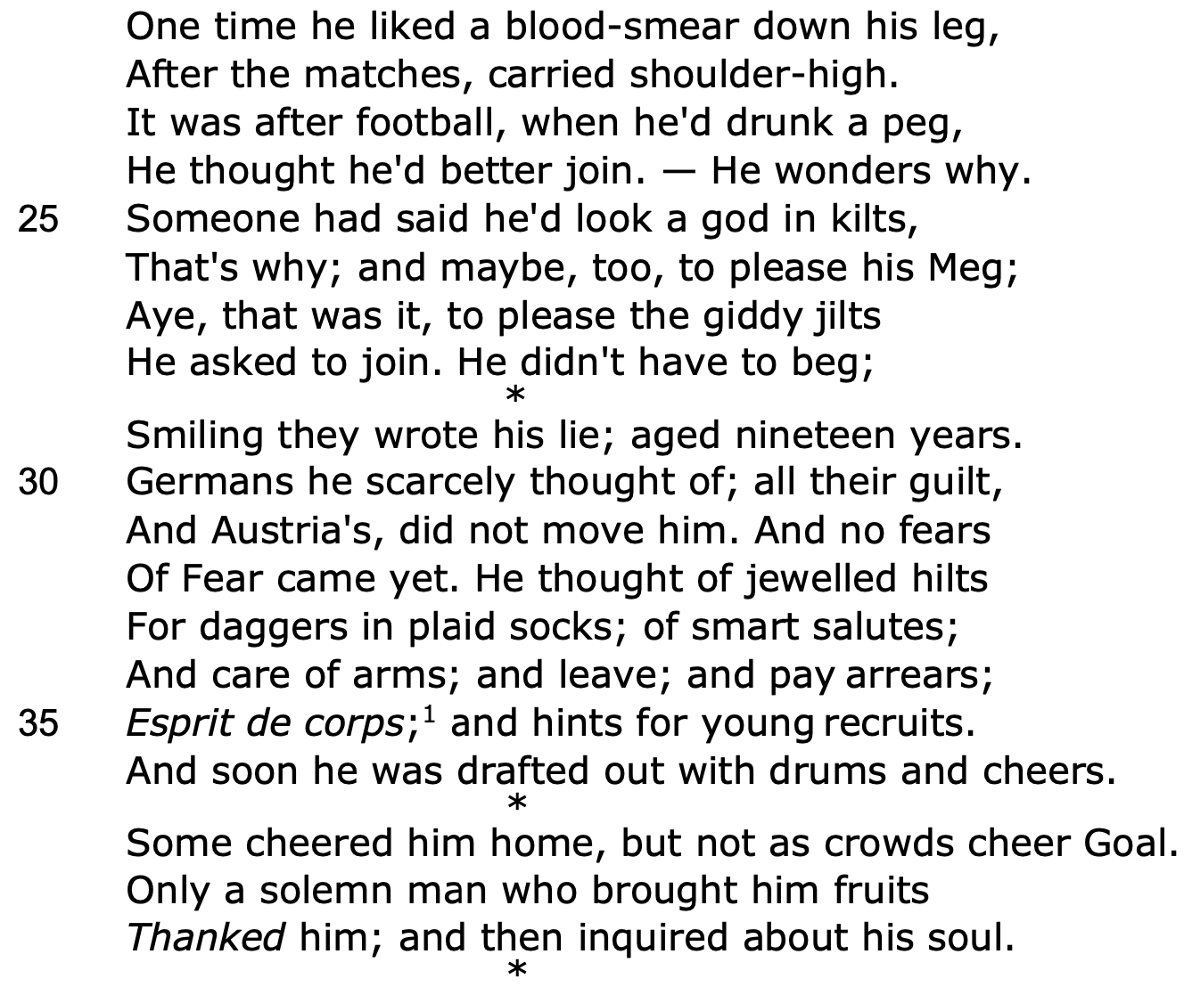
Badge of honour as it shows his prowess
Specific snapshot memory -
post-match celebration
Repetition of third person pronoun - it's ambiguous if he is joining the match or signing up for war
Caesura - volta as
he feels really regretful
Colloquial - we
hear his voice
He enlisted to gain respect from his peers
Young working class men signed up for war
Present-continuous verb
Adverb shows he did not realise the gravity of his actions
Proper nouns refer to the enemy countries
Bejewelled handles show
the allure of conscription
Capitalisation of abstract noun highlights he did not fear mortality or death
Asyndeton shows he took a superficial interest in participating in the war
Collective noun shows some people didn't appreciate his sacrifice
Anonymous

Slide 4
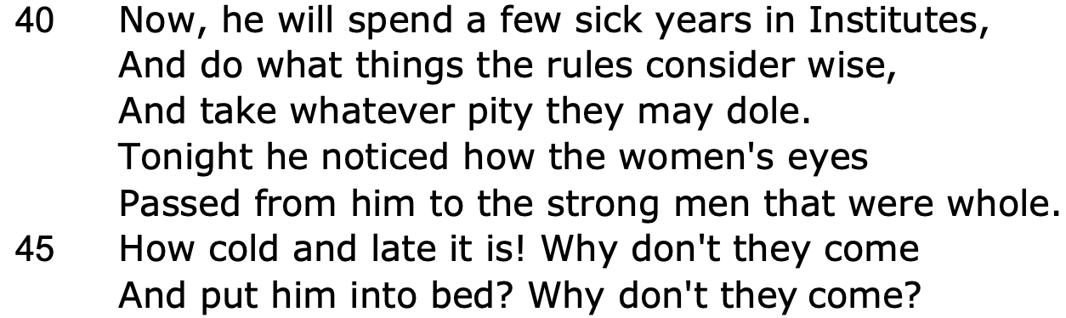
Temporal shift
Adjective shows hopeless stasis
Repetition of conjunction shows how monotonous and repetitive his life is
Symbolises desire
Contrasts title
Exclamatory sentence
Rhetorical questions emphasise how isolated he is - we feel pathos

Slide 5
THANK YOU!
WWW.FIRSTRATETUTORS.COM

