Slide 1

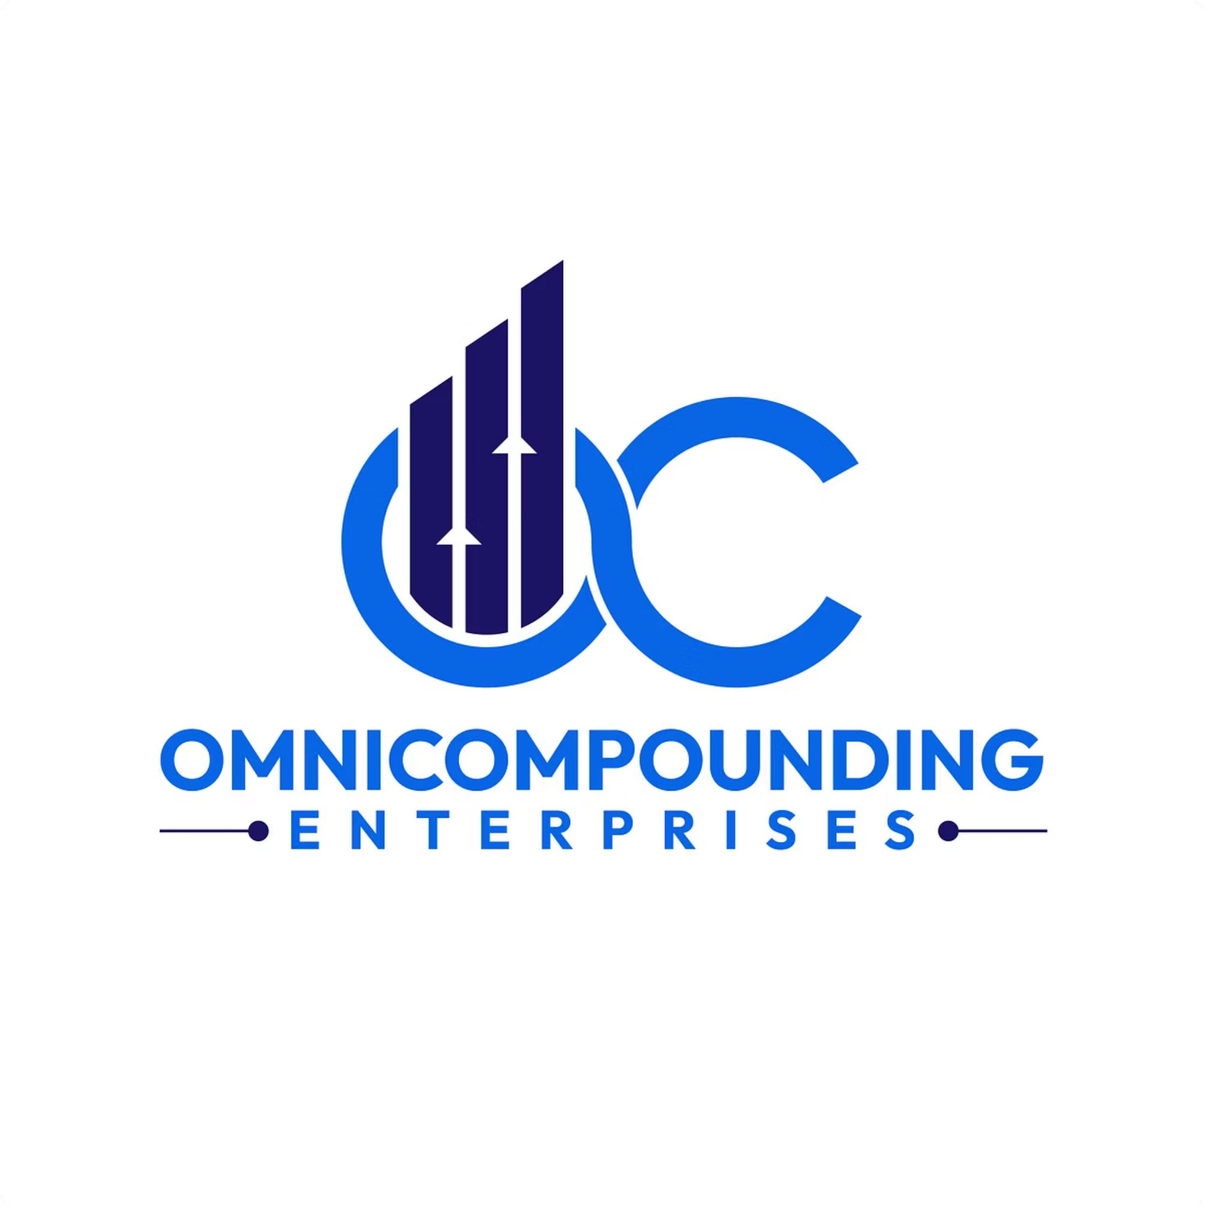
Business Development
Converting cold clients
to your Mutual Fund Business

Slide 2
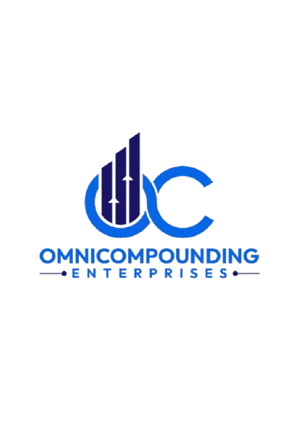
The Challenge Every New Distributor Faces
Starting with zero client base
Building credibility from scratch
Converting prospects who don’t know you
Overcoming rejection and skepticism
Creating consistent pipeline of leads

Slide 3


Your Business Development Framework
3. Conversion
Close with solutions that add value
2. Engagement
Build rapport and trust through conversations
1. Lead Generation
Identify and reach prospects systematically

Slide 4
Where to Find Your Cold Leads
Personal and professional network (friends & relatives)
Social media connections
Referrals from existing clients (very powerful)
Events, seminars and community programs
Corporate offices and businesses in your area

Slide 5



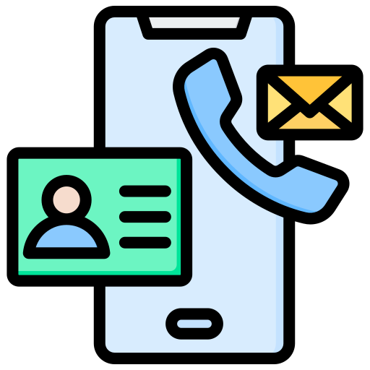
Preparation: The Secret Weapon
Before you make first call, know your prospect:
Professional background and career stage
Likely financial goals (retirement, education, wealth)
Recent life events (job change, promotions, major purchases)
How you got their contact information

Slide 6
Your Winning Opening Statement
Hi Mr…. , this is (your name). I got your contact from ….
I help professional like you build long term wealth
through strategic mutual fund investments that suits you.
Do you have 15 minutes for a quick conversation?

Slide 7



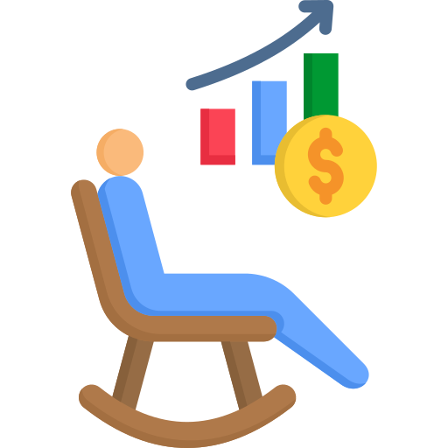

Ask Smart Qualifying Questions
What are your biggest financial goals for the next 5-10 years?
How are you currently managing your investments?
Are you on track with your retirement planning?
What concerns you most about your current financial situation?
Ask open ended questions not yes/no questions
Ask a question and listen with full attention
RULES:

Slide 8
Common Objections You'll Hear
“I’m already investing with someone”
“I don’t have time to discuss this now”
“I need to think about it”
“I don’t know much about mutual funds”

Slide 9
The 90-Day Follow-Up Rule
Most sales happen after the first call, not during it:
Day 1: initial call + build relation
Week 1: Send relevant article or market update
Week 2-3: phone call with personalized suggestion
Monthly: Regular touchpoints (email, call, meeting)

Slide 10
Trust = Your Most Valuable Asset
Always deliver what you promise
Be transparent about risks and benefits
Admit what you don’t know
Provide educational content without selling
Ask for referrals from satisfied clients

Slide 11
Moving from Prospect to Client
Schedule a proper financial planning meeting
Understand their complete financial picture
Present a customized investment solution
Explain fees and charges clearly (SEBI compliance)
Ask for commitment and get proper documentation

Slide 12
Week 1 Action Plan
Make
10 cold calls
Schedule
2-3 meetings
Track
Every interaction

Slide 13
Measure Your Progress
Calls made per day/week
Conversion rate (calls to meetings)
Meeting to client conversion rate
Average time to close a prospect
Average AUM per new client

Slide 14
Always Remember: Compliance First
Follow SEBI guidelines on disclosure
No misleading statements about returns
Proper documentation for every client
Know Your Customer (KYC) compliance
Keep records of all communications

Slide 15
Your Success Mindset
Rejection is NOT personal. It's just part of the process.
5 rejections = 1 qualified prospect
10 meetings = 2-3 clients

Slide 16
Mistakes That Kill Your Pipeline
Not following up consistently
Talking more than listening
Pushy sales tactics instead of advisory approach
Inconsistent communication and availability
Giving up after first “no”

Slide 17
Your 30-Day Challenge
Make 50 cold calls
Schedule 10 meetings
Convert 2-3 clients
Track everything. Review weekly. Adjust and improve.

Slide 18

Let's Build Your Business!
Miles journey starts with our first step
Building wealth through mutual funds, starts with one cold call

