Slide 1
Uniform Circular Motion
Slides Version 1
This version includes:
Slides with screenshot images from the video.
The video narration in the slide notes.
A blank template slide with the same background and font as the video.
Slides with some basic graphics from this video for you to use however you like.
Feel free to add, delete and edit slides to make your own presentation. You can use these slides in class or share them with your students, but please do not share them with anyone else.
If you have any feedback, suggestions or questions about these slides please email me at chris@physicslab.app or send me a message on Discord @physicslab.
physicslab.app

Slide 2
Heading
Text

Slide 3







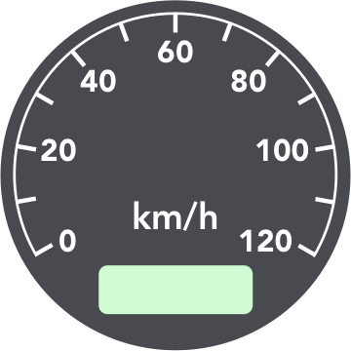













Slide 4
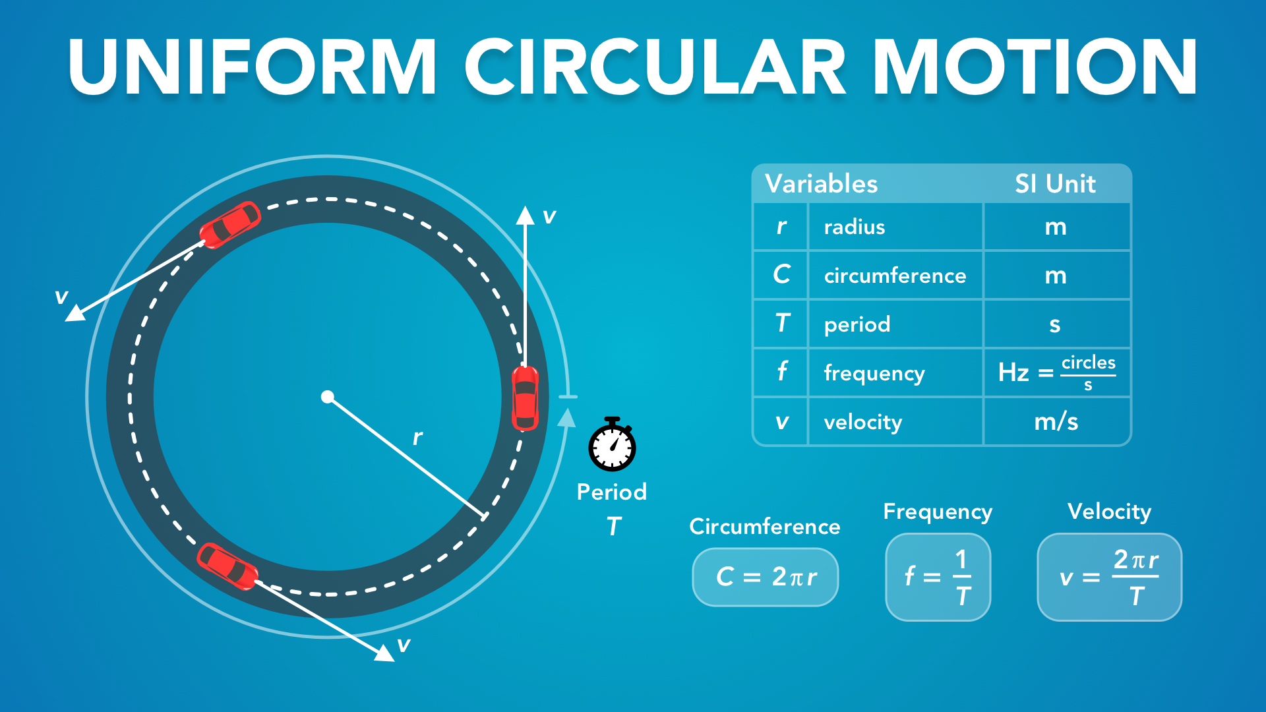
Notes:
Uniform Circular Motion
physicslab.app
If you have any questions, suggestions or feedback about these slides please email me at chris@physicslab.app or send me a message on Discord @physicslab.

Slide 5

Notes:
In this video we’re going to learn about uniform circular motion.

Slide 6
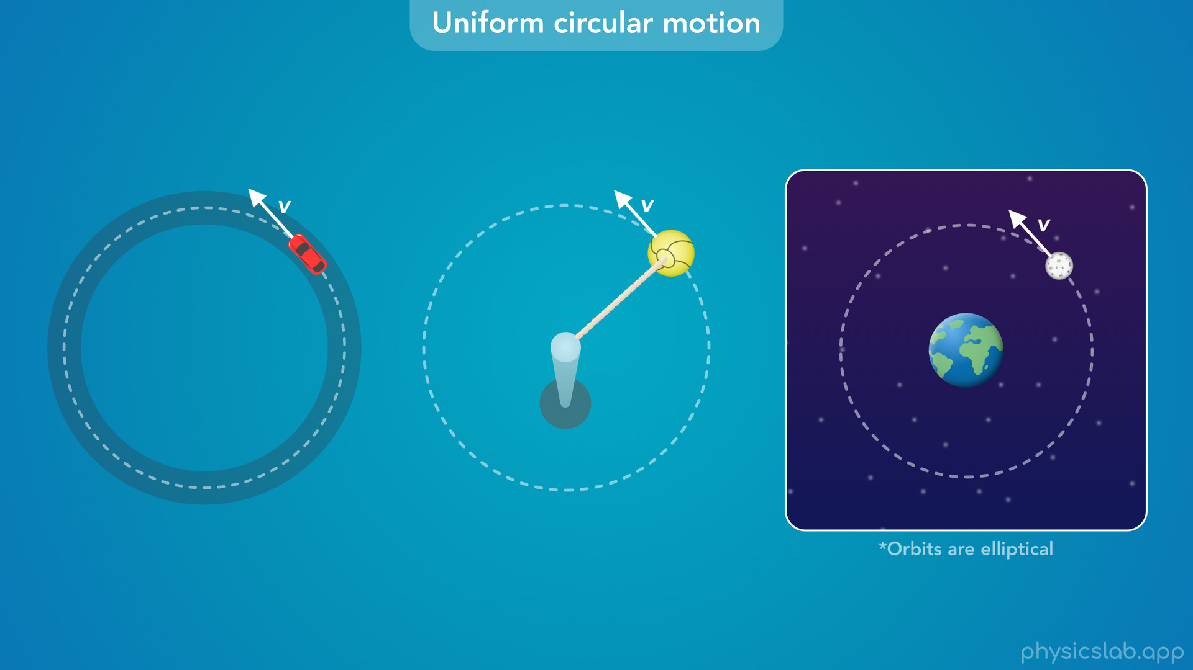
Notes:
• We’ll explain what the word uniform means and look at some examples.

Slide 7
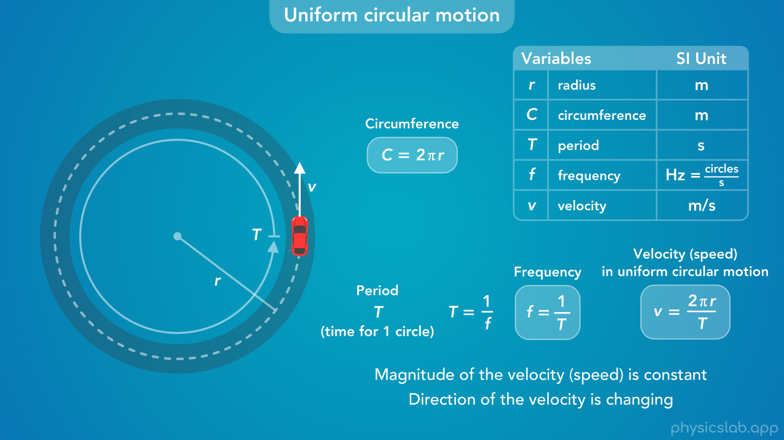
Notes:
• Then we’ll learn how to describe uniform circular motion using the radius, circumference, period, frequency and velocity.
• We’re going to cover centripetal acceleration and centripetal force in other videos, and this video will cover the basics.

Slide 8

Notes:
• So what is uniform circular motion?

Slide 9
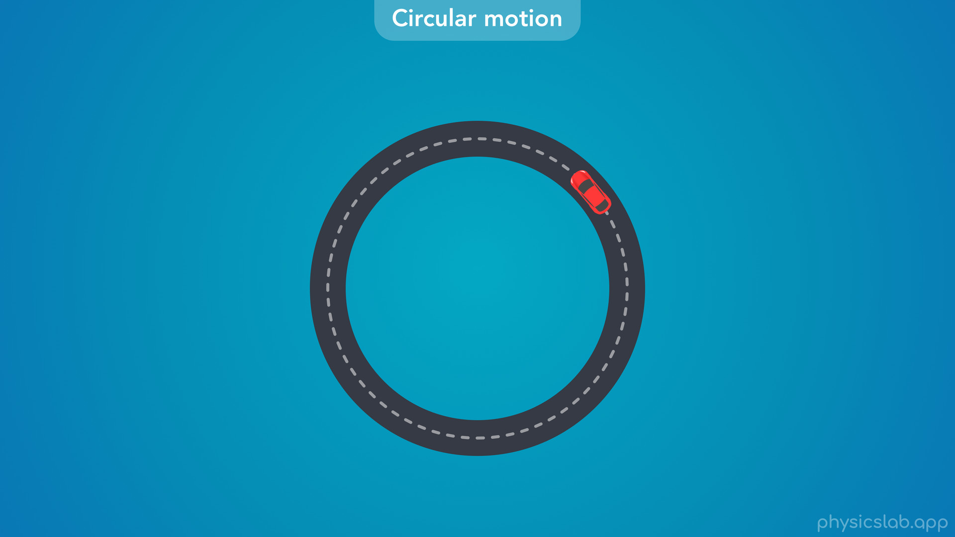
Notes:
• In a previous video, we learned about circular motion, where an object travels along a circular path, like this car.

Slide 10
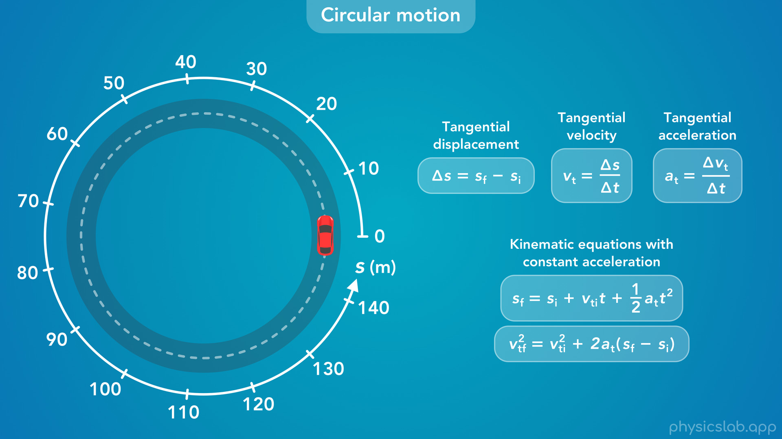
Notes:
• We can describe the motion of the car using a circular axis and these kinematic equations.

Slide 11
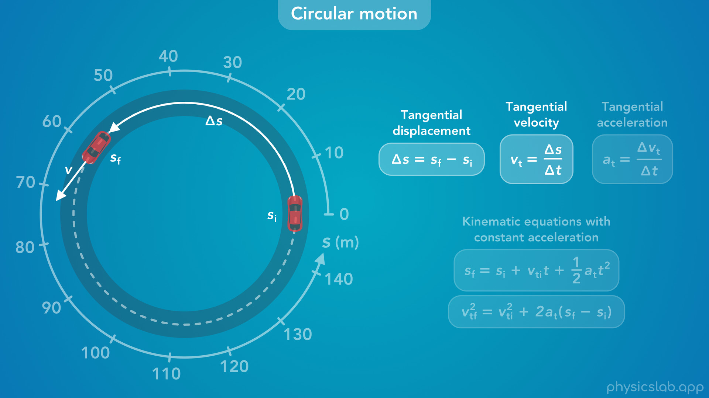
Notes:
• If the car travels from some initial position to some final position, we can describe its tangential displacement and its tangential velocity.

Slide 12
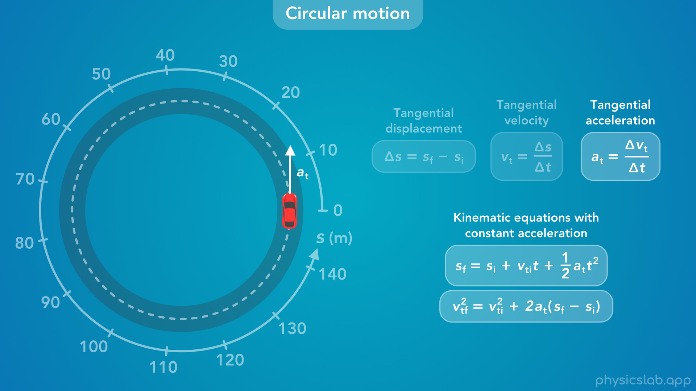
Notes:
• If the car has some tangential acceleration, it will speed up or slow down, and we can describe its position and velocity at any point in time.

Slide 13
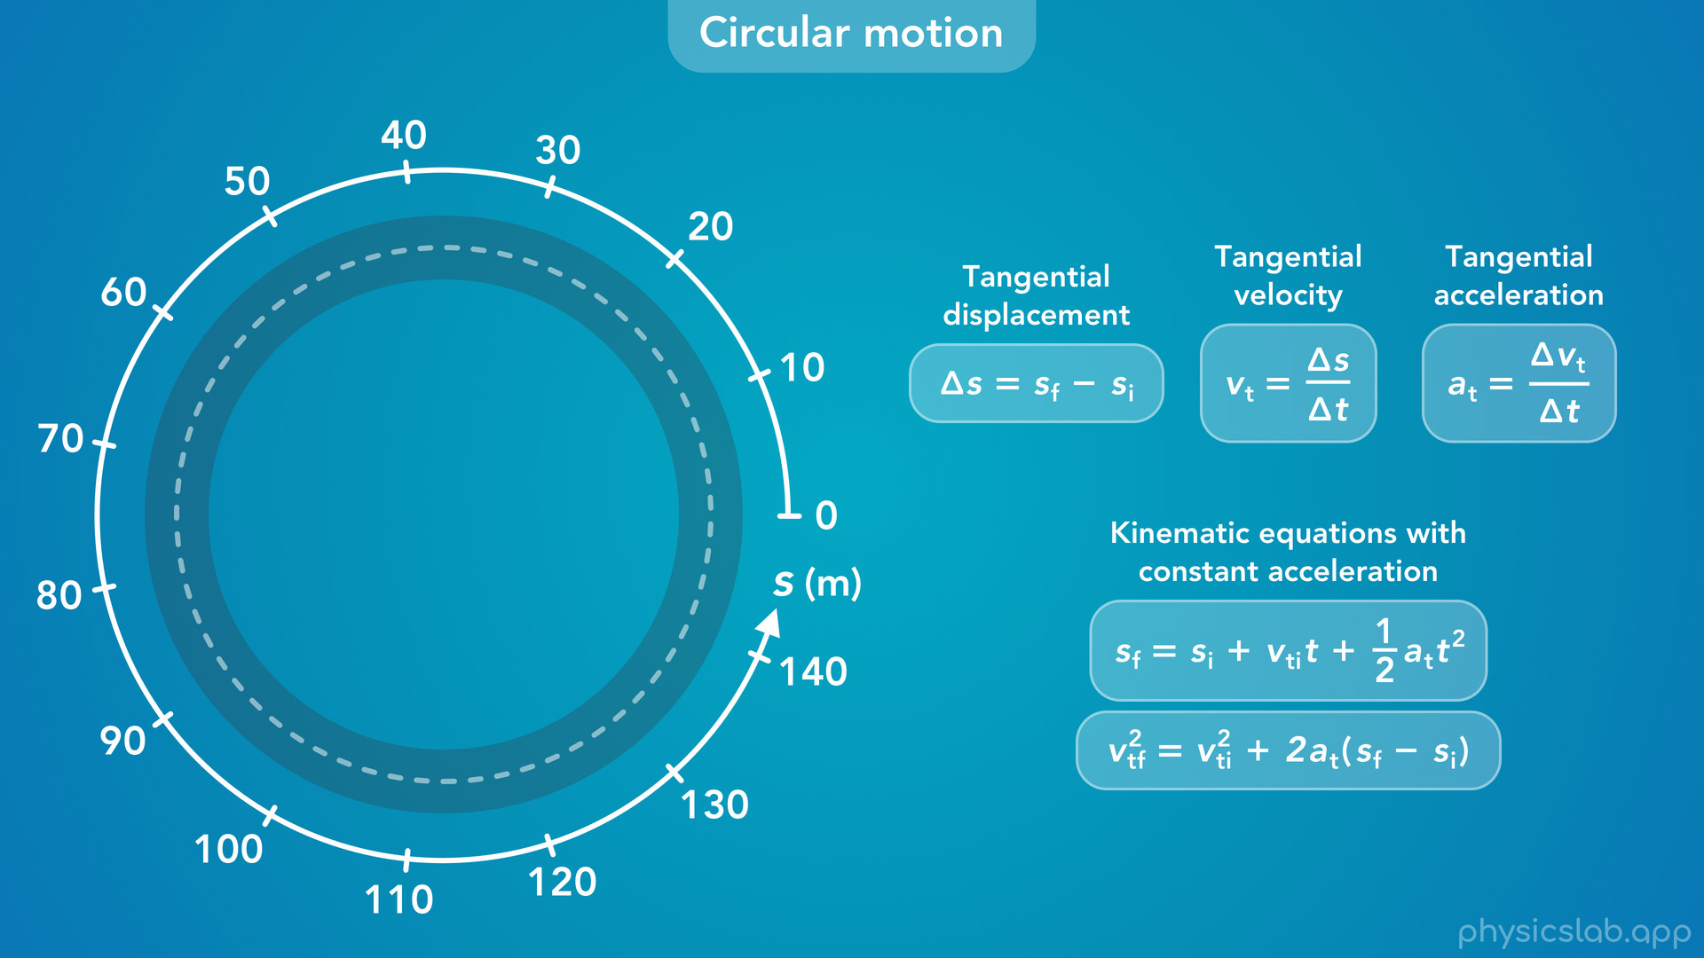
Notes:
• We can always use these equations for circular motion.

Slide 14
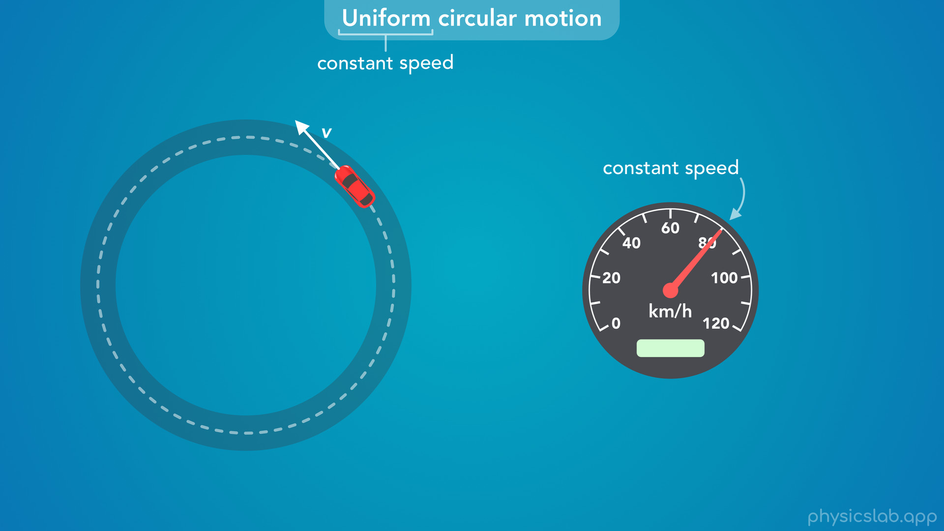
Notes:
• But what if we’re dealing with a simple case where the car keeps driving around at a constant speed, like 80 km/h or 22 m/s.
• This is what we call uniform circular motion.
• The word uniform means “constant”, and in this case it means constant speed.
• So the car continues to drive around in a circle, and it doesn’t speed up or slow down.

Slide 15
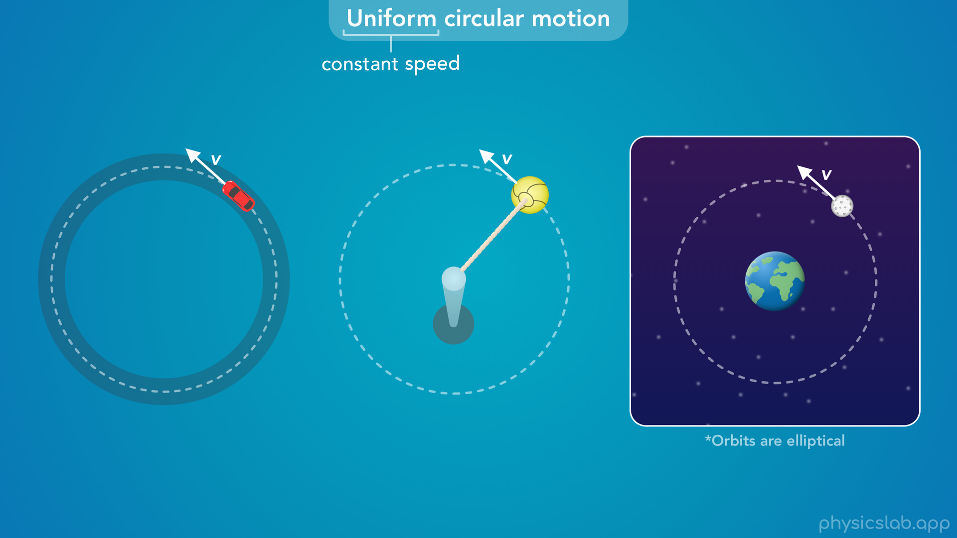
Notes:
• We can see this type of motion in other scenarios, like a tetherball attached to a rope that’s swinging around a pole at a constant speed.
• We’re also going to describe orbital motion as uniform circular motion, where a smaller object orbits around a larger object at a constant speed.
• Technically, orbits are elliptical, but we’re mostly going to treat them as circles when we learn about orbital motion.

Slide 16
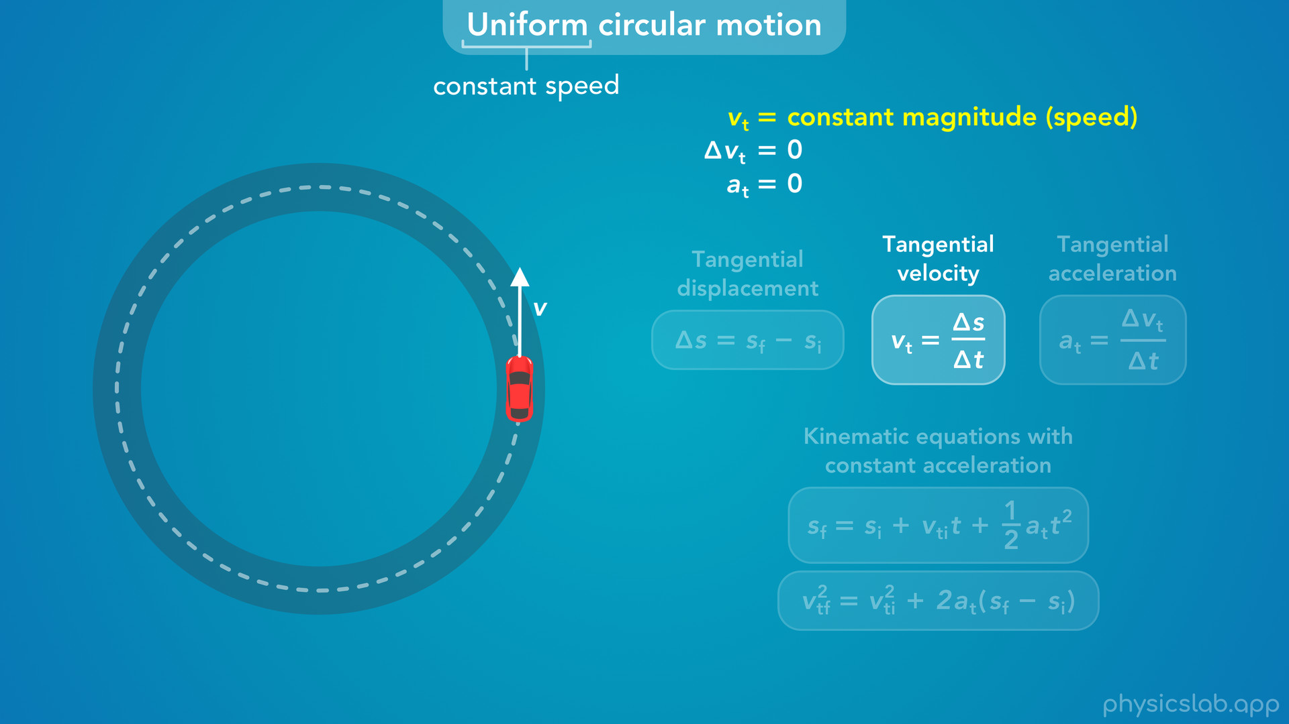
Notes:
• So in uniform circular motion, the magnitude of the tangential velocity is constant, which means there is no tangential acceleration, and we don’t need the equations with acceleration.
• And if the car continues going around the circle, we might not have initial and final positions, and we wouldn’t need to describe the displacement of the car.
• We’ll come back to the velocity equation later.
• So what are some other equations and variables we could use to describe uniform circular motion?

Slide 17
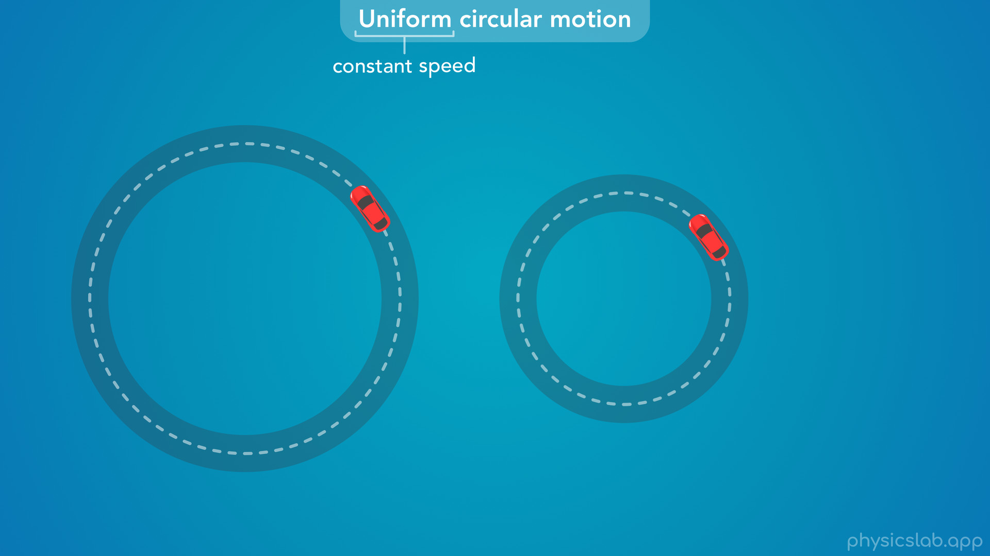
Notes:
• For example, what’s the difference between the motion of these two cars?

Slide 18
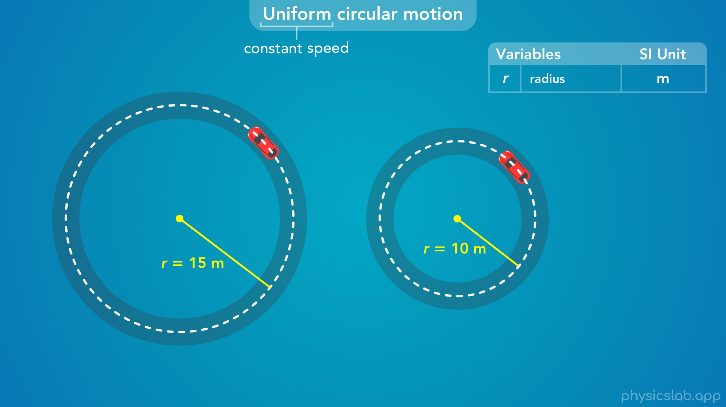
Notes:
• Well first, the circle on the left is bigger than the circle on the right.
• So the first variable we might need is the radius of the circle, r.
• And keep in mind that the circle we’re describing is the path traced out by a point at the center of the car.

Slide 19
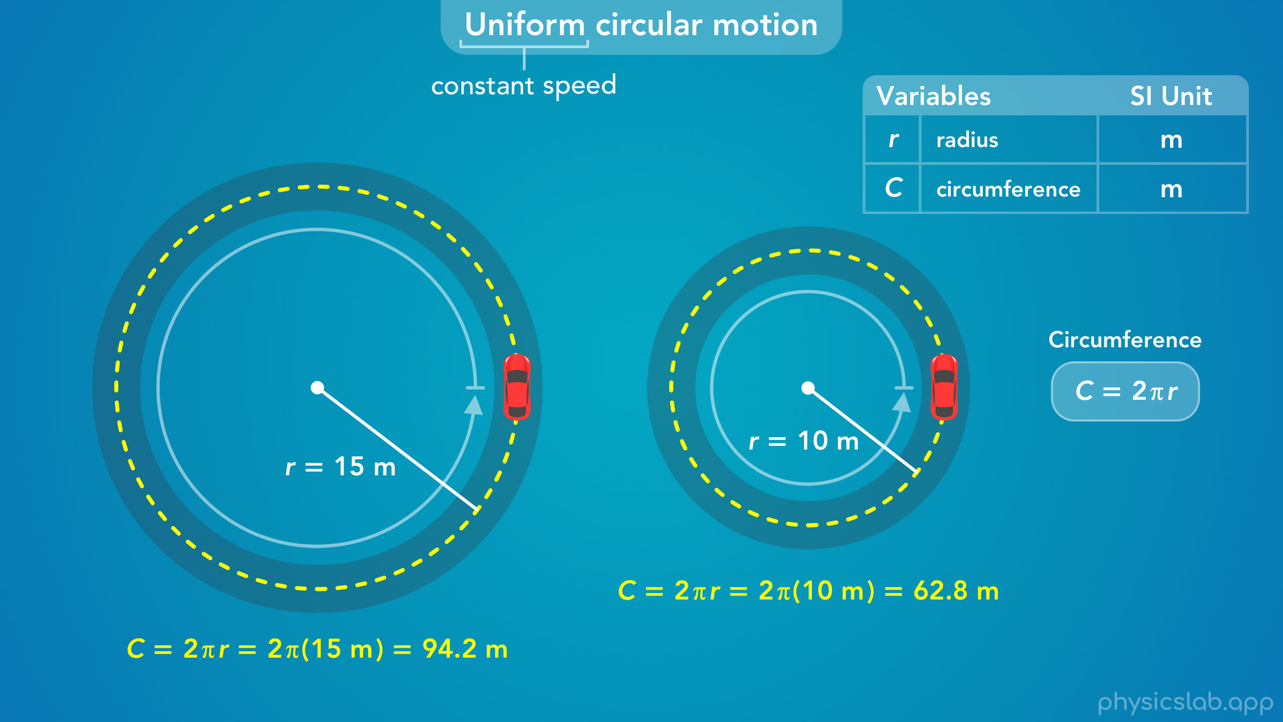
Notes:
• We could also describe the size of the circular path using the circumference, capital C, which equals 2 times pi times the radius.
• The circumference is the distance the car travels during one revolution or one lap around the circle.

Slide 20
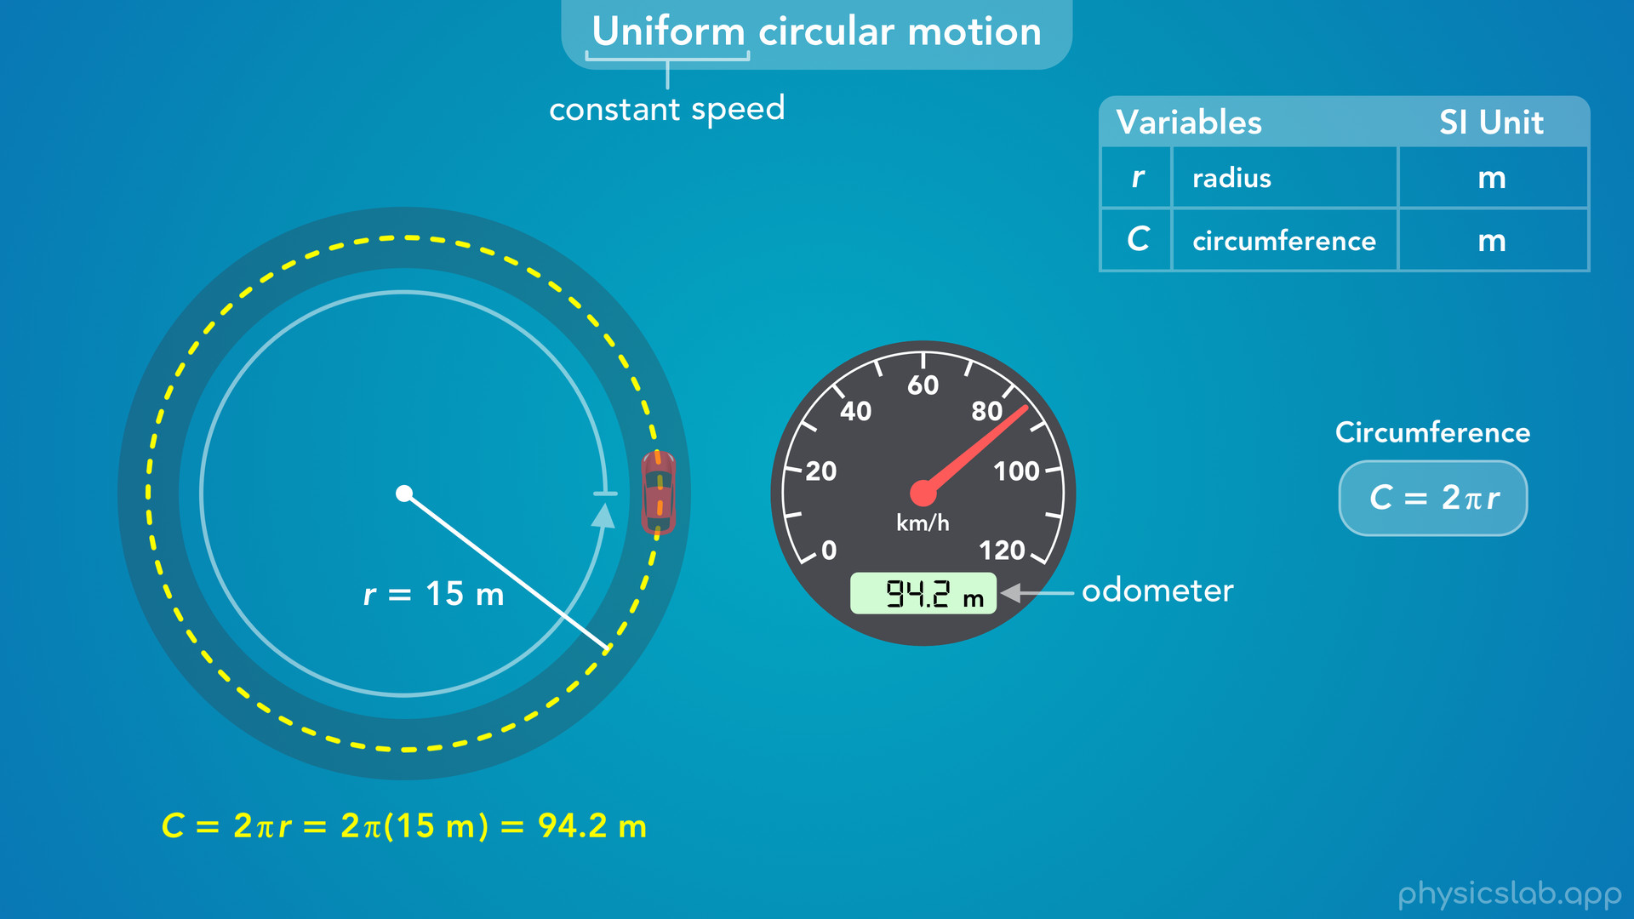
Notes:
• For example, if this car reset its odometer to zero and then did one lap around the circle, the distance measured by the odometer would be one circumference, 94.2 m.

Slide 21
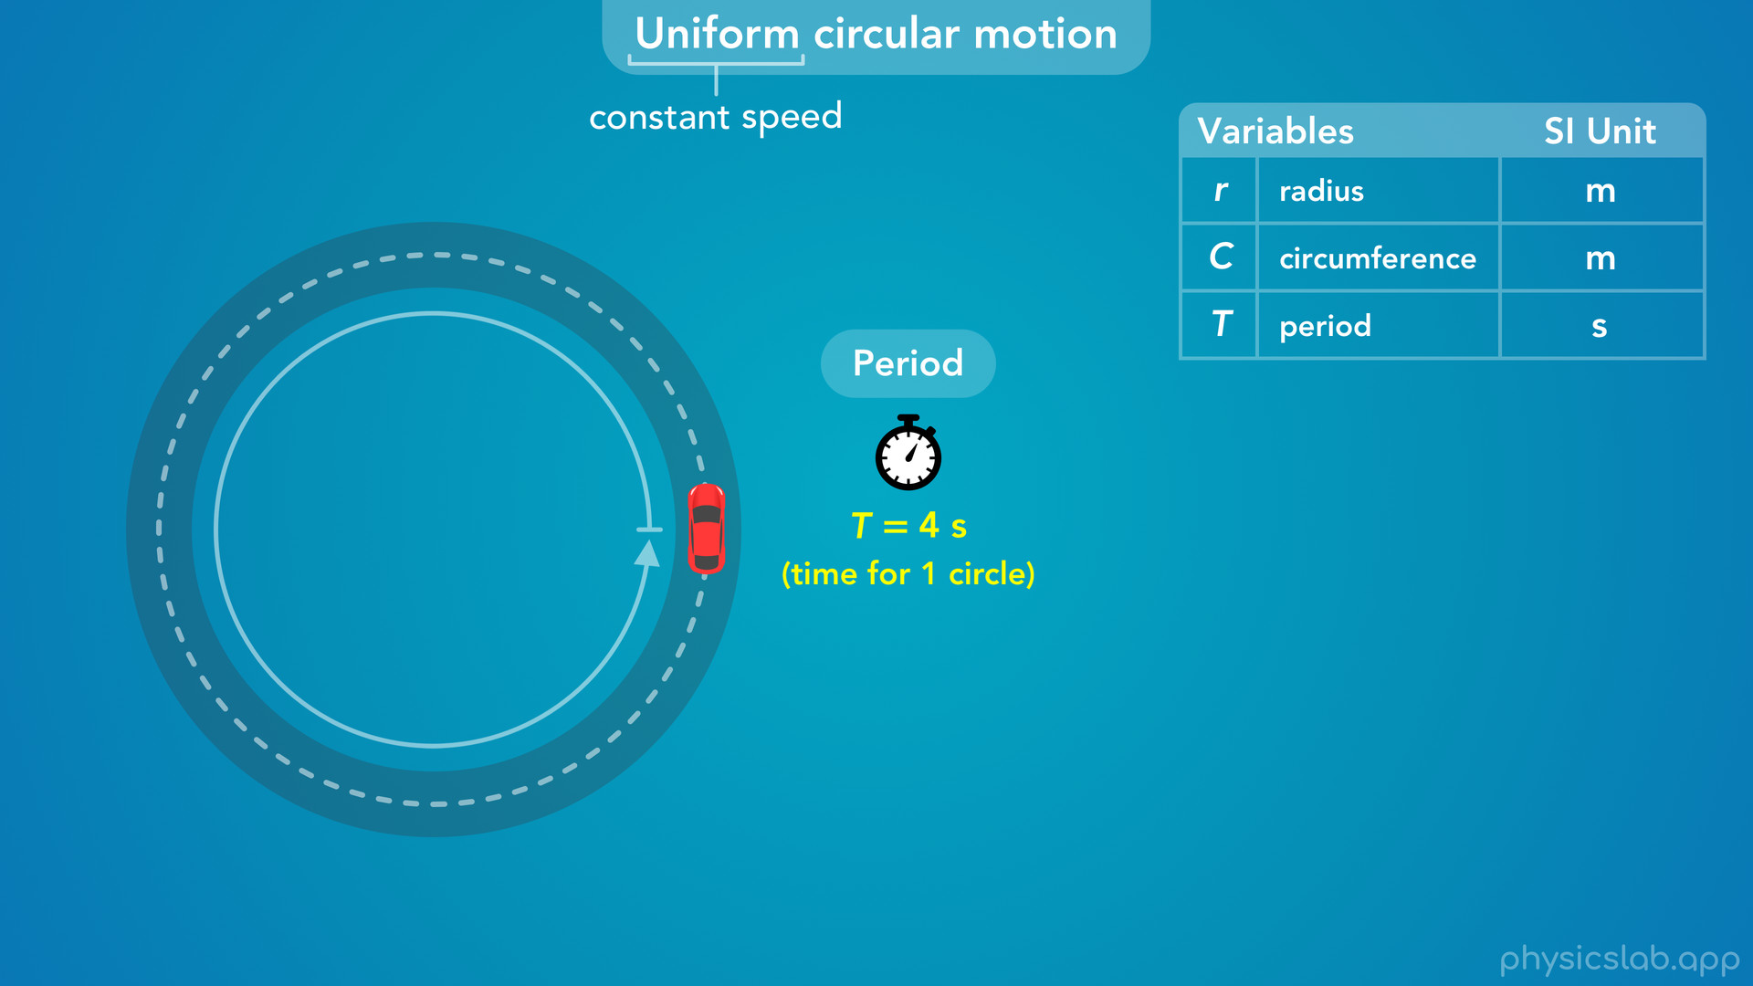
Notes:
• What else could we use to describe the motion of this car?
• If it keeps driving around the same circle at a constant speed, what else would be constant?
• One thing, would be the time it takes to complete one circle.
• If we used a stopwatch, we could measure that it takes 4 seconds for this car to complete one lap and return to the same spot.
• This is what we call the period.
• We represent it with capital T, and the SI unit is seconds.

Slide 22
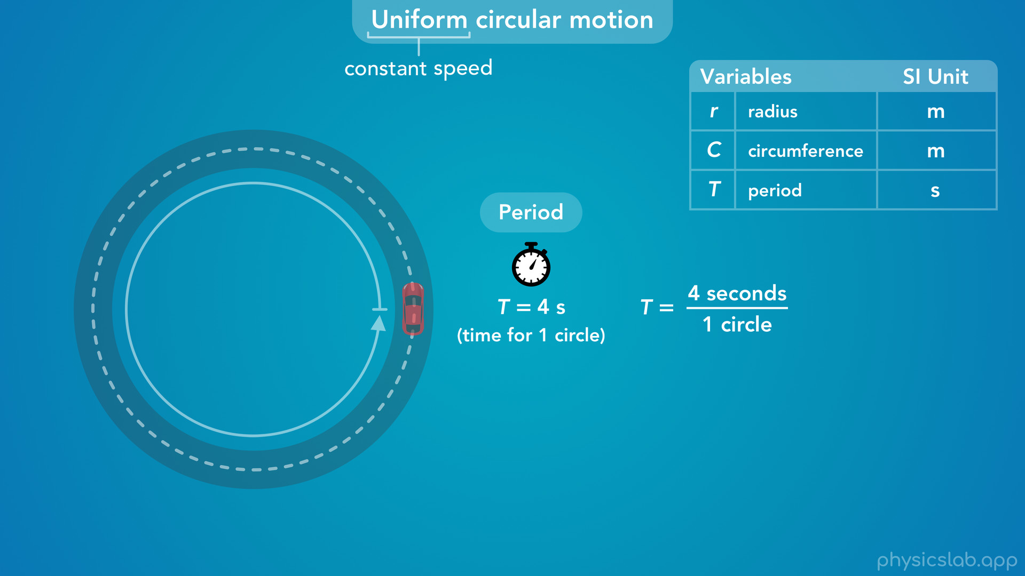
Notes:
• We could also write the period as a ratio like this, 4 seconds per 1 circle.

Slide 23
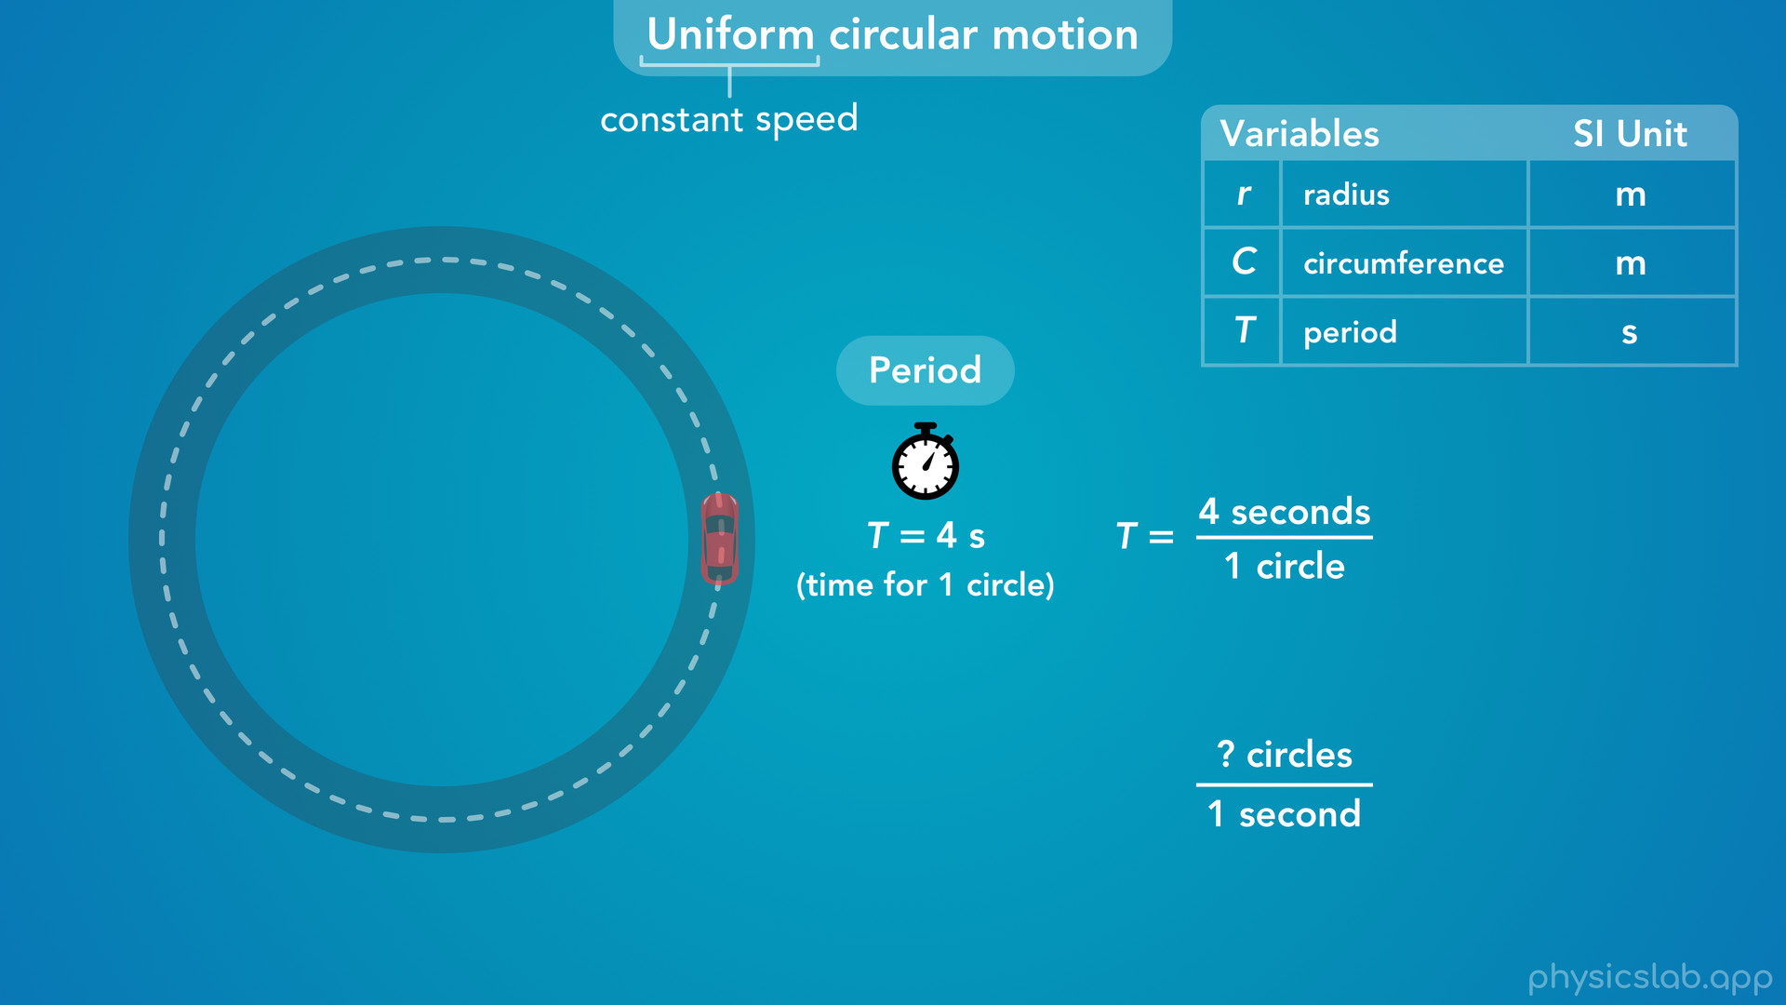
Notes:
• If that’s the time it takes to travel 1 circle, how many circles does the car travel in 1 second?

Slide 24
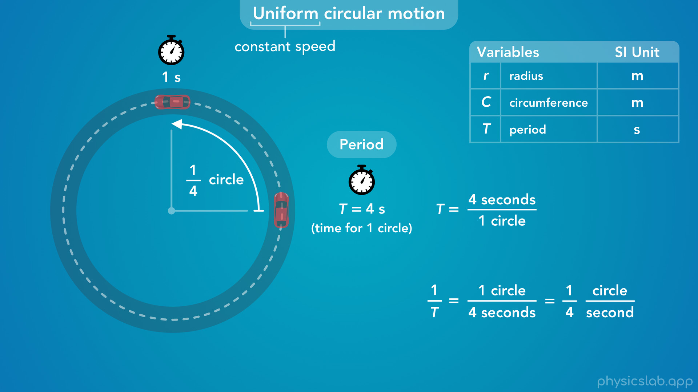
Notes:
• We can take the period, and flip it, or take the inverse.
• If it takes 4 seconds for 1 circle, then it travels 1 circle in 4 seconds.
• That means the car travels one fourth of a circle per second.

Slide 25
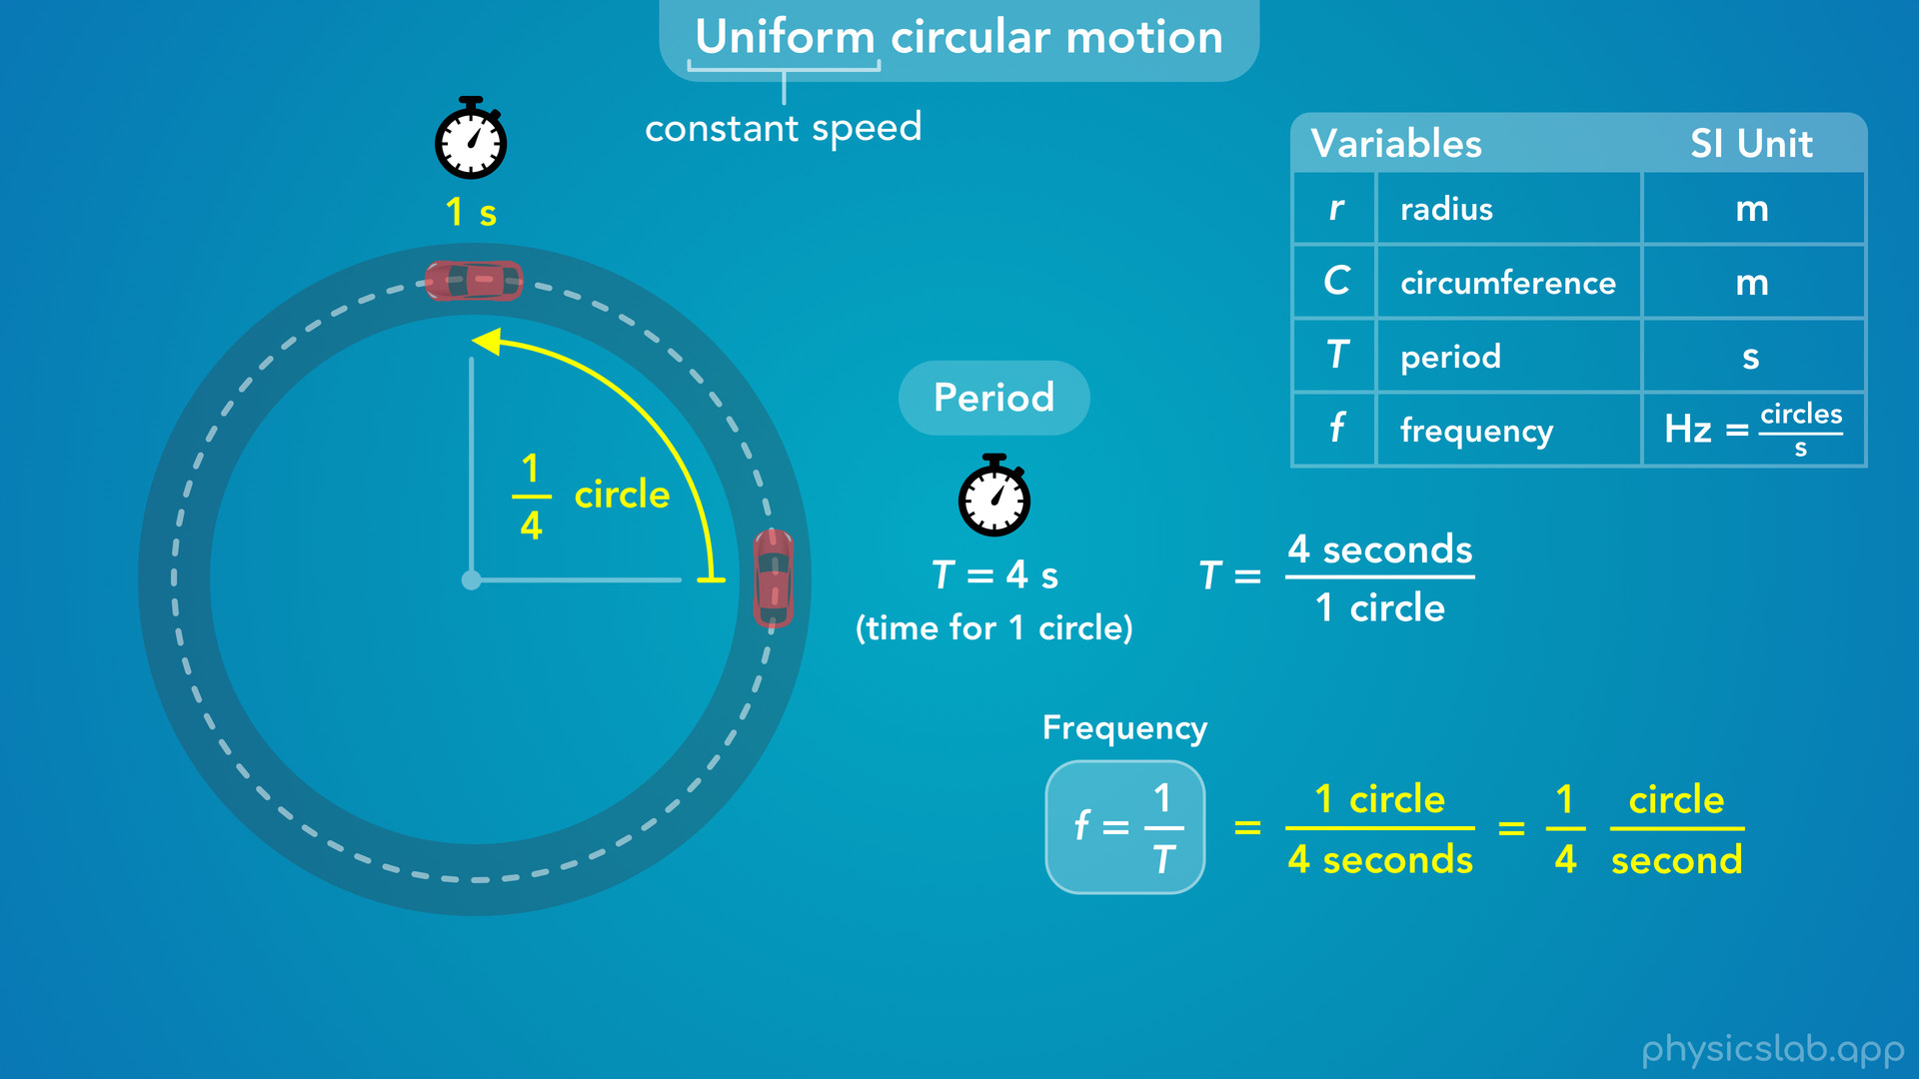
Notes:
• This ratio is what we call the frequency, and we represent it with lowercase f.
• The frequency is the inverse of the period, or one divided by the period.

Slide 26
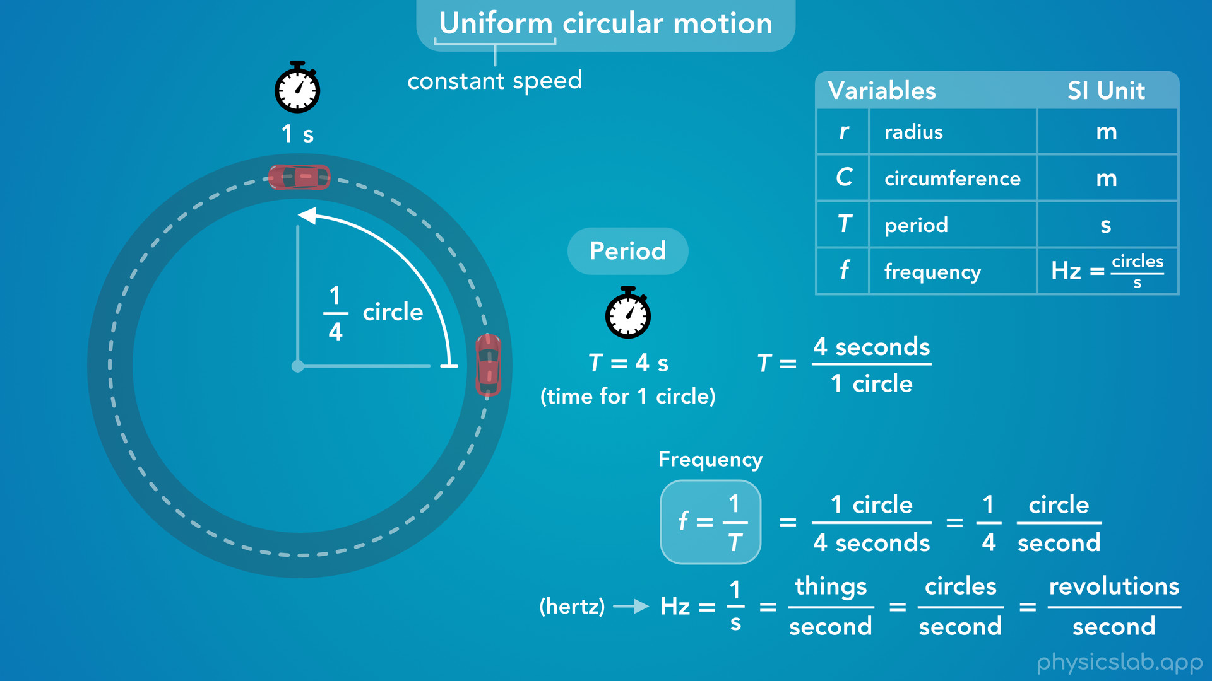
Notes:
• And the SI unit for frequency is hertz, which we abbreviate as capital H lowercase z.
• Since the period has units of seconds, the unit of hertz is just 1 divided by seconds.
• The numerator doesn’t really have a unit, and we can think of hertz as “things” per second.
• When we’re talking about uniform circular motion, this refers to circles per second or revolutions per second.
• And it doesn’t have to be multiple circles, it can be a fraction of a circle like it is for this car.
• When we learn about simple harmonic motion, frequency will mean cycles per second or oscillations per second.

Slide 27
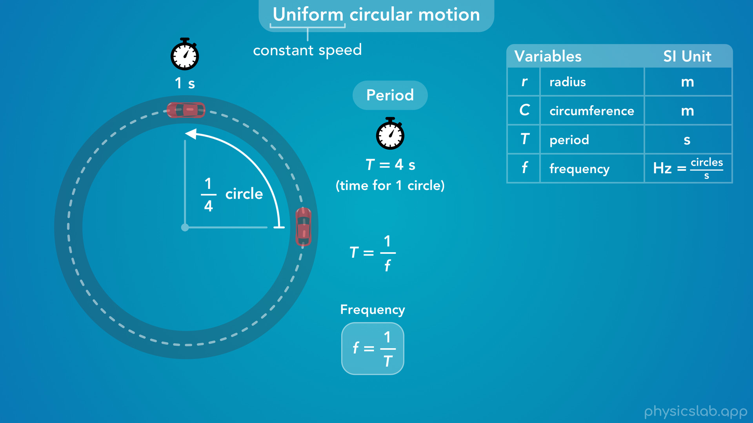
Notes:
• So the frequency is the inverse of the period.
• This means that the period is also the inverse of the frequency, so if we have one we can find the other.

Slide 28
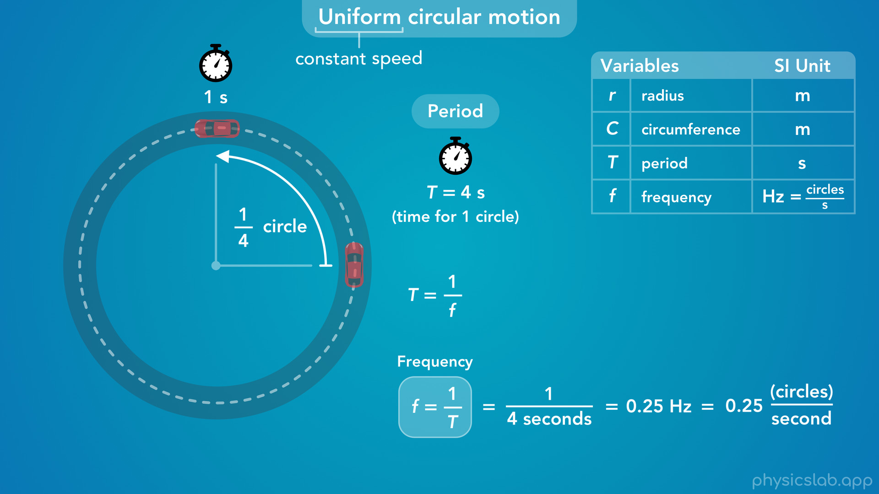
Notes:
• If we’re told that the period is 4 seconds, then we can calculate the frequency as 1 divided by 4 seconds.
• As a decimal, that’s 0.25 hertz or 0.25 circles per second.

Slide 29
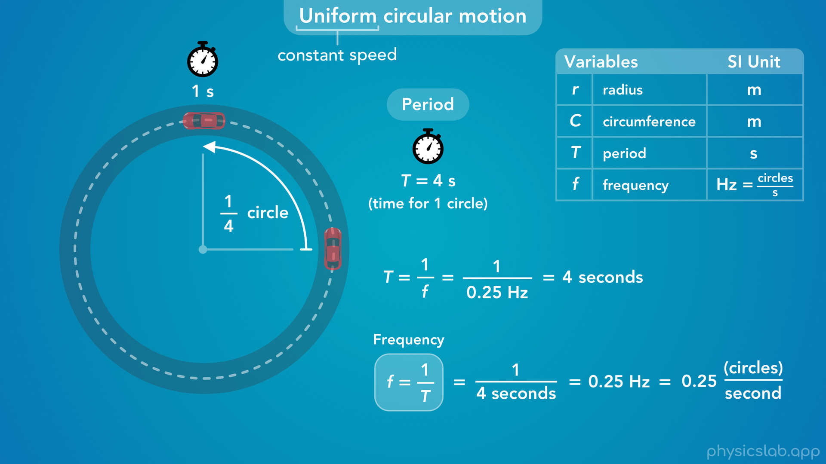
Notes:
• If we’re given the frequency, then we can calculate the period as 1 divided by 0.25 Hz.
• That would give us 4 seconds for the period.

Slide 30
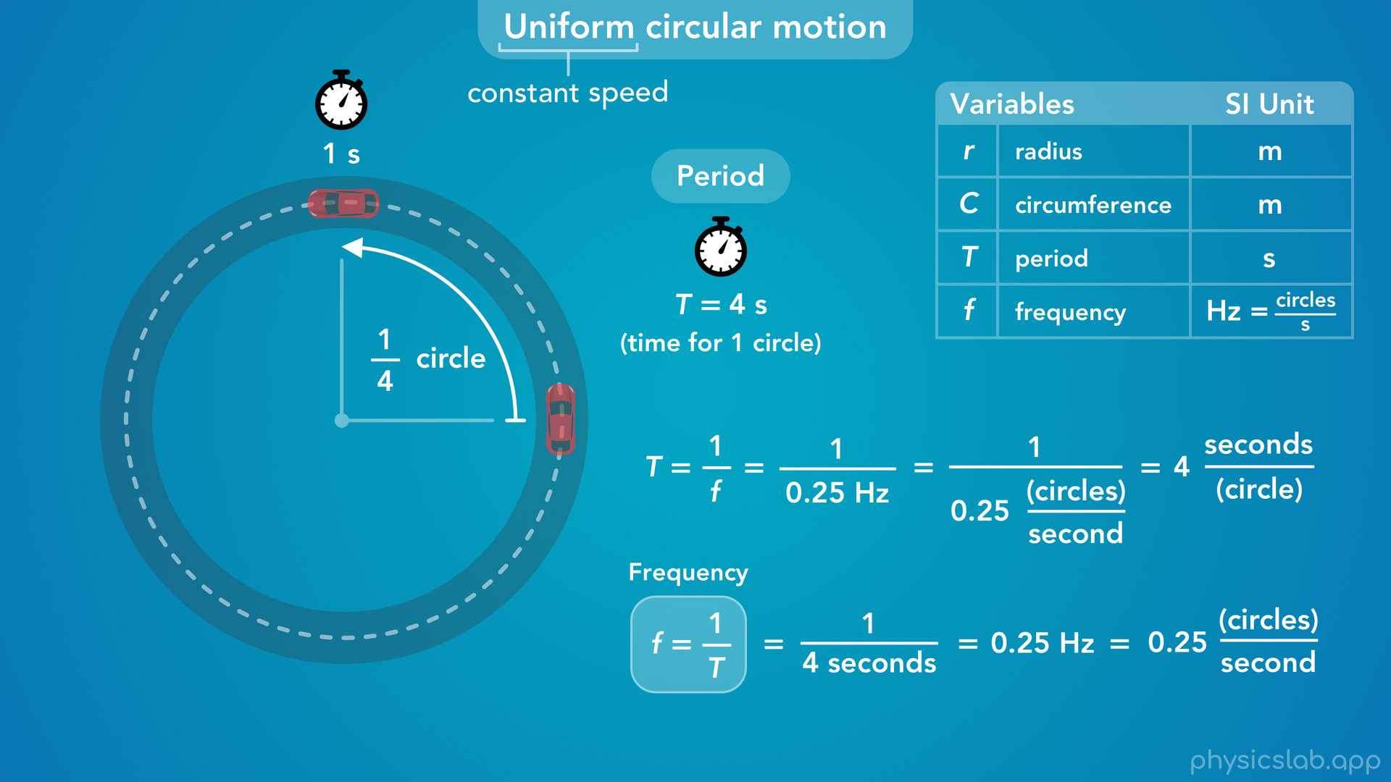
Notes:
• If want to write out more of the units, 0.25 Hz is the same as 0.25 circles per second.
• Dividing by a fraction is the same as multiplying by the inverse of the fraction.
• So one divided by circles per second gives us seconds per circle, which is the unit for the period.

Slide 31
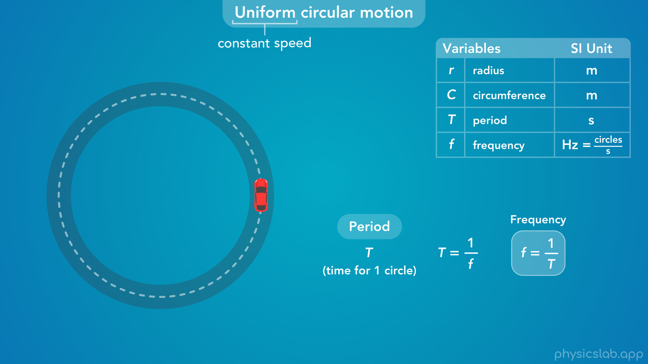
Notes:
• So these are two more variables we can use to describe uniform circular motion.
• The period and frequency only apply when the speed is constant, because the object takes the same amount of time to complete 1 circle every time it goes around.
• If the car had some tangnetial acceleration and it was speeding up or slowing down over time, the period and the frequency would change.
• So we don’t use them if the speed is changing, only if the speed is constant.

Slide 32
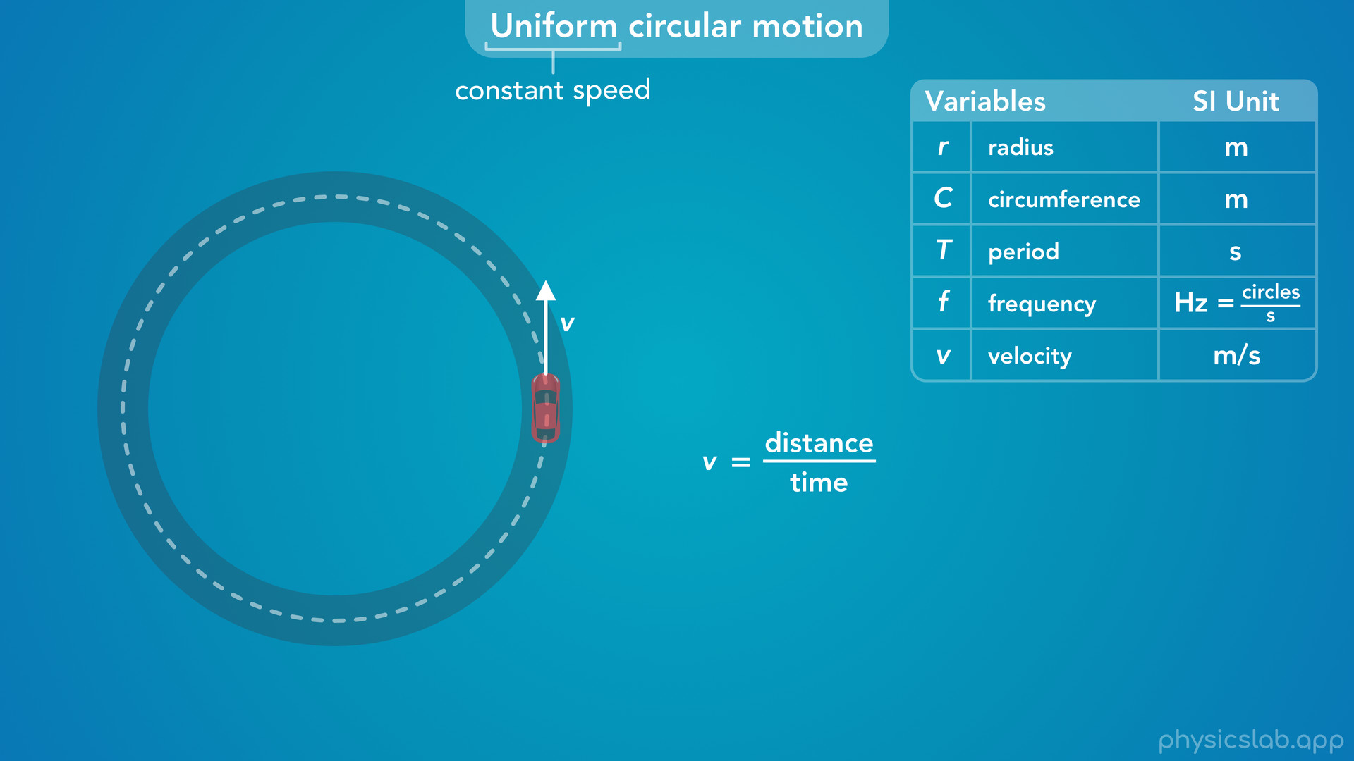
Notes:
• And the speed, or velocity, is actually the last thing we can use to describe uniform circular motion.
• So how would we calculate the speed of this car, which is magnitude of the velocity?
• We know that speed is distance divided by time, so what distance and time can we use?

Slide 33
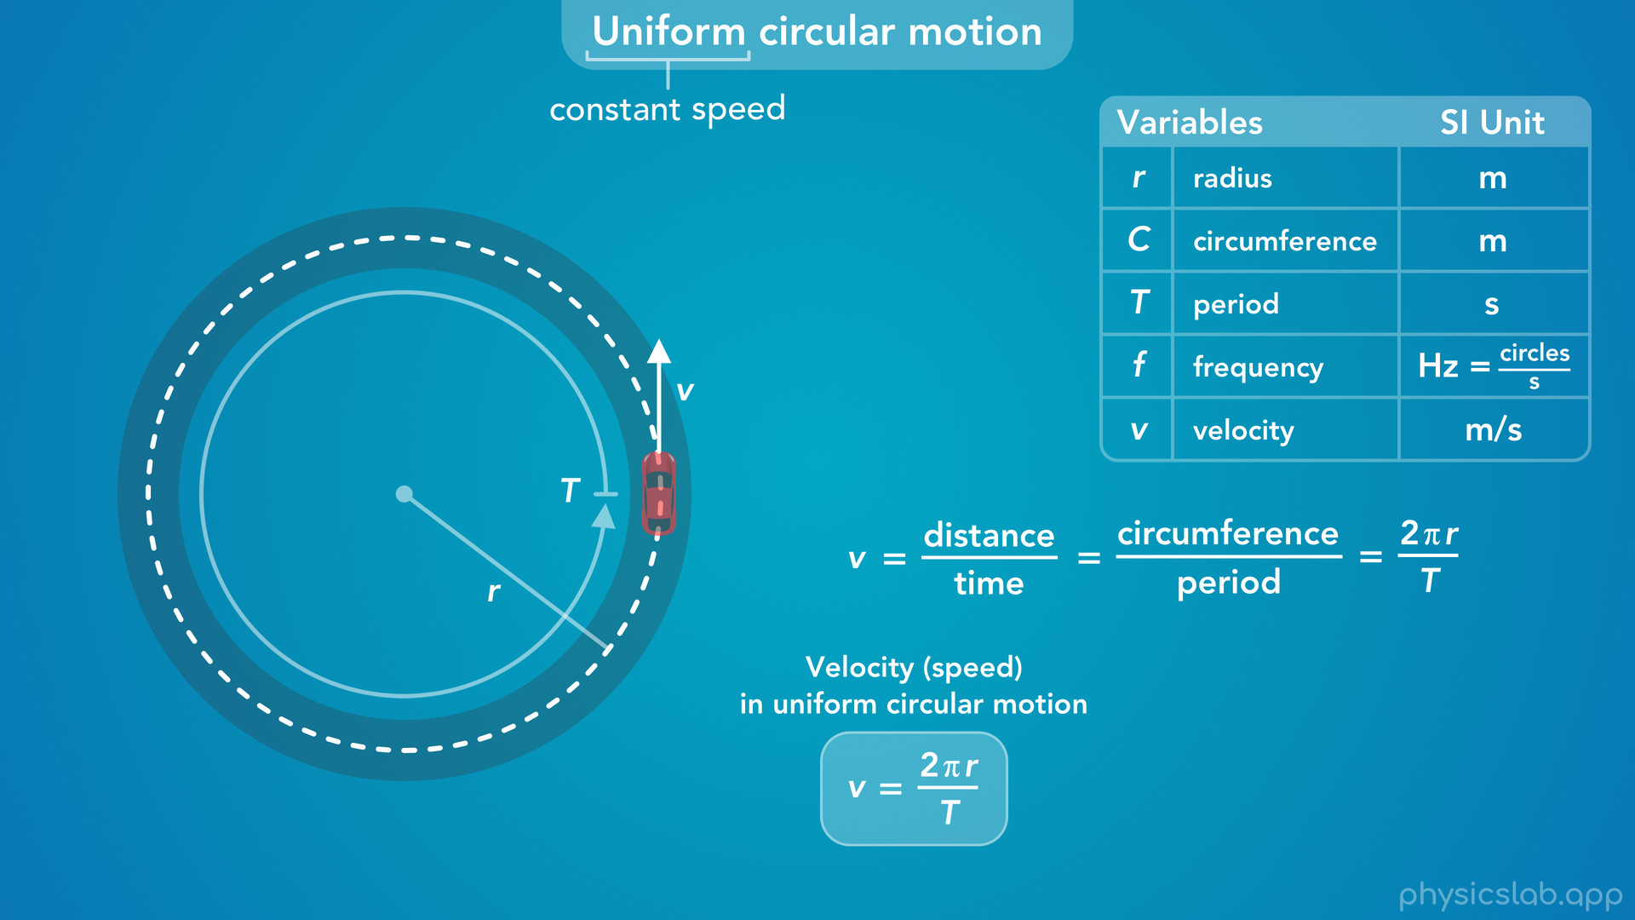
Notes:
• Well, we know that the period is the time it takes complete one circle, so what distance does the car travel during that time?
• That would be the circumference, which equals 2 times pi times the radius.
• So the magnitude of the tangential velocity, which is the speed, equals 2 pi r divided by the period.

Slide 34
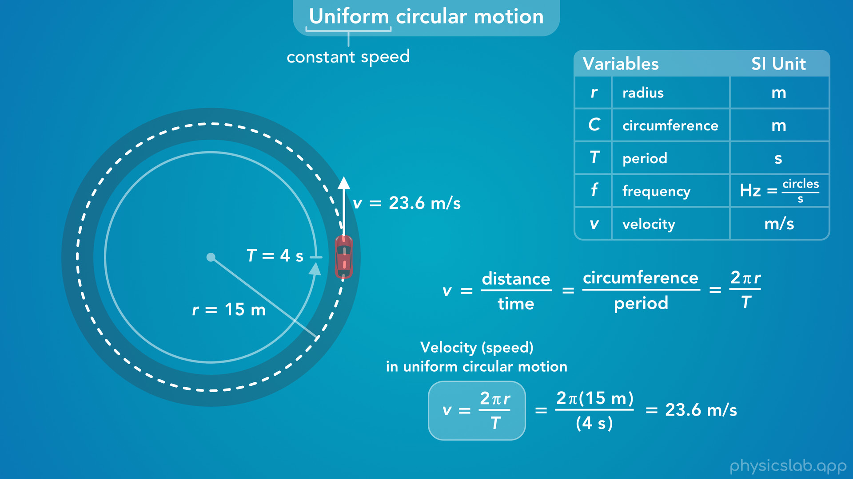
Notes:
• For this example, the radius is 15 m and the period is 4 seconds, so the speed of this car is 23.6 m/s.

Slide 35
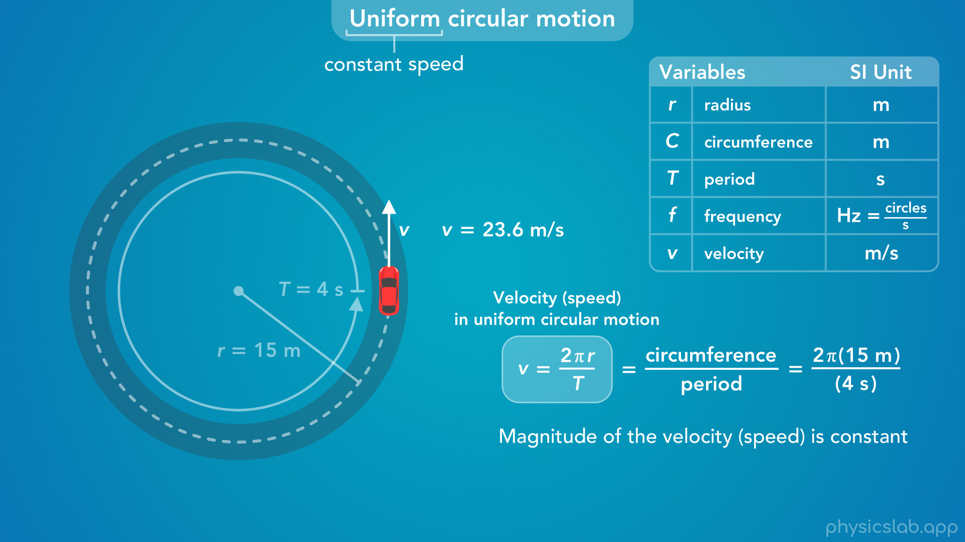

Slide 36
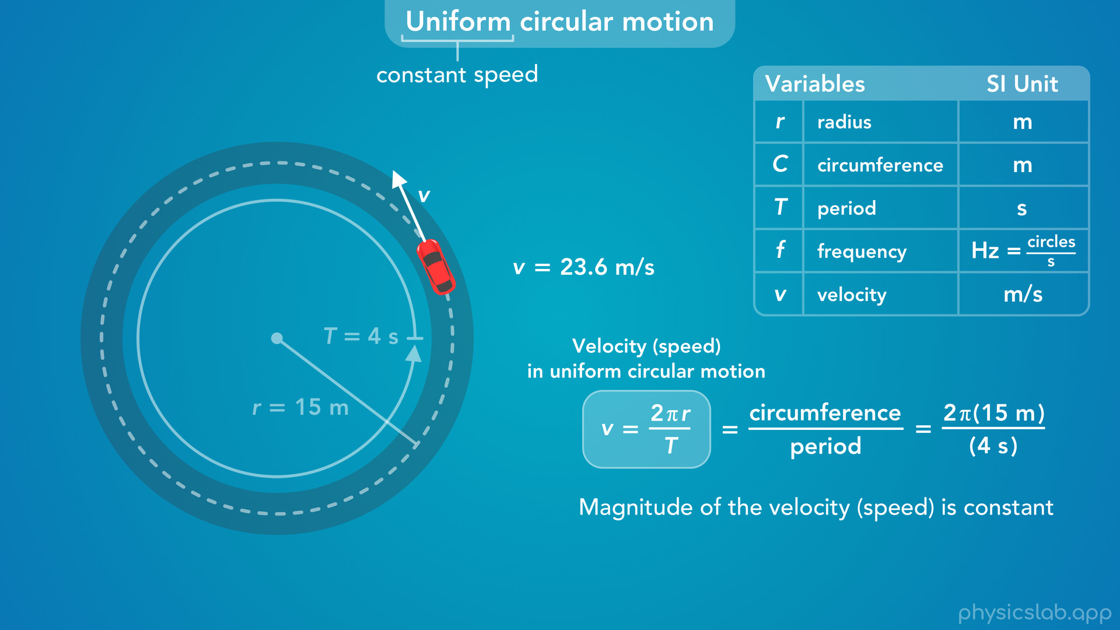
Notes:
• In uniform circular motion, the magnitude of the velocity, the speed, is constant.

Slide 37
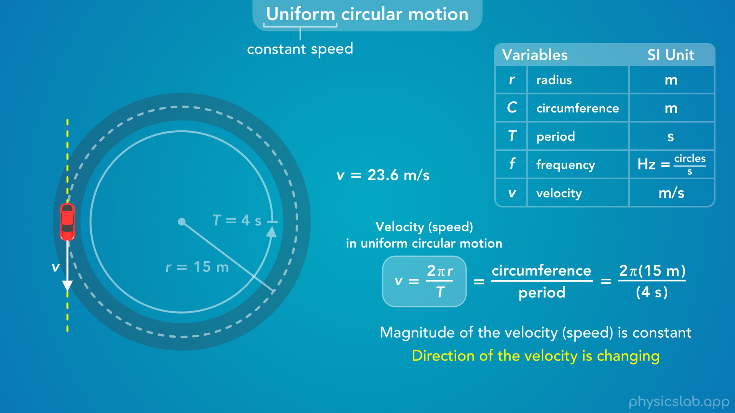
Notes:
• But since the car is moving in a circle, the direction of the velocity is changing.
• Remember, the velocity is always tangent to the circular path, so the velocity vector rotates and changes direction as the car moves around the circle.

Slide 38
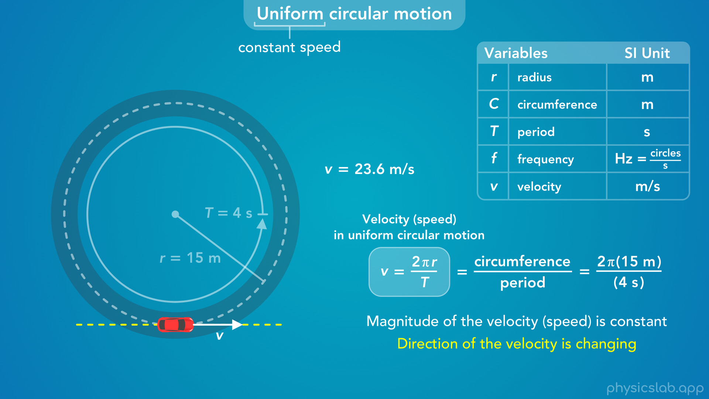

Slide 39
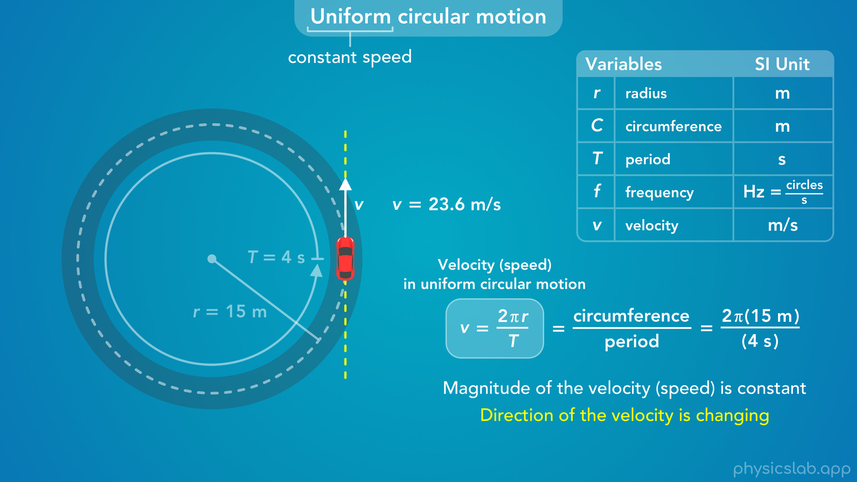

Slide 40
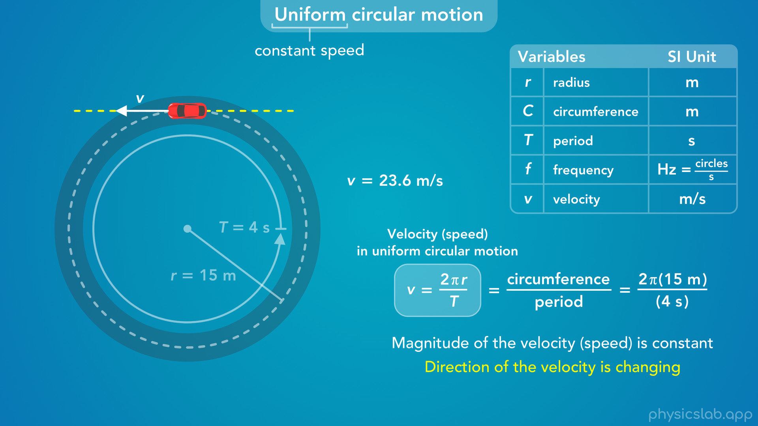

Slide 41
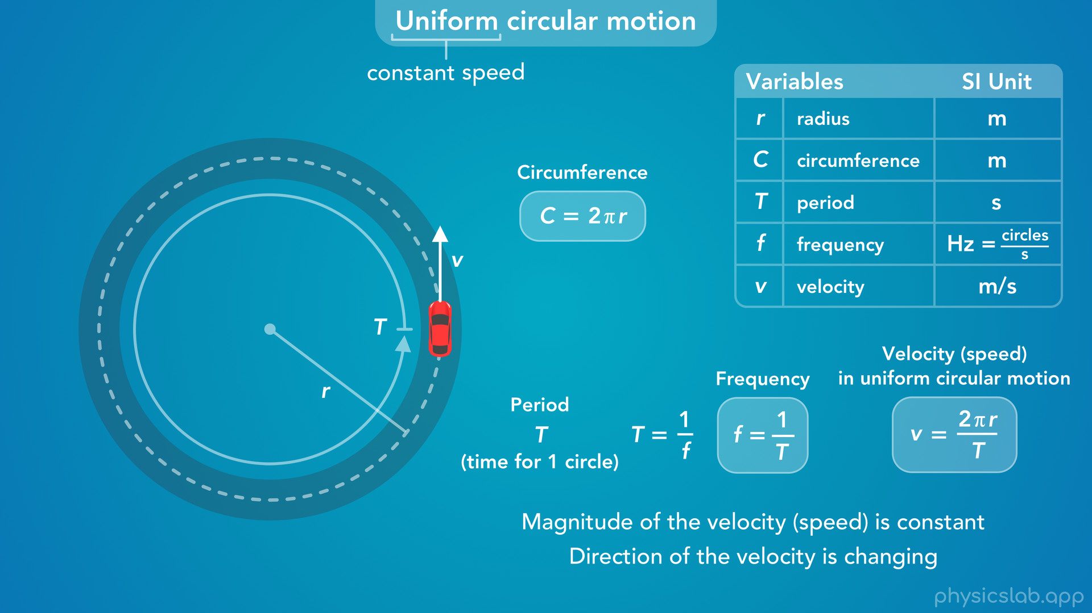
Notes:
• So those are the variables and equations we can use to describe uniform circular motion.
• We’re going to learn more about this type of motion when we cover centripetal acceleration and centripetal force.

