Slide 1
Velocity Vectors in 2D Motion
Slides Version 2
This version includes:
Slides with screenshot images from the video.
The video narration in the slide notes.
A blank template slide with the same background and font as the video.
Slides with some basic graphics from this video for you to use however you like.
Feel free to add, delete and edit slides to make your own presentation. You can use these slides in class or share them with your students, but please do not post them online.
If you have any feedback, suggestions or questions about these slides please email me at chris@physicslab.app or send me a message on Discord @physicslab.
physicslab.app

Slide 2
Heading
Text

Slide 3
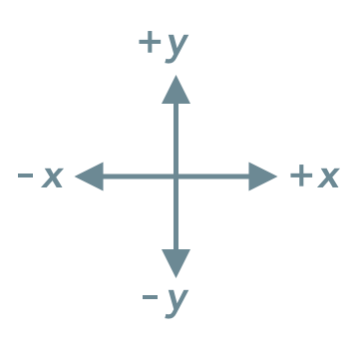
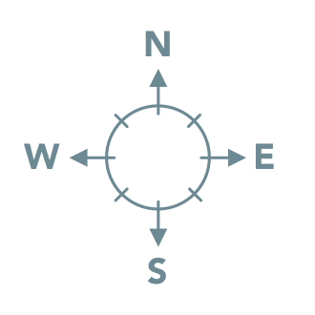
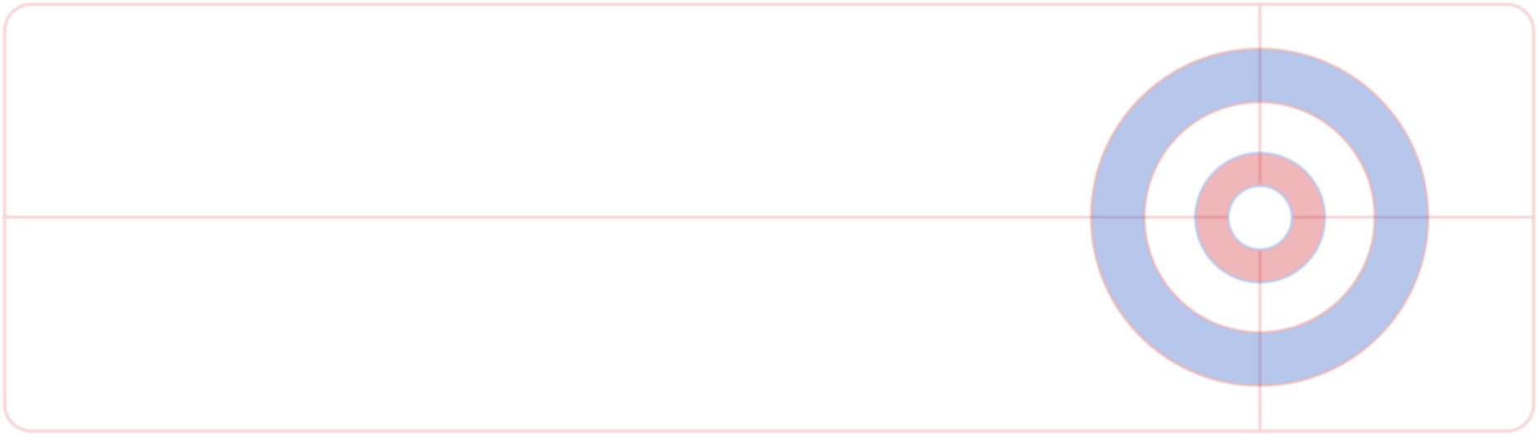




Slide 4
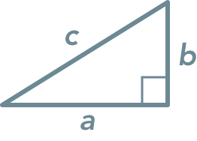

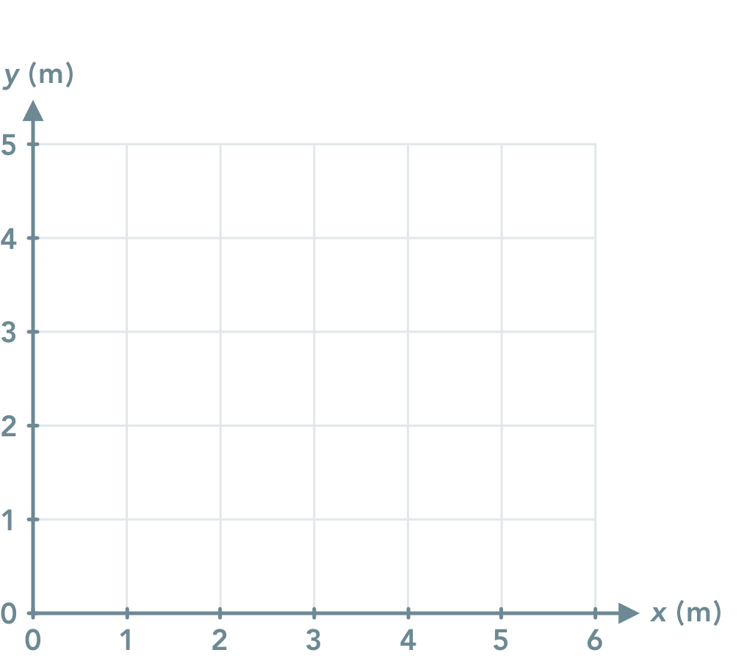

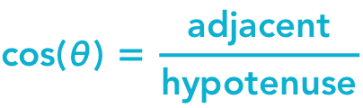
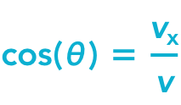



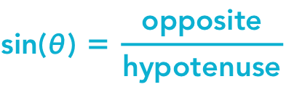
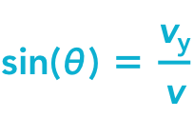


Slide 5

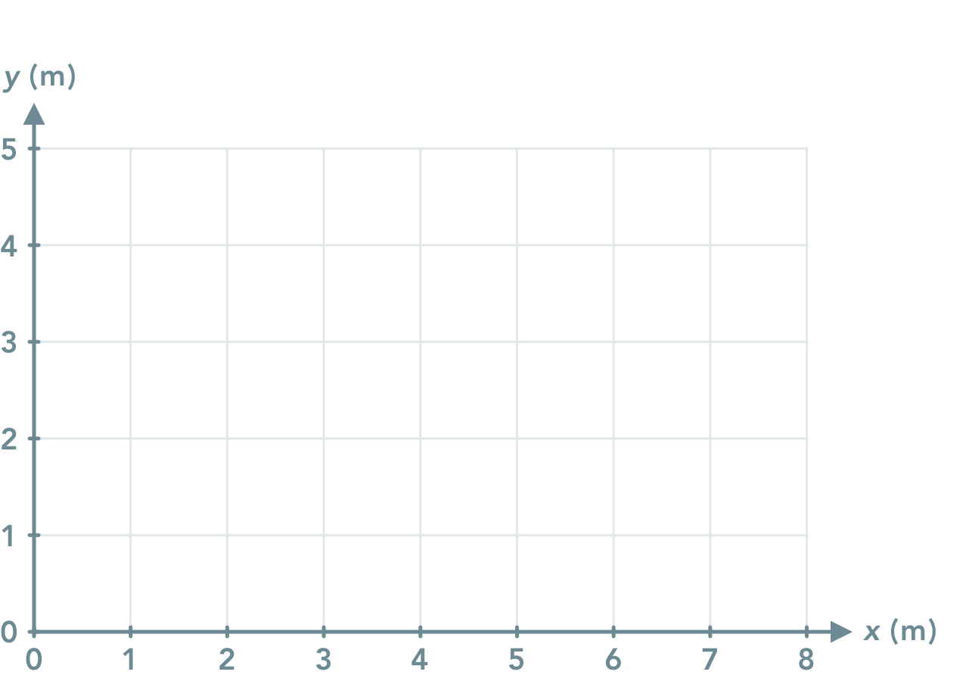

Slide 6
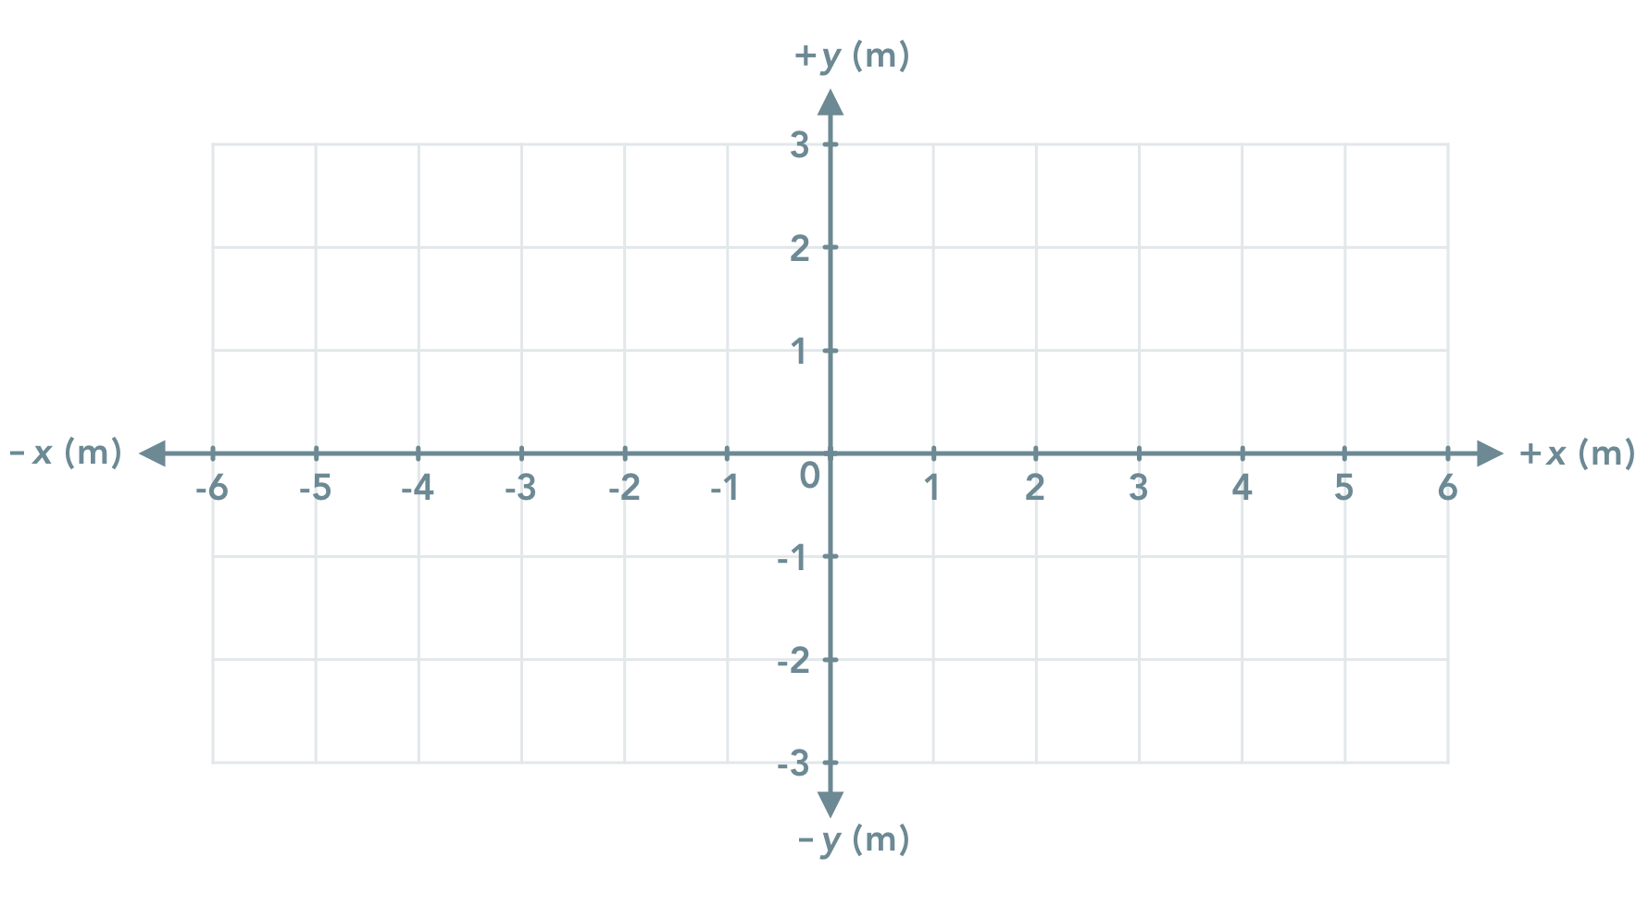

Slide 7






Slide 8
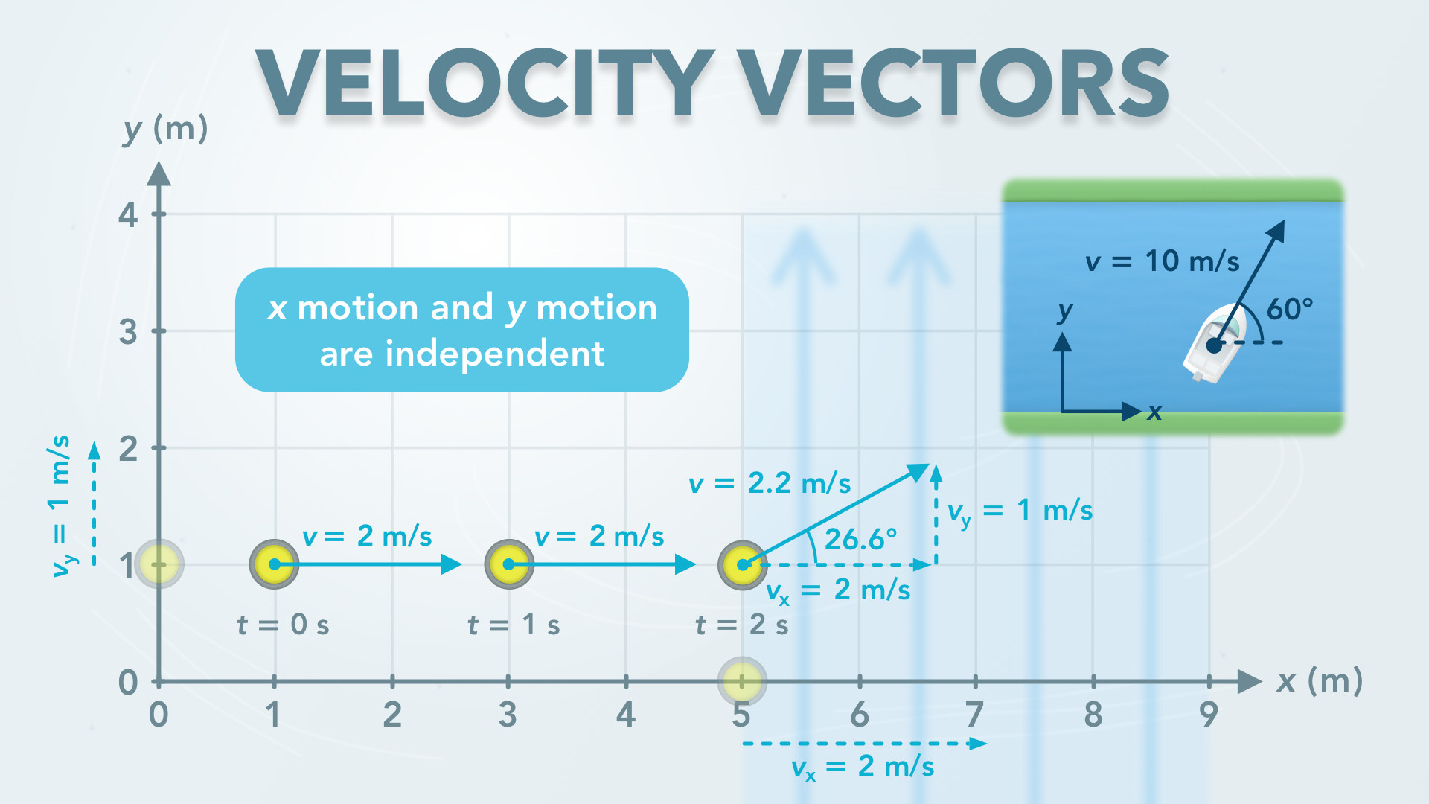
Notes:
Velocity Vectors in 2D Motion
physicslab.app
If you have any questions, suggestions or feedback about these slides please email me at chris@physicslab.app or send me a message on Discord @physicslab.

Slide 9
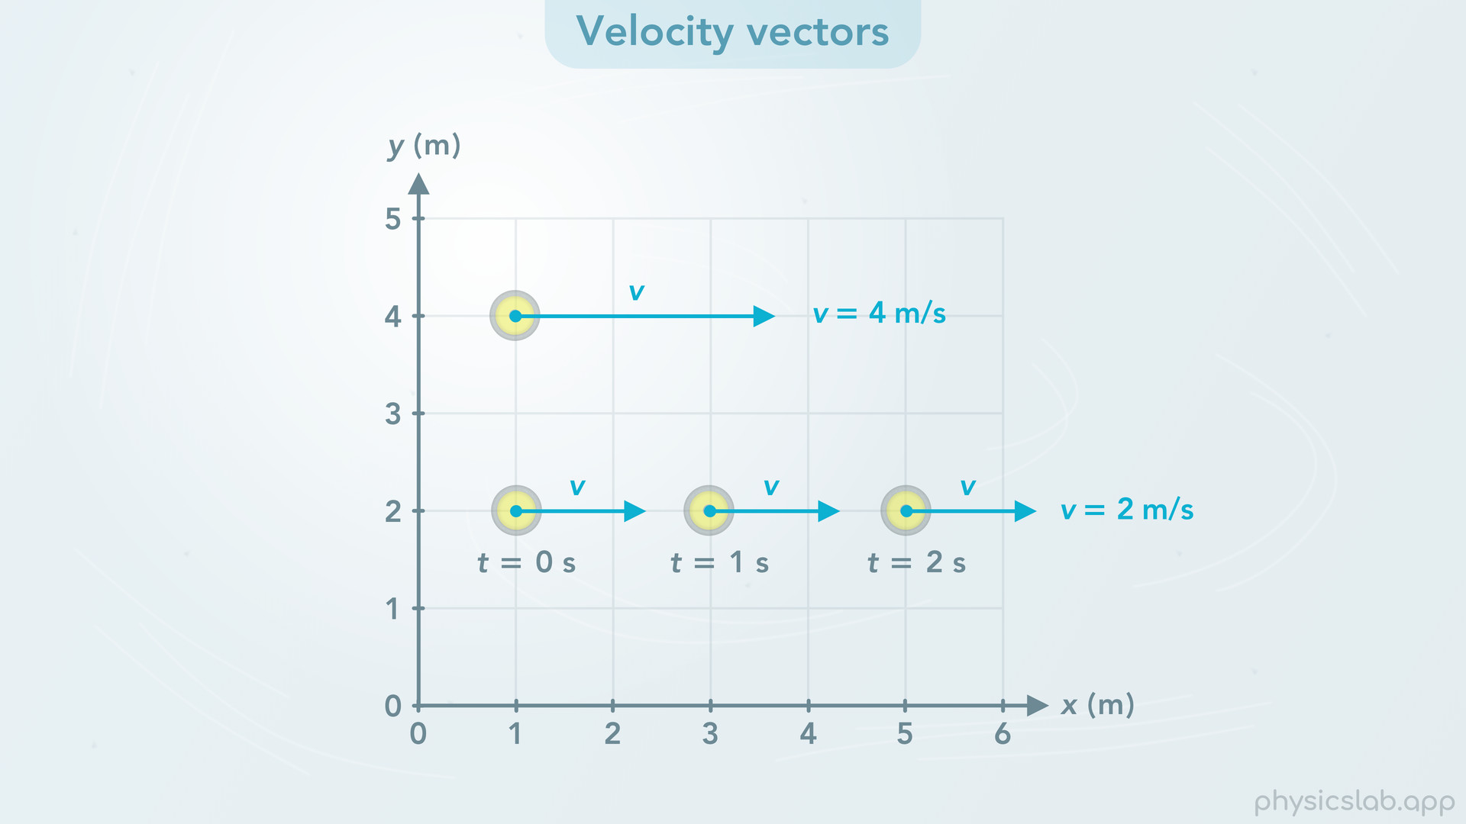
Notes:
• Hey everyone, in this video we’re gonna learn about velocity in two dimensional motion.
• First, we’ll learn how to draw velocity vectors.

Slide 10
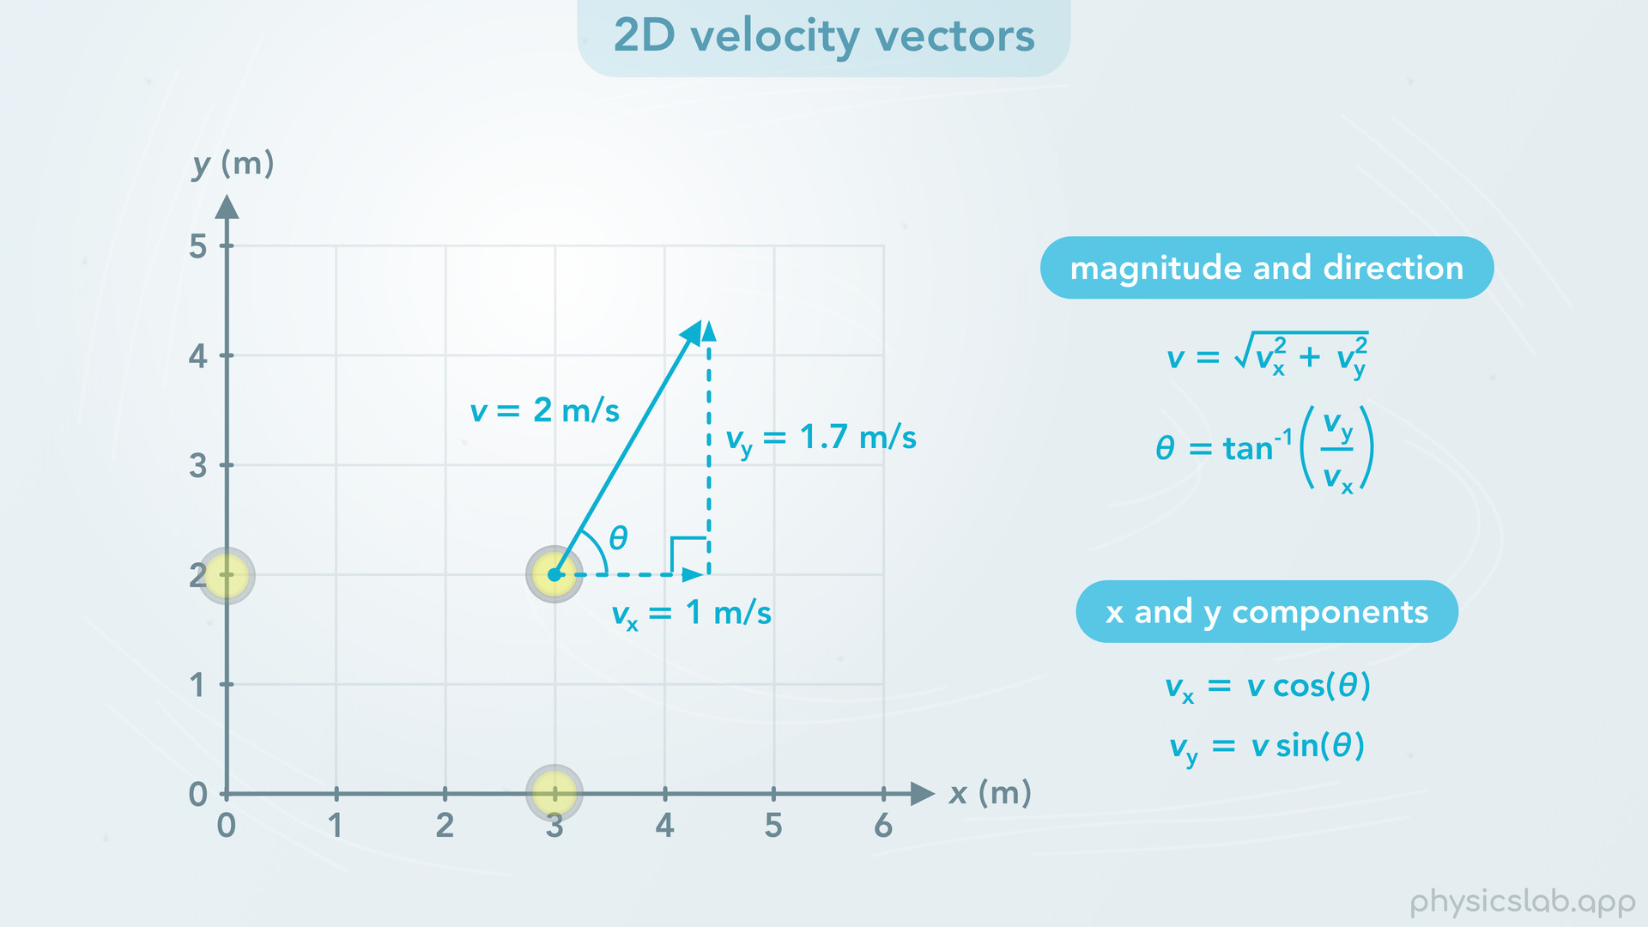
Notes:
• Then we’ll talk about two dimensional velocity vectors and how to convert between the magnitude and direction, and the x and y components, just like we did with displacement vectors.

Slide 11
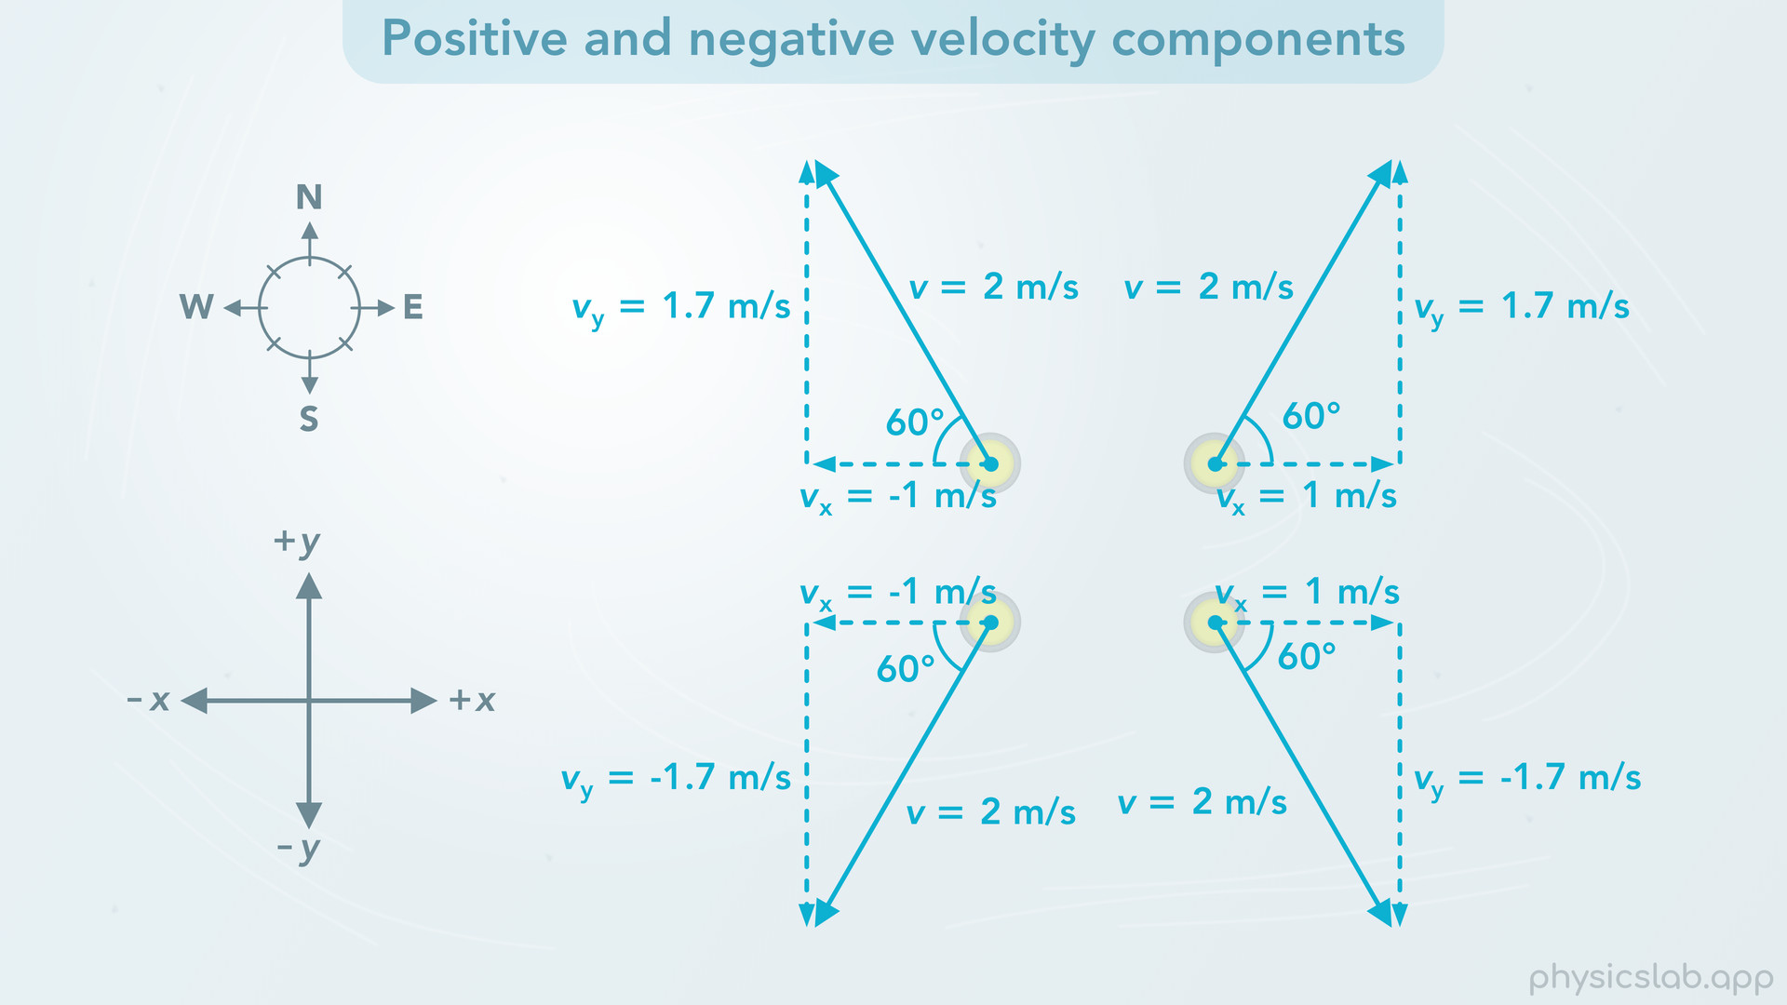
Notes:
• Next, we’ll talk about negative velocity components.

Slide 12
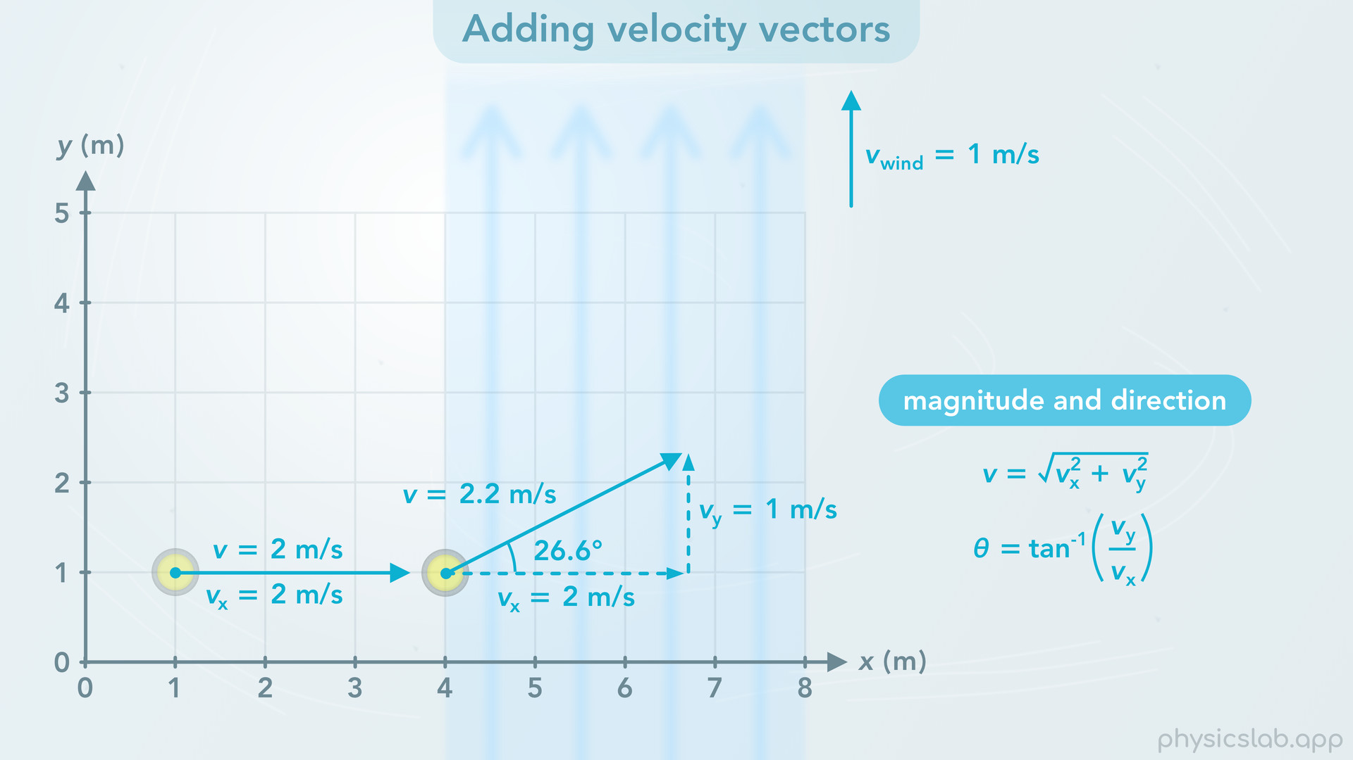
Notes:
• Then we’ll look at an example of adding velocity vectors and finding the magnitude and direction of the new velocity.

Slide 13
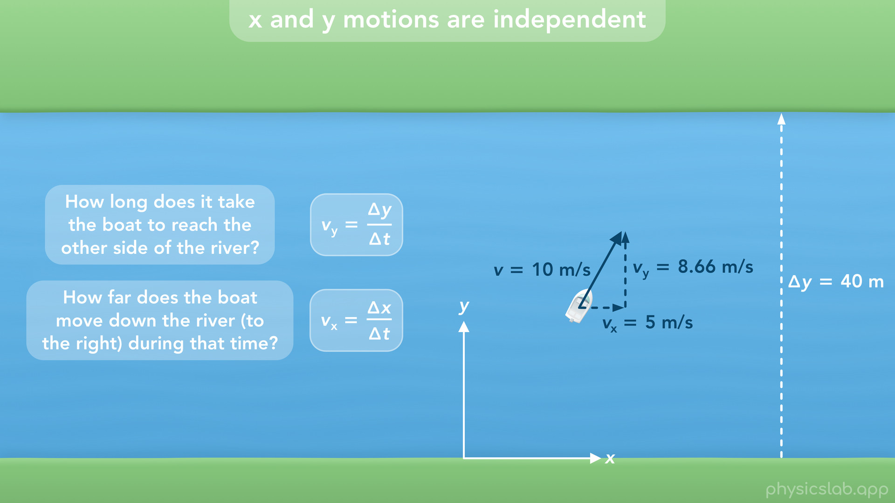
Notes:
• And finally, we’ll talk about how the x and y velocity components are completely independent of each other, and how we can take a two dimensional problem and make it two one-dimensional problems.

Slide 14
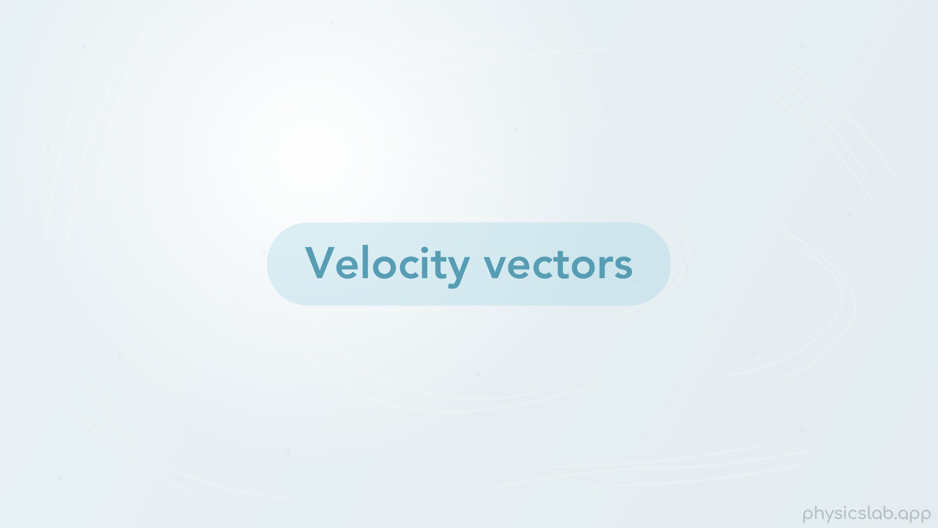
Notes:
• So let’s start with velocity vectors.

Slide 15
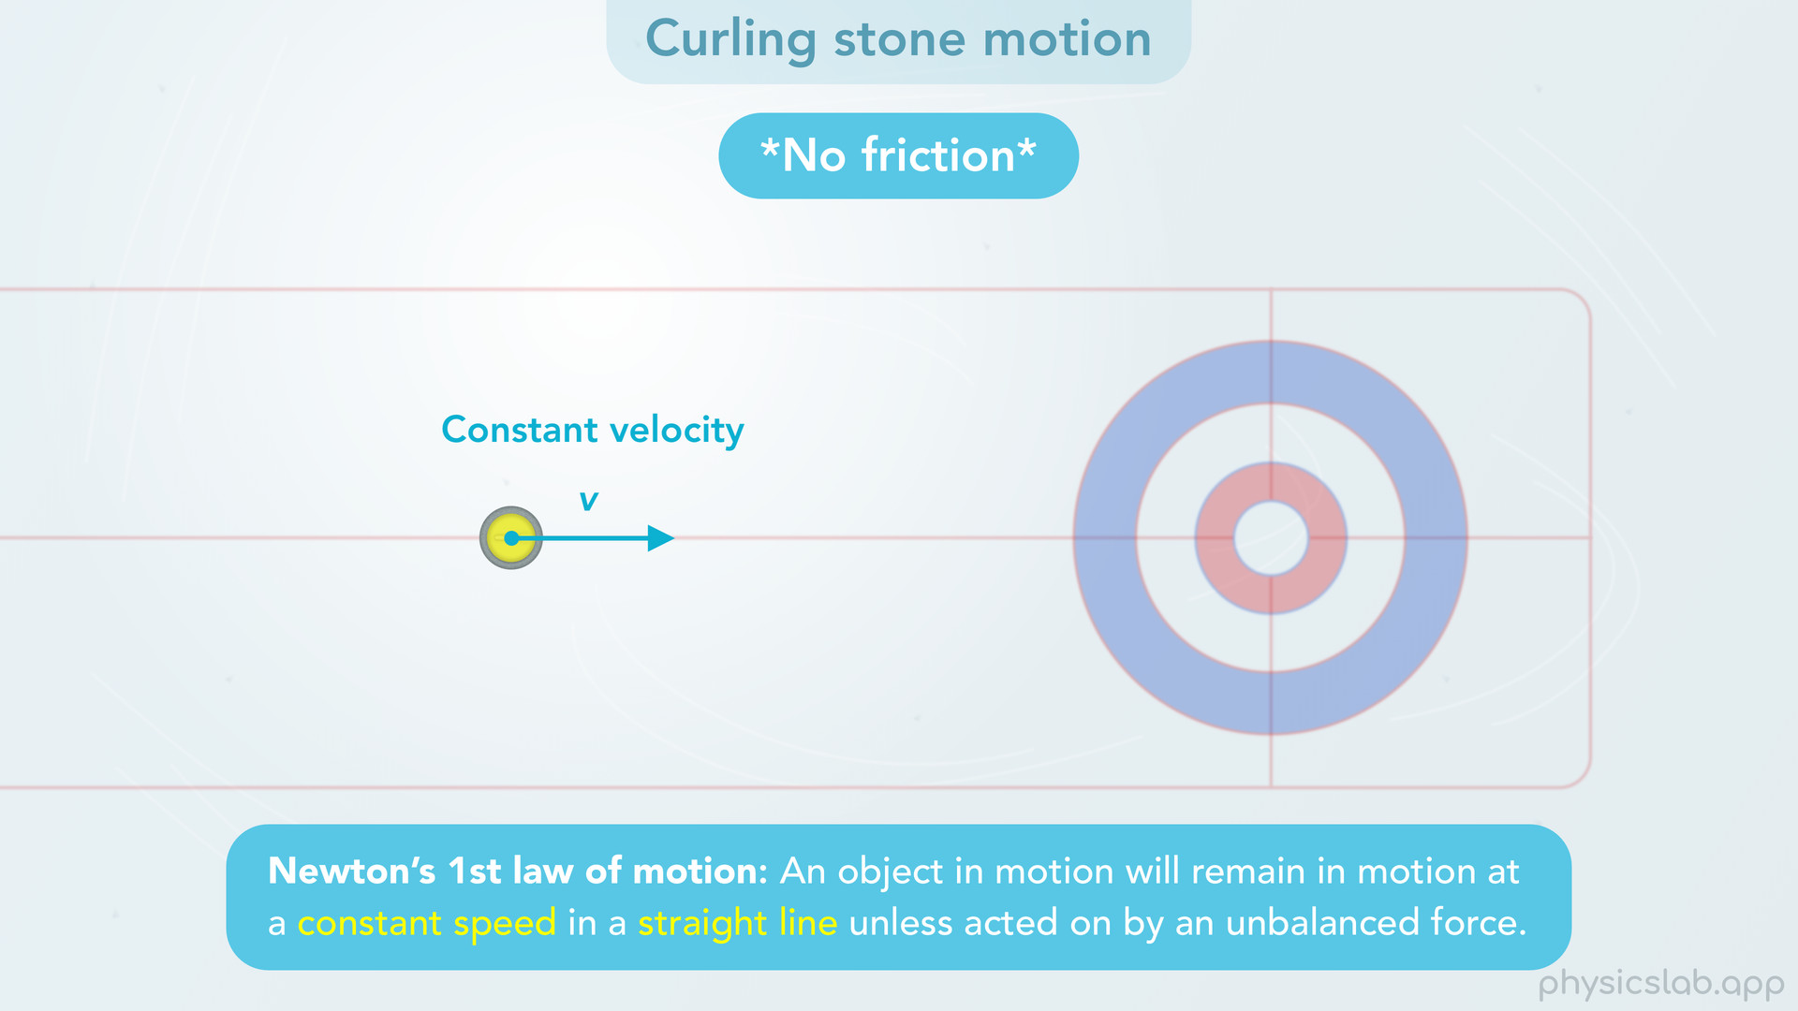
Notes:
• For most of this video, we’re gonna use a birds-eye-view of a curling stone sliding on ice. But first, there’s a few things we need to explain about the motion of the curling stone.
• Ice doesn’t have a lot of friction, so things can slide pretty far. In the real world, there’s still a little bit of friction, so the curling stone will eventually slow down and stop.
• But, in this video, and in many physics problems, we’re going to assume that there’s no friction. That means once the stone is moving, it’s not going to slow down, and it’ll never stop on its own.
• This is an example of Newton’s 1st Law of motion. “An object in motion will remain in motion at a constant speed in a straight line unless acted on by an unbalanced force”. We’ll cover Newton’s laws in a different section. But this means that without friction, the stone is going to move at a constant velocity, a constant speed in a straight line, unless some other force gets involved.
• So when we look at the motion of the curling stone, imagine it was pushed from somewhere out of view, and now it has a constant velocity. So the stone will move in a straight line at a constant speed.

Slide 16
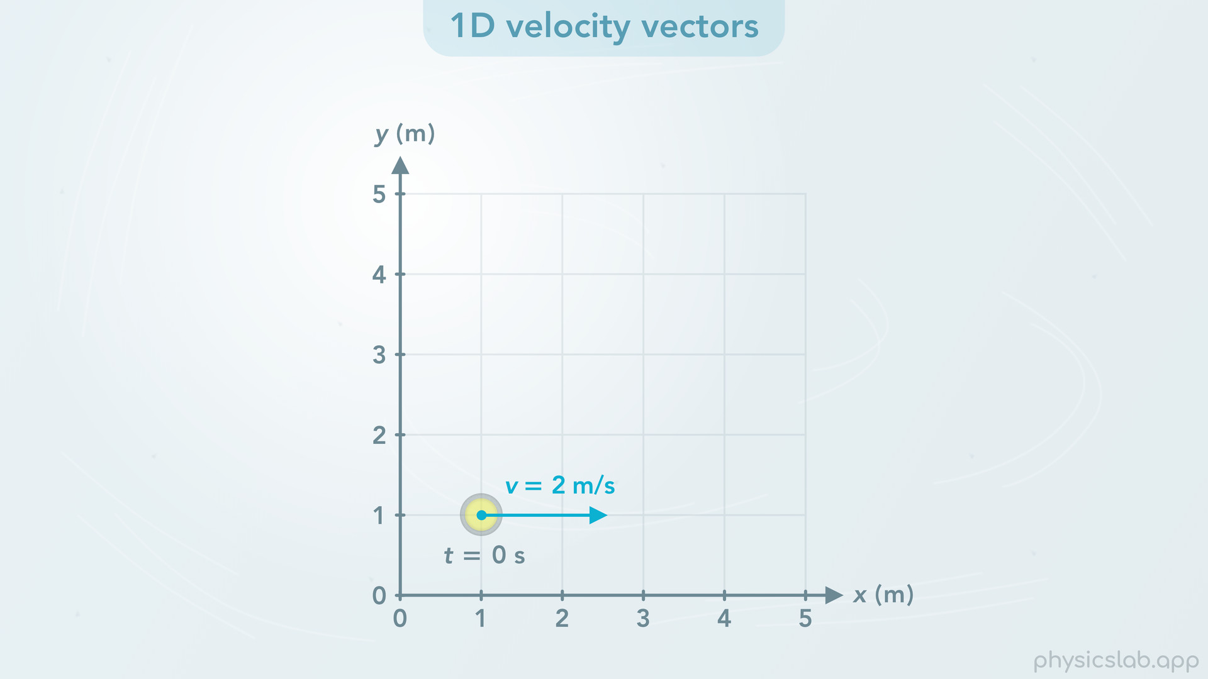
Notes:
• Alright, now that we understand how the stone moves, how do we describe its velocity using vectors?
• Let’s say this stone moves to the right at 2 m/s. What would its velocity vector look like? Let’s focus on the initial point when the stone is here. This is the velocity vector at this time. The vector points to the right, which is the direction of the motion. We can draw the vector on the object at a specific moment in time.

Slide 17
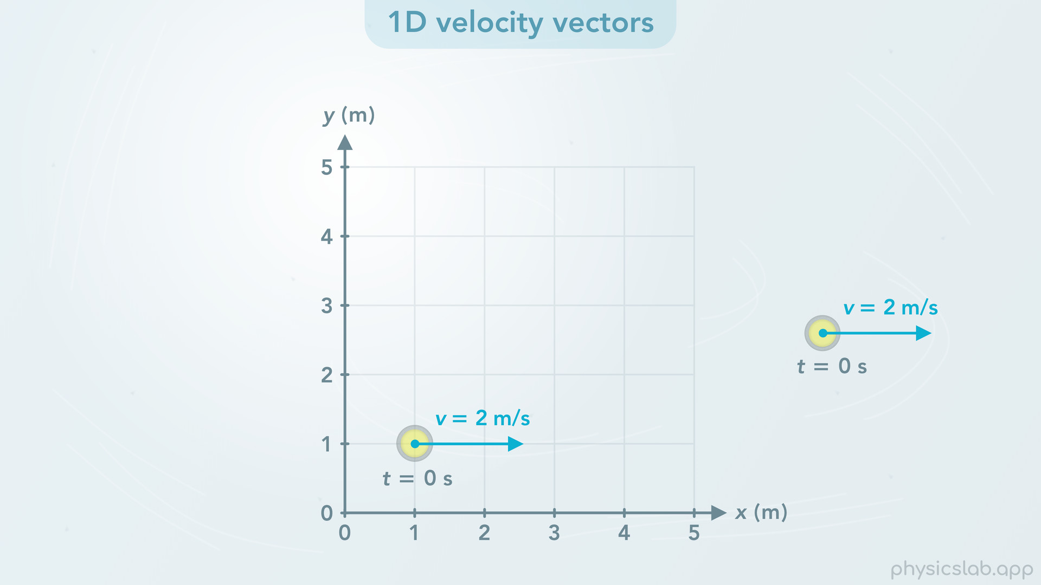
Notes:
We can also draw the vector anywhere else if the picture gets too crowded, we just need to keep track of the object and the time point that the vector represents.

Slide 18
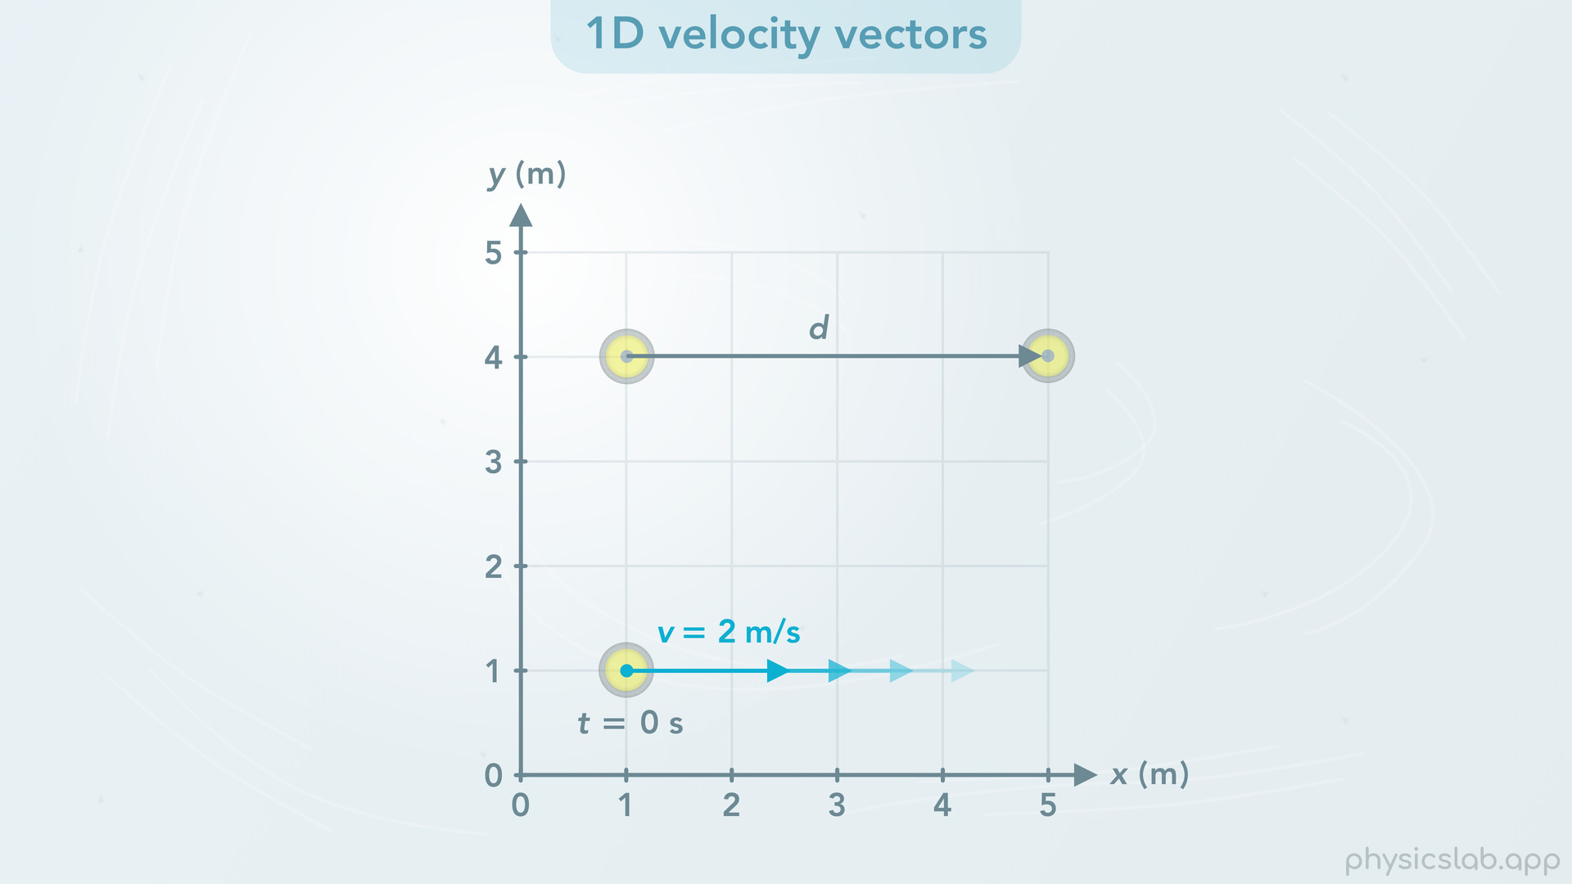
Notes:
• So the velocity of the stone is 2 m/s, but how long should this vector be?
• Drawing a velocity vector is a little different than drawing a displacement vector. Displacement vectors are unique because displacement includes an initial and a final point, so we could draw the vector connecting the points in 2D space.

Slide 19
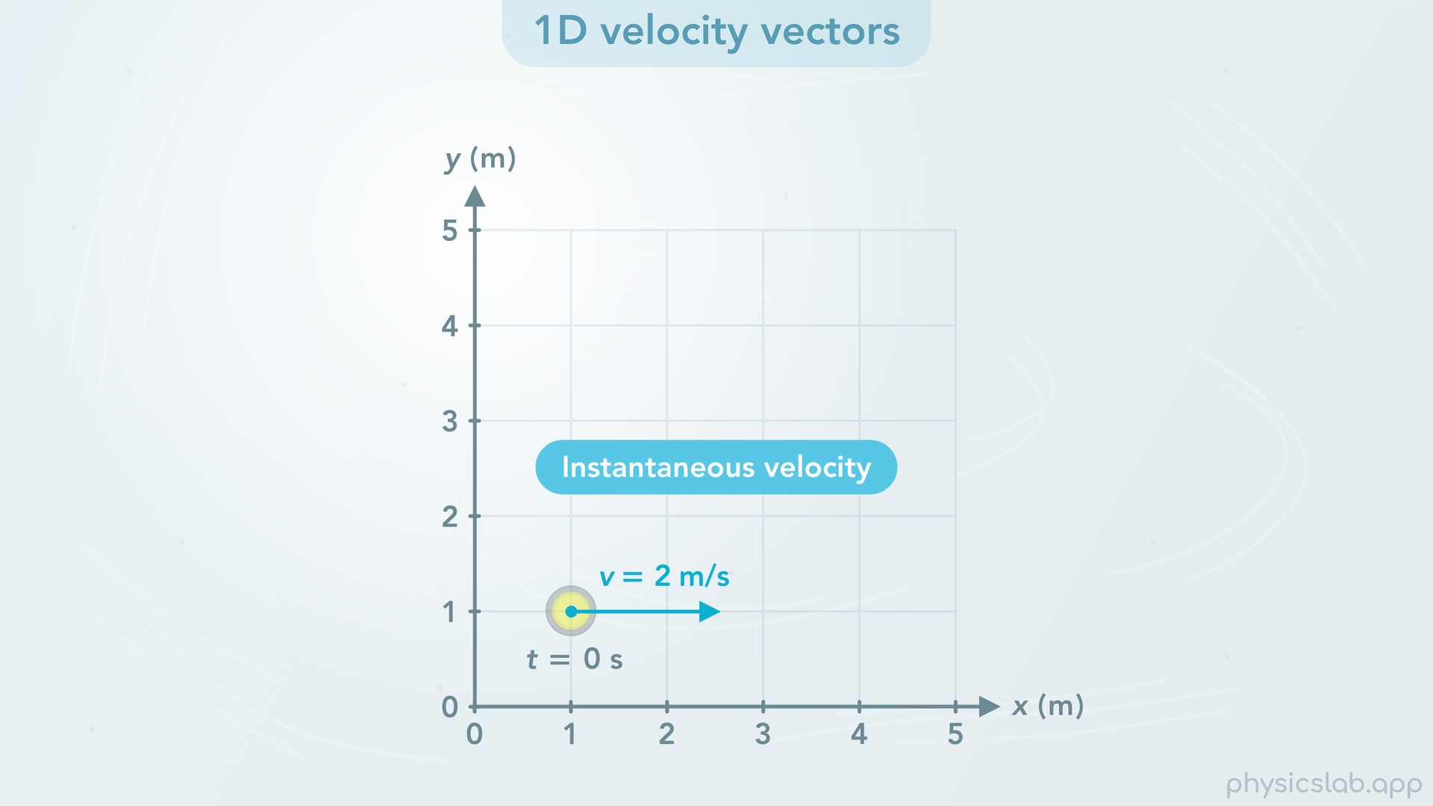
Notes:
• But when we draw a velocity vector, we usually represent the instantaneous velocity of an object. That means we’re describing the magnitude and direction of the velocity at one point, one instant in time. This also means the velocity vector is not tracing out the path of the object. It’s showing the direction of motion at one instant in time. That’ll make more sense later on. So the magnitude of the velocity is 2 m/s but we can draw the vector any length that we want.

Slide 20
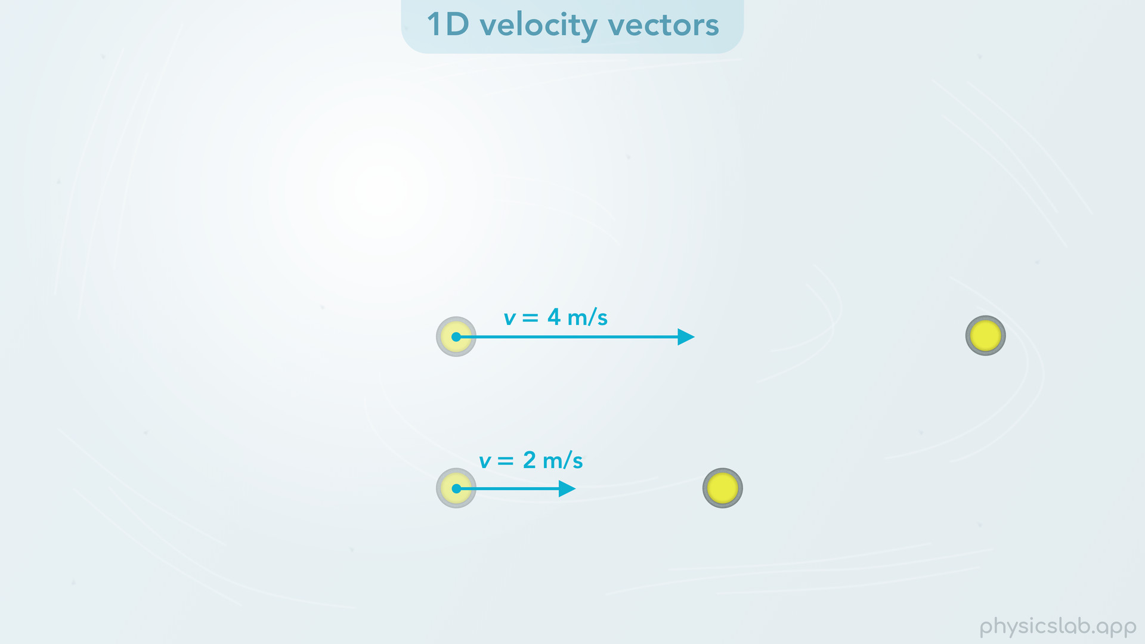
Notes:
• Having said that, the length does matter if we’re comparing multiple vectors. For example, if this stone is moving at 2 m/s and this one is moving at 4 m/s, we draw a longer velocity vector to represent a greater velocity. If the velocity is double, then the vector would be twice as long. So if we’re asked a question where there’s multiple vectors in one picture, just know that the length corresponds to the magnitude of the vector. If they’re velocity vectors, a longer arrow means its moving faster. But most of the time, if you’re drawing vectors yourself, just use numbers to keep track of the magnitudes and don’t worry too much about drawing the vectors to scale.

Slide 21
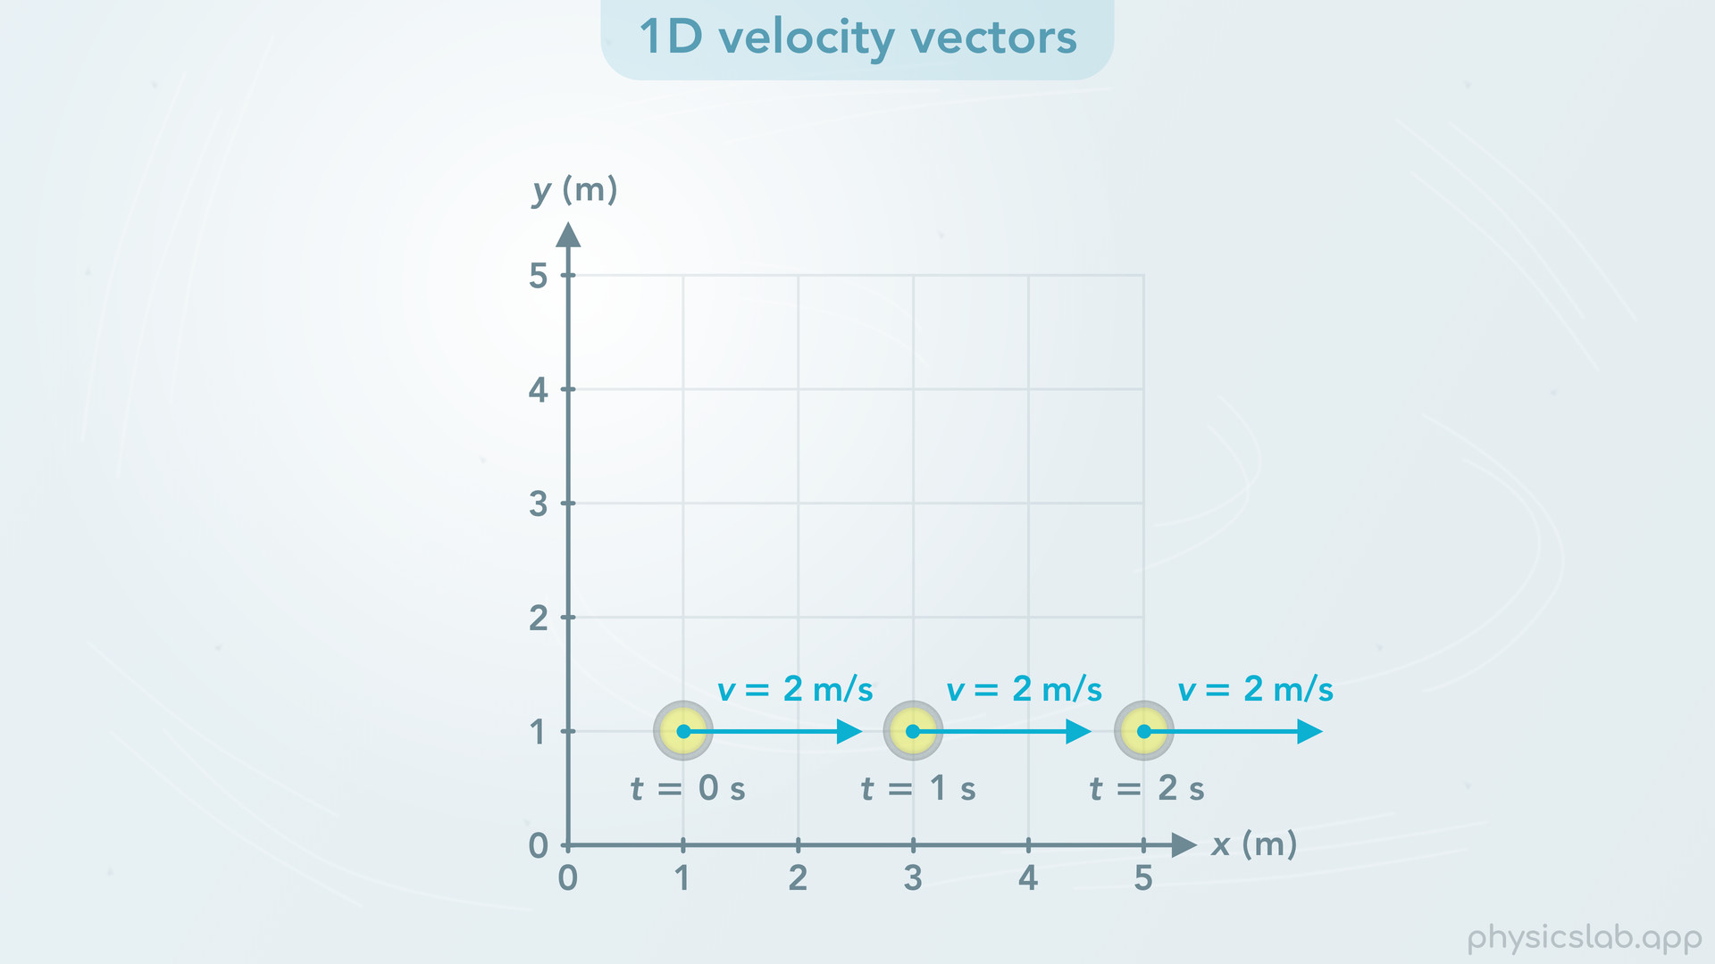
Notes:
• So that’s the velocity vector at this initial point. What about 1 second later when the stone is here? The velocity vector at this time would be the same. The stone has a constant velocity, so the velocity vector is the same at every point.

Slide 22
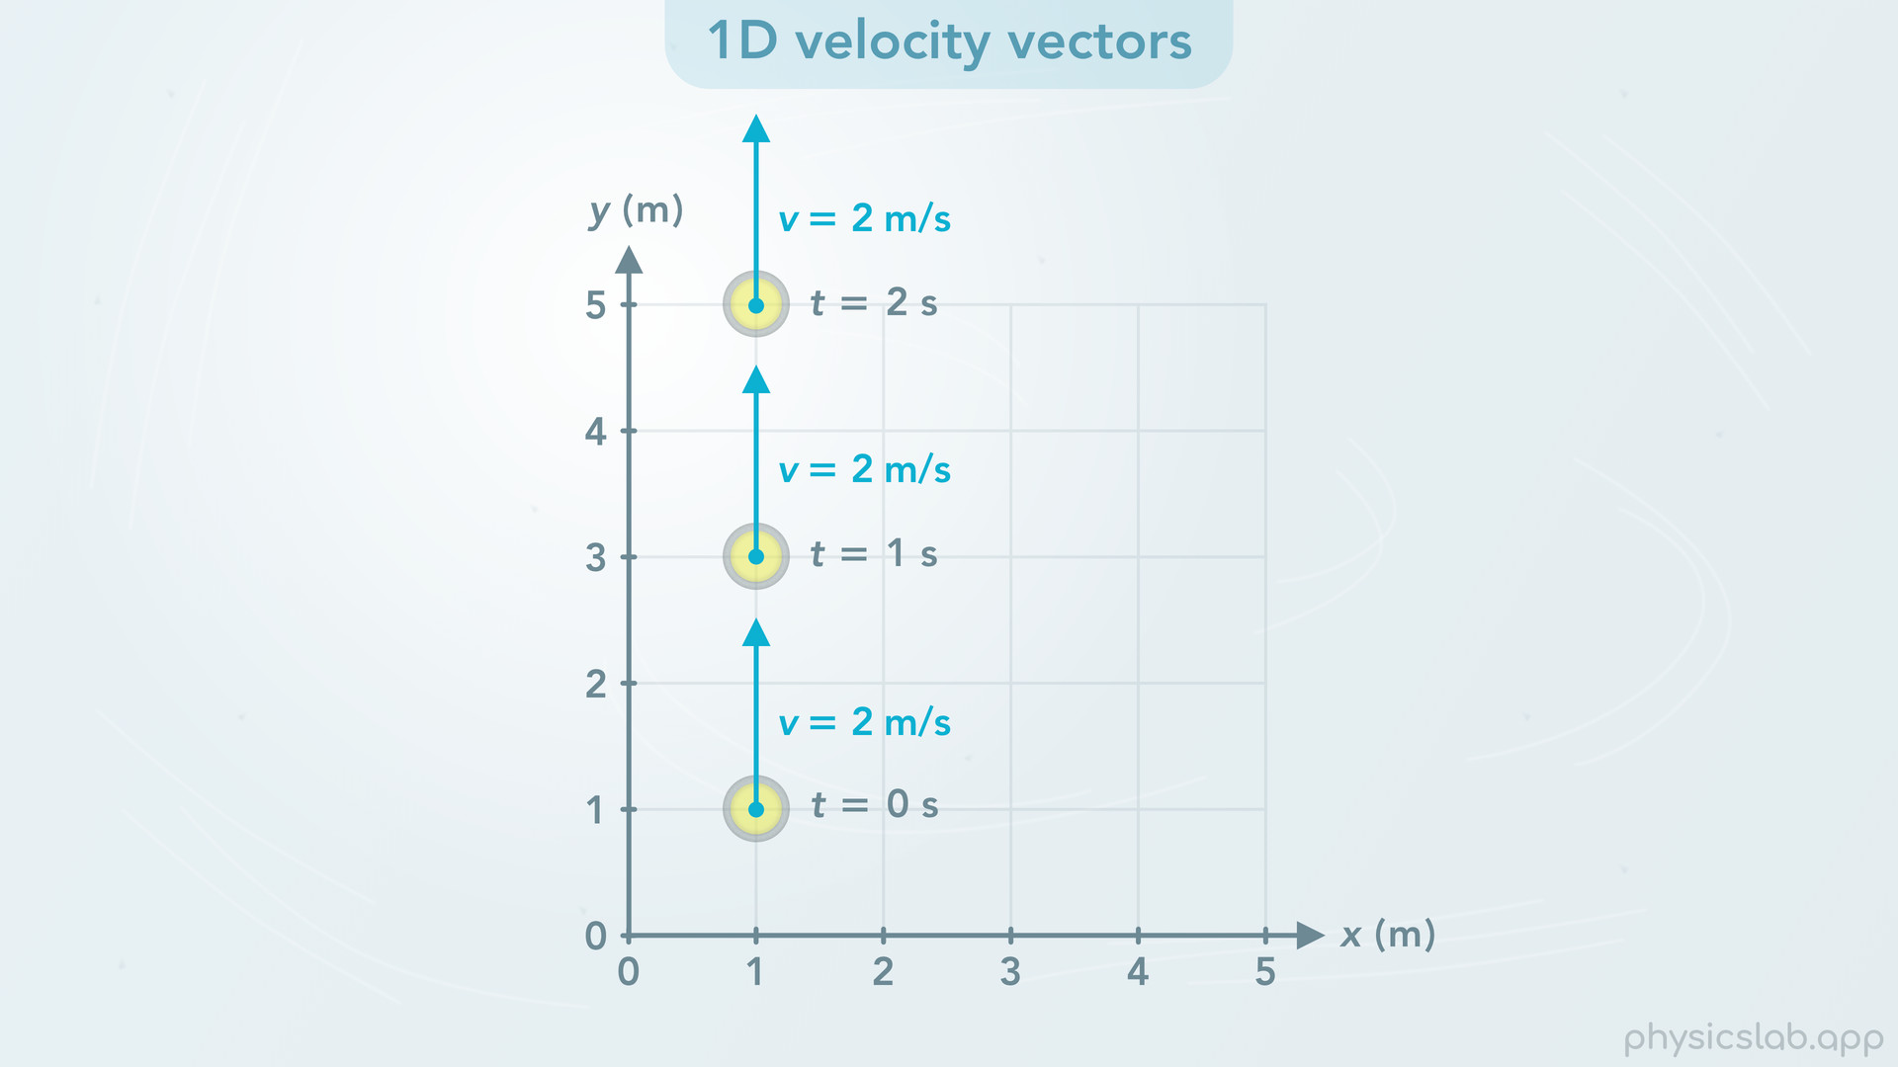
Notes:
• If the stone was moving in the y direction at 2 m/s, then the velocity vector would look like this, and it would be the same at every point in time.

Slide 23
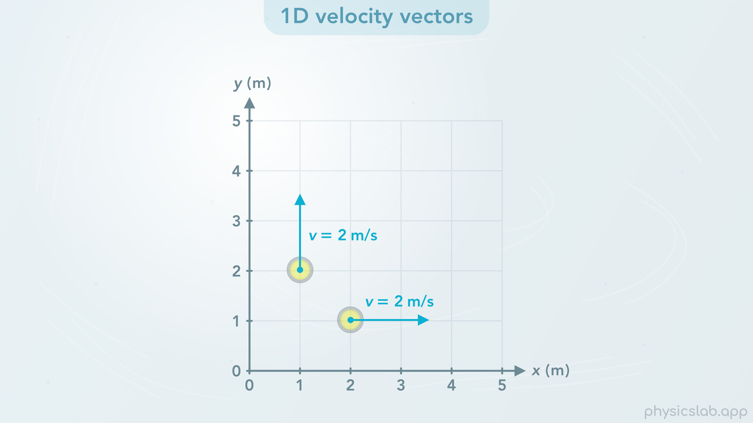
Notes:
• So those are examples of one dimensional velocity vectors.

Slide 24
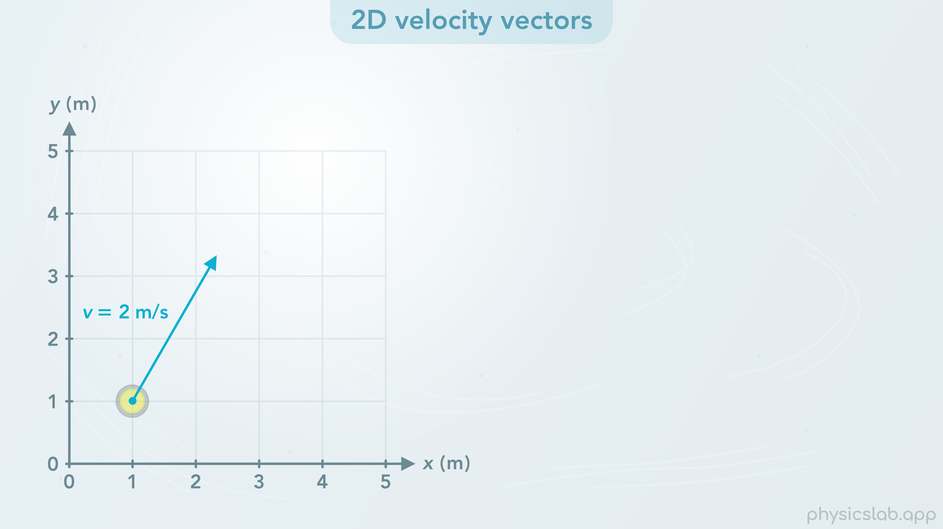
Notes:
• Now what if the stone is moving 2 m/s, but it’s moving in two dimensional motion? Then the velocity vector would look like this, it points in the direction of the velocity.
• But if the stone is moving at 2 m/s in that direction, how fast is the stone moving in the x direction, and how fast is it moving the y direction? Is it moving to the right at 2 m/s, and up at 2 m/s?

Slide 25
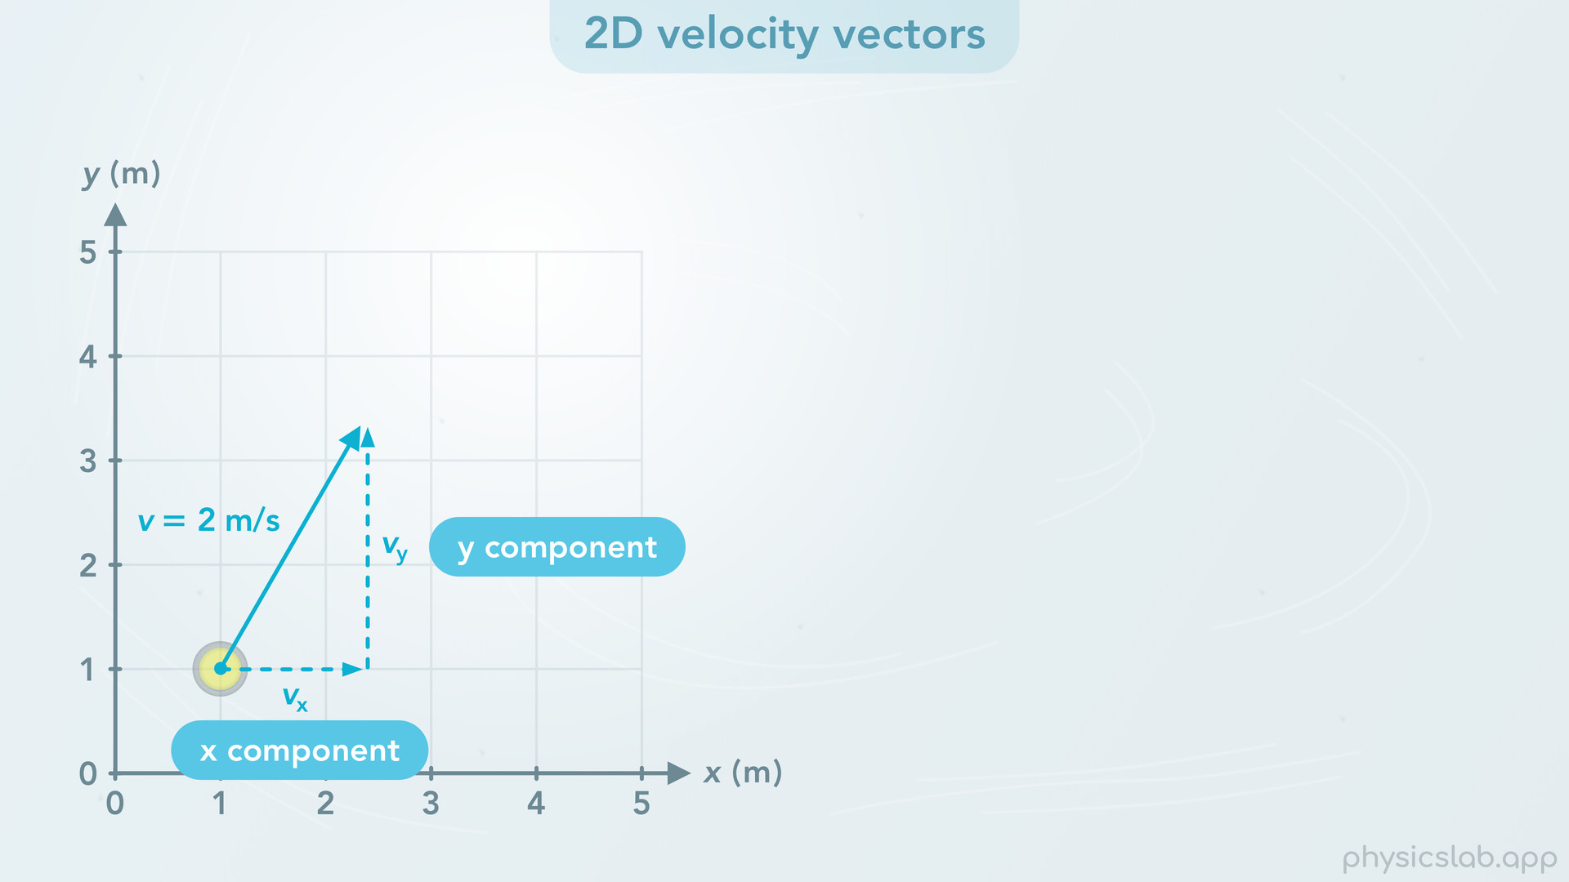
Notes:
• To answer that, we need to find the x and y components of the velocity vector. vx is the velocity component in the x direction and vy is the component in the y direction.

Slide 26
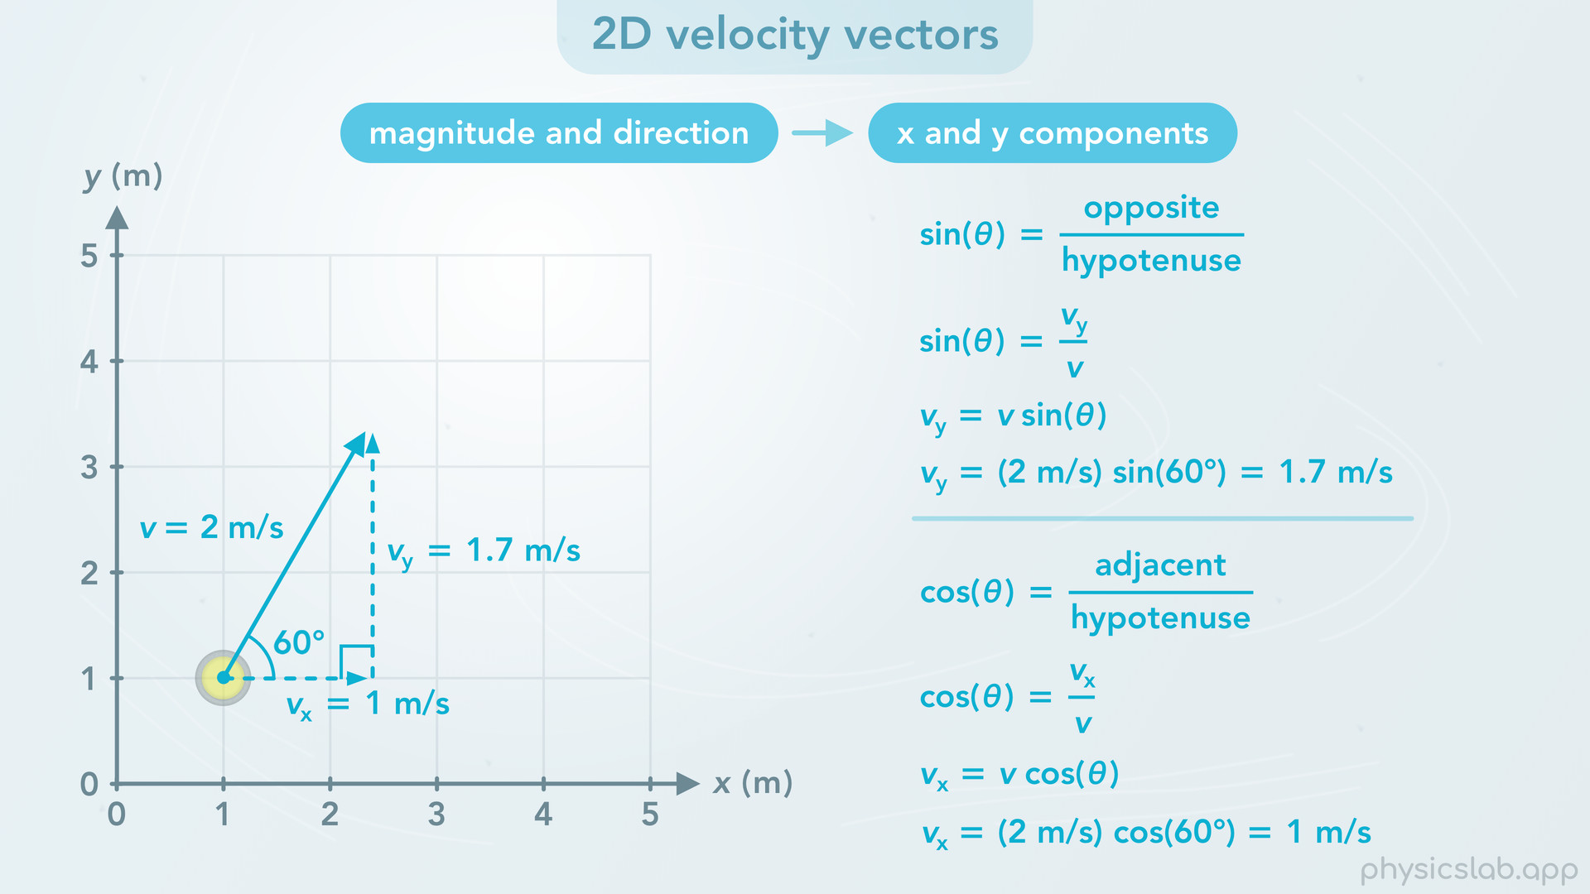
Notes:
We do the same thing that we did when we learned about displacement vectors and components. The vector, v, and its two components, vx and vy, form a right triangle, so we can use the trig functions to convert from the magnitude and direction into the x and y components. But we need to be given an angle, theta. In this case, theta is 60 degrees.
• Sine of theta equals the opposite side divided by the hypotenuse. vy is the opposite side from the angle and v is the hypotenuse. If we rearrange this equation, vy equals v times the sine of theta. If we plug in 2 m/s for v and 60 degrees for theta, we find that vy is 1.7 m/s, as long as our calculator is set to degrees instead of radians.
• We can do the same thing for the x component, but using cosine instead of sine, because the x component is adjacent to the angle that we’re using. When we do that, we find that vx is 1 m/s.
• Remember, we use sine for the component that’s opposite from the angle, and cosine for the one that’s adjacent to the angle. If we were given the other angle, then vx would use sine and vy would use cosine.

Slide 27
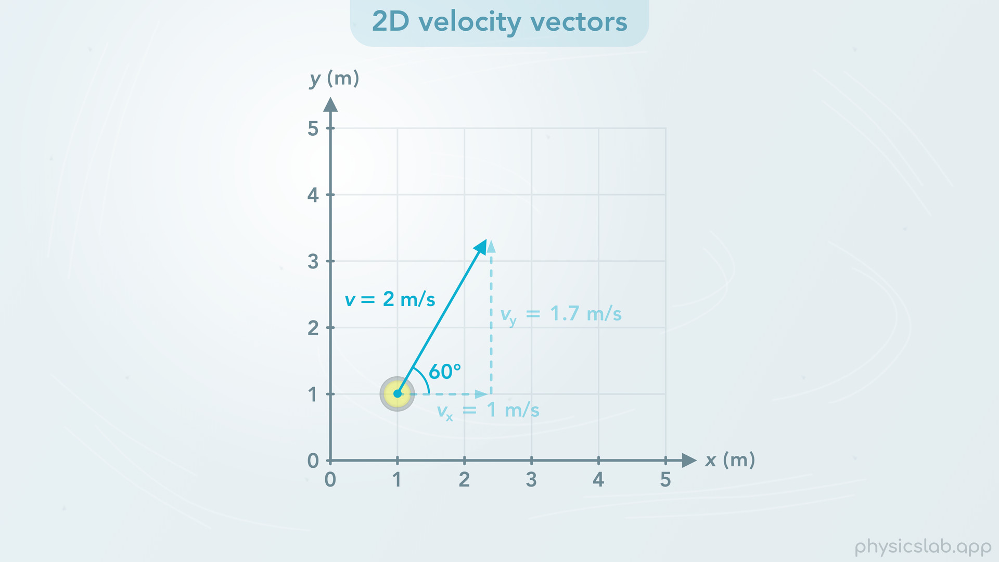
Notes:
• So, this stone is moving at 2 m/s at an angle of 60 degrees.

Slide 28
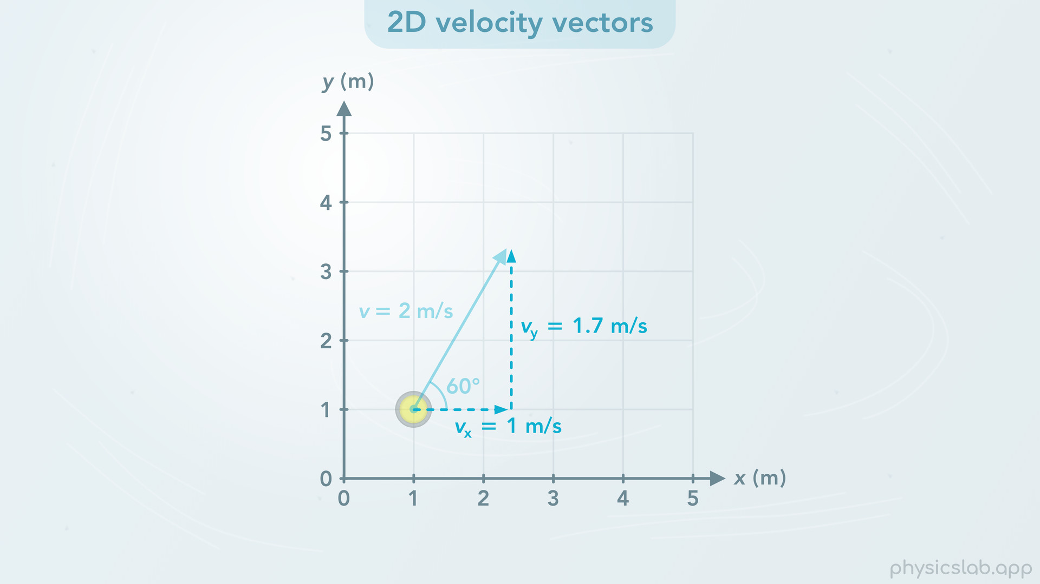
Notes:
But these components tell us that the stone is moving to the right at 1 m/s, and the stone is moving up at 1.7 m/s.

Slide 29
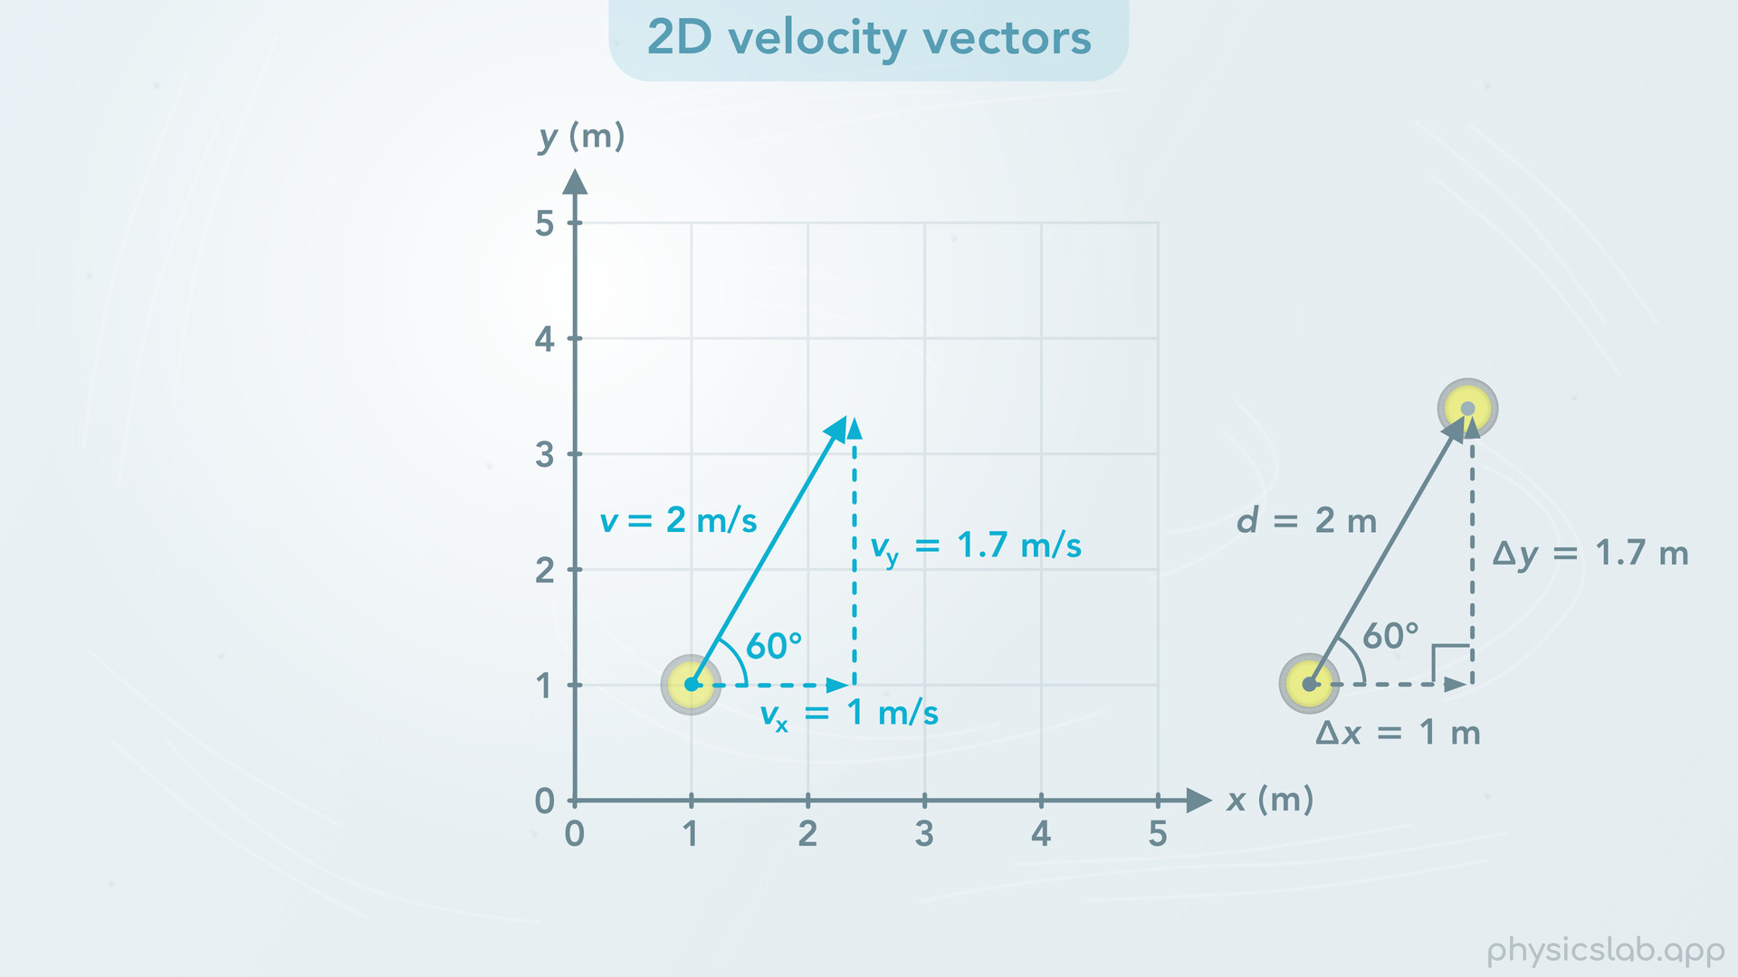
Notes:
• This might seem confusing if you’re not familiar with velocity vectors. Using the right triangle trig functions to find the components of a displacement vector makes sense because they’re side lengths of a triangle in 2D space. But the same thing works for velocity vectors and velocity components.

Slide 30
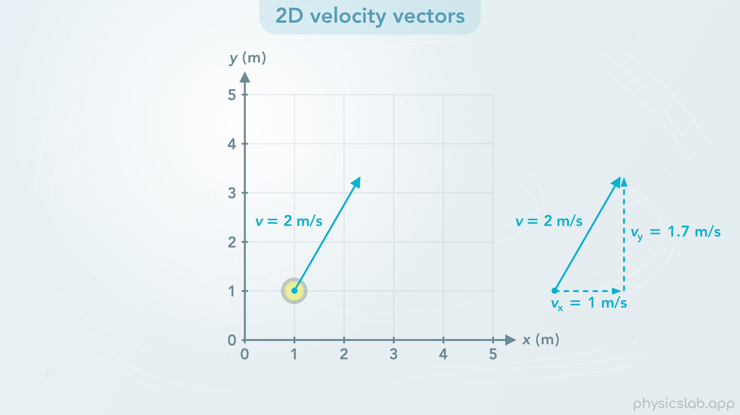
Notes:
• If we look at the actual velocity of the stone and we ignore the x and y components, the stone is moving at 2 m/s in the direction of the velocity vector.

Slide 31
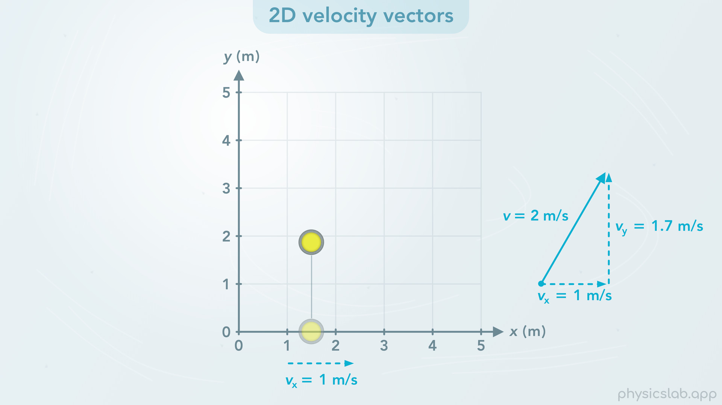
Notes:
• But if we imagine the stone is casting a shadow onto the x axis, and we follow its x position over time, then the velocity of this shadow is 1 m/s to the right.

Slide 32
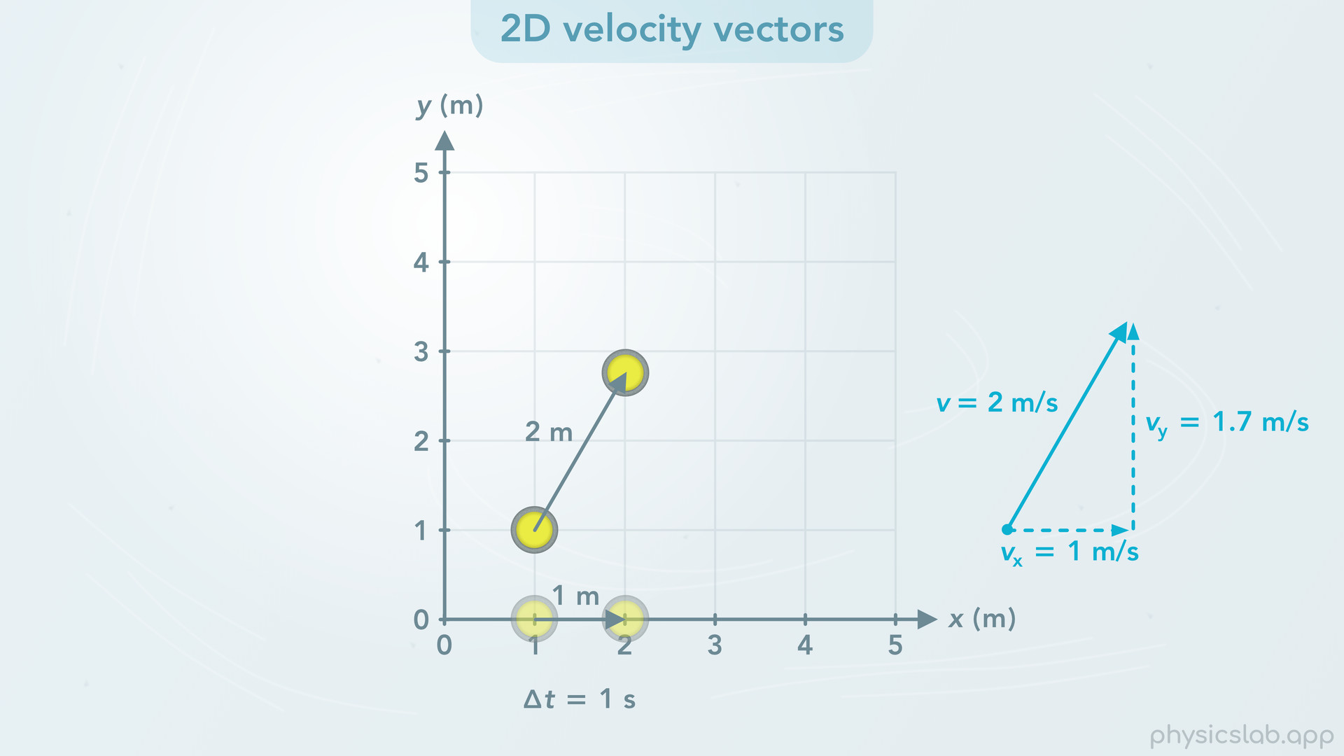
Notes:
Over a period of 1 second, the actual stone moves 2 m in the direction of its motion, but the shadow moves 1 m along the x axis. This is just geometry. The stone moved 1 m to the right in 1 second, so it’s velocity to the right is 1 m/s.

Slide 33
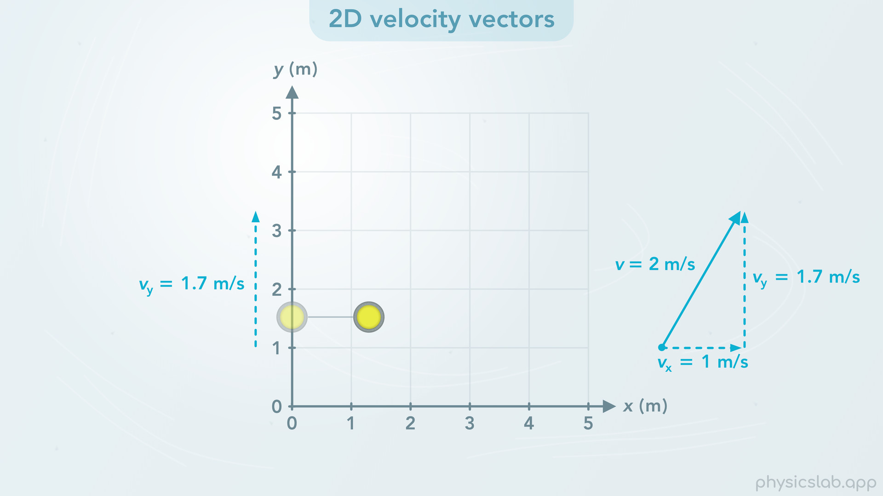
Notes:
• If we follow the shadow on the y axis, we see the shadow is moving upwards at 1.7 m/s.

Slide 34
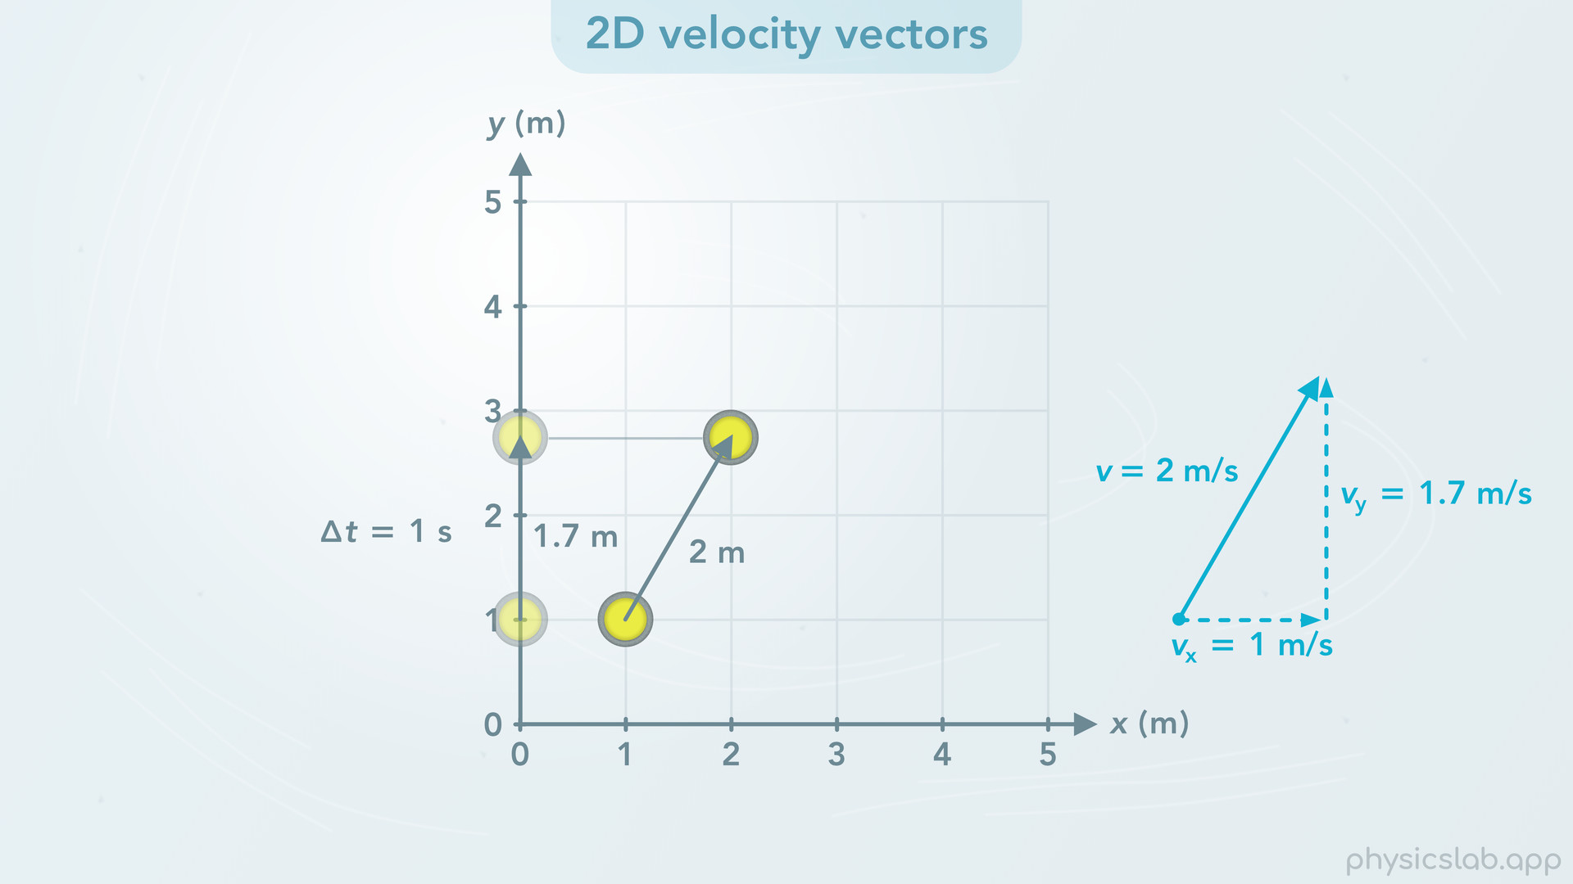
Notes:
The stone moves 1.7 m in the y direction in 1 second.

Slide 35
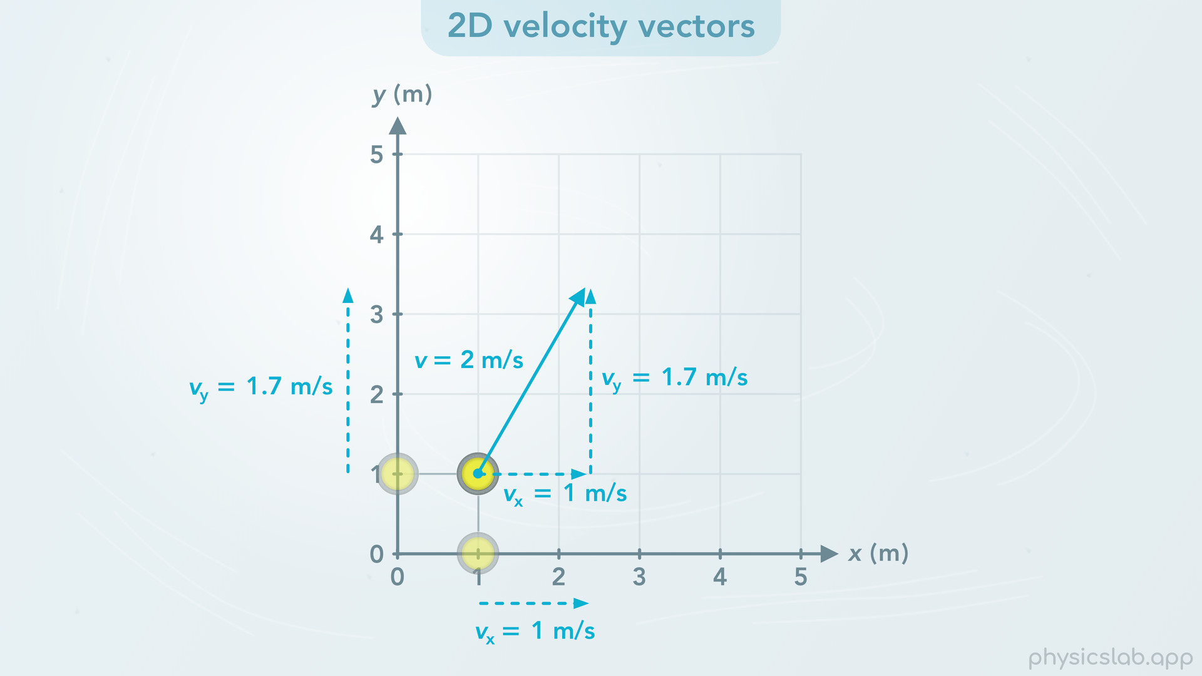
Notes:
• So a component of the velocity vector is like the velocity of the shadow along one axis. That’s how fast the object is moving purely in that direction.

Slide 36
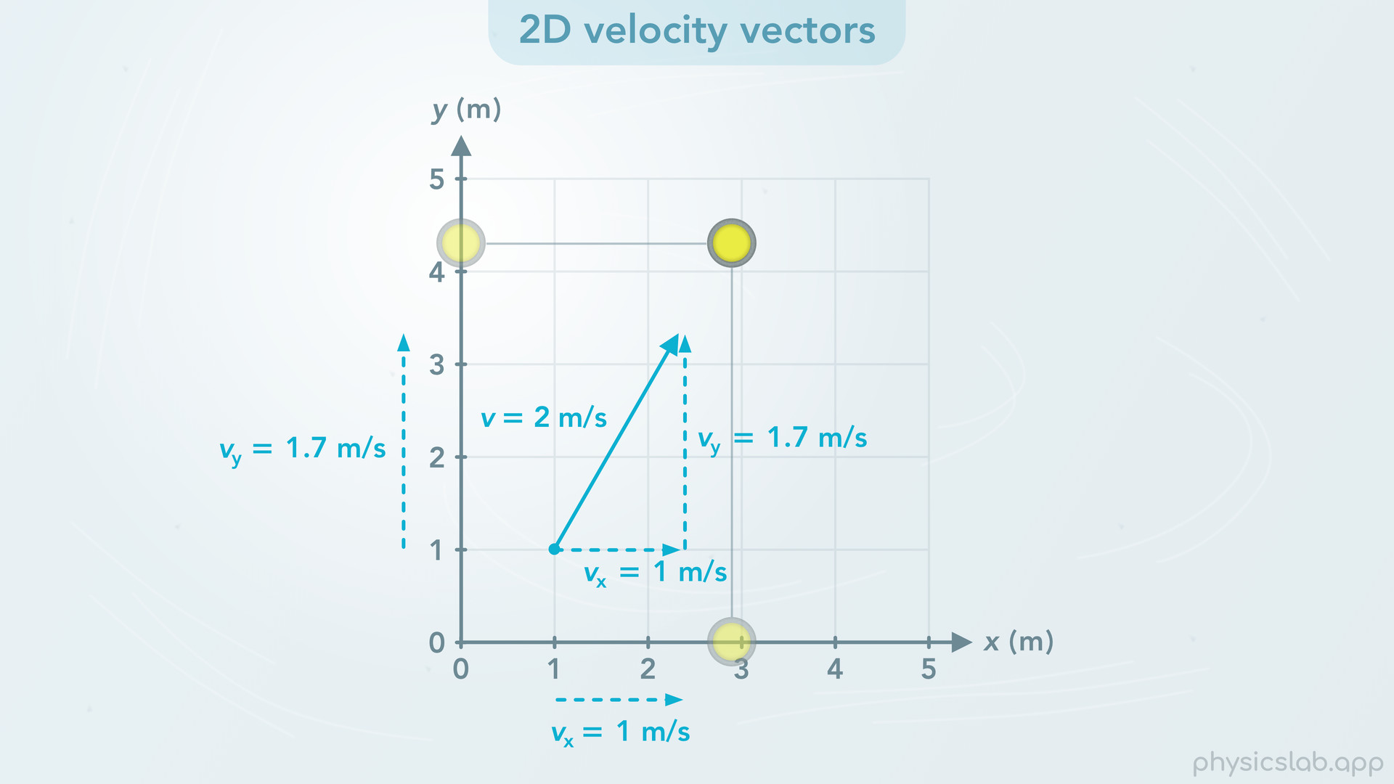

Slide 37
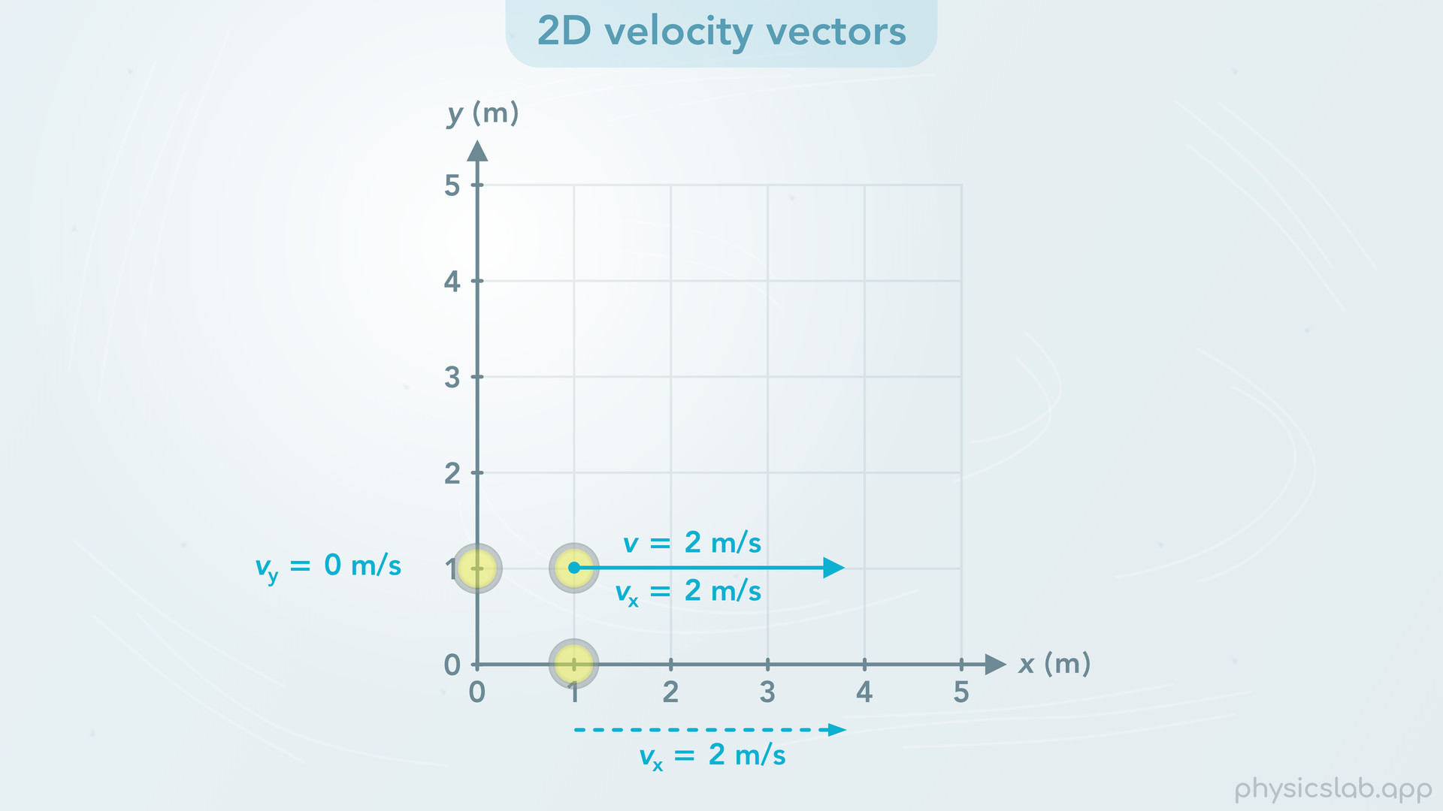
Notes:
• Let’s do a quick recap by looking at some examples.
• If the stone is moving directly to the right at 2 m/s, then the x component of the velocity is also 2 m/s and the y velocity is 0.

Slide 38
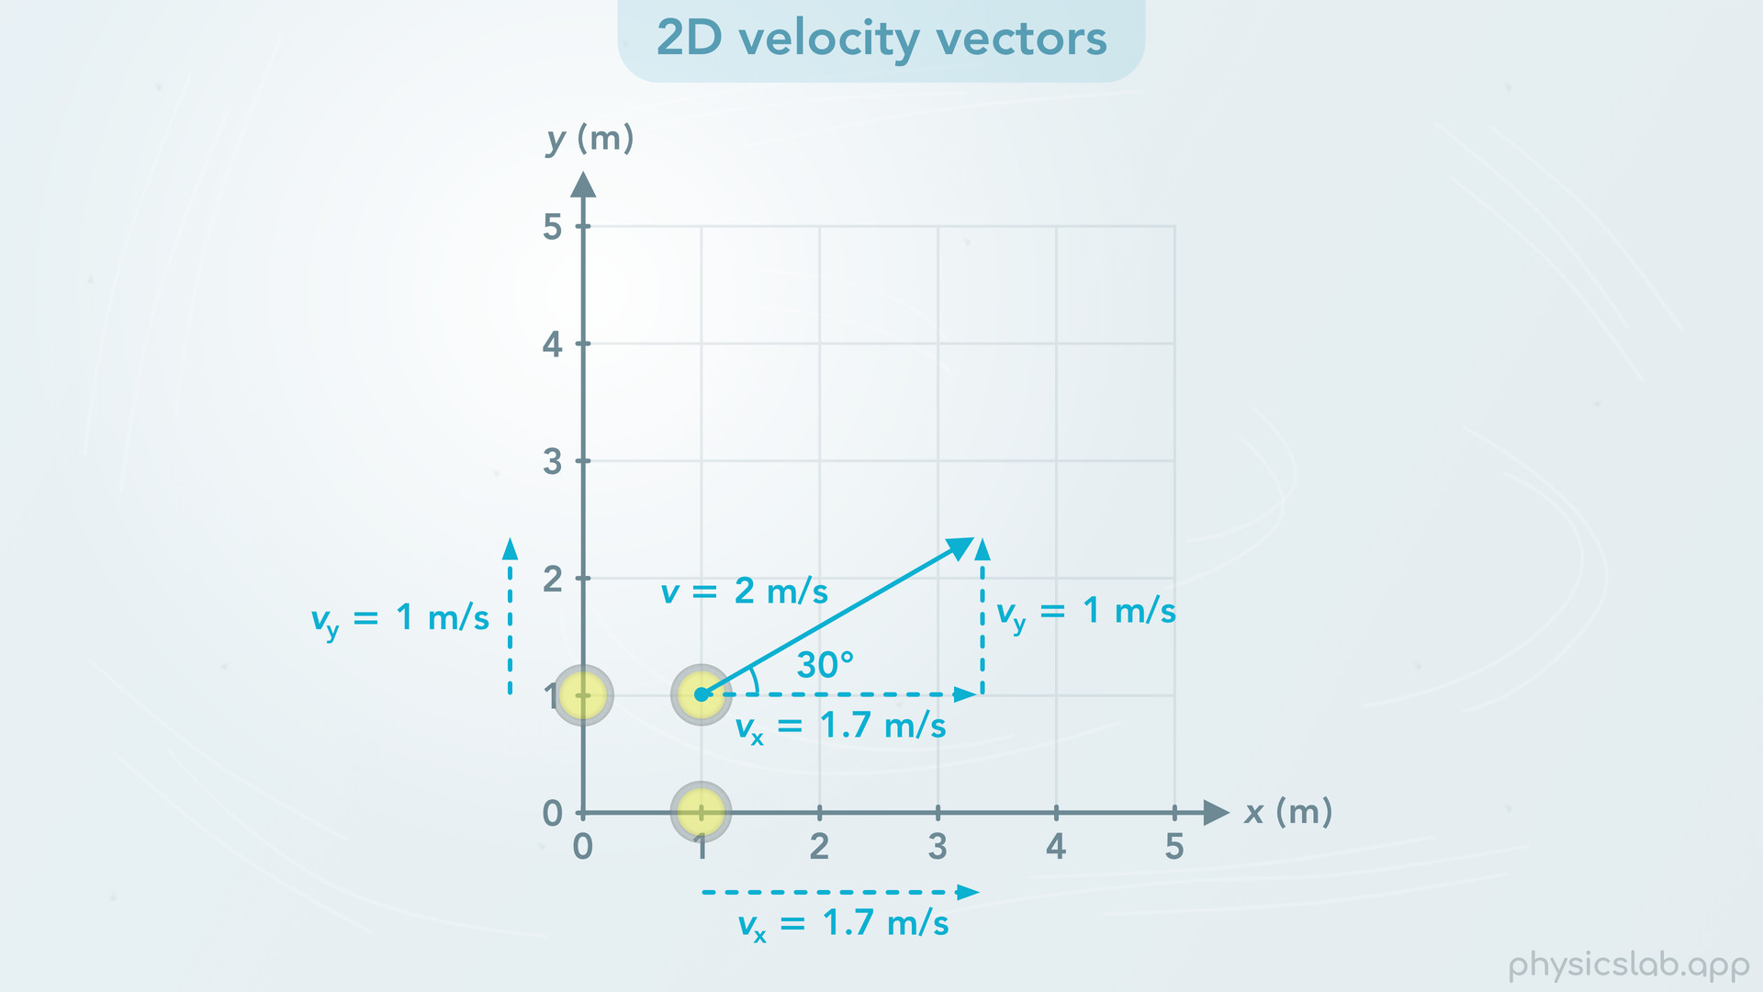
Notes:
• If the stone is moving at 30 degrees, the x velocity is 1.7 m/s and the y velocity is 1 m/s.

Slide 39
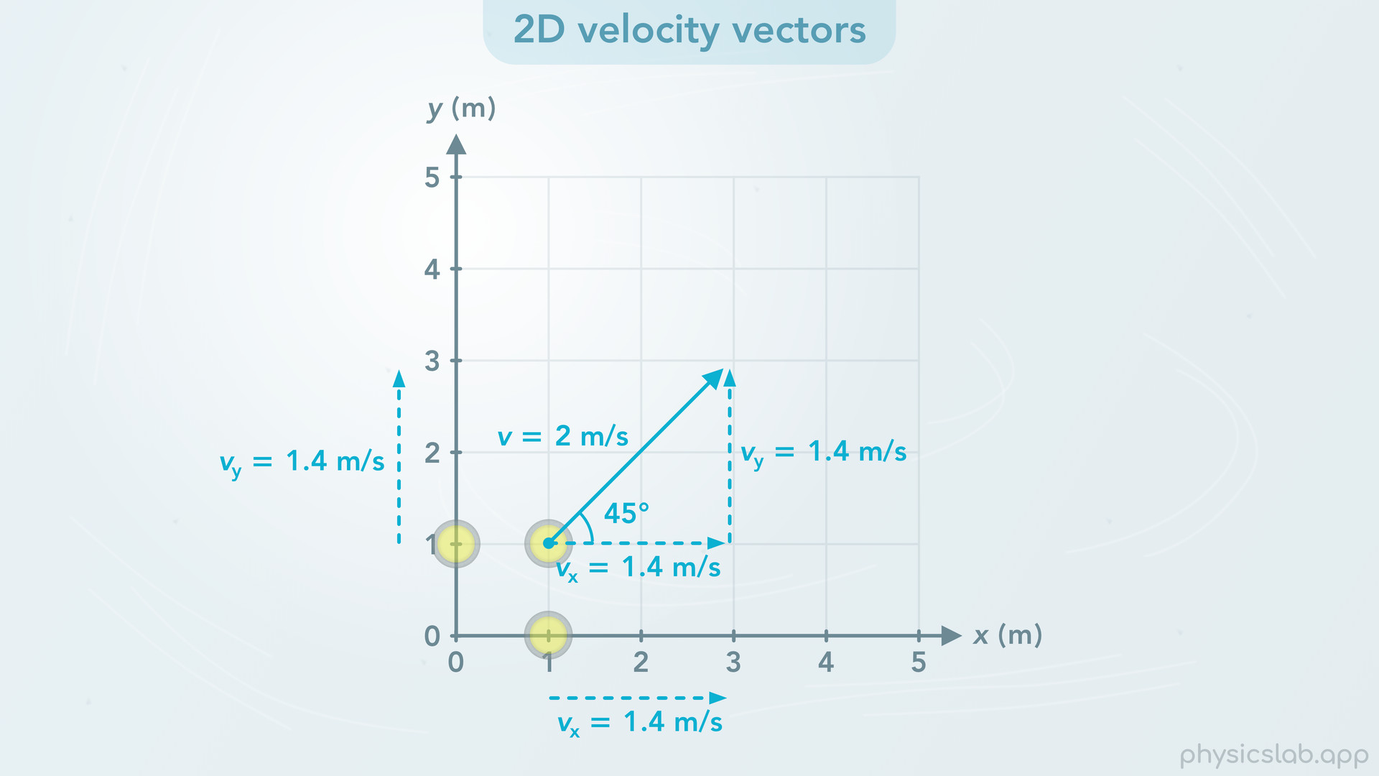
Notes:
• If the stone moves at 45 degrees then both the x and y velocity components are 1.4 m/s.

Slide 40
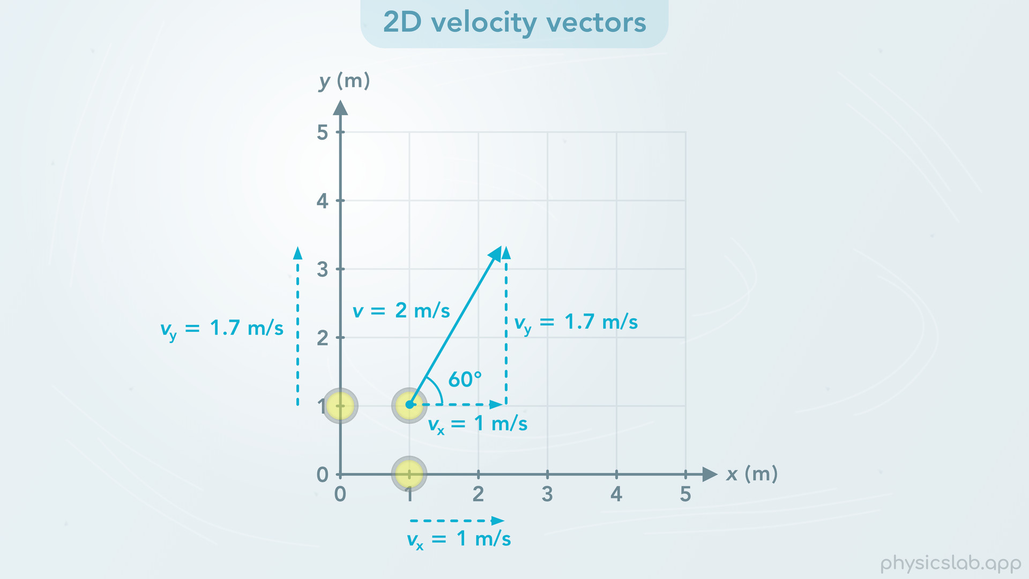
Notes:
• If the stone moves at 60 degrees like before, the x velocity is 1 m/s and the y velocity is 1.7 m/s.

Slide 41
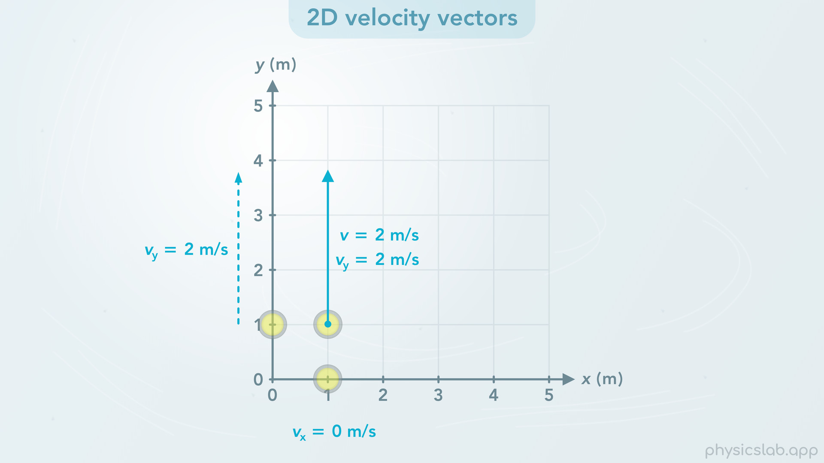
Notes:
• And if the stone moves directly upwards, then the y velocity is 2 m/s and the x velocity is 0.

Slide 42
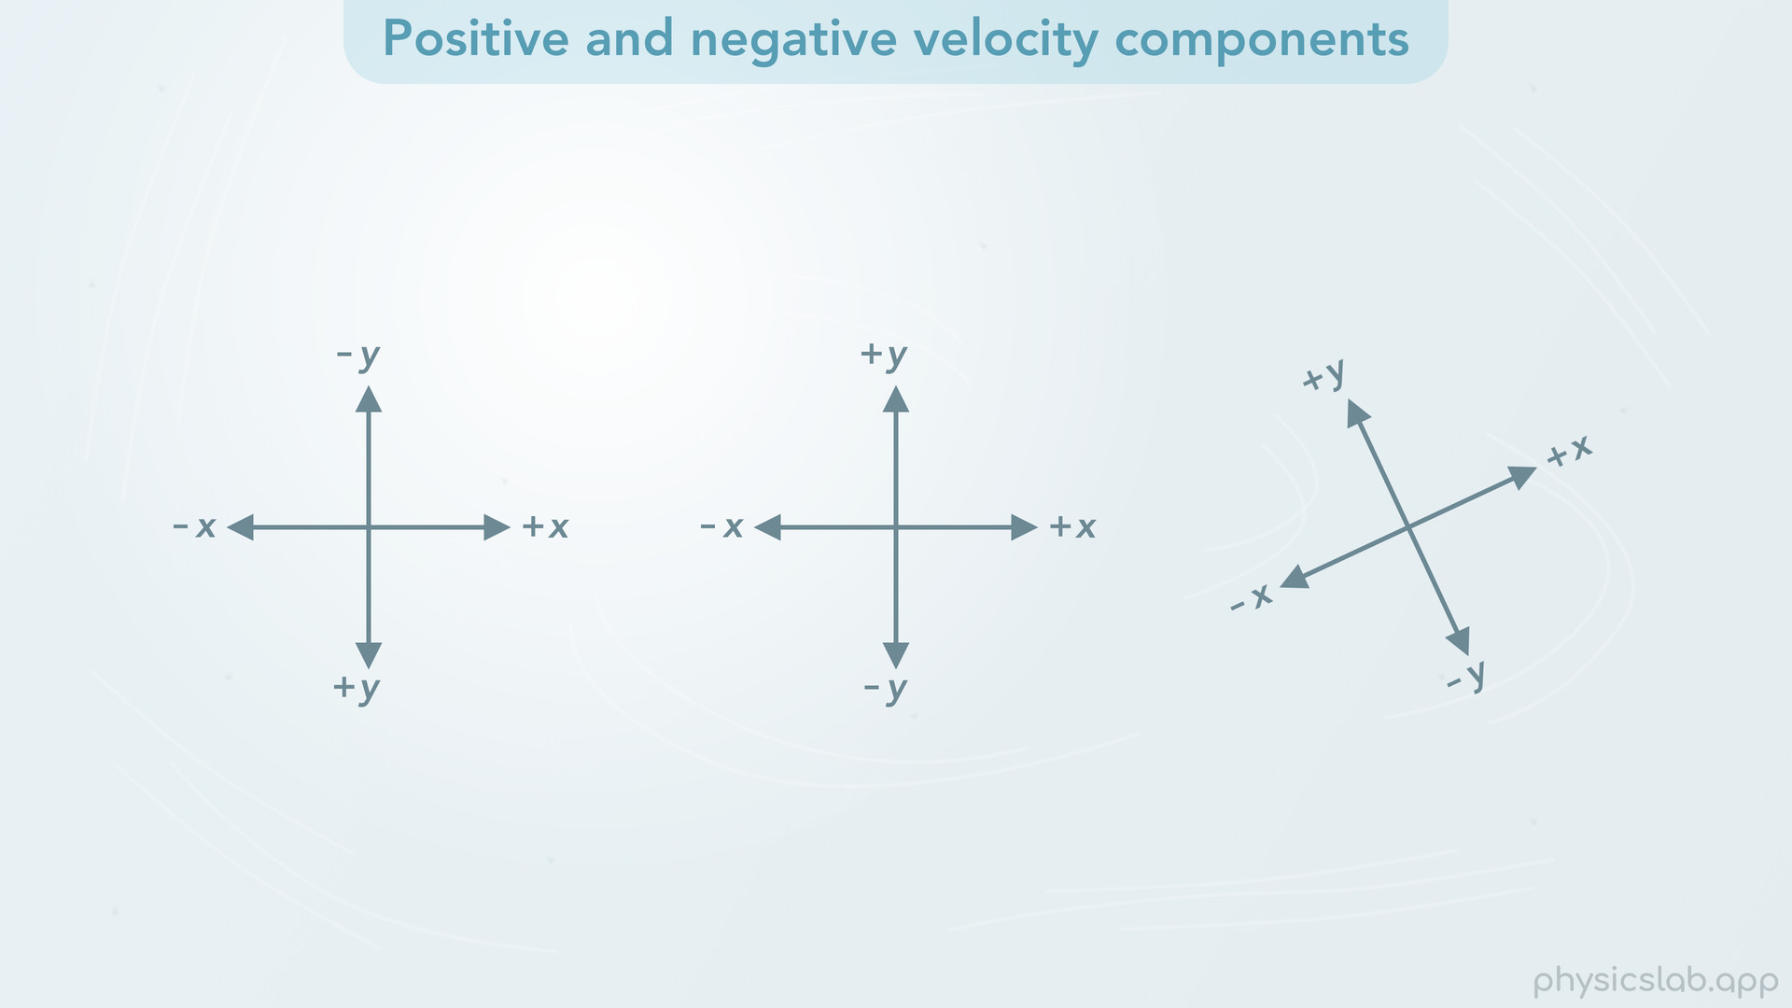
Notes:
• So far we’ve only seen the velocity vector point to the right and upwards. But what if it points down or to the left?
• In every physics scenario, we need to establish the x and y directions, and which way is positive and negative. In this example the positive x direction is to the right and the positive y direction is up.
• This means that left is the negative x direction and down is the negative y direction. You can choose different directions depending on the situation, but this is the most common way to setup the coordinate system.

Slide 43
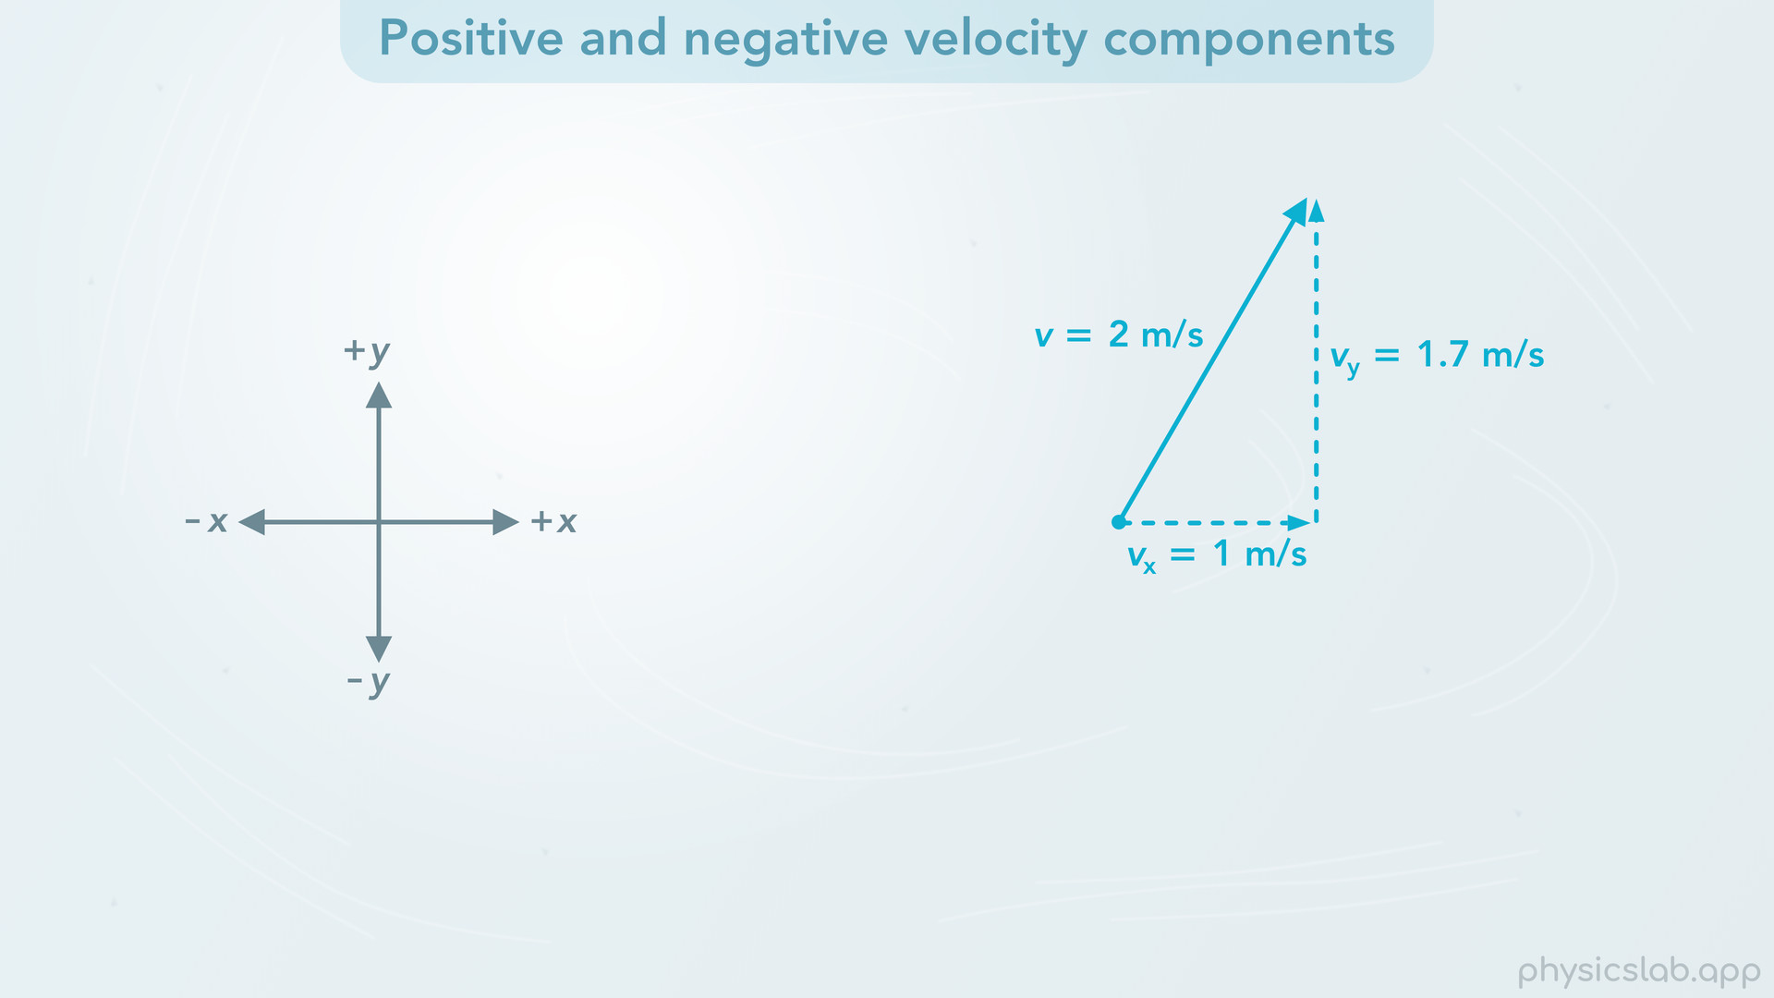
Notes:
• Just like we learned with displacement vectors, a component can be positive or negative depending on its direction.
• If the stone is moving in this direction, vx is positive, and vy is positive.

Slide 44
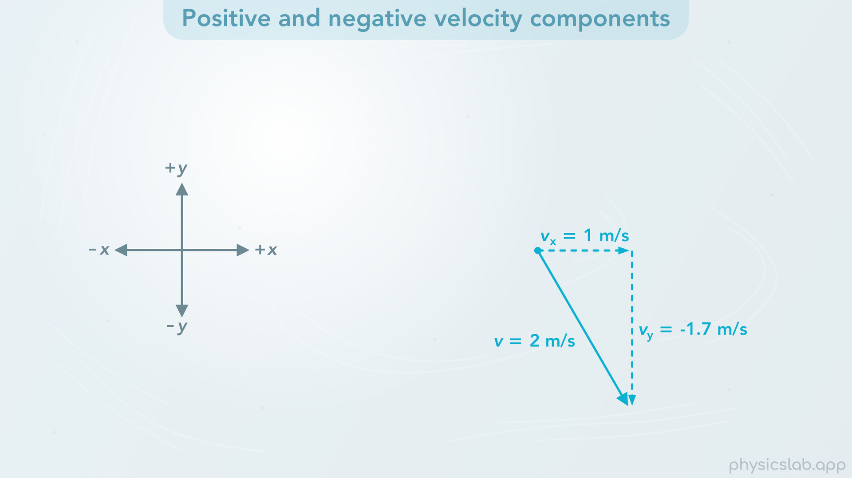
Notes:
• If the stone is moving in this direction, vx is positive, but vy is pointing in the negative y direction, so vy is negative.

Slide 45
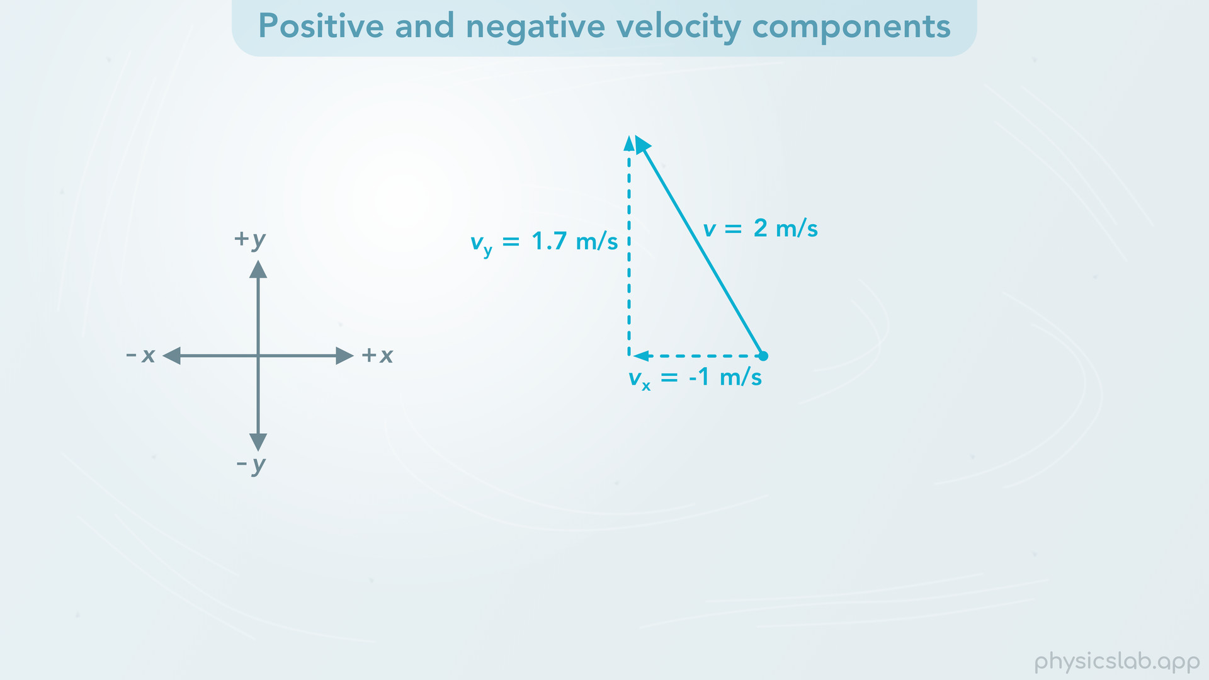
Notes:
• If the stone is moving in this direction, then vx is negative, and vy is positive.

Slide 46
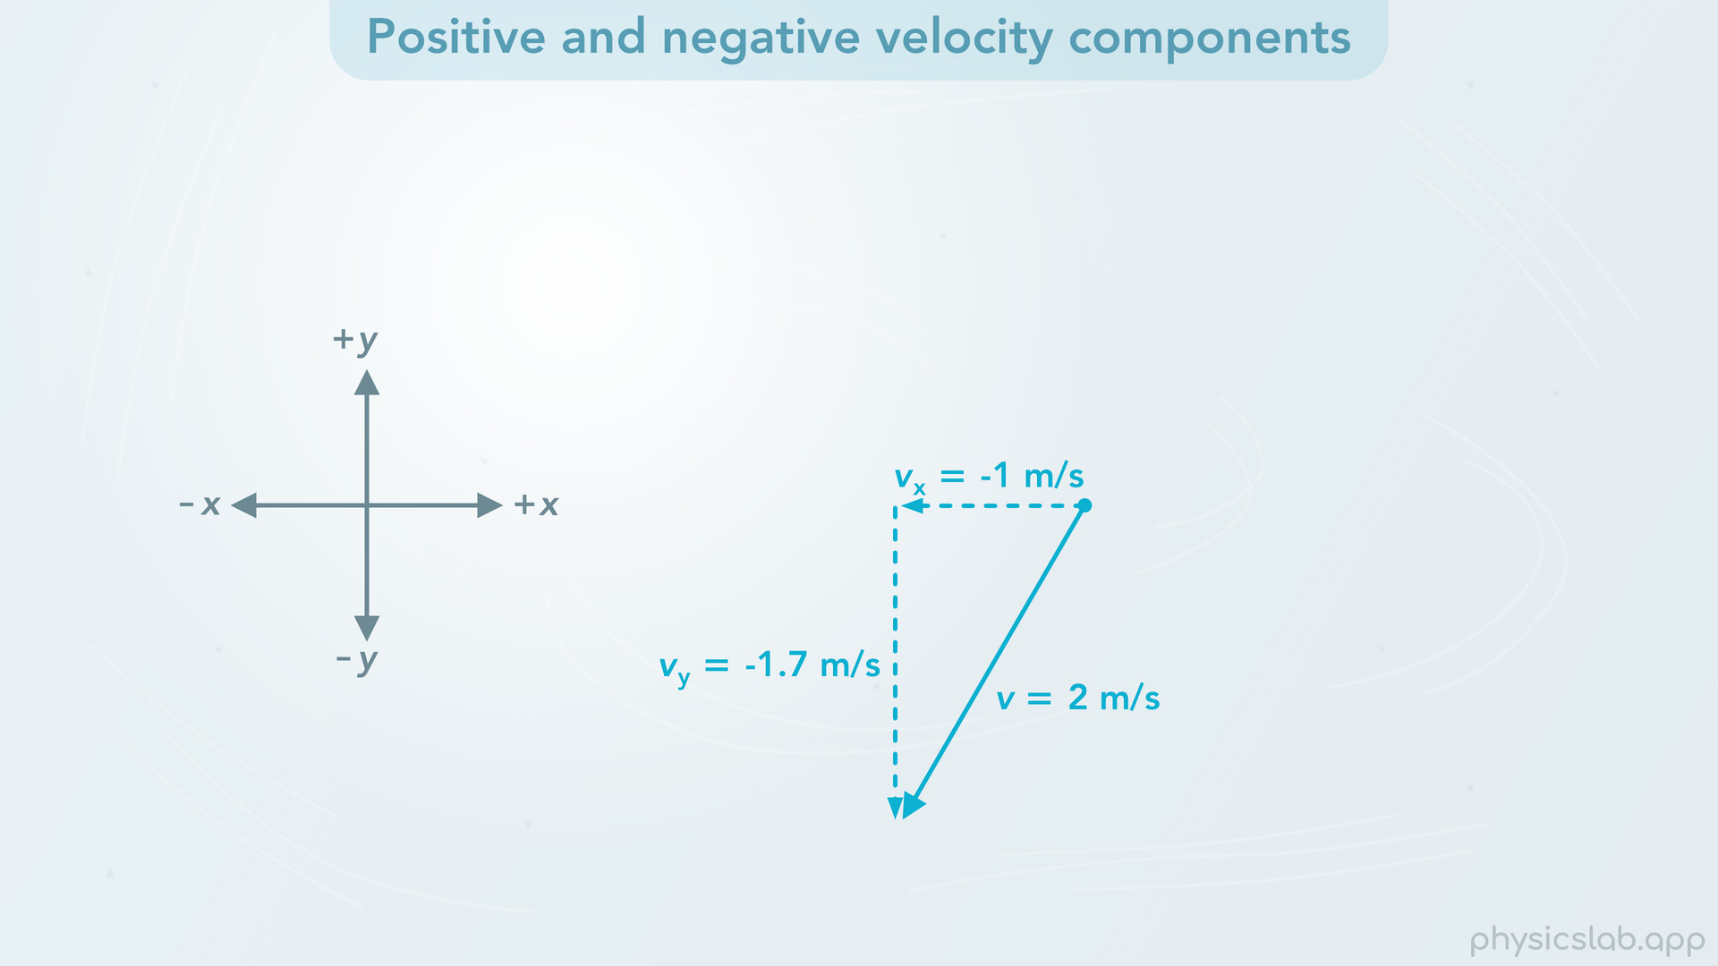
Notes:
• And if the stone is moving in this direction, vx and vy are both negative.

Slide 47

Notes:
• Remember that we can draw the components in different places, so do what makes the most sense to you.

Slide 48


Slide 49

Notes:
• You might have noticed that the components are switching between positive and negative, but the 2 m/s didn’t change. A vector’s magnitude is always positive. 2 m/s is the speed of the stone, which is the magnitude of the velocity. No matter which way the stone is moving, we would still say its speed, or magnitude, is positive 2 m/s.

Slide 50

Notes:
• And again, keep in mind that the components are positive or negative based on the direction they’re pointing, not on the position of the object. The positive and negative directions are always the same no matter where the object is. It’s like using compass directions. If a component is pointing to the right, it’s pointing in the east direction, which is positive. If the component is pointing to the left, it’s pointing in the west direction, which is negative.

Slide 51

Notes:
• As a visual example, here’s a curling stone moving in a circle. It’s speed is constant, so the velocity vector is always the same length. But watch how the x and y velocity components change depending on which direction the stone is moving at any moment in time.
• The positive and negative directions might seem confusing at first, but as long as you establish the directions when you start a problem and you stick with them, then the positive and negative signs in your math will work out.
*Note: the vector components should be parallel to the x and y axes but for some reason they are slightly off in these screenshots.

Slide 52


Slide 53


Slide 54


Slide 55


Slide 56


Slide 57


Slide 58

Notes:
• Alright, so we already learned how to take the magnitude and direction of the velocity and find the x and y components.

Slide 59

Notes:
• Now, let’s do things in reverse and learn how to create a new velocity vector by adding components together.

Slide 60

Notes:
• Here we have two stones that are not moving. Their x and y velocities are zero.

Slide 61

Notes:
Now let’s ignore the stones for a second and imagine the wind is blowing over one area of the ice, and the wind’s velocity is 1 m/s in the positive y direction.

Slide 62

Notes:
• In this example, if a stone is in an area where there’s wind, then the wind pushes the stone and changes the stone’s velocity.

Slide 63

Notes:
• We’re going to assume that the wind’s velocity is added to the stone. So the stone’s y velocity increases by 1 m/s.
• If the stone had no velocity before, its new y velocity would be a constant 1 m/s upwards.

Slide 64


Slide 65

Notes:
• Let’s pause and look at the new velocity vector of the stone at a moment in time. The wind is pushing the stone up, so the wind increases the stone’s y velocity component, vy. But it’s not pushing the stone left or right, so the wind does not change the x component, vx, which is still 0.

Slide 66

Notes:
• Now, let’s imagine a new scenario where the stone is already moving to the right at 2 m/s before it’s hit by the wind. The x component is 2 m/s because the vector is pointing in the x direction, and the y component is 0.

Slide 67

Notes:
• What will happen to the stone’s velocity when it’s hit by the wind? Let’s take a look.

Slide 68


Slide 69


Slide 70

Notes:
• The stone continues moving to the right but now it also moves up with the wind. So the stone’s velocity is now two dimensional, it’s moving in the x and y directions at the same time, and the new velocity vector is in this diagonal direction.
• The wind increases the stone’s y velocity like before.
• But the x velocity doesn’t change, it’s still 2 m/s.

Slide 71

Notes:
• Let’s watch the stone’s velocity along the y axis. It goes from 0 m/s to 1 m/s.

Slide 72


Slide 73


Slide 74

Notes:
• Now let’s look at the velocity along x axis. The x velocity stays at 2 m/s the whole time.

Slide 75


Slide 76


Slide 77


Slide 78


Slide 79

Notes:
• So what is the magnitude and direction of the stone’s velocity after it’s hit by the wind?
• Now that the stone has x and y velocity components, the actual velocity of the stone is the resultant vector when we add the two components together. This is just like when we added two displacement vectors.

Slide 80

Notes:
• Graphically, we can add vectors using the tip-to-tail method. So if we draw vx

Slide 81

Notes:
and then we draw the vy starting at the end of vx

Slide 82
Notes:
then the sum of the two components, vx plus vy, is this new vector, v. v starts at the beginning of the first component and ends at the end of the second component.
But what is the value, or the magnitude of this new vector, v? How fast is the stone moving after it’s hit by the wind? Is it 1 m/s? 2 m/s? And what’s the angle of the velocity?

Slide 83

Notes:
• Earlier, we used the magnitude and direction to find the x and y components. Now, we’re going to use the components to find the magnitude and direction of the vector.
• Let’s find the magnitude first. For that we’re going to use the Pythagorean theorem. For a right triangle where c is the length of the hypotenuse and a and b are the other two sides, then c squared equals a squared plus b squared. If we apply that to this vector, v is the hypotenuse (c) and vx and vy are the other sides (a and b). So v squared equals vx squared plus vy squared. We can take the square root of both sides so we just have v on the left. Then if we plug in 2 m/s for vx and 1 m/s for vy, we find that v equals 2.2 m/s. That’s the length of the hypotenuse and the it’s magnitude of the velocity.

Slide 84

Notes:
• Now let’s find the vector’s angle. To do that we’re going to use the inverse tangent function. Remember, tan of theta is equal to the opposite side divided the adjacent side. But if we want to find theta, then theta equals the inverse tangent of opposite over adjacent. If we’re trying to find this angle, then the opposite side is vy and the adjacent side is vx. We plug in 1 m/s for vy and 2 m/s for vx, and we find that theta equals 26.6 degrees.
• So at this moment in time when the stone is being pushed by the wind, the stone is moving 2.2 m/s at an angle of 26.6 degrees. That’s the actual magnitude and direction of the stone’s velocity. And vx and vy are the components of that velocity in the x and y directions.

Slide 85

Notes:
• So that’s how we describe the velocity of an object in two dimensional motion. We can use the x and y velocity components, or we can use the magnitude and the angle. And we can convert between them to answer different questions about the motion.

Slide 86

Notes:
• At this point, there’s an important concept we need to talk about, which is a fundamental part of motion and forces.
• And that’s the fact that x and y motions are independent.

Slide 87

Notes:
• In the last example, if the stone’s actual velocity was 2.2 m/s in this direction, then why do we care about these things called components? Why is it useful to focus on the stone’s motion in the x direction or the y direction?

Slide 88

Notes:
• Here’s the concept that’s gonna be very important as we study physics. “An object’s x motion and y motion are independent of each other”. Let’s read that again. “An object’s x motion and y motion are independent of each other”. Put another way, “x motion does not affect y motion, and y motion does not affect x motion”. This is a concept that you might not have thought about, and it’s not intuitive so it may take some time for it to sink in.

Slide 89

Notes:
• So what does this mean? First, motion can mean anything we’ve learned about in kinematics: position, displacement, velocity or acceleration. Since we’re covering velocity in this video, let’s use the word velocity.
• How does this apply to our last example? Let’s watch the motion of the stone again as it’s hit by the wind.
• The x velocity is 2 m/s to the right the entire time. The wind does not change the stone’s x velocity because the wind doesn’t push the stone in the x direction. The x motion and y motion are independent, so the change in the y velocity has no affect on the x velocity.
• The y velocity changes because the wind pushes the stone in the y direction. But the y velocity has nothing to do with the fact that the stone is moving to the right. The x motion does not affect the y motion.
• So, by knowing that the x and y velocities are independent, we were able to take two separate velocity vectors and add them to find the stone’s new velocity.

Slide 90

Notes:
• The concept of the x and y motions being independent will make more sense when we work with projectile motion. But let’s take a look at one more example using velocity.
• Here we have a boat crossing a river.
• Let’s say the x direction is to the right along the river and the y direction is upwards across the river.
• If the velocity of the boat is 10 m/s at an angle of 60 degrees, and the river is 40 m straight across, how long does it take the boat to reach the other side of the river? And how far does the boat move down the river (to the right) during that time? Keep in mind that for this example, the water is not moving.
• So we’re given the boat’s velocity as a vector with a magnitude and direction, but we’re being asked about the motion in the x direction and the y direction separately.

Slide 91

Notes:
• This is where x and y components are useful. We’ll skip the math for this example, but if we use the magnitude, the angle and the trig functions, we can find the x and y components of the velocity vector.
• As the boat moves, it’s travelling 8.66 m/s upwards, straight across the river. And it’s moving 5 m/s to the right, along the river.
• So, now that we know the boat’s velocity in each individual direction, we can answer these questions.

Slide 92

Notes:
• First, how long does it take the boat to reach the other side of the river?

Slide 93

Notes:
We know the river is 40 m across, which means the boat has to move 40 m in the y direction. Now that we know the boat’s y velocity, we can use that to find the time. We can rearrange the equation for velocity so we get time equals the y displacement divided by the y velocity. We plug in 40 m for delta y and 8.66 m/s for vy. Remember, we’re only focusing on the boat’s y motion, so we’re using the y displacement and the y velocity. This gives us 4.6 seconds for delta t, which is how long it takes the boat to reach the other side of the river.
• Notice that the x velocity, the velocity of the boat to the right, has no effect on the time it takes to cross the river. The only velocity that matters in this part is the velocity in the y direction, straight across the river.

Slide 94

Notes:
Instead of the boat moving 10 m/s at an angle, we can imagine the boat is moving straight across the river at 8.66 m/s. This is just like if the boat were casting a shadow along the y axis, which we saw before with the curling stone. Both of these boats have the same y velocity, and they’ll reach the other side in the same amount of time.

Slide 95

Notes:
• Now, how far does the boat move down the river (to the right) during that time? For this question, we’re looking at the motion in the x direction. However, notice that the same period of time, 4.6 seconds, applies to the y motion and the x motion. The concept that time is shared between the x and y motions will be important for projectile motion and we’ll revisit that idea in another lesson.

Slide 96

Notes:
• So if the boat is moving to the right at 5 m/s, how far does the boat move to the right in 4.6 seconds? Let’s start with the equation for velocity in the x direction, and rearrange it so that delta x is by itself on the left. Now we can plug in 5 m/s for vx and 4.6 seconds for delta t. And we find that delta x, the displacement in the x direction, is 23 m, which is how far the boat moved down the river during the time it took to reach the other side.

Slide 97

Notes:
• This is a basic example of why it’s useful to know that the x and y motions are independent. We started with two dimensional motion

Slide 98

Notes:
and we broke that down into one-dimensional motions. Then we used the kinematic equations to answer questions about the x motion and the y motion separately.

Slide 99

Notes:
• So that’s all we’re gonna cover in this video, let’s do a summary of the main points.

Slide 100

Notes:
• A velocity vector shows us the direction of an object’s velocity at an instant in time, so it represents the instantaneous velocity of the object. The length of the vector represents the magnitude of the velocity, which is the speed. We can draw a velocity vector any length, but if we’re comparing multiple vectors in one picture, then the relative lengths should correspond to the relative magnitudes. So if an object’s velocity is constant, then it’s velocity vector should stay the same over time. And if an object is moving twice as fast, it should have a velocity vector that’s twice as long. But if we’re just drawing vectors so we have a sketch of the problem we’re solving, the lengths don’t have to be exact.

Slide 101

Notes:
• When an object is moving in two dimensional motion, that means it’s position is changing along the x axis and y axis at the same time. A 2D velocity vector is at an angle and it has x and y components. The x component of the velocity, which we call vx, is the velocity of the object in the x direction, or we can think of it as the velocity of the object’s shadow along the x axis. And the same is true for the y component.

Slide 102

Notes:
• Like with any vector, if we know the magnitude and angle, we can use the cosine and sine functions to find the x and y components. And if we know the components, we can use the Pythagorean theorem and the inverse tangent function to find the magnitude and the angle.

Slide 103
Notes:
• Once we establish the positive and negative x and y directions, a velocity component will be negative if it points in the negative direction. However, the magnitude of the velocity is always positive.

Slide 104

Notes:
• We can add velocity vectors, just like we did with displacement vectors. The resultant velocity vector tells us the magnitude and direction of the object’s actual velocity.
• An important concept in physics is that an object’s x motion and y motion are independent. X motion does not affect y motion, and y motion does not affect x motion.

Slide 105

Notes:
• This means we can take two dimensional motion and break that down into the x motion and the y motion. Then we can study and answer questions about the x and y motions separately.

