Slide 1
Tension
Slides Version 2
This version includes:
Slides with screenshot images from the video.
The video narration in the slide notes.
A blank template slide with the same background and font as the video.
Slides with some basic graphics from this video for you to use however you like.
Feel free to add, delete and edit slides to make your own presentation. You can use these slides in class or share them with your students, but please do not share them with anyone else.
If you have any feedback, suggestions or questions about these slides please email me at chris@physicslab.app or send me a message on Discord @physicslab.
physicslab.app

Slide 2
Heading
Text

Slide 3













Free body diagram

Slide 4




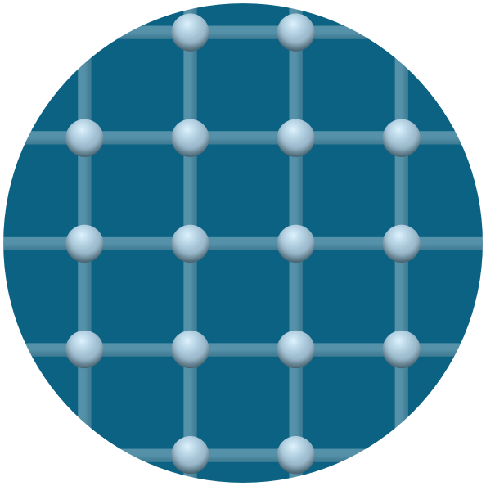
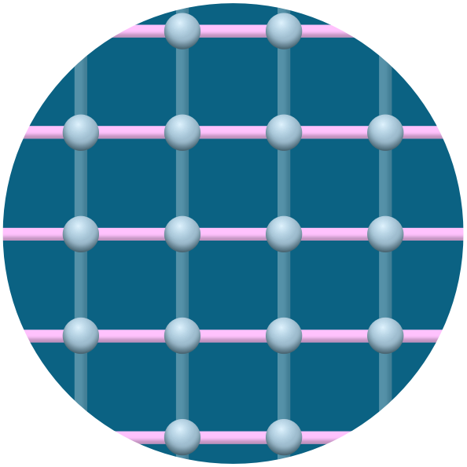





Slide 5
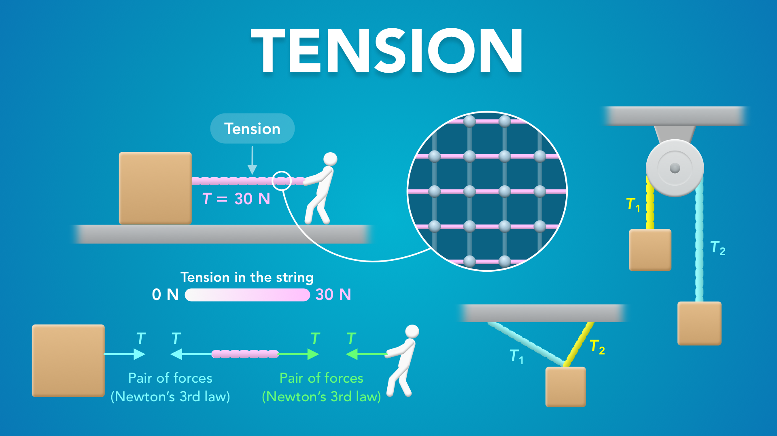
Notes:
Tension
physicslab.app
If you have any questions, suggestions or feedback about these slides please email me at chris@physicslab.app or send me a message on Discord @physicslab.

Slide 6

Notes:
• Hey everyone! In this video we’re going to start learning about tension.

Slide 7
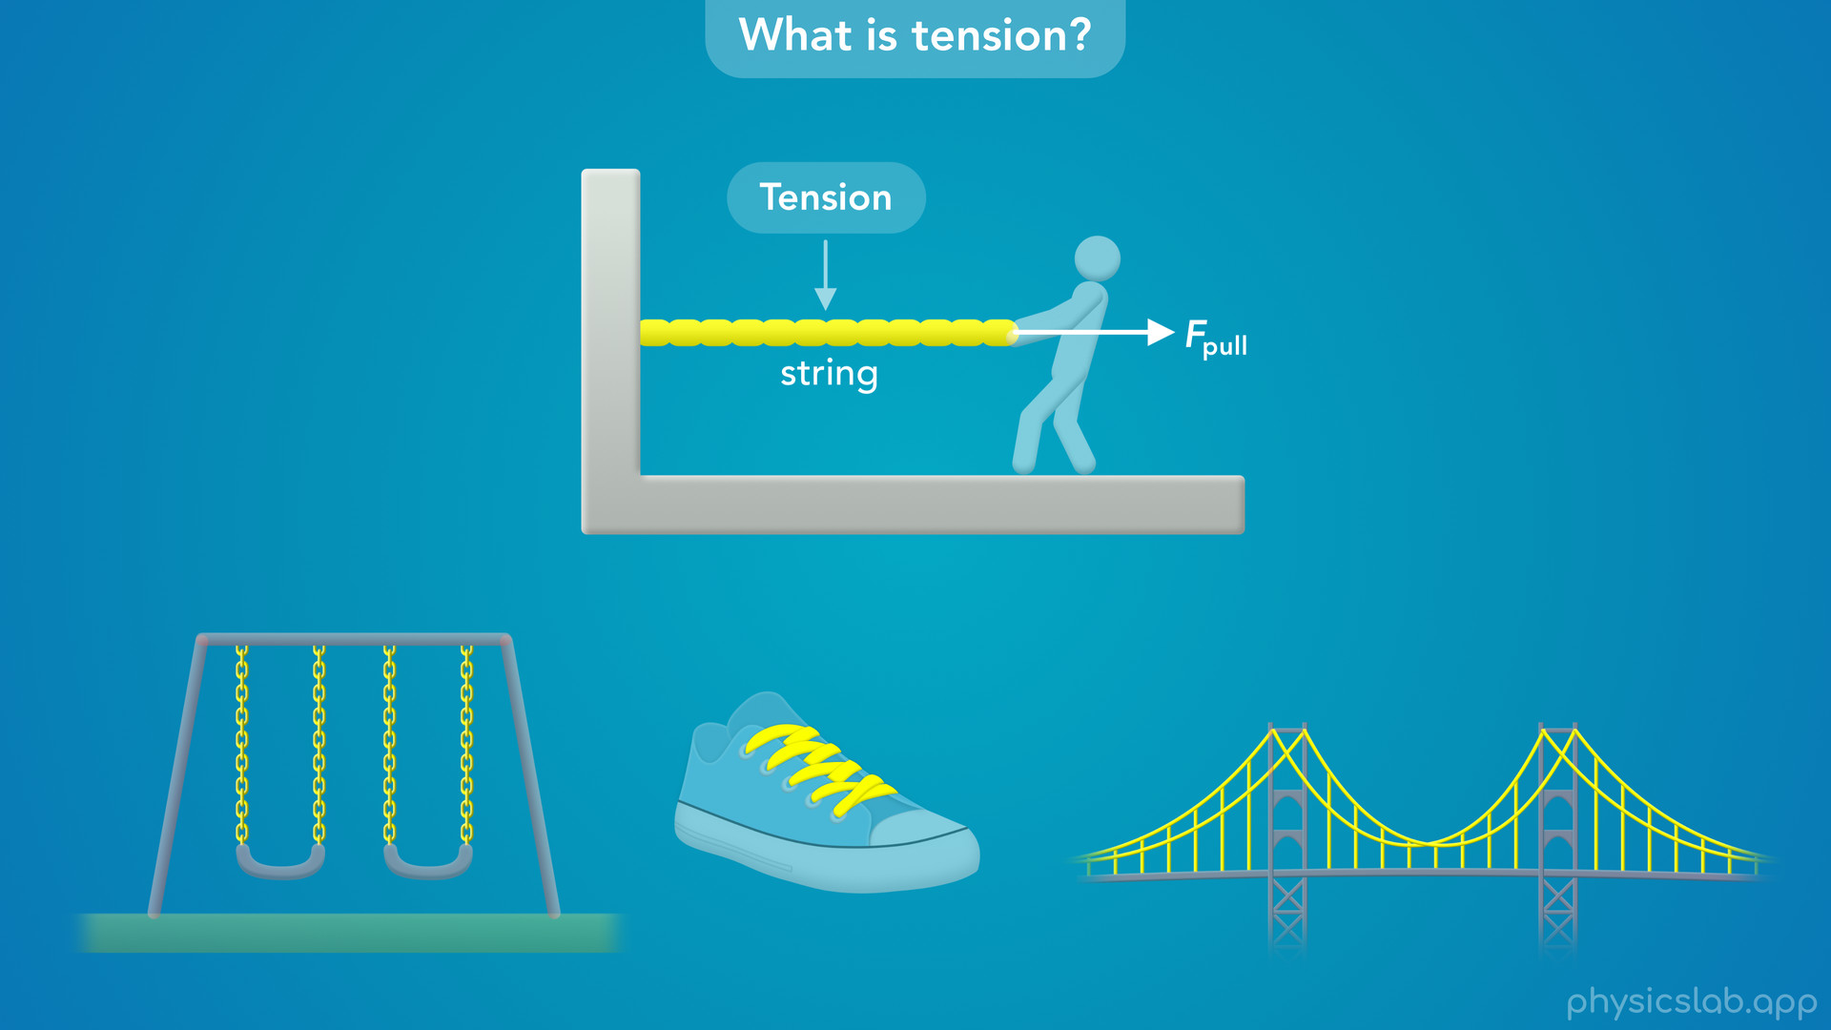
Notes:
• We’ll start with an introduction and look at some examples of tension.

Slide 8
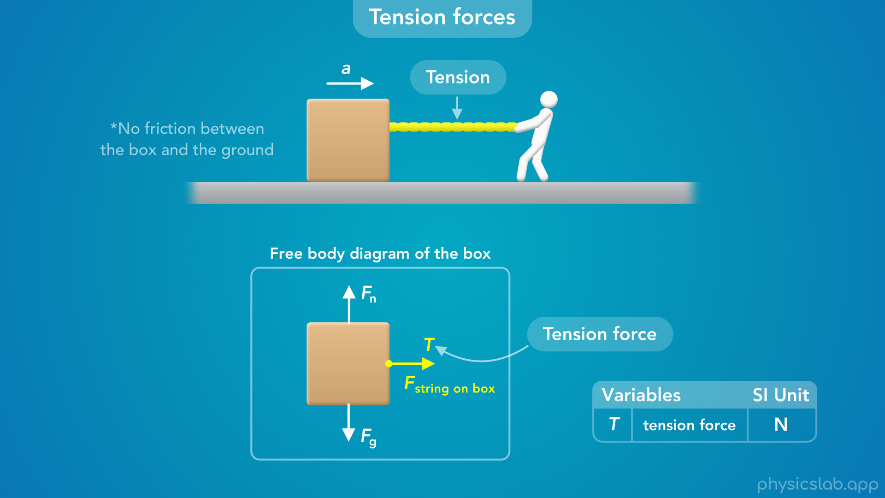
Notes:
• Then we’ll talk about tension in a string and how it exerts a force on other objects.

Slide 9
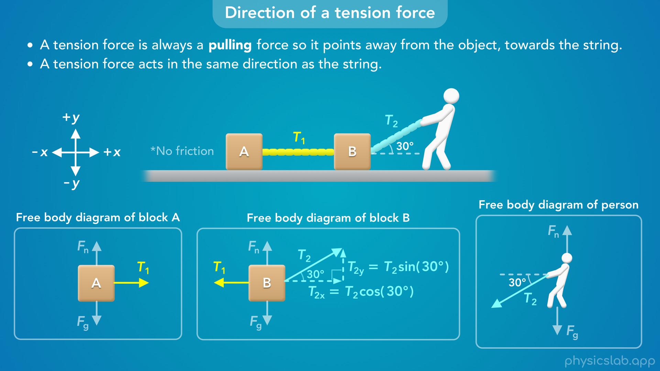
Notes:
• We’ll learn about the direction of a tension force...

Slide 10
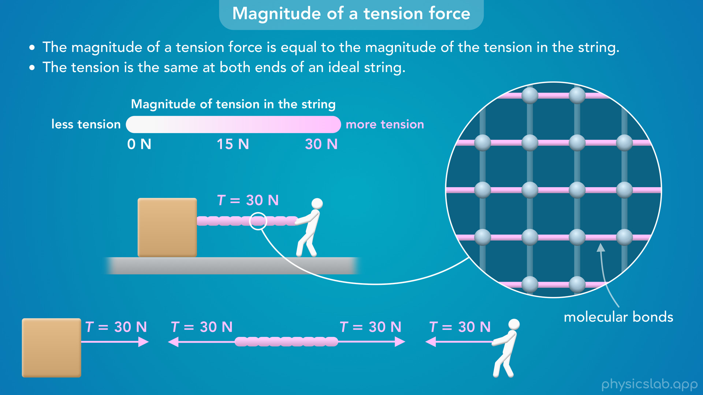
Notes:
• and we’ll learn about the magnitude of a tension force and how tension is transferred through a string.

Slide 11
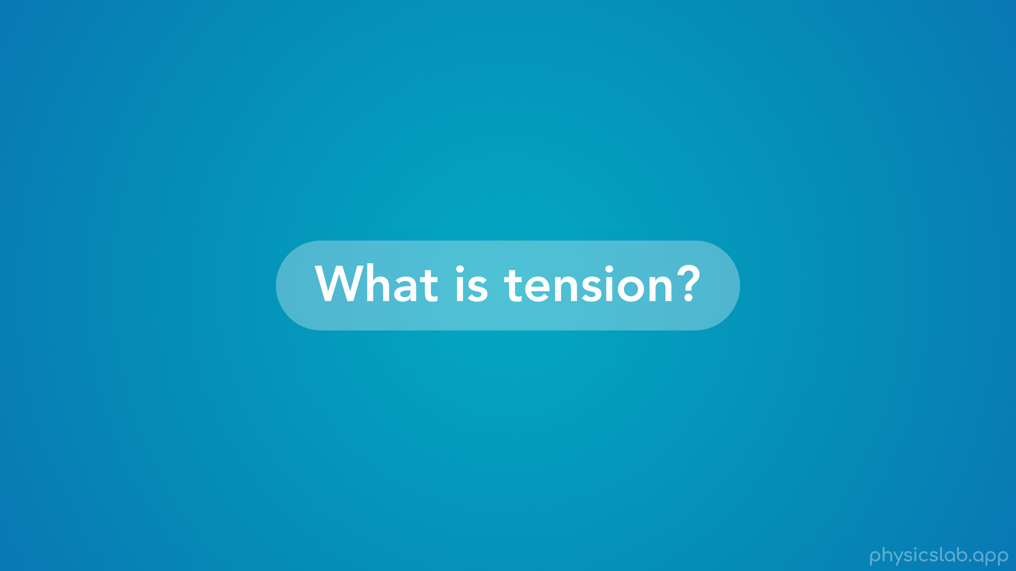
Notes:
• So what is tension?

Slide 12
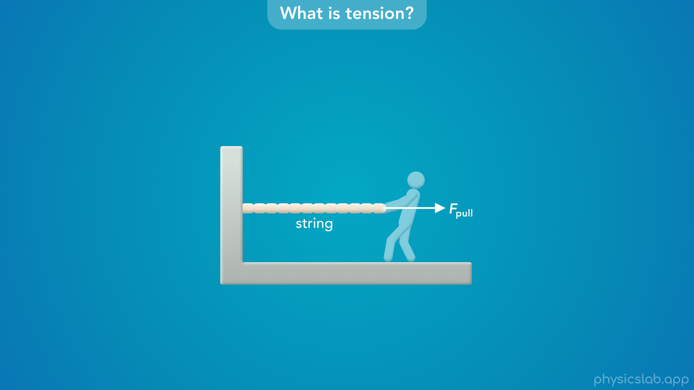
Notes:
• Let’s say that we have a string attached to a wall, and a person is pulling on the string to the right.

Slide 13
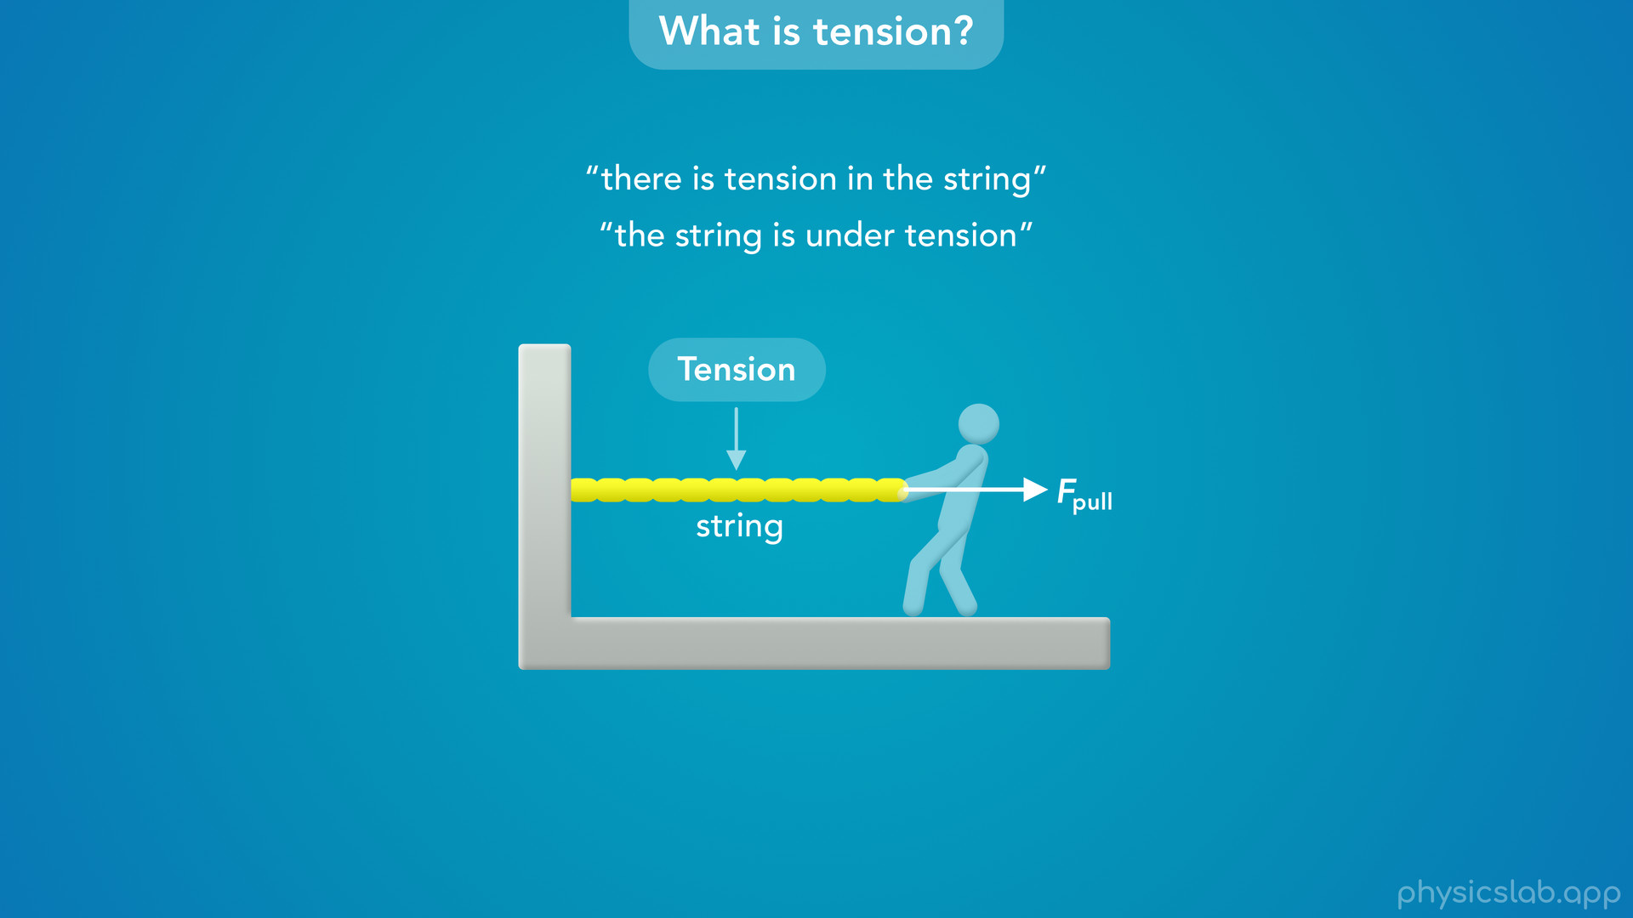
Notes:
• In this scenario, we say that there is tension in the string, or we could say the string is under tension.
• This tension comes from the forces that are pulling on the string.

Slide 14
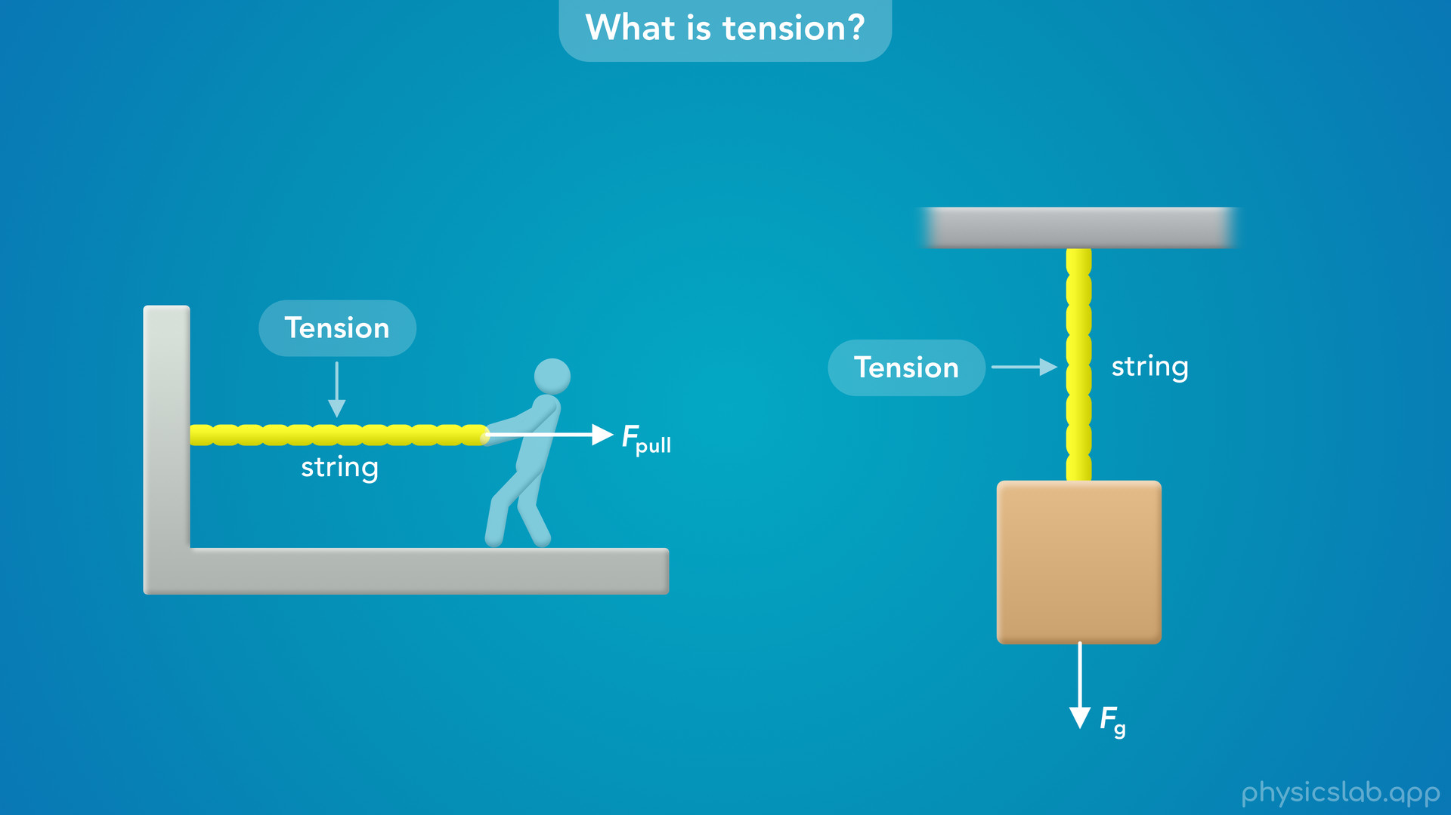
Notes:
• If we had a block that was suspended from the ceiling, there would be tension in the string because the gravitational force or weight of the block would be pulling down on the string.

Slide 15
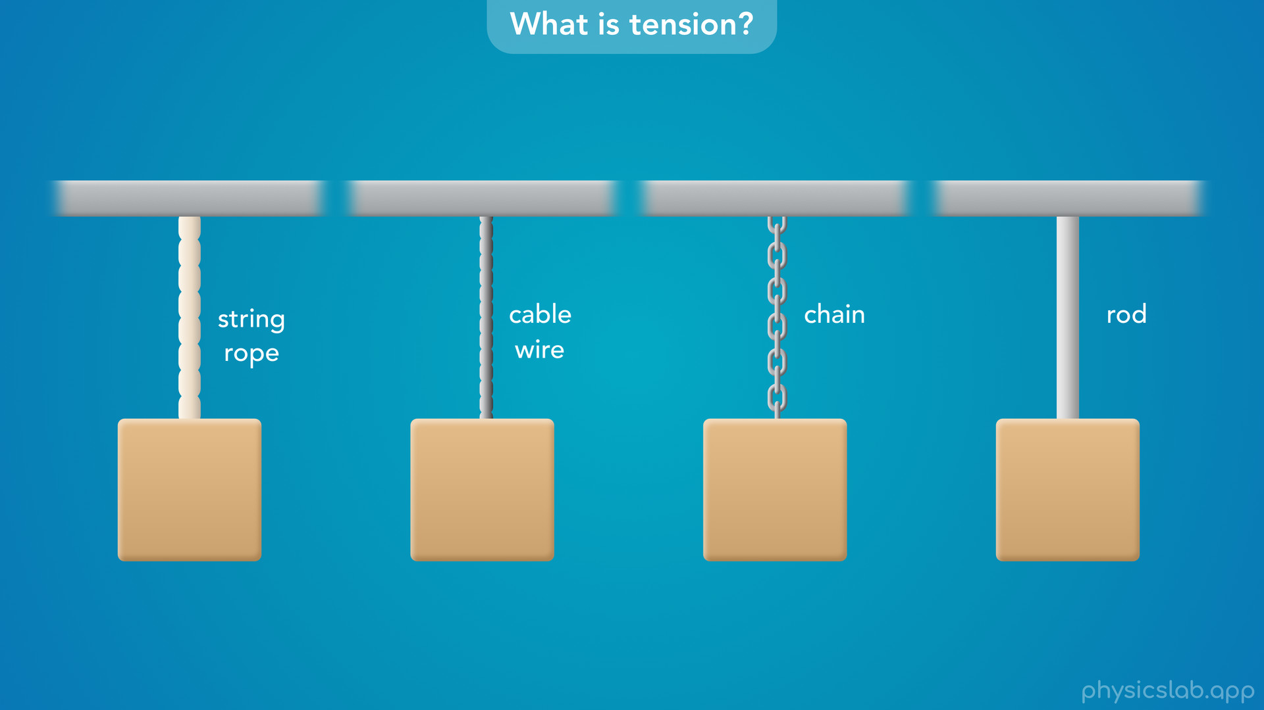
Notes:
• There can be tension in any object, but we usually associate tension with long, thin objects like a string, a rope, a cable, a wire, a chain or a rod.

Slide 16
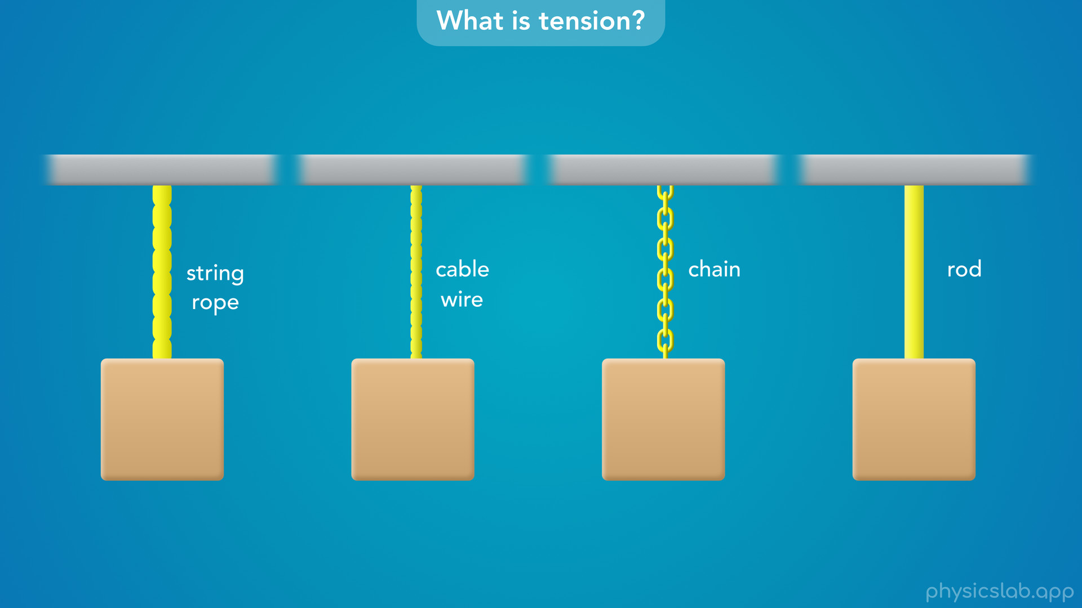
Notes:
• You might see any of these in different examples, but when it comes to working with tension, these are basically the same thing.

Slide 17
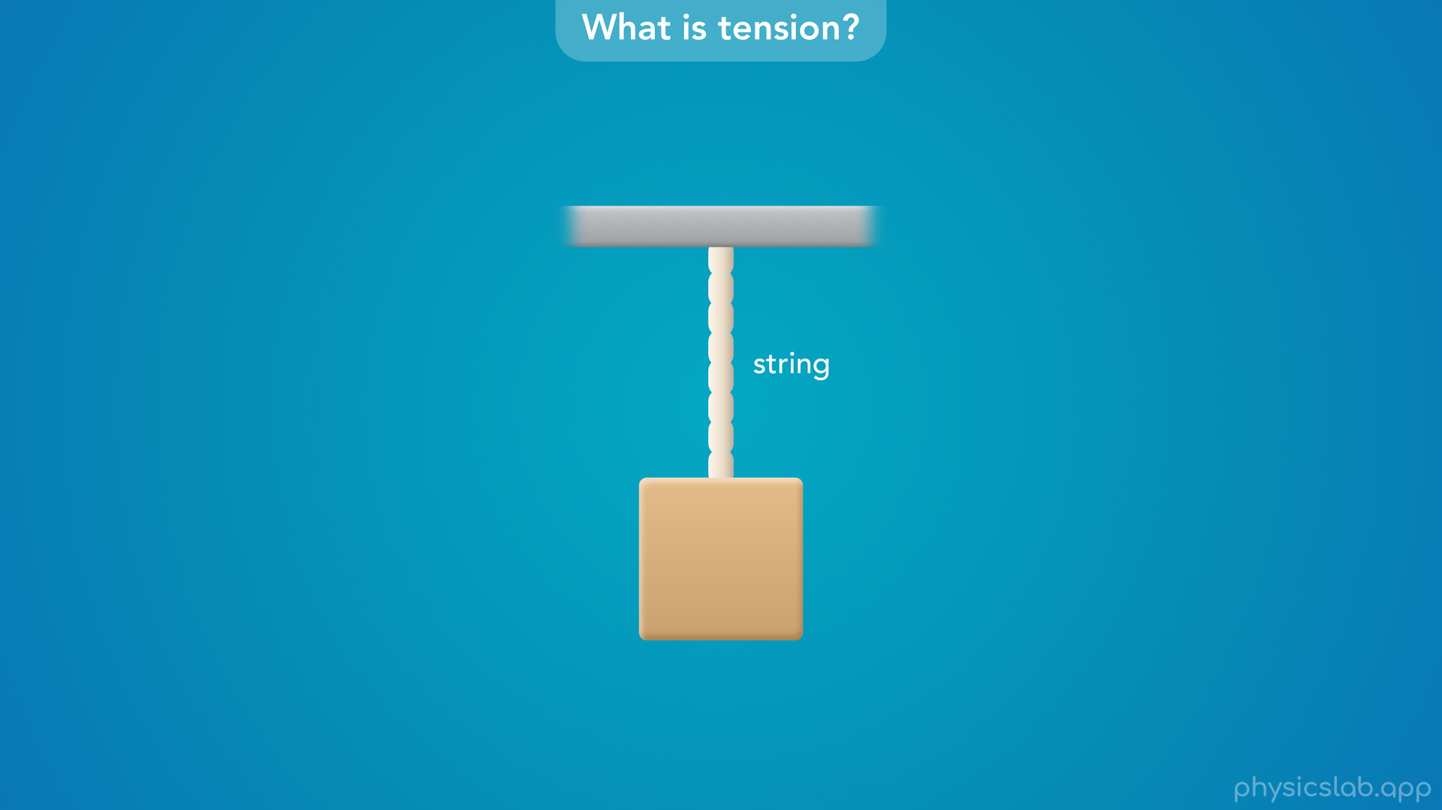
Notes:
• So we’re just going to use the word string in these videos.

Slide 18
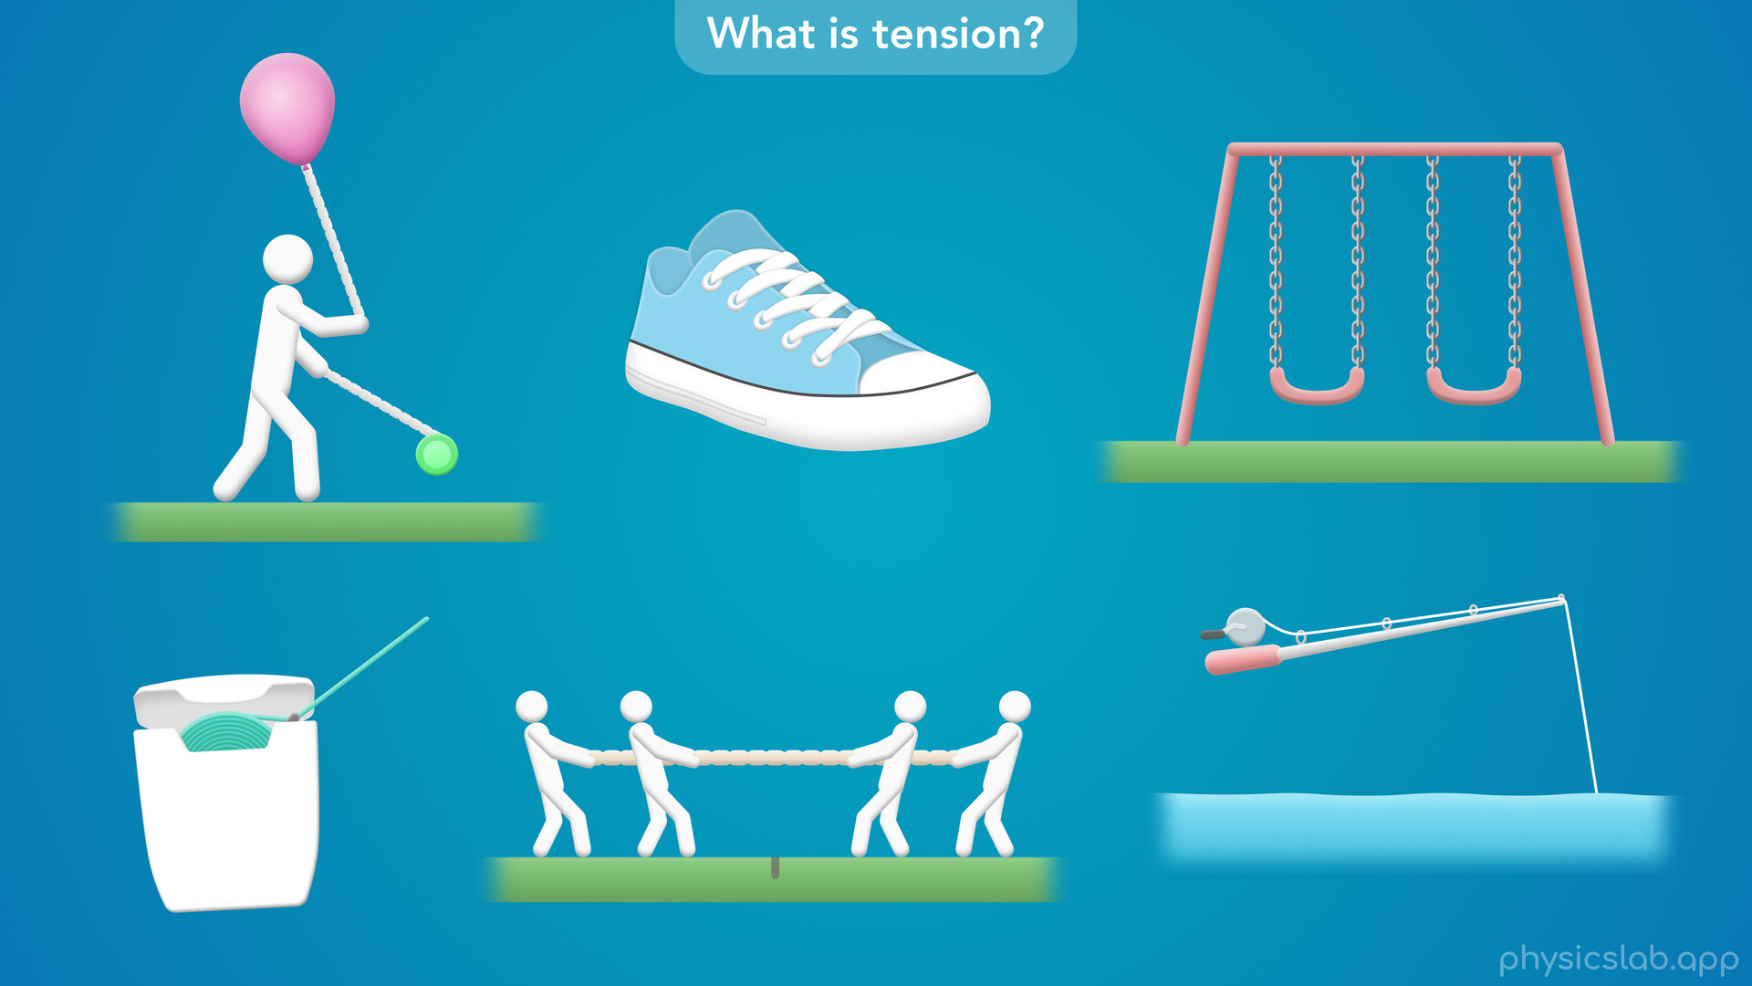
Notes:
• A lot of things around us are under tension, whether we can see it or not.

Slide 19
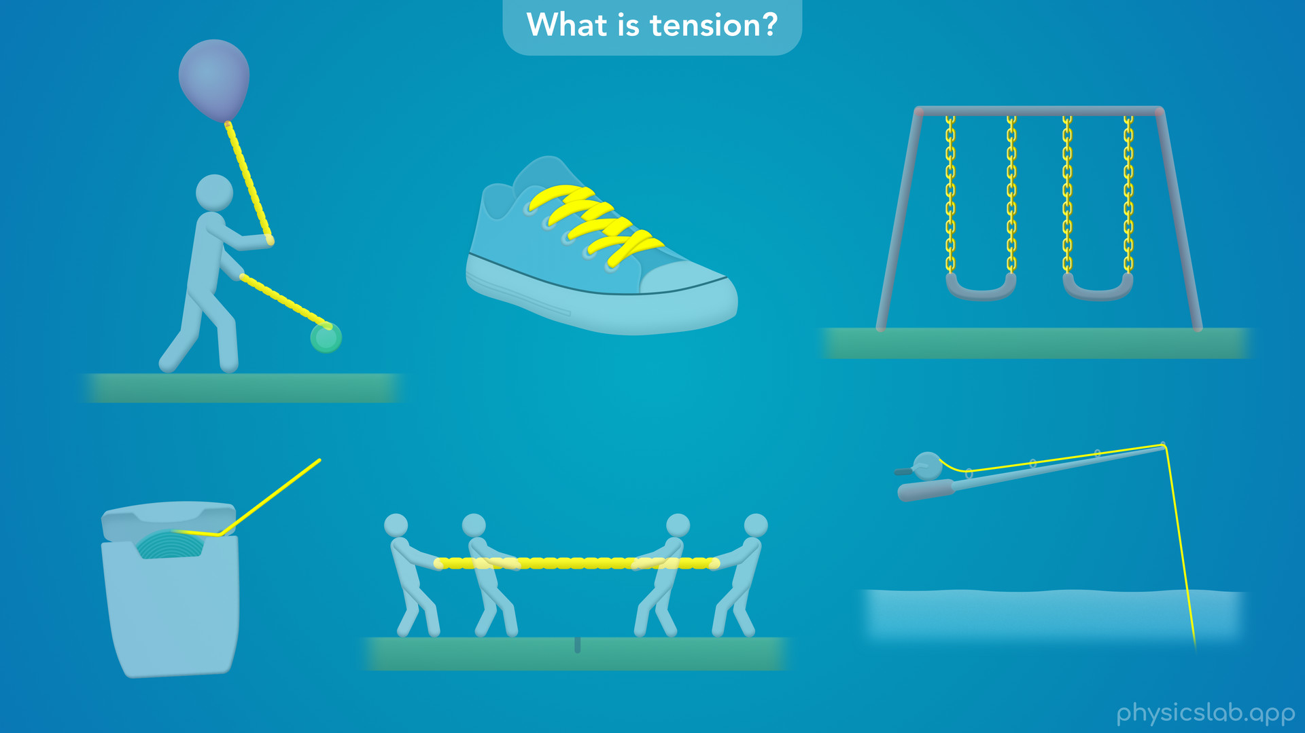
Notes:
• Any time that a string or a similar object is being pulled, it’s under tension.
• Tension might stop something from moving, or cause it to move in a straight line or a circle.

Slide 20
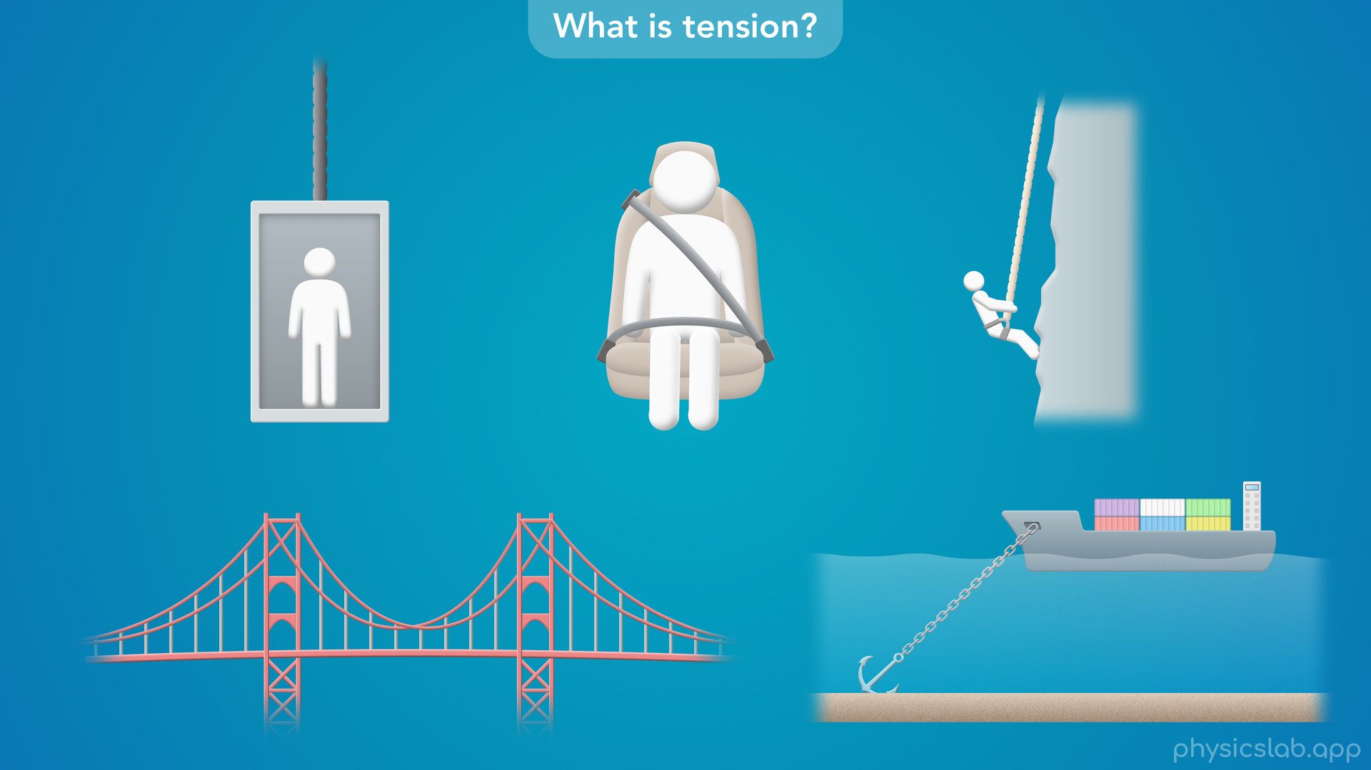
Notes:
• An object can only withstand a certain amount of tension before it breaks, which depends on the thickness and the material.

Slide 21
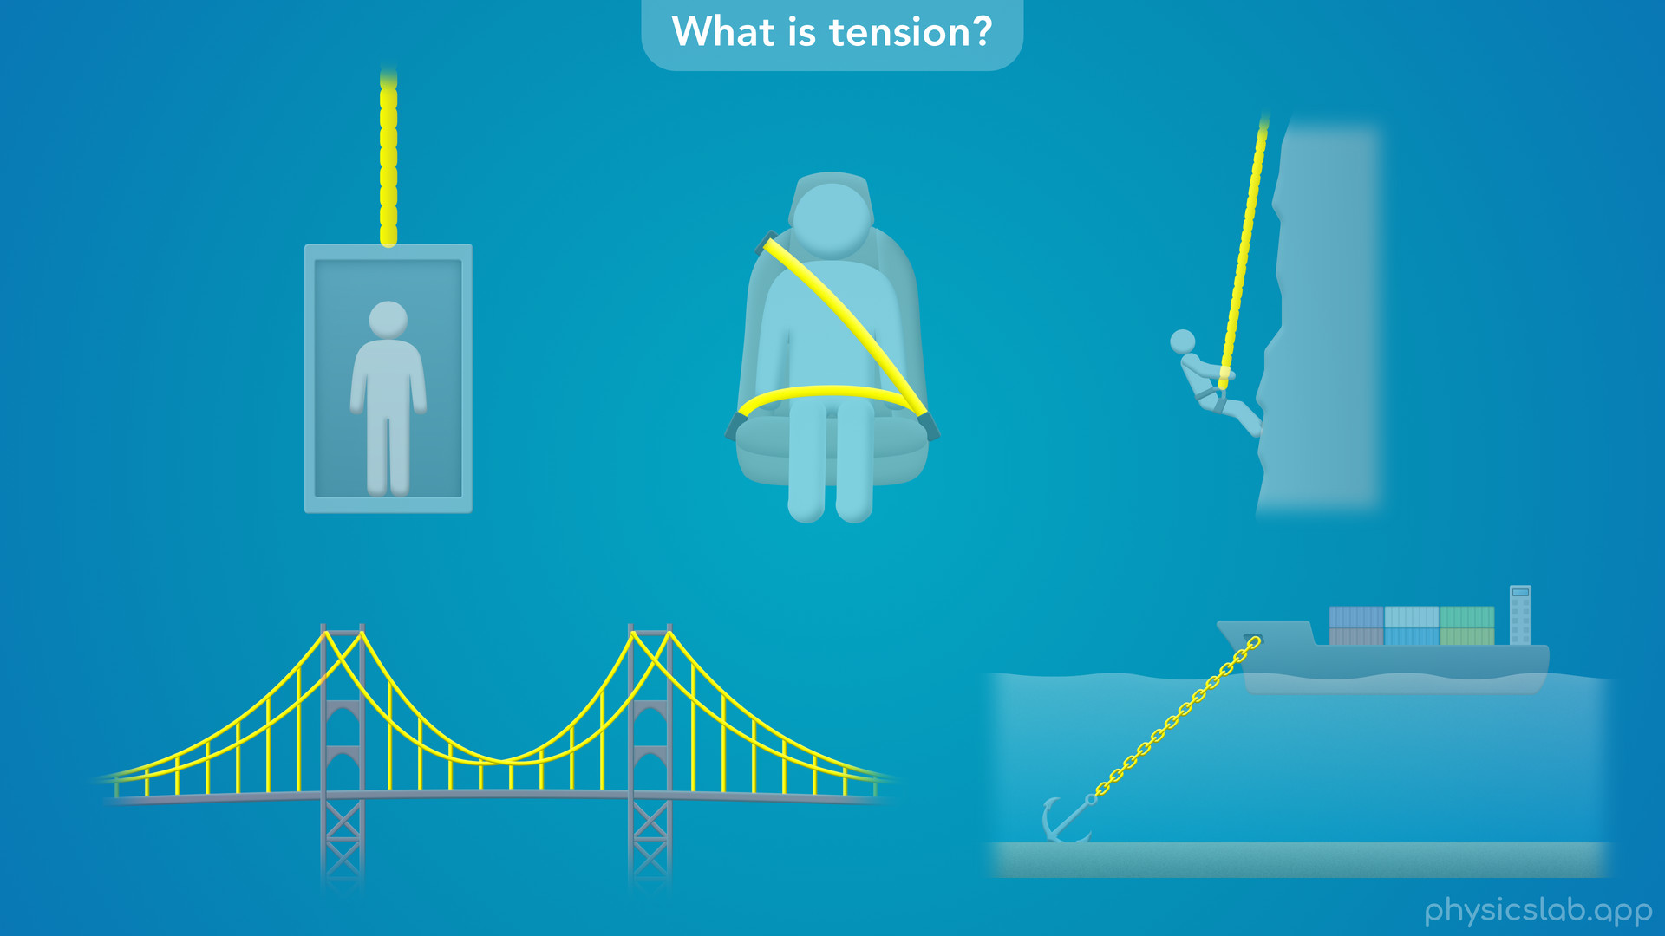
Notes:
• So if we don’t want something to break, we use physics to predict how much tension it’ll experience in different scenarios, and make sure we design it correctly.

Slide 22
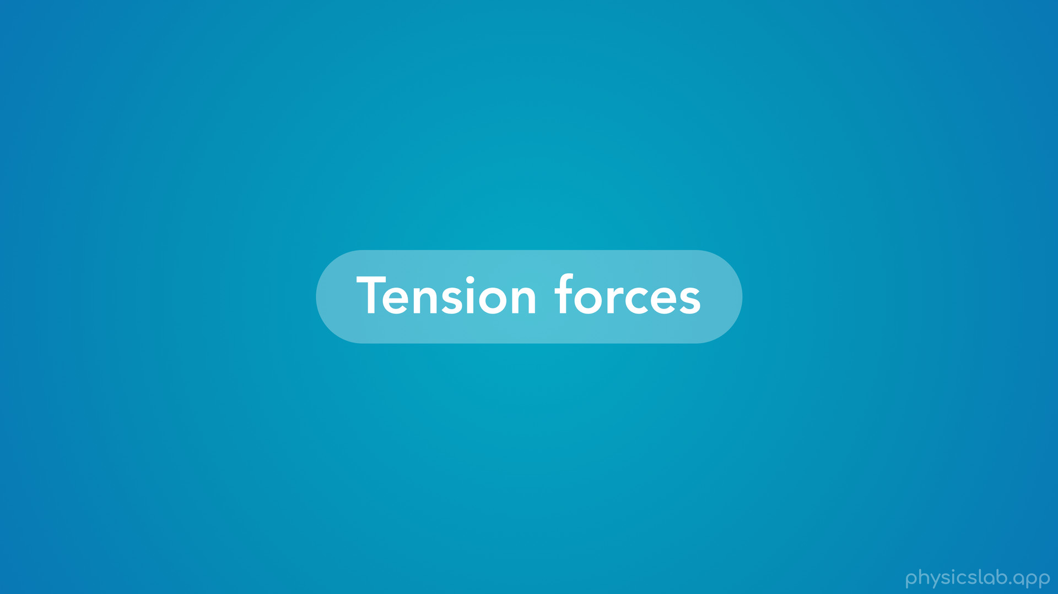
Notes:
• So that’s a quick introduction to tension, but what is a tension force?

Slide 23
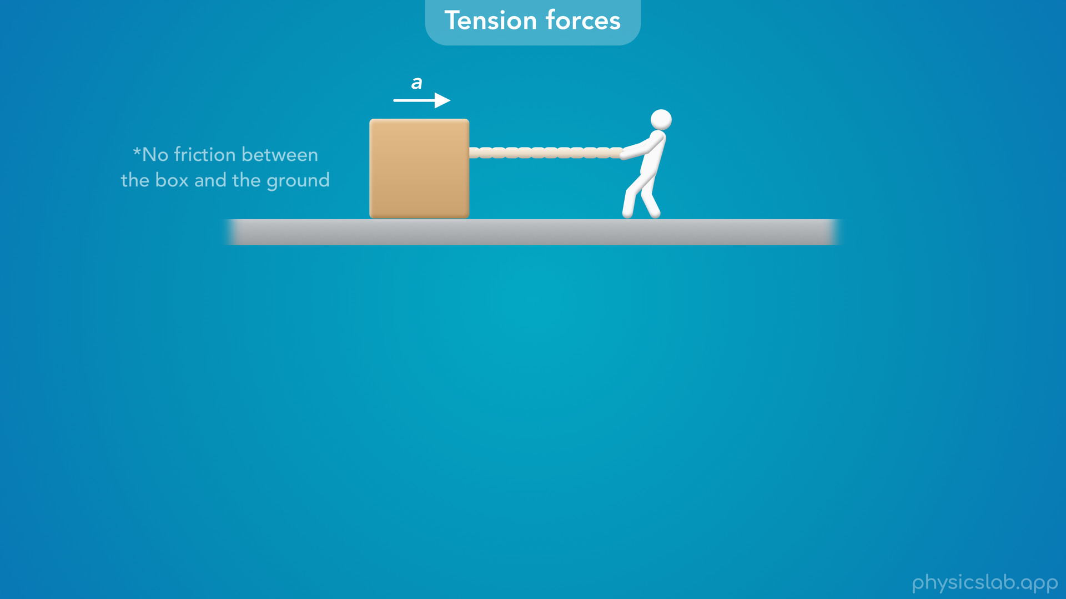
Notes:
• Let’s use this example, where a person is pulling on a string attached to a box, which causes the box to accelerate to the right.
• Let’s assume that there is no friction between the box and the ground.

Slide 24
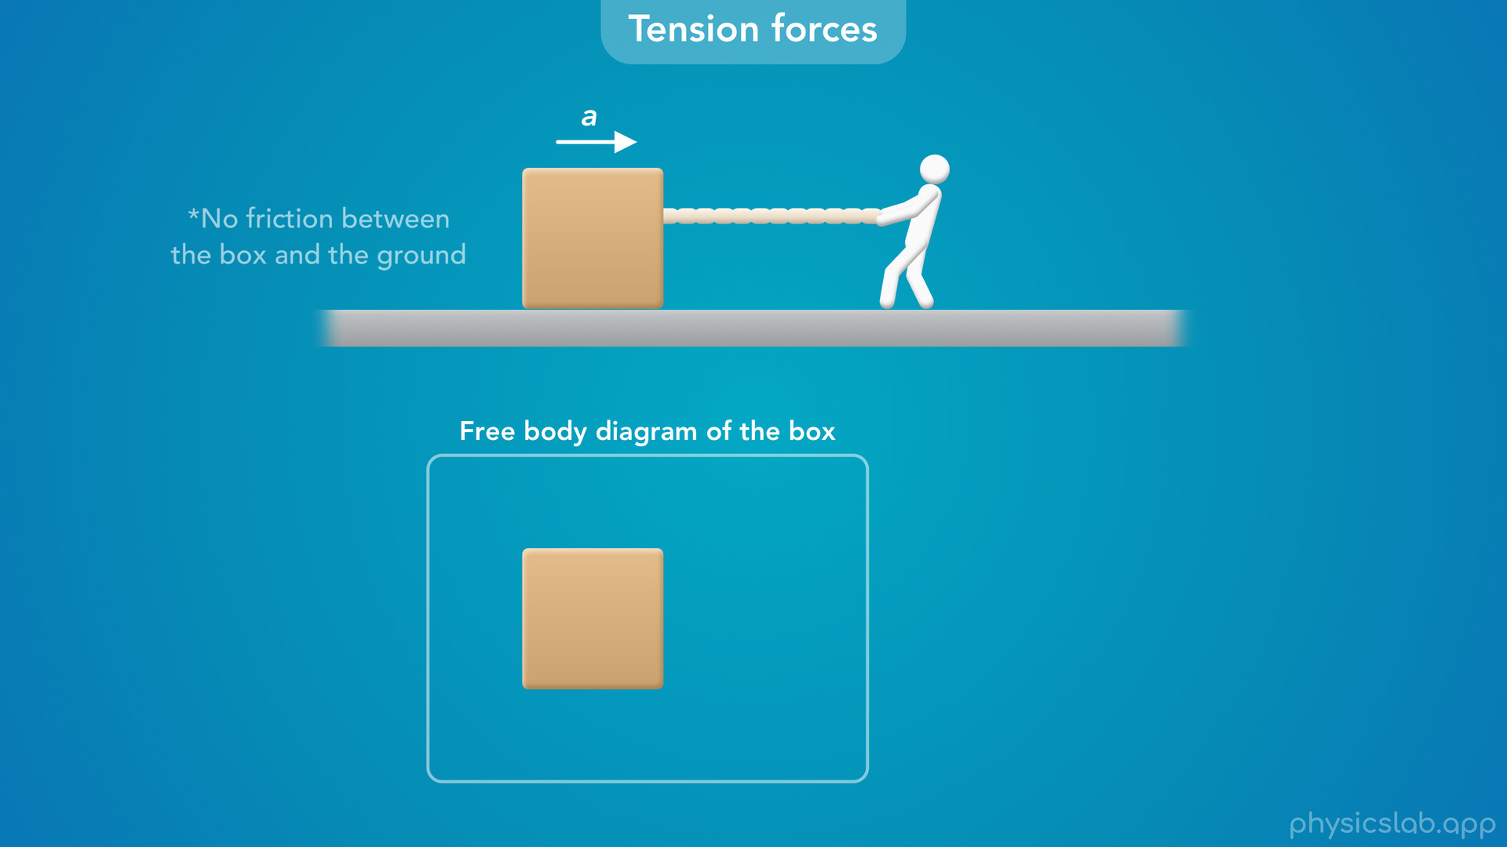
Notes:
If we draw a free body diagram of the box, what forces are acting on it?

Slide 25
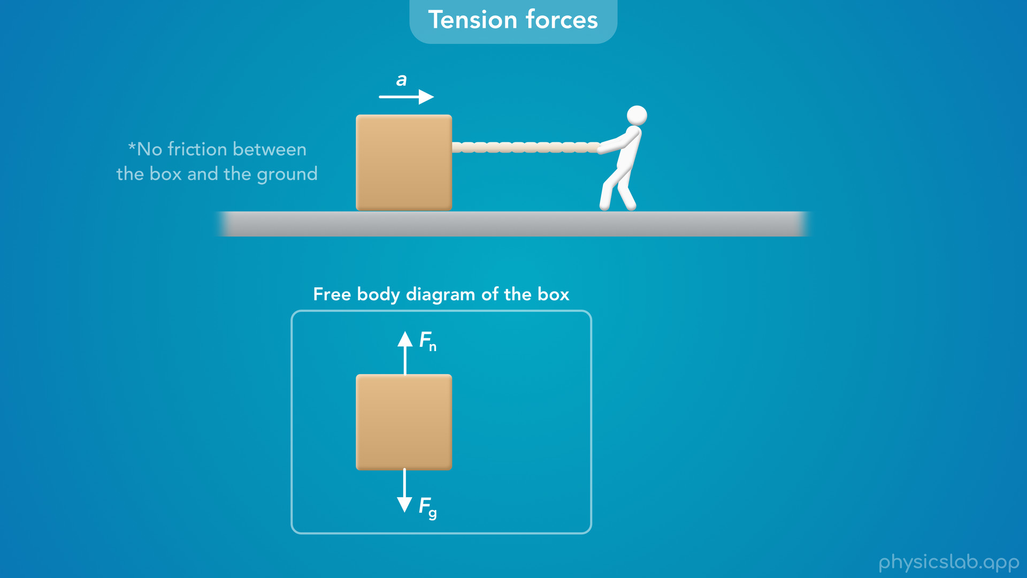
Notes:
• There would be a downwards gravitational force from the earth, and an upwards normal force from the ground.
• Are there any other forces acting on the box?

Slide 26

Notes:
• The box is accelerating to the right, so there must be some force acting to the right.
• That force is caused by the string, and it acts at the contact point where the string is attached to the box.
• So what should we call this force?

Slide 27

Notes:
• We could label it as the force from the string on the box.

Slide 28
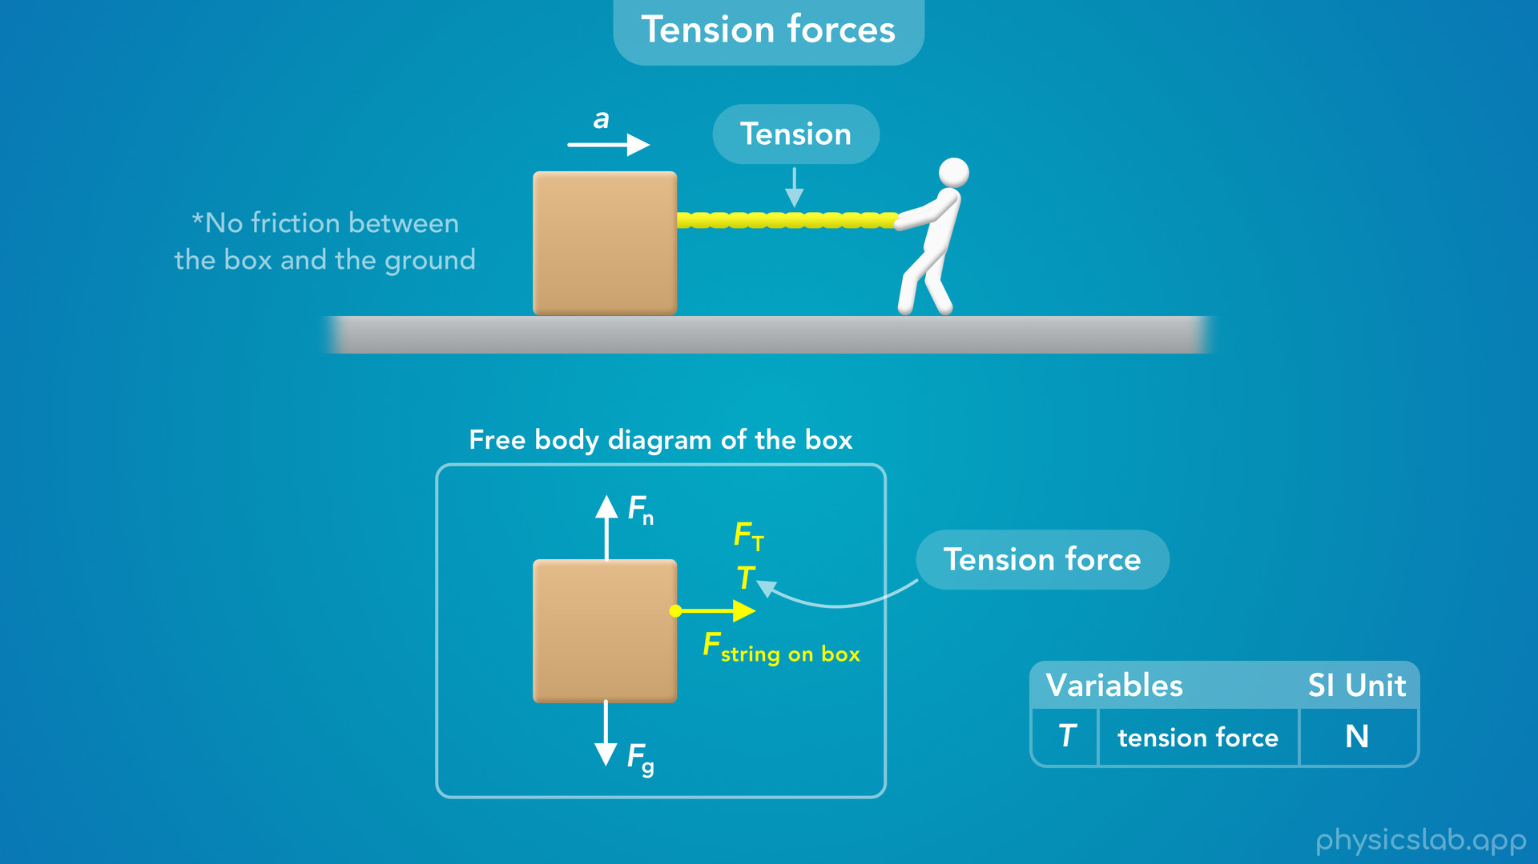
Notes:
• But since the person is pulling on the string, there is tension in the string, and that tension is being applied to the box.
• So we’re going to call this force a tension force, and label it as capital T.
• You might also see this labeled as F T.
• Like every other force, the SI unit for a tension force is newtons, capital N.

Slide 29
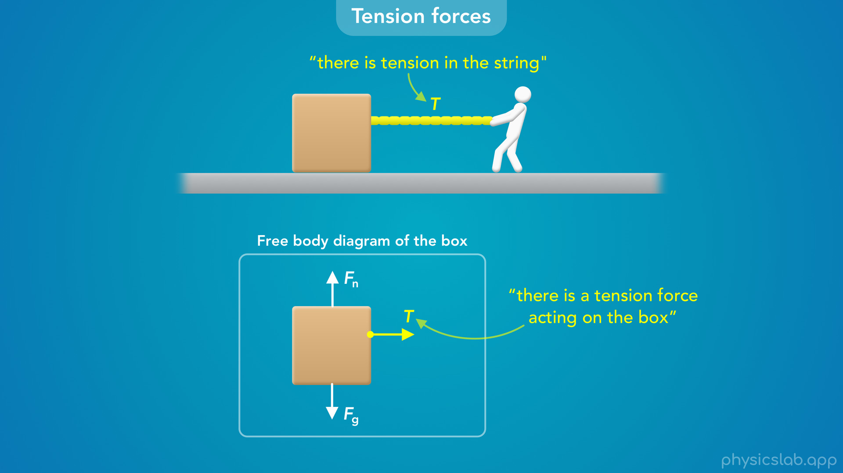
Notes:
• So these are the two ways that we talk about tension.
• We can say “there is tension in the string”, and we can say “there is a tension force acting on the box".

Slide 30
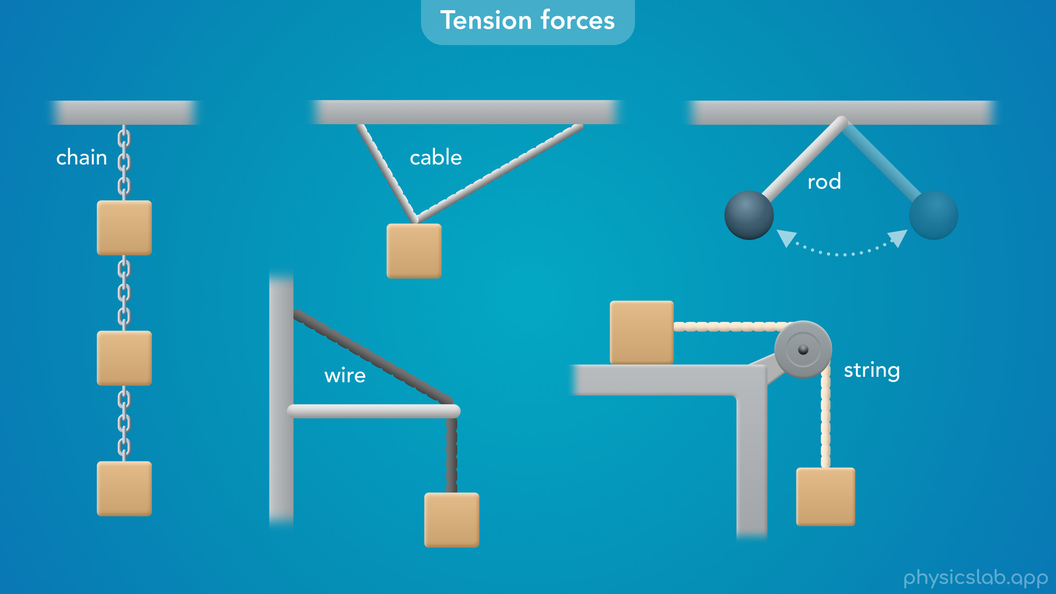
Notes:
• Any time we see strings, chains, cables, wires or rods...

Slide 31
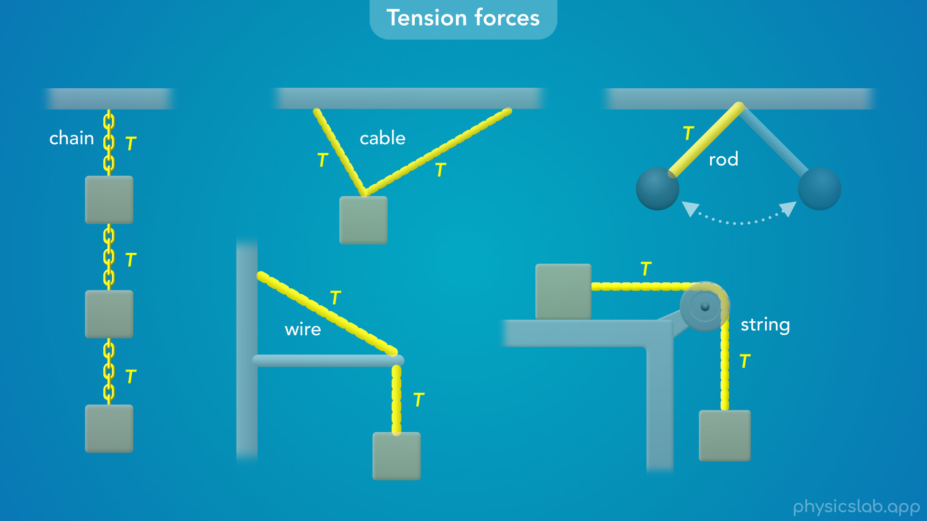
Notes:
• … we’re going to be working with tension.

Slide 32

Notes:
• If a scenario involves more than one segment, we’re going to label the tension in each segment as T1, T2 and so on.

Slide 33
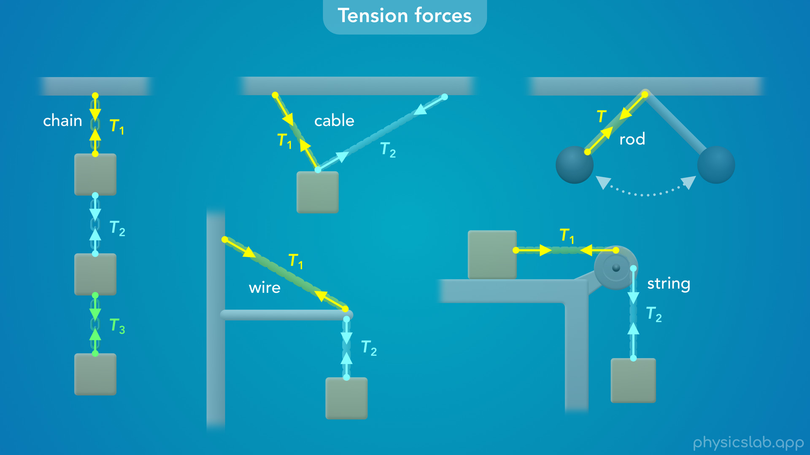
Notes:
• And if there’s tension, then there are tension forces acting on the objects at each end.

Slide 34
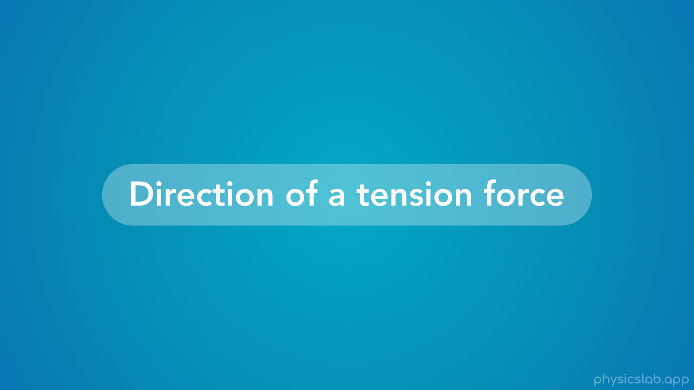
Notes:
• So what is the direction of a tension force?

Slide 35
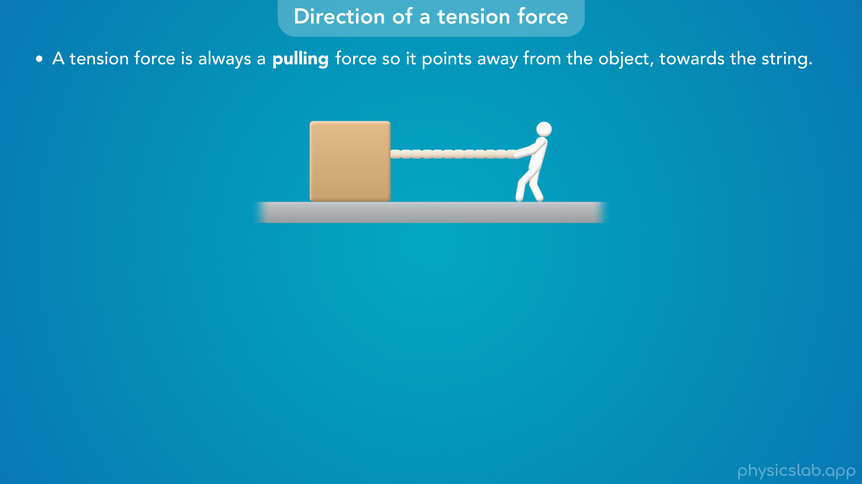
Notes:
• First, “a tension force is always a pulling force so it points away from the object, towards the string.”

Slide 36
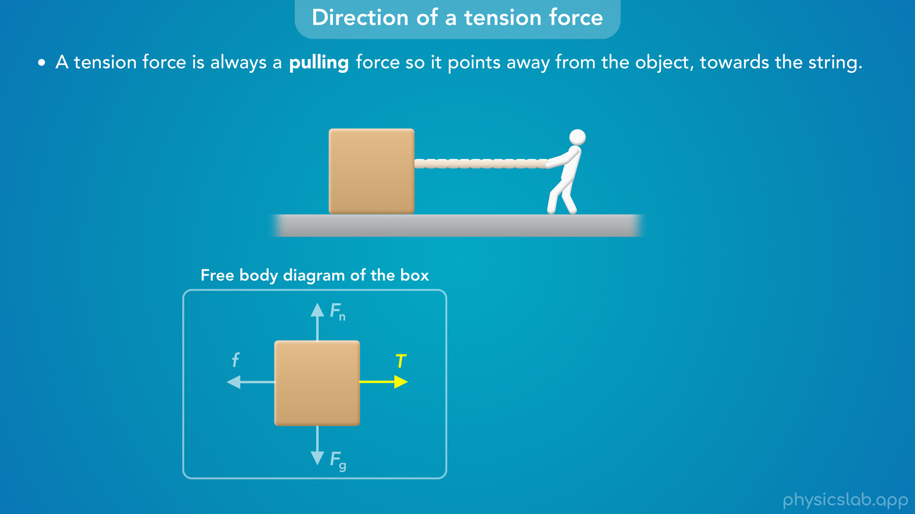
Notes:
• So the tension force acting on this box points to the right, away from the box and towards the string.

Slide 37
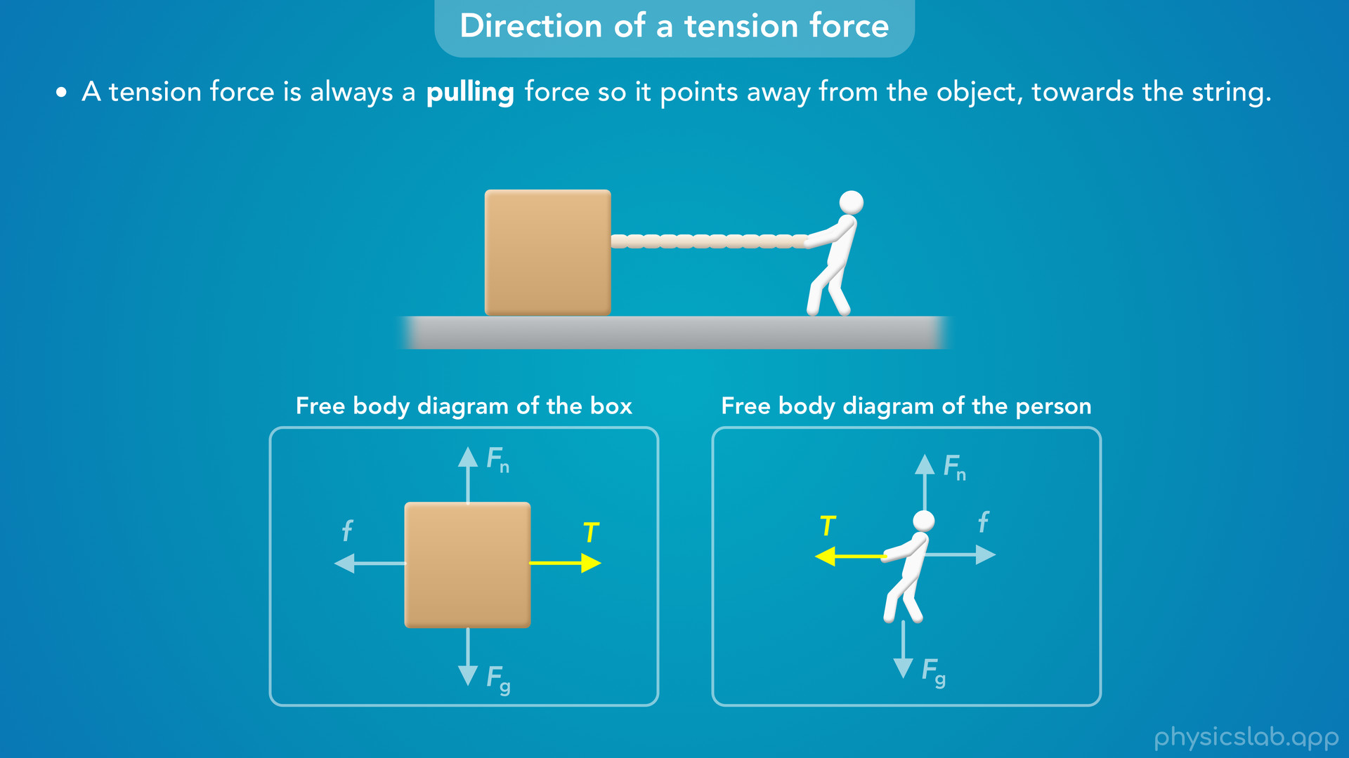
Notes:
• The tension force acting on the person points to the left, away from the person and towards the string.

Slide 38
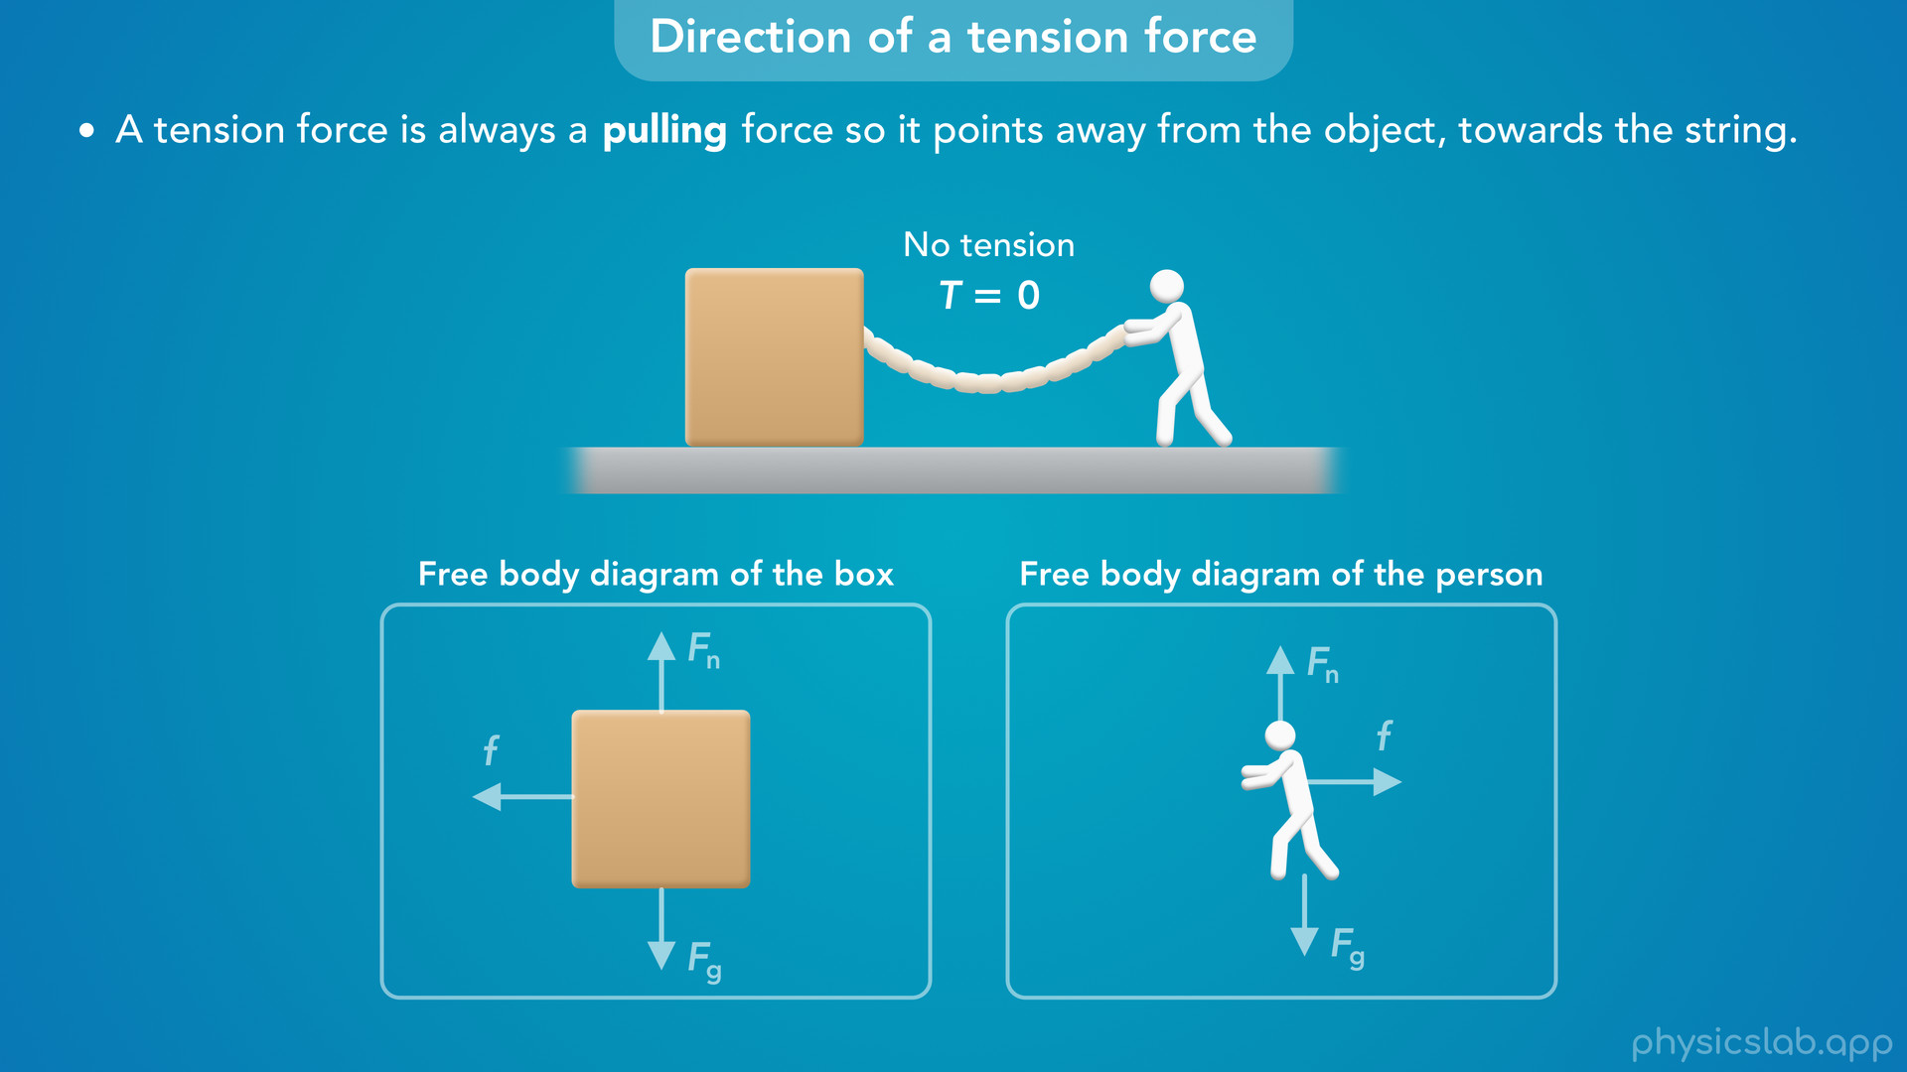
Notes:
• A tension force cannot be a pushing force.
• If the person tried to push on the string, there would be no tension.
• The string would collapse and they wouldn’t be able to push the box with the string.
• So if there’s tension, it’s always a pulling force.

Slide 39
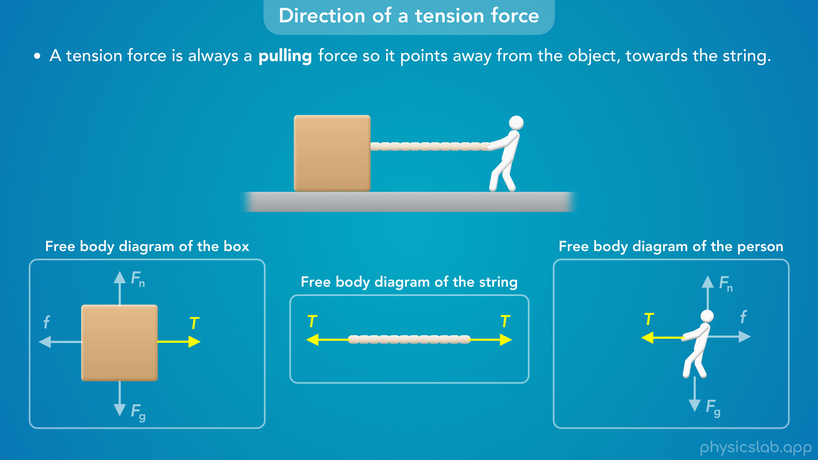
Notes:
• If we draw a free body diagram of the string, we can also see that the box and the person are exerting forces on the string.

Slide 40
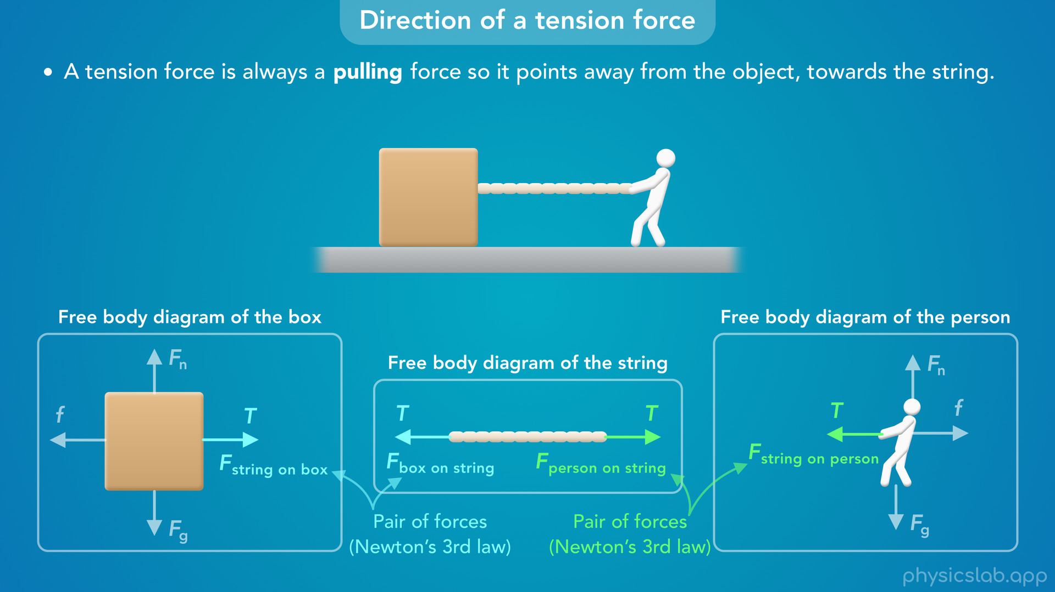
Notes:
• These are two pairs of equal and opposite forces from Newton’s 3rd law.
• If the string exerts a force on the box that acts to the right, the box must be exerting an equal and opposite force on the string that acts to the left.
• And if the string is exerting a force on the person, then the person is exerting a force on the string.
• That’s the force you probably think of when we say the person is pulling the string to the right.
• But Newton’s 3rd law says that the string is also pulling the person to the left at the same time.

Slide 41
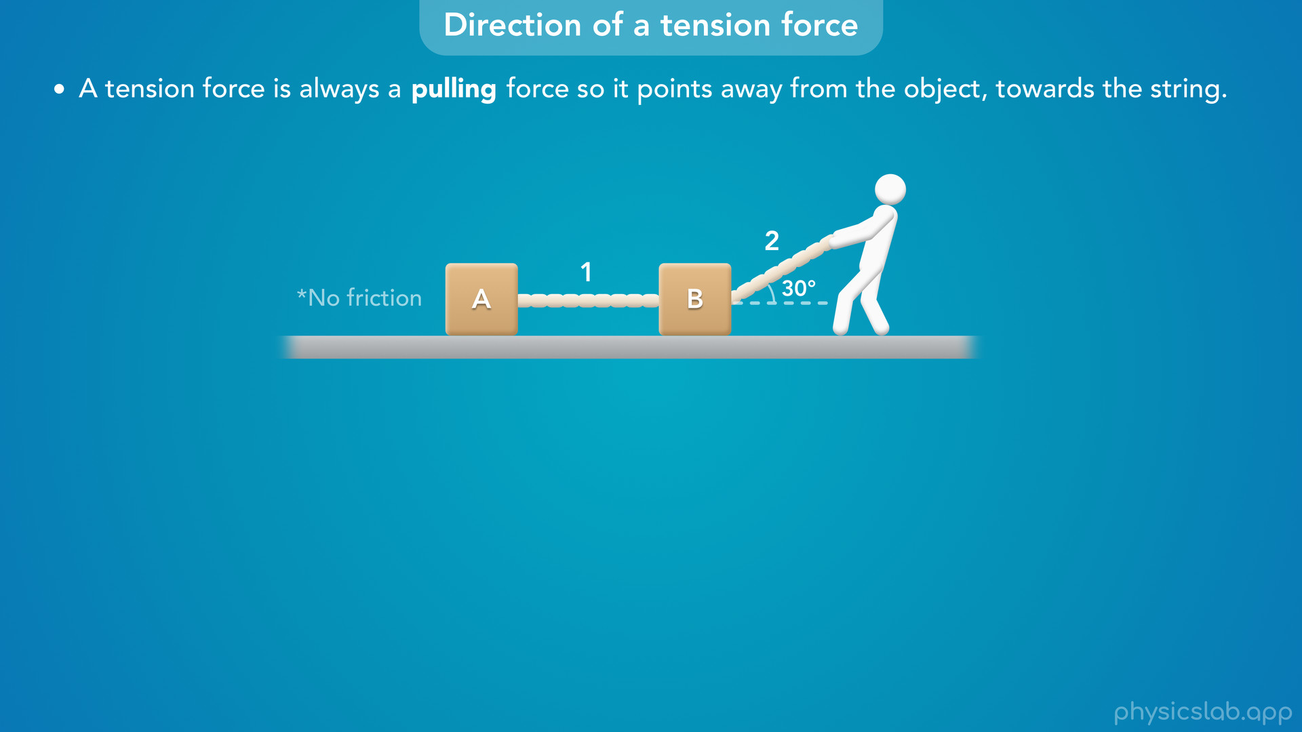
Notes:
• Let’s look at a different example, where two blocks are connected by string 1.
• And a person is pulling on string 2, which is attached to block B at an angle of 30 degrees above the horizontal.

Slide 42
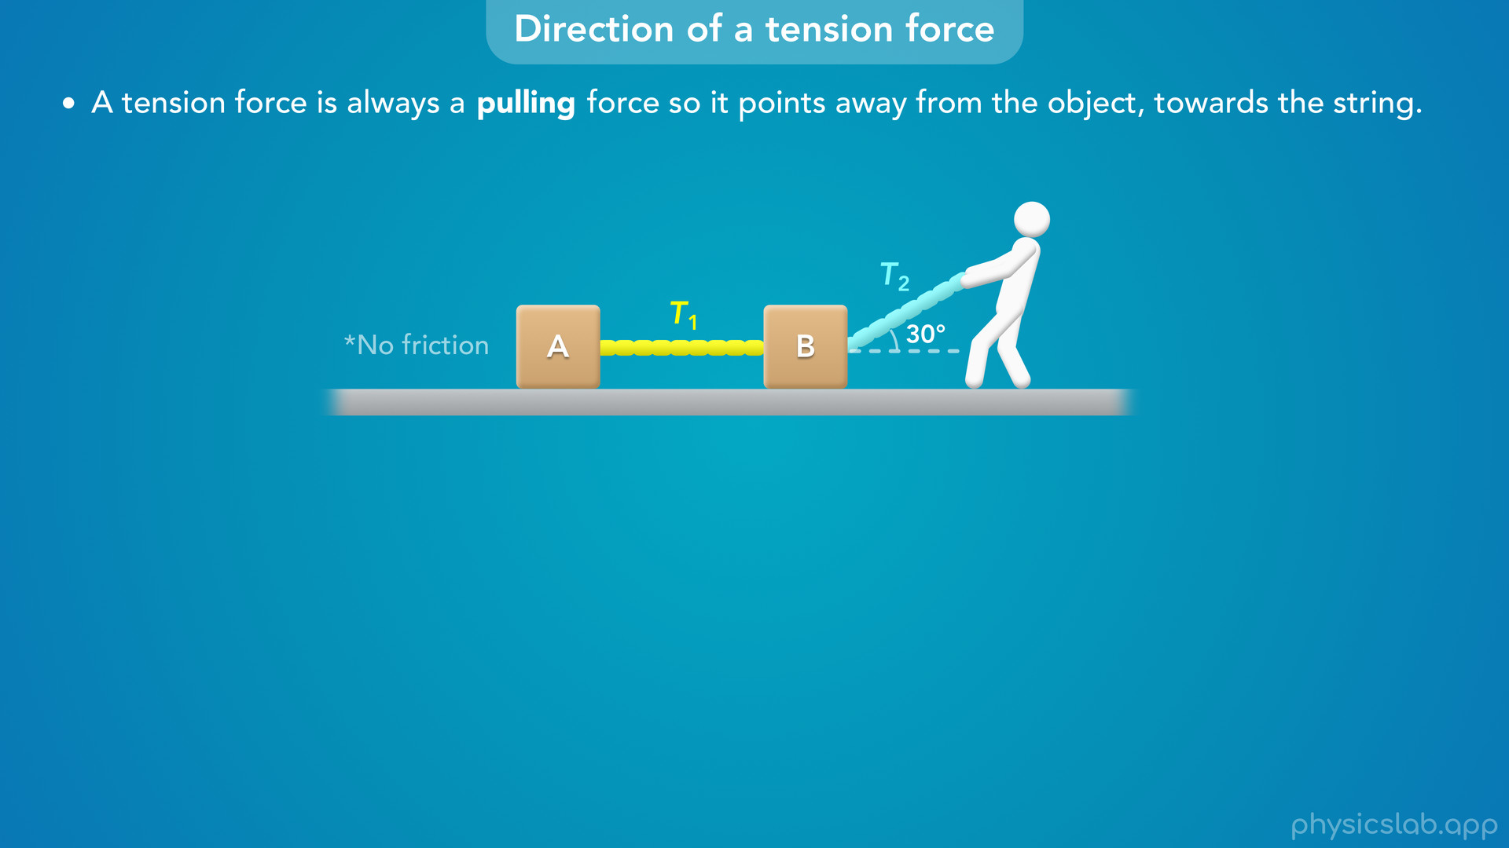
Notes:
The tension in string 1 is T1, and the tension in string 2 is T2.

Slide 43
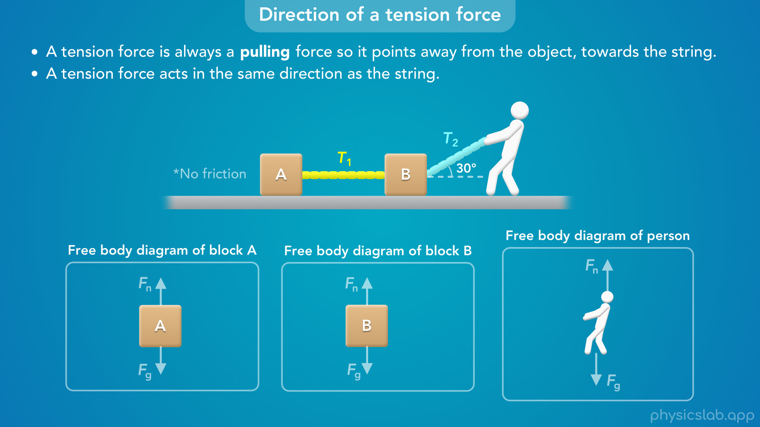
Notes:
• Let’s draw the tension forces acting on each object.
• We said that tension is a pulling force, and the other thing to know is that “a tension force acts in the same direction as the string”.

Slide 44
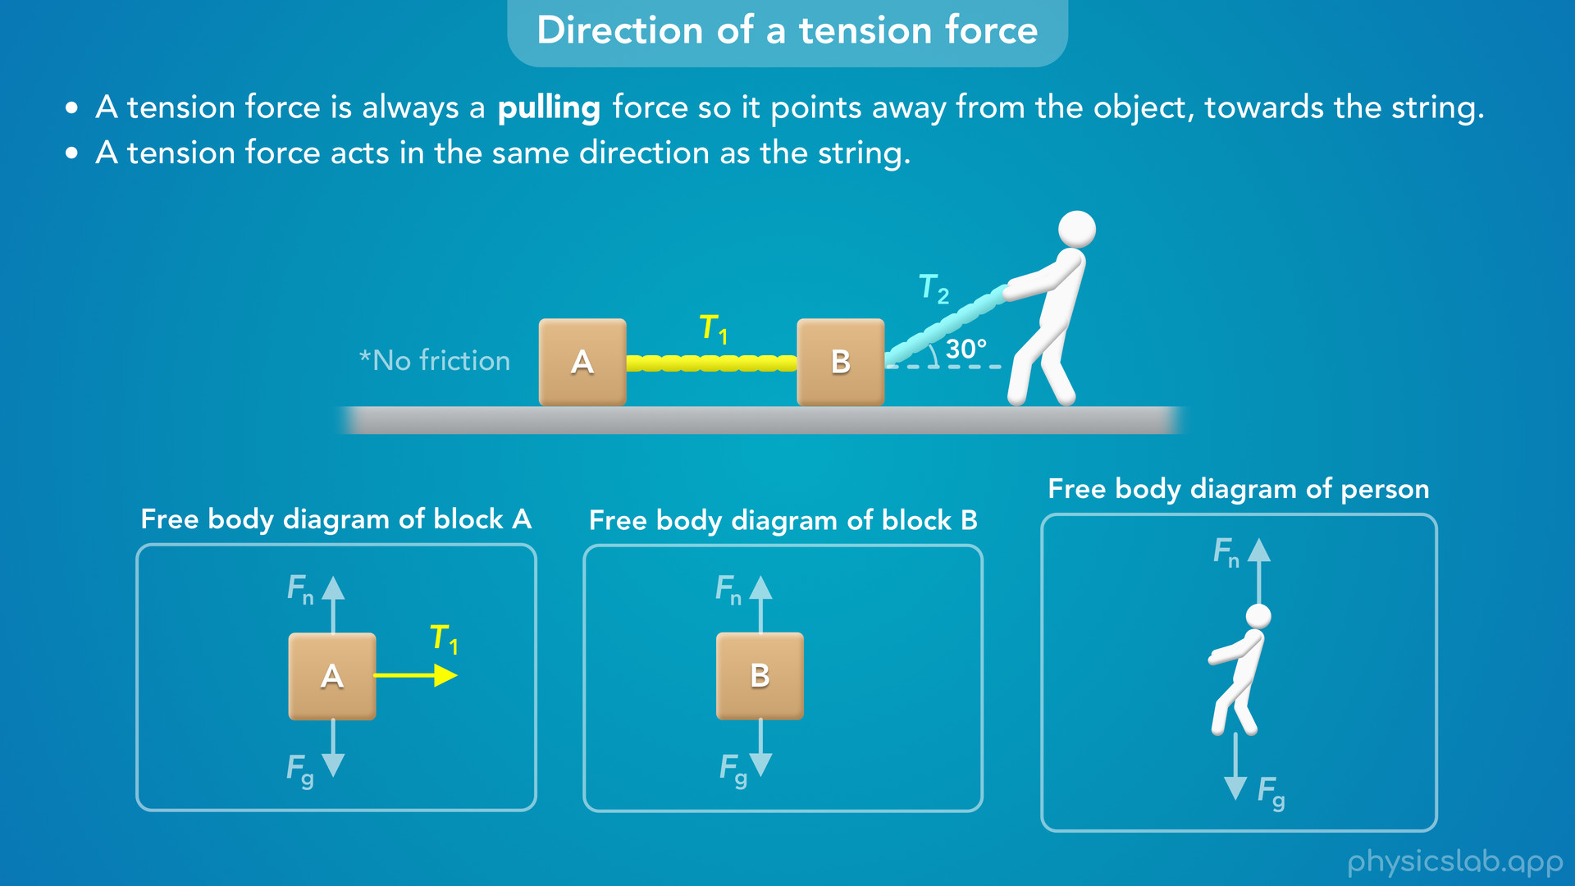
Notes:
For block A, there’s a tension force from string 1 acting to the right.

Slide 45

Notes:
• And for block B, there’s a tension force from string 1 acting to the left.
• String 1 is horizontal, so these two *forces* are horizontal.

Slide 46

Notes:
• Block B is also attached to string 2, so there’s a tension force that points in the same direction as string 2, at an angle of 30 degrees above the horizontal.
• Again, this is a pulling force that points away from block B, towards string 2.

Slide 47
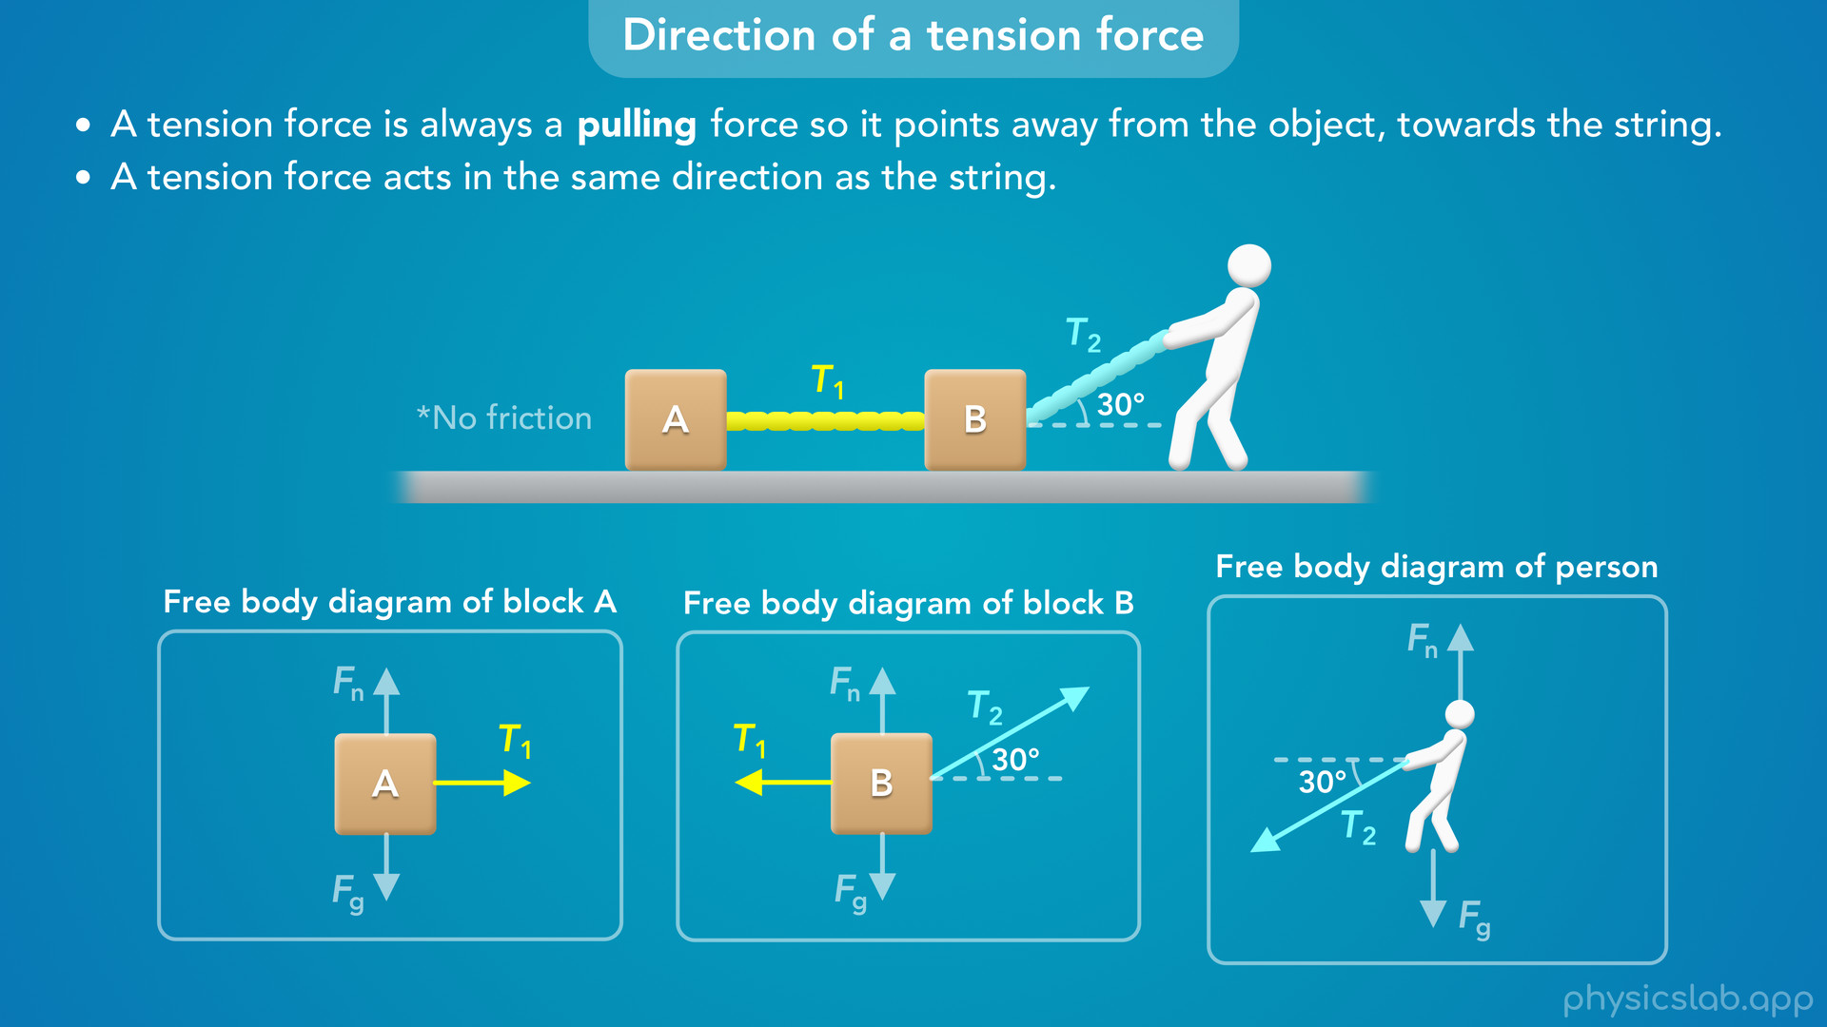
Notes:
• For the person, there’s a force from string 2 that points away from the person in the same direction as the string.

Slide 48
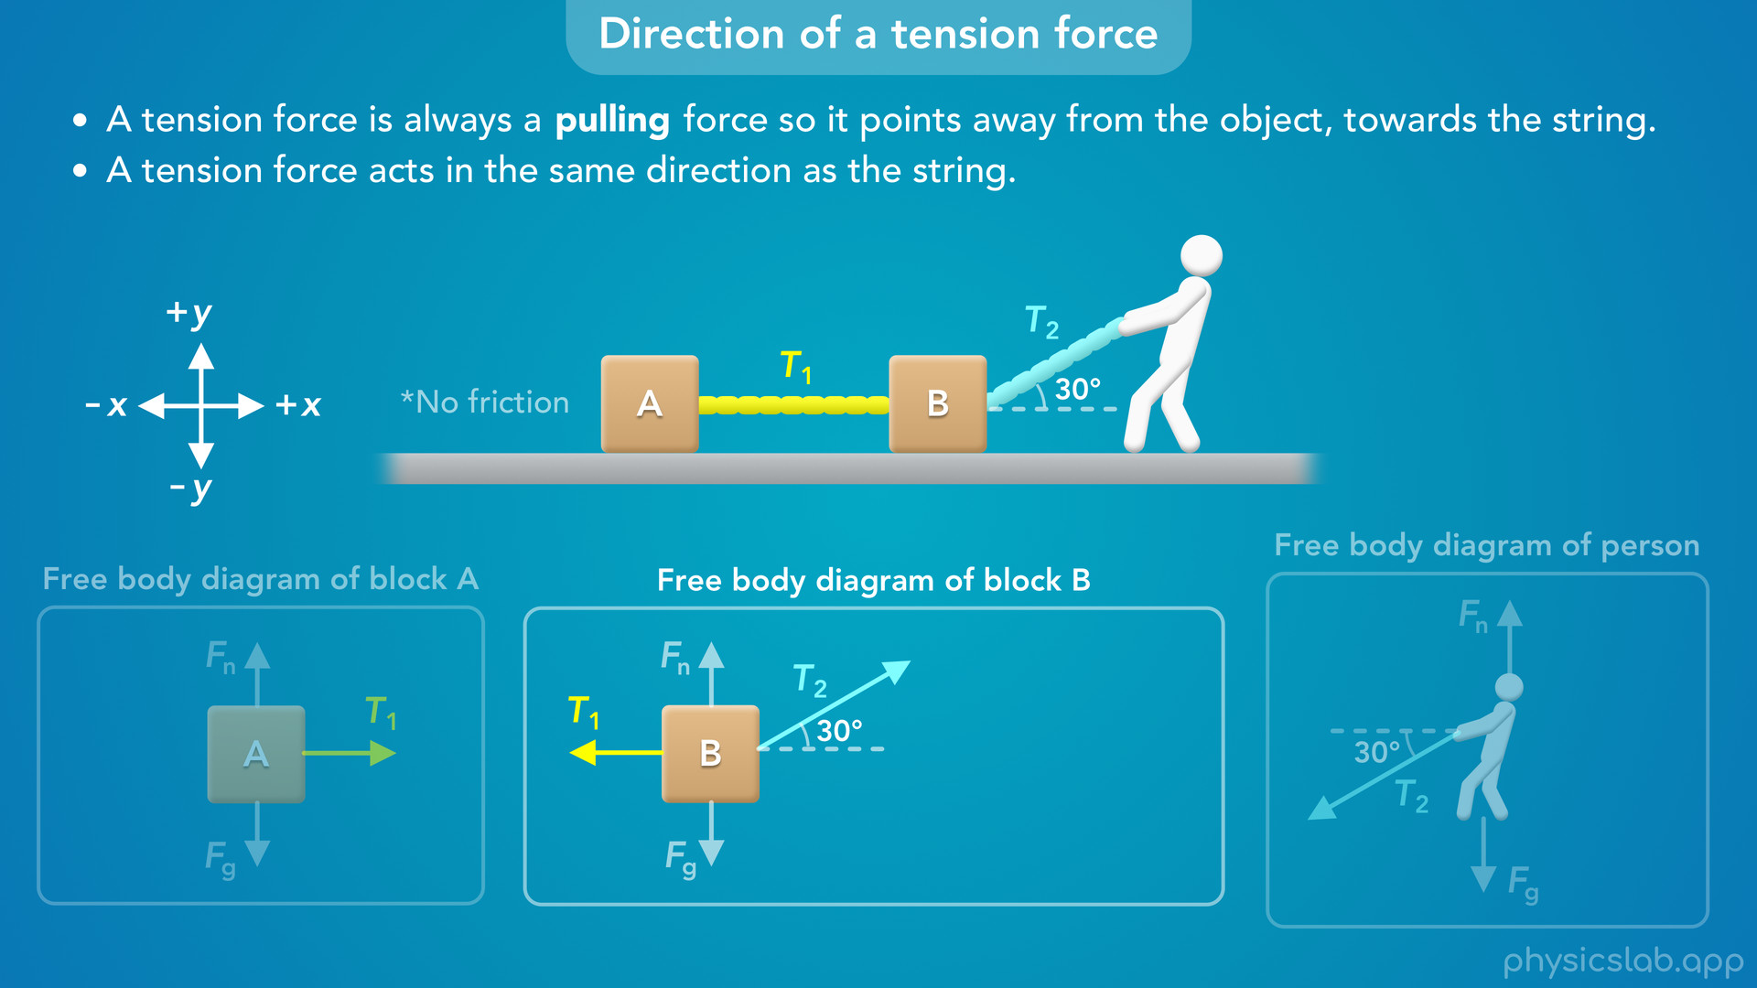
Notes:
• Whenever we’re dealing with a force at an angle, we usually need to find the x and y components of that force.
• If we set up our coordinate system so the x axis is horizontal and the y axis is vertical

Slide 49

Notes:
then the x and y components of T2 look like this.

Slide 50
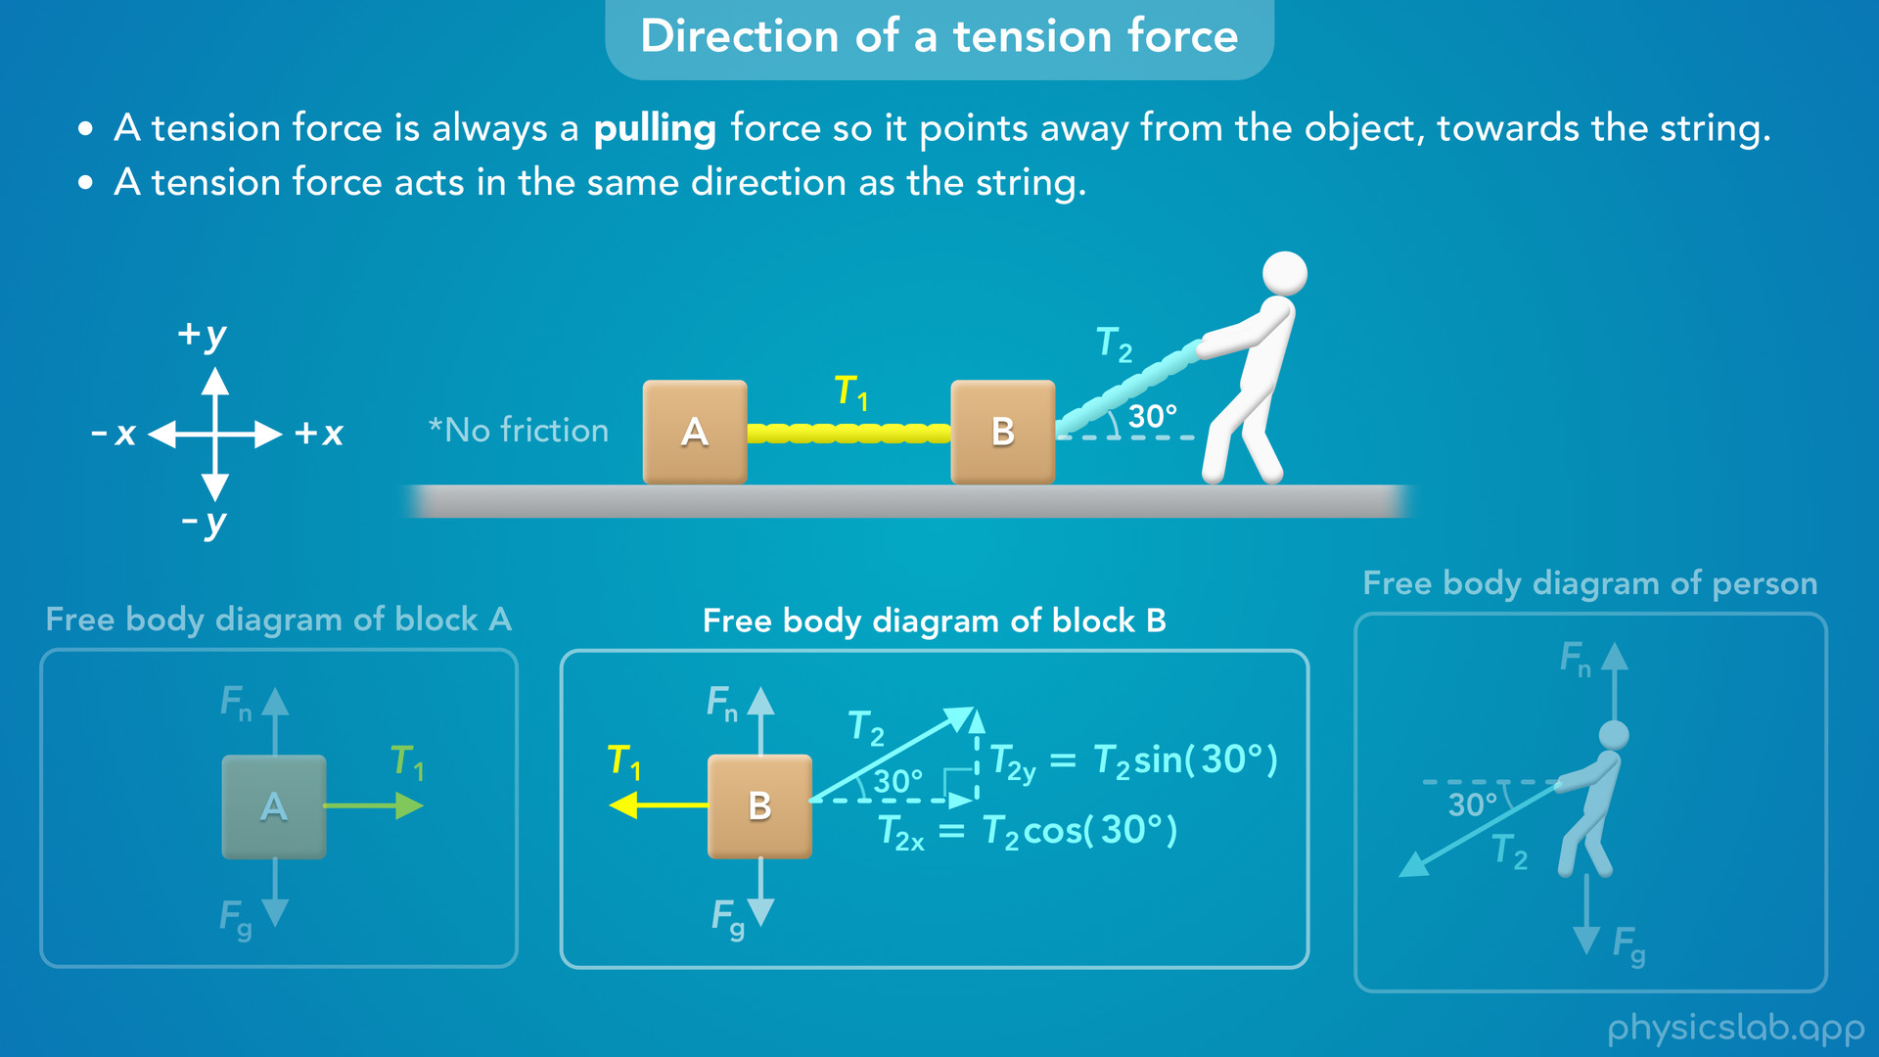
Notes:
• Using right triangle trig, the x component is adjacent to this angle, so T2x equals T2 times the cosine of 30 degrees.
• And the y component is opposite from this angle, so T2y equals T2 times the sin of 30 degrees.

Slide 51

Notes:
• So that’s how we draw the direction of a tension force in a free body diagram.
• Tension is a pulling force that always points away from the object in the same direction as the string.

Slide 52
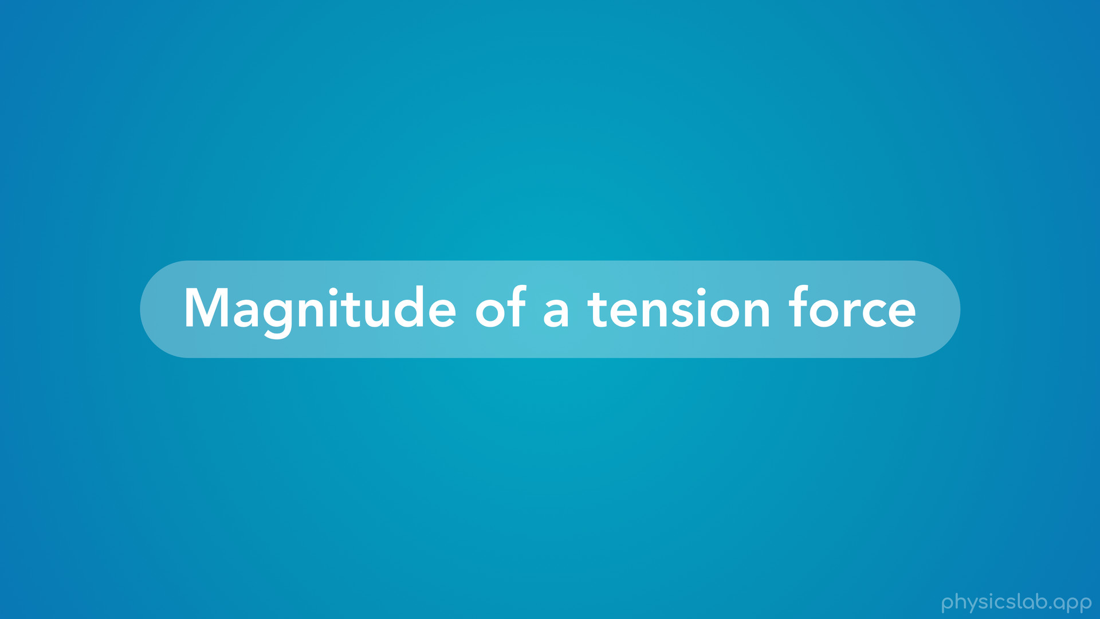
Notes:
• The last thing to cover is the magnitude of a tension force.

Slide 53
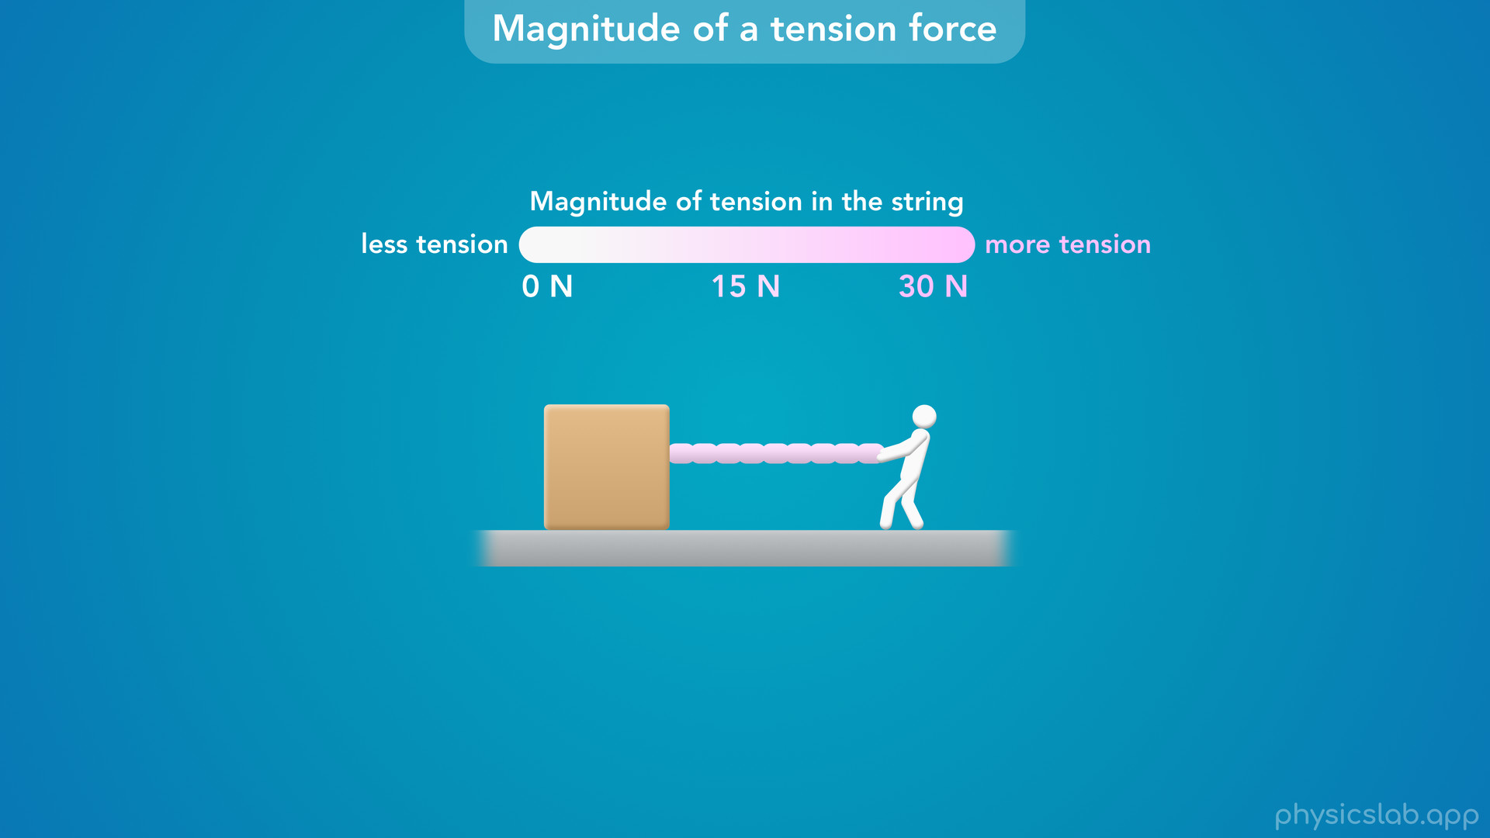
Notes:
• Here we have a person pulling on a string attached to a box, and we’re going to show the magnitude of the tension in the string using color.

Slide 54
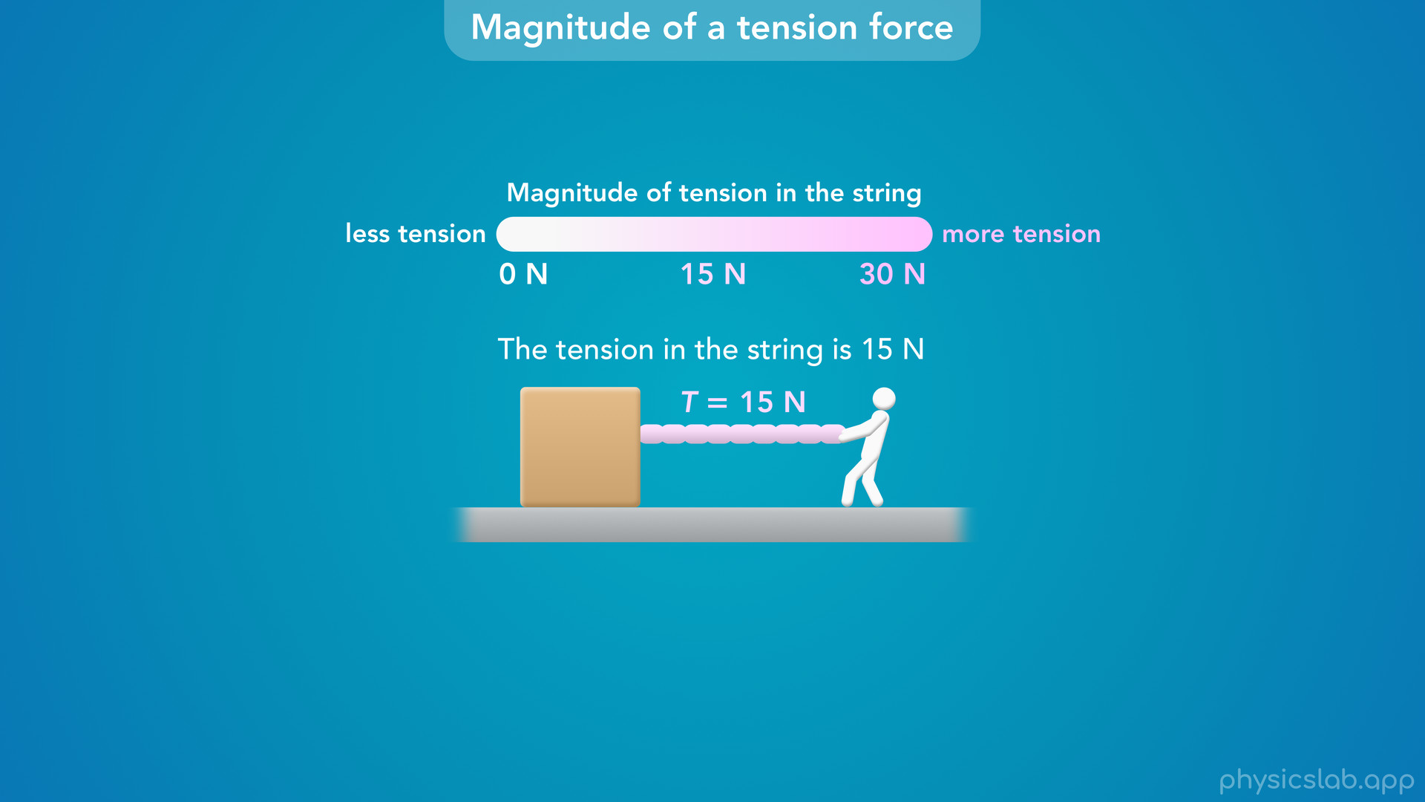
Notes:
• Right now, the tension in the string is 15 N.

Slide 55
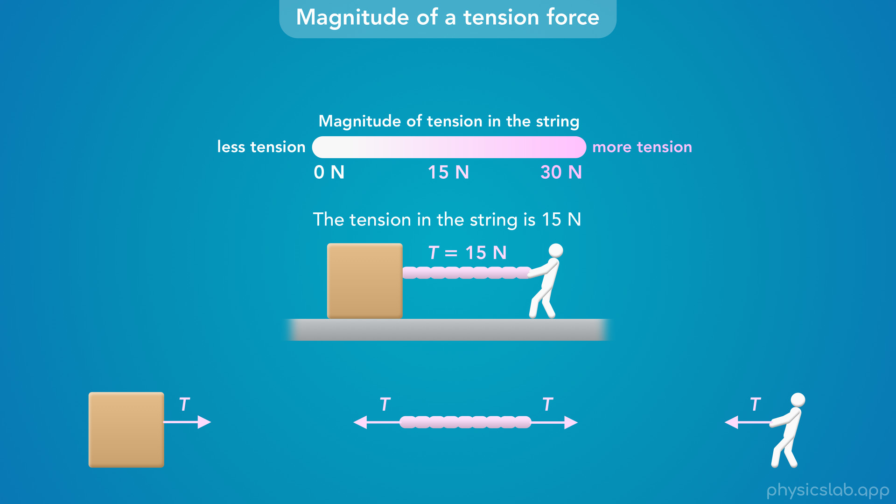
Notes:
• The string is exerting tension forces on the box and the person, but how big are those forces?

Slide 56

Notes:
• “The magnitude of a tension force is equal to the magnitude of the tension in the string”.
• So the tension force on the box is 15 N, and the tension force on the person is also 15 N.

Slide 57
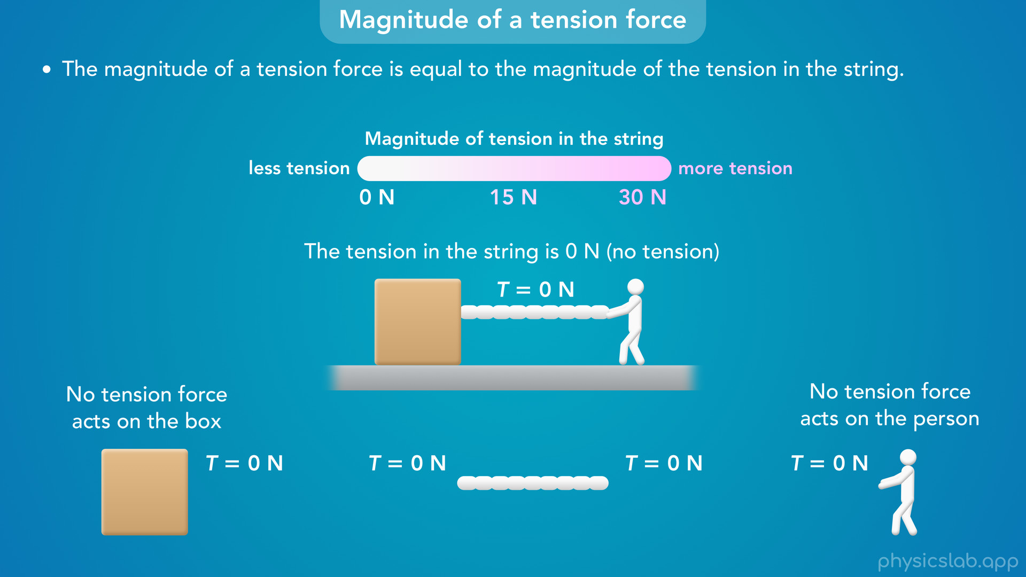
Notes:
• If the person is not pulling on the string, then the tension is the string is 0 N, there’s no tension.
• Even though the string is attached to the box and the person, there are no tension forces acting on them because there is no tension in the string.

Slide 58
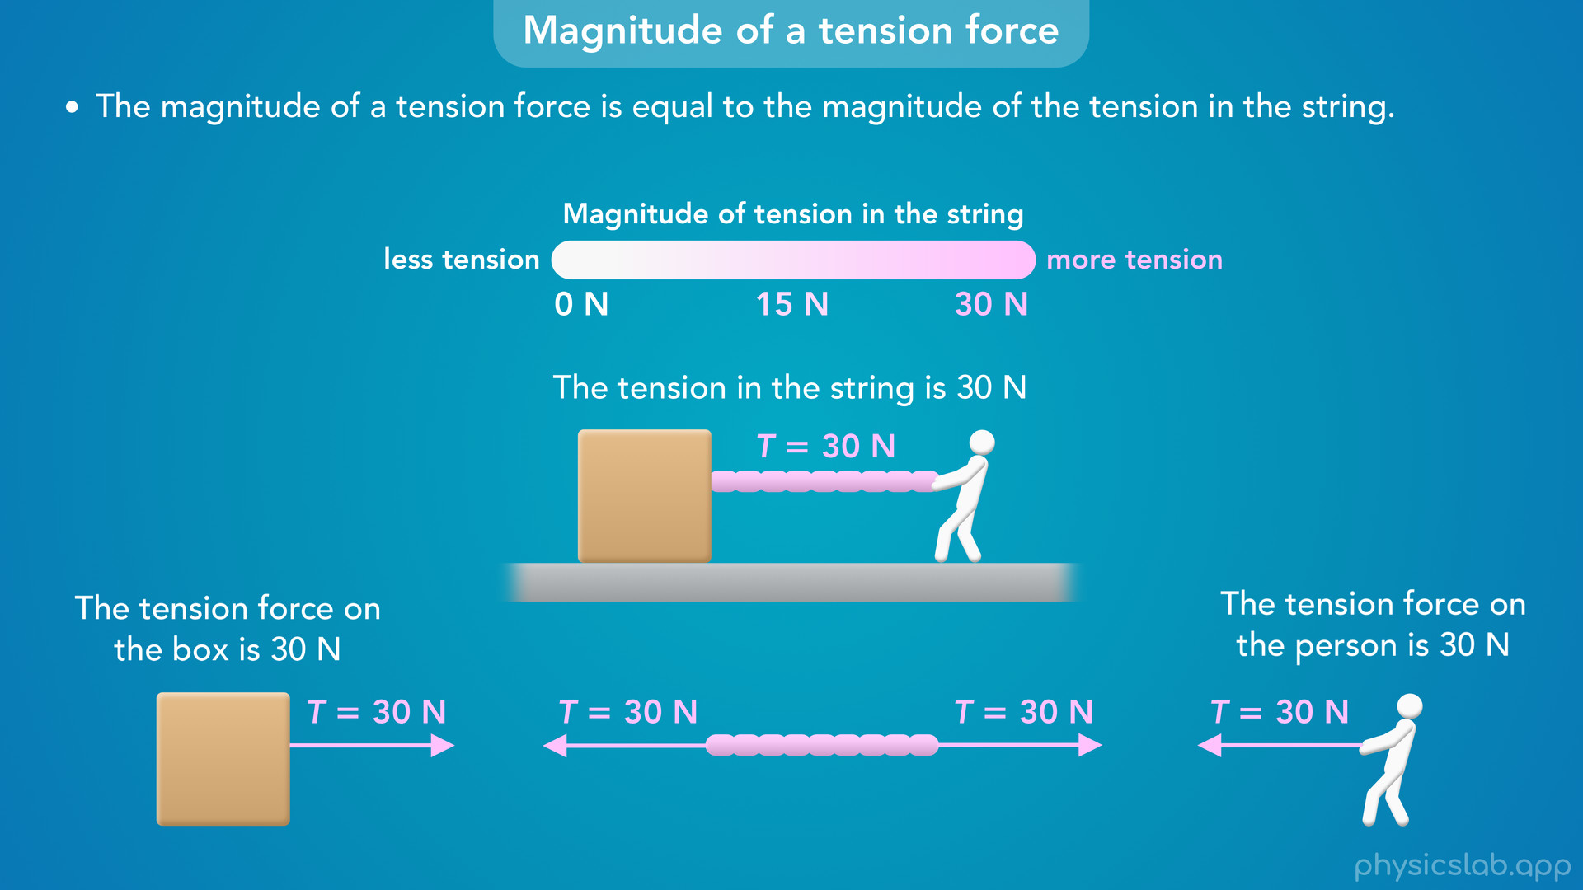
Notes:
• Now let’s say the person pulls harder and the tension is 30 N.
• That means the tension force on the box is 30 N, and the tension force on the person is 30 N.
• Notice that the tension forces are not half or double the tension in the string, they’re both equal to the tension in the string.

Slide 59

Notes:
• As the tension changes, the forces on each object also change…

Slide 60


Slide 61


Slide 62


Slide 63
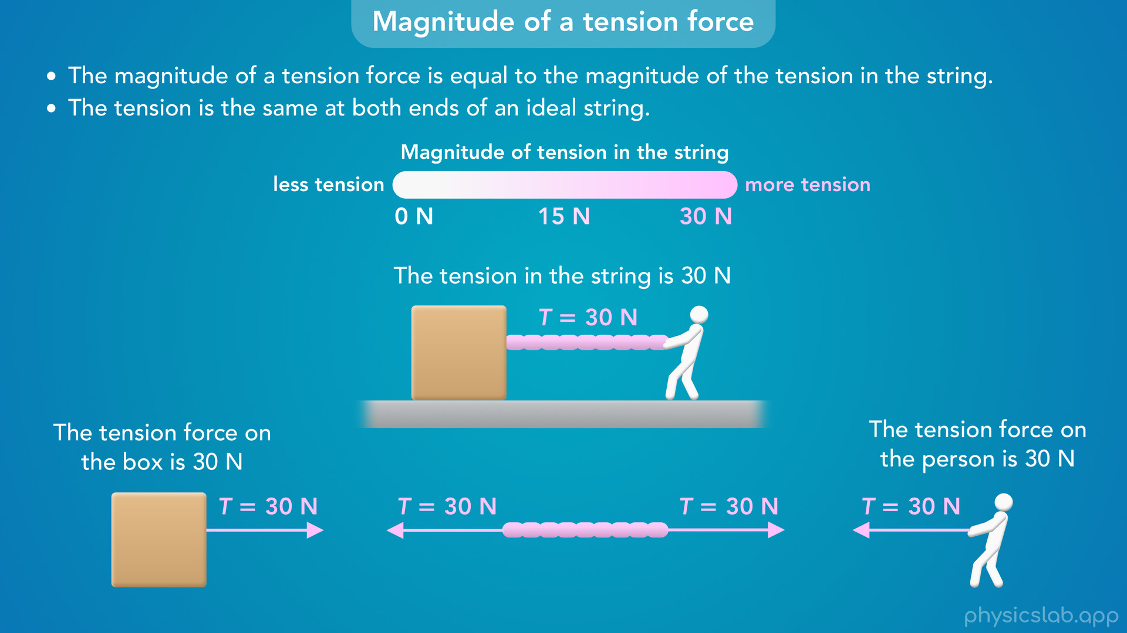
Notes:
• Another important point is that the tension is the same at both ends of an ideal string.
• We’ll talk more about ideal strings in the next video, but this means the tension force on the box is equal to the tension force on the person.
• But why is that, and what are we talking about when we say “the tension *in* the string is 30 N”?

Slide 64
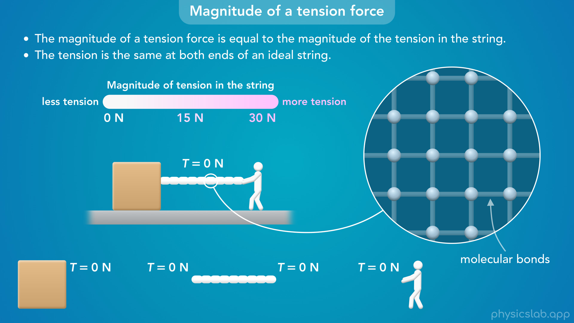
Notes:
• If we zoom in, the string is made of molecules that are bonded together.
• These molecular bonds are actually electric forces, but we can illustrate them like this.

Slide 65

Notes:
• When the person pulls on the string, that force is distributed across the molecular bonds.

Slide 66
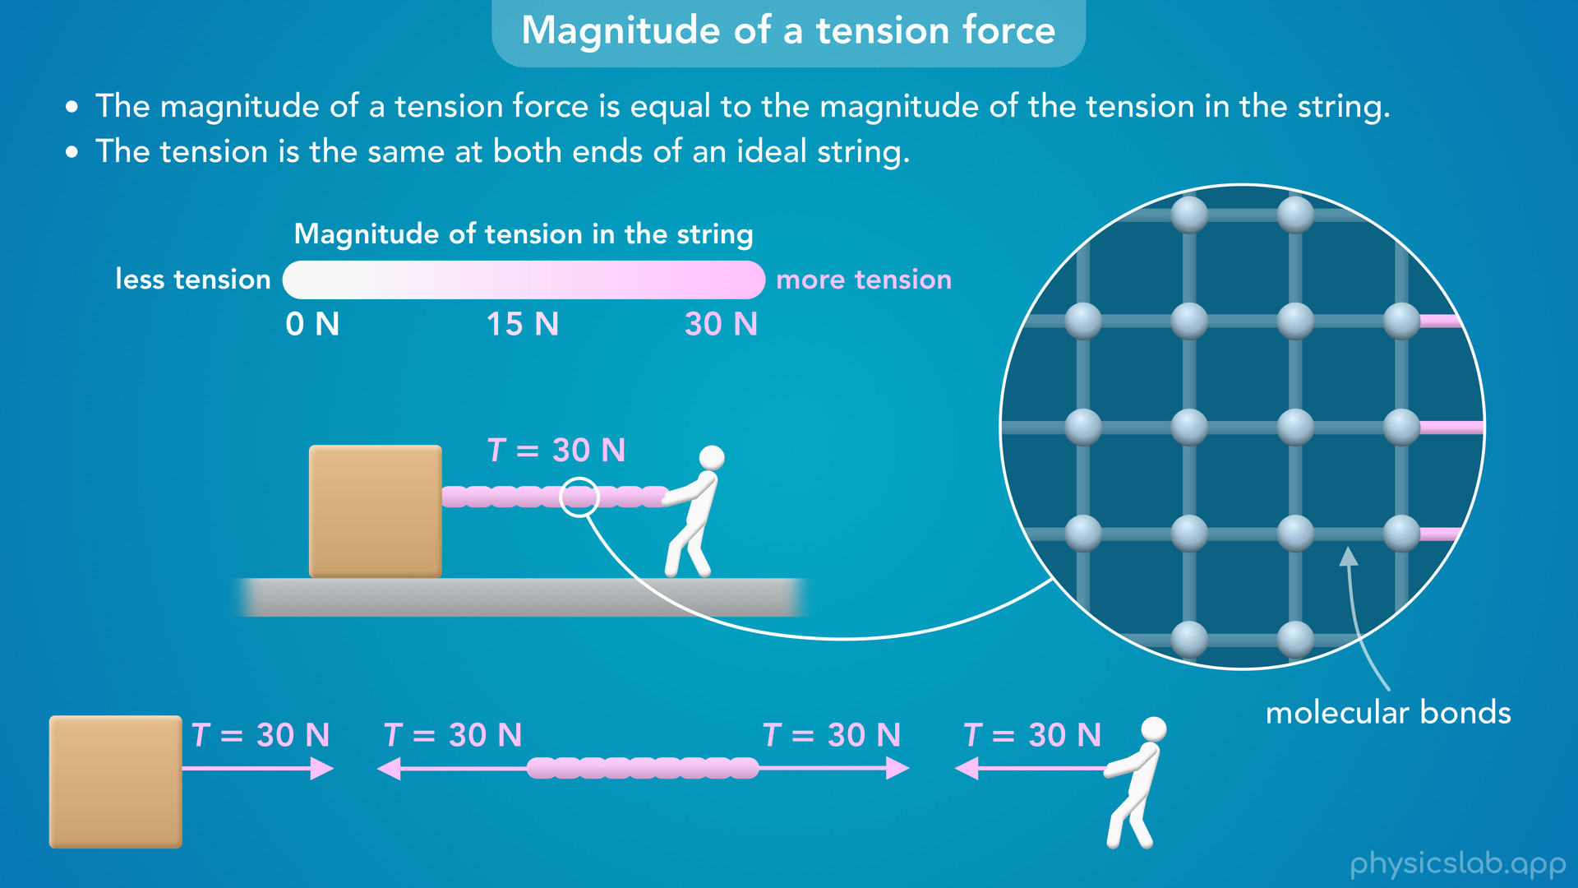
Notes:
• The person pulls on the molecules at the right end of the string, and those pull on the molecules to their left, and so on, until the entire string is at the same tension…

Slide 67


Slide 68


Slide 69


Slide 70
Notes:
• The tension moves across the string almost instantaneously.
• And for an ideal string, we’re going to assume that any force applied to one end is instantly transferred to the other end, just like we did with spring forces.
• So at any moment in time, the tension is the same at every point in the string, and the *forces* at each end are the same.

Slide 71

Notes:
• A tension force is actually pretty similar to a normal force, but it pulls an object instead of pushing it.
• Tension is just a contact force that reacts to other forces.
• And there’s no “equation” for tension, it’s just a label for the pulling force caused by a string.

Slide 72

Notes:
• Alright, that’s everything we’re gonna cover for now.
• In the next few videos, we’ll learn more about an ideal string and what assumptions we can make when solving a problem.

Slide 73

Notes:
• After that, we’ll look at examples with tension where everything is static.

Slide 74

Notes:
• That means the objects are not moving, so the net force on each object is zero.

Slide 75

Notes:
• After that, we’ll look at examples that are dynamic, where there *is* a net force causing objects to accelerate.

Slide 76

Notes:
• We’ll learn how to apply Newton’s 2nd law to each object…

Slide 77

Notes:
• ...and the system as a whole.

Slide 78

Notes:
• After that, we’ll cover pulley systems…

Slide 79

Notes:
• and we’ll learn how an ideal pulley can change the direction of a tension force without changing the magnitude.

