Slide 1
Circular Motion
Slides Version 2
This version includes:
Slides with screenshot images from the video.
The video narration in the slide notes.
A blank template slide with the same background and font as the video.
Slides with some basic graphics from this video for you to use however you like.
Feel free to add, delete and edit slides to make your own presentation. You can use these slides in class or share them with your students, but please do not share them with anyone else.
If you have any feedback, suggestions or questions about these slides please email me at chris@physicslab.app or send me a message on Discord @physicslab.
physicslab.app

Slide 2
Heading
Text

Slide 3




Slide 4



Slide 5

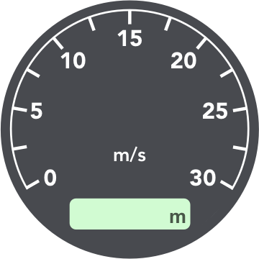




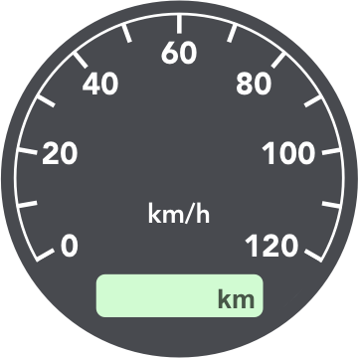

Slide 6








Slide 7
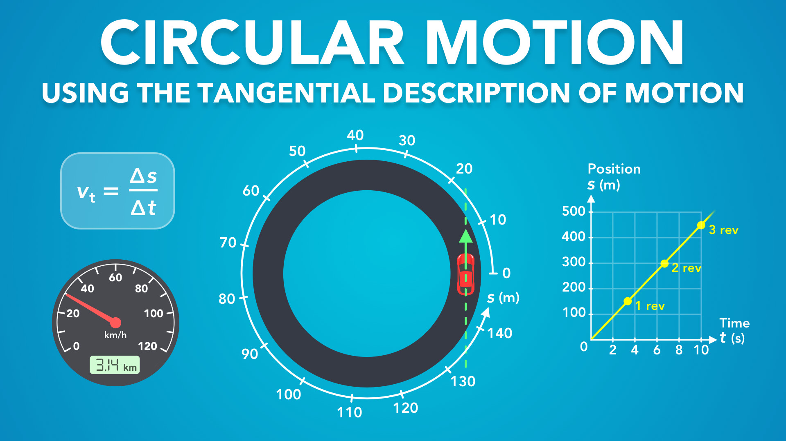
Notes:
Circular Motion - Using the Tangential Description of Motion
physicslab.app
If you have any questions, suggestions or feedback about these slides please email me at chris@physicslab.app or send me a message on Discord @physicslab.

Slide 8
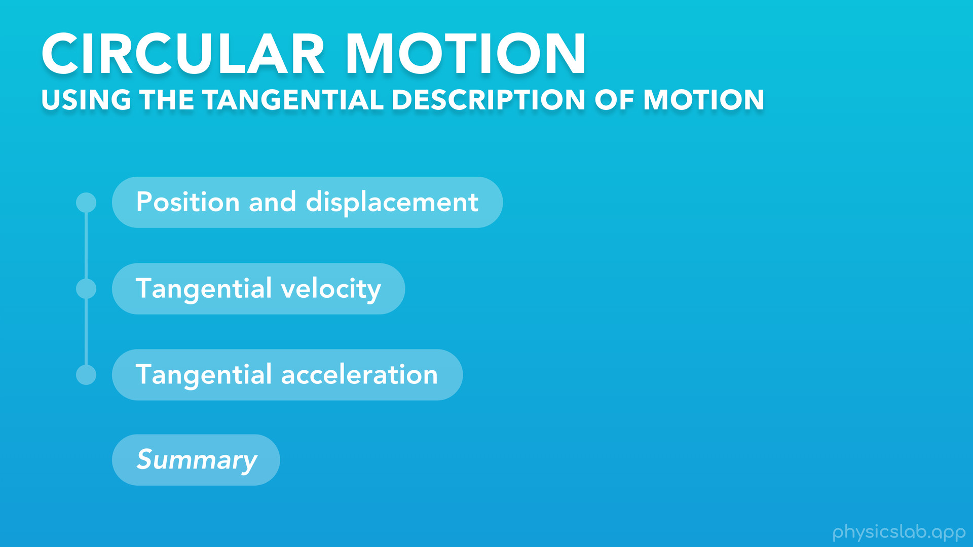
Notes:
○ Hey everyone, in this video we’re going to learn about circular motion using the tangential description of motion.

Slide 9
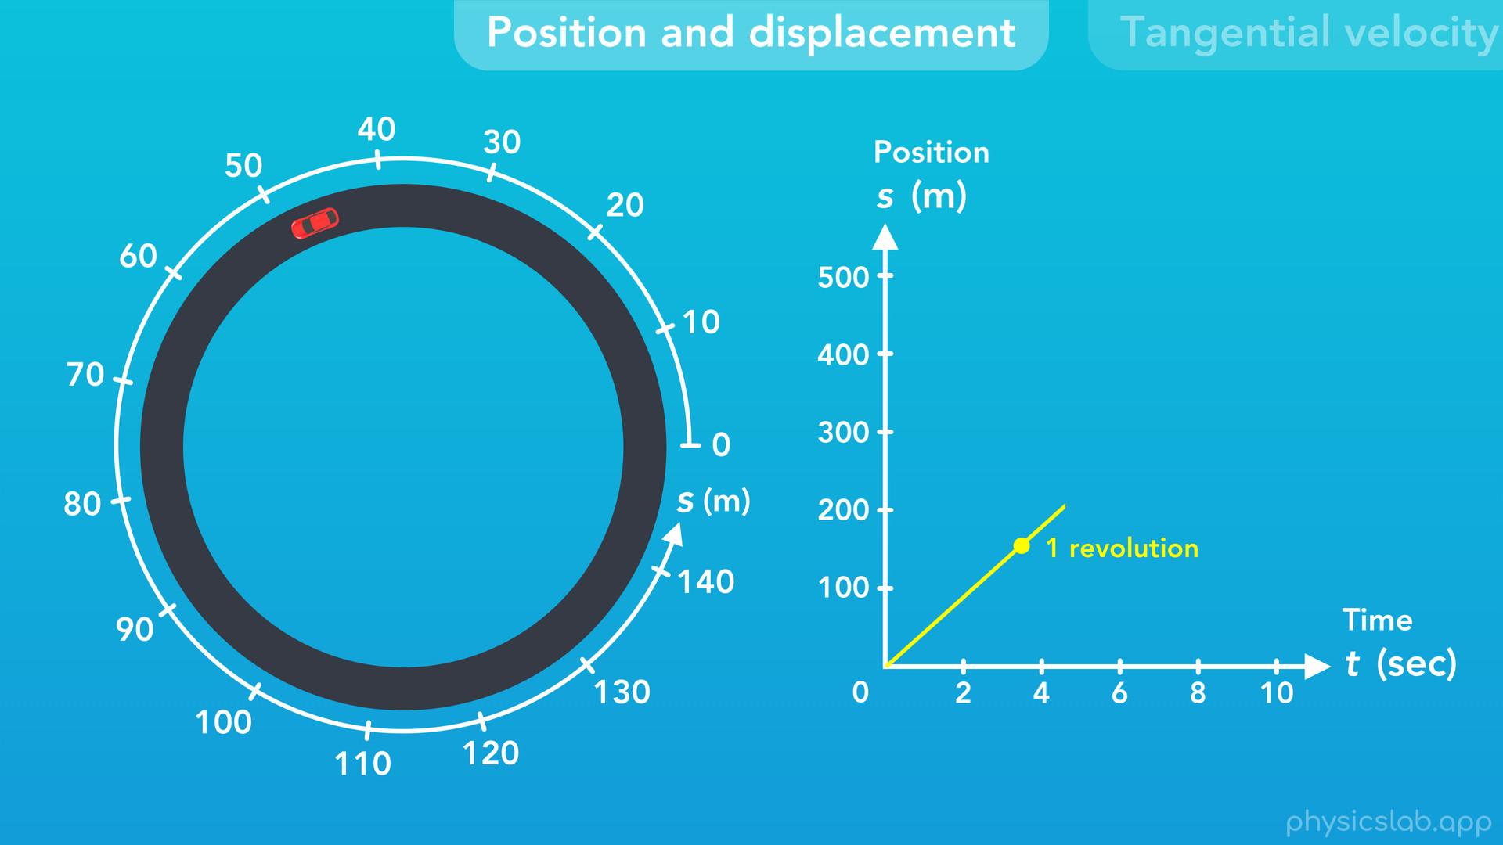
Notes:
We’ll cover position and displacement

Slide 10
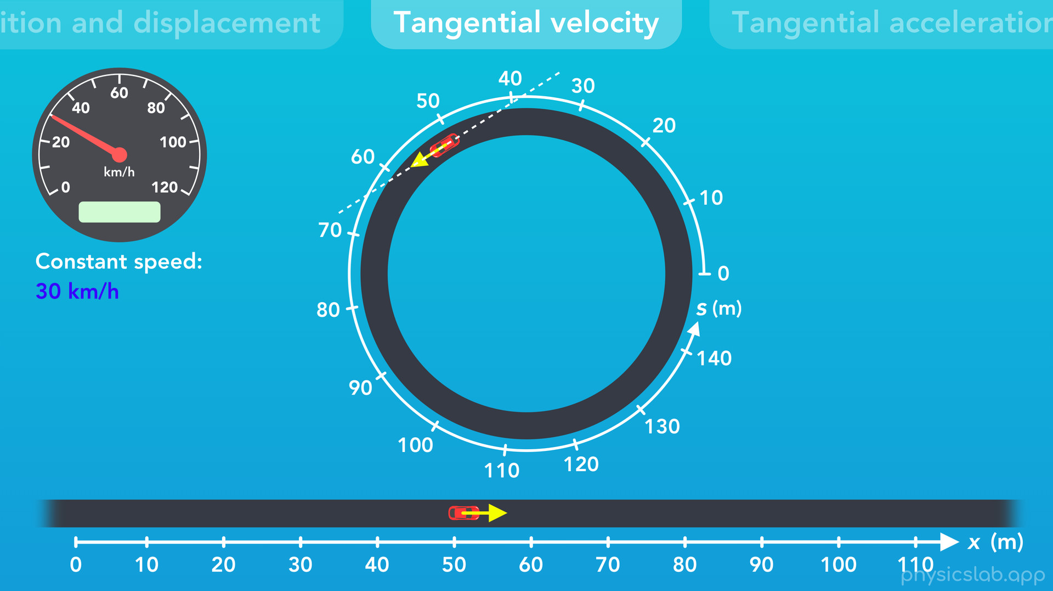
Notes:
tangential velocity

Slide 11
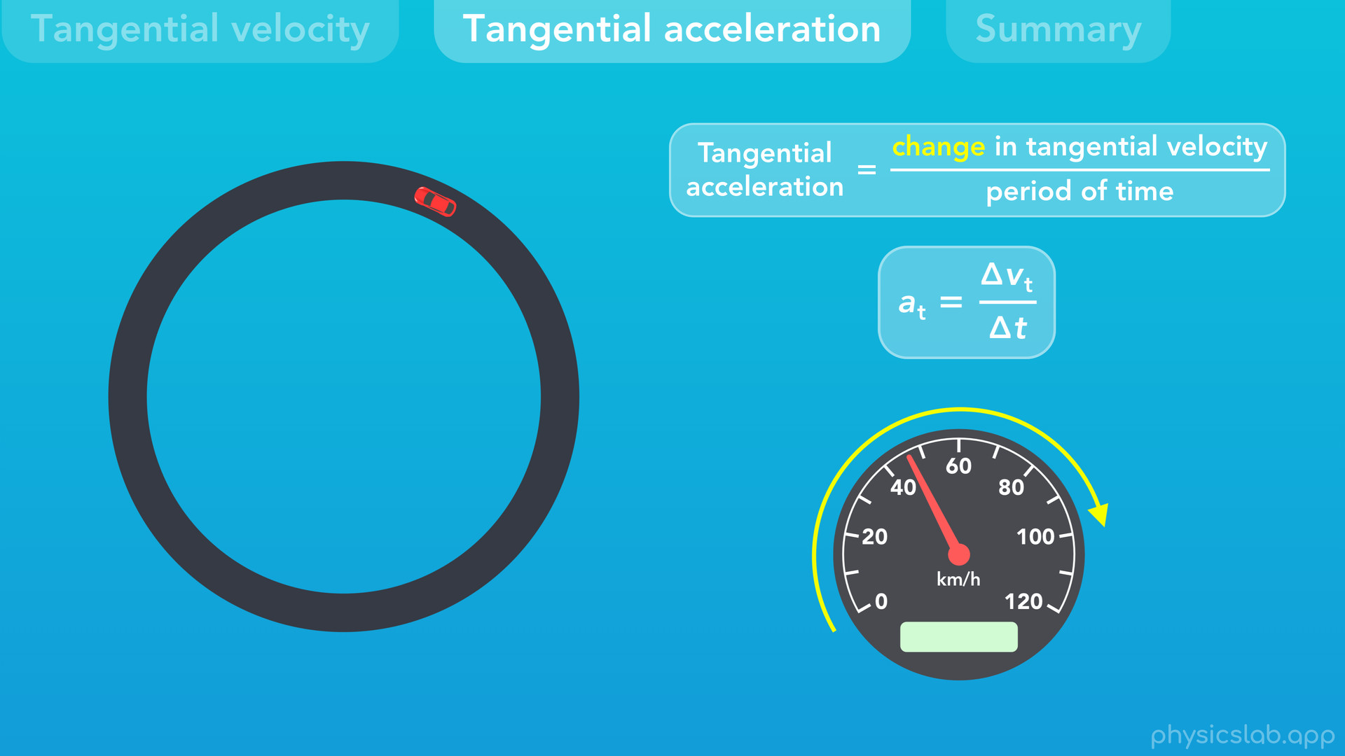
Notes:
and tangential acceleration.

Slide 12
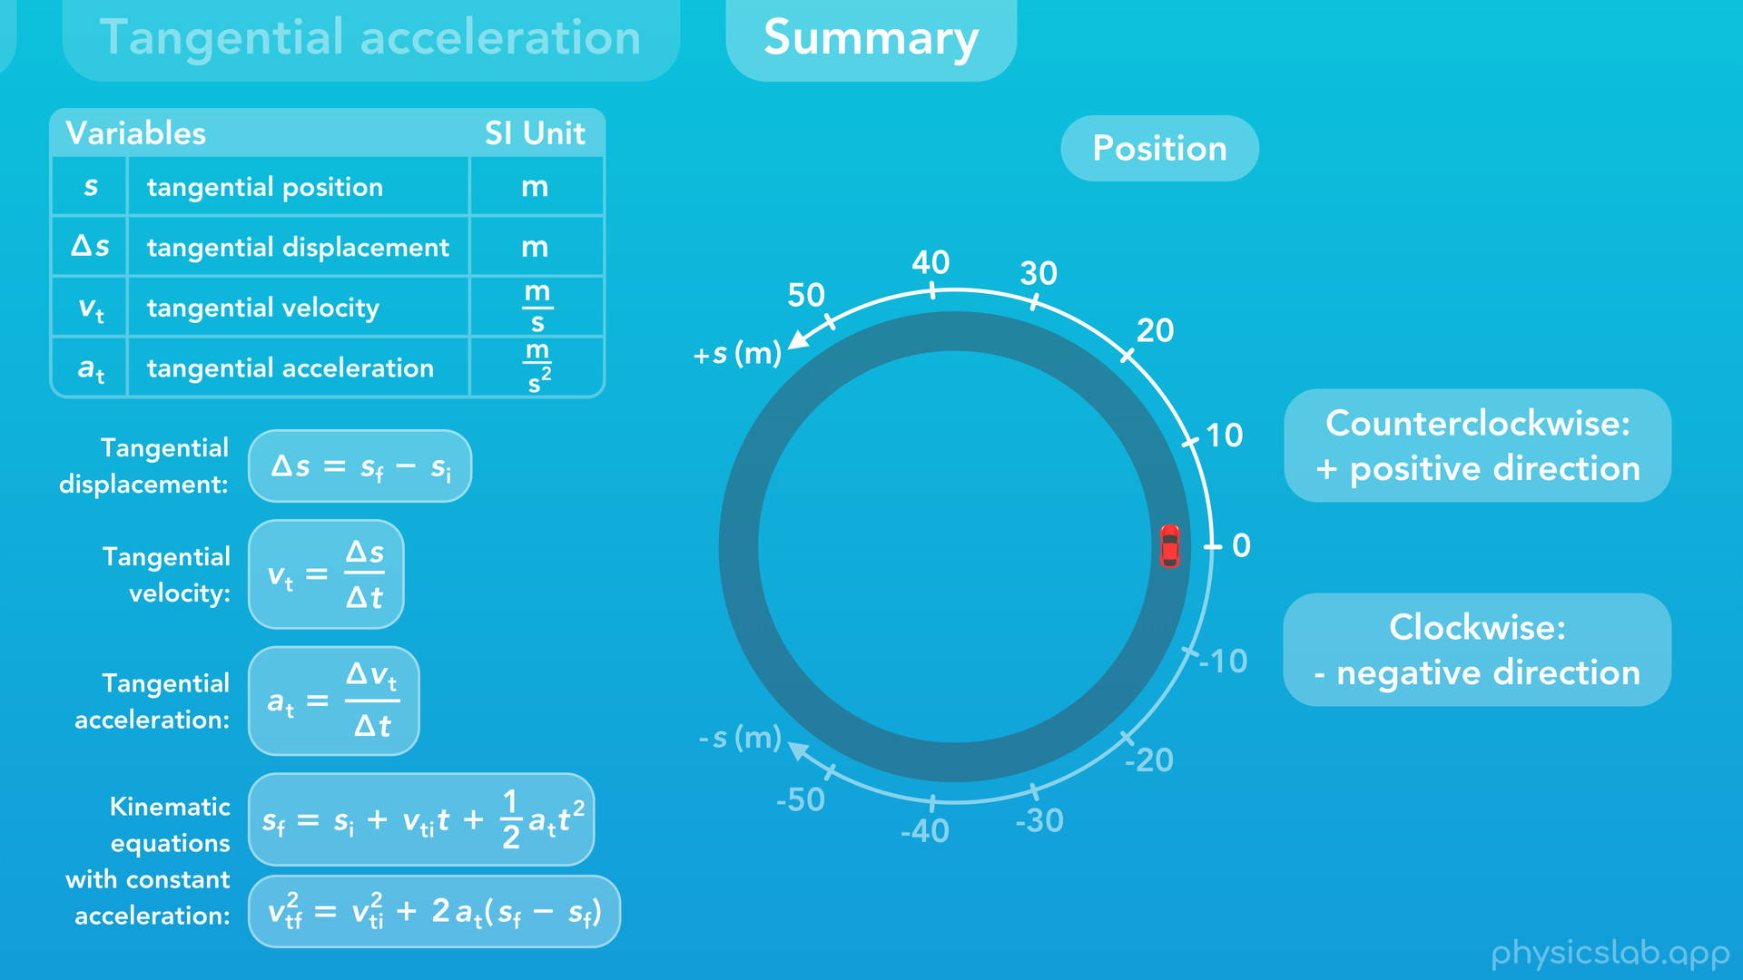
Notes:
Then, we’ll summarize the main points at the end.

Slide 13
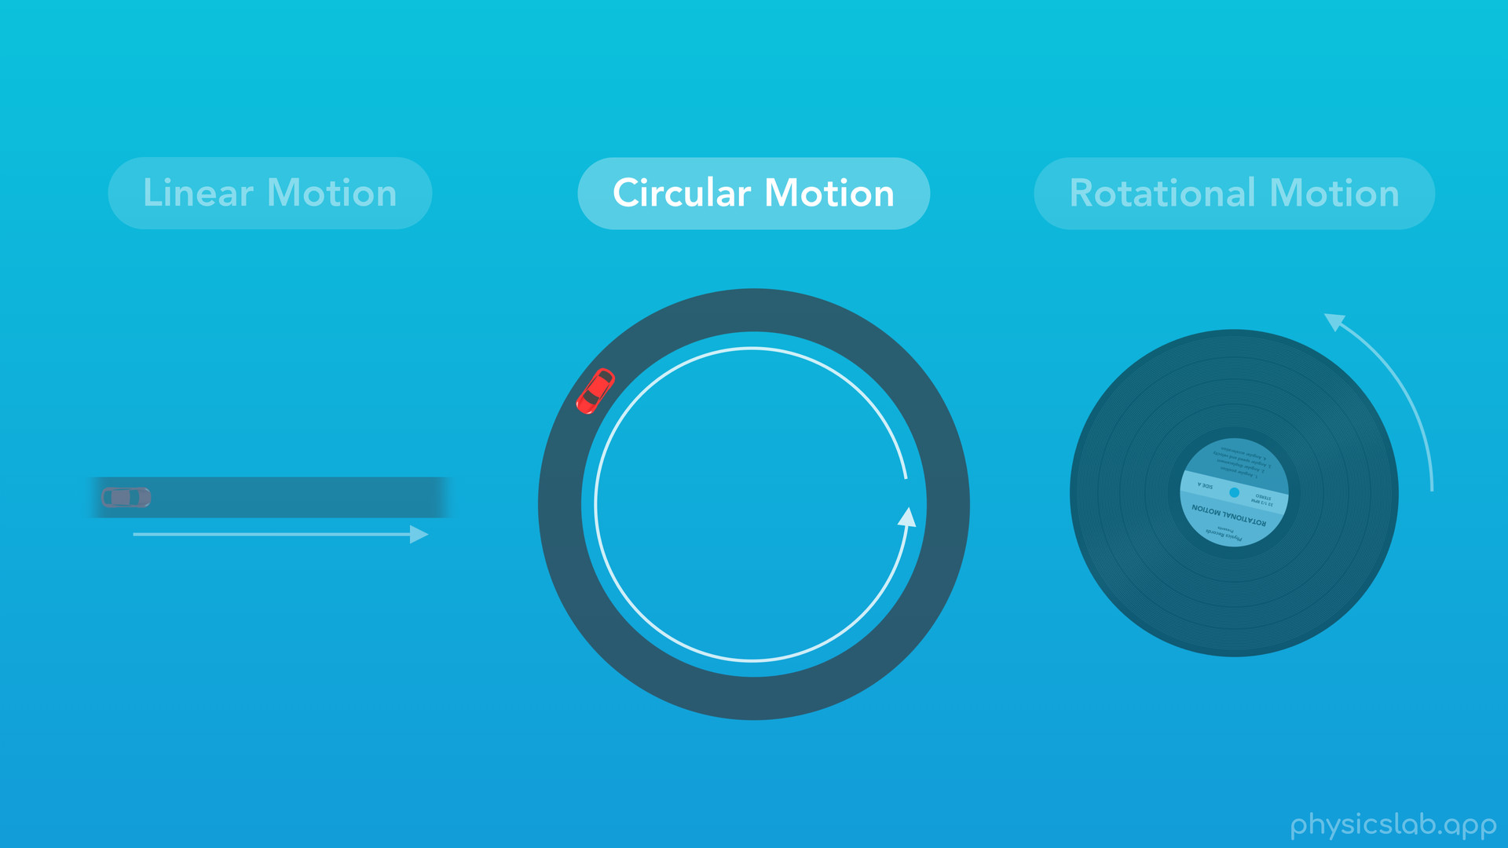
Notes:
○ Circular motion is when an object travels around a circular path.

Slide 14
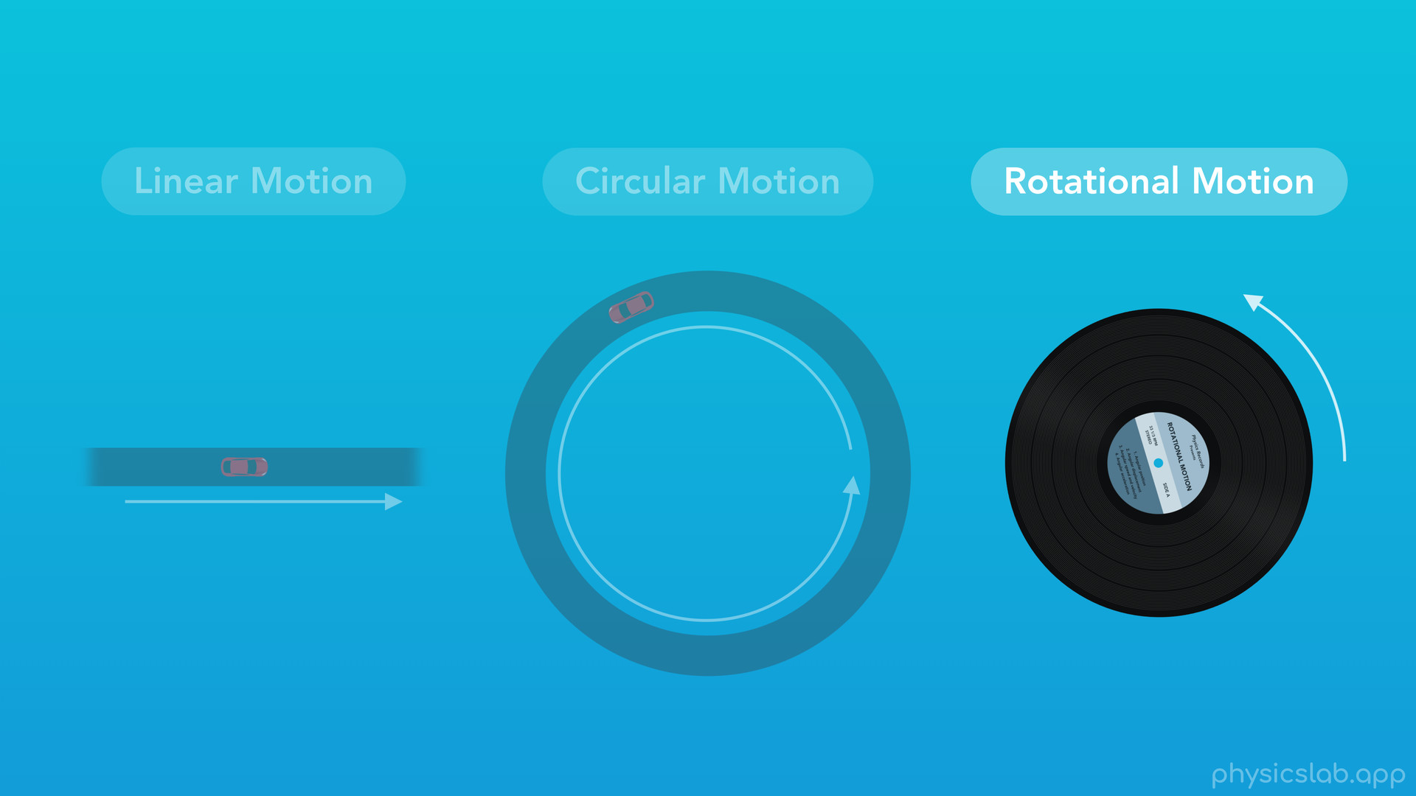
Notes:
By comparison, rotational motion is when an object itself is rotating about its own center, but it’s not translating. We’re gonna focus on circular motion in this video.

Slide 15

Notes:
○ This car is one example of circular motion, because it traces out a path in the shape of a circle.

Slide 16
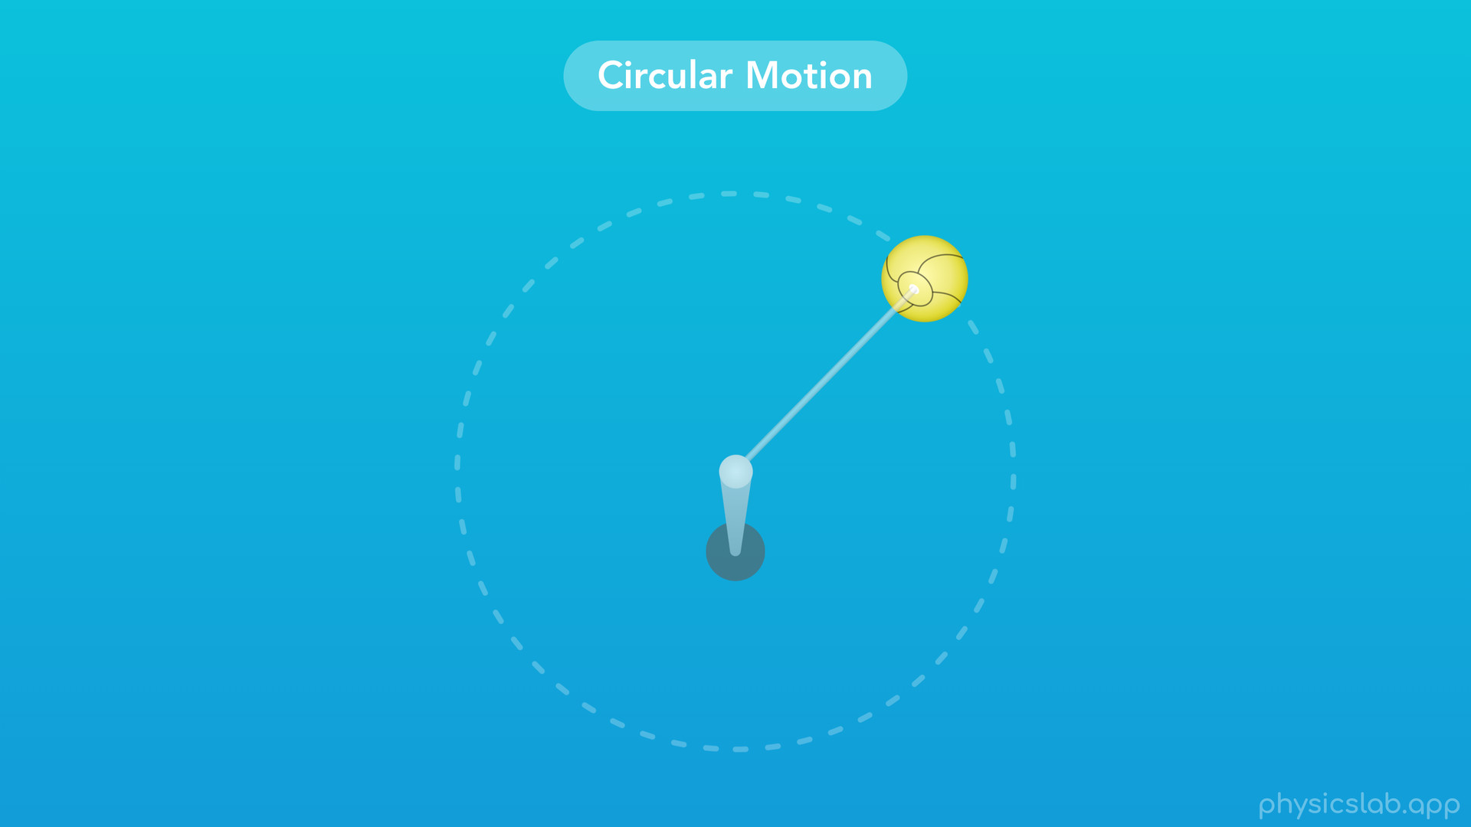
Notes:
○ Another example is a tetherball attached to a pole. As the ball swings around, it follows a circular path.

Slide 17

Notes:
○ There’s thousands of satellites orbiting the earth, and the Earth itself is orbiting the sun. Technically, most orbits follow an ellipse, but we’re mostly going to work with circular orbits.

Slide 18
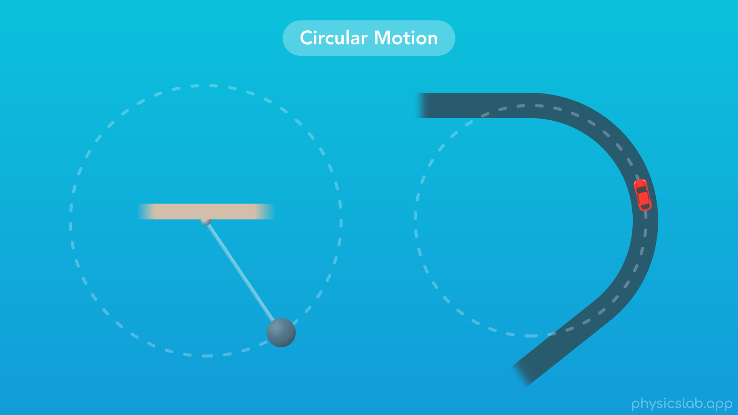
Notes:
○ Even if an object doesn’t complete a full circle, it’s still in circular motion if the shape of its path is a circle.

Slide 19
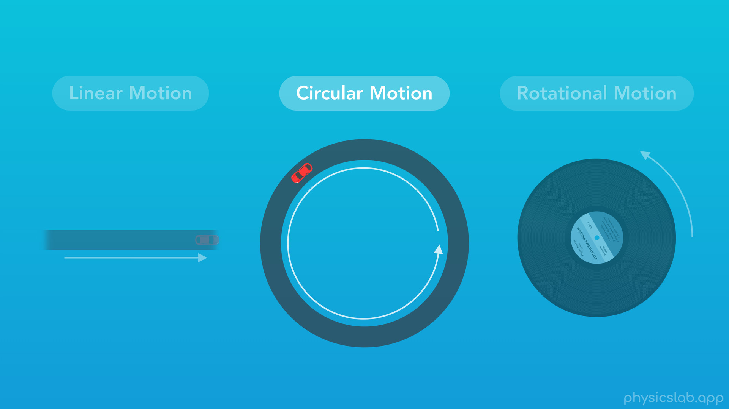

Slide 20
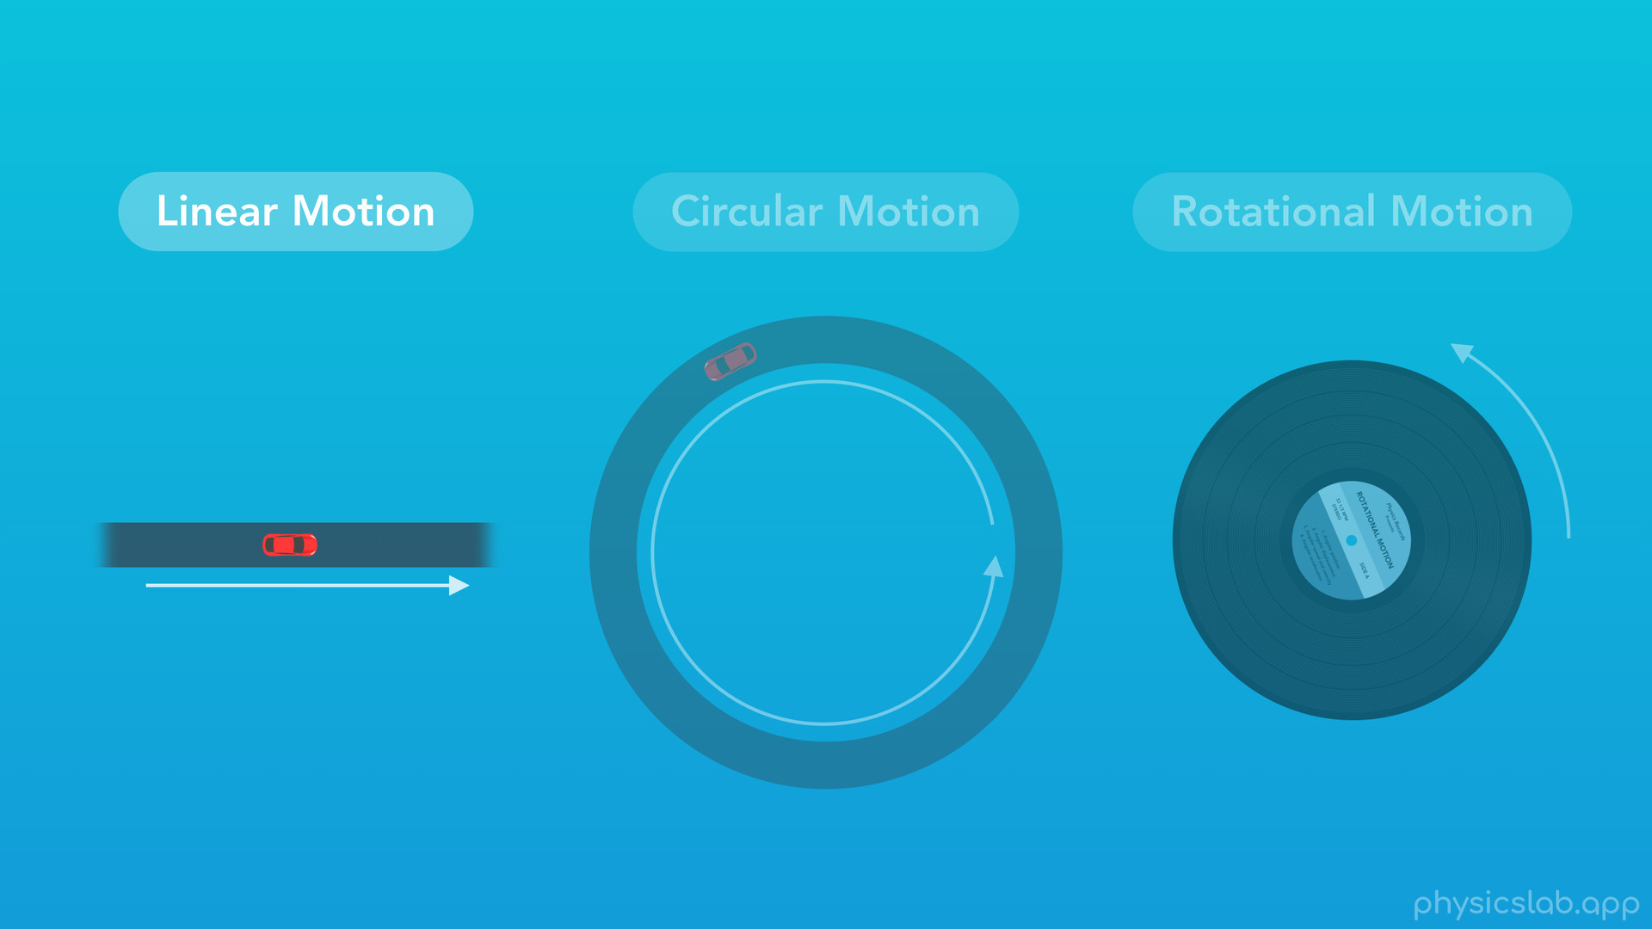
Notes:
○ It turns out that the tangential description of circular motion is similar to linear motion. So for comparison, let’s do a quick review of linear motion.

Slide 21

Notes:
○ This car is driving along a straight road.

Slide 22
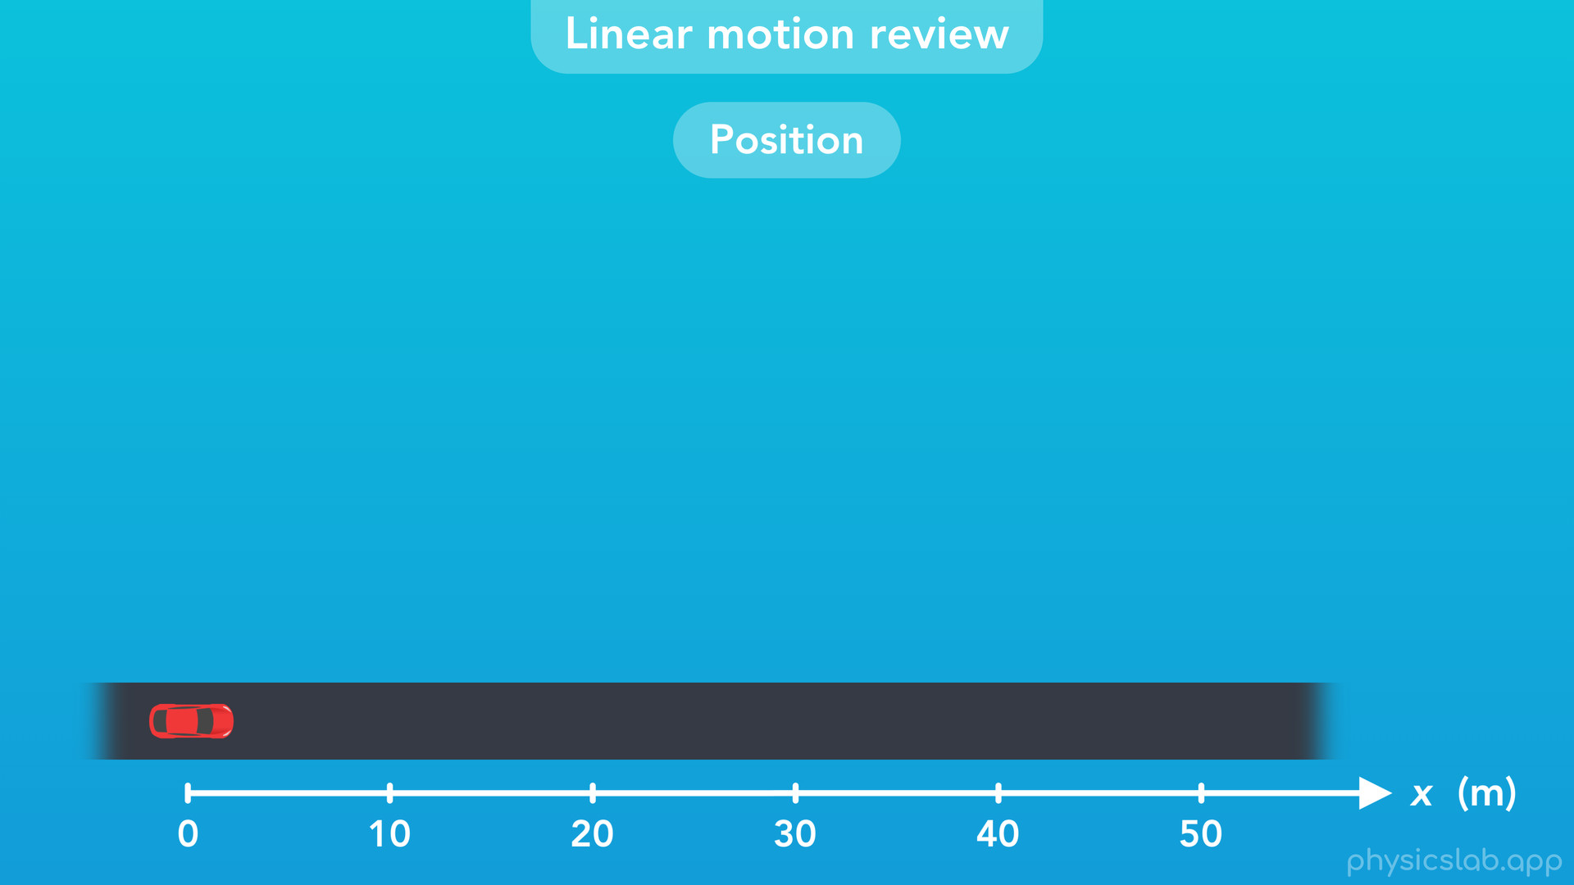
Notes:
With linear motion, we describe the position of the car along one axis, a straight line, relative to a zero point.

Slide 23
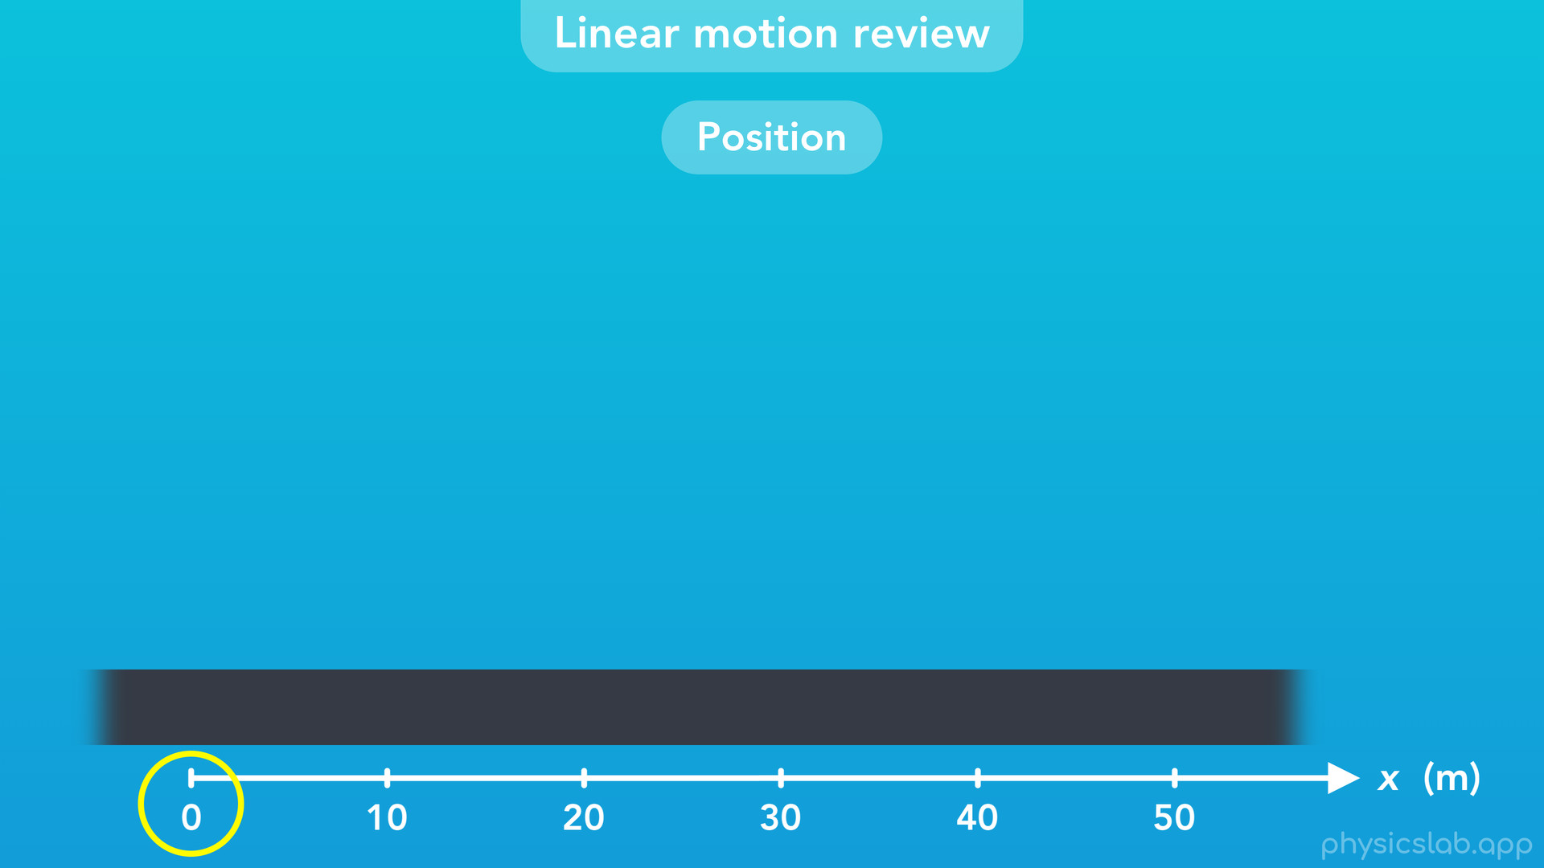

Slide 24
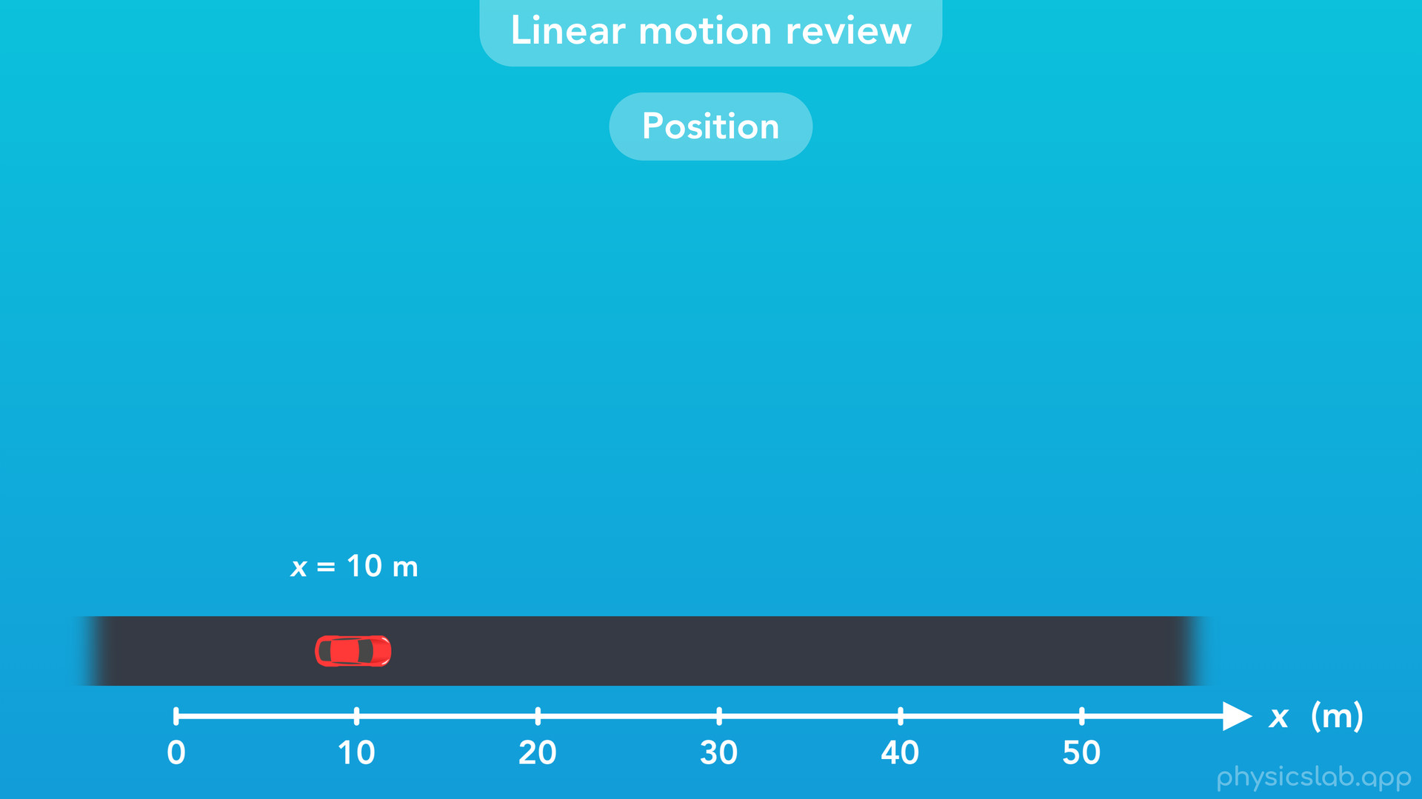
Notes:
Here the car’s position is 10 m

Slide 25
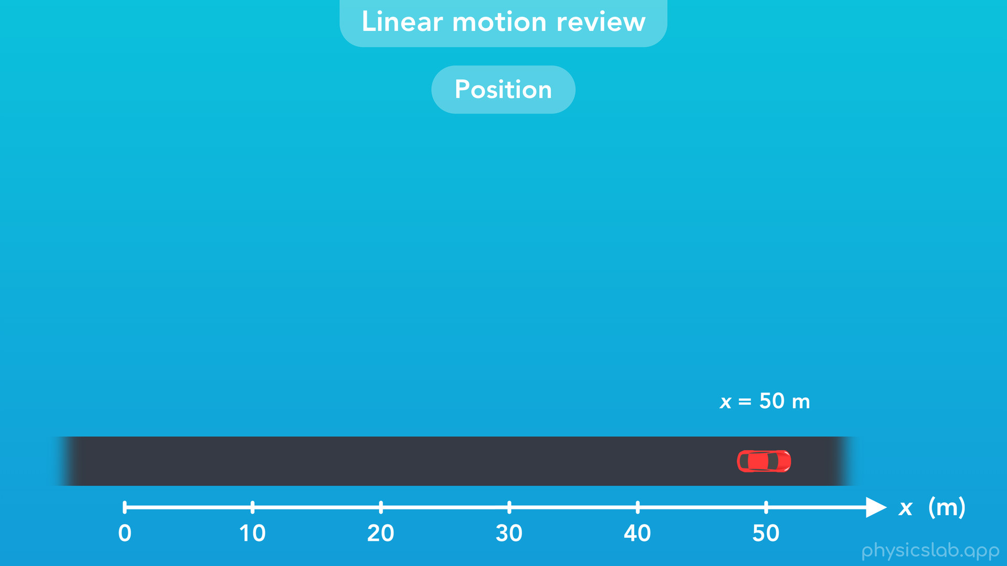
Notes:
and here the car’s position is 50 m.

Slide 26
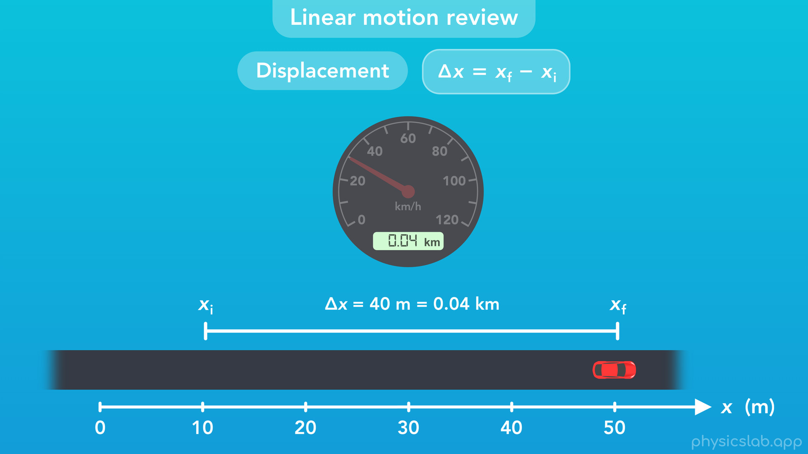
Notes:
○ Displacement is the change in position, or the final position minus the initial position. This car’s displacement would be 40 m, or 0.04 km, and the odometer in the car tell’s us how far the car drove.

Slide 27
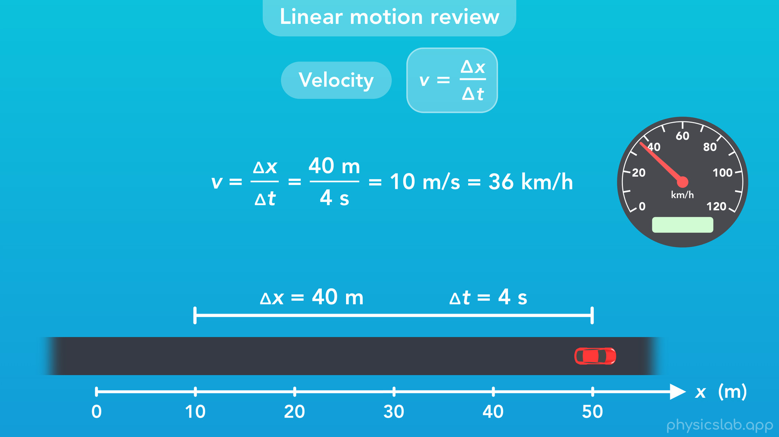
Notes:
○ Velocity is the displacement divided by time. If this car drove 40 m in 4 s, then 40 divided by 4 would be 10 m/s, or 36 km/h. The speedometer or speed gauge in the car would show us the speed of the car in the direction that it’s moving.

Slide 28
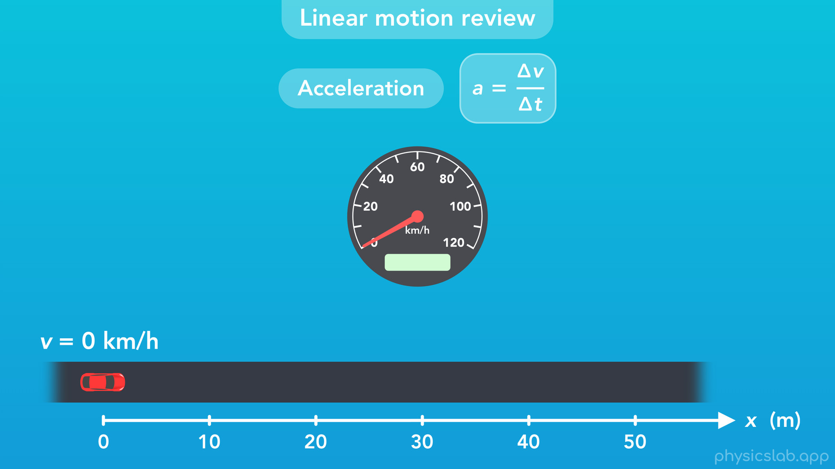
Notes:
○ Acceleration is the change in velocity over time. If this car starts from rest and then its velocity increases over time, that’s acceleration.

Slide 29
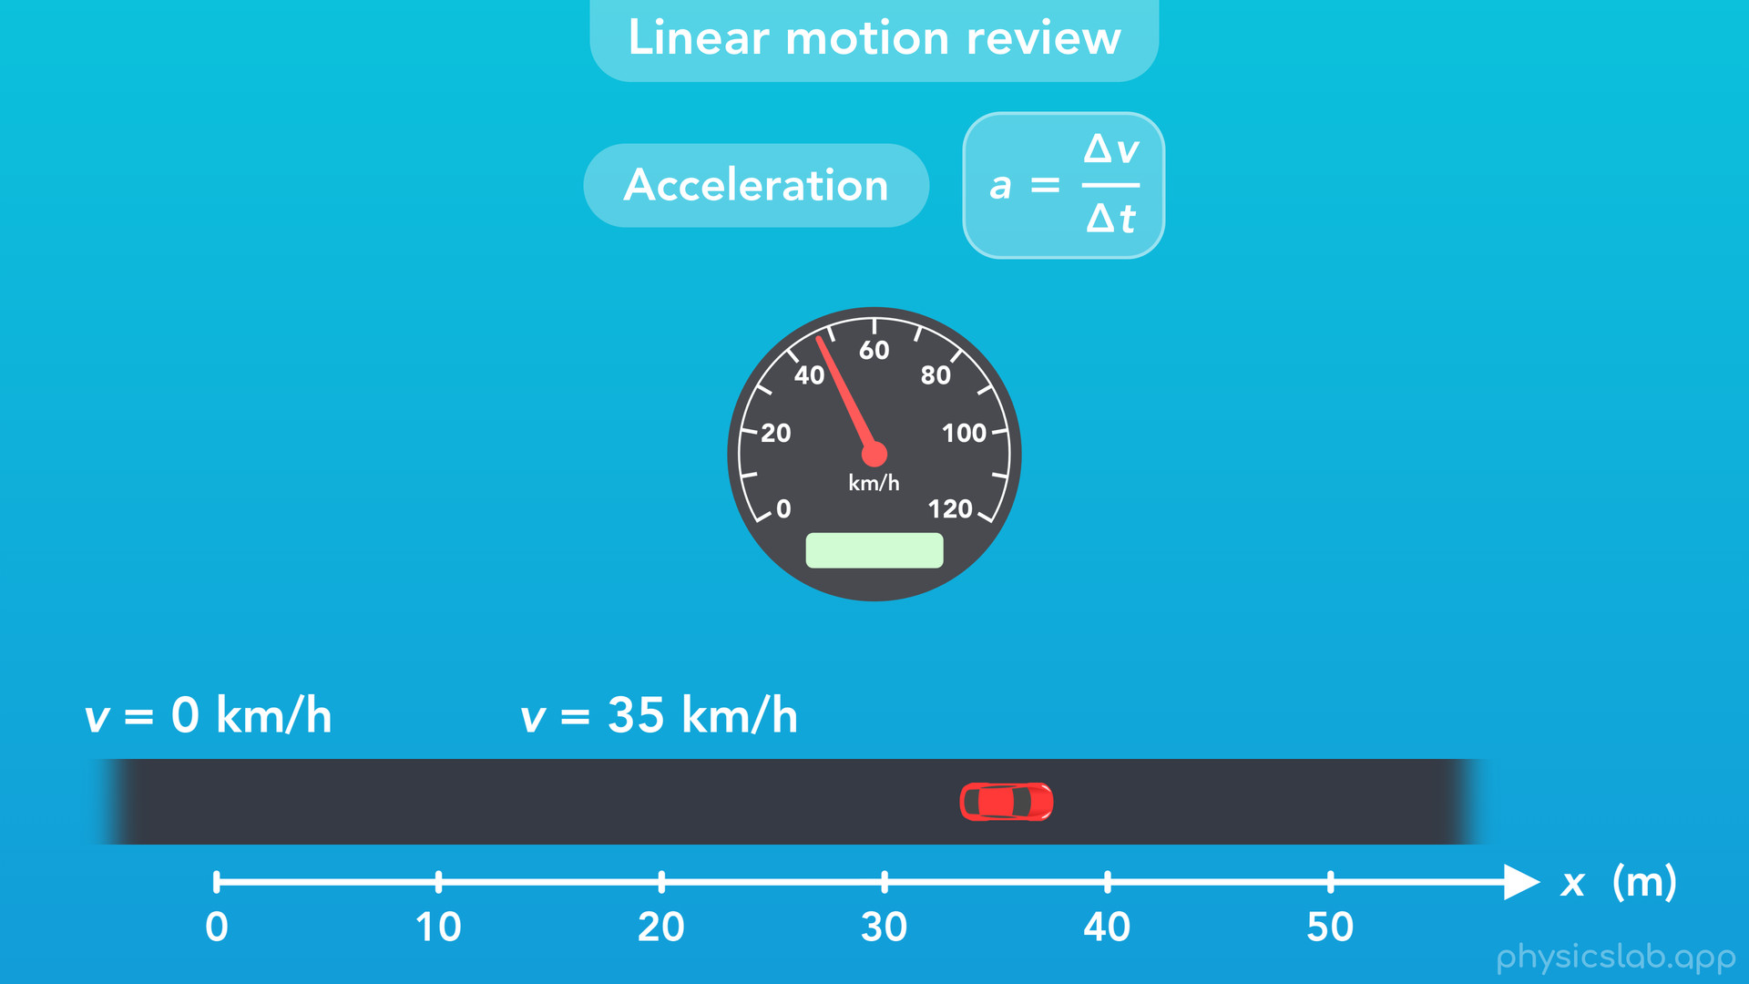

Slide 30
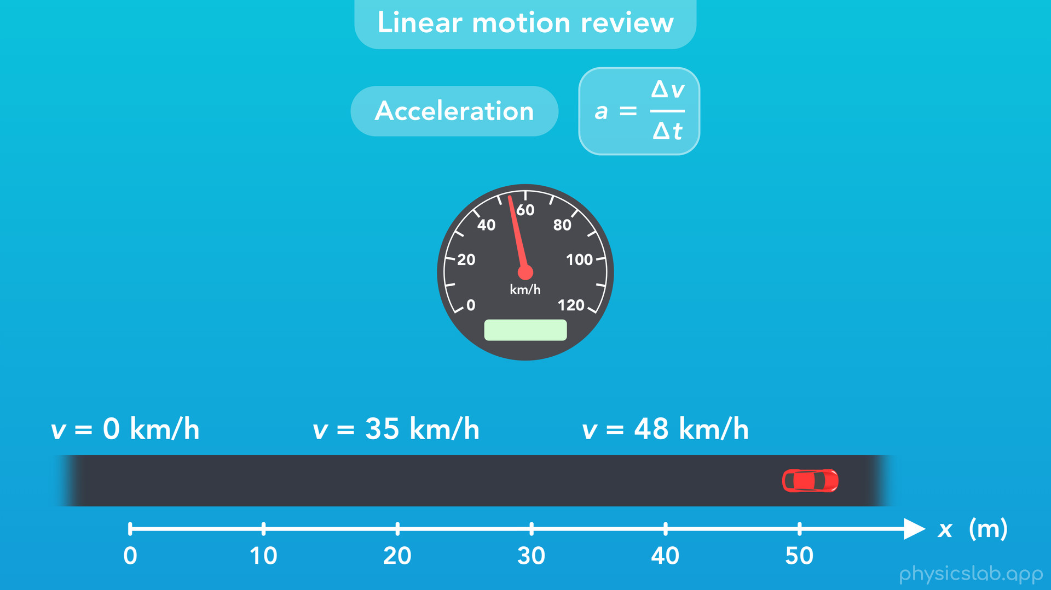

Slide 31
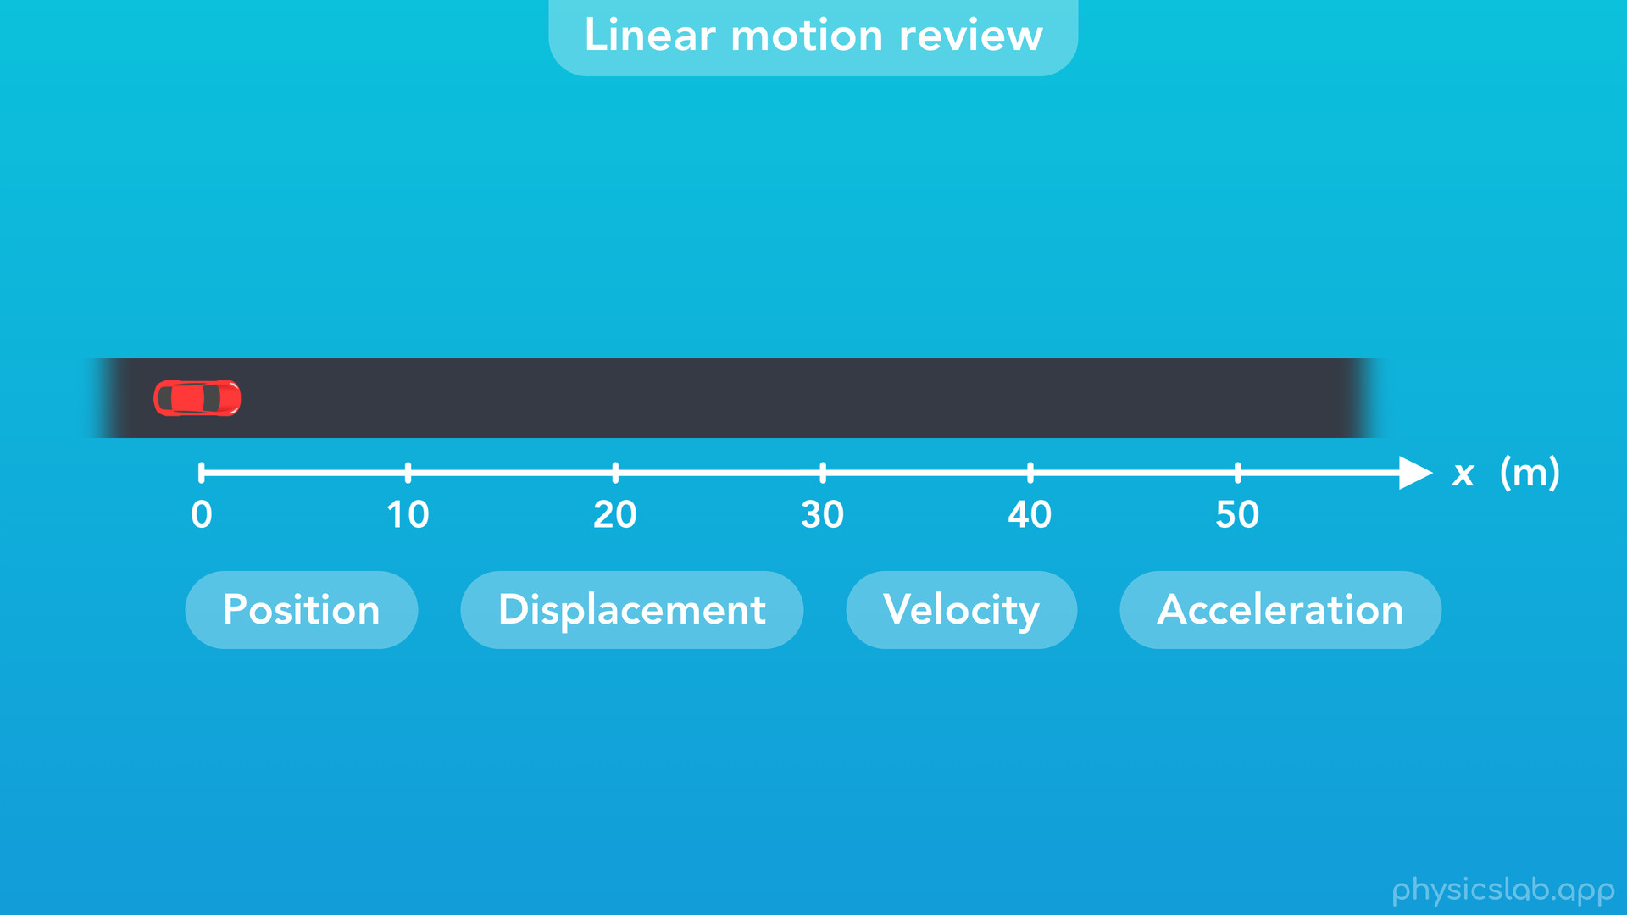
Notes:
○ So in linear motion, the position, displacement, velocity and the acceleration of an object are all described along a straight line, the “x” direction.

Slide 32
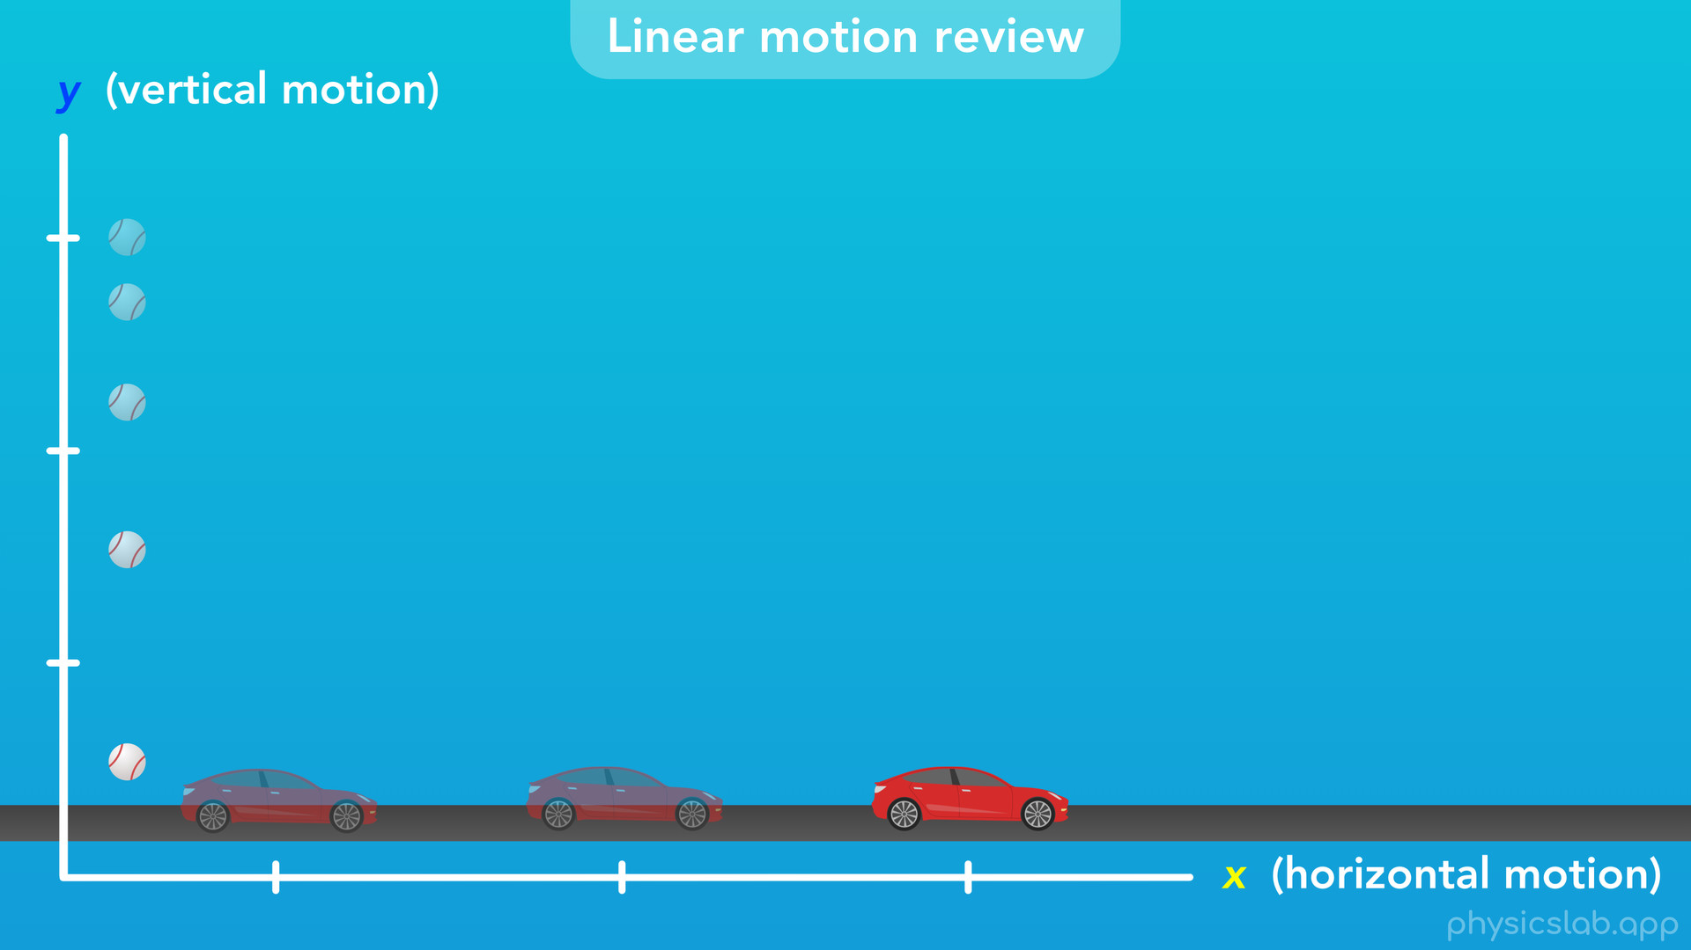
Notes:
○ We normally use the variable “x” to describe horizontal linear motion, and “y” to describe vertical linear motion.

Slide 33
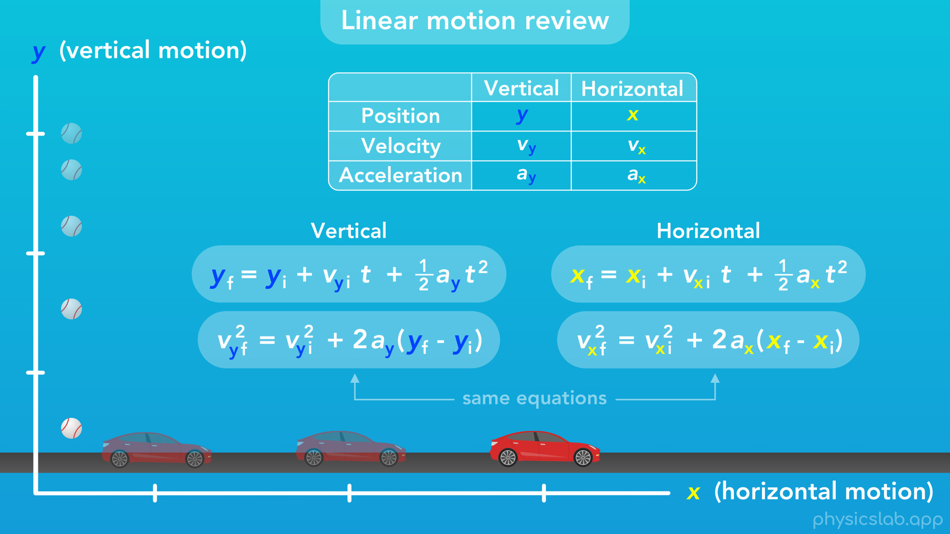
Notes:
So the equations for horizontal motion use “x”, and the equations for vertical motion use “y”. But the variables and equations mean the same thing for both directions. We’re just choosing to describe the motion in a way that’s useful, based on how an object is moving. The math works out the same either way.

Slide 34

Notes:
● Now let’s take a look at how the same things apply to circular motion.

Slide 35

Notes:
○ Let’s start with position and displacement.

Slide 36

Notes:
○ For this video, we’ll use a car driving around a circular track as our example for circular motion.
○ How can we describe the position of the car as it moves?

Slide 37
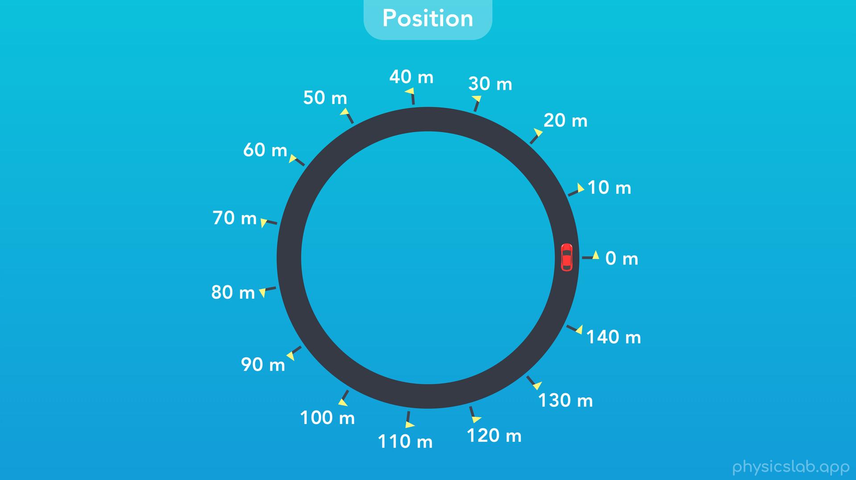
Notes:
One way is to place markers, like flags, at equal distances along the road. Let’s put a flag every 10 meters.

Slide 38
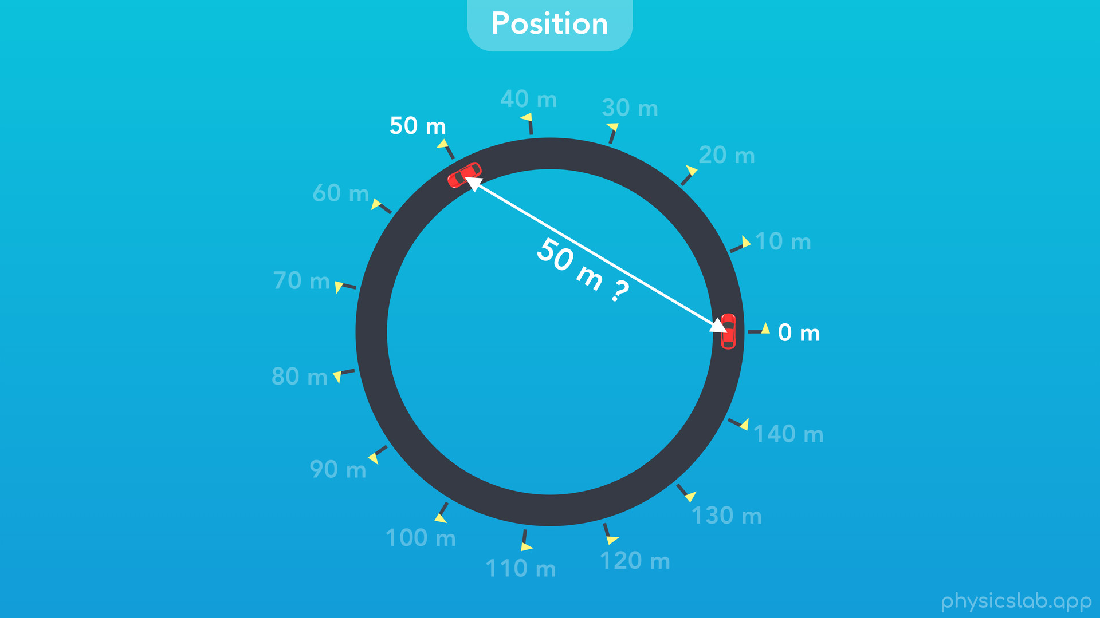
Notes:
○ But how are we measuring these distances? Is the 50 m flag placed at a straight-line distance of 50 m from the starting flag?

Slide 39
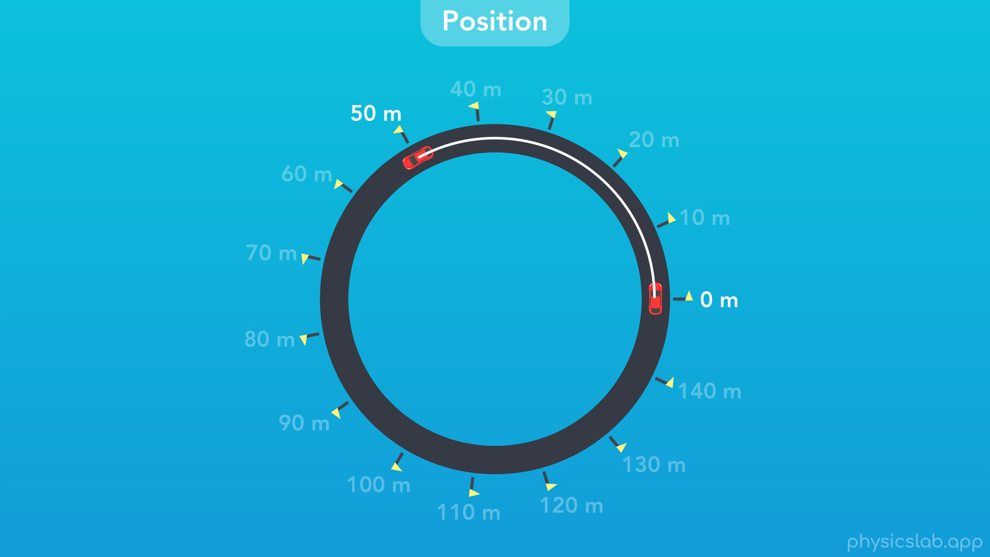
Notes:
Not exactly. 50 m is describing the length of the curved line between the two flags, the line that follows the path of the car, which is the circumference of a circle.

Slide 40
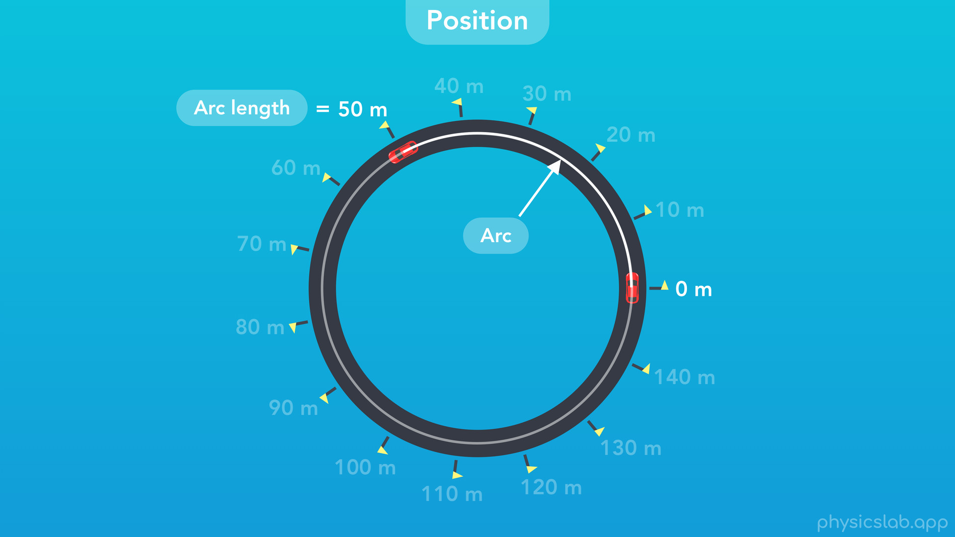
Notes:
A section of a circumference is called an “arc”. And the length of that arc is called the “arc length”. So the length of this arc is 50 m.

Slide 41
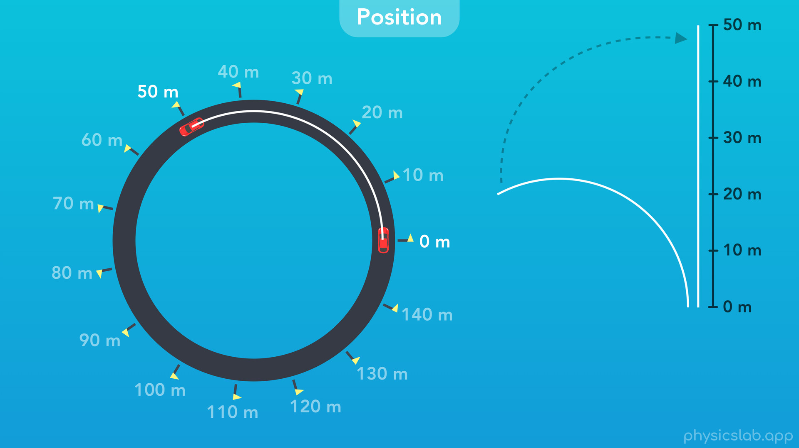
Notes:
○ If we took that arc and straightened it out, as if it were a string, it’s straight length would still be 50 m.

Slide 42
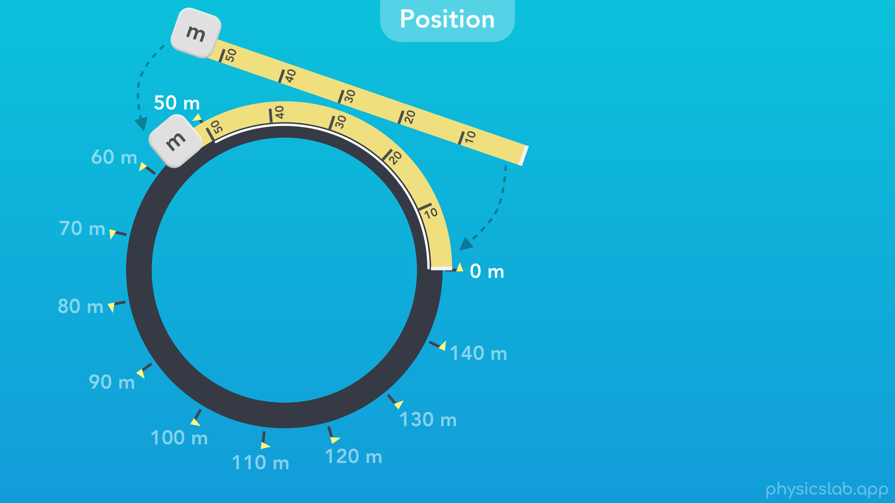
Notes:
○ We could also imagine taking a big tape measure and wrapping it around the road. That would tell us where to place each of these flags.

Slide 43
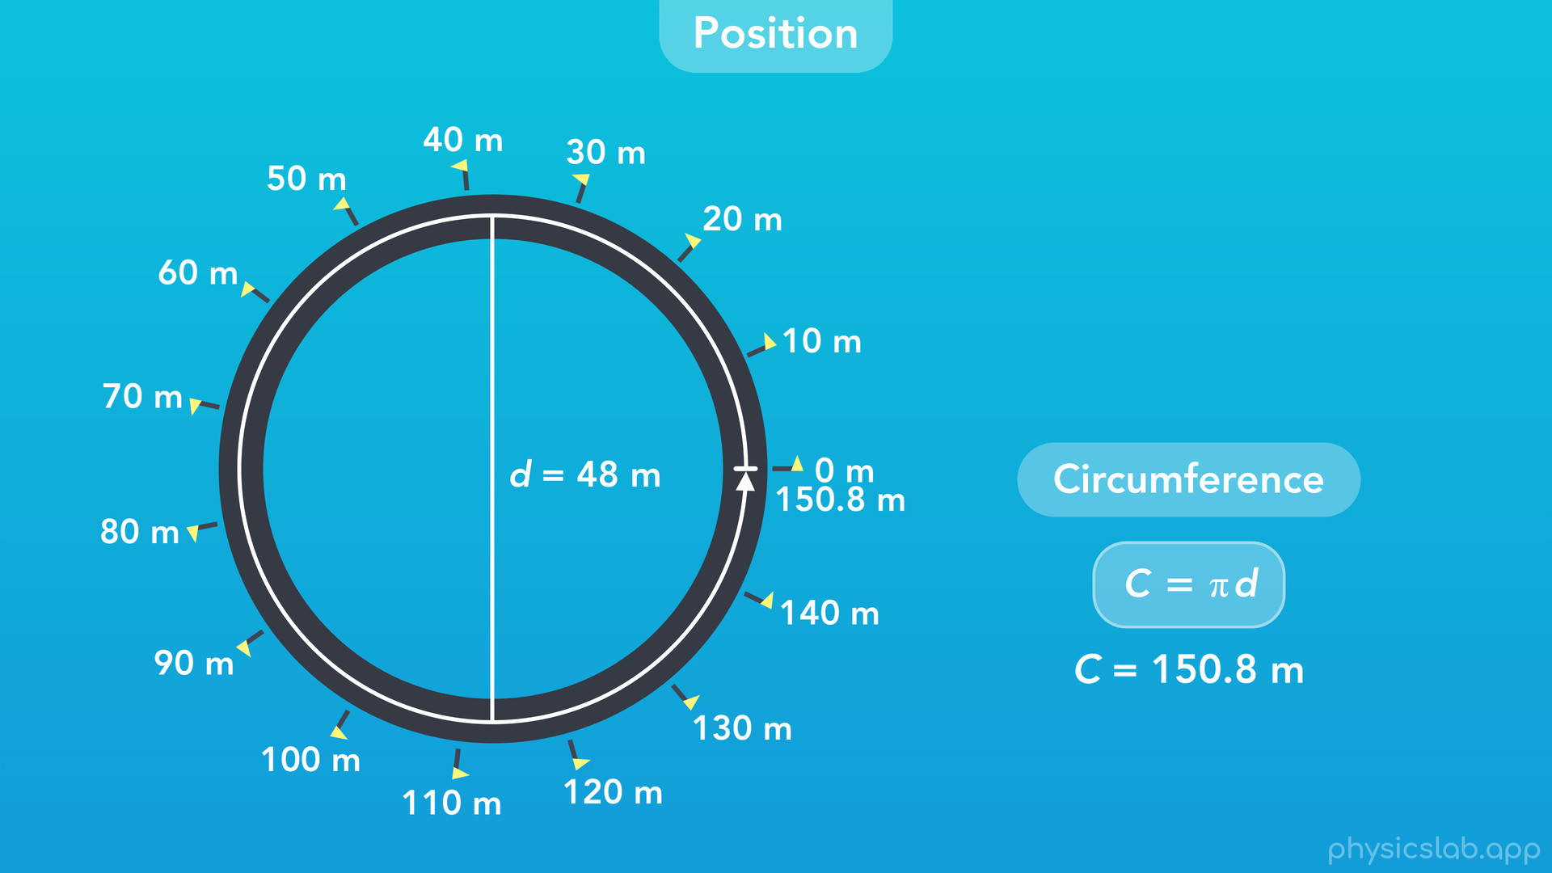
Notes:
○ What would be the length of the entire road? The road is a circle, and the circumference of a circle, C, is pi x the diameter, or 2 x pi x the radius. If the diameter, d, is 48 m, then the circumference is 150.8 m. That’s the total length of the path around this circular road.

Slide 44
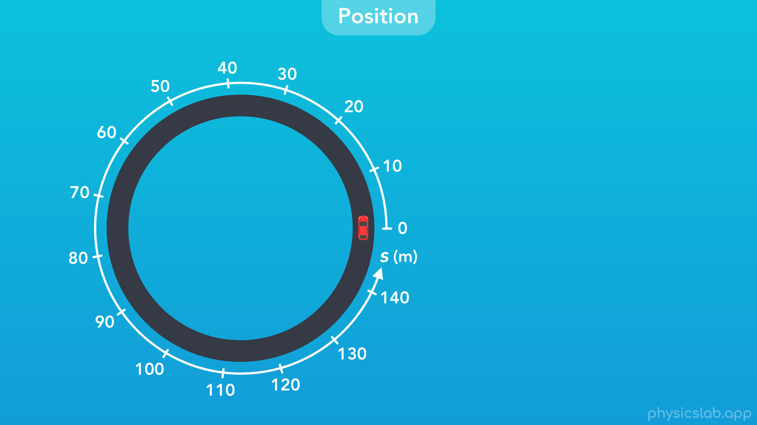
Notes:
○ Instead of using flags, let’s use this curved, circular axis. This is how we’re going to measure position in circular motion.

Slide 45
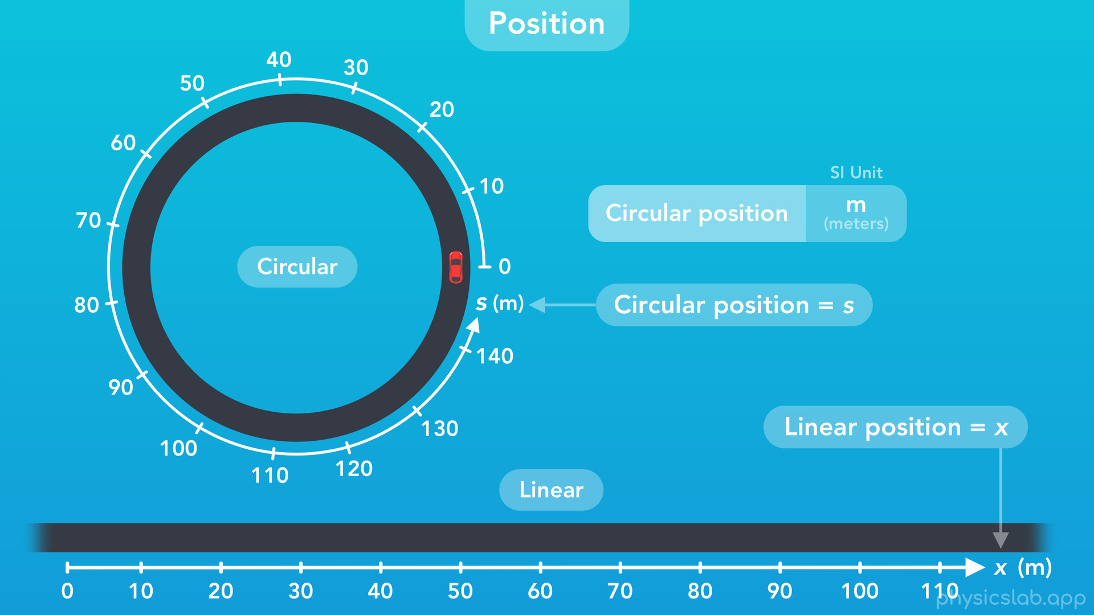
Notes:
This looks similar to the axis for linear motion, but instead, it’s wrapped around in a circle. And instead of using the variable “x” for linear position, we’re going to use the variable “s” for circular position. And just like with linear position, the SI unit for circular position is meters.

Slide 46
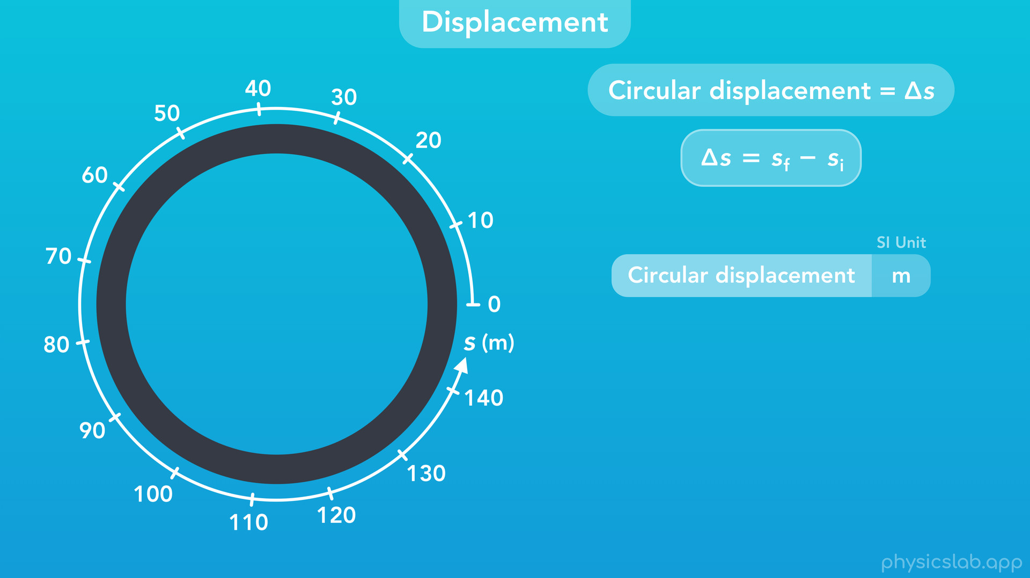
Notes:
○ So that’s position, what about displacement?
○ Just like with linear motion, the displacement of an object in circular motion is the change in position, delta s, which is equal to the final position minus the initial position. The SI unit for displacement is also meters.

Slide 47
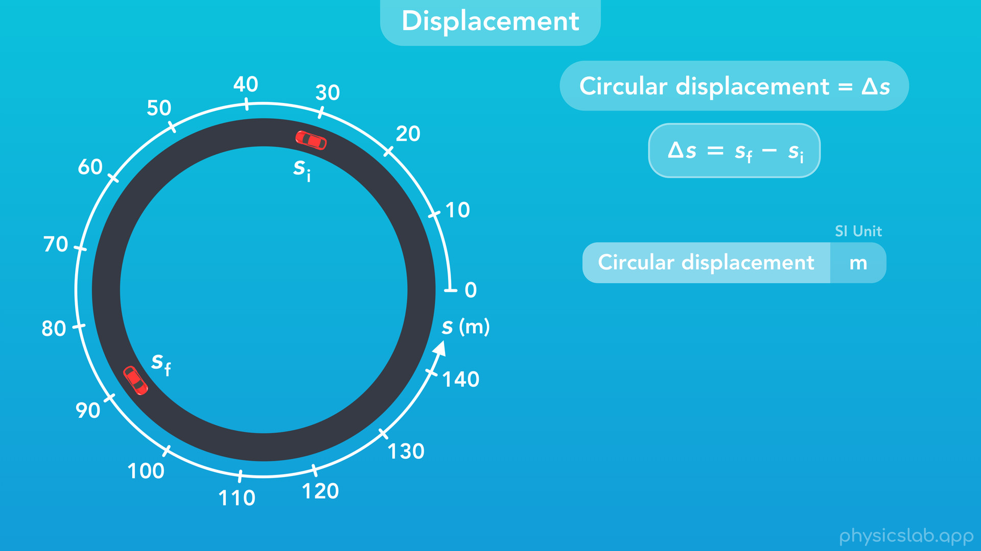
Notes:
○ As an example, if this car started at an initial position of 30 m and moved to a final position of 90 m

Slide 48
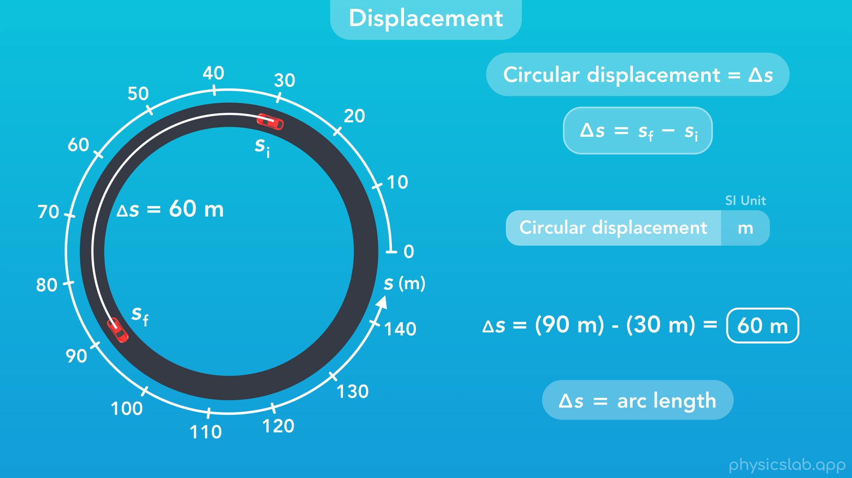
Notes:
then the car’s displacement would be 90 m – 30 m, which equals 60 m. And remember, this displacement is not a straight line between the initial and final points. This is the circular displacement of the car around this circular path. It’s also the length of this arc, which is why we sometimes also refer to delta s as arc length.

Slide 49
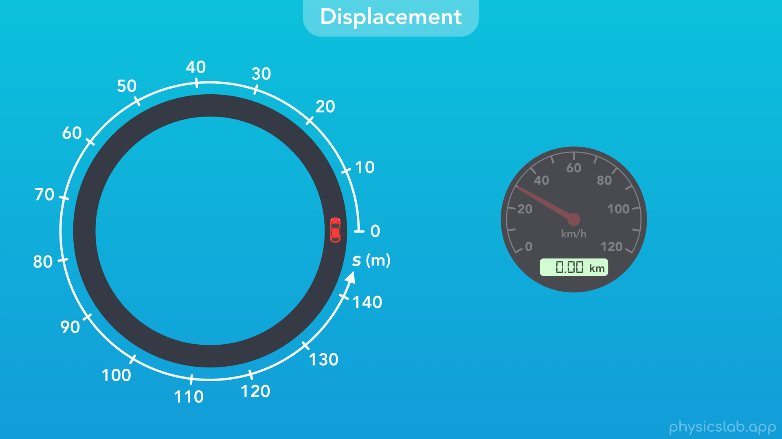
Notes:
○ Like with linear motion, the odometer in the car would show us our displacement along this circular road. The odometer doesn’t know whether we’re driving on a straight road or a curved road, it just measures the distance the car travels along whatever path it takes.
○ Even though this track is only 150.8 m long, what happens to the position and displacement if the car keeps driving around?

Slide 50
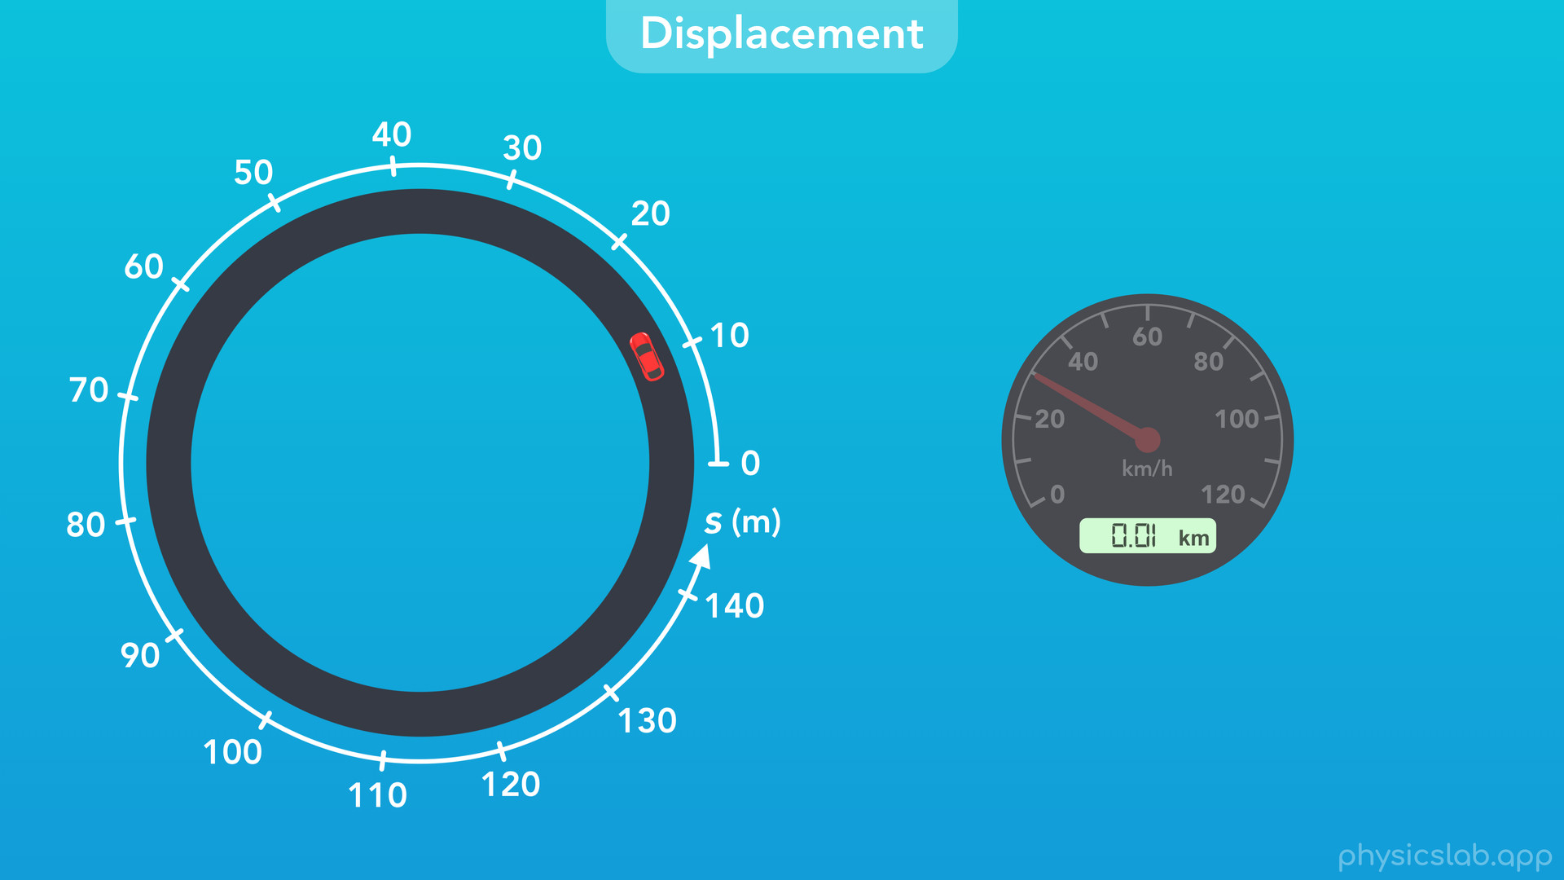

Slide 51


Slide 52
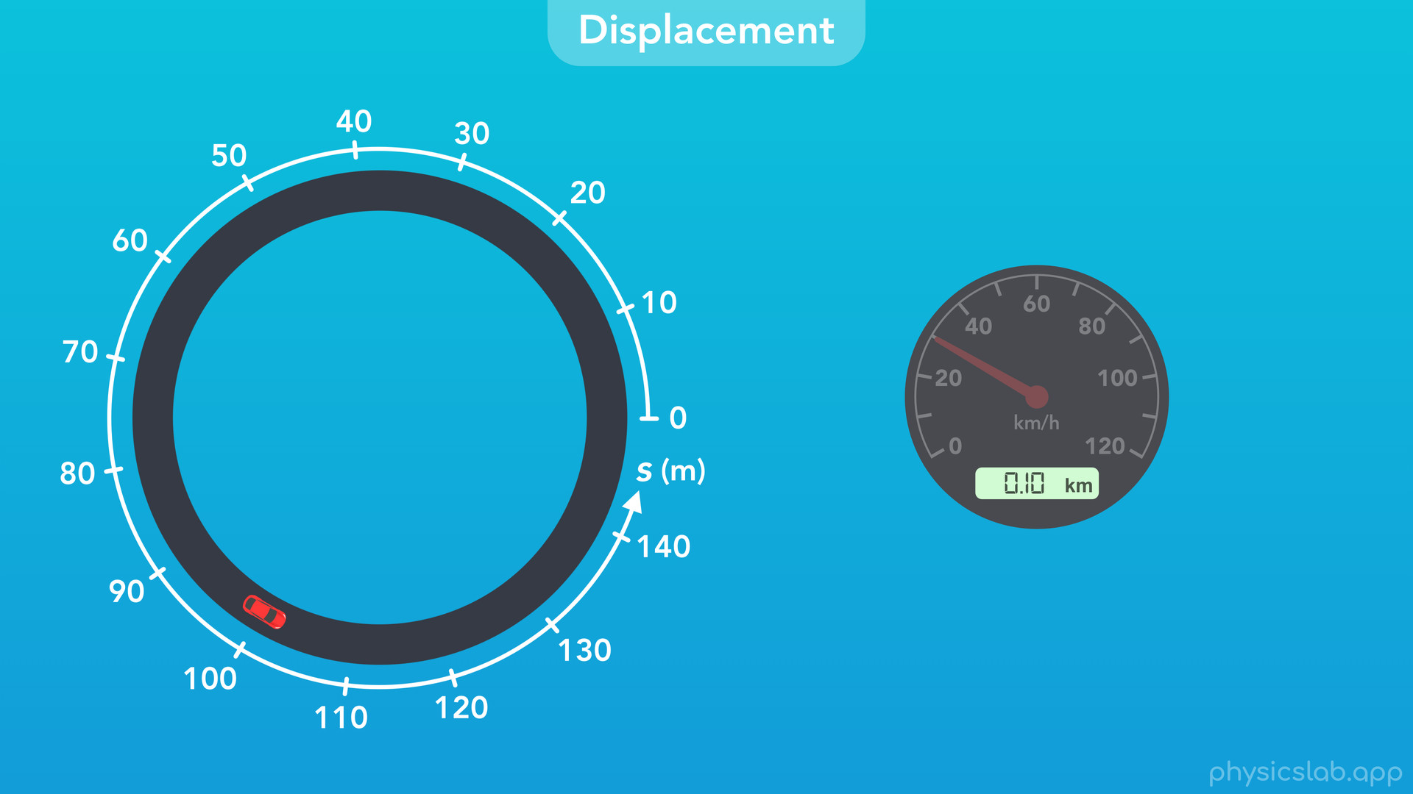

Slide 53

Notes:
The numbers don’t reset back to zero, they keep going up.

Slide 54


Slide 55


Slide 56
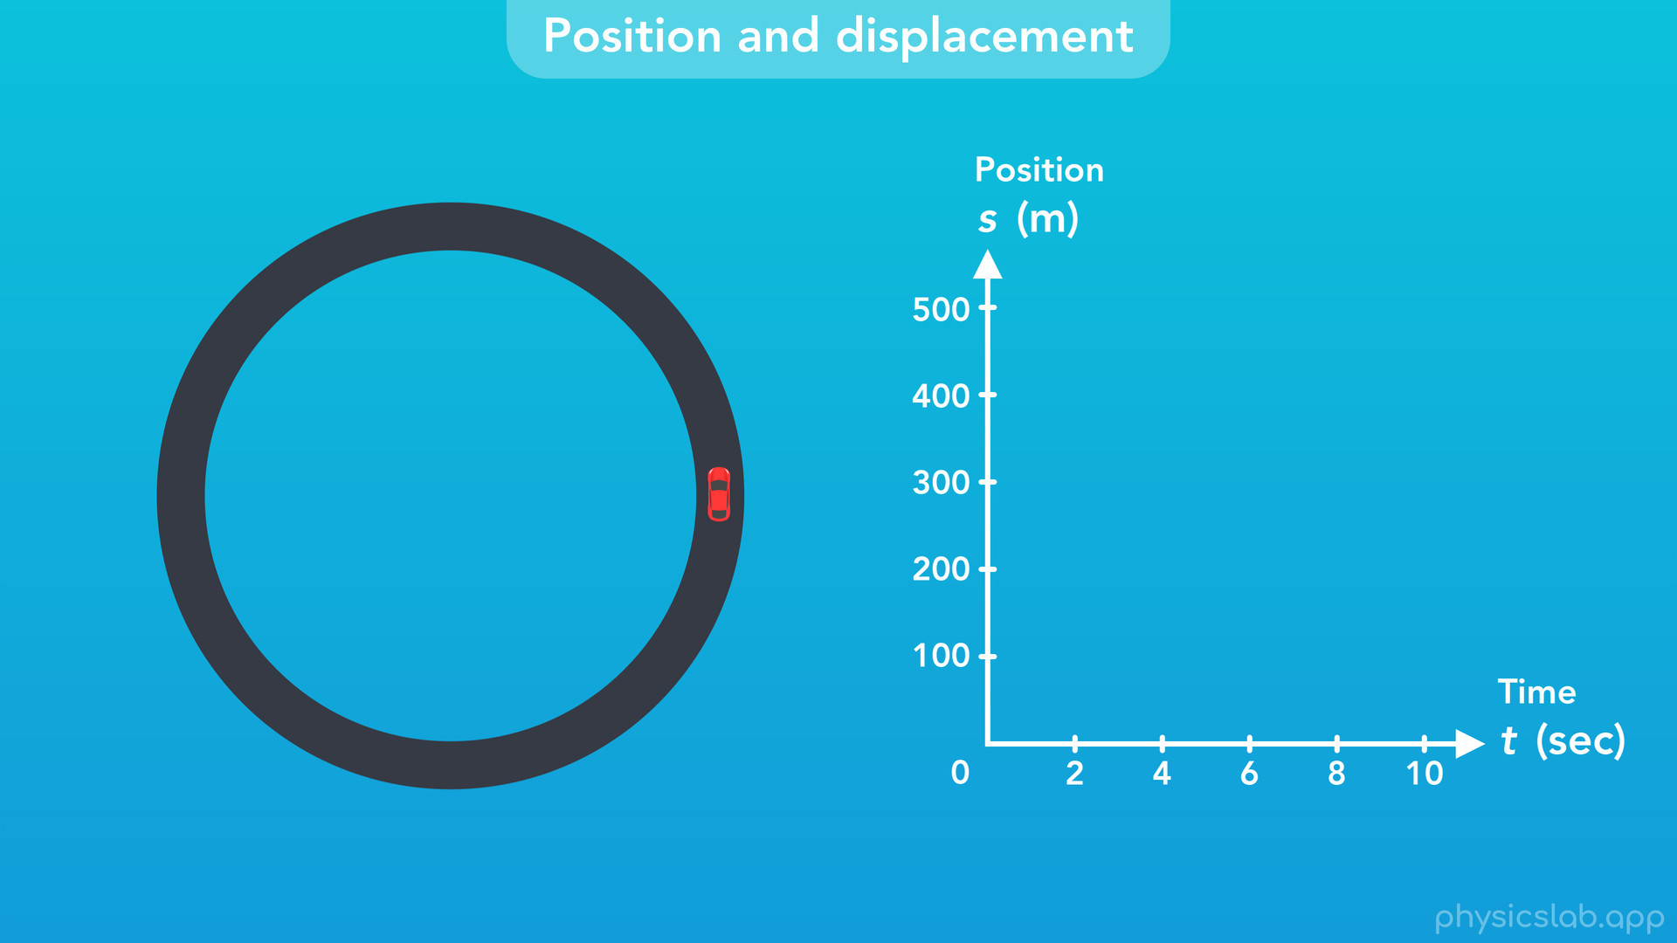
Notes:
○ We can also visualize things is by graphing the circular position of the car over time.

Slide 57
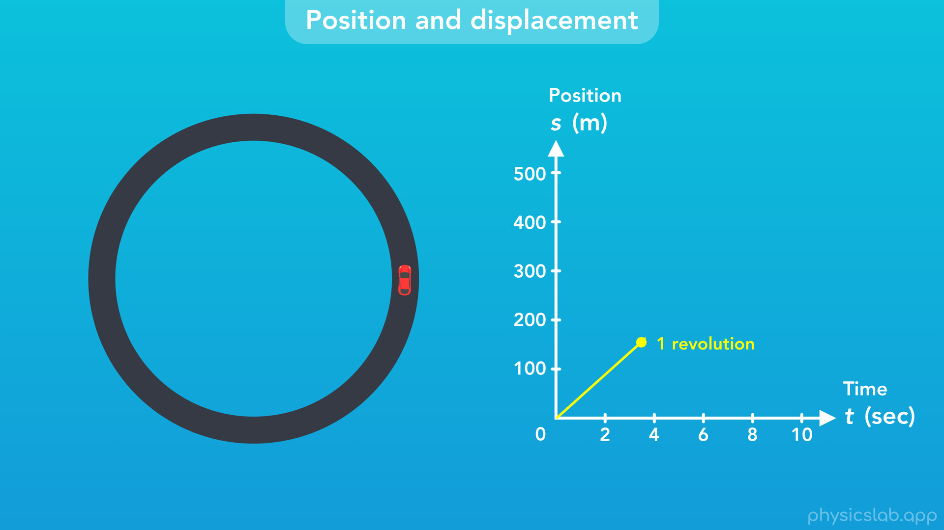
Notes:
After one revolution around this track, the position keeps increasing. It’s like the car is driving on an infinite straight road.

Slide 58
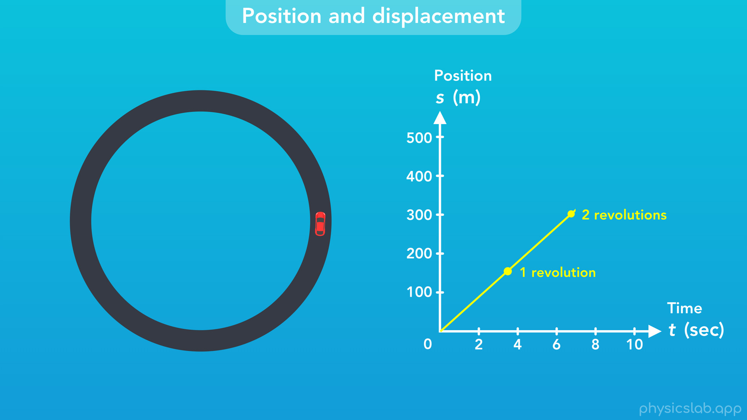

Slide 59
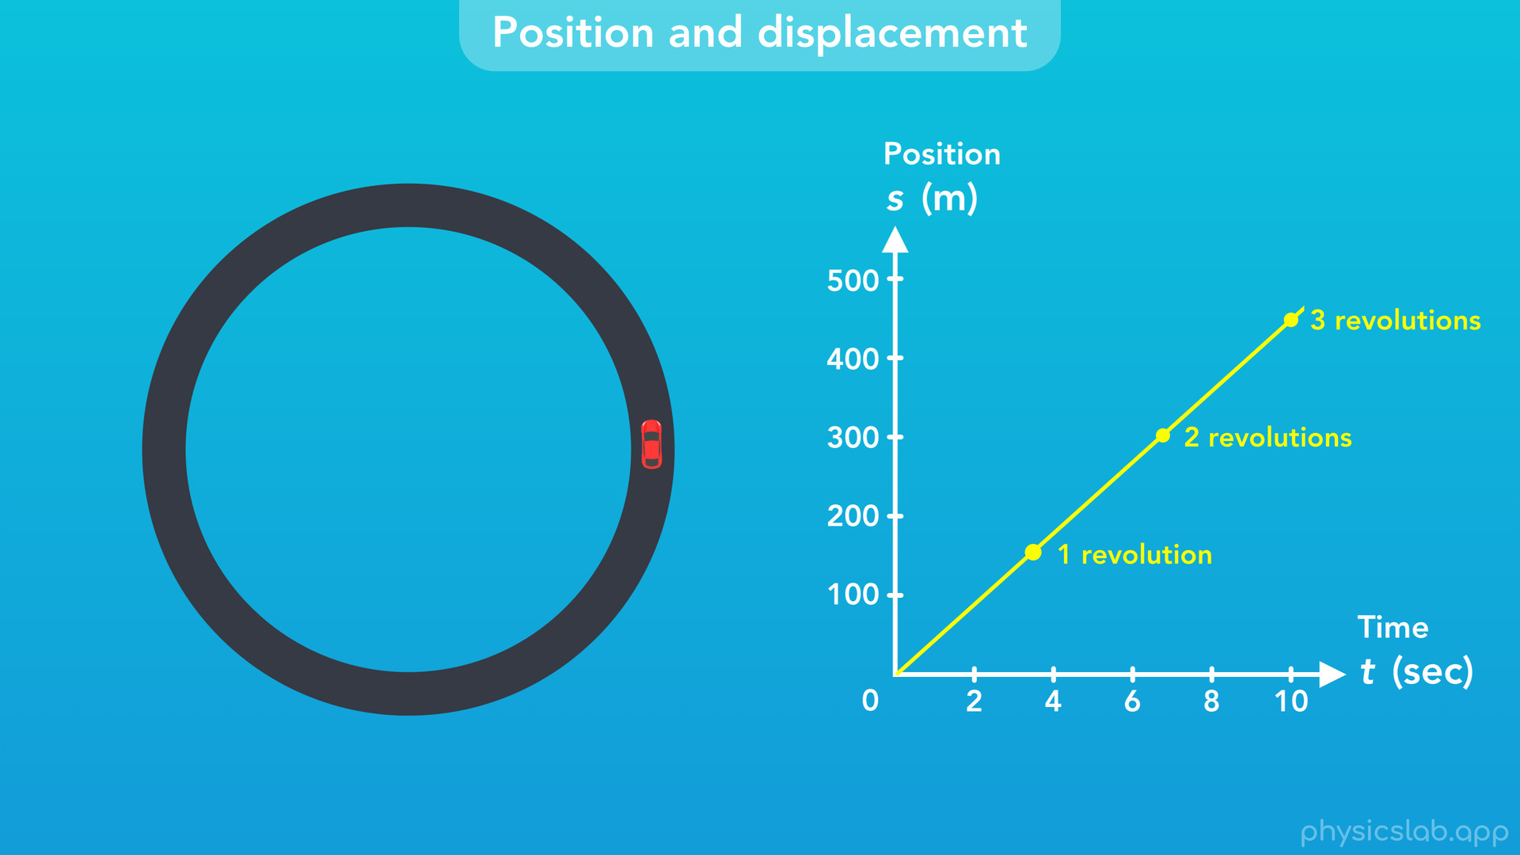

Slide 60
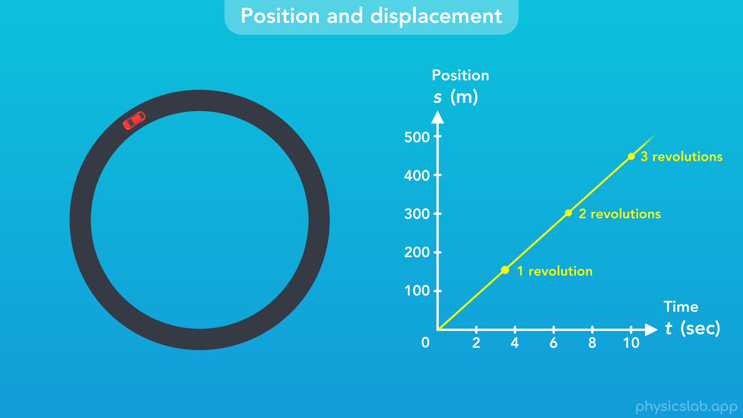

Slide 61
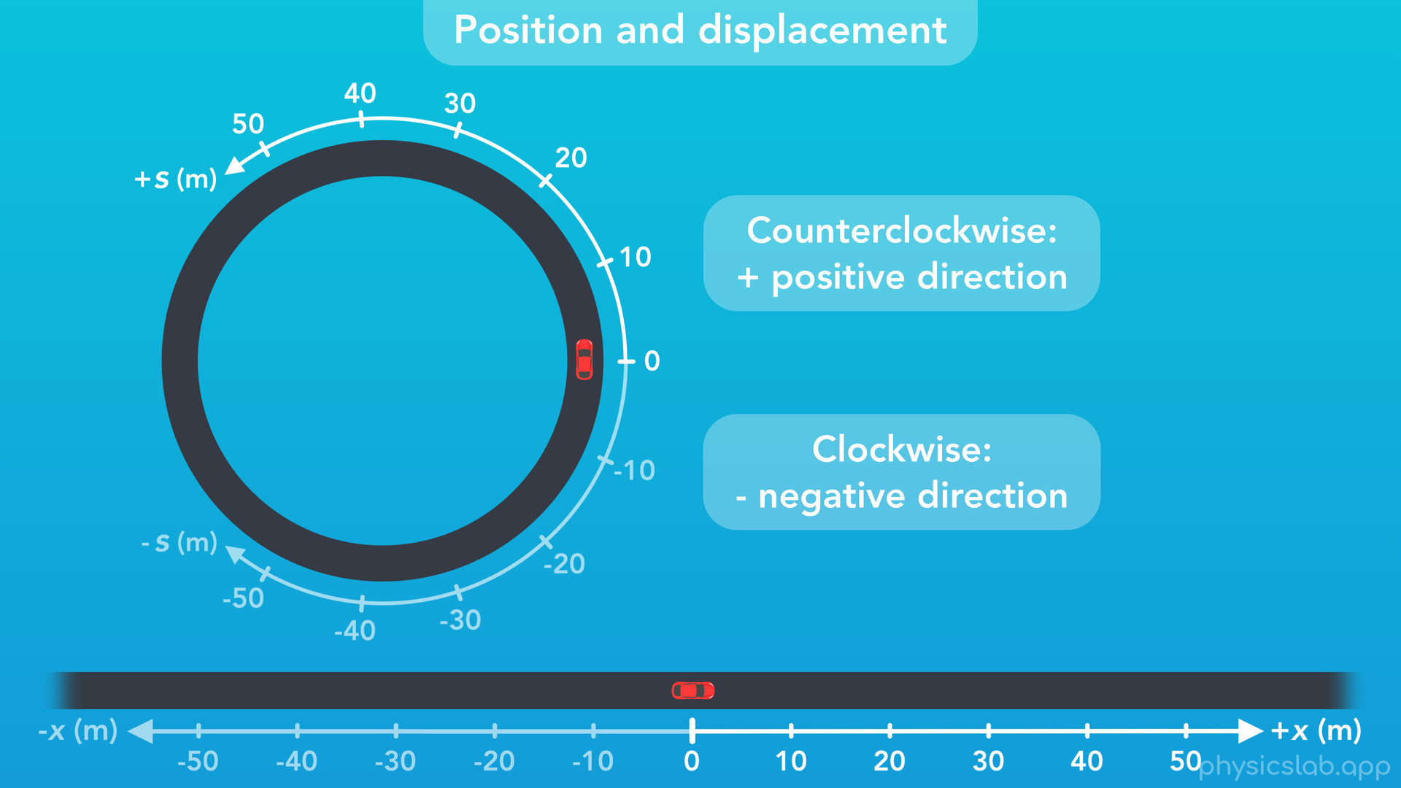
Notes:
○ What if the car drives in the other direction? Like with linear motion, we always define a positive and negative direction when we set up an axis. For circular motion, counter-clockwise (or anti-clockwise) is considered the positive direction, and clockwise is considered the negative direction. There may be situations where that’s not the case, but if we’re not told which direction is positive, we’re going to assume it’s counterclockwise.

Slide 62
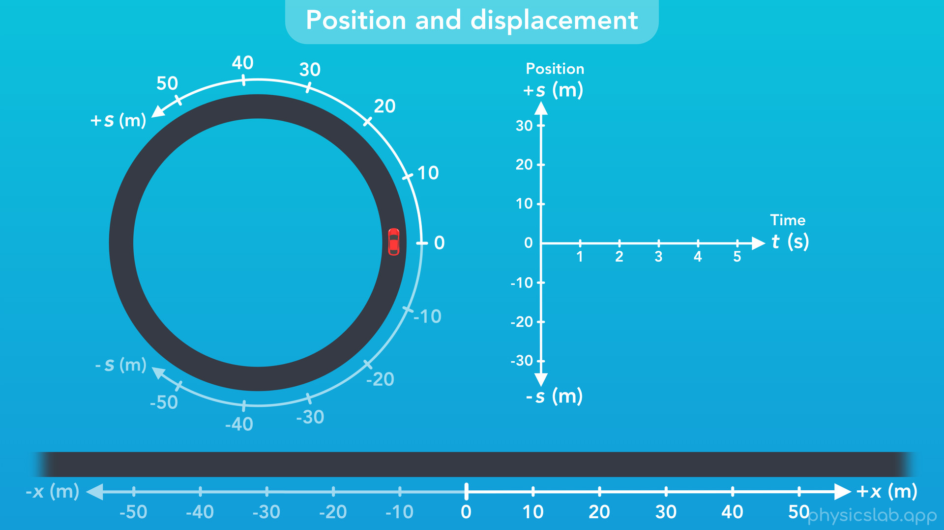
Notes:
○ As an example, if we graph the position of this car

Slide 63
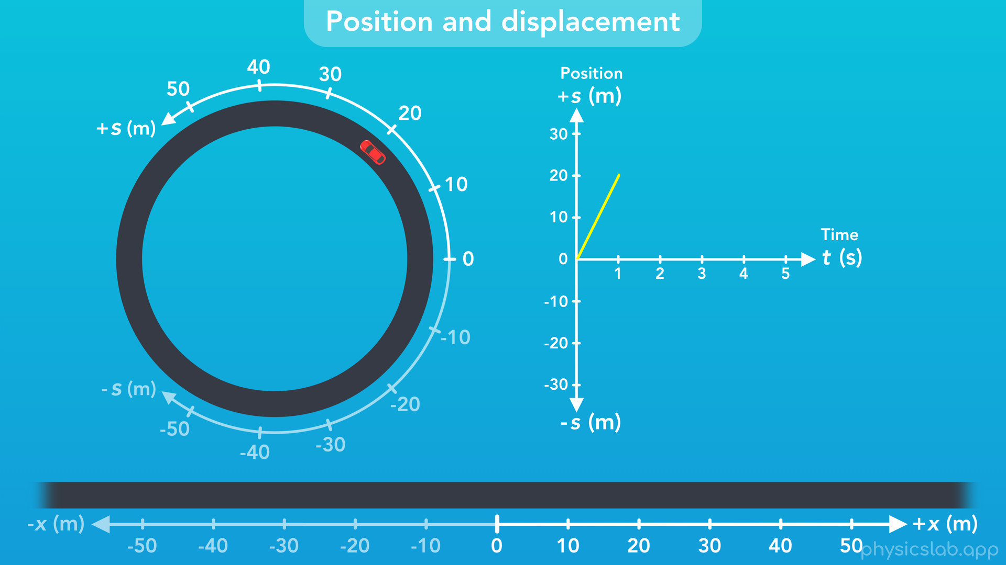
Notes:
we can see the car moves to positive 20 m

Slide 64

Notes:
stops

Slide 65
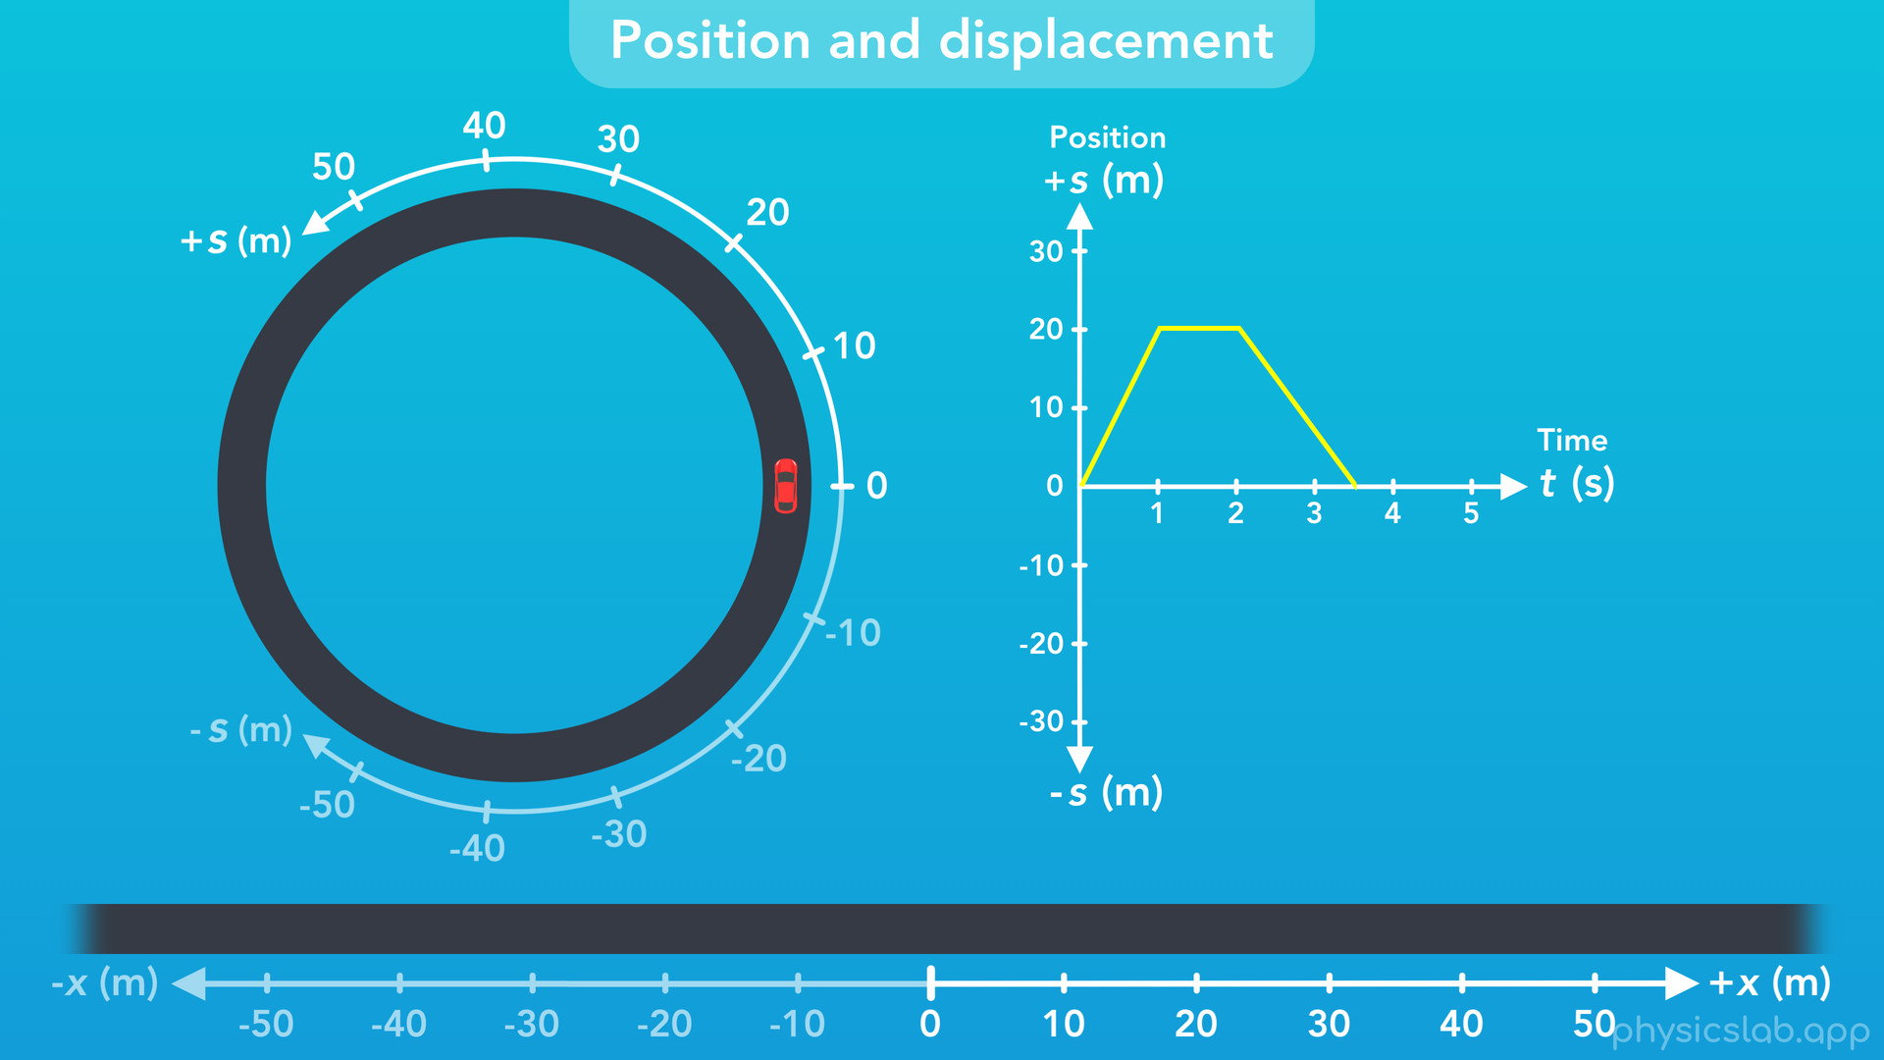
Notes:
reverses direction

Slide 66

Notes:
and moves to negative 20 m. The object can move as far as it wants in the positive or negative direction, and we measure its position relative to the initial zero point that we established.
So that’s how we describe position and displacement for circular motion.

Slide 67

Notes:
○ Now let’s talk about tangential velocity.

Slide 68

Notes:
○ Like linear velocity, tangential velocity is the circular displacement of an object divided by a period of time. We still use the variable “v” for velocity, and we use the subscript “t” to mean tangential, which we’ll explain soon.

Slide 69

Notes:
The SI unit for tangential velocity is m/s, the same as linear velocity.

Slide 70

Notes:
○ As an example, if this car drove 80 m around the track in 10 sec, then the car’s tangential velocity was 80 m / 10 s which is 8 m/s, or about 29 km/h. The speed gauge in the car would display the car’s tangential velocity. Remember, the gauge doesn’t know the car is driving in a circle, it just measures the velocity of the car along whatever path it’s following.

Slide 71

Notes:
○ Now, let’s talk about the difference between tangential speed and velocity.

Slide 72

Notes:
Remember that speed is a scalar. It only includes the magnitude of the velocity, and it’s always a positive number. But velocity is a vector. It includes both a magnitude and a direction, and it can be positive or negative.

Slide 73

Notes:
If a car’s speed is 30 km/h, the velocity needs a direction. For circular motion, that can only be 30 km/h counterclockwise or clockwise. Or instead, we could say positive or negative 30km/h based on our axis, where the positive and negative tell us the direction. So what does that look like?

Slide 74

Notes:
○ If this car is driving in a circle with a constant speed of 30 km/h, we could say that the velocity of the car is 30 km/h clockwise.

Slide 75

Notes:
But, we’re usually going to set up a circular axis to describe the motion, and we’re going to establish the positive and negative directions up front. Conventionally, clockwise is the negative direction, so based on this axis the velocity of the car would be negative 30 km/h.

Slide 76

Notes:
If the car was driving counterclockwise, then we would say the velocity is positive 30 km/h.
When talking about direction, there’s another thing we need to cover. Why do we call this the tangential velocity?

Slide 77

Notes:
○ It comes from geometry. For any point on a curved line or a circle

Slide 78

Notes:
a tangent line is a line that passes through that point and matches the slope or the curvature of the line at that point. For a point on a circle, the tangent line will only touch the circle at that one point.

Slide 79

Notes:
If we draw a line from that point to the center of the circle, the tangent line will be perpendicular to this radius line.

Slide 80

Notes:
And as this point moves around the circle, the tangent line rotates and always remains tangent to the circle.

Slide 81

Notes:
○ So as this car drives around in a circle, the direction the car is pointing always falls onto a line that is tangent to the circular path, so we call this the tangential velocity.

Slide 82

Notes:
○ You might also hear this referred to as the linear velocity of an object in circular motion, because we’re describing the object’s velocity along this tangent line at a given instant. From the car’s point of view, its motion is being described as if the circular path was straightened out into a line.

Slide 83


Slide 84

Notes:
○ So, while it’s fair to say that the direction of the car’s velocity is counterclockwise while it’s moving

Slide 85

Notes:
we can also describe the direction of the velocity at a single moment in time. This is what we call the instantaneous velocity, and it refers to the direction of the velocity vector, this arrow, at an instant in time.

Slide 86

Notes:
○ Let’s use a compass to help us describe it. If we pause time when the car is here, what direction is the car moving?

Slide 87

Notes:
At this moment, the car is moving upwards, which is north. So, the car’s velocity at this instant is 30 km/h north.

Slide 88

Notes:
If we pause time when the car is here, the car is moving to the left, so the velocity of the car at this time is 30 km/h west.

Slide 89

Notes:
Here, the car’s velocity is 30 km/h south.

Slide 90

Notes:
And here, it’s 30 km/h east.

Slide 91

Notes:
○ The direction of the instantaneous velocity is not important when we’re using the equations for circular motion from this video. It’s enough to describe the velocity as counterclockwise or clockwise, which is positive or negative. But, the direction of the instantaneous velocity is a concept that you’ll be expected to know.

Slide 92

Notes:
○ The last thing to cover is tangential acceleration.

Slide 93

Notes:
○ Like linear acceleration, tangential acceleration is the change in the tangential velocity divided by a period of time.
○ And we represent tangential acceleration as “a sub t”, “a” for acceleration and “t” for “tangential”. The SI unit is m/s2, the same as for linear acceleration.

Slide 94

Notes:
○ If this car starts with a tangential velocity of 0 km/h and then it speeds up over time, then the car is experiencing tangential accelerating.

Slide 95


Slide 96


Slide 97


Slide 98


Slide 99


Slide 100

Notes:
It’s important to remember that the term acceleration means a change in velocity, not necessarily an increase in velocity. If a car has a velocity of 100 km/h and slows down, that’s also considered acceleration, because it’s a change in velocity. In that example, the acceleration would be negative, but it’s still considered acceleration, just like velocity can be positive or negative.

Slide 101


Slide 102


Slide 103


Slide 104

Notes:
○ Let’s try calculating tangential acceleration. This car starts with zero velocity and then accelerates around the circle.

Slide 105

Notes:
Over 10 seconds, the car’s velocity changes from 0 m/s to 8 m/s, about 29 km/h.

Slide 106

Notes:
The tangential acceleration would be the change in velocity, 8 m/s – 0 m/s, over the period of time, 10 s. That gives us 8 m/s divided by 10 s, which equals 0.8 m/s per second. The unit meters per second per second is the same as meters per second squared.

Slide 107


Slide 108

Notes:
○ If someone says their car can do 0-60 mph in 4 seconds, or maybe 0-100 km/h in 4 seconds, their describing the acceleration of their car. If the car is traveling in circular motion, it would be the tangential acceleration of the car, which is the change in tangential velocity, divided by a period of time. This tangential acceleration of a car driving around a circular track is not that different from a car on a straight road. The tangential acceleration of an object in circular motion is just the acceleration along the path it’s following.

Slide 109

Notes:
○ Finally, let’s look at the 2 other kinematic equations for an object with a constant acceleration. These should look familiar.

Slide 110

Notes:
○ The first equation tells us that for an object in circular motion with a constant acceleration, the final position is equal to the initial position + the initial tangential velocity * time + 1/2 * the tangential acceleration multiplied by the time squared. This is useful for things like finding the position of an object in circular motion after it accelerates for a given period of time.

Slide 111

Notes:
○ The second equation tells us that for an object accelerating in circular motion, the final tangential velocity squared = the initial tangential velocity squared + 2 * the acceleration * the displacement (or the final minus the initial positions). That one can help us find things like the tangential velocity of an object in circular motion after accelerating over a given displacement.

Slide 112

Notes:
○ These should look familiar because they’re the same kinematic equations from linear motion. All we’re doing is changing the variables to represent the circular direction instead of the linear direction.

Slide 113

Notes:
For position, we’re using “s” for circular motion and “x” for linear motion.

Slide 114

Notes:
Displacement is the final position – the initial position.

Slide 115

Notes:
Velocity is the change in position over time.

Slide 116

Notes:
Acceleration is the change in velocity over time.

Slide 117

Notes:
The first kinematic equation is the same for both,

Slide 118

Notes:
and so is the second equation. Again, all we’re changing is the variables to represent one motion or the other, but the equations work the same way.

Slide 119

Notes:
○ So that’s everything we’re gonna cover, what should we be expected to know from this video?

Slide 120

Notes:
○ First, this lesson focused on objects in circular motion and how to use the tangential description of motion.

Slide 121

Notes:
○ These are the variables we learned and their SI units.
○ Here are the equations we covered. The first three are what we would call the definitions of tangential displacement, velocity and acceleration. The last two are the kinematic equations that we can use for an object with a constant acceleration. All of these equations are the same ones from linear motion, except they use the variables for the tangential description of motion that we see here.

Slide 122

Notes:
○ When we describe the position of an object in circular motion, it’s like taking a linear axis and wrapping it around in a circle.

Slide 123

Notes:
Conventionally, counterclockwise is the positive direction and clockwise is the negative direction.

Slide 124

Notes:
And remember, the position will continue to increase, or decrease, as the object travels more than one revolution.

Slide 125

Notes:
○ Tangential speed is a scalar, and only includes magnitude, and tangential velocity is a vector, which includes magnitude and direction. We call this motion “tangential” motion because the direction of the objects velocity is always tangent to the circular path an any instant in time.

Slide 126

Notes:
○ And just like with linear motion, the tangential acceleration is just the change in tangential velocity over time.

