Slide 1
Static Friction
Slides Version 2
This version includes:
Slides with screenshot images from the video.
The video narration in the slide notes.
A blank template slide with the same background and font as the video.
Slides with some basic graphics from this video for you to use however you like.
Feel free to add, delete and edit slides to make your own presentation. You can use these slides in class or share them with your students, but please do not share them with anyone else.
If you have any feedback, suggestions or questions about these slides please email me at chris@physicslab.app or send me a message on Discord @physicslab.
physicslab.app

Slide 2
Heading
Text

Slide 3









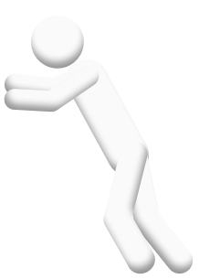



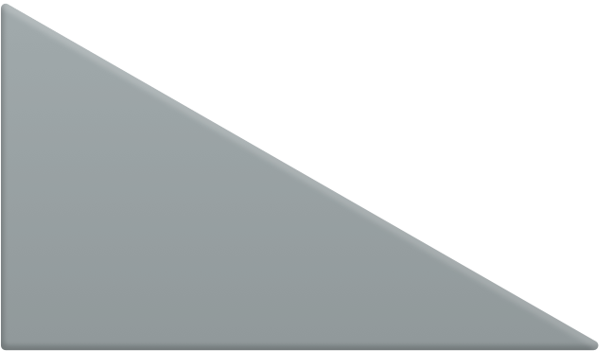








Slide 4

















Slide 5

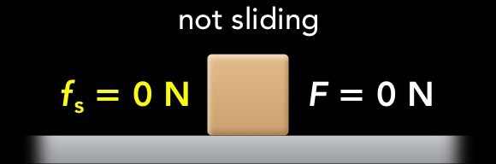
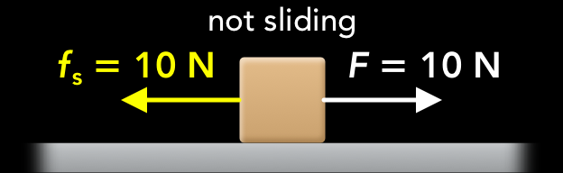

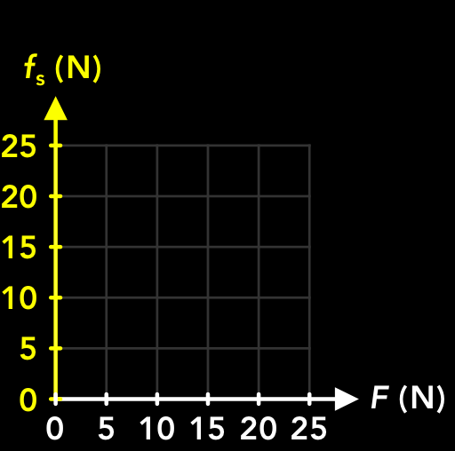
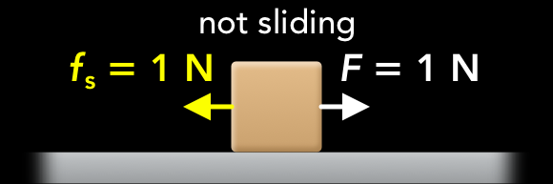
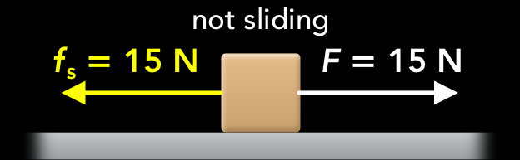
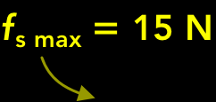

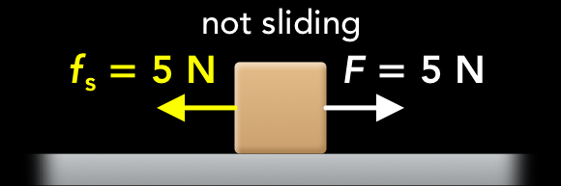


Slide 6
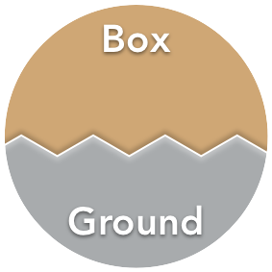



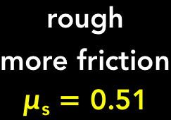
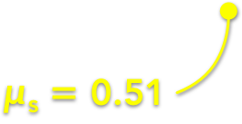




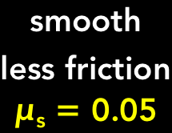
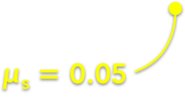

Slide 7


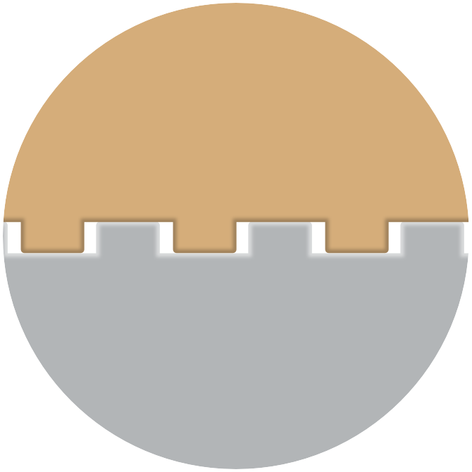
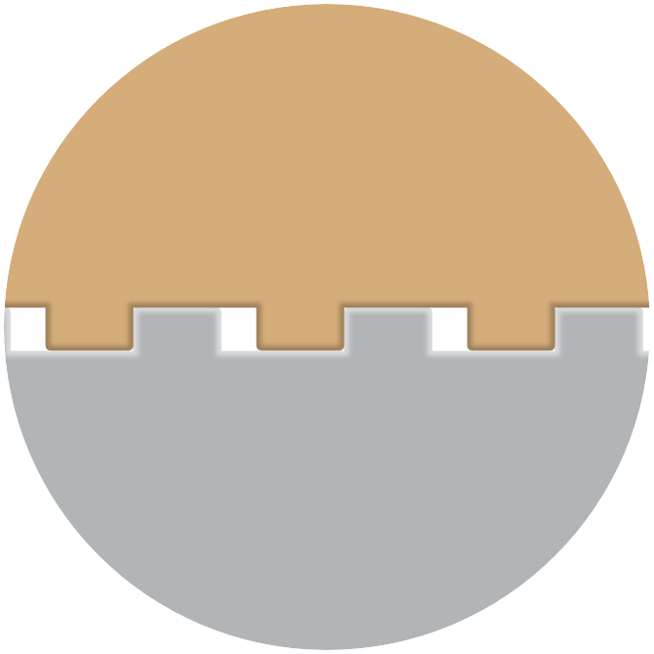

Slide 8



Slide 9
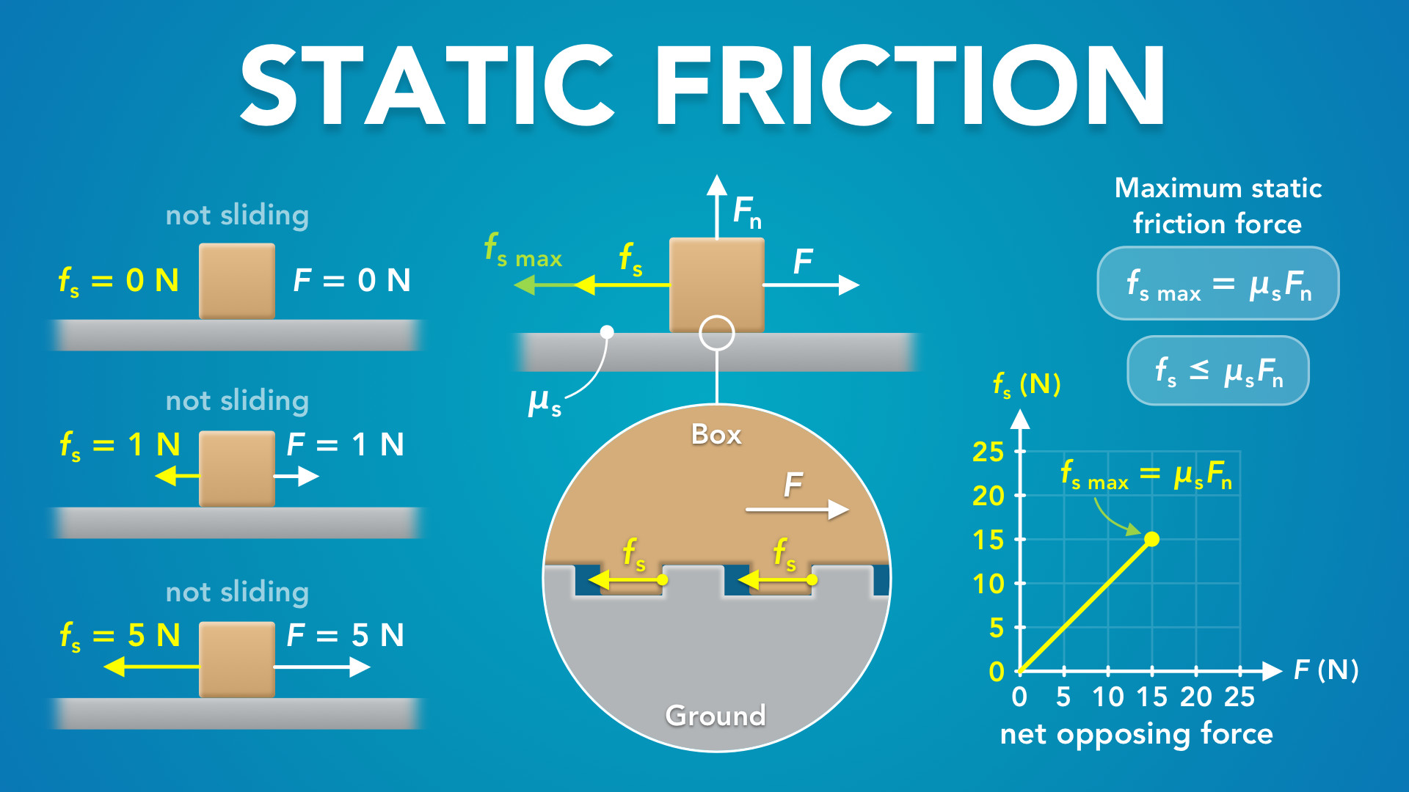
Notes:
Static Friction
physicslab.app
If you have any questions, suggestions or feedback about these slides please email me at chris@physicslab.app or send me a message on Discord @physicslab.

Slide 10
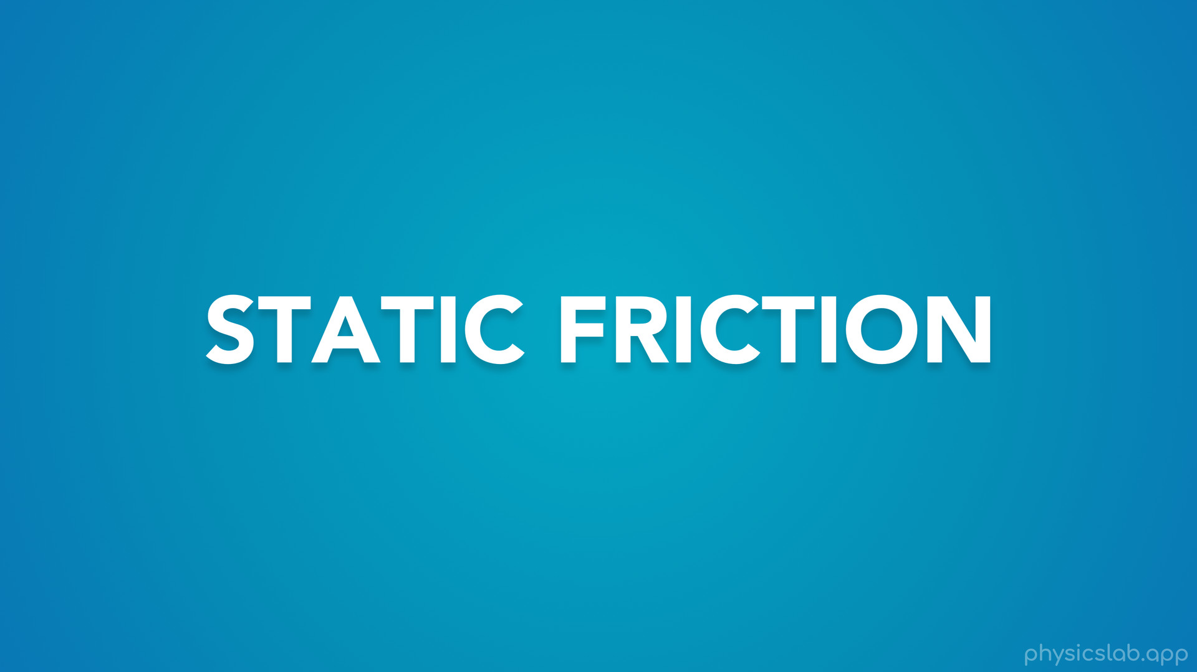
Notes:
• Hey everyone! In this video we’re gonna learn about static friction.

Slide 11
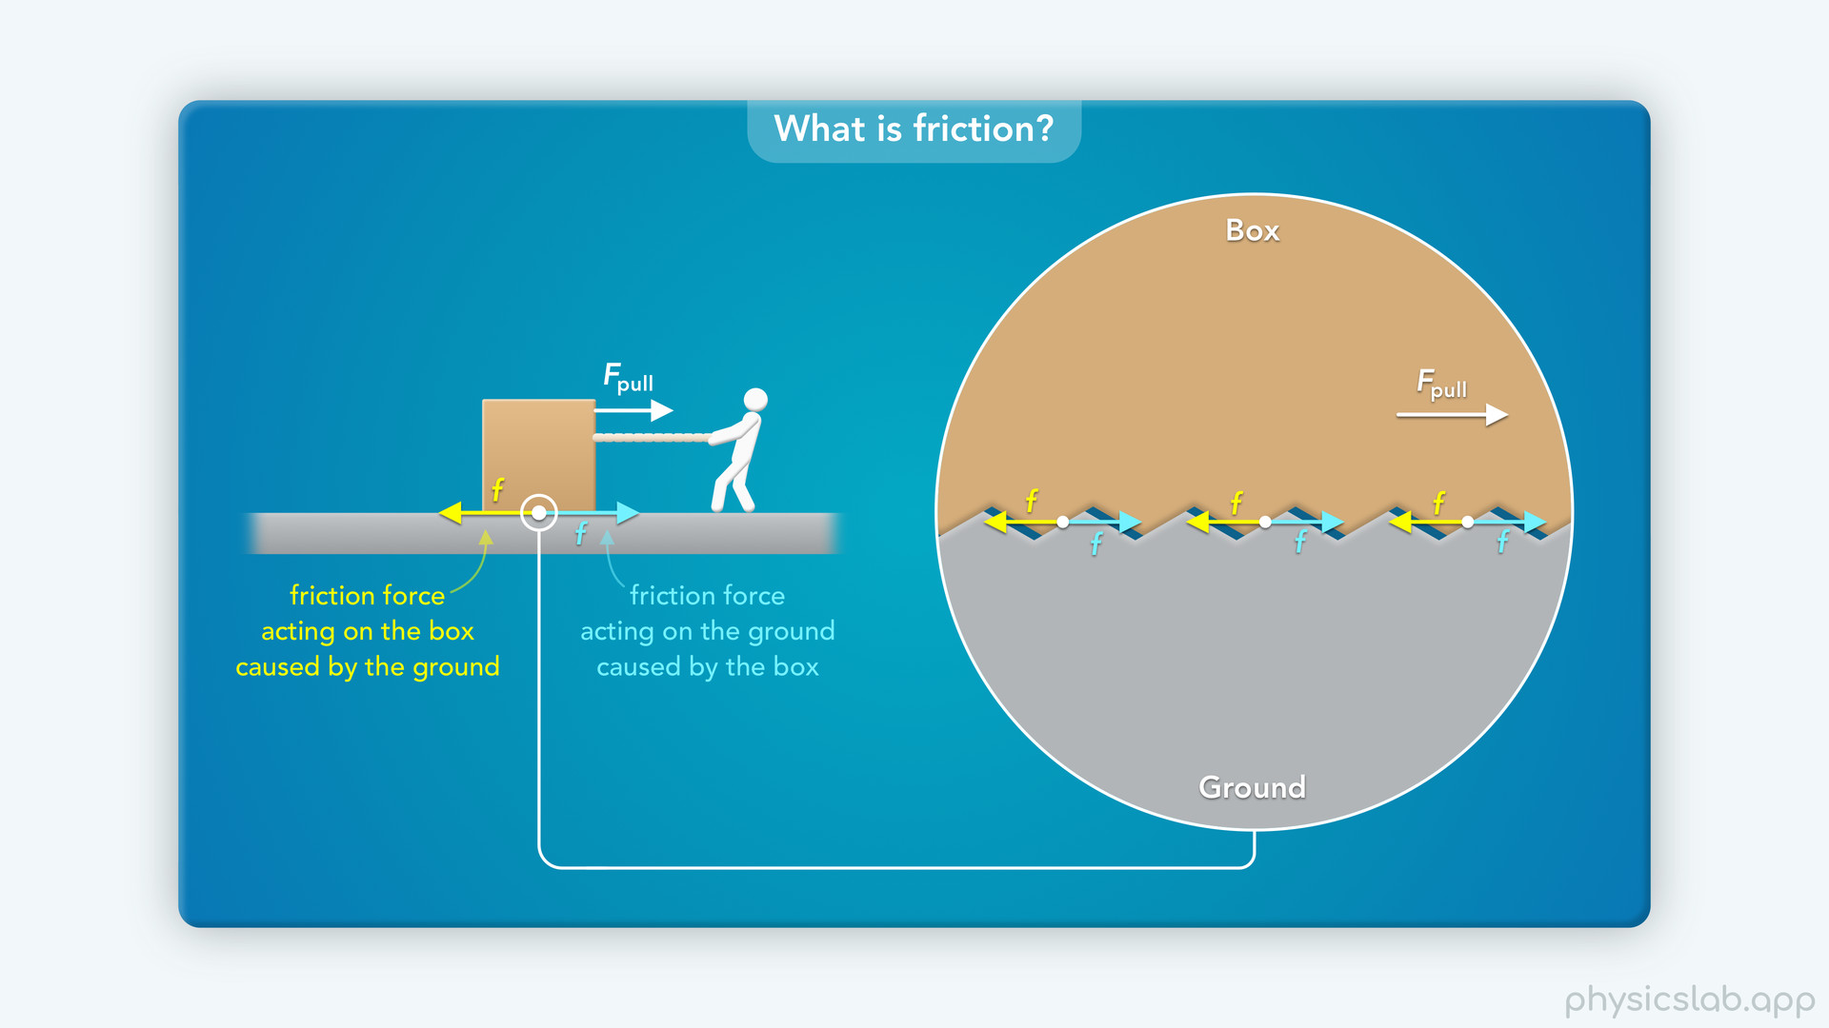
Notes:
• We already learned some things about friction in the last video, so make sure you watch that first.

Slide 12
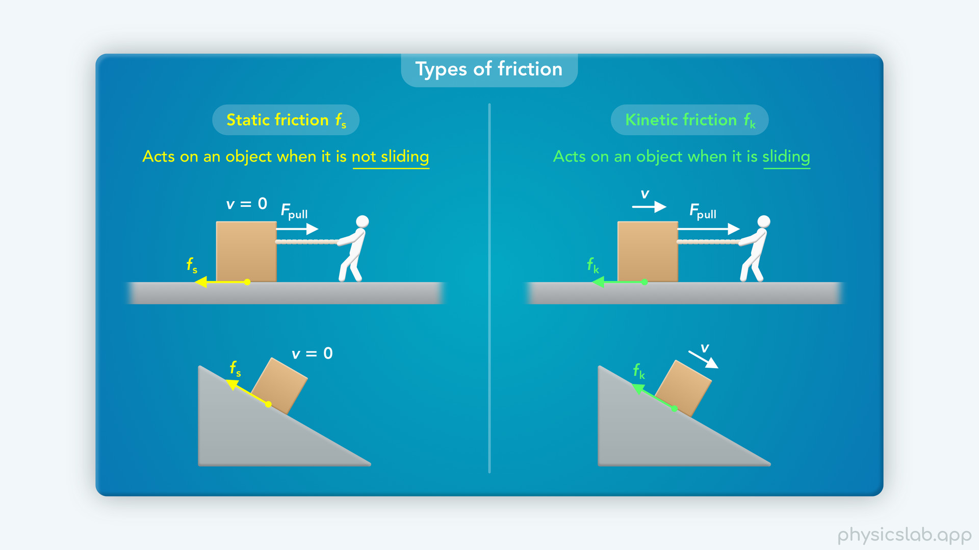
Notes:
This will video will focus on static friction, and the next one will cover kinetic friction.

Slide 13
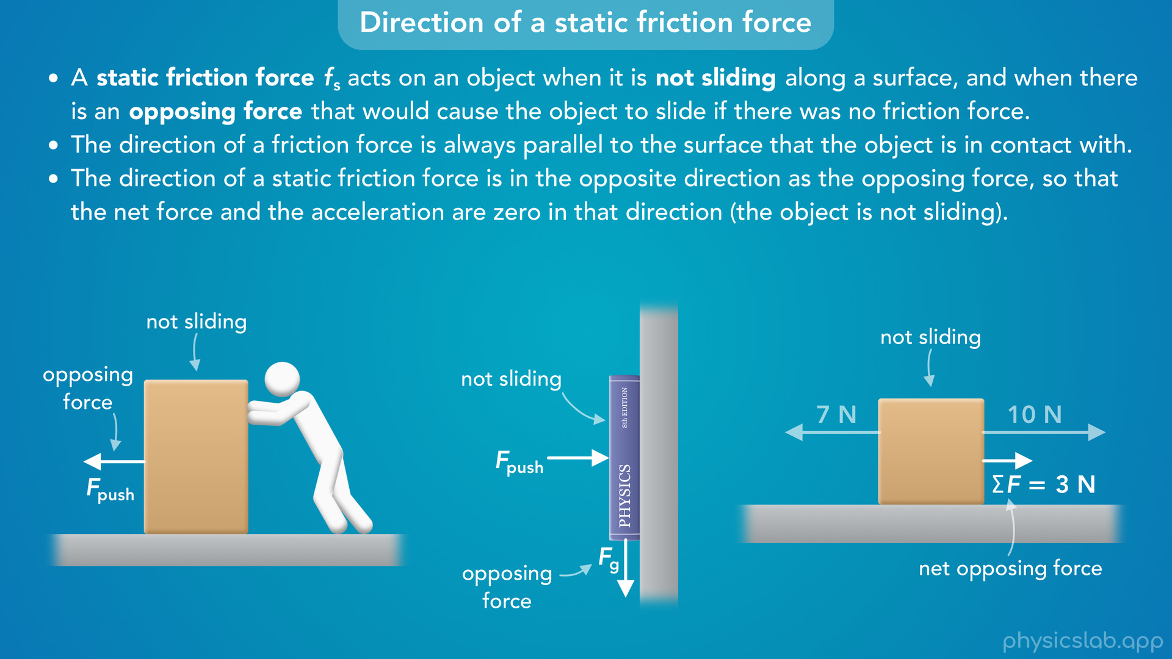
Notes:
• We’ll start by learning what a static friction force is and how to figure out its direction.

Slide 14
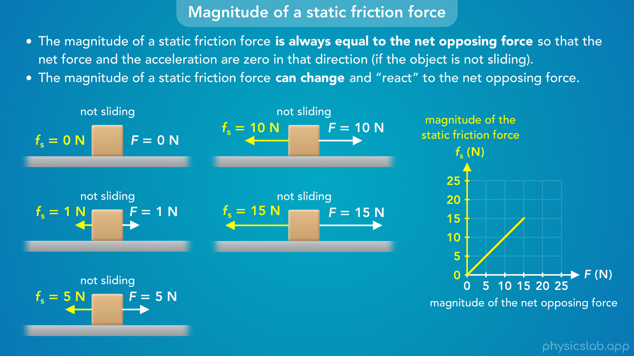
Notes:
• Then we’ll cover something that usually confuses people: the magnitude of a static friction force is always equal to the net opposing force, we don’t calculate it using an equation.

Slide 15
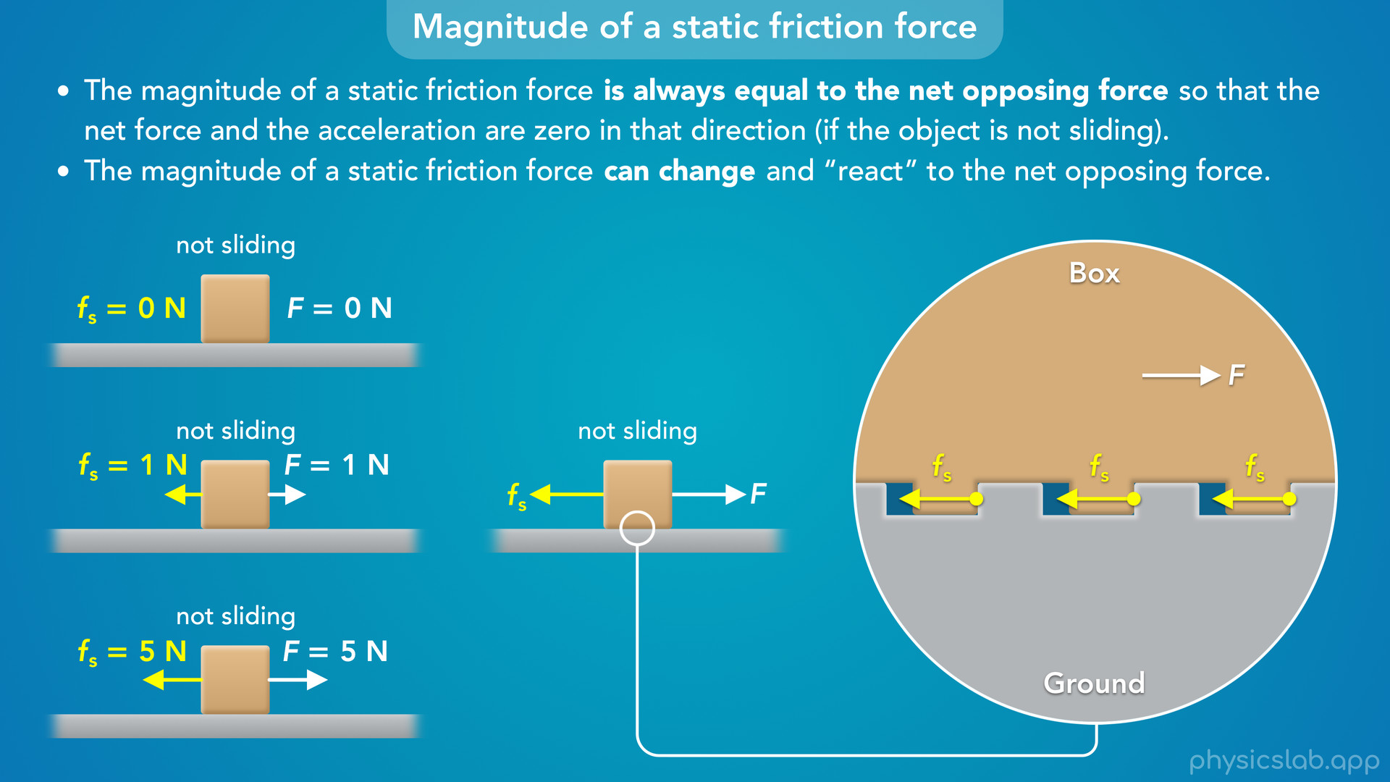
Notes:
• This means that the static friction force can change, and we’ll talk about why that happens.

Slide 16
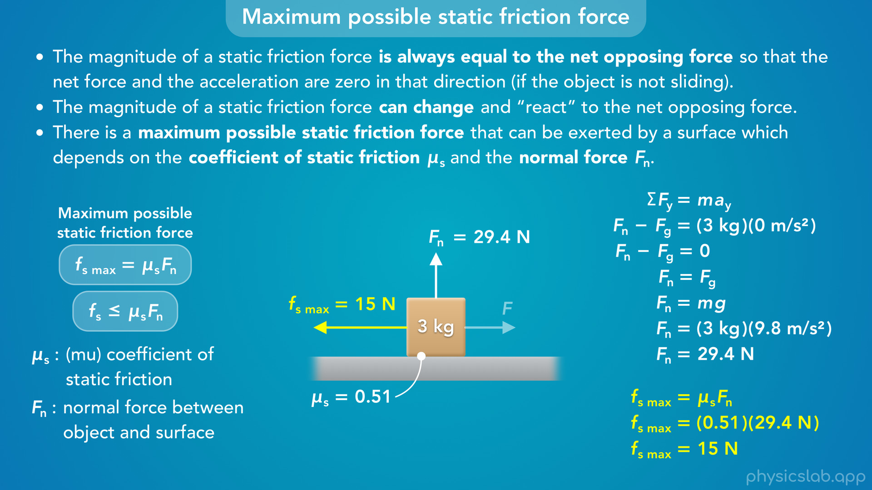
Notes:
• After that, we’ll learn about the equation for the maximum static friction force, which depends on the coefficient of static friction and the normal force.

Slide 17
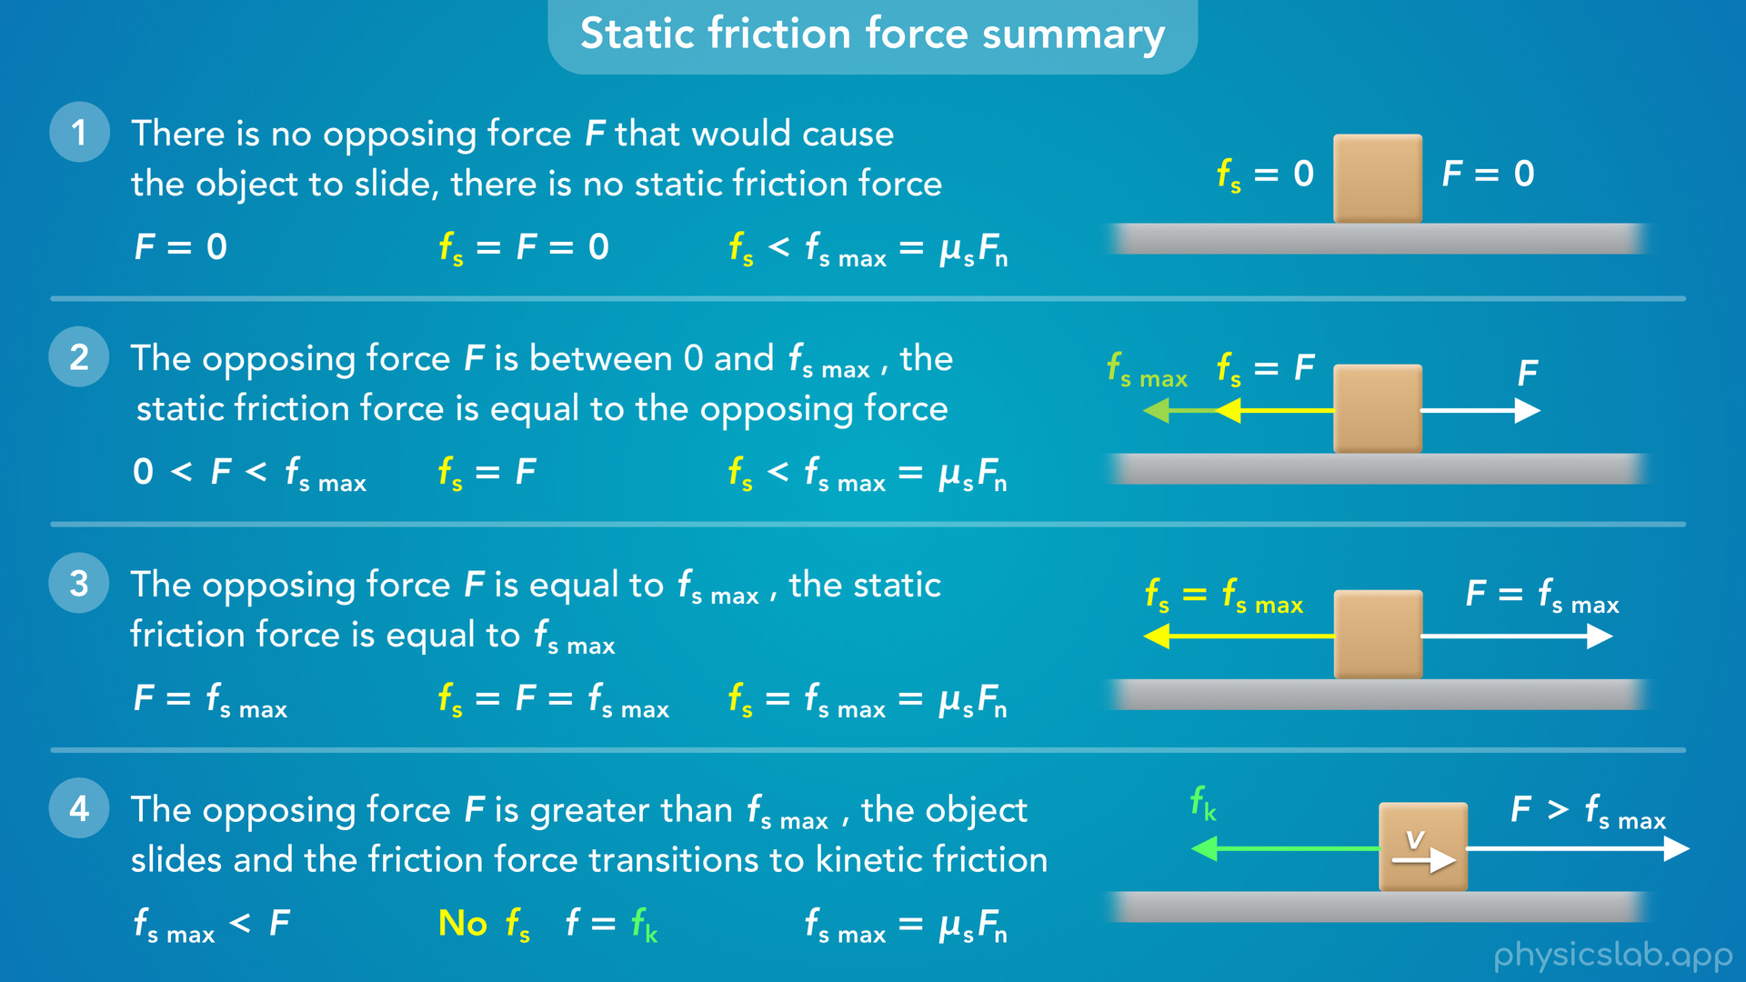
Notes:
• Then we’ll do a summary of the static friction force in each of the four possible cases.

Slide 18
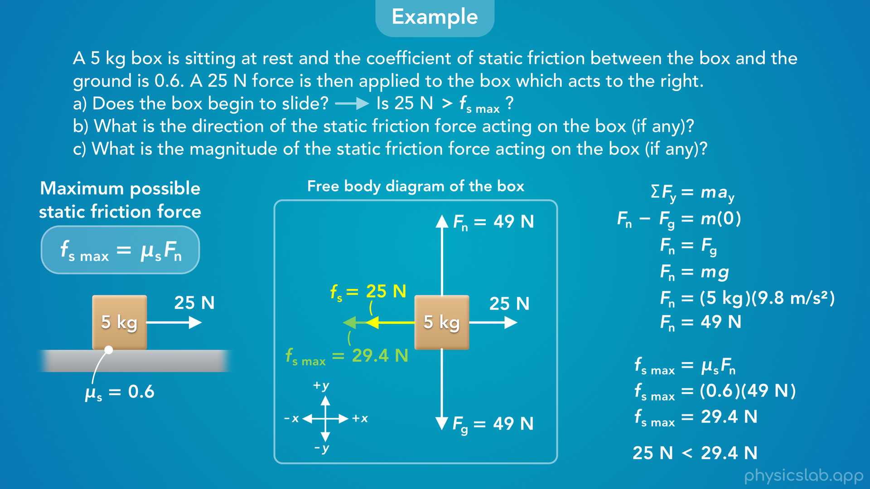
Notes:
• At the end, we’ll walk through an example and see how we can apply what we learned.

Slide 19
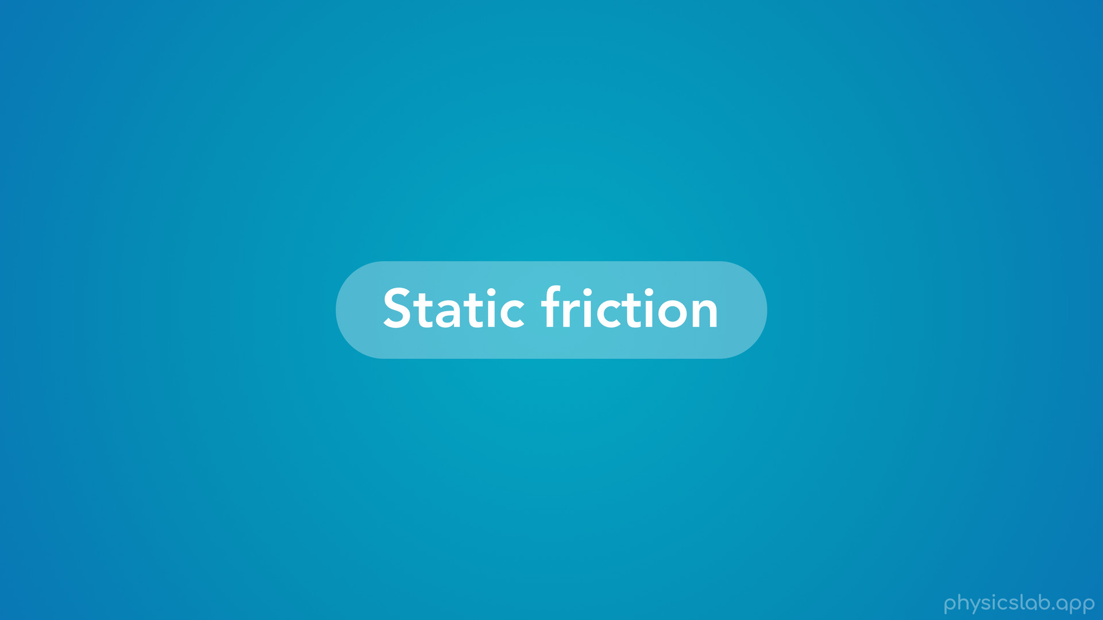
Notes:
• So what is static friction, and how does it work?

Slide 20
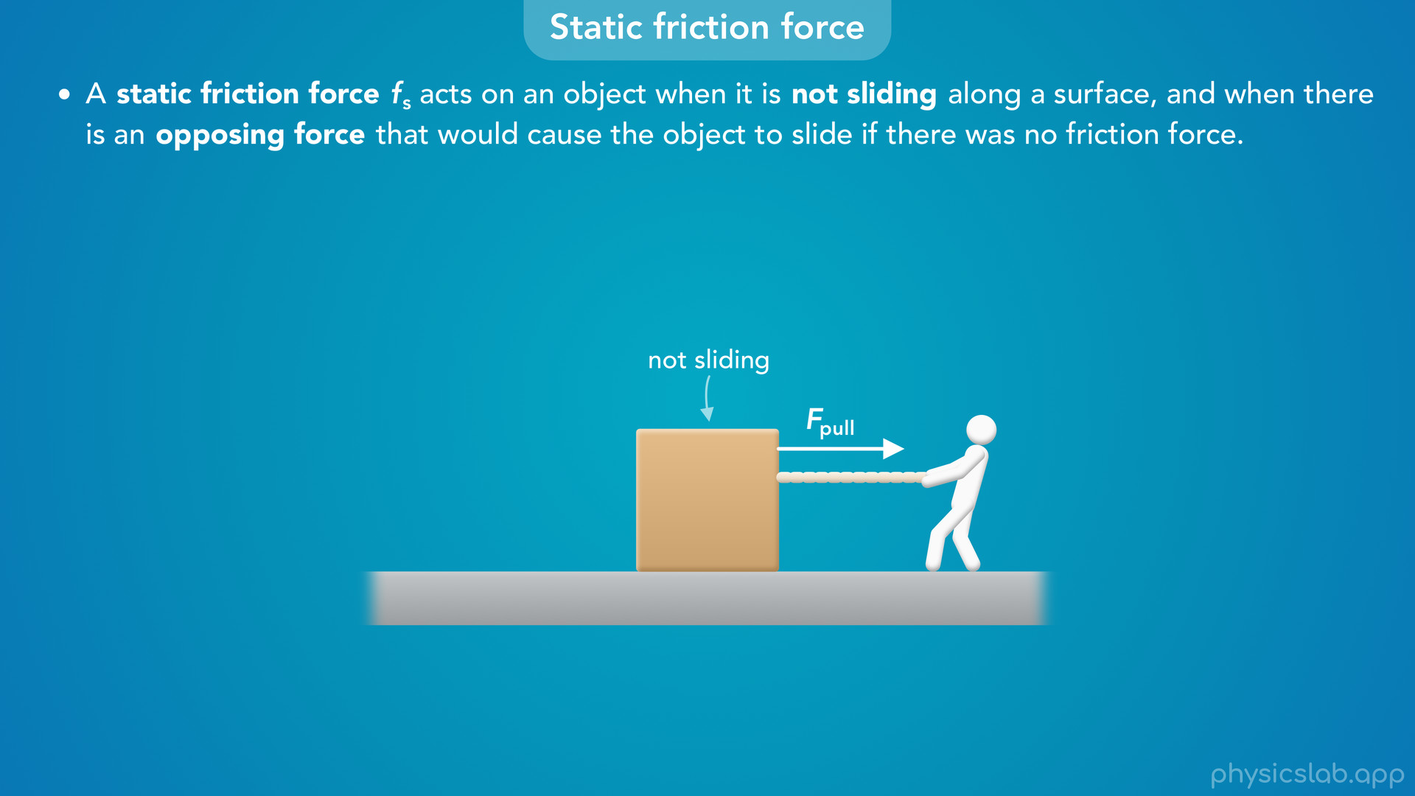
Notes:
• A static friction force, which we label fs, acts on an object when it is not sliding along a surface, and when there is an opposing force that would cause the object to slide if there was no friction force.
• So let’s say we have a box sitting on the ground, and a person is trying to pull the box to the right.

Slide 21
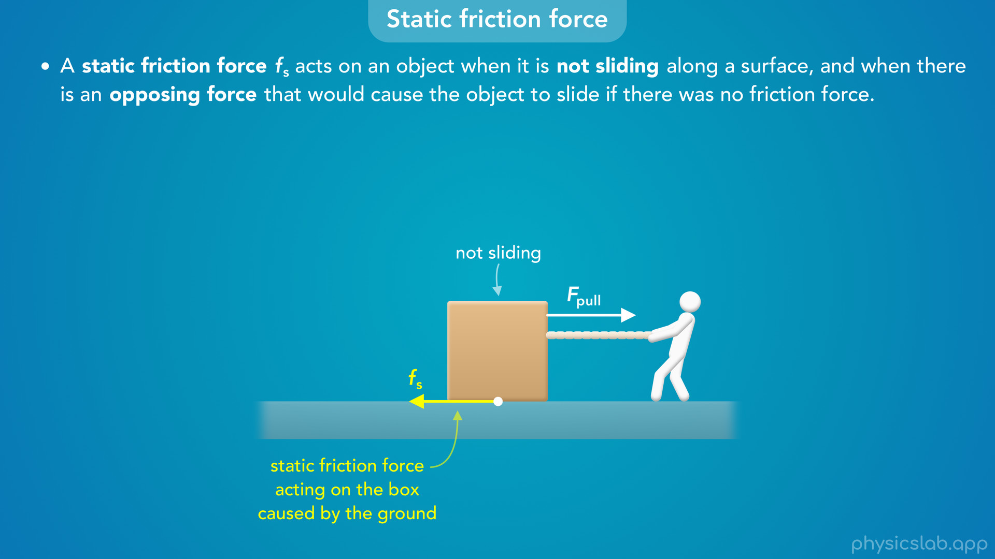
Notes:
• If we’re told that the box is not sliding, and it remains at rest, then there must be a static friction force acting on the box that points to the left.
• This force is acting on the box and it’s caused by the ground.

Slide 22
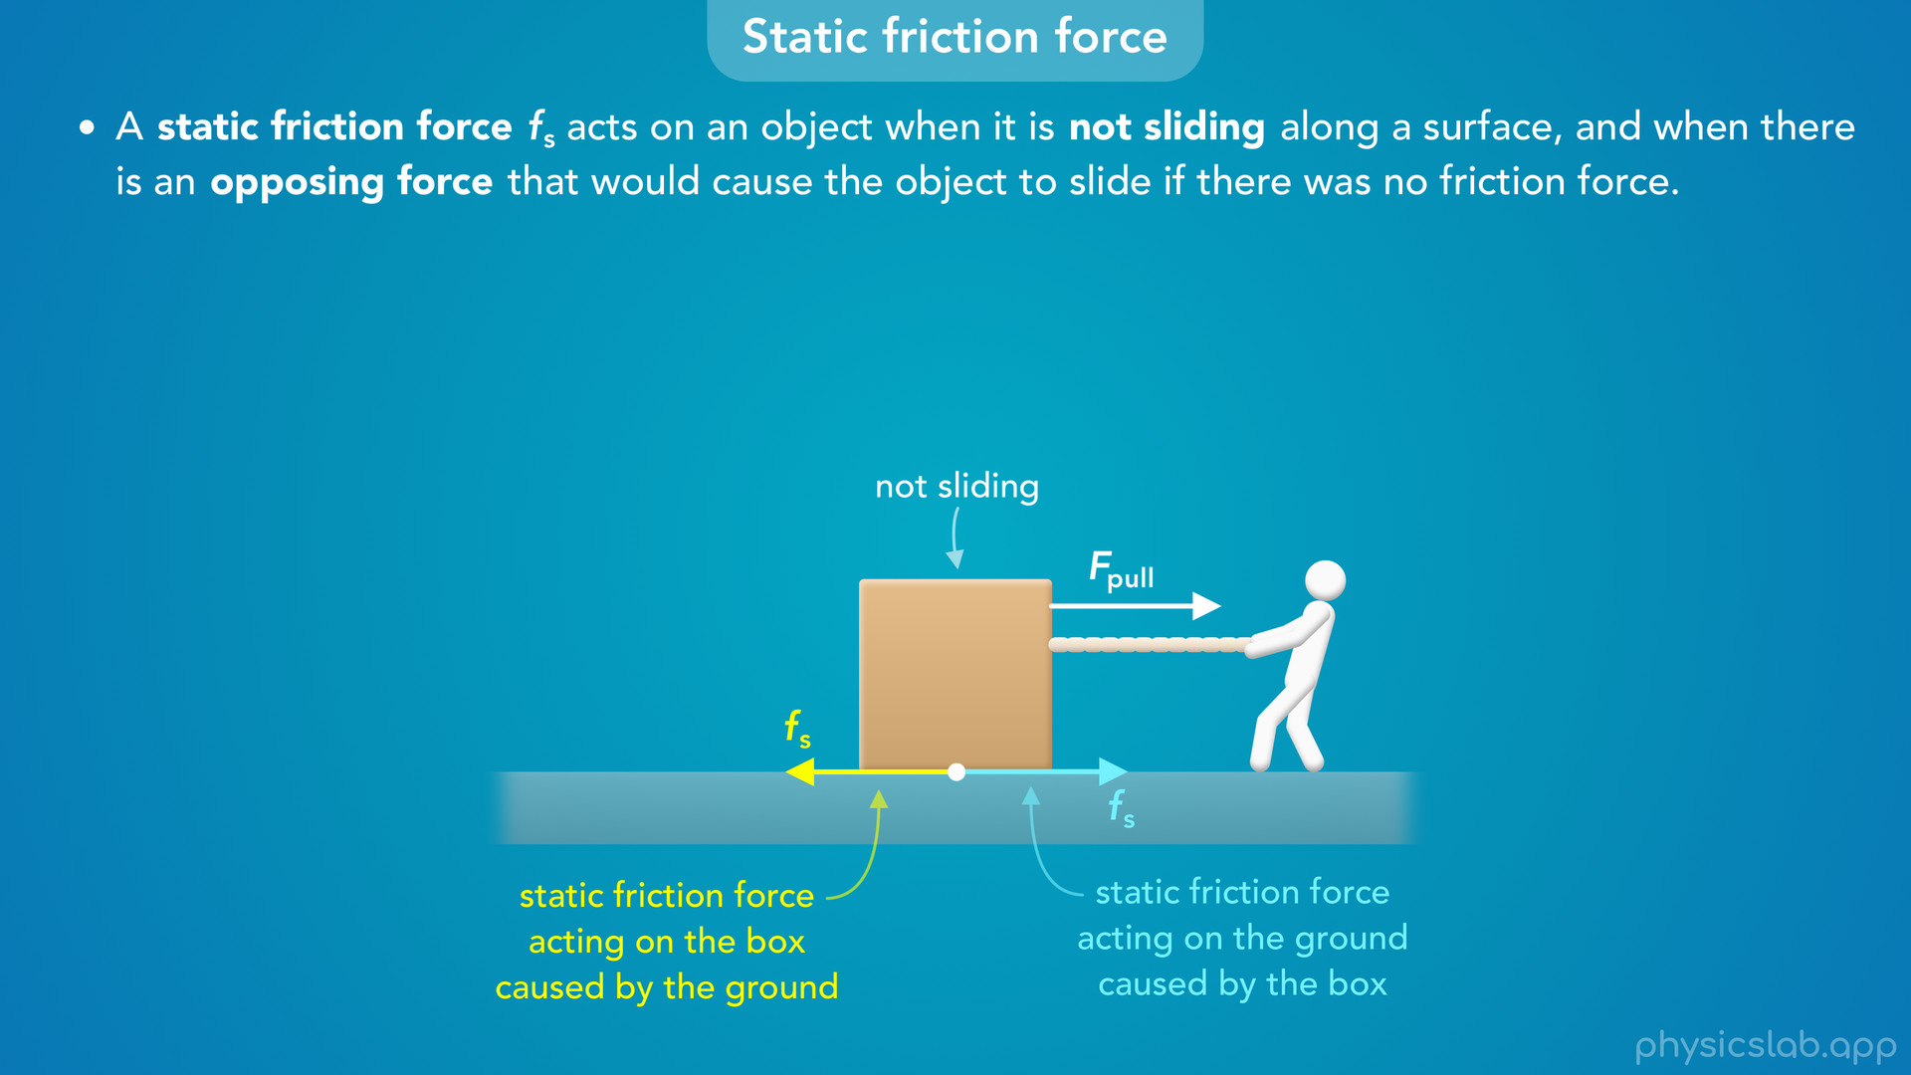
Notes:
• And according to Newton’s 3rd law of motion, there’s also a static friction force acting on the ground caused by the box which points to the right with the same magnitude.
• But we’re just gonna focus on the forces acting on the box.
• The friction force acts on the bottom surface of the box where it’s in contact with the ground

Slide 23
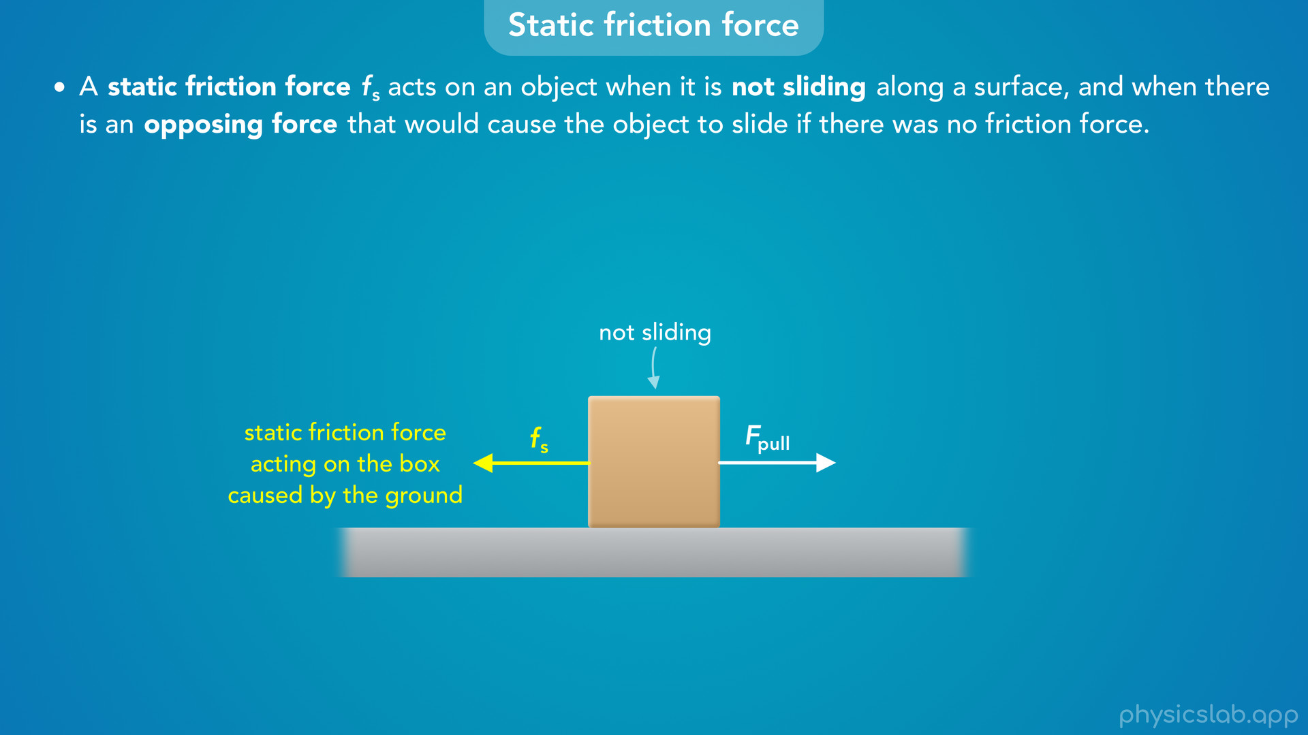
Notes:
but we usually draw a force starting on the side of the object so it’s easier to see.

Slide 24
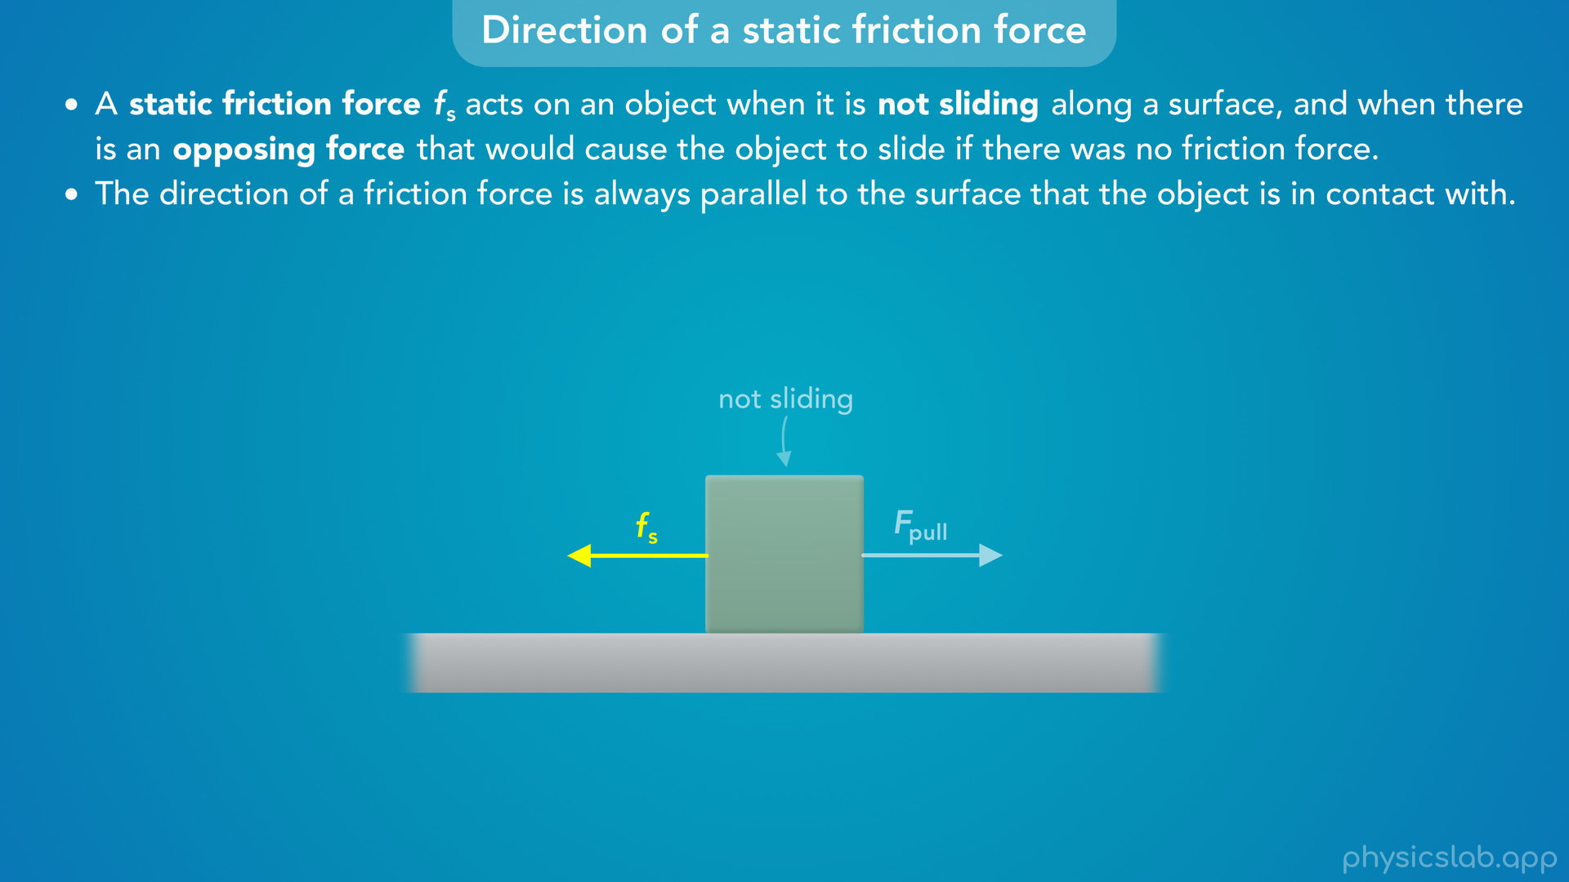
Notes:
• But how do we know the direction of the static friction force?
• First, the direction of a friction force is always parallel to the surface that the object is in contact with.
• So this friction force is parallel to the ground.

Slide 25
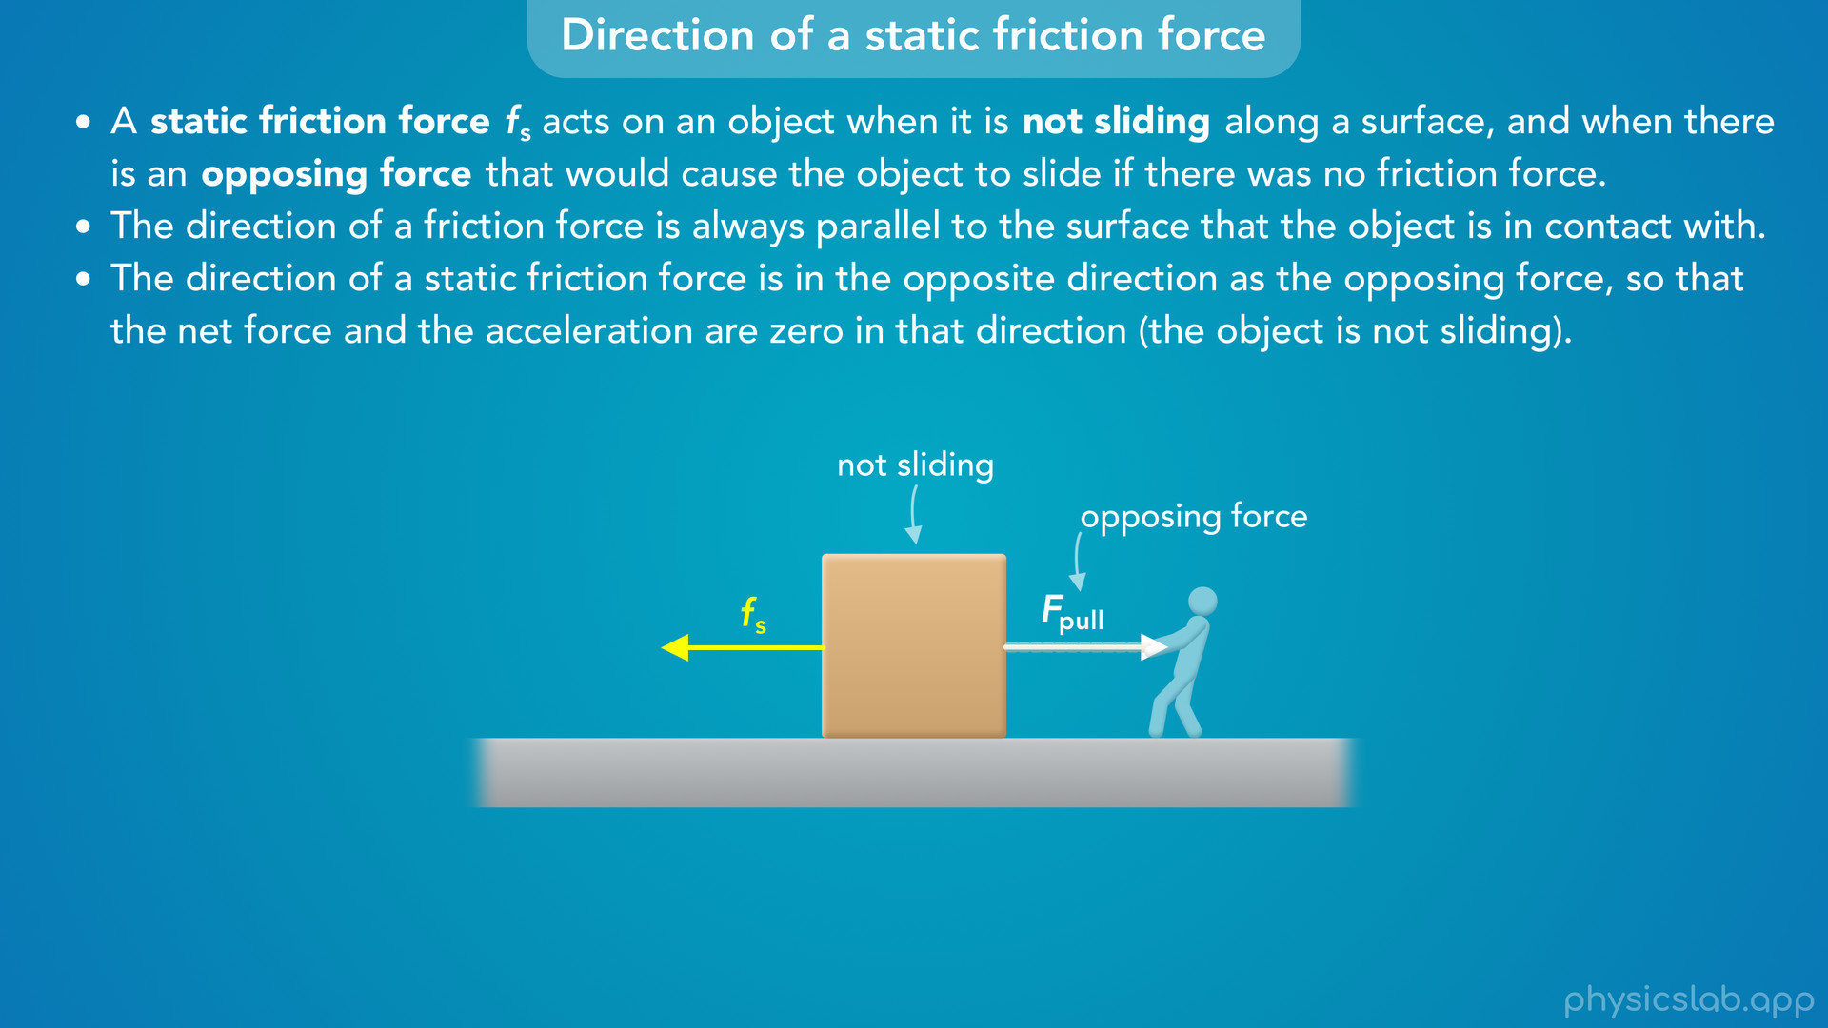
Notes:
• Second, the direction of a static friction force is in the opposite direction as the opposing force, so that the net force and the acceleration are zero in that direction, because the object is not sliding.
• So in this example, the “opposing force” would be the force from the person acting to the right.

Slide 26
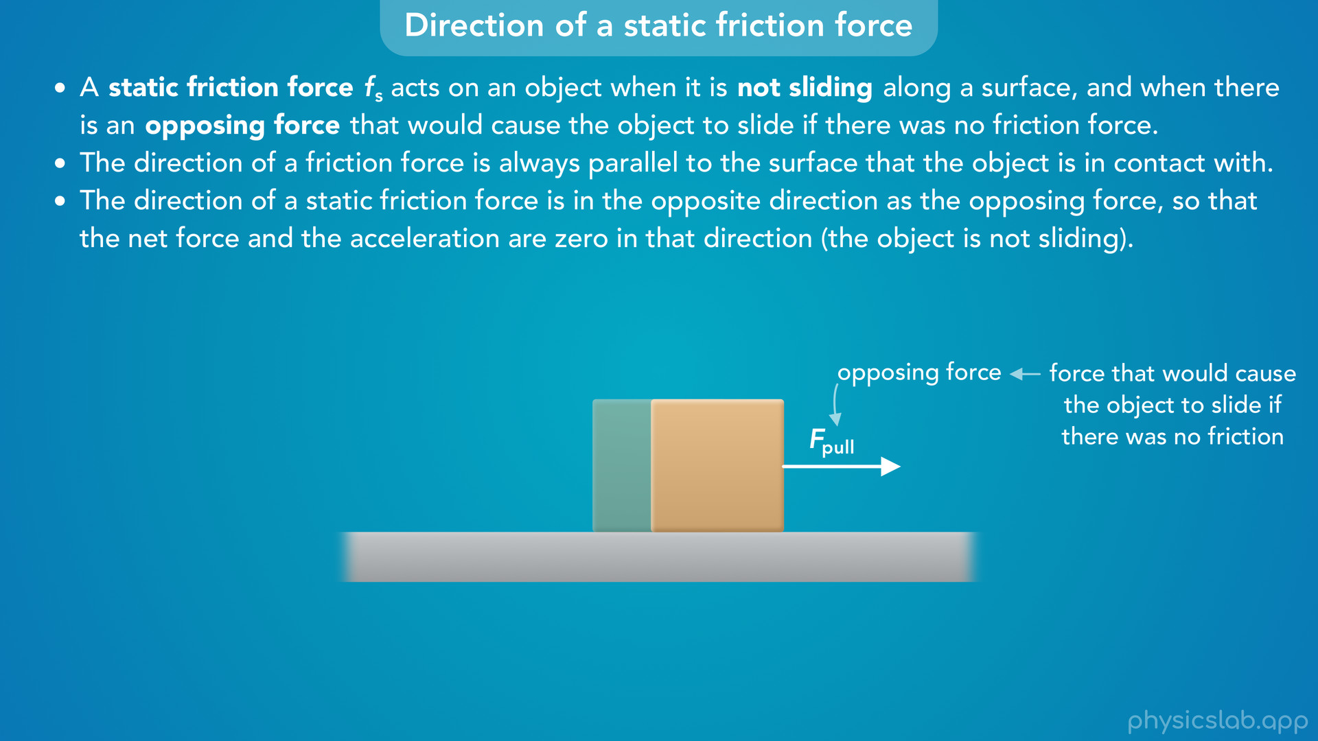
Notes:
• This is just the force that would cause the object to slide if there was no friction.
• If we removed the static friction force, the box would slide to the right.
• Therefore, the static friction force on the box must be acting to the left.

Slide 27
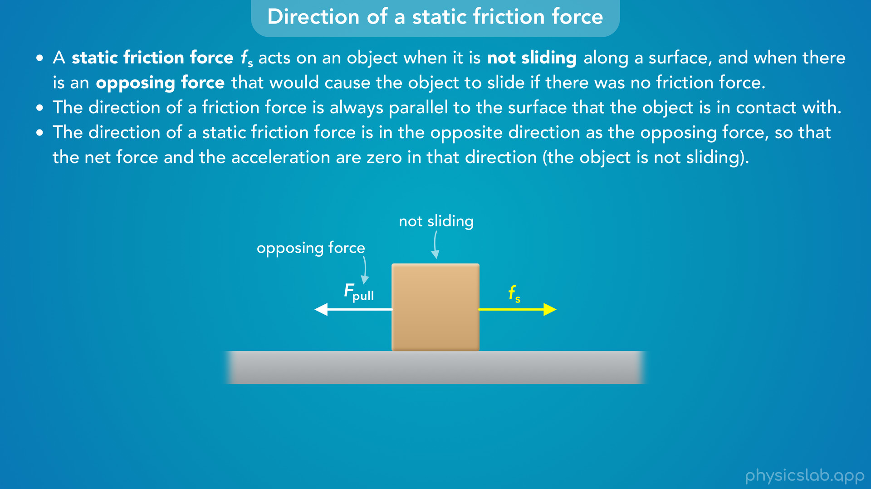
Notes:
• If this opposing force was pulling the box to the left, then the static friction force on the box would point to the right.
• If we’re told that the box is not sliding, then the net force must be zero, so these forces are balanced and they must be acting in opposite directions.

Slide 28
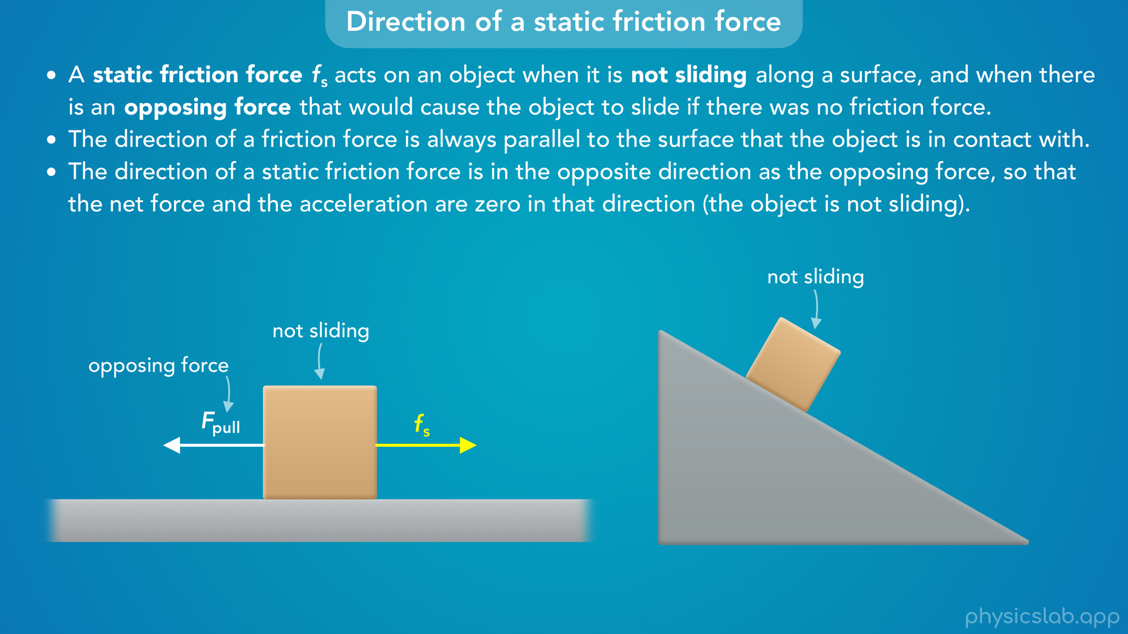
Notes:
• What if this box was on an inclined surface at an angle?

Slide 29

Notes:
• We learned in another video that there are components of the gravitational force on the box that act parallel and perpendicular to the surface of the incline.
• So if there was no friction, then gravity would cause the box to slide down the incline.
• We could say the opposing force is the component of the gravitational force that’s parallel to the incline.
• Since the box would slide down without friction, the static friction force must be acting up the incline, so that the net force is zero.
• And again, the friction force must be parallel to the surface.

Slide 30
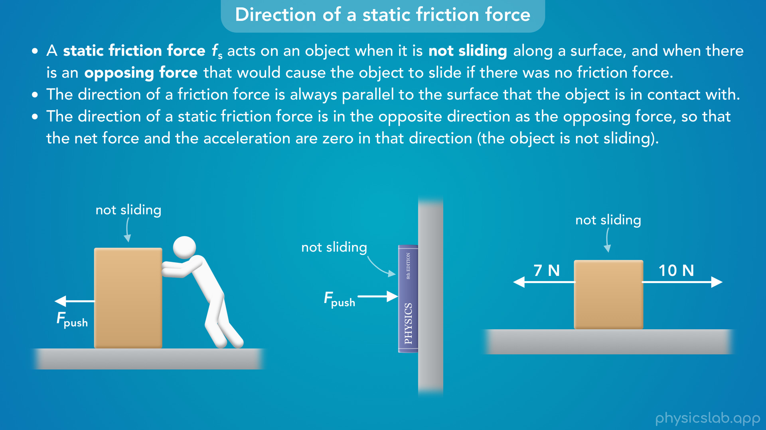
Notes:
• Let’s look at three more examples to make sure we understand this concept.
• First, a person is pushing a box to the left, but the box is not sliding.
• Second, someone is pushing a book sideways against a wall and the book is not sliding.
• Third, a 7 N force and a 10 N force are acting on a box, and the box is not sliding.
• Pause the video and see if you can figure out the direction of the static friction force acting on each object.

Slide 31
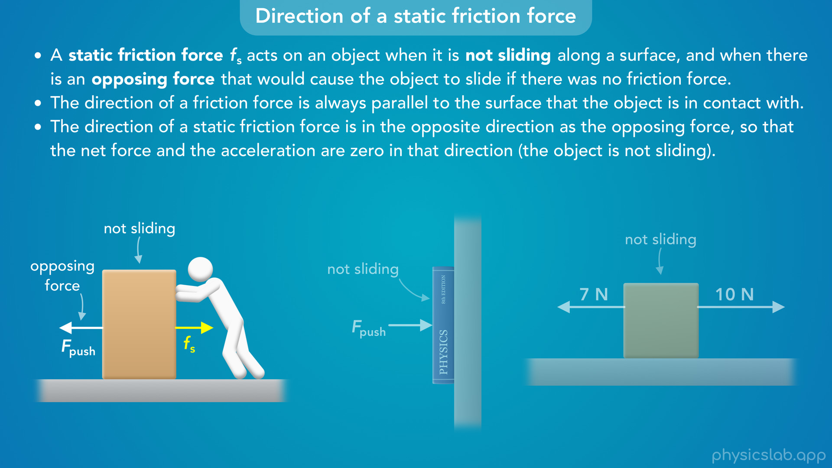
Notes:
• In the first example, the box would slide to the left if there was no friction, so the static friction force on the box must be acting to the right.

Slide 32
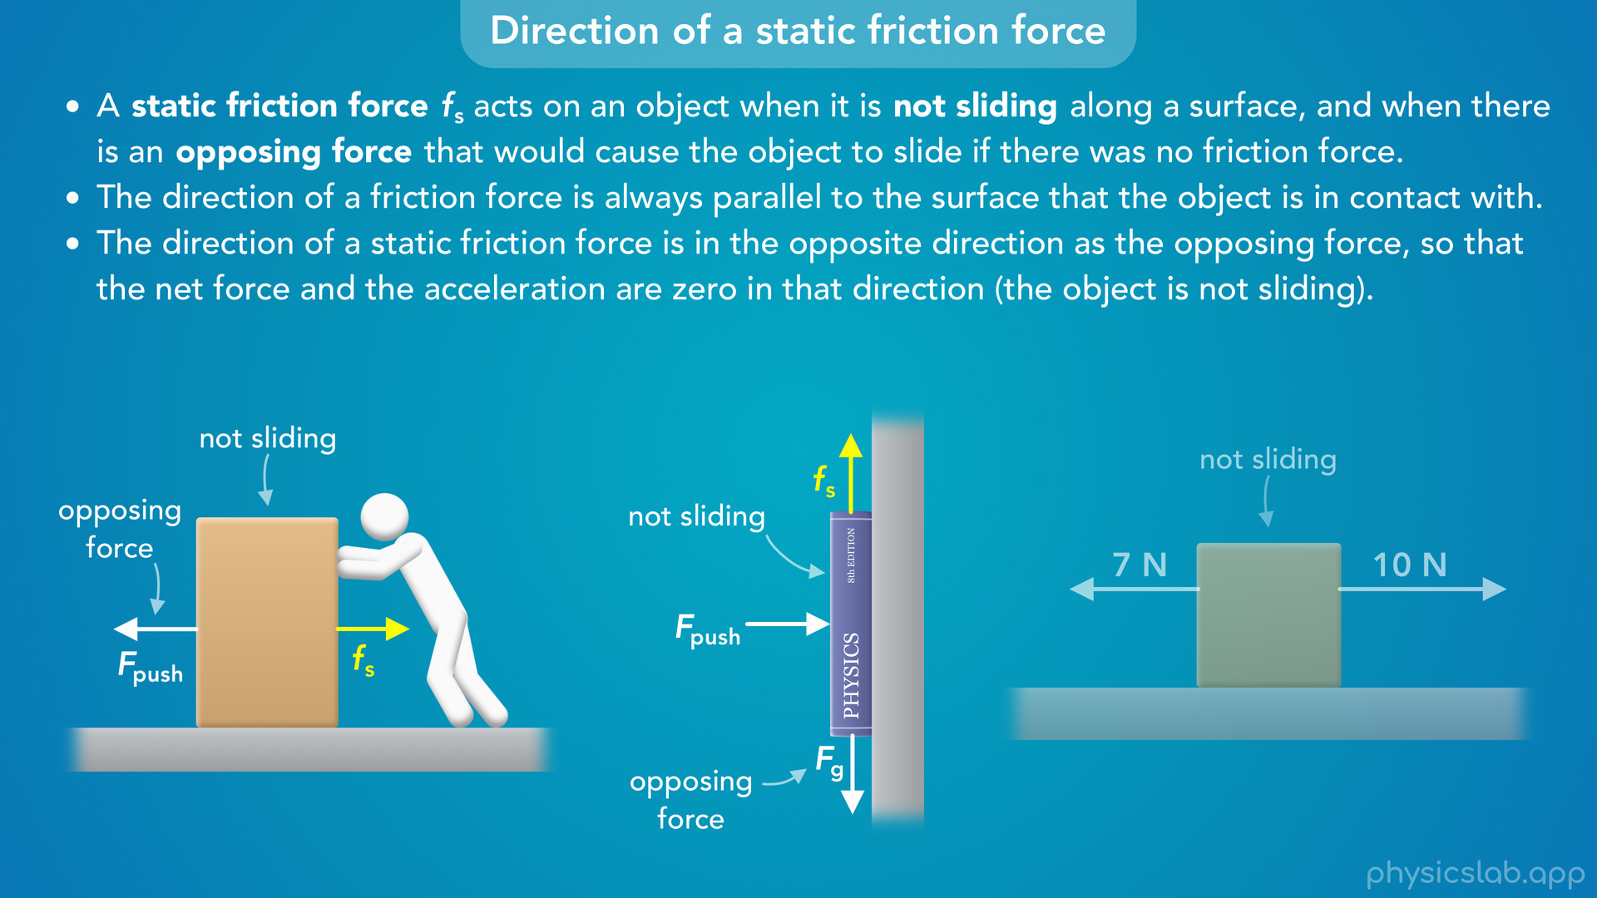
Notes:
• In the second example, the book would slide down the wall if there was no friction because of the downwards gravitational force.
• Therefore the static friction force on the book must be acting upwards, in the opposite direction as the gravitational force, and its parallel to the wall.
• The pushing force is horizontal, it’s not pushing up or down. The only reason the book doesn’t slide down is because of friction, which must be acting upwards.

Slide 33
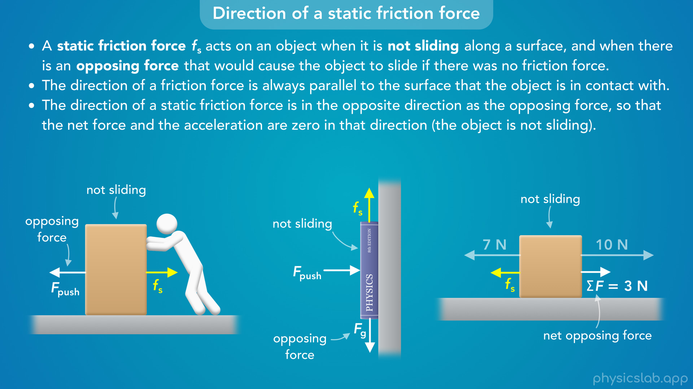
Notes:
• In the third example, what direction would the box slide if there was no friction?
• The net horizontal force without friction would be 3 N to the right, 10 N minus 7 N.
• That 3 N net force would cause the box to slide to the right without friction.
• That means the static friction force must be acting to the left.
• So it’s actually the net opposing force that we care about.
• In many cases there’s only one force that would cause the object slide, but if there are multiple forces parallel to the surface then we need to find the direction of the net force without friction.
• Then, the static friction force acts in the opposite direction to that, if the object is not sliding.

Slide 34
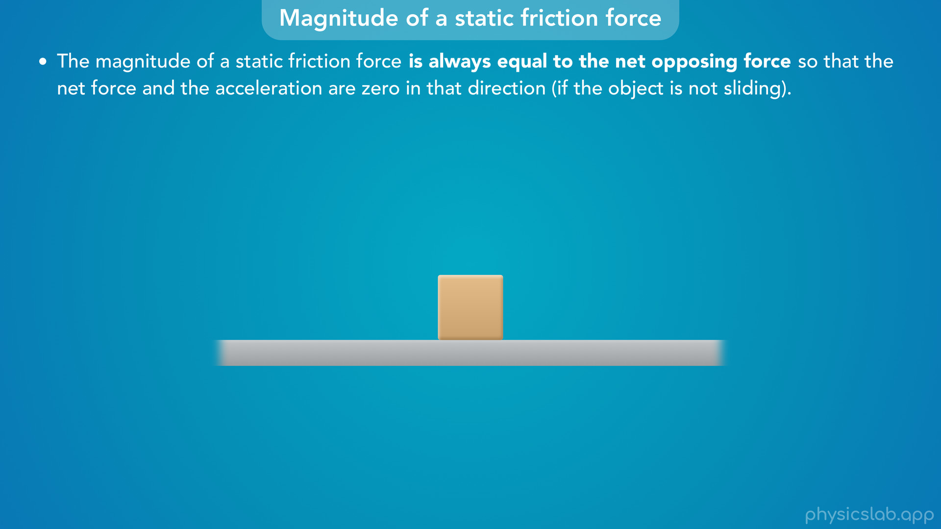
Notes:
• So now we know the direction of a static friction force, but how do we find the magnitude or the value?
• This is where a lot of people get confused, so this is really important to remember.
• The magnitude of a static friction force is always equal to the net opposing force so that the net force and the acceleration are zero in that direction, if the object is not sliding.
• We just used this concept to find the direction, but this also tells us the magnitude.

Slide 35
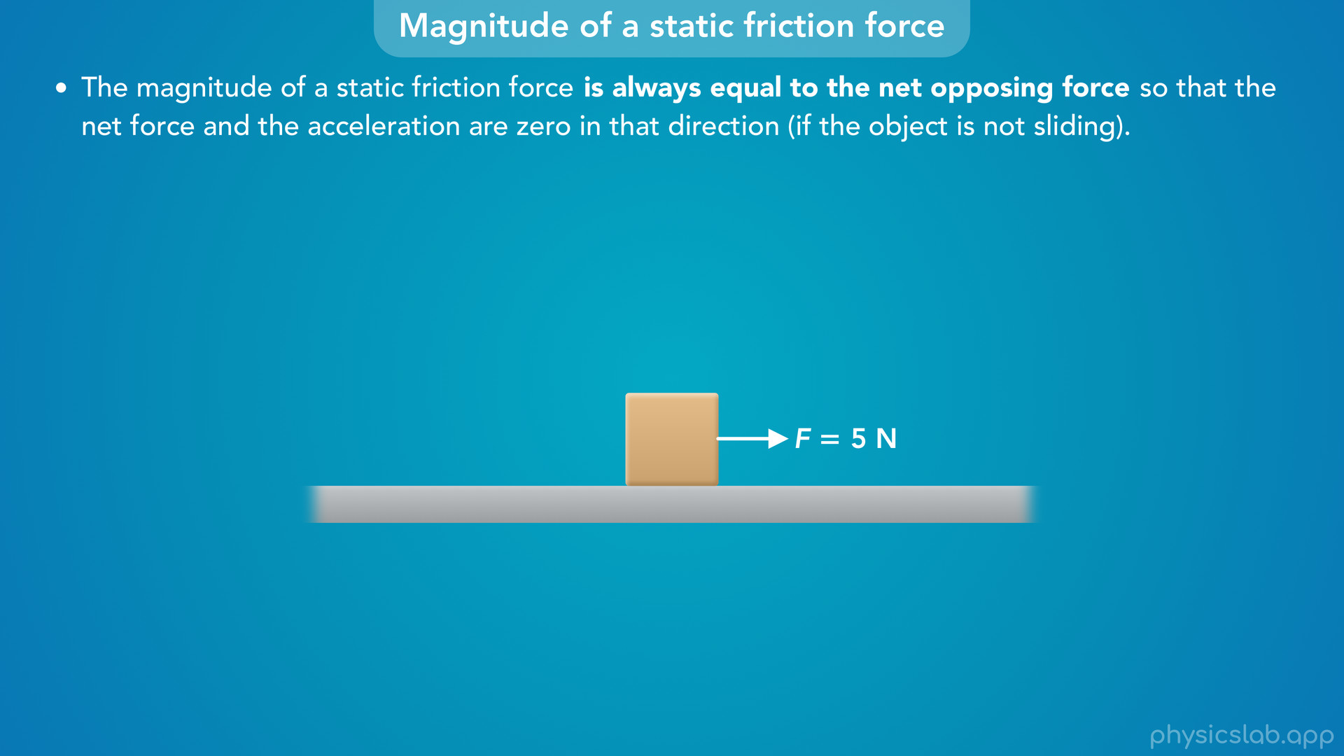
Notes:
• Let’s think through this. Let’s say this box is sitting on the ground and something is pulling it to the right with 5 N of force.

Slide 36
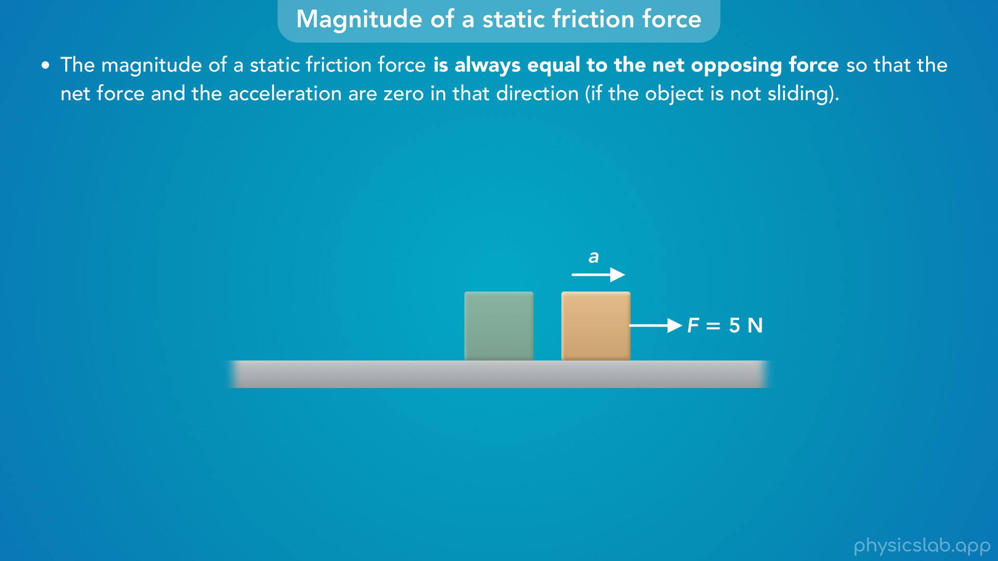
Notes:
• We know from Newton’s 2nd law that this force would cause the box to accelerate to the right.

Slide 37
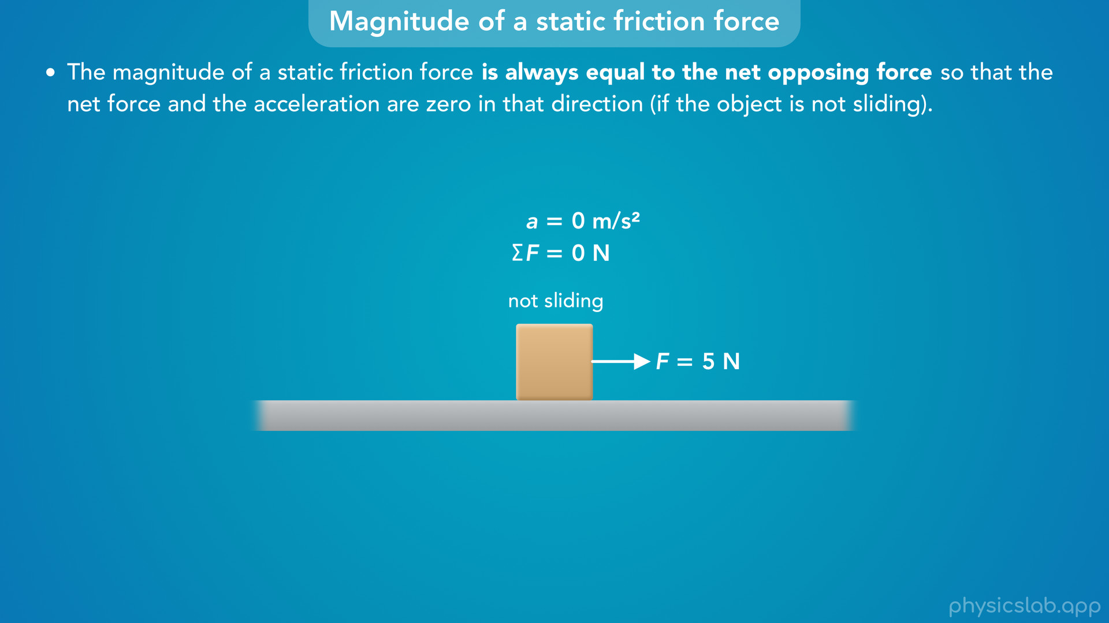
Notes:
• But if we’re told that the box is not sliding, then it’s not accelerating, and the net force on the box must be zero.

Slide 38
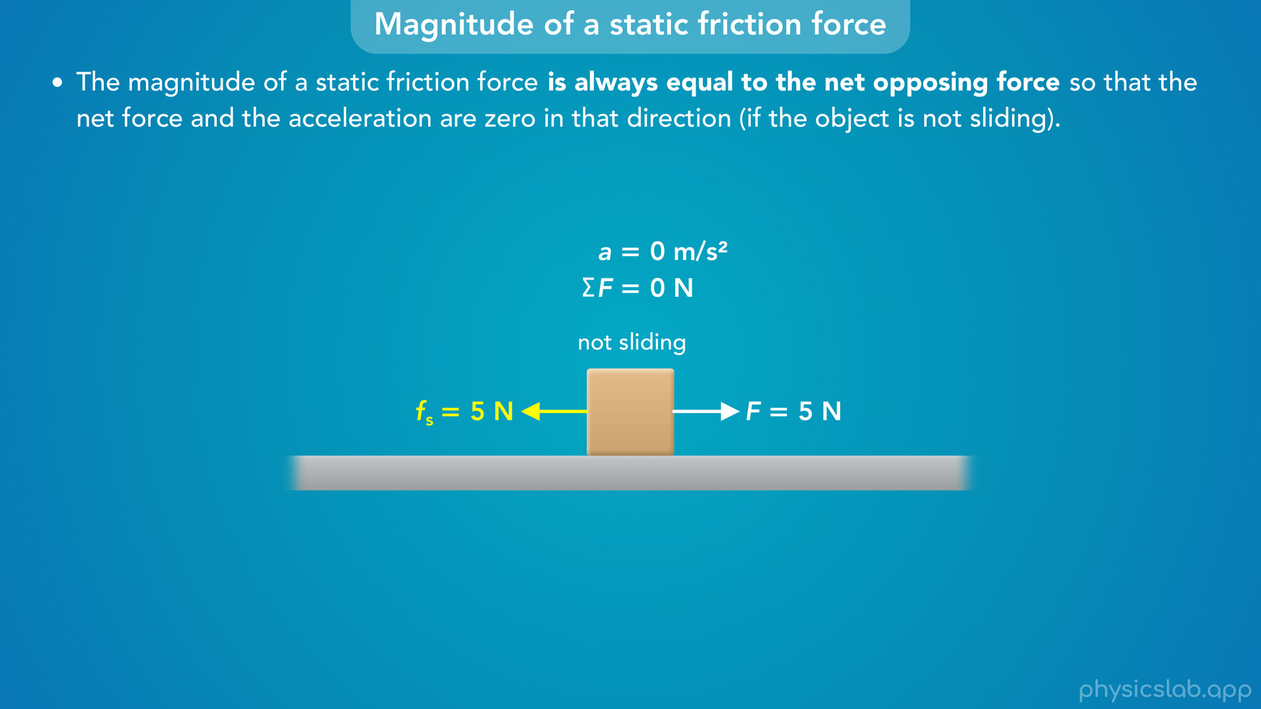
Notes:
• So, there must be another force acting to the left, which we just learned is the static friction force.
• But what would magnitude of the static friction force have to be so that the net force is zero and the box doesn’t slide?
• It would have to be 5 N so that it’s balanced with the 5 N force on the right.

Slide 39
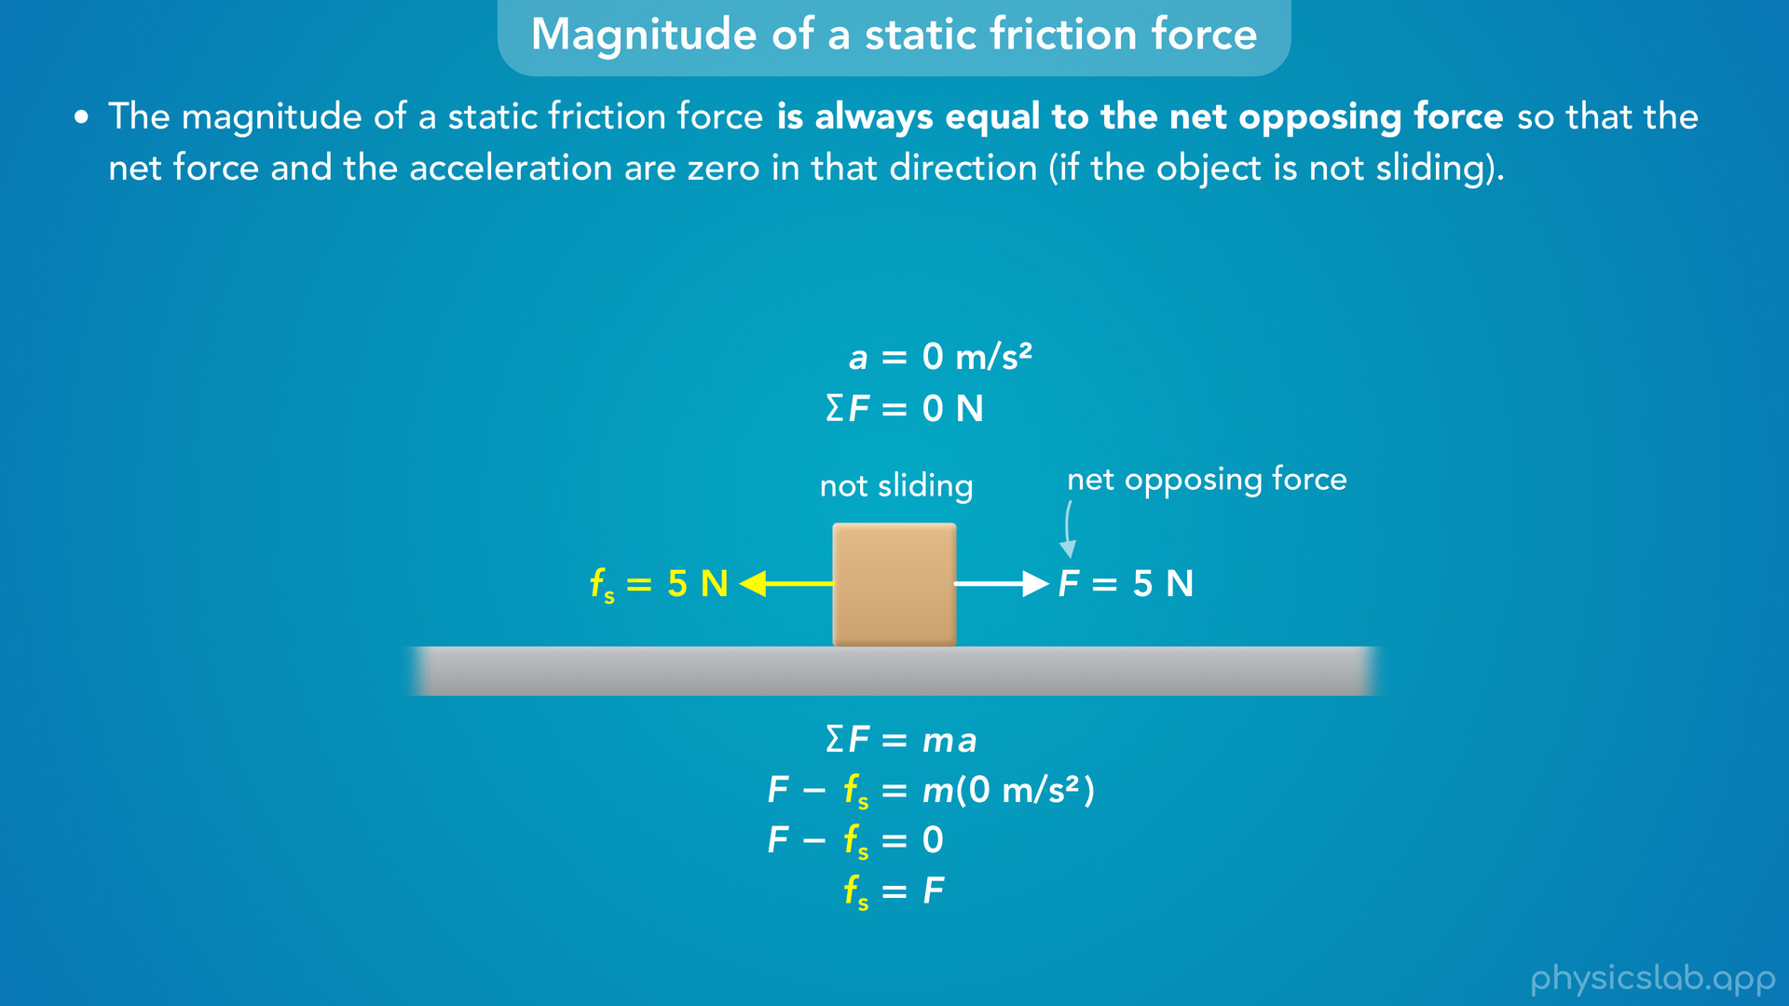
Notes:
• So we could label F as the net opposing force, and say the magnitude of the static friction force is always equal to that net opposing force, and it acts in the opposite direction.
• If we write out Newton’s 2nd law, the net force is equal to the mass times the acceleration.
• The net force would be F minus fs since they’re in opposite directions.
• We would plug in 0 for the acceleration because the box is not sliding.
• So F minus fs is equal to 0, so the static friction force is equal to F, the net opposing force.

Slide 40
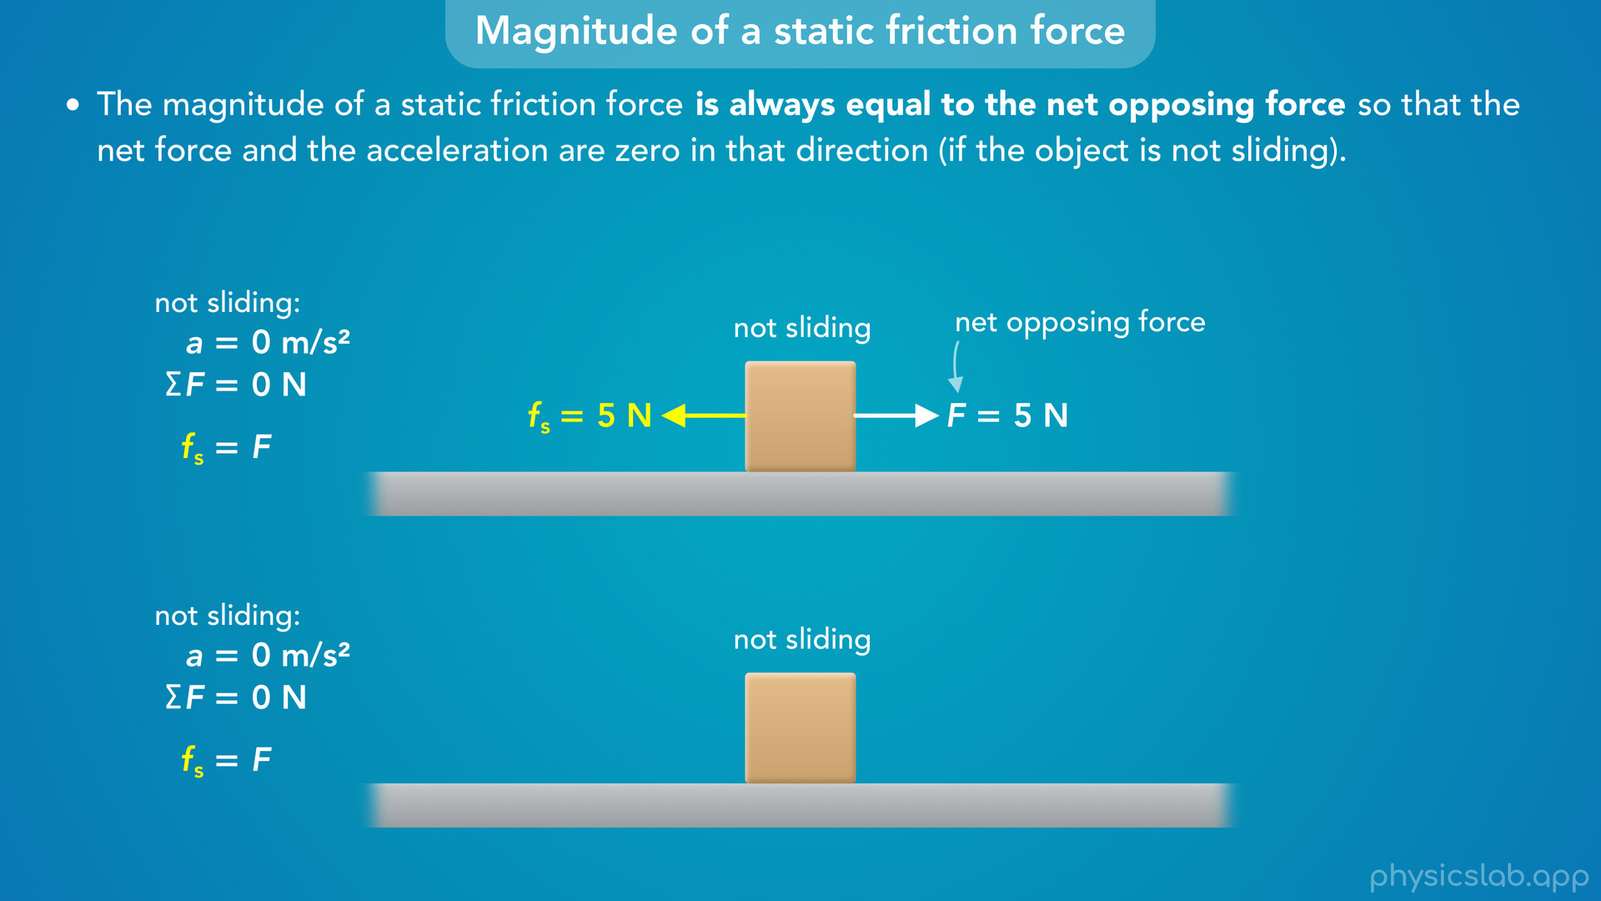
Notes:
• This is always true if the box is not sliding, even if the net opposing force changes.
• For example, what would be the magnitude of the static friction force if there are no other horizontal forces on this box?

Slide 41
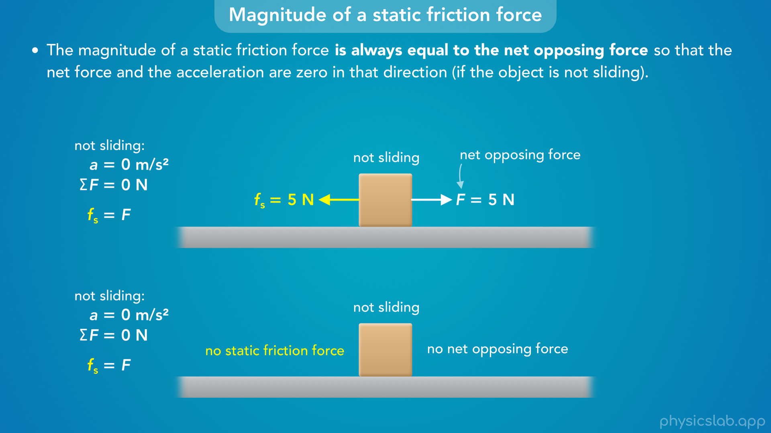
Notes:
• Well, there would be no static friction force because there’s no net opposing force.
• Nothing is trying to move the box so there’s no static friction force needed to keep it from sliding.

Slide 42
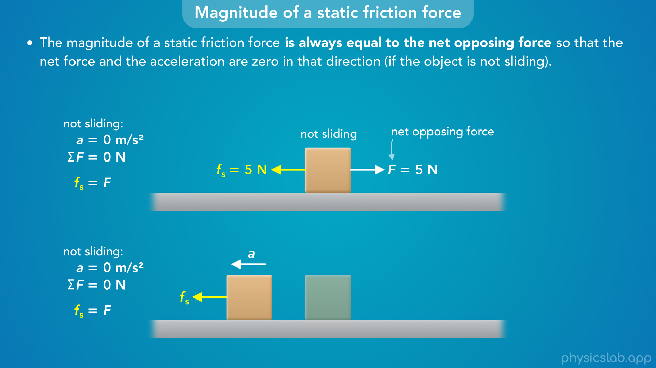
Notes:
• If there was some static friction force and no other horizontal forces, the static friction force would cause the box to accelerate in that direction, which can’t happen.

Slide 43
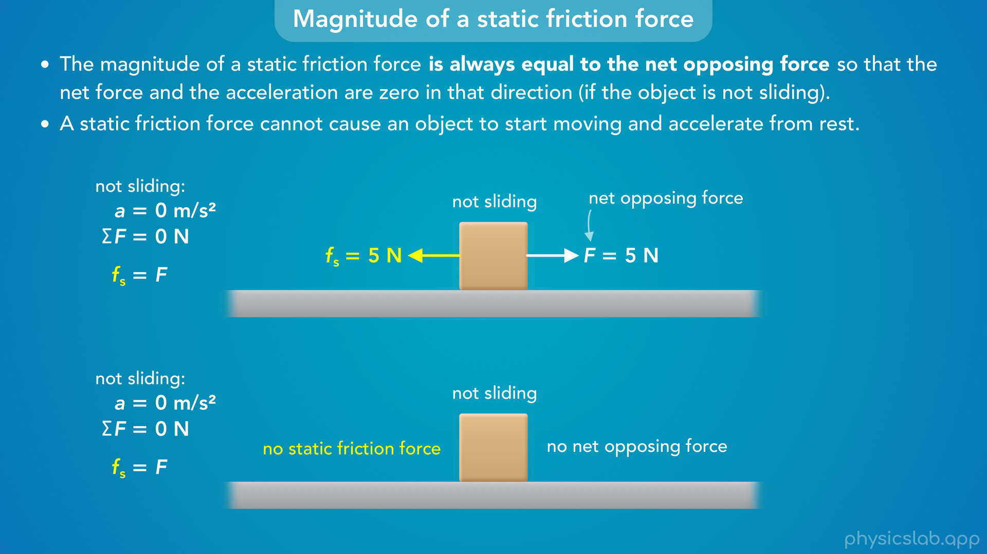
Notes:
• So keep in mind that a static friction force cannot cause an object to start moving and accelerate from rest.
• If it did, all of the objects around you would would start accelerating and nothing could just sit on a surface at rest.
• So if there’s no force to oppose, then there’s no static friction force.

Slide 44

Notes:
• What if the net opposing force pulled harder and increased from 5 N to 10 N?

Slide 45

Notes:
• If we’re told that the object is still not sliding, then the static friction force must have increased to 10 N so that it’s still equal to the net opposing force, so that the net force is zero.
• So the magnitude of a static force can change and react to the net opposing force.

Slide 46

Notes:
• What if the force increased to 15 N?
• Again, as long as we’re told that the box is not sliding, the static friction force will increase so that it’s equal to the net opposing force.

Slide 47

Notes:
• Another way to look at this concept is with a graph.
• The horizontal axis is the magnitude of the net opposing force, F, and the vertical axis is the magnitude of the static friction force, fs.
• Pause the video and think about what this graph will look like.

Slide 48

Notes:
• As long as the object is not sliding, the static friction force is always equal to the net opposing force, so this graph is a straight line with a constant slope of 1.

Slide 49

Notes:
• Let’s look at a few points.
• If there’s no opposing force, the static friction force is also zero.

Slide 50

Notes:
• If the opposing force is 1 N, the static friction force is also 1 N.

Slide 51

Notes:
• If the opposing force is 5 N, the static friction force is 5 N, and so on.

Slide 52

Notes:
• As long as the box is not sliding, the static friction force reacts to the changing opposing force so that they’re always equal.

Slide 53

Notes:
• It might seem weird that the static friction force behaves like, but we’ve already learned about a type force that does the same thing: a normal force.
• If you push a box against a wall, the wall will exert a normal force back on the box because they’re in contact.
• The net force on the box is zero, and the normal force from the wall will be equal to your pushing force.

Slide 54

Notes:
• If you pushing with 1 N of force, the normal force is also 1 N.

Slide 55

Notes:
• If you push harder with 5 N of force, the normal force increases to 5 N.
• The normal force reacts so that it’s always equal to your pushing force.

Slide 56

Notes:
• Friction is a little more complicated, but to help us understand this behavior, we can imagine the surfaces of the box and the ground have small bumps with small vertical surfaces.

Slide 57

Notes:
• If you pull the box to the right, the bumps on the box get stuck against the bumps on the ground.

Slide 58

Notes:
• At each point of contact, the ground exerts a small sideways normal force on the box that acts to the left.

Slide 59

Notes:
• As you increase the pulling force on the box, you’re forcing it against the bumps on the ground even more, so the sideways normal forces increase.

Slide 60

Notes:
• These sideways forces are the static friction force exerted on the box from the ground, and they add up to the total static friction force on the box.
• This is a simplification, but it can help us understand how the static friction force behaves.
• As long as the box does not slide, the static friction force will always be equal to the force that’s pulling the box to the right.

Slide 61


Slide 62


Slide 63

Notes:
• But what happens if we keep increasing that pulling force?

Slide 64


Slide 65


Slide 66

Notes:
• Eventually, the ground won’t be able to hold on to the box, and the box will start sliding.
• When that happens, the friction transitions from static friction to kinetic friction.
• The surface of the ground can only provide so much static friction force before the opposing force overcomes it and the box starts to slide.
• Again this is a simplification, but we could imagine the bumps on the box and the ground eventually start to break or deform and the ground can no longer prevent the box from sliding.

Slide 67


Slide 68


Slide 69

Notes:
• So even though the static friction force is always equal to the net opposing force, there is a limit.
• There’s a maximum amount of static friction that the ground can provide.
• In this example, let’s say the maximum static friction force from the ground is 15 N.
• If the opposing force is 15 N to the right, the static friction force will still be 15 N to the left.
• But if the opposing force increases to 15.1 N, the box begins sliding to the right and the friction force transitions from static friction to kinetic friction.
• The box is now sliding so there’s no longer a static friction force.

Slide 70

Notes:
• So first and foremost, remember that the static friction force is always equal to the net opposing force if the object is not sliding.

Slide 71

Notes:
• But there is a maximum static friction force that the surface can provide.
• So where does that maximum value come from?

Slide 72

Notes:
• For any two objects or surfaces that are in contact, like this box and the ground, there is a maximum possible static friction force that can be exerted by a surface which depends on the coefficient of static friction and the normal force.
• And this is the equation that we use to calculate it.
• Remember that the greek letter mu is the coefficient of friction, and mu s is the coefficient of static friction.

Slide 73

Notes:
• Like we mentioned in the last video, the coefficient of friction is a way to quantify the roughness of two surfaces, or at least the qualities that affect the friction.
• It does not have a unit, and it’s usually between 0 and 1.
• In this example, the surface of the ground is rough and the surface of the ice is smooth, so the coefficient of static friction between the box and the ground is higher than for the box and the ice.

Slide 74

Notes:
• And just for reference, here are some other coefficients of static friction for different pairs of objects or surfaces.
• You don’t need to know these, but notice that the coefficient depends on the materials and the conditions, like if they’re wet or dry.
• It can also depend on their temperatures.
• The important thing is that a greater coefficient of static friction results in a greater maximum static friction force.
• So if these boxes have the same mass and the same normal force, then the ground can provide a greater maximum static friction force than the ice can provide.

Slide 75

Notes:
• The second variable in this equation, Fn, is the normal force between the object and the surface, which in this case points upwards, perpendicular to the ground.
• This is the normal force that we’re used to working with, it’s not the small sideways normal forces that we drew in the zoomed in picture of the surfaces.
• So the maximum possible static friction force that the ground can provide is equal to the coefficient of static friction times the normal force.

Slide 76

Notes:
• As an example, let’s say the mass of this box is 3 kg, and the coefficient of static friction between the ground the box is 0.51.
What is the maximum possible static friction force between the box and the ground?

Slide 77

Notes:
• If we want to calculate the maximum possible static friction force, we need to find the normal force.
• To do that we can use Newton’s 2nd law in the vertical y direction.
• The net force in the y direction is the upwards normal force minus the downwards gravitational force.
• That’s equal to the mass times the vertical acceleration, which is zero, the box is not accelerating up or down.
• So the net vertical force is zero, and the normal force is equal to the gravitational force.
• We can replace Fg with m times g, plug in those values, and we get 29.4 N for the normal force acting upwards on the box.

Slide 78

Notes:
• Now we can use this new equation to calculate the maximum static friction force.
• We plug in 0.51 for the coefficient of static friction and 29.4 N for the normal force, and we get 15 N.
• So the ground can provide a maximum of 15 N of static friction on this box.

Slide 79

Notes:
• But that’s just the maximum possible value.
• If we pull on this box with a force that’s less than 15 N, the actual static friction force is still equal to that opposing force, not 15 N.

Slide 80

Notes:
• This equation is how we get the maximum value in the graph of the static friction force.
• If the normal force is 29.4 N and the coefficient of static friction is 0.51, then the maximum static friction force is 15 N.

Slide 81

Notes:
• The coefficient of friction and the normal force are usually constant in a given scenario.
• But look what happens if we change them.
• If we increase the mass and the normal force, the maximum static friction force also increases.

Slide 82

Notes:
• If we decrease the normal force, the maximum value decreases.

Slide 83

Notes:
• If we increase the coefficient of friction, the maximum value increases.

Slide 84

Notes:
• And if we decrease the coefficient of friction, the maximum value decreases.

Slide 85

Notes:
• Notice that the maximum static friction force does not depend on the opposing force F, it only depends on the coefficient of static friction and the normal force.

Slide 86


Slide 87

Notes:
• Also notice that the friction force does not depend on the surface area of the box that is touching the ground.

Slide 88

Notes:
• So if this box was wider but it had the same mass, then the normal force is the same so the maximum static friction force is the same.

Slide 89

Notes:
• You might also see this equation written like this, which says that the actual static friction force can be less than or equal to the coefficient times the normal force.
• Or put another way, the actual value of the static friction force is less than or equal to the maximum value, which makes sense.
• We can see this in the graph. The value can change depending on the net opposing force, and it’s always less than or equal to the maximum possible value.
• But remember, we do not use this equation to calculate the actual value of the static friction force.

Slide 90

Notes:
• This equation gives us the maximum possible value, and the actual static friction is only equal to the maximum value when the net opposing force also happens to be equal to this maximum value.

Slide 91

Notes:
• That’s the point that people usually forget.
• When they’re asked to find the magnitude of the static friction force, they jump straight to this equation because that’s what we’re used to.
• But for static friction, this gives us the maximum possible value, not the actual value.
• The actual static friction is equal to the net opposing force, as long as it’s less than the maximum value and the object doesn’t slide.
• If the net opposing force was 5 N to the right, the static friction force is 5 N to the left.

Slide 92

Notes:
• But if we used this equation incorrectly and said the actual static friction force is 15 N to the left, Newton’s 2nd tells us that the box would start to accelerate to the left in the direction of the static friction force.
• This can’t physically happen, so remember that a static friction force cannot cause an object to start moving and accelerate from rest.
• It can only prevent an object from moving and keep it at rest.

Slide 93
Notes:
• To wrap things up, let’s do a quick summary of static friction in each of the 4 cases, then we’ll walk through an example problem.
• First, if there is no opposing force that would cause the object to slide, then there is no static friction force.
• Second, if the opposing force is between 0 and the maximum static friction force, then the actual static friction force is equal to the opposing force, and it’s less than the maximum possible value.
• Third, if the opposing force is equal to the maximum static friction force, then the actual static friction force is equal to the maximum value.
• And fourth, if the opposing force is greater than the maximum static friction force, the object will slide and the friction force transitions to kinetic friction.

Slide 94

Notes:
• And here’s how each case relates to the graph.
• If the opposing force is zero, the static friction force is also zero.
• If the opposing force is greater than zero but less than the maximum static friction force, the static friction force is equal to the opposing force.
• If the opposing force is equal to the maximum static friction force, the static friction force is also equal to the maximum value.
• And if the opposing forces is greater than the maximum static friction force, then there’s no static friction force, only a kinetic friction force, and we’ll learn more about that in the next video.

Slide 95

Notes:
• Alright, let’s end this video with an example problem.
• A 5 kg box is sitting at rest and the coefficient of static friction between the box and the ground is 0.6. A 25 N force is then applied to the box which acts to the right.
• Does the box begin to slide?
• What is the direction of the static friction force acting on the box (if any)?
• And what is the magnitude of the static friction force?
• Pause the video and see if you can answer these questions before we go through them.
• So this box is initially at rest, it’s not moving, and then a 25 N force is applied to the right.
• How would we figure out if the box begins to slide, or if it remains at rest?

Slide 96

Notes:
• Like we just covered, the box will begin to slide if this 25 N force is greater than the maximum possible static friction force that the ground can exert on the box.

Slide 97

Notes:
• So we can use this equation to find that value and compare it to the 25 N force.

Slide 98

Notes:
• We need to find the normal force, so let’s draw a free body diagram of the box, and we’ll say right is the positive x direction and up is the positive y direction.

Slide 99

Notes:
• We’re told that there’s a 25 N force acting to the right, we know there’s a gravitational force acting downwards, and there’s a normal force acting upwards because the box is in contact with the ground.

Slide 100

Notes:
• Are there any other forces? We’ve obviously been talking about friction, but if we saw this question somewhere else, we would know that there’s a friction force between the box and the ground because the question mentioned the coefficient of static friction.
• If a question says that friction is negligible, then there would not be a friction force.

Slide 101

Notes:
• So what would be the direction of the static friction force if there is one?
• The 25 N force would cause the box to slide to the right if there was no friction, so if there is a static friction force it would act to the left.

Slide 102

Notes:
• For now, we want to find the normal force, so we can apply Newton’s 2nd law in the y direction.
• The box is not accelerating up or down, so the net vertical force is zero, and the normal force is equal to the gravitational force, which is 49 N.

Slide 103

Notes:
• Now we can use this equation to find the maximum static friction force.
• We plug in 0.6 for the coefficient of static friction and 49 N for the normal force.
• That gives us 29.4 N for the maximum possible static friction force acting on the box.

Slide 104

Notes:
• So does the box begin to slide?
• The ground can provide up to 29.4 N of static friction, and the 25 N force is less than that, so the box does not slide to the right.
• And a friction force can never cause an object to begin sliding in its direction, so the box would not slide to the left either.
• So the answer to part a would be no, which means the friction force on the box is static friction, not kinetic friction.

Slide 105

Notes:
• We already answered part b.
• The 25 N force would cause the box to slide to the right if there was no friction, so the static friction force must be acting to the left.
• What about part c, what is the magnitude of the static friction force?
• Would it be 29.4 N?

Slide 106

Notes:
• That’s the maximum possible static friction force, but the actual static friction force is always equal to the net opposing force, which in this case is 25 N.
• If the static friction force was 29.4 N, there would be a net force acting on the box to the left, and the box would accelerate in the direction of the static friction which can’t actually happen.

Slide 107

Notes:
• The static friction force would only be 29.4 N if this opposing force to the right was 29.4 N.

Slide 108
Notes:
• So that’s an example of working with static friction.
• Instead of asking us if the box will slide, a question will usually tell us whether it’s sliding or not, so we’ll know if the friction is static or kinetic.
• And again, don’t forget that this equation gives you the maximum value of the static friction force, not the actual value.
• To find that, you need to know the net opposing force.
• If an object is not sliding, the net force is zero, so draw a free body diagram and apply Newton’s 2nd law to find the actual static friction force.

