Slide 1
Forces and Free Body Diagrams
Slides Version 2
This version includes:
Slides with screenshot images from the video.
The video narration in the slide notes.
A blank template slide with the same background and font as the video.
Slides with some basic graphics from this video for you to use however you like.
Feel free to add, delete and edit slides to make your own presentation. You can use these slides in class or share them with your students, but please do not share them with anyone else.
If you have any feedback, suggestions or questions about these slides please email me at chris@physicslab.app or send me a message on Discord @physicslab.
physicslab.app

Slide 2
Heading
Text

Slide 3























Slide 4







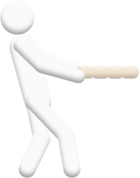



Slide 5













Slide 6
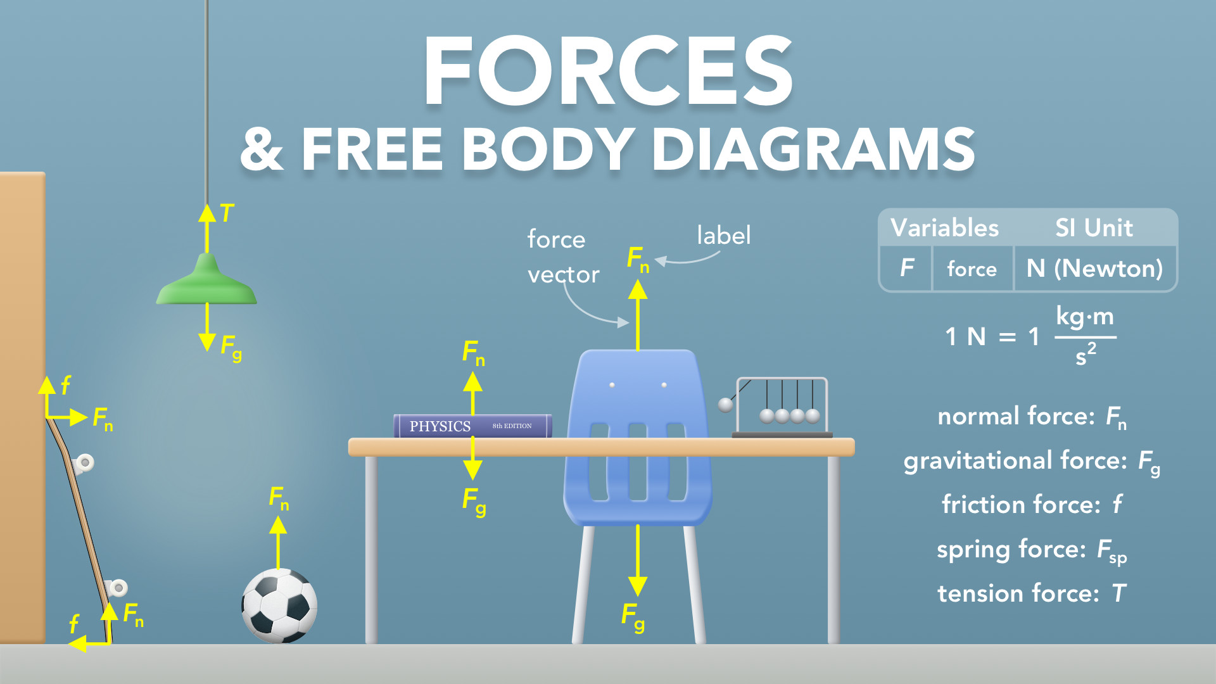
Notes:
Forces & Free Body Diagrams
physicslab.app
If you have any questions, suggestions or feedback about these slides please email me at chris@physicslab.app or send me a message on Discord @physicslab.

Slide 7
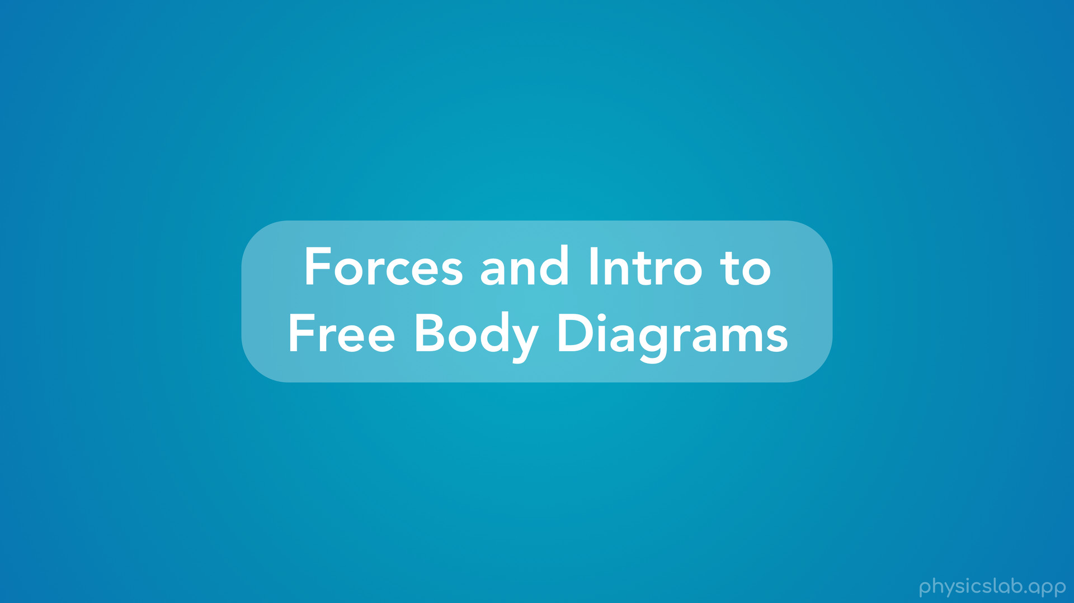
Notes:
• Hey everyone, in this video we’re gonna learn about forces and get an introduction to free body diagrams.

Slide 8
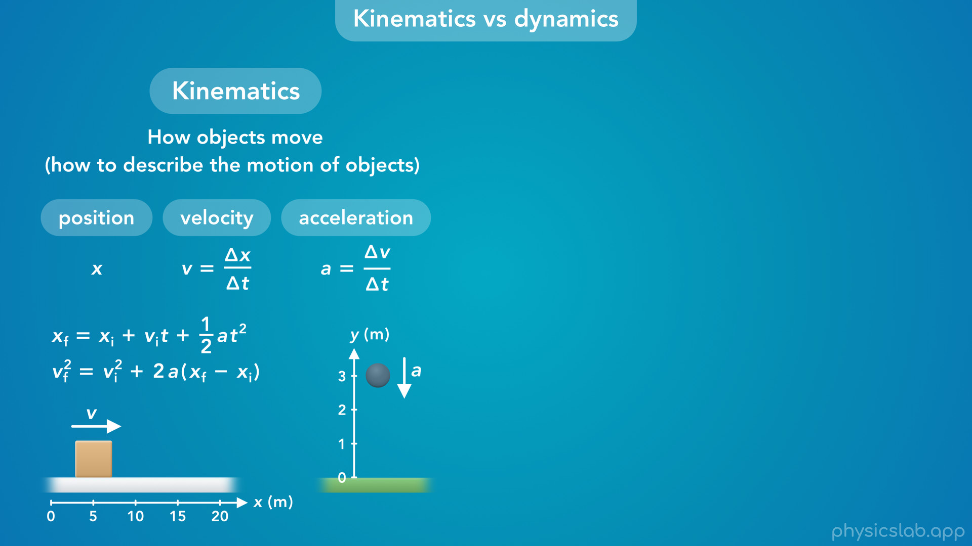
Notes:
• Like I said before, everything we’ve learned so far fits into the category of kinematics, which covers how objects move or how to describe the motion of objects. We used kinematic equations to help us describe the position, velocity and acceleration of an object, so we could answer questions like “how fast is the object moving?”, “where will it be at a certain time?”, and “how long will it take to travel some distance?”. But in every example, we were told how the object was moving. We never actually learned what was causing the object to move.

Slide 9
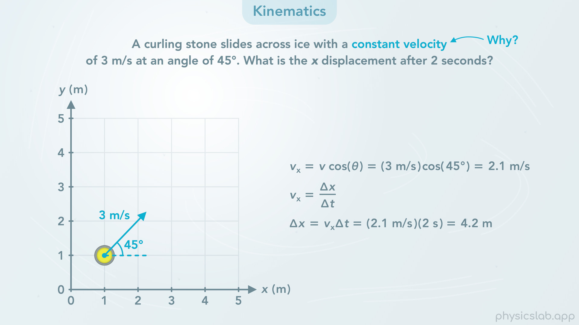
Notes:
• Let’s say we were given an example like this. “A curling stone slides across ice with a constant velocity of 3 m/s at an angle of 45 degrees. What is the x displacement after 2 seconds?”
• We would take that velocity and use a kinematic equation to find the displacement.
• But why was it moving at a constant velocity? Why wouldn’t it slow down over time?

Slide 10
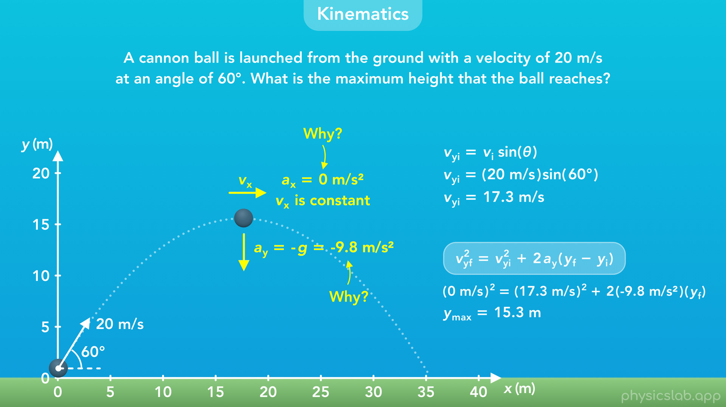
Notes:
• In projectile motion, we said that the vertical acceleration is always g, 9.8 m/s² downwards, and the horizontal acceleration is 0, so the horizontal velocity is constant. Then we could use the values we were given and some kinematic equations to answer questions about the motion.
• But why is the horizontal velocity constant, and why do all objects accelerate downwards at 9.8 m/s²?

Slide 11
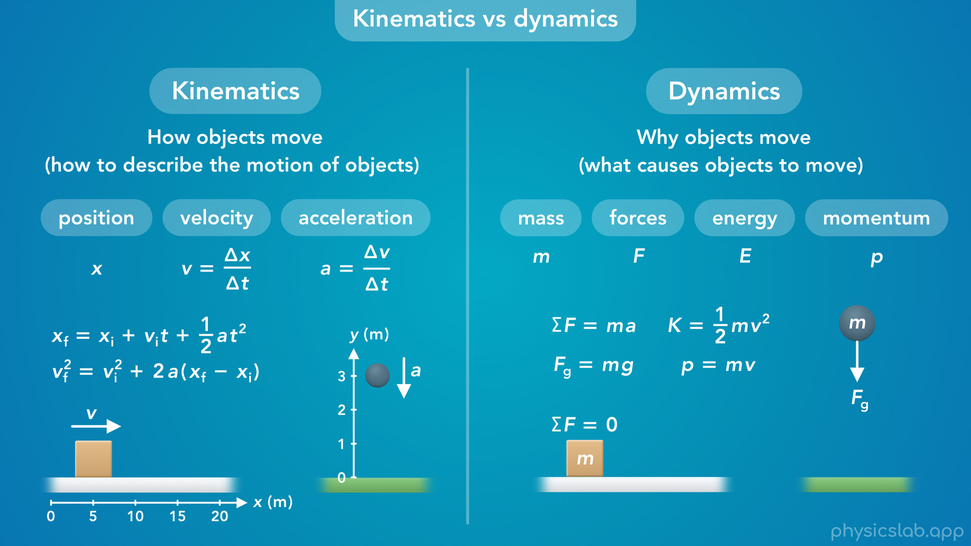
Notes:
• That’s what we’re gonna learn about in dynamics. Dynamics will explain why objects move and what causes them to move, and we’ll learn about mass, forces, energy, momentum, some fundamental laws and more.
• We’re going to cover dynamics throughout the rest of the course, starting with this video.

Slide 12
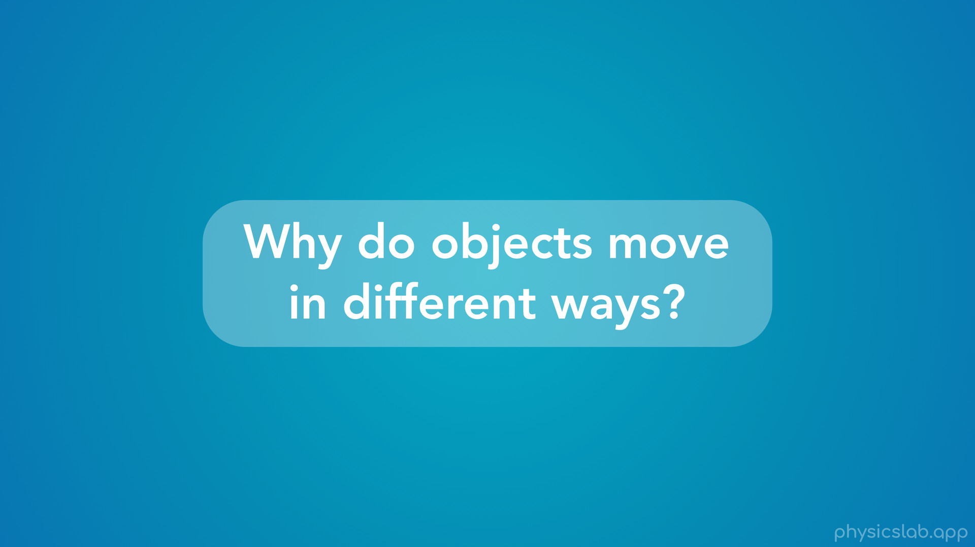
Notes:
• Alright, so why do objects move in different ways?

Slide 13
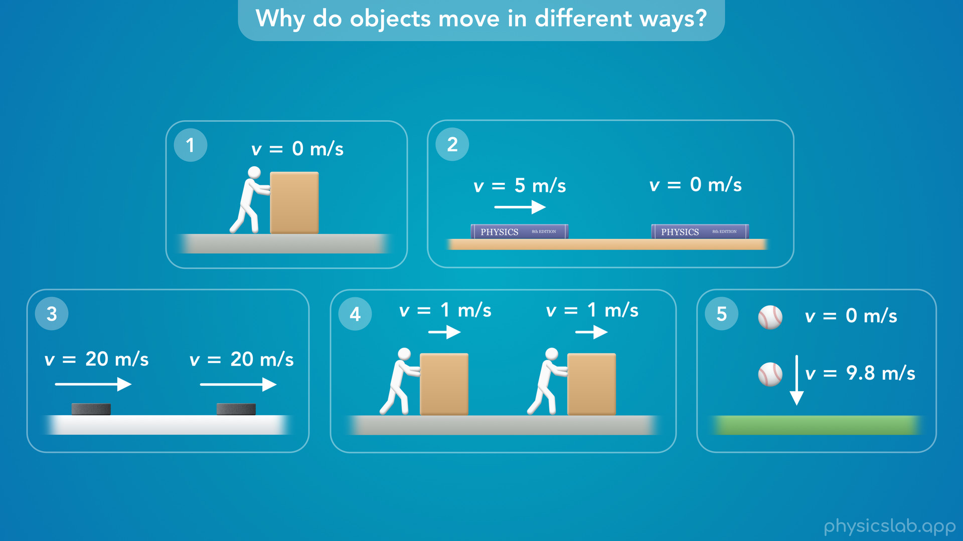
Notes:
• Things are moving, and not moving, all around us but we probably don’t think about why
• If you’re trying to move a box, and you push it as hard as you can but you can’t get it to move, “why doesn’t the box move?”
• If you grab a book and slide it across a table, why does the book eventually stop moving?
• If a hocker player passes a puck across the ice, why does the puck keep moving at a constant speed?
• If you’re trying to move another box and you’re able to slide it across the floor, why does this box move, and why would it move at a constant speed if you’re pushing on it?
• And if we drop a ball from some height, why does the ball accelerate downwards, why doesn’t the ball move at a constant speed?
• These scenarios might not seem that interesting, but almost everything in the world, and everything in the universe, behaves the same way as one of these 5 examples.
• It either doesn’t move, it slows down, it moves with a constant speed for different reasons, or it speeds up. It could also change direction, but we’ll get to that later.

Slide 14
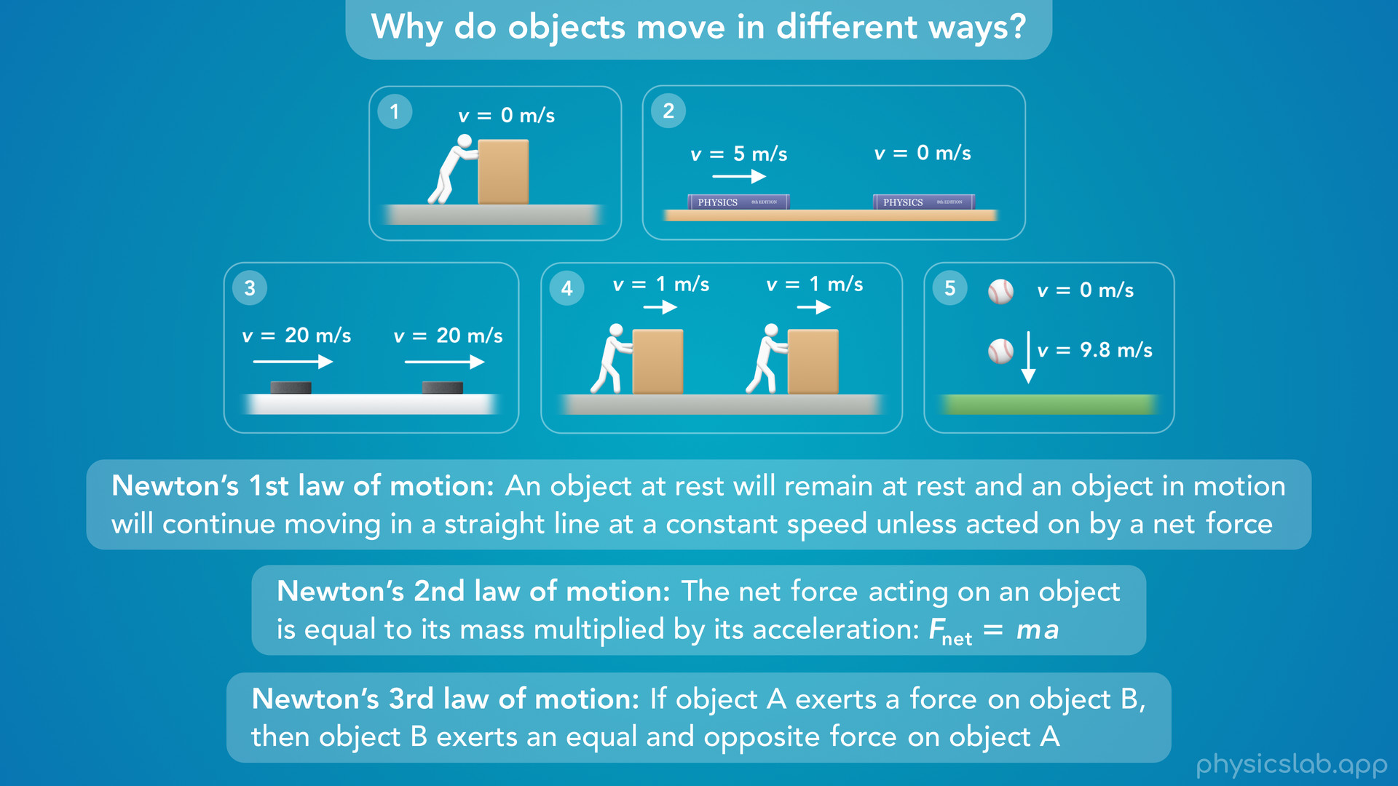
Notes:
• In the next few videos we’ll learn why these objects move in different ways using Newton’s 3 laws of motion.

Slide 15
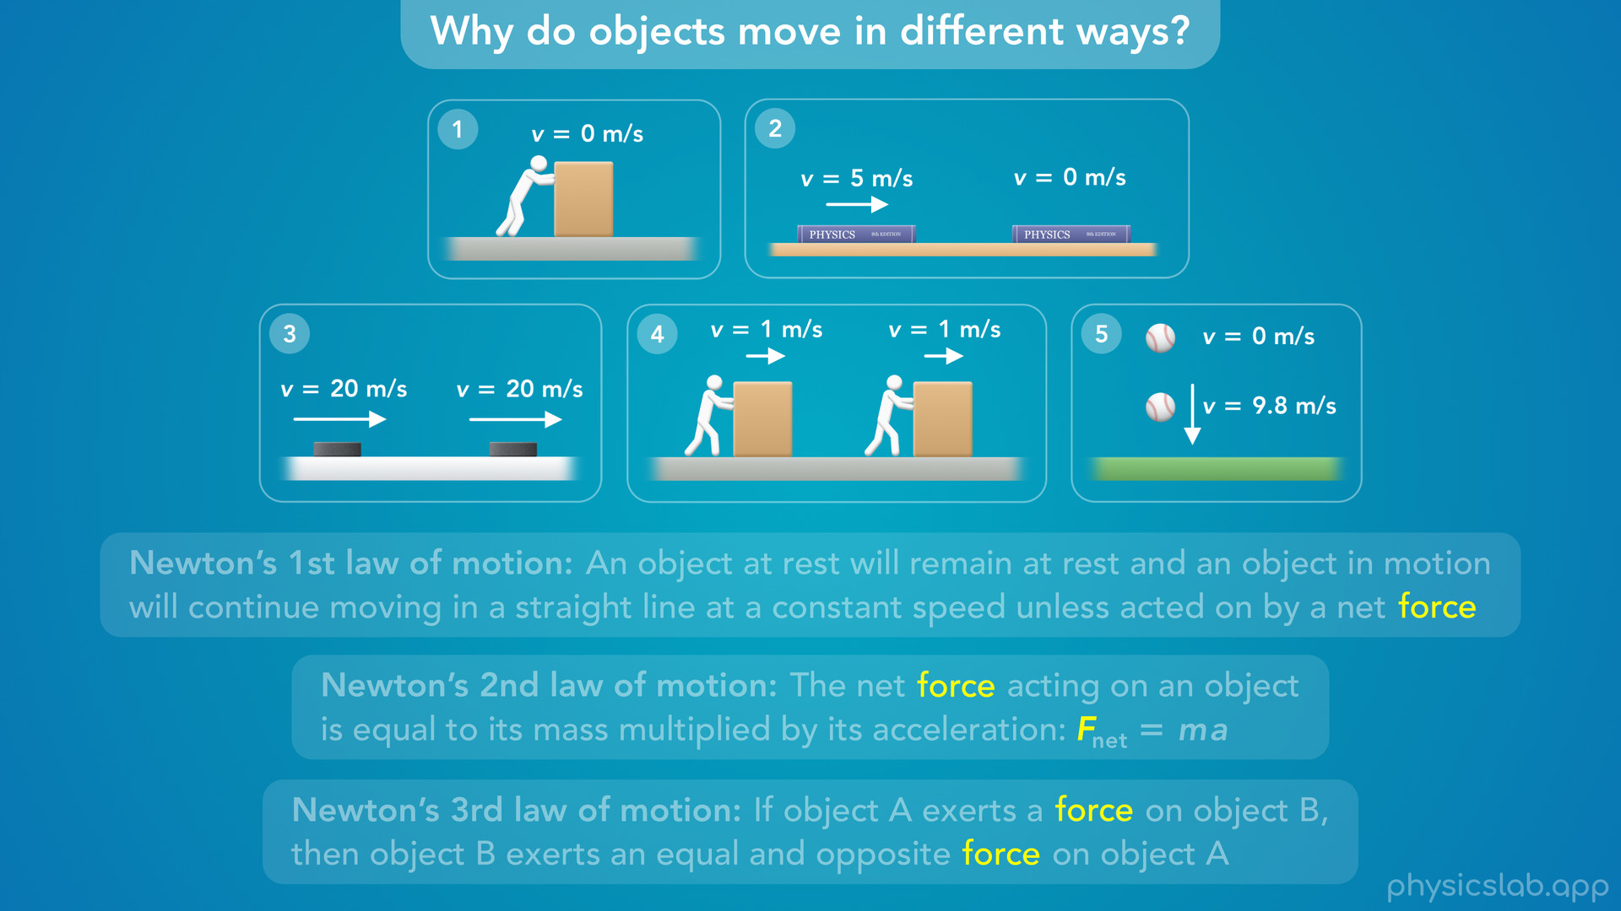
Notes:
• But before we can understand these laws, we need to learn about forces.

Slide 16

Notes:
• So, what is a force, how do we draw one, and what are the different types of forces?

Slide 17
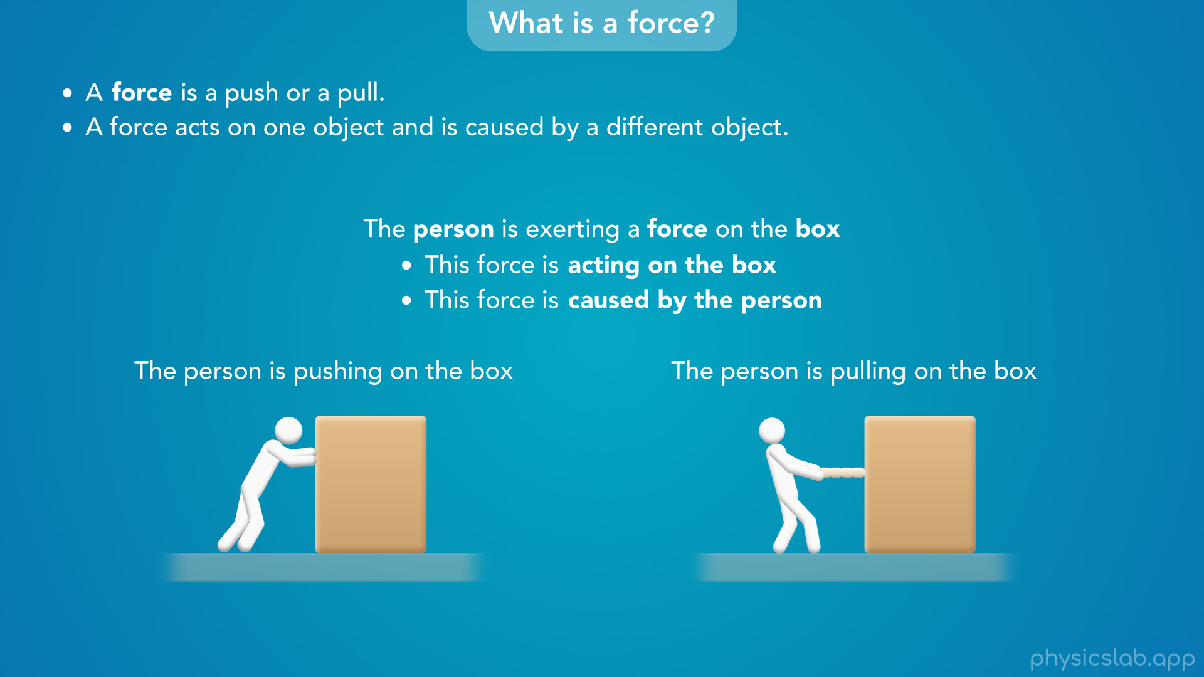
Notes:
• A force is really simple, it’s just a push or a pull.
• Let’s say the person on the left is pushing on a box, and the person on the right is pulling on a box. In both cases, the person is applying a force to the box. Or we might say the person is exerting a force on the box. These mean the same thing.
• Forces always come from the interaction between two objects. A force acts on one object and is caused by a different object. In this case this force is acting on the box and this force is caused by the person so the two objects are the box and the person.
• Even though people are pretty sophisticated objects and we can do a lot of things and move in complex ways, we’re still just objects when it comes to physics.
• If a person applies a force to an object, we don’t need to think about what the person is trying to do or anything complicated like that, we just treat it like any other force.

Slide 18
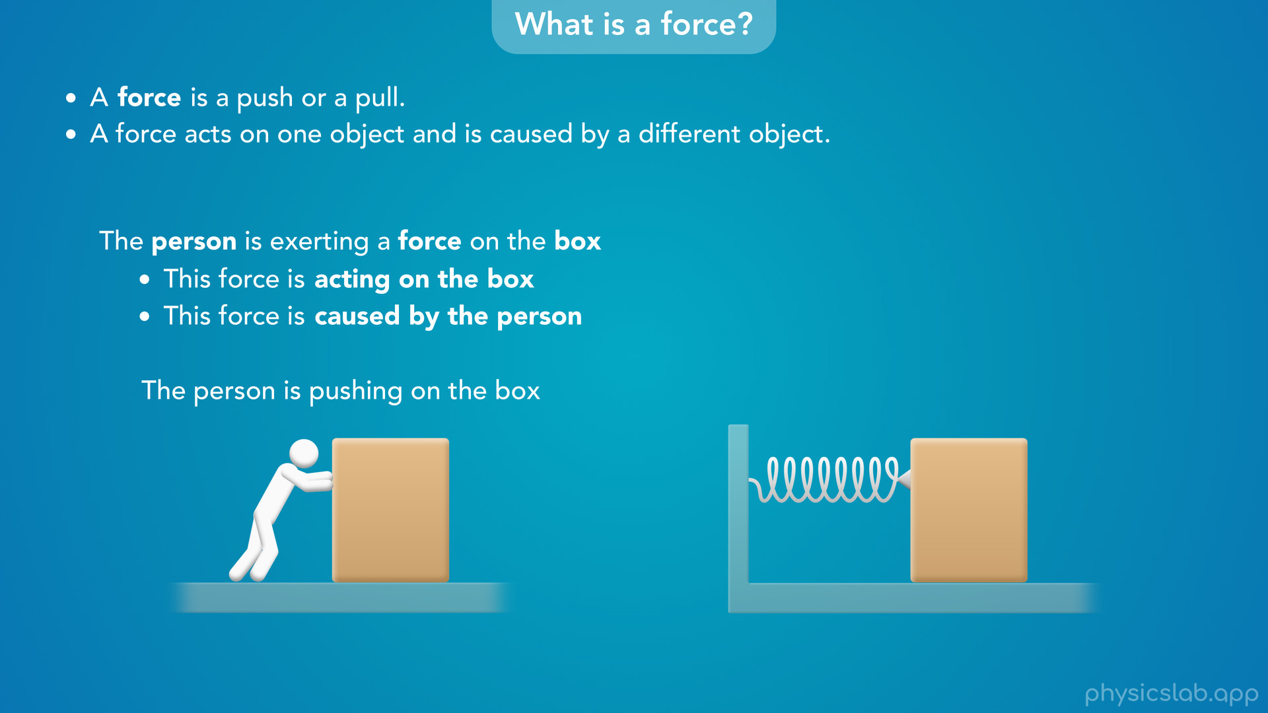
Notes:
• For example, if we attached a large spring to the box and squeezed it against a wall so that the spring wants to get longer

Slide 19
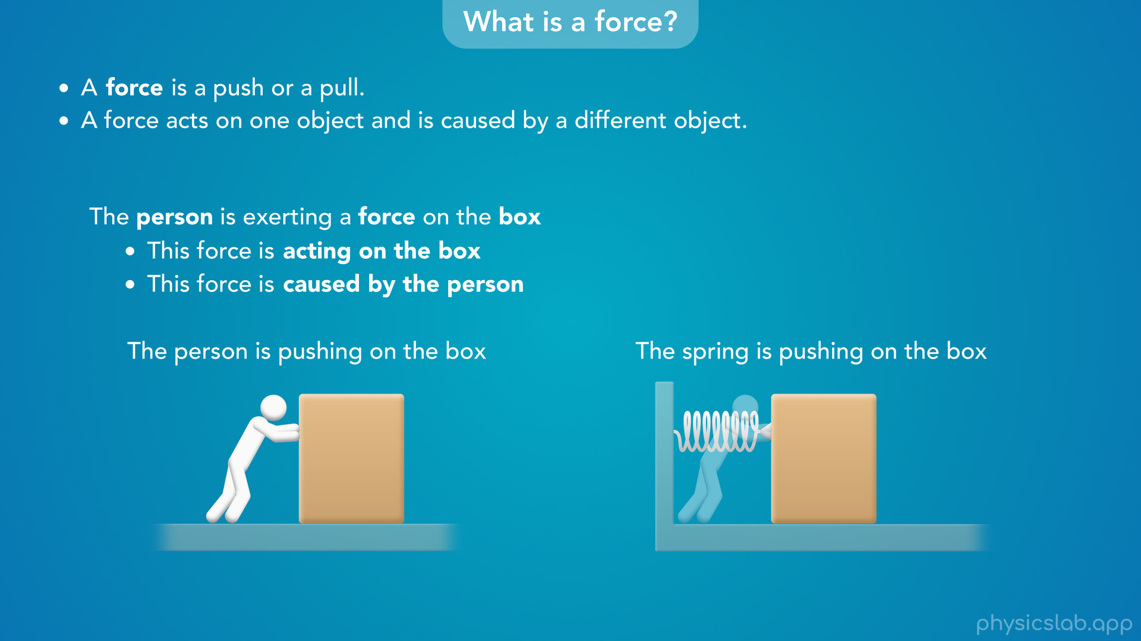
Notes:
the spring would push on the box just like a person would push on the box.

Slide 20
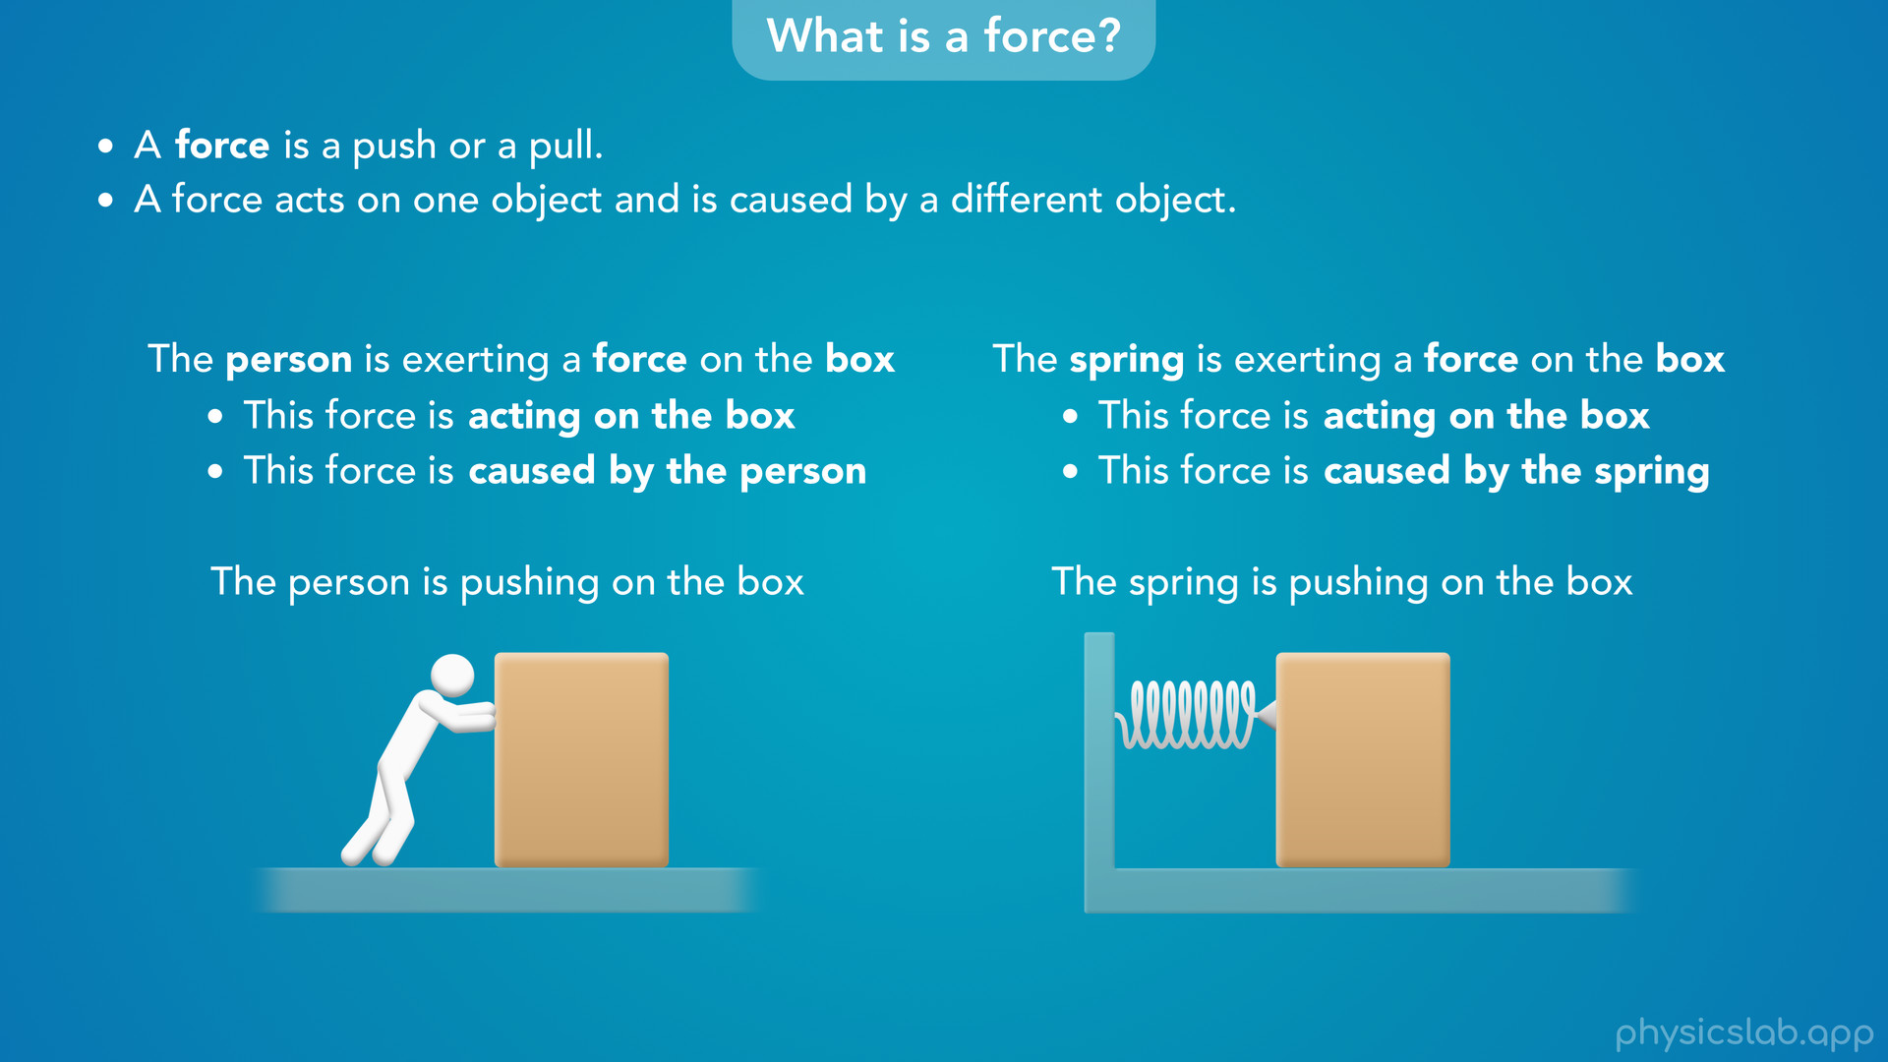
Notes:
This force is acting on the box but now the force is caused by the spring.

Slide 21
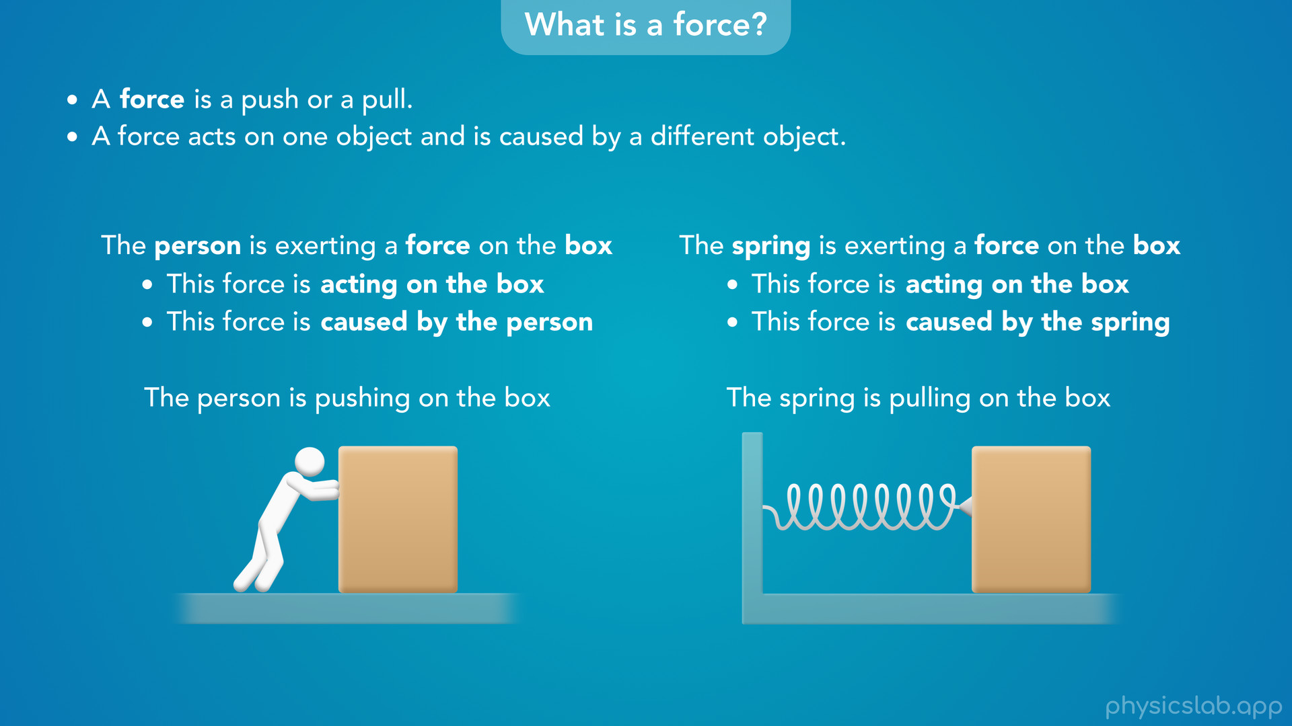
Notes:
• Or if we stretched the spring so it wants to get shorter

Slide 22
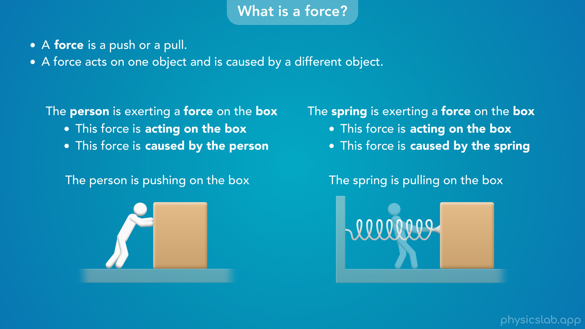
Notes:
the spring would actually pull on the box just like a person would pull on the box.
We’ll cover spring forces in another lesson, but the point is, objects exert forces on other objects, and a force is just a push or a pull.

Slide 23
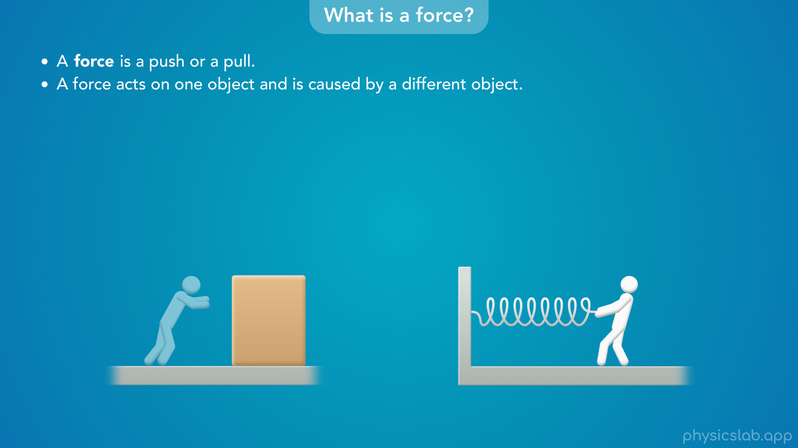
Notes:
• But what does a force look like? Well we can’t actually see a force. But sometimes we can see the effect of a force.
• If this person exerts a force on the box and the box moves, we can tell that the motion is probably caused by the pushing force from the person.
• Or if we exert a pulling force on a spring, or something like a rubber band, we can see the spring gets longer because of that force.

Slide 24
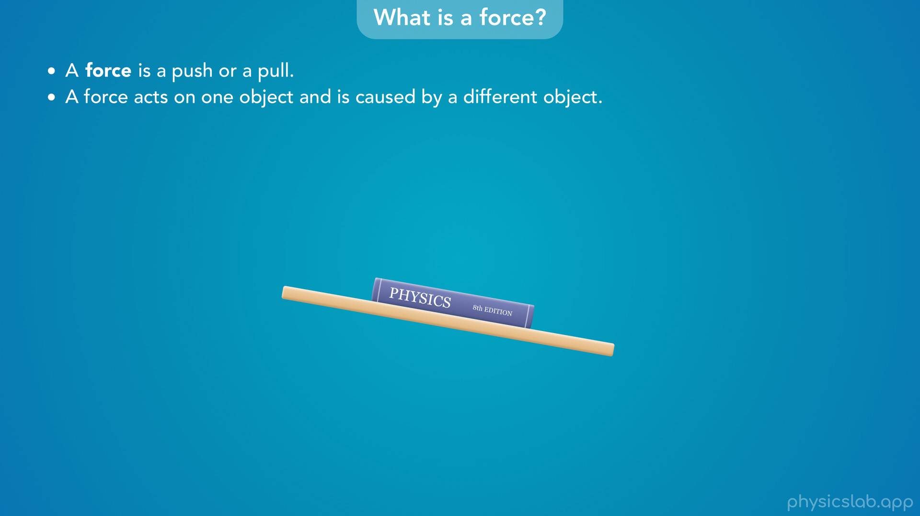
Notes:
• But most of the time, we won’t be able to see the effects of a force, at least not every force.
• For example, this book is sitting on an inclined table.

Slide 25
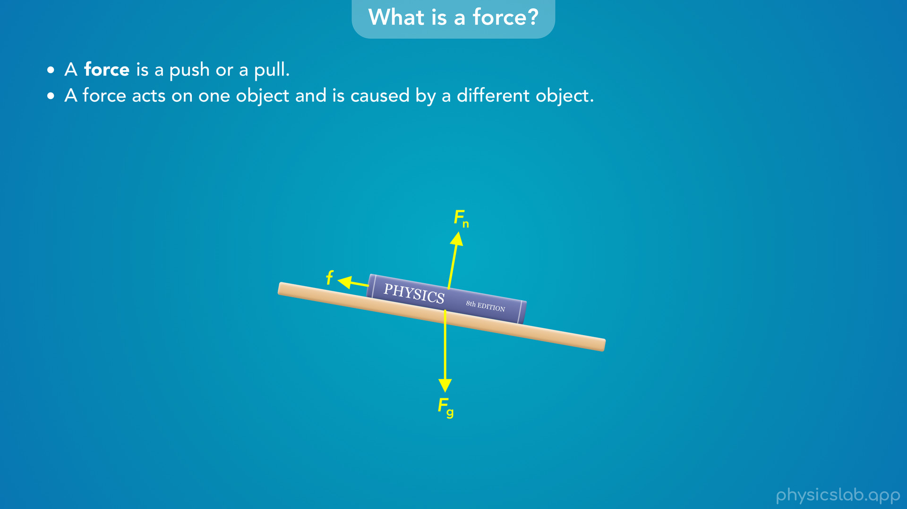
Notes:
Even though the book isn’t moving and nothing seems to be stretching, there’s actually 3 forces that are acting on the book.
So even though we can’t see a force, we can draw a force.

Slide 26
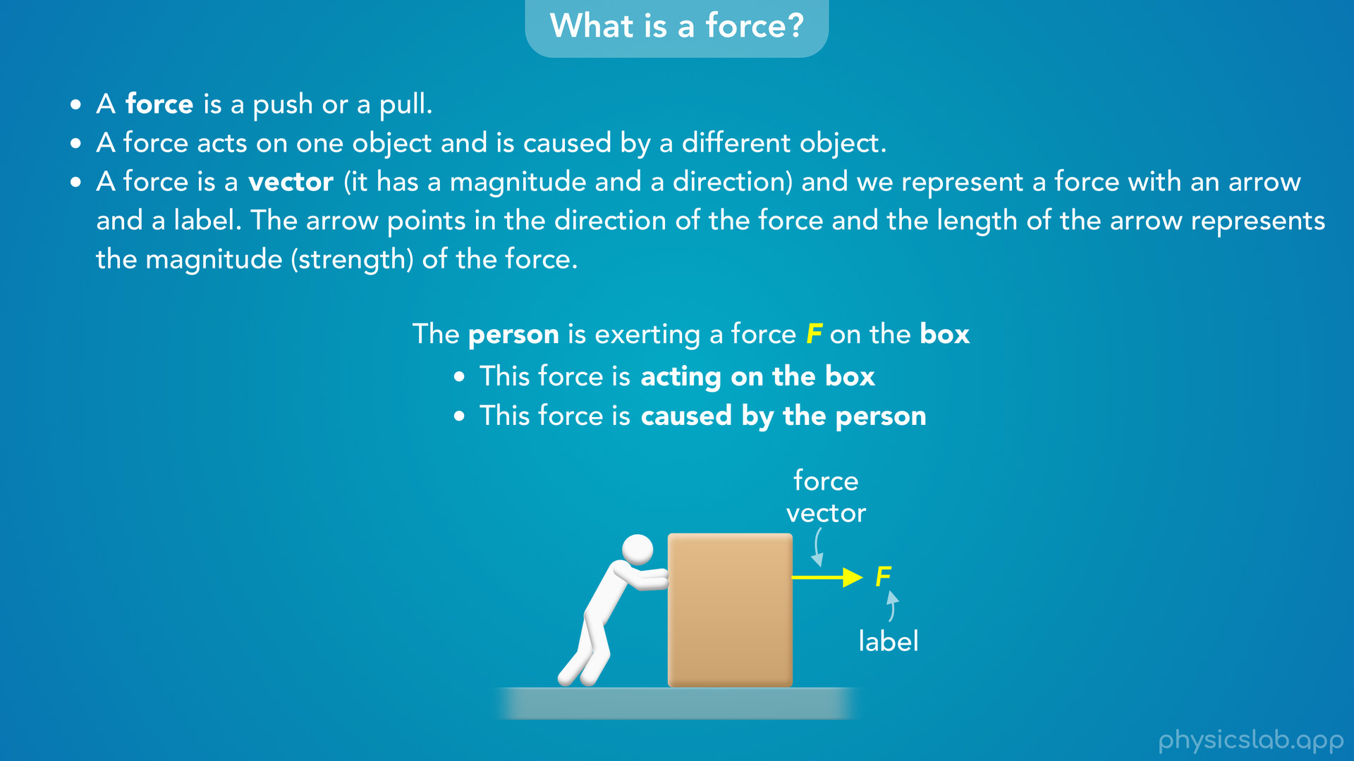
Notes:
• A force is a vector (it has a magnitude and a direction) and we represent a force with an arrow and a label. The arrow points in the direction of the force and the length of the arrow represents the magnitude or the strength of the force. This is just like when we drew displacement, velocity and acceleration vectors.
• So now we might say the person is exerting a force “F” on the box. F is just the default variable or label that we give a force. We could also add a subscript like “the force exerted by the person on the box”.
• The person is pushing the box to the right so the force vector points to the right.

Slide 27
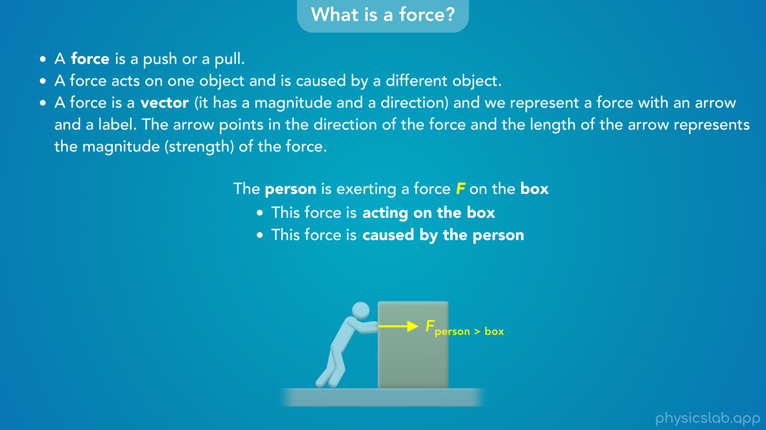
Notes:
• For translational dynamics, we can draw the force vector anywhere as long as we know what the force is acting on and what’s causing it. We could draw the force like this,

Slide 28

Notes:
we could draw it like this,

Slide 29
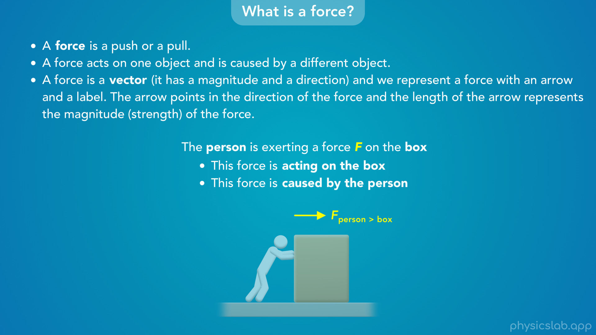
Notes:
or we could draw it somewhere else.

Slide 30
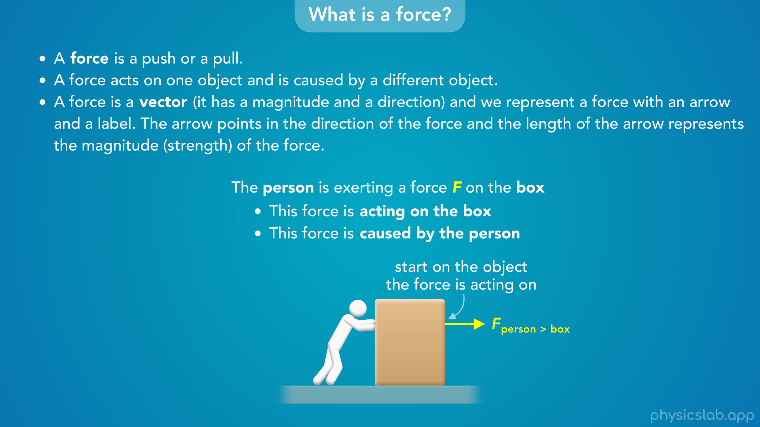
Notes:
• But as we’ll see later when we talk about free body diagrams, we usually draw the a force vector so it starts on the edge of the object that the force is acting on, and then it points in the direction of the force. This way the force doesn’t overlap with the object and it’s easier to see. But the most important part is the direction of the force.

Slide 31
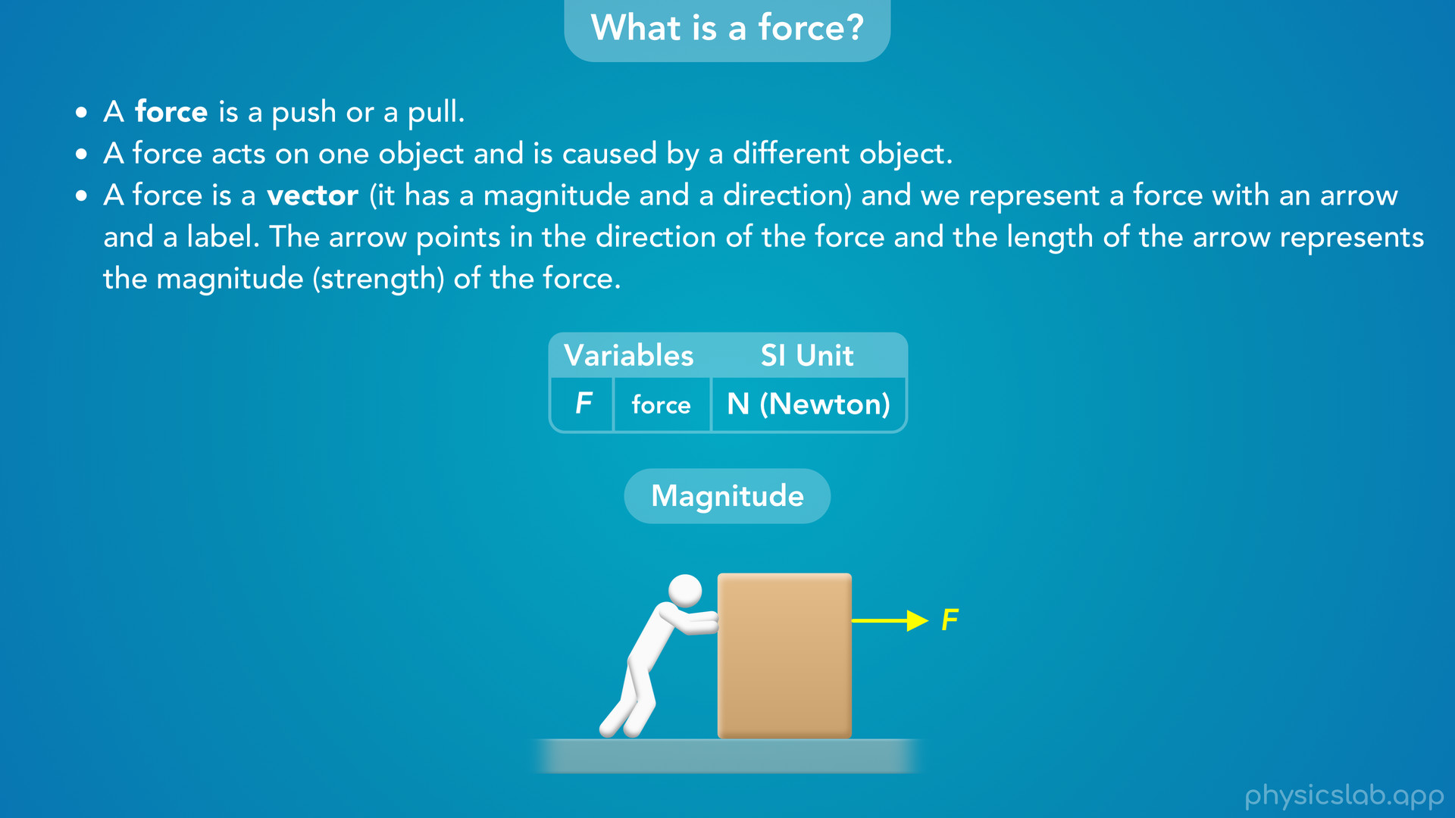
Notes:
• So that’s how we draw a force.
• But how do we describe the strength or magnitude of a force? How much force is this person exerting on the box?

Slide 32
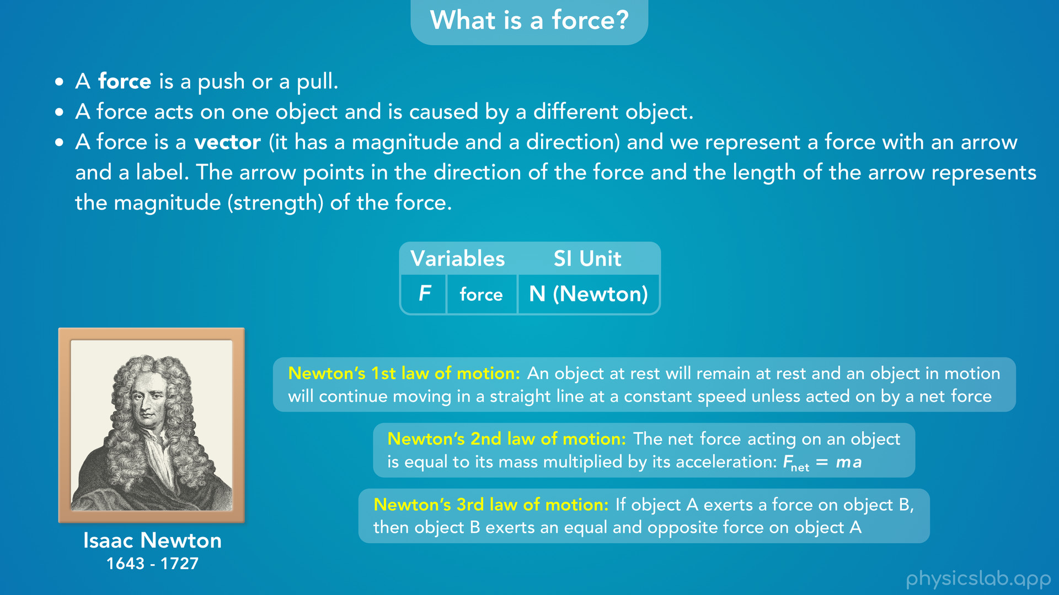
Notes:
• We measure a force using the SI unit of Newtons, abbreviated as capital N, and named after Isaac Newton, the guy that described motion using these 3 laws.

Slide 33
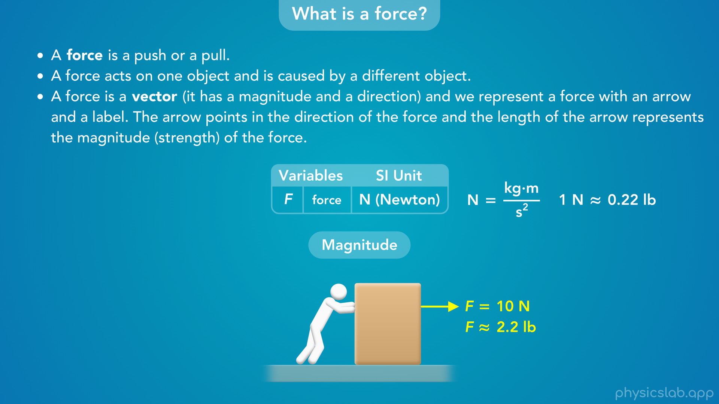
Notes:
• So let’s say this person is pushing on the box with a force of 10 N. That’s the magnitude or strength of the force.
• A Newton is actually a derived SI unit, and 1 N is equal to 1 kilogram meter per second squared, which will make a lot of sense when we cover Newton’s 2nd law.
• Also, 1 N is roughly equal 0.2 pounds. A pound is actually a unit of force, so we could say this person is pushing on the box with about 2.2 pounds of force.

Slide 34
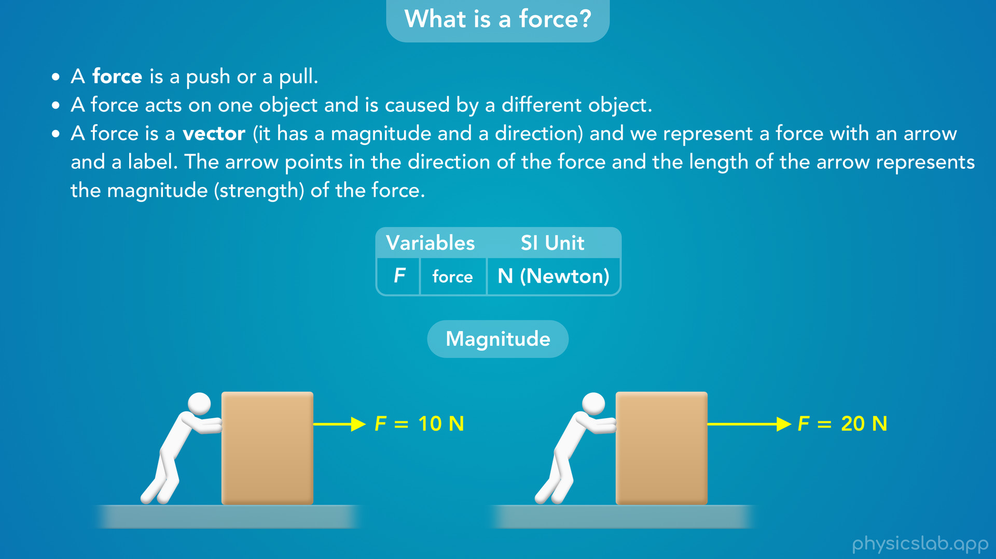
Notes:
• Remember, the length of the force vector represents the magnitude of the force. So if the person pushed twice as hard with 20 N of force, the force vector would be twice as long.

Slide 35
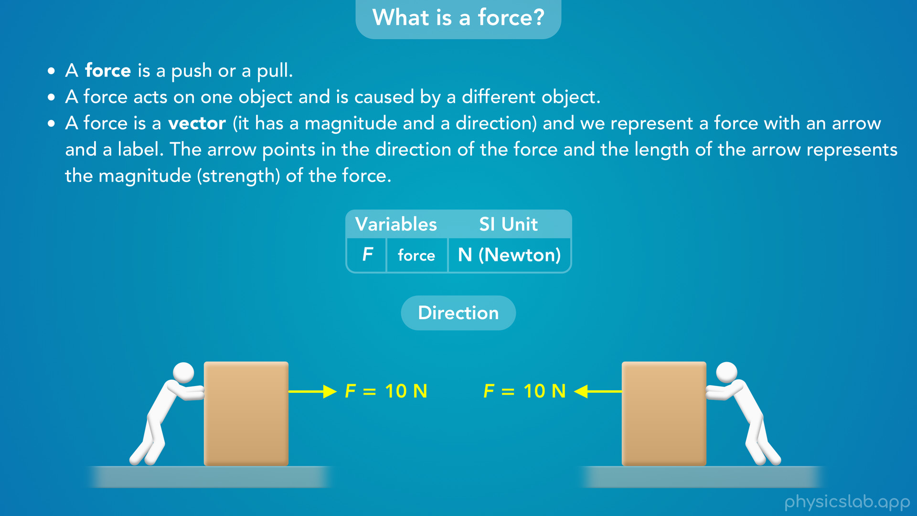
Notes:
• And again, the vector points in the direction of the force. So if the person was pushing the box to the left, we would draw the force vector pointing to the left.

Slide 36
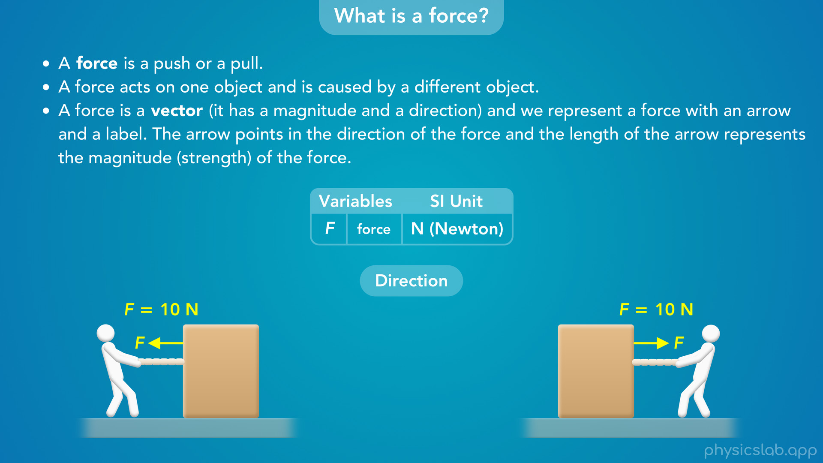
Notes:
• And what if the person was pulling on the box? If they’re pulling to the left, then the force vector points to the left, and if they’re pulling to the right, the force vector points to the right.
• It doesn’t matter if the force is a push or a pull, the vector always points in the direction of the force.

Slide 37
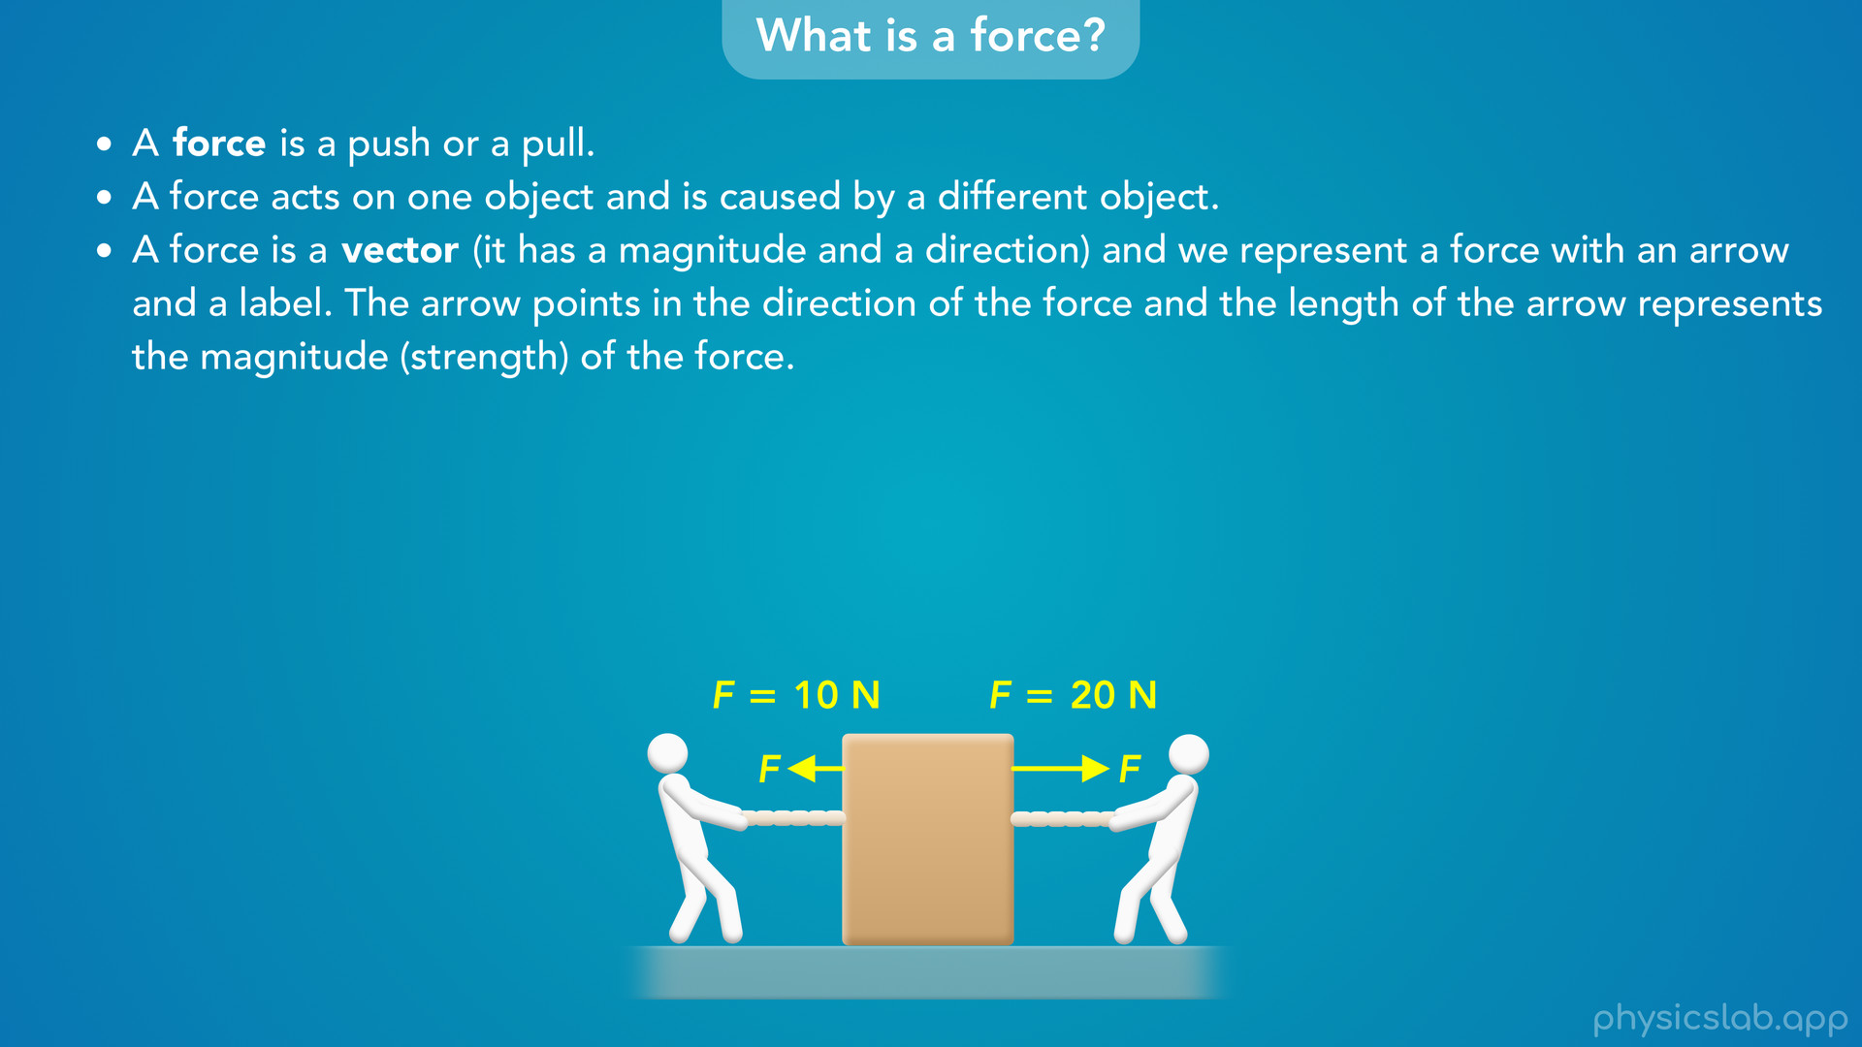
Notes:
• There can also be multiple forces acting on an object at the same time, and there usually is.
• Here we can see two people are pulling on the box in different directions.

Slide 38

Notes:
• Once we start to deal with multiple forces we may want to give them subscripts, and we could label these forces as F1 and F2.
• So that’s an introduction to forces.

Slide 39
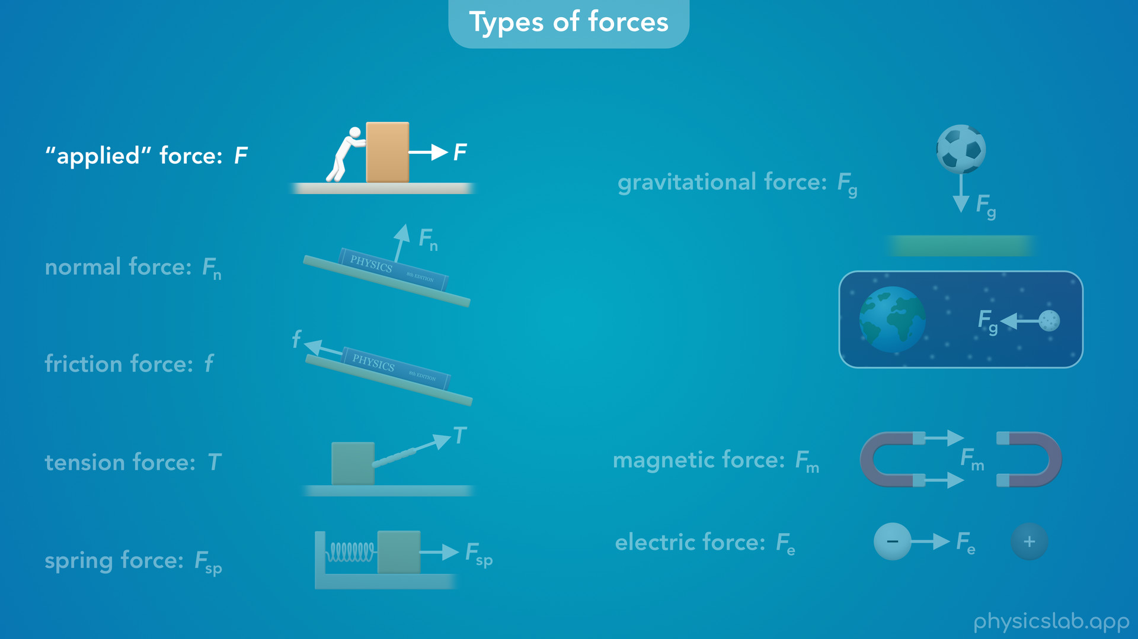
Notes:
• Let’s take a look at the forces that we’ll learn about in this course.
• So we just looked at a person pushing or pulling on an object. This is what we might call an “applied” force. This isn’t really a type of force, but a problem might just tell us that a force is applied to an object without telling us what’s causing the force.

Slide 40
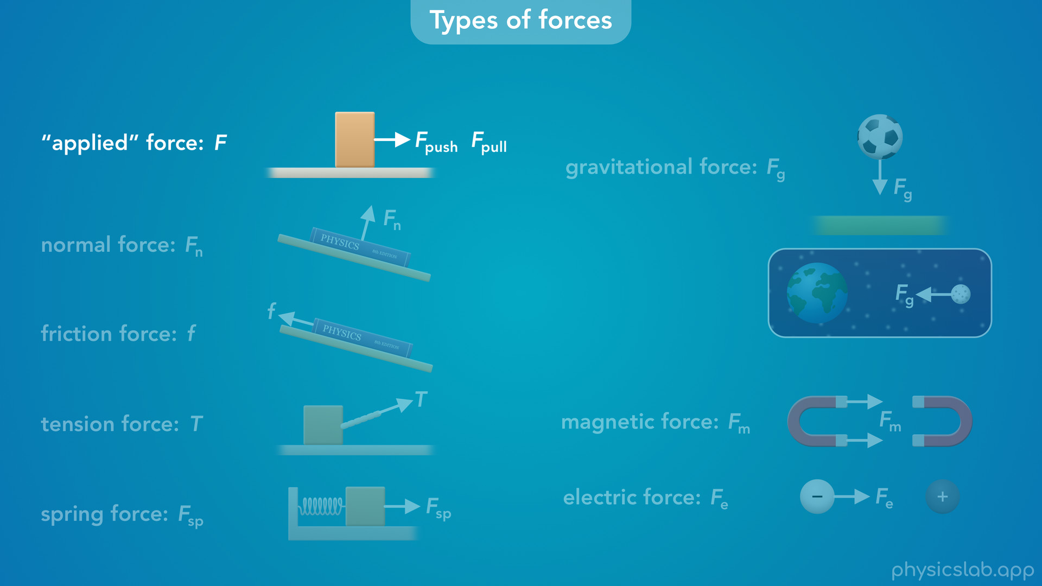
Notes:
We might label the force with something like F, F pull, the problem might use another variable like P,

Slide 41

Notes:
or we might just be given the magnitude of the force like 10 N.

Slide 42
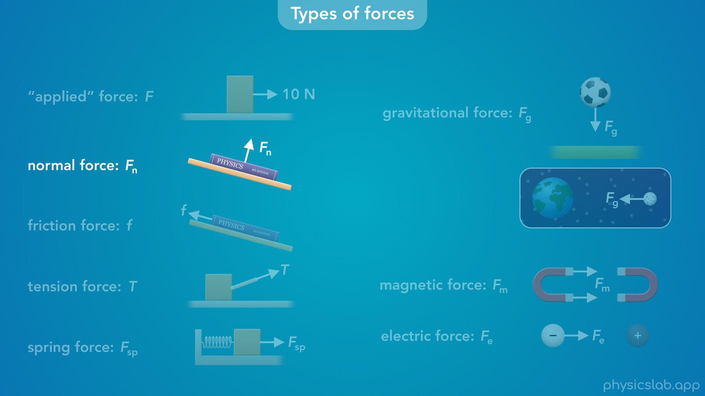
Notes:
• One of the first types of forces that we’ll learn about is a normal force, which we’ll label as F n. A normal force exists between any two objects that are in contact with each other, so it shows up all the time. It’s called a normal force because normal means perpendicular, and this force always acts perpendicular to the surface, no matter which way its oriented.

Slide 43
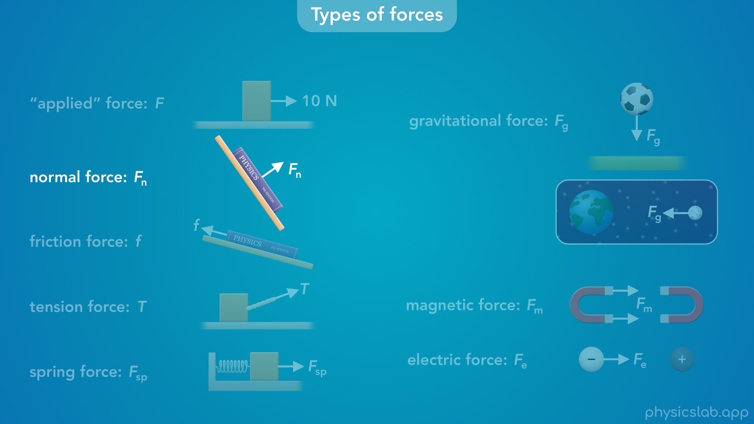

Slide 44
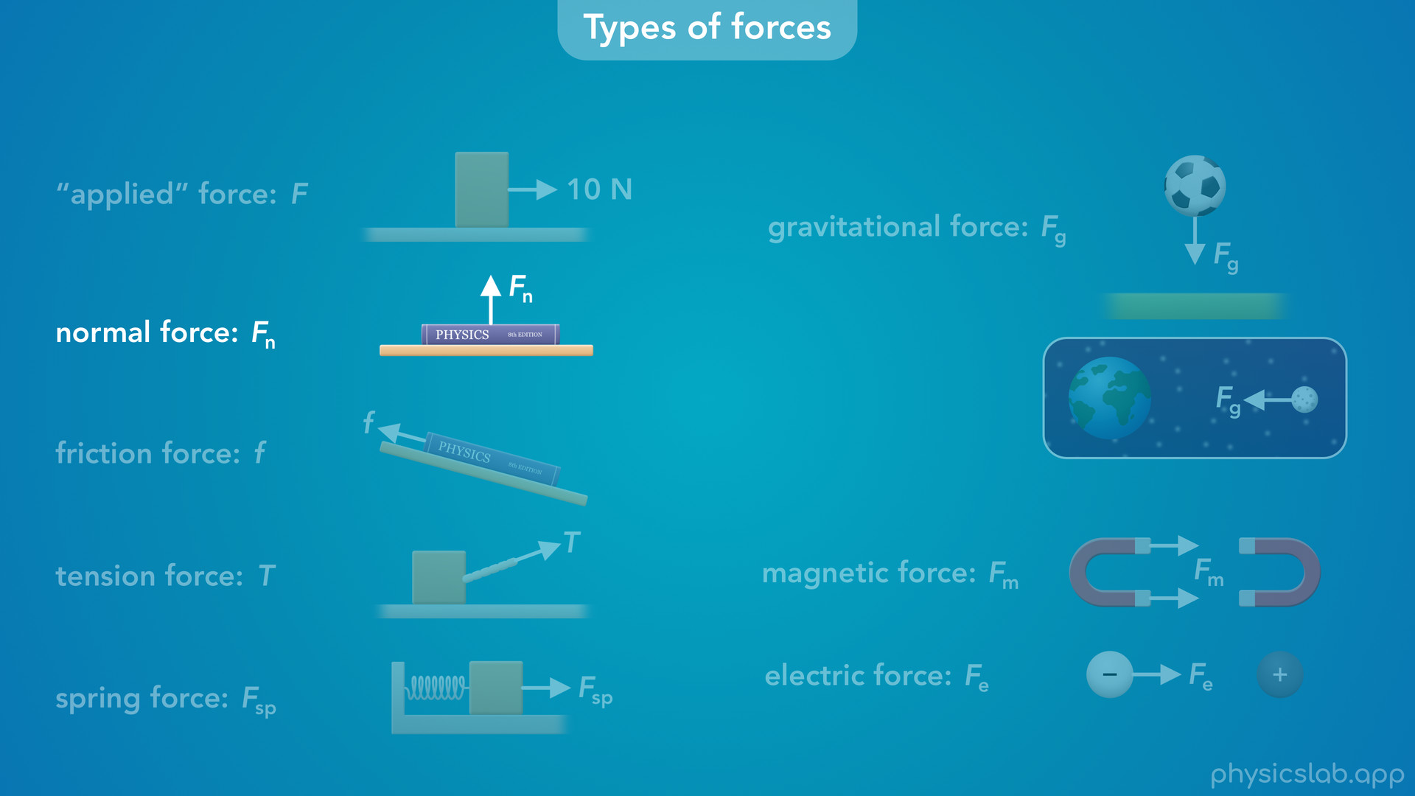
Notes:
So this table is exerting a normal force on this book…

Slide 45
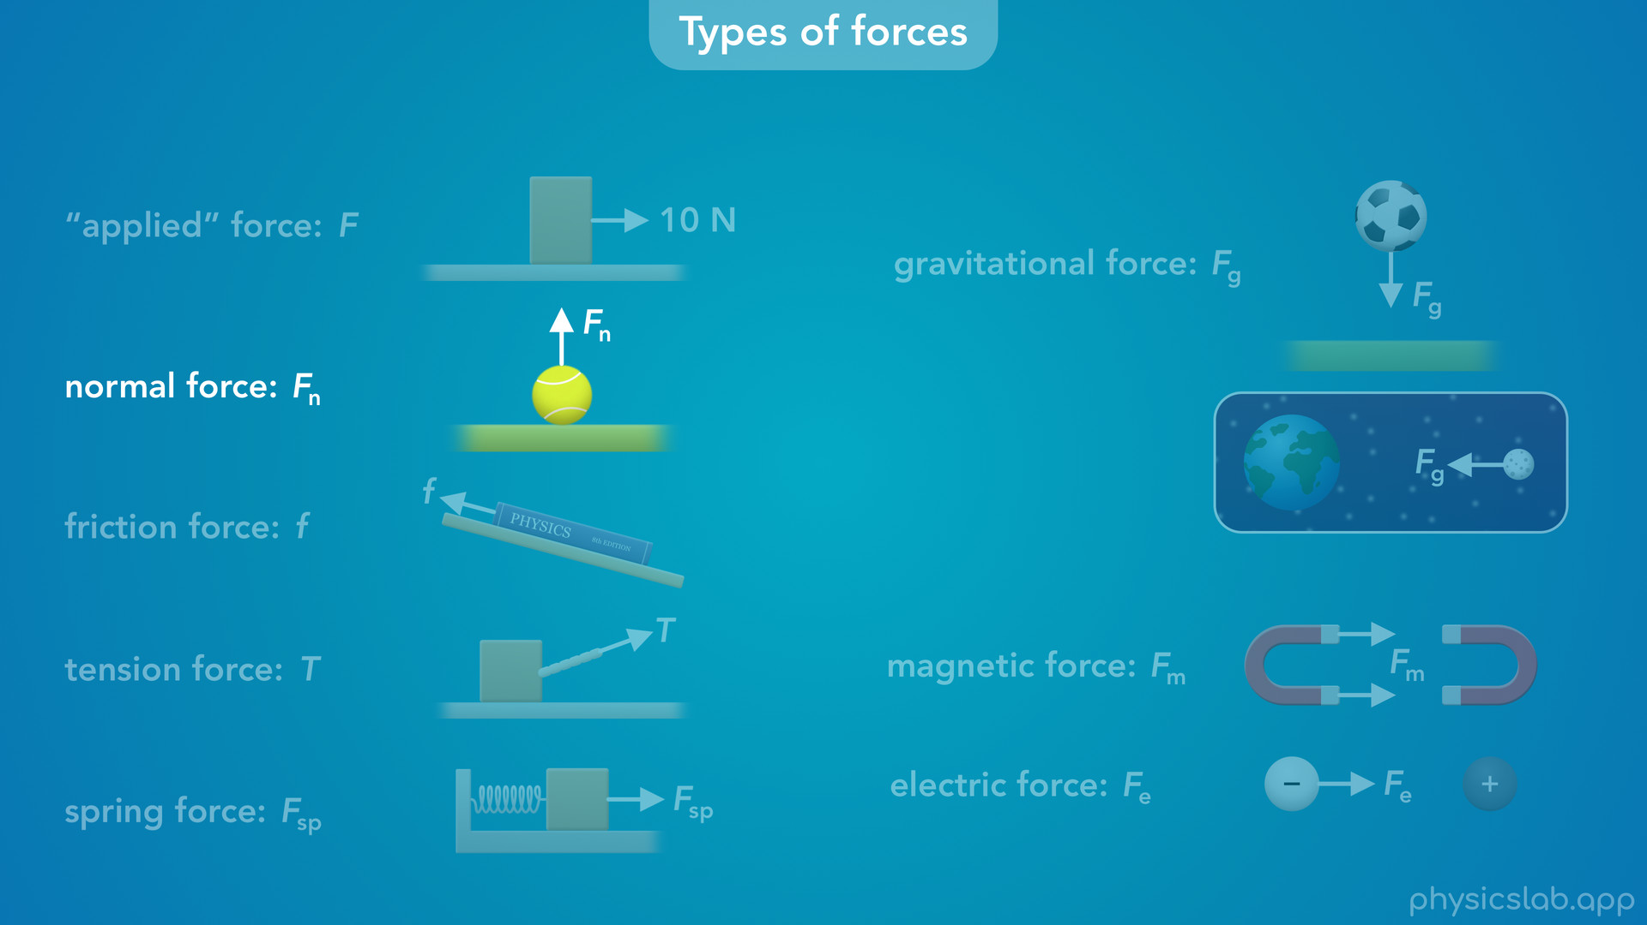
Notes:
and the ground is exerting a normal force on this ball.’

Slide 46
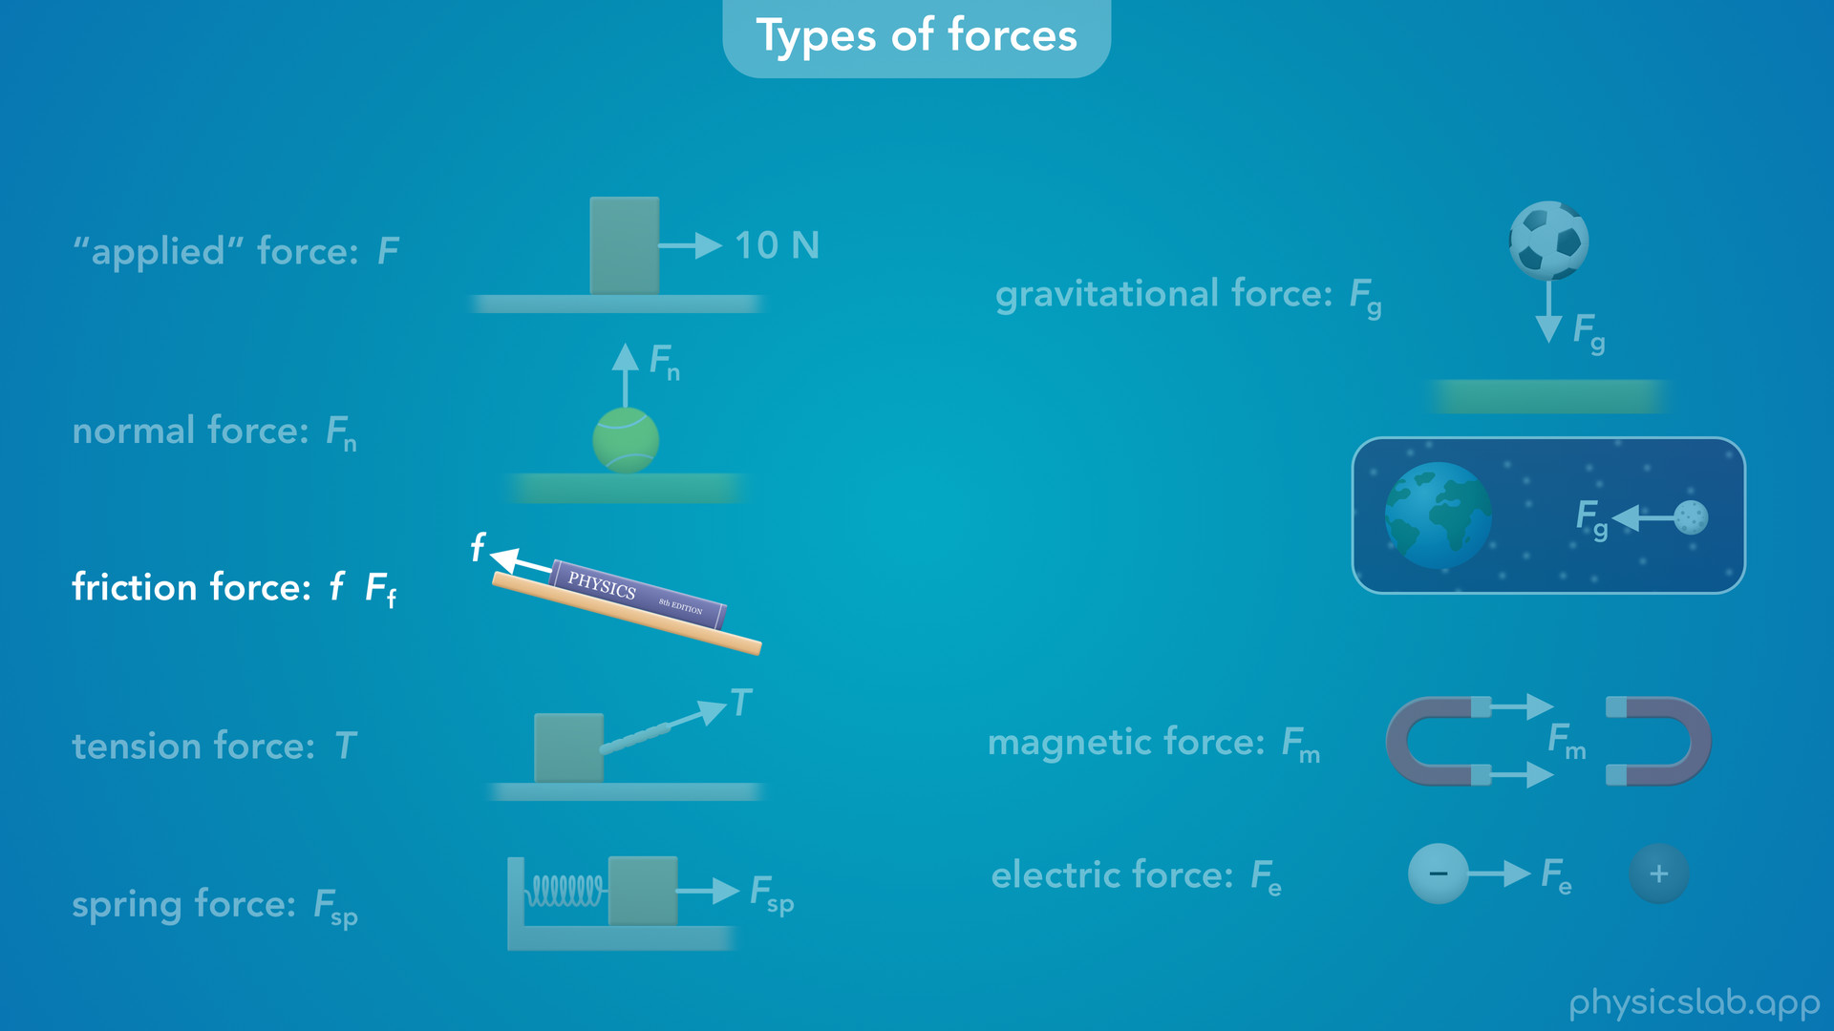
Notes:
• Another very common force is a friction force. This is usually labeled with a lowercase f, but you could also label it like this. A friction force can exist between any two objects that are in contact and it always opposes motion. So this book isn’t sliding down because the table is exerting a friction force in the other direction. Friction forces are everywhere, and they’re the reason that moving objects eventually slow down and stop. But friction also allows you to walk and drive a car, and it prevents everything from sliding around.

Slide 47
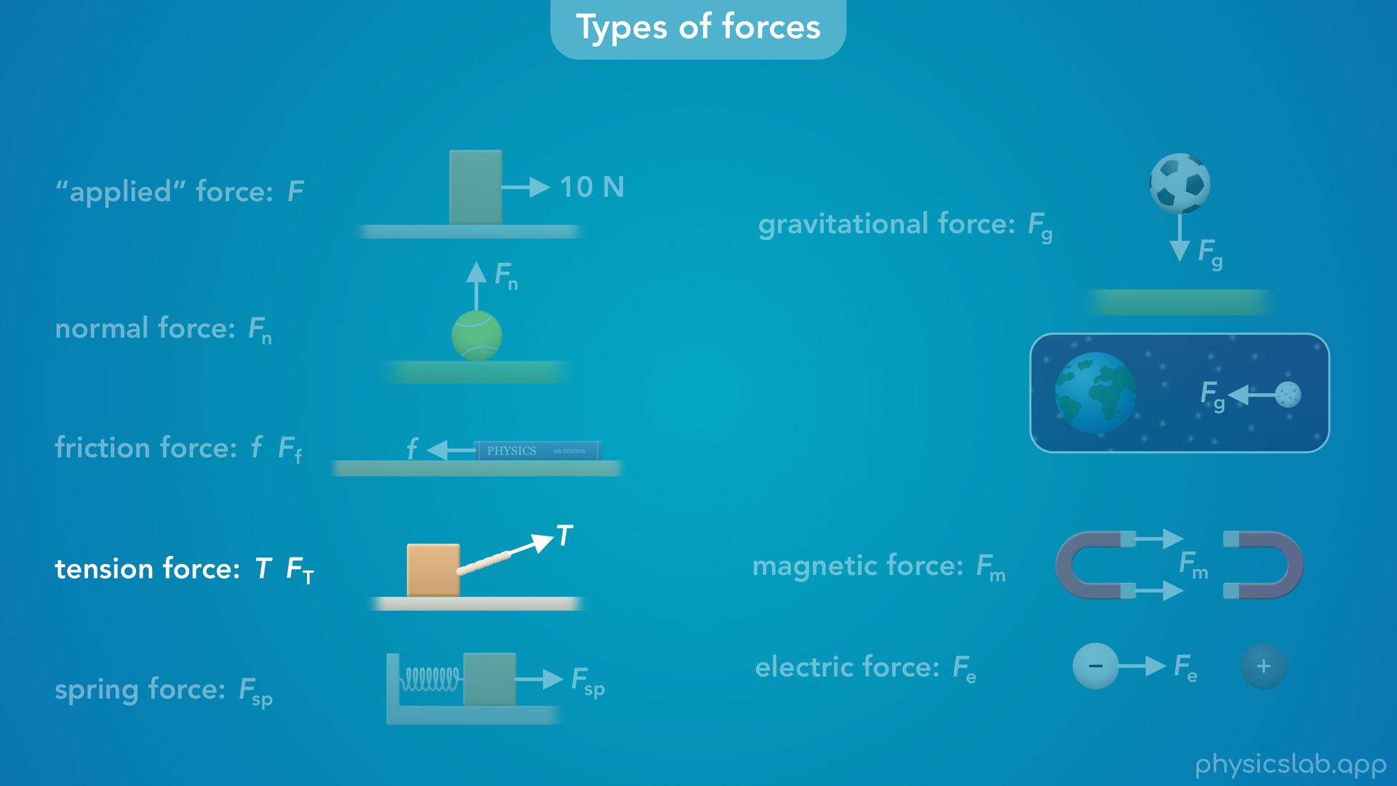
Notes:
• Another force that we’ll learn about is a tension force, usually labeled as T, but you could also use F T. Tension is a pulling force that we’ll see with things like ropes, strings and cables. If this box is being pulled by a rope, we’re going to call that pulling force a tension force.

Slide 48
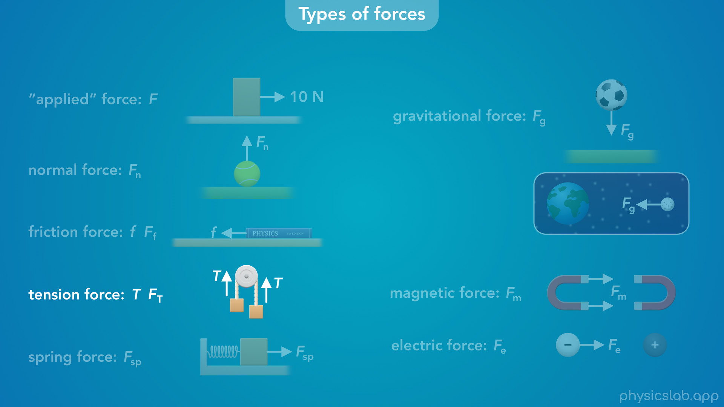
Notes:
We can also change the direction of a tension force without changing its magnitude by using a pulley, and we’ll learn more about pulley systems later on.

Slide 49
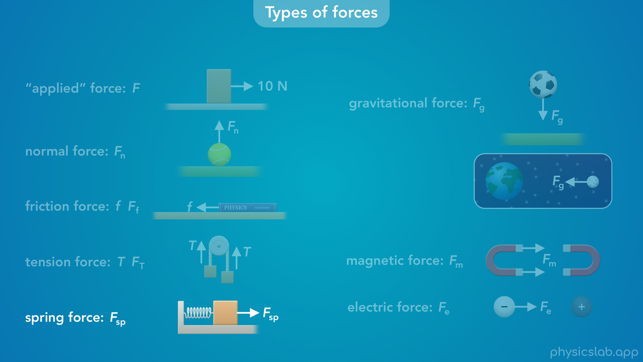
Notes:
• And like we mentioned before, a spring can exert a spring force on an object, which we can label as F sp for “spring”. It takes some force to stretch and compress a spring, and the spring will exert a force on the objects that it’s attached to.

Slide 50
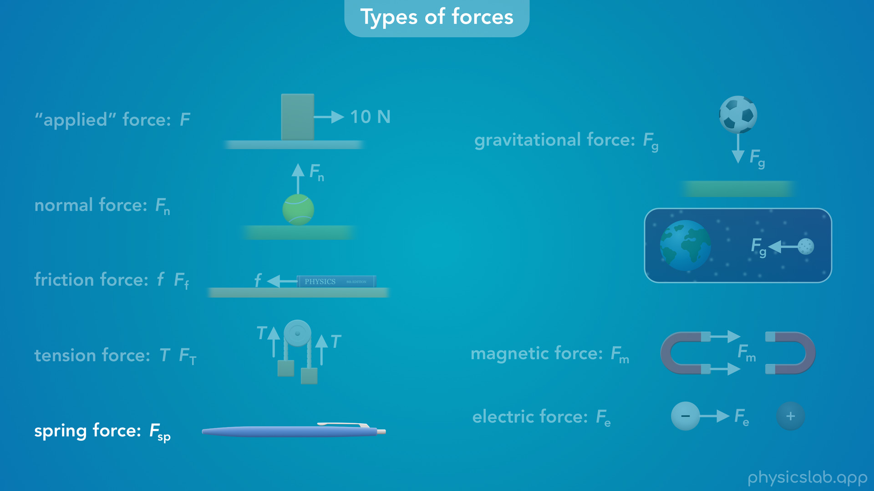

Slide 51
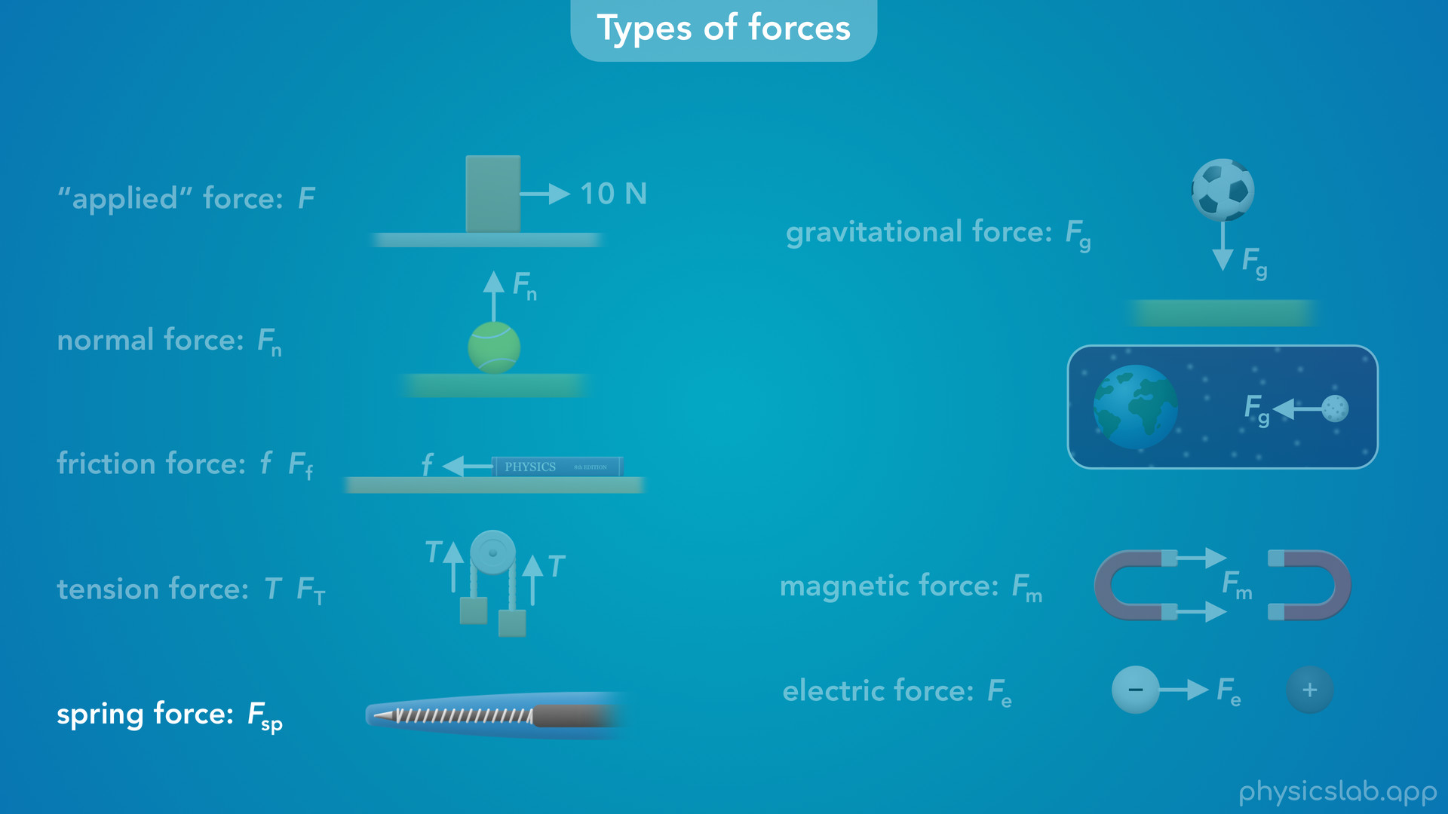
Notes:
A lot of things that we use, like pens, work by using springs because we can move stuff in a specific way by applying a force.

Slide 52
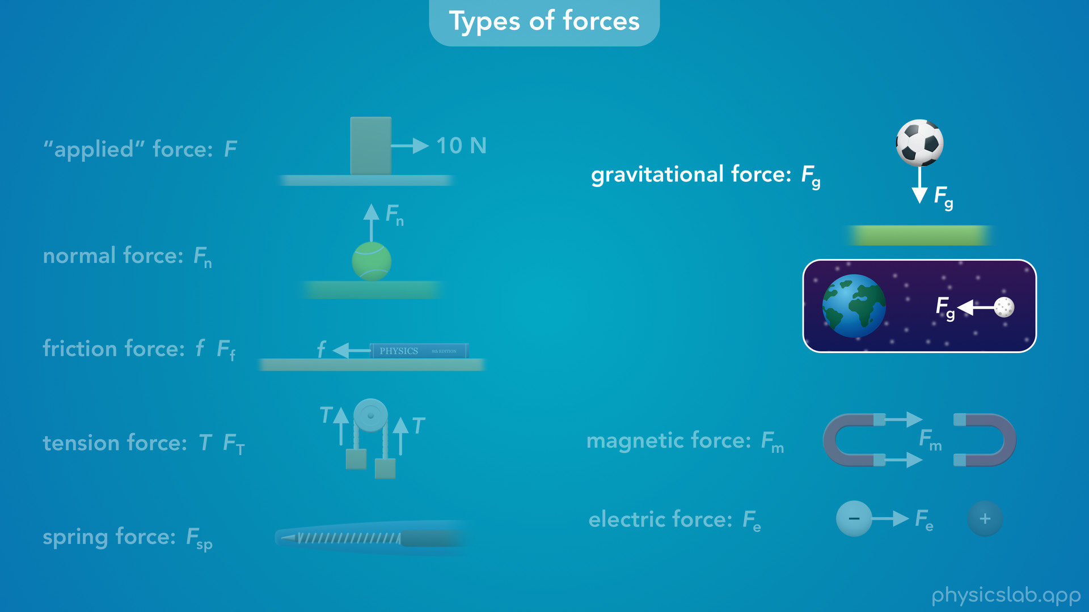
Notes:
• Another very important force is a gravitational force, which we’re gonna label as F g. In classical mechanics, which is what we’re learning in this course, what we experience as gravity is the Earth pulling down on every object with a gravitational force. This force exists between any two objects with mass, and the gravitational force that exists between the earth and this ball is the same gravitational force that exists between the earth and the moon, and it’s what keeps the planets in orbit around the sun.

Slide 53
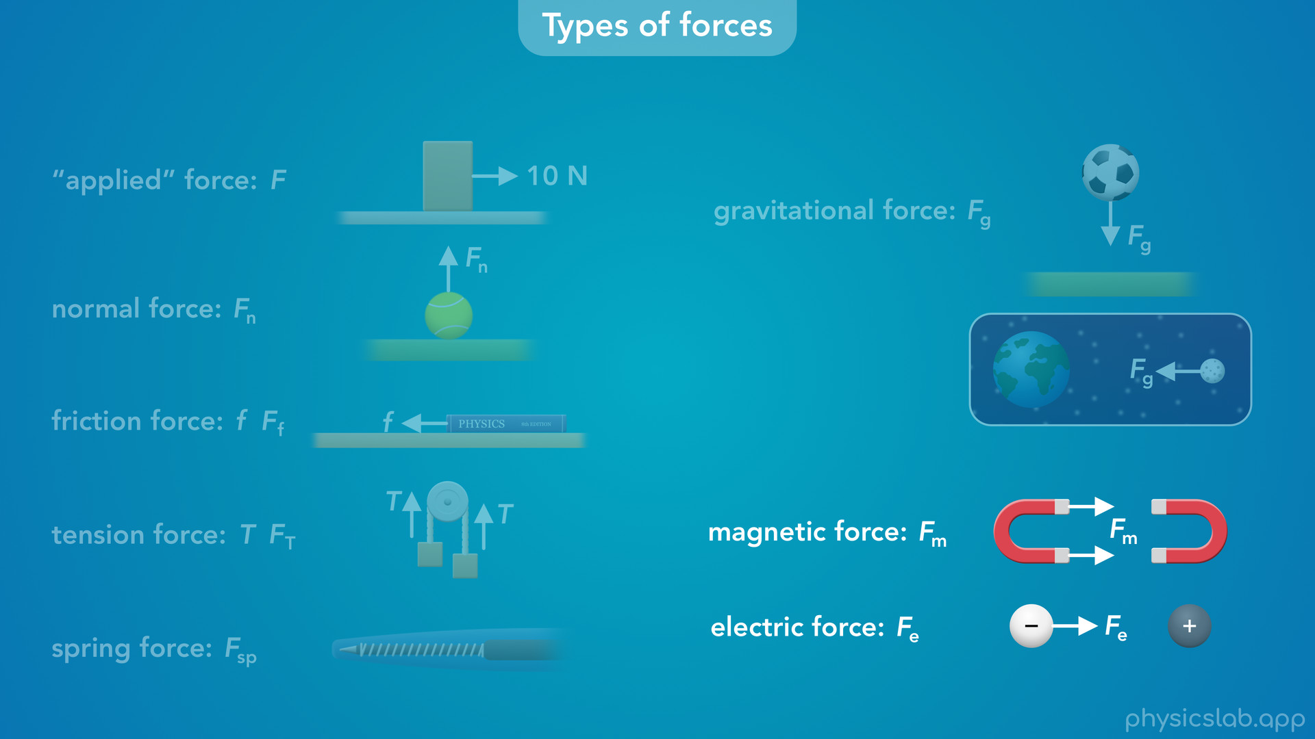
Notes:
• There’s two more forces that we’re not gonna learn about in this course, but we should definitely mention them: a magnetic force and an electric force. A magnetic force is what causes two magnets to be attracted or repelled away from each other. Its what causes a magnet to stick to your fridge, and what allows us to use a compass to navigate using the Earth’s magnetic field.
• An electric force is what causes charged particles to be attracted or repelled. Everything that uses electricity only works because of the electric forces between the electrons moving around in the wires.

Slide 54
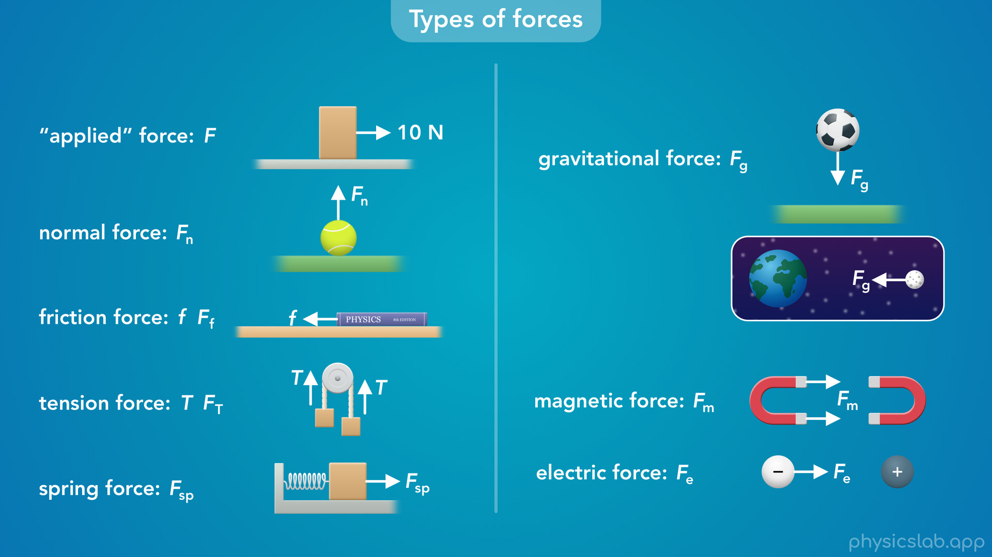
Notes:
• You might have noticed that the forces on the left exist between two objects that are touching each other, and the forces on the right exist even though the two objects are some distance apart.

Slide 55
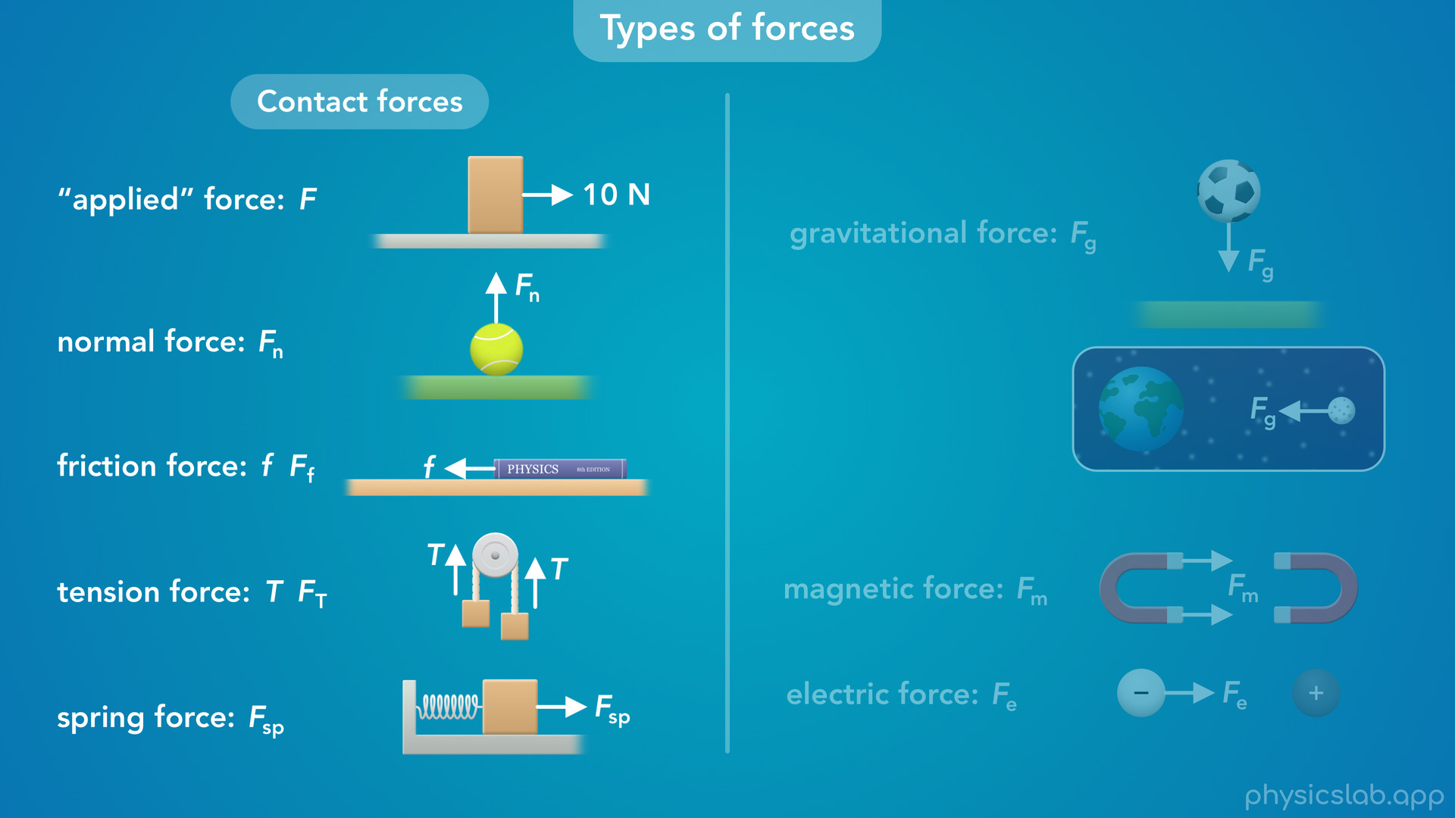
Notes:
We call the forces on the left “contact forces”

Slide 56
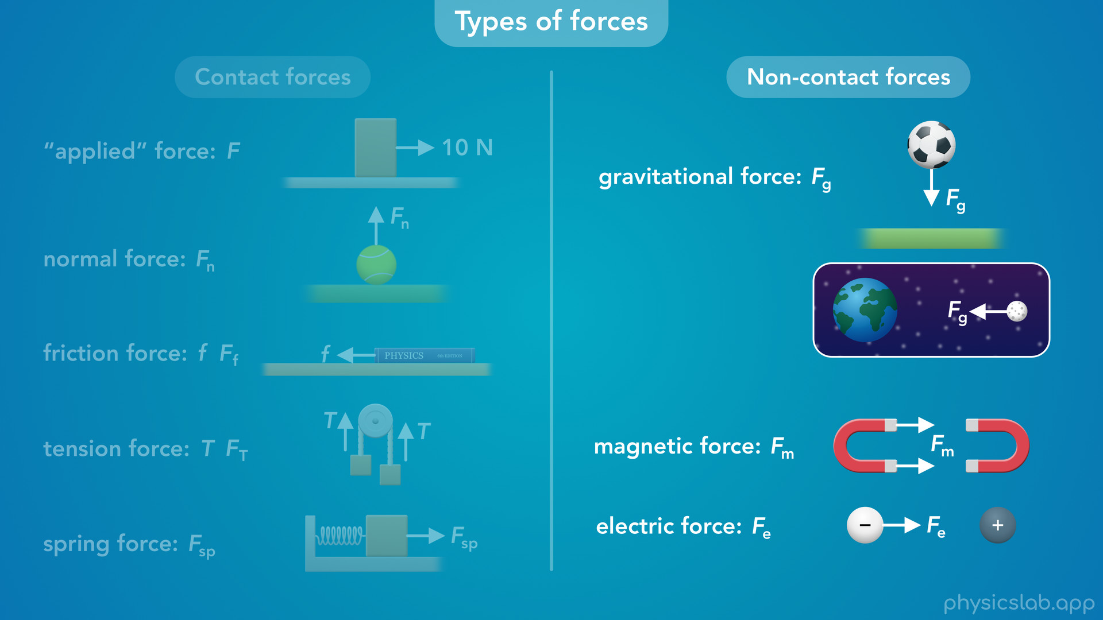
Notes:
and the ones on the right “non-contact forces”.
• The earth exerts a pulling force on an object even if it’s far away. Magnets attract and repel each other at a distance and so do charged particles. It might seem weird that an object can push or pull another object that it’s not touching. And, it is weird. It took a long time for us to figure out that this is how things work, so don’t worry if it’s not intuitive at first. We’ll learn a lot more about gravity in other lesson.

Slide 57
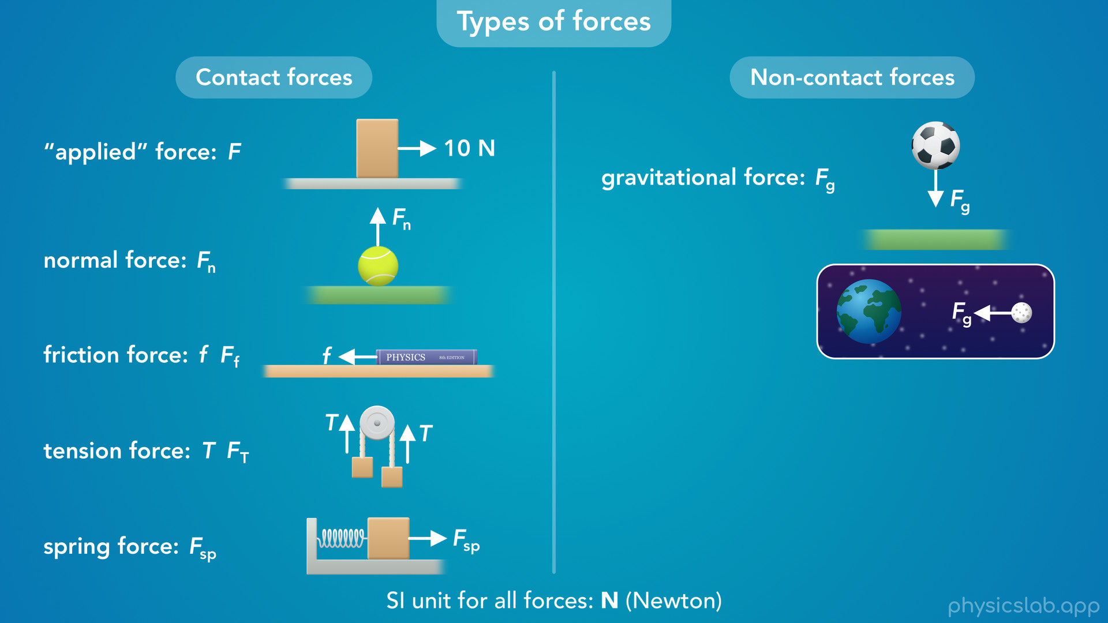
Notes:
So, these are the different types of forces that we’re gonna be learning about.
• Even though they’re different, they’re all forces, and they all use the same unit of Newtons.
• They have different causes and we use different equations to calculate them, but when we’re using Newton’s laws of motion, all of these forces are basically equivalent. Every force is just a push or a pull.
• But you can see how things might get complicated when there’s a lot of forces acting on an object.
• To keep things organized and help us see what’s going on…

Slide 58
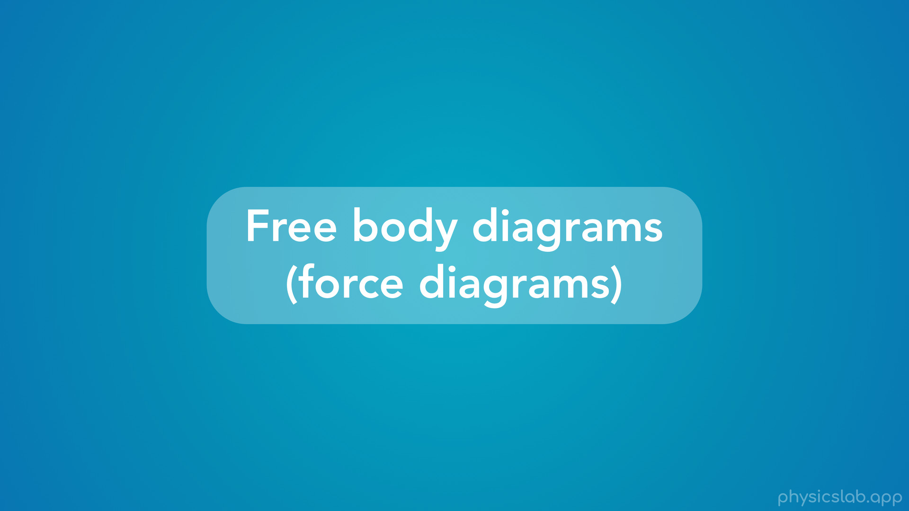
Notes:
• … we use free body diagrams, also known as force diagrams.

Slide 59

Notes:
• A free body diagram or a force diagram is just a picture that shows a single object (a body) and all of the forces that are acting on that object.
• So here’s a picture of a person pulling on a box with a rope. The picture includes the box, the rope, the person and the ground.

Slide 60

Notes:
• But the free body diagram of the box looks like this. It only shows the box and the forces that are acting on the box. In this example, there’s a tension force from the rope, a friction force from the ground, a normal force from the ground, and a gravitational force from the earth.

Slide 61

Notes:
Like we said before, we can draw these forces anywhere in the diagram as long as they point in the right direction. But we usually draw a force starting on the edge of the object and pointing in the direction of the force.

Slide 62

Notes:
• For a free body diagram, “we only include a single object and we do not draw any other objects or surfaces, which is why we call it a free body diagram”. The body, which is the box, is free and it’s isolated from the environment and other objects.

Slide 63

Notes:
• Also, “we only include the forces that are acting on this object. We do not include the forces that this object is exerting on other objects”. We’ll learn in another lesson that this box is also exerting a force on the ground, on the rope and on the earth, but we don’t include those forces in the free body diagram of the box. We only include the forces that are acting on the box.

Slide 64

Notes:
• Also, we can either draw the object or we can represent the object with a dot. This might make things easier to see if the object is large or has some weird shape.
• So that’s a quick introduction to free body diagrams, and we’ll learn more about how to use them in the video on Newton’s 2nd law of motion.
• But they’re basically just a way to focus on one object at a time and see all the forces that are acting on that object.

Slide 65

Notes:
• Whenever we work on a physics problem for the rest of the course, we always wanna start by drawing a free body diagram.

Slide 66

Notes:
• As we learn more about different types of forces and Newton’s laws of motion…

Slide 67

Notes:
• you might start seeing the forces that are acting on the stuff around you.

Slide 68

Notes:
• Even if something isn’t moving there’s probably some forces that are causing it not to move.

Slide 69

Notes:
• And when things do move, there might be more forces involved than you think.

Slide 70

Notes:
• Some free body diagrams will be pretty simple…

Slide 71

Notes:
• and some will be a little more interesting.

Slide 72
Notes:
• And even though we can’t see them…

Slide 73

Notes:
• we’ll know what forces are acting on the stuff around us, and we’ll know why things happen.

Slide 74

Notes:
• In the next video, we’ll learn about net forces, Newton’s 1st law of motion, and we’ll come up with explanations for the 5 scenarios that we saw earlier.

Slide 75

Notes:
• But that’s it for this video, so let’s do a quick summary.

Slide 76

Notes:
• Kinematics is the study of how objects move and how to describe motion.

Slide 77

Notes:
dynamics is the study of why objects move and what causes them to move.

Slide 78
Notes:
• We’re going to use Newton’s laws of motion to explain why objects move, and why they don’t move...

Slide 79
Notes:
• … and we need to understand forces in order to understand Newton’s laws.

Slide 80

Notes:
• A force is just a push or a pull.
• It acts on one object and is caused by a different object.

Slide 81
Notes:
• We can’t see a force.
• Sometimes we can see the effects of a force, like when an object moves or stretches like a spring.

Slide 82

Notes:
• A force is a vector (it has a magnitude and a direction) and we represent a force with an arrow and a label.

Slide 83

Notes:
The arrow points in the direction of the force

Slide 84

Notes:
and the length of the arrow represents the magnitude or the strength of the force.

Slide 85

Notes:
• The SI unit for force is a Newton, capital N, which is equal to 1 kg m / s^2.

Slide 86

Notes:
• And there can be multiple forces acting on an object at the same time, in which case we might want to give them subscripts, like F1 and F2, so that we know which force we’re talking about.

Slide 87

Notes:
• There are many different types of forces, and these are the forces we’ll be learning about.

Slide 88

Notes:
• There are other important forces like magnetic and electric forces, but we won’t cover those in this course.

Slide 89

Notes:
• Forces that occur when there’s physical contact between two objects are called contact forces.

Slide 90

Notes:
And forces between two objects that are some distance apart are called non-contact forces.

Slide 91
Notes:
• But all of these are forces, they’re just a push or a pull on an object. They all use the SI unit of Newtons, and we’re gonna use all of them with Newton’s laws of motion in the same way.

Slide 92
Notes:
• A free body diagram or a force diagram is just a picture that shows a single object (a body) and all of the forces that are acting on that object.
• We only include a single object, the box, and we do not draw any other objects or surfaces.
• Also, “we only include the forces that are acting on the box. We do not include the forces that the box is exerting on other objects”.

Slide 93

Notes:
• And even though forces are invisible, hopefully you’ll start to see all of the forces that are acting on the stuff around you, as we learn more about different types of forces and Newton’s laws of motion.

