Slide 1


The Necklace
Guy de Maupassant
Narrator: Barbara Njau

Slide 2

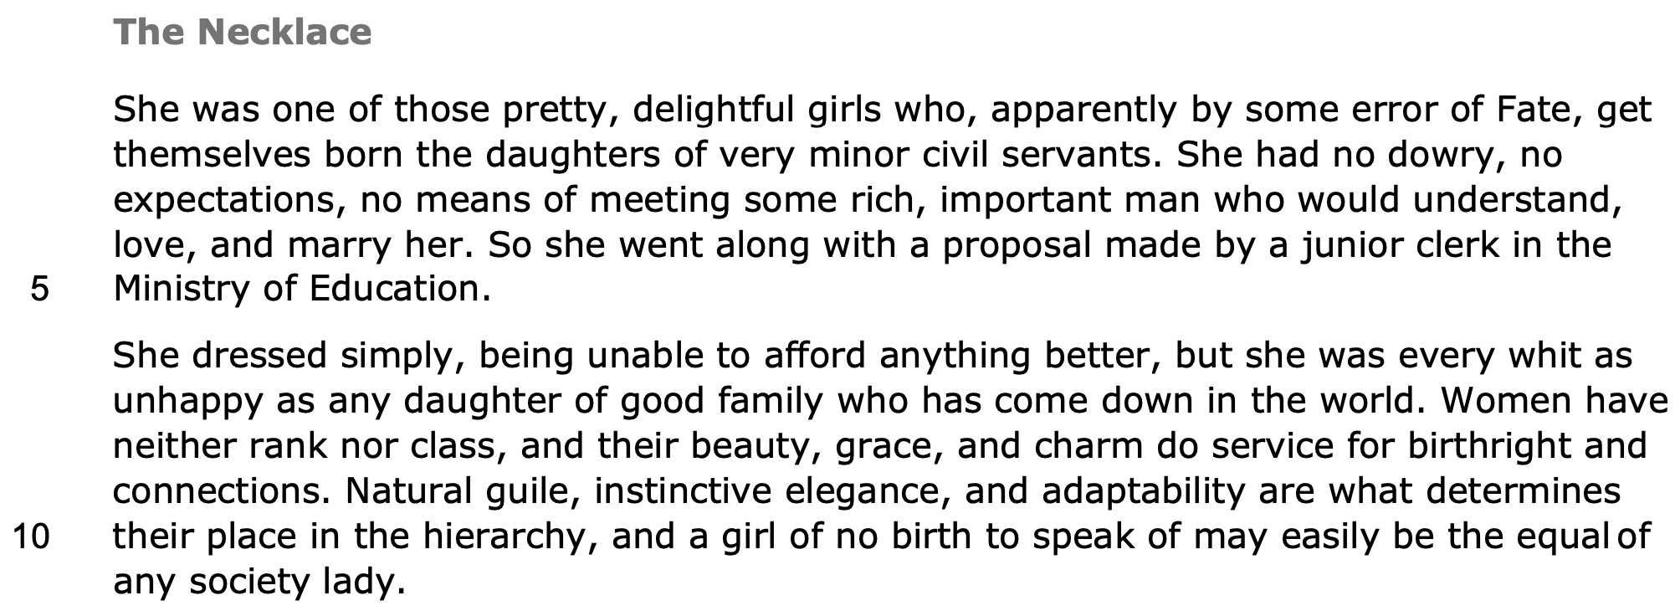

Published in 1884
Third person pronoun repetition
Premodifiers show
her beauty
Abstract noun:
her fortune
Social class
Alliteration
Repetition of 'no' shows her modest background
Rule of three: women totally dependent
on men
Adjective emphasises lower middle class social status
Sibilance
She was discontented
Ironic as she has preserved her social status
Importance of
appearance
Qualities women need to have socially
Dysphemism -
social pedigree
Women can use superficial appearances to get ahead in the social hierarchy
Proper noun: social
Victorian hierarchy

Slide 3
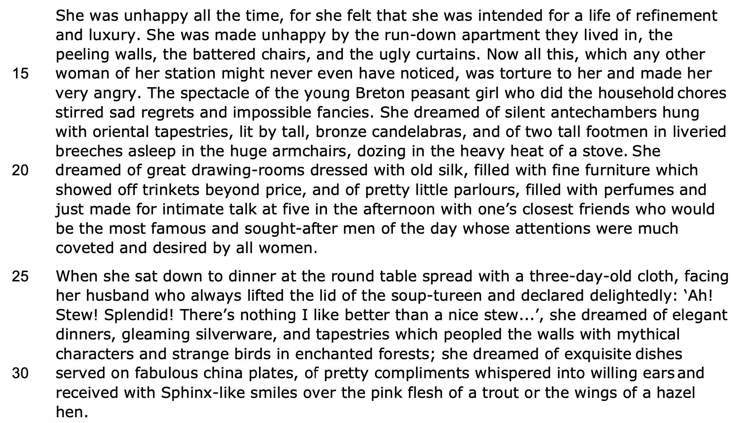
Repetition emphasises her obsession with her social status
Social ambition
Asyndeton
Social
pedigree
Hyperbole
Illusions about
upper class lifestyle
Premodifiers show she's middle class
Repetition: lives in a world of illusion
Opulent language refers to large palaces
Diminutive adjetives
Superlative shows focus on superficiality
Alliteration: retreats into inner world
Vapid desire to marry a wealthy man
Exclamatory sentences: vast gap between emotional states of her and her husband
Alliteration - husband is content
She feels her beauty should match a fanciful reality
Supernatural and uncanny language

Slide 4
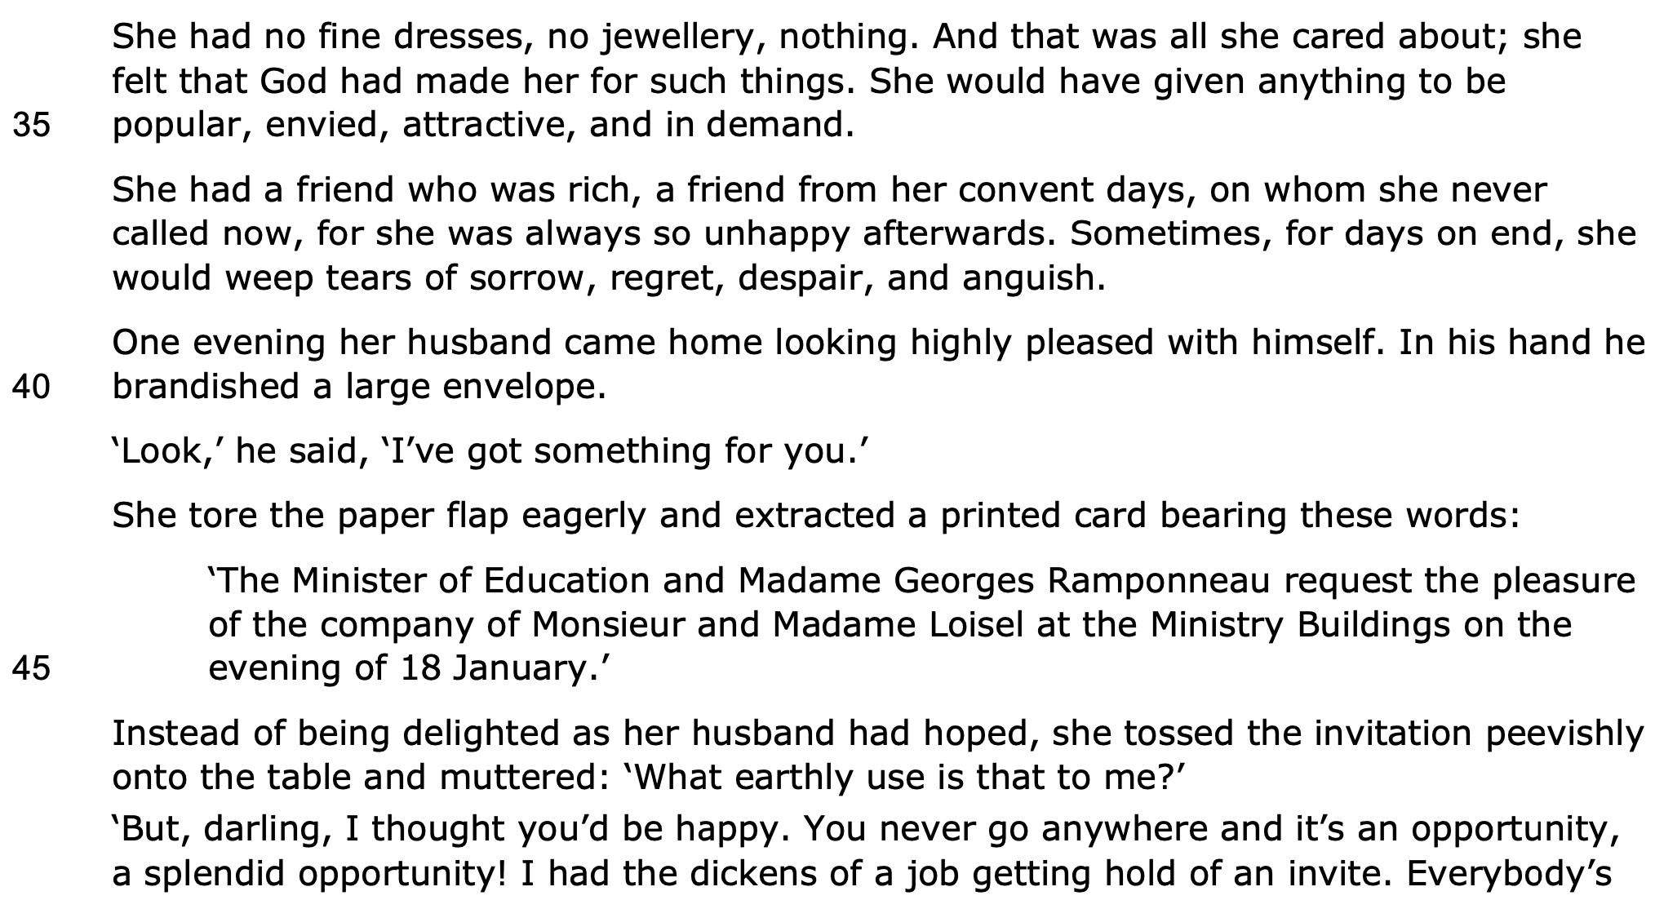
Asyndeton emphasises what she feels is an extremely austere lifestyle
Hyperbole
She believed her beauty entitled her to wealth
Asyndeton shows she is materialistic and craves social acceptance
Repetition - obsessed with friend's lifestyle
Intensifier
Semantic field of grief shows her jealousy
Adverbial phrase of time - temporal shift foreshadows irreversible changes
Simple sentence shows he values her:
he goes to great lengths to make her happy
Formal lexis
Verb
Adverb
Her unhappiness is greatly exaggerated
Mild expletive shows he worked hard to get the invitation

Slide 5
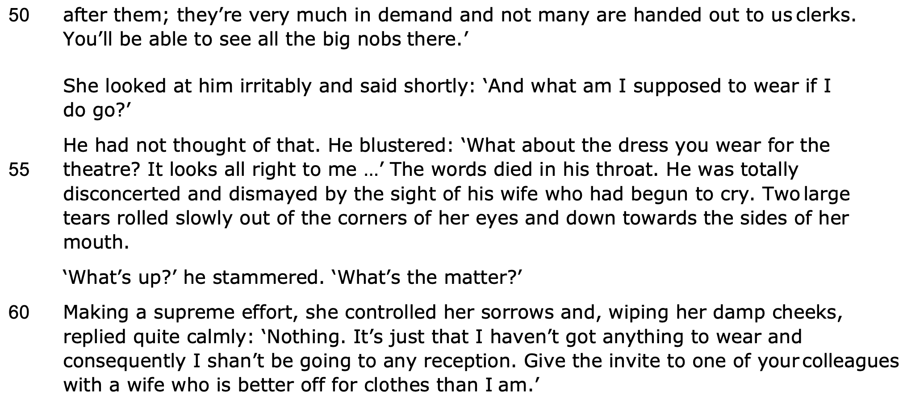
Pronoun emphasises his social group
Common noun - his modest job
Adverb shows she is ungrateful and self-centered
Personification shows the power dynamics in their relationship
Simple sentence shows his simplistic worldview
Melodramatic: only cares about her superficial appearance
Alliteration
Hyperbole
Her melodramatic response is humorous
Alliteration: speaking emphatically
Euphemism: subtle reference to their social status.
Obsessed with social comparison

Slide 6
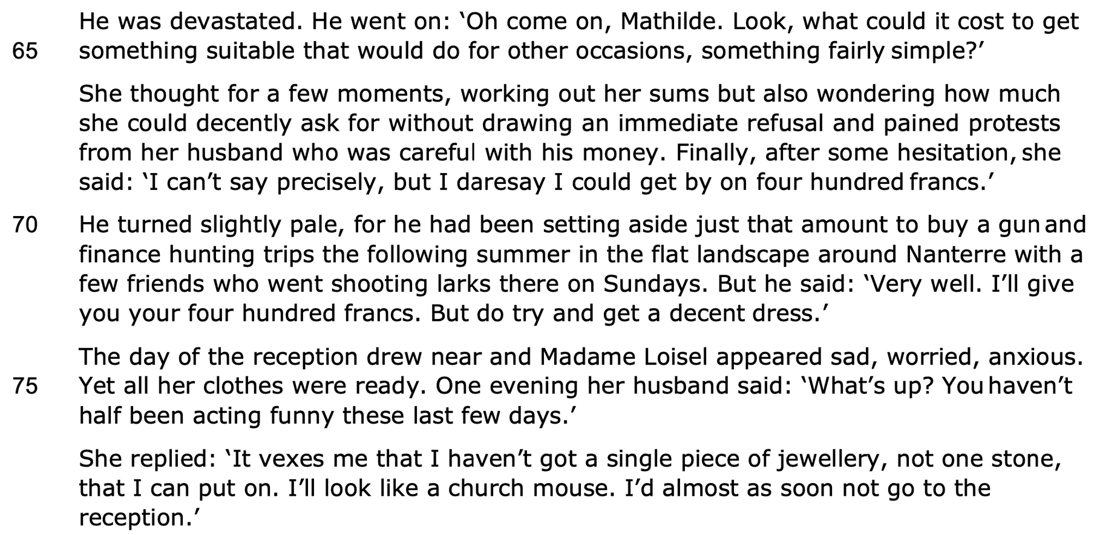
Simple sentence emphasises how much he loves her
She is manipulative and takes advantage of husband's generosity
Alliteration
Pronouns emphasise his focus on her happiness
Minor sentence shows he is generous
She takes for granted her status
Tricolon shows she has tumultuous moods
Her wish for material possessions is insatiable
Simile shows her callous ungratefulness

Slide 7
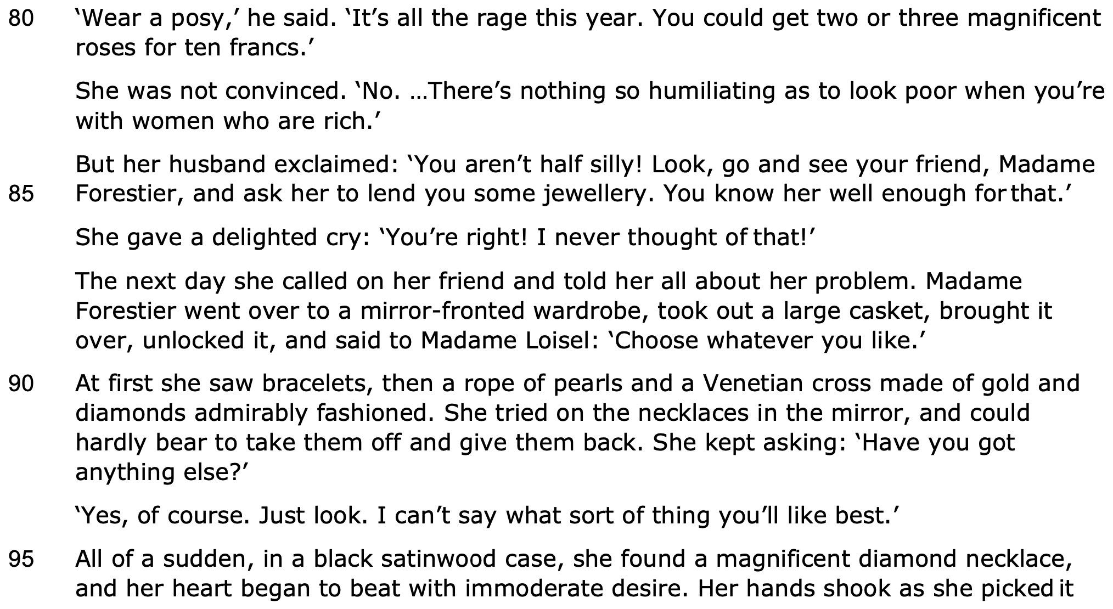
Suggestion on flowers shows his simplistic worldview
Hyperbole
Alliteration - constantly comparing herself to other women with wealthier husbands
Intensifier shows her focus on status is comical
Only cares about surface appearances
Exclamatory sentence -
offers a solution
Onomatopoeia - she's excited
Asyndeton shows her fluid movements - she is accustomed to having luxuries
Opulent lifestyle
Semantic field of jewellery
She is like Narcissus
She still covets more
Seems like a Pandora's box
She sees expensive objects as a way to look rich, forgetting she isn't as wealthy as she would like to appear

Slide 8
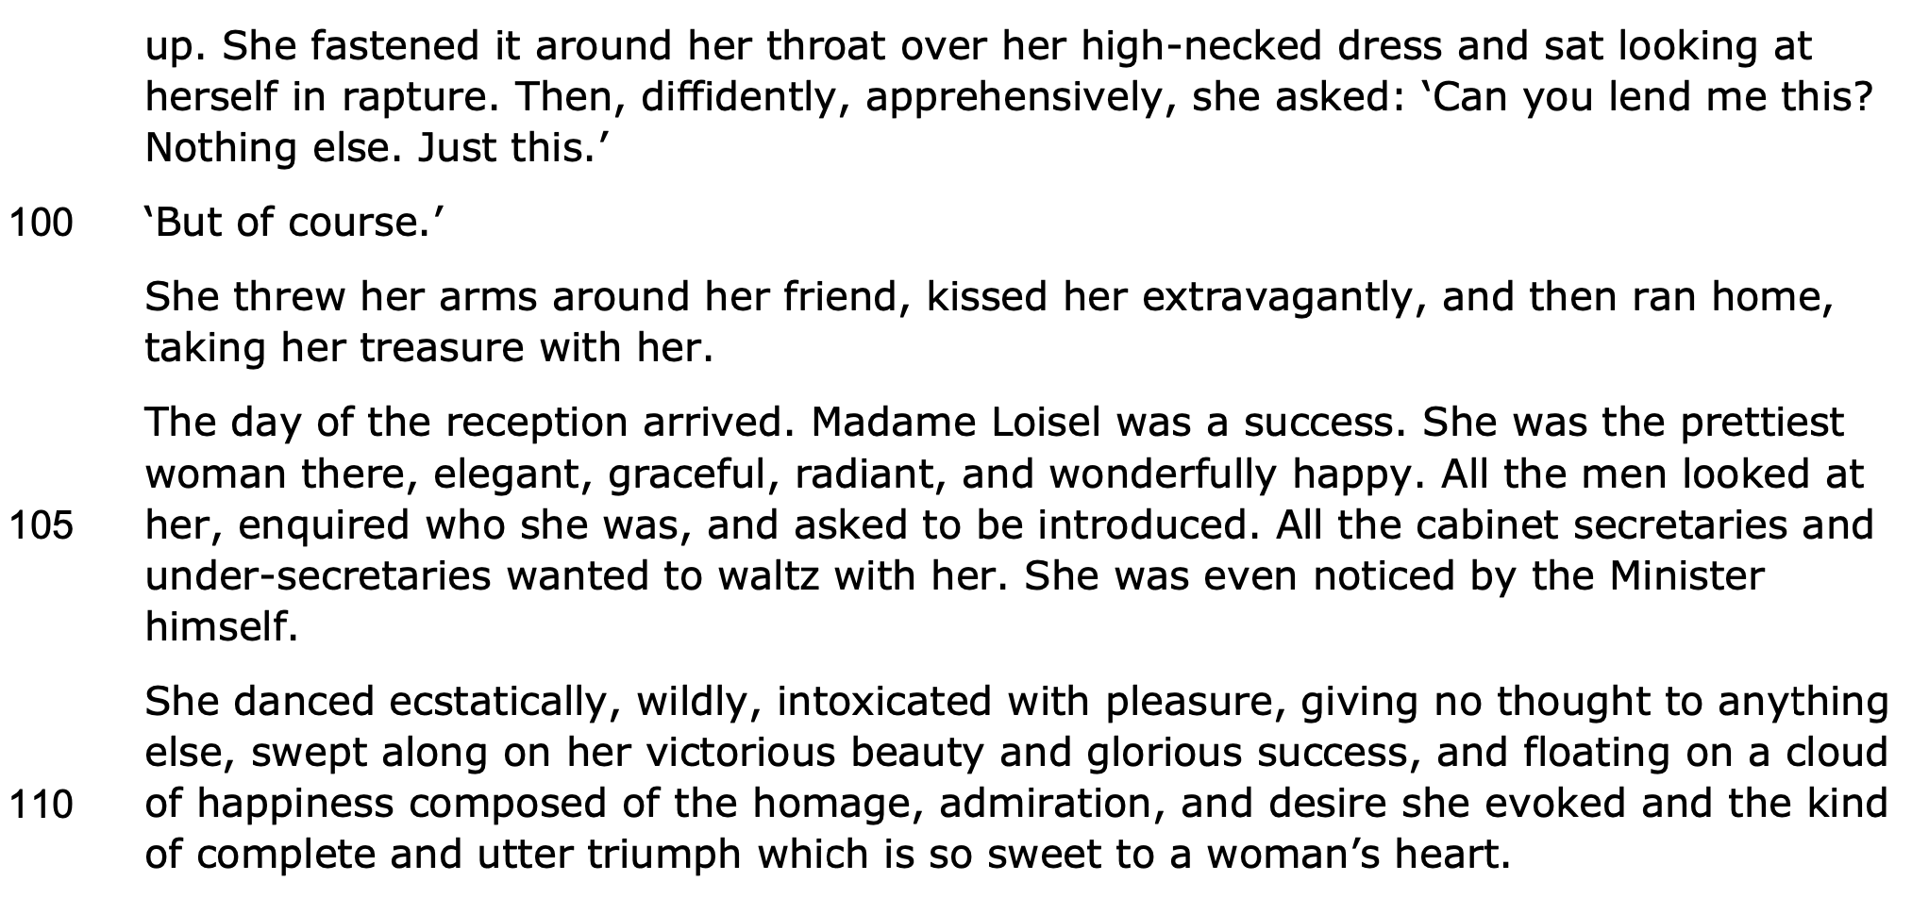
She is like Narcissus as she is enchanted with her appearance, not realising it will be her downfall
Simple sentences foreshadow how this necklace will dramatically alter her fate
Her frenzied response shows how shallow she is
Alliteration and metaphor is ironic as we later realise it is not worth much
Simple sentence - all she has ever wanted
Superlative - society only valued women based on their beauty
Emphasises her beauty
Asyndeton shows she is quite vain and has a superficial understanding of value
Repetition of "secretaries" emphasises their superior social status
Metaphor
Supports the idea that beautiful women of no means can socially advance
She only cares for social approval

Slide 9
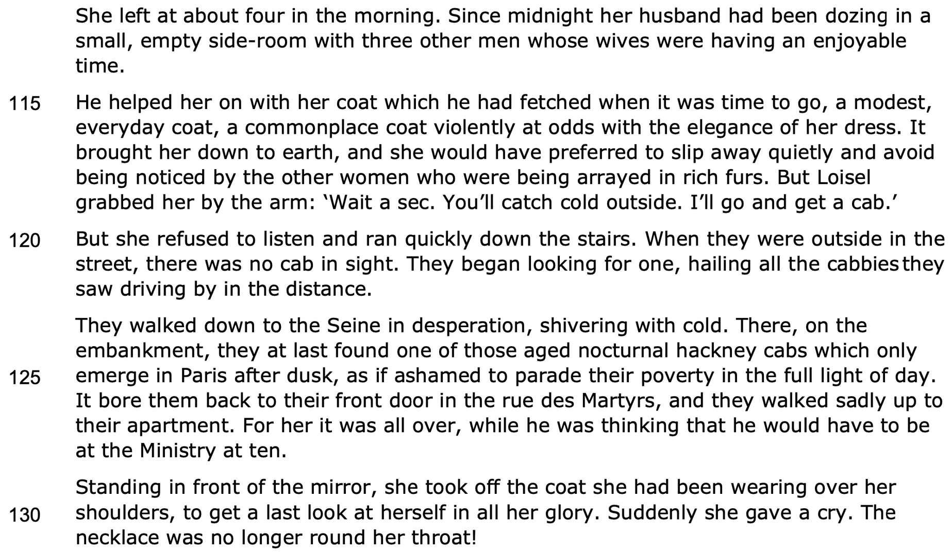
Complete disregard for her husband
Adverb:
disconnect
Adjectives and repetition of 'coat' shows
her appearance of wealth vanishes
Coat is personified and it forces her to leave her fanciful world of imagination
Sharp contrast
Simple sentences show his love
Disregards him
Pathetic fallacy shows the stark return to reality and their real social status
Metaphor for Mathilde
Adjectives emphasise reality has descended on them
Road of Martyrs foreshadows their eventual poverty
Illusion of wealth has ended
Onomatopoeia echoes her 'cry' in Madame Forestier's home
Vanity
Exclamatory sentence shows her extreme shock

Slide 10
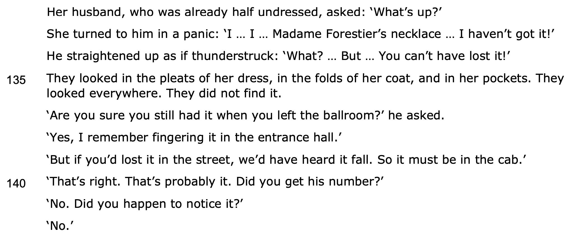
Exclamatory sentence shows she is growing increasingly panicked
Simile -
dramatic reaction
Simple sentence: the necklace which symbolises the illusion of wealth is gone
Complex sentence shows he is trying to rationalise the situation
Simple sentences shows she reverts to listening to her husband when it suits her
Minor sentence shows she was caught up in her fanciful imagination that she was unaware of what happened to the necklace

Slide 11
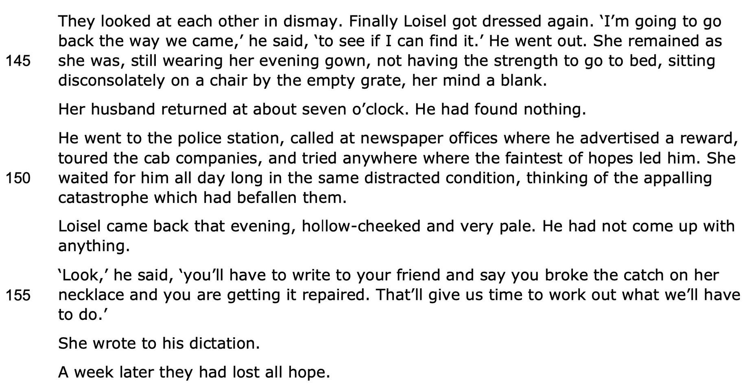
Simple sentence builds tension
Simple sentence highlights self-sacrificial nature of her husband
Sibilance emphasises how Mathilde is not self-sacrificing
Repetition of third person pronoun shows how frantically he was trying to help her
Metaphor emphasises her vapid nature
Vapid mindset
Trying to save face
Adverbial phrase of time shows the drastic change in their fortunes
She only listens to him when it benefits her

Slide 12
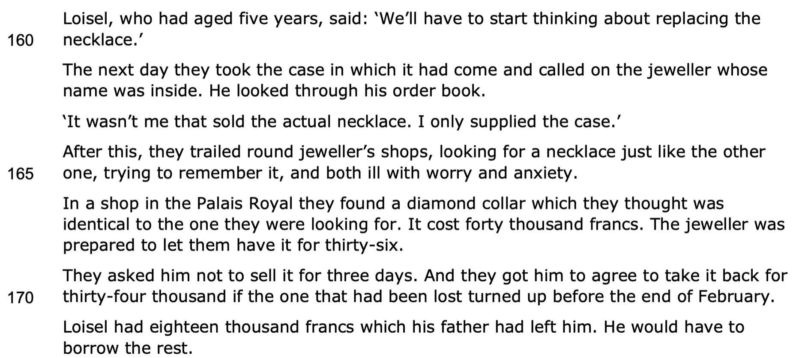
Hyperbole shows his wife has caused his ruin
Alliteration
They are frantically searching
Alliteration shows they only rely on superficial appearances
Astronomical sum
He is willing to give up his inheritance for his wife's happiness
Financial ruin

Slide 13
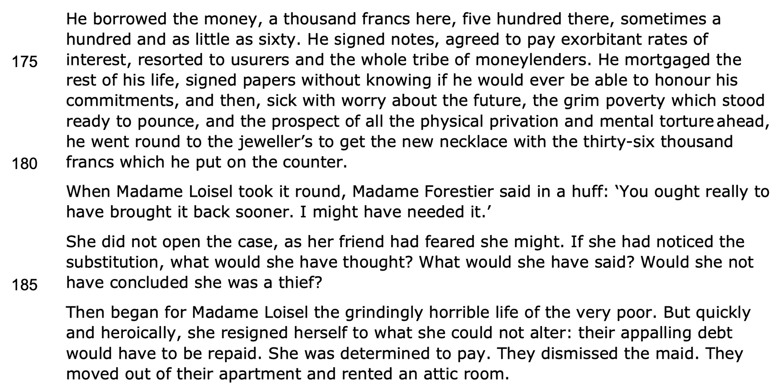
Asyndeton shows he is frantically borrowing from several people to save face: he is a martyr as this is extremely self-sacrificial
Semantic field of debt
Superficial appearances costed them their social status
Personification emphasises the brutality of poverty
Ironically Mathilde is about to experience real suffering
She did not care enough for her necklace or even value it
Conditional verb shows how self-centred and greedy she is
Rhetorical questions show Mathilde cares so much about social appearances and saving face
Contrasts her earlier life
Adverbs show she sees value in her suffering
Repetition of third person plural emphasises their social fall from middle class to working class status
Simple sentence makes us wonder whether her poverty will change her superficial outlook

Slide 14
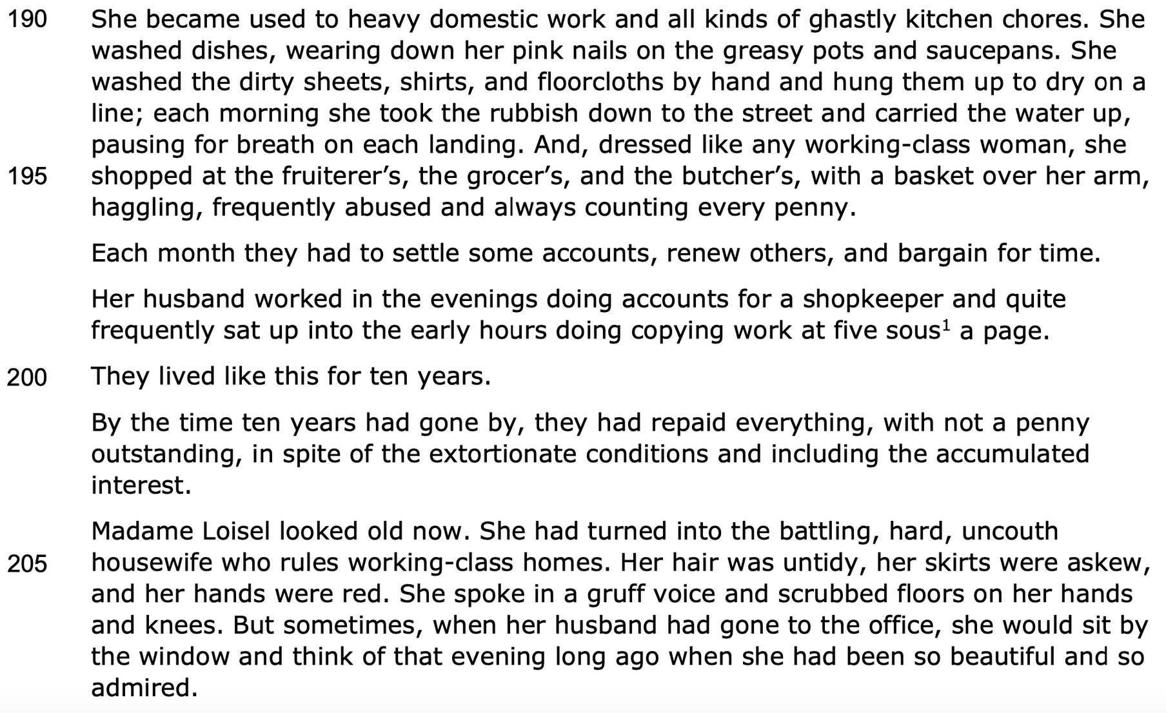
Premodifiers are ironic as she used to look down on having a simple maid
Repetition of third person pronoun
Adjective emphasises her dainty appearance
Simile contrasts her earlier appearance at the party
Emphasises how unaccustomed to labour she was
Rule of three shows deep debt
Alliteration emphasises self-sacrificial nature
They experience grinding poverty for a long time as a result of reliance on superficial appearances
Repetition
She has become accustomed to her working class status
She is a warning that beauty fades - she will become a victim of the same superficial standards she greatly admired
Tricolon shows she no longer has the same social graces
Complex sentence shows how degrading her life has become
Her daydreams have changed - no longer lofty illusions but she misses her past life and faded beauty
Intensifiers shows her internal dialogue

Slide 15
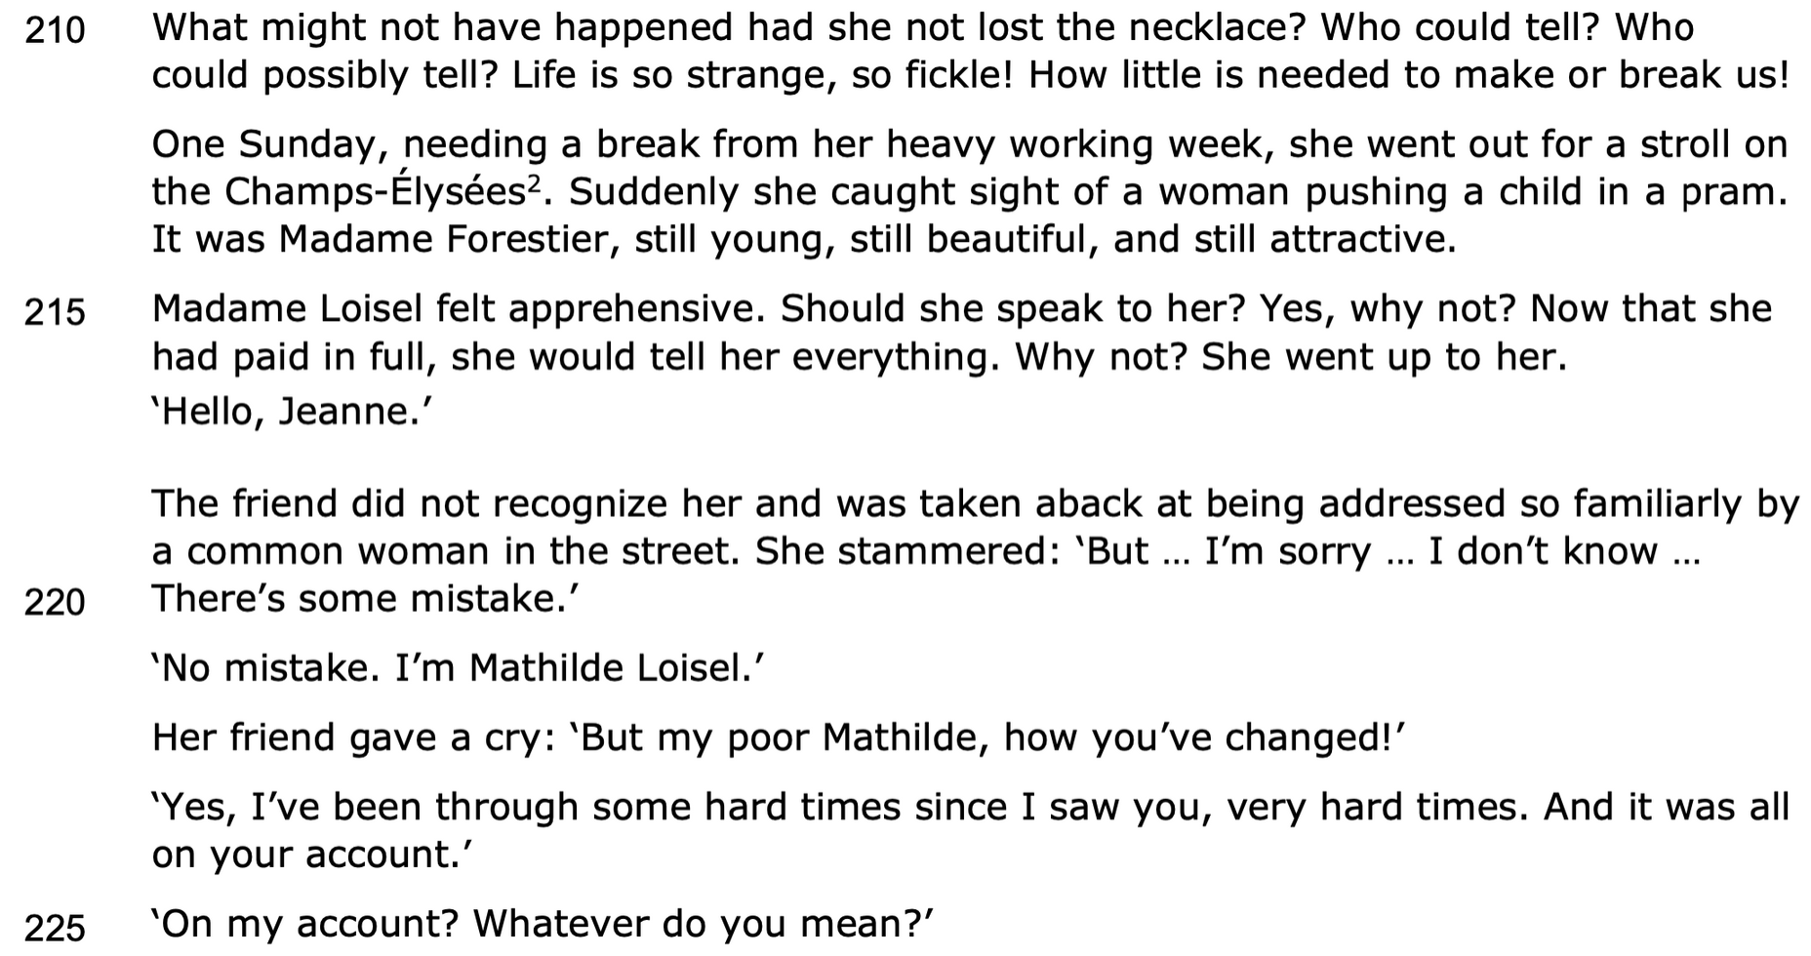
Rhetorical questions show her wishful thinking
Exclamatory sentences
Adverbial phrase of time
Sibilance signifies a sharp shift
Repetition of "still" and rule of three shows contrasting appearances and vast social gap
Contrast
Rhetorical questions show she feels self-conscious
Shows deceptiveness of appearances
Informal address
Adjective shows social status
Ellipsis shows her fear of women from a lower social pedigree
Blunt simple sentences shows she's lost her social graces
Repetition shows she is more grounded in reality
Onomatopoeia shows her shock
She is blaming her friend

Slide 16
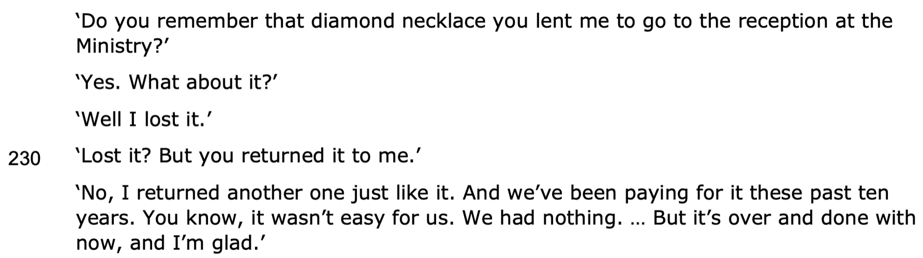
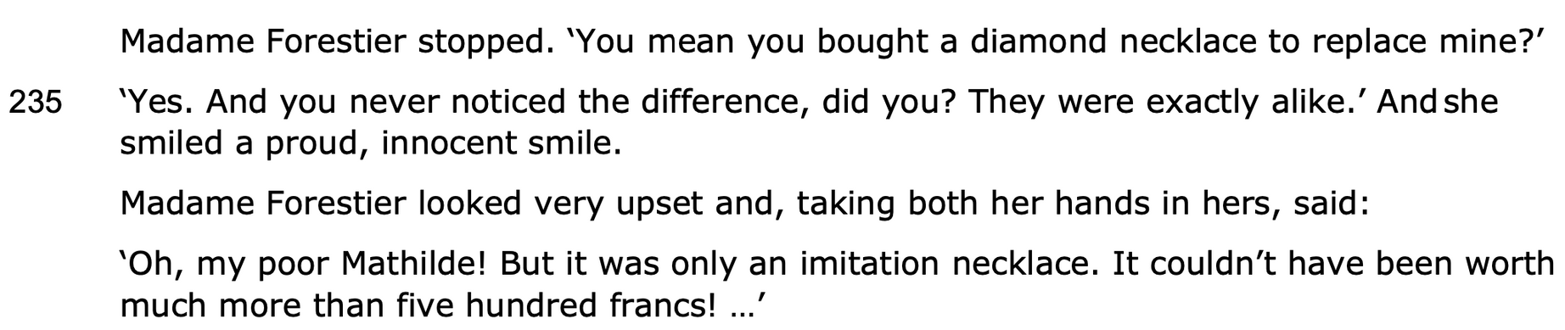
She finally confesses when she knows she has saved face
She is confused
Mathilde does not take responsibility for her actions
Simple sentence signifies plot twist
Adjectives show she found meaning in her suffering
Hypophora
Exclamatory sentence
Adjective highlights the deceptiveness of superficial appearances
Danger of giving too much power to material belongings

Slide 17
THANK YOU!
WWW.FIRSTRATETUTORS.COM

