Slide 1
HIGHLIGHTER
Adds impact and helps direct the listeners’ and/or viewers’ attention to a specific area of the slide

Slide 2
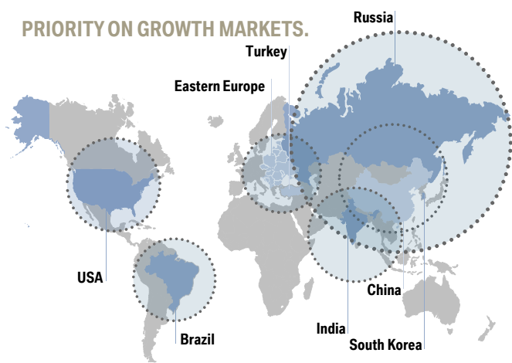
1
Source: BMW Group Investor Presentation, January 2014

Slide 3
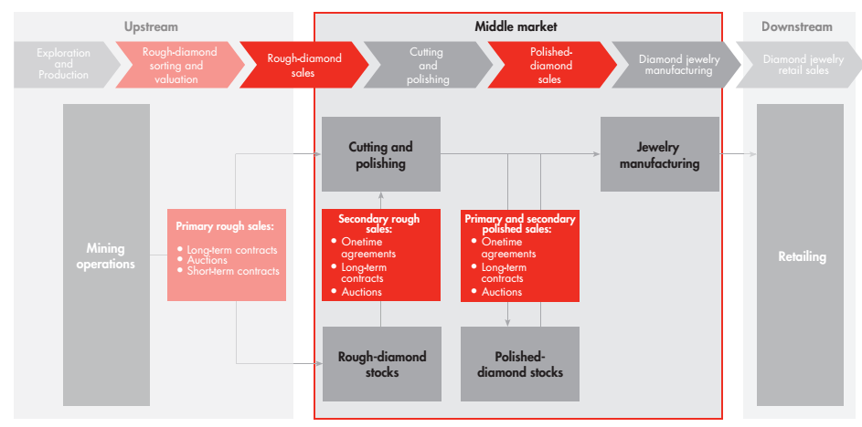
2
Source: BAIN_REPORT_The_global_diamond_report_2013

Slide 4
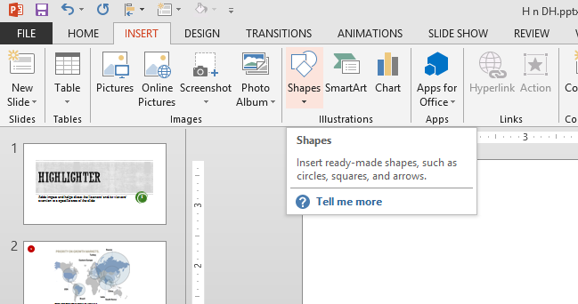
3

Slide 5
4
EUROS (MN.) | 1H14 | 2H14 | FY14 | 1H13 | 2H13 | FY13
Orders | 76.7 | 76.3 | 153 | 85.3 | 95.7 | 180.9
Sales | 68.5 | 91.7 | 160.2 | 80.8 | 88.8 | 169.6
EBITDA | -1.4 | 6.5 | 5.1 | 6 | 4.3 | 10.3
EBITDA margin | -2.10% | 7.10% | 3.20% | 7.40% | 4.80% | 6.10%
EUROS (MN.) | 1H14 | 2H14 | FY14 | 1H13 | 2H13 | FY13
Orders | 76.7 | 76.3 | 153 | 85.3 | 95.7 | 180.9
Sales | 68.5 | 91.7 | 160.2 | 80.8 | 88.8 | 169.6
EBITDA | -1.4 | 6.5 | 5.1 | 6 | 4.3 | 10.3
EBITDA margin | -2.10% | 7.10% | 3.20% | 7.40% | 4.80% | 6.10%

