Slide 1
CLONING OBJECTS
SHAPES | PICTURES | TEXT BOX | TABLES | CHARTS

Slide 2
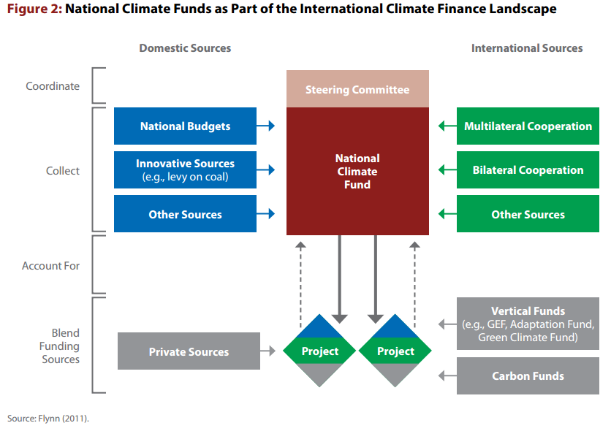
1
Source: UNDP - Blending_Climate_Finance_Through_National_Climate_Funds

Slide 3
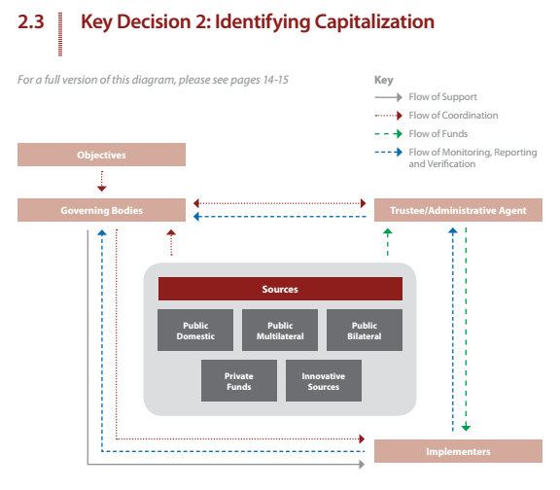
2
Source: UNDP - Blending_Climate_Finance_Through_National_Climate_Funds

Slide 4
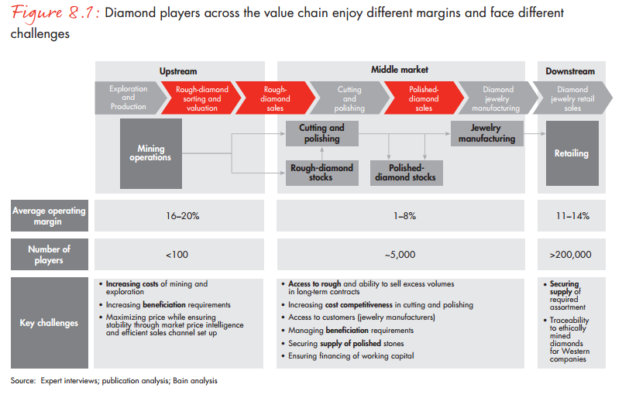
3
Source: BAIN_REPORT_The_global_diamond_report_2013

Slide 8
Rishabh Pugalia,
Analyst, Debt Capital Markets
Rishabh Pugalia,
Analyst, Debt Capital Markets
Rishabh Pugalia,
Analyst, Debt Capital Markets
Rishabh Pugalia,
Analyst, Debt Capital Markets
Rishabh Pugalia,
Analyst, Debt Capital Markets
Rishabh Pugalia,
Analyst, Debt Capital Markets
Rishabh Pugalia,
Analyst, Debt Capital Markets
Rishabh Pugalia,
Analyst, Debt Capital Markets

Slide 11
CLONING OBJECTS
“CTRL” + D for duplicating
Press “CTRL” and then drag the object away and release it
Press “SHIFT + CTRL” and then drag the object away and release it

