Slide 1
Huck Finn: we don’t need to research that period of history…twain tells us what we need to know.
Tom Sawyer: assumes we have read huck finn

Slide 2

Biblical Interpretation:
What role does biblical theology have in biblical interpretation?

Slide 3
Class Goals:
Understand the discipline of biblical theology.
Practice biblical theology.

Slide 4
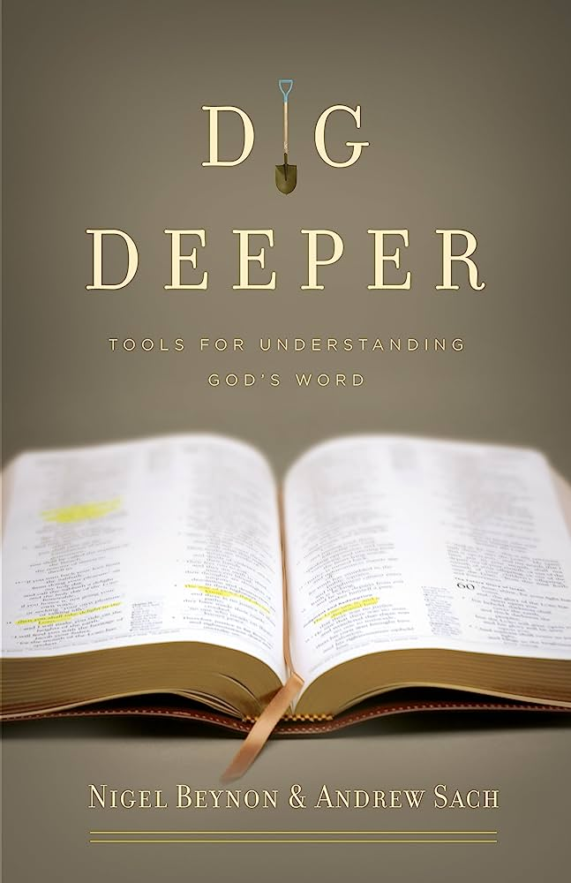
This is a text box with quotes from the book. This is a text box with quotes from the book. This is a text box with quotes from the book. This is a text box with quotes from the book. This is a text box with quotes from the book.

Slide 5
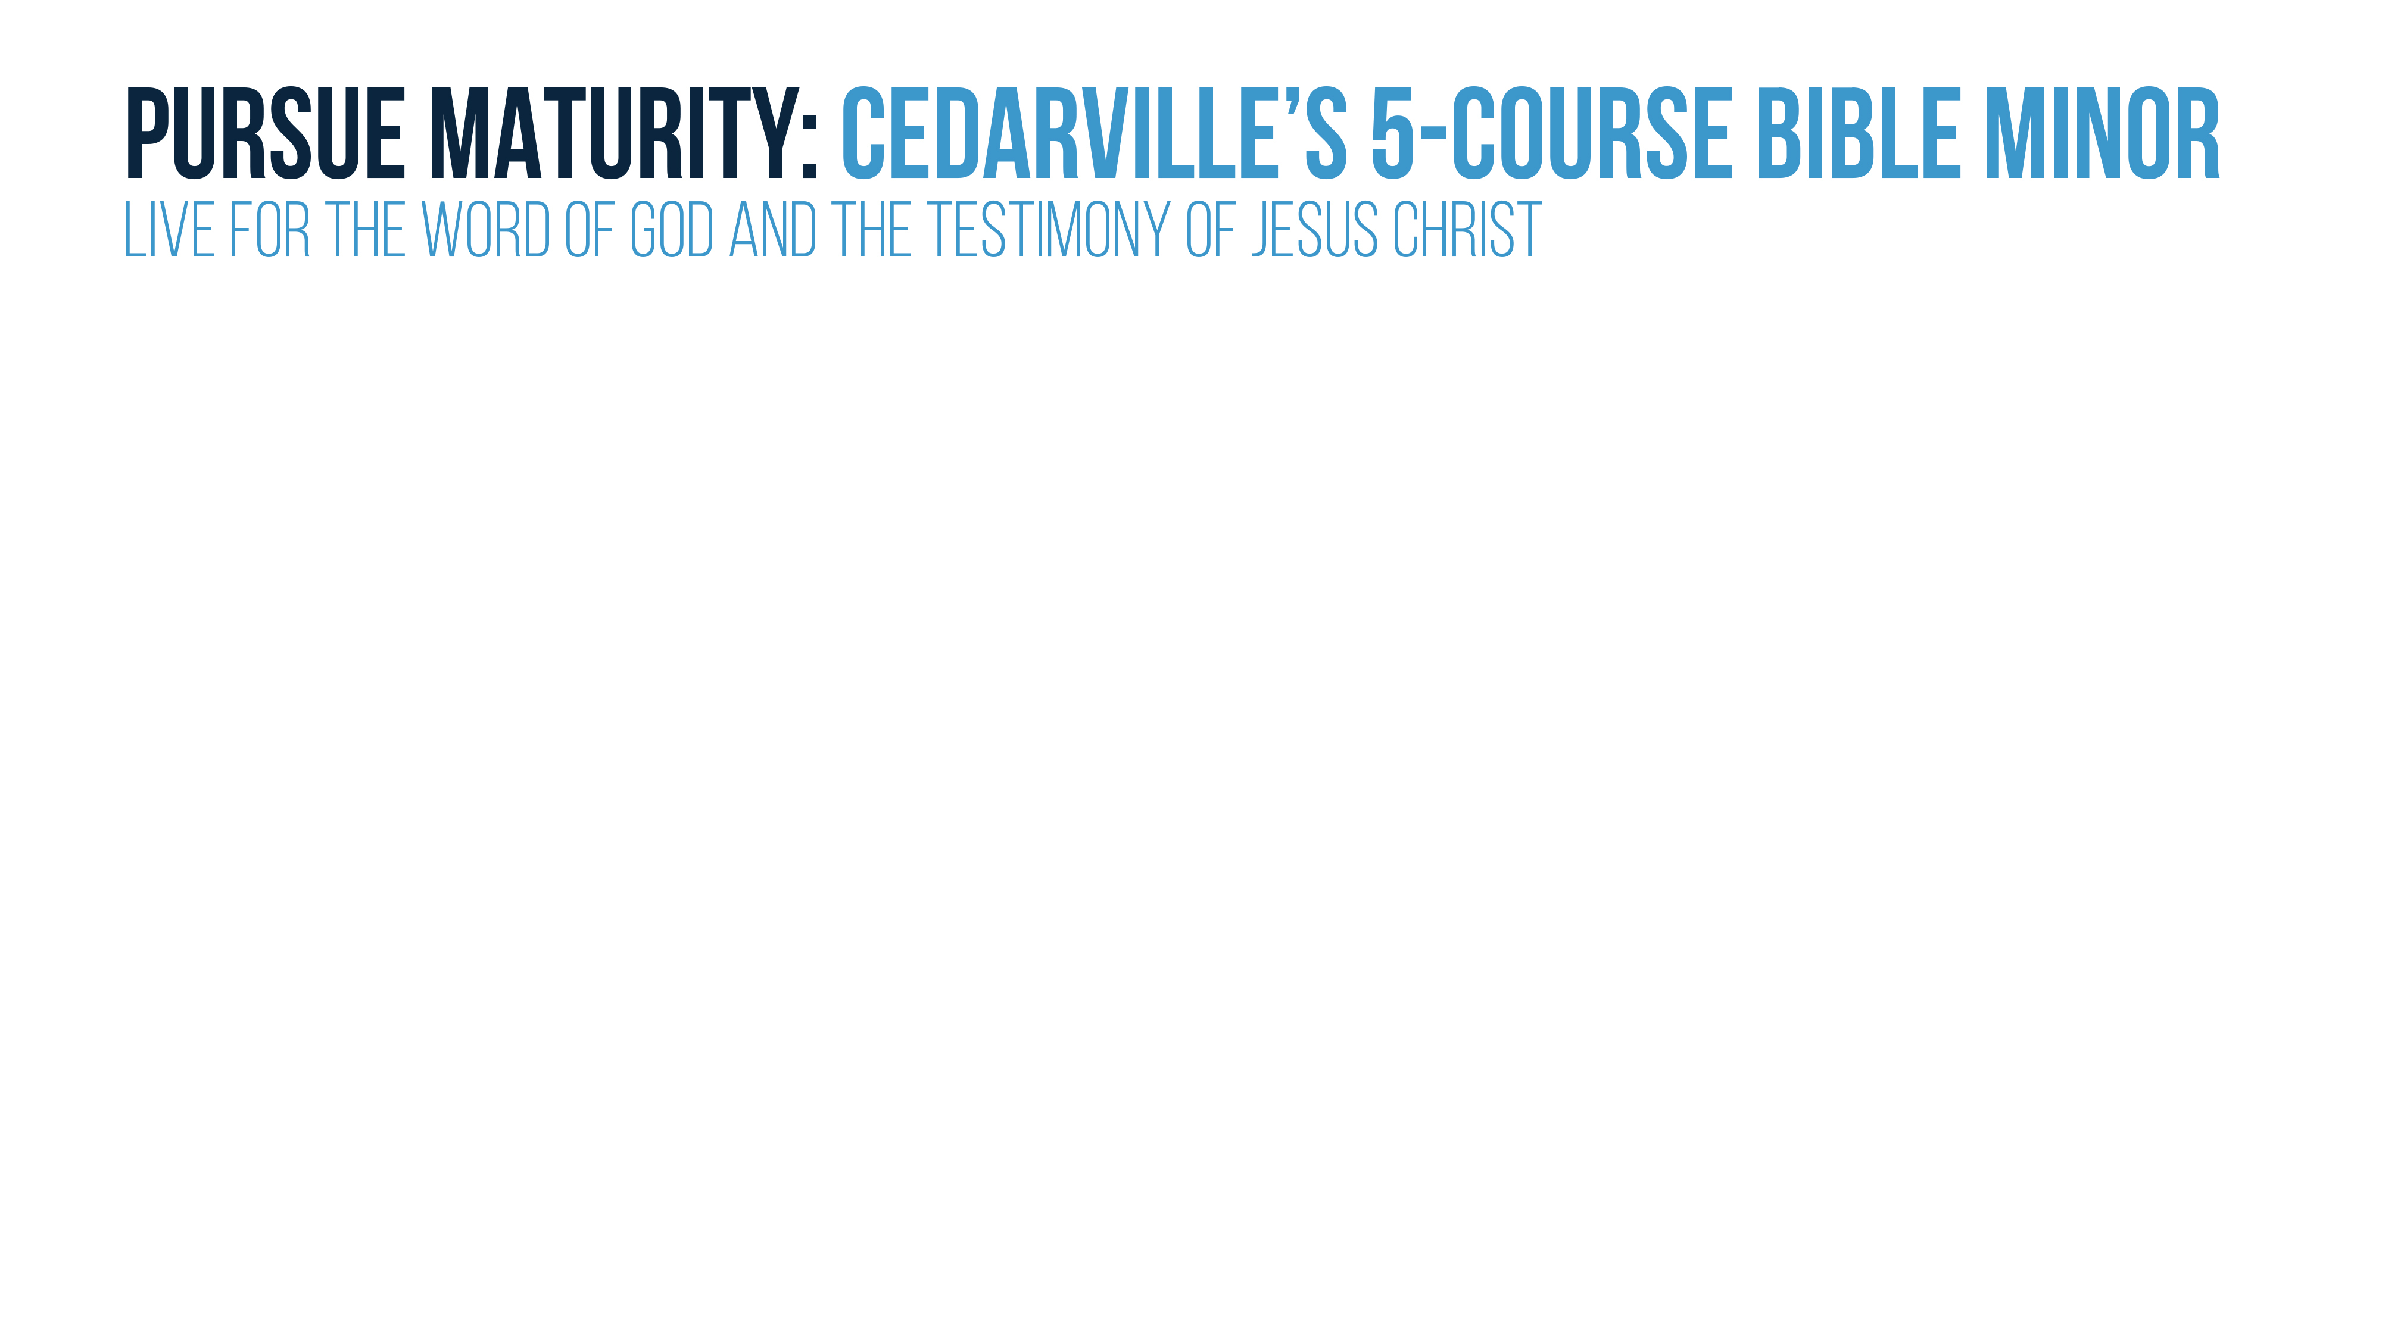
Course Objectives: Bible and the Gospel
EXPLAIN the biblical understanding of the gospel, the proper response of faith, and the resulting new life.
PRACTICE biblically-oriented spiritual disciplines for Christian growth.
PRIORITIZE a lifestyle of engagement in the local church and in God’s mission of reaching the nations through the gospel.
SUMMARIZE key issues in the doctrine of the Scriptures.
DEMONSTRATE skill in studying the Bible through proper interpretation of the author’s intended meaning.

Slide 6
BIBLICAL THEOLOGY AND INTERPRETATION

Slide 7
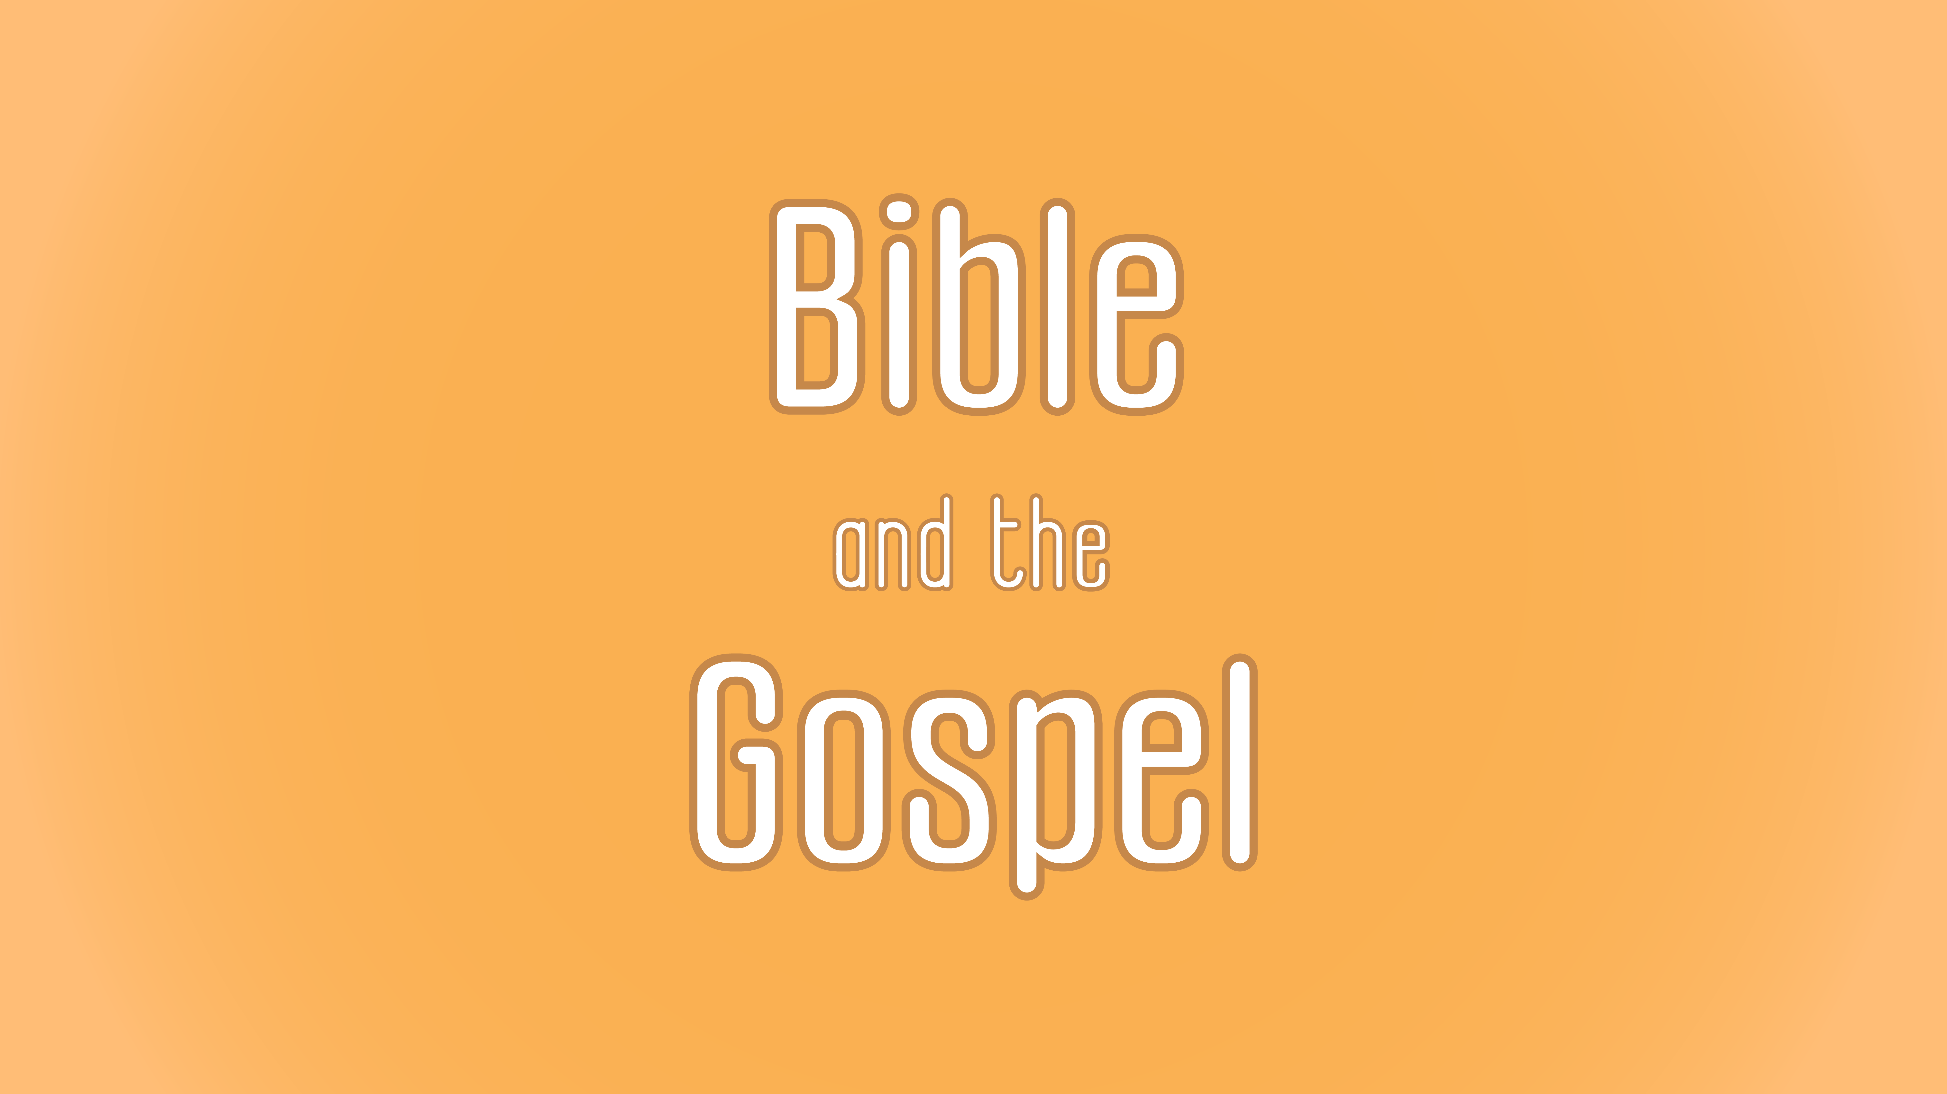
Notes:
-new section…the final section of the course→ new PP colors
How do we interpret the Bible?
Are there wrong interpretations of the Bible?
Tell the story of reading Deut 6:4-9 with Bob Royalty
→there are incorrect interpretations
→there is a right way to read
→I don’t mean that arrogantly…I mean that Christianly
The most important thing is that God has spoken, and I want to understand that message rightly

Slide 8
Biblical Interpretation:
What role does biblical theology have in biblical interpretation?

Slide 9
Class Goals:
Understand the discipline of biblical theology.
Practice biblical theology.

Slide 10
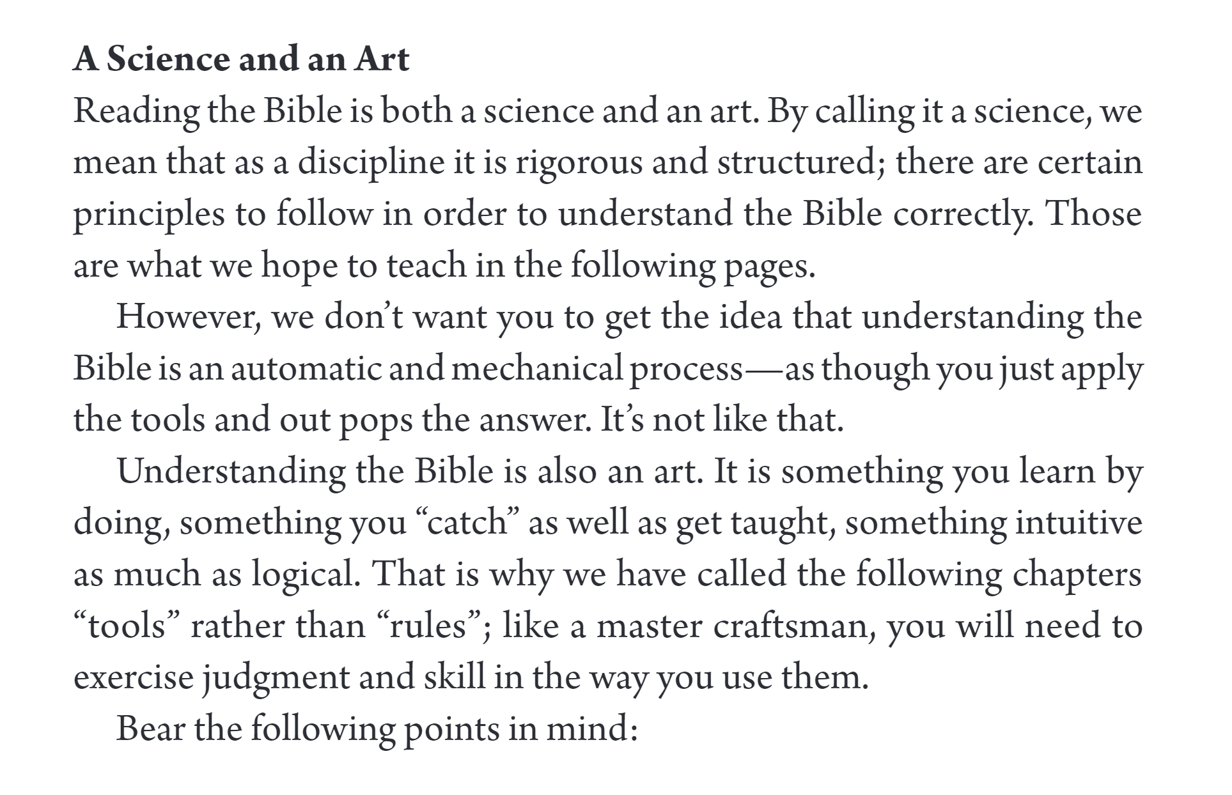

Slide 11
Biblical Interpretation and Theology: Some Definitions
EXEGESIS: careful study of the Bible to understand the author’s meaning (i.e. using your tools from Dig Deeper).
  tends to focus on analysis.
BIBLICAL THEOLOGY: careful study of how the Bible progresses and climaxes in Christ.
  tends to focus on progression and synthesis.
[HISTORICAL THEOLOGY]: learning from others’ careful study of the biblical text.
  has a ministerial authority while the Bible has magisterial authority.
SYSTEMATIC THEOLOGY: logical ordering of biblical truth into categories
  focuses on holistic integration of biblical data…synthetic exegesis.
PASTORAL THEOLOGY: how people should respond to God’s revelation
  brings the intention of the author to the lives of the people.
Notes:
-historical theology is in brackets suggest that it contributes to the other disciplines but is not part of that line

Slide 12
The Process of Biblical Interpretation
Notes:
The process is not as sequential as we might hope.

Slide 13
BIBLICAL INTERPRETATION
EXEGESIS
-text criticism
-word study
-grammar
-syntax
-context discourse
-canon
BIBLICAL THEOLOGY
HISTORICAL THEOLOGY
SYSTEMATIC THEOLOGY
PASTORAL / APPLIED THEOLOGY

Slide 14
What people often mean by exegesis…
Whole Bible
Books of bible
paragraphs
sentences
words
Notes:
Even, exegesis is not always as linear

Slide 15
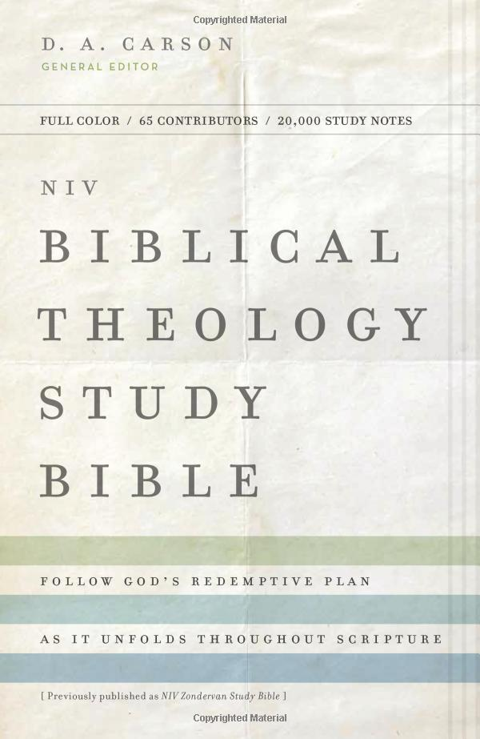
Biblical Interpretation and Theology: What is Biblical Theology
Biblical Theology has at least four priorities (from NIV Biblical Theology Study Bible):
  Read the Bible progressively as a historically developing collection of documents.
  Presuppose that the Bible is coherent.
  Work inductively from the text—from individual books and from themes that run through the Bible as a whole.
  Make theological connection within the entire Bible and that the Bible itself authorizes.

Slide 16
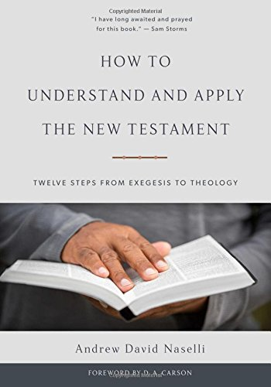
Biblical Interpretation and Theology: What is Biblical Theology
Some ways to make biblical theological connections (Naselli, How to Understand and Apply the NT, 232):
  Trace a theme’s salvation historical progression (we’ll practice this later).
  Consider continuity and discontinuity between covenants.
  Track promise and fulfillment.
  Trace type and antitype.
  Think through how the NT uses the OT.

Slide 17
Biblical Interpretation and Theology: What is Systematic Theology
Systematic Theology attempts to order biblical truth in logical categories.
  1. Theology proper (the doctrine of God)
  2. Bibliology (the doctrine of the Bible)
  3. Angelology (the doctrine of angels and demons)
  4. Anthropology (the doctrine of humans)
  5. Hamartiology (the doctrine of sin)
  6. Christology (the doctrine of Christ)
  7. Soteriology (the doctrine of salvation)
  8. Pneumatology (the doctrine of the Holy Spirit)
  9. Ecclesiology (the doctrine of the church)
  10. Eschatology (the doctrine of the end times)

Slide 18
Biblical Interpretation and Theology: A Model for Practice
Creation
Fall
Patriarchs
Exodus
Conquest
Kings (including Prophets)
Wisdom Literature (e.g., Job, Psalms, Proverbs, Ecclesiastes, Song of Solomon)
Exile (including Prophets)
Return
Jesus
Church
Heaven

Slide 19
Biblical Interpretation and Theology: A Model for Practice
Creation
Fall
Patriarchs
Exodus
Conquest
Kings (including Prophets)
Wisdom Literature (e.g., Job, Psalms, Proverbs, Ecclesiastes, Song of Solomon)
Exile (including Prophets)
Return
Jesus
Church
Heaven

Slide 20
Biblical Interpretation and Theology: Practicing Biblical Theology
Creation: God created the glorious stars, the resplendent flowers, and intricate animals, and he declares it all to be good. Perhaps the most remarkable aspect of creation is that in all this created goodness, God pointed out something that is incomplete. At the end of each day, God has declared things to be good. But “Then the LORD God said, ‘It is not good that man should be alone; I will make a helper fit for him’” (Gen 2:18). God created Eve by using a part of Adam, not because God couldn’t have created her without the rib, but so that God could teach us about the created intention for marriage: “Therefore a man shall leave his father and his mother and hold fast to his wife, and they shall become one flesh.” Even this explanation of marriage is prospective because there weren’t yet parents from whom to leave. It is remarkable that the foundational relationship God creates is the husband and the wife, not other good relationships like the parent-child or siblings—those relationships will flow out of the marriage relationship. Their commission to “be fruitful and multiply” is dependent on their marriage union.
Fall: The Fall occurs through usurpation of marriage roles, and the result of that usurpation is the further disruption of the marriage relationship. They cannot regain the purity of their complementarity: “Your desire shall be for your husband, and he shall rule over you” (Gen 3:16).
Patriarchs: When we read the biblical accounts of the patriarchs, we must remember that what the Bible describes is not always what it endorses. Their pattern of failures in marriage teaches us about the brokenness of the world and God’s grace in the midst of human unfaithfulness. The lingering sting of the Fall is evident in Abraham and Sarah’s marriage through their inability to conceive children. Marriage is created to result in fruitfulness, but even physical intimacy and its fruits are affected by the Fall. When their marriage doesn’t produce offspring, Abraham and Sarah take matters into their own hands, and distort marriage even further by Abraham having children with another woman. This plan to operate outside of God’s good bounds results in further heartache. We begin to see a pattern develop: redefining marriage results is terrible heartache. Isaac and Rebekah’s marriage isn’t blissful, as she manipulates him through Jacob. Similarly, Jacob’s polygamous marriages result in competition and heartache to the extent that his wives barter for his sexual activity.

Slide 21
Biblical Interpretation and Theology: Practicing Biblical Theology
Exodus/Law: The Law reinforces the created goodness of marriage, and protections are established to help marriage thrive. For example, Deuteronomy 20:7 instructs the recently married husband to refrain from war for a year’s time, so that he can bring happiness to his wife. The law describes an implicitly good view of marriage, and thus the law prescribes protecting that union. By the time God gives the Law, the Israelites must have been practicing divorce. Again God established protections to uphold marriage. Another remarkable aspect of Israelite marriage is that prohibition of exogamy is a way to guard against idolatry. Israelites must marry other God-worshippers.
Kings: Tragically Israel’s kings do not embody God-honoring marriage. Instead, Israel’s kings use marriage for their insatiable pleasure and for political alliance. King David is an example of marriage being redefined to their heartache. He married Maacha for political advancement, and it ends in civil war. He married Bathsheba for pleasure, and he commits adultery and murder to accomplish it. He married Michal for standing, and it results in despising one another. Solomon’s extreme polygamy begets extreme heartache, and his wives lead his heart into idolatry.
Wisdom Literature: Since marriage is the foundational structure of society, it is no surprise that Proverbs offers considerable instruction. The author warns against adultery, and correspondingly celebrates marital physical intimacy: “Let your fountain be blessed, and rejoice in the wife of your youth, a lovely deer, a graceful doe. Let her breasts fill you at all times with delight; be intoxicated always in her love” (Prov 5:18-19). The text communicates a biblical view of marriage that is for procreation (i.e. “fountain be blessed”) and for pleasure (“rejoice” “delight” “intoxicated”). On the contrary, Proverbs warns several times about the heartache of abandoning God-honoring marriage: “It is better to live in the corner of a housetop than is a house shared with a quarrelsome wife” (Prov 21:9). The wise instruction about marriage culminates in Proverbs 31 that describes the wise woman who is a joy and delight to her husband.

Slide 22
Biblical Interpretation and Theology: Practicing Biblical Theology
Poetic Texts: The Song of Solomon graphically describes marital love. Some argue that this description is a metaphor for God’s love while others take it at face value as a literal description of marital love. Regardless of the interpretation, the view of marriage is positive and physical intimacy within marriage is viewed positively.
Prophets: There is a remarkable shift in the way marriage is described in the prophetic texts. Instead of speaking of the created goodness of marriage, the prophetic texts focus on the brokenness of marriage, heartache, and adulterous betrayal. And they use this tragedy of human marriage to describe the betrayal of God by his people. Marriage becomes a powerful metaphor for the relationship between God and his people. The audience knows both the joy that marriage should be and heartache that it often is. Isaiah 1:21 “How the faithful city has become a whore, she who was full of justice! Righteousness lodged in her, but now murderers.” Jeremiah 2:20-24: “For long ago I broke your yoke and burst your bonds; but you said, ‘I will not serve.’ Yes, on every high hill and under every green tree you bowed down like a whore. Yet I planted you a choice vine, wholly of pure seed. How then have you turned degenerate and become a wild vine? Though you wash yourself with lye and use much soap, the stain of your guilt is still before me, declares the Lord God. How can you say, ‘I am not unclean, I have not gone after the Baals’? Look at your way in the valley; know what you have done—a restless young camel running here and there, a wild donkey used to the wilderness, in her heat sniffing the wind! Who can restrain her lust? None who seek her need weary themselves: in her month they will find her.” Ezekiel 16 and the Book of Hosea continue this imagery of idolatry being compared to adultery.

Slide 23
Biblical Interpretation and Theology: Practicing Biblical Theology
Exile and Return: The return from exile describes another tragic event in which God’s people abandon his prescription for marriage. They intermarry with women who do not worship God, and as a result their hearts are drawn toward idolatry. And in a surprising act of faithfulness, they discontinue these marriages that would lead to idolatry.
Jesus: While Jesus never married, he held high the institution of marriage, even performing his first miracle at a wedding feast. In Matthew 19, he corrects some of the abuses of marriage and reinforces the permanence that God has always intended for marriage. Jesus’s emphasis on the permanence of marriage begins to hint at what Paul will develop more fully in his Epistles that human marriage pictures the divine marriage between Christ and the church, which has eternal permanence.

Slide 24
Biblical Interpretation and Theology: Practicing Biblical Theology
Church: Paul reinforces the goodness of marriage and physical intimacy, and he bases that on the theology of the goodness of the material body. In 1 Corinthians 7, he instructs the church that singleness has great value for mission, but not everyone has the gift of singleness; in fact, many have the gift of marriage, and married couples should give themselves to one another physically. Nevertheless, marriage is not ultimate; devotion to God and expressing that devotion in how God has called you is ultimate. Similar to Paul’s instructions for wives to submit and husbands to lead lovingly, 1 Peter 3 instructs husbands and wives. Perhaps the most significant text for understanding the ultimate meaning of marriage is Ephesians 5 in which Paul explains human marriage as pointing to a greater and deeper spiritual reality, Christ’s love for the church.
Heaven: In Luke 20:27-36, Jesus explains that there will be no marriage at the resurrection. Why? Well, the purposes of marriage are transformed. Procreation will be unnecessary. Pleasure will be escalated to be life with God. Companionship will be fulfilled in that life with God. The Book of Revelation contrasts the Wicked Woman of Babylon with the Bride of Christ. The climax of Revelation is the marriage feast of the Lamb and his bride the church.
Biblical Theological Summary: The Bible begins and ends with a marriage. As the story unfolds, it becomes clear that human marriage, as wonderful as it can be, exists to point to an even greater reality, Christ’s love for the church.

Slide 26


VS.

Slide 27
Words:
Lexical studies
Clauses: Grammar
Sentences:
Syntax
Paragraphs: Argument Analysis
Books: Discourse Analysis
Canon: Biblical Theology

Slide 28
Words:
Lexical studies
Clauses: Grammar
Sentences:
Syntax
Paragraphs: Argument Analysis
Books: Discourse Analysis
Canon: Biblical Theology
8. Vocabulary
9. Translations
More inclined to the original languages
5. Linking Words
6. Parallels
12. Quotation/ Allusion
3. Context Tool
7. Narrator’s Comment
11. Repetition
14. Copycat
2. Author’s Purpose
3. Structure
10. Tone and Feel
13. Genre
9. Translations
15. Bible Timeline
One challenge is that all the tools do not divide neatly into these categories. For example, repetition can occur at the level of sentences, paragraphs, books, and canon.

Slide 29
Words:
Lexical studies
Clauses: Grammar
Sentences:
Syntax
Paragraphs: Argument Analysis
Books: Discourse Analysis
Canon: Biblical Theology
8. Vocabulary
9. Translations
More inclined to the original languages
5. Linking Words
6. Parallels
12. Quotation/ Allusion
3. Context Tool
7. Narrator’s Comment
11. Repetition
14. Copycat
2. Author’s Purpose
3. Structure
10. Tone and Feel
13. Genre
9. Translations
15. Bible Timeline
One challenge is that all the tools do not divide neatly into these categories. For example, repetition can occur at the level of sentences, paragraphs, books, and canon.

Slide 30
THE VOCABULARY TOOL

Slide 31
Biblical Interpretation:
What is the vocabulary tool?

Slide 32
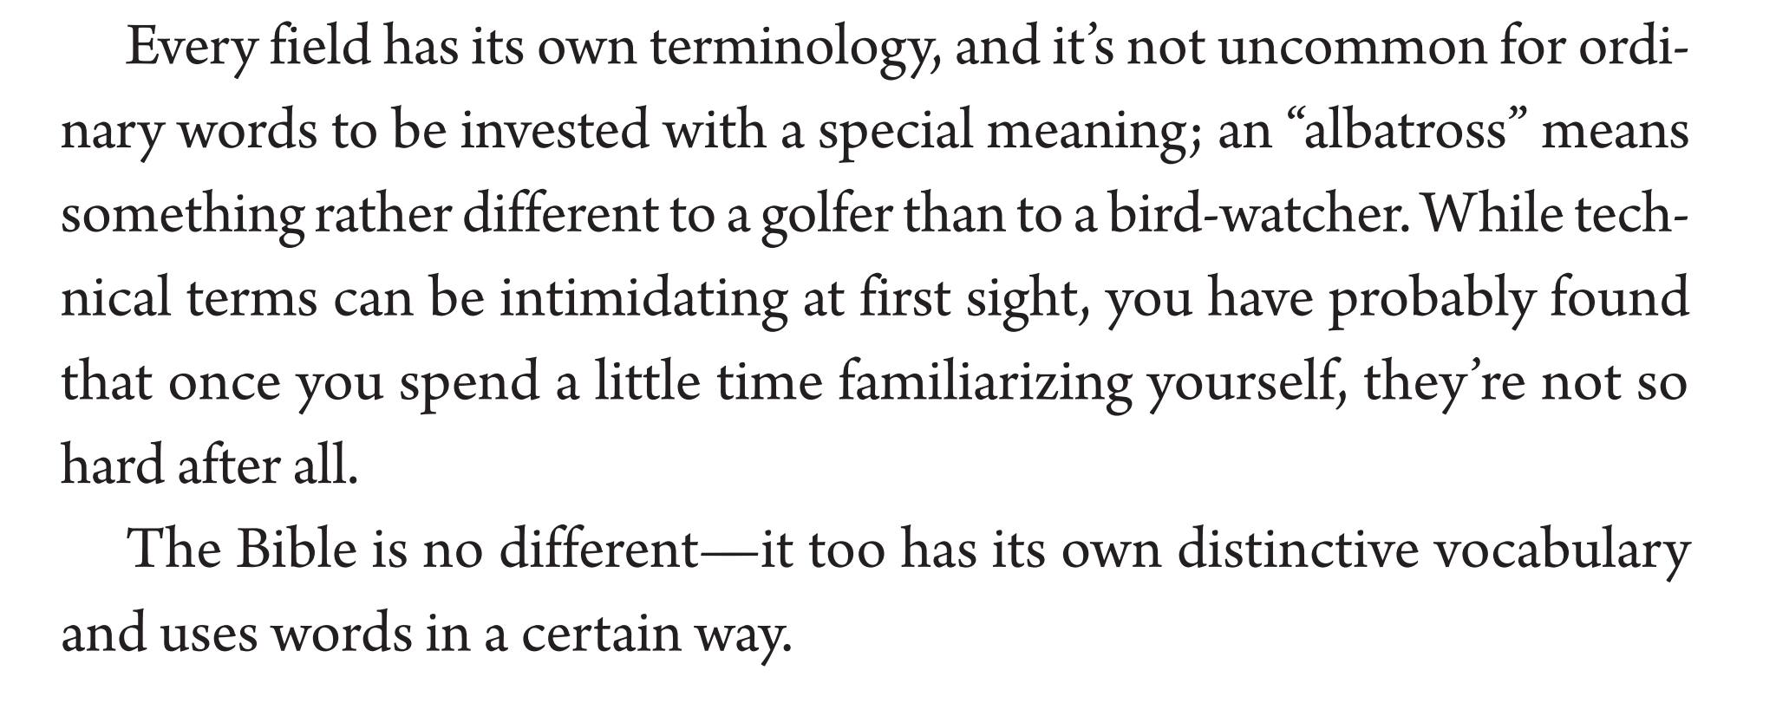

Slide 33
Class Goals:
Understand the vocabulary tool.
Practice the vocabulary tool.

Slide 34
The Vocabulary Tool
WORDS
SENTENCES
PARAGRAPHS
BOOKS
BIBLE
Can you name a word that has just one meaning?
Read the selection from Naselli, How to Understand and Apply the New Testament, 206-207.
“Word study is not an end in itself. As mentioned, a word means virtually nothing apart from its context, and so word study is merely one (albeit vital) component part in the overall process of interpretation” (Fuhr and Köstenberger, Inductive Bible Study, 233).

Slide 35
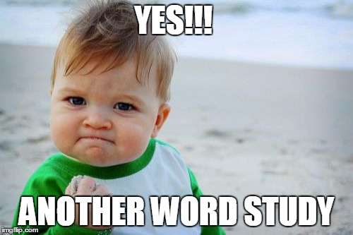

Slide 36
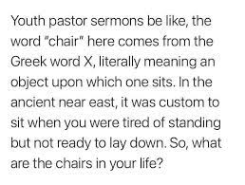

Slide 37
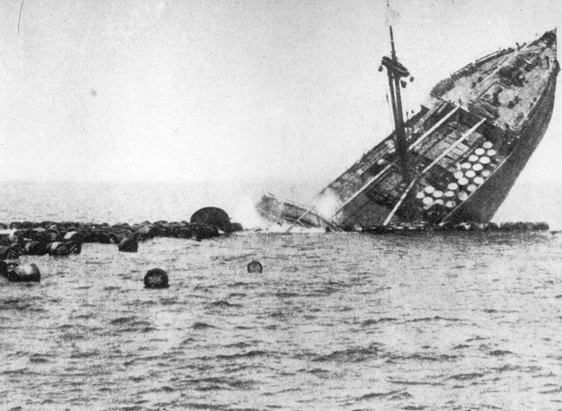
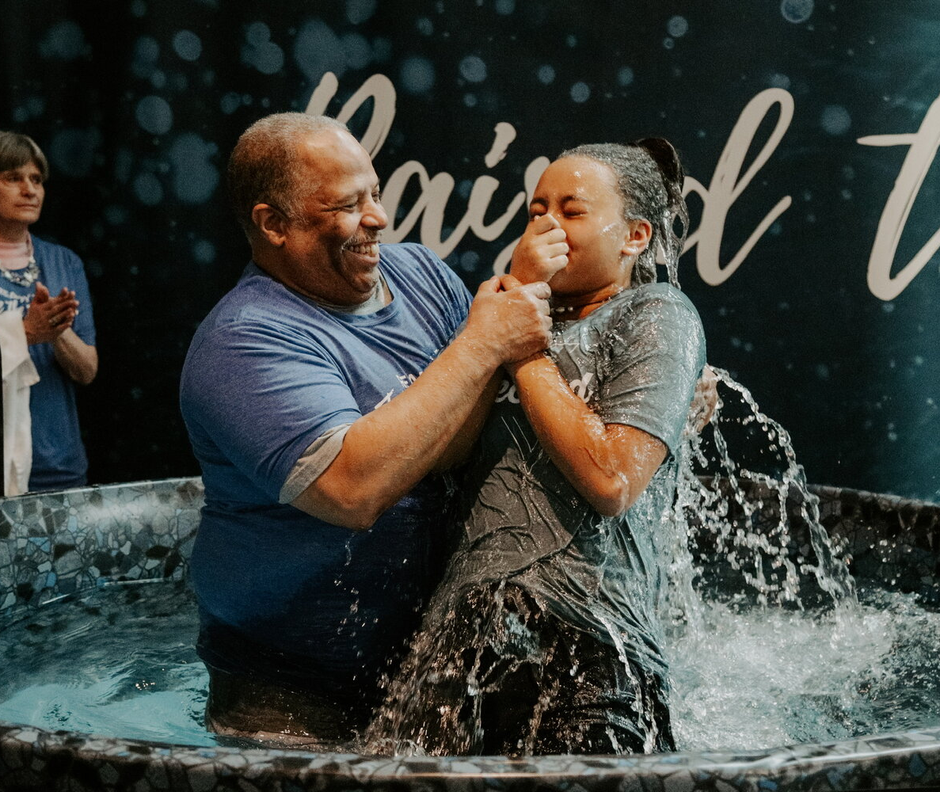

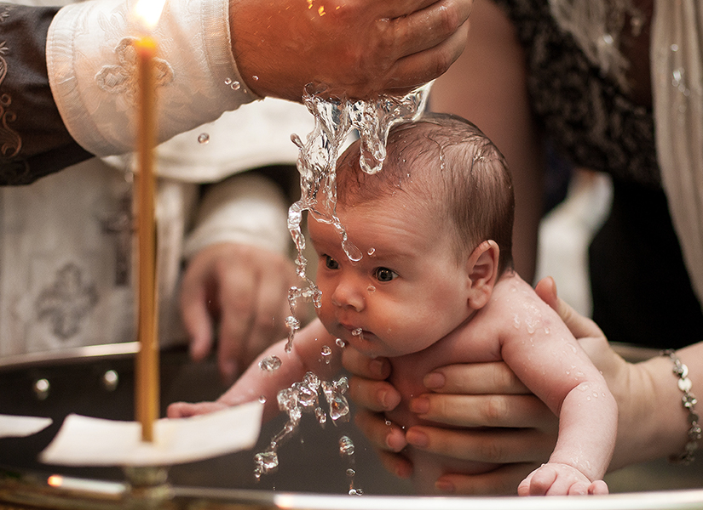
Word Study: Introduction

Slide 38
Word Study: what does the word “eunuch” mean?
27 καὶ ἀναστὰς ἐπορεύθη. καὶ ἰδοὺ ἀνὴρ Αἰθίοψ εὐνοῦχος δυνάστης Κανδάκης βασιλίσσης Αἰθιόπων, ὃς ἦν ἐπὶ πάσης τῆς γάζης αὐτῆς, ὃς ἐληλύθει προσκυνήσων εἰς Ἰερουσαλήμ, 28 ἦν τε ὑποστρέφων καὶ καθήμενος ἐπὶ τοῦ ἅρματος αὐτοῦ καὶ ἀνεγίνωσκεν τὸν προφήτην Ἠσαΐαν. Acts 8:27-28
27 And he rose and went. And there was an Ethiopian, a eunuch, a court official of Candace, queen of the Ethiopians, who was in charge of all her treasure. He had come to Jerusalem to worship 28 and was returning, seated in his chariot, and he was reading the prophet Isaiah.
Acts 8:27-28 ESV
Ιωσηφ δὲ κατήχθη εἰς Αἴγυπτον, καὶ ἐκτήσατο αὐτὸν Πετεφρης ὁ εὐνοῦχος Φαραω, ἀρχιμάγειρος, ἀνὴρ Αἰγύπτιος, ἐκ χειρὸς Ισμαηλιτῶν, οἳ κατήγαγον αὐτὸν ἐκεῖ…7 καὶ ἐγένετο μετὰ τὰ ῥήματα ταῦτα καὶ ἐπέβαλεν ἡ γυνὴ τοῦ κυρίου αὐτοῦ τοὺς ὀφθαλμοὺς αὐτῆς ἐπὶ Ιωσηφ καὶ εἶπεν Κοιμήθητι μετʼ ἐμοῦ. Gen 1:1…7
Now Joseph was led down to Egypt, and Potiphar, the eunuch of Pharaoh, an Egyptian man who was the chief cook, acquired him from the hands of the Ishmaelites who led him down there…. 7 And it happened after these matters that the wife of his lord cast her eyes on Joseph and said, “Sleep with me!” Gen 1:1…7 NETS

Slide 39
Word Study: what does the word “love” mean?
15 Ὅτε οὖν ἠρίστησαν λέγει τῷ Σίμωνι Πέτρῳ ὁ Ἰησοῦς· Σίμων Ἰωάννου, ἀγαπᾷς με πλέον τούτων; λέγει αὐτῷ· Ναὶ κύριε, σὺ οἶδας ὅτι φιλῶ σε. * λέγει αὐτῷ· Βόσκε τὰ ἀρνία μου. 16 λέγει αὐτῷ πάλιν δεύτερον· Σίμων Ἰωάννου, ἀγαπᾷς με; λέγει αὐτῷ. Ναὶ κύριε, σὺ οἶδας ὅτι φιλῶ σε. * λέγει αὐτῷ· Ποίμαινε τὰ πρόβατά μου. 17 λέγει αὐτῷ τὸ τρίτον· Σίμων Ἰωάννου, φιλεῖς με; ἐλυπήθη ὁ Πέτρος ὅτι εἶπεν αὐτῷ τὸ τρίτον· Φιλεῖς με; καὶ λέγει αὐτῷ· Κύριε, πάντα σὺ οἶδας, σὺ γινώσκεις ὅτι φιλῶ σε. * λέγει αὐτῷ [ὁ Ἰησοῦς]· Βόσκε τὰ πρόβατά μου. 18 ἀμὴν ἀμὴν λέγω σοι, ὅτε ἦς νεώτερος, ἐζώννυες σεαυτὸν καὶ περιεπάτεις ὅπου ἤθελες· ὅταν δὲ γηράσῃς, ἐκτενεῖς τὰς χεῖράς σου, καὶ ἄλλος σε ζώσει καὶ οἴσει ὅπου οὐ θέλεις. 19 τοῦτο δὲ εἶπεν σημαίνων ποίῳ θανάτῳ δοξάσει τὸν θεόν. καὶ τοῦτο εἰπὼν λέγει αὐτῷ· Ἀκολούθει μοι. John 21:15–19
Notes:
15 When they had finished breakfast, Jesus said to Simon Peter, “Simon, son of John, do you love me more than these?” He said to him, “Yes, Lord; you know that I love you.” He said to him, “Feed my lambs.” 16 He said to him a second time, “Simon, son of John, do you love me?” He said to him, “Yes, Lord; you know that I love you.” He said to him, “Tend my sheep.” 17 He said to him the third time, “Simon, son of John, do you love me?” Peter was grieved because he said to him the third time, “Do you love me?” and he said to him, “Lord, you know everything; you know that I love you.” Jesus said to him, “Feed my sheep. 18 Truly, truly, I say to you, when you were young, you used to dress yourself and walk wherever you wanted, but when you are old, you will stretch out your hands, and another will dress you and carry you where you do not want to go.” 19 (This he said to show by what kind of death he was to glorify God.) And after saying this he said to him, “Follow me.”
The Holy Bible: English Standard Version (Jn 21:15–19). (2016). Crossway Bibles.

Slide 40
The Vocabulary Tool
WORDS
SENTENCES
PARAGRAPHS
BOOKS
BIBLE
The importance:
  Words have meaning.
  You can’t understand the author’s meaning if you don’t understand his words.
  E.G., In order to graduate you must go to the NJFDSN office.
The challenges:
  Stained-glass words: some biblical words are not used in everyday speech. They are words reserved for Christian speech.
    E.g., Redemption, propitiation, etc.
  Everyday words can be used differently: some words are defined differently by popular culture. The translation might be correct but still needs to be nuanced.
    E.g., love, hope, etc.
  Words can have changing meaning: some words were rendered properly at the time of their translation, but their meaning has since shifted in the English language.
    E.g., Charity.
So how do we discern what a biblical author meant by a given word?

Slide 41

The Vocabulary Tool
WORDS
SENTENCES
PARAGRAPHS
BOOKS
BIBLE
Steps for a word study…
  Identify the most significant or unclear words.
  Establish the possible meanings of the word.
  Gather all the uses of this word in the Bible (if possible).
  Survey how the word is used (e.g., different contexts and associations with other words).
  Analyze this text to discern the most likely meaning for the specific use of the word.
  Check your assessment with other translations and commentaries.
NOTE: Blueletterbible.com has many of these resources in one place, but physical books are also able to do this.
Doing a word study can be like playing Guess Who? You start by establishing all the possibilities, and then you strategically eliminate them, until you arrive at your best assessment.
Notes:
For translations of “propitiation” use the NET Bible.

Slide 42
The Vocabulary Tool
WORDS
SENTENCES
PARAGRAPHS
BOOKS
BIBLE
Step 1: Identify the most significant or unclear words.
Some guidelines for selecting words to study
  Unclear: you don’t understand what the word means.
  Contextually-Crucial: the meaning of the text hangs on the meaning of this word.
  Theologically-Significant: the word has a profound theological meaning.
  Figurative or Symbolic: the word alludes to or stands for something else.
  Compared or contrasted: the word is used in relationship to other important words.
  Repeated: the word recurs in a given passage.

Slide 43
The Vocabulary Tool
WORDS
SENTENCES
PARAGRAPHS
BOOKS
BIBLE
Note: steps 2 and 3 go hand-in-hand because you are establishing meaning as you gather uses.
Step 2: Establish the possible meanings of the word.
  You can use a dictionary or compile the meanings as you gather the uses.
  A Bible-specific dictionary can be more helpful. Here are some online tools with varying levels of helpfulness.
    https://www.biblestudytools.com/dictionaries/smiths-bible-dictionary/
    https://www.biblegateway.com/resources/dictionaries/
    https://www.biblestudytools.com/dictionaries/
Example (Naselli, How to Understand and Apply the New Testament, 209)
    I run 2 miles every day.
    She has a run in her nylons.
    That grapevine runs through the fence.
    My nose runs when I have a cold.
    I need to run to the store.
    My new computer runs faster than my previous one.
    I try not to let the water run when I’m not using it because that runs up the water bill.
    I ran out of gas today.
    Someday I’ll run for president.

Slide 44
The Vocabulary Tool
WORDS
SENTENCES
PARAGRAPHS
BOOKS
BIBLE
Step 3: Gather the uses of this word in the Bible.
English vs. Greek or Hebrew
  Original language is better because…
    multiple Greek words might have the same English translation (e.g. John 21).
    one Greek word might have different English translations because language isn’t a 1-1 correspondence (e.g., church lady offering to translate for a missionary).
Some suggested tools in increasing order of usefulness (and thus inverse order of accessibility)
  English Language Word Search
    https://www.esv.org/Matthew+1/
  Original Language Concordance
    Strong’s Concordance
    https://www.biblestudytools.com/concordances/strongs-exhaustive-concordance/
  Logos Bible Works
Notes:
Value of original language:
-believe / faith
-gospel / preach the gospel

Slide 45
The Vocabulary Tool
WORDS
SENTENCES
PARAGRAPHS
BOOKS
BIBLE
Step 4: Survey how the word is used (e.g., different contexts and associations with other words).
Use the list of occurrences, and read them in their context.
Ask these questions:
  Is this word concentrated in a particular part of the Bible?
  In what types of writing is this used (e.g., law, poetry, etc.)?
  In what settings is this word used (rural/urban, war/peace, etc.)?
  With what other words is this word often associated?
  How does the author of your specific text tend to use the word?
You are beginning to eliminate some of the possible meanings.

Slide 46
The Vocabulary Tool
WORDS
SENTENCES
PARAGRAPHS
BOOKS
BIBLE
Step 5: Analyze this text to discern the most likely meaning for the specific use of the word.
You are moving from semantic range to specific use.
Some questions to ask:
  What does this passage seem to be about?
  Are there other uses/contexts that are similar to this passage?
  Read the paragraph with each of the probable meanings. Which one makes the most sense?

Slide 47
The Vocabulary Tool
WORDS
SENTENCES
PARAGRAPHS
BOOKS
BIBLE
Step 6: Check your assessment with other translations and commentaries.
The people who translate the Bible are not fools.
The people who translate the Bible are not infallible.
The people who translate the Bible can have agendas.
Your own word study helps you evaluate and nuance a translation.
https://net.bible.org/#!bible/Matthew+1
https://www.biblegateway.com/
https://www.biblestudytools.com/compare-translations/

Slide 48
The Vocabulary Tool
WORDS
SENTENCES
PARAGRAPHS
BOOKS
BIBLE
Let’s Practice: 1 Corinthians 14 might be a good place.
  Identify the most significant or unclear words.
    Let’s make a list.
  Establish the possible meanings of the word.
    Let’s make a list.
    https://www.biblestudytools.com/dictionaries/
  Gather all the uses of this word in the Bible (if possible).
    Let’s make a list.
    https://www.biblestudytools.com/concordances/strongs-exhaustive-concordance/
  Survey how the word is used (e.g., different contexts and associations with other words).
    Let’s annotate our list.
  Analyze this text to discern the most likely meaning for the specific use of the word.
    Let’s plug in our probable meanings in this passage.
  Check your assessment with other translations and commentaries.
    https://www.biblegateway.com/

Slide 49
The Vocabulary Tool
WORDS
SENTENCES
PARAGRAPHS
BOOKS
BIBLE
Some Cautions with Word Studies:
  Don’t import meaning unjustifiably! The immediate context is most important.
  Don’t try to import the entire semantic range (illegitimate totality transfer)! The word generally has a specific use in a specific usage.
  Don’t assume frequency is the determining factor!
  Don’t assume that the word is just the some of it’s parts (i.e., etymological fallacy). Words often take on meaning beyond the conglomeration of their parts (e.g., butterfly).
  Don’t assume that the author is trying to heighten distinction (i.e., exegetical distinction fallacy)! For example, parallelism can be used to make a distinction or to restate something for emphasis.

Slide 50
THE TRANSLATIONS TOOL

Slide 51
Biblical Interpretation:
How can multiple translations help in biblical interpretation?

Slide 52
Class Goals:
Understand the translations tool.
Practice the translations tool.

Slide 53
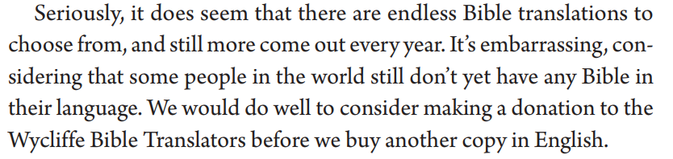

Slide 54
BIBLE AND THE GOSPEL: how the Bible comes to us
Striving for Faithfulness
Inspired Writing
Transmission
Translation
Infallible
Trustworthy
Canon: recognition of authority
Text Criticism: seeking the original
Re-translation: updating language

Slide 55
BIBLE AND THE GOSPEL: how the Bible comes to us
TRANSLATION: some important ideas
Translation necessitates interpretation.
Translation is an ongoing process (in part because receptor languages change).
Readability: the degree to which a work is expressed in common language, often measured by reading level
Translation Committee: group of people (sometimes more or less diverse and skilled) charged with producing a translation.
Translation Theory: The stated approach and objectives of the translator(s) in producing a document.
  Formal Equivalence:
  Functional / Dynamic Equivalence:

Slide 56
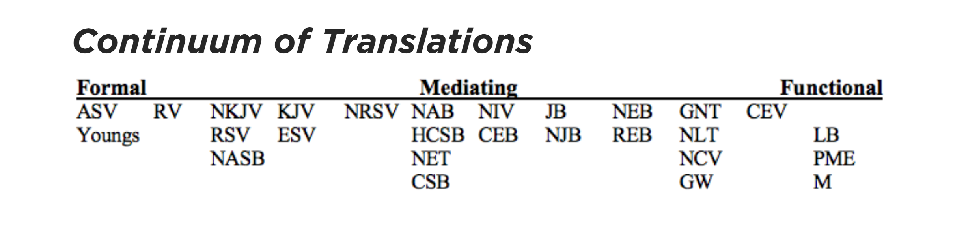
https://www.thegospelcoalition.org/essay/the-bible-in-translation/
Notes:
NOTE: this is from Mark Strauss posted on TGC

Slide 57
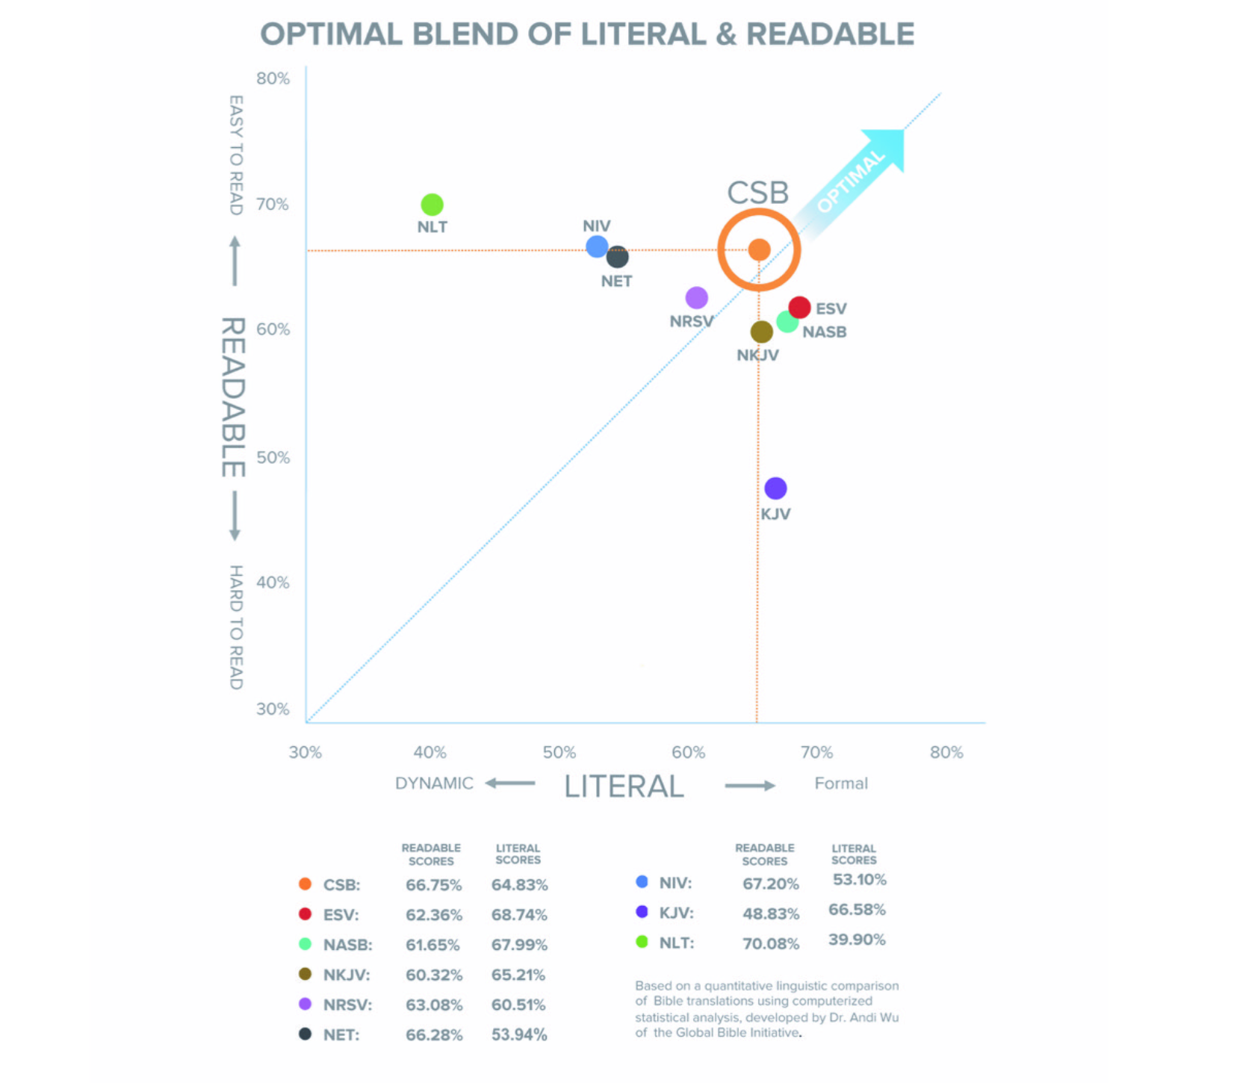
Notes:
NOTE: this is information put out by the CSB to argue for their translation

Slide 58
The Translations Tool
WORDS
SENTENCES
PARAGRAPHS
BOOKS
BIBLE
Comparing translations helps you to see nuances of the original and not make incorrect inferences about the text.
Some qualities that make a good translation: accurate, clear, natural, and audience-appropriate (see Naselli, How to Understand and Apply the New Testament, 53).
Three main approaches to translations (not dealing with paraphrases):
  Formal equivalence (more form-based): more word-for-word or literal from Greek to English.
    Benefit: enables the English reader to see the original language structure
    Benefit: enables the English reader to trace better the argument structure
    Benefit: less interpretive, so less-likely to err, and leaves interpretation to reader
  Functional equivalence (more meaning based): conveys Greek meaning in natural English.
    Benefit: can be clearer, especially with the translation of idioms
    Benefit: tends to be more natural English
  A mediating approach:
A good explanation (with some disagreement): attempts to combine the strengths of each https://www.youtube.com/watch?v=yZSHztdJ6tw

Slide 59

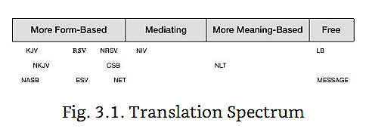
The Translations Tool
WORDS
SENTENCES
PARAGRAPHS
BOOKS
BIBLE

Slide 60
The Translations Tool
WORDS
SENTENCES
PARAGRAPHS
BOOKS
BIBLE
Let’s look at Colossians 3:16.
  NASB: Let the word of Christ richly dwell within you, with all wisdom teaching and admonishing one another with psalms and hymns and spiritual songs, singing with thankfulness in your hearts to God.
  ESV: Let the word of Christ dwell in you richly, teaching and admonishing one another in all wisdom, singing psalms and hymns and spiritual songs, with thankfulness in your hearts to God.
  NIV: Let the message of Christ dwell among you richly as you teach and admonish one another with all wisdom through psalms, hymns, and songs from the Spirit, singing to God with gratitude in your hearts.
  NLT: Let the message about Christ, in all its richness, fill your lives. Teach and counsel each other with all the wisdom he gives. Sing psalms and hymns and spiritual songs to God with thankful hearts.
  (Message): Let the Word of Christ—the Message—have the run of the house. Give it plenty of room in your lives. Instruct and direct one another using good common sense. And sing, sing your hearts out to God. Let every detail in your lives—words, actions, whatever—be done in the name of the Master, Jesus, thanking God the Father every step of the way.
  NA28: Ὁ λόγος τοῦ Χριστοῦ ἐνοικείτω ἐν ὑμῖν πλουσίως, ἐν πάσῃ σοφίᾳ διδάσκοντες καὶ νουθετοῦντες ἑαυτούς, ψαλμοῖς ὕμνοις ᾠδαῖς πνευματικαῖς ἐν [τῇ] χάριτι ᾄδοντες ἐν ταῖς καρδίαις ὑμῶν τῷ θεῷ·

Slide 61
The Translations Tool
WORDS
SENTENCES
PARAGRAPHS
BOOKS
BIBLE
We saw the value of Translations Tool when we used the Vocabulary Tool.
Use a resource like Bible Gateway.
  https://net.bible.org/#!bible/Matthew+1
  https://www.biblegateway.com/
  https://www.biblestudytools.com/compare-translations/
Here’s a good analysis: https://www.desiringgod.org/interviews/what-do-you-think-about-paraphrased-bible-translations
Here’s a good resource: http://evangelicalbible.com/translations/bible-translation-guide/

Slide 62
THE QUOATATION / ALLUSION TOOL

Slide 63
Biblical Interpretation:
What role do intertextual connections have?
Notes:
Huck Finn and Tom Sawyer

Slide 64
Class Goals:
Understand the quotation / allusion tool.
Practice the quotation / allusion tool.

Slide 65
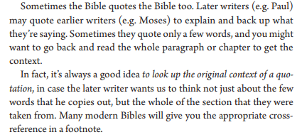

Slide 66

Illustrating The Context of a Reference…
From which movies do these quotes come?
“Toto, I’ve got a feeling we’re not in Kansas anymore.”
“May the force be with you.”
“Bond. James Bond.”
“You’re gonna need a bigger boat.”
“I’ll be back.”
“Houston, we have a problem.”
“Elementary, my dear Watson.”
“Yo, Adrian!”
“My precious.”
Now let’s think about how these simple quotes call vastly different contexts to our minds.

Slide 67
The Quotation/Allusion Tool
WORDS
SENTENCES
PARAGRAPHS
BOOKS
BIBLE
As you read, think about where you’ve seen this concept before.
Use the references in the margins of your Bible.
Look up the reference in its original context.
The author often assumes you understand the context from the original quotation.
  E.g. “I have a dream…”
Allusions are harder to spot.
  It is easier to spot more unique quotations.
  E.g., “four score and seven years ago…”
  Allusions require more careful reading and a better understanding of the whole Bible.
Let’s look at the beginning of the NT, Matt 1.
Notes:
The most important context for understanding the Bible is the Bible itself
Huck Finn: we don’t need to research that period of history…twain tells us what we need to know.
Tom Sawyer: assumes we have read huck finn

Slide 68
Illustrating The Context of a Reference from Hebrews 1:1-7
What images or contexts do these quotes bring to mind?
“You are my Son, today I have begotten you…” (Heb 1:5)
  Quotation: Psalm 2: the kingship of God over all and the enthronement of his servant David over all the nations, and thus pointing to an even greater Son
“I will be to him a father, and he shall be to me a son…”(Heb 1:5)
  Quotation: 2 Sam 7:14: God’s covenantal promises to David and his line.
“When he brings the firstborn into the world” (Heb 1:6)
  Allusion: Psalm 89:27: focusing on God’s steadfast love to David and his status as “firstborn” over all the kings of the earth. It recalls God’s forever covenant with David.
“Let all the angels worship him…” (Heb 1:6)
  Quotation: Deut 32:43 LXX: Call for all heavens and earth to worship God who enacts his judgment over all who oppose him. Hebrews applies this call to worship God to the Son who is worthy of worship—the true seed of David.
“He makes his angels winds, and his ministers a flame of fire”
  Quotation: Psalm 104:4: description of the majesty of God in created all things. This majesty is ascribed to the Son as in Hebrews 1:3.
The biblical authors assume that you’ll know the reference and the context.

Slide 69
The Quotation/Allusion Tool
WORDS
SENTENCES
PARAGRAPHS
BOOKS
BIBLE
Let’s look at 1 Corinthians 10:1-13
10:1-5: allusions to the Wilderness Generation
10:6: the principle
10:7-10: quotations and allusions
  He appeals primarily to four narratives drawn from the wilderness generation:
  the Golden Calf (Exod 32): 10:7
  intermarriage with the Midianites (Num 25): 10:8
  judgment by serpents (Num 21): 10:9
  grumbling (Num 16): 10:10
10:11-13: conclusion
10:14: application to the Christians at Corinth
Takeaway: The Bible provides its on textual context. Understanding the whole Bible enables you to understand the particular passage.
Notes:
10:1–13 Warnings From Israel’s History. Paul argues with another example: when the people of Israel compromised with idolatry, it led to God’s judgment.
10:1 the cloud. The pillar of cloud that accompanied the people of Israel during the exodus from Egypt (Exod 13:21–22; 14:24; see Ps 105:39). passed through the sea. Crossed the Red Sea (Exod 14:21–22; see Ps 78:13).
10:2 baptized into Moses. Figurative use of the Greek word baptizo, the basic meaning of which is “immerse.” Paul speaks of the Israelites’ incorporation into, or affiliation with, Moses, whom God appointed as Israel’s leader and whom they were to obey.
10:3 spiritual food. The miracle of the quail and the manna (Exod 16:1–16; Num 11:4–34).
10:4 spiritual drink. The miracle of the water from the rock (Exod 17:1–7; Num 20:7–11). The two miracles are interpreted typologically in terms of the salvation provided by God through Jesus Christ. the spiritual rock that accompanied them. Jewish tradition deduced, from the reference to the rock at the beginning (Exod 17:1–7) and at the end (Num 20:2–13) of the desert journey, that the rock followed (“accompanied”) the people of Israel. When Paul speaks of a “spiritual” rock, he indicates that he does not think of the physical rock in the desert that gave water. that rock was Christ. The rock is interpreted symbolically: the gifts of salvation that God provides for his people are given through Christ. Just as Paul transferred the term “Lord” from God to Jesus Christ (e.g., 1:2), so he transfers the term “rock” from God (e.g., Deut 32:4, 15, 30–31) to Jesus. Since he described Jesus as mediator of creation in 8:6, he may also be thinking of the preexistent Christ. Paul’s main point is the early history of Israel: though sustained by God’s grace, the Israelites were destroyed in the desert due to their idolatry.
Moo, D. J. (2015). . In D. A. Carson (Ed.), NIV Zondervan Study Bible: Built on the Truth of Scripture and Centered on the Gospel Message (pp. 23432344). Grand Rapids, MI: Zondervan.
Moo, D. J. (2015). The Letters and Revelation. In D. A. Carson (Ed.), NIV Zondervan Study Bible: Built on the Truth of Scripture and Centered on the Gospel Message (pp. 2343–2344). Grand Rapids, MI: Zondervan.
10:3–4 spiritual food … drink. Paul is referring to God providing Israel with bread from heaven (“manna,” Exodus 16) and water from a rock. This rock appears both at the beginning of their wanderings in the desert (Ex. 17:1–7) and near the end (Num. 20:2–13). Rabbinic exegesis from after Paul’s time surmised that the rock followed the Israelites throughout their wanderings. This understanding of the rock may have been current in Paul’s time. If so, Paul’s claim that the Rock following them was both spiritual and Christ shows that he did not believe that a physical rock traveled with the Israelites, but that Christ (in spiritual form) was ever-present with them: he was there to supply their need for water, and there to judge those who tested him (1 Cor. 10:9). “Rock” is a common OT name for God (e.g., Deut. 32:4, 15, 18, 30–31), and this probably facilitated Paul’s identification of the rock with Christ.
Crossway Bibles. (2008). (p. 2204). Wheaton, IL: Crossway Bibles.
Crossway Bibles. (2008). The ESV Study Bible (p. 2204). Wheaton, IL: Crossway Bibles.

Slide 70
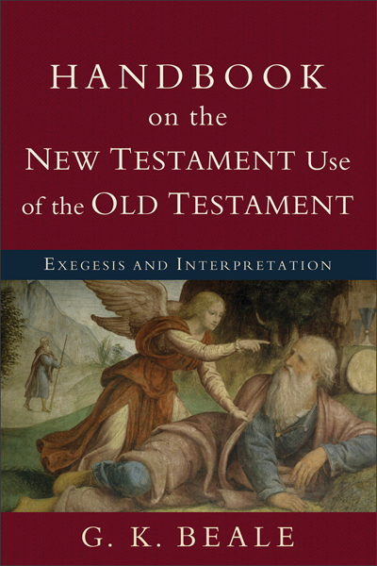
The Epistle to the :
Key Facts
This line describes the content and purpose of the Book in one memorable sentence.
Some ways that the NT uses the OT
To Indicate Direct Fulfillment of Old Testament Prophecy
To Indicate Indirect Fulfillment of Old Testament Typological Prophecy
To Indicate Affirmation That a Not-Yet-Fulfilled Old Testament Prophecy Will Assuredly Be Fulfilled in the Future
To Indicate an Analogical or Illustrative Use of the Old Testament
To Indicate the Symbolic Use of the Old Testament
To Indicate an Abiding Authority Carried Over from the Old Testament

Slide 71
The Epistle to the :
Key Facts
This line describes the content and purpose of the Book in one memorable sentence.
Some ways that the NT uses the OT
To Indicate a Proverbial Use of the Old Testament
To Indicate a Rhetorical Use of the Old Testament
To Indicate the Use of an Old Testament Segment as a Blueprint or Prototype for a New Testament Segment
To Indicate an Alternate Textual Use of the Old Testament
To Indicate an Assimilated Use of the Old Testament
To Indicate an Ironic or Inverted Use of the Old Testament

Slide 72
THE COPYCAT TOOL

Slide 73
Biblical Interpretation:
What is the copycat tool?

Slide 74
Class Goals:
Understand the copycat tool.
Practice the copycat tool.

Slide 75
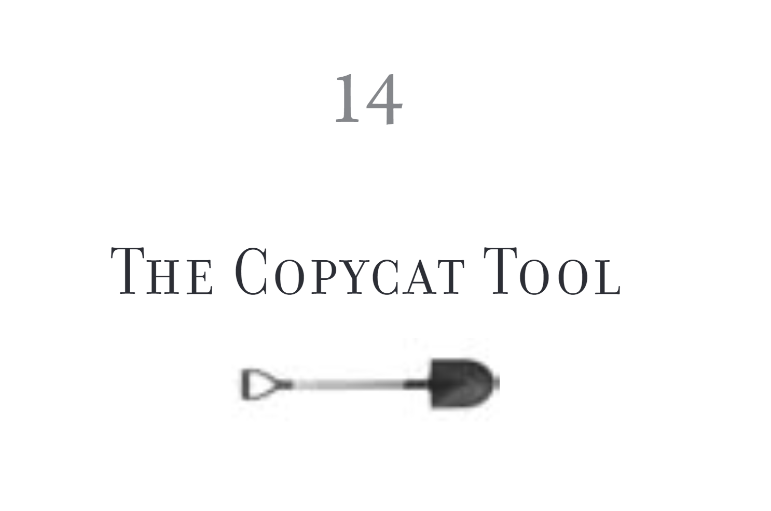

Slide 76
The Copycat Tool
The Copycat Tool asks what we should copy in our lives?
Prescriptive/normative: commands or patterns that we should imitate or follow.
Descriptive: an account of how things happened, not necessarily to be imitated.
Distinguish between description and prescription. There’s a big difference between “This event happened” (that’s situational or descriptive) and “We must do this today” (that’s normative or prescriptive). Just because the Gospels or Acts tell a story about an event doesn’t mean that we must repeat that event today. Before you apply the Gospels and Acts to today, you must locate where the events fit in salvation history and reflect on the nature and purpose of the story (Naselli, How to Understand and Apply the New Testament, KL 23).

Slide 77
Copycat Tool (with narrative): Descriptive vs. Prescriptive
Some texts in Acts are descriptive—they state what the church was like and do not give us a command for today.
Other texts are prescriptive—they direct and govern how things should be in the church today.
One of the challenges in a narrative text like Acts is to discern what things are ongoing commands and practices for the church today, and what things were specific to the church in Acts. Sometimes the language is clear. Take the Great Commission for example. Most people think that the command to “make disciples of all nations” (Matt 28:19) is an ongoing command in part because Jesus promises his ongoing presence (Matt 28:20). On the other hand, most people do not think that we need to go to the mountain in Galilee (Matt 28:26). Other texts are not as clear.
Let’s use Acts 2:42-48 as an example. Which of these actions must characterize the church today, and which ones simply describe what was going on in that church? Teaching? Fellowship? Lord’s Supper? Prayer? Many wonders and signs? Distributing goods to the poor? Attending the temple? Eating together in homes? Praising God? Having favor with all people? Increasing number of believers?

Slide 78
The Copycat Tool
Let’s discern whether these are descriptive or prescriptive.
  Christian husbands loving their wives (Eph 5)
  Abraham claiming his wife is his sister (Gen 20)
  Eating with thanksgiving (1 Cor 10)
  Not lapping water (Judg 5)
  Being led by the Spirit (Rom 8)
  Ministering in the church (1 Cor 12)
  Speaking in tongues (Acts)

Slide 79
Copycat Tool (with Narrative): Descriptive vs. Prescriptive
Does the text indicate the extent of the action or command’s reach? For example, if the Bible were to say “all Christians must” then it is likely prescriptive today.
Is the command or action repeated in a way that makes it characteristic of many, most, or all Christians? This helps to establish it as a pattern beyond the specific context.
Is this the only pattern for this type of action? If there is only one pattern for a particular action, there is a stronger case for it to be prescriptive.
Are the people in the text at a similar covenantal location in the Bible? For example, the difference in covenantal location is the reason Christians do not observe the commands in the OT sacrificial system.
Is there a prescriptive principle with a descriptive application? Sometimes the biblical authors command a principle and give specific applications of that principle to a particular context. The principle may be ongoing even while the specific applications may need to be adjusted to a new context.

Slide 80
THE STRUCTURE TOOL

Slide 81
Class Goals:
Understand the structure tool.
Practice the structure tool.

Slide 82
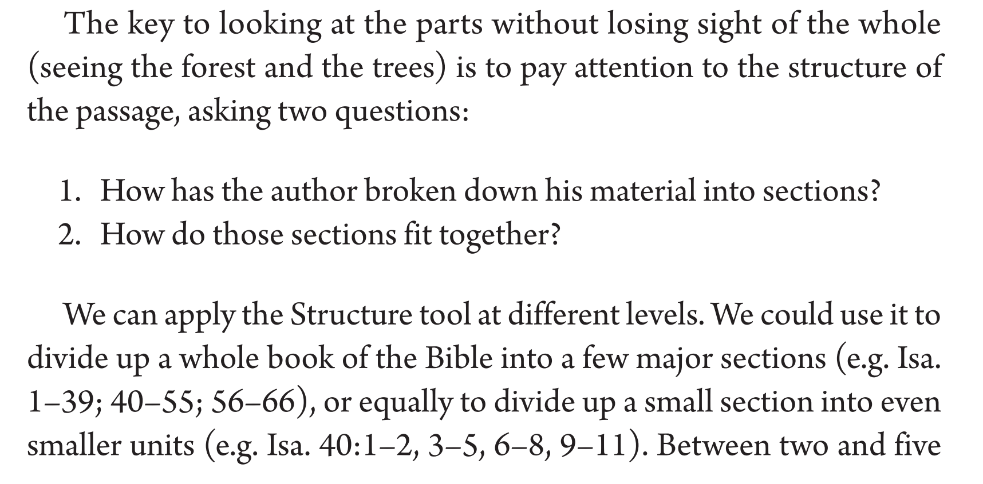

Slide 83
The Structure Tool
WORDS
SENTENCES
PARAGRAPHS
BOOKS
BIBLE
At the level of the Book…
  How has the author broken down his material into sections?
  How do these sections fit together?
At the level of the paragraph…
  How does the argument progress?
  What is the beginning and the end of the argument?
  What is the main point(s)?
  Let’s look more closely at how clauses within a paragraph relate.

Slide 84
8 Now concerning food offered to idols: we know that “all of us possess knowledge.” This “knowledge” puffs up, but love builds up. 2 If anyone imagines that he knows something, he does not yet know as he ought to know. 3 But if anyone loves God, he is known by God. 4 Therefore, as to the eating of food offered to idols, we know that “an idol has no real existence,” and that “there is no God but one.” 5 For although there may be so-called gods in heaven or on earth—as indeed there are many “gods” and many “lords”— 6 yet for us there is one God, the Father, from whom are all things and for whom we exist, and one Lord, Jesus Christ, through whom are all things and through whom we exist. 7 However, not all possess this knowledge. But some, through former association with idols, eat food as really offered to an idol, and their conscience, being weak, is defiled. 8 Food will not commend us to God. We are no worse off if we do not eat, and no better off if we do. 9 But take care that this right of yours does not somehow become a stumbling block to the weak. 10 For if anyone sees you who have knowledge eating in an idol’s temple, will he not be encouraged, if his conscience is weak, to eat food offered to idols? 11 And so by your knowledge this weak person is destroyed, the brother for whom Christ died. 12 Thus, sinning against your brothers and wounding their conscience when it is weak, you sin against Christ. 13 Therefore, if food makes my brother stumble, I will never eat meat, lest I make my brother stumble.
9 Am I not free? Am I not an apostle? Have I not seen Jesus our Lord? Are not you my workmanship in the Lord? 2 If to others I am not an apostle, at least I am to you, for you are the seal of my apostleship in the Lord. 3 This is my defense to those who would examine me. 4 Do we not have the right to eat and drink? 5 Do we not have the right to take along a believing wife, as do the other apostles and the brothers of the Lord and Cephas? 6 Or is it only Barnabas and I who have no right to refrain from working for a living? 7 Who serves as a soldier at his own expense? Who plants a vineyard without eating any of its fruit? Or who tends a flock without getting some of the milk? 8 Do I say these things on human authority? Does not the Law say the same? 9 For it is written in the Law of Moses, “You shall not muzzle an ox when it treads out the grain.” Is it for oxen that God is concerned? 10 Does he not certainly speak for our sake? It was written for our sake, because the plowman should plow in hope and the thresher thresh in hope of sharing in the crop. 11 If we have sown spiritual things among you, is it too much if we reap material things from you? 12 If others share this rightful claim on you, do not we even more? Nevertheless, we have not made use of this right, but we endure anything rather than put an obstacle in the way of the gospel of Christ. 13 Do you not know that those who are employed in the temple service get their food from the temple, and those who serve at the altar share in the sacrificial offerings? 14 In the same way, the Lord commanded that those who proclaim the gospel should get their living by the gospel. 15 But I have made no use of any of these rights, nor am I writing these things to secure any such provision. For I would rather die than have anyone deprive me of my ground for boasting. 16 For if I preach the gospel, that gives me no ground for boasting. For necessity is laid upon me. Woe to me if I do not preach the gospel! 17 For if I do this of my own will, I have a reward, but if not of my own will, I am still entrusted with a stewardship. 18 What then is my reward? That in my preaching I may present the gospel free of charge, so as not to make full use of my right in the gospel. 19 For though I am free from all, I have made myself a servant to all, that I might win more of them. 20 To the Jews I became as a Jew, in order to win Jews. To those under the law I became as one under the law (though not being myself under the law) that I might win those under the law. 21 To those outside the law I became as one outside the law (not being outside the law of God but under the law of Christ) that I might win those outside the law. 22 To the weak I became weak, that I might win the weak. I have become all things to all people, that by all means I might save some. 23 I do it all for the sake of the gospel, that I may share with them in its blessings. 24 Do you not know that in a race all the runners run, but only one receives the prize? So run that you may obtain it. 25 Every athlete exercises self-control in all things. They do it to receive a perishable wreath, but we an imperishable. 26 So I do not run aimlessly; I do not box as one beating the air. 27 But I discipline my body and keep it under control, lest after preaching to others I myself should be disqualified.
10 For I do not want you to be unaware, brothers, that our fathers were all under the cloud, and all passed through the sea, 2 and all were baptized into Moses in the cloud and in the sea, 3 and all ate the same spiritual food, 4 and all drank the same spiritual drink. For they drank from the spiritual Rock that followed them, and the Rock was Christ. 5 Nevertheless, with most of them God was not pleased, for they were overthrown in the wilderness. 6 Now these things took place as examples for us, that we might not desire evil as they did. 7 Do not be idolaters as some of them were; as it is written, “The people sat down to eat and drink and rose up to play.” 8 We must not indulge in sexual immorality as some of them did, and twenty-three thousand fell in a single day. 9 We must not put Christ to the test, as some of them did and were destroyed by serpents, 10 nor grumble, as some of them did and were destroyed by the Destroyer. 11 Now these things happened to them as an example, but they were written down for our instruction, on whom the end of the ages has come. 12 Therefore let anyone who thinks that he stands take heed lest he fall. 13 No temptation has overtaken you that is not common to man. God is faithful, and he will not let you be tempted beyond your ability, but with the temptation he will also provide the way of escape, that you may be able to endure it. 14 Therefore, my beloved, flee from idolatry. 15 I speak as to sensible people; judge for yourselves what I say. 16 The cup of blessing that we bless, is it not a participation in the blood of Christ? The bread that we break, is it not a participation in the body of Christ? 17 Because there is one bread, we who are many are one body, for we all partake of the one bread. 18 Consider the people of Israel: are not those who eat the sacrifices participants in the altar? 19 What do I imply then? That food offered to idols is anything, or that an idol is anything? 20 No, I imply that what pagans sacrifice they offer to demons and not to God. I do not want you to be participants with demons. 21 You cannot drink the cup of the Lord and the cup of demons. You cannot partake of the table of the Lord and the table of demons. 22 Shall we provoke the Lord to jealousy? Are we stronger than he? 23 “All things are lawful,” but not all things are helpful. “All things are lawful,” but not all things build up. 24 Let no one seek his own good, but the good of his neighbor. 25 Eat whatever is sold in the meat market without raising any question on the ground of conscience. 26 For “the earth is the Lord’s, and the fullness thereof.” 27 If one of the unbelievers invites you to dinner and you are disposed to go, eat whatever is set before you without raising any question on the ground of conscience. 28 But if someone says to you, “This has been offered in sacrifice,” then do not eat it, for the sake of the one who informed you, and for the sake of conscience— 29 I do not mean your conscience, but his. For why should my liberty be determined by someone else’s conscience? 30 If I partake with thankfulness, why am I denounced because of that for which I give thanks? 31 So, whether you eat or drink, or whatever you do, do all to the glory of God. 32 Give no offense to Jews or to Greeks or to the church of God, 33 just as I try to please everyone in everything I do, not seeking my own advantage, but that of many, that they may be saved..
11 Be imitators of me, as I am of Christ. (1 Co 8:1–11:1 ESV)
Notes:
Argument: Paul consistently prohibits Christians from eating εἰδωλόθυτα by appealing first to their obligation to love other believers and then to their obligations of exclusive faithfulness to Christ. One issue was the acceptability of eating “food sacrificed to idols.” This “food sacrificed to idols” was probably food that was sacrificed and served within the temple precincts of a pagan god. In the ancient world, many temples had attached dining halls in which worshippers could eat portions of the meat that was sacrificed. These dining halls also could take on more “secular” purposes in that business groups (i.e. guilds of tradesmen) would meet to discuss matters pertaining to commerce. Some Christians seemed to have reasoned that because the gods themselves were not real then eating food dedicated to them and eating in space dedicated to them was harmless. Over the course of three chapters, Paul writes a sustained rebuke of this thinking. He urges them to pursue undivided worship of God and not to compromise the purity of worship by associating with idols, which Paul understands to be undergirded by demons. Paul’s argument progresses in three stages with an addendum. In chapter 8, Paul argues that Christians should not eat “food sacrificed to idols” out of a concern for the consciences of other Christians. If the Corinthians would respond that it is their Christian right to be free from these restrictions, in chapter 9 he uses himself as an example of sacrificing legitimate apostolic rights for the sake of others. If Paul sacrifices his true apostolic rights for the good of others, how much more should they be willing to sacrifice their false rights for the good of others. Finally, in chapter 10, Paul clarifies that their participation in food sacrificed with idols is actually an act of idolatry.
Historical Background: This seems so foreign to us. Why would anyone want to eat “food sacrificed to idols”?
Financial Reasons: guilds of tradesmen met here
Social Reasons: families and friends could meet in these dining halls
Entertainment Reasons: they were parties
Pleasure Reasons: idols feasts were especially associated with sexual immorality and prostitution
Worship Reasons: perhaps, some of the Christians were hedging their bets
Argument:
Some of the interpretive challenges with 1 Cor 8-10 are apparent from even a surface reading, while other issues require more careful analysis. The problems involve contradictory statements and incoherence or tone of argument.
Contradictions: (primarily a problem within ch. 8): One of the most straightforward examples is the comparison between 8:1 and 8:7
“Now concerning food sacrificed to idols we know that all of us possess knowledge.”
in the intervening 5 verses, Paul explains what is the content of that knowledge.
“It is not everyone however who has this knowledge.”
Incoherence/Changes in Tone (primarily a problem between 8 and 10 and within ch. 10):
ch. 8: Appealing out of love for brothers
instructions on the basis of love for one another—you don’t eat εἰδωλόθυτα because of love for another, not because of any objective problem with the food.
“Therefore, if food is a cause of their falling, I will never eat meat, so that I may not cause one of them to fall.” (8:13)
10:1-22: Warning of the judgment of Christ
retelling the history of the Wilderness Generation places the whole argument in the context of God’s judgment on unfaithfulness.
instead of εἰδωλόθυτα in ch. 8, now Paul commands them not to be idolaters (εἰδωλολάτραι) and not to commit idolatry (εἰδωλολατρία)
appeal to the Lord’s Supper demonstrates that there is a fundamental incompatibility between eating at the table of the Lord and the table of an idol→ the argument is framed in terms of faithfulness to God
the danger of eating εἰδωλόθυτα is that you might arouse the jealous anger of God
10:23-11:1: Possibly permissible to eat food associated with idols
eat food from the meat market (probably associated with idols)
eat food in a pagan’s home (again probably associated with idols)
“If I partake with thankfulness, why should I be denounced because of that for which I give thanks?” (10:30)
Chapter 8: Don’t eat “food sacrificed to idols” on account of your brother. You might wound his conscience and cause him to sin.
Chapter 9: You’re so concerned about claiming your “rights”, which in this case aren’t even actual rights. If I am willing to sacrifice my actual apostolic rights for the sake of the gospel, how much more should you sacrifice your pseudo-rights?
Chapter 10: In reality, eating “food sacrificed to idols” is actual idolatry. You should not eat because it arouses the jealousy of the Lord.

Slide 85
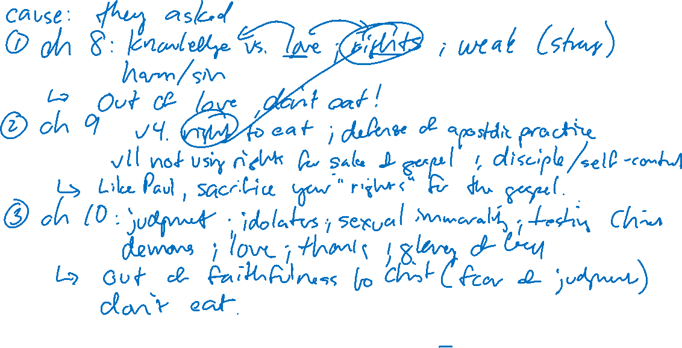
The Argument of 1 Corinthians 8–10
Notes:
Assertion: 8-10 is the same argument and topic
How does Paul signal a new section?
How do the parts fit within the whole?

Slide 86
The structure tool
Argument of 1 Corinthians 8-10—It’s an argument as a whole.
Cause: The Corinthians asked questions.
Ch. 8: Don’t eat food sacrificed to idols out of love for a brother.
Ch. 9: If Paul sacrifices his legitimate rights, how much more should they sacrifice their pseudo-rights for the sake of the gospel [also a defense of Paul’s ministry].
Ch. 10: Don’t eat food sacrificed to idols because it is idolatry and leads to the wrath of God.
Argument: Do not eat food sacrificed to idols on account of love for your brother (chs. 8–9) and faithfulness to God (ch. 10).

Slide 87
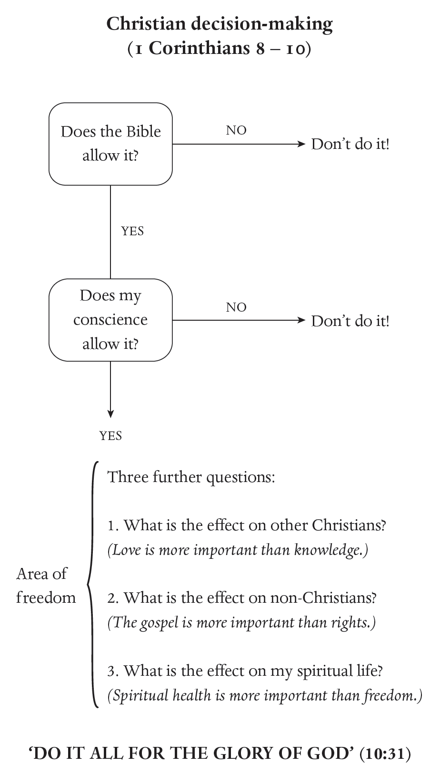
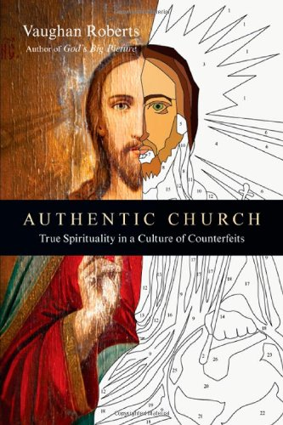

Slide 88
The Argument of Romans 9–11

Slide 89
The structure tool
Argument of Romans 9-11—It’s an argument as a whole.
Cause: Some might allege that God’s “unfaithfulness” to Israel might entail his unfaithfulness to the church.
Ch. 9: God never promised to save every Israelite—it’s about God’s grace not race.
Ch. 10: Israel failed to believe when given the chance—Israel, not God, is unfaithful.
Ch. 11: God will still save many Israelites—his promises await future fulfillment.
Argument: God is always faithful to keep his promises.

Slide 90
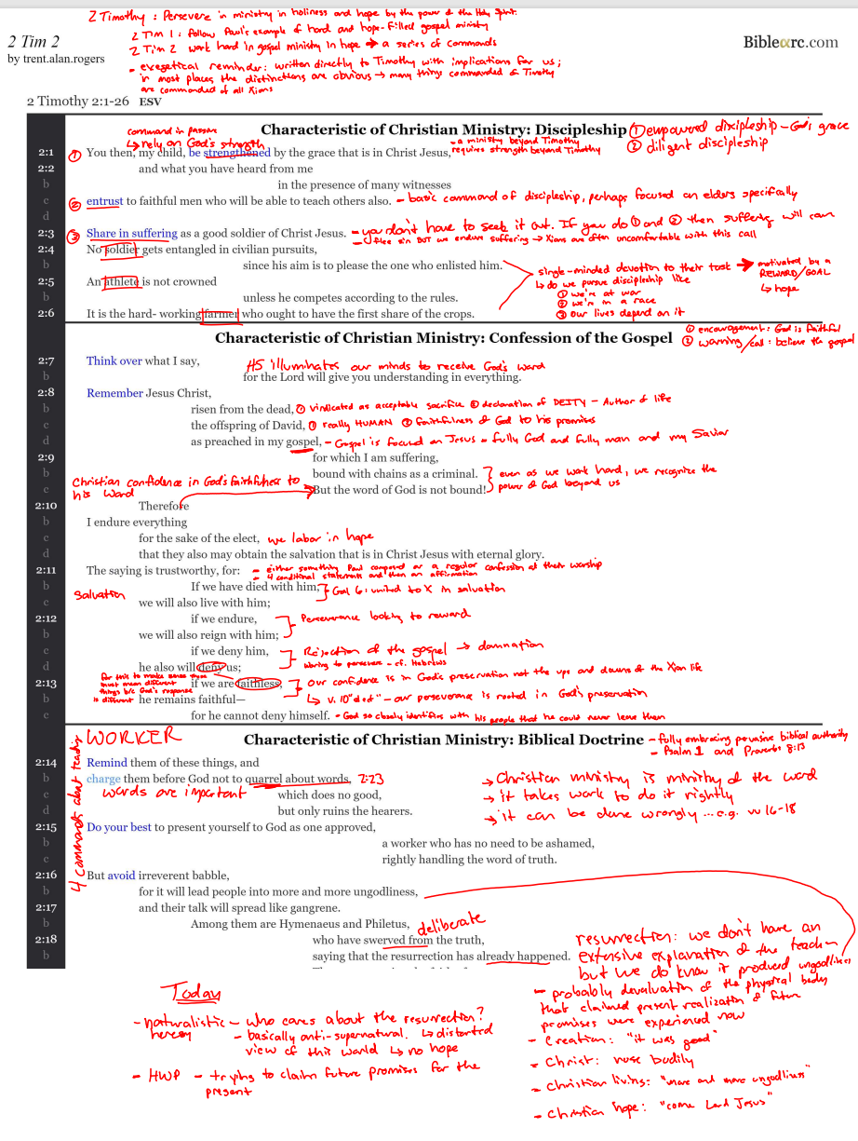
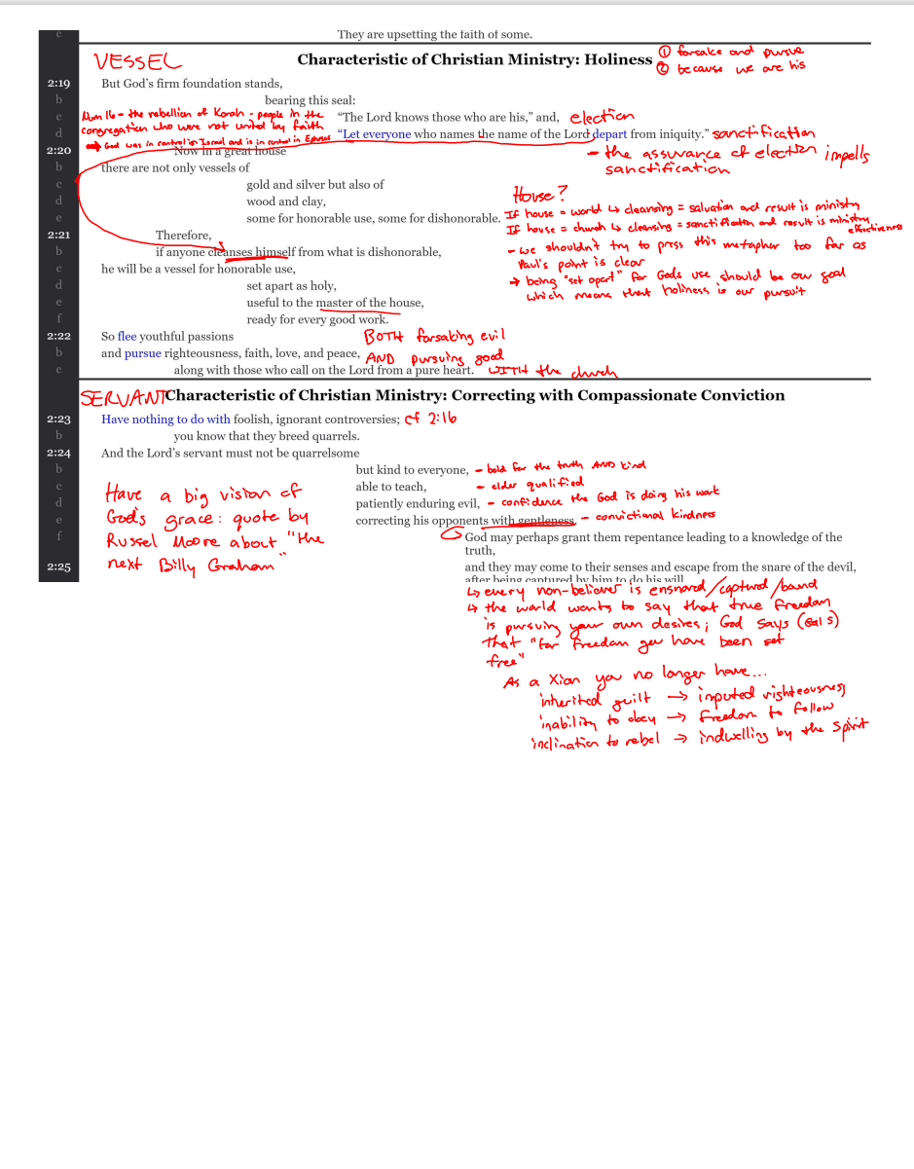
Notes:
Structure at the level of the chapter

Slide 91
The Structure Tool
Semantic Labels for Diagramming
Basic Expressions | Events/Actions | Argument/Discussion
ASSERTION EVENT OR ACTION RHETORICAL QUESTION DESIRE (WISH OR HOPE) EXCALAMATION EXHORTATION(COMMAND ENCOURAGEMENT) WARNING PROMISE PROBLEM/RESOLUTION ENTREATY | TEMPORAL LABELS: Time Simultaneous Sequence Progression LOCAL LABELS: Place Sphere Source Separation OTHER LABELS: Measure Circumstance Object (direct or indirect) Cause Result Purpose Means Manner Agency Reference Advantage Disadvantage Association Relationship Possession | LOGIC LABELS: Basis Inference Condition Concession Contrast or Compare General or Specific CLARIFICATION LABELS: Restatement Description Identification Illustration/Example Apposition Explanation Alternative Question or Answer Content Verification FORM LABELS: Introduction Conclusion or Summary List Series Parallel
WORDS
SENTENCES
PARAGRAPHS
BOOKS
BIBLE

Slide 92
THE LINKNG WORDS TOOL

Slide 93
Biblical Interpretation:
What textual clues signal connections among paragraphs?

Slide 94
Class Goals:
Understand the linking words tool.
Practice the linking words tool.

Slide 95
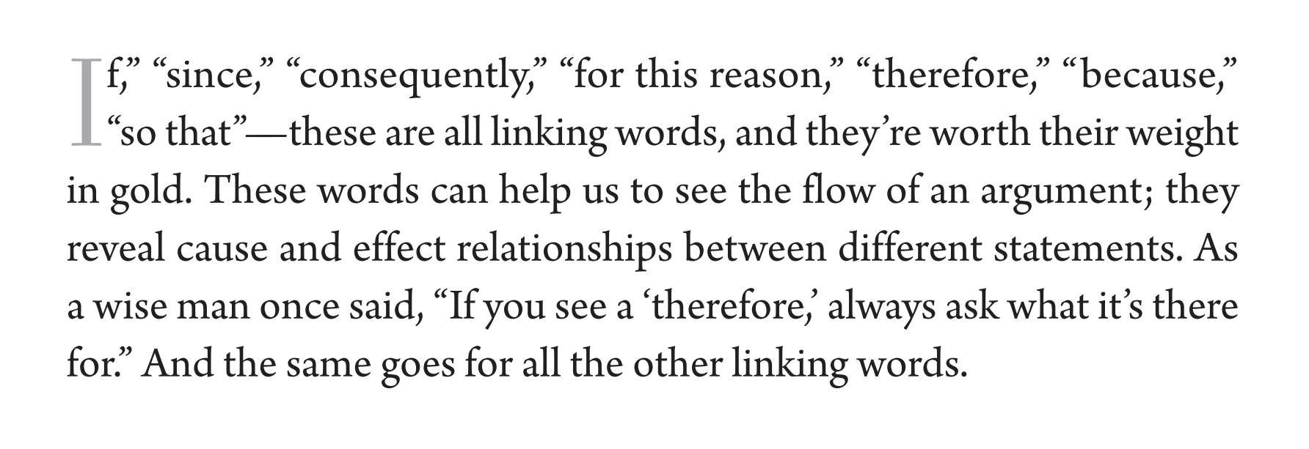

Slide 96
The Linking Words Tool
WORDS
SENTENCES
PARAGRAPHS
BOOKS
BIBLE
Colossians 2: For I want you to know how great a struggle I have for you and for those at Laodicea and for all who have not seen me face to face, 2 that their hearts may be encouraged, being knit together in love, to reach all the riches of full assurance of understanding and the knowledge of God’s mystery, which is Christ, 3 in whom are hidden all the treasures of wisdom and knowledge. 4 I say this in order that no one may delude you with plausible arguments. 5 For though I am absent in body, yet I am with you in spirit, rejoicing to see your good order and the firmness of your faith in Christ. 6 Therefore, as you received Christ Jesus the Lord, so walk in him, 7 rooted and built up in him and established in the faith, just as you were taught, abounding in thanksgiving. 8 See to it that no one takes you captive by philosophy and empty deceit, according to human tradition, according to the elemental spirits of the world, and not according to Christ. 9 For in him the whole fullness of deity dwells bodily, 10 and you have been filled in him, who is the head of all rule and authority.

Slide 97
The Linking Words Tool
WORDS
SENTENCES
PARAGRAPHS
BOOKS
BIBLE
Colossians 2: For I want you to know how great a struggle I have for you and for those at Laodicea and for all who have not seen me face to face, 2 that their hearts may be encouraged, being knit together in love, to reach all the riches of full assurance of understanding and the knowledge of God’s mystery, which is Christ, 3 in whom are hidden all the treasures of wisdom and knowledge. 4 I say this in order that no one may delude you with plausible arguments. 5 For though I am absent in body, yet I am with you in spirit, rejoicing to see your good order and the firmness of your faith in Christ. 6 Therefore, as you received Christ Jesus the Lord, so walk in him, 7 rooted and built up in him and established in the faith, just as you were taught, abounding in thanksgiving. 8 See to it that no one takes you captive by philosophy and empty deceit, according to human tradition, according to the elemental spirits of the world, and not according to Christ. 9 For in him the whole fullness of deity dwells bodily, 10 and you have been filled in him, who is the head of all rule and authority.

Slide 98
Biblical Interpretation:
What are several tools for interpretation?

Slide 99
Class Goals:
Understand the parallels, narrator’s comment, tone and feel, repetition, and context tools.
Practice the parallels, narrator’s comment, tone and feel, repetition, and context tools.
Notes:
These tools are important, but they are fairly intuitive

Slide 100
THE PARALLELS TOOL

Slide 101
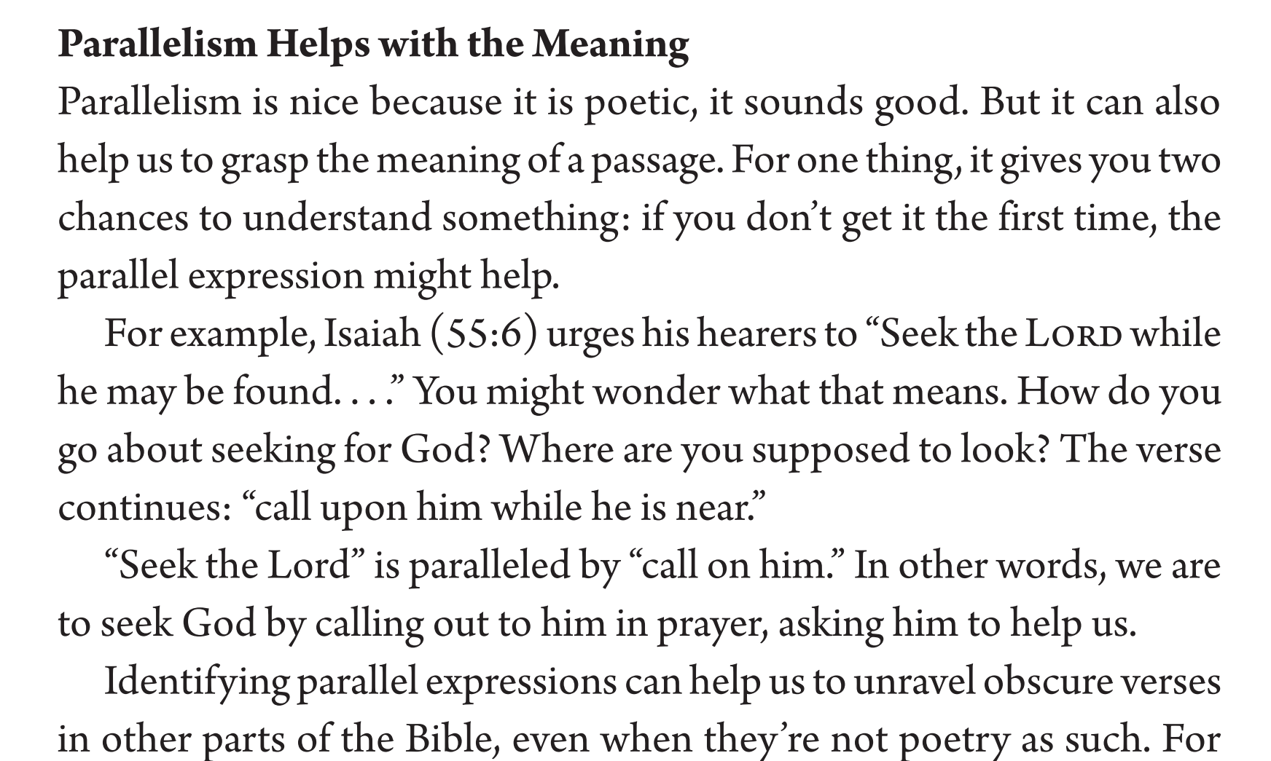

Slide 102
The Parallels Tool
WORDS
SENTENCES
PARAGRAPHS
BOOKS
BIBLE
An example from Digging Deeper…
Long ago, at many times and in many ways, God spoke to our fathers by the prophets,
2 but in these last days he has spoken to us by his Son, whom he appointed the heir of all things, through whom also he created the world. (Hebrews 1:1-2 ESV)
  Parallelism emphasizes the connection between Jesus and previous revelation.
  Parallelism emphasizes the uniqueness of Jesus as the climax of revelation.
Parallelism can be used for comparison or contrast.

Slide 103
THE NARRATOR’S COMMENT TOOL

Slide 104
The Narrator’s Comment Tool
WORDS
SENTENCES
PARAGRAPHS
BOOKS
BIBLE
This is a feature of narrative because there is a storyteller.
The narrator breaks in to help interpret or explain the events more clearly.
Remember that the Bible often gives us both an accurate description of events and an authoritative interpretation of those events.
An example from John 2…
  18 So the Jews said to him, “What sign do you show us for doing these things?”
  19 Jesus answered them, “Destroy this temple, and in three days I will raise it up.”
  20 The Jews then said, “It has taken forty-six years to build this temple, and will you raise it up in three days?”
    Did Jesus promise that he would rebuild Herod’s Temple?
    But he never accomplished this.
  21 But he was speaking about the temple of his body. 22 When therefore he was raised from the dead, his disciples remembered that he had said this, and they believed the Scripture and the word that Jesus had spoken.
Notes:
Mark 7:19

Slide 105
THE TONE AND FEEL TOOL

Slide 106
The Tone and Feel Tool
WORDS
SENTENCES
PARAGRAPHS
BOOKS
BIBLE
Especially prominent in narrative and prophecy…
How would you characterize the author’s tone in the following texts?
  Psalm 32:1-5
  Galatians 1:6-10; 3:1-9
  Philippians 1:3-11
  1 Thessalonians 2:7-12

Slide 107
THE REPETITION TOOL

Slide 108
The Repetition Tool
WORDS
SENTENCES
PARAGRAPHS
BOOKS
BIBLE
Repetition adds emphasis.
What words are repeated?
What concepts are repeated?
An example at the Book level:
  Joy in Philippians.
  Belief in John.
An example at the passage level:
  “Each one of the four living creatures had six wings and was full of eyes all around and inside. They never rest day or night, saying: ‘Holy Holy Holy is the Lord God, the All-Powerful, Who was and who is, and who is still to come!’” (Revelation 4:8)

Slide 109
THE CONTEXT TOOL

Slide 110
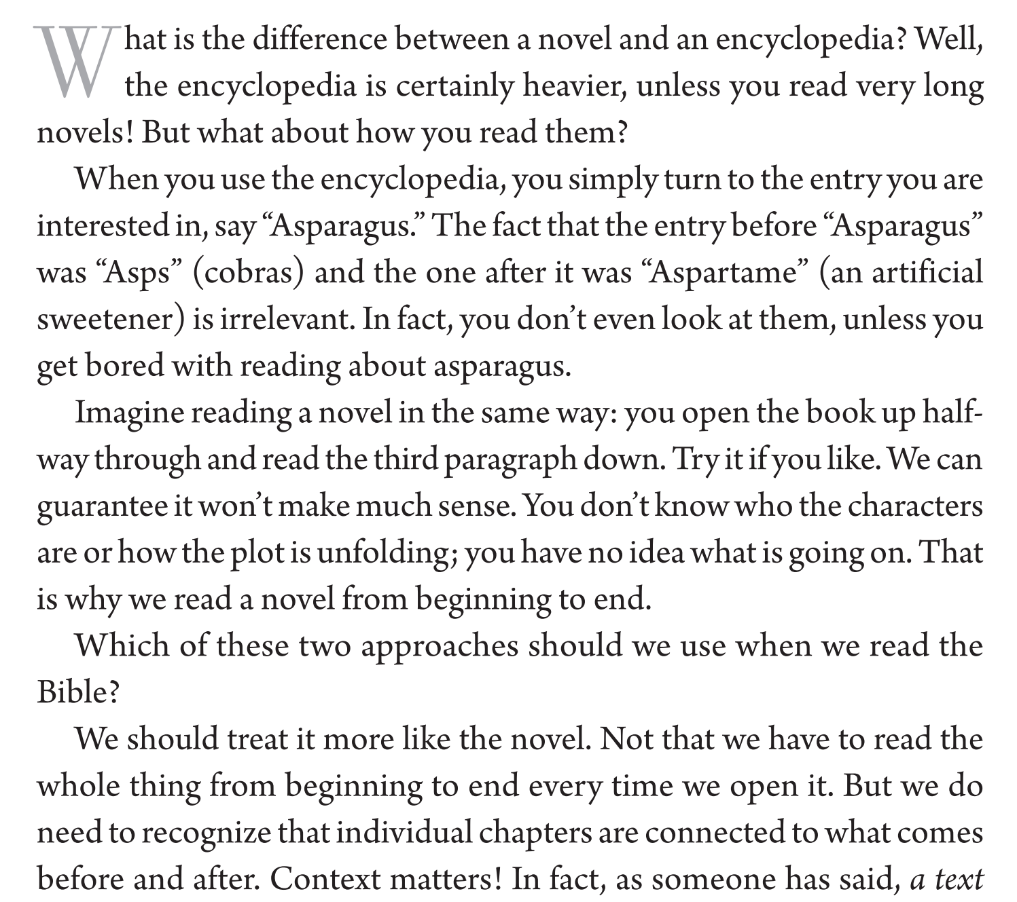

Slide 111
The Context Tool
WORDS
SENTENCES
PARAGRAPHS
BOOKS
BIBLE
“Context is King.”
It is most helpful in seeking to understand what the author intended.
Context clarifies meaning.
Context enhances meaning.
We have modeled the importance of context when we’ve used the other tools. When we used the Vocabulary Tool, we relied on context to discern the specific use from the semantic range.

Slide 112
The Context Tool
WORDS
SENTENCES
PARAGRAPHS
BOOKS
BIBLE
Whole Bible
Books of bible
paragraphs
sentences
words

Slide 113
The Context Tool
WORDS
SENTENCES
PARAGRAPHS
BOOKS
BIBLE
Putting the tool to work…
Look at 1 Corinthians 13:7.
Look at 1 Corinthians 13:1-7.
Look at 1 Corinthians 13:7-13.
Look at 1 Corinthians 12-14.
Look at 1 Corinthians 1-16.
Look at the Pauline Epistles.
Look at the Bible.
Whole Bible
Books of bible
paragraphs
sentences
words

Slide 114
THE AUTHOR’S PURPOSE TOOL

Slide 115
Biblical Interpretation:
How do you determine the author’s purpose in writing?

Slide 116
Class Goals:
Understand the author’s purpose tool.
Practice the author’s purpose tool.

Slide 117
Matthew
Matthew
Romans
1 Corinthians
Ephesians

Slide 118
The Author’s Purpose Tool
WORDS
SENTENCES
PARAGRAPHS
BOOKS
BIBLE
“Author’s Purpose is king. It is the tool par excellence, the Swiss army knife from which all of the other tools fold out, and which keeps them all together” (Beynon and Sach, Digging Deeper, 30).
This is a bigger issue than some of us realize.
Hopefully the sermons in your church have assumed that what the author intended to say matters.
Here’s why it matters:
  The problem illustrated: https://www.youtube.com/watch?v=cmonGuE789I
  What are the implications if it is God who is speaking?
  Does meaning rest with the divine author or with the reader?
  E.g., a mistaken devotional on Matthew 4:9.
Now let’s understand the tool…
Notes:
Importance: a devotional on Matthew 4:9 ““All these I will give you, if you will fall down and worship me.””
Just like we look at God’s, the author of life, story of Scripture, so we look at the author’s purpose in each text.
Why this tool? Where is the meaning of the text? In myself? “in between the lines”? In what God, the author says?
-Paul to the Colossians.

Slide 119
The Author’s Purpose Tool
WORDS
SENTENCES
PARAGRAPHS
BOOKS
BIBLE
The author’s purpose tool seeks to understand not just what the author says but also why he said it.
The only vehicle for understanding the author’s purpose is the text itself.
God speaks. And the most important thing is what God means when he speaks.
“Since the biblical writers were inspired, their purpose is God’s purpose. That means that one of the biggest and most helpful questions we can ever ask of a passage in the Bible is simply, ‘Why did the author write this?’” (Beynon and Sach, Digging Deeper, 30).
Occasionally, the authors tell us why they wrote the books of the Bible: Luke 1.1-4; John 20.31; 1 John 5.13
A Note on the NT’s use of the OT
  Sensius plenior: OT passages are given a “fuller” meaning in the NT
  E.g., Hosea 11:1 and Mathew 2:15
  Don’t ignore the meaning of the text in the OT passage
  Recall the Divine Author might have meant something more than even the human author realized.

Slide 120
The Author’s Purpose Tool
WORDS
SENTENCES
PARAGRAPHS
BOOKS
BIBLE
Putting the tool to work in the Book of Ephesians…
What is the author’s purpose in writing the Book of Ephesians?
  Scan the whole book to get an understanding of the content (you might use the paragraph or chapter structure of your English translations and note quickly what each section is about).
  Carefully read the whole book noting patterns and themes.
  Answer these questions (Digging Deeper, 29)
    Who is writing and to whom?
    What is the situation of the author and the readers?
    Are we made aware of any problems that need to be addressed?
    Are there any repeated themes or a single idea that holds everything together?
Carefully study the beginning and ending of the book.
Formulate a statement about the book’s purpose.
Consult trusted reference works.

Slide 121
The Author’s Purpose in Ephesians
Notes:
Scan the whole Book
Note major sections or arguments
Pay close attention to the beginning and ending
Formulate a statement
Consult trusted references
The gospel creates a family with a new way of living
Why do I use the image of the family?
God our Father (1:2, 3, 17)
Predestined for adoption as sons (1:5)
We have obtained an inheritance (1:11)
HS is the guarantee of our inheritance (1:14)
Formerly were sons of disobedience (2:2)
Adoption moves us from foreigners/aliens to being citizens (2:19)
Reconciliation metaphor is family-based
Mystery of the gospel is that Gentiles are fellow-heirs (3:6)
“the Father, from whom every family in heaven and on earth is named” (3:15)
What does life look like in the family of God? (e.g., have you ever heard a parent say, “I our family we do/don’t?”)
4:1-16: Unity not divisions
4:17-: new way of living
Ch 5: “children of the light walk in love”
Ch5: those in God’s family also have earthly families (that ultimately picture the heavenly family)
Ch6: this family is fighting against spiritual powers

Slide 122
The Author’s Purpose in the Gospel of Matthew
Notes:
Scan the whole Book
Note major sections or arguments
Pay close attention to the beginning and ending
Formulate a statement
Consult trusted references
…to follow Jesus, the Davidic messiah who establishes the worldwide kingdom of God.
Follow: discipleship, Mt 4:19
Davidic Messiah: Mt 1
Worldwide: Mt 1 Abraham; Mt 28 Great Commission
Kingdom
Matt 3:2
Parables of the kingdom Mt 13
Mt 26:29 last supper
Mt 28 a king and his authority

Slide 123
The Author’s Purpose in the Gospel of John
Notes:
Scan the whole Book
Note major sections or arguments
Pay close attention to the beginning and ending
Formulate a statement
Consult trusted references
…to believe in Jesus, the eternal Son of God who gives eternal life.
John 20:31
Believe: 1:7, 12; 2:11 (purpose of the signs) 3:16; signs
Eternal Son of God: John 1; “I Am”; John 20:28
Gives: John 3:16, 5:26
Eternal life: 3:16; 17:3

Slide 124
The Author’s Purpose in 1 Corinthians
Notes:
Scan the whole Book
Note major sections or arguments
Pay close attention to the beginning and ending
Formulate a statement
Consult trusted references
to convince Christians to live in light of their gospel call, not revert to a pagan way of life.

Slide 125
THE GENRE TOOL
I am indebted to Dr. Jason Lee for some of this material.

Slide 126
Biblical Interpretation:
What impact does the form of the writing have on interpretation?

Slide 127
Class Goals:
Understand the genre tool.
Practice the genre tool.

Slide 128
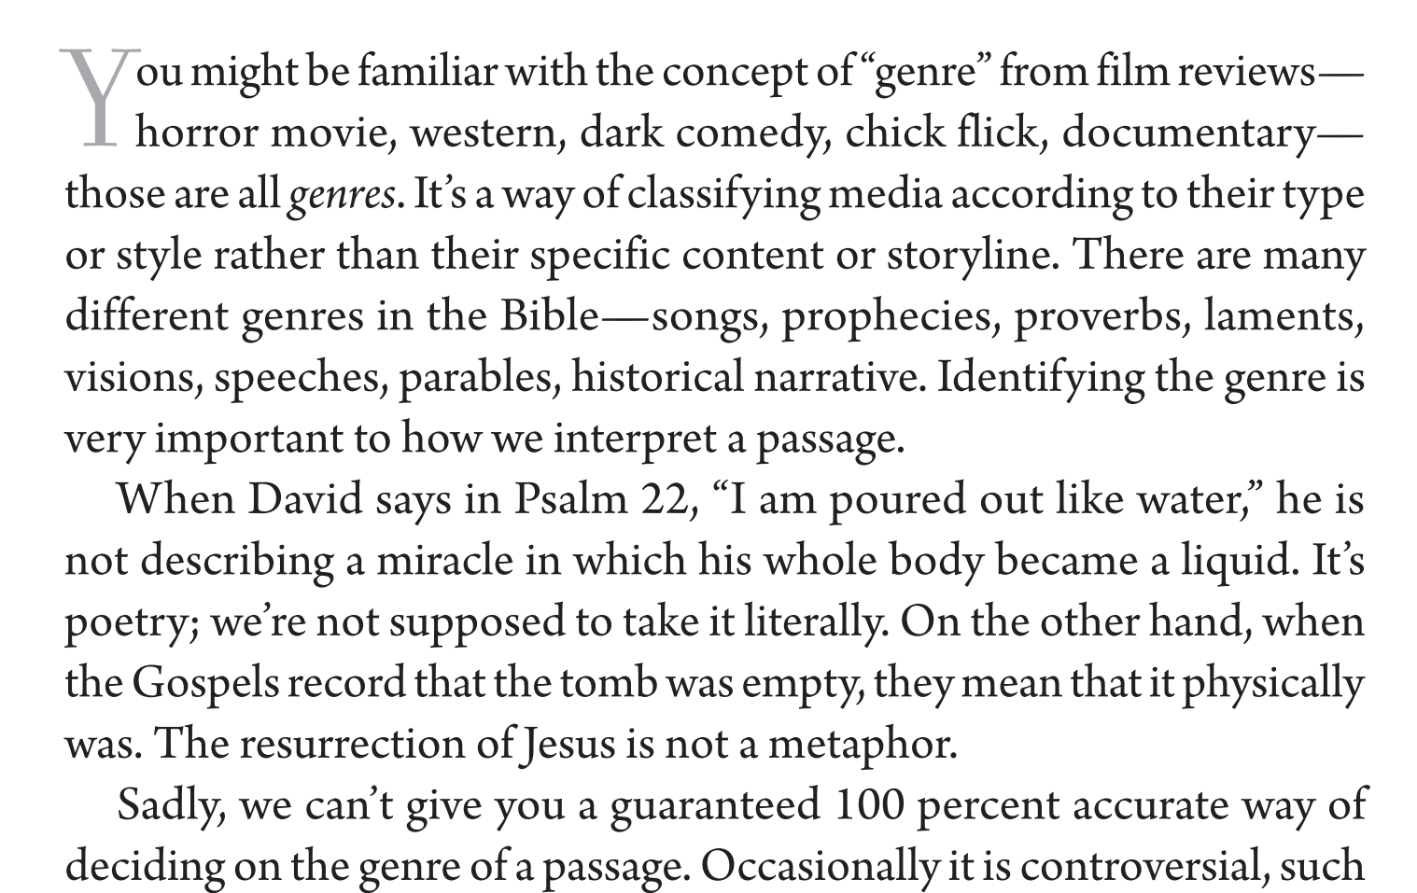

Slide 129
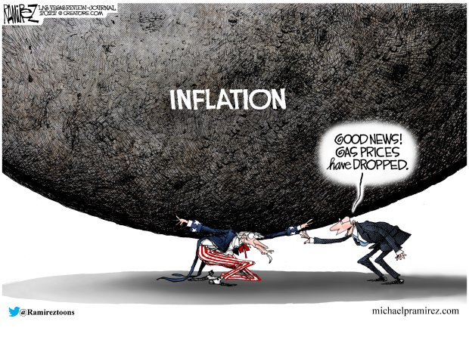
The Genre Tool
WORDS
SENTENCES
PARAGRAPHS
BOOKS
BIBLE
Describe this painting. Don’t offer any interpretation. Just make observations.
What things clue you in to think that there is a deeper meaning?
Now offer an interpretation of the painting. What is its point?
Would you call this a “painting” or a “political cartoon”? What’s the difference?
Main Point: The author communicates meaning through a particular form.
Notes:
You understand that this is a political cartoon. You don’t take everything literally.
BY CHOOSING THIS TYPE/GENRE THE AUTHOR IS COMMUNICATING SOMETHING.
Other areas impacted: you always sort your mail by genre.

Slide 130
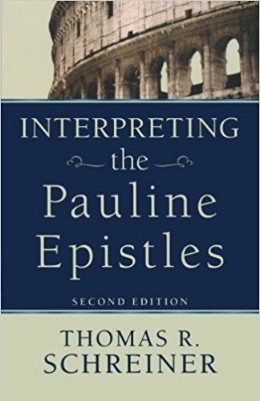
The Genre Tool
WORDS
SENTENCES
PARAGRAPHS
BOOKS
BIBLE
“Perhaps the most important issue in interpretation is the issue of genre. If we misunderstand the genre of the text, the rest of our analysis will be askew. If we interpret a fairy tale as a historical report, the interpretation may be profound and insightful in many ways, but the interpretation will be fatally flawed from the beginning because of a misreading of the genre of the text” (Schreiner, Interpreting the Pauline Epistles, 11).
Notes:
The form communicates some meaning.
E.g., reading political cartoons
E.g., editorial vs. news piece (the blurring of genre is proving detrimental)
E.g., writing a note to your girlfriend vs. a term paper

Slide 131
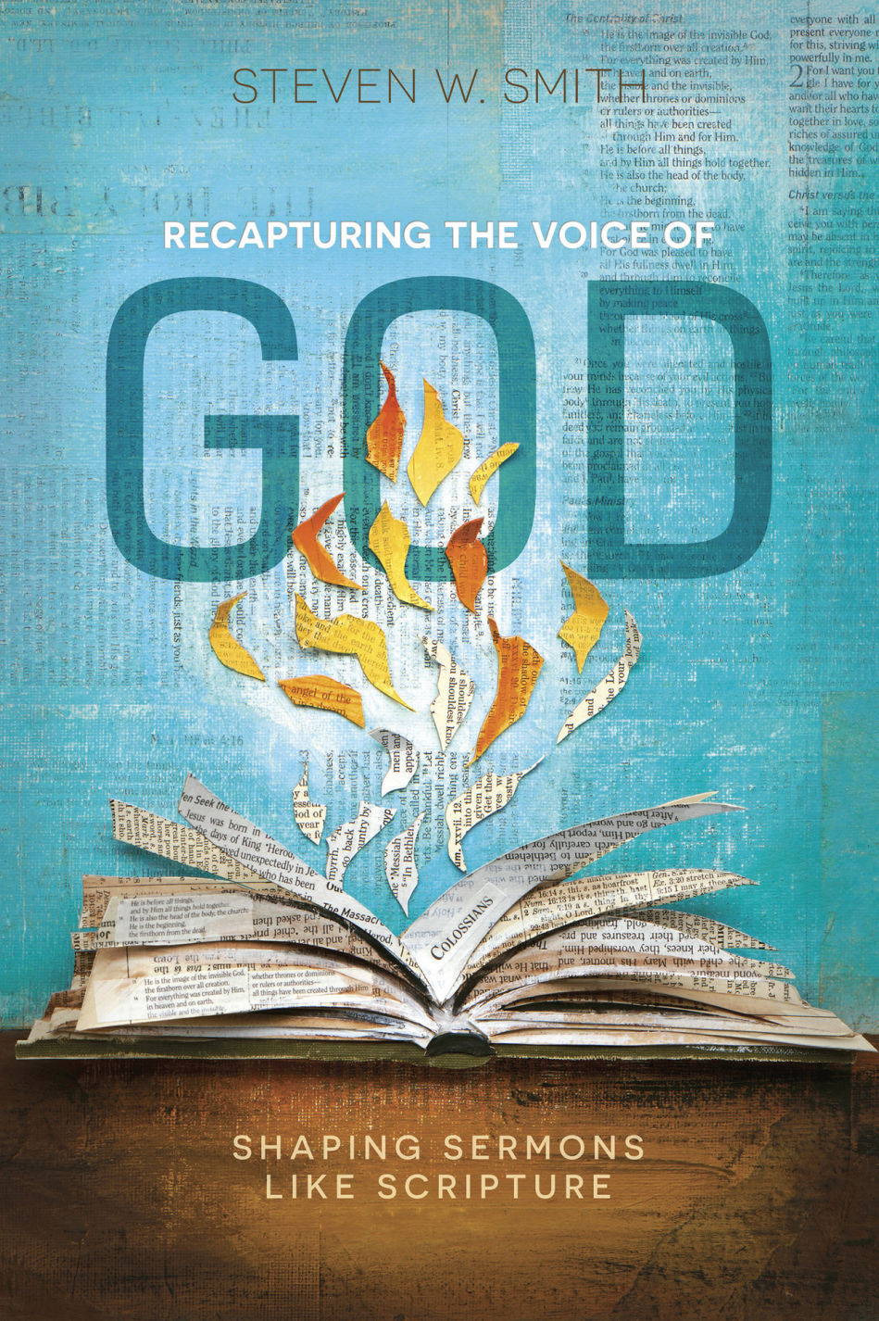
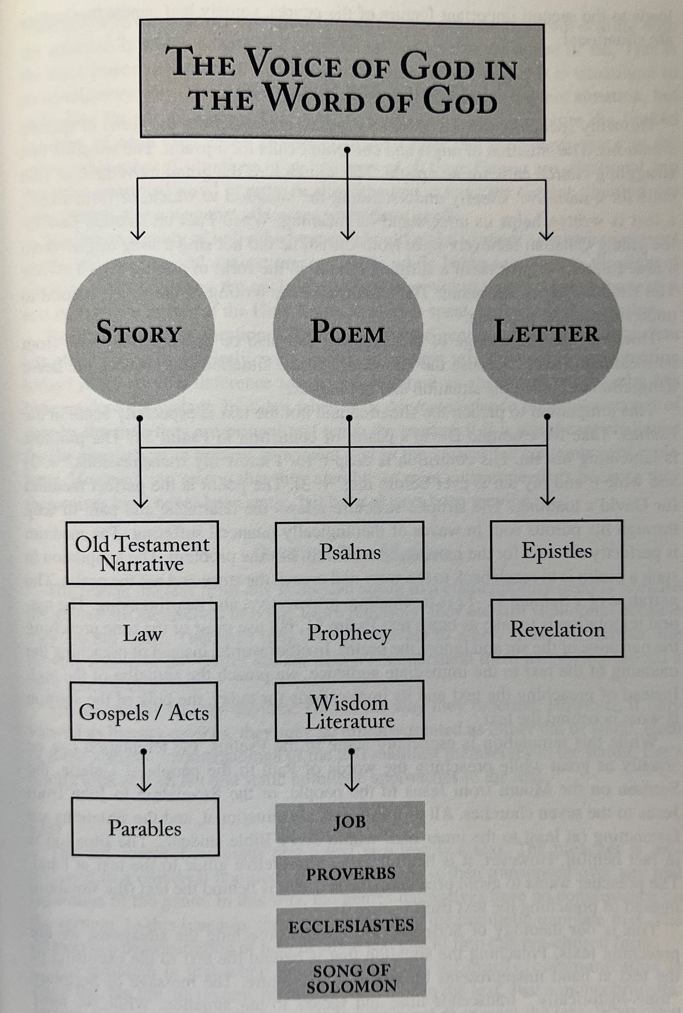

Slide 132
The Genre Tool
WORDS
SENTENCES
PARAGRAPHS
BOOKS
BIBLE
Biblical authors used three major literary types when composing their books:
  Discourse / Epistle
  Narrative
  Poetry
Each of these literary types have their own typical patterns. This intrinsic genre helps sets the expectation of the reader as to the meaning of the whole. It also helps establish the type of relationship between the author (divine and human) and the reader.
These literary patterns are helpful clues in interpreting the biblical author’s meaning. The literary type is an important consideration in thinking about the compositional strategy of a biblical book.

Slide 133
Biblical Interpretation:
DISCOURSE AND EPISTLES
Notes:
In some ways, discourse is the most intuitive for us.

Slide 134
Interpreting Discourse/Epistles: Some Definitions
Discourse can occur at the book or section level.
Section Level
  Extended speeches in Acts and the Gospels
Book Level
  21 of the NT books are epistles
  NT Epistles fall somewhere in between the highly structured and artistic treatises and simple direct letters.
  Many of the epistles were probably read publicly in the corporate gathering of the church.
Epistles or Letters
  Situation
  Autobiographical
  Expected circulation

Slide 135
Interpreting Discourse/Epistles: Common Structures
OPENING
BODY OF THE EPISTLE
CLOSING
Takeaway:
  Be aware of this form.
  Know what the author is doing with this form.
  Note when an author deviates from this form (e.g., the omission of thanksgiving section from Galatians).

Slide 136
Interpreting Discourse/Epistles: Common Structures
OPENING
  Sender of the Letter
    Sometimes with co-senders
    Self-description is significant (e.g., Romans, and the question of the legitimacy of Paul’s apostleship)
  Addressees
    Most often churches, even when he writes to individuals (e.g., 1 Tim, 2 Tim, Titus)
    Description is significant (e.g., 1 Corinthians, and the emphasis on what unites them)
  Greeting (e.g., grace and peace)
    The greeting “χαίρειν” (greetings) was common in Greek letters. Paul typically uses “χάρις” (grace).
    Most greetings are from “God the Father and the Lord Jesus Christ” (exception: Col 1:2).
  Prayer and/or Thanksgiving
    Hellenistic letters often contained a wish for good health (e.g., I hope this finds you well).
    Thanksgiving is absent only in Titus (because it was a brief letter to a close friend) and Galatians (because Paul was writing a stern rebuke for their abandonment of the gospel).
    Paul often establishes some of the major themes of the epistle in the prayer and thanksgiving.

Slide 137
Interpreting Discourse/Epistles: Common Structures
BODY
  There are different structures to different Epistles.
    E.g., 1 Corinthians is episodic in character and addresses oral reports and then written reports.
    E.g., Romans contains more of a unifying or overarching argument.
    E.g., Colossians and Ephesians are roughly divided into two halves, the theological and then the practical.
  Instruction:
  Correction:
  Doctrinal Teaching:
CLOSING
  It is not always clear where the body concludes and the closing begins.
  Here are some possible elements in the closing (see Schreiner, Interpreting the Pauline Epistles, 17):
    Travel plans
    Prayers and prayer request
    Commendation of fellow workers
    Final instructions and exhortations
    Greetings
    Benediction

Slide 138
Interpreting Discourse/Epistles: Some Helpful Tips
Mind the gaps! The letters are written for us but not to us.
  E.g., “holy kiss” 1 Cor 16:20 (sometimes there’s a prescriptive principle with a cultural-specific application)
Discern the occasion for the Epistle! They are circumstantial.
  E.g., Romans: explaining the gospel in order to request support
  E.g., 1 Corinthians: addressing various issues in the church
  E.g., Galatians: correcting their misconstrual/abandonment of the gospel
Trace the argument as a whole!
  Read the Epistle in one sitting (e.g., Col 4:16; 1 Thess 5:27).
  See Biblearc.com
Use your tools from Digging Deeper!

Slide 139
Biblical Interpretation:
NARRATIVE

Slide 140
Interpreting Biblical Narrative: Some Definitions
“Narratives are stories—purposeful stories retelling the historical events of the past that are intended to give meaning and direction for a given people in the present” (Stuart and Fee, How to Read the Bible for All Its Worth, 90).
Most of the material (in terms of volume of words, not number of books) in the OT and NT is in the form of narrative texts. Narrative texts may be historical or fictional (e.g., parables). They may provide the framework for sub-types of material like poetic verse, legal material, genealogies, or parables.

Slide 141
Interpreting Biblical Narrative: Features of Narrative
Biblical “narrative” could refer to the type of the Book as a whole or to sections within the book.
Often books of the Bible contain more than one genre (e.g., Acts is a narrative with discourse material).
Biblical narrative, like other narrative texts, contains certain elements:
  Setting
  Plot
  Characterization
  Conclusions
Biblical narrative often includes intertextuality (references to the OT in things such as Jesus’s dialogues or the apostles’ sermons).

Slide 142
Interpreting Biblical Narrative: Characteristics of Narrative
Biblical authors retell the past and foretell the future to help us live in the present
Levels of Biblical Narratives:
  Individual stories
  Story of the Book as a whole
  Metanarrative of the Bible
The primary actor of the overarching story of the Bible is God himself.
Narratives have a narrator who selects, tells, and often interprets events to be recorded.
Narrators have a point of view.
Notes:
Narrators have a point of view.
E.g., Israel’s kings judged on the criterion of faithfulness to God.
E.g., Acts’ interest in Peter and Paul.

Slide 143
Interpreting Biblical Narrative: Types of Narrative
For the sake of our class discussions, we will divide the narrative texts into three basic categories:
  Historical narratives are selected portrayals of events. In many OT books and in the Gospels/ Acts, historical narrative is the predominant literary form. Narrative texts often tell their story over multiple chapters, and they allow the author to depict meaning in descriptive texts. The explicit or implicit commentary provided by the author (perhaps through a character in the story) provides significant guidance to the author’s overall purpose.
  Prophetic narratives are a sub-type of historical narrative, but they include lengthy sections of prophetic or apocalyptic material. The historical narrative often serves as the framework or lengthy introduction to the prophetic material (which is often poetic).
  Parables- are brief stories to make a teaching point.

Slide 144
Interpreting Biblical Narrative: OT Historical Narratives
Their importance and relevance…
  John 5:39: “You search the Scriptures because you think that in them you have eternal life; and it is they that bear witness about me…”
  Romans 15:4: “For whatever was written in former days was written for our instruction, that through endurance and through the encouragement of the Scriptures we might have hope.”
  1 Cor 10:6: [retelling of Israel’s history in the Wilderness] “Now these things took place as examples for us, that we might not desire evil as they did.”
Narrator
  He has a purpose in telling the story.
  He chooses what is included.
  He chooses from whose perspective it is told.
Scenes
  OT narratives tend to be constructed around successive scenes.
Characters
  Characters often appear in contrast or in parallel (e.g., the descriptions of Israel’s kings).
  Characterization occurs primarily through the characters’ own words and deeds, not through the narrator’s descriptions.
Plot
  Stories have beginnings, middles, and ends.
  Plots in OT narratives tend to move quickly.
  Repetition is a common tool for emphasis.
Notes:
Note the arcs of 1 & 2 Samuel: Eli, Samuel, SAUL, DAVID

Slide 145

Interpreting Biblical Narrative: NT Historical Narratives
NT Narratives: Gospels, Acts, and Revelation
Principles for interpreting NT Narrative (Naselli, How to Understand and Apply the New Testament, 22-25)
  Interpret the NT narratives as history—the events really happened.
  Discern why they recount the events the way they do.
  Compare parallel passages, especially with the Gospels.
  Pay special attention to the editorial/narrator comments (e.g., Mark 7:19).
  Discern if the author intends for you to imitate a character (e.g., John 12:6).
  Distinguish between description and prescription.
  In the Gospels, understand the meaning of the kingdom of God. “The kingdom of God is God’s rule over his people and the entire created order” (p.23). We are living in the period between D-Day and VE-Day.
  Look to the series of stories.
    E.g., Mathew 8:23-9:8 (PP.24-25). These three miracles show Jesus’ authority:
      In 8: 23–27, Matthew tells the story about Jesus’ calming a storm to show that Jesus has authority over nature.
      In 8: 28–34, Matthew tells the story about Jesus’ healing two men with demons to show that Jesus has authority over demons.
      In 9: 1–8, Matthew tells the story about Jesus’ healing a person who could not walk to show that Jesus has authority over sin and sickness.

Slide 146
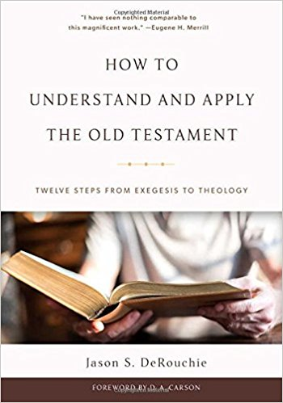
Interpreting Biblical Narrative: Prophetic Narratives
“The Bible presents YHWH’s prophets as ambassadors of the heavenly court (2 Kings 17:13; Jer. 23:21-22), individuals whom God commissioned for two purposes: to preach for God to the people and to pray for the people to God” (DeRouchie, How to Understand and Apply The Old Testament, 44).
Sometimes prophets spoke in answer to questions, but most prophetic utterances were from God to call the people to covenant faithfulness.
Sometimes prophets predict future events, but their predominant role is to call God’s people to covenant faithfulness.
The Categories of Prophetic Speech
1 | Indictment | Statement of the offense | Mic 3:8; Isa 58:1
2 | Instruction | Clarification of the expected response | Mic 6:8
3 | Warning/Punishment | Declaration of the punishment to be carried out | Deut 27-32; Dan 9:11
4 | Hope/Salvation | Affirmation of future hope or deliverance | Zech 8:7-8

Slide 147
Interpreting Biblical Narrative: Parables
Parables are stories, typically brief, that provide a central teaching point.
  E.g., Matthew 13:44
    The story is NOT about the ethics of finding a treasure.
    The story is about the immeasurable worth of the treasure.
Longer parables might have more than one meaning.
  E.g., Prodigal Son in Luke 15. Craig Blomberg argues that since this parable has three main characters (the prodigal, the older brother, and the father), it has three points, which he states this way:
    Even as the prodigal always had the option of repenting and returning home, so also all sinners, however wicked, may confess their sins and turn to God in contrition.
    Even as the father went to elaborate lengths to offer reconciliation to the prodigal, so also God offers all people, however undeserving, lavish forgiveness of sins if they are willing to accept it.
    Even as the older brother should not have begrudged his brother’s extends.
    Caution: even with this rich parable, the meaning is not inexhaustible.
    Note: the parable also has meaning in its context, with the rebuke of the Pharisees.
Typically, parables are introduced by a brief, historical narrative (e.g. a conversation with Jesus and another character).
They are best interpreted in connection with the surrounding textual material.
Pay special attention to how a series of parables functions (e.g., Luke 15; Matthew 13).

Slide 148
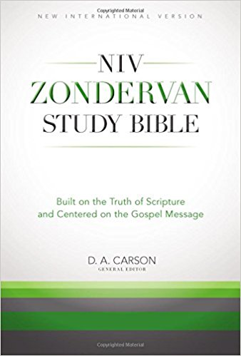

Slide 149
Interpreting Biblical Narrative: Tips for Interpretation
Pay attention to the covenants!
Be aware of prescriptive vs. descriptive language!
Pay attention to the narrator’s comments and interpretation of events!
Try to state in a single sentence the narrative’s main point!

Slide 150
Biblical Interpretation:
POETRY

Slide 151
Old Testament Poetry: Features of Poetry
An introduction to and hints for interpreting and teaching poetic books: Poetic Texts (00:52- 6:30)
Job, Psalms, Proverbs, Ecclesiastes, and Song of Solomon could all be considered to be poetic or wisdom literature.
Poetic books have some regular features that are helpful in finding the author’s purpose for the book and thereby have some help in interpreting individual units.
  Parallelism as a structural device (e.g., Ps 1:5; 37:9).
  Economy of words and the use of word plays (meter).
  Imagery as key vehicle of meaning.
    What is the image?
    What does the image mean (or point to)?
  Intertextual allusions/ quotations.

Slide 152
Interpreting OT Poetry: The Psalms as Messianic Music
Jesus regularly quoted the Psalms to explain his identity and ministry.
  E.g., Matthew 21:42
  E.g, Matthew 22:43-44
Psalm 110 is the most quoted OT text in the NT.
Jesus, the Son of God and son of David, embodies and fulfills the promises of the psalms, which are rooted in the promises God gave to Abraham and David concerning the blessings he would give their descendants, and through them, all peoples. God promised Abraham that kings would come from his line (Gen 17:6, 16; 35:11), later revealed as being through the line of Judah (Gen 49:10). In 2 Sam 7:11–16, God promised David—who was from the line of Judah—that he would always have a descendant on the throne (see also 89:3–4, 28–37; 132). He was God’s chosen, anointed king, sitting on “the throne of the Lord” (1 Chr 29:23), with God’s kingdom entrusted into the care of his descendants (2 Chr 13:5, 8). David was the symbol of the ideal, godly king, the standard by which later kings were judged (e.g., 1 Kgs 15:3, 11; 2 Kgs 14:3; 16:2; 18:3; 22:2). In the Psalter, the royal psalms celebrate this ideal, which David embodies (see introductions to Pss 2; 18; 20; 21; 45; 72; 89; 101; 132; 144). (Zondervan NIV Study Bible, 976)

Slide 153
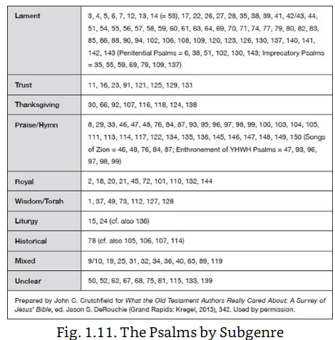
Interpreting OT Poetry: The Subgenres of the Psalms
Subgenres of Psalms:
  Lament Psalms (including penitential and imprecatory): cries for help in the midst of pain.
  Trust or Confidence Psalms: declarations of confidence in God and his trustworthiness, often in the midst of pain.
  Thanksgiving Psalms: expressions of gratitude for deliverance after the pain.
  Praise Psalms: celebrations of who God is and what he’s done for both his people and the whole world.
  Royal Psalms: descriptions of God’s king(s).
  Wisdom or Torah Psalms: reflections on God’s law and patterns of wise living (Prov. 8).
  Historical Psalms: retelling of God’s deliverance of his people.

Slide 154
Interpreting OT Poetry: The Subgenres of the Psalms
Some subgenres are highly structured, such as the lament psalm (APTRAP):
  Address to God
  Petition, typically to be heard
  Trouble described
  Reason for why God should answer
  Assurance declared
  Praise or promise of sacrifice
Putting it all together: https://www.youtube.com/watch?v=j9phNEaPrv8

Slide 155
Interpreting OT Poetry: Guidelines for Interpreting the Psalms
Pay attention to the covenantal location of the Psalms!
Pay attention to the structure of the Psalter as a whole!
Think about how the psalm points to God’s King!
Discern the structure of the individual Psalm!
Try to discern the subgenre of the individual Psalm!
Read the Psalms as poetry, observing the various poetic features!

Slide 156
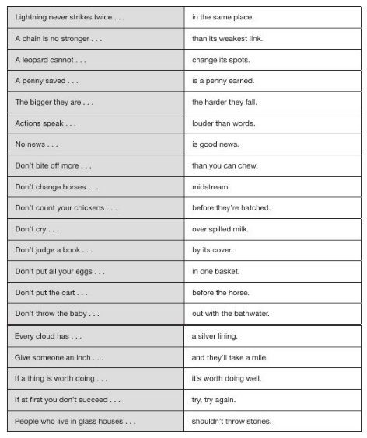
Interpreting Old Testament Poetry: the Proverbs

Slide 157
Interpreting OT Wisdom Literature: Proverbs
“A proverb is a succinct, memorable saying in common use that states a general truth or piece of advice” (DeRouchie, How To Understand and Apply the Old Testament, 84).
Proverbs aren’t unique to the Bible. Biblical proverbs, however, are inspired.
Characteristics:
  Memorable
  Designed for specific locations (e.g., Prov 26:4-5)
  Express ultimate not always immediate truths (e.g., Prov 26:27)
Let’s look at Proverbs 22:6
  How have you heard this taught?
  What challenges that interpretation?
  What are the implications of that interpretation?
  Proverbs are NOT promises.
  Proverbs are wisdom.

Slide 158
Interpreting OT Poetry: Interpretive Principles for Proverbs
Read Proverbs as a collection.
Proverbs are more practical than theoretical.
Proverbs are worded to be memorable, and not exhaustive treatment of a particular subject.
Proverbs need to be read in their own context (e.g., Prov 22:11).
Proverbs are NOT promises.
  “Proverbs state a wise way to approach certain selected practical goals but do so in terms that cannot be treated like a divine warranty of success. The particular blessings, rewards, and opportunities mention in Proverbs are likely to follow is one will choose the wise courses of action outlines in the poetic, figurative language of the book. But nowhere does Proverbs teach automatic success” (Fee and Stuart, How to Read the Bible for All Its Worth, 235).
  E.g., Proverbs 15:25; 22:26-27; 29:12.

Slide 159
THE “So What?” TOOL
Notes:
Matt 7:24-26

Slide 161
Biblical Interpretation:
How do we live in obedience to the Bible?

Slide 162

Living God’s Word: Defining Application
What is the goal of reading the Bible?

Slide 163
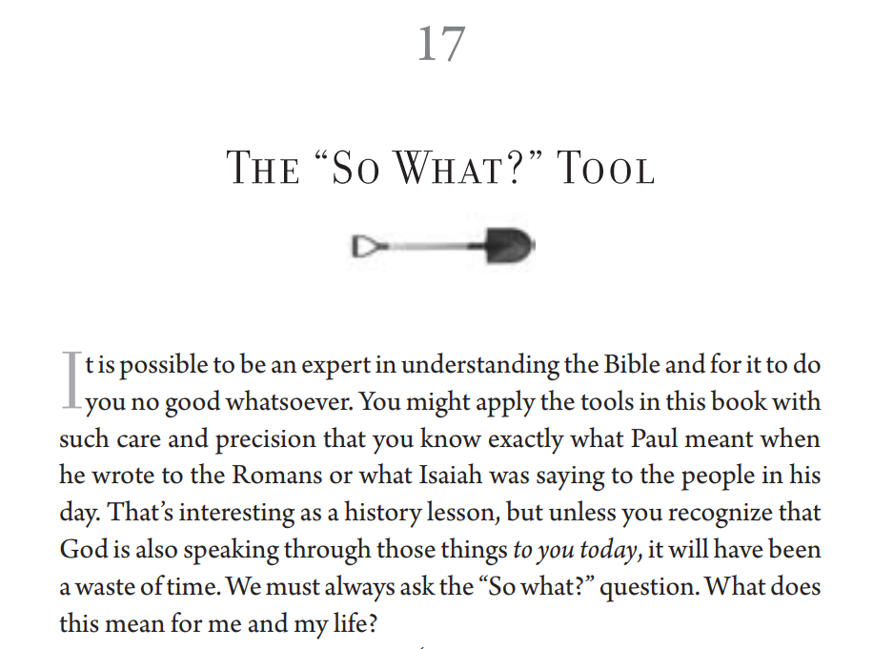

Slide 164
The Necessity of Application
“When God communicates information, we are obligated to believe it. When he tells us to do something, we are obligated to obey. When he tells us a parable, we are obligated to place ourselves in the narrative and meditate on the implications of that. When he expresses affection, we are obligated to appreciate and reciprocate. When he gives us a promise, we are obligated to trust. Let’s define the authority of language as its capacity to create an obligation in the hearer. So the speech of an absolute authority creates absolute obligation” (Frame, The Doctrine of the Word of God, 5).

Slide 165
Living God’s Word: Defining Application
“Application is the present personal consequence of scriptural truth. Without application, a preacher has no reason to preach, because truth without actual or potential application fulfills no redemptive purpose” (Chapell, Christ-Centered Preaching, 210).
“Trained agnostics are intellectually capable of comprehending the Bible—until they come to application” (Daniel Doriani, Getting the Message, 127).
Process: Observation → Exegesis → Meaning → Application
Goal: “The meaning of Scripture is its application” John Frame.
Application is a part of proper understanding
Notes:
Application is a part of proper understanding
E.g., I tell my son to clean his room.
How do I know if he has understood (1) who I am (2) his role (3) and what I’ve asked him to do?
He has only understood properly when he has responded with the appropriate action.

Slide 166
Living God’s Word: Interpretation and Application
Observation → Exegesis → Meaning → Application
Observations: What things do you see in the text?
Interpretation: Use your tools from Digging Deeper.
Meaning: What is the author’s intent?
Application: What are the implications from the text for how we live today?
Notes:
Caution: not just DO!

Slide 167
Living God’s Word: Gospel-Centered Application
GOSPEL-CENTERED APPLICATION: The gospel is the central message of the Bible, so our application ought to reflect a gospel-centeredness. It is easy to list a bunch of things that people can and cannot do, but I want to suggest that this approach does not accurately reflect the gospel.
The gospel is about what God has done in Christ, especially his death in resurrection, to reconcile lost sinners to himself and make them sons of God. The gospel is about God, and our application ought to be about God, not just a list of things I should do. Moreover, the gospel focuses on the cross of Christ, so our application ought to be informed and empowered by the cross.

Slide 168
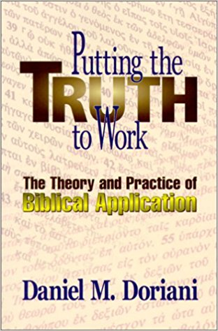
Living God’s Word: Gospel-Centered Application
Imagine a reporter interviewing a losing football coach. The reporter states and questions, “I think you would have had a better chance with 13 players on the field. Why didn’t you play with 13?” How might he respond?
  Duty: It’s against the rules.
  Character: Because I am not a cheater. I will not win at any price.
  Goal: It wouldn’t work because the refs would notice. There would be no glory or entertainment because that is about man vs. man.
  Discernment: How unbalanced is it that we scrutinize a football game more carefully than the systems that lead to poverty

Slide 169
Living God’s Word: More Robust Application
 | Duty | Character | Goal | Discernment
It asks… | What should I do, or how should I act? | Who am I and what should I become? | What should I pursue and devote energy to, and why? | How can I distinguish truth from error?
It says… | You must | You are | You may | You perceive
It seeks to… | Do | Be | Accomplish | Understand
Responds to… | Law’s requirements | God’s gifts | Worthy projects | God’s word and the world
Without this we | Disobey | Have a vice | Have futile lives | Are conformed to the values of the world
Notes:
DUTY—what should I do?
Duties are the moral obligations that provide structure for Christian living. They communicate Christian responsibilities to God and others.
Duties can range from general Christian principles to specific actions required in a given context.
Here is how a duty could progress in its specificity: Be holy! Be holy sexually! Avoid sexual temptation! Get internet accountability software! If single, don’t spend extended and potentially compromising times alone with the opposite sex!
CHARACTER—who should I be?
Character is the distinguishing nature or essence of a person. Character is about the sanctifying work of God in us to give us new desires (character is cultivated and should be distinguished from personality).
Good deeds will flow spontaneously from a person transformed by God’s Spirit
Developing character creates patterns of obedience that create paradigms for encountering new situations.
While non-believers can follow rules for a little while, character is developed as we respond obediently to the work of the Spirit.
This drives us to the essence of our identity—WHO WE ARE CHRIST.
If duty says “No one should act that way” character says “I cannot act that way.”
GOALS—what should I pursue and devote energy to?
Goals are the causes and aspirations that direct our choices. Goals supply the reason for committing ourselves to particular projects.
Goals remind us that some things are innocuous or harmless, but they are also pointless (e.g., watching some TV shows).
Selfish goals violate the law of love.
DISCERNMENT—how can I distinguish truth from error?
Discernment is the insight, understanding, and perception to see things from God’s perspective.
What people do depends on how they see the situation.
Do they understand the world and their circumstances in terms of worldly mindset or in terms of a biblical worldview.
Discernment allows us to step back and align our view with God’s so we see our duty, character, and goals as God does.

Slide 170
COURSE OBJECTIVES:
Bible and the Gospel
EXPLAIN the biblical understanding of the gospel, the proper response of faith, and the resulting new life.
PRACTICE biblically-oriented spiritual disciplines for Christian growth.
PRIORITIZE a lifestyle of engagement in the local church and in God’s mission of reaching the nations through the gospel.
SUMMARIZE key issues in the doctrine of the Scriptures.
DEMONSTRATE skill in studying the Bible through proper interpretation of the author’s intended meaning.

Slide 171
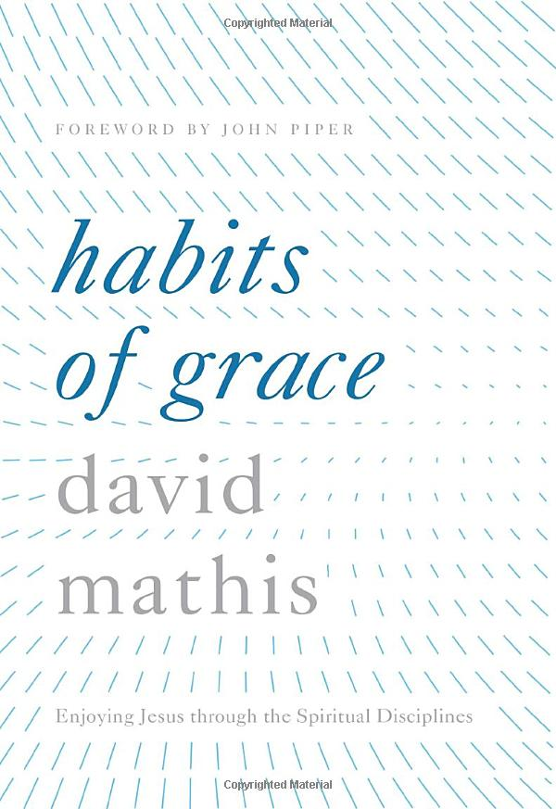
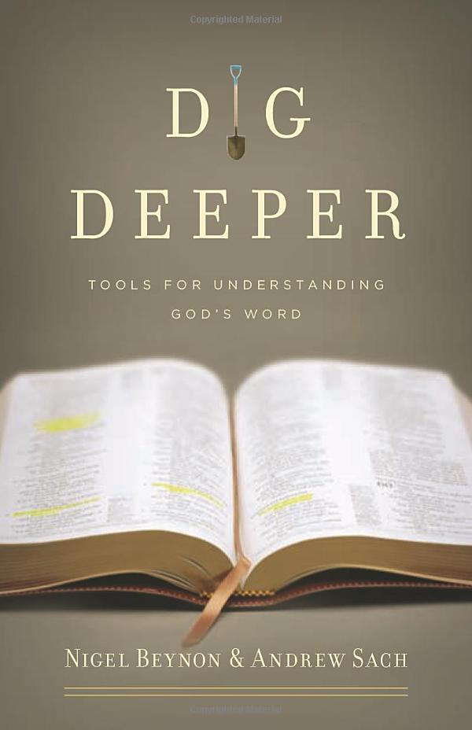
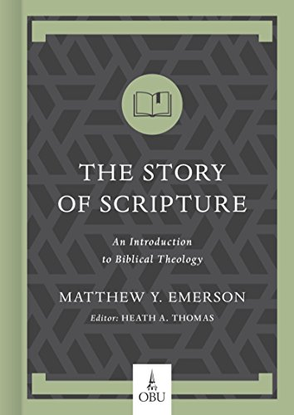
COURSE PROGRESSION:
Bible and the Gospel
Biblical Gospel and New Life
Biblically-Oriented Spiritual Disciplines
Character and Content of the Bible
Practice of Proper Interpretation
Notes:
New Life and New Calling:
1 Pet 2:9
1 Cor 10:31
Eph 4:1
Disciplines
Character of the Bible
Proper Interpretation

Slide 172
Biblical Interpretation:
How do we share God’s Word?

Slide 173
Sharing God’s Word
Evangelism is communicating the content and the appeal of the gospel, in the prayerful hope that the hearer will repent and believe. -JKL
Basic components of a gospel conversation:
  The biblical message with a focus on God, sin, salvation in Jesus Christ, and new life in Him (content)
  Your own testimony of faith as a part of an appeal to believe (appeal)
  Call to repentance and faith (content and appeal)
To simplify some concepts, unbelievers can be separated into two categories:
  Those who have heard the gospel (perhaps multiple times) and yet have not believed→ often called evangelism).
  Those who have never heard the gospel (or maybe even have no access to it)→ often called missions
At some level these tasks are similar (center around sharing the Bible’s message of the gospel), but the situations may call for differing approaches and therefore different preparations beforehand.

Slide 174
Sharing God’s Word
2 Resources
  Video: http://spreadtruth.com/thestory
  Method: https://www.thegospelcoalition.org/article/spurgeons-three-rs-a-useful-method-for-evangelism/
    Ruin
    Redemption
    Regeneration

Slide 175
Typical steps to prepare for gospel conversations:
Continue to grow in your own knowledge of the Bible and its gospel presentation
Practice sharing gospel concepts with other believers (to increase clarity)
Pray by yourself and with others for those who have yet to believe
Be regular in “living out the text” as being consistent with gospel message
Engage unbelievers with gospel conversations (usually involves going and some level of cross-cultural engagement, especially for unreached and unengaged people groups)
Connect your gospel outreach with the mission and fellowship of the church

Slide 179
Biblical Interpretation:
What is the Bible?

Slide 180
Class Goals:
Understand
Explain

Slide 181
This is a text box with quotes from the book. This is a text box with quotes from the book. This is a text box with quotes from the book. This is a text box with quotes from the book. This is a text box with quotes from the book.

Slide 182

biblical interpretation: demonstrating its importance
Notes:
NOTE:
To change the image on this slide, select the picture and delete it. Then click the Pictures icon in the placeholder to insert your own image.

Slide 183
Biblical Interpretation: Demonstrating its Importance
Let’s look at 1 Corinthians 14.
  Issue 1: What is tongues?
  Issue 2: What does it mean for women “to be silent”?
What does this text mean?
  Interpretive Principle: clear passages interpret less clear passages.
  Interpretive Principle: the Bible provides its own textual context.
  Interpretive Principle: the interpretive context expands outward from the passage (e.g., words, passage, Book, corpus, Testament, Bible).
How do we live in light of it?
  Mind the gaps.
  Don’t evade biblical authority.
Notes:
My conclusion: Paul prohibits wives from weighing the prophecies of their husbands.

Slide 184
Biblical Interpretation: Demonstrating its Importance
Some Interpretive Ground Rules
What is the sufficiency of Scripture?
  The Bible contains everything we need to know and love God.
  The Bible provides its own context (in expanding concentric circles).
What is the clarity (i.e. perspicuity) of Scripture?
  The Bible is understandable.
  Clearer passages interpret less clear passages.
What is the authority of Scripture?
  The Bible stands over all my thoughts and actions (i.e. the Bible gets the first and the last word).
  Let’s not try to escape what the Bible calls us to.
What is the necessity of Scripture?
  The Bible is essential for us to love and obey God (i.e. we can’t come to personal and saving knowledge of God apart from the Bible).
  We can’t please God by reasoning our way to what he desires. He reveals it in his word.

Slide 185
THE BIBLE TIMELINE TOOL

Slide 186
The Bible Timeline Tool
WORDS
SENTENCES
PARAGRAPHS
BOOKS
BIBLE
THE STORY OF THE BIBLE…
God enacts his kingdom (through Jesus for his glory) by bringing his holy people into his perfect place under his righteous rule. It focuses on God’s King, Jesus. And it unfolds through a series of covenants.

Slide 187

The Bible Timeline Tool
WORDS
SENTENCES
PARAGRAPHS
BOOKS
BIBLE
Where does the passage fit in the flow of redemption history?
Recall the importance of the covenants as structuring the overarching story of the Bible.
Life, Death, Resurrection
of Jesus
Creation
Return of Christ
Fall

Slide 188
Living God’s Word: Drawing Application from 1 Corinthians 10
Observation → Exegesis → Meaning → Application
Let me do the first 3 for you.
Now let’s use our rubric for application:
  Duty:
  Character:
  Goal:
  Discernment:
What do you think of this application?
  https://www.desiringgod.org/interviews/goodbye-burger-king
  How would you evaluate application?

Slide 189
Living God’s Word: 9 Marks Application Grid
Mark Dever and his 9Marks ministry have developed a very helpful application grid. I have provided both the simplified version and the more complex form. I have found the simplified version to be more intuitive and better for my uses. This tool intends to help you make the main point of the text the main point of your contextualized points of application. You begin by interpreting the main point that the author is trying to make to his original audience. That is, what did the author want to convey to the first century audience? Then think about how this point of application is transferrable to your own context. The goal is not necessarily to fill out the grid completely; rather, it is a tool to help you think through different points of application for different categories of hearers. The grid lists five groups of people that we should think about how the application relates to them. For example if the application point is to be unified in Christ, it might specifically apply to groups in this way:
Non-Christian: we live in a world fragmented by differences, and there is nothing strong enough or persuasive enough to unite diverse people…other than the gospel of Jesus Christ. True unity in diversity only comes when we are created radically new in Christ.
Public: You might have noticed that the people at our church are fairly diverse economically, ethnically, educationally, etc. Going to church isn’t like going to a football game. A sporting event only brings one type of people, sports fans. Jesus calls all people to faith in him, and we are united in response to him; hence, the one thing that we all seem to be carrying is his Word.
Christ: We have to marvel at the magnitude of Christ’s work. He brings rebels and an offended King into right relationship.
Christian: We take our reconciliation with God for granted when we refuse to reconcile with fellow believers.
Your Church: The church at Corinth compromised its witness about the gospel because their disunity didn’t show that the gospel was powerful enough to bring them together. If we want to reach our community with the power of the gospel, the power of the gospel must be reflected in our corporate unity.

Slide 190
Living God’s Word: 9 Marks Application Grid
Some concluding insights: https://www.sermoncentral.com/pastors-preaching-articles/tim-keller-biblical-preaching-application-vs-exegesis-1022

Slide 191
Living God’s Word: Some Quick Teaching Tips
A Paradigm for Preparation
  Study your students (Before class)
  Study Scripture with your students in mind (Before class)
  Surface the students’ need (During class)
  Satisfy their needs with the bite and balm of the text (During class)
A Model for Organization: HLBT (Richards, Creative Bible Teaching, 160)
  1. Hook (Introduction or opening activity)
    Gain attention and create interest.
    Lead naturally to Bible passage.
  2. Book (Content Presentation and discovery)
    Present passage clearly.
    Interpretation true to text.
  3. Look (Seeing the truth in contemporary life- ‘guided discovery’)
    Link naturally to “Book”?
    Deal with life implications really found in the passage?
  4. Took (Action plan in response to the Scripture)
    Provision made for follow through and follow-up of responses.

