Slide 1


The Danger of a Single Story
Chimamanda Ngozi Adichie
Narrator: Barbara Njau

Slide 2

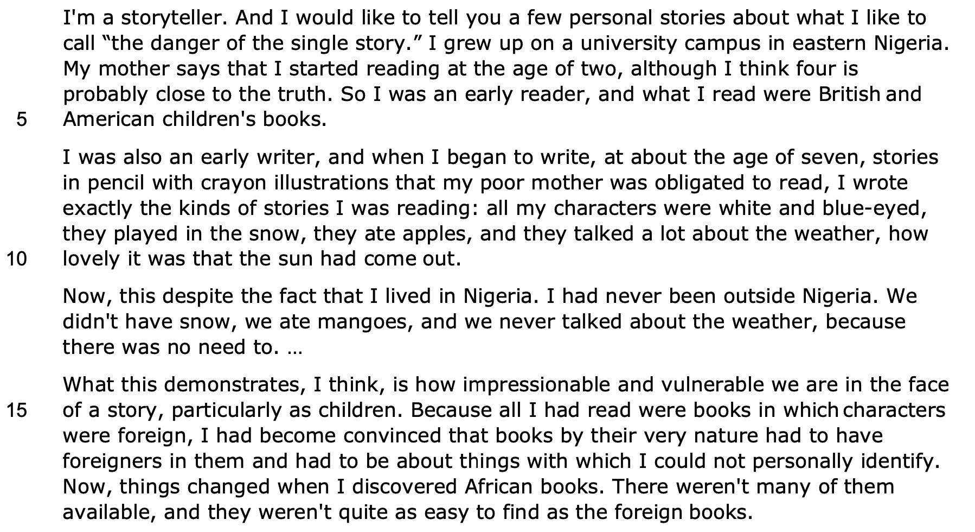

Adjective - places us
in her confidence
Direct address
Simple sentence
Declarative
sentence
Sibilance
Proper noun
shows she
was very Westernised
Intensifier - conversational tone
Repetition
Adjective - humour
Reference to
European
Western
ideals
Humour - she lives in a hot country
Repetition
Adjectives - victimisation and
the power of a story
Abstract
noun
Volta

Slide 3
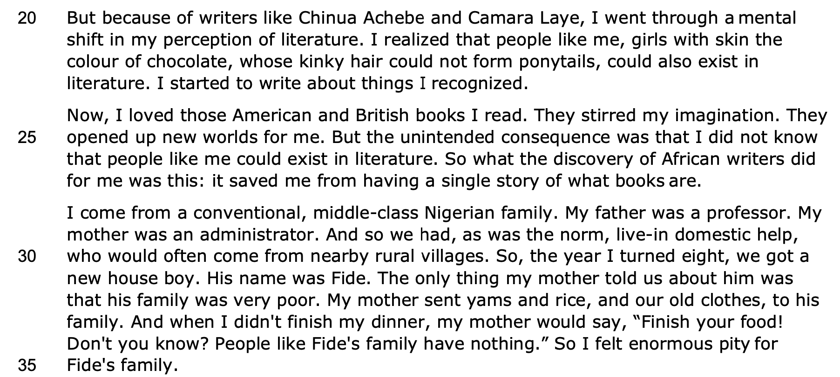

Conjunction
Proper nouns - famous African authors
Alliteration
Pre-modifier
Declarative sentence - she is three-dimensional
Personification
Hyperbole
Hero connotations
Simple sentences
Common nouns - provincial
Focus on humanising him
Imperative sentence

Slide 4
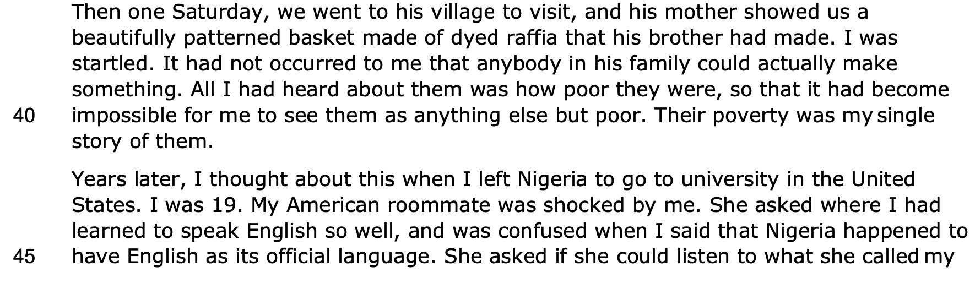
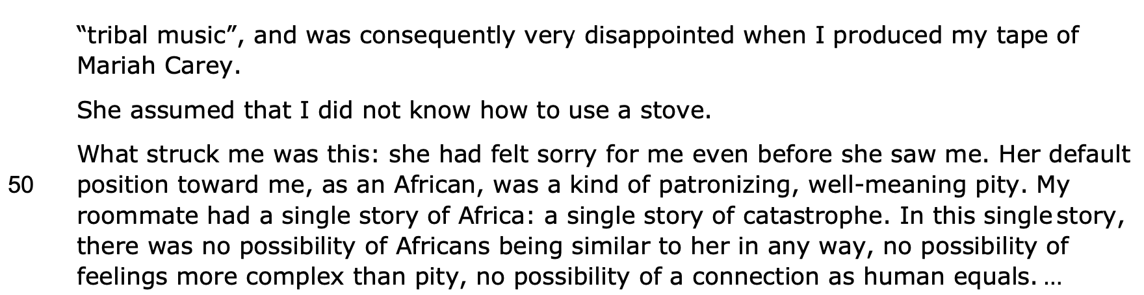
Pre-modifying adjectives - African material jargon
Adverb - emphasises narrow-minded view
Repetition of sibilant sounds - rhetorical device
Repetition
Temporal shift
Simple sentence - seminal moment
Repetition - third person pronoun - emphasises separation and alienation
Adjective - racist
Proper noun - pop cultural icon: humorous
Mirroring how she saw Fide
Adjectives - damaging stereotypes
Repetition - rhetorical device
like a refrain
Repetition of negatives emphasises hoplessness
Racist underpinnings

Slide 5
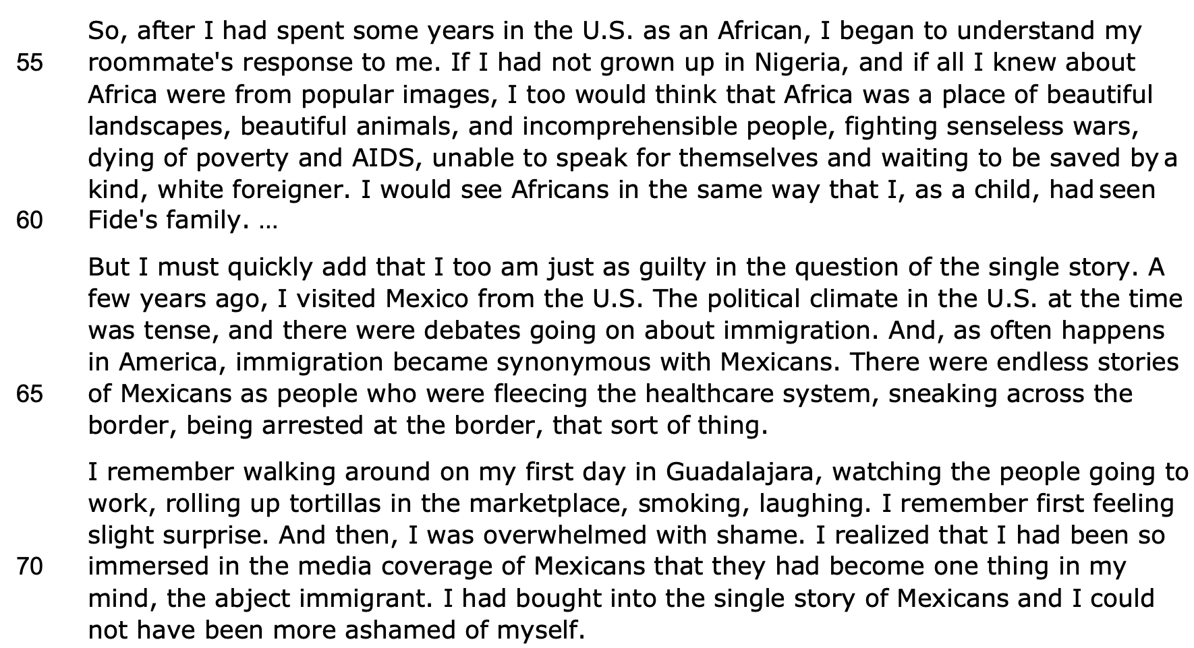
Identity has broadened
from being Nigerian
Alliteration
Stereotypes
of safaris
and war
Western media
Pre-modifiers
"saviour complex"
Political tensions
Abstract noun - culpability
Repetition - dehumanises as they are just a mass of people
Colloquialisms
Specific location - jargon
Sibilance
Western media
Very dehumanising - like pests
Comparative adjective

Slide 6
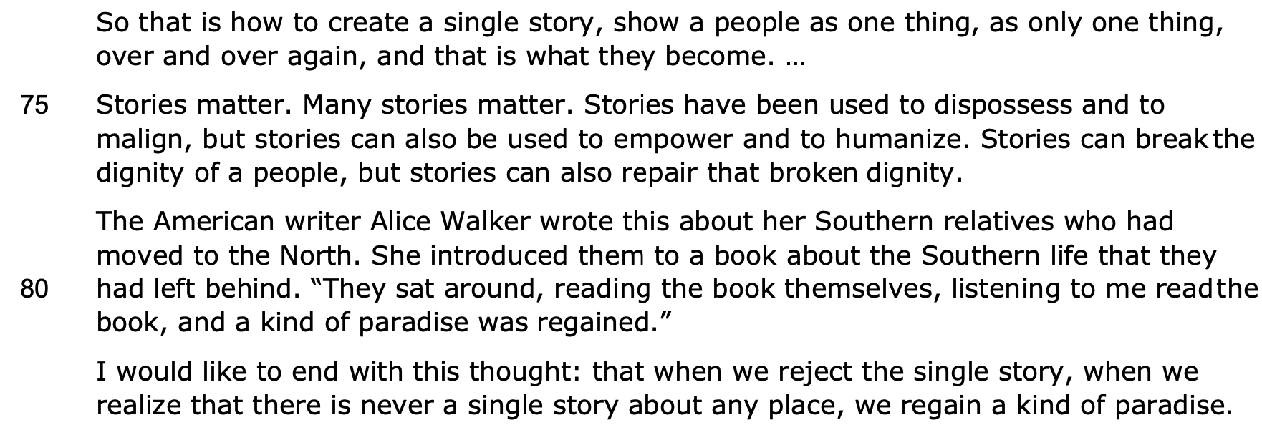
Repetition emphasises how repetitive and tedious the narrative surrounding Africa is
Simple sentence
Power
Proper noun
Direct speech - the global and timeless impact of narrative
Metaphor - enlightenment

Slide 7
THANK YOU!
WWW.FIRSTRATETUTORS.COM

