Slide 1

“That God has acted and spoken in history is ultimately newsworthy. Everything in history depends on these two presuppositions: God has acted (there is news to report); God has spoken (the news is reliable because God is the source of the report). Extra, extra! Read all about it (in the Bible): God has put the world right.” Vanhoozer, Hearers and Doers, 239

Slide 2
The BIBLE and the GOSPEL
Unit 1: Faith and New Life
Thanks to Dr. Jason Lee for some of
the structure AND CONTENT of this class

Slide 3

Class Goals:
Understand the concept of spiritual disciplines.
Explain some biblical examples of spiritual disciplines.

Slide 4
New Life in Christ:
How does a Christian live out the new life in Christ?
Notes:
-After my first year of college, I was on the planning team for a new ministry that was about to launch. When asked the question, “What does it look like for you to engage the Bible”, each of the prospective leaders answered. One leader said, “I have read most of it before, so now I read it when I need to reference things. But I don’t read the Bible regularly.” Would you consider this person fit for a leadership role?
Think of Psalm 1
Think of the example of Jesus
Christian ministry is ministry of the Word

Slide 5

BIBLE AND THE GOSPEL:
Spiritual Disciplines
The spiritual disciplines are those practices found in Scripture that promote spiritual growth among believers in the gospel of Jesus Christ. They are habits of devotion, habits of experiential Christianity that have been practiced by God’s people since biblical times.

Slide 6
BIBLE AND THE GOSPEL:
Bible-based Disciplines
Disciplined dependence: the life of faith (depending on Christ) is lived through discipline—the spiritual disciplines.
“Think of yourself seated in a jet passenger plane flying thirty-five thousand feet above the earth…You see the fuselage, where you are sitting, the two wings, and the tail assembly. As you look at the two wings you see the words dependence on the left wing and discipline on the right wing. This airplane illustrates one of the most important principles in the Christian life. Just as the airplane must have both wings to fly, so we must exercise both discipline and dependence in the pursuit of holiness” (Bridges, The Discipline of Grace, 129-130).

Slide 7
BIBLE AND THE GOSPEL:
Biblical examples of disciplines
10 When Daniel knew that the document had been signed, he went to his house where he had windows in his upper chamber open toward Jerusalem. He got down on his knees three times a day and prayed and gave thanks before his God, as he had done previously. 11 Then these men came by agreement and found Daniel making petition and plea before his God. 12 Then they came near and said before the king, concerning the injunction, “O king! Did you not sign an injunction, that anyone who makes petition to any god or man within thirty days except to you, O king, shall be cast into the den of lions?”
(Daniel 6:10–12 ESV)

Slide 8
BIBLE AND THE GOSPEL:
Biblical examples of disciplines
15 But now even more the report about him went abroad, and great crowds gathered to hear him and to be healed of their infirmities. 16 But he would withdraw to desolate places and pray. (Luke 5:15–16 ESV)
7 “And when you pray, do not heap up empty phrases as the Gentiles do, for they think that they will be heard for their many words. 8 Do not be like them, for your Father knows what you need before you ask him. 9 Pray then like this… (Matthew 6:7–9 ESV)
41 Watch and pray that you may not enter into temptation. The spirit indeed is willing, but the flesh is weak.” 42 Again, for the second time, he went away and prayed… (Matthew 26:41–42 ESV)
Notes:
Also have a corporate element

Slide 9
BIBLE AND THE GOSPEL:
Biblical examples of disciplines
6 If you put these things before the brothers, you will be a good servant of Christ Jesus, being trained in the words of the faith and of the good doctrine that you have followed. 7 Have nothing to do with irreverent, silly myths. Rather train yourself for godliness; 8 for while bodily training is of some value, godliness is of value in every way, as it holds promise for the present life and also for the life to come. 9 The saying is trustworthy and deserving of full acceptance. 10 For to this end we toil and strive, because we have our hope set on the living God, who is the Savior of all people, especially of those who believe.
11 Command and teach these things. 12 Let no one despise you for your youth, but set the believers an example in speech, in conduct, in love, in faith, in purity. 13 Until I come, devote yourself to the public reading of Scripture, to exhortation, to teaching.
(1 Tim 4:6–13 ESV)

Slide 10
BIBLE AND THE GOSPEL:
Biblical examples of disciplines
23 Let us hold fast the confession of our hope without wavering, for he who promised is faithful. 24 And let us consider how to stir up one another to love and good works, 25 not neglecting to meet together, as is the habit of some, but encouraging one another, and all the more as you see the Day drawing near. (Heb 10:23–25 ESV)

Slide 11
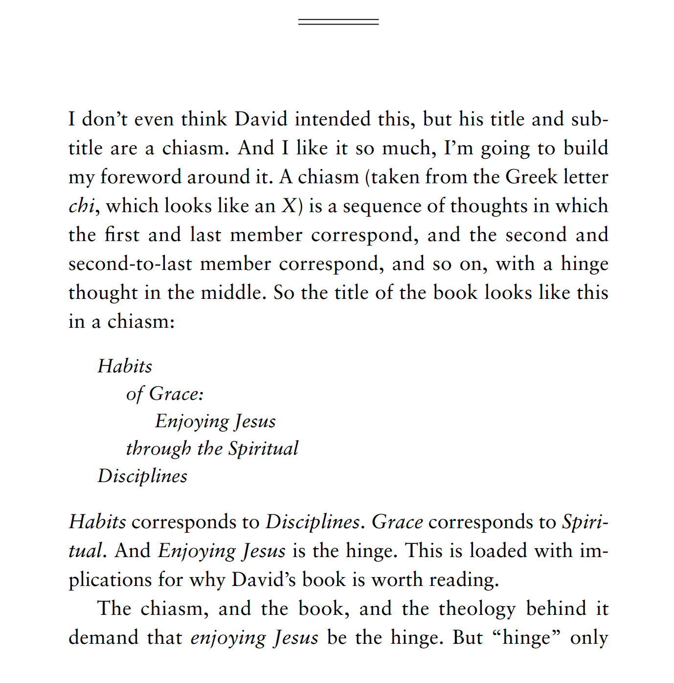

BIBLE AND THE GOSPEL:
Bible-based Disciplines
Notes:
-the Christian life is NOT saved by grace (gospel) and sanctified by sweat
Derived from the gospel: lived by dependence
Not legalism (gaining right standing before God): e.g. Pharisees…my experience in Chicago
Not an end in themselves: pursuit of God (and your heart does not always incline toward what is good)
Practices: things that you do…not the fruit of the Spirit that results from it
Practices that are in the Bible: not just a walk in the park…you don’t get to define the path to growth
Often need a plan: only simple desires are achieved without a plan

Slide 12
BIBLE AND THE GOSPEL:
Bible-based Disciplines
“I am eager to help Christians young and old simplify their approach to their various personal habits of grace, or spiritual disciplines, by highlighting the three key principles of ongoing grace: hearing God’s voice (his word), having his ear (prayer), and belonging to his body (fellowship).” (Mathis, Habits of Grace, 15)
Notes:
-Dutiful delight

Slide 13
BIBLE AND THE GOSPEL:
Bible-based Disciplines
Since the Bible is the primary means that God uses to guide us to walk in the Spirit (fulfilling our calling), we should develop habits that will keep us seeking Him in the written Word.
The Bible is the Word of God, inspired by the Spirit, written for our understanding and submission. Our access to God the Son (the Word) is through the preaching (word) of the prophets and the apostles as it comes to us in the pages of Scripture.
Though we will discuss more about the nature of the Scriptures and how to interpret them later in the course, suffice for now that the Bible plays a unique role of how God speaks to us changing our hearts and minds to reflect His.
Notes:
-the Christian life is NOT saved by grace (gospel) and sanctified by sweat
-we live out the Christian life through the gospel by repentance and reliance
-recall: dutiful delight
-your heart does not naturally incline toward that which is most beautiful
-only simple desires are achieved without a plan
-e.g. men coming home from promise keepers (sometimes the heart follows the hands)

Slide 14
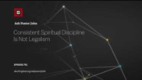

Slide 15

Faith and New Life:
BIBLE
Notes:
Dutiful delight

Slide 16
Class Goals:
Know some key verses about the role of the Bible in the life of the believer.
Explain the ongoing role of the Bible in the life of the believer.
Notes:
-After my first year of college, I was on the planning team for a new ministry that was about to launch. When asked the question, “What does it look like for you to engage the Bible”, each of the prospective leaders answered. One leader said, “I have read most of it before, so now I read it when I need to reference things. But I don’t read the Bible regularly.” Would you consider this person fit for a leadership role?
Think of Psalm 1
Think of the example of Jesus
Christian ministry is ministry of the Word

Slide 17
New Life in Christ:
What is the Bible?
Notes:
We will spend a great deal of time on this later in the course.

Slide 18
New Life in Christ:
Why engage the Bible?

Slide 19



Faith and New Life: MOTIVATION FOR BIBLE READING
What is the goal of reading the Bible?
OR
What motivates your Bible reading?

Slide 20
Faith and New Life: MOTIVATION FOR BIBLE READING
…TO OBEY GOD.
How do you know what God requires of you, unless you have his Word?
24 “Everyone then who hears these words of mine and does them will be like a wise man who built his house on the rock. 25 And the rain fell, and the floods came, and the winds blew and beat on that house, but it did not fall, because it had been founded on the rock. 26 And everyone who hears these words of mine and does not do them will be like a foolish man who built his house on the sand. 27 And the rain fell, and the floods came, and the winds blew and beat against that house, and it fell, and great was the fall of it.”(Matthew 7:24-27 ESV)
Notes:
-Recall that our primary calling is to glorify God.
-How does obedience glorify God?
-God is glorified as we continually declare his righteousness and wisdom—his way is best. We declare in obedience that he is King of everything, including my life.
-We declare with our actions the worth of God and the worthiness of his ways.

Slide 21
Faith and New Life: MOTIVATION FOR BIBLE READING
…FOR YOUR JOY.
The Bible reveals the object and source of your joy, God himself. The Bible is God’s self-revelation.
As the Father has loved me, so have I loved you. Abide in my love. If you keep my commandments, you will abide in my love, just as I have kept my Father's commandments and abide in his love. These things I have spoken to you, that my joy may be in you, and that your joy may be full. (John 15:9-11 ESV)
Lead me in the path of your commandments, for I delight in it.” (Psalm 119:35)
His delight is in the law of the Lord, and on his law he meditates day and night. (Psalm 1:2)
“The fundamental reason that the Word of God is essential to joy in God is that God reveals himself mainly by his Word. And seeing this revelation of God is the foundation of our joy.” (Piper, When I Don’t Desire God: How to Fight for Joy, 95)
Notes:
-How does this glorify God? Because God wants to be treasured (Mt 13) and enjoyed. You declare his infinite worth over and against everything else.
-God is jealous for your affections. This is analogous to raising children: I don’t want my kids just to obey me. I want them to enjoy me.

Slide 22
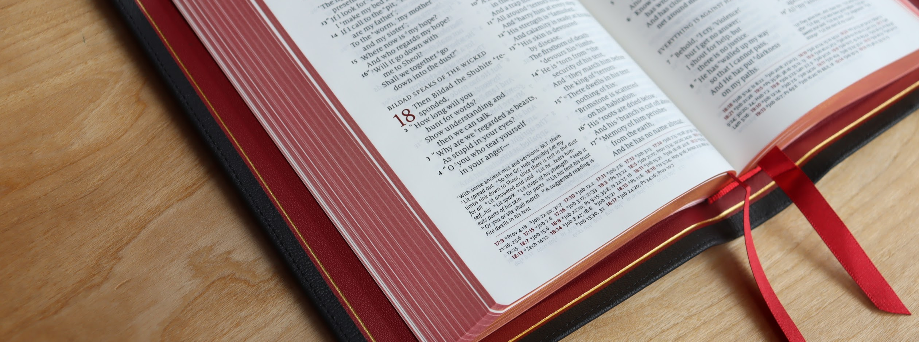
“One of the ways we can fight against the inclinations that lure us from the Word of God to computers or television or any other substitute pleasure is to remind ourselves often of the immeasurable and superior benefits of the Word of God in our lives.” (Piper, When I Don’t Desire God, 97)
Notes:
Our hearts don't always to incline to what is best. Sometimes we must train our hearts through prayerful discipline.

Slide 23
Faith and New Life: MOTIVATION FOR BIBLE READING
…TO APPRECIATE GOD’S BEAUTY.
Our ultimate goal in reading the Bible is that God’s infinite worth and beauty would be exalted in the everlasting, white-hot worship of the blood-bought Bride of Christ from every people, language, tribe, and nation. (http://www.desiringgod.org/messages/the-ultimate-goal-of-reading-the-bible )
“Open my eyes, that I may behold wonderful things from your law” (Psalm 119:18).
“Satisfy us in the morning with your steadfast love, that we may rejoice and be glad all our days” (Psalm 90:14).
Notes:
-E.g., no one has to be convinced to marvel at the Grand Canyon—they just need to see it clearly.
-How does this glorify God? Because God wants to be known and savored. Even “the heavens declare his glory” how much more should those creatures to whom he has given mouths.

Slide 24
Faith and New Life: MOTIVATION FOR BIBLE READING
“It is good, therefore, to store up true principles in our hearts, and to refresh them often, that, in virtue of them, our affections and actions may be more vigorous. When judgment is fortified, evil finds no entrance, but good things have a side within us to entertain them…And because knowledge and affection mutually help one another, it is good to keep up our affections of love and delight by all sweet inducements and divine encouragements; for what the heart likes best, the mind studies most. Those that can bring their hearts to delight in Christ know most of his ways” (Sibbes, A Bruised Reed [Puritan Paperbacks], 102-103)
“The great truth in Bunyan’s Pilgrim’s Progress is not that Christian endured great hardships on his way to the eternal city, but that Christian thought it to be worth his while to endure those hardships.” (Whitney, Simplify Your Spiritual Life, 126)
Recall Matthew 13
Notes:
This is the WHY of spiritual disciplines
Reading the Bible is a great joy to the soul.
Recall “dutiful delight”

Slide 25
Faith and New Life: MOTIVATION FOR BIBLE READING
…TO FIGHT (God-dishonoring and joy-killing) SIN
How can a young man keep his way pure? By guarding it according to your word. With my whole heart I seek you; let me not wander from your commandments! I have stored up your word in my heart, that I might not sin against you. (Psalm 119:9-11ESV)
Sanctify them in the truth; your word is truth. As you sent me into the world, so I have sent them into the world. And for their sake I consecrate myself, that they also may be sanctified in truth. (John 17:17-19 ESV)
Notes:
-Odysseus: NOT “bind me to the mast” but rather “enrapture my heart with a sweeter song”
-This book will keep you from sin, or sin will keep you from this book.
-So often people ask me how they can fight against enslaving sin (e.g., anxiety, lust, worry, anger, bitterness). Disciplined dependence is absolutely necessary. God’s means of grace are Bible, Prayer, and Church. You will have to cling to and rely and BE DISCIPLINED in pursuit of these means.
How does this glorify God? Because you say with your actions that God is more desirable than any false joy and lie of Satan.

Slide 26
Faith and New Life: MOTIVATION FOR BIBLE READING
…TO BE ASSURED OF YOUR HOPE.
“I write these things to you who believe in the name of the Son of God, that you may know that you have eternal life.” (1 John 5:13 ESV).
“For whatever was written in former days was written for our instruction, that through endurance and through the encouragement of the Scriptures we might have hope. 5 May the God of endurance and encouragement grant you to live in such harmony with one another, in accord with Christ Jesus, 6 that together you may with one voice glorify the God and Father of our Lord Jesus Christ” (Rom 15:4-6 ESV).
Notes:
-How does this glorify God? Because we rely on and trust him for our future, declaring his incomparable trustworthiness.
-Imagine how great the testimony of God’s greatness would be if all Christians were characterized by an unshakable hope.

Slide 27
Faith and New Life: MOTIVATION FOR BIBLE READING
…TO SUSTAIN YOUR FAITH.
So faith comes from hearing, and hearing through the word of Christ. (Rom 10:17 ESV)
Now Jesus did many other signs in the presence of the disciples, which are not written in this book; but these are written so that you may believe that Jesus is the Christ, the Son of God, and that by believing you may have life in his name. (John 20:30-31 ESV)
Notes:
How does this glorify God? Because you declare that his way is best. You declare that he is trustworthy and should be relied upon.

Slide 28
Faith and New Life: MOTIVATION FOR BIBLE READING
…TO LIVE A WISE AND TRUTHFUL LIFE.
"Your word is a lamp to my feet and a light to my path” (Psalm 119:105).
“I still have many things to say to you, but you cannot bear them now. When the Spirit of truth comes, he will guide you into all the truth, for he will not speak on his own authority, but whatever he hears he will speak, and he will declare to you the things that are to come. He will glorify me, for he will take what is mine and declare it to you. All that the Father has is mine; therefore I said that he will take what is mine and declare it to you. (John 16:12-15 ESV)
Notes:
-How does this glorify God? Because you declare that his way is best.
-People spend a great deal of time trying to discern how to be wise and discerning. Christians ought to be characterized by wise living that demonstrates to the world the wisdom of God.

Slide 29
Faith and New Life: MOTIVATION FOR BIBLE READING
Summary of some motivations:
  Obedience – knowing what God commands of you
  Joy – revealing the object and source of our joy
  Appreciate God’s beauty – seeing God for who he is
  Holiness – fighting sin
  Hope – assuring you of your future
  Faith – sustaining your trust
  Life – to live a wise and truthful life

Slide 30
1 Blessed is the man
who walks not in the counsel of the wicked,
nor stands in the way of sinners,
nor sits in the seat of scoffers;
² but his delight is in the law of the LORD,
and on his law he meditates day and night.
³ He is like a tree
planted by streams of water
that yields its fruit in its season,
and its leaf does not wither.
In all that he does, he prospers.
⁴ The wicked are not so,
but are like chaff that the wind drives away.
⁵ Therefore the wicked will not stand in the judgment,
nor sinners in the congregation of the righteous;
⁶ for the LORD knows the way of the righteous,
but the way of the wicked will perish.
(Psalm 1:1-6 ESV)
Why do the nations rage
and the peoples plot in vain?
² The kings of the earth set themselves,
and the rulers take counsel together,
against the LORD and against his Anointed, saying,
³ “Let us burst their bonds apart
and cast away their cords from us.”
⁴ He who sits in the heavens laughs;
the Lord holds them in derision.
⁵ Then he will speak to them in his wrath,
and terrify them in his fury, saying,
⁶ “As for me, I have set my King
on Zion, my holy hill.”
⁷ I will tell of the decree:
The LORD said to me, “You are my Son;
today I have begotten you.
⁸ Ask of me, and I will make the nations your heritage,
and the ends of the earth your possession.
⁹ You shall break them with a rod of iron
and dash them in pieces like a potter’s vessel.”
¹⁰ Now therefore, O kings, be wise;
be warned, O rulers of the earth.
¹¹ Serve the LORD with fear,
and rejoice with trembling.
¹² Kiss the Son,
lest he be angry, and you perish in the way,
for his wrath is quickly kindled.
Blessed are all who take refuge in him. (Psalm 2:1-12)

Slide 31


























1 Blessed is the man
who walks not in the counsel of the wicked,
nor stands in the way of sinners,
nor sits in the seat of scoffers;
² but his delight is in the law of the LORD,
and on his law he meditates day and night.
³ He is like a tree
planted by streams of water
that yields its fruit in its season,
and its leaf does not wither.
In all that he does, he prospers.
⁴ The wicked are not so,
but are like chaff that the wind drives away.
⁵ Therefore the wicked will not stand in the judgment,
nor sinners in the congregation of the righteous;
⁶ for the LORD knows the way of the righteous,
but the way of the wicked will perish.
(Psalm 1:1-6 ESV)
Why do the nations rage
and the peoples plot in vain?
² The kings of the earth set themselves,
and the rulers take counsel together,
against the LORD and against his Anointed, saying,
³ “Let us burst their bonds apart
and cast away their cords from us.”
⁴ He who sits in the heavens laughs;
the Lord holds them in derision.
⁵ Then he will speak to them in his wrath,
and terrify them in his fury, saying,
⁶ “As for me, I have set my King
on Zion, my holy hill.”
⁷ I will tell of the decree:
The LORD said to me, “You are my Son;
today I have begotten you.
⁸ Ask of me, and I will make the nations your heritage,
and the ends of the earth your possession.
⁹ You shall break them with a rod of iron
and dash them in pieces like a potter’s vessel.”
¹⁰ Now therefore, O kings, be wise;
be warned, O rulers of the earth.
¹¹ Serve the LORD with fear,
and rejoice with trembling.
¹² Kiss the Son,
lest he be angry, and you perish in the way,
for his wrath is quickly kindled.
Blessed are all who take refuge in him. (Psalm 2:1-12)
Notes:
Composed independently but complement each other well, and introduce the psalms to us
-Both of these psalms are anonymous
-begin and end with "blessed"
-way of the righteous vs. The way of the wicked (Ps 1 personally and Ps 2 corporately)
-meditate (1:2) is the same Hebrew word as "plot" (1:2)
-ideal righteous individual (Ps 1) and the chosen King (Ps 2)
-cherishing the written word and the living Word
NIV Study Bible: 2:7 You are my son. Recalls God’s promise to David regarding his son Solomon: “I will be his father, and he will be my son” (2 Sam 7:14). The Davidic kings would henceforth be “sons” of God, reflecting the close bond between the divine King and human kings. David’s descendants were expected to be vice-regents in God’s stead on earth in a kingdom whose “capital” was Zion (see v. 6 and note). Scripture later reflects this many times (e.g., 1 Chr 28:5; 2 Chr 13:8). See “Sonship,” p. 2352. These words are repeated at Jesus’ baptism (Mark 1:11) and are also applied to his resurrection (Act 13:33). They also proclaim his superiority to the angels (Heb 1:5) and his appointment as the new high priest (Heb 5:5). Carson, D. A., ed. (2018). NIV Biblical Theology Study Bible (p. 879). Zondervan.

Slide 32
New Life in Christ:
How to engage the Bible?

Slide 33
Class Goals:
Know some strategies for how to engage the Bible in daily life.
Explain the ongoing role of the Bible in the life of the believer.

Slide 34
Faith and New Life: APPROACH TO BIBLE READING
We will consider a few practical areas…
DIGGING AND RAKING
MEMORIZATION AND MEDITATION
MARKING AND ENGAGING
READING IN COMMUNITY

Slide 35
Digging
and
Raking

Slide 36
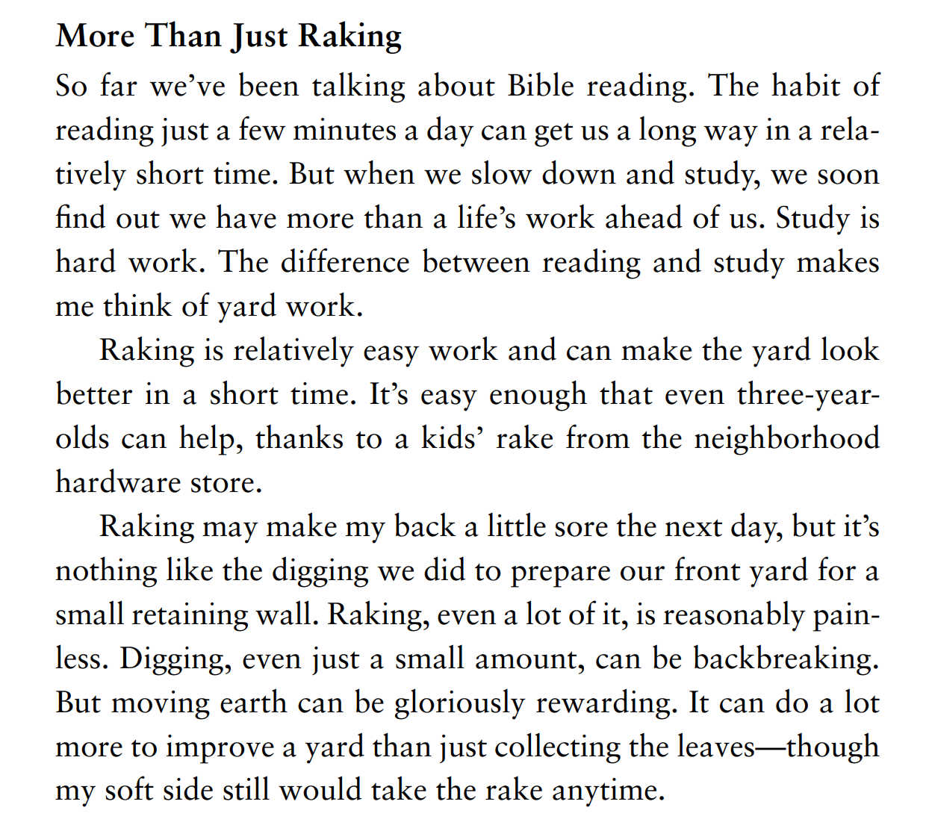
BIBLE AND THE GOSPEL:

Slide 37
Faith and New Life: APPROACH TO BIBLE READING…DIGGING & RAKING
DIGGING AND RAKING:
-reading for breadth and studying for depth
-raking for breadth and digging for depth
RAKING: Fast Reading
  Gets the Big Picture
  Establishes the Textual Context
  Very helpful for tracing themes
  Note: done well, this takes just as much care as raking
DIGGING: Slow Reading
  Observes the Textual Features
  Gathers the Textual Clues
  Understanding comes from careful study of the textual features/ clues to meaning. The study must draw on the textual context and be compatible with it. This study must be done with diligence and endurance.
  Meditation on the author’s textual meaning leads to a life informed / changed by the text.

Slide 38
Faith and New Life: APPROACH TO BIBLE READING…DIGGING & RAKING
Levels of Raking
Canon
  How does the Bible fit together?
  What is the overarching story?
  How does a particular theme develop throughout the Bible?
Corpus
  Does this build on other books?
  What has the author said elsewhere?
Book
  What is the main point of the book?
  How does this passage fit within that?

Slide 39
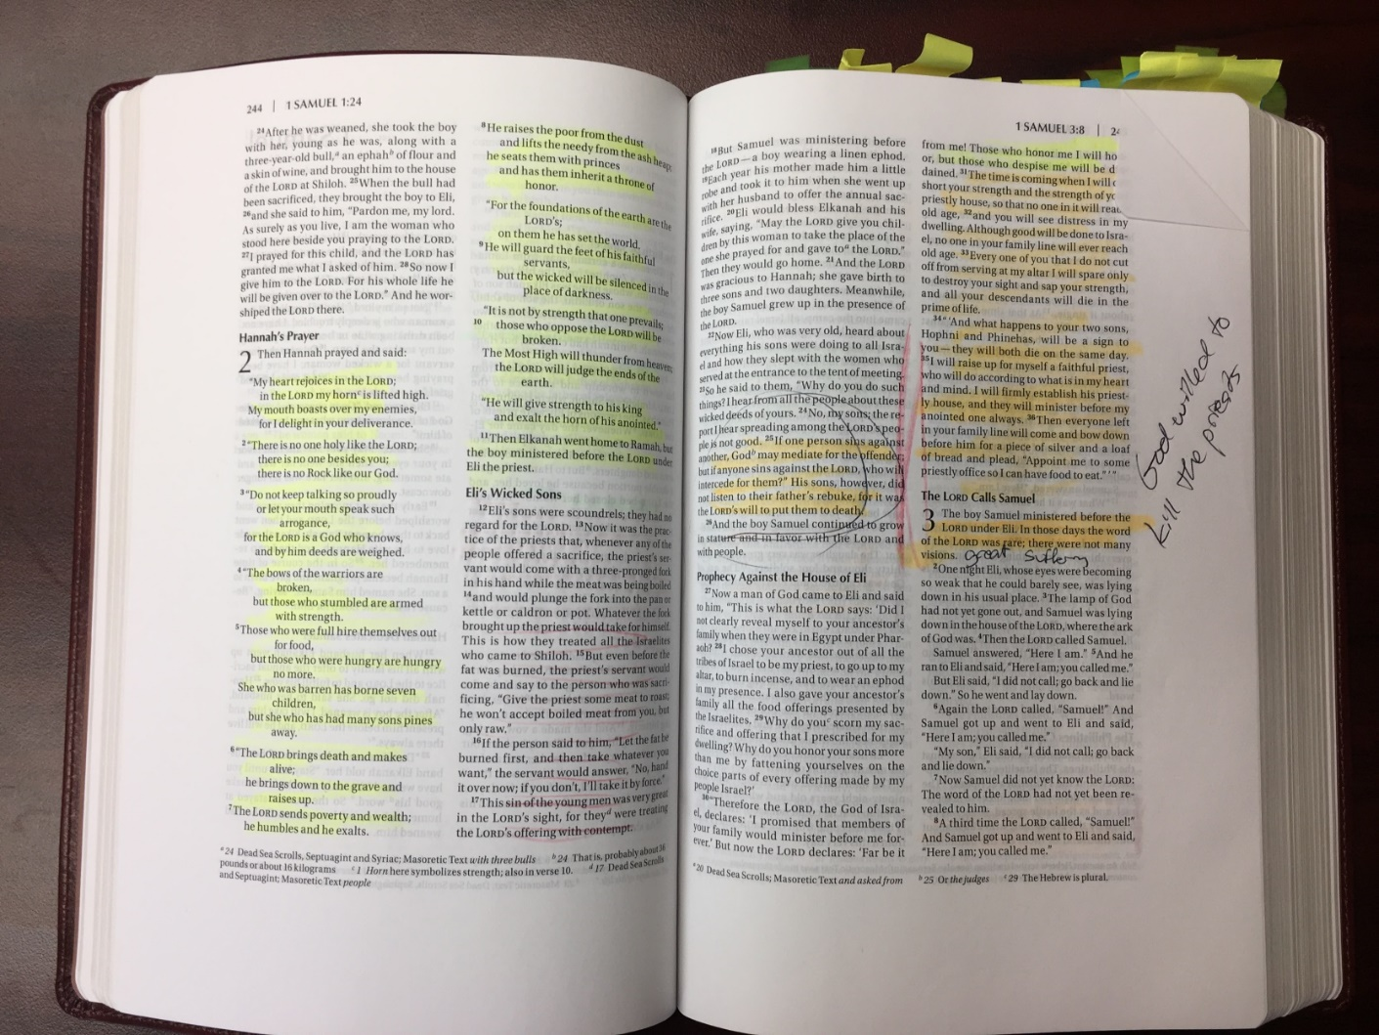
Faith and New Life: APPROACH TO BIBLE READING…DIGGING & RAKING
An idea for raking…
Notes:
suffering

Slide 40
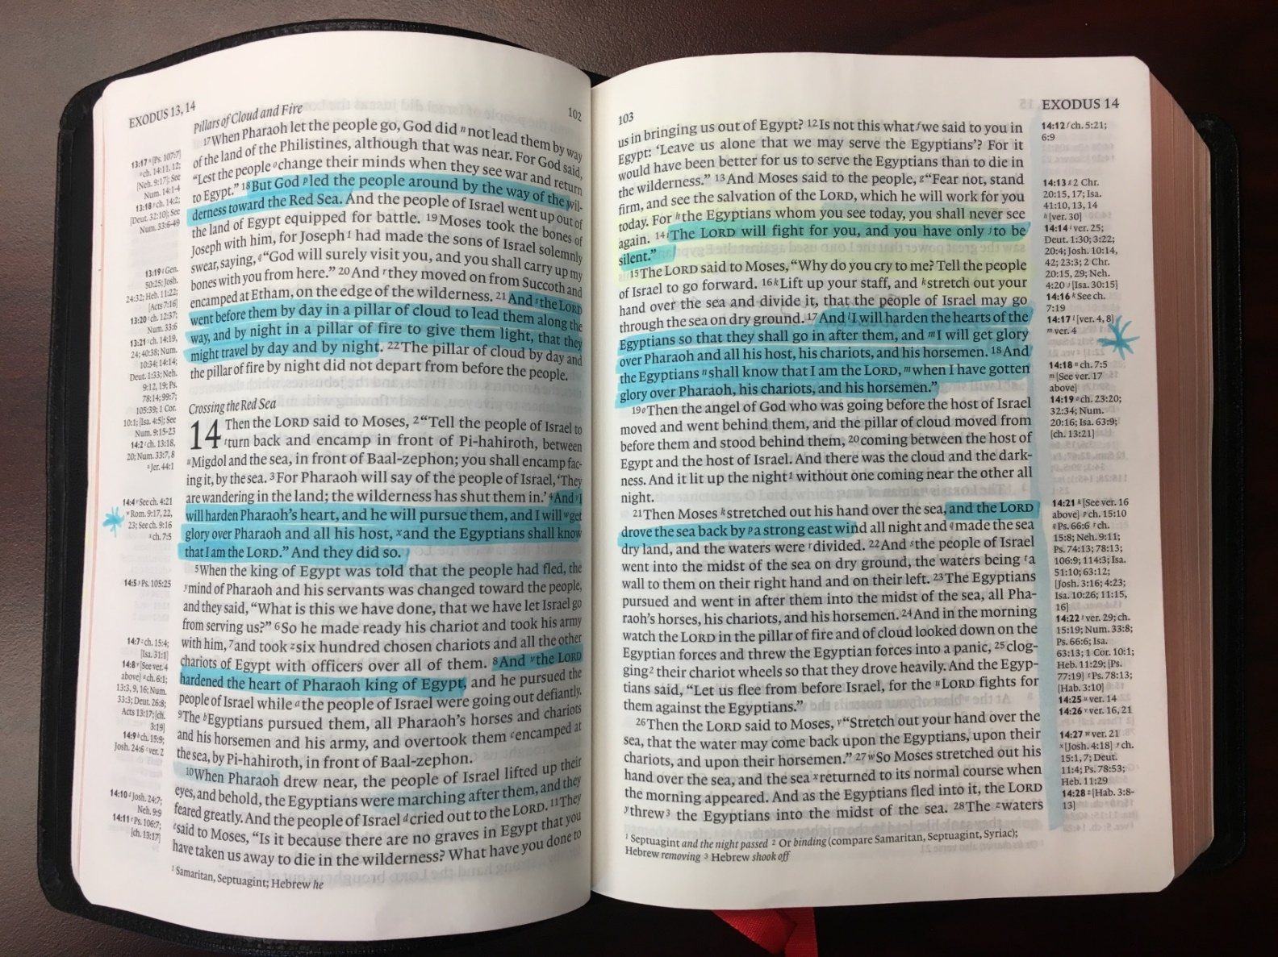
Faith and New Life: APPROACH TO BIBLE READING…DIGGING & RAKING
An idea for raking…
Notes:
Sovereignty

Slide 41
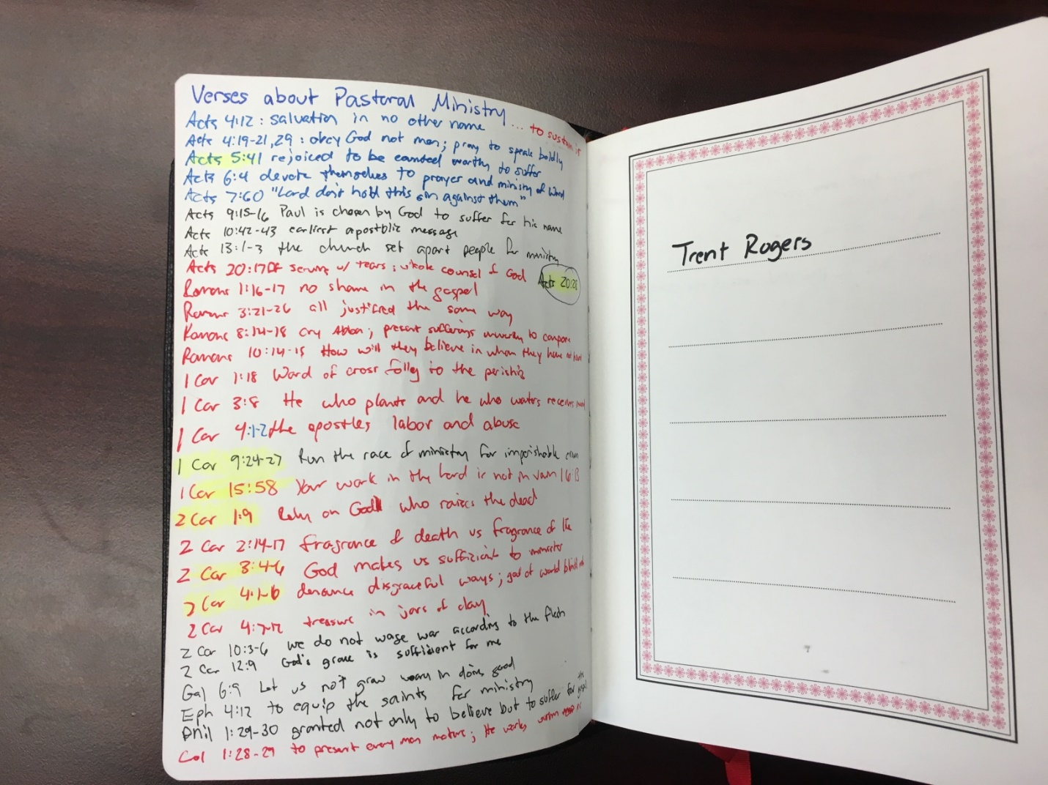
Faith and New Life: APPROACH TO BIBLE READING…DIGGING & RAKING
An idea for raking…

Slide 42
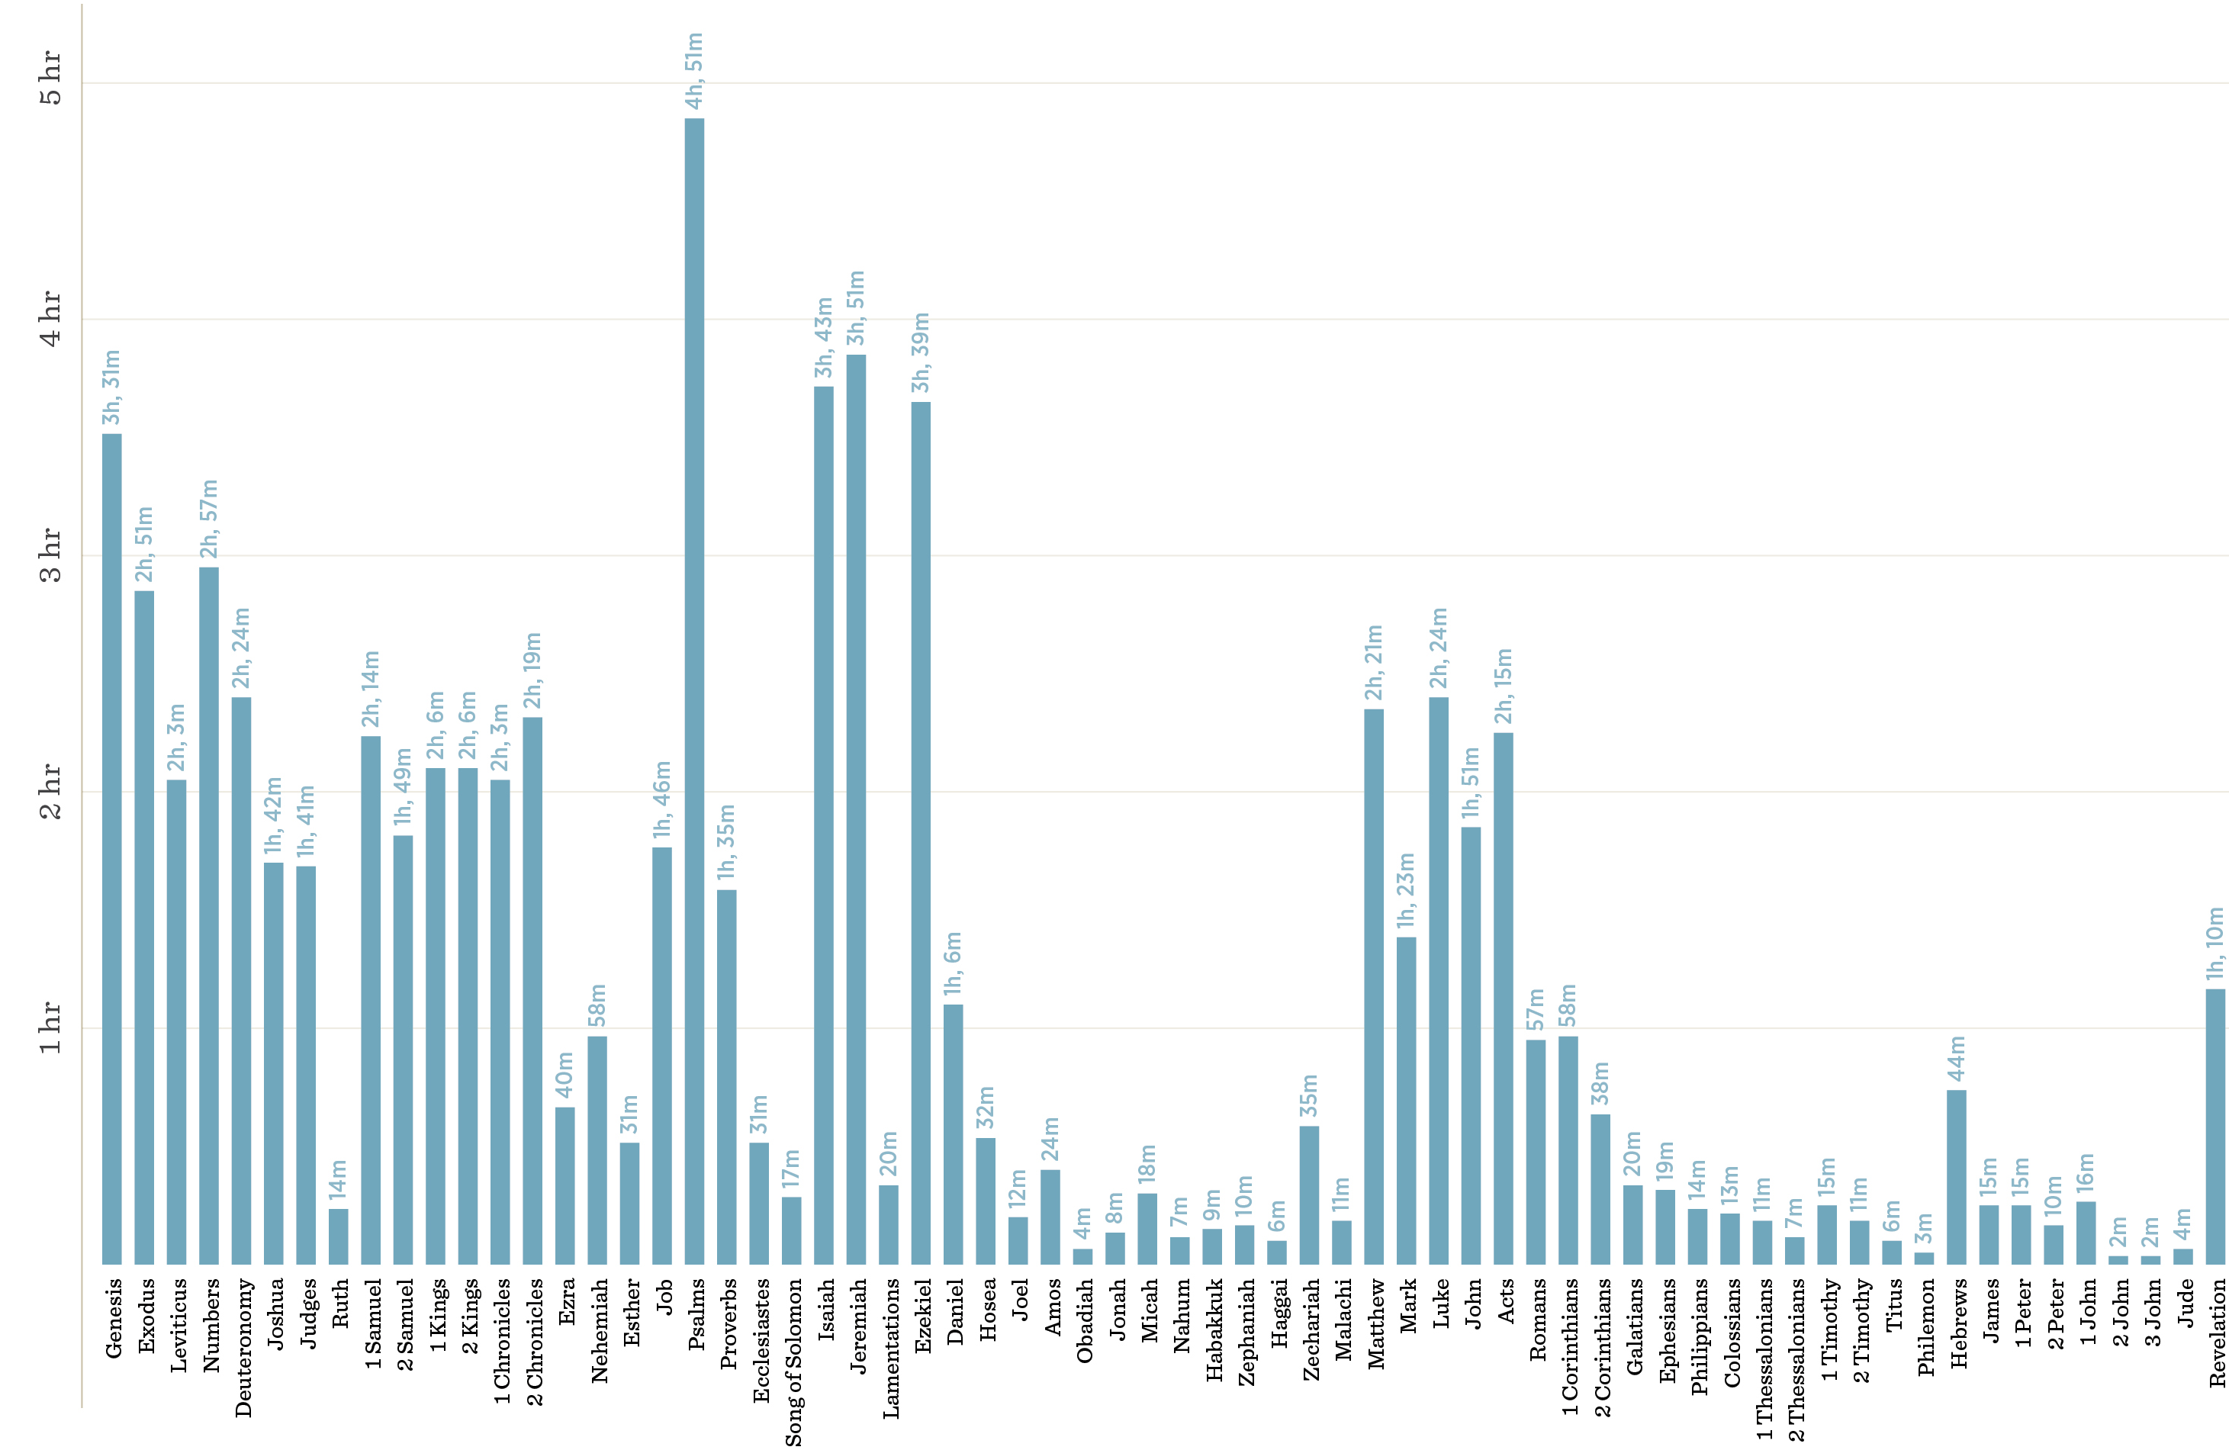
How long does it take to read each book of the Bible? https://www.crossway.org/articles/infographic-you-can-read-more-of-the-bible-than-you-think/

Slide 43
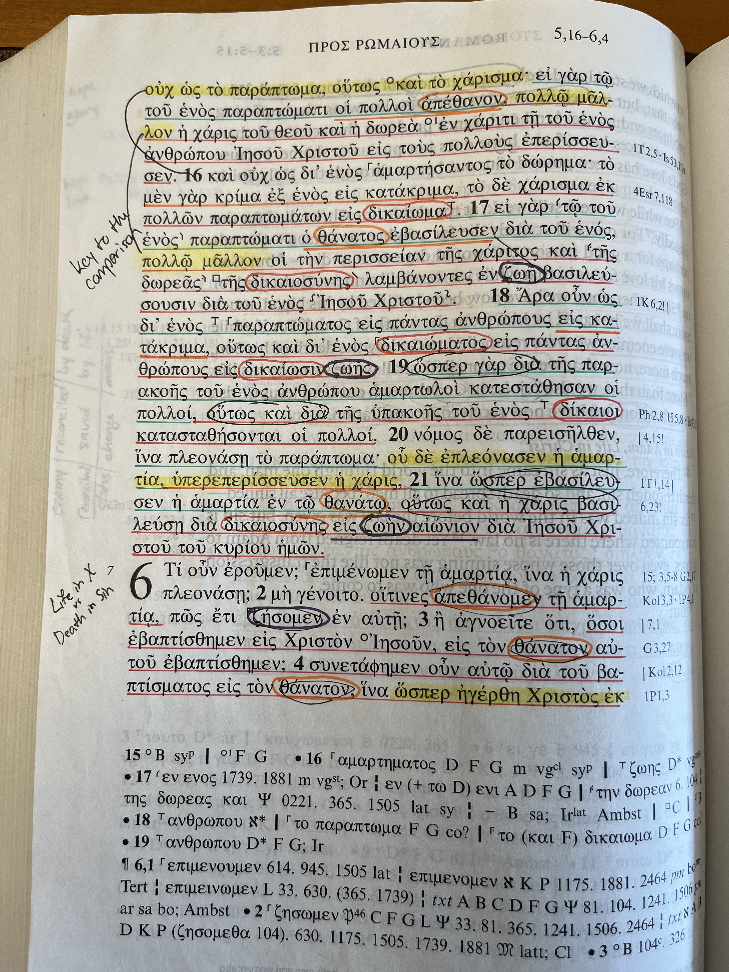
Faith and New Life: APPROACH TO BIBLE READING…DIGGING & RAKING
An idea for digging…

Slide 44
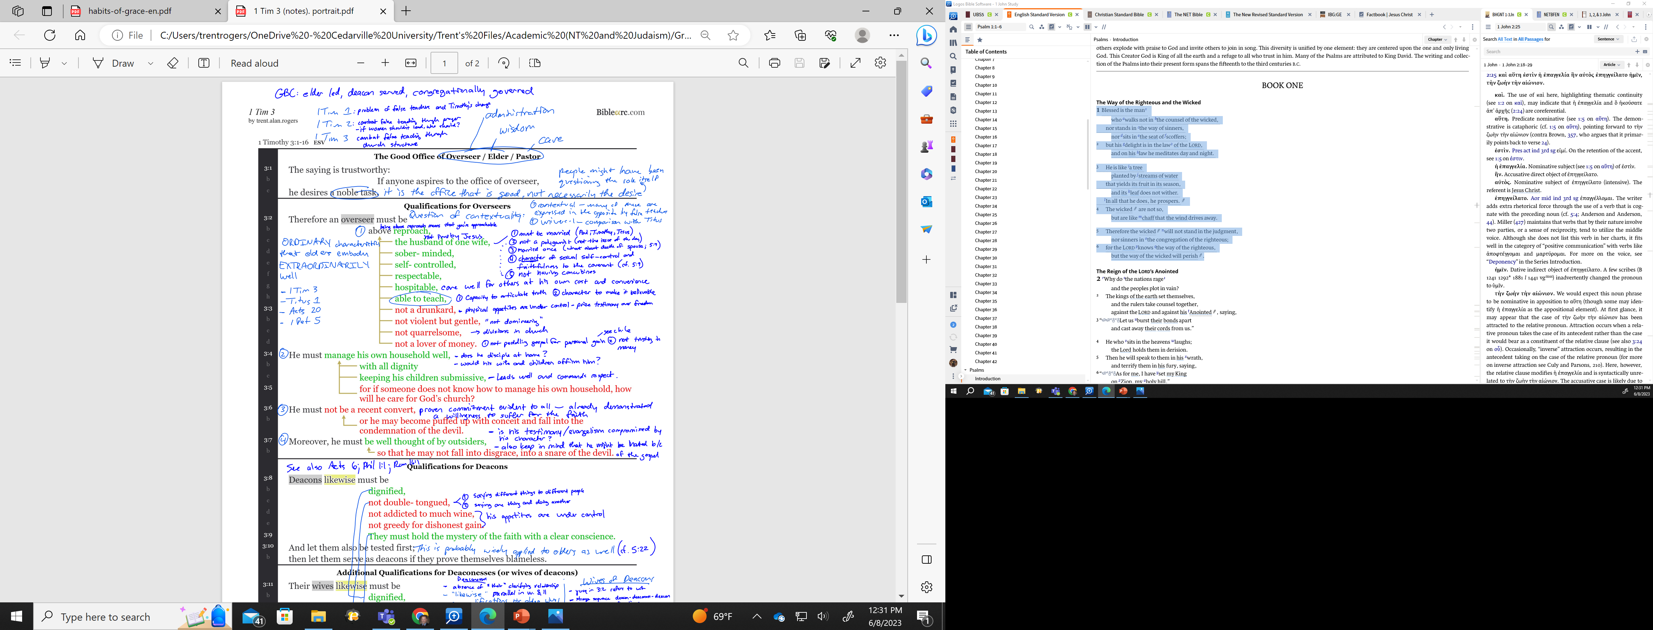
Faith and New Life: APPROACH TO BIBLE READING…DIGGING & RAKING
An idea for digging…

Slide 45
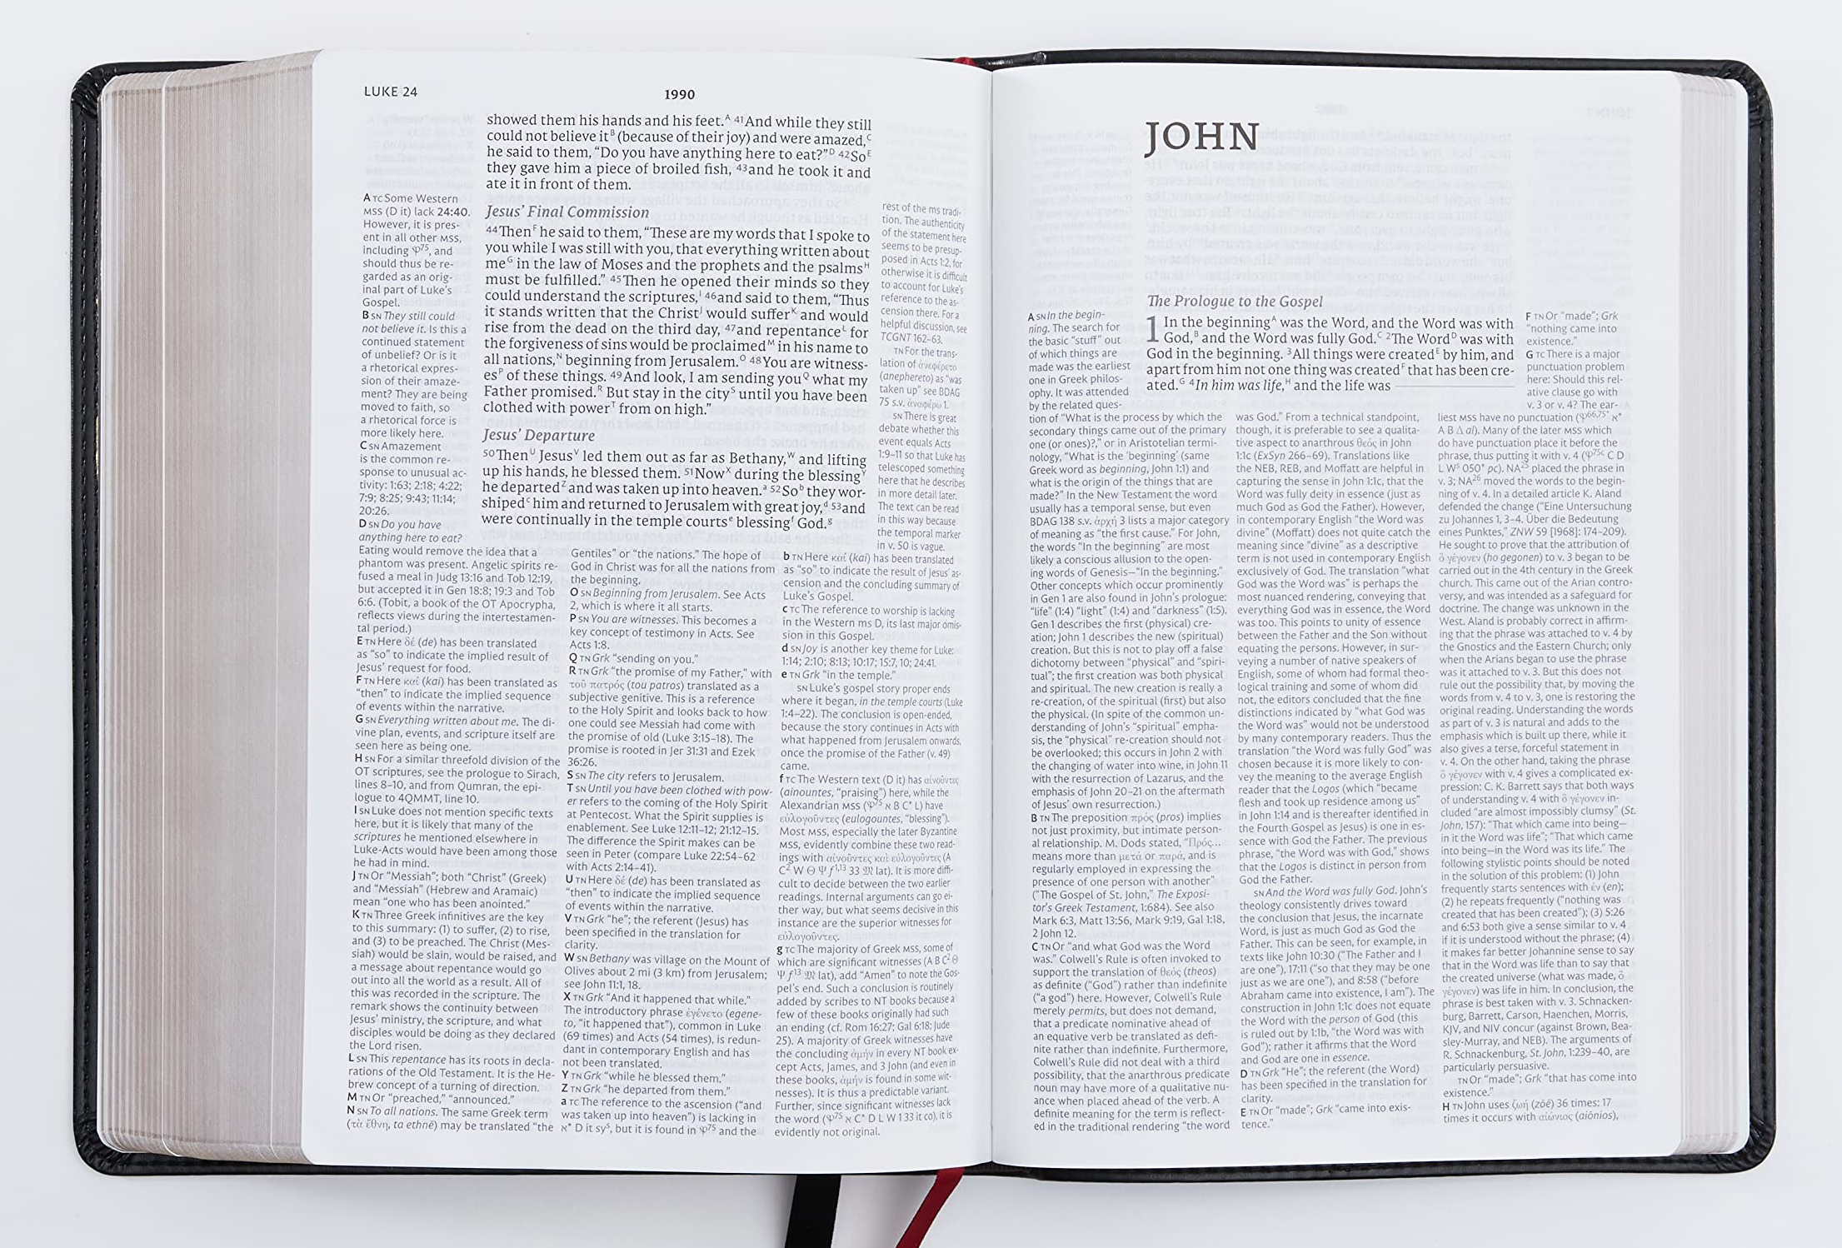
Faith and New Life: APPROACH TO BIBLE READING…DIGGING & RAKING
An idea for digging…

Slide 46
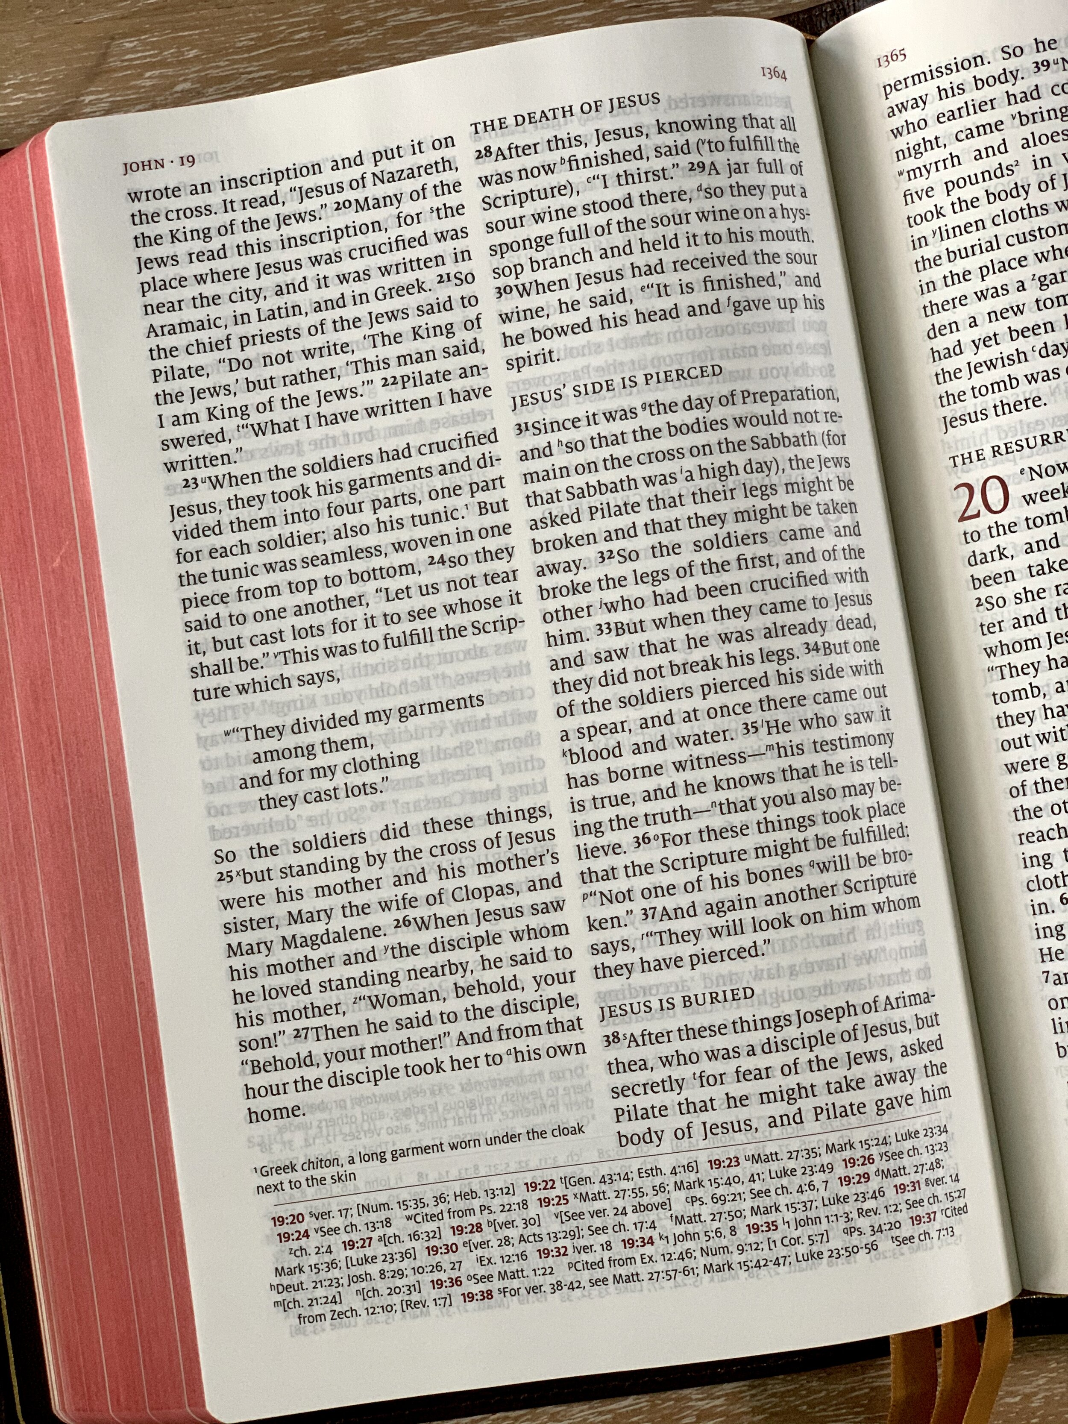
Faith and New Life: APPROACH TO BIBLE READING…DIGGING & RAKING
An idea for digging…

Slide 47
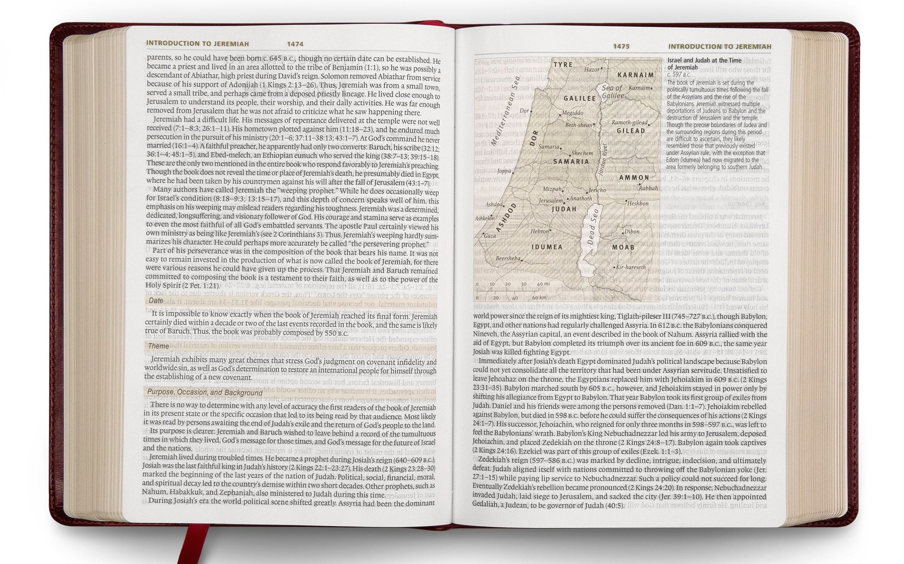
Faith and New Life: APPROACH TO BIBLE READING…DIGGING & RAKING
An idea for digging…

Slide 48
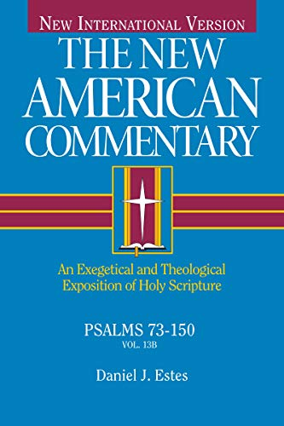
Faith and New Life: APPROACH TO BIBLE READING…DIGGING & RAKING
An idea for digging…

Slide 49


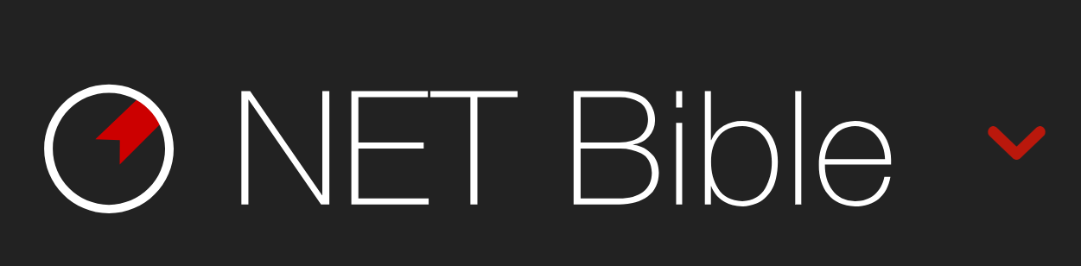

Faith and New Life: APPROACH TO BIBLE READING…DIGGING & RAKING
Some tools for digging…

Slide 50
Memorization
And
Meditation

Slide 51
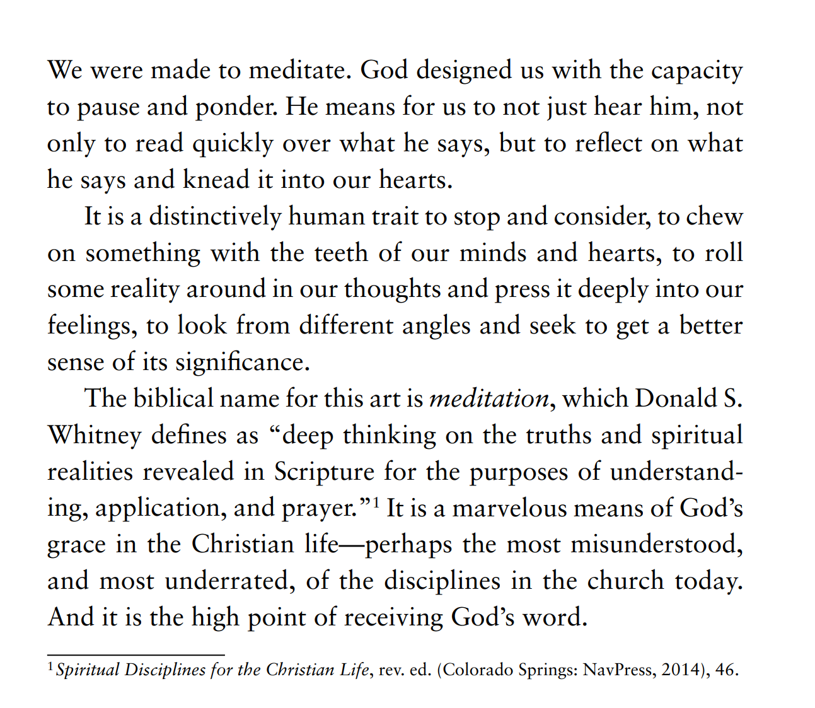
BIBLE AND THE GOSPEL:
Notes:
Page 55

Slide 52
Faith and New Life: APPROACH TO BIBLE READING… MEMORIZING &MEDITATING
MEMORIZATION IS FOR MEDITATION
Meditation on Scripture is simply the repeated reflection on a passage of the Bible while asking God to awaken your heart to its message.
Sometimes we approach the Bible with the goal of moving through a text quickly, perhaps because our Bible reading plan calls for a certain number of chapters. There is great value in reading large chunks of Scripture, especially reading whole books, at one sitting. And there is also value in setting aside some time to repeatedly reflecting on one particular text, perhaps of a text that deals with a burning issue in your life.

Slide 53
Faith and New Life: APPROACH TO BIBLE READING… MEMORIZING &MEDITATING
Psalm 1:1-3
  Blessed is the man who walks not in the counsel of the wicked, nor stands in the way of sinners, nor sits in the seat of scoffers; but his delight is in the law of the LORD, and on his law he meditates day and night.
Psalm 119:15-16
  I will meditate on your precepts and fix my eyes on your ways. I will delight in your statutes; I will not forget your word.
Philippians 4:8
  Finally, brothers, whatever is true, whatever is honorable, whatever is just, whatever is pure, whatever is lovely, whatever is commendable, if there is any excellence, if there is anything worthy of praise, think about these things.
Colossians 3:2-3
  Set your minds on things that are above, not on things that are on earth. For you have died, and your life is hidden with Christ in God.

Slide 54
Faith and New Life: APPROACH TO BIBLE READING… MEMORIZING &MEDITATING
Thomas Brooks, in his classic work Precious Remedies Against Satan’s Devices, puts it memorably: “Remember, it’s not hasty reading, but serious meditating upon holy and heavenly truths, that make them prove sweet and profitable to the soul. It’s not the bee’s touching of the flower which gathers honey—but her abiding for a time upon the flower, which draws out the sweet. It’s not he who reads most—but he who meditates most, who will prove the choicest, sweetest, wisest, and strongest Christian.”
Interview with Donald Whitney: https://www.youtube.com/watch?v=CDt_dSFwWFU&feature=em-uploademail

Slide 55
Faith and New Life: APPROACH TO BIBLE READING… MEMORIZING &MEDITATING
A model for meditation (Some of this is adapted from Donald S. Whitney, Spiritual Disciplines for the Christian Life [Colorado Springs: NavPress], 2014)…
1. Begin to memorize the passage. Try to have the text memorized after two weeks (Most texts of fitting length for meditation are also appropriate length for memorization).
2. Read the text multiple times, and emphasize a different word each time. Think deeply on the significance of each word.
3. Rewrite or summarize the text in your own words.
4. Think of a way to illustrate the text. Is there a person, event, play, or TV segment that exemplifies the text’s main point?
5. Read the text in the context of the surrounding chapters. How does it fit into the flow of the larger argument?
6. How does the text point to the gospel (the good news about what God has done in Christ, especially his death and resurrection, to reconcile humans to God and make them sons of God)?
7. How is the text calling the original audience to respond? How is the Spirit calling me to respond?

Slide 56
Faith and New Life: APPROACH TO BIBLE READING… MEMORIZING &MEDITATING
8. Pray through the text asking God to “open my eyes that I may behold wondrous things out of your law” (Psalm 119:18).
9. Meditate until you discover 10 insights from the text.
10. What does the text reveal about my heart and affections? Does it cultivate godly affections or challenge my misplaced desires?
11. What question does the text answer? Or what problem does the text solve? Where do you see that question or problem today?
12. What is the text telling you about God (Father, Son, and Holy Spirit)?
13. Make a map of the text. You can use sentence diagramming if that helps. You can also use a diagram by putting the main idea in a circle and then creating branches off of it for additional ideas from the text.
14. Recite the text from memory 14 times.

Slide 57
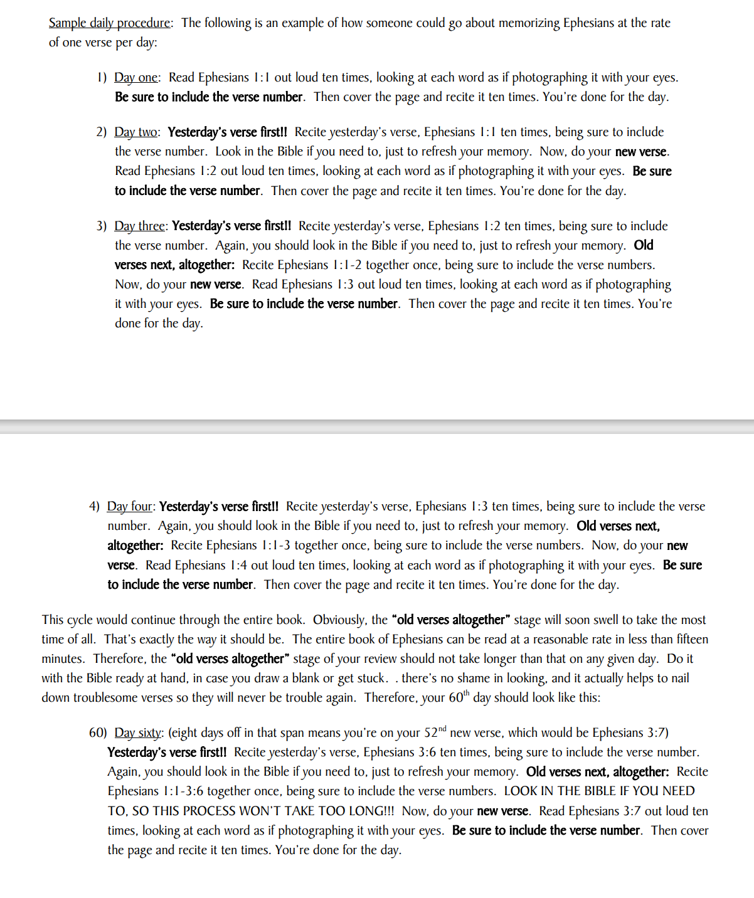
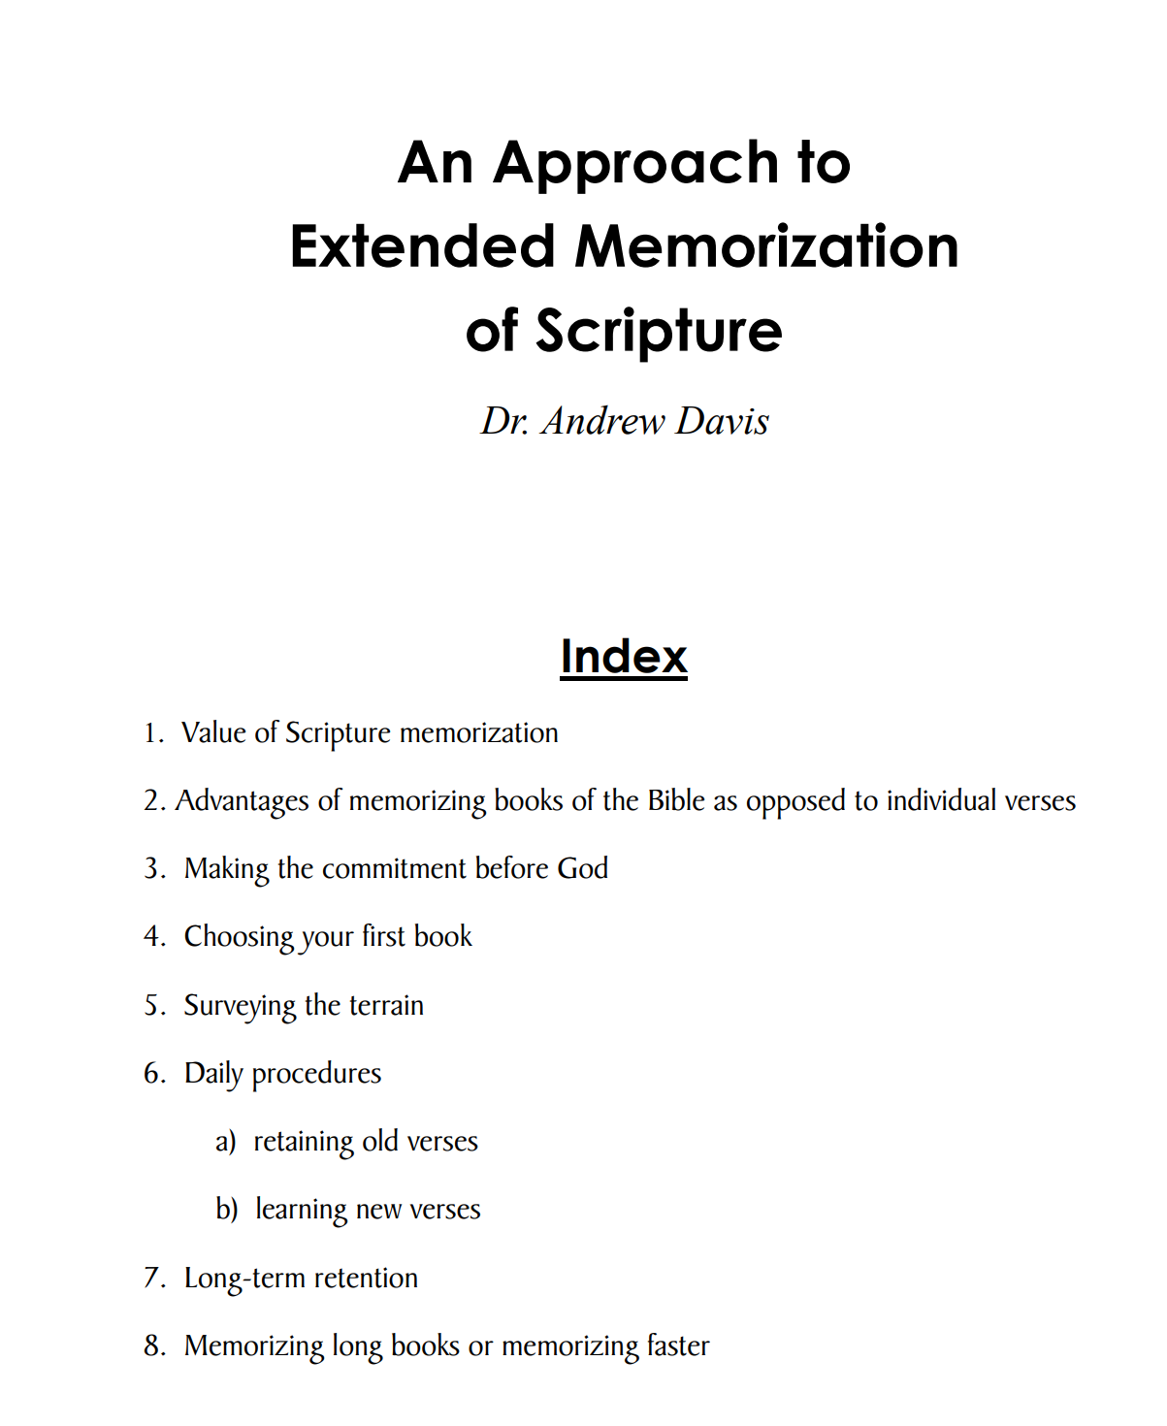
Faith and New Life: APPROACH TO BIBLE READING… MEMORIZING &MEDITATING

Slide 58
BIBLE AND THE GOSPEL:
Tips for Memorization (Habits of Grace, 73-74)
Diversify you picks (sections, chapters, books)
Take it with you during the day (note cards; audio Bible)
Seek to understand, feel, and apply the text as you memorize (memorization is not the goal)
Turn your text into prayer
Memorize in light of the gospel (“Let the word of Christ dwell in you richly” Col 3:16)
Notes:
Page 55

Slide 59
Marking
and
Engaging

Slide 60
Faith and New Life: APPROACH TO BIBLE READING… MARKING
Reasons to Mark in your Bible
For more focused engagement (using more senses)
For more seeing what is there (marking asks questions)
For connecting what is there (marked themes are seen)
For reference (seeing marked themes)
For others (modelled engagement in text)
For patterns of interpretation (e.g., OT references)
For memories of spiritual growth (e.g., our family Bible)
→ for worship with heart and mind

Slide 61
Reading
in
Community

Slide 62
Faith and New Life: APPROACH TO BIBLE READING… IN COMMUNITY
Is it necessary to read the Bible with other Christians? What is lost if we only read it privately?
Christian faith, while personal, is never private, and it is meant to be lived in public. The spiritual disciplines correspond to these personal and public aspects of our faith.
Apostolic Practice: Acts 2:14-41 and subsequent sermons.
Apostolic Commitment: Acts 2:42; Acts 6:4;
Apostolic Command: 1 Timothy 4:13

Slide 63
Faith and New Life: APPROACH TO BIBLE READING… IN COMMUNITY
Public Reading of the Word
In addition to our own private reading of the Word, we should read (and study) the Word of God together with other believers.
Reading or even reciting the Scriptures together helps us develop a Word-centered community.
Throughout the Bible, there is a practice of God’s people coming together to hear the Word (and someone interpreting it for them).
The Bible Project: https://www.youtube.com/watch?v=BO1Y9XyWKTw

Slide 64
Faith and New Life: APPROACH TO BIBLE READING… IN COMMUNITY
Reading the Bible in community is the BIBLICAL PATTERN. The psalms, for example, are prayers often addressed to the corporate group of worshippers, even while they are applicable to individual use. Paul’s epistles were directed to churches and likely read aloud in the congregational gathering. Paul reminds Christians that the Bible is written for our (i.e. the corporate church) instruction: “For whatever was written in former days was written for our instruction, that through endurance and through the encouragement of the Scriptures we might have hope” (Romans 15:4 ESV; cf. 1 Cor 10:11).
Reading the Bible in community uncovers BLIND SPOTS. Christians can have interpretive and/or applicational blind spots. Sometimes we simply misread a text, and the community of believers, indwelt by the Spirit, can collectively interpret God’s Word. And sometimes we can miss the application of a text to our own lives, and additional viewpoints from those who care about us can help to uncover those missed points of application.
See also, https://www.desiringgod.org/articles/read-the-bible-with-someone-else?utm_campaign=Daily%20Email&utm_source=hs_email&utm_medium=email&utm_content=61084551&_hsenc=p2ANqtz-8X0zlYEcZcx6UUopi6lJjTWMGTXul3LiN9ptzW7stcuu1C46Gn0z9015o9oKI-DP08Cszi6K7g-kcnJnXwtoxPwFVGE7Tsn3BQLfSltGZcokvt2B4&_hsmi=61084551
Notes:
In most evangelical churches, there is a healthy emphasis on personal spiritual disciplines, especially reading and memorizing Scripture. That is a necessary discipline, but we should devote ourselves with equal vigor to reading God’s Word with other believers. We tend to privatize some things that were meant to be corporate. For example, think about Paul’s letters. The majority of them were written to churches, not just private individuals. And if we read Bible exclusively by ourselves, it is less likely that we will respond rightly to God than if we consistently read the Bible within a community of believers. God’s normal means of transforming people’s lives is his Spirit working through his Word among his people. Stated negatively, “We compromise discipleship, since God’s normal means of preserving our faith is a community we can see that reinforces the Word that we hear” (Dever and Dunlop, Compelling Community, 210). Here a few, although not exhaustive, benefits of reading Scripture in Christian community.

Slide 65
Faith and New Life: APPROACH TO BIBLE READING… IN COMMUNITY
Reading the Bible in community provides MOTIVATION. Other believers observe the effects of sin in your life, and can help you see more clearly the joy of following Jesus. Part of effective application is giving people some motivation to change. In a community group setting, you know the person’s life and will be able to communicate how the change might affect the person positively.
Reading the Bible in community tends toward SPECIFICITY in application. If someone in my community group confesses a sin and then makes an ambiguous commitment to “do better in the future,” other Christians will help him envision the way toward obeying Jesus. First they will remind him to repent and rely on the grace of God, and secondly, they will want to know how exactly he intends to “do better in the future.” They will push him toward articulating action steps.

Slide 66
Faith and New Life: APPROACH TO BIBLE READING… IN COMMUNITY
Reading the Bible in community reinforces the TRUTHFULNESS of the Bible. The circumstances of life can make us doubt God’s Word, and a community living faithfully in response to God’s Word strengthens my faith. “Christian community makes faith plausible. When I am tempted to believe this world’s lies, community helps me remember that God’s truth is perfect” (Dever and Dunlop, Compelling Community, 41).
Reading the Bible in community provides SUPPORT. In a group setting, sometimes a person will respond to the Spirit’s convicting and have a genuine desire to change. If not tended, that spark of repentance can be snuffed out by other things and events. Christian community provides follow-up that reinforces the Spirit’s leading. Community recalls God’s leading and provides the accountability, support, and encouragement to follow-through.

Slide 67
Faith and New Life: APPROACH TO BIBLE READING… IN COMMUNITY
What are some ways to read the Bible in community, and what are the advantages/disadvantages of each way?

Slide 68
Faith and New Life:
PRAYER
In prayer, “God will either gives us what we ask or give us what we would have asked if we knew everything he knows.” (Keller, Prayer, 228)

Slide 69
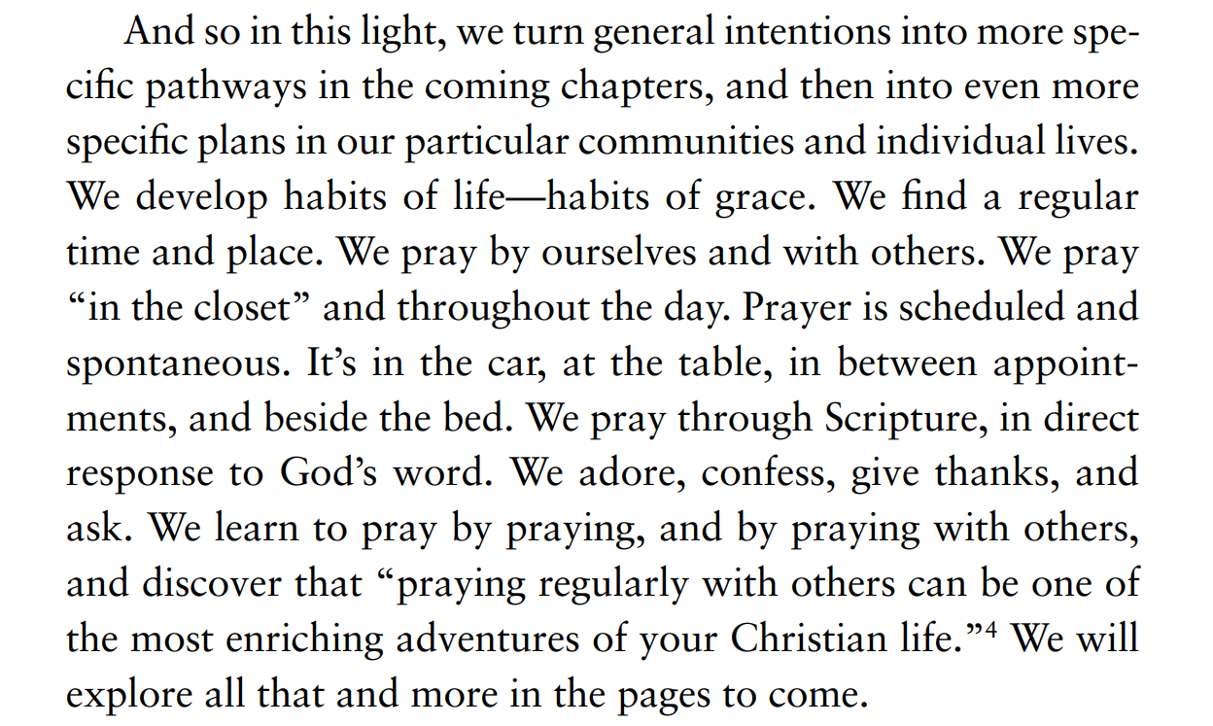
BIBLE AND THE GOSPEL:
Notes:
Page 97

Slide 70
Class Goals:
Know some key verses about the role of prayer in the life of the believer.
Explain the ongoing role of prayer in the life of the believer.
Notes:
I once heard a quote that, “In our church services, we should pray so much that non-believers get bored.” What do you think about that? Do we actually pray enough in church that a non-believer would be bored?
Prayer requires that we believe God exists
Prayer requires that we believe God cares
Prayer requires that we believe God acts and is capable
Prayer is an expression of dependence

Slide 71
What is prayer?

Slide 72
Faith and New Life: What is prayer?
Martin Luther: “As it is the business of tailors to make clothes and of cobblers to mend shoes, so it is the business of Christians to pray.”
“The plants of ceaseless prayer grow in the garden of persistent discipline.” (Piper, When I Don’t Desire God: How to Fight for Joy, 158)
“Until you are convinced that you can’t change your child’s heart, you will not take prayer seriously.” (Miller, A Praying Life, 167)
Notes:
Luther: a Christian endeavor
Piper: disciplined and spontaneous
Miller: dependence

Slide 73
Faith and New Life: What is prayer?
A non-believer asks you what prayer is. How would you define it?
A Muslim Imam asks you what prayer is. How would you define it?
Your child asks you what prayer is. How would you define it?

Slide 74
Faith and New Life: What is prayer?
Westminster Shorter Catechism Q.97: Prayer is an offering up of our desires unto God, for things agreeable to his will, in the name of Christ, with confession of our sins, and thankful acknowledgment of his mercies.
New City Catechism Q.38: Prayer is pouring out our hearts to God in praise, petition, confession of sin, and thanksgiving.
Mathis, Habits of Grace, 94: “Prayer, simply put, is talking to God. It is irreducibly relational. It’s personal— he is the Absolute Person, and we are derivative persons, fashioned in his image. In a sense, prayer is as basic as persons relating to each other, conversing, interacting, but with this significant caveat: in this relationship, we don’t chat as peers. He is Creator, and we are creatures. He is the great Lord, and we are his happy servants.”
C.S. Lewis (cited in Mathis): “Prayer in the sense of petition, asking for things, is a small part of it; confession and penitence are its threshold, adoration its sanctuary, the presence and vision and enjoyment of God its bread and wine.”
A brief theology of prayer by John Piper: https://www.youtube.com/watch?v=OssBHX5rSiE

Slide 75
Faith and New Life: What is prayer?
Prayer is about…
  Dependence (cf. Luke 18): “Your heart can become a prayer factory because…you are completely dependent.” (Miller, A Praying Life, 72)
  Being shaped by God
  Praising God
  Thanking God
  Confessing and Repenting
  Living the gospel: “Prayer mirrors the gospel. In the gospel, the Father takes us as we are because of Jesus and gives us his gift of salvation. In prayer, the Father receives us as we are because of Jesus and gives us his gift of help. We look at the inadequacy of our praying and give up, thinking something is wrong with us. God looks at the adequacy of his Son and delights in our sloppy, meandering prayers.” (Miller, A Praying Life, 55)

Slide 76
Christian prayer is Trinitarian prayer.

Slide 77
Faith and New Life: Christian prayer
The NT pattern of prayer is to the Father through the Son in the Spirit.
Briefly explained through Rom 8

Slide 78
Faith and New Life: Christian prayer
The NT pattern of prayer is to the Father through the Son in the Spirit.
15 For you did not receive the spirit of slavery to fall back into fear, but you have received the Spirit of adoption as sons, by whom we cry, “Abba! Father!” 16 The Spirit himself bears witness with our spirit that we are children of God, 17 and if children, then heirs—heirs of God and fellow heirs with Christ, provided we suffer with him in order that we may also be glorified with him. (Rom 8:15–17 ESV)

Slide 79
Faith and New Life: Christian prayer
The NT pattern of prayer is to the Father through the Son in the Spirit.
26 Likewise the Spirit helps us in our weakness. For we do not know what to pray for as we ought, but the Spirit himself intercedes for us with groanings too deep for words. 27 And he who searches hearts knows what is the mind of the Spirit, because the Spirit intercedes for the saints according to the will of God. (Rom 8:26–27 ESV; cf. the Son in 8:34)

Slide 80
Faith and New Life: Christian prayer
The NT pattern of prayer is to the Father through the Son in the Spirit.
32 He who did not spare his own Son but gave him up for us all, how will he not also with him graciously give us all things? 33 Who shall bring any charge against God’s elect? It is God who justifies. 34 Who is to condemn? Christ Jesus is the one who died—more than that, who was raised—who is at the right hand of God, who indeed is interceding for us…38 For I am sure that neither death nor life, nor angels nor rulers, nor things present nor things to come, nor powers, 39 nor height nor depth, nor anything else in all creation, will be able to separate us from the love of God in Christ Jesus our Lord. (Rom 8:32–39 ESV)

Slide 81
Why pray?

Slide 82
Faith and New Life: Reasons for prayer.
God COMMANDS it.
“‘Until now you have asked nothing in my name. Ask, and you will receive, that your joy may be full’” (John 16:24 ESV).
Continue steadfastly in prayer, being watchful in it with thanksgiving. 3 At the same time, pray also for us, that God may open to us a door for the word, to declare the mystery of Christ, on account of which I am in prison— 4 that I may make it clear, which is how I ought to speak. (Col 4:2–4 ESV)
16 Rejoice always, 17 pray without ceasing, 18 give thanks in all circumstances; for this is the will of God in Christ Jesus for you. 19 Do not quench the Spirit. (1 Thess 5:16–19 ESV)

Slide 83
Faith and New Life: Reasons for prayer.
Jesus MODELED it.
22 Immediately he made the disciples get into the boat and go before him to the other side, while he dismissed the crowds. 23 And after he had dismissed the crowds, he went up on the mountain by himself to pray. When evening came, he was there alone… (Matt 14:22–23 ESV)
15 But now even more the report about him went abroad, and great crowds gathered to hear him and to be healed of their infirmities. 16 But he would withdraw to desolate places and pray. (Luke 5:15–16 ESV)

Slide 84
Faith and New Life: Reasons for prayer.
God WANTS to be asked.
7 And he went and took the scroll from the right hand of him who was seated on the throne. 8 And when he had taken the scroll, the four living creatures and the twenty-four elders fell down before the Lamb, each holding a harp, and golden bowls full of incense, which are the prayers of the saints (Rev 5:7–8 ESV)
(narrative from the Magician’s Nephew)
  ‘I’m sure Aslan would have if you’d asked him,’ said Fledge.
  ‘Wouldn’t he know without being asked?’ said Polly.
  ‘I’ve no doubt he would,’ said the Horse, (still with his mouth full [of grass]). ‘But I’ve a sort of idea he likes to be asked.’”
  See: In Matthew 6:8, Jesus assured His disciples, “Your Father knows what you need before you ask Him.” And then Jesus proceeds to give them instructions about how to pray.

Slide 85
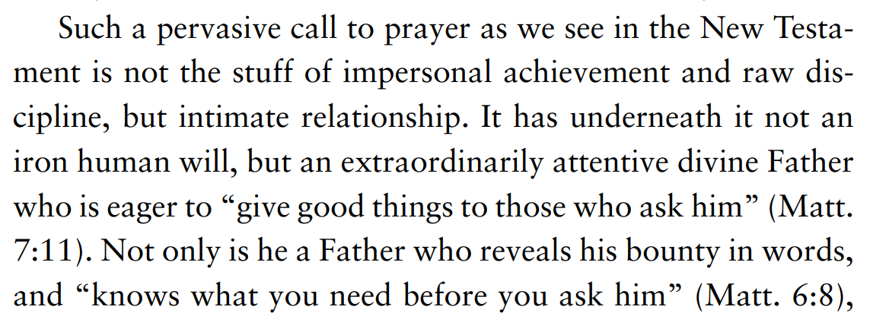
BIBLE AND THE GOSPEL:
Notes:
Page 96

Slide 86
Faith and New Life: Reasons for prayer.
It FORMS you.
“‘Until now you have asked nothing in my name. Ask, and you will receive, that your joy may be full’” (John 16:24 ESV).
2 Continue steadfastly in prayer, being watchful in it with thanksgiving. 3 At the same time, pray also for us, that God may open to us a door for the word, to declare the mystery of Christ, on account of which I am in prison— 4 that I may make it clear, which is how I ought to speak. (Col 4:2-4 ESV)
14 And this is the confidence that we have toward him, that if we ask anything according to his will he hears us. 15 And if we know that he hears us in whatever we ask, we know that we have the requests that we have asked of him. (1 John 5:14–15 ESV)
Notes:
JOY
Seeing God answer
Shaping us toward his will

Slide 87
Faith and New Life: Reasons for prayer.
God RESPONDS to it.
7 “Ask, and it will be given to you; seek, and you will find; knock, and it will be opened to you. 8 For everyone who asks receives, and the one who seeks finds, and to the one who knocks it will be opened. 9 Or which one of you, if his son asks him for bread, will give him a stone? 10 Or if he asks for a fish, will give him a serpent? 11 If you then, who are evil, know how to give good gifts to your children, how much more will your Father who is in heaven give good things to those who ask him! (Matt 7:7–11 ESV)
Notes:
It is a mystery how God responds, but we know that he does

Slide 88
Faith and New Life: Reasons for prayer.
18 And he told them a parable to the effect that they ought always to pray and not lose heart. 2 He said, “In a certain city there was a judge who neither feared God nor respected man. 3 And there was a widow in that city who kept coming to him and saying, ‘Give me justice against my adversary.’ 4 For a while he refused, but afterward he said to himself, ‘Though I neither fear God nor respect man, 5 yet because this widow keeps bothering me, I will give her justice, so that she will not beat me down by her continual coming.’ ” 6 And the Lord said, “Hear what the unrighteous judge says. 7 And will not God give justice to his elect, who cry to him day and night? Will he delay long over them? 8 I tell you, he will give justice to them speedily. Nevertheless, when the Son of Man comes, will he find faith on earth?” Luke 18:1–8 ESV
Notes:
Don’t give up
Keep praying
God has a purpose in persistence (even if I don’t understand)
God is good
He desires relationship

Slide 89
Why be taught how to pray?

Slide 90
Faith and New Life: Should Christians be taught HOW to pray?
Objection: …just talk to God.
  Response: Teaching on prayer is analogous to the clarity (perspicuity) of Scripture, in that we still train exegetical skills.
Objection: …just talk like your talking to a friend.
  Response: God is not just my friend.
Objection: …just talk like you’re talking to your dad.
  Response: Parents spend A LOT of time teaching their children how to interact with them.
“Now Jesus was praying in a certain place, and when he finished, one of his disciples said to him, ‘Lord, teach us to pray, as John taught his disciples.’ And he said to them, ‘When you pray, say…’” (Luke 11:1-2 ESV)
Notes:
Consider this exchange between Jesus and his disciples: “Now Jesus was praying in a certain place, and when he finished, one of his disciples said to him, ‘Lord, teach us to pray, as John taught his disciples.’ And he said to them, ‘When you pray, say…’” (Luke 11:1-2 ESV). What we learn from this is that John taught his disciples to pray in a certain ways. Jesus modelled appropriate prayer to God, and witnessing Jesus’ prayers, caused the disciples to ask for his instruction in prayer. And then Jesus proceeds to teach them to pray.

Slide 91
Faith and New Life: Should Christians be taught HOW to pray?
1) Teaching how to pray is biblical.
2) Teaching how to pray the Bible shapes our hearts.
3) Teaching how to pray is practical.
Notes:
1) Teaching Prayer is Biblical: Both John the Baptist and Jesus taught their disciples to pray. There are numerous examples in the Old Testament of believers praying to God, and these prayers are recorded for our instruction. Moreover, Paul often includes the content of his prayers in the beginning of his epistles in order to teach us how to pray.
2) Teaching to Pray the Bible Shapes Our Hearts: If we use Scripture in in our prayers, by praying back to God the prayers he has given to us, it will shape our prayers and hearts to be the things that God desires. There is often a great contrast between the things for which we pray and the things for which the biblical authors pray. Often we pray predominantly for physical provision while neglecting others’ spiritual growth; in contrast, Paul is constantly praying for Christians’ spiritual growth while rarely mentioning physical needs. We are in desperate need for Scripture to shape our thoughts and hearts, including our prayers.
3) Teaching Prayer is Practical: When we assume Christians will naturally intuit the spiritual disciplines, we set them up for frustration. Just like we teach Christians how to study their Bibles, care for one another, and share the gospel, we should teach them how to pray. Another practical aspect of praying Scripture is that it engages more senses which in turn keeps our attention.

Slide 92
Faith and New Life: Should Christians be taught HOW to pray?
1) Teaching how to pray is biblical.
2) Teaching how to pray the Bible shapes our hearts.
3) Teaching how to pray is practical.
4) Teaching how to pray is preparatory.
5) Teaching how to pray reinforces the church.
Notes:
4) Teaching Prayer is Preparatory: Sometimes people assume that giving structure to something destroys the authenticity of the action. For example, genuine prayers in situations of desperation rarely follow a structured pattern; they are desperate pleas to God. But relating rightly to God in desperation is dependent on relating rightly to God in the calm (i.e., you don’t need to be taught how to cry “God help me” but you do need to be taught about who this God is and what he has promised). Another way of saying this is that it is better to teach someone how to repair a roof when the sun is shining than when it is raining. The more we engrain proper theology into our regular prayers, the more we are prepared to respond properly to God in desperate situations. Integrating Scripture into our prayers can be a helpful way of reinforcing a theology and proper response to God.
5) Teaching Prayer Reinforces the Church: The prayers recorded in the Bible are prayers to be shared with the church. Teaching prayer in your community group reinforces a church-centered vision of the Christian life as you teach Christians how to interact with one another as they pursue God in community.

Slide 93
How to pray the Bible?

Slide 94
Faith and New Life: How to Pray the Bible…some reasons.
Have you ever experienced “mental drift” while praying? Have your prayers ever become stagnant and repetitive? Or have you ever wondered if you were praying for the kinds of things that God would want you to request? One of the best ways to combat all these frustrating tendencies in prayer is to pray Scripture back to God.
Donald Whitney describes the act of praying Scripture: “So basically what you are doing is taking words that originated in the heart and mind of God and circulating them through your heart and mind back to God. By this means his words become the wings of your prayers” (Whitney, Praying the Bible, 32).
Do you pray like an unbeliever? Praying the Bible shapes our prayers and desires.
Notes:
(N.B. this is not devoid of interpretation)

Slide 95
Faith and New Life: How to Pray the Bible…some reasons.
Why should we pray the Bible?
engages the whole person
enables you to hear God: conversation
combats repetition
focuses us on God
corrects incorrect thinking
provides structure
gives us a clearer vision of God as he has revealed himself
“And without the Scripture to shape our prayers, we are far more likely to pray in unbiblical ways than if we pray the thoughts that occurs to us as we read the Scripture” (Whitney, Praying the Bible, 37)

Slide 96

Faith and New Life: How to Pray the Bible…some reasons.
“Because prayer is a conversation we didn’t start, but https://www.youtube.com/watch?v=9LS3YkUXRc0
An explanation by Don Whitney: https://www.youtube.com/watch?v=2IJdCQAPiGk
An explanation by John Piper: https://www.youtube.com/watch?v=QvZmB81sZp4
How to improve your prayer life: https://www.youtube.com/watch?v=pXXAQW_5vGs

Slide 97
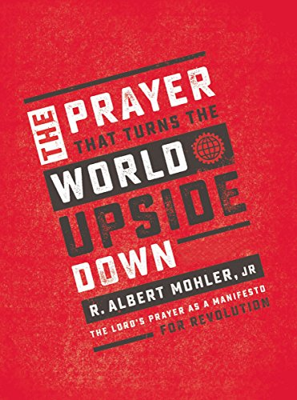
Faith and New Life: How to Pray the Bible…some approaches.
Some ways to pray the Bible
  Psalm of the Day
  Prayers of Paul
  The Lord’s Prayer
  ACTS Model of Prayer
  N.B. Praying the Bible should also be accompanied by proper interpretation.
Notes:
Psalms: models for daily devotion (also could be paired with Proverb of the day)
Paul’s prayers: shapes our thinking
Lord’s Prayer: modeling ourselves after Jesus’s instruction
ACTS: prayer/worship is in response to God’s self-revelation
Concentric Circles: a way to model and teach intercession; it’s memorable and reproducible

Slide 98
How to pray the Bible?
…Psalms

Slide 99
Faith and New Life: How to Pray the Bible…the Psalms.
It has been said that God inspired a Psalm for every sigh of the soul.
Step 1: Take about 30 seconds to scan quickly the psalm that corresponds to that date (e.g., on October 5th, read Psalm 5). Add 30, and read that psalm (e.g., Psalm 35), and repeat that until there are no more psalms (65, 95, 125)
Step 2: Choose a psalm that resonates with your soul on that day. Some have said that there is a psalm for every sigh and sounding of the soul.
Step 3: Meditate on that psalm by reading verses and then praying your heart’s response. Whitney explains this approach, “To pray the Bible, you simply so through the passage line by line, talking to God.”
“God gave the Psalms to us so that we would give the Psalms back to God. No other book of the Bible was inspired for that expressed purpose” (Whitney, Praying the Bible, 46).
Notes:
The same thing can be done with the Proverbs (e.g., Brian Hanson’s experience at the Statehouse).
-helps us process our emotions rightly through God’s word.

Slide 100
How to pray the Bible?
…Paul’s prayers

Slide 101
Faith and New Life: How to Pray the Bible…Paul’s Prayers.
For what kinds of things would you want your pastor to pray for you?

Slide 102
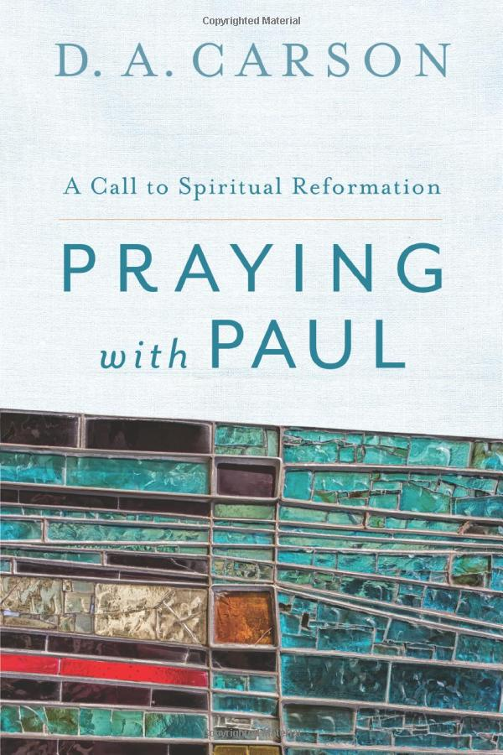
Faith and New Life: How to Pray the Bible…Paul’s Prayers.

Slide 103
Faith and New Life: How to Pray the Bible…Paul’s Prayers.
Many portions of Scripture can be incorporated into our prayers, and Paul’s epistles contain some prayers that are especially applicable to us. When Paul writes letters to the churches, he often begins by thanking God for his work in the church and then praying for specific things in the church. He models prayer and records those prayers for us, so that we can learn from them and mimic them. Here are some of his prayers: Ephesians 1:15-23; 3:14-21; Philippians 1:9-11; Colossians 1:9-14; 1 Thessalonians 3:9-13; 2 Thessalonians 1:3-12.
A Few Observations About Paul’s Prayers:
  Paul often thanks God for the same things he requests from God. That is, he begs God to keep producing spiritual fruit in their lives.
  Paul’s prayers focus on the spiritual maturing and enrichment of God’s people. He gives thanks for God’s spiritual provision and requests that it continue.
  Paul’s prayers focus on the advancement of the gospel.
  Paul reports to the people that he prays for them. This encourages them, and helps them to aspire to embody Paul’s prayers.
  Paul is attentive to the ways that God is working. If we are to pray like Paul, we have to be looking for God’s activity.
Notes:
-If you have time, pray Colossians 1 for the students

Slide 104
Faith and New Life: How to Pray the Bible…Paul’s Prayers.
For whom could I pray the prayers of Paul?
Myself: Paul prays for things that I want to be true in my life.
Family: Praying these prayers helps us to step back and pray for spiritual maturity in our loved ones.
Community Group Members: Our Christian community groups ought to be focused on growing in Christ together. Only God can produce spiritual fruit, so we ask him for it.
New Church Members: When someone new joins the church, you might not know the specific requests of their lives. You can still pray Paul’s prayers for them. You don’t have to know them well to ask God that (for example) they would grow in love, knowledge, and faith.

Slide 105
3 We always thank God, the Father of our Lord Jesus Christ, when we pray for you, 4 since we heard of your faith in Christ Jesus and of the love that you have for all the saints, 5 because of the hope laid up for you in heaven. Of this you have heard before in the word of the truth, the gospel, 6 which has come to you, as indeed in the whole world it is bearing fruit and increasing—as it also does among you, since the day you heard it and understood the grace of God in truth, 7 just as you learned it from Epaphras our beloved fellow servant. He is a faithful minister of Christ on your behalf 8 and has made known to us your love in the Spirit.
9 And so, from the day we heard, we have not ceased to pray for you, asking that you may be filled with the knowledge of his will in all spiritual wisdom and understanding, 10 so as to walk in a manner worthy of the Lord, fully pleasing to him: bearing fruit in every good work and increasing in the knowledge of God; 11 being strengthened with all power, according to his glorious might, for all endurance and patience with joy; 12 giving thanks to the Father, who has qualified you to share in the inheritance of the saints in light. 13 He has delivered us from the domain of darkness and transferred us to the kingdom of his beloved Son, 14 in whom we have redemption, the forgiveness of sins. (Col 1:3–14 ESV)

Slide 106
How to pray?
…ACTS

Slide 107
Faith and New Life: How to Pray the Bible…ACTS model of prayer.
The “ACTS Prayer” is a model of prayer that helps us to pray prayers beyond “God give me.” Before we ever ask for God’s provision, the ACTS prayer leads us to see God for who he is, us for who we are, and God’s work for us. It is an easily-remembered acronym for Adoration, Confession, Thanksgiving, and Supplication. Incorporating Scripture into the prayer guides us to see God and the world rightly. (See Mathis, Habits of Grace, 104)

Slide 108
Faith and New Life: How to Pray the Bible…ACTS model of prayer.
ADORATION: Psalms 8, 63:1-8, 100, 113, 117, 135:1-7 (see also, Psalms 29, 34:1-3, 46, 50:1-6, 66, 77:11-20, 84, 90:1-4, 93, 95:1-7, 96, 145, 146, 147, 148, 149, 150)
  Prayer Starts: “God you are so…” or “I praise you because you are…
  Engage your mind, heart, and imagination with the awesomeness of God
  Recount who he is, his attributes, and his actions
  Rejoice in the things that make God unique, and God alone
CONFESSION: Psalms 24:3-6, 32:1-5, 38, 51, 103:6-14, 130.
  Prayer Starts: “God please forgive me because…”
  Pray these prayers silently
  Ask God to show you your heart
  Cling to the assurances God has given
  “Confession is a verbal way of spiritually recovering our authenticity in Christ.” (Dodson, Gospel Centered Discipleship, 68)
Notes:
Prayer is more than just asking
Prayer is in response to God’s self-revelation
WE need God’s word to shape our prayers.

Slide 109
Faith and New Life: How to Pray the Bible…ACTS model of prayer.
THANKSGIVING: Psalms 9:1-2, 92:1-4, 103:1-5, 118:28-29; 136:1-3.
  Prayer Starts: “Thank you, God, for…”
  Thank God for his provision in salvation
  Thank God for his provision in our daily lives (i.e., daily bread)
  Thank God for the work you see him accomplishing in others’ lives
SUPPLICATION: Psalms 20:6-8, 33:16-22, 61:1-3, 62:5-8, 121 (See also Psalms 3, 17:6-9, 18:1-6, 23, 25, 31:1-5, 44:23-26, 67, 127, 141)
  Prayer Starts: “God please help…”
  Pray for God’s provision, both physically and spiritually
  Pray for both yourself and others
  Think about the things for which Paul prays (e.g., increase in love, knowledge of God, unity, etc.)
Notes:
Lessons from the ACTS prayer:
-Prayer is more than just asking
-Prayer is in response to God’s self-revelation
-Singing is prayer
-WE need God’s word to shape our prayers.

Slide 110
Faith and New Life: How to Pray the Bible…ACTS model of prayer.
Leading Your Community Group:
The ACTS prayer can be prayed personally, in family devotions, or in a corporate setting.
Personally: There might be particular attributes of God on which you want to focus for a period of time.
Family Devotions: This is a very effective model of prayer to teach children the breadth of expressions in prayer. Then, sometimes you could spend an extended time in one of the areas. For example, you might spend an extended time giving thanks to God.
Corporate Setting: In a larger group, I typically divide the group into smaller groups. I open the prayer and read a psalm about Adoration. The triads spend the time praising God for who he is, and then I will read a psalm of confession. Typically, I ask the participants to pray silently about their prayers of confession. After a few minutes, I proceed to reading a psalm of Thanksgiving with the triads responding, and the same with Supplication.
Incorporating Music: In my small group (13 people) and my ABF (150+), we have a pattern of incorporating music into the ACTS prayer. I read a psalm of Adoration and then allow them time to pray prayers of adoration. Then we sing a song praising God, and then we move through the rest of the letters. This teaches your people that prayer and music (i.e. forms of worship) are responses to God’s self-revelation in Scripture.
Notes:
Prayer is more than just asking
Prayer is in response to God’s self-revelation
WE need God’s word to shape our prayers.

Slide 111
How to pray?
…Concentric Circles

Slide 112
BIBLE AND THE GOSPEL:
Five Counsels for Praying with Company
Make it regular
Start with Scripture
Limit share time
Encourage brevity and focus
Pray without show, but with others in mind
Notes:
Page 110-112

Slide 113
A Model of Supplication…
A Model We Use in Small Groups
A Model We Use as Elders
OTHER
Evangelism and salvation
FAMILY
Intercession for Members
KIDS
Unity, Faithfulness,
Vision, Direction
SPOUSE
Elders Themselves
SELF
Praise and Thanks
Notes:
-memorable
-adaptable
-keeps everyone on the same page
-provides structure
-allows others to model prayer

Slide 114
How to pray?
…Repentance

Slide 115
Faith and New Life: Prayers of Repentance.
So, prayer— having God’s ear— is ultimately about having more of God. And having God’s ear (like hearing his voice) is not first and foremost about our particular practices and postures— the specific habits we develop— but the principle of continually relating to him, privately and with others. He is holy, and so we worship (adoration). He is merciful, and so we repent (confession). He is gracious, and so we express appreciation (thanksgiving). He is loving and caring, and so we petition him for ourselves, our family, our friends, and our world (supplication).(Mathis, Habits of Grace, 60).
Notes:
-Let’s focus on one aspect of prayer that is often overlooked.
-It’s essential for us because it is a gospel informed way of praying: repentance involves the recognition of God’s holiness, our unholiness, and the work of Christ.
-It is a way to live out gospel-dependence of repentance and reliance.
-And it is often misunderstood and misconstrued.

Slide 116
Faith and New Life: Prayers of Repentance.
    In the book of Matthew, we see Jesus encouraging the habit of repentance:
  John the Baptist (3:2) and Jesus (4:17) both preached the necessity of repentance to enter the kingdom
  Repentance is the response for those who put down their self-righteousness (5:20, 48) and admit to being a sinner (9:12-13).
    Another biblical text
  2 Cor 7:9-11; The truth of God produces sorrow & then repentance in those who belong to Him.
Notes:
2 equally bad approaches to sin in our lives:
(1) Minimization/Trivialization of sin so it seems insignificant → minimizes the cross
(2) Maximization of sin so that it is insurmountable → minimizes the cross
→Both of the these approaches avoid real biblical repentance.
In repentance, we see the horror of sin for what it truly is, and we run to an all-sufficient Savior.
Glance at sin and gaze at the cross.

Slide 117

Faith and New Life: Prayers of Repentance.
What is repentance?
What might be some signs of insincere repentance?
  Refusal to abandon sin.
  Refusal to protect guard against future sin, even to one’s inconvenience.
  Partial abandoning of sin while harboring others.
  Elusive descriptions of sin.
  Refusing to make restitution if possible
  Talking about sin in the passive voice (e.g., when the affair happened).
  Attempts to mitigate the personal consequences of sin.
  Focusing on personal loss/pain and not the effects on others.
  Making the “best” of one’s sins.
  Not acknowledging that it is against God.
  Refusal to take full responsibility.
  “Repentance” expressed only after one is “caught.”
  Motivated exclusively by fear (especially of consequences).
  Refusing to receive the discipline of the Lord.
  Exclusively emotional response or exclusively an intellectual response.
Notes:
Signs of insincere repentance:
Reason that we discern false repentance:
-OUR OWN hearts
-church leadership (if we really want to help someone, we have to be discerning with them)
-discipleship
-parenting

Slide 118
Faith and New Life: Prayers of Repentance.
Spurgeon: Repentance is a discovery of the evil of sin, a mourning that we have committed it, a resolution to forsake it. It is, in fact, a change of mind of a very deep and practical character, which makes the man love what once he hated, and hate what once he loved.
Packer: Repentance means turning from as much as you know of your sin to give as much as you know of yourself to as much as you know of your God, and as our knowledge grows at these three points so our practice of repentance has to be enlarged.
Piper: Repenting means experiencing a change of mind that now sees God as true and beautiful and worthy of all our praise and all our obedience.
MacArthur: But because true repentance involves a change of heart and purpose, it inevitably results in a change of behavior. Like faith, repentance has intellectual, emotional, and volitional ramifications.

Slide 119
Faith and New Life: Prayers of Repentance.
Rogers Family Catechism: Repentance is turning from sin and turning to God. In repentance, we see the horror of sin for what it truly is, and we run to and rely on an all-sufficient Savior. We glance at sin and gaze at the cross.
Sproul: “Genuine repentance is something that is worked in us by the Holy Spirit. It is a gracious activity by God. We have seen that conversion and repentance are inseparably linked. If we look carefully at the New Testament concept of faith, which is the supreme requirement for redemption, we learn that godly repentance is an integral part of faith. If a person has faith but not repentance, that person does not have authentic faith. That person does not possess the necessary ingredients for redemption; conversion is a result of faith and repentance.”

Slide 120
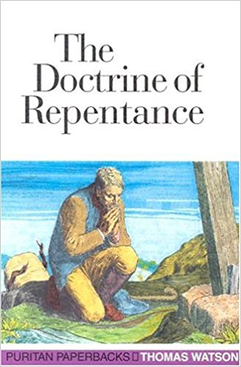
Faith and New Life: Prayers of Repentance.
Sight of sin
Sorrow for sin
Confession of sin
Shame for sin
Hatred of sin
Turning from sin

Slide 121
Faith and New Life: Prayers of Repentance.
Sight of sin – spiritual realization/awakening
  Prodigal: “But when he came to himself” (Luke 15:17).
  Nathan…David: “You are the man…I have sinned against the Lord” (2 Sam 12:7…13).
Sorrow for sin – a holy agony
  David: “I confess my iniquity; I am sorry for my sin” (Psalm 38:18).
  Sinful Woman: …weeping, she began to wet his feet with her tears and wiped them with the hair of her head and kissed his feet and anointed them with the ointment (Luke 7:38).
  David: The sacrifices of God are a broken spirit; a broken and contrite heart, O God, you will not despise (Ps 51:17).
Confession of sin – the verbal overflow of sorrow
  And the Israelites[a] separated themselves from all foreigners and stood and confessed their sins and the iniquities of their fathers (Neh 9:2).
  Therefore, confess your sins to one another and pray for one another, that you may be healed (James 5:16).

Slide 122
Faith and New Life: Prayers of Repentance.
Shame for sin – “When the heart has been made black with sin, grace makes the face red with blushing” (Watson, Doctrine of Repentance, 39).
  God: describe to the house of Israel the temple, that they may be ashamed of their iniquities (Ezekiel 43:10).
  O my God, I am ashamed and blush to lift my face to you, my God, for our iniquities have risen higher than our heads, and our guilt has mounted up to the heavens (Ezra 9:6).
Hatred for sin – seeing with God’s eyes
  Then you will remember your evil ways, and your deeds that were not good, and you will loathe yourselves for your iniquities and your abominations (Ezekiel 36:31).
  Through your precepts I get understanding; therefore I hate every false way (Ps 119:104).
Turning from sin – “True repentance, like nitric acid, eats asunder the iron chain of sin” (Watson, Doctrine of Repentance, 52).
  “Repent and turn away from your idols, and turn away your faces from all your abominations” (Ezekiel 14:6).
  let the wicked forsake his way, and the unrighteous man his thoughts; let him return to the Lord, that he may have compassion on him, and to our God, for he will abundantly pardon (Isaiah 55:7).

Slide 123
Faith and New Life: Prayers of Repentance.
Repentance is turning from sin and turning to God. In repentance, we see the horror of sin for what it truly is, and we run to and rely on an all-sufficient Savior. We glance at sin and gaze at the cross.
Repentance is a gospel-shaped way of relating to God.
 | GOSPEL | DISCIPLINE OF REPENTANCE
God | God is the holy Creator to whom we are accountable. | We acknowledge that we are accountable to our Creator and Redeemer.
Man | Man rebels against God | Sight and confession of our rebellion.
God | God in Christ redeems man | Reliance on and trust in the work of Christ on our behalf.
(Man) | Man must respond in faith | Being assured of and rejoicing in the work of Christ.

Slide 124
5 This is the message we have heard from him and proclaim to you, that God is light, and in him is no darkness at all. 6 If we say we have fellowship with him while we walk in darkness, we lie and do not practice the truth. 7 But if we walk in the light, as he is in the light, we have fellowship with one another, and the blood of Jesus his Son cleanses us from all sin. 8 If we say we have no sin, we deceive ourselves, and the truth is not in us. 9 If we confess our sins, he is faithful and just to forgive us our sins and to cleanse us from all unrighteousness. 10 If we say we have not sinned, we make him a liar, and his word is not in us.
2 My little children, I am writing these things to you so that you may not sin. But if anyone does sin, we have an advocate with the Father, Jesus Christ the righteous. 2 He is the propitiation for our sins, and not for ours only but also for the sins of the whole world. 3 And by this we know that we have come to know him, if we keep his commandments. 4 Whoever says “I know him” but does not keep his commandments is a liar, and the truth is not in him, 5 but whoever keeps his word, in him truly the love of God is perfected. By this we may know that we are in him: 6 whoever says he abides in him ought to walk in the same way in which he walked. (1 John 1:5–2:6 ESV)

Slide 125
How to pray?
…with Fasting

Slide 126
Faith and New Life: Praying and Fasting.
What is fasting?
What is the purpose of fasting? OR why should we fast?
Notes:
Fasting is the voluntary abstinence from a good thing for the purpose of spiritual devotion. Normally fasting is associated with the voluntary abstinence from food. For example, “And after fasting forty days and forty nights, he [i.e. Jesus] was hungry” (Matthew 4:2 ESV). His hunger suggests that he abstained from food, and The Gospel of Luke clarifies, “And he ate nothing during those days. And when they were ended, he was hungry” (Luke 4:2 ESV). While the normal pattern of fasting involves the voluntary withholding of food, sometimes it might also involve liquids (e.g., Daniel 1:8). The Bible also describes that Christians might voluntarily abstain from other good things (e.g., sex; 1 Corinthians 7:5) for spiritual purposes, and it would be appropriate to call this a fast.

Slide 127
Faith and New Life: Praying and Fasting.
Well-fed Christians tend to lose sight of their utter dependence on God. They tend not to express a holy discontentment with the world and homesickness for heaven. In our fight to savor Jesus, practice urgency in prayer, and seek God’s will, God graciously gives us the spiritual discipline of physical fasting to focus our prayers. To many Christians, the practice of fasting is something uncommon or extraordinary, but the Bible presents it as a normal devotional practice. Fasting was practiced by believers in the Old Testament, Jesus himself, the disciples, and the early church. Moreover, fasting has been a consistent spiritual discipline throughout the history of the church. Jesus said to his disciples, “‘And when you fast…’” (Matthew 6:16). Jesus gives instruction about fasting with the assumption that his disciples will fast. And impetus toward fasting is heightened after his ascension into heaven: “And Jesus said to them, ‘Can the wedding guests mourn as long as the bridegroom is with them? The days will come when the bridegroom is taken away from them, and then they will fast’ (Matthew 9:15 ESV).

Slide 128
Faith and New Life: Praying and Fasting.
What is fasting?
Fasting is the voluntary abstinence from a good thing for the purpose of spiritual devotion.
“Christian fasting is a believer’s voluntary abstinence from food for spiritual purposes.” (Whitney, Spiritual Disciplines for the Christian Life, 192)
“Fasting is calculated to bring a note of urgency and importunity into our praying, and to give force to our pleading in the court of heaven. The man who prays with fasting is giving heaven notice that he is truly in earnest….Not only so, but he is expressing his earnestness in a divinely-appointed way. He is using a means that God has chosen to make his voice be heard on high.” (Arthur Wallis cited in Whitney, Spiritual Disciplines for the Christian Life, 201)
“…the point of fasting is to express longing for Christ and all that God is for us in him. Fasting is the hungry handmaiden of prayer.” (Piper, When I Don’t Desire God: How to Fight for Joy, 171)

Slide 129
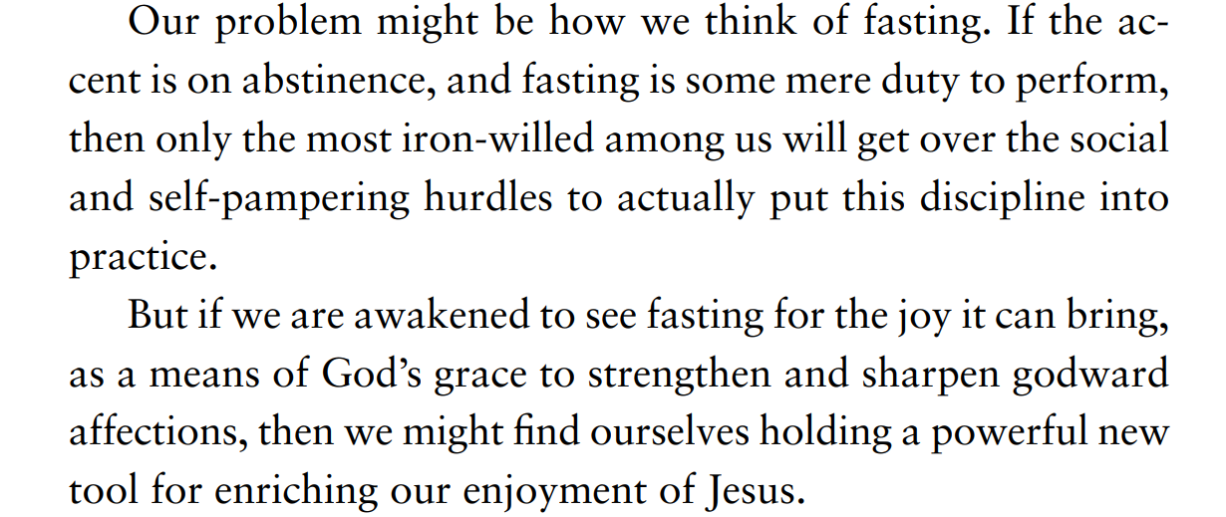
BIBLE AND THE GOSPEL: Praying and Fasting
Notes:
Page 116

Slide 130

BIBLE AND THE GOSPEL: Praying and Fasting
Food is an incredibly important concept in the Bible:
Creation
Fall
Cain and Abel
Patriarchs
Exodus/Law
Promised Land and Kings
Exile
JESUS
Church
Consummation
The incompleteness of food points us to an all-satisfying God: “Oh, taste and see that the Lord is good! Blessed is the man who takes refuge in him!” (Ps 34:8) and “‘Do not work for the food that perishes, but for the food that endures to eternal life, which the Son of Man will give to you.’” (John 6:27).
Notes:
Page 55

Slide 131
Faith and New Life: Praying and Fasting.
The necessity of food teaches us to depend on God.
  Fasting (voluntarily forgoing food) acknowledge that it is God who provides.
Food is not to have dominion over us.
  Fasting is spiritual practice of self-discipline with food.
Food brings us into fellowship.
  Fasting as a community deepens our fellowship in prayer.
The unsatisfying nature of food points us to Jesus.
  Fasting expresses our commitment to something sweeter and more satisfying than food—life with God.

Slide 132
Faith and New Life: Praying and Fasting.
How do we fast?
There are a few different expressions of fasting in Scripture:
Normal fast: not eating food but drinking water. This is the pattern we observed with Jesus in the wilderness, and it is the assumed activity unless otherwise stated.
Partial fast: not eating a particular food or quantity of food, but drinking water. Whereas, a normal fast is for a particular period of time, the partial fast may extend indefinitely. Daniel and his friends, for example, chose a diet consisting exclusively of vegetables and water (Daniel 1:12), and John the Baptist chose a diet of locusts and wild honey (Matthew 3:4). Moreover the Nazirite vow involves a partial fast (Number 6:1-21).
Absolute fast: neither eating nor drinking. This type of fasting is rare in Scripture and occurs in times of extreme urgency (e.g., Ezra 10:6; Esther 4:16; Acts 9:9).
Supernatural fast: neither eating nor drinking for an extended period of time. It seems that there are only two instances of this, by Moses and Elijah (Deuteronomy 9:9; 1 Kings 19:8). There is no indication that the supernatural fast is a model that we are encouraged to pursue.
For more, see Donald S. Whitney, Spiritual Disciplines for the Christian Life (Colorado Springs: NavPress, 2014), 193-195.

Slide 133
Faith and New Life: Praying and Fasting.
Why do people fast?
for seeking direction.
for repentance.
for dedication to God.
for divine protection.
for the regular pursuit of God.
Notes:
for seeking direction: When the church at Antioch was trying to discern if and whom they should commission for ministry, they devoted themselves to God in fasting and prayer: “While they were worshiping the Lord and fasting, the Holy Spirit said, ‘Set apart for me Barnabas and Saul for the work to which I have called them.’ Then after fasting and praying they laid their hands on them and sent them off” (Acts 13:2-3 ESV). This pattern of prayer and fasting continues in the early church and even includes praying for newly installed pastors: “And when they had appointed elders for them in every church, with prayer and fasting they committed them to the Lord in whom they had believed” (Acts 14:23 ESV).
for repentance: Fasting can be a physical way of expressing repentance of sin. It is a way to express the grief over sin and earnestness is following God. God commands his wayward people to return to him with their whole hearts, expressed by prayerful fasting: “‘Yet even now,’ declares the LORD, ‘return to me with all your heart, with fasting, with weeping, and with mourning; and rend your hearts and not your garments’” (Joel 2:12-13 ESV).
for dedication to God: It is somewhat unclear why Jesus would be baptized and then fast for 40 days. Just like his baptism established a pattern for us to follow, the practice of fasting is a practice for us to follow (even while we recognize there will be some differences between what we practice and what Jesus did). At the very least, his fast was an expression of his dedication to God. It seems that this was a time that Jesus set aside for private communion with the Father prior to his public ministry. Additionally the Nazirite vow was taken to dedicate one’s life to God.

Slide 134
Faith and New Life: Praying and Fasting.
Why do people fast?
for seeking direction.
for repentance.
for dedication to God.
for divine protection.
for the regular pursuit of God.
Notes:
for divine protection: When the Jews returned to the land, they placed their faith in God’s protection and requested, through fasting and prayer, that God bring them safely into the land: “Then I proclaimed a fast there, at the river Ahava, that we might humble ourselves before our God, to seek from him a safe journey for ourselves, our children, and all our goods. For I was ashamed to ask the king for a band of soldiers and horsemen to protect us against the enemy on our way, since we had told the king, ‘The hand of our God is for good on all who seek him, and the power of his wrath is against all who forsake him.’ So we fasted and implored our God for this, and he listened to our entreaty” (Ezra 8:21-23 ESV). Fasting for protection is a physical practice signifying our utter dependence on God. It focuses our prayers on his provision.
for the regular pursuit of God: Our hearts can be deceived to cherish God’s good gifts above God himself. We can become complacent and comfortable, and no longer live as if heaven is our home. Paul describes how a person like this approaches food: “Their end is destruction, their god is their belly, and they glory in their shame, with minds set on earthly things. But our citizenship is in heaven, and from it we await a Savior, the Lord Jesus Christ, who will transform our lowly body to be like his glorious body, by the power that enables him even to subject all things to himself” (Philippians 3:19-21 ESV). How do we fight against a tendency toward love of the world? One of God’s graces to us comes through the spiritual discipline of fasting. Fasting is not about asceticism; it’s a discipline or tool for enjoying Jesus. Jesus describes fasting as an expression of our longing to be with him in heaven: “And Jesus said to them, ‘Can the wedding guests mourn as long as the bridegroom is with them? The days will come when the bridegroom is taken away from them, and then they will fast’” (Matthew 9:15 ESV). Fasting is a physical expression of our longing for perfect union with Jesus—it’s a godly discontentment about our separation from our Savior. Here’s how John Piper describes it: “…when I say that the root of Christian fasting is the hunger of homesickness for God, I mean that we will do anything and go without anything if, by any means, we might protect ourselves from the deadening effects of innocent delights and preserve the sweet longings of our homesickness for God" (Piper, A Hunger for God, 18-19). Fasting is the practice of focusing our hearts on Jesus and asking him to remove desires for our that is unholy or trivial.

Slide 135
Faith and New Life: Praying and Fasting.
Fasting is
  An OT pattern and practice
  A NT pattern and practice
  Commanded by Jesus
Have you ever known someone in your life to fast? Share one experience you’ve had with fasting?
Why don’t Christians practice fasting?
Notes:
Why don’t we fast? Why do you think we are generally unmotivated to fast?
Since Jesus himself expects that his disciples will fast especially when we’re apart from his physical presence with us, we have to question why we don’t fast. There might be some who are simply comfortable with disobedience to our Lord, but for most Christians underlying their non-practice of fasting is a lack of understanding and motivation. Certainly we don’t naturally like hunger pangs and we don’t desire to do without a good thing, such as food. One reason Christians don’t fast is that fasting is not commonly taught in American churches. Moreover, American Christians feel that they are inordinately busy, and therefore they are unable to abstain from food because performance might suffer (on this topic, see Daniel 1:8-21). We also tend to divide the spiritual from the physical, not understanding how a physical practice could have a spiritual effect. In contrast, biblical authors assume that physical practices have a tremendous impact on our spiritual lives—they had a theology of the human being where the spiritual and physical were inextricably connected. For example, the biblical authors believed that a physical sin, such as gluttony, had a strong impact on one’s relationship with God. Correspondingly, voluntarily abstaining from a physical good could have a positive impact on one’s relationship with God. Perhaps a deeper issue lies at the heart of our non-practice…perhaps we don’t have the urgency and desperation in prayer that would lead us to cry out to God in a way that expresses our longing for God to act even more than we long for the basic necessities of our lives. If you want a dependent heart that prays with earnestness, urgency, and confidence, start practicing fasting! Fasting can be both a thermometer and a thermostat of our prayer lives.

Slide 136
Faith and New Life:
CHURCH
Mathis points us to the need for fellowship. This fellowship should be grounded in commitment (to God and one another) and focused on the local church.

Slide 137
What is the church?

Slide 138
Class Goals:
Articulate a biblical understanding of the church.
Explain what is the mission of the church.
Know some key texts about the church.

Slide 139
Faith and New Life:
DEFINING THE CHURCH
You were created for community. You were recreated for the church.
God
Adam and Eve
Israel
Law
Incarnation
Jesus and his disciples
Early church
Today
Vision of heaven
Community is a thread that runs through CREATION, CROSS, AND CONSUMMATION.
Notes:
Trinity is Community. In in himself, expressing love for the glory of himself.
Adam and Eve created to be in community “It is not good for him to be alone”. Before the Fall, humans are created to be together. Part of imagio dei is to be relational and in community.
Israel—God calls a people together for his glory. The very term “Israelite” draws attention to the corporate identity of all being a part of the lineage of Israel. The idea of a “loner Israelite” was unthinkable.
Incarnation—God became human and participated in community with us “Immanuel.”
Jesus and his disciples: community functions at different levels: 5,000, 72 12, 3 (Peter, James, and John). Because Jesus was fully human, he interacted with other humans in community.
Early church: those that responded in faith to the gospel gathered together in churches. They did not go off by themselves, but rather they saw the need to gather together.
Today: The pattern for believers is to gather together in order to pursue Christ together. You might think that in parts of the world where Christian assembly is outlawed and can get you killed
Revelation describes the consummation of community, where we are still in community before God’s throne—Rev 23:1
→Humans, by God’s design are interpersonal and relational. In order to live the Christian life especially, we need each other
→ Community is a thread that runs through CREATION (in God’s image ), CROSS, AND CONSUMMATION.

Slide 140
Faith and New Life:
DEFINING THE CHURCH
What is the church?
What image would you use to describe the church? What do each of these images communicate or emphasize about the church?
  Colony of heaven
  Gathering of saints
  Kingdom outpost
  Community of heaven
  Embassy of the King
  Proxy for Christ
  Secret nation
  Advancing army
  Preview of eternity
  Forward operating base
Notes:
-Mathis: argues that commitment to a local church, not simply attendance is important

Slide 141
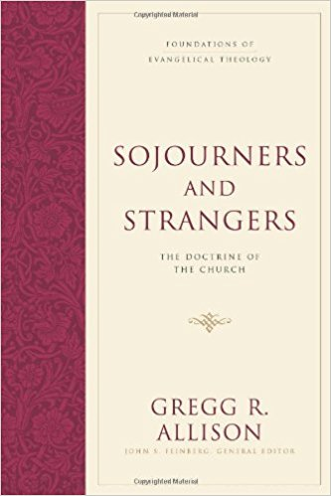
Faith and New Life:
DEFINING THE CHURCH
Definition of the universal church: “The church is the people of God who have been saved through repentance and faith in Jesus Christ and have been incorporated into his body through baptism with the Holy Spirit” (Allison, Sojourners and Strangers, 29).
Dever: The local church is the gospel made visible.
Definition of the local church: a group believers in a particular place, committed together in common faith in and obedience to Christ, teaching the word of God, rightly observing the ordinances, and under qualified leadership.
Notes:
People of God: continuity with the OT and communicating God’s universal reign
Salvation in Jesus: gospel forms a people
Faith: the church is comprised of believers
Incorporated: the is a definable group that is the church
Holy Spirit: the Spirit embodies, empowers, and directs

Slide 142
Faith and New Life:
DEFINING THE CHURCH
New Covenant People of God:
  The church is in continuity with the people of God from the beginning in creation, but the church is significantly distinct in that it is called under the new covenant of Christ’s blood.
  1 Peter 2
Body of Christ:
  The church is united together under the headship of Christ, with all the members serving interdependently.
  1 Corinthians 12
Temple of the Holy Spirit:
  The church is the dwelling place of God’s Spirit who empowers the church for ministry. The temple is an OT image that has been transformed radically.
  1 Corinthians 3
Notes:
Use the notes in summer curriculum: Lesson 1.

Slide 143
Faith and New Life:
DEFINING THE CHURCH
Universal Church: 9 But you are a chosen race, a royal priesthood, a holy nation, a people for his own possession, that you may proclaim the excellencies of him who called you out of darkness into his marvelous light. 10 Once you were not a people, but now you are God’s people; once you had not received mercy, but now you have received mercy. (1 Pet 2:9–10 ESV)
…
Local Church: So I exhort the elders among you, as a fellow elder and a witness of the sufferings of Christ, as well as a partaker in the glory that is going to be revealed: 2 shepherd the flock of God that is among you, exercising oversight, not under compulsion, but willingly, as God would have you; not for shameful gain, but eagerly; 3 not domineering over those in your charge, but being examples to the flock. 4 And when the chief Shepherd appears, you will receive the unfading crown of glory. 5 Likewise, you who are younger, be subject to the elders. Clothe yourselves, all of you, with humility toward one another, for “God opposes the proud but gives grace to the humble.” (1 Pet 5:1–5 ESV)

Slide 144
Faith and New Life:
DEFINING THE CHURCH
Characteristics of the church according to
Allison, Sojourners and Strangers
Doxological- Worship
Logocentric- eternal Word and inspired word
Pneumadynamic- Spirit
Covenantal- Committed
Confessional- Believing
Missional- Misson
Spatio-temporal/Eschatological-in this world and pointing to the next
Notes:
The church is characterized by seven attributes. The first three are characteristics regarding the origin and orientation of the church: it is (1) doxological, or oriented to the glory of God; (2) logocentric, or centered on the incarnate Word of God, Jesus Christ, and the inspired Word of God, Scripture; and (3) pneumadynamic, or created, gathered, gifted, and empowered by the Holy Spirit. The final four are characteristics regarding the gathering and sending of the church: it is (4) covenantal, or gathered as members in new covenant relationship with God and in covenantal relationship with each other; (5) confessional, or united by both personal confession of faith in Christ and common confession of the Christian faith; (6) missional, or identified as the body of divinely-called and divinely-sent ministers to proclaim the gospel and advance the kingdom of God; and (7) spatio-temporal/eschatological, or assembled as a historical reality (located in space and time) and possessing a certain hope and clear destiny while its lives the strangeness of ecclesial existence in the here-and-now.

Slide 145
Faith and New Life:
THE MISSION OF THE CHURCH
What is the mission of the church? If you had to make a mission statement for a church plant, what would it be?
What are some ways that churches stray from their primary mission?
Notes:
Examples of straying: over political engagement; exclusively social justice; exclusively environmental concerns

Slide 146
What is the mission of the church?

Slide 147
Faith and New Life:
THE MISSION OF THE CHURCH
“In the end, the Great Commission must be the mission of the church for two very basic reasons: there is something worse than death, and there is something better than human flourishing” (Gilbert and DeYoung, What is the Mission of the Church, 242).
“The Bible places the task of reaching the unreached squarely on the church, which means we cannot pass it off solely to a para-church group or a missions agency” (https://www.imb.org/2017/02/15/healthy-sending-means-going/).
“Missions is not the ultimate goal of the church. Worship is. Missions exists because worship doesn’t. The Great Commission is first “to delight yourself in the Lord” (Ps 34:7) and then to declare, “Let the nations be glad and sing for joy” (Ps 67:4). In this way, God will be glorified from beginning to end, and worship will empower the missionary enterprise until the coming of the Lord” (Piper, Let the Nations Be Glad, 43).

Slide 148
Faith and New Life:
THE MISSION OF THE CHURCH
Matthew 28
  “worshipped”: Worship is the faith-filled response to Jesus.
  “All authority”: The church operates under the ultimate authority of Jesus.
  “Go”: Think about the church in Acts.
  “make disciples”: Help people find and follow Jesus
  “all nations”: Not just Jews but also Gentiles.
  “baptizing”: Identification and Obedience
  “teaching”: disciples of Jesus cling to his words
Book of Acts
Epistles of Paul

Slide 149
What is church membership?

Slide 150
Class Goals:
Explain the practice of church commitment or membership.
Know some key texts about commitment to the local church.

Slide 151
BIBLE AND THE GOSPEL: Committed Fellowship
One thing to make explicit here at the end of this first chapter on fellowship, and the beginning of part 3 on the means of grace in the church, is that the deepest, most durable form of fellowship is covenantal—in other words, it is between parties that have made formal commitments to each other. This is not only true in the partnership of marriage, but also in the local church. When we make vows and promises to each other in covenanting together in a local church as “members” or “partners” (or whatever term a church uses), we don’t inhibit the true life of the church, but give the truest conditions for its growth and flourishing.
When our fellowship is not simply a network of loose Christian relationships, but anchored in a particular “covenant community” as committed members together in a local outpost of Christ’s kingdom, we come closest to experiencing what those first Christians did, when people didn’t just drift in and out of the community, but were either in or out— and those who were in were pledged to be the church for each other through thick and thin. Covenant community is like Christian marriage in that it is within the framework of stated commitments and promised allegiances that life in relationship is guarded, nourished, and encouraged most to thrive” (Mathis, Habits of Grace,139-140).
Notes:
Page 149

Slide 152
Faith and New Life: CHURCH COMMITMENT
What would you say to a young man who has dated a girl for years but refuses to commit to marriage because “I don’t need to sign on a dotted line for my love and commitment to be real”?
Notes:
1. Result: this ends in disaster and broken hearts
2. His view: formalization destroys authenticity (the relationship is truer if he can leave at any moment)
3. Reality: the rejection of commitment is a rejection of authenticity (love is commitment, so to reject commitment is to reject love)
4. His view: relationship sustains commitment (so long as he feels a certain way for his girlfriend, the relationship can thrive and he’ll be committed)
5. Reality: commitment sustains the relationship, NOT the other way around
6. Formal commitment does not destroy organic relationships, it is the fertile soil on which they can grow. The person who doesn’t want to ruin the genuineness of their love by getting married, has only the visage of genuine love because love is commitment.
Now, the analogy to church membership is not a perfect one, but there are some points of similarity.
1. Many people reject church membership because “signing on a dotted line doesn’t make me any more or less committed to this church.” In response, yes it does make you more committed—it formalizes a commitment to other church members and church leaders that you have been rejecting, or at best avoiding. Genuine lasting relationships are inherently commitment-based, and relationships that reject commitment reject authenticity.
2. Just like the formalization of the marriage makes a person accountable to uphold the words of that commitment, so church membership makes informal association with a church accountable—other church members and church leaders will hold the new member accountable in ways they cannot when he has yet to make that commitment.
3. Moreover, the work of marriage only begins at the wedding; the real work of marriage is lived out in the day in and day out covenant keeping. The same is true of keeping the membership covenant.
When a student asks me if he should propose to a girl. I always ask where she is a church member.
“As you consider the person you are physically attracted to, look for evidence of commitment in his or her life. Has he joined and become committed to a local church? … I think that church membership is a huge consideration, precisely because there is no such thing as a perfect church, and in our day and age in the West, we have so many options to choose from. Churches are full of sinners, so there will always be some messiness in a church. Churches are like families that way. So when a person stays in a church for long period of time, there is evidence that she has been able to see that everything is not perfect, but she nevertheless said, ‘I’m going to stay. I’m going to try to make this work. My commitment is more important than my desire to run away’” (Chandler, The Mingling of Souls, 40-41).

Slide 153
Faith and New Life:
CHURCH COMMITMENT
What does commitment to church look like?
My intent is to engage you in the discussion and encourage you to deeper commitment to your church.
Notes:
OBJECTIVES:
describe what church commitment looks like
(2) engage the students to think about church involvement
(3) encourage the discipline of commitment to their local church
-Mathis: argues that commitment to a local church, not simply attendance is important

Slide 154

Faith and New Life: CHURCH COMMITMENT
https://babylonbee.com/news/man-refuses-to-join-local-gym-claims-hes-just-part-of-the-universal-gym/
Notes:
-this is the difference between the church universal and local, and the church invisible and visible.
-the way that the universal invisible church becomes visible is through particular local churches
-Let’s assume that it is legitimate for me to assign you to read your Bible and engage in some form of prayer. Is it legitimate for me to assign other things?

Slide 155

Faith and New Life: CHURCH COMMITMENT
“A person is included in the universal church through salvation. Yet at this point the church remains an abstract idea without a palpable and public presence. A second constitutive movement is needed in order for the ‘the church’ to show up on planet earth. For that to happen, a group of Christians must gather and organize themselves (or be organized) as a congregation and affirm one another as believers” (Leeman, Political Church, 333).
Notes:
-this is the difference between the church universal and local, and the church invisible and visible.
-the way that the universal invisible church becomes visible is through particular local churches
-Let’s assume that it is legitimate for me to assign you to read your Bible and engage in some form of prayer. Is it legitimate for me to assign other things?

Slide 156
Faith and New Life: CHURCH COMMITMENT
Would it be an inappropriate assignment for this class to join your local church? Why or why not?
  Recall that part of the purpose of this class is spiritual formation.
  Recall also that one of the disciplines of grace is commitment to your local church.
Is the normal expectation of a Christian in the New Testament that they are committed to a particular local church? Can you think of a NT Christian who is not associated with a local church or moving in the direction of associating with a local church?

Slide 157
Faith and New Life:
CHURCH COMMITMENT
Church membership is a formal commitment to live out the Christian life with a particular group of believers. It is a commitment to be overseen by godly leaders, and it is a commitment to pursue discipleship and mission together.
Notes:
Some modern Christians find membership to be a difficult concept. There are two dispositions that contribute to this aversion to membership. (1) The first contributing factor is a denial of our interdependence. Church membership makes formal and public the declaration that we are not sufficient for the Christian life on our own—we need one another. Church membership’s “declaration of interdependence” stands in stark contrast to the American impulse to declare our independence. (2) A second contributing factor is the general desire towards autonomy, self-governance, self-direction and individual pursuit. The call to submission and oversight by leadership seems archaic, monarchial, and even dictatorial. Despite these American inclinations away from interdependence and submission to leadership, Scripture calls us to commit formally in our local church.
The church is the new covenant people of God, and there are some continuities to how God led his people in the Old Testament. They were gathered together as an identifiable people under leadership. There are quite a few discontinuities (e.g., ethnic and national identity), but it is important to note that God has consistently chosen to make his name known in a particular group of people, and he has provided that people with leadership. Membership in the local church makes visible what is invisible: that we participate in the new covenant with Christ and thus participate with his people. Most NT epistles are addressed to churches (and most of the others are to church leaders) in a way that it is assumed that individual believers are identified with a specific church. In the early church, it would have been unthinkable for a Christian to be a solitary Christian, not identifying with any particular church. Where would that person learn about God, exhort and encourage others, be exhorted and encouraged by others, use his spiritual gifts, celebrate the ordinances, etc.? We will look at four areas that help us to understand church membership in the Bible: images for the church, structure of the church, practices of the church, and care of the church.

Slide 158
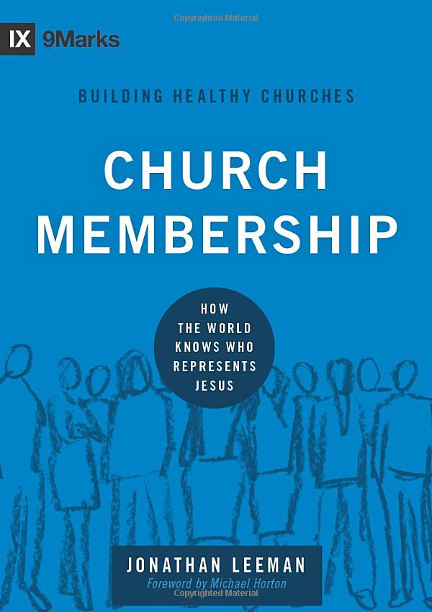
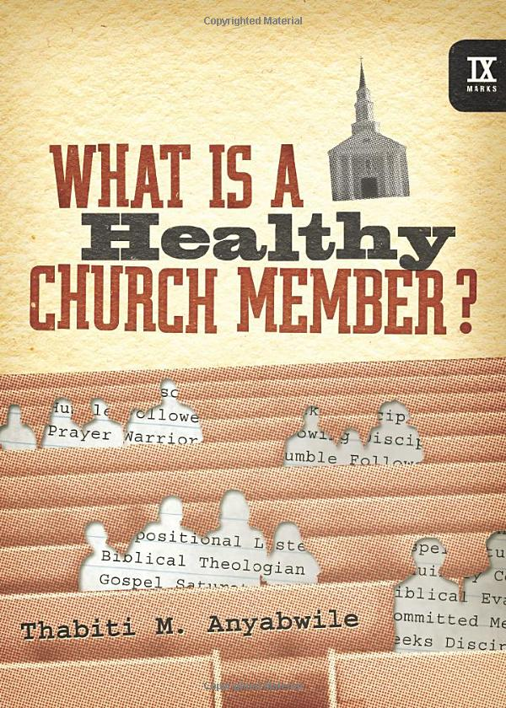
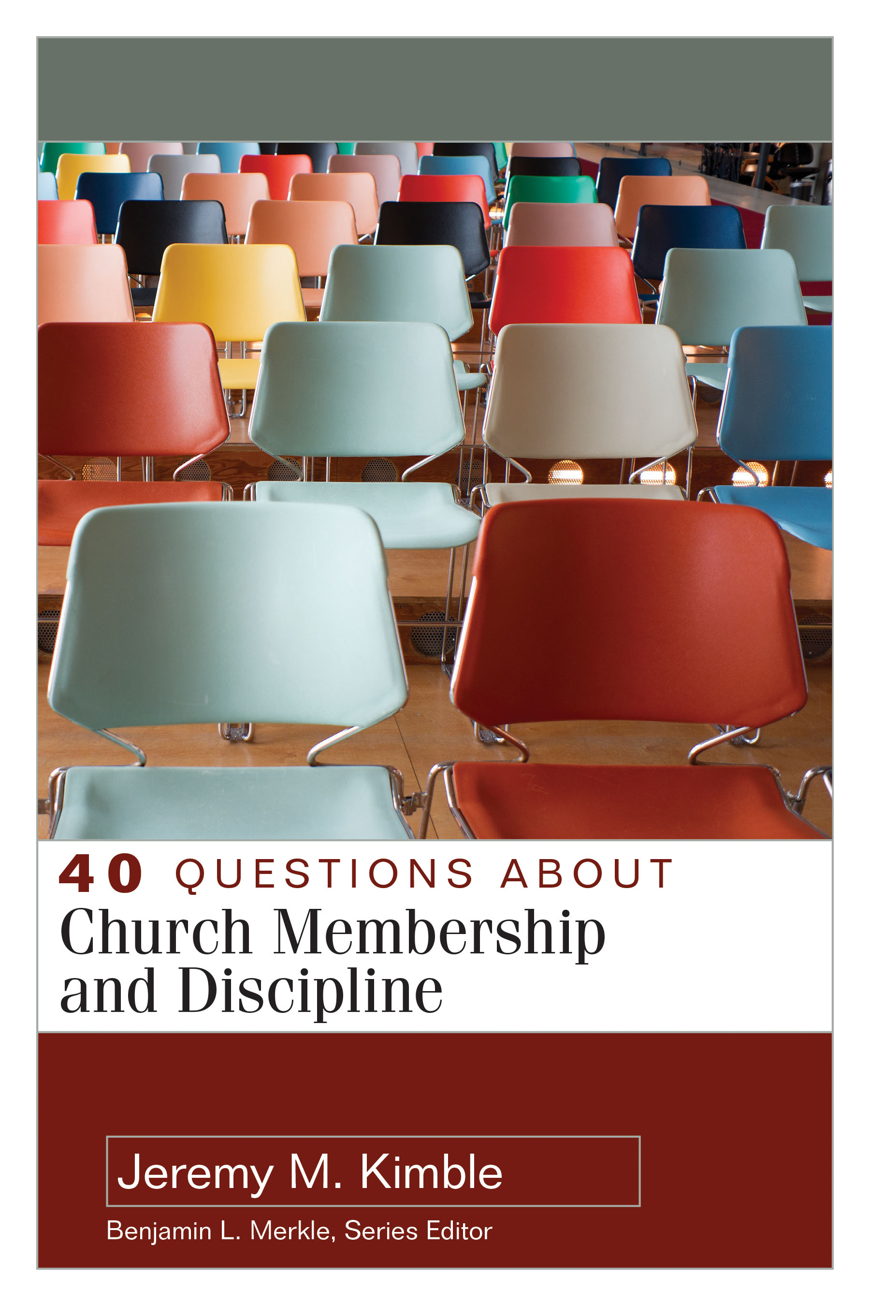
Faith and New Life:
CHURCH COMMITMENT
“Christians don’t join churches; they submit to them” (Leeman, Church Membership, 30).
“To fail to associate ourselves in a lasting and committed way with the Head of the church by joining his body is surely a sign of ingratitude, whether from an uninformed or a dull heart” (Anyabwile, What Is a Healthy Church Member?, 70).
“Church membership can be defined simply as a formal commitment or covenant between an individual and a local church” (Kimble, 40 Questions About Church Membership and Discipline, 47).
Notes:
Some people look at lists in general as unbiblical
Lamb’s Book of life (Rev)
Care of the church (1 Tim 5:9)

Slide 159
Faith and New Life: IS CHURCH MEMBERSHIP BIBLICAL?
“the modern practice of church membership, though nowhere explicitly commanded in the New Testament, best achieves the commitment and identification with himself that God intends for his people throughout the Bible and in the New Testament church.” Ninemarks.org
“The NT demonstrates that this membership is not merely in the universal church but is also comprised of belonging to and being in covenant with a local assembly of believers. God calls for believers to gather together locally, administer ordinances, exercise the authority of the keys of the kingdom, fulfill the ‘one another’ commands, hold one another accountable, and exercise church discipline. Thus while church membership is not explicitly mentioned in numerous places throughout the NT, one can see that all the items listed previously assume and demand that people are gathered together locally and living out and overseeing one another’s discipleship in specific ways. The Bible, therefore, calls us to submit to local church membership” (Kimble, 40 Questions About Church Membership and Discipline, 49).

Slide 160
Faith and New Life: IS CHURCH MEMBERSHIP BIBLICAL?
4 key biblical categories…
IMAGES for the Church
STRUCTURE of the Church
PRACTICES of the Church
CARE of the Church
Notes:
So how does the Bible describe the church?
What are the images of the church?

Slide 161
Faith and New Life: IS CHURCH MEMBERSHIP BIBLICAL?
Images for the Church
Body (1 Cor 12:12-31; Rom 12:4-8)
Household (1 Tim 3:15)
Field (1 Cor 3:5-9)
Building (1 Cor 3:10-15)
Temple (1 Cor 3:16-17)
Flock (1 Pet 5:2-4)
What do these images have in common?
Notes:
Collective
Emphasis on whole
Boundaries implicit
→ Several NT images for the church describe cooperative wholes with definable boundaries. Church membership defines the boundaries of the church.
→Unlike real shepherds, we don’t put ear tags in our flock to identify them. We just ask that you join the church.
In the OT there was an identifiable nation, Israel, who was the people of God. Israel was larked off as distinct from other nations in peculiar practices such as festivals, Sabbath observation, sacrifices, dietary restrictions, and circumcision. In the New Covenant, the people of God are those from every nation who respond in faith to Jesus, and these people gather in local churches to identify with Christ as his Bride. The Bible uses several metaphors to describe the local church, and many of these images describe individuals as comprising a singular, irreducible whole. The emphasis is on the unity and functionality of the whole rather than on the individual parts. Moreover, each of these images creates a boundary between those within the whole and those outside the whole. For example, fields have boundaries, buildings have beginnings and ends, and shepherds clearly mark their own flocks. Suggested in these metaphors is the necessity of enacting the boundaries of the church community for the purpose of its holiness and gospel proclamation—church membership helps define the local church.

Slide 162
Faith and New Life: IS CHURCH MEMBERSHIP BIBLICAL?
Structure of the Church
Accountability to leaders: Christians are commanded to be obedient to and supportive of the leaders who are over them in the local church (Heb. 13:17; 1 Thess. 5:12-13). This suggests a formal commitment of an individual Christian to a particular church and its leaders.
Accountability of leaders for members: Leaders are held accountable for how they shepherd those under their care (1 Pet 5:1-5). In order to care effectively, they must know who is under their care which comes through formal commitment.
Notes:
The NT calls us to accountable relationships, specifically with leaders and with one another. Church membership makes us accountable to specific leaders and specific Christians.
(1)
O These commands are given in the context of the local church. Is it possible to be obedient to them if you do not identify with a particular church?
O Can you think of any ways that a Christian who rejects local church membership could also be obedient to the command to be in submission to leaders?
(2)
O How does a leader know whom he is called to oversee?
O How does an elder know who is his flock?
O Is it acceptable or wise for an elder to focus his pastoral care for those who have formally committed to his church?
To whom are you accountable? Your leaders and teachers at CU don’t look at themselves as your elders/pastors.

Slide 163
Faith and New Life: IS CHURCH MEMBERSHIP BIBLICAL?
Practices of the Church
Baptism (cf. 1 Cor 12:12-13)
Lord’s Supper (1 Cor 10)
Discipline (cf. 1 Cor 5:1-2)
Meeting Together (cf. Heb 10:24-25)
Notes:
The New Testament explicitly commands Christians to practice baptism, the Lord’s Supper, and discipline. The logical questions are “where and with whom?”. These are practices of the local church that are performed within the membership of the local church. We’ll look at each of these practices in more detail in later lessons, and here we’ll note how they relate to church membership. While there is some variation and exception with these practices, generally they are the actions of the membership of a local church. Christians are baptized by the Holy Spirit into the universal church, and they are baptized by immersion into the local church. The Lord’s Supper is a practice of the fellowship of believers (those committed to one another in covenant community) in the local church. And in church discipline, the members of a church protect the purity and witness of the church.
Baptism: Baptism is both a picture of regeneration and an entrance into a local community who performs the ordinance of baptism.
Read 1 Corinthians 12:12-13 that describes the local church as the body of Christ.
Is it correct to view baptism as a formal entrance into the community/fellowship of the church?
Would you agree that it is generally (or perhaps always) appropriate to have baptism celebrated within the local church (as a people not necessarily a building).
Discipline: Jesus and Paul command churches to practice church discipline, and discipline necessitates clear delineations between members and non-members of a community. You cannot remove someone from a non-delineated whole (Matt 18:15-20; 1 Cor 5:1-13; 2 Cor 2:6).
If a church doesn’t have a clear delineation of member and non-member, could it practice church discipline? Can you think of any way that a church could be obedient to the multiple commands to practice church discipline if they didn’t have clear boundaries of those inside and outside the church?
Imagine a situation in which the church tries gently and graciously to correct a brother in sin. When he remains unrepentant and unmoved, the church begins discipline. If he claims “I am not a part of this church” can the church move forward? [Note: Grace’s membership documents state that a person cannot withdraw from membership so long as church discipline is proceeding.]
Meeting Together: Since the founding of the church, Christians have gathered together in local churches.
Read Hebrews 10:24-25.
With whom are we to be meeting? Is it a specific group of Christians, or is it just Christians in general?
Would it make sense for a Christian to claim that they are faithful to the commands to “meet together” if they were not identified with a specific local church?

Slide 164
Faith and New Life: IS CHURCH MEMBERSHIP BIBLICAL?
Care of the Church
“One another” commands.
Care for the poor.
Notes:
The NT commands us to give special care to those within our church. Church membership defines those who are to receive special care from our particular local church.
The Bible is filled with commands directed toward “one another” that are specific to the local fellowship of believers. While it is impossible to live out the “one another” commands with the global church, they ought to be fulfilled in the local church (e.g., John 13:34-5; Rom 14:13, 15:15; Gal 5:13, 6:2; Eph 4:32; Col 3:13, 3:16; Heb 3:13; James 5:16; 1 John 3:23). With whom should I live out the “one another commands” of Scripture?
Care for the poor marks Christians generally, but it is to be concentrated upon caring for those within the church (Acts 6:1-7).1 Timothy 5:9 “Let a widow be enrolled if she…”Summary: Church membership provides a context in which we can be faithful to the NT commands for how we interact in the local church.

Slide 165
Faith and New Life: IS CHURCH MEMBERSHIP BIBLICAL?
Let’s assume that a freshman asks you if he/she should join a local church. And let’s assume that the answer is “yes.” What reasons would you give him/her?

Slide 166
Faith and New Life: CHURCH COMMITMENT
Why do students need the church?
  For the good of their souls today…
    Obedience to Jesus.
    Modeling NT pattern of Christians.
    Jesus has one bride, the church expressed in local churches.
    Jesus’ promises (e.g., that the gates of Hell won’t prevail) are to the church.
    Reflects the diversity (and universality) of the gospel call.
  For the good of their souls tomorrow…
    Establishing patterns of faithfulness for the rest of your life.
    Preparing a home in which a family can flourish spiritually.
  For the love of your church leaders.
  For the love of other church members.
  For our testimony to the world.

Slide 167
Faith and New Life: CHURCH COMMITMENT
Can I be a Christian without the church?
Yes, BUT it would be like driving at night without headlights:
  It’s not how the manufacturer designed it (God gives us the church with purpose).
  It’s unwise (Wisdom does not neglect something for our good and others’ good.).
  It’s dangerous (Who will warn you of sin and oversee your soul?).
  It’s hazardous to those with you and around you (you will lead others in the neglect of the church).

Slide 168
Faith and New Life: CHURCH COMMITMENT
Why doesn’t Cedarville University have church services on Sunday?
What is the difference between the University and the church?
Why do you need the church, and why does the church need you?

Slide 169
Faith and New Life: CHURCH COMMITMENT SUMMARY
Church membership provides a context in which we can be faithful to the NT commands for how we interact in the local church.
Church membership answers the following questions about the application of biblical commands:
  With whom am I called to live out the “one another” commands in Scripture?
  With whom am I to meet regularly?
  Whose life do I have a responsibility to ensure is holy?
  Over whose lives should the elders exercise oversight?
  To which leaders do I submit?
  With whom do I celebrate the Lord’s Supper and baptism?
  With which group of people do I make the gospel visible?
  From whom could I be excommunicated if I persist in unrepentant sin?

Slide 170
Faith and New Life: Leeman’s 12 reasons to join your church
1. It’s biblical. Jesus established the local church and all the apostles did their ministry through it. The Christian life in the New Testament is church life. Christians today should expect and desire the same.
2. The church is its members. To be a church in the New Testament is to be one of its members (read through Acts). And you want to be part of the church because that’s who Jesus came to rescue and reconcile to himself.
3. It’s a prerequisite for the Lord’s Supper. The Lord’s Supper is a meal for the gathered church, that is, for members (see 1 Cor. 11:20–33). And you want to take the Lord’s Supper. It’s the team flag that makes the church team visible to the nations.
4. It’s how you officially represent Jesus. Membership is the church’s affirmation that you are a citizen of Christ’s kingdom and therefore a passport-carrying Jesus representative before the nations. And you want your representation to be authorized. Closely related to this.…
5. It’s how you declare your highest allegiance. Your membership on the team, which becomes visible when you wave the flag of the Lord’s Supper, is a public testimony that your highest allegiance belongs to Jesus. Trials and persecution may come, but your only words are, “I am a Christian.”
6. It’s how you embody and experience biblical images. It’s within the accountability structures of the local church that Christians live and experience the interconnectivity of his body, the spiritual fullness of his temple, and the safety and intimacy and shared identity of his family.
Leeman, J. (2012). Church Membership: How the World Knows Who Represents Jesus (pp. 79–81). Wheaton, IL: Crossway.

Slide 171
Faith and New Life: Leeman’s 12 reasons to join your church
7. It’s how you serve other Christians. Membership helps you to know which Christians on planet Earth you are specifically responsible to love, serve, warn, and encourage. It enables you to fulfill your biblical responsibilities to Christ’s body (for example, see Eph. 4:11–16, 25–32).
8. It’s how you follow Christian leaders. Membership helps you to know which Christian leaders on planet Earth you are called to obey and follow. Again, it allows you to fulfill your biblical responsibility to them (see Heb. 13:7, 17).
9. It helps Christian leaders lead. Membership lets Christian leaders know which Christians on planet Earth they will “give an account” for (Acts 20:28; 1 Pet. 5:2).
10. It enables church discipline. It gives you the biblically prescribed place to participate in the work of church discipline responsibly, wisely, and lovingly (1 Cor. 5).
11. It gives structure to your Christian life. It places an individual Christian’s claim to obey and follow Jesus into a real-life setting where authority is actually exercised over us (see John 14:15; 1 John 2:19; 4:20–21). It’s God’s discipling program.
12. It builds a witness and invites the nations. Membership puts the alternative rule of Christ on display for the watching universe (see Matt. 5:13; John 13:34–35; Eph. 3:10; 1 Pet. 2:9–12). The very boundaries, which are drawn around the membership of a church, yield a society of people that invites the nations to something better. It’s God’s evangelism program.
Leeman, J. (2012). Church Membership: How the World Knows Who Represents Jesus (pp. 79–81). Wheaton, IL: Crossway.

Slide 172
Faith and New Life: QUOTES ABOUT CHURCH COMMITMENT
“To fail to associate ourselves in a lasting and committed way with the Head of the church by joining his body is surely a sign of ingratitude, whether from an uninformed or a dull heart” (Anyabwile, What Is a Healthy Church Member?, 70).
“Christ commands His people not to forsake the assembling together (Heb. 10:25). When God constituted the people of Israel, He organized them into a visible nation and placed upon them a sober and sacred obligation to be in corporate worship before Him. If a person is in Christ, he is called to participate in koinonia—the fellowship of other Christians and the worship of God according to the precepts of Christ. If a person knows all these things and persistently and willfully refuses to join in them, would that not raise serious questions about the reality of that person’s conversion? Perhaps a person could be a new Christian and take that position, but I would say that’s highly unlikely. Some of us may be deceiving ourselves in terms of our own conversion. We may claim to be Christians, but if we love Christ, how can we despise His bride? How can we consistently and persistently absent ourself from that which He has called us to join—His visible church? I offer a sober warning to those who are doing this. You may, in fact, be deluding yourself about the state of your soul” (Sproul, What is the Church?, 24-25)
“Nothing in the world is dearer to God’s heart than his church; therefore, being his, let us also belong to it, that by our prayers, our gifts, and our labours, we may support and strengthen it. If those who are Christ’s refrained, even for a generation, from numbering themselves with his people, there would be no visible church, no ordinances maintained, and, I fear, very little preaching of the gospel” (Spurgeon, “The Best Donation” sermon 2234).

Slide 173




Faith and New Life:
WORSHIP
  “I may have two jobs, three sisters, or five friends, but only one spouse. Some relationships are, by their nature, exclusive. The most basic of these is our relationship with God. There’s room on the throne of each person’s life for only one occupant” (Randy Alcorn, For the Fame of God’s Name, 319).

Slide 174
Class Goals:
Explain the function of worship, especially corporate worship, in the life of the believer.
Know some key texts about worship.

Slide 175
What is worship?

Slide 176
Faith and New Life: WORSHIP
What is worship?
  Does it have an outward aspect?
  Is it exclusively inward?
  Is it focused vertically or horizontally as well?
  Should it be emotional? See Piper, Desiring God, 81.
  Should it be emotion-driven?
Are there things in the Christian life that don’t fall under the category of worship?
Are there things in the Christian life that are especially identified as worship?

Slide 177
Faith and New Life: WORSHIP
Worship is a faith-filled response to who God is and what he’s done—its expressed in adoration and action.
The worshipper is like a mirror that reflects back to God the brilliance of his worth, and in the process is warmed himself.
Notes:
What actions constitute worship? Ministry? Praise? Repentance?

Slide 178
Faith and New Life: WORSHIP
Lessons from JOHN 4:1–26
Worship is a response to God’s self-revelation.
The main question in worship is NOT where.
The main questions in worship are…
  WHOM to worship (Jesus).
  HOW to worship (spirit and truth).
The Spirit of God awakens and enables worship.
A worship-filled heart leads to worship-filled actions.

Slide 179
Faith and New Life: WORSHIP
The Bible never gives a definition worship. On the one hand, worship involves everything that a believer does (a total-life response to God), but worship also is recognized in particular acts and contexts. Worship is to be integrated into the regular pattern of human existence as believers in the OT had regular patterns of sacrifice and festivals and believers in the NT met weekly. One of the simplest definitions of worship is: a faith-filled response to who God is or what God has done. Worship can involve such basic acts as “bending the knee” in homage and submission to God, acts of service, and acts of giving. Perhaps the most characteristic action of worship is that of singing songs/hymns and playing music; this is a theme in the OT, NT, church history, and in heaven (by both humans and angels). Worship also involves an attitude or disposition toward God of fear, reverence, and respect. Worship that is directed either at the wrong object or in the wrong way is the sin of idolatry. In the OT, worship typically centers around the tabernacle or temple, but religious activity also pervades believers’ entire lives. The concentric circles of holiness surrounding the Holy of Holies in the tabernacle/temple emphasized both the holiness of God and the necessary holiness of the worshipper. Similarly, animal sacrifices emphasized the demands of holiness for worship and humans’ inability to meet that standard. The Gospels describe Jesus as the one greater than the temple and He is the focus of worship. Through Jesus’ life, death, and resurrection, a new way of access to God is opened, and it is the gospel that provides the means and impulse of worship. Those who are in Christ receive the Spirit of Christ and can worship God in spirit and in truth. For the believer, worship includes obedience motivated by faith and love. Corporate Christian gatherings are both worshipful of God and edifying of believers. Worship is a central and unending theme of heaven, and Revelation describes how both the God the Father and God the Son are worshipped both by humans and by heavenly beings—everything is created to respond to God in worship.

Slide 180
Faith and New Life: WORSHIP
What motivates your worship and obedience?
Are there incorrect motivations even if they produce the right actions?
Recall the concept of “dutiful delight.” See Piper, Desiring God, 92.
Notes:
LOVE: Here is a helpful illustration. Imagine a father watching his young son play baseball for his team, having spent hours in the yard teaching him batting technique. This father already loves his son fully and completely. If his son forgets his father’s instructions and strikes out, it will in no way lessen his father’s love for him or approval of him. The son is assured of his father’s love, regardless of his performance. But the son will still long to hit that home run. Not for himself to gain his father’s love—but for his father, because he is already loved. If he doesn’t know his father loves him, his efforts will be for himself—to win that love. But because he knows his father already loves him, his efforts are for his father—to please him.
GRATITTUDE Tim Keller tells the story of a woman who had begun to understand the gospel, but she was hesitant to embrace the gospel of grace. She reasoned that if the gospel was based on works, then there was a limit to what God could ask of her. But if the gospel is the free gift of God’s grace, then there was no limit of what God could demand of those whom he saved. While there is some truth in this approach, some such as John Piper have warned that embracing a “debtor’s ethic” can be ineffective and perhaps even dangerous (http://www.desiringgod.org/interviews/is-gratitude-a-bad-motivation-for-obeying-god ).
FEAR: Many Christian groups have embraced fear as a motivation for worship. Tim Keller cautions that this approach by itself is misguided: “Our motivation will lose its power over time. Fear as an emotion is very draining. It moves you to great feats at first, but eventually it is exhausting. People who live in great fear experience a numbing effect after a while. Slowly, one becomes too tired to care, indifferent to what happens. Fear-based religion therefore often tends to be short-lived…Fear-based obedience will always make it difficult to endure suffering or troubles. The fear-based person will either think: God is paying me back! God has abandoned me! Maybe I crossed the line this time … or: This isn’t fair! I obey so that God will bless me, so that these bad things won’t happen! In other words, despair or bitterness will be the result of suffering if one’s Christian life is fear-based”
JOY: Is it possible to be motivated to worship because it brings us joy? Obedience to God leads to our joy, and the very acts of worship produce self-perpetuating desire for worship.
REWARD: Jesus often holds out the promise of eternal rewards for those who follow him. Is it appropriate to be motivated by heavenly rewards?

Slide 181
Why worship with other people?

Slide 182
Faith and New Life:
CORPORATE WORSHIP
“Corporate worship is the single most important means of grace and our greatest weapon in the fight for joy, because like no other means, corporate worship combines all three principles of God’s ongoing grace: his word, prayer, and fellowship. It is corporate worship, with its preaching and sacraments and collective praises, confessions, petitions, and thanksgivings, which most acutely brings together the gifts of God’s voice, his ear, and his body” (Mathis, Habits of Grace, 120-121).

Slide 183
Faith and New Life:
CORPORATE WORSHIP
Mathis’ reasons for the necessity of corporate worship:
AWAKENING: an antidote for spiritual lethargy
ASSURANCE: local church worship points to the universal church
ADVANCE: catalyst for our growth in Christ
ACCEPTING LEADERSHIP: we embrace being led
ACCENTURATED JOY: shared joy is double joy

Slide 184
Faith and New Life:
CORPORATE WORSHIP
In the church, corporate worship involves…
  Preaching
  Singing
  Praying
  Baptism
  Lord’s Supper
  Commissioning others for ministry
  Heaven won’t be you singing a solo to Jesus. Some of us might be surprised to be in a cosmic choir.

Slide 185
Faith and New Life:
CORPORATE WORSHIP
“God's jealousy for God's own self is a powerful dynamic throughout Scripture. But, on the other hand, God's battle against the gods of human hands (and all they represent) can be seen as a function of his loving benevolence toward us and indeed toward his whole creation. Divine jealousy is in fact an essential function of divine love. It is precisely because God wills our good that he hates the self-inflicted harm that our idolatry generates. God's conflict with the gods is ultimately for our own good as well as for God's glory. This further highlights why idolatry is such a primary sin in the Bible--identified as such by the primacy of the first two commandments of the Decalogue. It is not merely that idolatry steals God's glory but it also thwarts God's love--the love that seeks the highest good of all God's creation. Idolatry therefore contradicts the very essence, the Godness, of God, for 'God is love” (Wright, Mission of God, 177).
“This [Christ being seen as most desirable] will happen when Christians don’t just say that Christ is valuable, or sing that Christ is valuable, but truly experience in their hearts the unsurpassed worth of Jesus with so much joy that they can say, “I count everything as loss because of the surpassing worth of knowing Christ Jesus my Lord” (Phil. 3:8). Christ will be glorified in the world when Christians are so satisfied in him that they let goods and kindred go and lay down their lives for others in mercy, missions, and, if necessary, martyrdom. He will be magnified most among the nations when, at the moment Christians lose everything on earth, they say, “To live is Christ, and to die is gain” (Phil. 1:21)” (Piper, When I Don’t Desire God, 21).

Slide 186
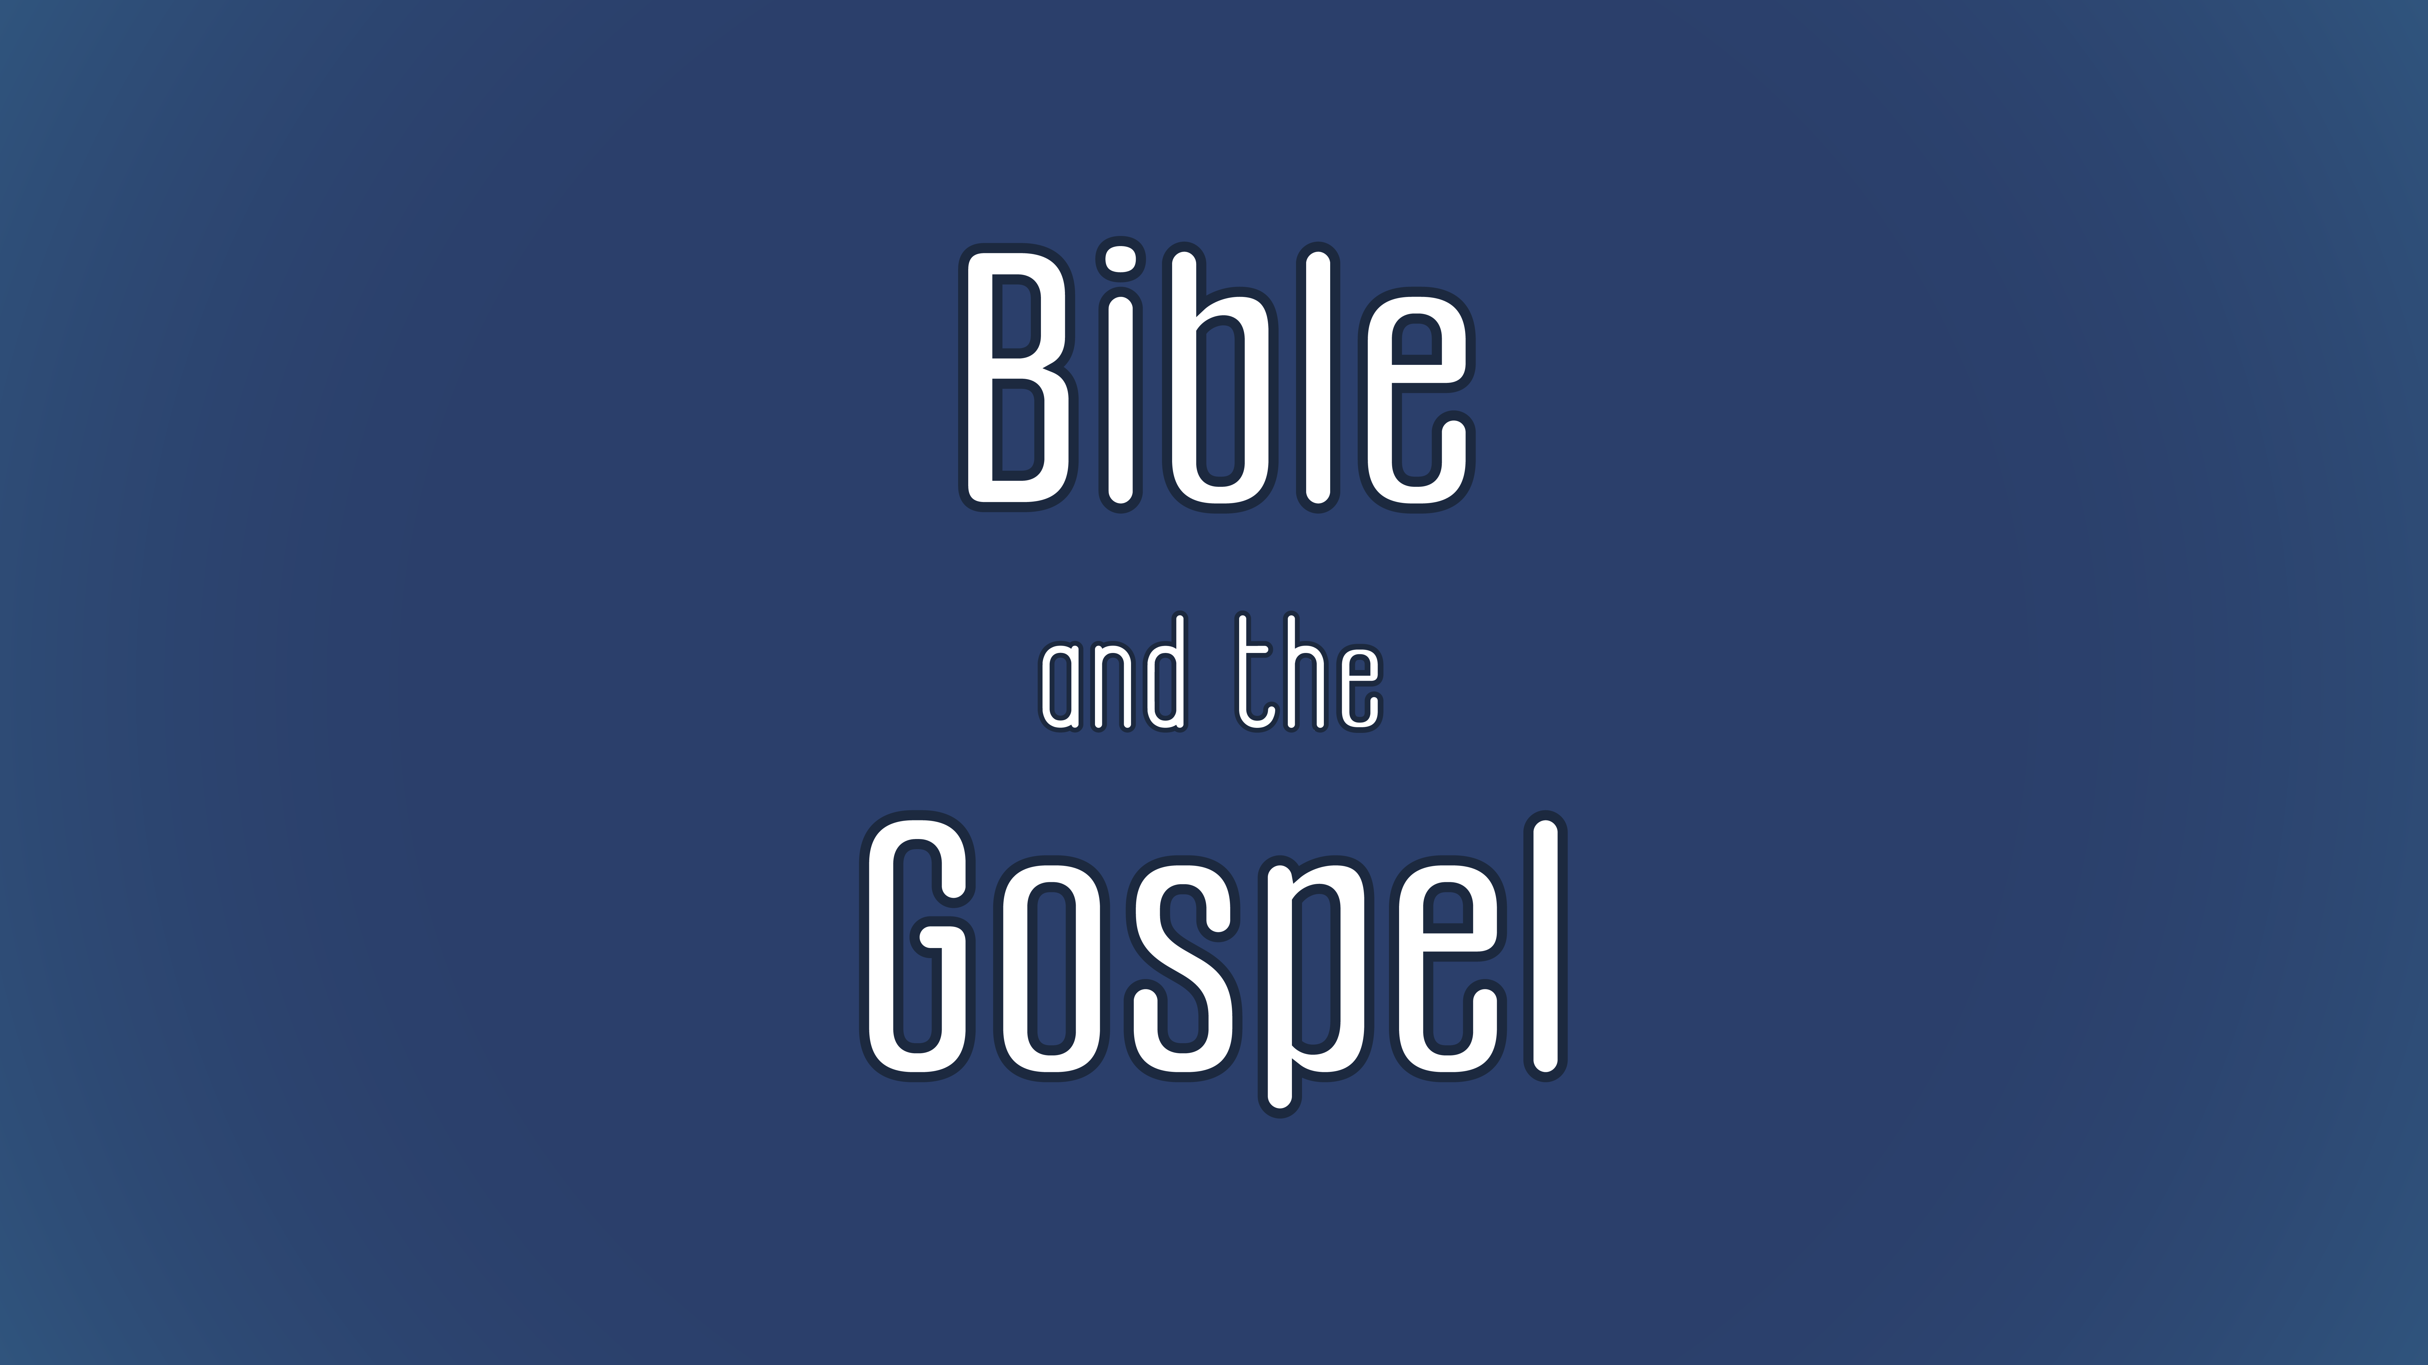
Evangelism
Notes:
-tie this to the heart of worship in John 4…the woman naturally tells

Slide 187
Class Goals:
Understand the biblical call to share the gospel.
Know some key biblical texts about the evangelism.
Practice sharing the gospel.

Slide 188
Faith and New Life:
EVANGELISM
Should evangelism be covered as a spiritual discipline?
Mathis’ response: “However, I find it most helpful to treat mission, time, and money together as disciplines and pursuits that are first and foremost effects of our regular hearing of God’s word, having his ear, and belonging to his body. Receiving God’s ongoing grace for our souls sustains us, inspires us, and empowers us for evangelism and stewardship” (Mathis, Habits of Grace, 161-162)

Slide 189
Faith and New Life:
EVANGELISM
“Evangelism is the proclamation of the gospel in the power of the Holy Spirit with the aim of persuading people to repent and believe in Christ” (p. 50).

Slide 190
Faith and New Life:
EVANGELISM
    Evangelism is based on the beliefs that people are in a desperate situation, a remedy exists, and you have a role in making that remedy known.
      Universalism: no problem from which to be saved or all are saved.
        e.g., We are all children of God.
      Inclusivism: there are many ways to the one means of salvation.
        e.g., Christ’s work is the means by salvation, and God recognizes piety in a number of religions.
      Pluralism: there are many means to salvation.
        e.g., Many religions offer salvation.
      Exclusivism: there is only one means (Christ’s work) and only one way (personal faith) for true salvation.
        e.g., To be saved from the wrath of God a person must repent of his sins and personally trust in Christ.
      The key question is whether or not we believe the Bible…
Notes:
Challenges to exclusivism
Universalism – everyone ultimately will be saved
Tolerance – the highest value of our age “live and let live”
Affirming someone’s right to believe as they wish (religious freedom) does not mean we must affirm the veracity of their beliefs.

Slide 191
BIBLE AND THE GOSPEL:
Biblical texts about evangelism
16 “For God so loved the world, that he gave his only Son, that whoever believes in him should not perish but have eternal life. 17 For God did not send his Son into the world to condemn the world, but in order that the world might be saved through him. 18 Whoever believes in him is not condemned, but whoever does not believe is condemned already, because he has not believed in the name of the only Son of God. 19 And this is the judgment: the light has come into the world, and people loved the darkness rather than the light because their works were evil. 20 For everyone who does wicked things hates the light and does not come to the light, lest his works should be exposed. 21 But whoever does what is true comes to the light, so that it may be clearly seen that his works have been carried out in God.”…36 Whoever believes in the Son has eternal life; whoever does not obey the Son shall not see life, but the wrath of God remains on him. (John 3:16-21…36 ESV)

Slide 192
BIBLE AND THE GOSPEL:
Biblical texts about evangelism
6 Jesus said to him, “I am the way, and the truth, and the life. No one comes to the Father except through me. 7 If you had known me, you would have known my Father also. From now on you do know him and have seen him.”
(John 14:6–7 ESV)
12 And there is salvation in no one else, for there is no other name under heaven given among men by which we must be saved.” (Acts 4:12 ESV)

Slide 193
New Life in Christ:
Where does the Bible call us to share the gospel?

Slide 194
BIBLE AND THE GOSPEL:
Biblical texts about evangelism
16 Now the eleven disciples went to Galilee, to the mountain to which Jesus had directed them. 17 And when they saw him they worshiped him, but some doubted. 18 And Jesus came and said to them, “All authority in heaven and on earth has been given to me. 19 Go therefore and make disciples of all nations, baptizing them in the name of the Father and of the Son and of the Holy Spirit, 20 teaching them to observe all that I have commanded you. And behold, I am with you always, to the end of the age.” (Mt 28:16–20 ESV)

Slide 195
BIBLE AND THE GOSPEL:
Biblical texts about evangelism
12 And there is salvation in no one else, for there is no other name under heaven given among men by which we must be saved.”
…
18 So they called them and charged them not to speak or teach at all in the name of Jesus. 19 But Peter and John answered them, “Whether it is right in the sight of God to listen to you rather than to God, you must judge, 20 for we cannot but speak of what we have seen and heard. (Acts 4:12…18–20 ESV)

Slide 196
BIBLE AND THE GOSPEL:
Biblical texts about evangelism
8 But what does it say? “The word is near you, in your mouth and in your heart” (that is, the word of faith that we proclaim); 9 because, if you confess with your mouth that Jesus is Lord and believe in your heart that God raised him from the dead, you will be saved. 10 For with the heart one believes and is justified, and with the mouth one confesses and is saved. 11 For the Scripture says, “Everyone who believes in him will not be put to shame.” 12 For there is no distinction between Jew and Greek; for the same Lord is Lord of all, bestowing his riches on all who call on him. 13 For “everyone who calls on the name of the Lord will be saved.”
14 How then will they call on him in whom they have not believed? And how are they to believe in him of whom they have never heard? And how are they to hear without someone preaching? 15 And how are they to preach unless they are sent? As it is written, “How beautiful are the feet of those who preach the good news!” (Rom 10:8–15 ESV)
Notes:
Also have a corporate element

Slide 197
New Life in Christ:
Why share the gospel?

Slide 198
Faith and New Life:
EVANGELISM
What motivates you (or people you know) to share the gospel?

Slide 199
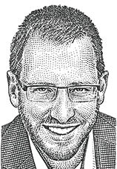

BIBLE AND THE GOSPEL:
Biblical texts about evangelism
There is work to be done
  Matthew 9:37-38: Then he said to his disciples, “The harvest is plentiful, but the laborers are few; therefore pray earnestly to the Lord of the harvest to send out laborers into his harvest.”
2. Jesus has commanded you to do it
Matthew 28:18-20
3. Success is guaranteed
John 10:16: And I have other sheep that are not of this fold. I must bring them also, and they will listen to my voice. So there will be one flock, one shepherd.
4. Jesus is the only salvation
John 14:6: Jesus said to him, “I am the way, and the truth, and the life. No one comes to the Father except through me.”
5. You were given the Holy Spirit for this purpose
Acts 1:8: But you will receive power when the Holy Spirit has come upon you, and you will be my witnesses in Jerusalem and in all Judea and Samaria, and to the end of the earth.
6. People won’t be saved without hearing
Romans 10:14-15: How then will they call on him in whom they have not believed? And how are they to believe in him of whom they have never heard? And how are they to hear without someone preaching? And how are they to preach unless they are sent? As it is written, “How beautiful are the feet of those who preach the good news!”
7. Evangelism is necessary for your own growth in Christ
Philemon 6: And I pray that the sharing of your faith may become effective for the full knowledge of every good thing that is in us for the sake of Christ.
https://www.challies.com/resources/7-scripture-texts-about-evangelism/
Notes:
To these ideas, we should emphasize the ultimate reason…the glory of God.

Slide 200
BIBLE AND THE GOSPEL:
Biblical texts about evangelism
And they sang a new song, saying,
“Worthy are you to take the scroll and to open its seals, for you were slain, and by your blood you ransomed people for God from every tribe and language and people and nation, 10 and you have made them a kingdom and priests to our God,
and they shall reign on the earth.” (Rev 5:9–10 ESV)
9 After this I looked, and behold, a great multitude that no one could number, from every nation, from all tribes and peoples and languages, standing before the throne and before the Lamb, clothed in white robes, with palm branches in their hands, 10 and crying out with a loud voice, “Salvation belongs to our God who sits on the throne, and to the Lamb! (Rev 7:9–10 ESV)
Notes:
God is glorified by demonstrating that he is a worldwide God.

Slide 201
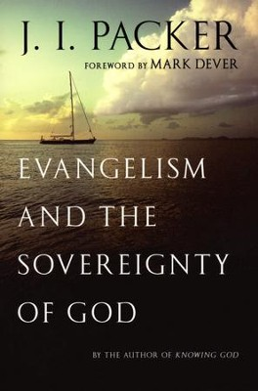
BIBLE AND THE GOSPEL:
Biblical texts about evangelism
We glorify God by evangelizing, not only because evangelizing is an act of obedience, but also because in evangelism we tell the world what great things God has done for the salvation of sinners. God is glorified when His mighty works of grace are made known. (Packer, Evangelism and the Sovereignty of God, 75)
Notes:
Also have a corporate element

Slide 202

BIBLE AND THE GOSPEL:
Biblical texts about evangelism
“Missions is not the ultimate goal of the church. Worship is. Missions exists because worship doesn’t. The Great Commission is first “to delight yourself in the Lord” (Ps 34:7) and then to declare, “Let the nations be glad and sing for joy” (Ps 67:4). In this way, God will be glorified from beginning to end, and worship will empower the missionary enterprise until the coming of the Lord” (Piper, Let the Nations Be Glad, 43).
Notes:
Also have a corporate element

Slide 203
New Life in Christ:
How to share the gospel?
I am indebted to Drs. Josh Bowman and Jason Lee for some of these ideas.

Slide 204
Faith and New Life:
EVANGELISM
What are some effective ways to share the gospel?
What makes the gospel compelling?
Notes:
What makes the gospel compelling is the Holy Spirit awakening dead hearts. The Spirit often uses the testimony of transformed lives and the joy they express in their faith.

Slide 205
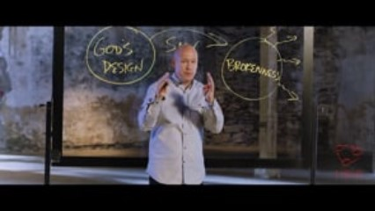
Faith and New Life: EVANGELISM

Slide 206


Slide 207


Slide 208
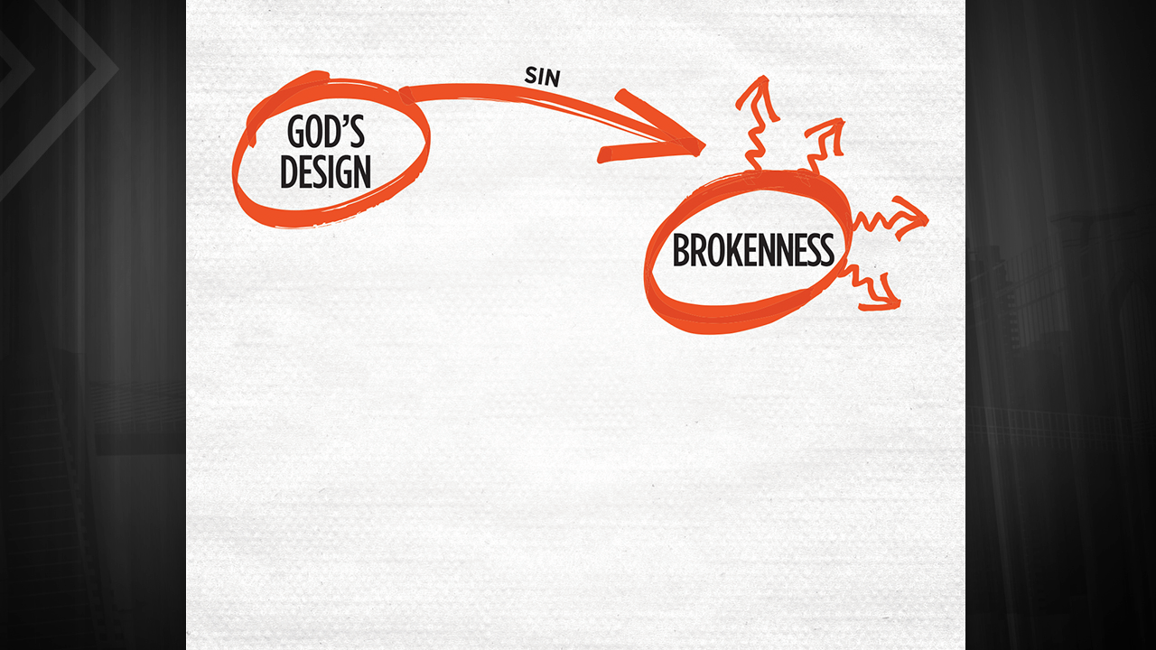

Slide 209
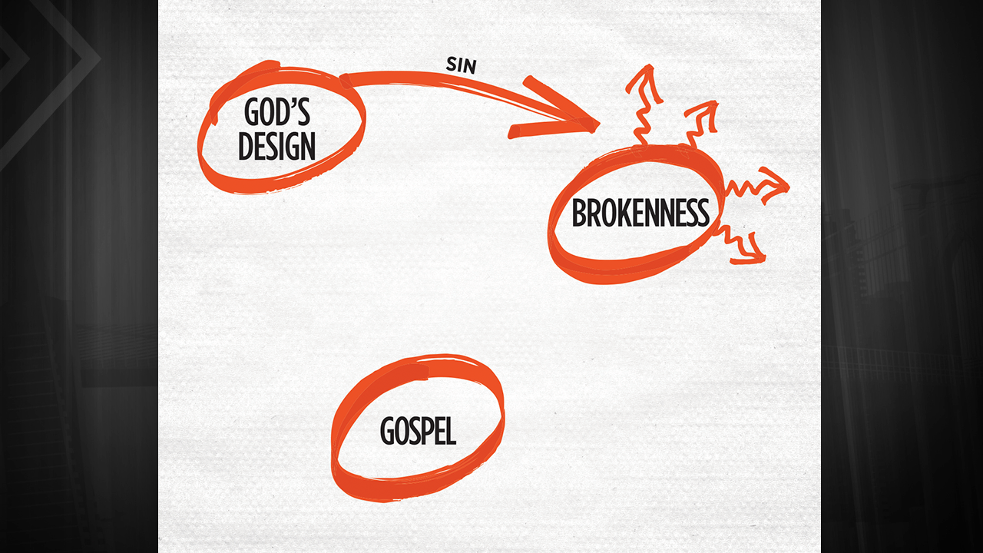

Slide 210
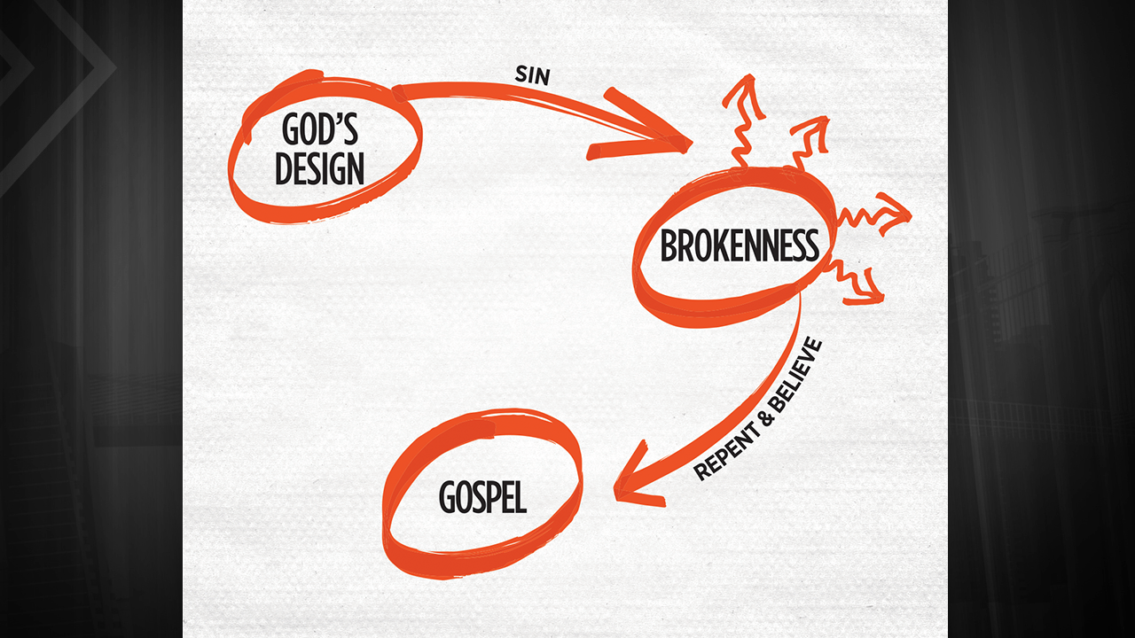

Slide 211
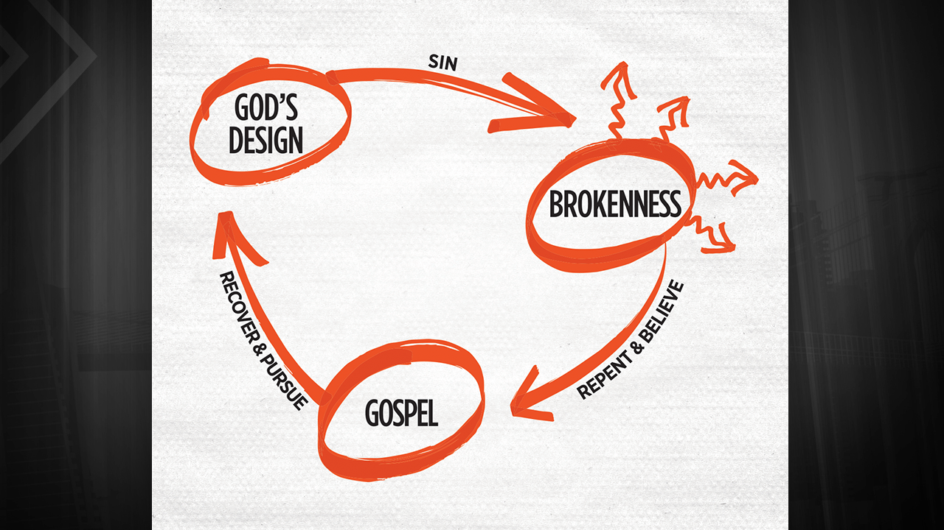
Notes:
Ended here quickly on Wed. Need to do longer practice. MWF has watched all the videos

Slide 213
New Life in Christ:
What is the Bible?

Slide 214
COURSE SECTION: SUBSECTION TOPIC
Point
  subpoint
Point
  Subpoint
Point
  subpoint
Point
  subpoint

