Slide 1
LOCK DRAWING MODE
FOR SHAPES

Slide 2
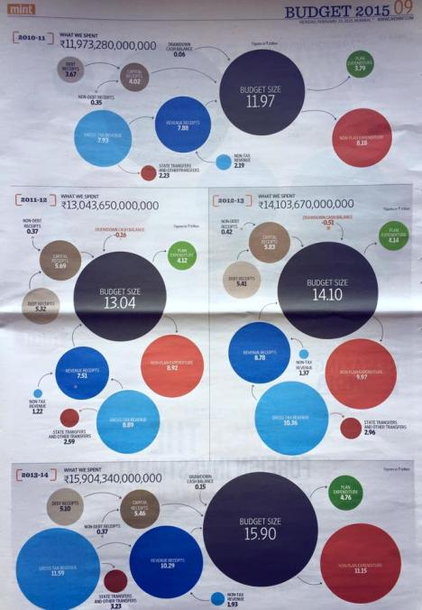
Source: MINT Newspaper (India)

Slide 3
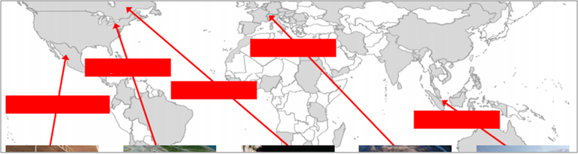
Source: MINT Newspaper (India)

